Slide 1
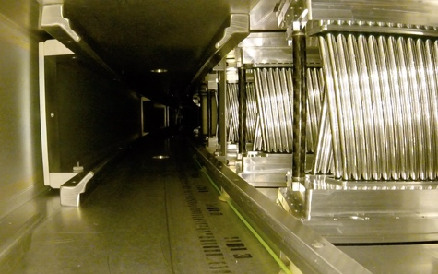


Latest results from the g-2 experiment at Fermilab
Joe Price
on behalf of the g-2 experiment
WIN2025: 09/06/2025: 1

Slide 2
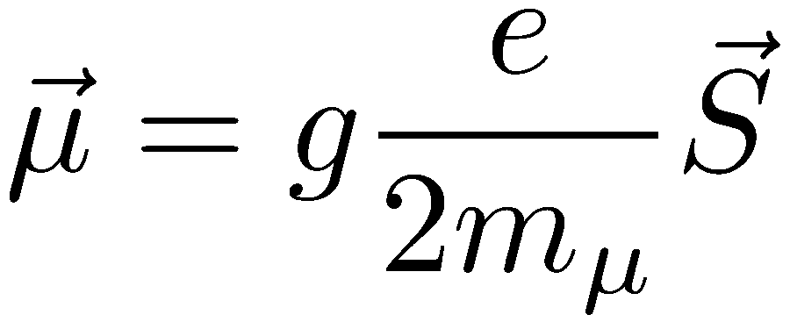
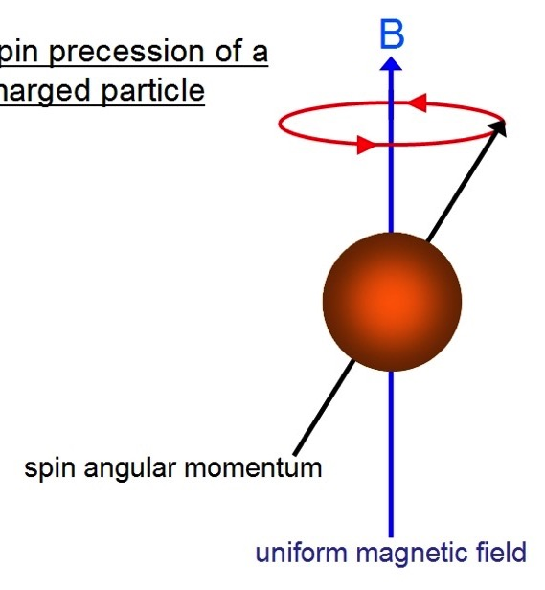

Magnetic moments
The muon has an intrinsic magnetic moment that is coupled to its spin via the gyromagnetic ratio g:
Magnetic moment (spin) interacts with external B-fields
Makes spin precess at frequency determined by g
WIN2025: 09/06/2025: 2

Slide 3
Magnetic Moments & Virtual Loops
For a pure Dirac spin-½ charged fermion, g is exactly 2
Interactions between the muon and virtual loops change the value - virtual particles could be SM or new physics:
WIN2025: 09/06/2025: 3

Slide 4
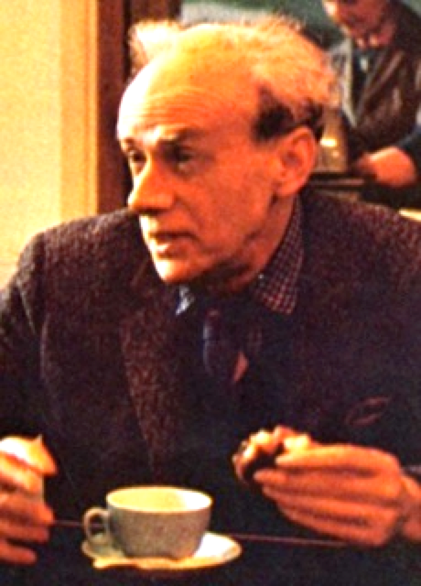
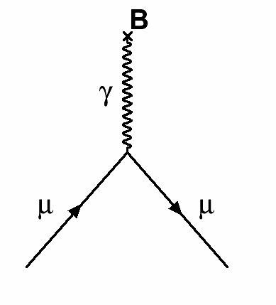
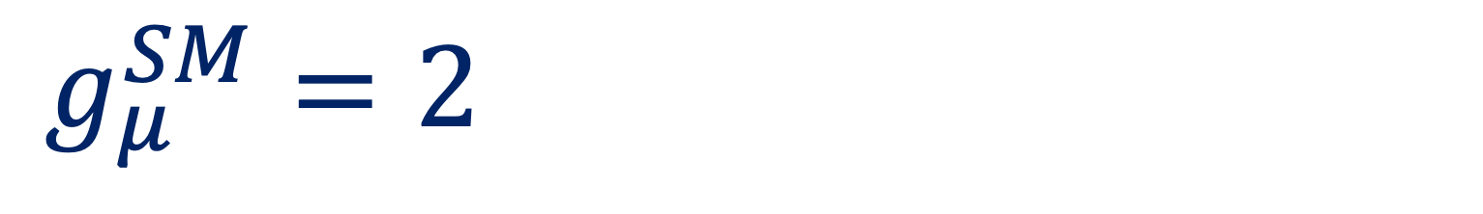
Standard Model components of g_{μ}
Dirac
Charged,
spin ½
$$g_{μ}^{SM}=2$$
WIN2025: 09/06/2025: 4

Slide 5
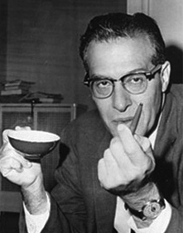
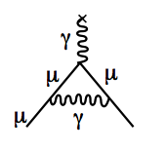
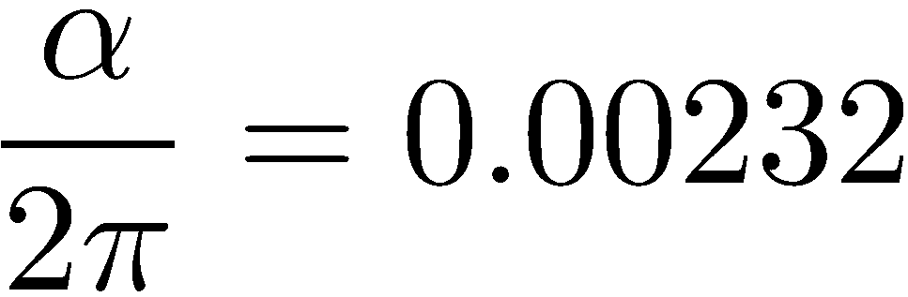
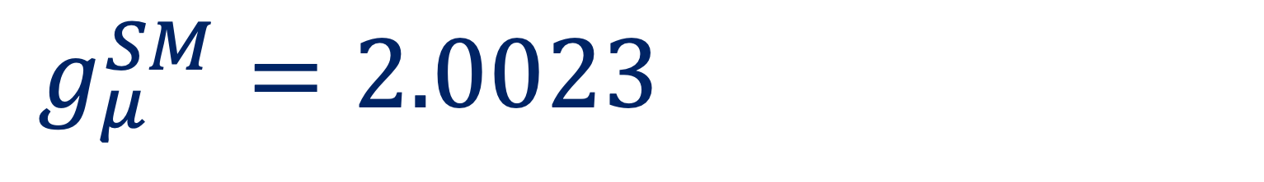
Standard Model components of g_{μ}
Dirac
Charged,
spin ½
$$g_{μ}^{SM}=2.0023$$
Schwinger
1st Order QED
WIN2025: 09/06/2025: 5

Slide 6

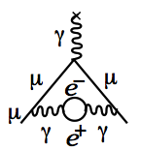
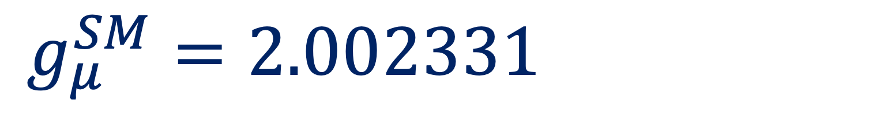
Standard Model components of g_{μ}
Dirac
Charged,
spin ½
Up to 10th Order QED
Kinoshita
+12671 diagrams
$$g_{μ}^{SM}=2.002331$$
Schwinger
1st Order QED
WIN2025: 09/06/2025: 6

Slide 7
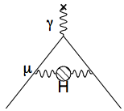
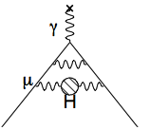
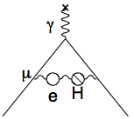
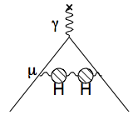
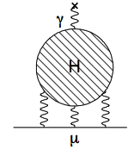
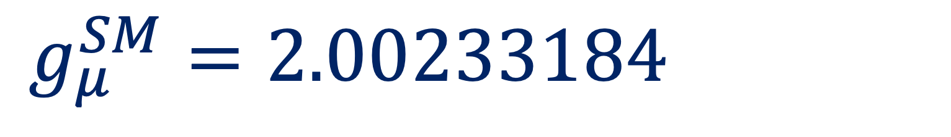
Standard Model components of g_{μ}
Dirac
Charged,
spin ½
Up to 10th Order QED
Kinoshita
+12671 diagrams
$$g_{μ}^{SM}=2.00233184$$
Hadronic
Schwinger
1st Order QED
WIN2025: 09/06/2025: 7

Slide 8
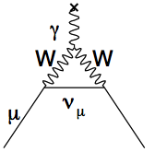
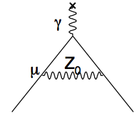
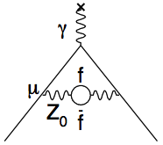
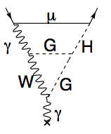
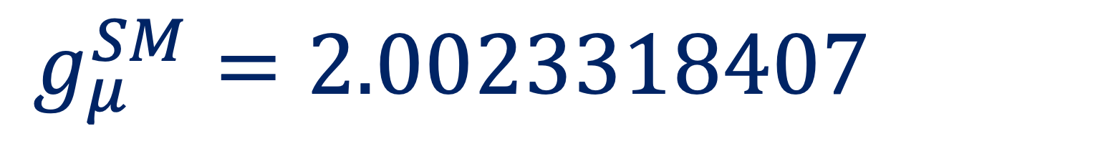
Standard Model components of g_{μ}
Dirac
Charged,
spin ½
Up to 10th Order QED
Kinoshita
+12671 diagrams
Electroweak
$$g_{μ}^{SM}=2.0023318407$$
Hadronic
Schwinger
1st Order QED
WIN2025: 09/06/2025: 8

Slide 9
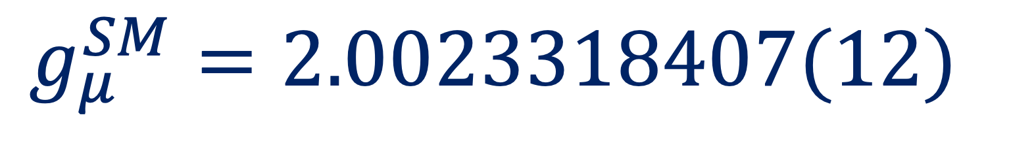
Standard Model components of g_{μ}
Dirac
Charged,
spin ½
Up to 10th Order QED
Kinoshita
+12671 diagrams
Electroweak
$$g_{μ}^{SM}=2.0023318407(12)$$
Hadronic
BSM?
Schwinger
WP2025:
arXiv 2505.21476
1st Order QED
WIN2025: 09/06/2025: 9

Slide 10
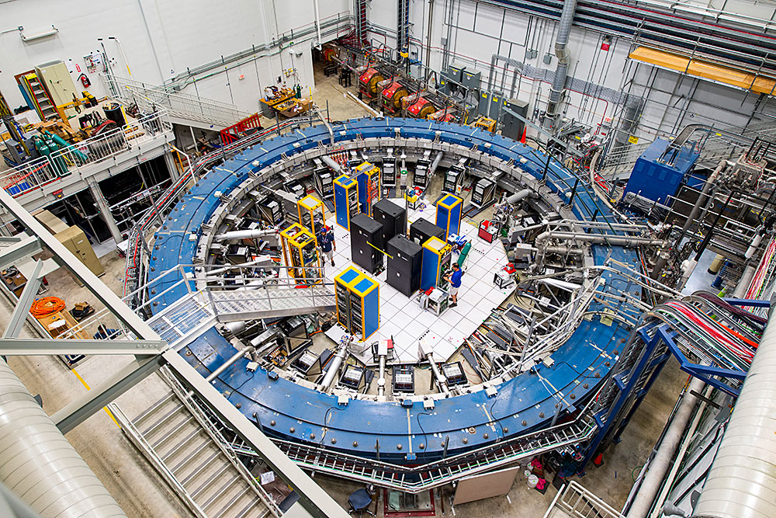
The Fermilab Muon g-2 Experiment
WIN2025: 09/06/2025: 10

Slide 11
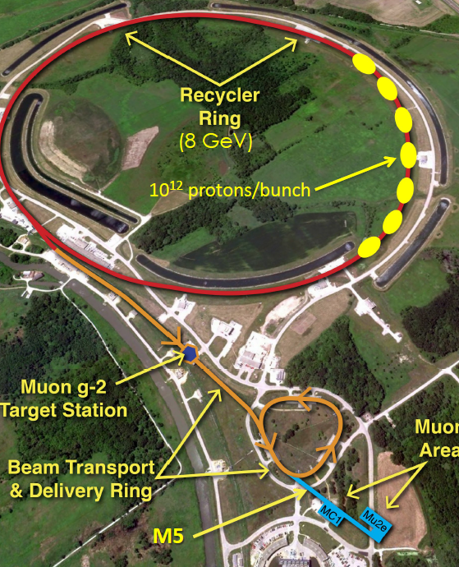
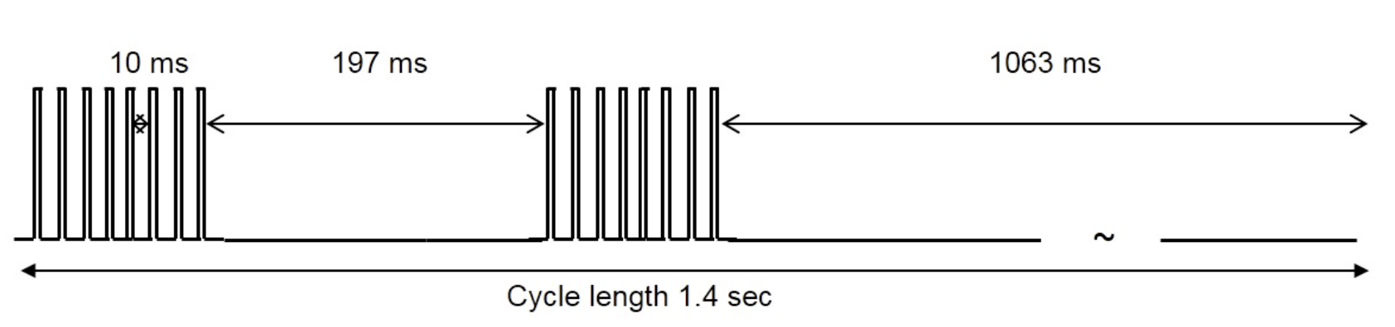
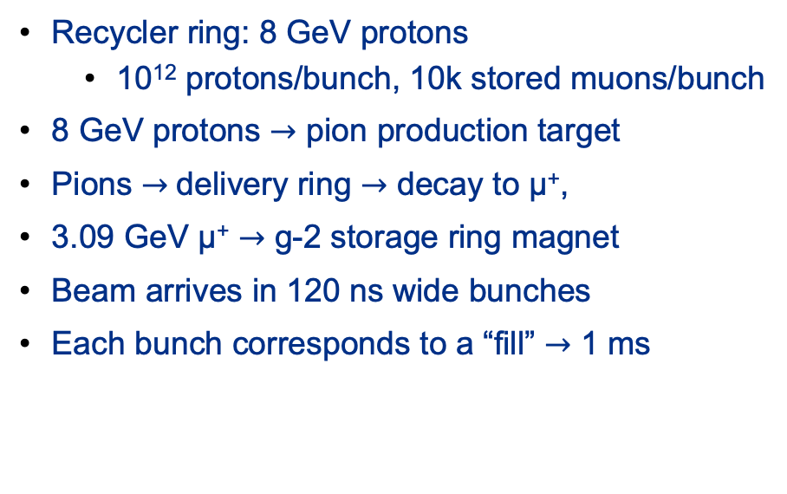
FNAL: Muon Campus
Recycler ring: 8 GeV protons
  10¹² protons/bunch, 10k stored muons/bunch
8 GeV protons $→$ pion production target
Pions $→$delivery ring $→$ decay to μ⁺,
3.09 GeV μ⁺ $→$ g-2 storage ring magnet
Beam arrives in 120 ns wide bunches
Each bunch corresponds to a “fill” $→$ 1 ms
3.09 GeV μ⁺ $→$Ɣ = 29.3 $→$ ~64μs lifetime
WIN2025: 09/06/2025: 11

Slide 12
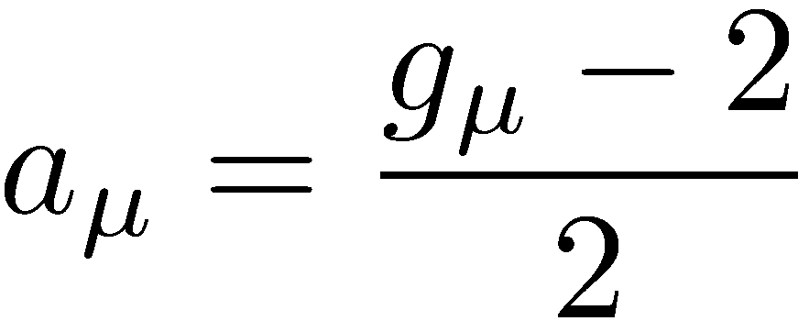
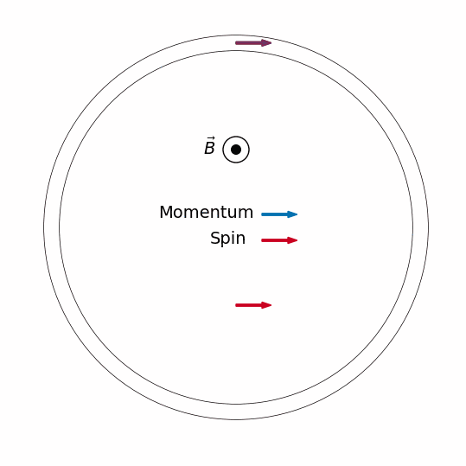
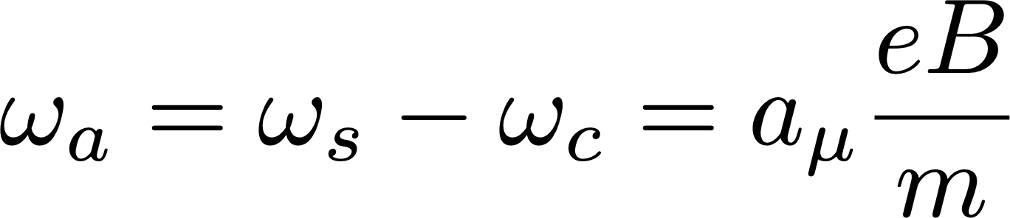
Measurement Principle
Muons orbit the ring with cyclotron frequency ω_{c}
Spin precesses with frequency ω_{s}
Both spin and cyclotron frequencies are proportional to B
Difference frequency ω_{a} is proportional to a_{μ} and B
Spin rotates ahead of momentum as the muon orbits the ring
If g = 2 there would be no precession
T_{c}≈149ns
T_{s}≈138ns
WIN2025: 09/06/2025: 12

Slide 13



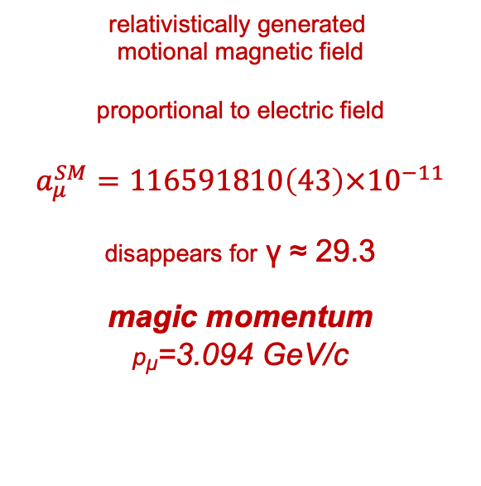

Relativistic equation
relativistically generated
motional magnetic field
proportional to electric field
$$a_{μ}^{SM}=116591810\left(43\right)×{10}^{−11}$$
disappears for γ ≈ 29.3
magic momentum
p_{µ}=3.094 GeV/c
non-relativistic limit
electron motion
non-perpendicular
to magnetic field
cyclotron motion assumed motion perpendicular to magnetic field
pitch of electron
E-field correction
$$C_{e}$$
Not all muons are at the ‘magic’ momentum of 3.1GeV
Vertical momentum component aligned with B field
Pitch correction
$$C_{p}$$
WIN2025: 09/06/2025: 13

Slide 14
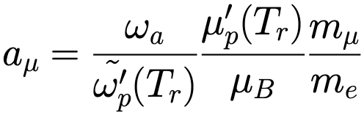
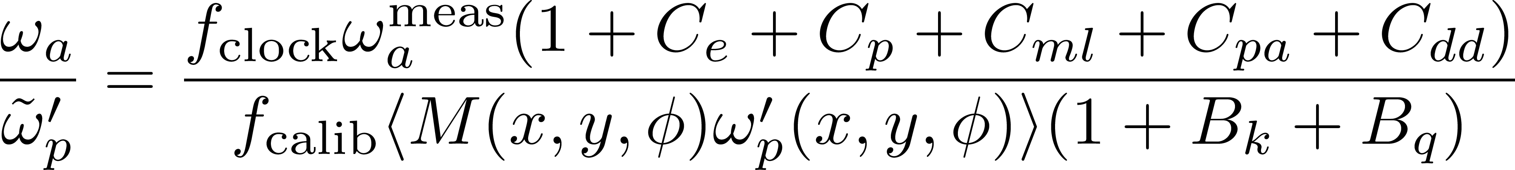
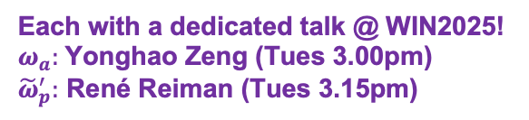
Measurement Components
The experiment actually measures two frequencies
Each with a dedicated talk @ WIN2025!
$ω_{a}:$Yonghao Zeng (Tues 3.00pm)
${\tilde{ω}}_{p}^{′}:$ René Reiman (Tues 3.15pm)
Both external ratios from CODATA 2022
Rev. Mod. Phys. 97, 025002
Unblinding conversion factor
Measured precession frequency
Corrections from beam dynamics systematic effects
Magnetic field weighted over
the muon distribution and
azimuthally averaged
Corrections from
the transient magnetic field
NMR probe calibration factor
WIN2025: 09/06/2025: 14

Slide 15
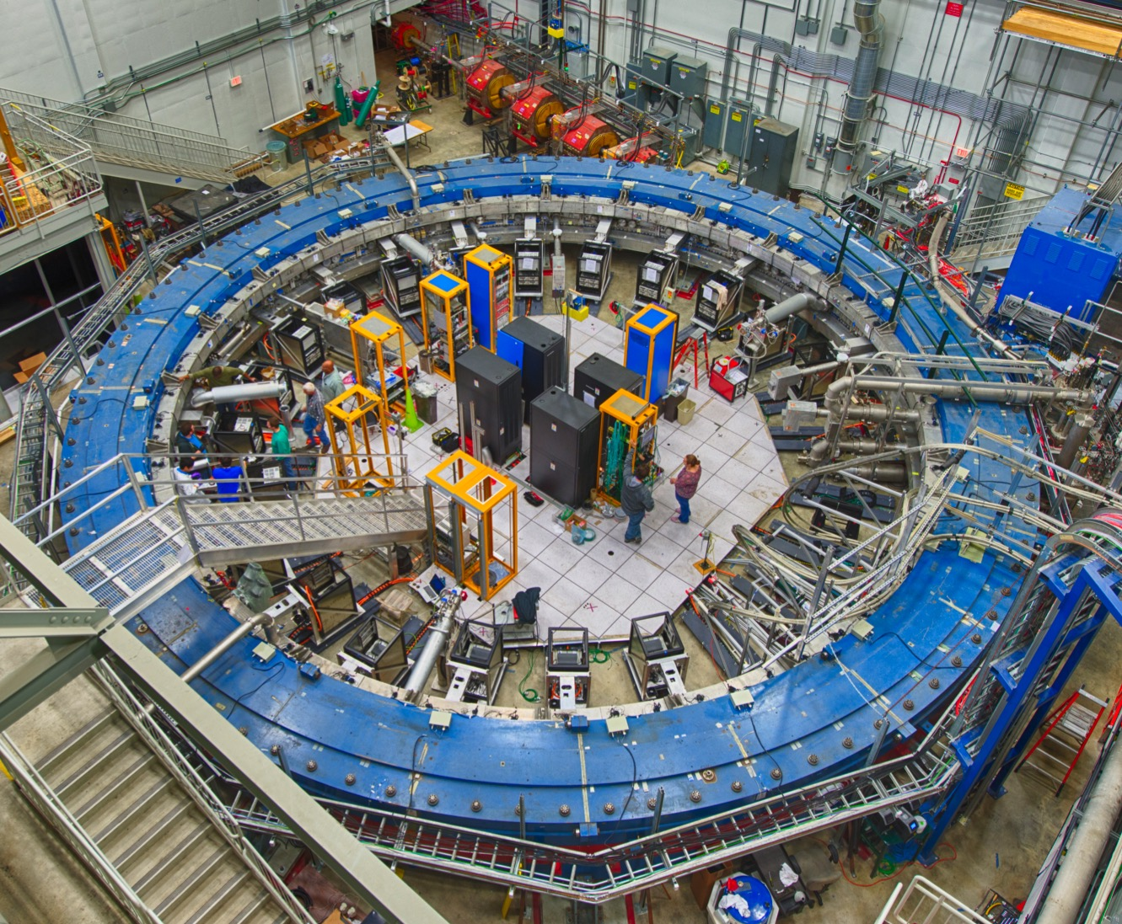
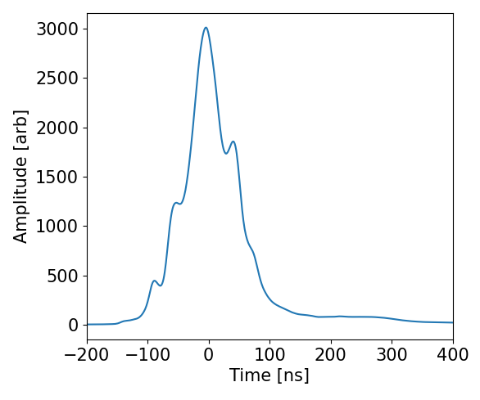
Beam injection
Monitor beam profile before entrance with scintillating X and Y fibres
Get time profile of beam using scintillating pad
~125ns wide
Cancel B-field during injection using Inflector, so muons can get into the ring
μ⁺
WIN2025: 09/06/2025: 15

Slide 16
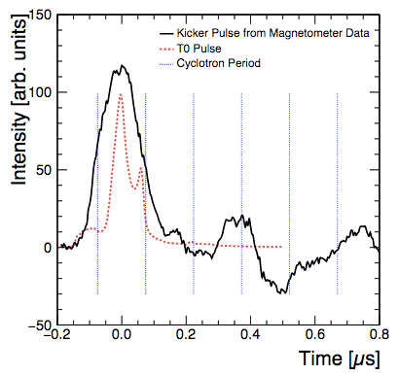
‘Kick’ onto correct orbit
μ⁺
After Inflector muons are 77mm away from ideal radius
Apply short magnetic pulse to ‘kick’ muons onto the correct orbit
WIN2025: 09/06/2025: 16

Slide 17
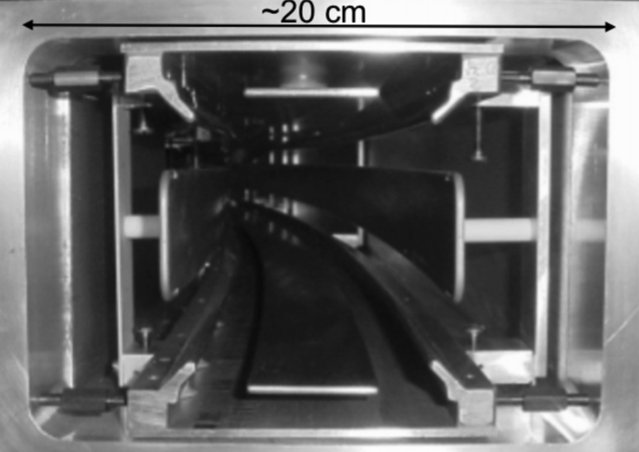
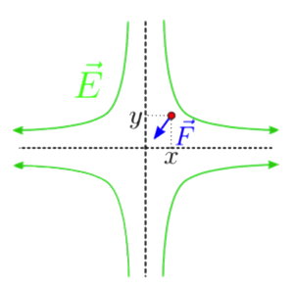
Beam focusing
μ⁺
Focus the muons vertically
Aluminum electrodes cover ~43% of total circumference
WIN2025: 09/06/2025: 17

Slide 18

Beam focusing
μ⁺
Focus the muons vertically
Aluminum electrodes cover ~43% of total circumference
Added new quad RF modulation (~1kV) for first $6μs$ of storage
Reduces harmonic motion of beam
Run 4/5/6 split into noRF, xRF, xyRF5 and xyRF6 datasets
WIN2025: 09/06/2025: 18

Slide 19
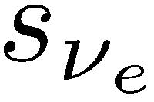
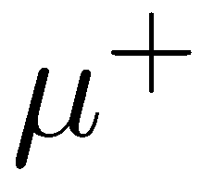
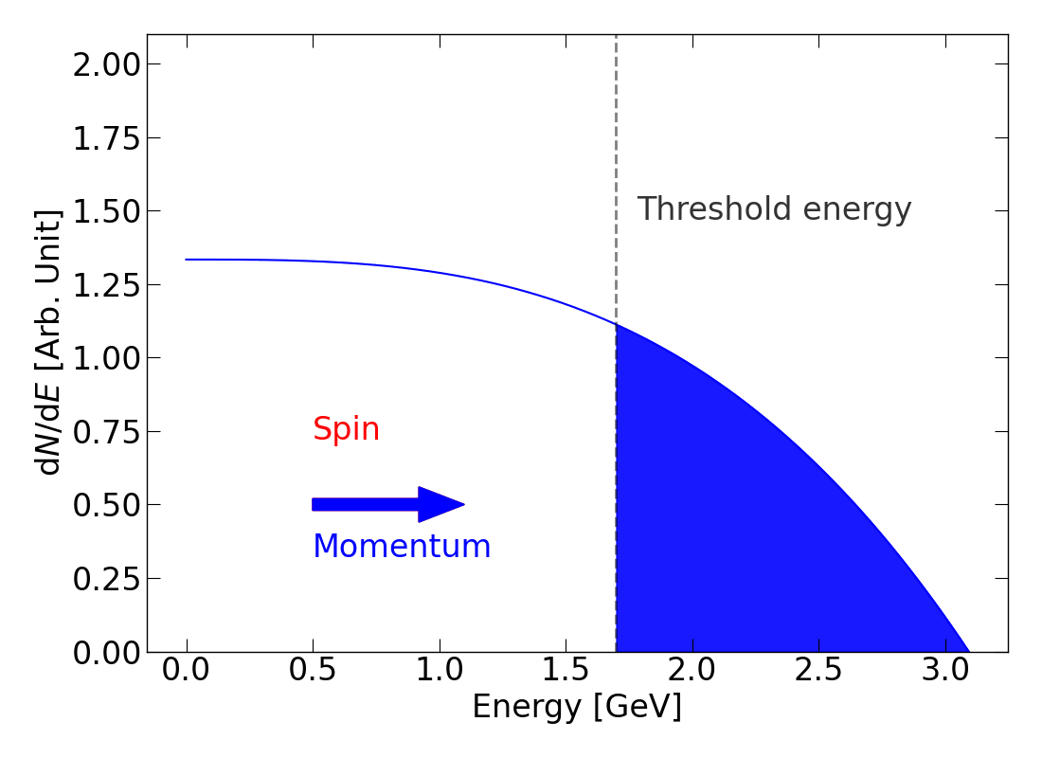
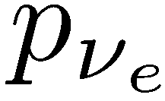
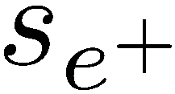
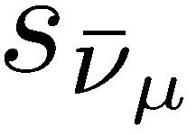
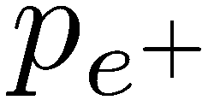
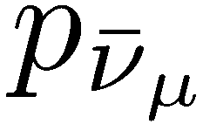
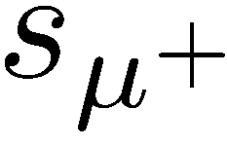

Measuring ω_{a}
The number of high momentum positrons above a fixed energy threshold oscillates at precession frequency
Simply measure the time and energy of decay positrons and count the number above an energy threshold
WIN2025: 09/06/2025: 19
Simply measure the time and energy of decay positrons and count the number above an energy threshold

Slide 20



Calorimeters
μ⁺
24 Calorimeters
Each crystal array of 6 x 9 PbF₂ crystals - 2.5 x 2.5 cm² x 14 cm (15X₀)
Readout by SiPMs to 800 MHz WFDs (1296 channels in total)
WIN2025: 09/06/2025: 20

Slide 21



Fitting ω_{a}
Simplest fit model captures exponential decay & g-2 oscillation
$N\left(t\right)=N_{0} e^{−t/τ} \left[1+A\cos{(ω_{a}t −φ_{0})}\right]$
$$ω_{a}/2π$$
Simple fit
Full fit
Beam frequencies show up in the residuals of a simple 5 parameter fit
After accounting for these frequencies in the final fit, the residuals are removed
$χ^{2}/NDF$ $=4007/4097$ for highest statistics dataset
WIN2025: 09/06/2025: 21

Slide 22

Tracking Detectors
μ⁺
2 Tracking stations
Each contain 8 modules
128 gas filled straws in each module
Traceback positrons to their decay point
WIN2025: 09/06/2025: 22

Slide 23


Beam Measurements
No RF
RF on
Use the tracking detectors to measure the decay positrons to infer the decay position
Muons oscillate radially and vertically at different frequencies, according to the quadrupole strength, and RF conditions
WIN2025: 09/06/2025: 23

Slide 24


Field measurement
Muon beam profile
Measuring the magnetic field
WIN2025: 09/06/2025: 24

Slide 25




Measuring the field: the NMR Trolley
An in-vacuum trolley with 17 NMR probes drives around the ring every ~3-7 days, mapping out the field components
Fixed probes
Trolley probes
Field measured by extracting frequency from a Free Induction Decay (FID) spectrum
At ~8000 azimuthal locations, obtain a field contour plot from the 17 probes
Fixed probes
Use fixed probe to tie together field from bookended trolley run to interpolate field during muons fills
WIN2025: 09/06/2025: 25

Slide 26


The muon-weighted field
To obtain the field experience by the muons, the magnetic field distribution as a function of time must be weighted by:
  The number of muons as a function of time, N(t)
  The beam distribution as a function of time
Number of e⁺ vs time N(t)
Dipole field vs time m1(t)
The field is weighted by the 2D beam distribution. An average beam distribution for every 3 hours is used.
Measured field (every 1.7 s) is weighted by the number of detected e⁺
WIN2025: 09/06/2025: 26

Slide 27
Corrections
Beam and Field Corrections
WIN2025: 09/06/2025: 27

Slide 28





E-field Correction
~0.1% spread in momentum in the ring
<R> of stored muons depends on p
Fourier analysis to determine equilibrium positions
Correction is ~0.4ppm (!)
$$\frac{p−p(\text{magic})}{p(\text{magic})}$$
WIN2025: 09/06/2025: 28

Slide 29

E-field Correction
As is typical with all corrections, multiple methods were used to extract the size of the correction, and the corresponding uncertainty. Good agreement between all cross checks

Slide 30
Corrections - summary
347ppb
175ppb
-33ppb
26ppb
0ppb
$$ω_{a}=ω_{a}^{m}\left(1 + C_{e}+ C_{p} + C_{pa} + C_{dd} + C_{ml}\right)$$
Electric-field & Up/Down motion
Spin precesses slower than
in basic equation
Phase changes over each fill:
Phase-Acceptance, Differential
Decay, Muon Losses
-37ppb
-21ppb
$${\tilde{ω}}_{p}^{′}=ω_{p}^{′}\left(1+ { B}_{k} + { B}_{q}\right)$$
Eddy currents from the kicker
Last into fill time
Vibrations in quadrupoles disturb the B-field

Slide 31


Uncertainties
Run-4/5/6
Electric Field
Pitch
Phase Acceptance
Differential Decay
Muon Loss
Transient Kicker
Transient ESQ
  TDR goal of 100ppb reached!
  No dominant source
  Further improving would require to reduce in many categories

Slide 32
Statistical Improvement
 | Analyzed Positrons (10⁹) | Fraction (%) | Stat. Uncertainty (ppb)
Run-1 | 15.4 | 5 | 434
Run-2/3 | 70.9 | 23 | 201
Run-4/5/6 | 222.2 | 72 | 114
Run-1-6 | 308.5 | … | 98
TDR goal – 100ppb
WIN2025: 09/06/2025: 32

Slide 33
Statistical Improvement
 | Stat. Uncertainty (ppb) | Syst. Uncertainty (ppb) | Total Uncertainty (ppb)
Run-1 | 434 | 159* | 462
Run-2/3 | 201 | 78* | 216
Run-4/5/6 | 114 | 76 | 137
Run-1-6 | 98 | 78 | 125
TDR goal – 140ppb
WIN2025: 09/06/2025: 33

Slide 34

Experimental Result - 2023
Before the result on June 3rd the experimental uncertainty was ~200ppb
This is using the latest CODATA external measurements, and contains small corrections found in the latest analysis
WIN2025: 09/06/2025: 34

Slide 35

Experimental Result - 2025
Including the latest result the Fermilab average is:
$$a_{μ}\left(FNAL\right)=116 592 0705\left(148\right) × {10}^{−12} (127ppb)$$
WIN2025: 09/06/2025: 35

Slide 36

Experimental Result - 2025
Including the latest result the Experiment average is:
$$a_{μ}\left(EXP\right)=116 592 0715\left(145\right) × {10}^{−12} (124ppb)$$
WIN2025: 09/06/2025: 36

Slide 37
Conclusions
High precision measurement of Muon g-2 is a stringent test of SM theory
Full FNAL dataset analysed and published:
arXiv: 2506.03069
PRL pending…
FNAL measurement surpassed TDR goals in statistics and systematics! More than 4 times more precise than BNL
Run-4/5/6 data consistent with previous Run-1/2/3 result, and BNL
More to come from FNAL g-2 experiment:
    EDM measurement
  CPT/Lorentz violation searches
  Dark Matter search
WIN2025: 09/06/2025: 37

Slide 38









Thank you!
US Universities
  Boston
  Cornell
  UIUC
  James Madison
  Kentucky
  Massachusetts
  Michigan
  Michigan State
  Mississippi
  North Central College
  Regis
  Trinity
  Virginia
  Washington
  York CUNY
US National Labs
  Argonne
  Brookhaven
  Fermilab
China
  Shanghai Jiao Tong
Germany
  Dresden
  Mainz
Italy
  Frascati
  Molise
  Naples
  Pisa
  Roma Tor Vergata
  Trieste
  Udine
Korea
  CAPP/IBS/KAIST
Russia
  Budker/Novosibirsk
United Kingdom
  Lancaster/Cockcroft
  Liverpool
  Manchester
  University College London
176 collaborators
34 Institutions
7 countries
Muon g-2 Collaboration Meeting @ Liverpool
July 2023
WIN2025: 09/06/2025: 38

Slide 39
Backups…
Queen Mary: 18/10/2023: 39

Slide 40


The g-2 storage ring magnet
Magnet cross-section
7.112 m radius ‘C’-shape magnet with vertically-aligned field B = 1.45 T
Dipole field has ppm-level uniformity
Tiny (ppm) changes in magnet geometry, driven by temperature changes, cause the field to drift over time
378 ‘fixed’ NMR probes, built for this experiment, around the ring measure the drift continuously, and provide feedback to the magnet power supply to keep the dipole (vertical) term constant
Shimming devices minimise gradients (transverse and azimuthal field components).
Top-down view
WIN2025: 09/06/2025: 40

Slide 41


EDM analysis
Muon EDM causes tilt in precession plane
Asymmetry in vertical decay angle of positrons
Vertical angle measured by tracking detectors
Momentum binned analysis for maximum sensitivity
Run 1 analysis still blinded. Assuming zero signal expecting limit of:
|d_{μ}| < 2.0 × 10⁻¹⁹e.cm (95% C.L.)
Still statistically limited in tracker analysis
Factor of ~10 improvement for statistics accumulated so far, with tracking improvements

Slide 42




Clock Blinding
The clock is hardware blinded to have a frequency of (40 ± ε) MHz
Only 2 people outside of the collaboration set and know the number
Blinding offset was ± 25 ppm (approx ⨉10 BNL-SM difference)
Additionally each analysis is blinded in software
Queen Mary: 18/10/2023: 42

Slide 43

Additional measurements

Slide 44

Multiple datasets

Slide 45

Theory comparison

Slide 46

Effect of RF on the beam

Slide 47

Magnetic field calibration

Slide 48

Run 4/5/6 start time scan

Slide 49


Slide 50


Slide 51


