Slide 1

A-STAR a wakefield accelerator for high-repetition rate XFELs
A
A
A
A
A
A
A
A
A
A
Presenter: A. Zholents, APS/ANL
W. Jansma, S. Lee¹, M. Kasa, A. Nassiri, B. Popovic, M. Qian, S. Sorsher, N. Strelnikov², K. Suthar, E. Trakhtenberg, G. Waldschmidt (APS/ANL)
S. Doran (HEP/ANL)
M. Fedurin, K. Kusche (ATF/BNL)
Siy³, N. Behdad, J. Booske (University of Wisconsin)
S. Baturin⁴, P. Piot⁵, W.-H. Tan⁶ (Northern Illinois University);
1) now at LANL, 2) at Amazon, 3) at Quaise Energy, 4) at ITMO University, 5) at HEP/APS/ANL, 6) at SLAC
AAC’2026 UCLA
July 30, 2026

Slide 2
LCLS-II sets a new standard for the X-ray laser, delivering millions of X-ray pulses per second to scientific users to tackle questions that had previously been impossible to address
“The increase (from 120 Hz to 1 MHz) has already made an amazing change,” Dakovski said^{*)}. “Not only is the data coming in faster and with clarity we haven’t seen before, it actually helps us see how the materials are transforming over time. We can watch how energy flows through the material and how the atomic components interact. We can create frame-by-frame ‘movies’ of the dynamic processes.”
^{*)} https://www6.slac.stanford.edu/news/2025-08-07-united-states-just-got-new-x-ray-laser-toolkit-study-natures-mysteries

Slide 3
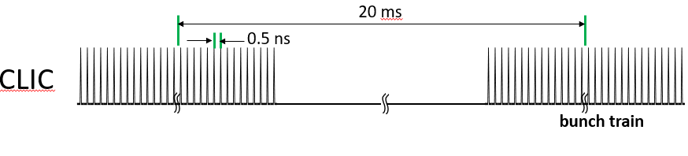
Could we replace the SRF linac with more affordable compact accelerator?
1. Plasma-based wakefield accelerators driven by electron or laser beams
The bunch length is not much smaller than the plasma wavelength ☹
Operating at a high repetition rate is challenging ☹
2. Structure-based accelerators driven by external RF sources
C³ - the cryogenically cooled copper C-band linac
The CompactLight design study: leveraging the latest innovations in X-band linac and undulator technologies
Long RF pulse -> low repetition rate ☹
3. EuPRAXIA: combines structure-based and plasma-based -> low repetition rate ☹
3. Two-beam wakefield accelerator -> CLIC (X-band 50 Hz, 312 bunches)
☹

Slide 4

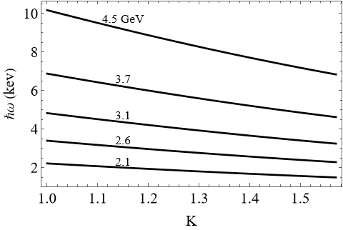

Multi-user tender-to-hard X-ray free electron laser facility
Wavelengths from 1.5 keV to 10 keV. This range includes 𝐾-edges of 18 atoms from silicon to zinc.
4.5 GeV
Undulators
Beamlines
Switch yard
e-gun
200 kHz
End stations
1 GeV SRF linac
Accelerator for drive and witness bunches
.
Array of collinear wakefield accelerators
XFEL undulators and beamlines
Photon energy ℏ𝜔 versus undulator parameter 𝐾 calculated for FNAPU with a period of 12.6 mm.
High wall plug power efficiency
CWAs do not need electrical power (almost)
Undulators do not need electrical power (almost)

Slide 5

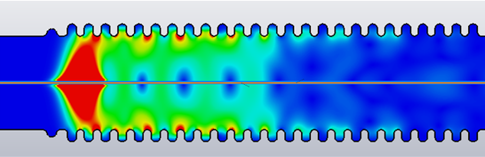

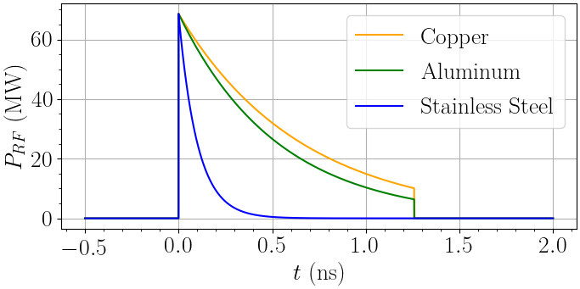
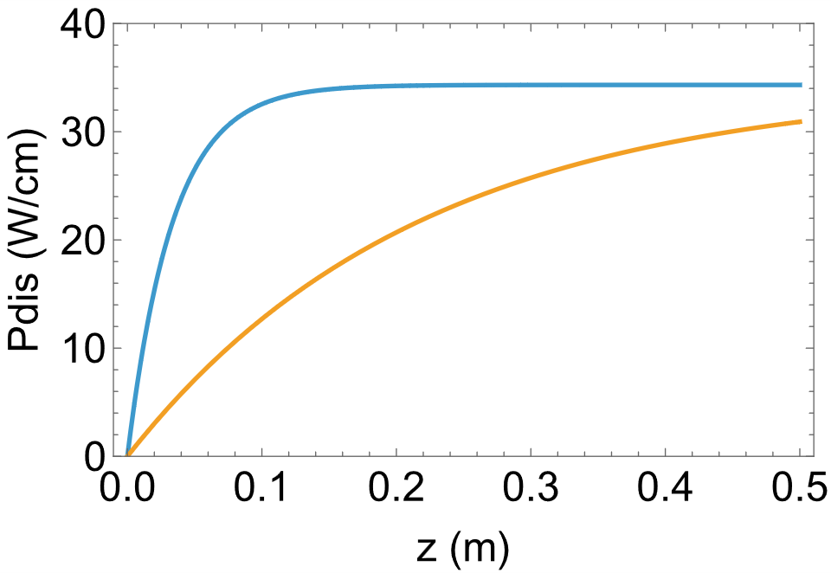
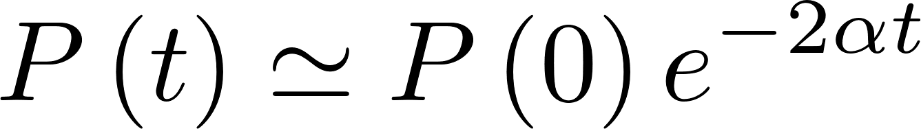
Collinear wakefield acceleration using one drive and one witness bunch is well suited for a high repetition rate operation
witness
<<
drive
4 ps
… because the wakefield needs to exist only for a short time!
The corrugated waveguide is used to obtain a wakefield
RF power dissipation
SS
Cu
Calculated using
10 nC and 20 kHz
head
tail, attenuated
RF power envelope at the end of a 0.5 m long section of CWA operating at 180 GHz. The wakefield decays due to dissipation in the walls.
Using sub-THz frequency and lossy material is beneficial for obtaining short pulses, and possibly high breakdown fields

Slide 6
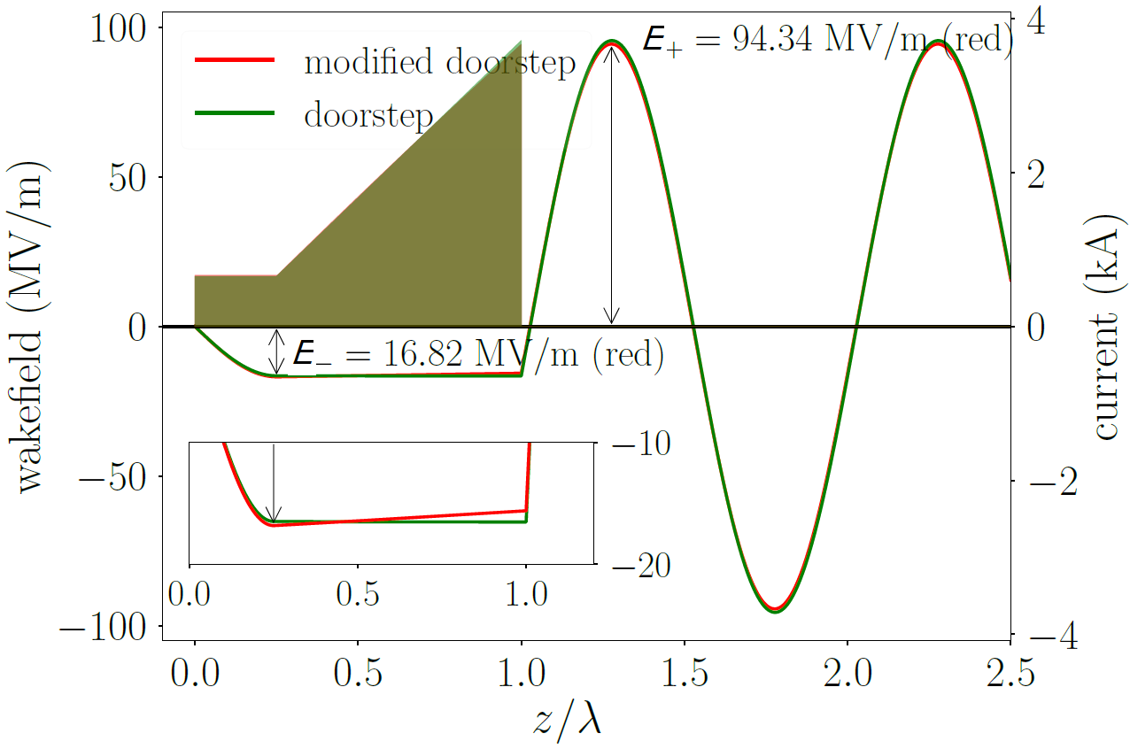

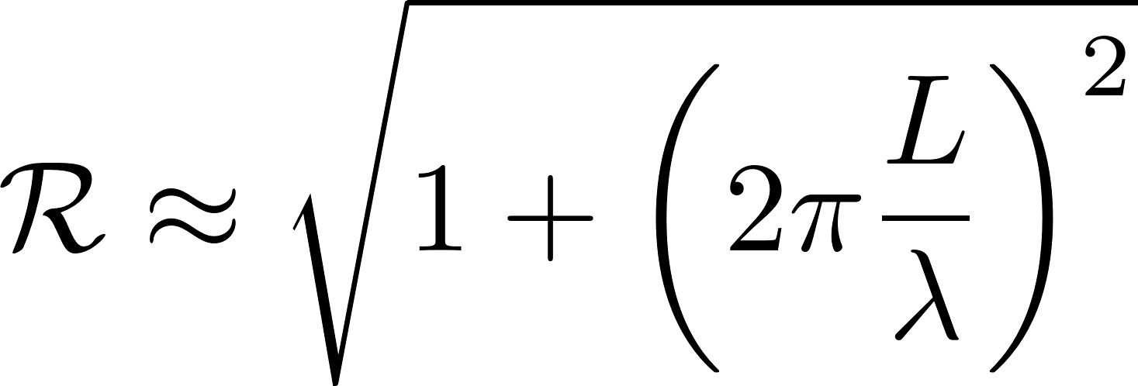
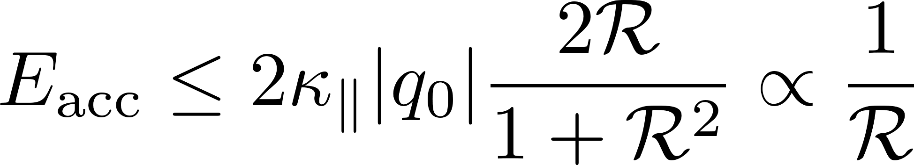
Shaped drive bunch to obtain a high accelerating field for a witness bunch and an equal deceleration rate for almost all electrons in the drive bunch
A "doorstep" charge distribution¹
Transformer ratio
acc
q₀=10nC
dec
L
loss factor
( λ=1.7 mm )
1) K. Bane, P. Chen, P. Wilson, Proc. of the Part. Acc. Conf. (PAC1985), Vancouver, Canada, p.3524–3526, 1985.

Slide 7
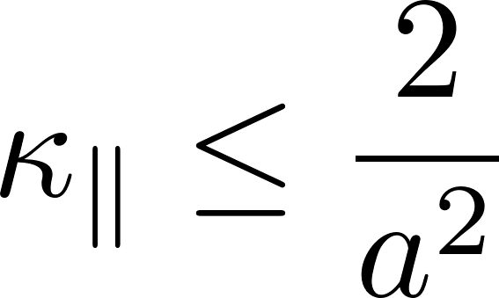
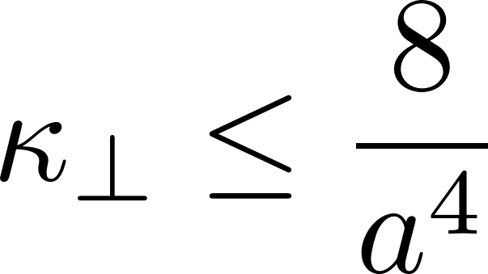

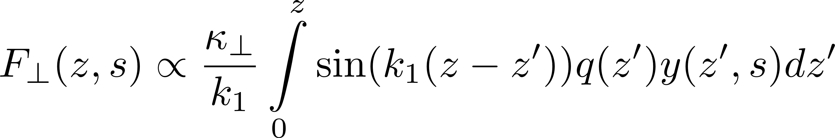
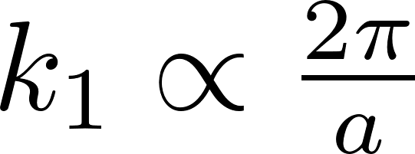
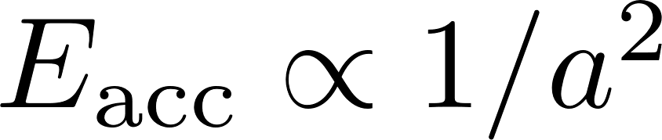
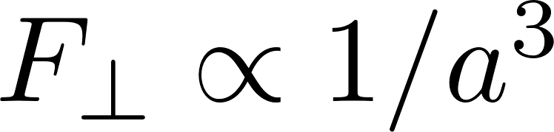
maximum accelerating field
loss factor in CGS units
kick factor in CGS units
tail
Lorentz force (cause of BBU)
head
where
Thus

Slide 8
Adaptive energy chirp is used to facilitate BNS damping of BBU instability
A "doorstep" charge distribution¹
Transformer ratio
acc
q₀=10nC
dec
L
loss factor
( λ=1.7 mm )
1) K. Bane, P. Chen, P. Wilson, Proc. of the Part. Acc. Conf. (PAC1985), Vancouver, Canada, p.3524–3526, 1985.

Slide 9
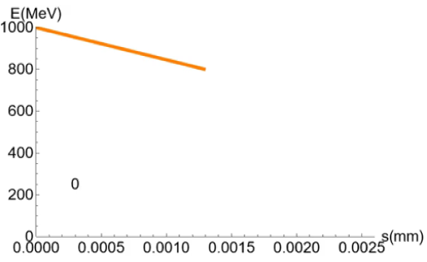
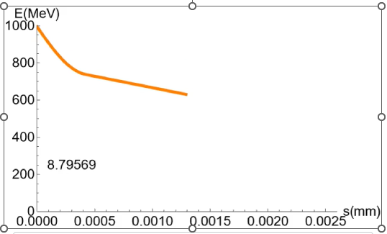
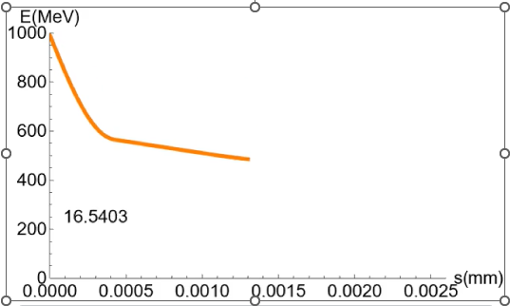
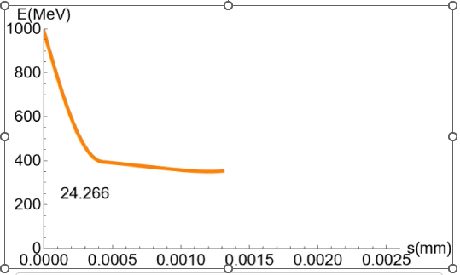
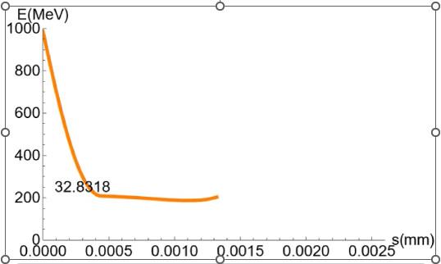
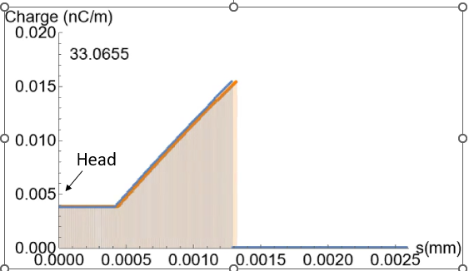
Snapshots of the drive bunch longitudinal phase space taken at different locations along the A-STAR
Energy chirp = 15%
Energy spread = 0
distance from the beginning of A-STAR
Charge distribution
beginning
ending

Slide 10
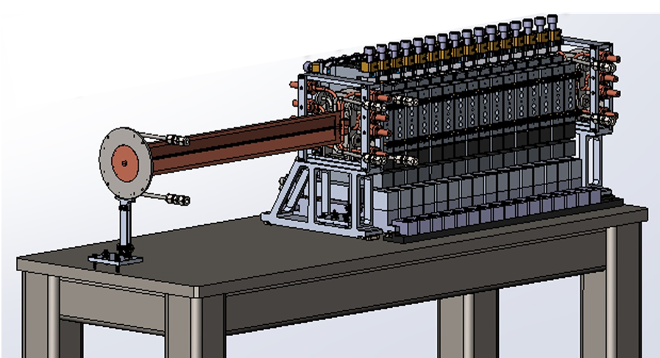
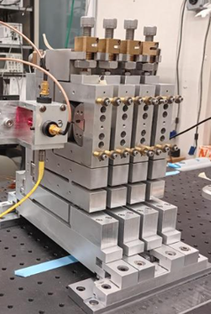
Implementation of BNS damping
FODO focusing structure”
Transition section
Corrugated waveguide
3-mm bore diameter quadrupoles play a decisive role in suppressing BBU instability
Two 0.5 m long modules of the collinear wakefield accelerator connected in series with the “quadrupole wiggler” removed on the left

Slide 11
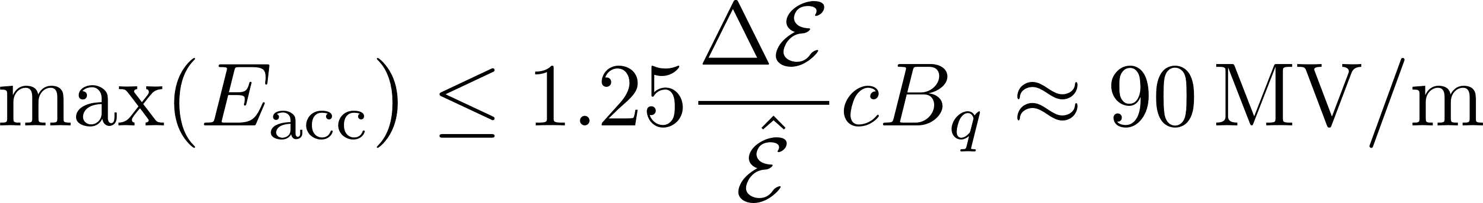
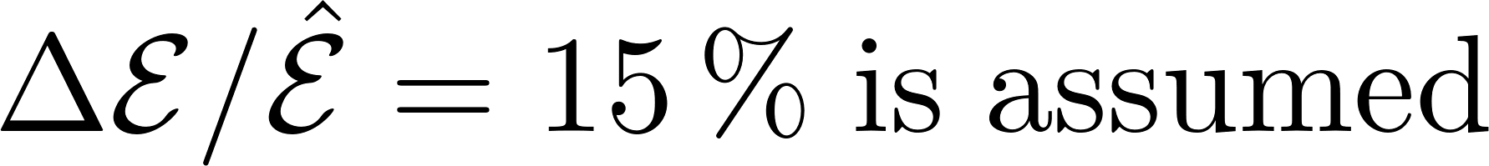
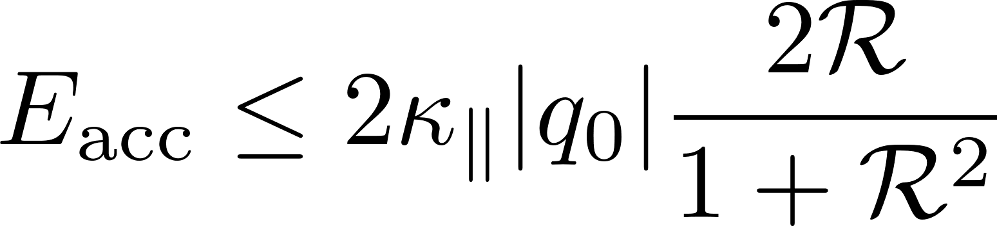
Upper bound for the maximum accelerating field in the structure-based collinear wakefield accelerator is defined by BBU
quadrupole’s pole tip field at saturation (1.6 T is assumed )
Using practical constraints
𝑎 = 1 mm,
𝑞0 = 10 nC,
R = 5,
we calculate 𝐸_{acc} ≈ 90 MV/m.

Slide 12
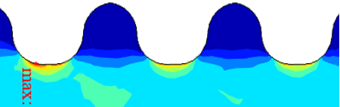

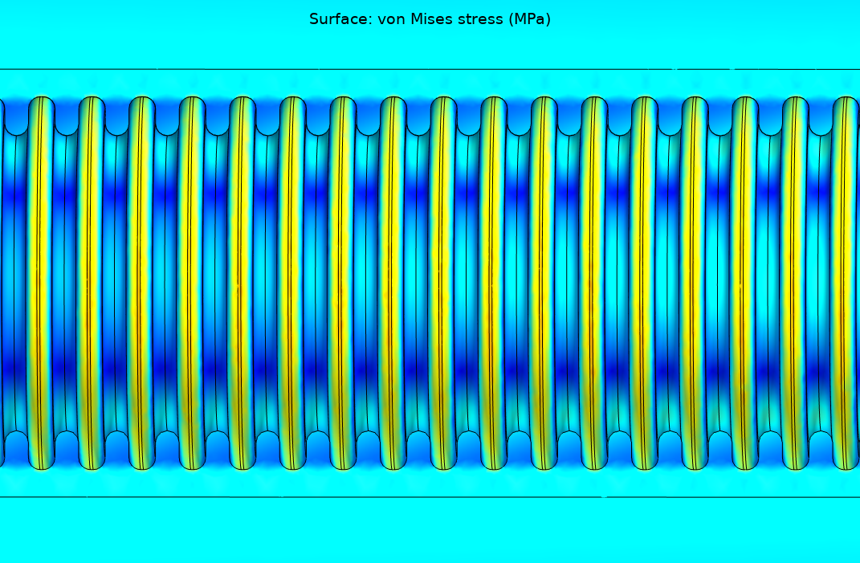
Bunch repetition rate is defined by the heat load and the tensile stress
Corrugation groove 41 MPa
Corrugation rib
10 kHz bunch rep. rate was used in this example
von Mises stress (MPa)
This CWG section experiences the highest heat load

Slide 13
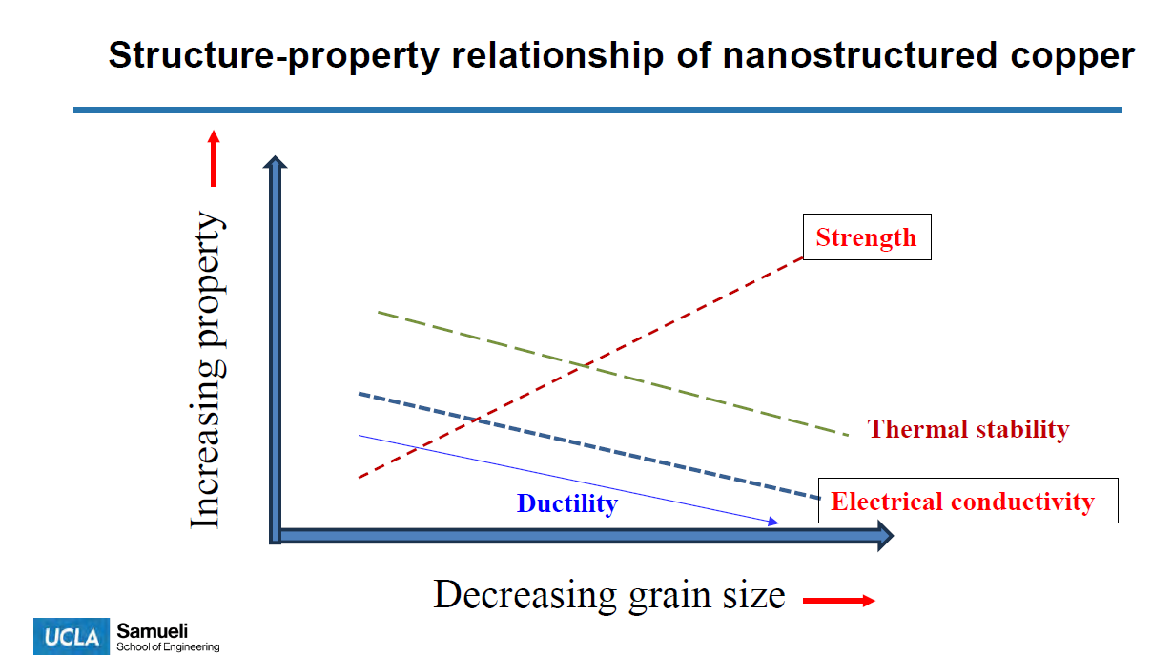
Electroforming is used to make the corrugated waveguide
Electroformed copper can have much higher tensile stress threshold than ordinary copper (Hall-Petch effect) such as 100 kHz bunch repetition rate could be within the reach.
Courtesy Morris Wang, UCLA
M. Wang, et. al., Nat. Commun. 13, 5581 (2022).

Slide 14
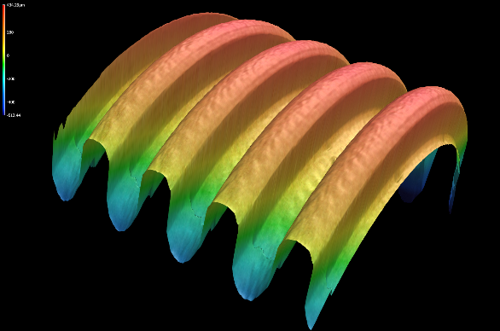
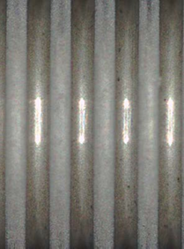
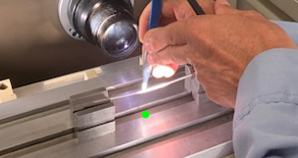
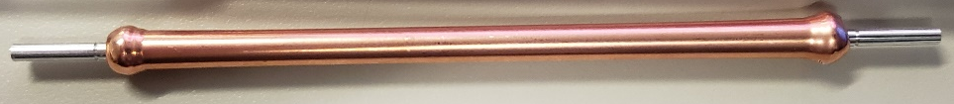
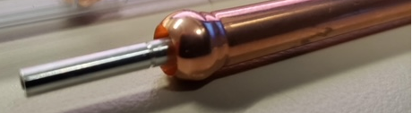

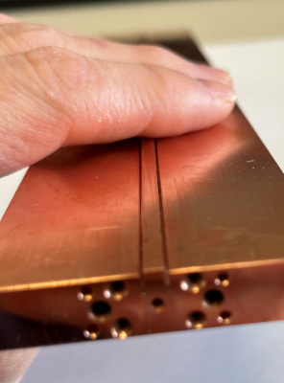
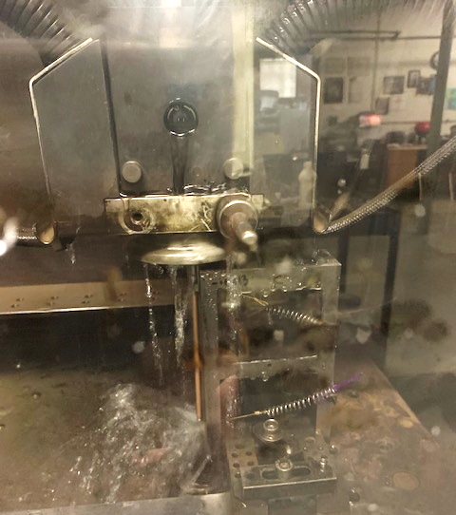
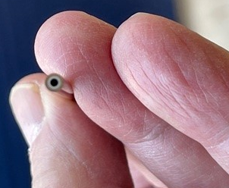
Electroforming of an axially symmetric corrugated waveguide
Aluminum mandrel production
Mandrel inspection and straightening
Electroforming
High-Quality Surface Finish
100 mm
Proprietary micro-machining process
Tooth Height 252.7 μm; error 1.5 μm RMS
Tooth Width 175.9 μm; error 2.0 μm RMS
using optical comparator
EDM of outside diameter
Precision cut of edges
chamber with five 10-cm long tubes after brazing (currently use three);
low temperature brazing at 360 ºC
followed by second straightening
followed by aluminum etching
14

Slide 15

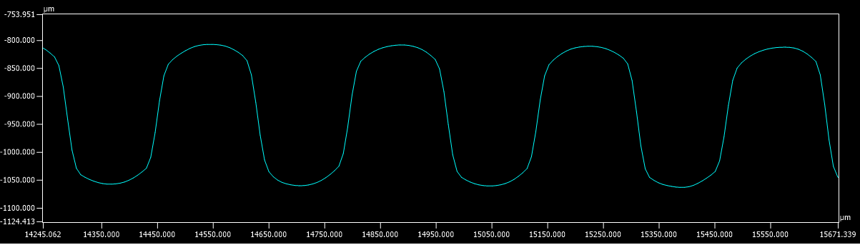
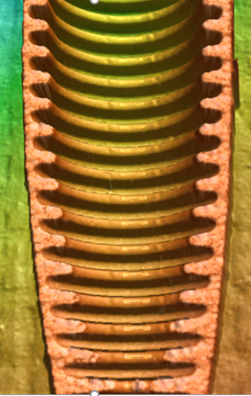
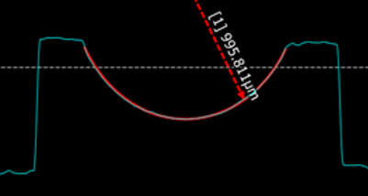
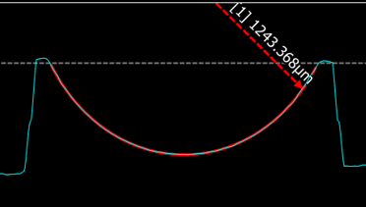
Example of a fabricated corrugated waveguide
straight cut
Test samples are wire EDM cut to expose the internal corrugations for dimensional analysis
Magnified longitudinal profile of corrugations
249.3 μm
340.7 ± 5μm
Average height of the corrugations of 249.7 μm was determined.
Tooth Cross-Section
Groove Cross-Section
Measurements indicate excellent fabrication quality
angular cut
Notes:
A Keyence VR3200 3D surface profiler was used to perform high-precision metrology for the dimensional analysis of electroformed corrugated waveguide samples.

Slide 16
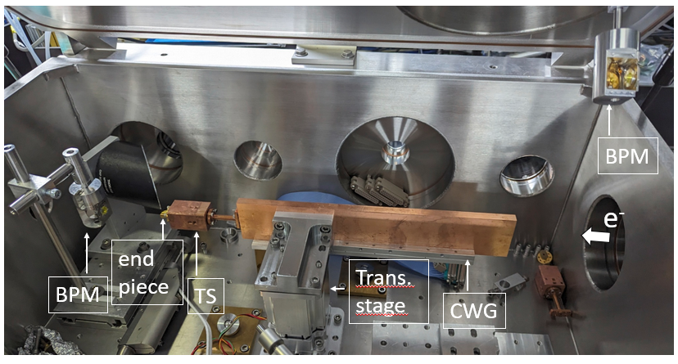
Setup of the experiment at ATF
300 mm

Slide 17
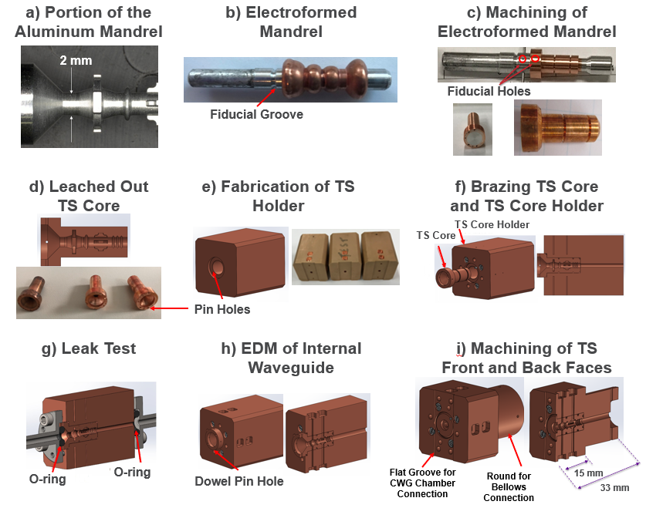
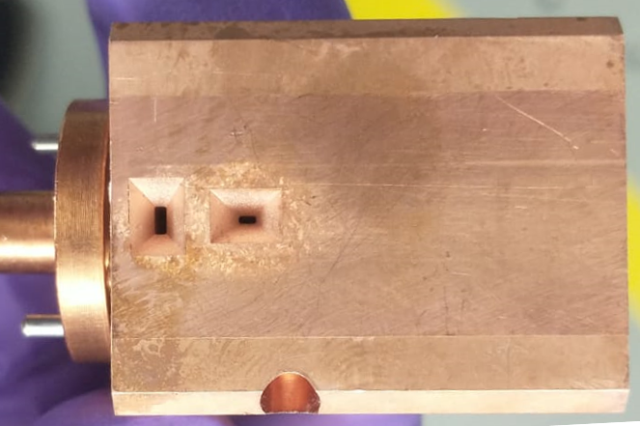
Fabrication of transition section between accelerator modules
TM₀₁ coupler horn antenna, 0.72 mm × 1.78 mm
5.6 mm
33 mm
Integrated offset monitor horn antenna, 1.10 mm × 0.45 mm

Slide 18
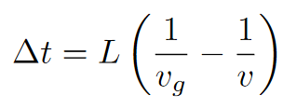
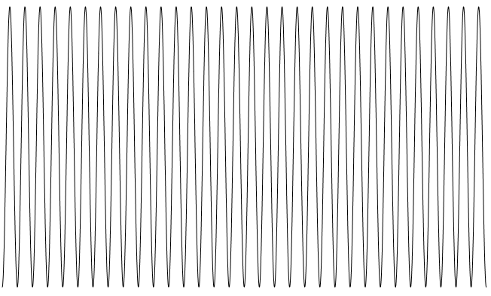
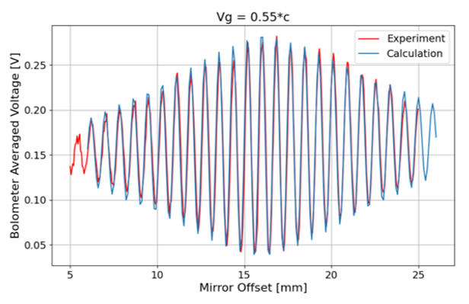
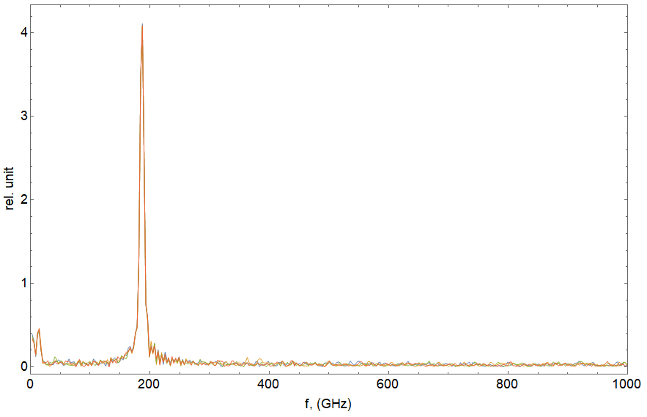
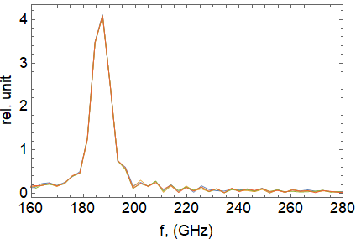
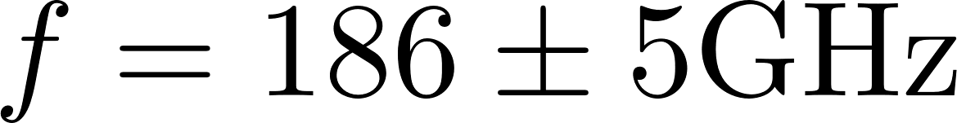
Measurement of CWG: Frequency & group velocity
(L=34 mm)
Michelson interferometer
design:
v_{g} = 0.57c
1.5 ps
measured:
v_{g} = 0.55c
Interferogram
TM₀₁
Design: 180 GHz
no HOM
f, GHz

Slide 19









Measurement of the electron beam self energy modulation
Calculated results for a 5 ps, 130 pc bunch with a flattop peak current distribution and 65 keV slice energy spread. Off crest acceleration by 6.0 degree. Tube length=74.12mm
a)
tail
e)
tail
head
head
b)
diagnostic screen
f)
diagnostic screen
Reconstruction using theoretical wakefield
c)
g)
d)
Tube with a smooth wall
h)
Corrugated Waveguide
Measurement
Energy (MeV)
Energy (MeV)

Slide 20

Future work:
measurement of the electrical breakdown threshold and the rate of the breakdown events
development of the electroformed copper with a high tensile stress threshold

Slide 21
Conclusion
BBU instability constrains the accelerating gradient in A-STAR to 90 MV/m.
All principal A-STAR components were fabricated and tested on the bench and with the electron beam. Work as designed.
As is, the A-STAR is expected to operate with the bunch repetition rate of 20 kHz. With more R&D, achieving 100 kHz could be feasible.
In the A-STAR project, we prioritize a full utilization of the drive-bunch energy in one stage and achieving a high bunch repetition rate, rather than a high accelerating field. Even so, A-STAR is designed for a real-estate acceleration rate of 90 MeV/m using 10 nC drive bunches.

Slide 22


Bunch “train” structure
Linear collider CLIC
20 ms
0.5 ns
312 bunches
XFEL user’s preference
(1 – 50) μs
X-ray pulses
collect data pulse-by-pulse

Slide 23




Comparison of options for obtaining high energy witness bunch
Accelerator length (m), final energy (MeV)
50,4611
Drive bunch:
Charge = 10 nC
Initial energy = 1 GeV
Final energy = 0.1 GeV
Witness bunch:
Charge = 0.15 nC
Initial energy = 1 GeV
Final energy, see Table
36,4209
23,3625
77.7 MV/m
Witness bunch energy (MeV)
93.7 MV/m
117 MV/m
Option | Transformer Ratio | E_{acc} (MV/m) | Maximum Energy (MeV) | Acc. Length (m) | Bunch rep. rate (kHz) | Efficiency %
1 | 3.2 | 117 | 3625 | 23 | 10 | 57
2 | 4.2 | 93.7 | 4209 | 36 | 15 | 100
3 | 5.1 | 77.7 | 4611 | 50 | 22 | 161
reference option

Slide 24




Animation
Head
Head

Slide 25

Heat load
Calculations of a steady state temperature are performed using 20 kHz bunch repetition rate and assuming reduced copper conductivity σ = 2.3e7 S/m (instead of 5.9e7 S/m)
Water
temperature 25.6 ºC
Vacuum chamber
Average power dissipation on 0.5 m long CWG at 20 kHz bunch repetition rate is 1050 W

