Slide 1
Contrast enhancement results of a novel spatially-combined, pulse-stacked ultrafast fiber laser system
David Feng¹, Christopher Pasquale², Yanwen Jing², Michael Garner², Almantas Galvanauskas²
¹Lawrence Livermore National Laboratory, Livermore, CA 94550
²University of Michigan, Ann Arbor, MI 48109
A2-Working Group # 2. AAC 2026, UCLA.
July 30th, 2026

Slide 2
Presentation outline
Introduction & motivation (3 slides)
Experiment & setup (4 slides)
Results (5 slides)
Challenges (2 slides)
Conclusion (1 slide)

Slide 3
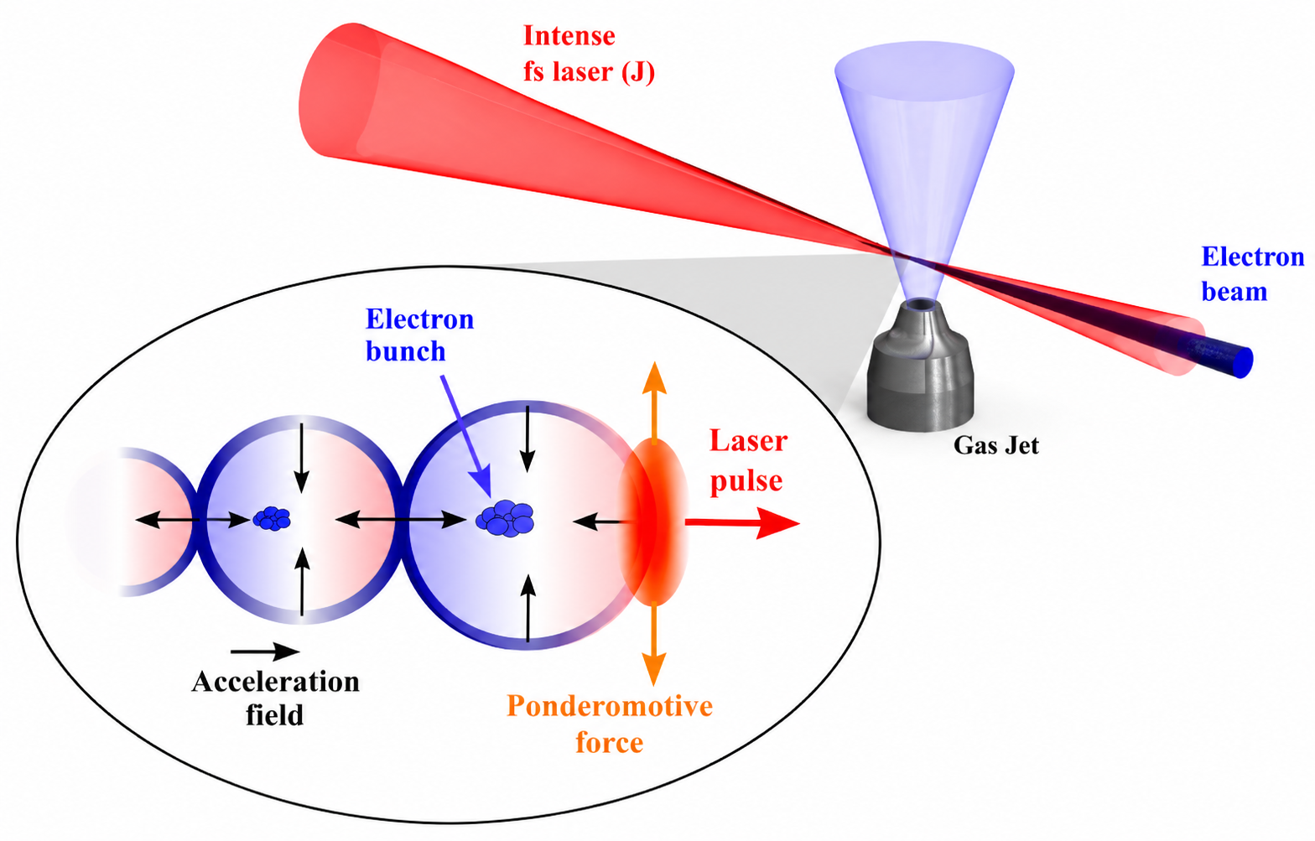
Lasers for wakefield particle acceleration
Accelerating electrons to relativistic energies is expensive – km in length & can cost billions of dollars.
Lasers can reduce size & cost by driving strong electric fields in laser-based plasmas to accelerate particles.
Principle of laser wakefield electron acceleration.
Notes:
-Intense laser pulse comes into gas jet
-Gas is ionized at the rising edge of pulse → plasma is formed
-Main pulse peak interacts with said plasma
-Electrons in plasma undergo periodic modulations of electron density (Langmuir wave)
-Ponderomotive force drives electrons away from propagation axis, charge separation brings them back
-”Plasma bubble” forms, electron bunches appears, get rapidly accelerated into laser propagation direction by its E-field
-Laser field can be stronger than conventional RF linear accelerators (~GeV/m), e-densities of 10^18 cm-3

Slide 4
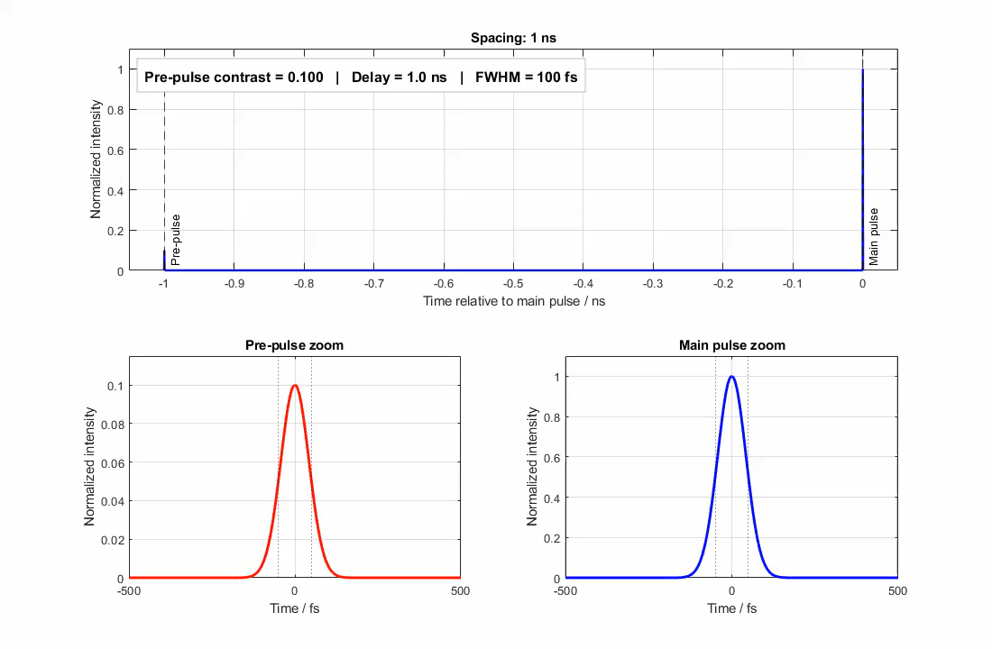
Challenges to deployment of such laser systems
A viable laser for MeV-GeV-class acceleration would require the following specifications:
  High peak power (>100 GW)
  High average power (>1 kW)
  Ultrafast (≤50 fs)
  High repetition rate (>1 kHz)
  High contrast (<10⁻⁶)
Pre-pulse contrast simulation.
Notes:
All these parameters are typical of a laser capable of outputting electrons accelerated to MeV-GeV.
For sub-10 fs, ~800 nm laser intended to demonstrate LWFA:
Pulse energy: 3–10 mJ
Pulse duration: 5–8 fs
Peak power: approximately 0.4–2 TW
Average power: determined by repetition rate, but 1-2 kHz good enough for MeV scale electrons
Focused intensity: approximately $1×{10}^{18}$ to $1×{10}^{19} W/cm^{2}$
Focal spot: 4–8 µm FWHM
Plasma density: several ${10}^{19} cm^{−3}$, can be ionization injection assisted

Slide 5
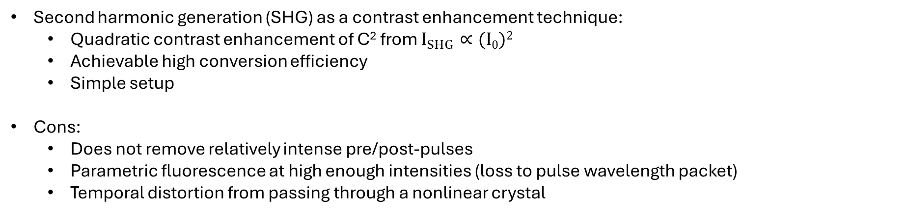


Second harmonic generation as contrast enhancement
Second harmonic generation (SHG) as a contrast enhancement technique:
  Quadratic contrast enhancement of C² from $I_{SHG}∝(I0)2$
  Achievable high conversion efficiency
  Simple setup
Cons:
  Does not remove relatively intense pre/post-pulses
  Parametric fluorescence at high enough intensities (loss to pulse wavelength packet)
  Temporal distortion from passing through a nonlinear crystal
Nonlinear crystal
$$λ_{0}$$
$${λ_{SHG}=λ}_{0}/2$$
Representation of SHG.
Notes:
Add in the equation for SHG equation
-Can compensate for wavelength with geometry of the beam focus

Slide 6
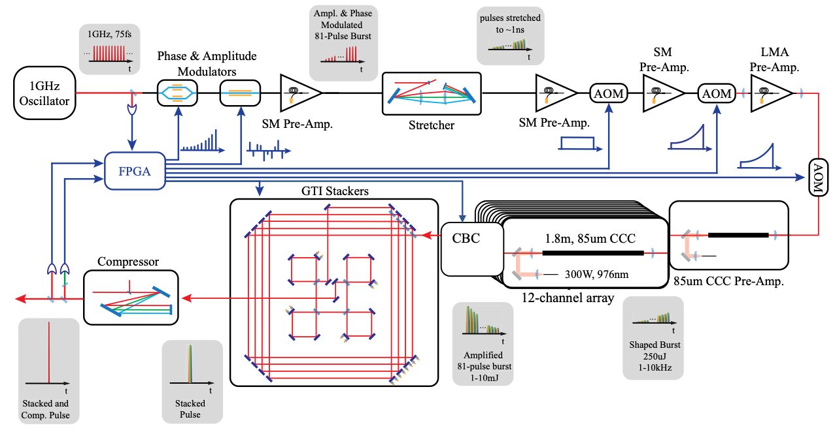
12-Channel Spatially and Temporally Combined (CBC-CPSA) Fiber Laser System

Slide 7
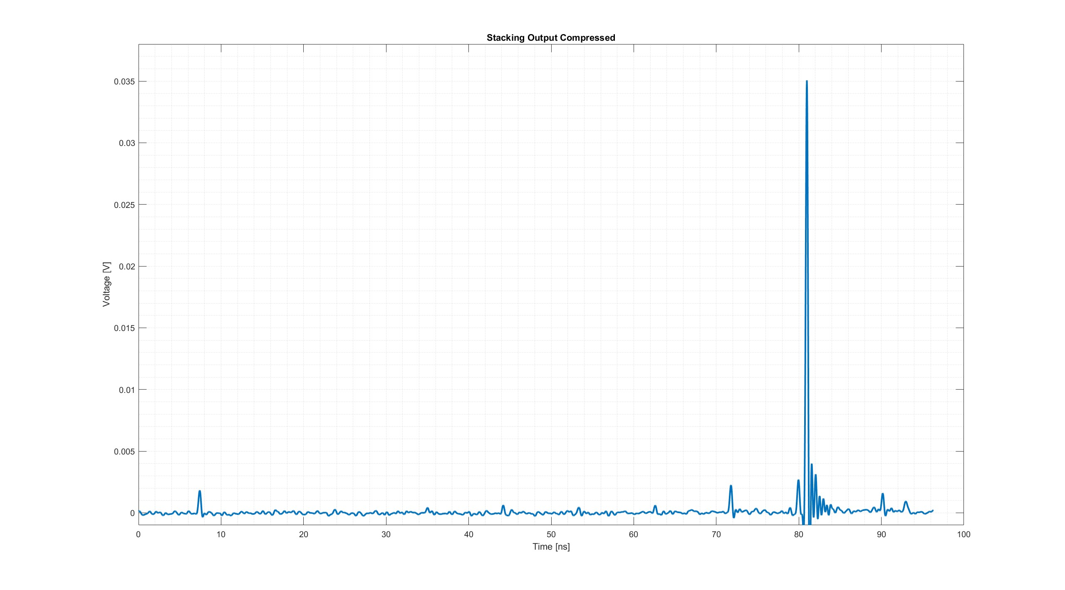
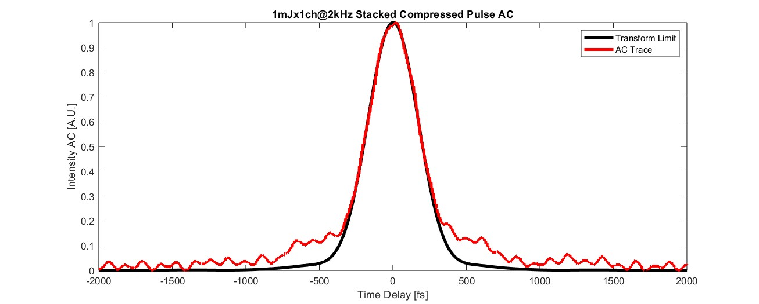
12-Channel Spatially and Temporally Combined (CBC-CPSA) Fiber Laser System
1mJx12 Channel Stacking
12-channel CBC+CPSA Results:
  1mJ/fiber @ 2 kHz
  CBC efficiency: 90%
    ~20W for temporal combining
  Stacking efficiency: 80.2%
Energy per fiber (12 total) | 1 mJ
Repetition rate | 2 kHz
Pulse duration | 300 fs (transform limited)
Avg power/pulse energy into experiment | 6 W max, 3 mJ max
Beam size (elliptical major axis) | 10 mm
Notes:
For 1mJx12ch combining, the stacking efficiency now is related to how much power in the stacker:
P=3W stacking efficiency: 80.2%
P=20W stacking efficiency: 60.8%
Rms stability:
1mJ (0428wfm3): 0.961%
3mJ (0604wfm5): 3.572% (another 3mJ shot on the same day has 1.648%)
6mJ (0714wfm3): 4.402%
No data for 1x12
2.105% for 1mJx12 when 60mW into stacker
3 mJ, unfocused beam → 25GW/cm^2

Slide 8
Experimental setup
DM
NL crystal
HWP
DM
Telescope
x0.75, 0.5, 0.25
HWP
Residual fundamental
Dump
TFP
PBS
Attenuator
1st order beam
PD
HWP
0th order beam
t_{p} = 300 fs
d = 10 mm
Focus
lens
AOM (532nm)
Beam entrance
Notes:
We keep the 1st order beam because it can be time-gated on the detector/scope
Even though in this experiment, the pre-pulse & the main pulse were not separated by such a large time interval so the 1st order beam was not necessary
However we kept it just in case for future experiments

Slide 9
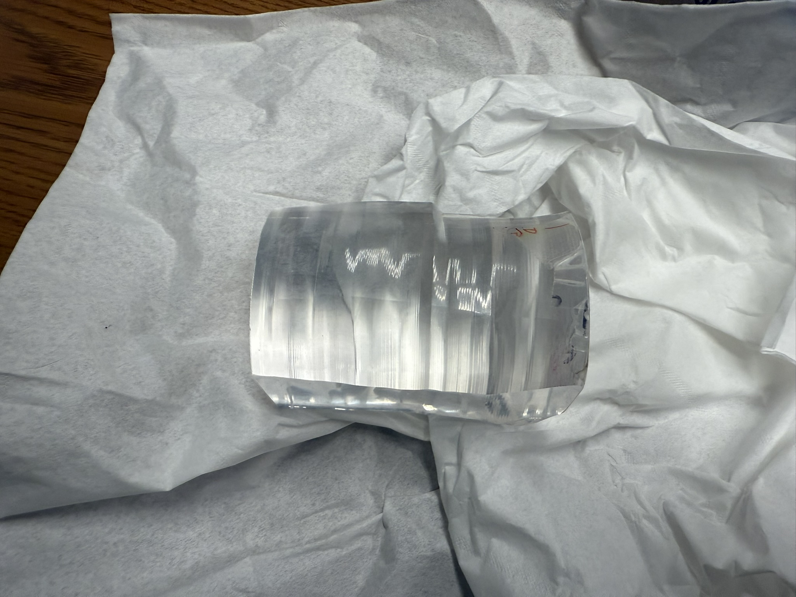
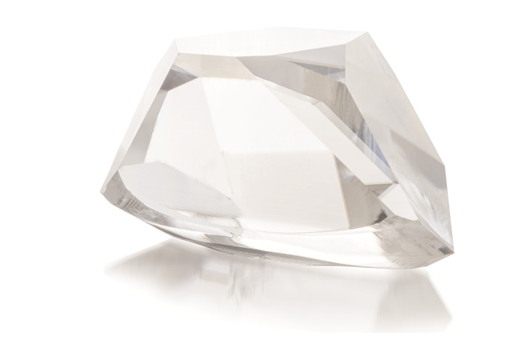
Nonlinear Crystals Used
Equipment:
2mm-L, 50mm-D Type I LBO @ 1035 nm, (90,13.2)∘
10mm-L, 25.4mm-D LBO Type I LBO @ 1053 nm (90,12)∘
5mm-L, 50mm-D YCOB @ 1047nm (150, 0)∘
10mm-L, 50mm-D YCOB @ 1047nm (150, 0)∘
LBO crystal (Cristal Lasers).
YCOB boule (LLNL).
Notes:
Angles are (theta, phi) at each respective wavelength. Our wavelength is at 1035nm, so we would need about at least 1 deg of tuning to get proper phase matching for LBO
For YCOB, it is assumed that the cut was phase-matched at 1047nm. This corresponds to about 0.5 deg of tuning to get to 1035nm phase matching.

Slide 10
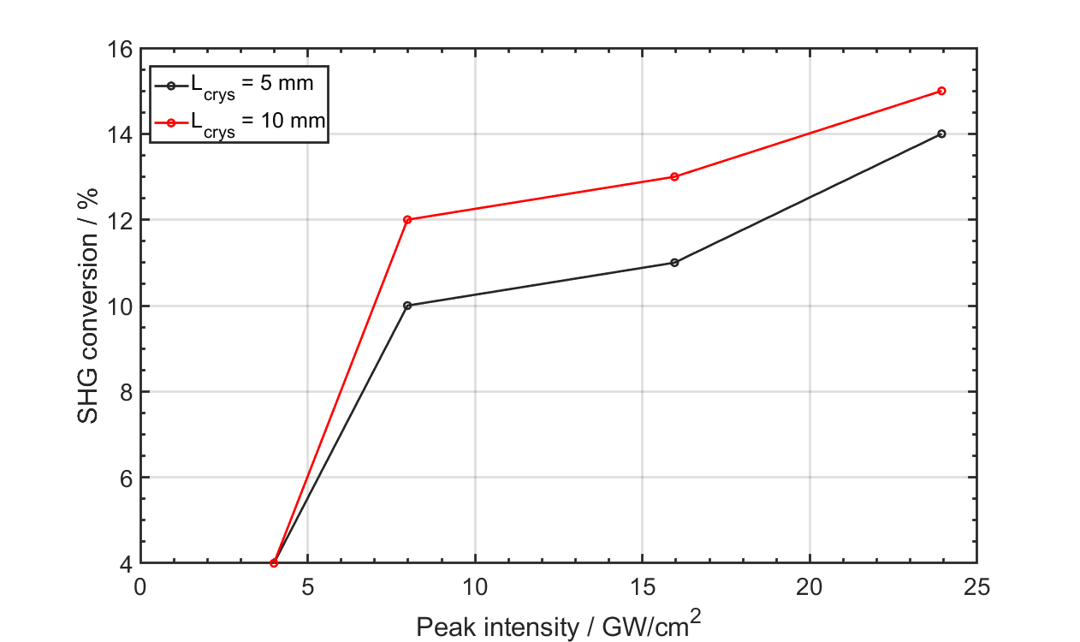
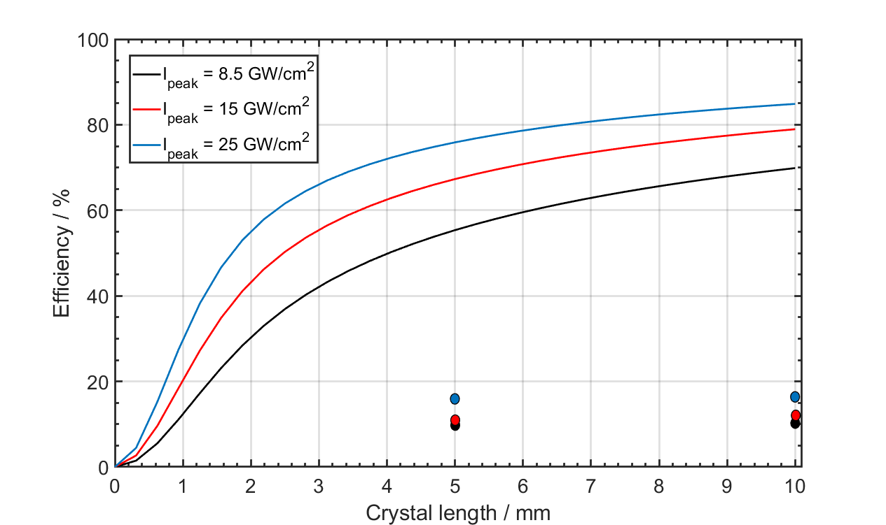
YCOB results
Experimental results for YCOB.
Modeling by SNLO (2D) and comparison with experiment (dots).
Original crystal contained several inner crystal defects; scratch-dig was worse than 20/10.
Better phase matching requires tilting about polarization axis, which was not attempted.
There was also absorption loss in the dichroic mirrors for both IR & visible.
Notes:
Measurements collected with two separate power meters, one for IR, one for green
Average power was measured, beam profile measured beforehand
-YCOB crystal was cut by LLNL optic shop, so crystal axis was largely guessed in an educated manner (through deduction from the original labeling).

Slide 11
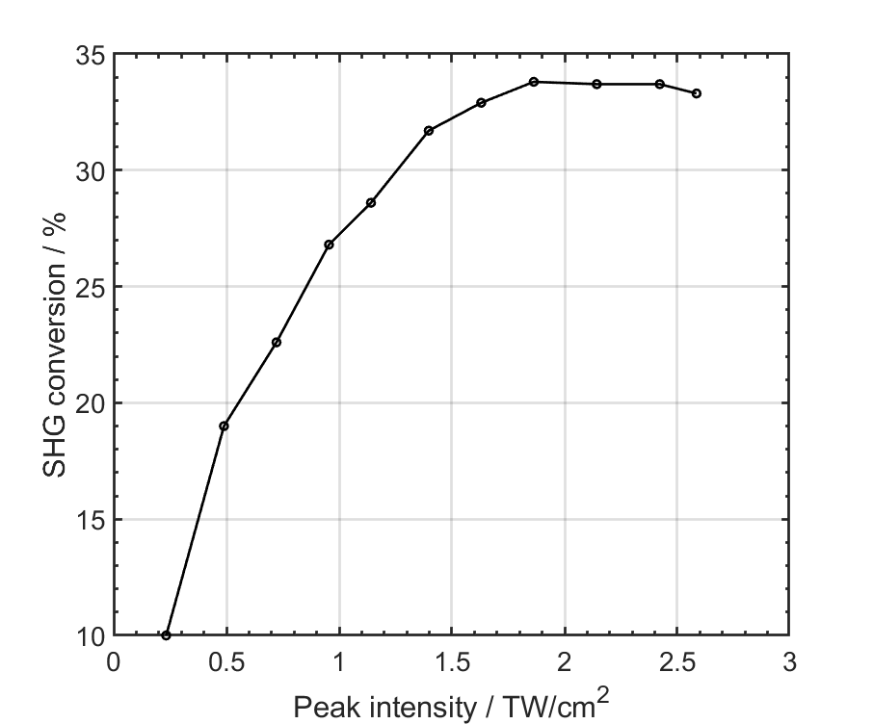
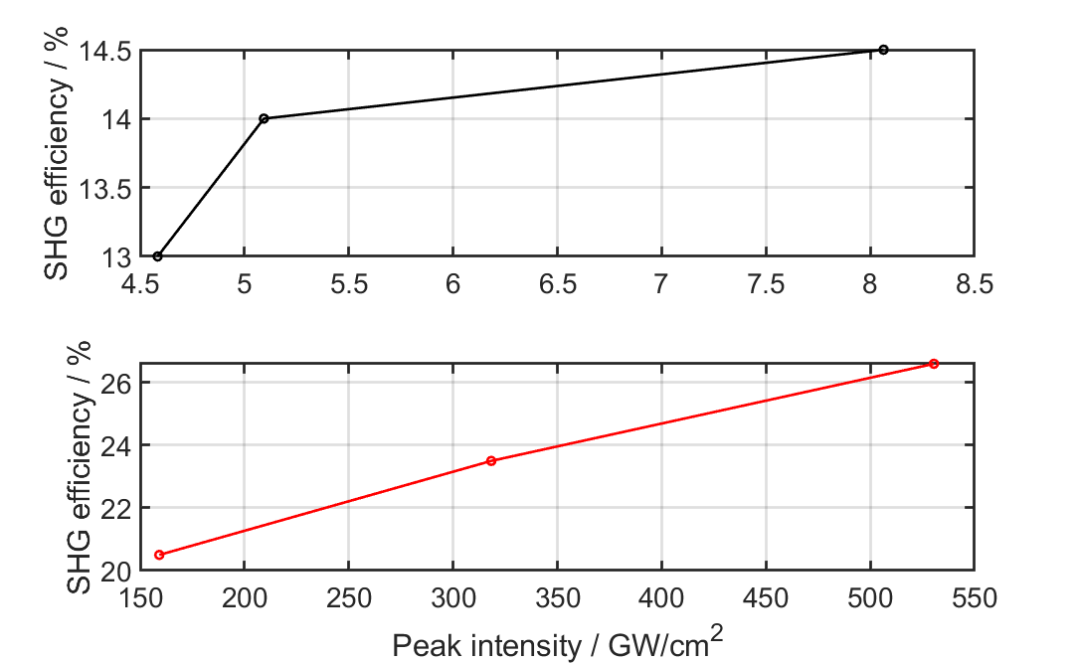
LBO results
Crystal length of 10 mm.
Crystal length of 2 mm.
Notes:
We could not get any higher than 36% overall.

Slide 12
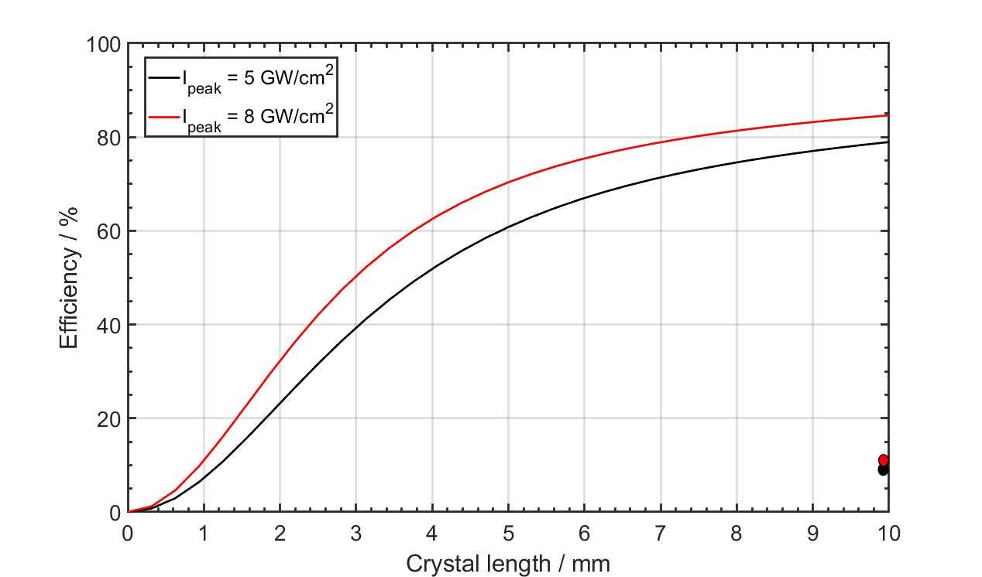
LBO results
Huge discrepancy in SNLO!
Modeling by SNLO (2D) and comparison with experiment (dots).
Notes:
We could not get any higher than 36% overall.
2TW/cm^2 curves aren’t shown due to model not being able to accommodate such high peak intensities.

Slide 13
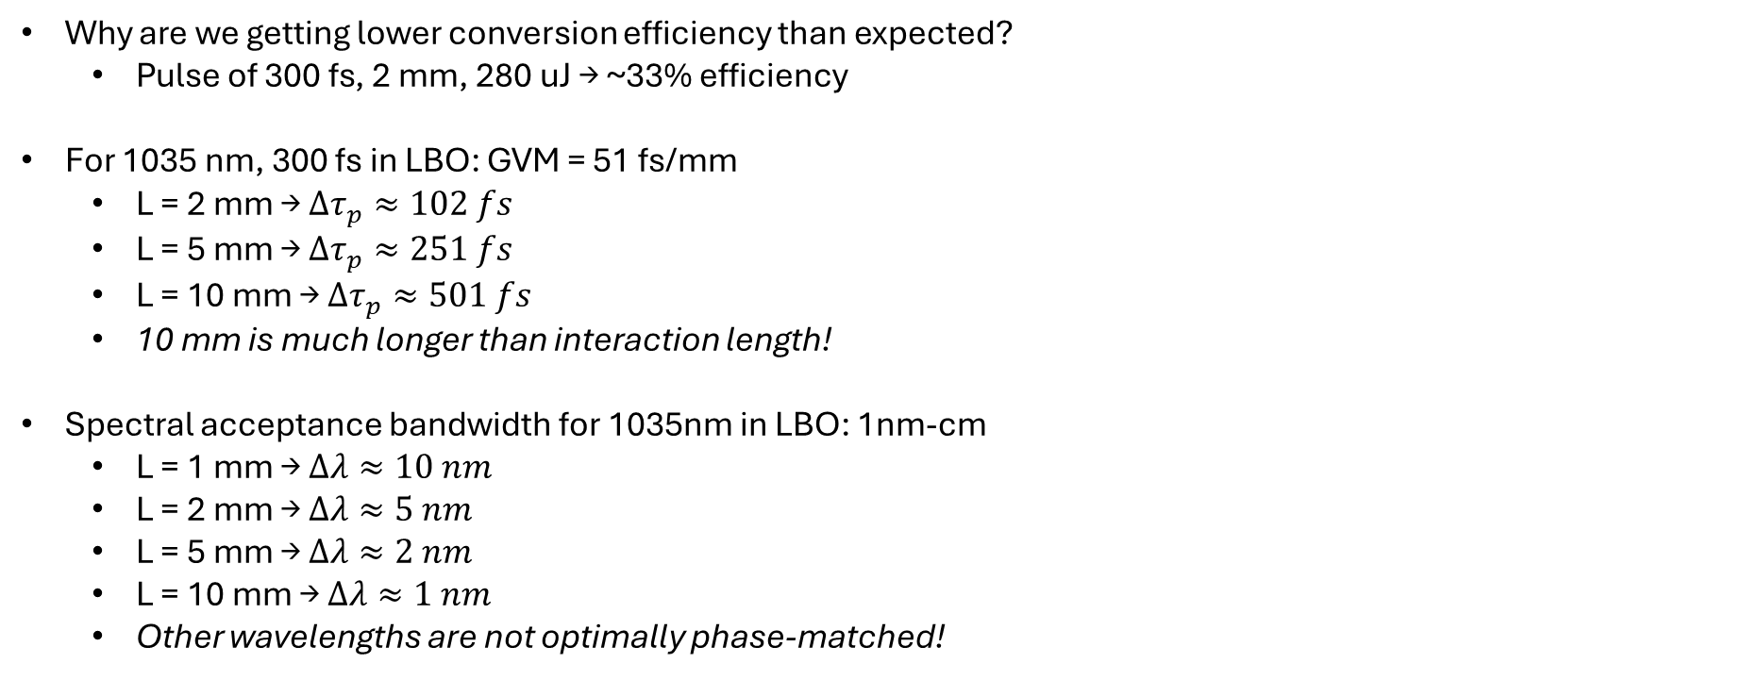
Discussion of results
Why are we getting lower conversion efficiency than expected?
  Pulse of 300 fs, 2 mm, 280 uJ → ~33% efficiency
For 1035 nm, 300 fs in LBO: GVM = 51 fs/mm
  L = 2 mm → $Δτ_{p}≈102 fs$
  L = 5 mm → $Δτ_{p}≈251 fs$
  L = 10 mm → $Δτ_{p}≈501 fs$
  10 mm is much longer than interaction length!
Spectral acceptance bandwidth for 1035nm in LBO: 1nm-cm
  L = 1 mm → $Δλ≈10 nm$
  L = 2 mm → $Δλ≈5 nm$
  L = 5 mm → $Δλ≈2 nm$
  L = 10 mm → $Δλ≈1 nm$
  Other wavelengths are not optimally phase-matched!

Slide 14
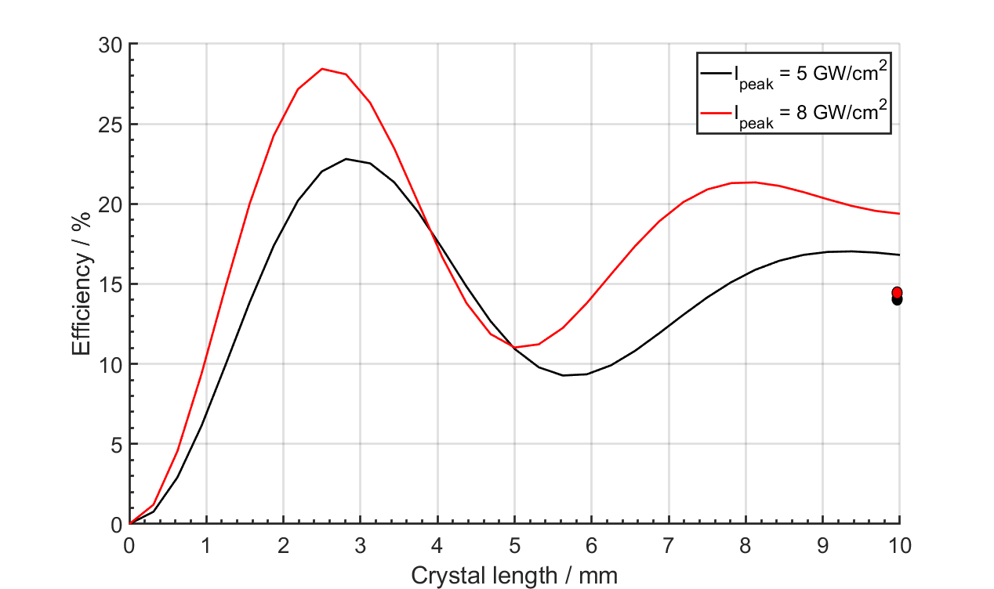
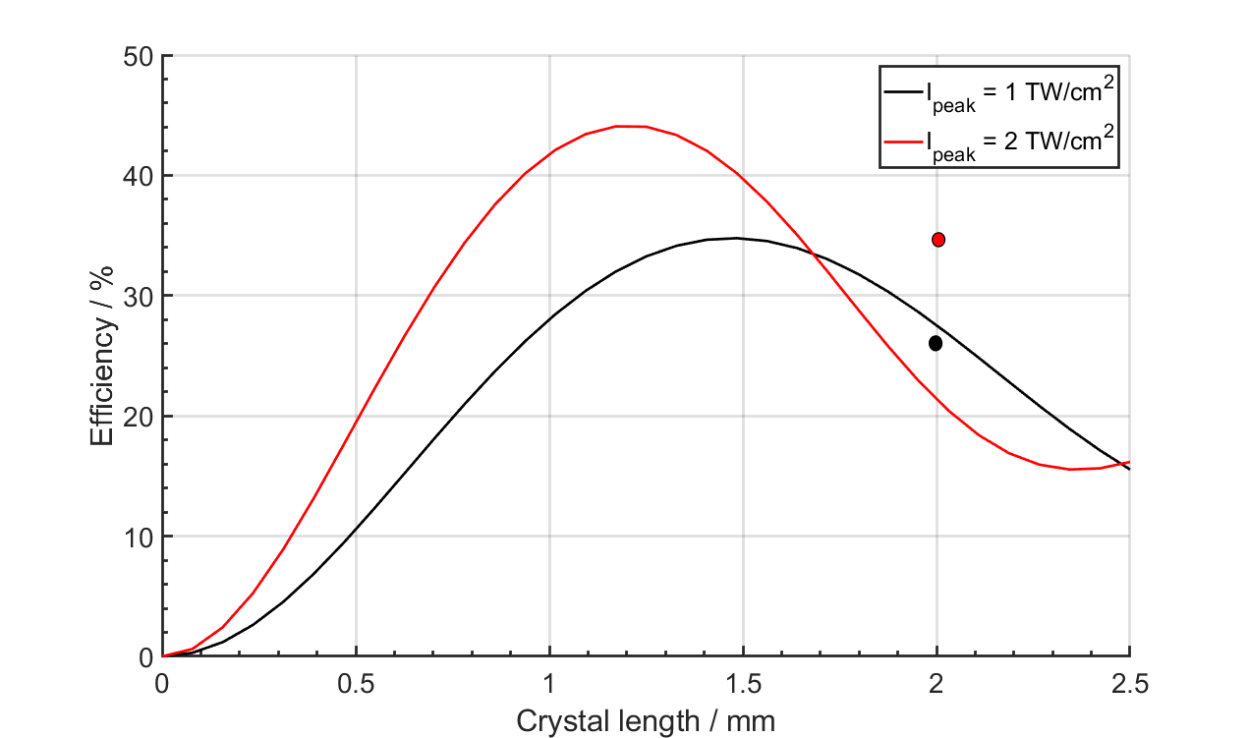
Discrepancies
Taking this into account in the modeling (phase mismatch, spectral acceptance bandwidth):
LBO crystal modeling results for different peak intensities.
Notes:
And the efficiency at 2 mm is actually not much greater!
Phase mismatch is a huge key. 1-2 deg off could throw it off by a lot.
Used Gaussian as the main temporal pulse shape, did not take into account real pulse shape in lab

Slide 15
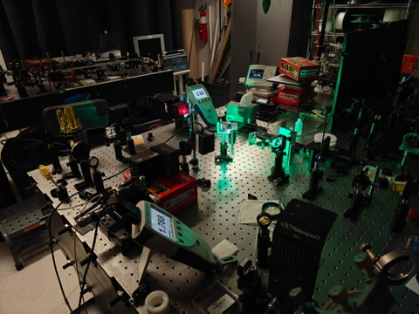
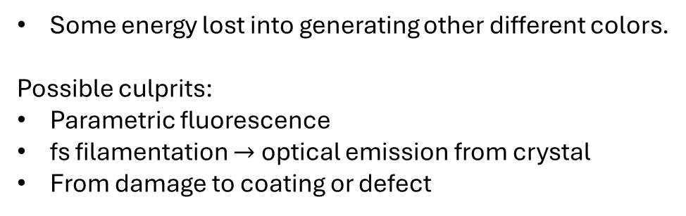
Discrepancies
Additional nonlinear wavelength generation observed in the lab:
Some energy lost into generating other different colors.
Possible culprits:
Parametric fluorescence
fs filamentation $→$ optical emission from crystal
From damage to coating or defect
Live experiment in the lab showing a red ring around the power meter head.
Notes:
If the audience knows what it is, they are free to comment
We started seeing this at around 100 GW/cm^2

Slide 16
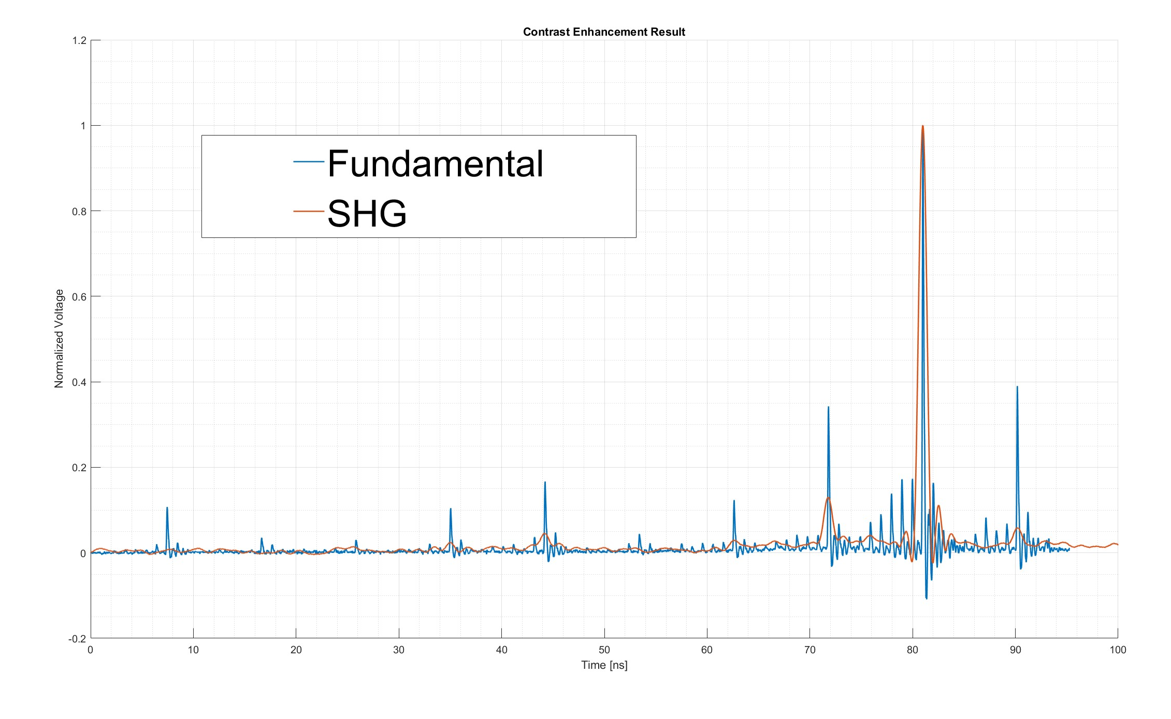
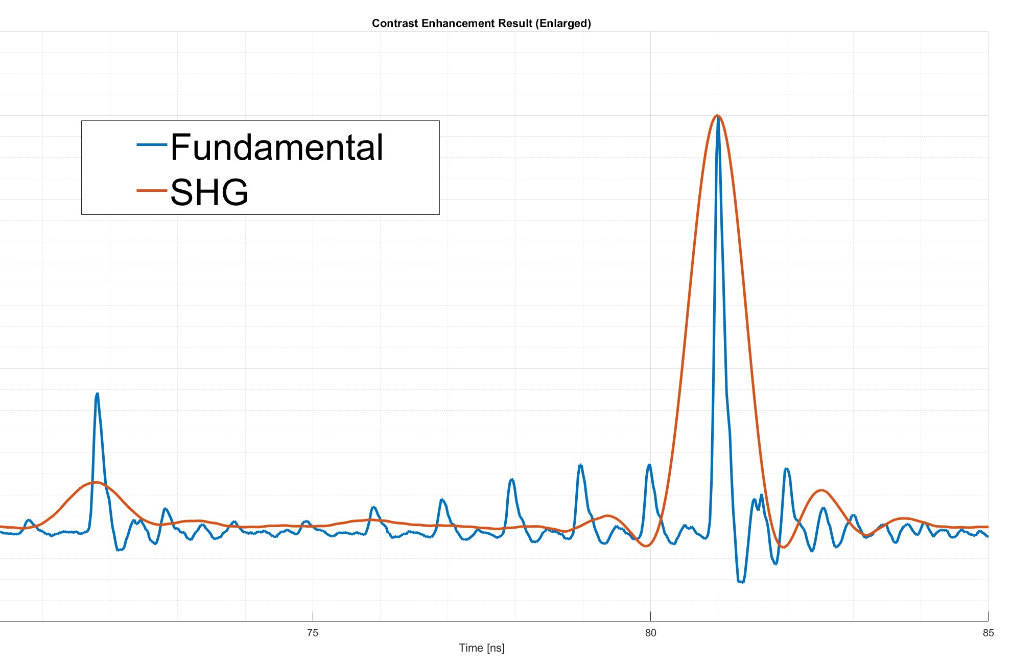
Contrast enhancement
Prepulse contrast:
Fundamental: 4.65 dB
SHG: 8.88 dB
Prepulse contrast enhancement:
8.88dB / 4.65dB = 1.91
Confirmed that the prepulse contrast enhancement is ~I²
Notes:
>> 10*log10(0.3427)
ans =
-4.6509
>> 10*log10(0.1294)
ans =
-8.8807
>> 10*log10(0.1294) / (10*log10(0.3427))
ans =
1.9095
Prepulse contrast enhancement:
Fundamental: 34.27%
SHG: 12.94%

Slide 17
Summary & future work
Two types of nonlinear crystals were used for contrast enhancement.
Efficiency was much lower than expected.
Should be mainly due to imperfect phase-matching of the crystal.
Observed some kind of optical emission after the crystal.
Return to Michigan, re-do experiments with crystal lengths between 2-10 mm (specifically 4, 5, 6 mm).
Completely characterize pulse before & after crystal – set up autocorrelator after SHG for fundamental pulse.
Better prepared, know how to improve diagnostics & what laser intensity range to run.

