Slide 1




Optimizing Laser Parameters For Blowout Regime: From Petawatt NIR to LWIR Wakefield Drivers
Navid Vafaei-Najafabadi

Slide 2
The Collaboration
Stony Brook University
Brookhaven National Laboratory
Accelerator Test Facility (ATF)
University of Texas at Austin
N. Vafaei-Najafabadi, Evan Trommer, Spencer Diamond, A. Gaikwad, N. Pathak, A. Jain
I. Pogorelsky, M. Polyanskiy, W. Li
Y. Cao, R. Zgadzaj, M. Downer
Acknowledging funding from DOE Grant DE-SC0014043
Perlmutter @ NERSC facility operated under Contract DE-AC02-05CH11231
SEAWULF @ Stony Brook University

Slide 3

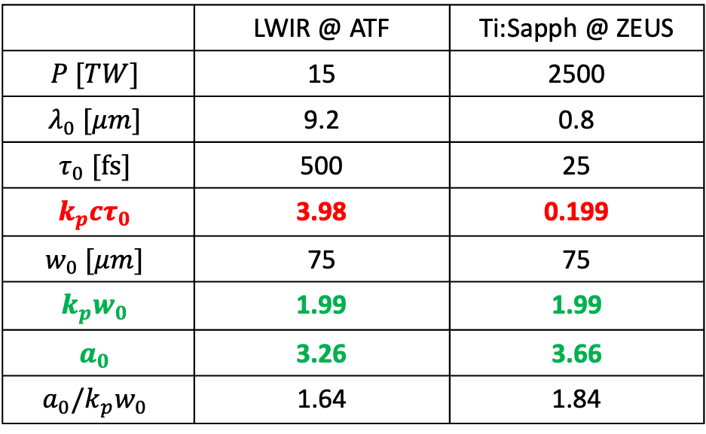
What laser parameters underly the blowout formation and wakefield strength?
Consider two realistic laser systems
 | LWIR @ ATF | Ti:Sapph @ ZEUS
$$P [TW]$$ | 15 | 2500
$$λ_{0} [μm]$$ | 9.2 | 0.8
$$τ_{0} [fs]$$ | 500 | 25
$${k_{p}cτ}_{0}$$ | 3.98 | 0.199
$$w_{0} [μm]$$ | 75 | 75
$${k_{p}w}_{0}$$ | 1.99 | 1.99
$$a_{0}$$ | 3.26 | 3.66
$$a_{0}/k_{p}w_{0}$$ | 1.64 | 1.84
Similar
Different
$n=2 × {10}^{16}$; $\frac{1}{k_{p}}=37.6 μm$

Slide 4
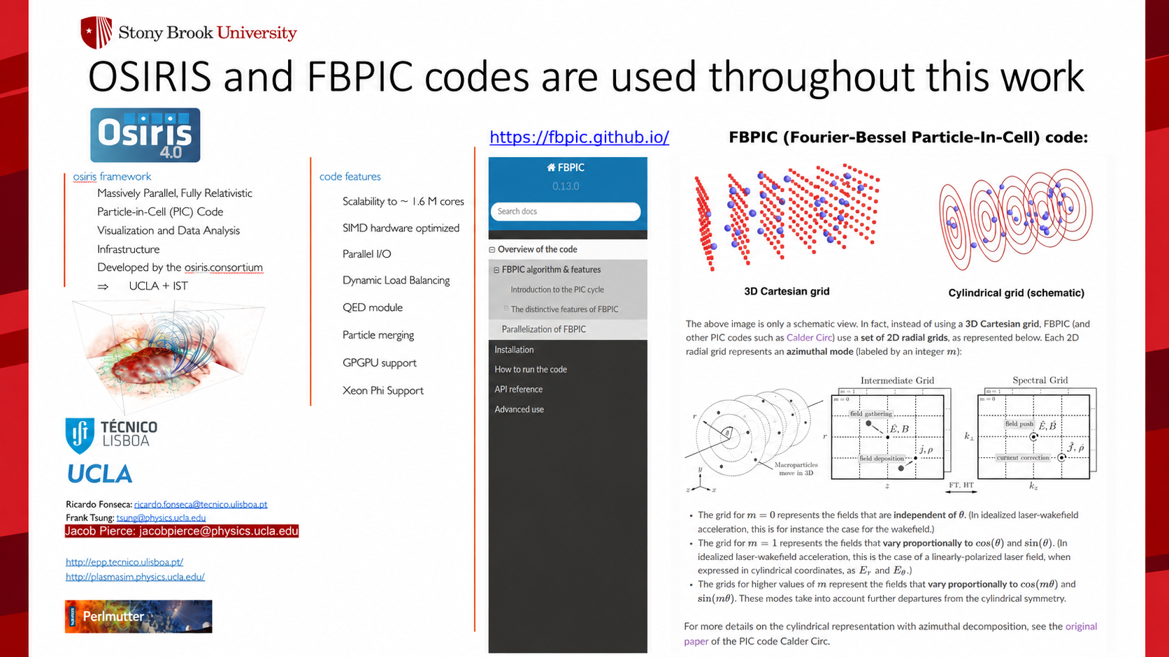

Slide 5
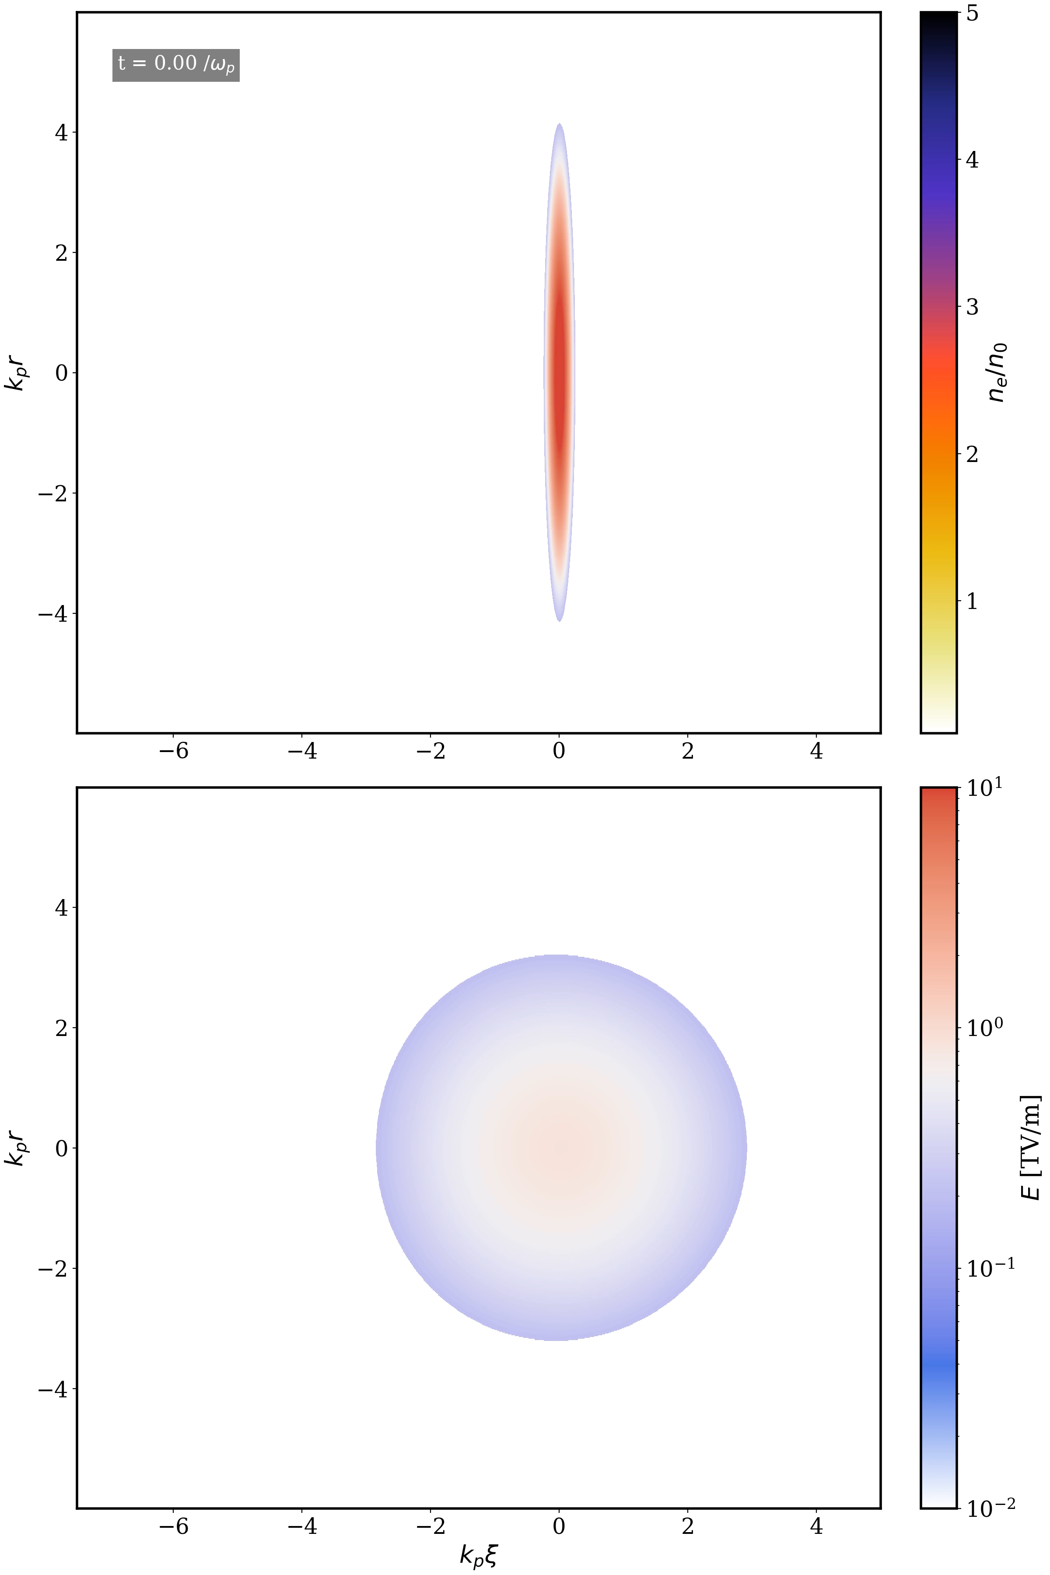
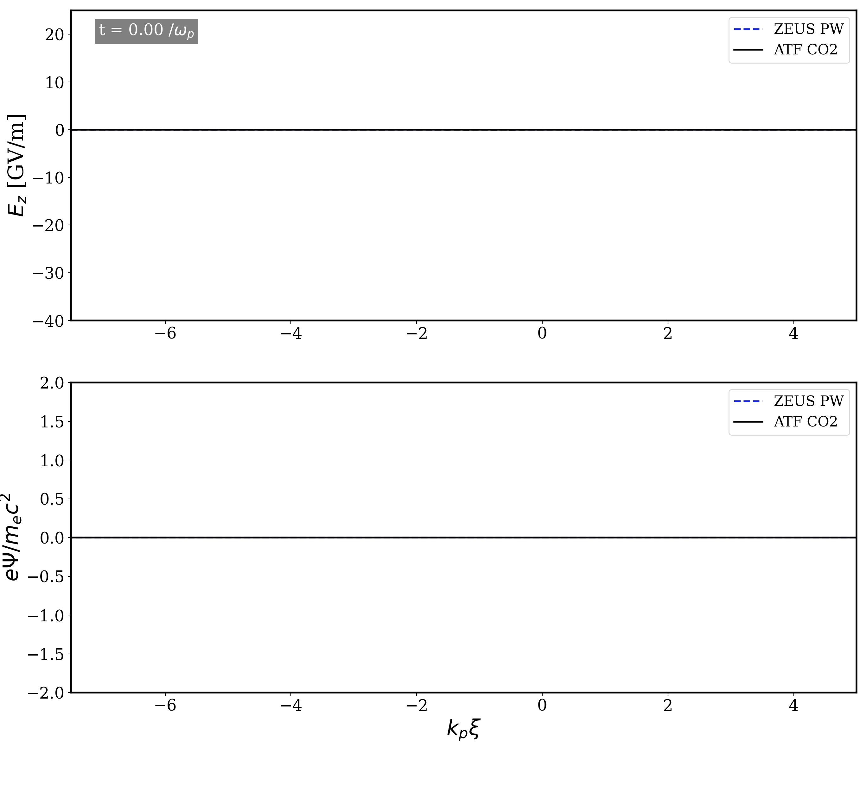
ZEUS
Ti:Sapph
ATF
LWIR

Slide 6
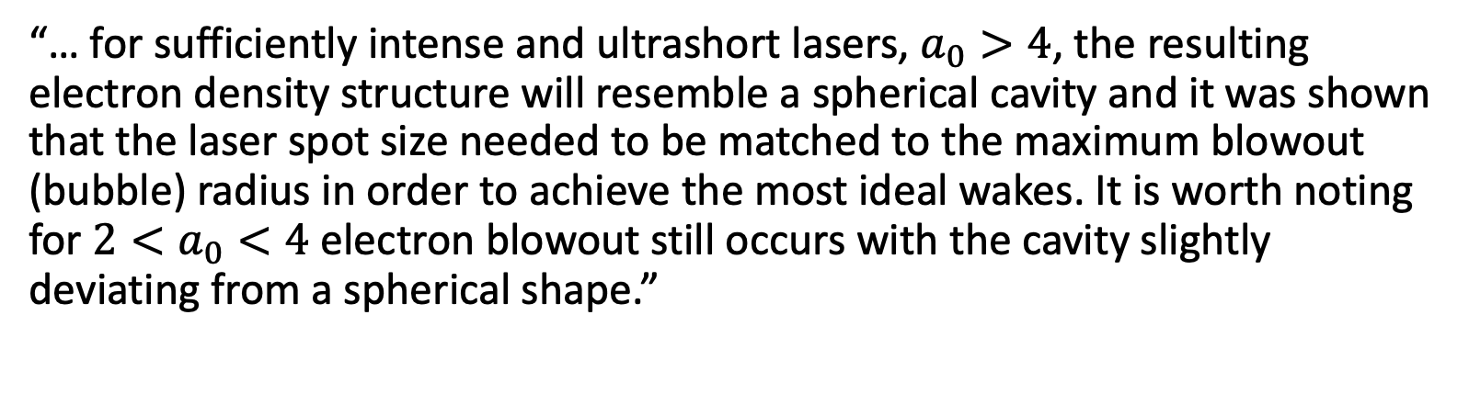
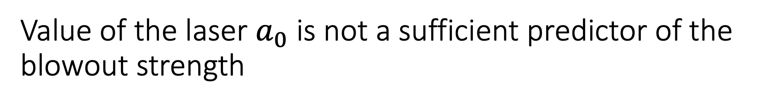
Value of the laser $a_{0}$ is not a sufficient predictor of the blowout strength
This conclusion is contrary to the conventional view of this interaction
“… for sufficiently intense and ultrashort lasers, $a_{0}>4$, the resulting electron density structure will resemble a spherical cavity and it was shown that the laser spot size needed to be matched to the maximum blowout (bubble) radius in order to achieve the most ideal wakes. It is worth noting for $2<a_{0}<4$ electron blowout still occurs with the cavity slightly deviating from a spherical shape.”
W. Lu, et al., “Generating multi-GeV electron bunches using single stage laser wakefield acceleration in a 3D nonlinear regime,” Phys. Rev. ST Accel. Beams 10, 061301 (2007).

Slide 7
Synthesis
Large blowout radius is important for a number of applications, including staging, multi-beam experiments like seeding ionization injection, or colliding beam experiments such as inverse Compton scattering.
Both spot size and pulse length play essential roles in reaching blowout. Laser wavelength has no independent effect when normalized strength, size, and duration are matched.
Across simulations, the onset of blowout is described by an integrated-force criterion
LWIR lasers are naturally well suited to driving ‘petawatt-class’ plasma wakefields

Slide 8
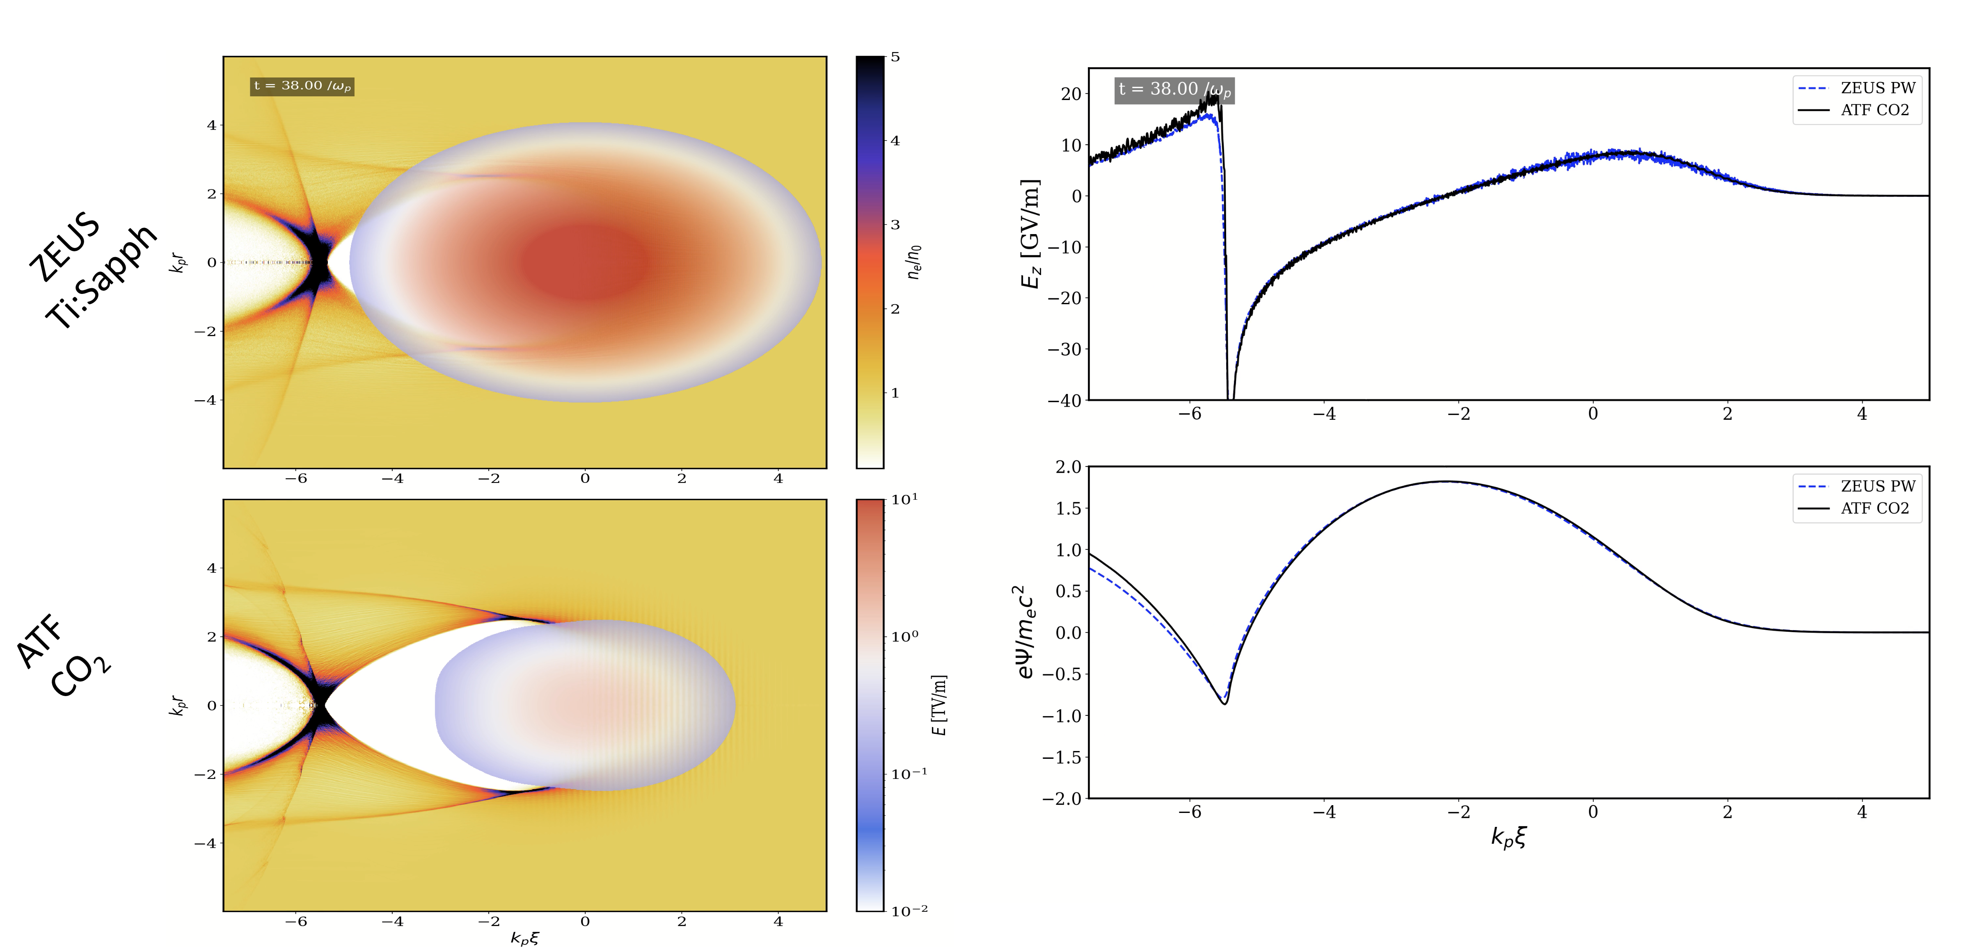
Laser wavelength does not control blowout when normalized size and strength are equal
For a direct comparison, Ti:Sapphire parameters are adjusted so that $a_{0}$, $k_{p}w_{0}$, and $k_{p}cτ$ match the LWIR case
ZEUS - modified

Slide 9
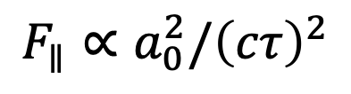
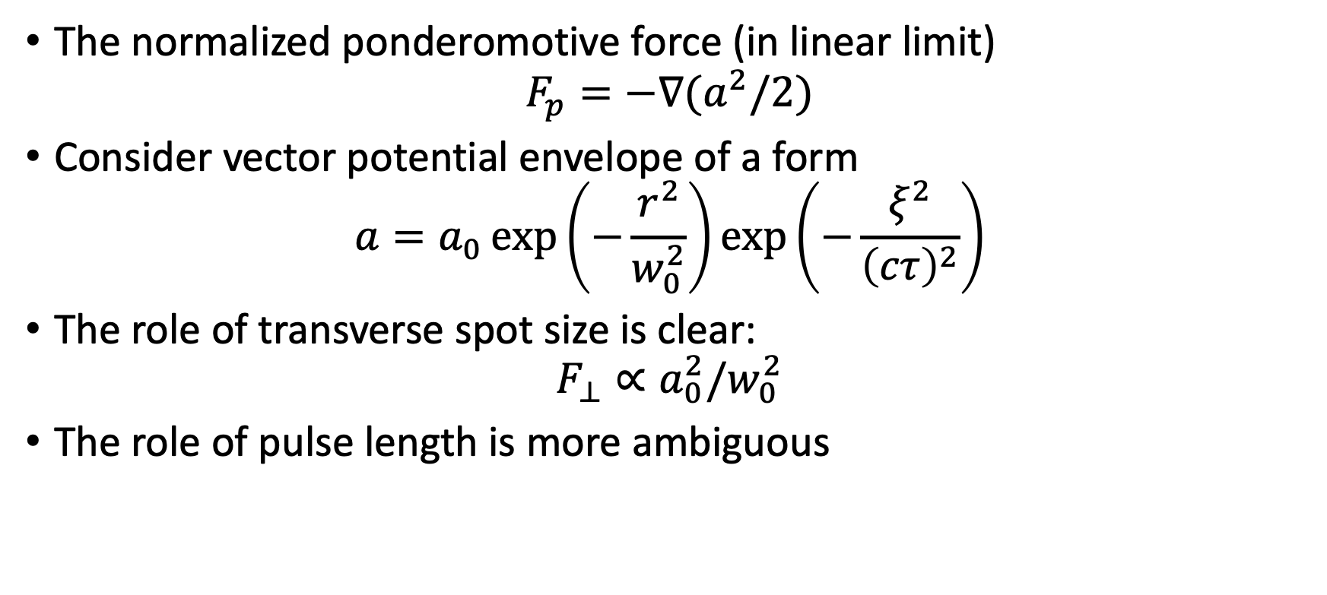
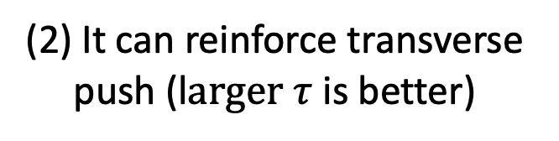
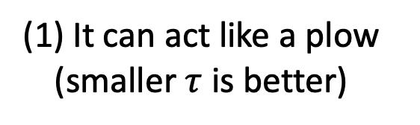
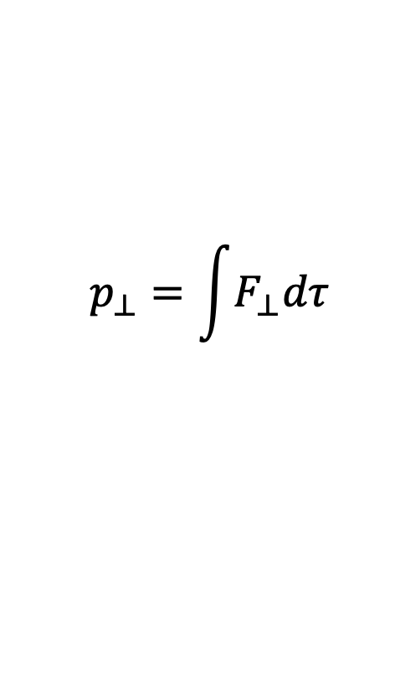
Let’s return to basics…
The normalized ponderomotive force (in linear limit)
$$F_{p}=−∇(a^{2}/2)$$
Consider vector potential envelope of a form
$$a=a_{0}\exp\left(−\frac{r^{2}}{w_{0}^{2}}\right)\exp\left(−\frac{ξ^{2}}{{\left(cτ\right)}^{2}}\right)$$
The role of transverse spot size is clear:
$$F_{⊥}∝a_{0}^{2}/w_{0}^{2}$$
The role of pulse length is more ambiguous
(1) It can act like a plow (smaller $τ$ is better)
(2) It can reinforce transverse push (l$arger τ$ is better)
$$p_{⊥}=\int{F_{⊥}dτ}$$
$$F_{∥}∝a_{0}^{2}/{\left(cτ\right)}^{2}$$

Slide 10
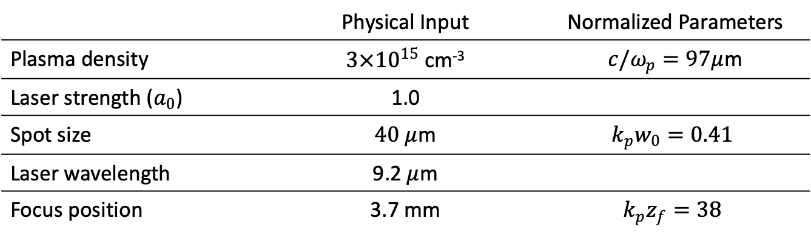
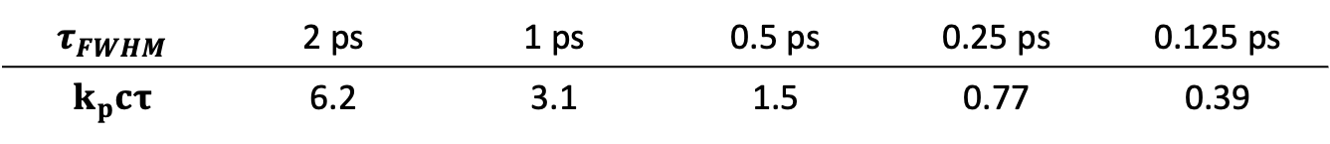
Performed a pulse length scan to isolate its role
Fixed Conditions
 | Physical Input | Normalized Parameters
Plasma density | $3×{10}^{15}$ cm⁻³ | $c/ω_{p}=97μ$m
Laser strength ($a_{0}$) | 1.0
Spot size | $40 μ$m | $$k_{p}w_{0}=0.41$$
Laser wavelength | 9.2 $μ$m
Focus position | 3.7 mm | $$k_{p}z_{f}=38$$
Pulse Length Scan
$$τ_{FWHM}$$ | 2 ps | 1 ps | 0.5 ps | 0.25 ps | 0.125 ps
$$k_{p}cτ$$ | 6.2 | 3.1 | 1.5 | 0.77 | 0.39

Slide 11
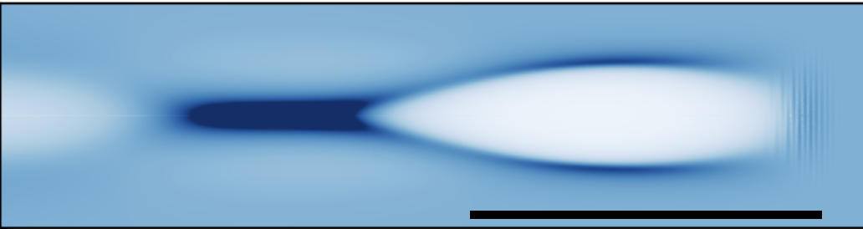
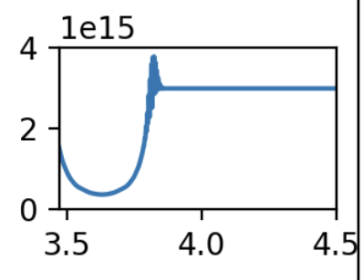
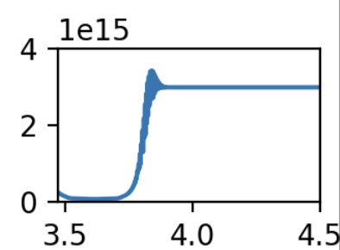
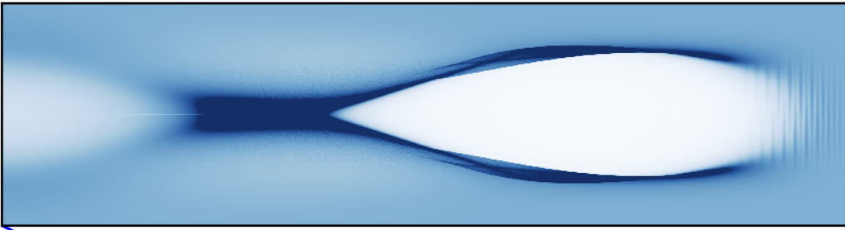
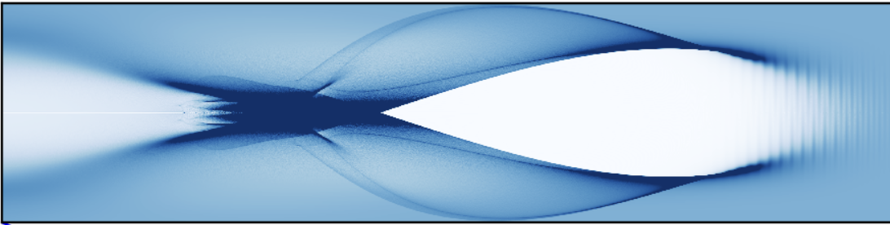
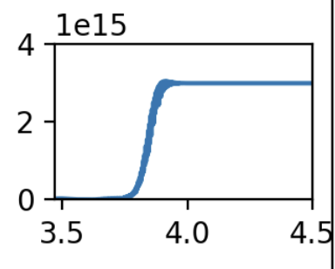
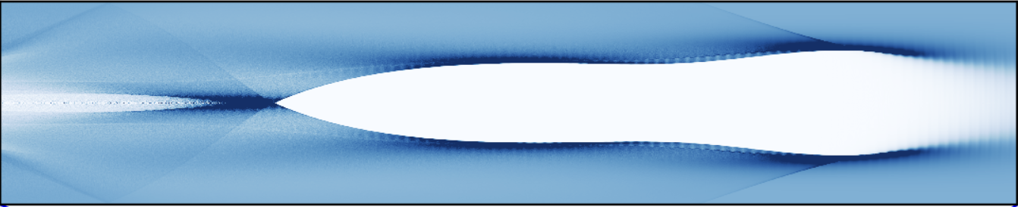
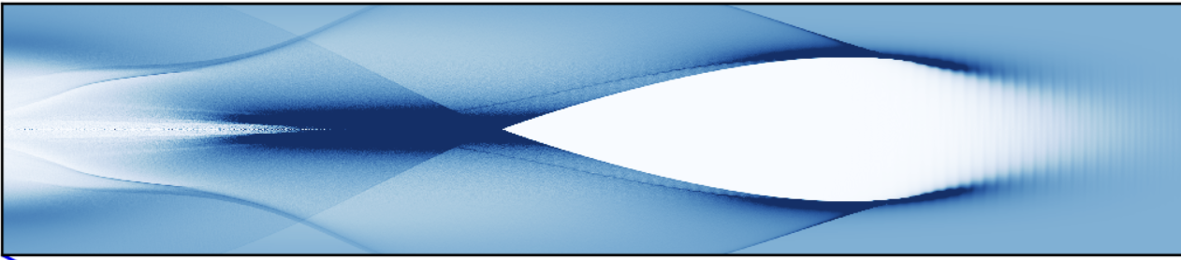









For a fixed $a_{0}/w_{0}$, reducing pulse length only reduces the degree of nonlinearity
On-axis density
Not blown out
$0.125$ps $=0.39 ω_{p}^{−1}$
Increasing pulse length primarily manifests in the transverse momentum of electrons in “outer sheath” defining wakefield boundary
The “inner sheath” is formed by a population of electrons starting from laser edge and are only modestly affected by laser fields
Therefore, past a threshold, increasing pulse length does not affect the blowout region
1mm = 10 $c/$
$$ω_{p}$$
Borderline
$0.25$ps $=0.77 ω_{p}^{−1}$
Fully blown out
$0.5$ps $=1.5 ω_{p}^{−1}$
This case is the exception!
$2$ps $=6.2 ω_{p}^{−1}$
$2$ps $=6.2 ω_{p}^{−1}$
Fully blown out
$1$ps $=3.1 ω_{p}^{−1}$
(mm)
Fully blown out
X. Xu et al., PRAB 26, 111302 (2023).
Apurva Gaikwad WG 5 – Thu, 2:10 pm

Slide 12
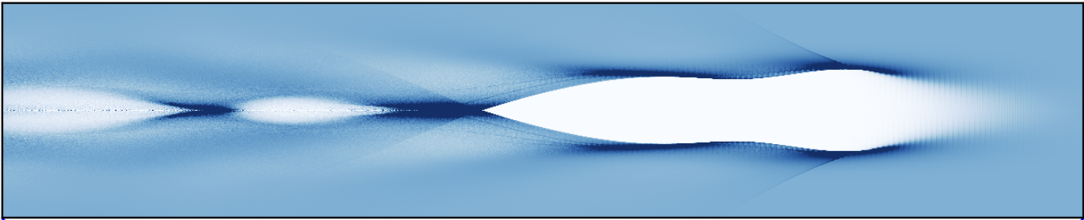
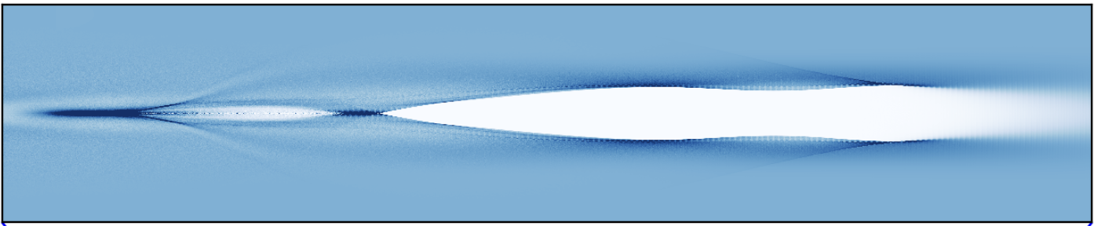
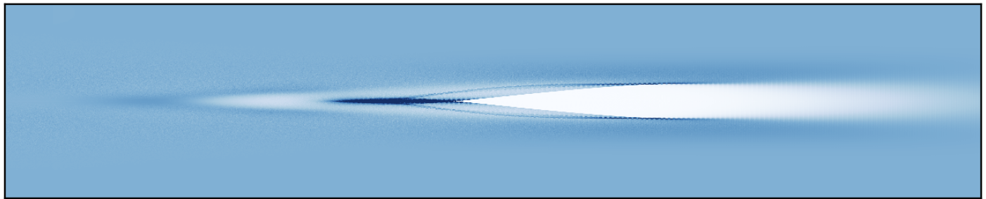


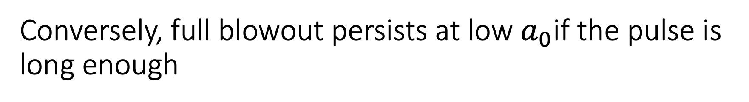




Conversely, full blowout persists at low $a_{0}$​if the pulse is long enough
$w_{0}=60 μm$, $k_{p}w_{0}=0.62$
$n_{e}=3×{10}^{15}$cm⁻³
$τ$=2ps, $k_{p}cτ=6.2$
$$a_{0}=1.5$$
$$a_{0}=0.8$$
$$a_{0}=0.5$$

Slide 13
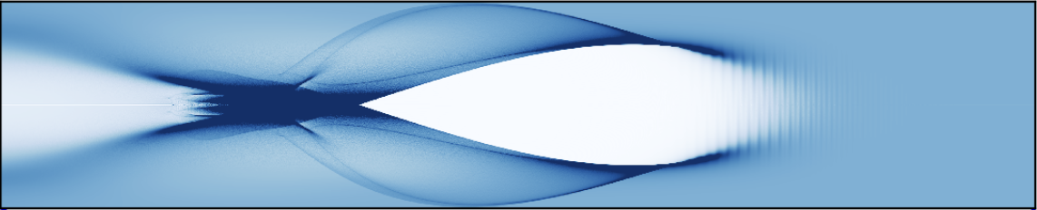
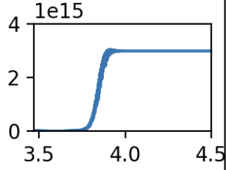
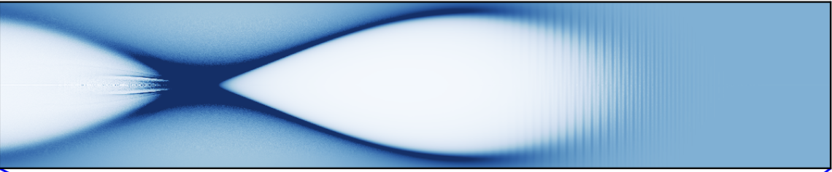
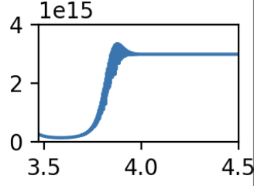
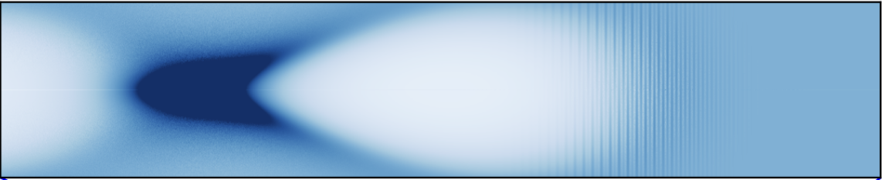
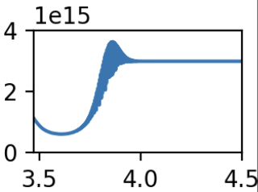


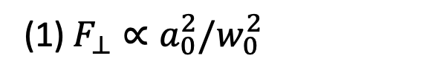




Spot size governs the strength and the size of the wake
$$a_{0}=1$$
$n_{e}=3×{10}^{15}$cm⁻³
$τ$=0.5 ps, $k_{p}cτ=1.5$
$w_{0}=40$, $k_{p}w_{0}=0.41$
Blowout
$w_{0}=80$, $k_{p}w_{0}=0.82$
Borderline
$w_{0}=120$, $k_{p}w_{0}=1.2$
Not blown out
(1) $F_{⊥}∝a_{0}^{2}/w_{0}^{2}$
(2) Electrons forming the “inner sheath” comes from the outer edge of laser

Slide 14
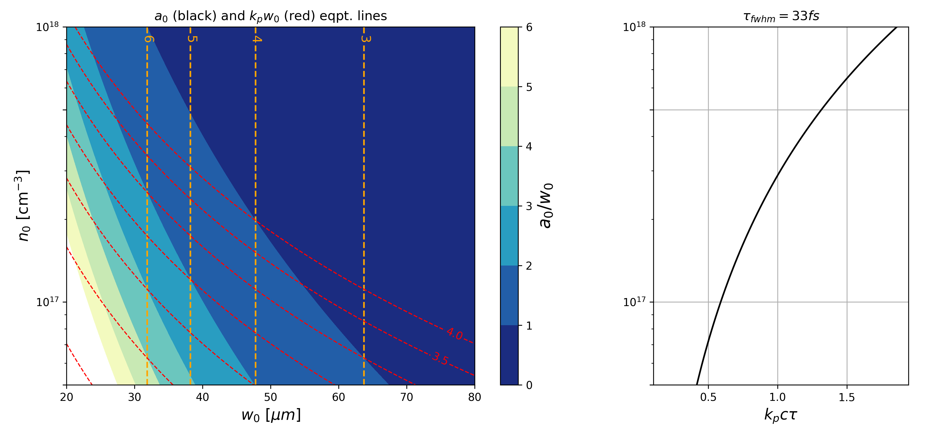

A multi-dimensional view is needed for optimizing wake strength towards blowout
Conventional view
Multi-dimensional view – 1 PW example ($\sim$40J, 33fs)
(Spherical) Bubble Regime
4
3
Blowout Regime
$$a_{0}$$
2
Weakly Nonlinear
1
Linear Regime
The smaller $a_{0}/w_{0}$, the longer $k_{p}cτ$ is needed to reach blowout

Slide 15
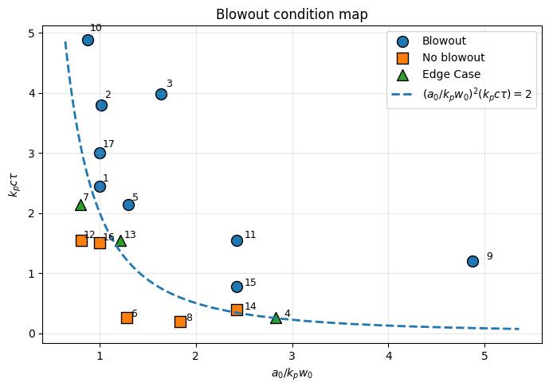
Looking across simulations, we can come to a (preliminary) criteria for ‘integrated ponderomotive force’
Test Cases

Slide 16
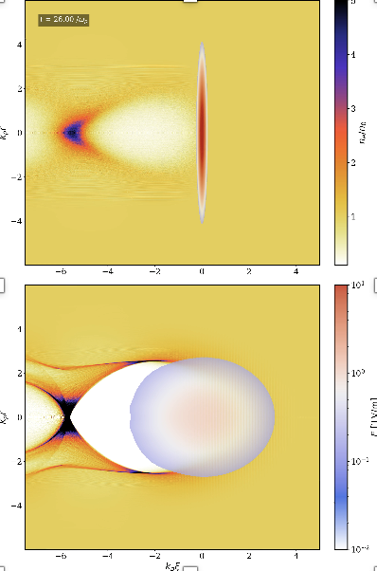
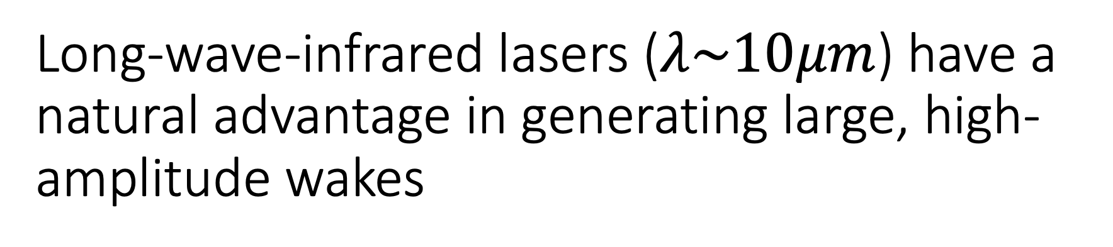
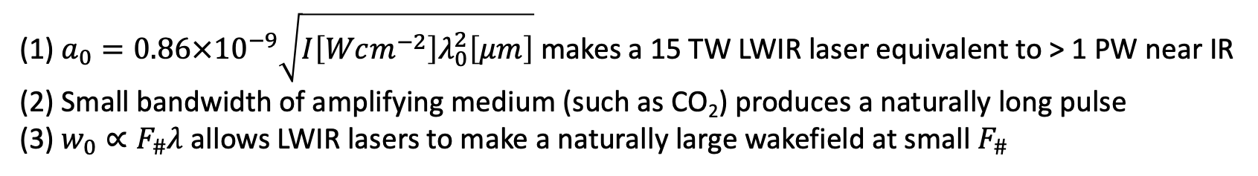
Long-wave-infrared lasers ($λ\sim 10μm$) have a natural advantage in generating large, high-amplitude wakes
(1) $a_{0}=0.86×{10}^{−9}\sqrt{I\left[Wcm^{−2}\right]λ_{0}^{2}\left[μm\right]}$ makes a 15 TW LWIR laser equivalent to > 1 PW near IR
(2) Small bandwidth of amplifying medium (such as CO₂) produces a naturally long pulse
(3) $w_{0}∝F_{\#}λ$ allows LWIR lasers to make a naturally large wakefield at small $F_{\#}$

Slide 17
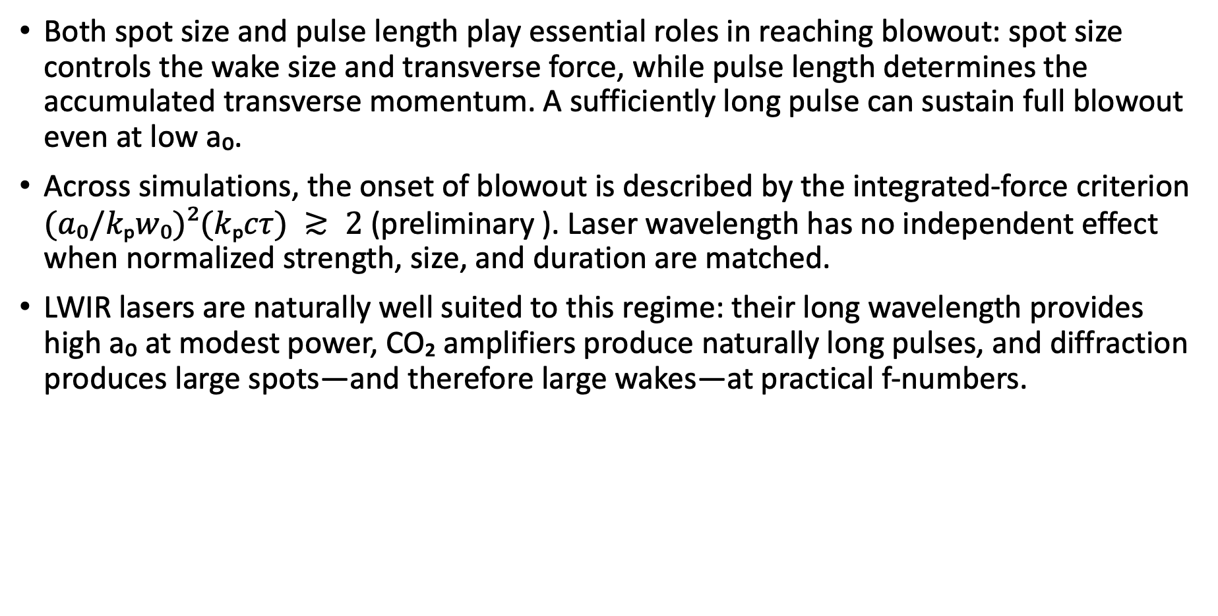
Conclusions
Both spot size and pulse length play essential roles in reaching blowout: spot size controls the wake size and transverse force, while pulse length determines the accumulated transverse momentum. A sufficiently long pulse can sustain full blowout even at low a₀.
Across simulations, the onset of blowout is described by the integrated-force criterion $(a₀/kₚw₀)²(kₚcτ) ≳ 2$ (preliminary ). Laser wavelength has no independent effect when normalized strength, size, and duration are matched.
LWIR lasers are naturally well suited to this regime: their long wavelength provides high a₀ at modest power, CO₂ amplifiers produce naturally long pulses, and diffraction produces large spots—and therefore large wakes—at practical f-numbers.

Slide 18
The End

Slide 19
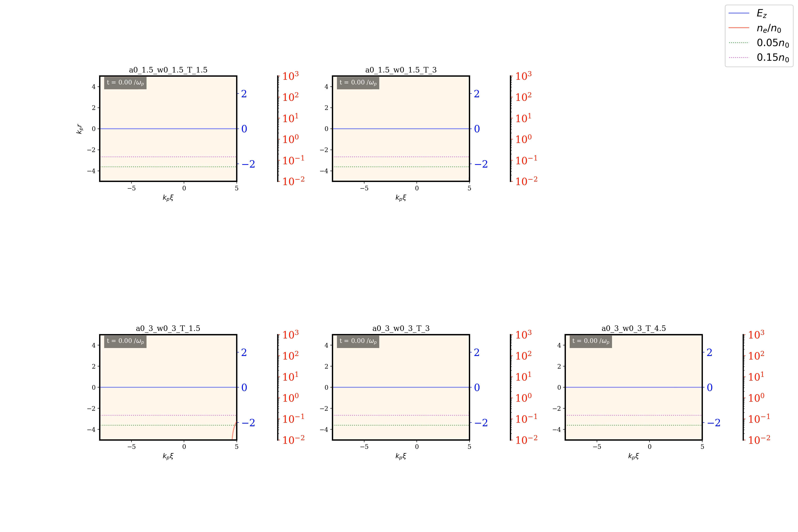

Slide 20
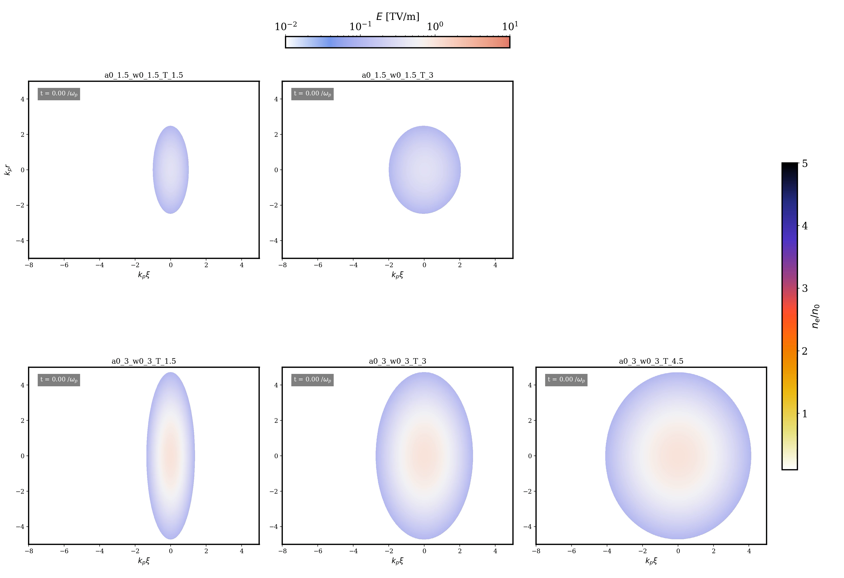

Slide 21
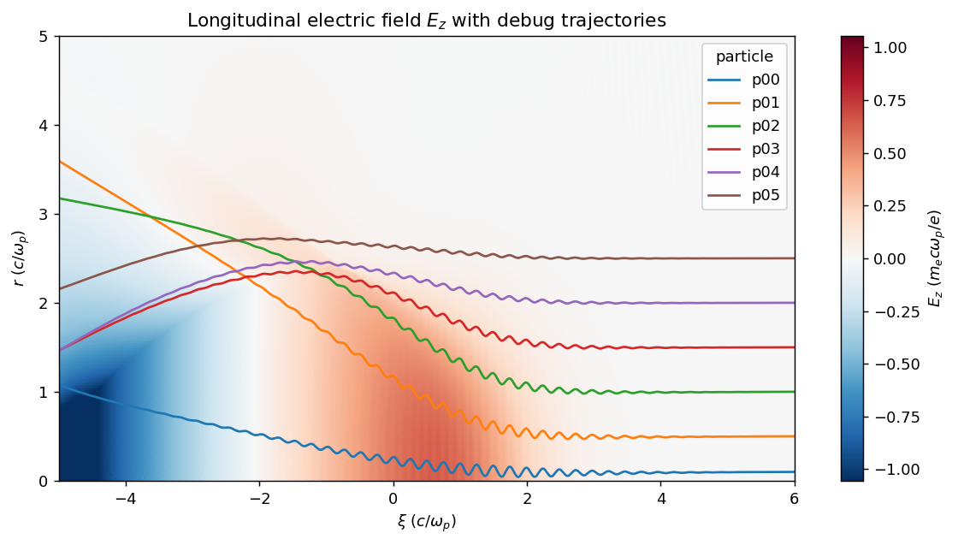
Example single particle trajectory show the role of electrons at different points

Slide 22

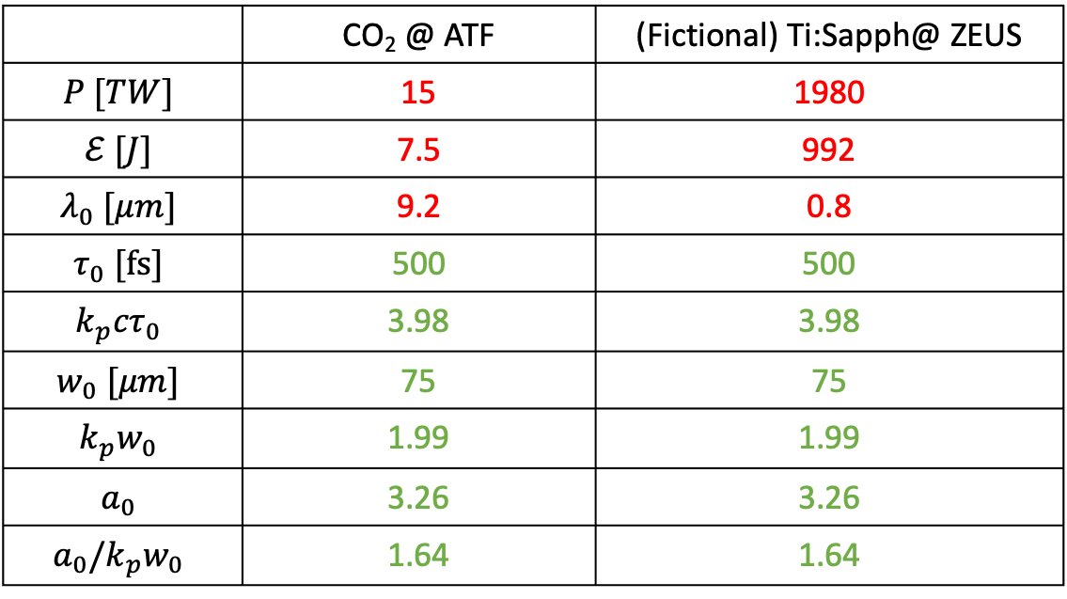
Comparing TS vs CO2 with same properties
 | CO₂ @ ATF | (Fictional) Ti:Sapph@ ZEUS
$$P [TW]$$ | 15 | 1980
$$ℰ [J]$$ | 7.5 | 992
$$λ_{0} [μm]$$ | 9.2 | 0.8
$$τ_{0} [fs]$$ | 500 | 500
$${k_{p}cτ}_{0}$$ | 3.98 | 3.98
$$w_{0} [μm]$$ | 75 | 75
$${k_{p}w}_{0}$$ | 1.99 | 1.99
$$a_{0}$$ | 3.26 | 3.26
$$a_{0}/k_{p}w_{0}$$ | 1.64 | 1.64
$n=2 × {10}^{16}$; $\frac{1}{k_{p}}=37.6 μm$

Slide 23
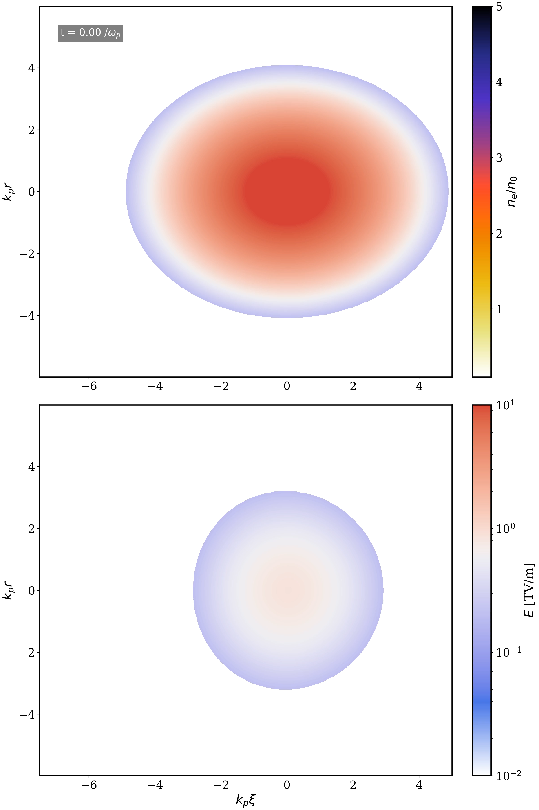

ZEUS - modified
Ti:Sapph
ATF
CO₂

Slide 24
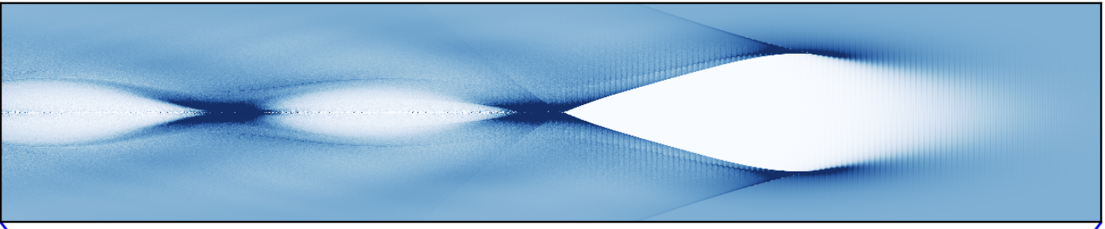




Spot size directly impacts the blowout length
n_e=3e15
$τ$=2ps
$$a_{0}=1.5$$
$$w_{0}=100$$
$$w_{0}=60$$

