Slide 1
Coherent Beam Stacking Enabled Compact, Energy Scalable, and Several Optical Cycle Capable Ultrashort Pulse Post-Compression for the Next-Generation LWFA Drivers
Tayari Coleman^{1*}, Bowei Yang¹, Christopher Pasquale¹, Yanwen Jing¹, Almantas Galvanauskas¹
¹Gérard Mourou Center for Ultrafast Optical Science, University of Michigan, USA
*tayaric@umich.edu

Slide 2
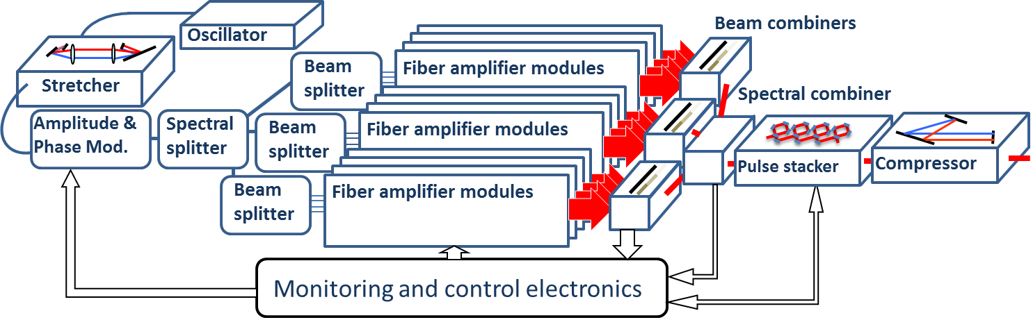
High Energy, High Rep Rate, Ultrafast Sources Needed
Laser Wakefield Accelerators are in need to high efficiency, high energy, high repetition rate driving sources with <30fs pulse durations
Current Fiber CPSA architecture is scalable to J level energies at 10kHz repetition rates, but pulse durations are limited by the gain bandwidth of Ytterbium and gain narrowing of the power amplifiers to somewhere in ~50-100fs range
Spectral combining can be used to increase the bandwidth, but adds complexity to the system
Here we present a new CPSA-compatible post-compression method for achieving ~30fs pulses potentially scalable into TW-PW peak power range
Mourou, G., Brocklesby, B., Tajima, T., & Limpert, J. (2013). The future is fibre accelerators. Nature Photonics, 7(4), 258–261.
Notes:
Laser driven PWEA Win leemans and eric

Slide 3
Coherent Pulse Stacking Amplification
Temporal energy scaling through coherent pulse stacking
  Carefully crafted input pulse bursts enable extraction of all amplifier stored energy
  Experimentally shown (~%90) stacking efficiency of bursts into a single pulse using G.T.I. stackers
Spatial energy scaling through spatial combining
  Comines N channels with M pulses per burst
  Experimentally shown (%90+) combining efficiency
Mode-locked
Oscillator (80fs)
Burst Carving and Shaping
Stretcher
Pre-Amp
Beam Splitting
Power Amplifiers
Beam Combining
G.T.I. Stackers
Compressor
1 GHz
AM
PM
: N
:
N
:
N
:
N
t
t
t
t
t
t
M Pulses
-> 1ns/ Pulse
-> 10mJ/Channel
-> 10mJ*N
-> 10mJ*N
-> 300fs
Notes:
Run code for pules durations down to ~ 10fs, Calculate A_o pa limited by gain narrowing of amplifers and system dispersion wrrameter,

Slide 4
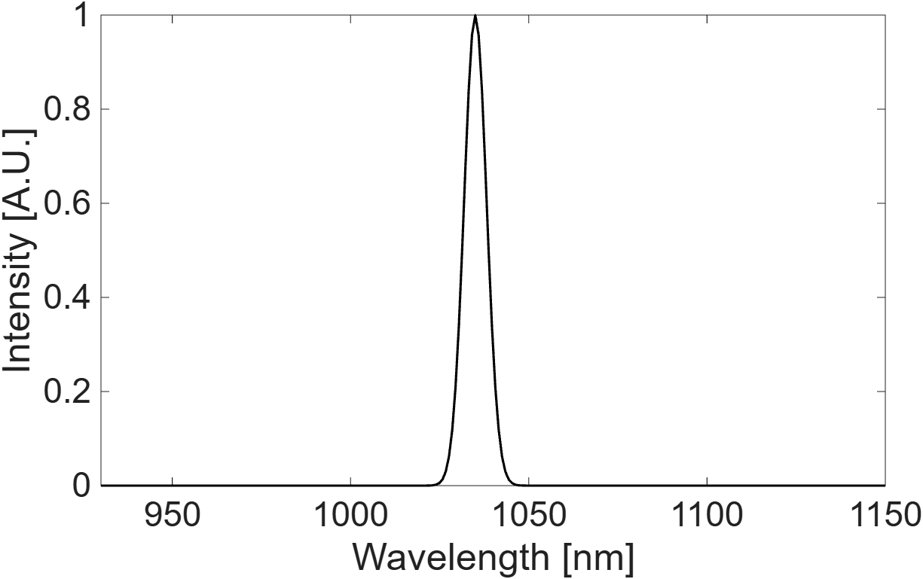
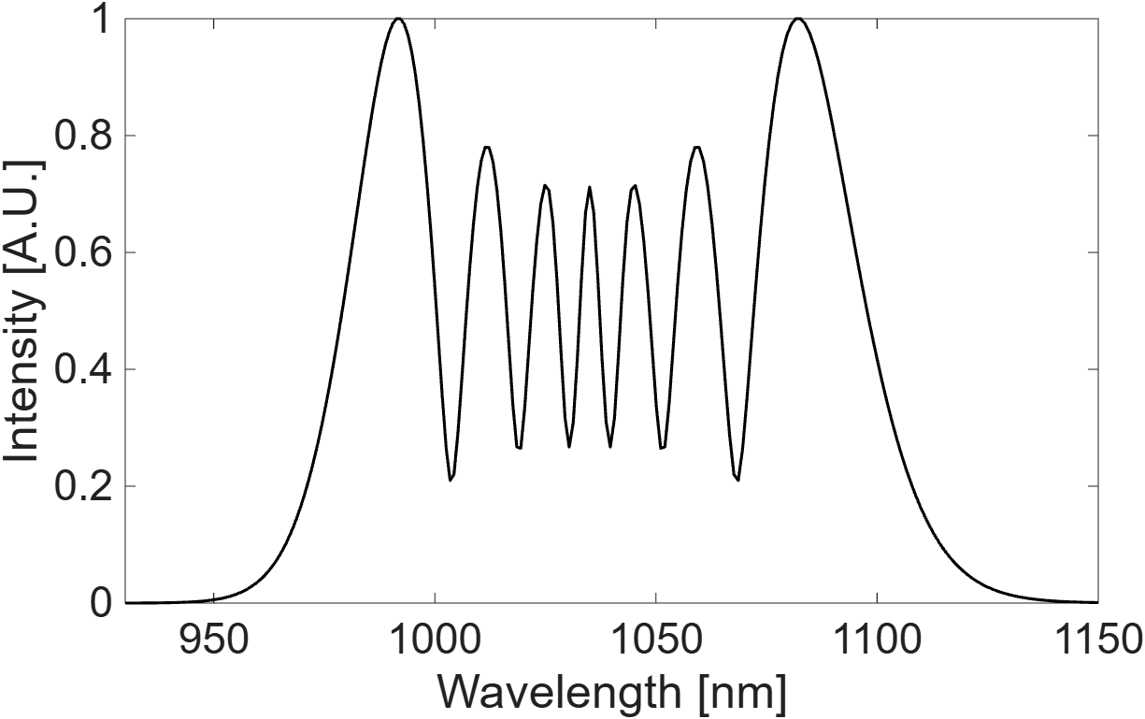
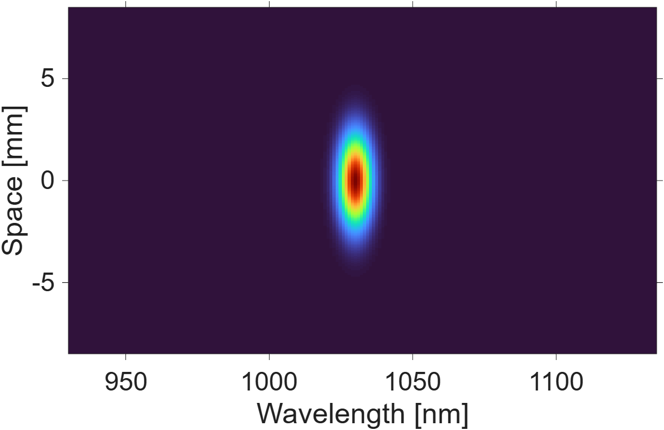
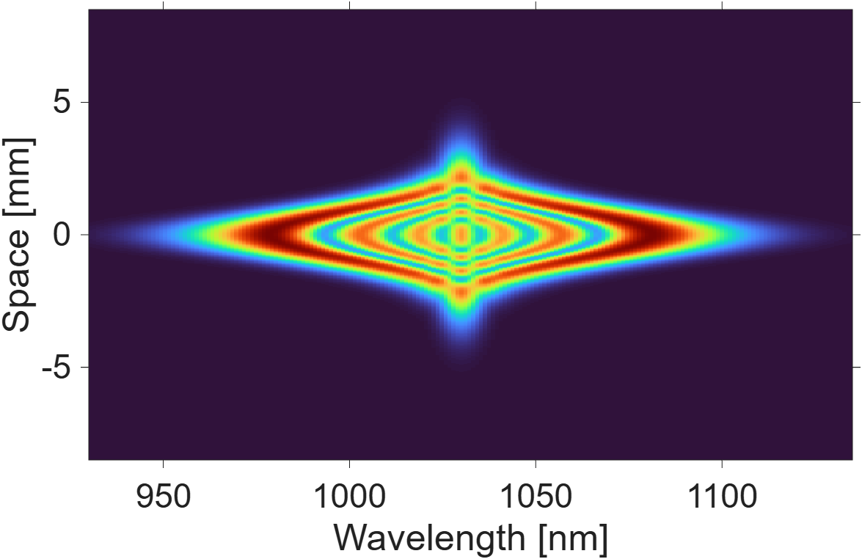
Nonlinear Post-compression: Theory
Self Phase modulation used to broaden the spectrum of the pulse
In free space it produces a spectrally inhomogeneous beam
Fiber don’t have this problem, but they can’t support high energies
For high energies multi-pass cells (MPC) are the solution
Nonlinear Medium
Free Space Propagation

Slide 5
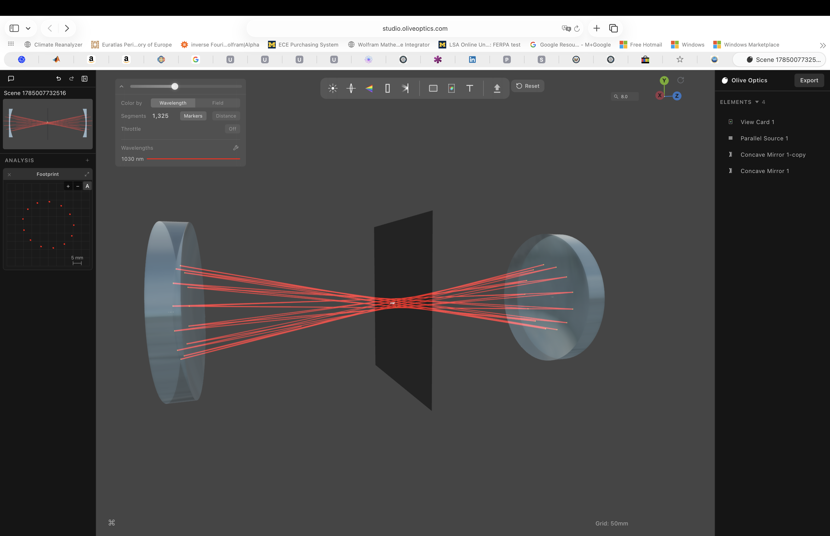
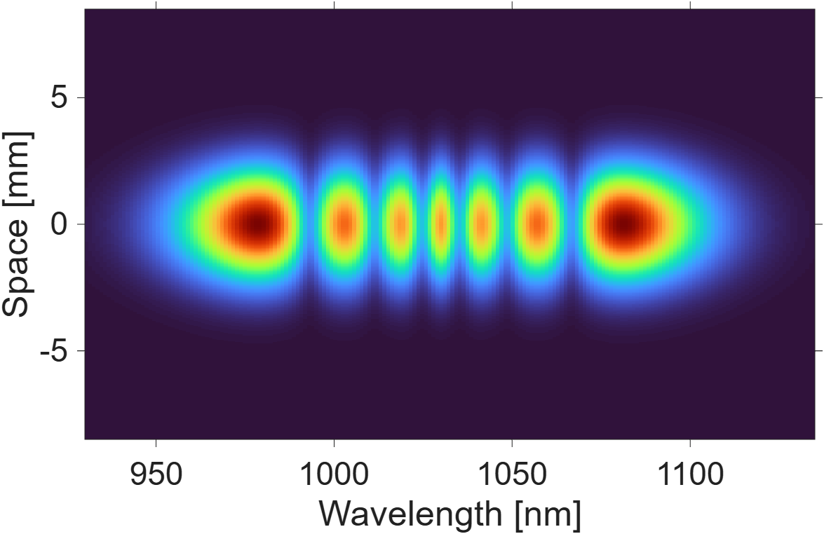
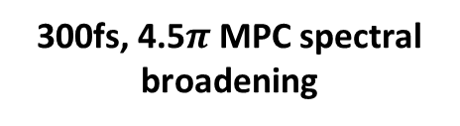
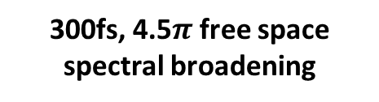
Nonlinear Post Compression: State of the Art
Gas MPC’s are robust, and less complex than their counterparts
Similar to waveguides these cavities maintain excellent spatio-spectral homogenity
Size scales with pulse energy
Highest demonstrated energy is 200mJ in 10m long cell
Kw average powers have been demonstrated
300fs, 4.5$π$ free space spectral broadening
300fs, 4.5$π$ MPC spectral broadening

Slide 6
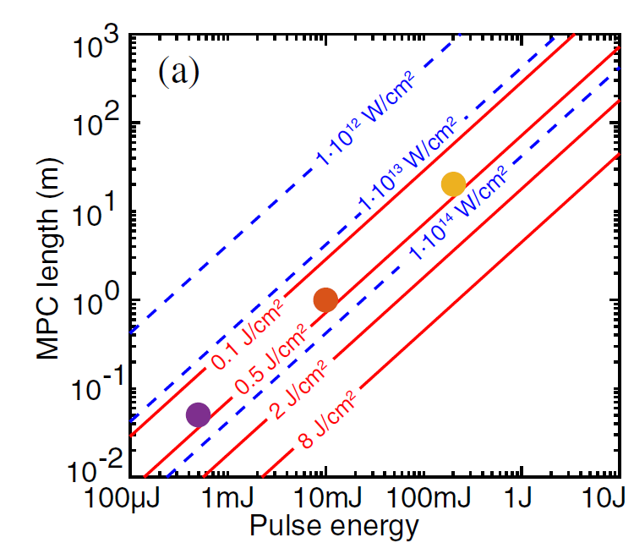

Nonlinear Post Compression: Limitations
Material LIDT restrictions
Gas ionization restrictions
Nonlinear per transit restrictions
Size scales with pulse energy
1 Joule estimated at 50m
Divided Pulse Post Compression
Equal Amplitude Pulse Division
Equal Amplitude Pulse Combining
-> 30fs
Multi-pass Cell
Compressor
t
$$\text{λ}$$
t
t
Anne-Lise Viotti, Marcus Seidel, Esmerando Escoto, Supriya Rajhans, Wim P. Leemans, Ingmar Hartl, and Christoph M. Heyl, "Multi-pass cells for post-compression of ultrashort laser pulses," Optica 9, 197-216 (2022)
L. H. Stark, Pulse Energy Scaling of Ultrafast Lasers via Spectral-Temporal Shaping and Coherent Combination, doctoral dissertation, Friedrich Schiller University Jena, Jena, Germany (2025).
Notes:
Need to tune carefully the pass number which allows for sufficient redistribution

Slide 7
Coherent Beam Splitting and Recombination Based MPC Post-Compression
Multiple beams are spectrally-broadened in parallel – enabling post-compression pulse energy scaling in a compact MPC setup
Existing coherent beam combining/splitting methods are impractical for this:
  - Filled-aperture methods require individual alignment of each beam
  - Tiled-aperture methods are inefficient, and cannot be used for beam splitting
To be practical, it should:
  - Not require beam rephasing after spectral broadening
  - Be simple to implement
Multi-focal phase-plate beam splitter
Multi-pass Cell
Multi-focal Phase-Plate Beam Recombiner
Chirped Mirror Compressor
➔ 50-100mJ/300fs
➔ >50mJ/30fs
LPA Experiments
t
t
$$\text{λ}$$
t
t

Slide 8
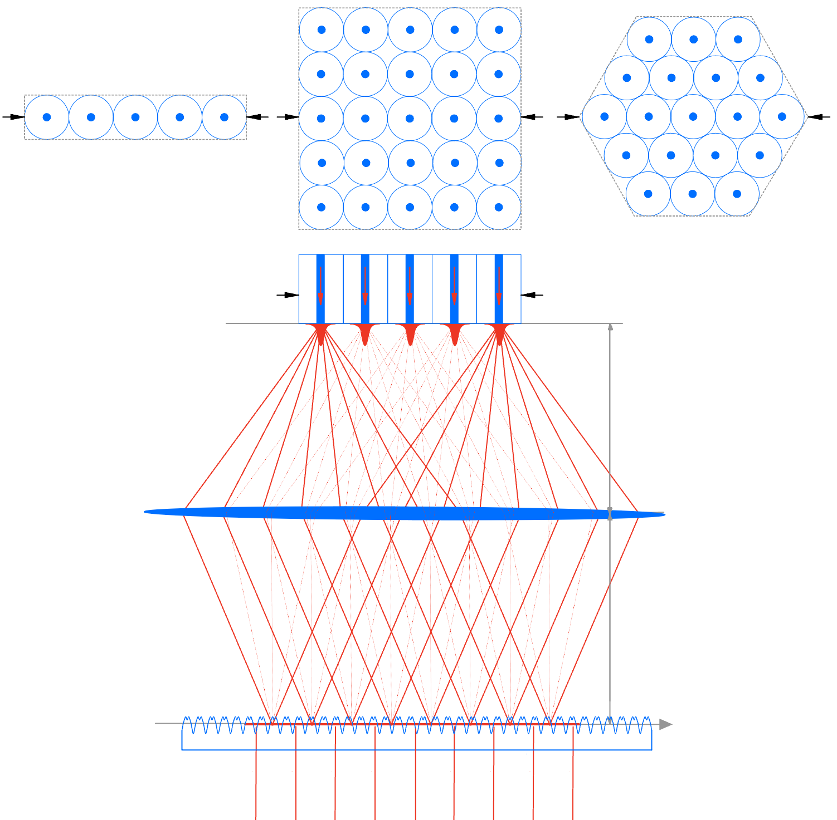

Coherent Beam Stacking (CBS):
A New 100% Efficient Tiled-Aperture Combining Method
This is a Spatial-Domain Implementation of a Coherent Pulse Stacking Technique
CBS-phase encoded
focal-spot array:
CPS-phase encoded stacking burst is replaced by a CBS-phase encoded stacking beam array
GTI pulse stacker is replaced by a CBS phase mask
CBS-phase encoding erases diffraction orders, and thus enables 100% efficiency without beam-array fill-factor constraints
Since combining occurs in a CBS phase mask, reverse propagation direction produces beam splitting
No individual beam alignment is needed
F_{L}
F_{L}
Incident or recombined Gaussian beam
CBS-phase mask multi-focal beam transformer
Example of a square 2D focal-spot array
Fourier lens
Fourier/Far-field image plane
Beam splitting direction
Beam combining direction
Notes:
Need to tune carefully the pass number which allows for sufficient redistribution

Slide 9
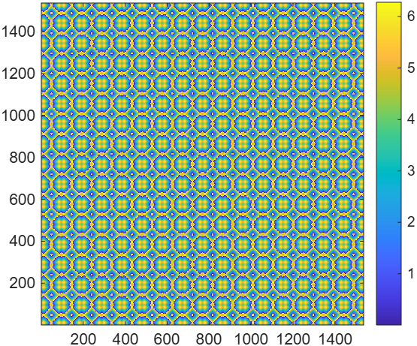
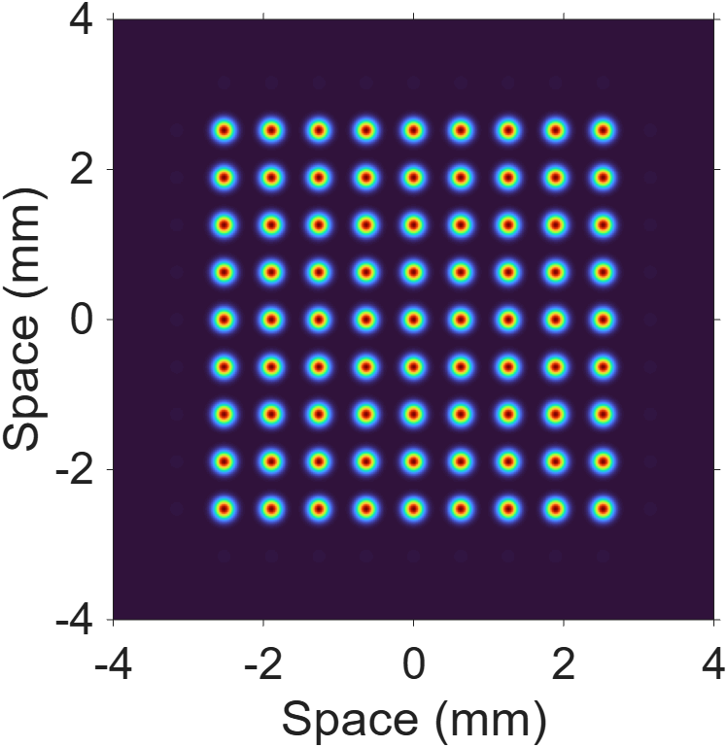
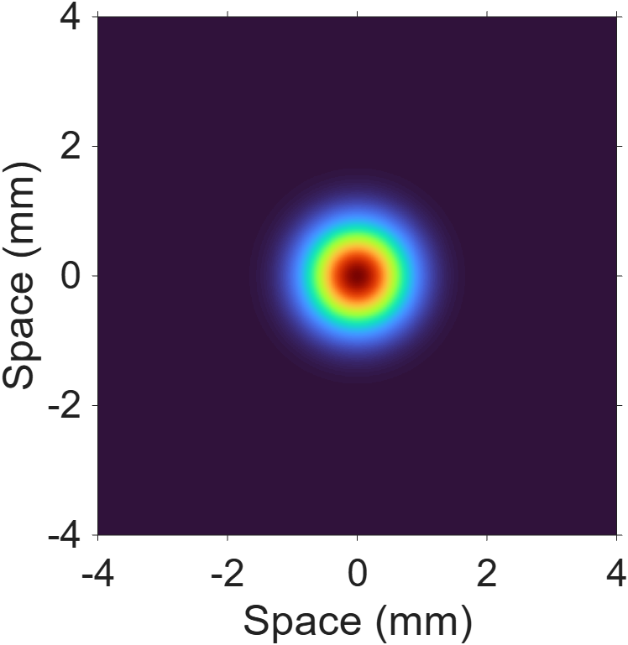
Coherent Beam Stacking has been Validated Theoretically and Numerically with Beam Propagation Methods
CBS phase mask combiner of the 9x9 stacking-beam array
Fourier Imaging L = 2f
Fibers
Phase Mask
f
f
Lens
Numerically simulated stacking beam 9x9 array (from a fiber-bundle array)
Numerically simulated combined Gaussian beam after the CBS phase mask combiner
Notes:
Need to tune carefully the pass number which allows for sufficient redistribution

Slide 10
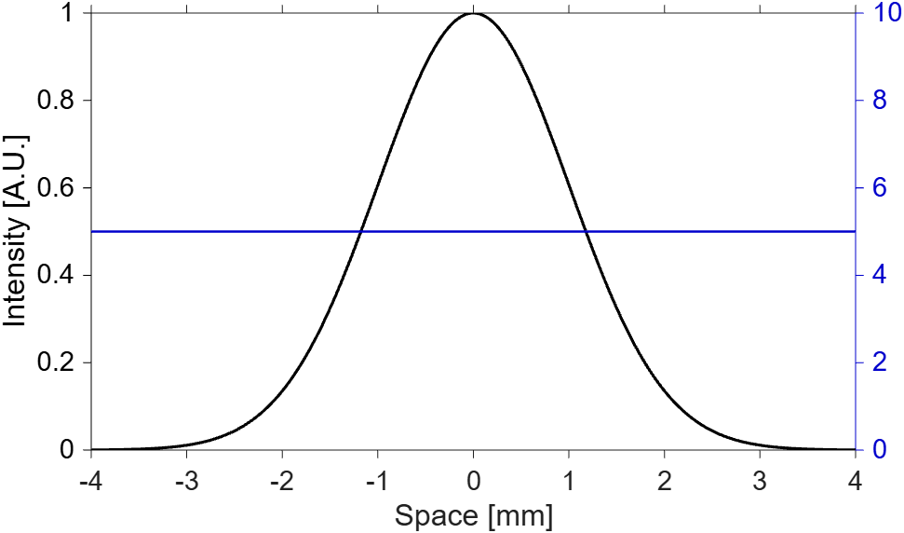
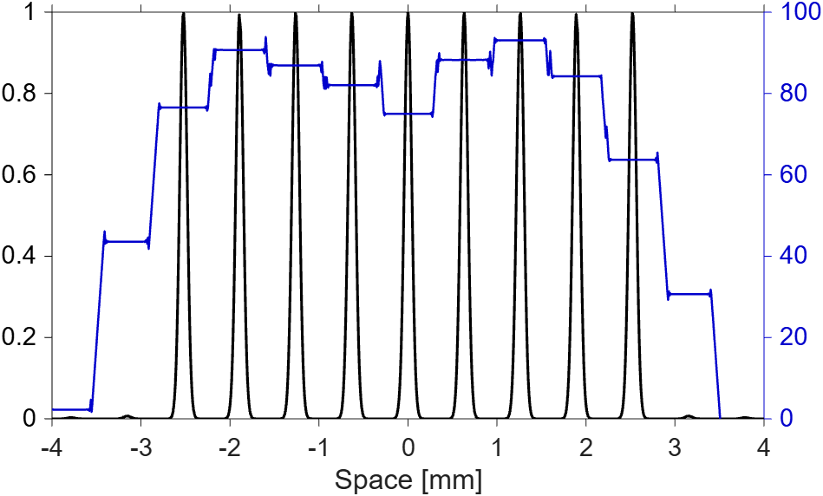
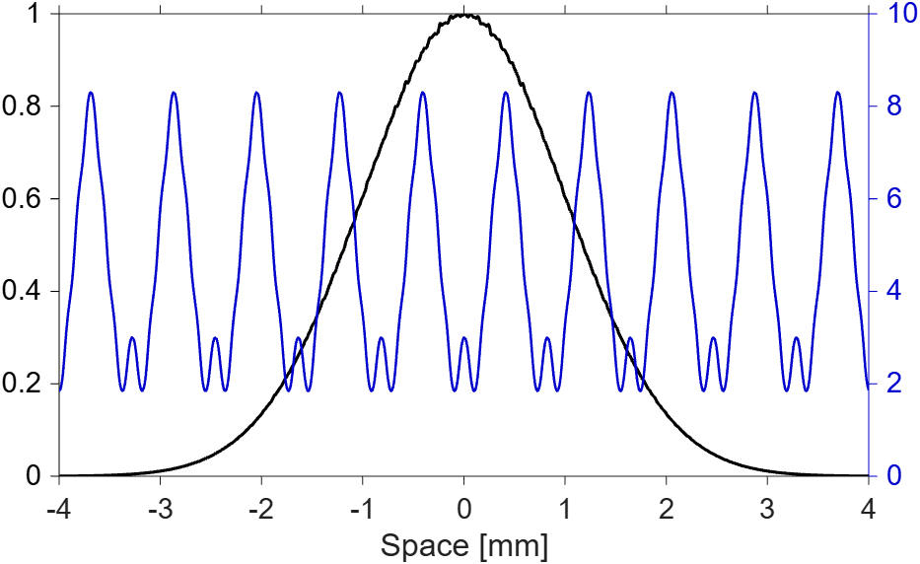
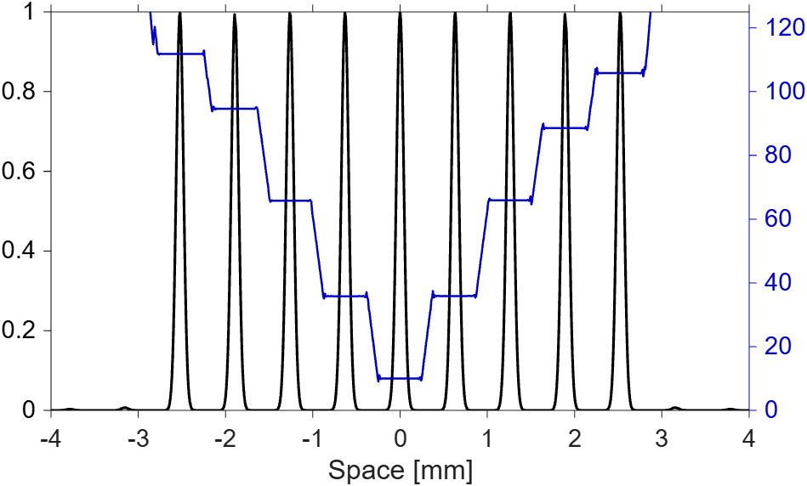
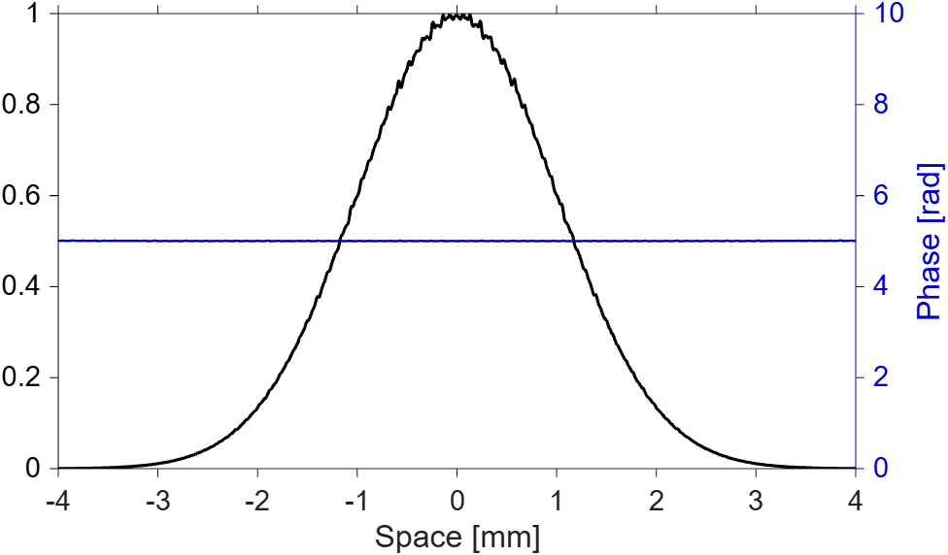
Coherent Beam Stacking can be Implemented in Confocal Cavity Configurations
CBS can be implemented in confocal cavity configurations demonstrating simultaneous splitting and recombining
f
2f
2f
2f
f
Notes:
Need to tune carefully the pass number which allows for sufficient redistribution

Slide 11
CBS Enabled Energy Scalable MPC Configuration
Cavity mirrors
Focal plane
Recombining phase mask
Cavity mirrors
Gaussian beam passes CBS phase mask positioned in the MPC focal plane, and gets transversely phase modulated
After FL mirror the phase-modulated Gaussian is converted into a focal-spot array in the MPC focal plane
After the second FL mirror phase-modulated Gaussian beam is reconstituted in the MPC focal plane
Step 2 is repeated again
Step 3 is repeated again
Diffraction-limited Gaussian beam reconstituted after CBS phase mask in the MPC focal plane at the output
6
Recombined diffraction-limited beam
Phase-modulated Gaussian beam
5
Out
4
Focal spot plane
3
Phase-modulated Gaussian beam
2
Focal spot plane
1
Phase-modulated Gaussian beam
Gaussian diffraction-limited beam
In
Splitting phase mask
Confocal MPC configuration
Focal spot array

Slide 12
CBS Enabled Energy Scalable MPC
Post-Compression Configuration
In the presence of nonlinearity, we see minimal differences when compared to standard cavity propagation
Nonlinear Medium
Nonlinear Medium
Notes:
Need to tune carefully the pass number which allows for sufficient redistribution

Slide 13
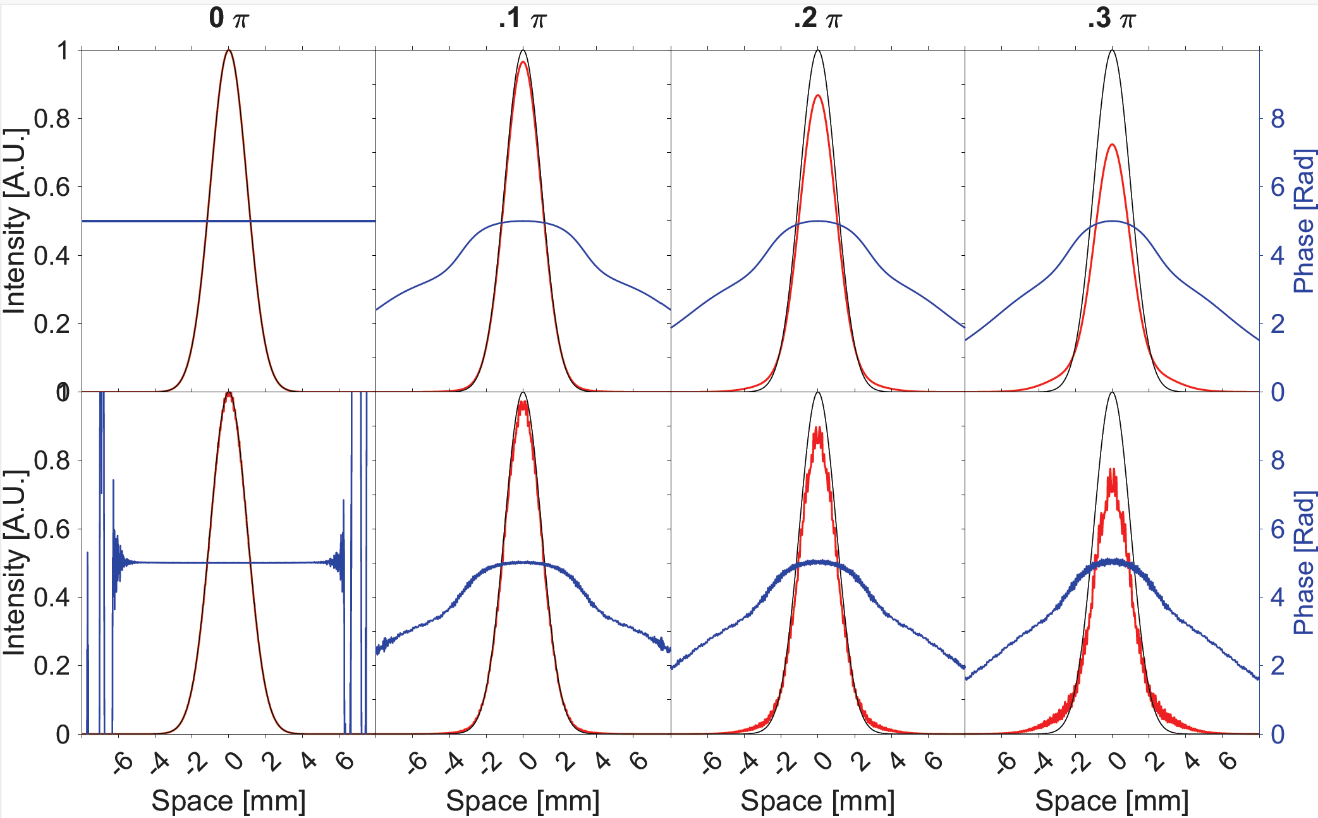
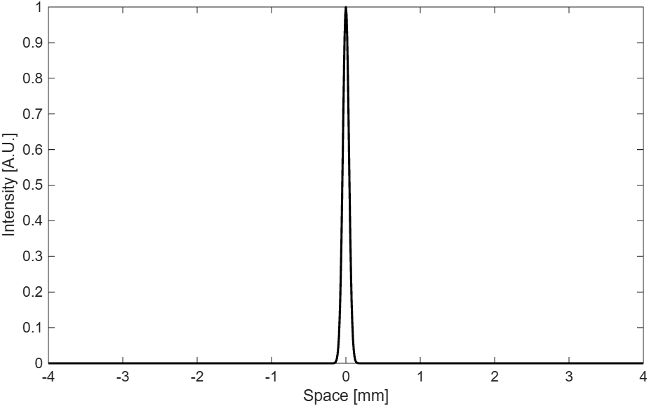
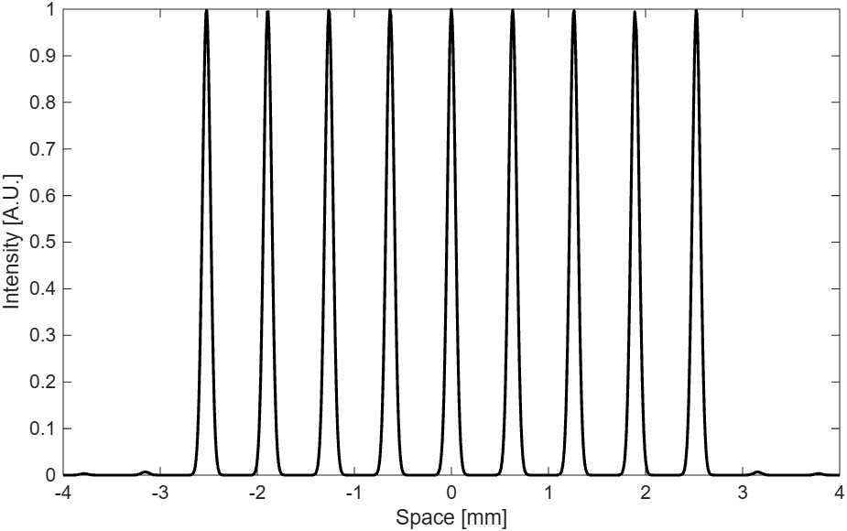
CBS Enabled Energy Scalable MPC
Post-Compression Configuration: Data
We compare the response of CBS confocal to standard confocal cavities in the presence of nonlinearity
Focal Plane Field Pattern
Each beam in the beam array behaves nearly identical to a single beam in the presence of nonlinearity

Slide 14
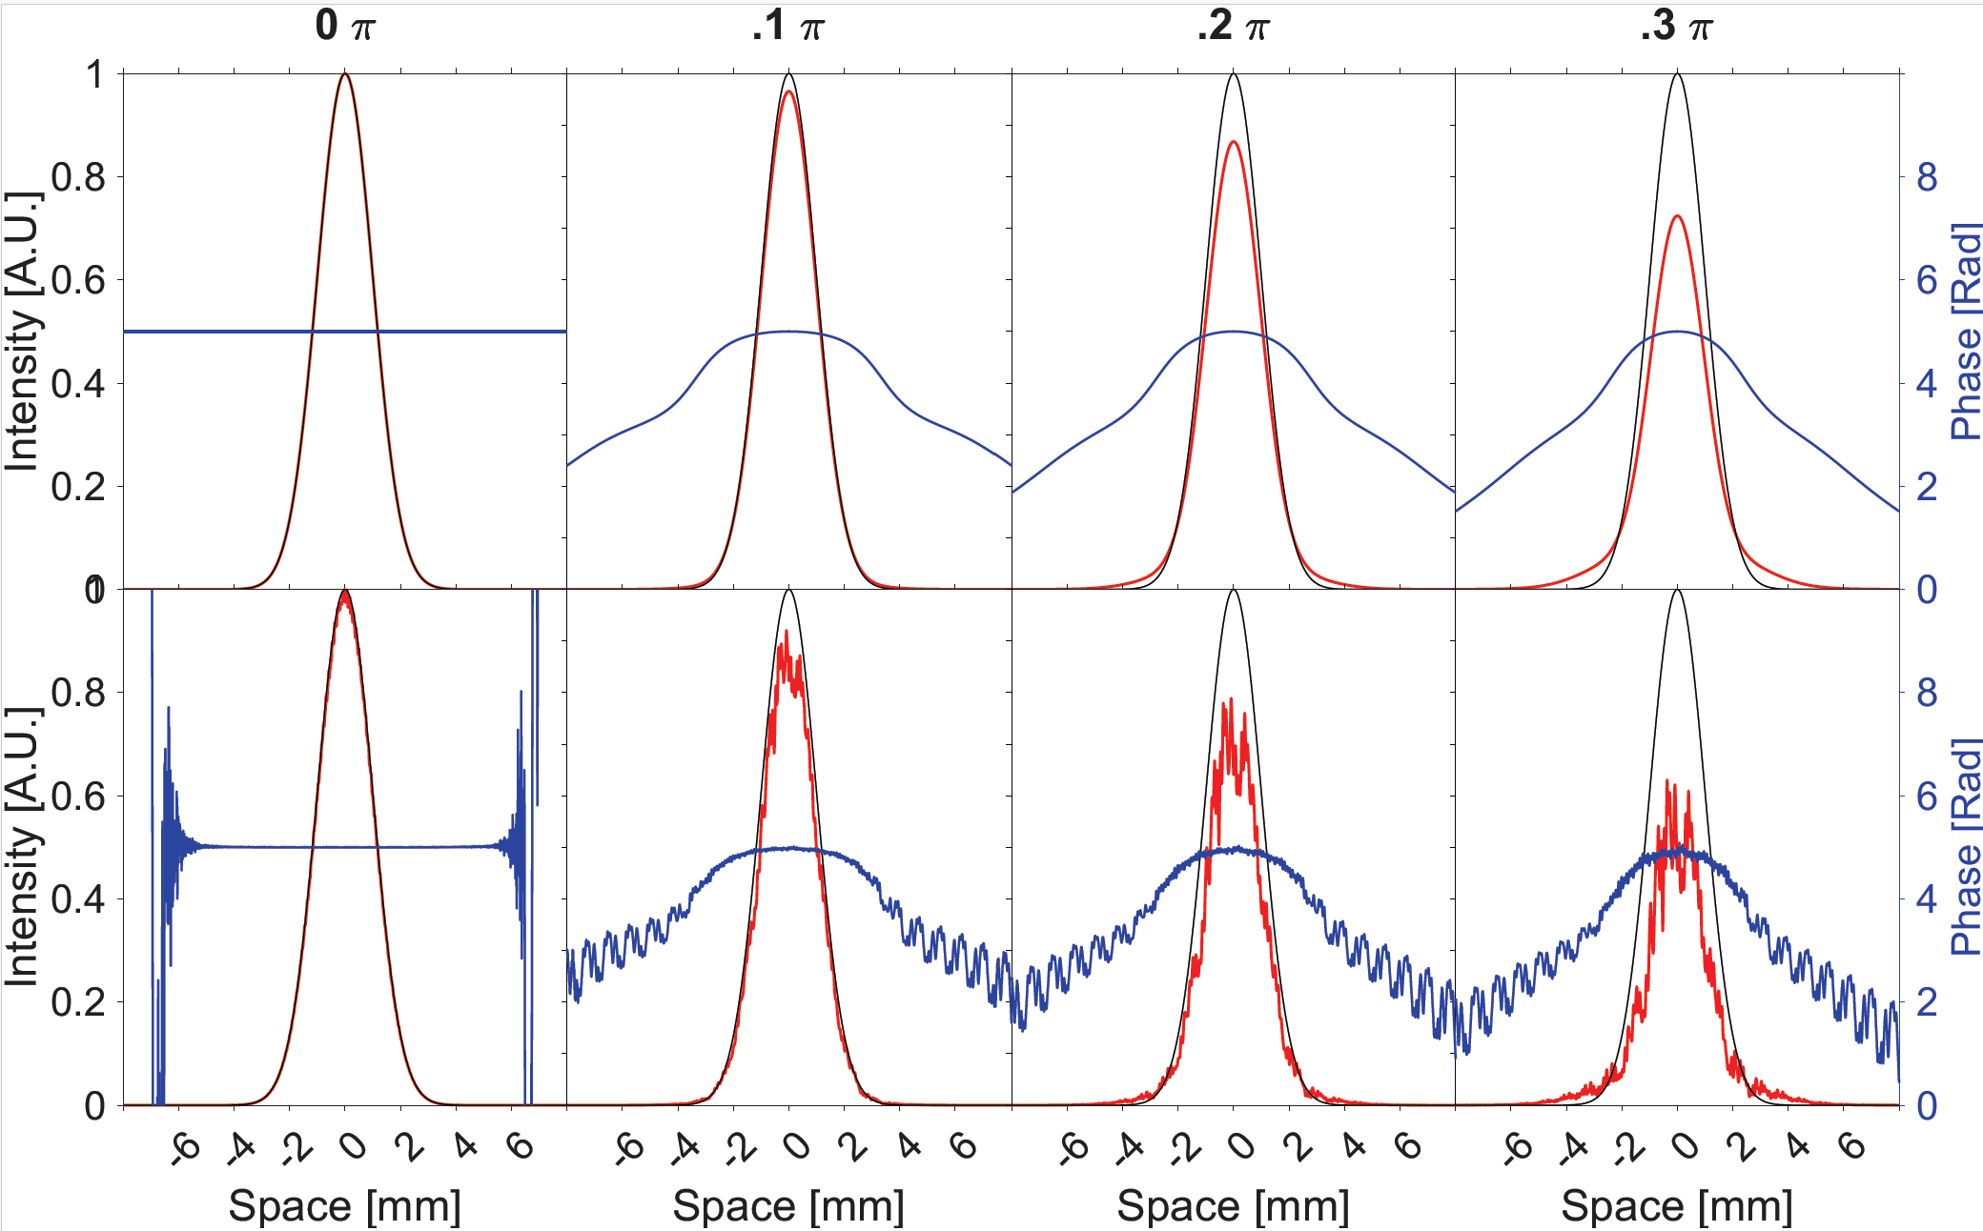
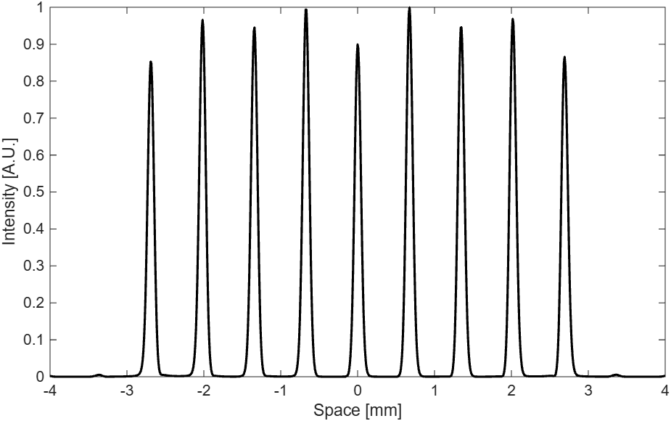
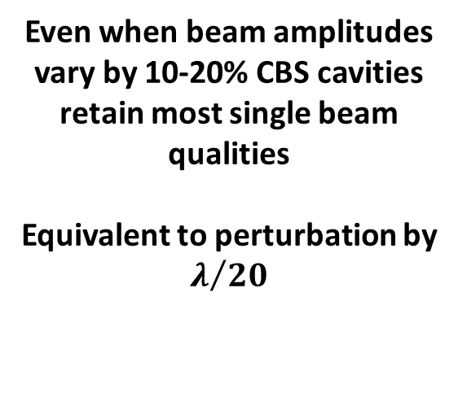
CBS Enabled Energy Scalable MPC
Post-Compression Configuration: Data
We probe the resilience of these CBS cavities by studying the field response for unequal beam array amplitudes
Focal Plane Field Pattern
Even when beam amplitudes vary by 10-20% CBS cavities retain most single beam qualities
Equivalent to perturbation by $λ/{20}$
Demonstrates resilience to random perturbations: No need for active rephasing before recombination

Slide 15


1mJ Demonstrated Nonlinear Post-compression
Laboratory Scale 1mJ Cavities Have Been Demonstrated
60cm R.o.C.
60cm R.o.C.
2.5mm $1/{e^{2}}$ Diameter
~3.25 Total Nonlinearity Accumulated
98% + Spatio- Spectral Homogeneity
96% + Throughput Transmission
200fs -> 31fs
300um $1/{e^{2}}$ Diameter
1.183m
Grebing C, Müller M, Buldt J, Stark H, Limpert J. Kilowatt-average-power compression of millijoule pulses in a gas-filled multi-pass cell. Opt Lett. 2020 Nov 15;45(22):6250-6253. doi: 10.1364/OL.408998. PMID: 33186962.
Notes:
Need to tune carefully the pass number which allows for sufficient redistribution

Slide 16
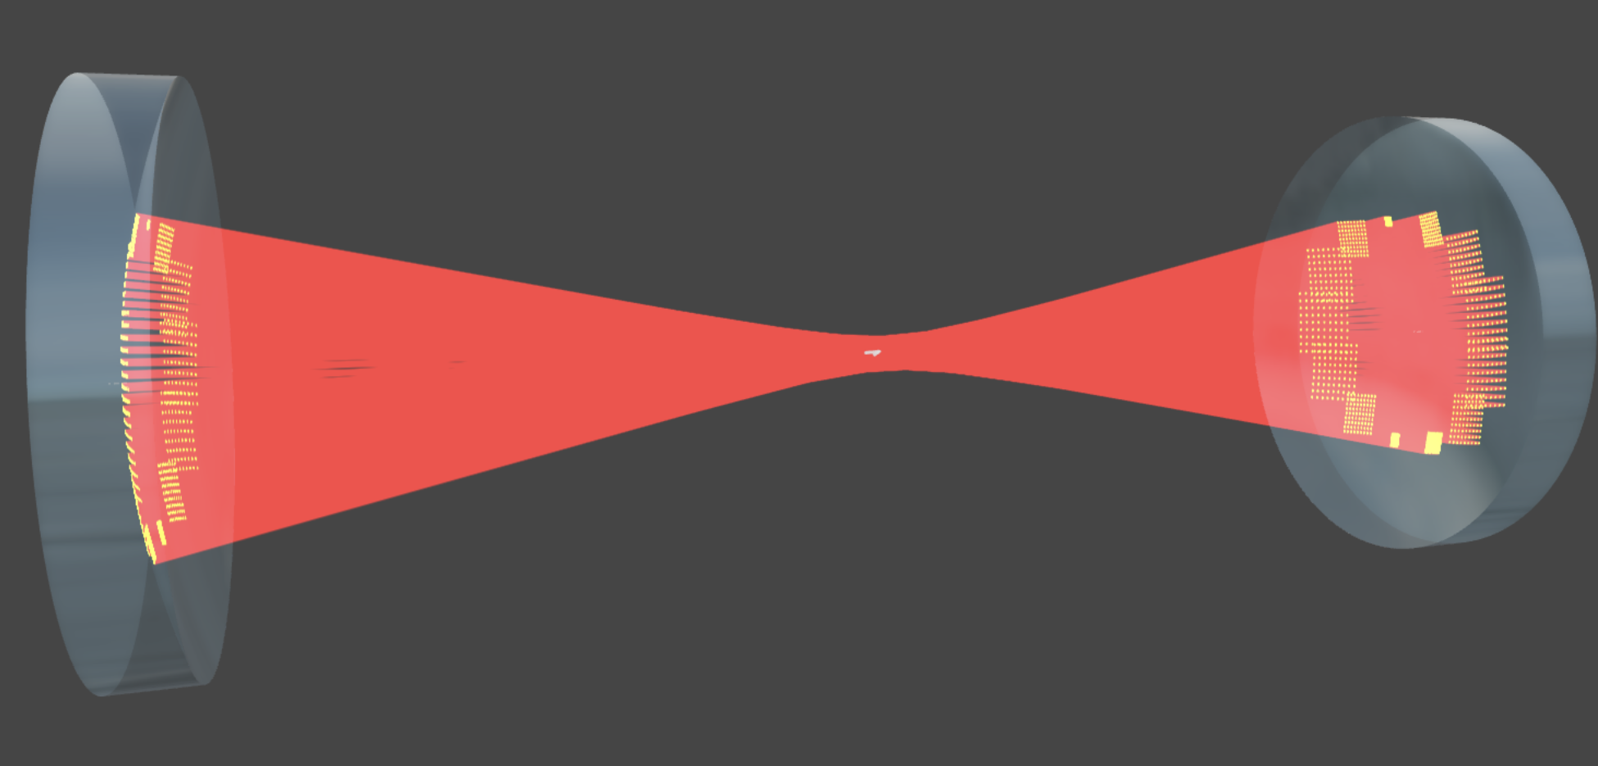


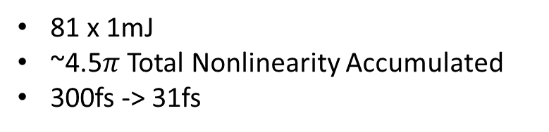
CBS Enabled Energy Scalable MPC
Post-Compression Configuration: Scalability
CBS can directly be applied to demonstrated compact cavities
60cm R.o.C.
60cm R.o.C.
81 x 2.5mm $1/{e^{2}}$ Diameter
81 x 1mJ
~4.5$π$ Total Nonlinearity Accumulated
300fs -> 31fs
81 x 300um $1/{e^{2}}$ Diameter
1.183m
CBS is a pathway to joule level energies in compact cavity footprints
Notes:
Need to tune carefully the pass number which allows for sufficient redistribution

Slide 17

Summary
High-intensity power and energy scalable laser drivers need broader bandwidths to achieve shorter pulse durations
CBS Post-compression as an add on to CPSA to enable an increase in bandwidth and subsequent beam stacking
Use of Gas MPC’s for highest broadening performance at high energy and average powers
Experiment is designed for demonstrating CBS Post-compression with 81+ beams for 81 mJ spectral broadening in a 1.2m long cavity.
CBS shows promise for scalability for joule level energies in compact footprints.
This work is supported by the Department of Energy
“RESEARCH OPPORTUNITIES IN ACCELERATOR STEWARDSHIP” grant

