Slide 1
Update on the
Long-Wave-Infrared
Laser Capability at ATF
Mikhail Polyanskiy, Marcus Babzien, Igor Pogorelsky,
William Li, Dismas Choge
AAC 2026-07-27

Slide 2


A Different Laser Regime: 9 µm
Facility | Final amplifier technology | λ (µm) | Energy (J) | Pulse (fs) | Peak Power (TW) | Note
ELI-NP HPLS ELI-NP, Romania | Ti:Sapphire | 0.8 | 230 | 23 | 10,000
ZEUS U Michigan | Ti:Sapphire | 0.8 | 50 | 25 | 2,000 | Design goal: 3 PW NSF user facility
NSF OPAL LLE, NY | OPCPA | 0.92 | 500 x 2 | 20 | 25,000 x 2 | Under design
BELLA Petawatt LBNL, CA | Ti:Sapphire | 0.8 | 40 | 40 | 1,000
Texas Petawatt UT Austin | Nd:glass | 1.057 | 150 | 150 | 1,000
ALEPH Colorado State | Ti:Sapphire | 0.8 | 26 | 30 | 850
OMEGA EP LLE, NY | Nd:glass | 1.053 | 500 | 700 | 700
Scarlet Ohio State | Ti:Sapphire | 0.8 | 15 | 40 | 400
ATF 9-micron BNL, NY | CO₂ | 9.2 μm | 10 J | 2,000 fs | 5 TW | 2–3 TW typical 25 TW in design Part of DOE user facility
~ 0.9 µm
~ 9 µm

Slide 3
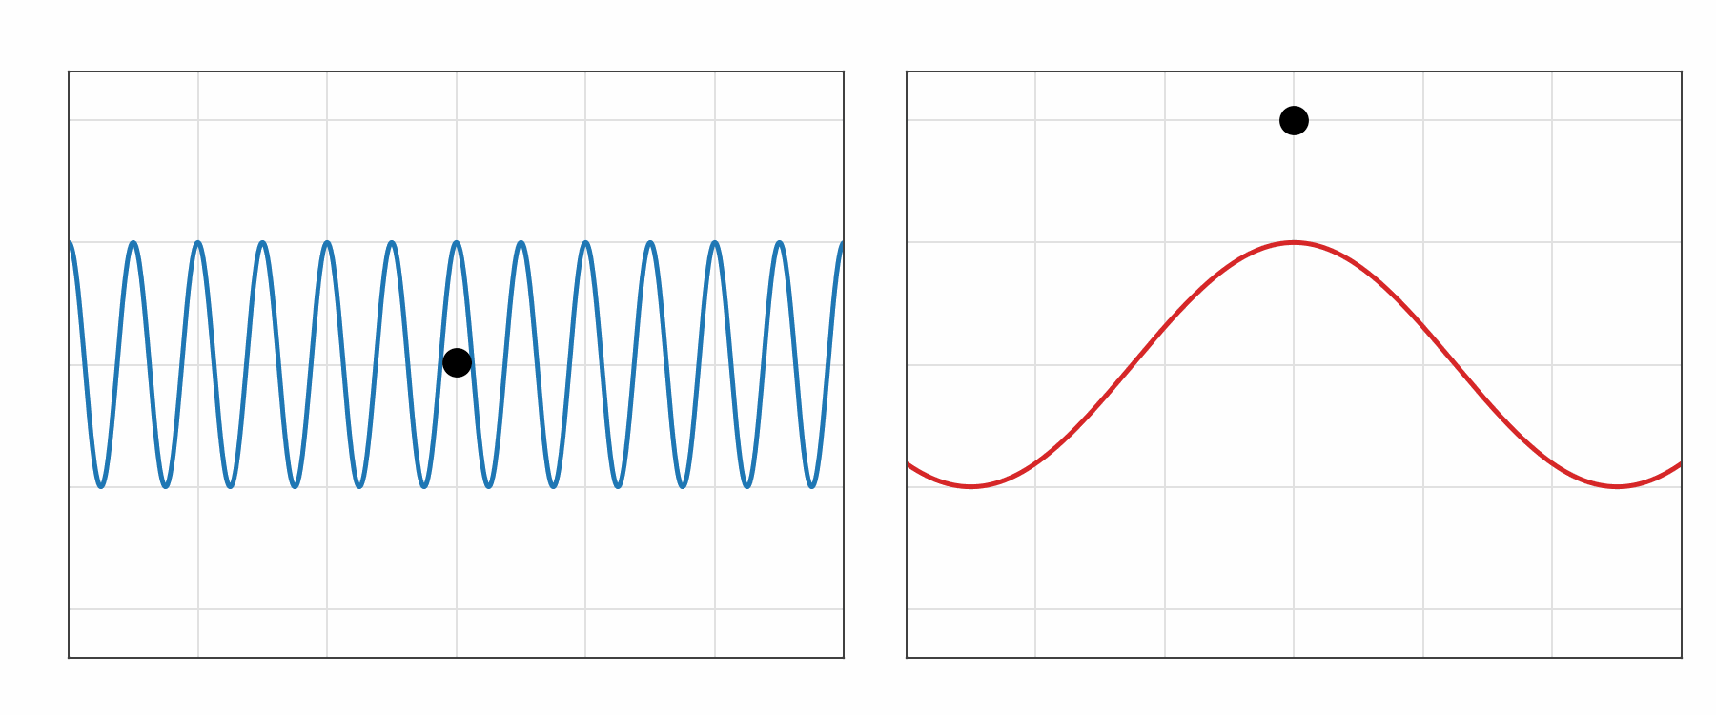
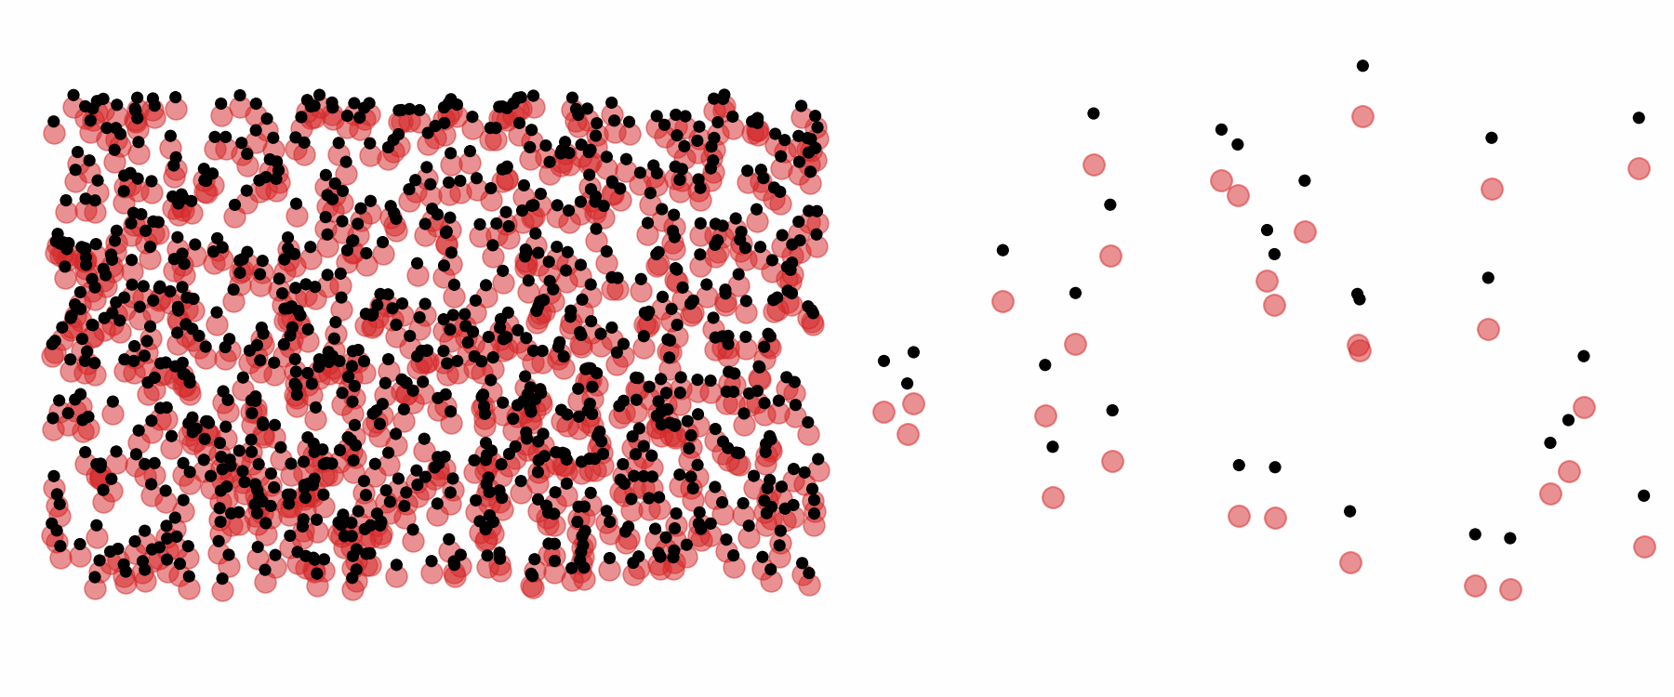
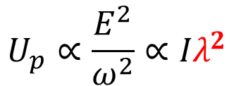
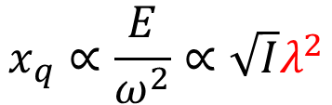


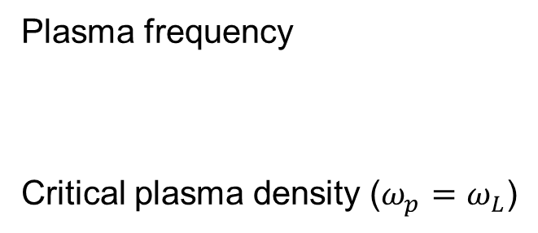
Electron in Laser Field
λ = 0.9 µm
λ = 9 µm
Quiver amplitude
Ponderomotive potential
$$x_{q}∝\frac{E}{ω^{2}}∝{\sqrt{I}λ}^{2}$$
$$U_{p}∝\frac{E^{2}}{ω^{2}}∝{Iλ}^{2}$$
Plasma in Laser Field
e-
Plasma frequency
Critical plasma density ($ω_{p}=ω_{L}$)
p+
$$ω_{p}∝\sqrt{n_{e}}$$
n_{crit} ~ 10²¹ cm⁻³
n_{crit} ~ 10¹⁹ cm⁻³
$n_{crit}∝{ (ω_{L})}^{2}$ $∝λ^{−2}$

Slide 4
Science with ATF 9-micron laser

Slide 5
Science with ATF 9-micron laser
Tuesday 17:20 WG-1
Navid Vafaei-Najafabadi
Optimizing laser parameters for blowout regime: from petawatt NIR to LWIR wakefield drivers
Thursday 13:30 WG-6
Yusuke Sakai
Nonlinear Inverse Compton Scattering experiments enabled by Long-Wave Infrared Laser in BNL ATF
Thursday 14:10 WG-5
Apurva Gaikwad
1-D plasma lens by laser-driven elongated wakefield
Thursday 17:20 WG-2
Nicholas Dover
Diagnosing near-critical-density laser plasma interaction and ion acceleration using dynamic optical probing
Monday poster session WG2
Anusorn Lueangaramwong
Study of laser-driven ion accelerators via ultra-fast optical and electron radiography of high-density plasmas at ATF
Monday poster session WG1
Dismas Choge
Laser-induced damage in optical components for high-power infrared laser systems
LWFA
Compton
LWFA
Ion Acceleration
Plasma dynamics
Laser technology

Slide 6
Laser Status and FY27 User Parameters
Commissioning status
Laser operation was authorized earlier in 2026 following the extended ATF shutdown for the Accelerator Readiness Review (ARR).
Commissioning was subsequently interrupted by a component failure and limited personnel availability during ARR preparation.
Near-term milestone: CO₂ preamplifier commissioning targeted for next week.
Full-power operation: targeted for August 2026.
FY27 user capability
    Central wavelength 9.24 µm
    FWHM bandwidth 0.10 µm
    FWHM pulse duration 2.0 ps 70 ps with compressor bypassed
    Pulse energy ≤7 J ≤10 J with compressor bypassed
    Peak power ≤3 TW
    Pulse repetition interval ≥90 s
    Additional operating modes
      Linearly polarized output with continuously rotatable polarization angle.
      Circular polarization available at reduced pulse energy, typically <0.5 J.
      mJ-level pulses at 1.5 Hz for experimental setup and alignment.

Slide 7
Operational priorities and enabling R&D
Operation improvement priorities:
Improve beam quality and focusing, deliver 5 TW to users
Minimize downtime (e.g., alignment-related interruptions)
Improve in-line diagnostics, monitoring, and data logging
R&D priorities toward 25 TW
Develop and qualify critical optical components
Improve numerical modeling of laser components and system performance
DOE Accelerator Stewardship-supported
materials R&D helps advance these priorities
Ultrafast laser damage at 9.2 µm
Dismas Choge – poster session tonight
Nonlinear refraction and absorption in LWIR optical materials
Opt. Mater. Express
14, 696 (2024)

Slide 8
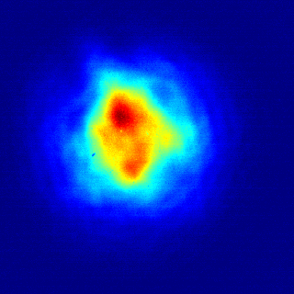
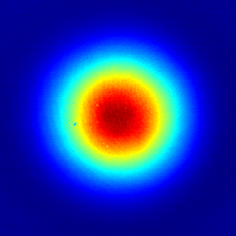
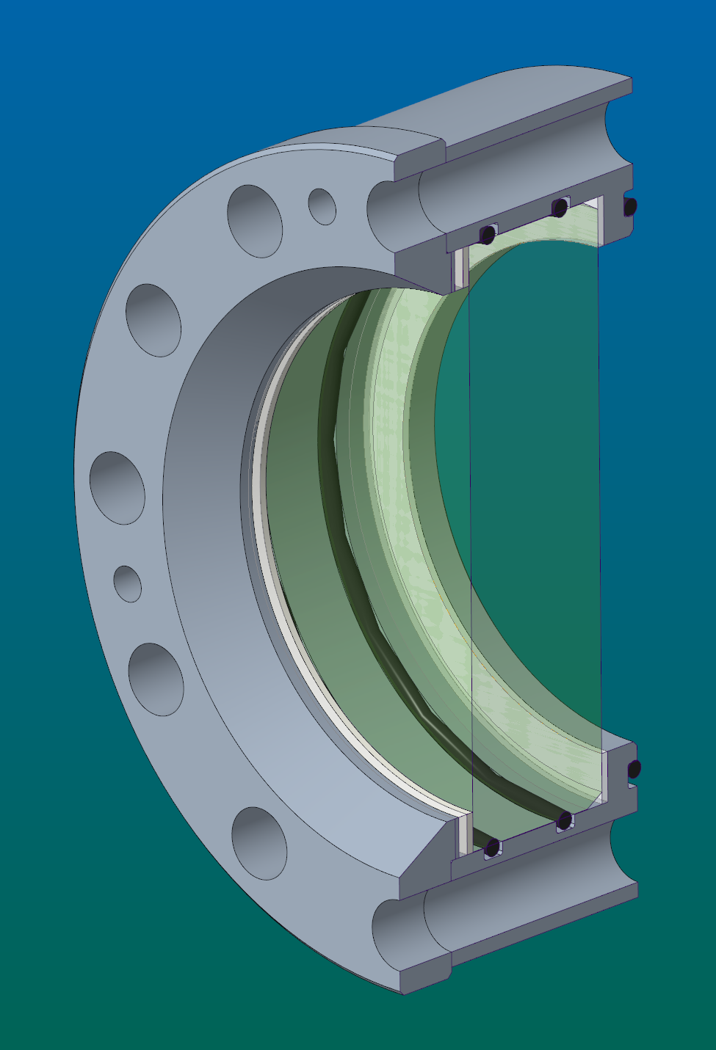
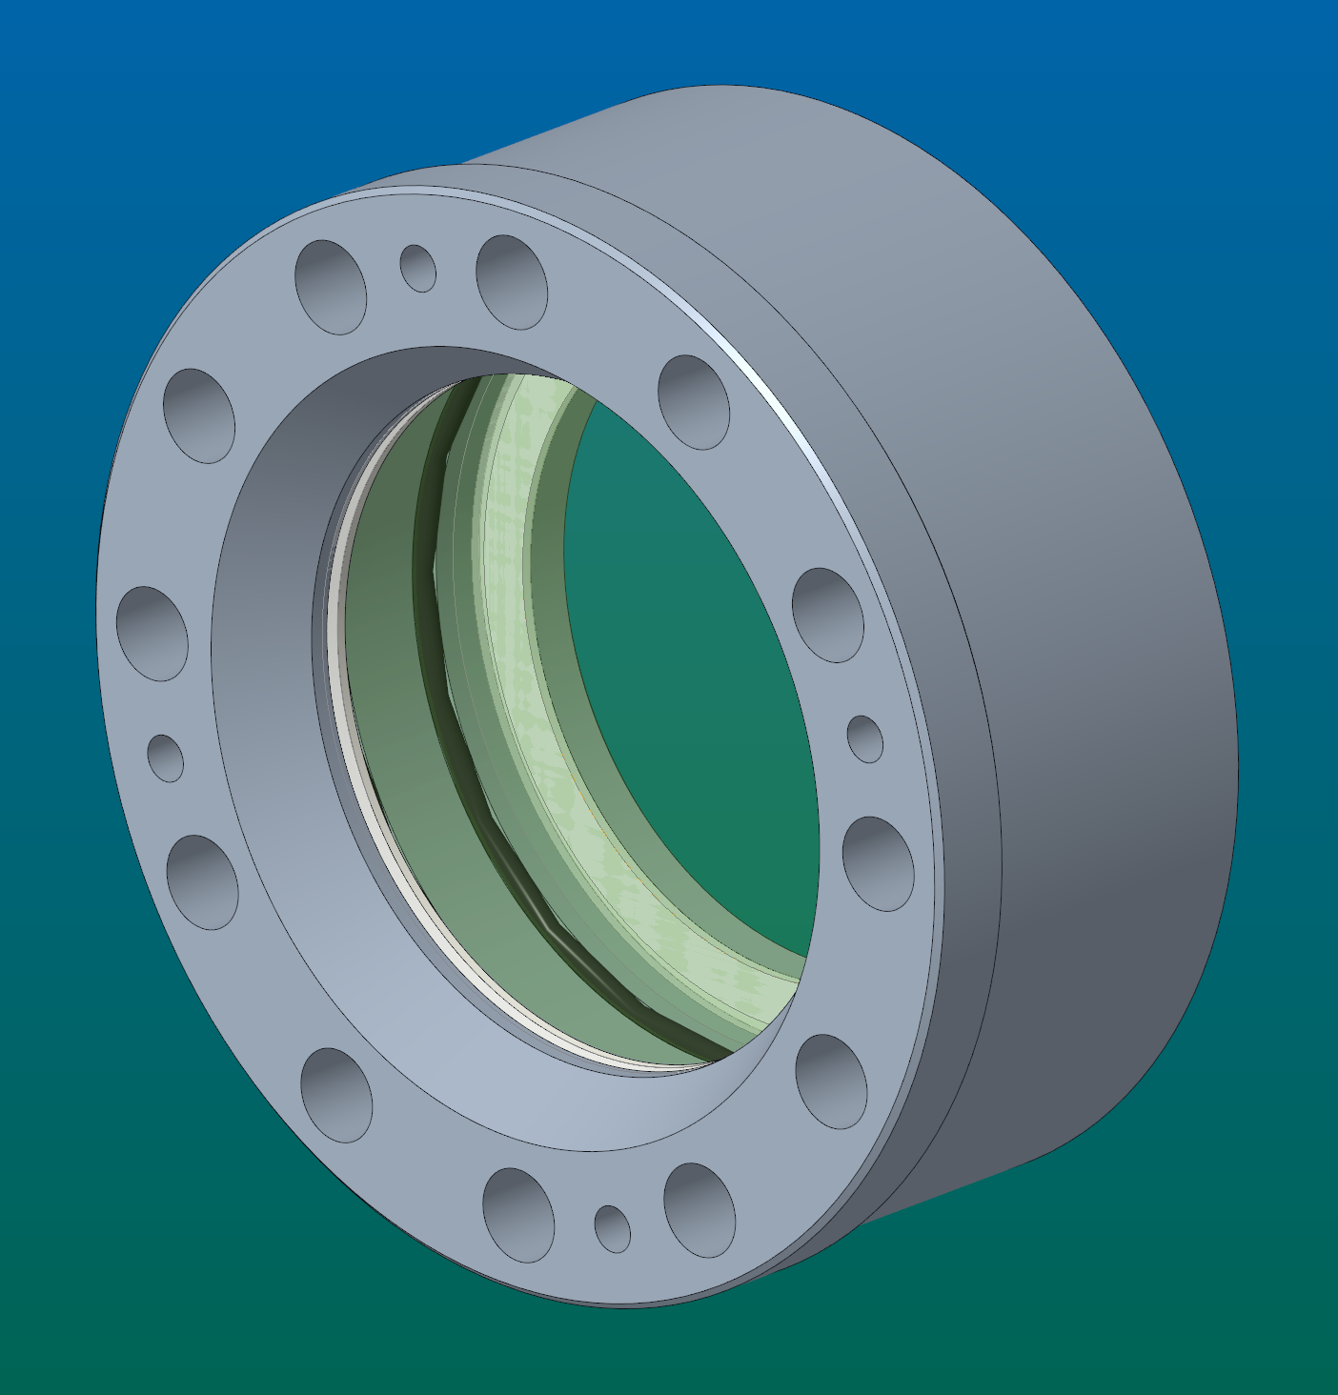
Example of incremental performance upgrade
NaCl / BaF₂
Beam
profiler
BaF₂ window housing for
high-pressure CO₂ amplifier
Improved beam quality
3x thinner than NaCl
Parameter (@ 9.2 μm) | Unit | NaCl | BaF₂
Solubility in water | g/L | 360 | 1.61
Modulus of rupture | MPa | 2.4 | 26.9
Refractive index | - | 1.500 | 1.412
Fresnel reflection | % | 4.0 | 2.9
Volume absorption | % / cm | 0.0 | 2.8
Nonlinear index | 10⁻²⁰ m²/W | 3.5 | 1.7
Group-velocity dispersion | fs²/mm | -1010 | -2340

Slide 9
ATF 9-micron laser & recent changes
vacuum
air
NaCl→BaF₂
≤14 J, 2 ps
“5 TW”
@ 9.2 µm
20 J
70 ps
Compressor
10 mJ
70 ps
NaCl→BaF₂
Ti:S
Ge
Coupler
[2 μJ]
[140 ps]
Seed
laser
Final CO₂
amplifier
100 mJ, 6 ns @ 1.064 µm
P(CO₂+N₂+He) = 10 atm
¹⁶O : ¹⁸O = 50 : 50
C¹⁶O₂ : C¹⁶O¹⁸O : C¹⁸O₂ = 25 : 50 : 25
Regenerative CO₂
pre-amplifier
osc
15 μJ
350 fs
OPA
Stretcher

Slide 10
Next-generation concept
25 TW, 100 fs
Post-Compressor
Present system upgrade path
[ Report of the Basic Research Needs Workshop on Laser Technology. DOE & NSF, 2024]
2 ps
5 TW
10 mJ seed
500 fs
15 TW
Post-compressor
100 fs
25 TW
Post-compressor
demonstrator
500 fs
3 TW

Slide 11
Summary
The ATF 9-micron laser is a unique instrument for advanced accelerator research and related applications.
The laser is being recommissioned following the extended ATF shutdown, with user operation planned for FY27.
Near-term upgrades will improve the present multi-TW system while establishing a path toward a few-cycle, 25-TW capability.
Future LWIR systems are expected to rely largely on solid-state technology, retaining a compact CO₂ amplifier as the high-energy core.
CO₂
CO₂
CO₂
S.S.
Solid
state
Solid
state
past
present
goal

