Slide 1
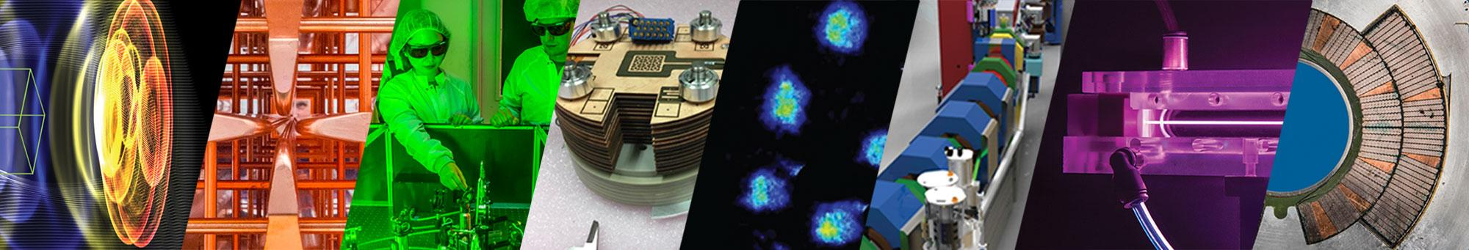


Design and progress of a 150 mJ, 40 fs, 5 kHz
fiber-laser accelerator driver
Tong Zhou, Qiang Du, Fanting Kong, Mahek Logantha, Mingshu Chen, Alessio Amodio, Dan Wang, Qing Ji, Jeroen van Tilborg, Carl Schroeder, Almantas Galvanauskas*, Jens Osterhoff, Cameron Geddes
Lawrence Berkeley National Laboratory
* University of Michigan
AAC 2026, July 27, 2026, UCLA

Slide 2
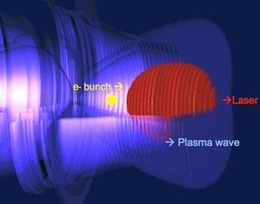
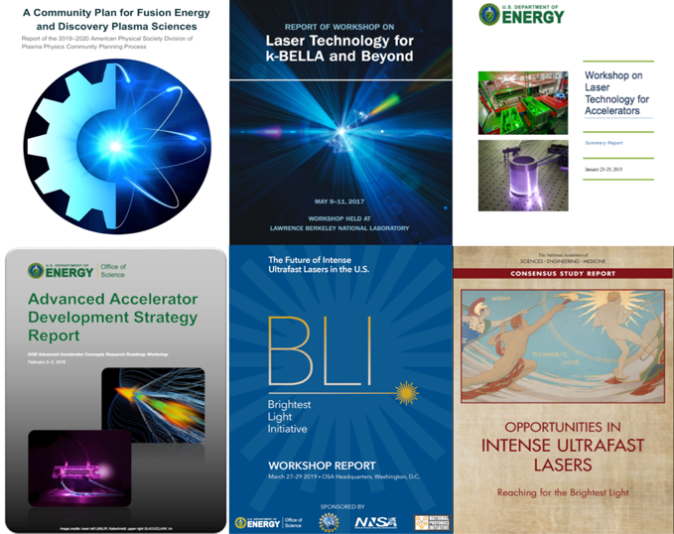
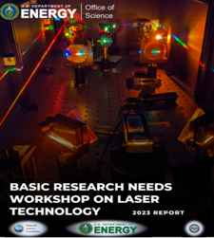
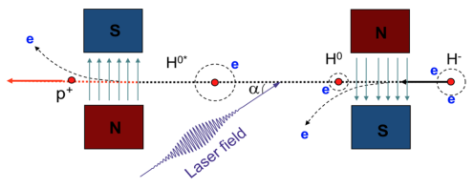
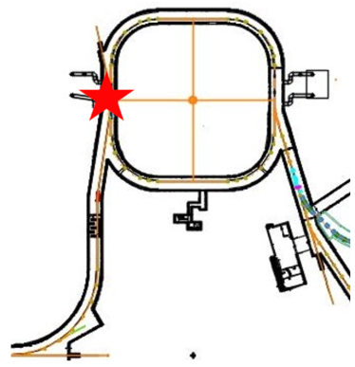
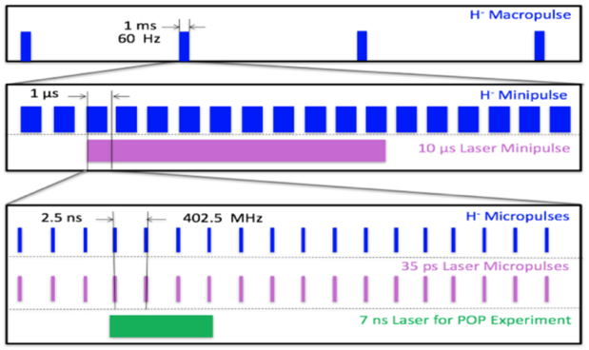

High average power (kW+) and high rep-rate (kHz+) lasers are needed
for new precision LPAs, light sources, and RF accelerator upgrades
Laser plasma acceleration (LPA)
Community Planning Priorities (DOE & National Academies)
Laser-based beam manipulation & stripping at RF accelerator facilities:
kHz+ lasers can enable laser Compton scattering for bunch intensity control in RF accelerators, e.g. FCC-ee
Laser-assisted stripping (LACE) overcomes power limits of current foil-based e- stripping. It needs: kW+ class power, MHz pulses in macro-pulses
  LPA based applications and light sources need kHz+ rates
  kHz+ rates can enable precision LPAs via feedback control
  New laser requirements for future kHz+ LPAs
High average power capability (up to 100’s kW)
High wall-plug efficiency (10s%)
Current Ti:sapphire lasers limited
  Need new laser technology beyond kHz rep-rate!
Promising: Fiber laser, Tm:YLF bulk, Yb:YAG bulk
  LACE Principle
Laser parameter | In progress | kBELLA* (GeV e-) | 10 kHz driver | 5 GeV driver
Energy | ~0.2J | 3J | 3J | 10J
Pulse duration | ~40fs | 30fs | 30fs | 30fs
Rep-rate | 5 kHz | 1kHz | 10kHz | 50kHz
Average power | ~1kW | 3kW | 30kW | 500kW
  LACE at SNS, ORNL
  Complex pulse structure at SNS

Slide 3
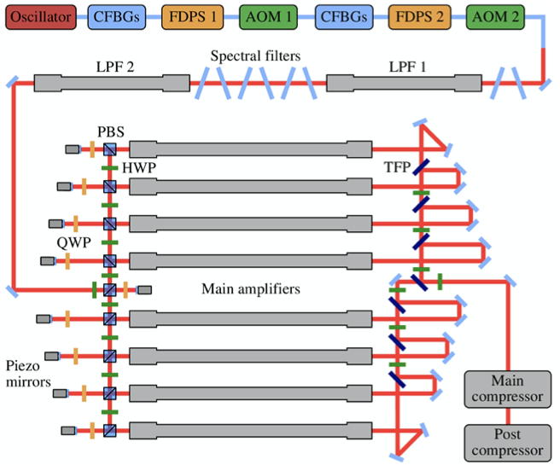

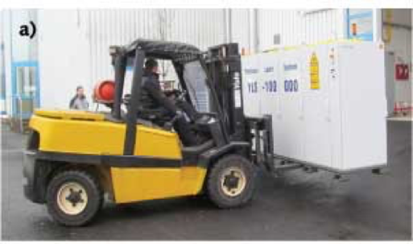
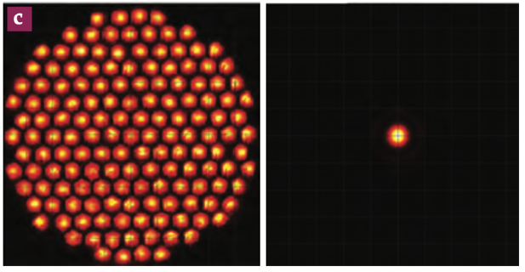

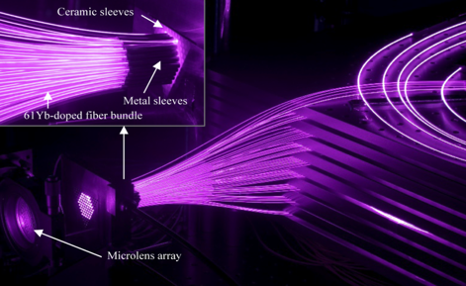

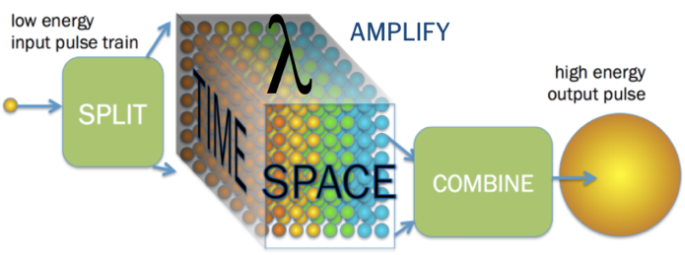
Coherently-combined fiber lasers can provide high power, rep-rate, energy, and efficiency
Fiber laser: most efficient high power laser & compactly integrable
Coherent combined fiber lasers rapidly developing worldwide, enabling high energy and power
Commercial fiber laser
from IPG Photonics
(120 kW CW, WPE>45% )
nLIGHT’s 300 kW tiled-aperture combined fiber laser
61-fiber-laser combining system (1kW, ~250fs)
32mJ, 158fs, 640W combining 16 fibers
10mJ, 120fs, 1kW combining 16 fibers
- Physics Today 77 (1), 2024
- Fsaifes et al. Opt. Express 28, (2020)
- Stark et al. Optics Letters 48, 3007 (2023)
- Stark et al. Optics Letters 46, 969 (2021)
LBNL, U Michigan, collaborators established scalable, multi-dimensional fiber combining architecture for high power, rep-rate, energy, efficiency
100-200 mJ, 1 kW demonstrators at multi-kHz rep-rates are in progress at UM (built) and LBNL
Demonstrated:
Temporally combined 81 pulses
Spatially combined 81 beams
Spectrally combined to 42 fs
Spatial-temporal combining (4x81) to 27mJ at 9.5 mJ/channel, kHz
- A. Rainville, et al. Optica 11.11 (2024)
- Q. Du, et al. Opt. Express 29.4 (2021)
- S. Chen, et al. Opt. Express 31.8 (2023)
- A. Rainville, et al. CLEO 2023, pp. SF3H.6

Slide 4
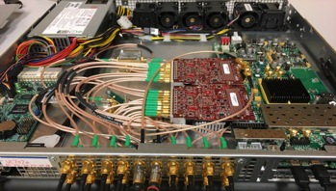

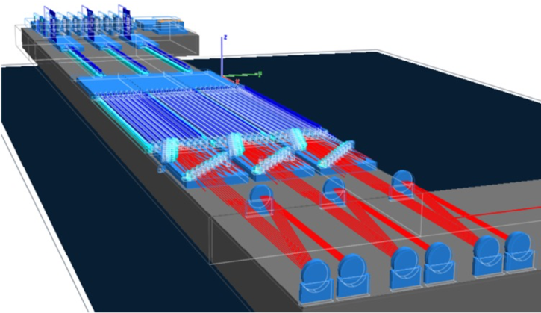



A 150 mJ, 40 fs, 5 kHz demonstrator is in progress at LBNL,
directly enabling kHz LPA and scalable to higher energy
3x - 4x
2x - 3x
nonlinear fiber amp
spectral splitting
pulse shaper
spectral filter
pulse modulator
beam splitter
beam combining
temporal
combining
Yb fiber amp
phaser
fs oscillator
pulse stretcher
Yb fiber amp
pulse modulator
fiber amp
fiber amp
pulse
compressor
(150mJ output)
amp & pha modulator
pulse compressor
spectral
combining
Coherently combine fiber laser pulses in space, time, and spectrum:
Final fiber amps
(>250mJ total)
Temporal pulse stacking: Stack ~100 pulses in time to extract all stored energy (10 mJ per fiber)
Spatial beam combining: Power and energy scaling (>250 mJ from 3x9 fibers)
Spectral combining: Simultaneous energy/power scaling and pulse duration reduction (from >100 fs to 30-50 fs)
Architecture scalable to 10 J & 100s kW, >30% wall-plug efficiency, capable of compact system integration

Slide 5
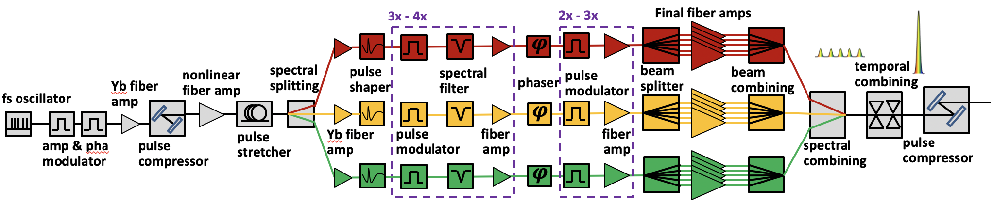
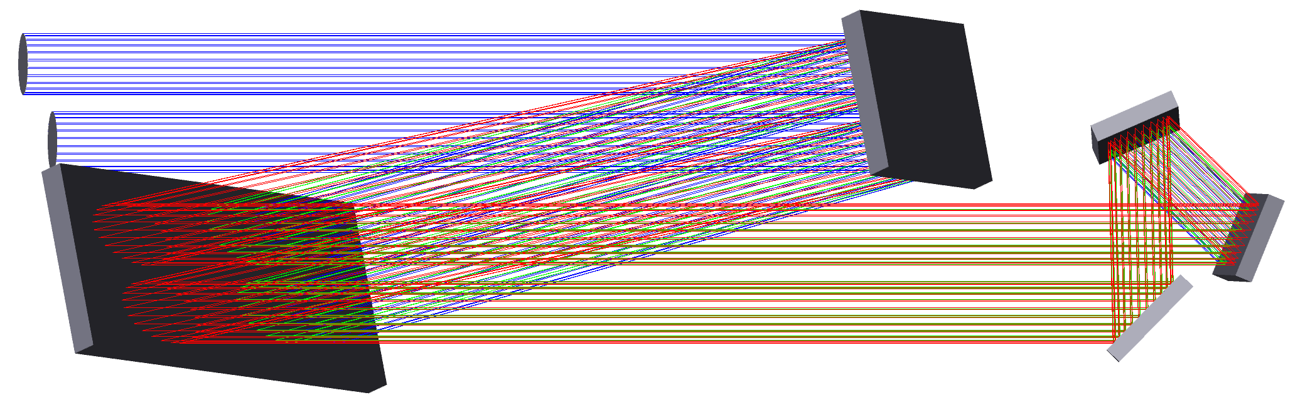
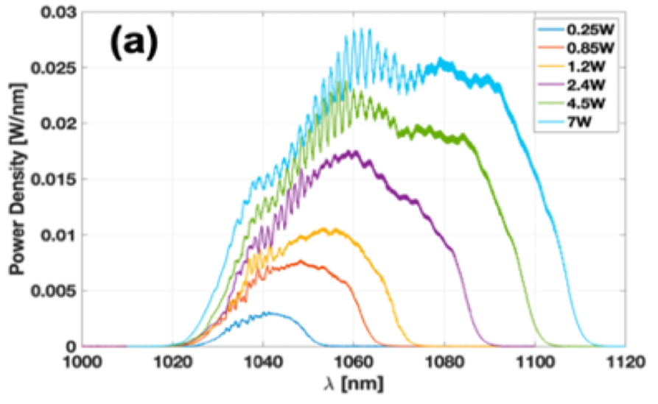
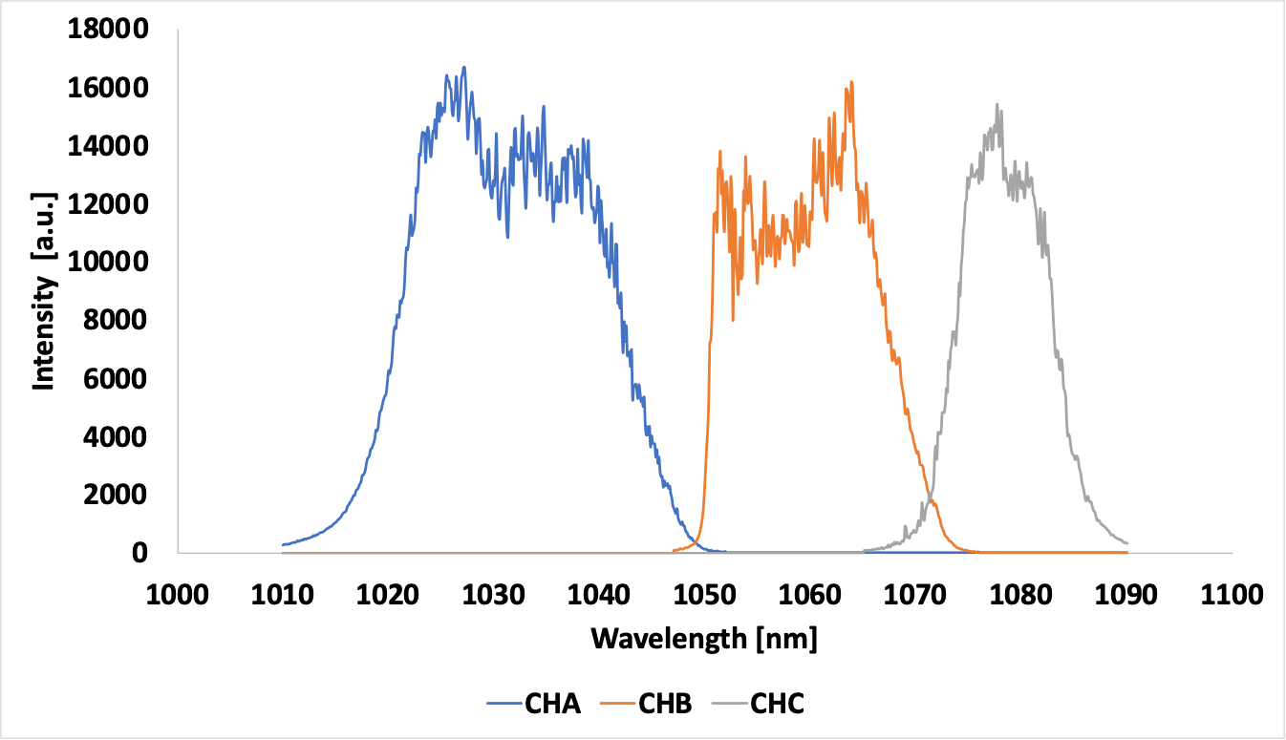
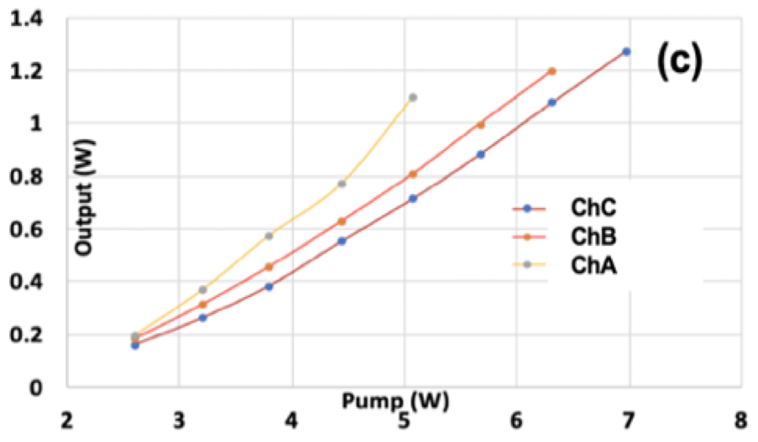
The 150mJ, 5kHz demonstrator is a fiber CPA system operating with
full bandwidth of Yb:fiber gain spectrum
- M. Logantha, et al. CLEO 2026, pp. JTU-220
Out-of-plane MLD grating compressor design
Backbone component is the 85µm core, high energy fiber amplifier
Spectral broadening with a gain-managed nonlinear amplifier (GMNA)
Distributed spectral filtering to mitigate gain narrowing
40µm photonic-crystal fiber pre-amplification
(1st stage)
75 nm gain bandwidth (Yb), <40 fs FWHM duration, (quasi-square spectrum)
3 spectral channels, 1020-1053 nm (A), 1049-1075 nm (B), 1070-1095 nm (C)
Programmable pulse shapers spectrally synthesized to provide full band, high-res. shaping (spectral phase & intensity)

Slide 6
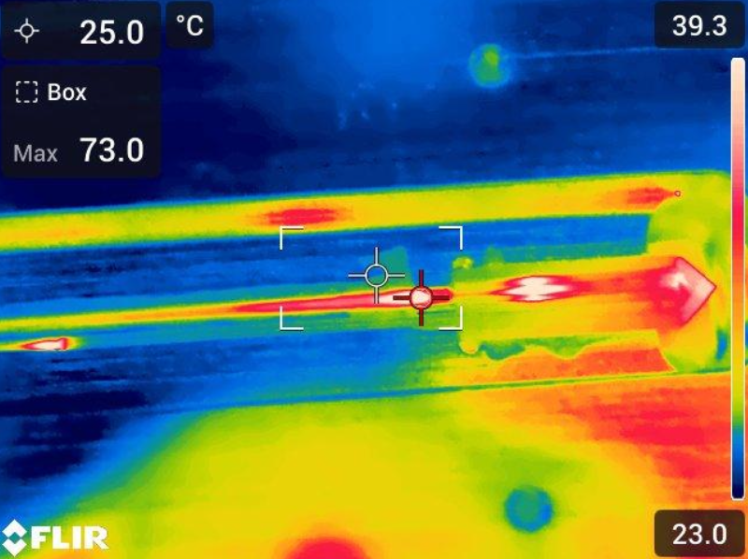
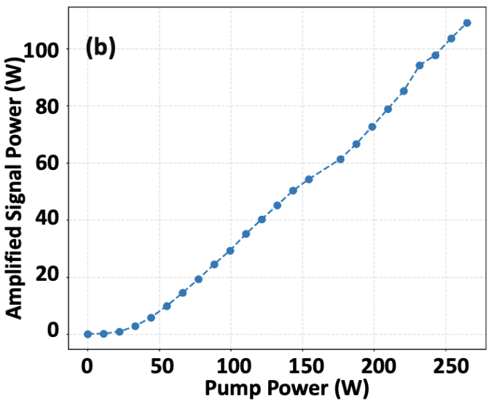
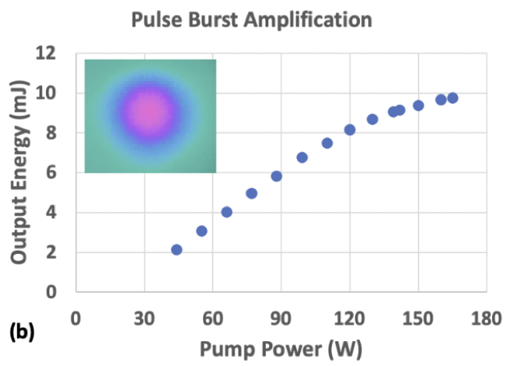
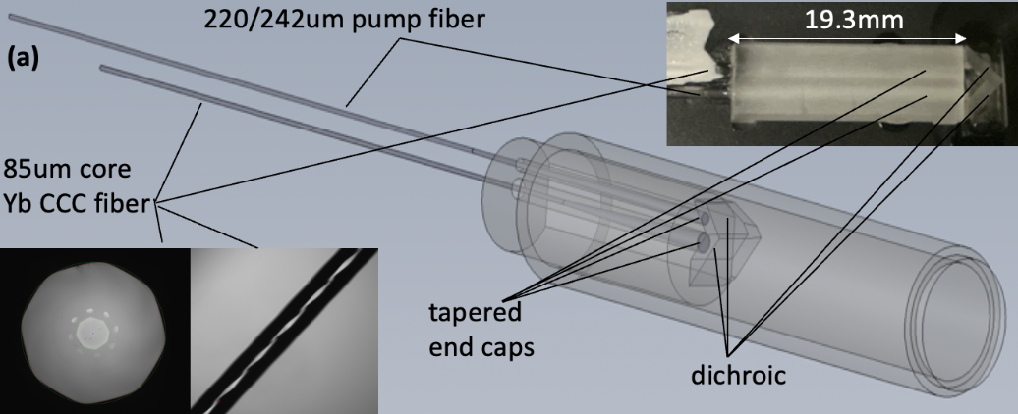




Integrated large-core fiber amplifier modules are developed
– key for scaling to high energy systems
  Today’s large-core fiber amplifiers: free-space pump light coupling
  They need to be monolithically integrated and modularized for high energy systems (robust, compact, alignment-free, low-cost → scalable)
  We developed world’s largest-core (>85µm) and highest energy (10mJ) monolithically integrated fiber amplifier (CCC-CPTEC)
  Next step: Full monolithic integration for further scalability (~1cm transverse size of current module → ~1mm )
Thermally stable at high power
- Chen, M. Chen, et al. CLEO 2026, pp. SM4H-4.

Slide 7
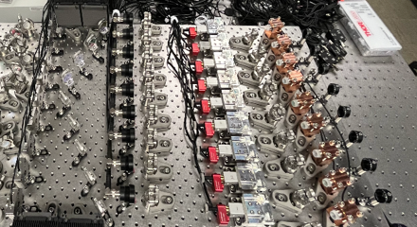
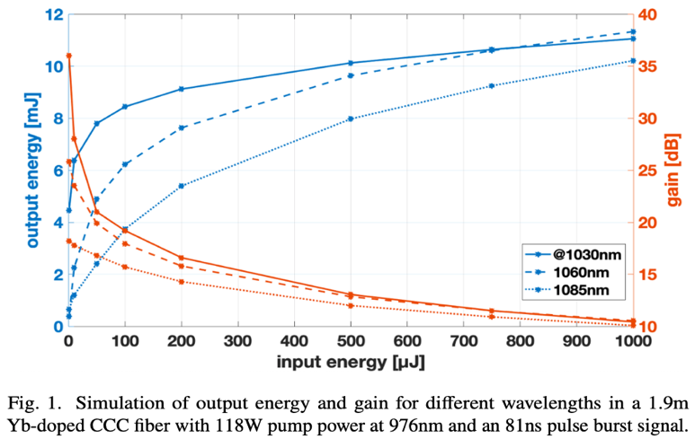
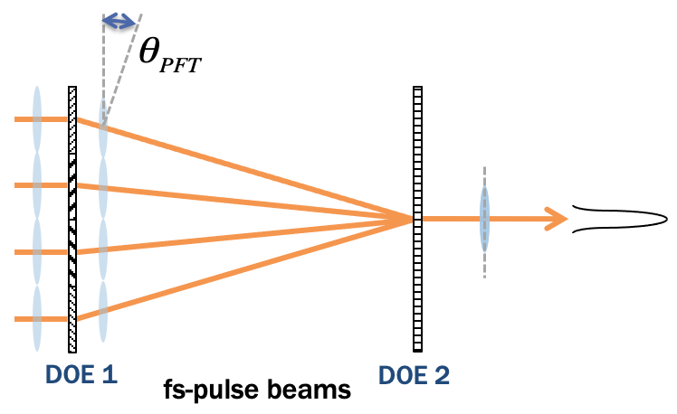
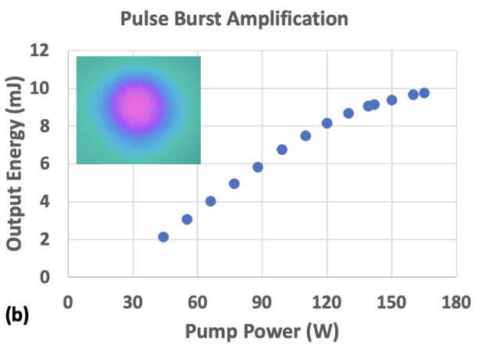
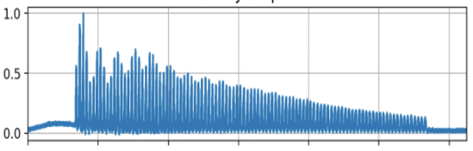
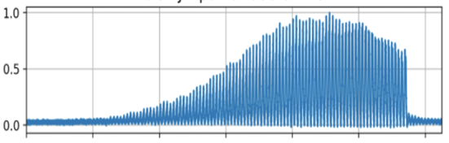
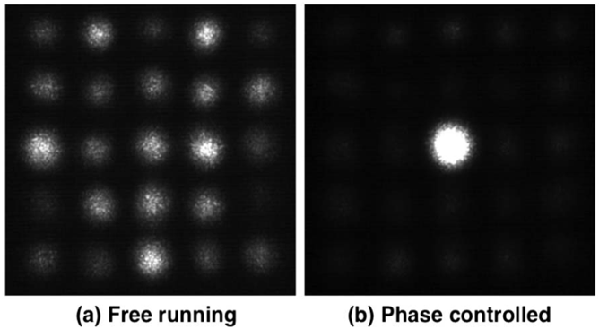
85µm core integrated fiber amplifier tested for final amplification;
Spatial diffractive beam combining in progress
…
Modeling shows high energy is achievable in different spectral channels
We developed novel diffractive pulse combining that can combine many ultrashort-pulse laser beams with two diffractive optical elements (DOE)
Previously combined eight 120-fs beams with maximum efficiency >90%
9-beam, high power DOE combiner in the 150 mJ demonstrator in progress
- T. Zhou, et al, Opt. Lett. (2017); - T. Zhou, et al. Opt. Lett. (2018); - R. Wilcox, US Patent (2019);
- D. Wang, et al, Opt. Express (2021); - Q. Du, et al, Opt. Express (2021)

Slide 8
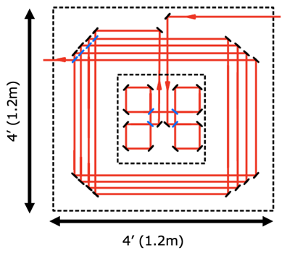
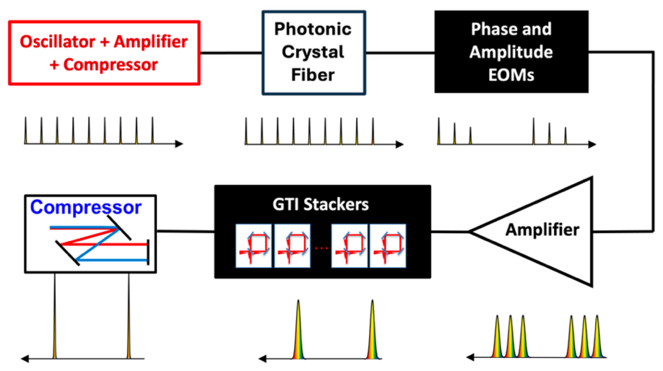
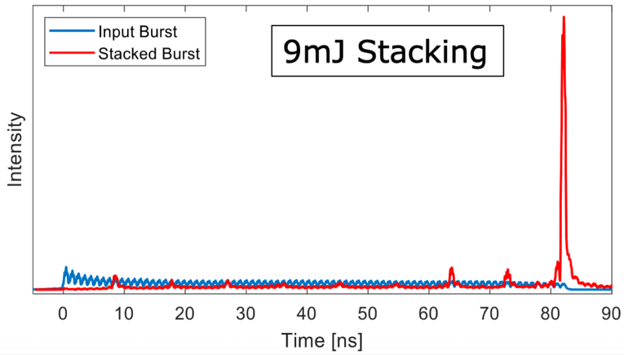
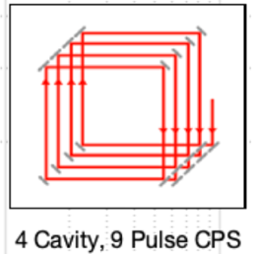
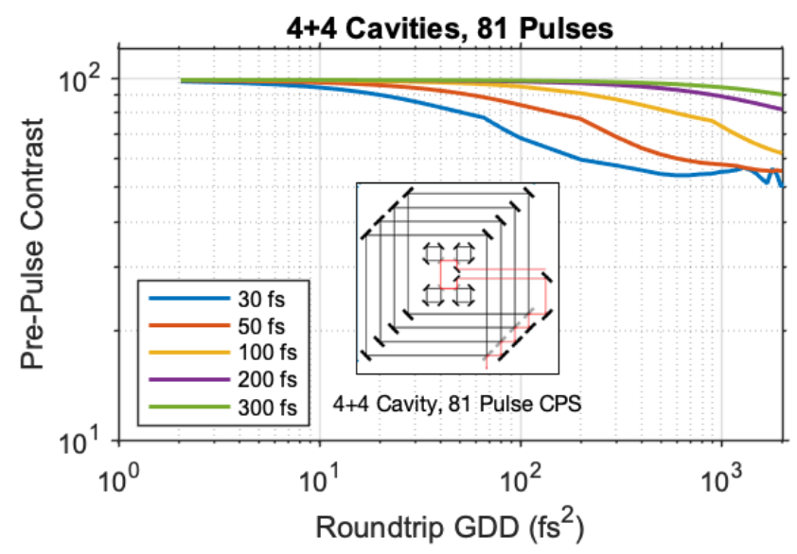
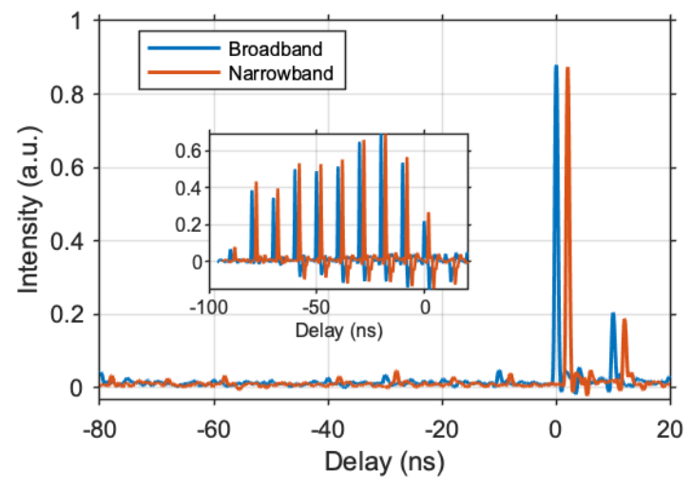
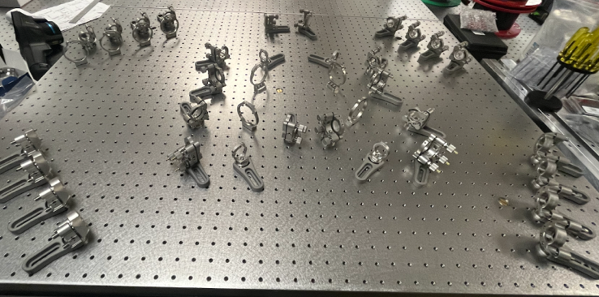
Temporal coherent pulse stacking (CPS) enables extraction of full stored energy
in fiber; CPS accommodates ultrashort pulses <50 fs
4+4 cavities to stack 81 pulses
Modeling & experiment showed broad bandwidth (supporting as short as ~30 fs) can achieve excellent stacking with low dispersion optics
T. Zhou, et al. Opt. Express 23, 7442 (2015)
A. Rainville, et al. Optica 11.11 (2024)
8-cavity, 81-pulse, broadband pulse stacker in progress at LBNL
L. Cooper, et al. CLEO 2023, pp. SF1N.6
T. Zhou, et al. Photonics West 2024, pp. PC1286503

Slide 9
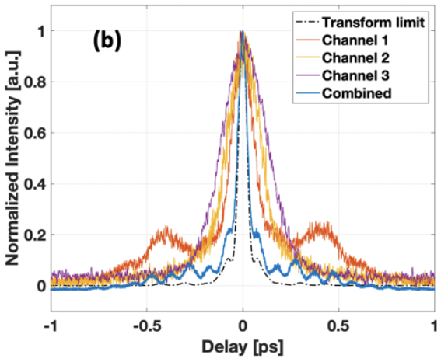
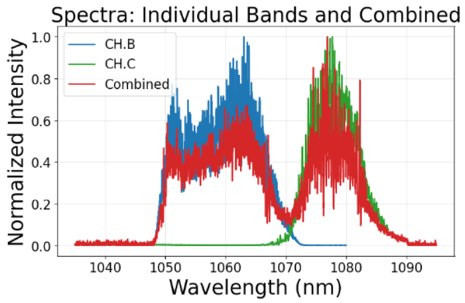
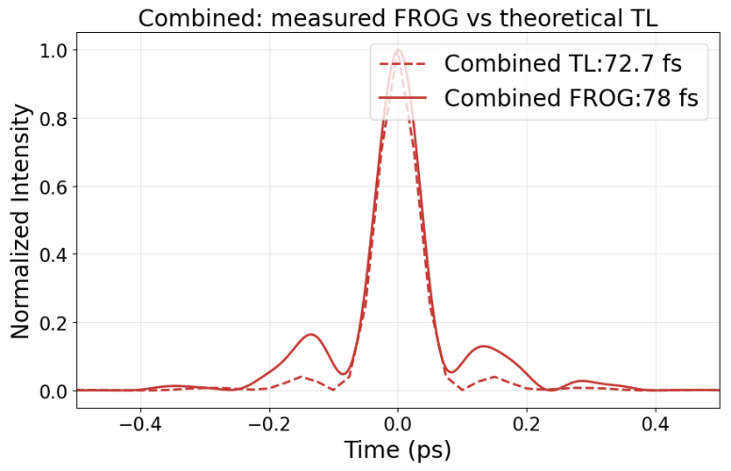
Concept of broadband spectral combining with pulse shaping proved;
Current work shows the approach works in the 150 mJ demonstrator
Proof-of-principle demo (20dB gain, 20ps chirped pulse): Record short pulse (42fs) from fiber combination systems
Coherently-spectrally synthesized pulse shaping achieves full-band spectral control
S. Chen, et al. Opt. Express 31, 12717 (2023)
T. Zhou, et al. US Patent (2025)
Current work: Extend the approach in the 150 mJ demonstrator system (high gain/energy, high dispersion)
First test: spectral combining before large-core fiber stages (80 dB gain, 800 ps chirped pulse), 2 channels
Achieved close to transform limit (TL), combined & compressed pulse (78fs vs 73 fs TL)
In next presentation by Mahek Logantha

Slide 10
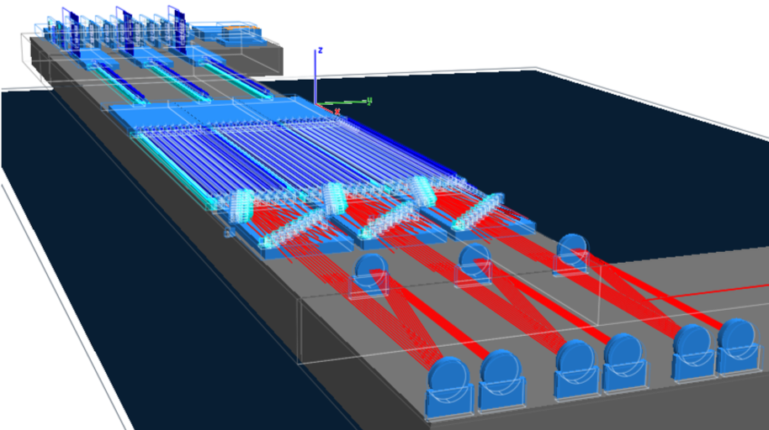
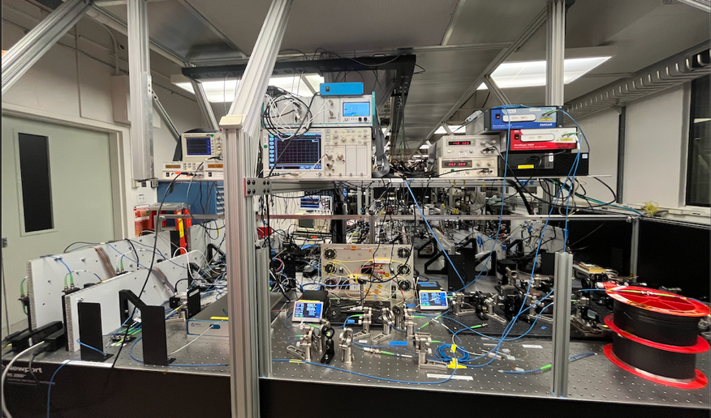
100-200 mJ, 1 kW fiber laser demonstrators are in progress:
step-stones towards high energy and power
DOE Stewardship
DOE ECRP
& Moore
10 kW Class
50 kW Class
System
engineering needed
…
<2 mJ
>50fs
2 kW
>1 MHz
(50% SNS stripping)
Type
Energy
Duration
Power
Rep-rate
Research (mostly funded)
0.15 – 0.2 J
40 fs
1 kW
5 kHz
<10 mJ
>30fs
10 kW
>1 MHz
(beam shaping, full SNS stripping)
<60 mJ
>30fs
60 kW
>1 MHz
(beam shaping, future high intensity facility stripping)
Research (funded)
0.1 J
100 fs
1 kW
10 kHz
Facility
1 J
30 fs
10 kW
10 kHz
Facility
3 J
30fs
30 kW
10 kHz
OR:
OR:
OR:
12-Channel system has been built at UM:
- 2:50pm presentation by Christopher Pasquale
27-Channel system (3 spectral bands) in progress at LBNL:
3 spectral bands

Slide 11

Summary
kW+, kHz+, efficient lasers needed for new precision LPAs, light sources, and RF accelerator upgrades
LBNL, UM, and collaborators established scalable fiber combining architecture, up to 10 J, 100s kW
A 150 mJ, 40 fs, 5 kHz fiber demonstrator is in progress at LBNL, directly enabling kHz LPA, scalable
100-200 mJ, 1 kW fiber laser demonstrators are in progress at UM (built) and LBNL: step-stones towards high energy and power
Coherent combining in space, time, and spectrum: Simultaneous energy/power scaling and pulse duration reduction
Developed integrated large-core fiber amplifier (scalability), tested record high energy (10 mJ)
Temporal & Spatial combining tested broadband operation supporting the demonstrator
Spectral combining tested large bandwidth, dispersion, and gain; Validated for the demonstrator
This work is supported by DOE Office of High Energy Physics, including the Accelerator Stewardship program, and the Gordon and Betty Moore Foundation.

