Slide 1
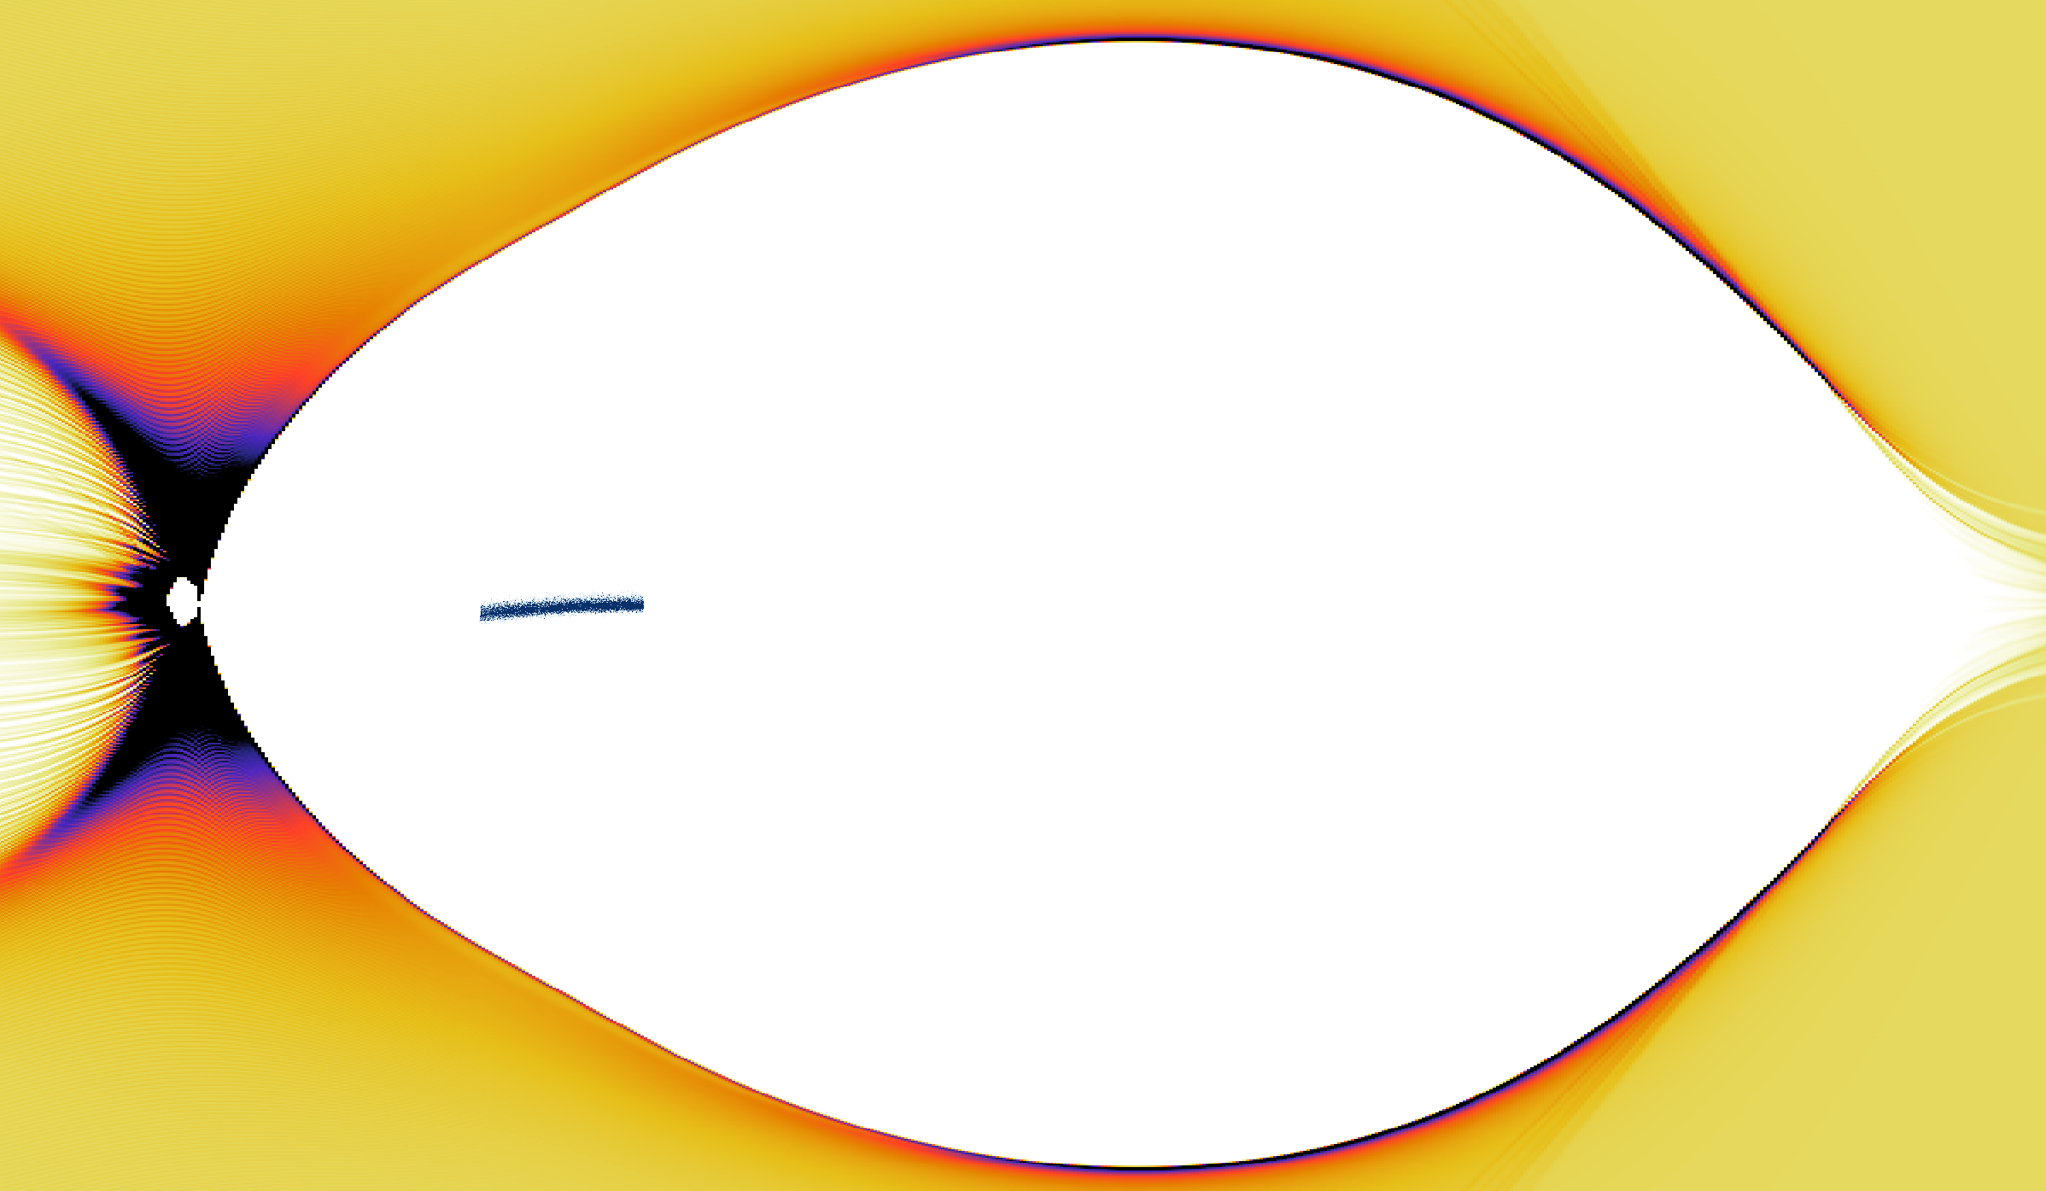
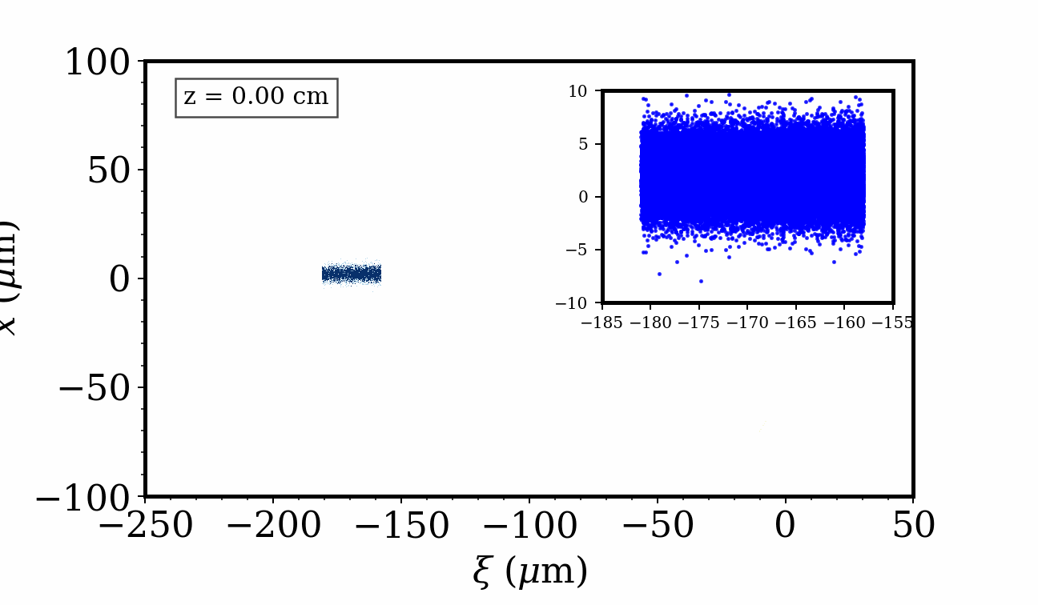





Investigation of transverse instability in efficient plasma-based accelerators
Arohi Jain, Navid Vafaei-Najafabadi
Stony Brook University
1

Slide 2
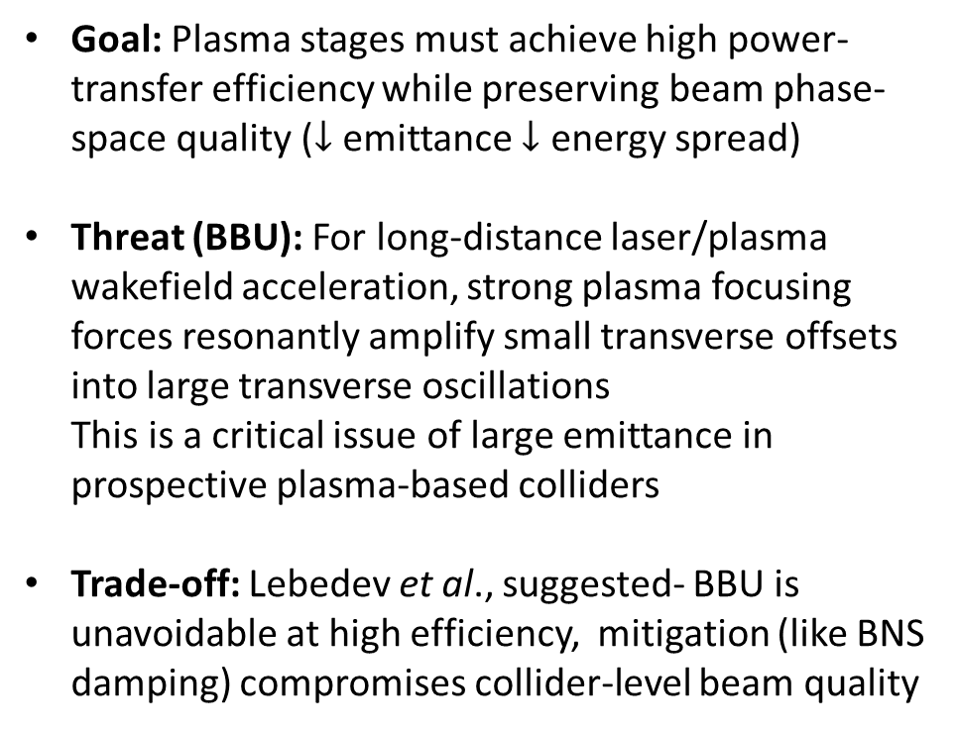

Efficiency vs Instability
Goal: Plasma stages must achieve high power-transfer efficiency while preserving beam phase-space quality ($↓$ emittance $↓$ energy spread)
Threat (BBU): For long-distance laser/plasma wakefield acceleration, strong plasma focusing forces resonantly amplify small transverse offsets into large transverse oscillations This is a critical issue of large emittance in prospective plasma-based colliders
Trade-off: Lebedev et al., suggested- BBU is unavoidable at high efficiency, mitigation (like BNS damping) compromises collider-level beam quality
Beam-breakup (BBU) instability growth
$$x(μm)$$
Trailing bunch
$↓$Instability $↑$E$fficiency↓$ Energy spread
Lebedev et al., PRAB(2017)

Slide 3
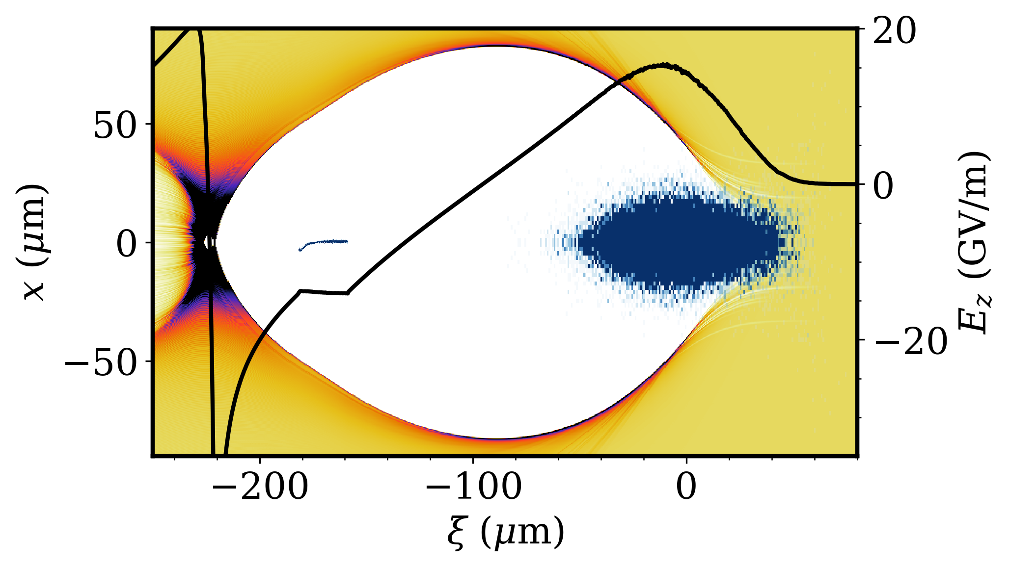
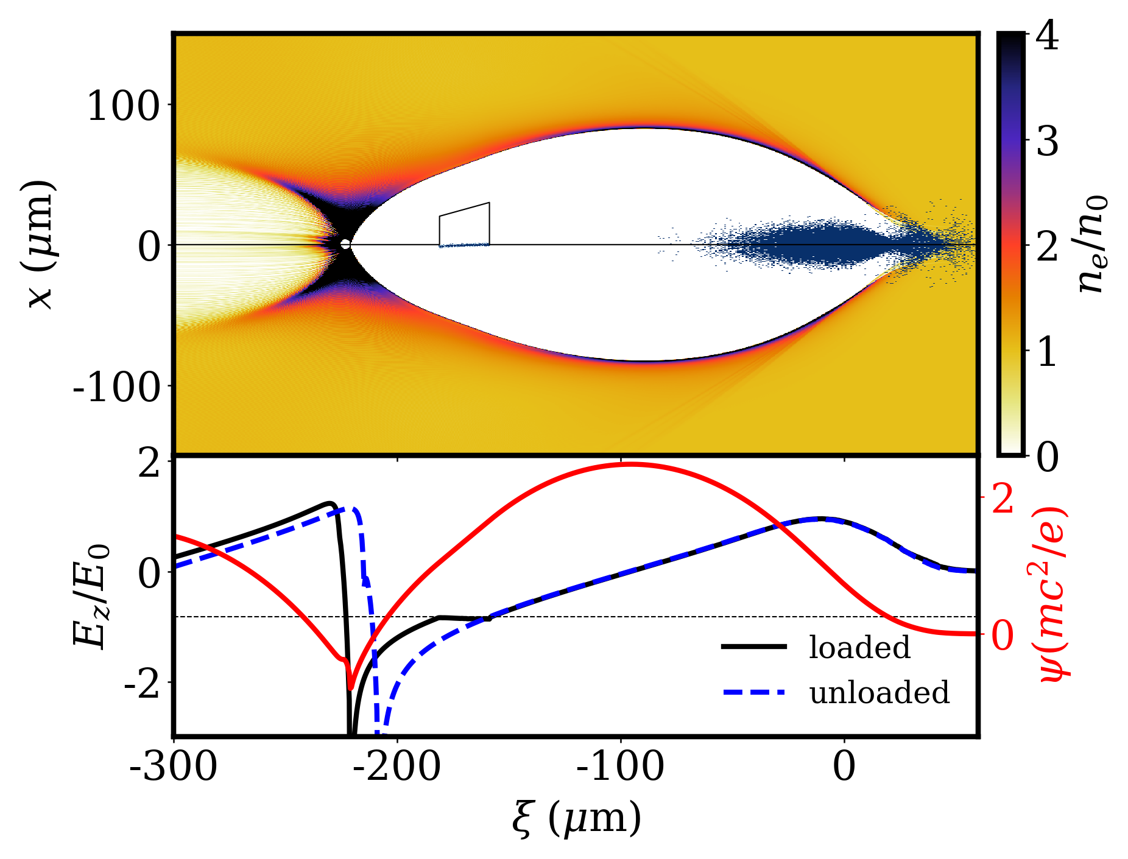
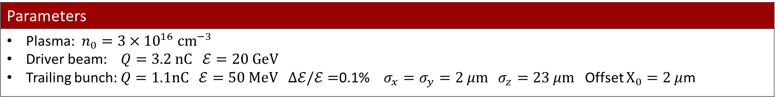
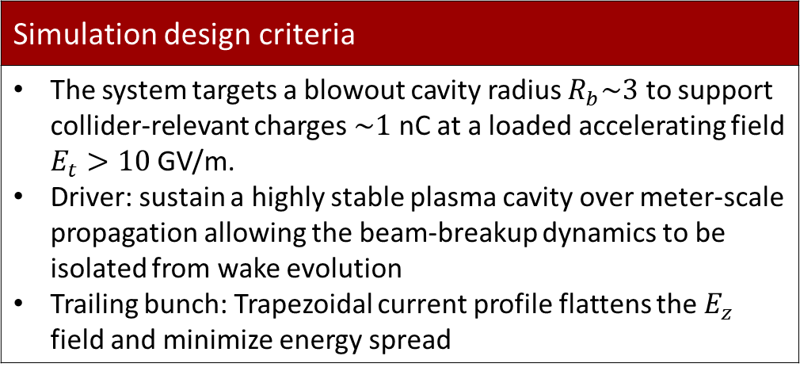

Beam loading for achieving low energy spread
Simulation design criteria
The system targets a blowout cavity radius $R_{b}\sim 3$ to support collider-relevant charges $\sim 1$ nC at a loaded accelerating field $E_{t}>10$ GV/m. Driver: sustain a highly stable plasma cavity over meter-scale propagation allowing the beam-breakup dynamics to be isolated from wake evolution Trailing bunch: Trapezoidal current profile flattens the $E_{z}$ field and minimize energy spread
Trapezoidal trailing bunch
$E_{t}=14$GV/m
Driver
Parameters
Plasma: $n_{0}=3×{10}^{16} {\text{cm}}^{−3}$ Driver beam: $Q=3.2 nC ℰ=20 GeV$ Trailing bunch: $Q=1.1nC ℰ=50 MeV Δℰ/ℰ=$0.1% $σ_{x}=σ_{y}=2 μm$ $σ_{z}=23 μm$ Offset $X_{0}=2 μ$m
M. Tzoufras et al., PRL(2008)
A.Jain et al., PRR(2026)
Jiayang Yan PhD thesis (2025)

Slide 4
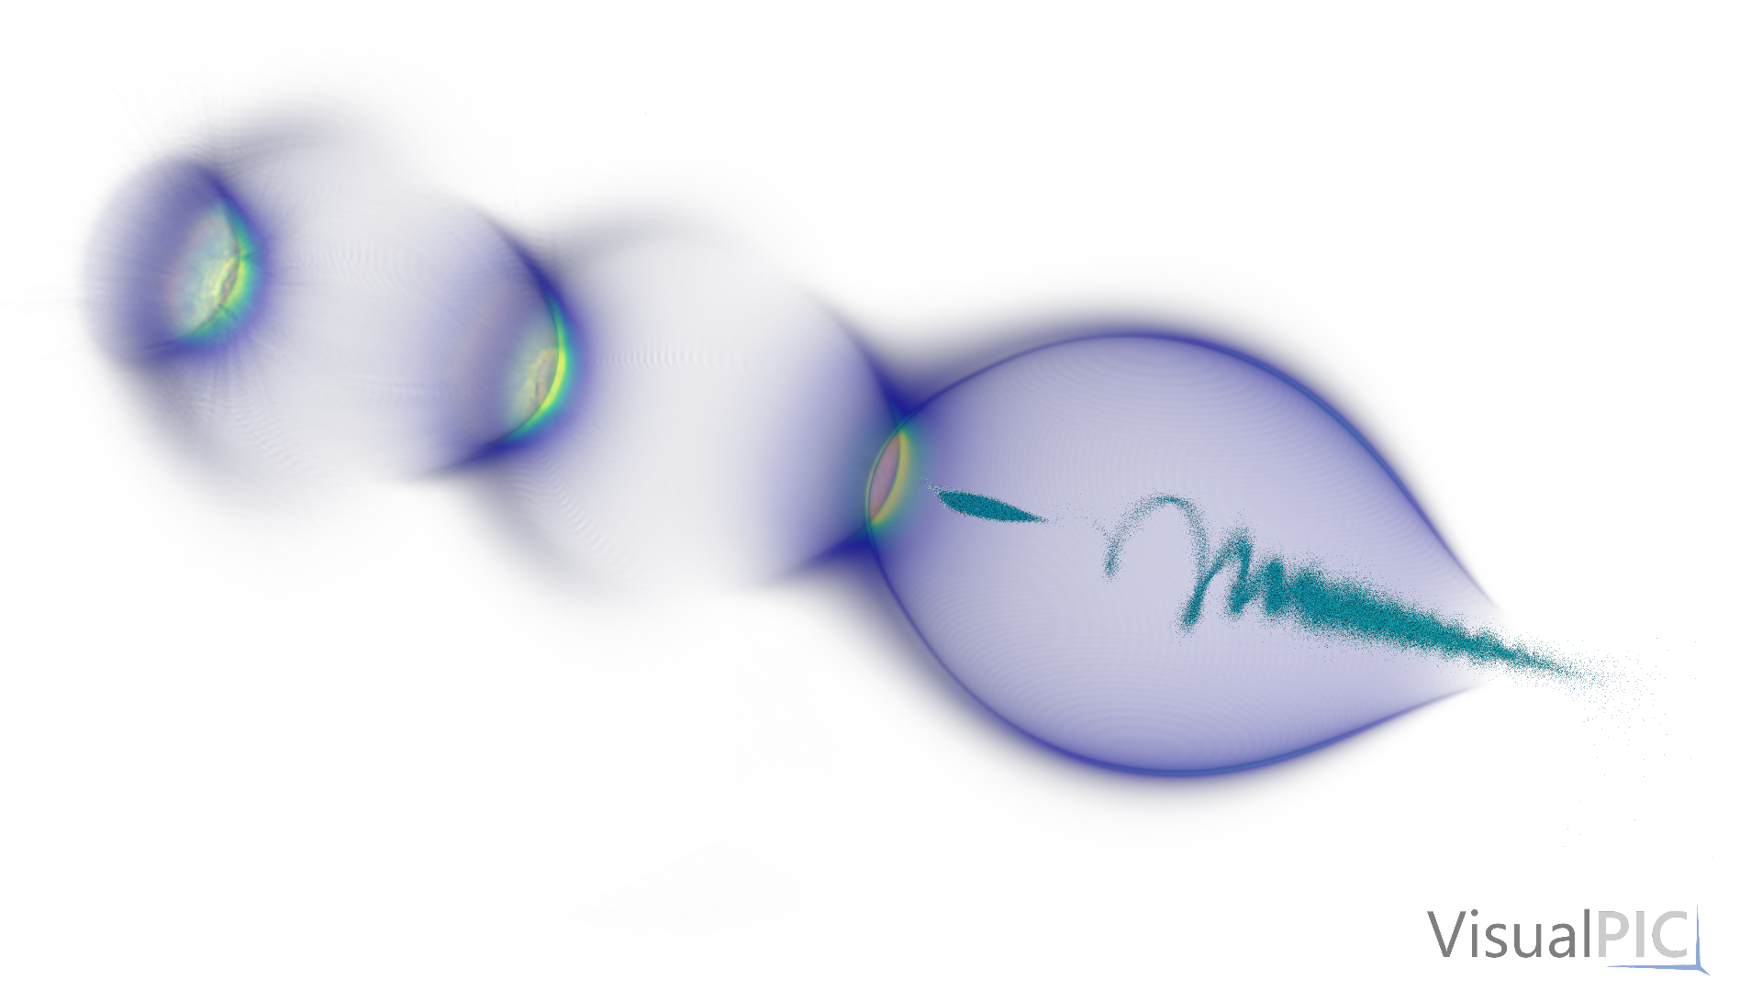

The code HiPACE++
3D, QS PIC for plasma acceleration
Runs on GPU and (multi-core) CPU
Open-source:https://github.com/Hi-PACE/hipace
Documentation: https://hipace.readthedocs.io/en/latest/
Main features:
  Multiple beams and plasma species to simulation beam-driven wakefield acceleration
  A laser envelope solver to simulate laser-driven wakefield acceleration
  Mesh refinement for efficient computation
  An advanced explicit field solver for increased accuracy
  Diagnostics compliant with the openPMD standard
  Arbitrary profiles for the beams and plasma profiles
  Readers from files for the beam and laser profiles
S. Diederichs et al., Comput. Phys. Comm. 278: 108421 (2022)

Slide 5
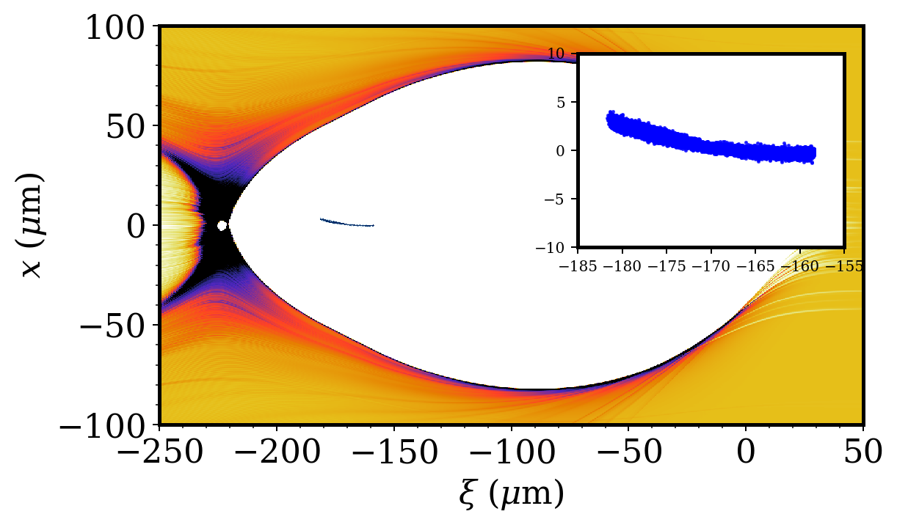

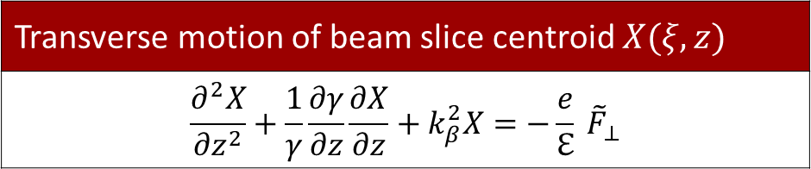


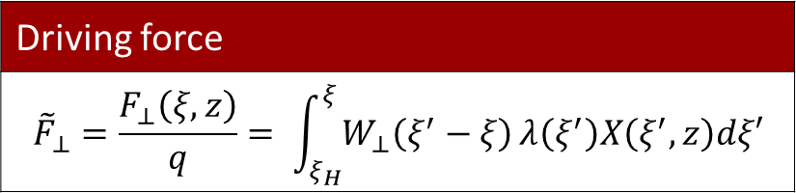

Modelling beam-breakup instability
Transverse motion of beam slice centroid $X(ξ,z)$
$$\frac{∂^{2}X}{∂z^{2}}+\frac{1}{γ}\frac{∂γ}{∂z}\frac{∂X}{∂z}+k_{β}^{2}X=−\frac{e}{ℇ} {\tilde{F}}_{⊥}$$
$$X(ξ)$$
$$X(ξ_{H})$$
Centroid
Adiabatic damping due to energy gain
Ion restoring force
$$ξ$$
$$ξ_{H}$$
Bunch head position
Driving force
$${\tilde{F}}_{⊥}=\frac{F_{⊥}\left(ξ,z\right)}{q}= \int_{ξ_{H}}^{ξ}{W_{⊥}\left(ξ^{′}−ξ\right)}λ\left(ξ^{′}\right)X\left(ξ^{′},z\right)dξ′$$
Precise determination of transverse wake function $W_{⊥}$ is crucial for accurate modeling of transverse instabilities in a plasma accelerator

Slide 6
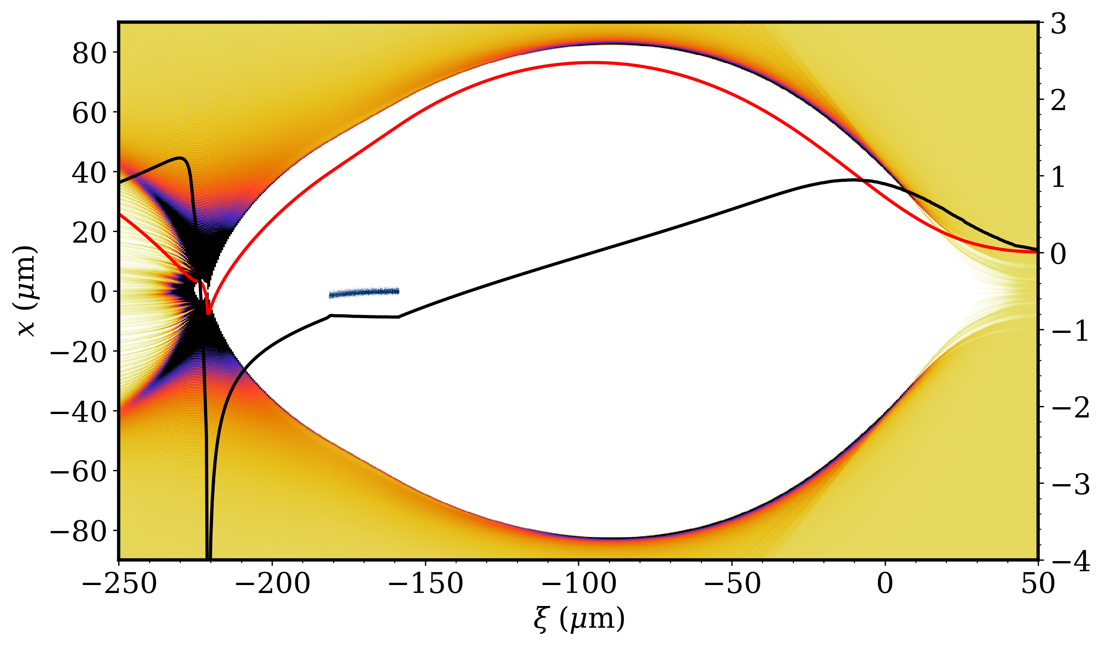
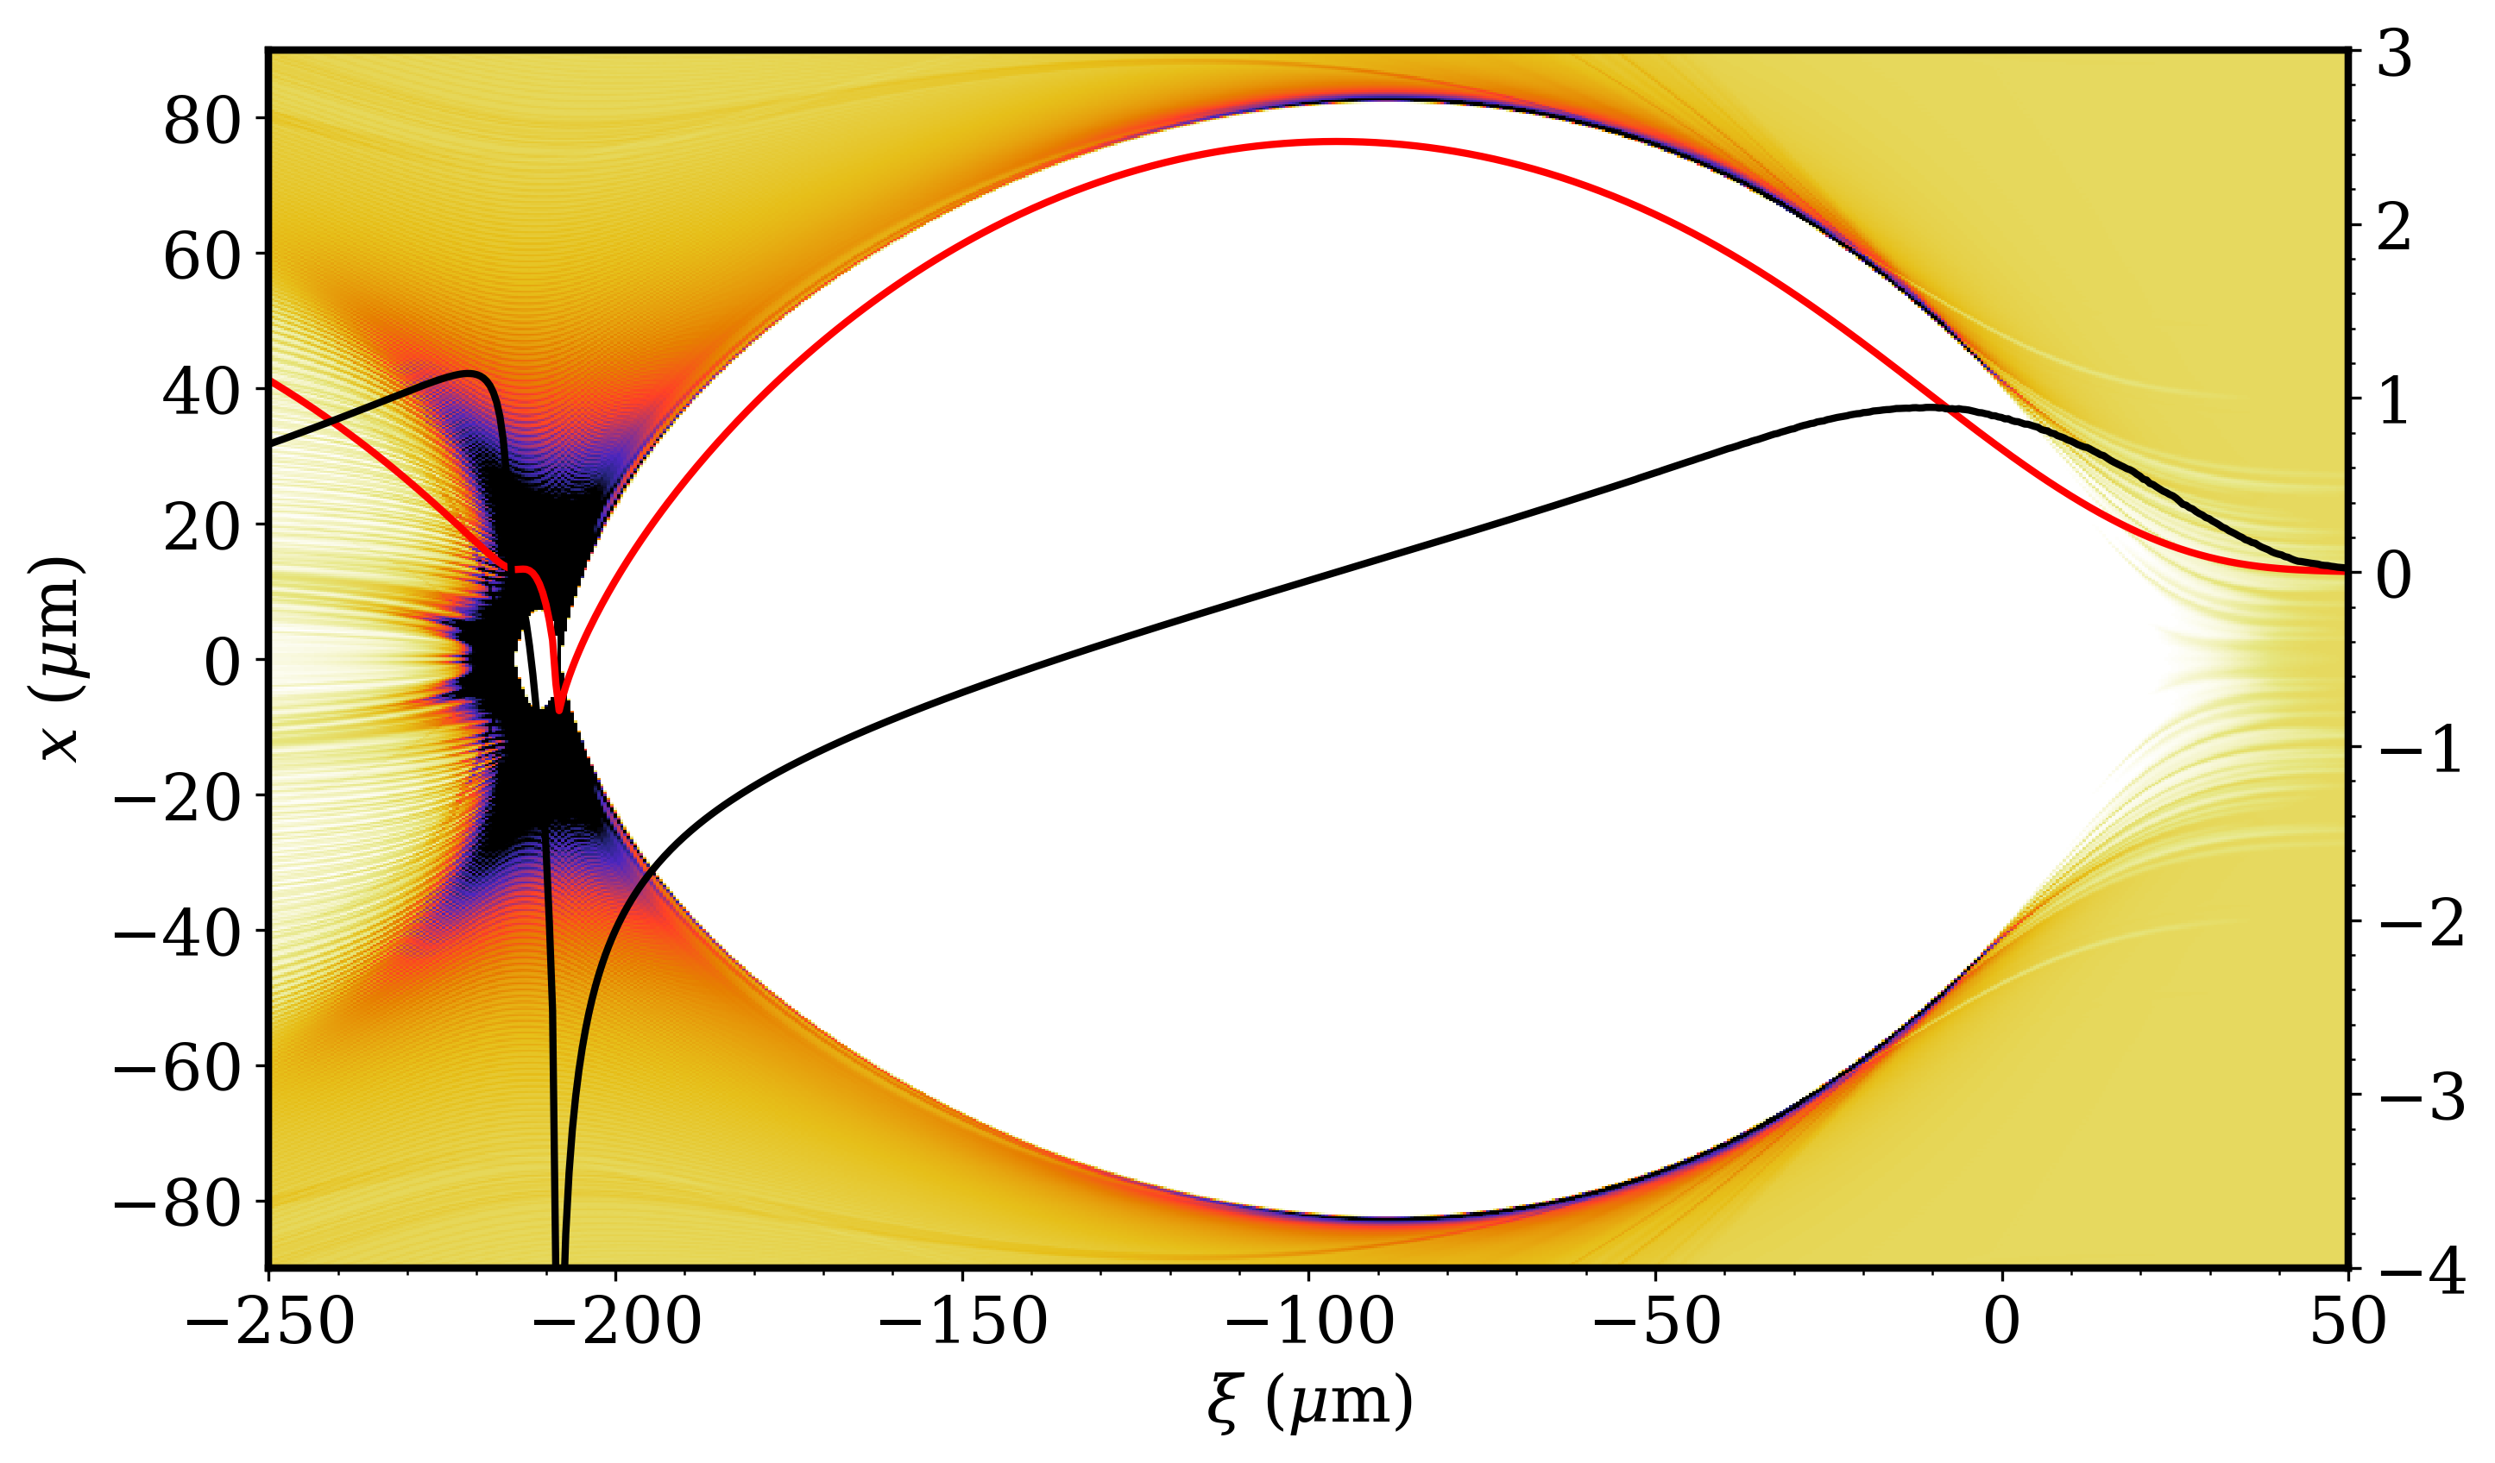

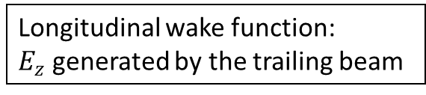
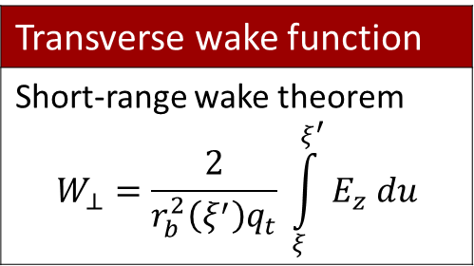

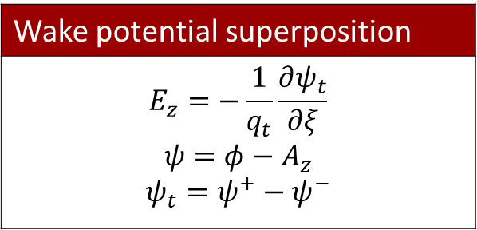

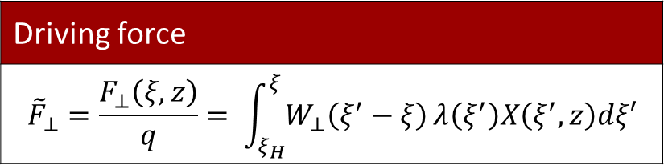

Wake potential model
Driving force
$${\tilde{F}}_{⊥}=\frac{F_{⊥}\left(ξ,z\right)}{q}= \int_{ξ_{H}}^{ξ}{W_{⊥}\left(ξ^{′}−ξ\right)}λ\left(ξ^{′}\right)X\left(ξ^{′},z\right)dξ′$$
Wake potential superposition
$$E_{z}=−\frac{1}{q_{t}}\frac{∂ψ_{t}}{∂ξ}$$ $$ψ=φ−A_{z}$$ $$ψ_{t}=ψ^{+}−ψ^{−}$$
Transverse wake function
Short-range wake theorem $$W_{⊥}=\frac{2}{r_{b}^{2}\left(ξ^{′}\right)q_{t}} \int_{ξ}^{ξ^{′}}{E_{z} du}$$
With trailing bunch
Without trailing bunch
$$ψ^{+}$$
$$ψ^{−}$$
$$E_{z}^{+}$$
$$E_{z}^{−}$$
Longitudinal wake function:
$E_{z}$ generated by the trailing beam
Our wake potential model is valid for both LWFA and PWFA

Slide 7
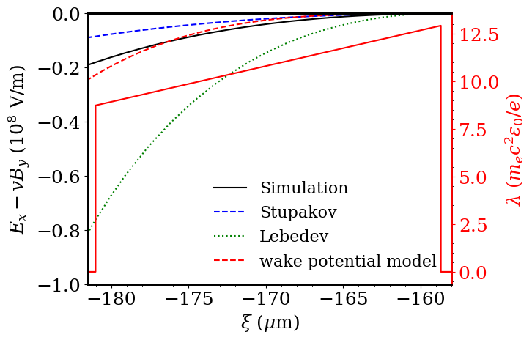
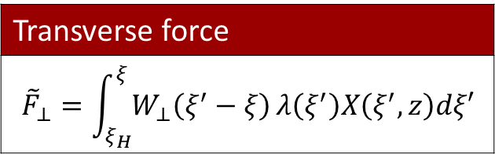
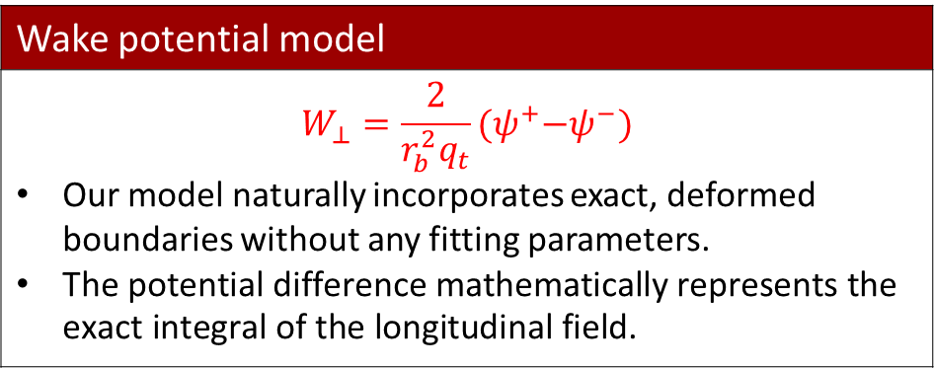
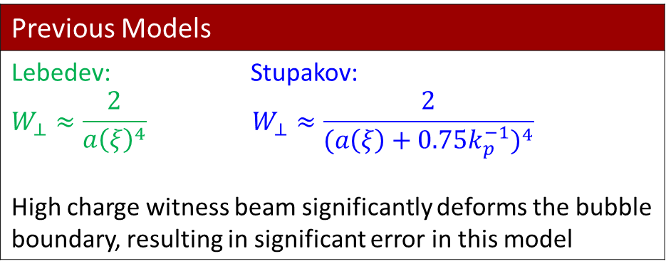
Wake potential model shows excellent agreement with simulation
Previous Models
Lebedev: Stupakov: $$W_{⊥}≈\frac{2}{a{\left(ξ\right)}^{4}} W_{⊥}≈\frac{2}{(a{\left(ξ\right)+0.75k_{p}^{−1})}^{4}}$$ High charge witness beam significantly deforms the bubble boundary, resulting in significant error in this model
Transverse force
$${\tilde{F}}_{⊥}=\int_{ξ_{H}}^{ξ}{W_{⊥}\left(ξ^{′}−ξ\right)}λ\left(ξ^{′}\right)X\left(ξ^{′},z\right)dξ′$$
Wake potential model
$$W_{⊥}=\frac{2}{r_{b}^{2}q_{t}}{(ψ}^{+}−ψ^{−})$$ Our model naturally incorporates exact, deformed boundaries without any fitting parameters. $\text{The} \text{potential} \text{difference} \text{mathematically} \text{represents} \text{the} \text{exact} \text{integral} \text{of} \text{the} \text{longitudinal} \text{field}\text{.}$
A factor-of-four error can lead to a substantial overestimate of the accumulated transverse instability.
Lebedev et al., PRAB(2017)
Stupakov et al., PRAB(2018)
A. Jain arXiv:2607.10497 (2026) [under review in PRAB]

Slide 8
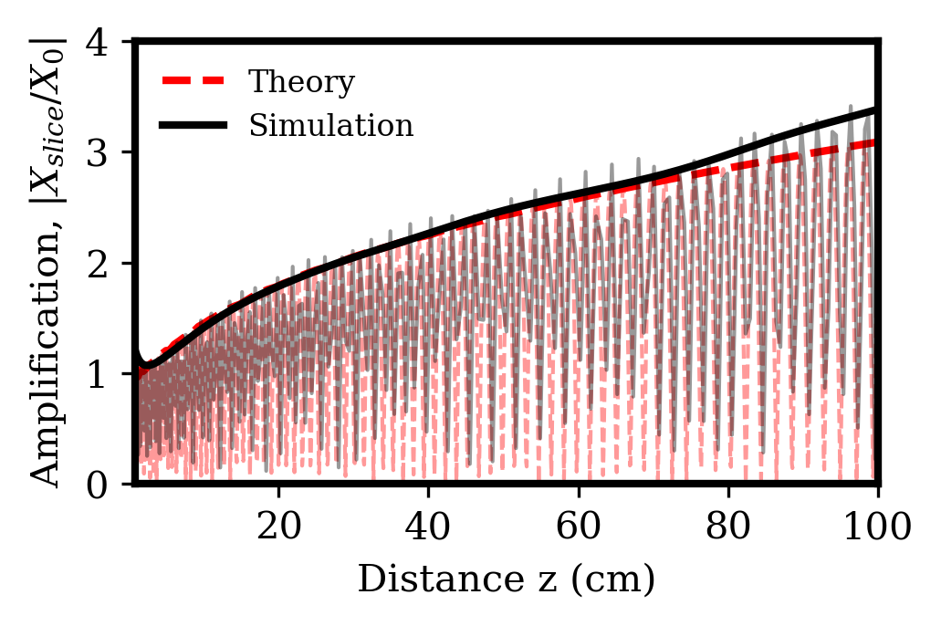
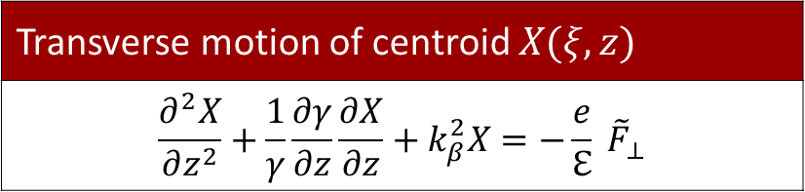

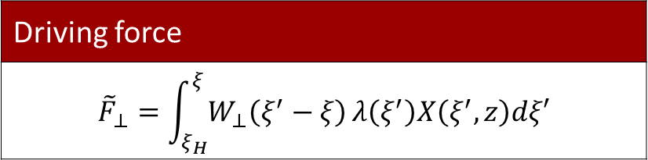
Bunch slice centroid evolution
Transverse motion of centroid $X(ξ,z)$
$$\frac{∂^{2}X}{∂z^{2}}+\frac{1}{γ}\frac{∂γ}{∂z}\frac{∂X}{∂z}+k_{β}^{2}X=−\frac{e}{ℇ} {\tilde{F}}_{⊥}$$
Driving force
$${\tilde{F}}_{⊥}=\int_{ξ_{H}}^{ξ}{W_{⊥}\left(ξ^{′}−ξ\right)}λ\left(ξ^{′}\right)X\left(ξ^{′},z\right)dξ′$$
Transverse wake function
$$W_{⊥}=\frac{2}{r_{b}^{2}q_{t}}{(ψ}^{+}−ψ^{−})$$
The agreement remains strong over a meter of propagation at 10 GeV/m
Wake potential formalism captures the transverse beam dynamics with predictive accuracy
A. Jain arXiv:2607.10497 (2026) [under review in PRAB]

Slide 9

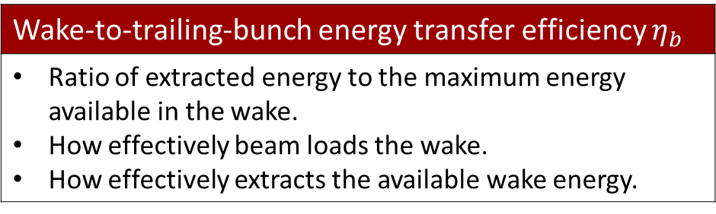

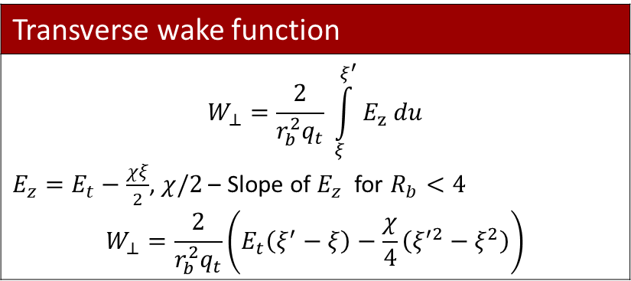
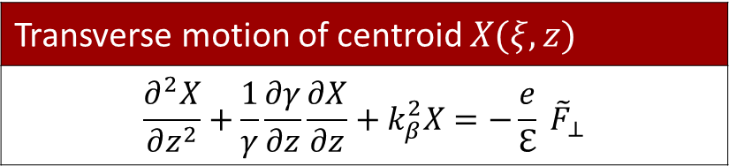
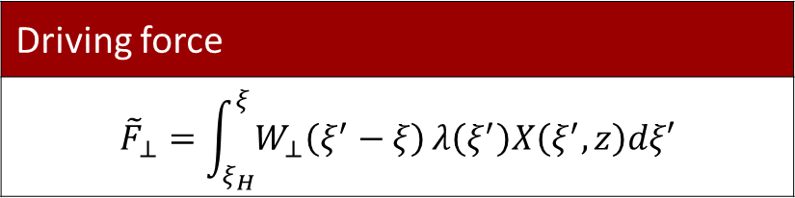
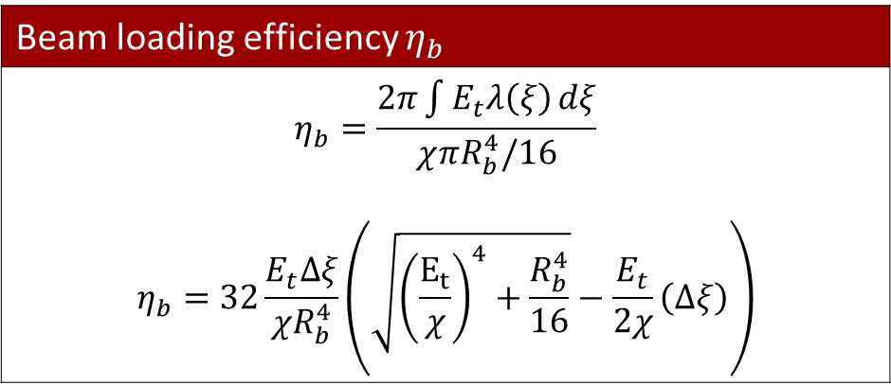
Analytical modelling of efficiency and instability
Instability- $X/X_{0}$
Efficiency- $η_{b}$
Transverse wake function
$$W_{⊥}=\frac{2}{r_{b}^{2}q_{t}} \int_{ξ}^{ξ^{′}}{E_{z} du}$$ $E_{z}=E_{t}−\frac{χξ}{2}$, $χ/2$ – Slope of $E_{z}$ for $R_{b}<4$ $$W_{⊥}=\frac{2}{r_{b}^{2}q_{t}}\left(E_{t}\left(ξ^{′}−ξ\right)−\frac{χ}{4}\left(ξ^{′2}−ξ^{2}\right)\right)$$
Wake-to-trailing-bunch energy transfer efficiency $η_{b}$
Ratio of extracted energy to the maximum energy available in the wake. How effectively beam loads the wake. How effectively extracts the available wake energy.
Beam loading efficiency $η_{b}$
$$η_{b}=\frac{2π\int{E_{t}λ\left(ξ\right)}dξ}{χ{πR}_{b}^{4}/16}$$ $$η_{b}=32\frac{E_{t}Δξ}{{χR}_{b}^{4}}\left(\sqrt{{\left(\frac{E_{t}}{χ}\right)}^{4}+\frac{R_{b}^{4}}{16}}−\frac{E_{t}}{2χ}\left(Δξ\right)\right)$$
Driving force
$${\tilde{F}}_{⊥}=\int_{ξ_{H}}^{ξ}{W_{⊥}\left(ξ^{′}−ξ\right)}λ\left(ξ^{′}\right)X\left(ξ^{′},z\right)dξ′$$
Transverse motion of centroid $X(ξ,z)$
$$\frac{∂^{2}X}{∂z^{2}}+\frac{1}{γ}\frac{∂γ}{∂z}\frac{∂X}{∂z}+k_{β}^{2}X=−\frac{e}{ℇ} {\tilde{F}}_{⊥}$$
M. Tzoufras et al., PRL (2008)
A. A. Golonov et al.,PPCF (2021)
Jiayang Yan PhD thesis (2025)

Slide 10
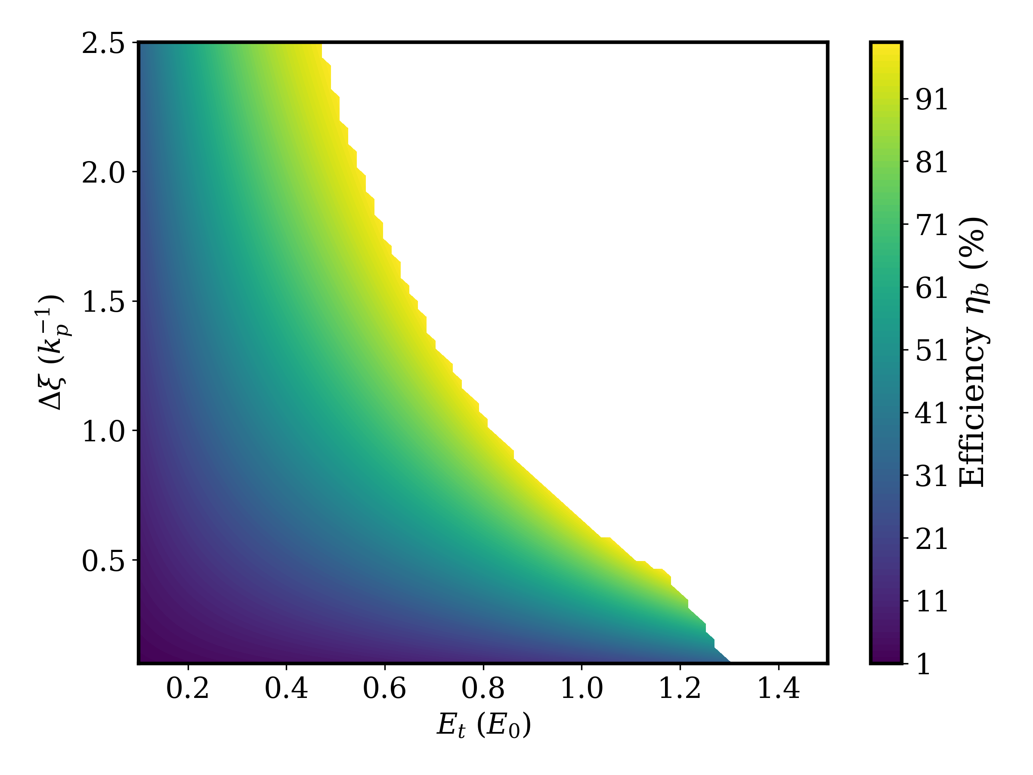
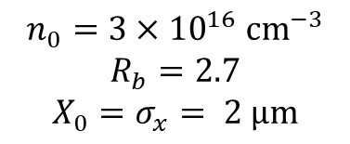
Mapping the High-Efficiency, High-Stability Operating Window
Physically inaccessible
Bunch Length
$$n_{0}=3×{10}^{16} {\text{cm}}^{−3}$$
$$R_{b}=2.7$$
$$X_{0}=σ_{x}= 2 \text{μm}$$
Loaded field
A. Jain arXiv:2607.10497 (2026) [under review in PRAB]

Slide 11
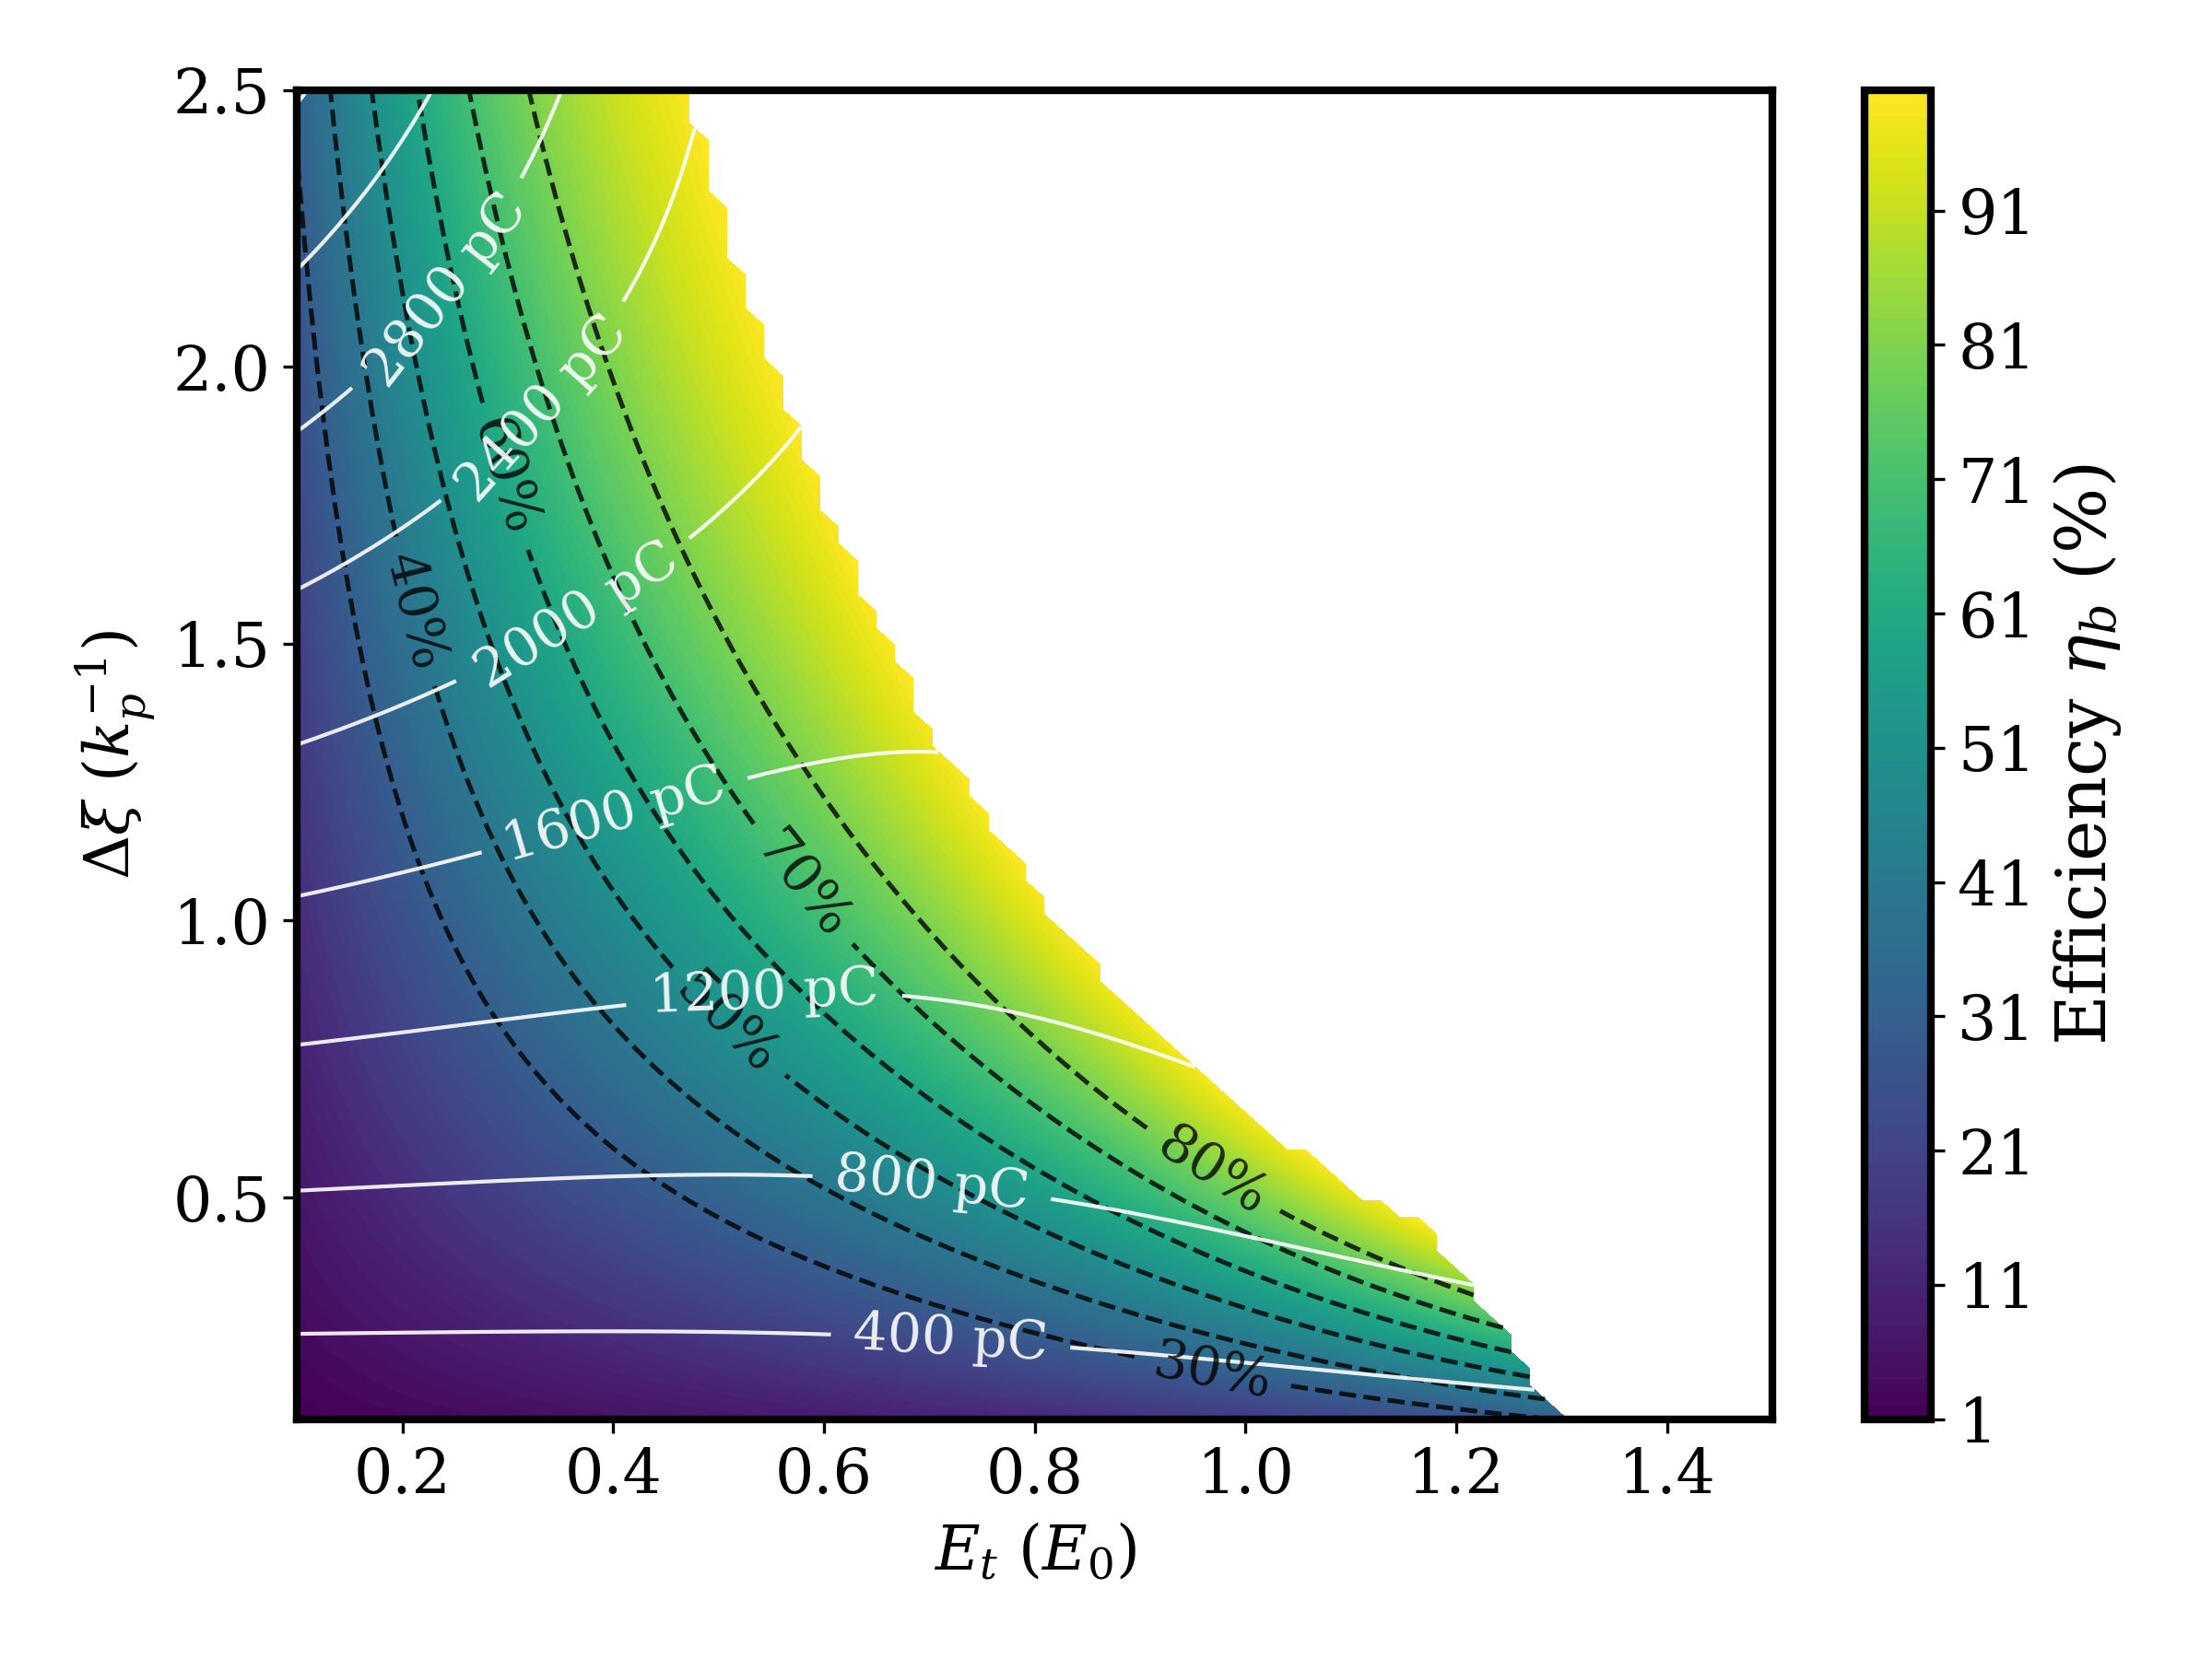
Mapping the High-Efficiency, High-Stability Operating Window
Efficiency levels
Charge
A. Jain arXiv:2607.10497 (2026) [under review in PRAB]

Slide 12
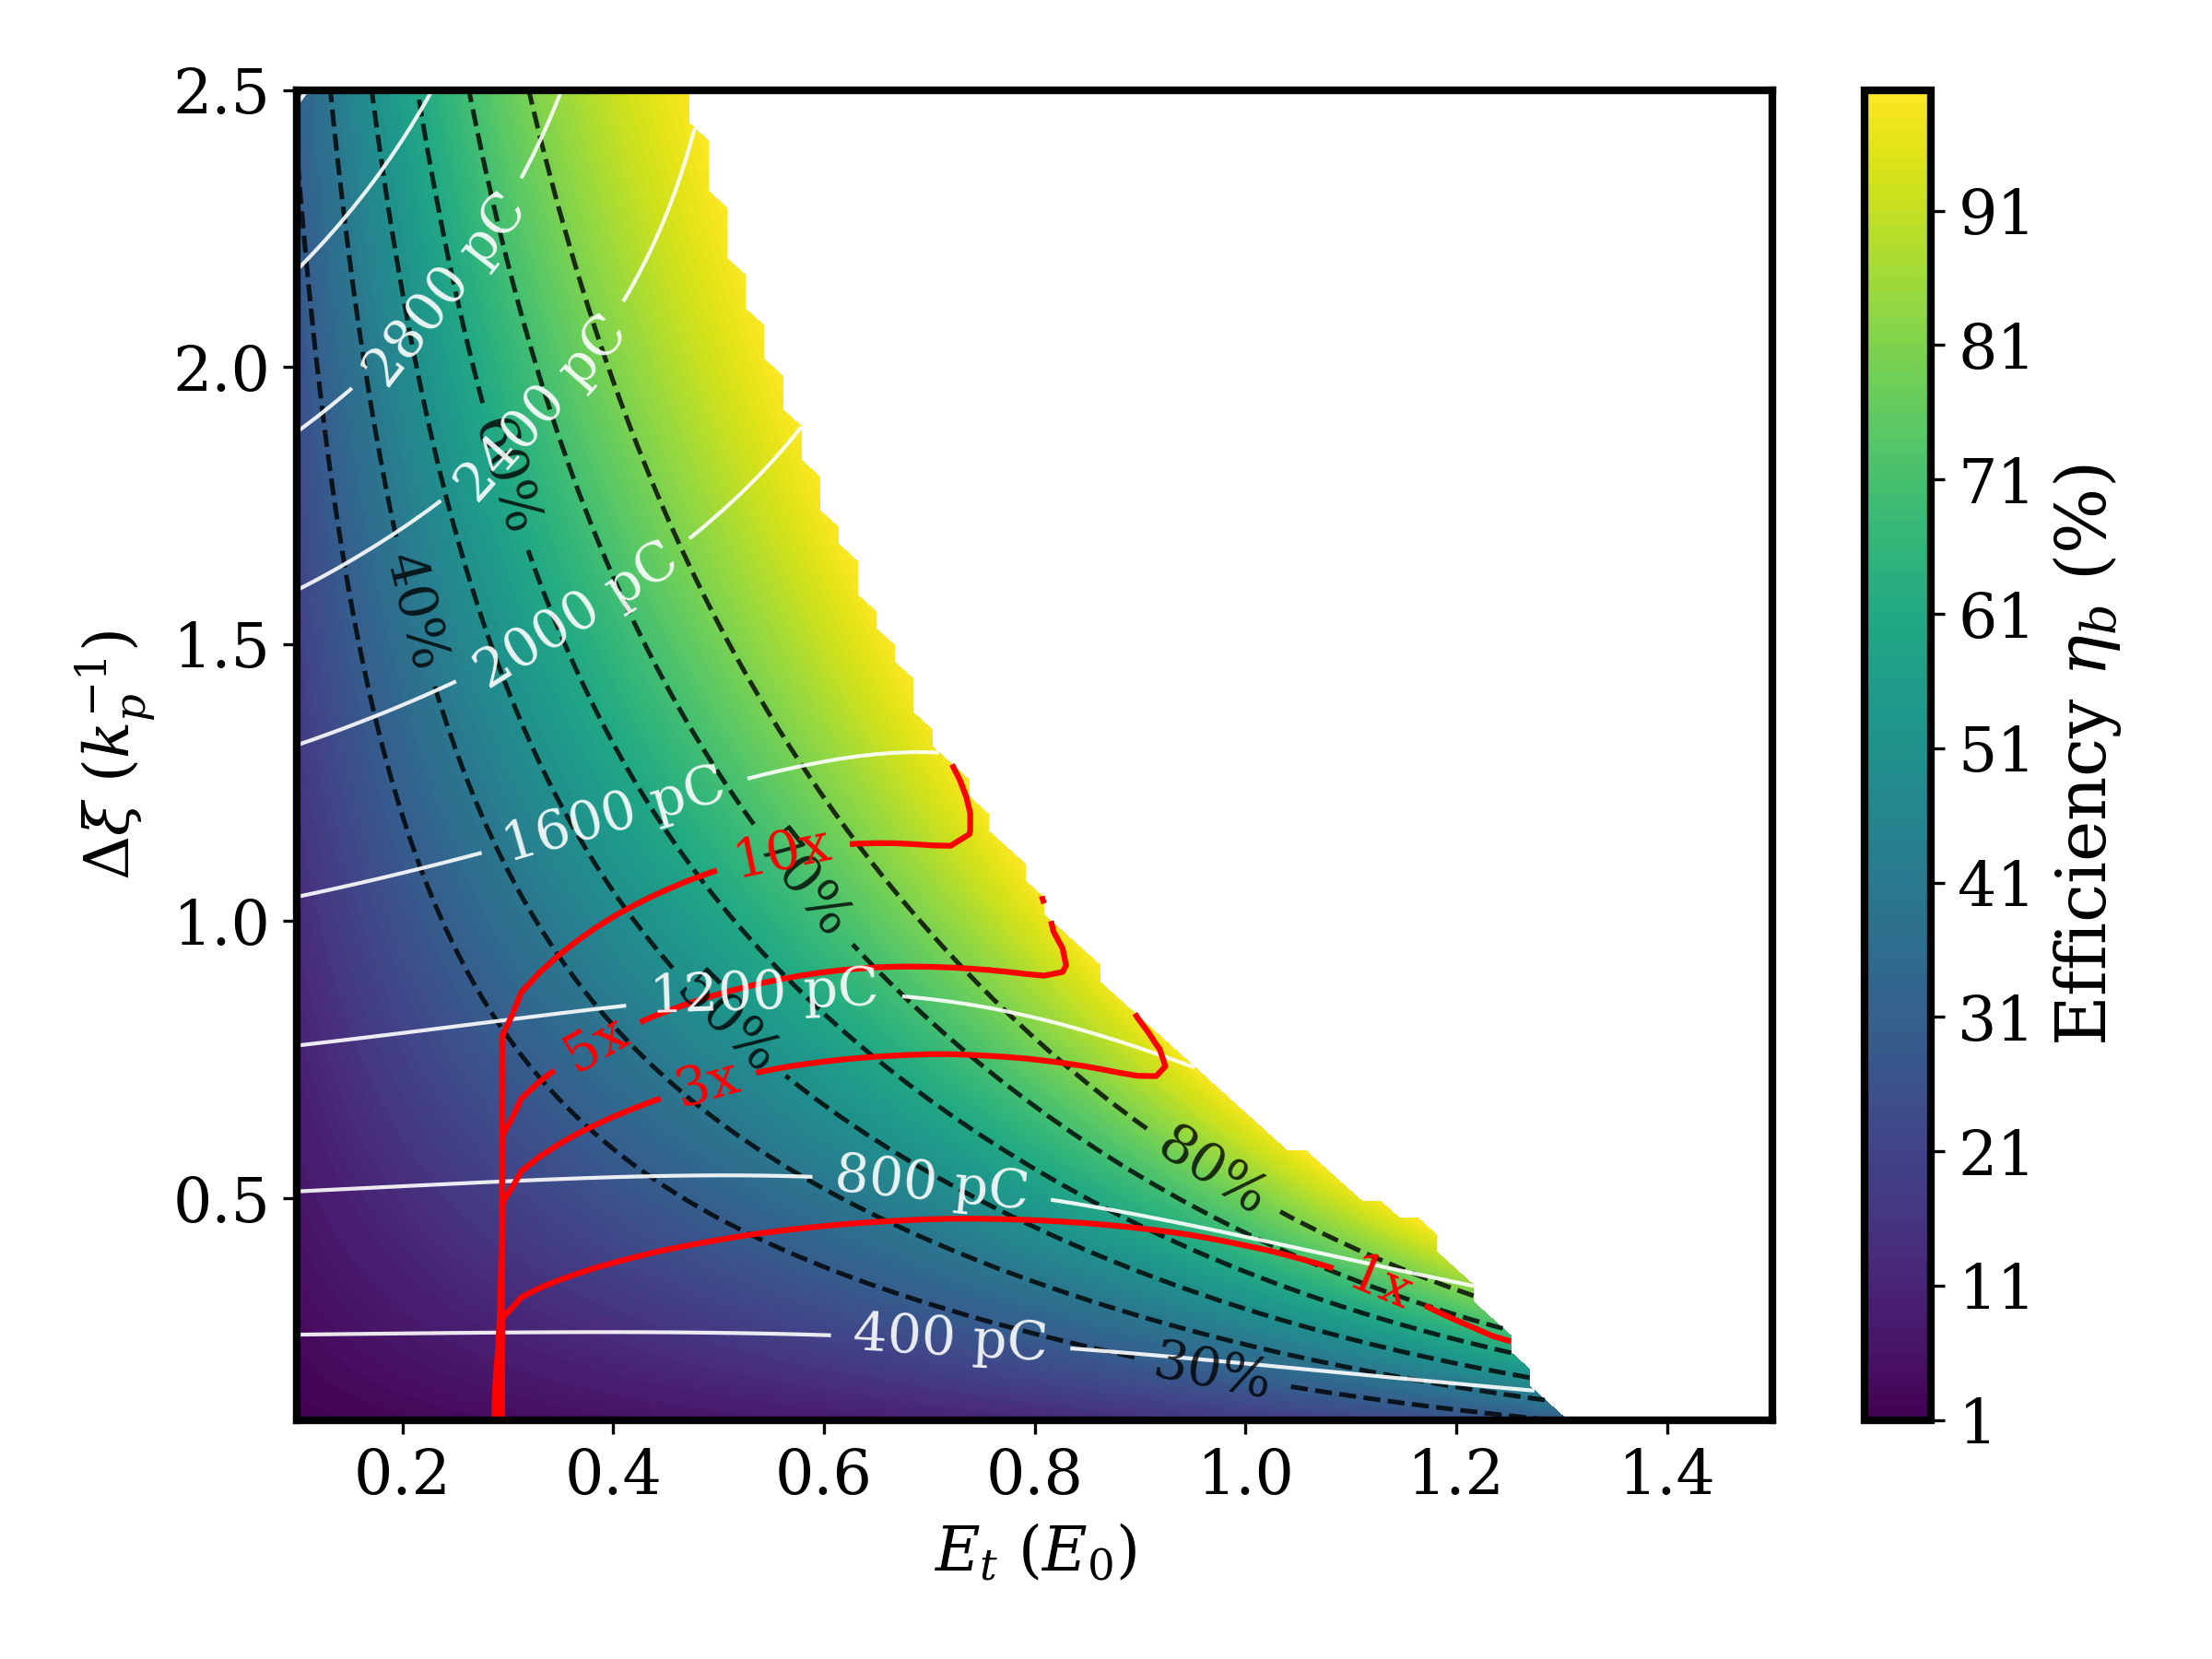
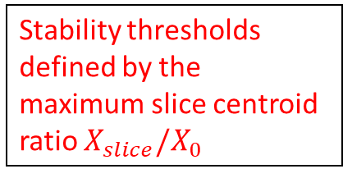
Mapping the High-Efficiency, High-Stability Operating Window
Stability thresholds defined by the maximum slice centroid ratio $X_{slice}/X_{0}$
A. Jain arXiv:2607.10497 (2026) [under review in PRAB]

Slide 13

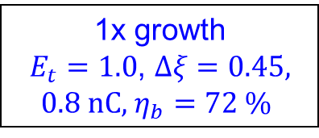
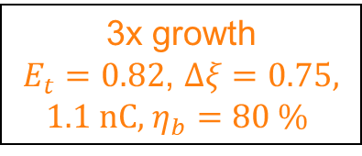
Mapping the High-Efficiency, High-Stability Operating Window
3x growth
$E_{t}=0.82$, $Δξ=0.75,$ 1.1 nC, $η_{b}=80 \%$
1x growth
$E_{t}=1.0$, $Δξ=0.45,$ 0.8 nC, $η_{b}=72 \%$
A. Jain arXiv:2607.10497 (2026) [under review in PRAB]

Slide 14
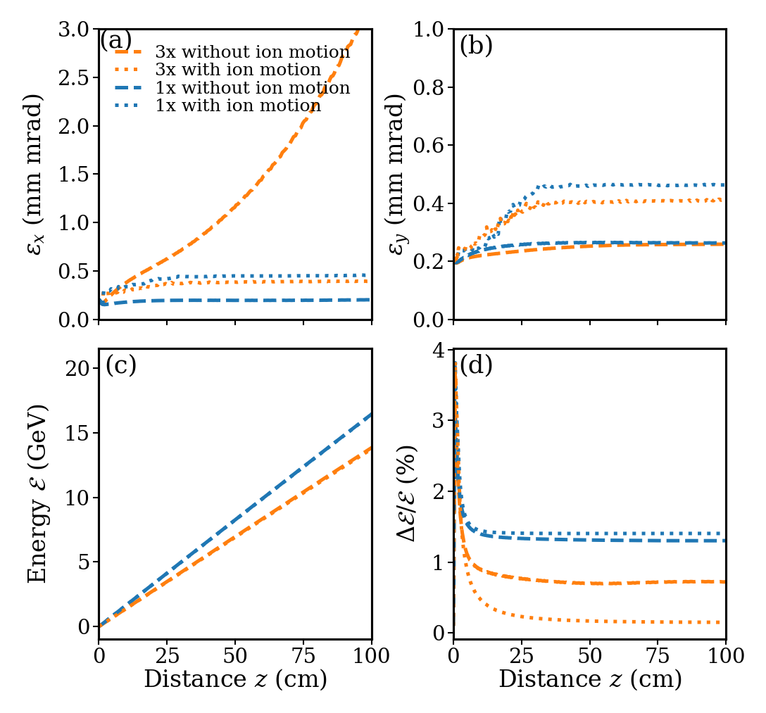

Preservation of the beam quality over a meter-long plasma
Ion motion (dotted lines)
Well-known mechanism for bounding BBU growth in plasma accelerators Phase Mixing: Nonuniform focusing along the trailing bunch causes different slices to accumulate differing betatron phases, reducing the BBU growth rate. Ion response introduces additional transverse forces modifying projected beam quality in configurations with limited centroid growth. Ion motion bounds the emittance growth of 3× while a baseline emittance increase in 1x
Emittance below 500 nm rad
Energy gain up to 16.5 GeV
Relative energy spread <1.5 %
$η_{b}\sim 80\%$, $η \sim 40 \%$
T. J. Mehrling et al., PRL (2018)

Slide 15
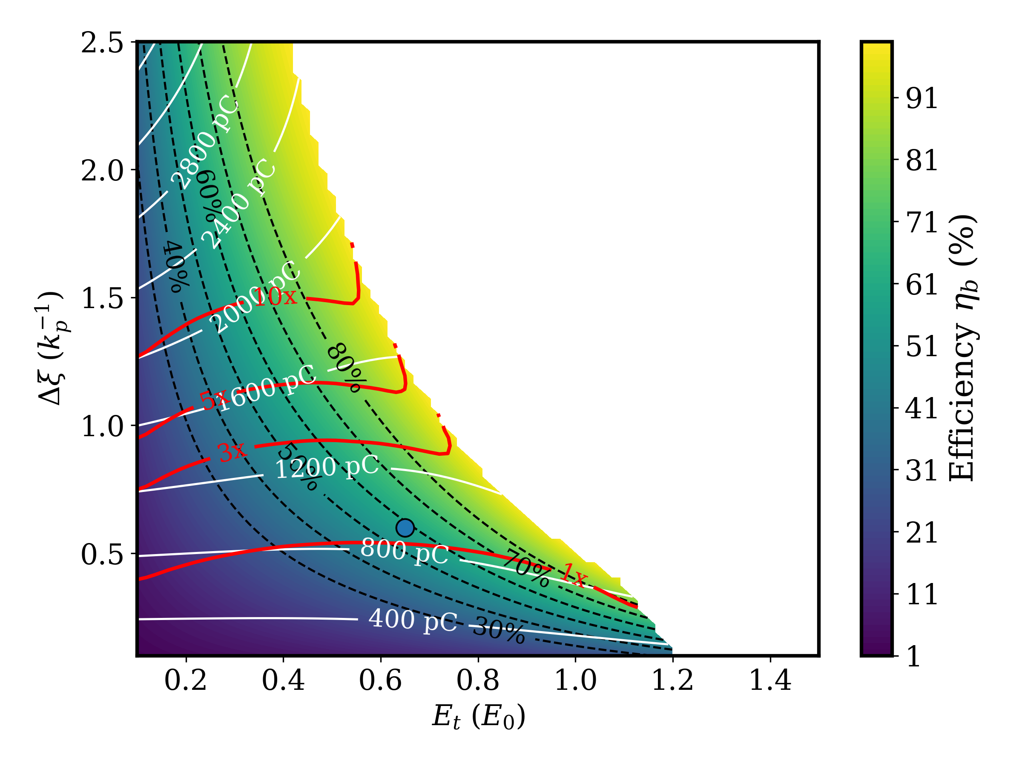
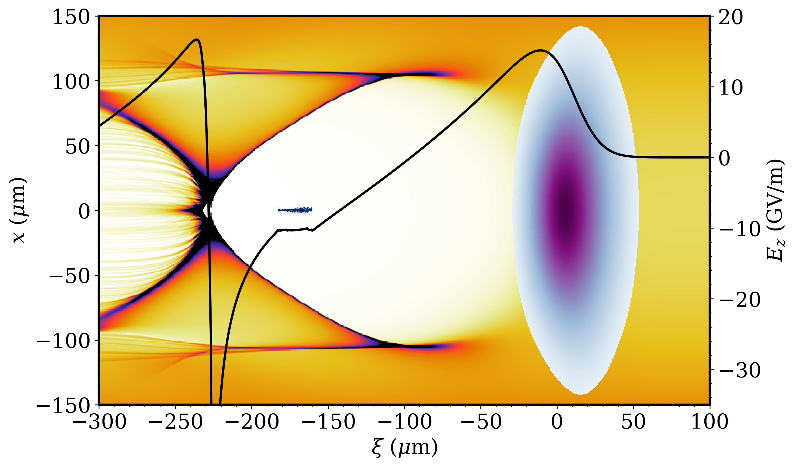

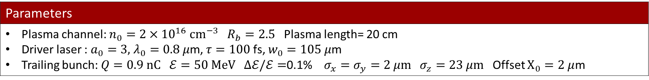
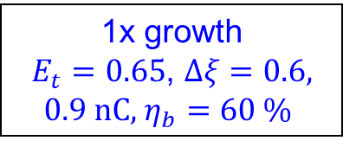
Laser driven simulation set up
1x growth
$E_{t}=0.65$, $Δξ=0.6,$ 0.9 nC, $η_{b}=60 \%$
Trapezoidal bunch
$E_{t}=10$GV/m
Laser Pulse
Parameters
Plasma channel: $n_{0}=2×{10}^{16} {\text{cm}}^{−3} R_{b}=2.5$ Plasma length= 20 cm Driver laser : $a_{0}=3,$ $λ_{0}=0.8 μ$m, $τ=100$ fs, $w_{0}=105 μ$m Trailing bunch: $Q=0.9 nC ℰ=50 MeV Δℰ/ℰ=$0.1% $σ_{x}=σ_{y}=2 μm$ $σ_{z}=23 μm$ Offset $X_{0}=2 μ$m

Slide 16
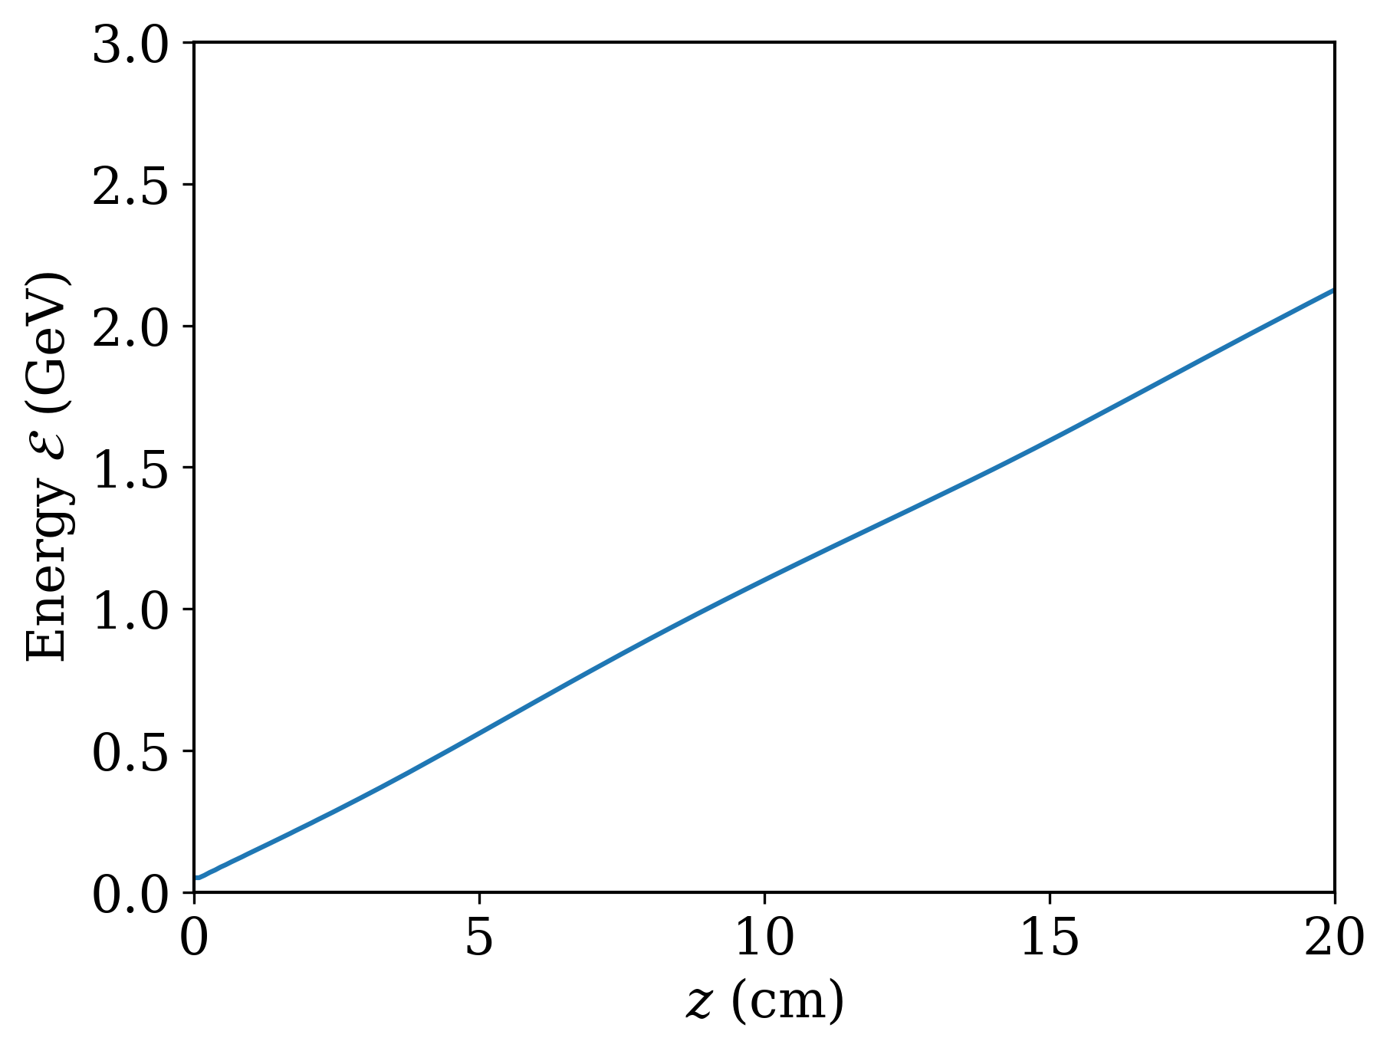
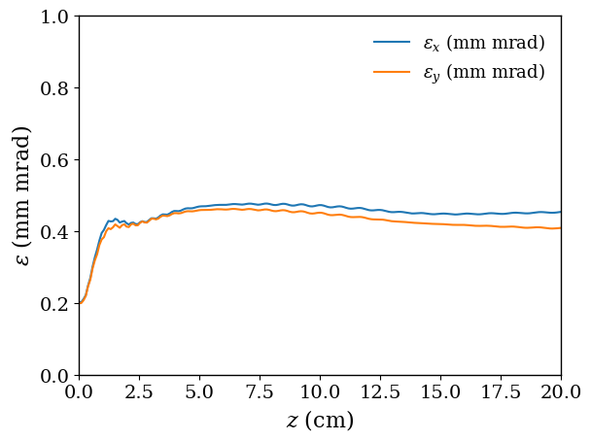
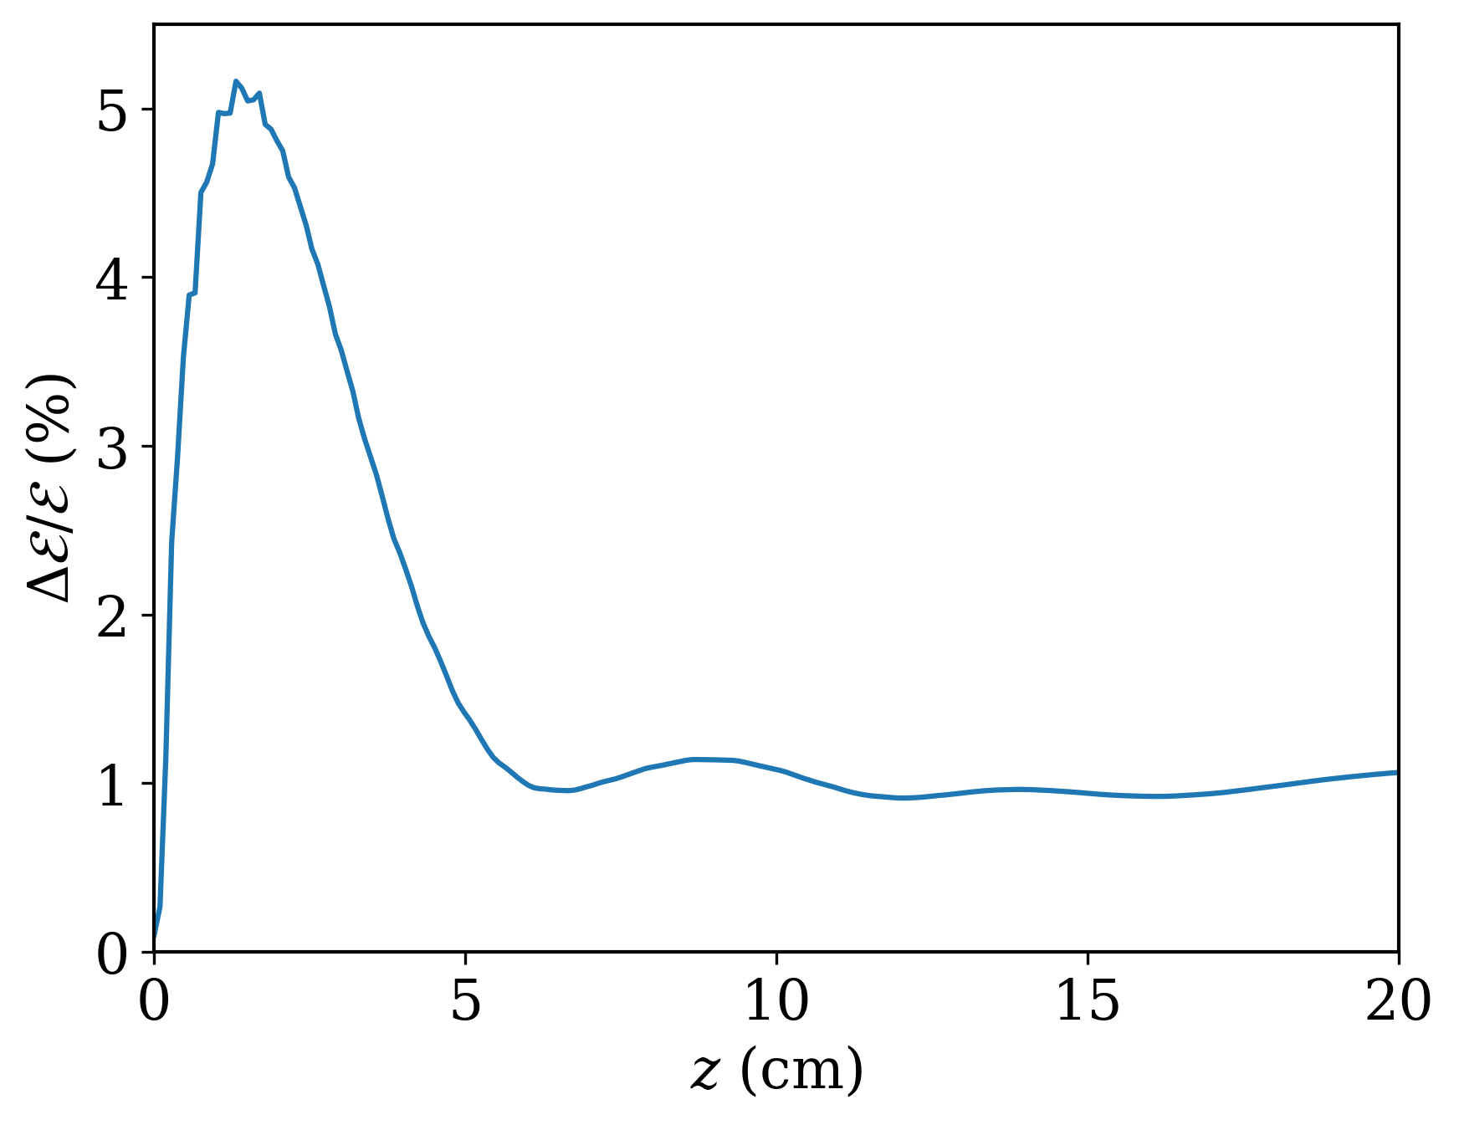
Preservation of the beam quality in 20 cm long plasma
Energy gain up to 2 GeV
Emittance below 500 nm rad
Energy gain up to 2 GeV
Relative energy spread ~1%
Relative energy spread ~1%

Slide 17
Conclusions
Simulation Validation: Full 3D PIC simulations show excellent quantitative agreement with our analytical transverse force and centroid predictions over a meter-long plasma.
Parametric Mapping: The analytical model maps energy-extraction limits directly against stability thresholds to isolate a highly stable operating window.
Beam Quality Preservation: We successfully map out a highly stable, high-efficiency operating space over a 1 m acceleration distance, simultaneously demonstrating:
  Near 80% energy transfer efficiency
  Sub-500 nm rad transverse emittance preservation
  Up to 16.5 GeV energy gain with < 1.5% relative energy spread
Bypassing the Barrier: Our study demonstrates that the efficiency-instability trade-off is not an absolute limit. It can be systematically managed and circumvented by pairing precise wake potential modeling with tailored beam loading.
Future Work: This wake-potential formulation provides a path to integrate additional, self-consistent plasma effects like ion motion.

Slide 18
Thank you

Slide 19
Backup slides

Slide 20
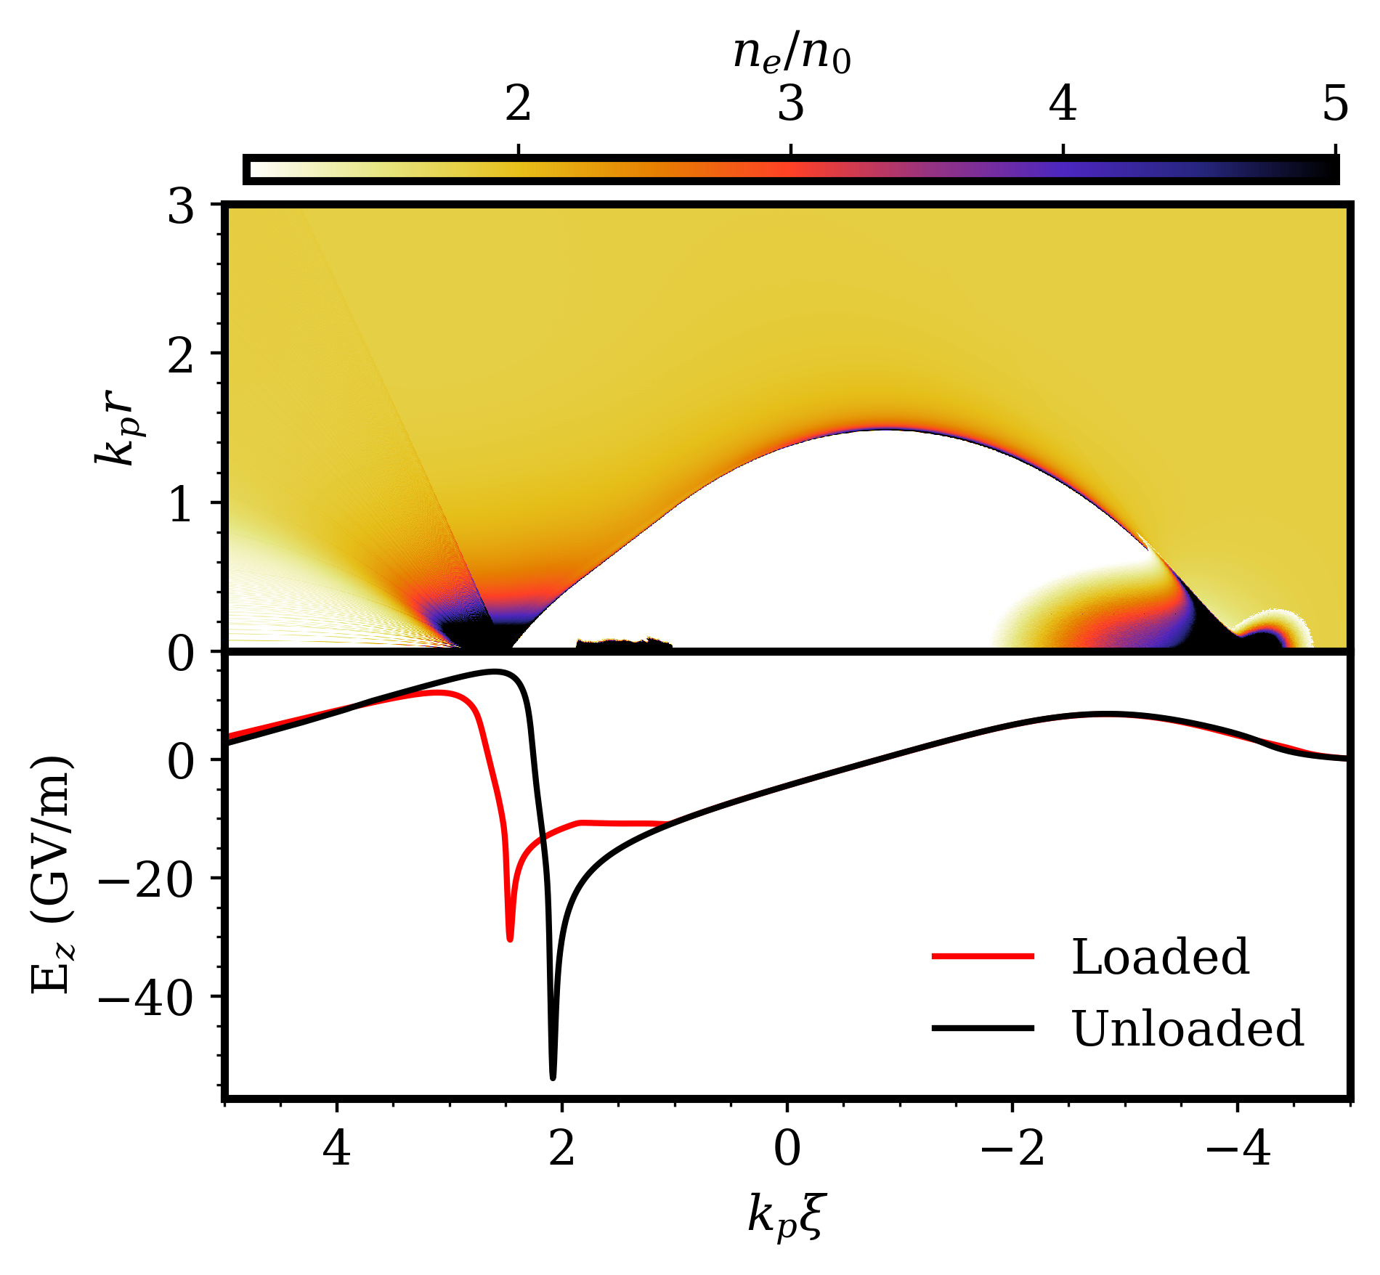
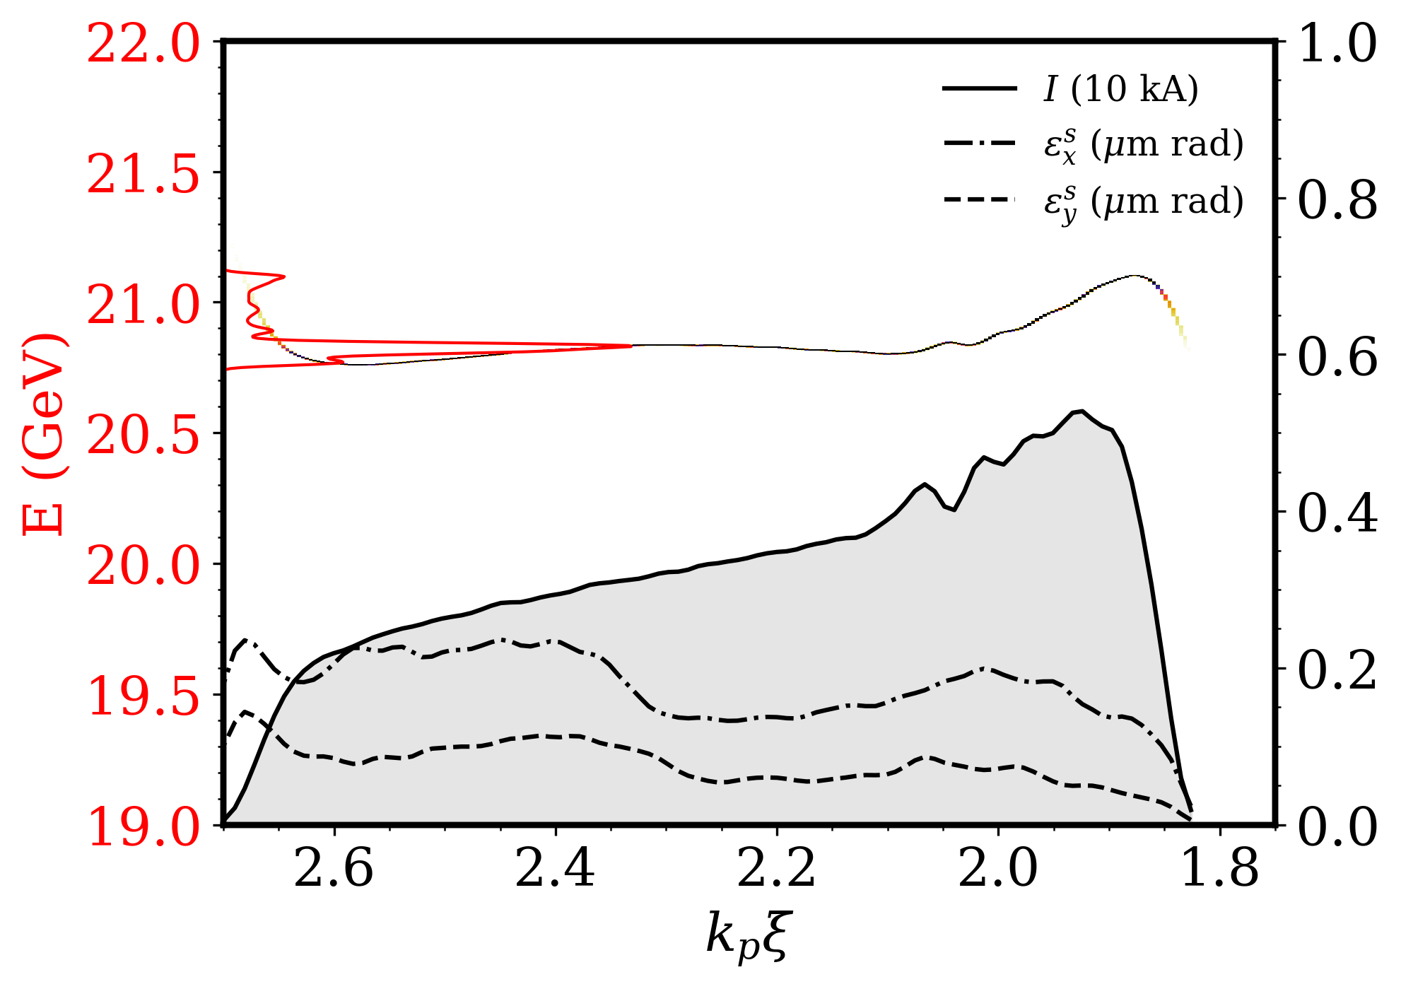
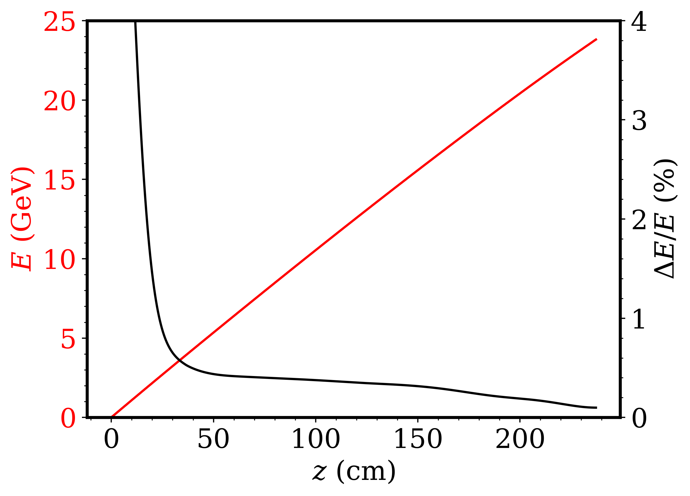


Ideal Beam Loading: Achieving Low Energy Spread and High Efficiency for Future Compact Colliders
Electron beam driver
Injected trapezoid
Current Profile
$Q=220$ pC
Trapezoidal current profile is needed for flattening accelerating field
Two-color injection experiment at ATF offers a path towards such collider quality trapezoidal beam [1]
Such a beam also enables high energy extraction efficiency (43% in current simulation, theoretically >90% [2])
[1] A.Jain et al., PRR(2026)
[2] M. Tzoufras, Phys. Rev. Lett 101, 14 (2008)
* See backup slides for detailed simulation parameters

Slide 21
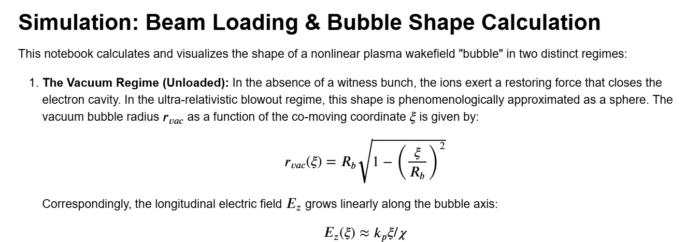
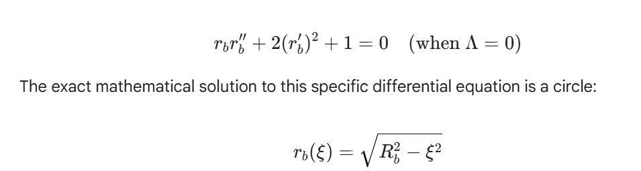

$$r_{b}{\left(ξ\right)}^{2}+{\left(2a\right)}^{2}ξ^{2}=R_{b}^{2}$$

Slide 22
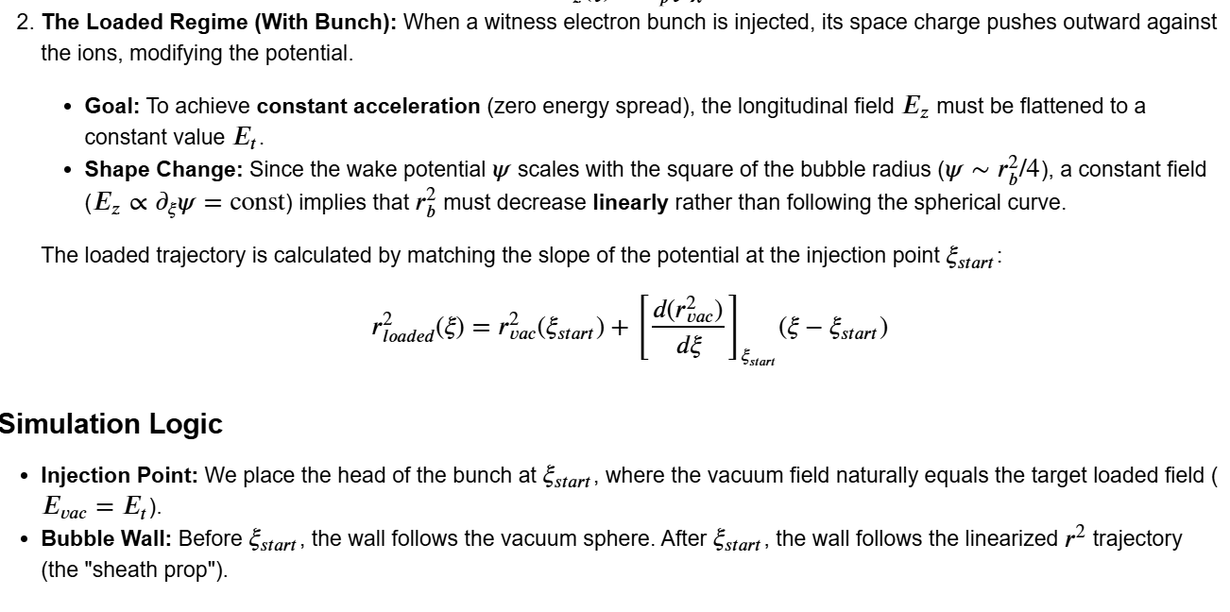

Slide 23








Backup: details of previous work
$$n_{0}=2e16 cm^{−3}$$
Driver
$λ_{0}=9.2 μm$
$τ=250 fs$
$w_{0}=105 μm$
$a_{0}=2.7$
Injector
$λ_{0}=0.4 μm$
$τ=20 fs$
$w_{f}=8.6 μm$
$a_{0}=0.17$
$β_{f}=1.04$
Generated beam
$Q=220 pC$
$ε_{x}=170 nm⋅rad$
$ε_{y}=76 nm⋅rad$
$$k_{p}ξ$$
Ion. level | $a_{T}$ (Driver) | $a_{T}$ (Injector)
Kr⁷⁺ -> Kr⁸⁺ | 1.87 | 0.06
Kr⁸⁺ -> Kr⁹⁺ | 3.10 | 0.16
Kr⁹⁺ -> Kr¹⁰⁺ | 3.78 | 0.20
Kr¹⁰⁺ -> Kr¹¹⁺ | 4.51 | 0.23
Driver
Injector
Injected beam
A. Jain, et al., Phys.l Rev. Research 8.2 (2026): 023213.

Slide 24






$$R_{b}=2$$
$$R_{b}=3$$
$$R_{b}=4$$
$n_{0}=5×{10}^{16} cm^{−3}, offset=2.4 μ$m, 20 GeV acceleration of the beam

Slide 25
Mapping the High-Efficiency, High-Stability Operating Window
Bubble closure constraint:
ensuring cavity does not collapse before the end of the bunch./Physically inaccessible
Bunch Length
$$n_{0}=3×{10}^{16} {\text{cm}}^{−3}$$
$$R_{b}=2.7$$
$$X_{0}=σ_{x}= 2 \text{μm}$$
Loaded field

