Slide 1







Effects of Laser-Plasma Waveguide Coupling on Accelerated Electron Bunch Stability and Spatial Profiles
UNIVERSITY OF MARYLAND AT COLLEGE PARK
Dept. of Physics
Dept. of Electrical and Computer Engineering
Institute for Research in Electronics and Applied Physics
Ari J. Sloss, Bo Miao, Jaron E. Shrock, Ela Rockafellow, Nishchal Tripathi, Scott W. Hancock, Howard M. Milchberg
Institute for Research in Electronics and Applied Physics and Department of Physics, University of Maryland, College Park, Maryland 20742, USA
Advanced Accelerator Concepts Workshop 2026, Los Angeles, CA
Supported by DARPA under the Muons for Science and Society (MuS2) program
LLNL work done under Contract DE-AC52-07NA27344
E. Rockafellow supported by NSF GRFP (Grant No. DGE 1840340)

Slide 2


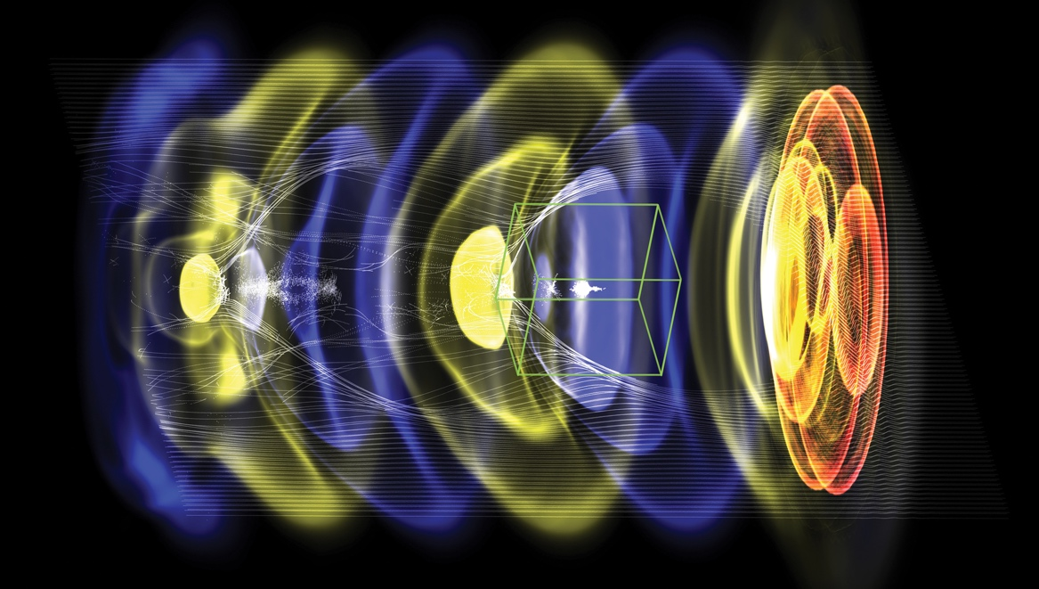


Acknowledgements
WarpX: open-source particle-in-cell code with advanced algorithms at Exascale
PI: Jean-Luc Vay (LBNL)
DoE Exascale Computing Project
Bo Miao, Jaron E. Shrock, Ela Rockafellow, Nishchal Tripathi, Manh S. Le, Scott W. Hancock, Frederica Sorkin, Mayank Gupta
J. Sisma, M. Nevrkla, F. Vitha, A. Spadova, S. Lorenz, I. Zymak, G. Grittani, A. Cimmino, R. Versaci, C. Lazzarini, S. V. Bulanov
Advanced algorithms for plasma acceleration
Performance-portability
Built on AMReX (LBNL, ECP co-design center)
Users/contributors welcome!
>30 contributors from LBNL, LLNL, CEA, DESY, SLAC
2021: 10 multi-GeV stages
Goal 2023: TeV multi-stage collider
S. Zahedpour, R. C. Hollinger, S. Wang, J. King, P. Zhang, J.J. Rocca
https://ecp-warpx.github.io
Vay, J-L., et al., Nucl. Instrum. Meth. A 909 (2018)
I. Pagano, F. Teffert, S. Kerr, B. Reagan, J. Williams
FBPIC: Fourier Bessel Particle-in-Cell code
open-source
R. Lehe et al., CPC, 2016
R. Lehe et al., PRE, 2016
M. Kirchen et al., PoP, 2016
Remi Lehe (LBNL)

Slide 3

Outline
Self-Waveguided LWFA
Plasma waveguides and modal dynamics
Acceleration of non-Gaussian electron bunches by higher order waveguide modes
Funnel-mouthed waveguides from logarithmic diffractive axicons and their effects on electron acceleration
Longitudinal control of plasma waveguides with modular gas jets
B. Miao et al., Phys. Rev. Accel. Beams 27, 08132 (2024)

Slide 4
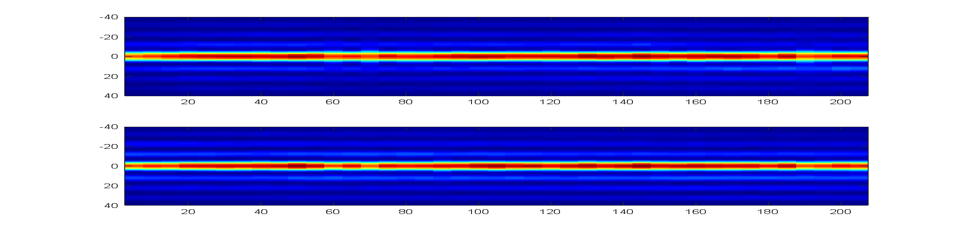
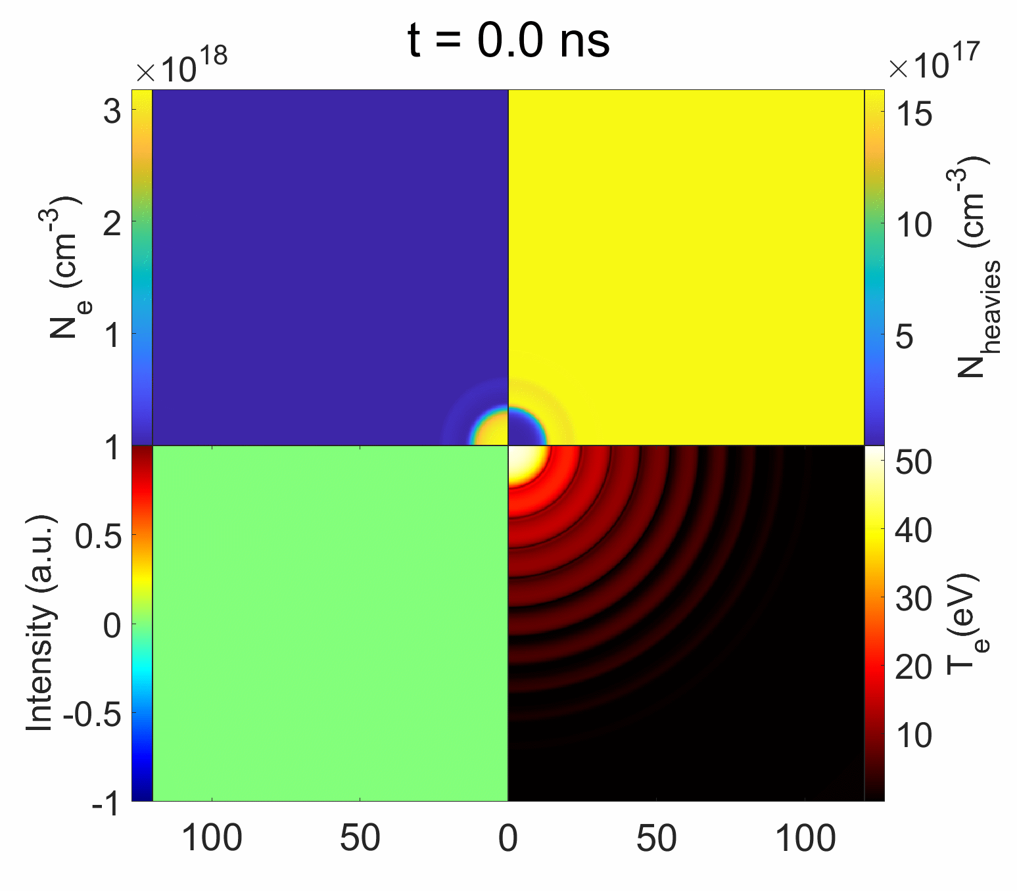
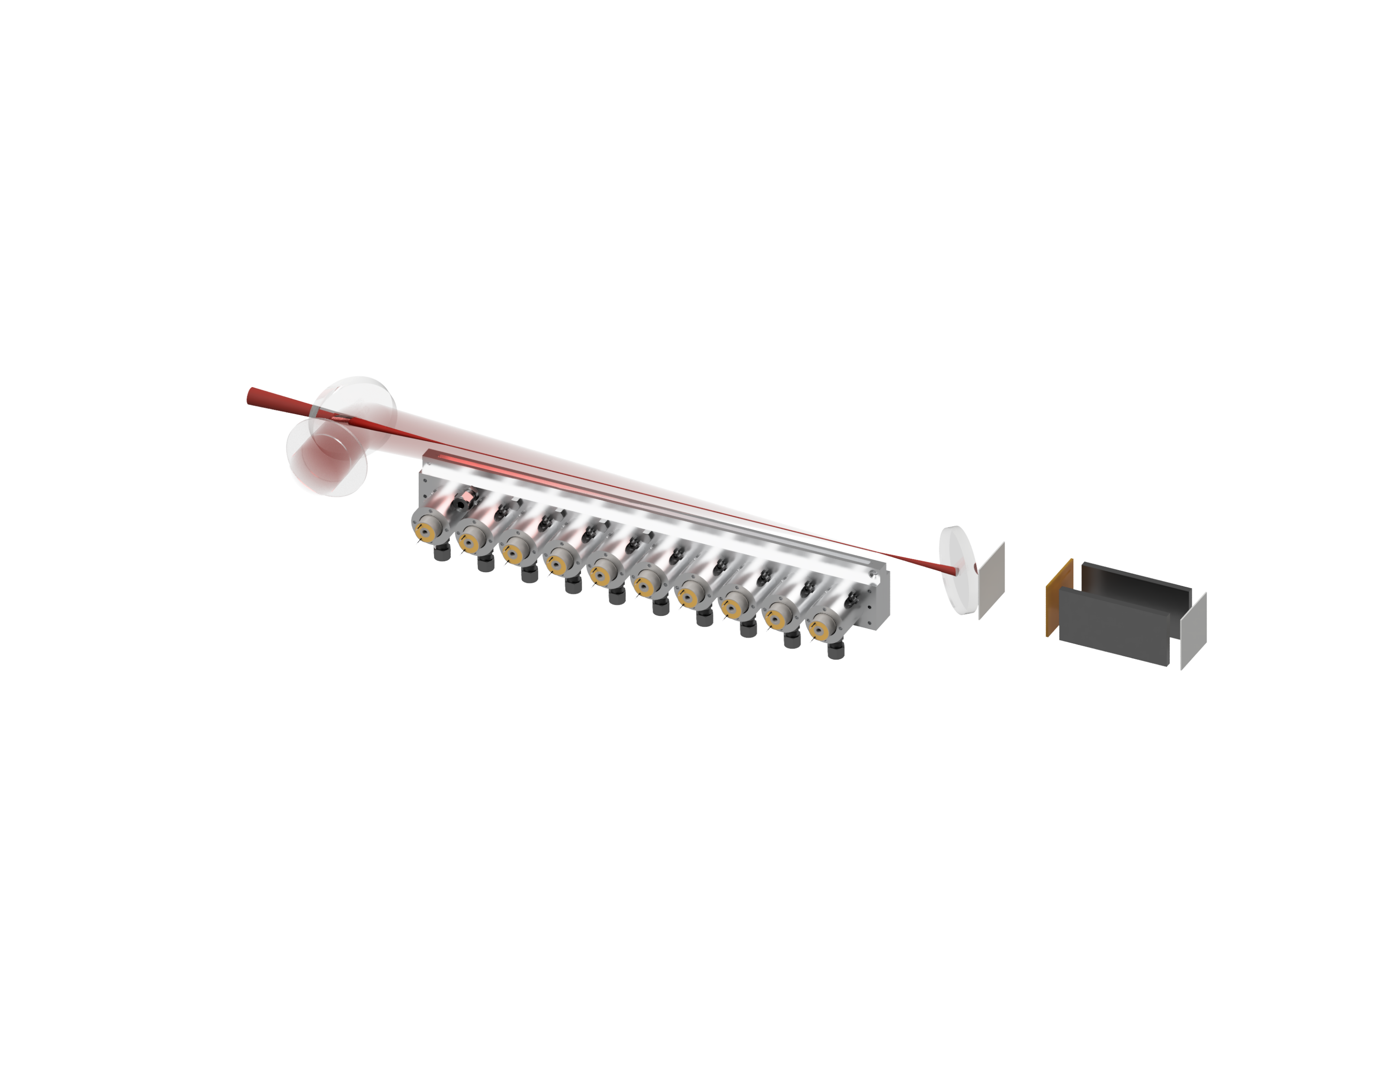
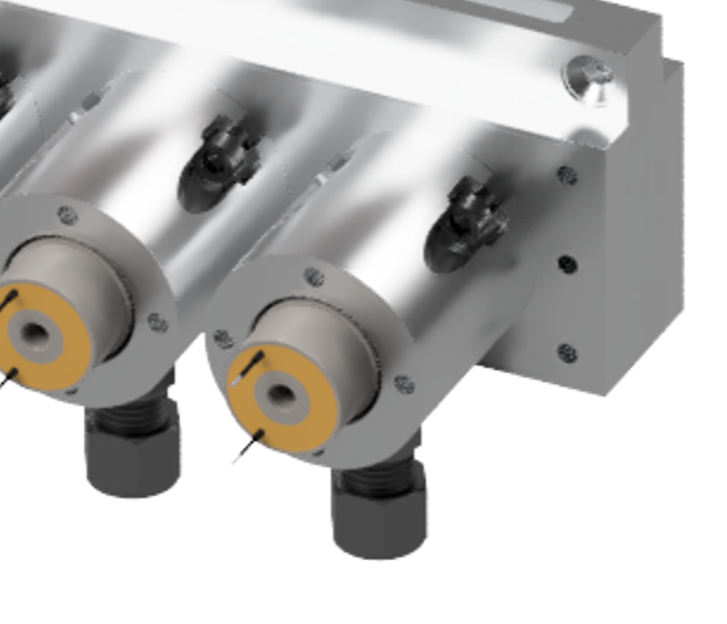

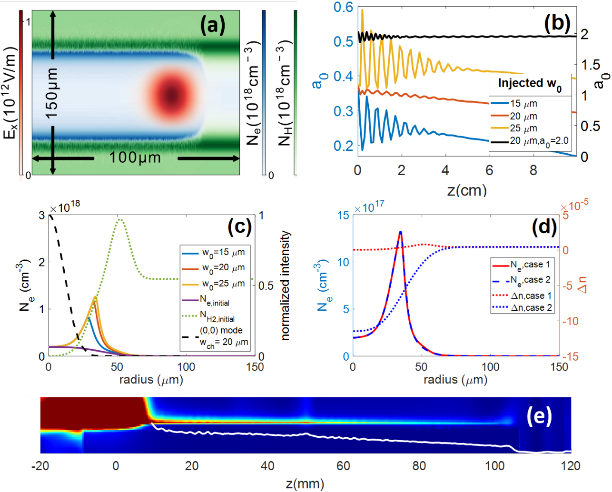

Self-Waveguided LWFA
P1
DM1
30 cm
P3
P2
DA
DM2
LA1
LA2
LA3
UMD developed 30 cm supersonic gas jet (Gen. VI)
Magnetic
spectrometer
First plasma waveguides: Durfee and Milchberg, PRL 71, 2409 (1993)
B. Miao et al., Phys. Rev. Accel. Beams 27, 08132 (2024)
N. Lemos et al., Phys. Plasmas 20 061302 (2013)
R. Shalloo et al., Phys. Rev. E 97, 053203 (2018)
A. Morozov et al., Phys. Plasmas 25, 053110 (2018)
B. Miao et al., Phys. Rev. Lett. 129, 074801 (2020)
L. Feder et al., Phys. Rev. Res. 2, 043173 (2020)
A. Picksley et al., Phys. Rev. Accel. Beams 23, 1 (2020)
J. E. Shrock et al., Phys. Plasmas 29, 073101 (2022)
B. Miao et al., Phys. Rev. Accel. Beams 27, 08132 (2024)
Leading wings of injected high intensity pulse ionize neutral shock

Slide 5
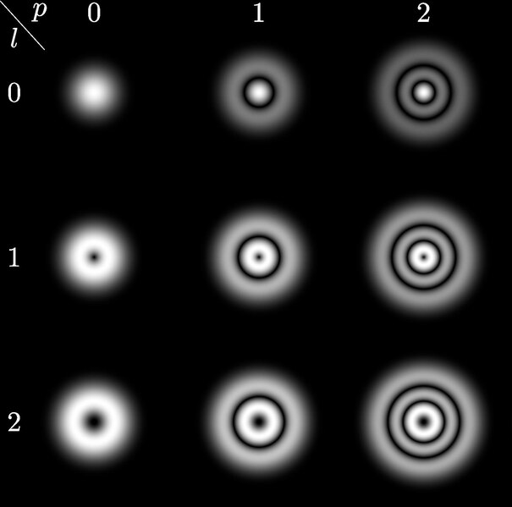
Plasma waveguide modes
Wikipedia
Plasma term
Geometric term
Bound (LG) modes of parabolic channels are a good approximation to real channels.
Group velocity walkoff causes spatial decoherence of different modes.
C. G. Durfee and H. M. Milchberg, Phys. Rev. Lett. 71 2409 (1993)
C. G. Durfee et al., Opt. Lett. 19 1937-1939 (1994)
T. R. Clark and H. M. Milchberg, Phys. Rev. Lett. 81 357 (1998)
T. R. Clark and H. M. Milchberg, Phys. Rev. E 61 1954 (2000)

Slide 6

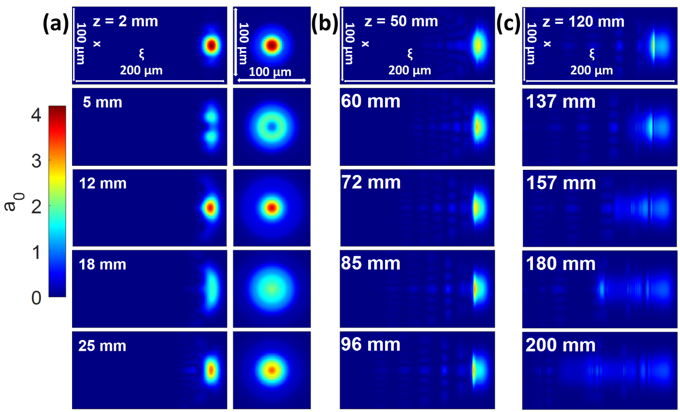
Simulation of group velocity dispersion
$a_{0i}=2.0, w_{0}=30 μm, τ_{fwhm}=35 fs$ in a prepared index structure with $w_{ch} ≈ 20 μm$ and on axis plasma density $N_{e0}=2.0×{10}^{17} cm^{−3}$.
J. E. Shrock et al., Phys. Rev. Lett. 132, 045002 (2024)

Slide 7
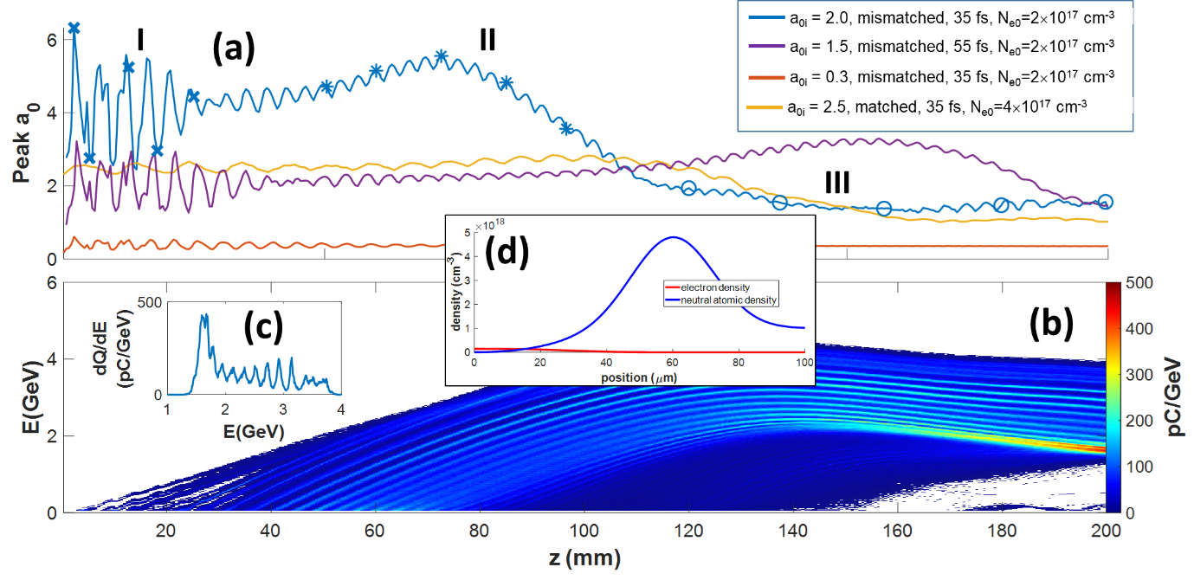
Plasma waveguide modes
3 propagation stages: I, II, III
I: Beating from coupling into many modes
II: Regular beating from continuous coupling into (0,0), (1,0)
III: Depletion, Dephasing
Ionization injection during stage II
J. E. Shrock et al., Phys. Rev. Lett. 132, 045002 (2024)

Slide 8
Plasma waveguide modes
3 propagation stages: I, II, III
Electron beam spatial profile
Angle-resolved spectrum
Ionization injection during stage II

Slide 9
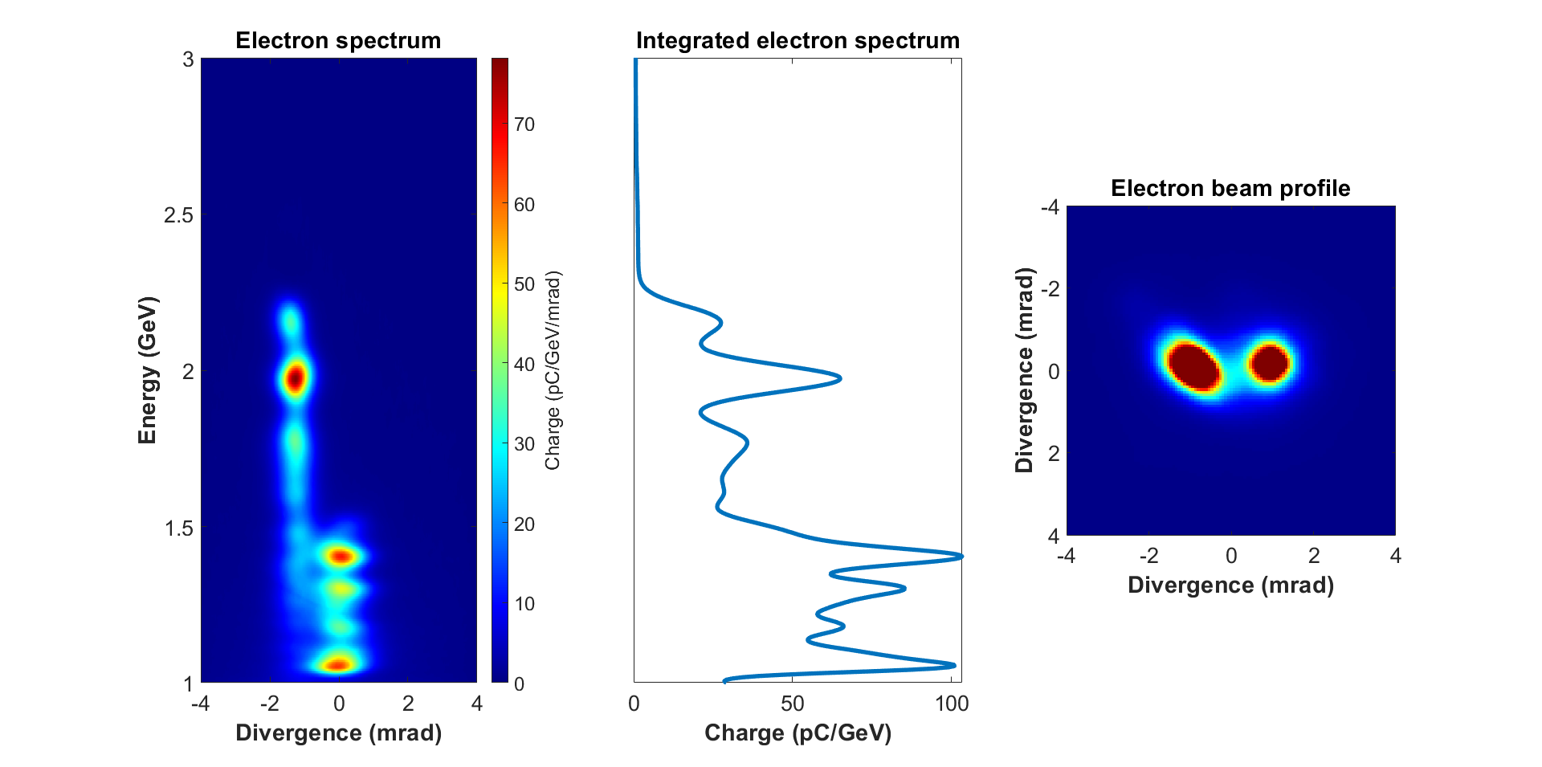
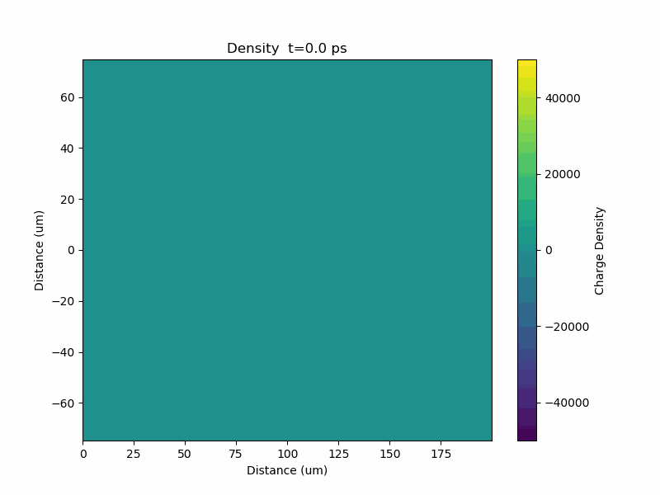
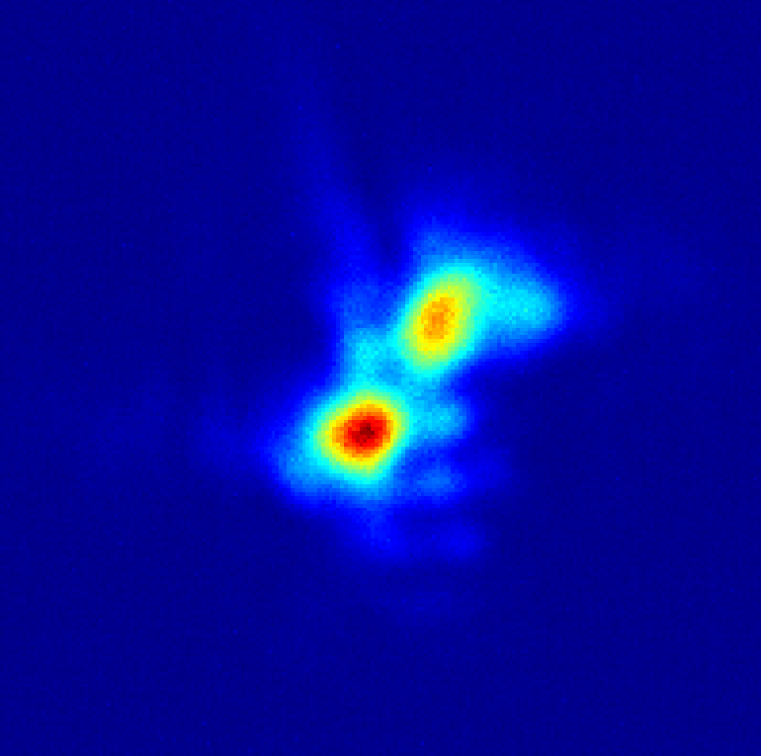

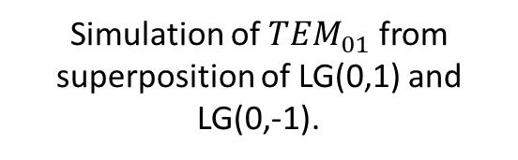
Acceleration of modal electron beams
Manuscript in preparation
Preferential excitation of higher order waveguide modes can accelerate ‘modal’ electron beams
Likely first observed in 2024
$${\sim TEM}_{01}$$
Low-power focus
Simulation of ${TEM}_{01}$ from superposition of LG(0,1) and LG(0,-1).

Slide 10
Examples
Laser polarization independent
Electron beam spatial profile
Electron beam at collimator
Energy
Spectrum

Slide 11

Logarithmic Axicon
See S. Hancock’s poster this afternoon
N. Tripathi et al., Opt. Lett. 50, 3441-3444 (2025)
E. Rockafellow et al., In preparation

Slide 12
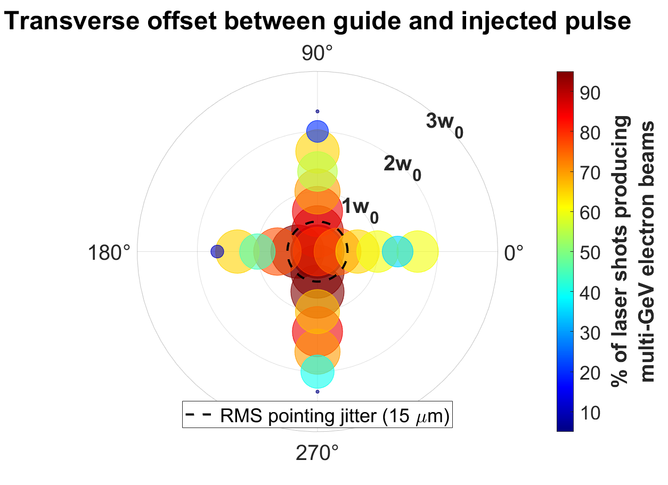
Funnel-mouth acceleration enhancements
Conventional waveguides require alignment within 1w₀ for acceleration.
Funnel mouth acts like a plasma lens, improving accelerator robustness to laser misalignment.
E. Rockafellow et al., In preparation

Slide 13
Funnel-mouth acceleration enhancements
Longitudinal waveguide entrance position with respect to laser focus
E. Rockafellow et al., In preparation
Notes:
Estimated for vacuum focus, not self-consistent.
Similar improvements are made with laser pointing.

Slide 14
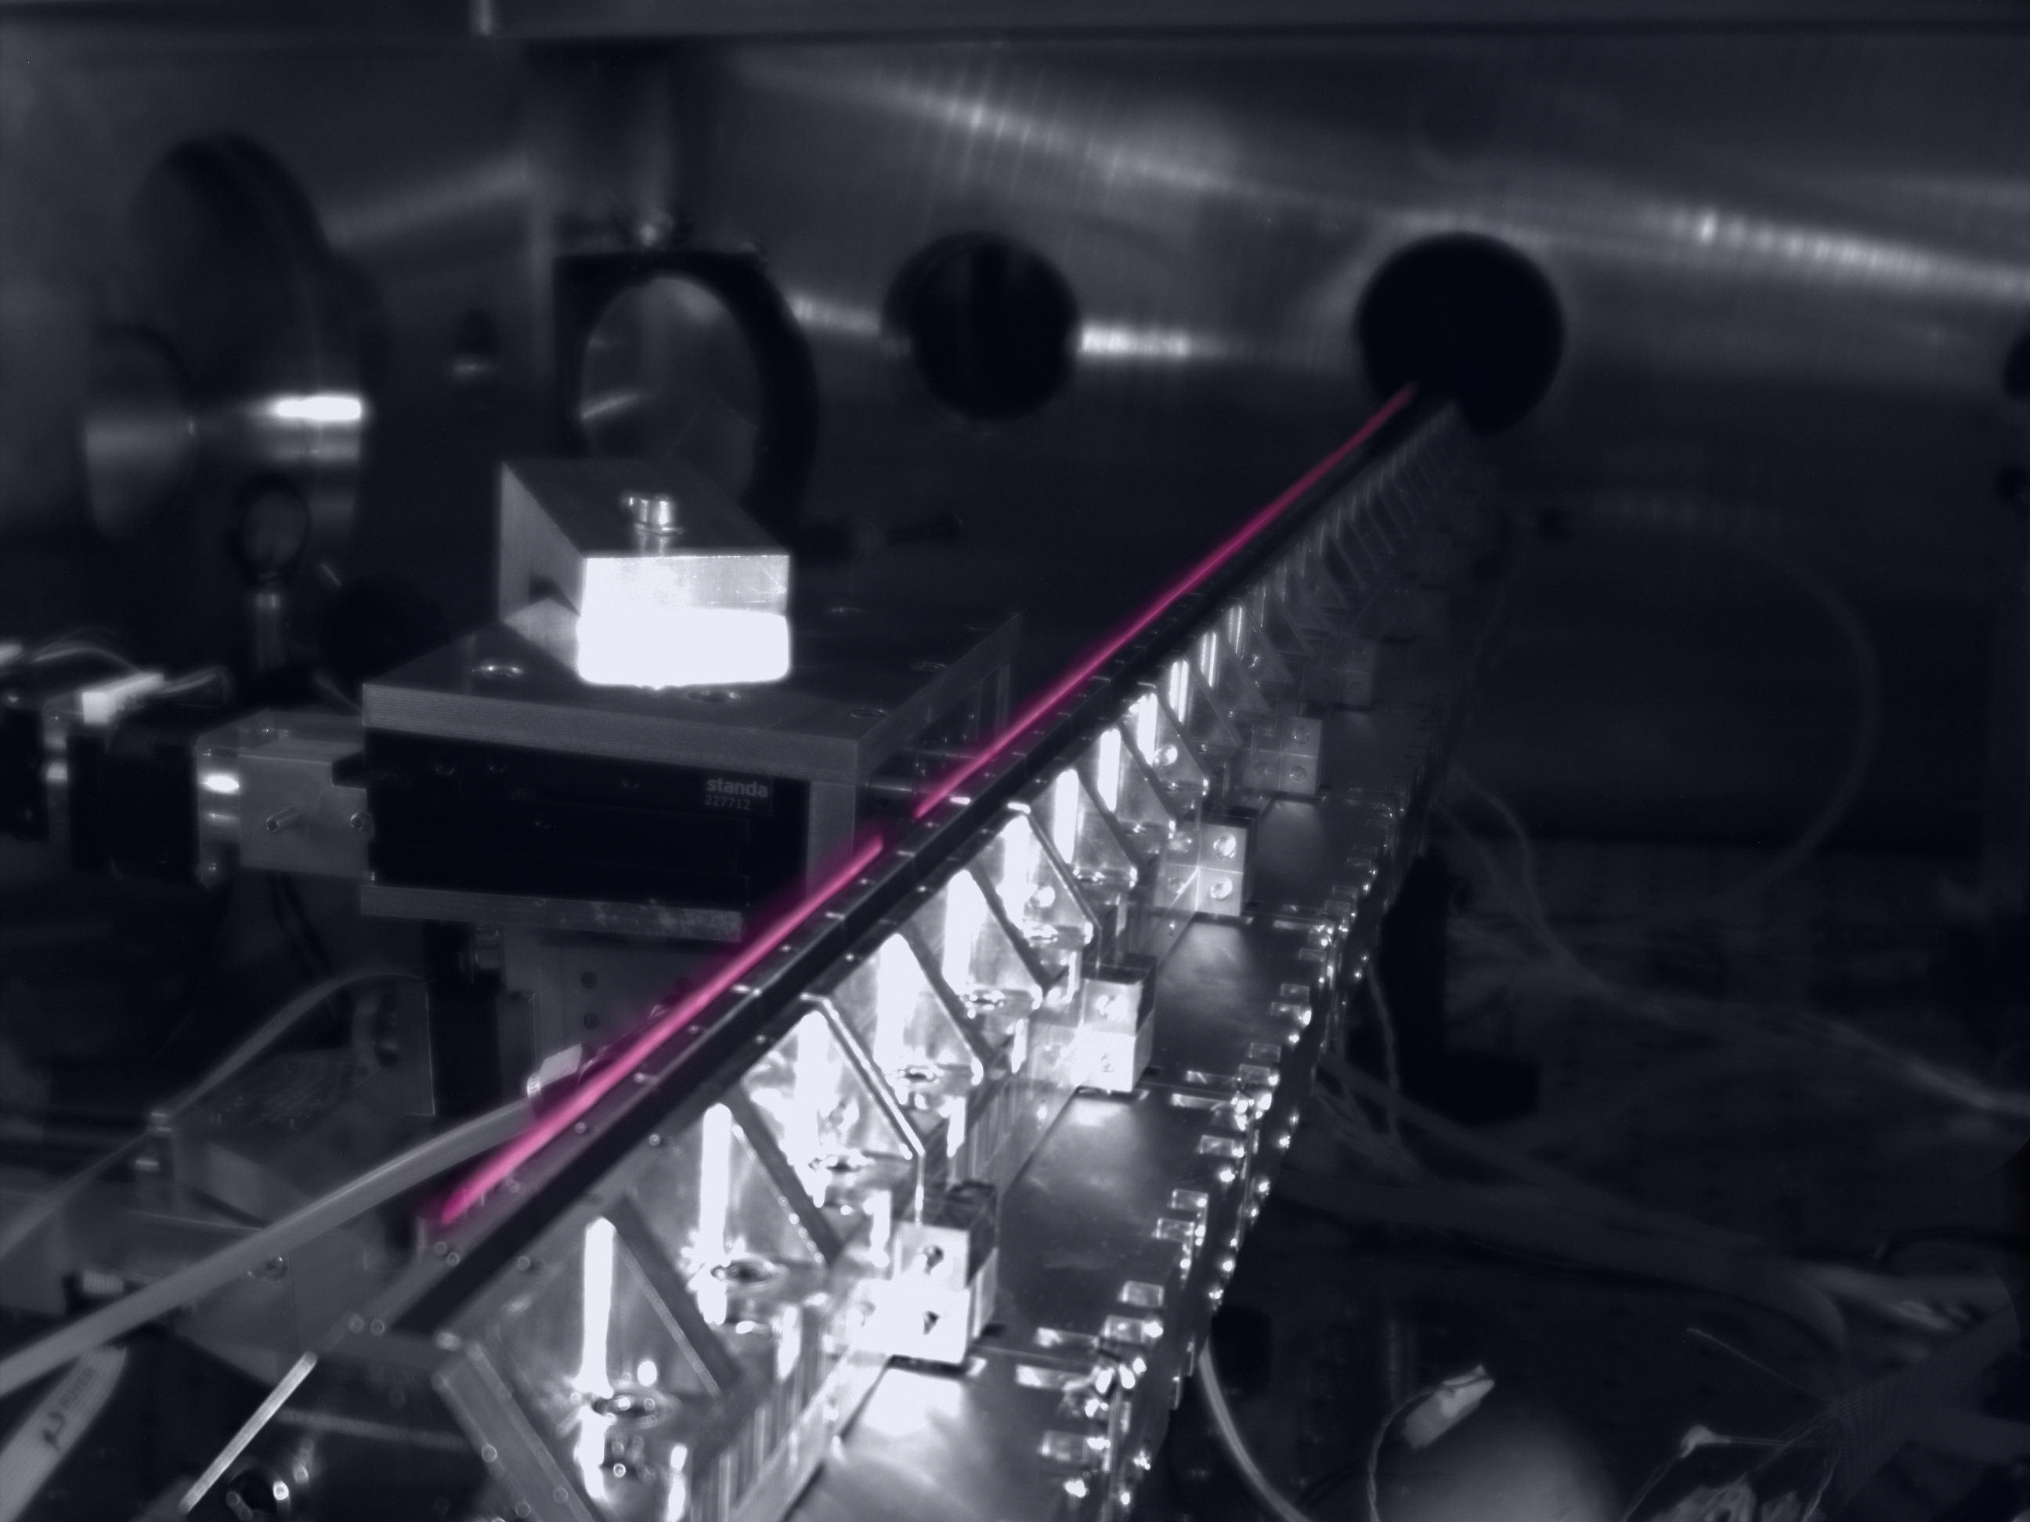

Summary
Can control spatial profile of electron beams with higher order waveguide modes
Improve pointing, charge, and stability with funnel-mouthed waveguides
Demonstrated longitudinal control of plasma waveguides with modular gas jets
H₂ plasma fluorescence above 1 meter jet
Localized injection section (N₂)
1 m log axicon used to make the plasma
B. Miao et al., Phys. Rev. Accel. Beams 27, 08132 (2024)
B. Miao et al., Rev. Sci. Instrum. 96, 043003 (2025)
E. Rockafellow et al., Phys. Plasmas 32, 053102 (2025)
J. E. Shrock et al., Phys. Rev. Lett. 132, 045002 (2024)

Slide 15
Extra Slides

Slide 16
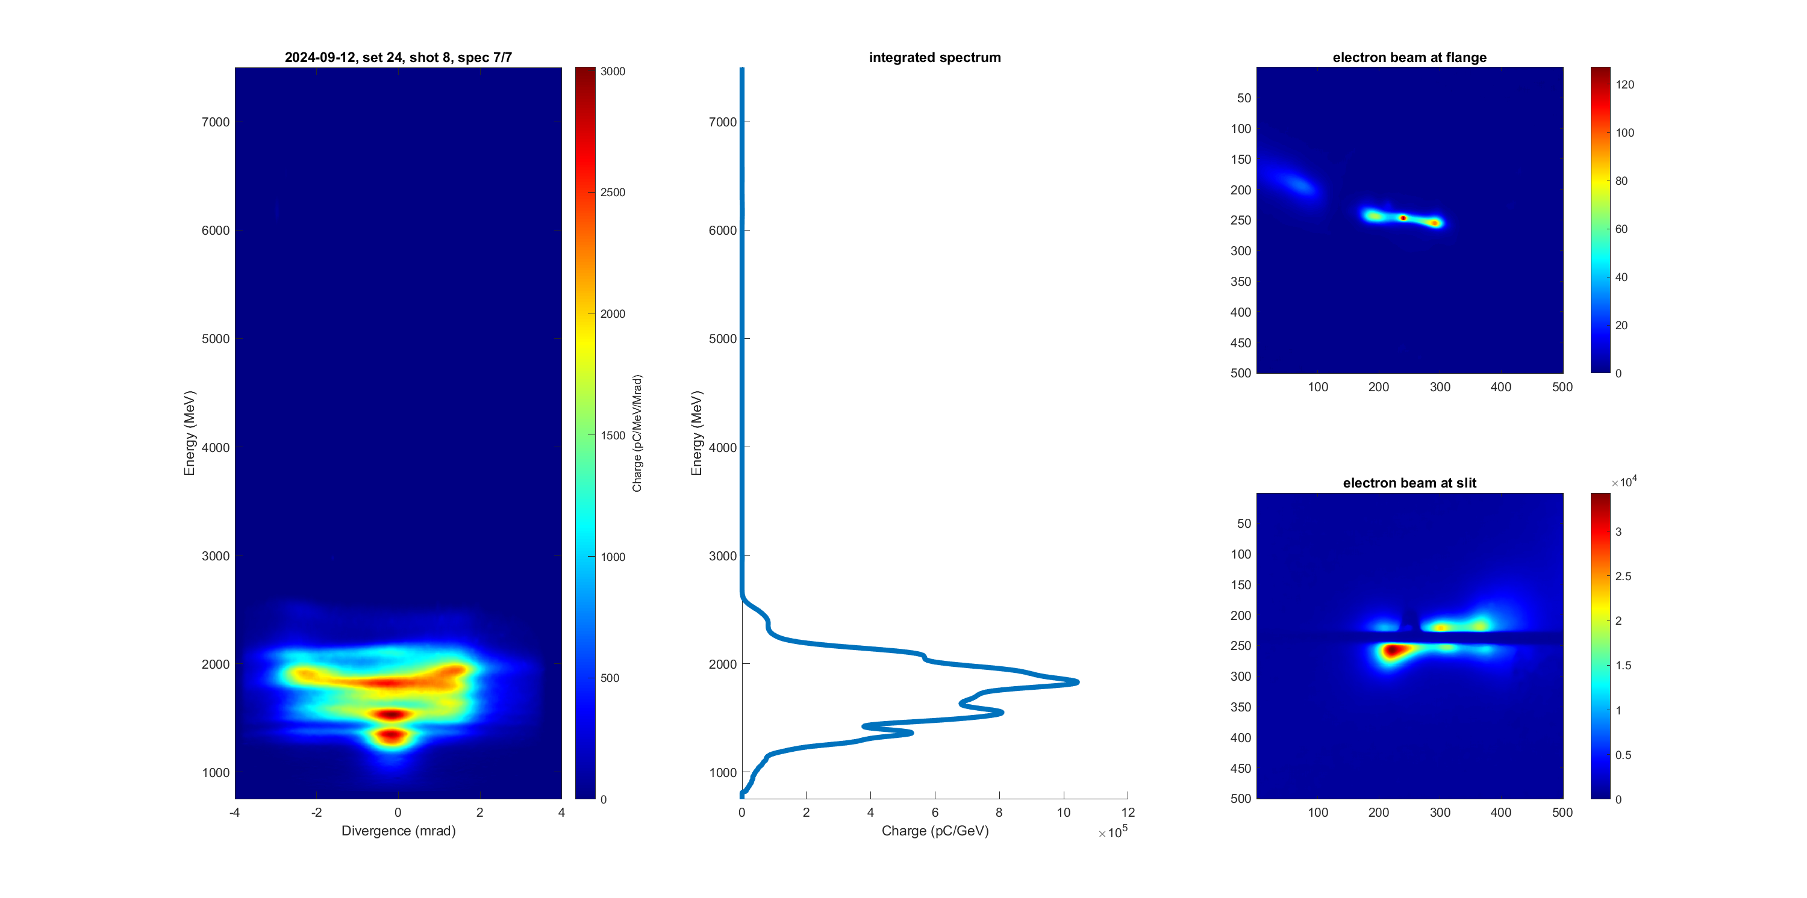
Acceleration of modal electron beams
Beams are observed corresponding to other higher order modes
p = 0
m = 1
*2p = |m|
p = 1
m = 0
p = 0
m = -±2
&
Manuscript in preparation

Slide 17
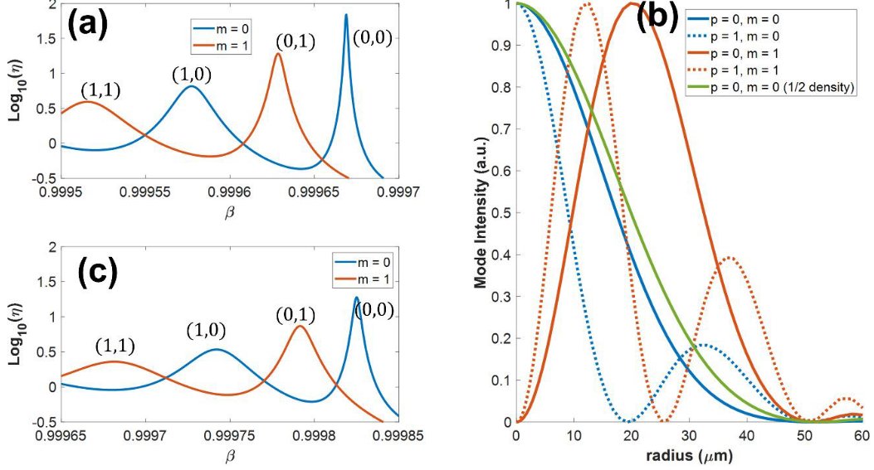
Quasibound Mode Confinement

Slide 18
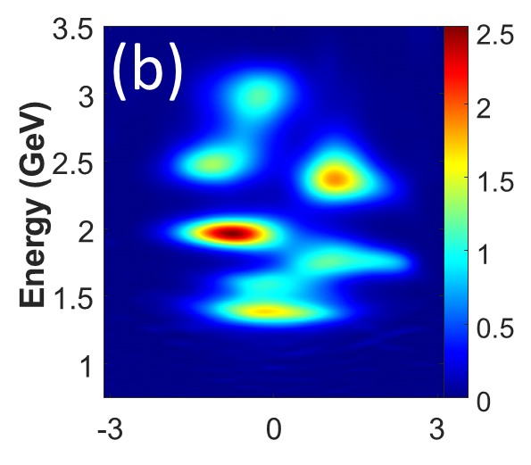
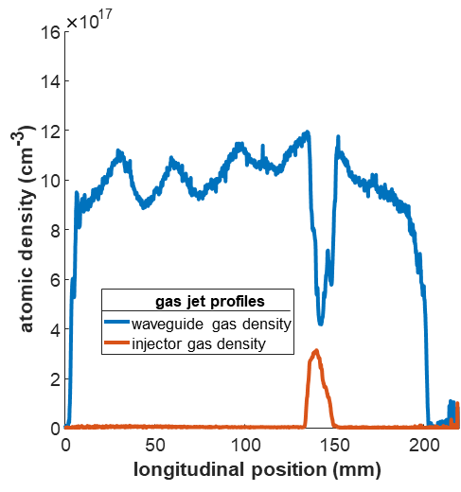
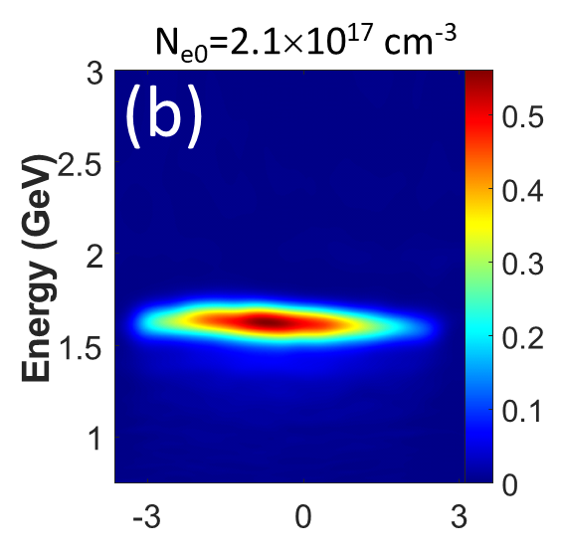
Modular gas jets
Local axial control of plasma parameters and mode properties (gas species, density)
Arbitrarily extendable, with log axicon enabling >1 meter channel lengths
H₂ plasma fluorescence above 1 meter jet
Localized injection section (N₂)
1 m log axicon used to make the plasma
B. Miao et al., Rev. Sci. Instrum. 96, 043003 (2025)
E. Rockafellow et al., Phys. Plasmas 32, 053102 (2025)
J. E. Shrock et al., Phys. Rev. Lett. 132, 045002 (2024)

Slide 19
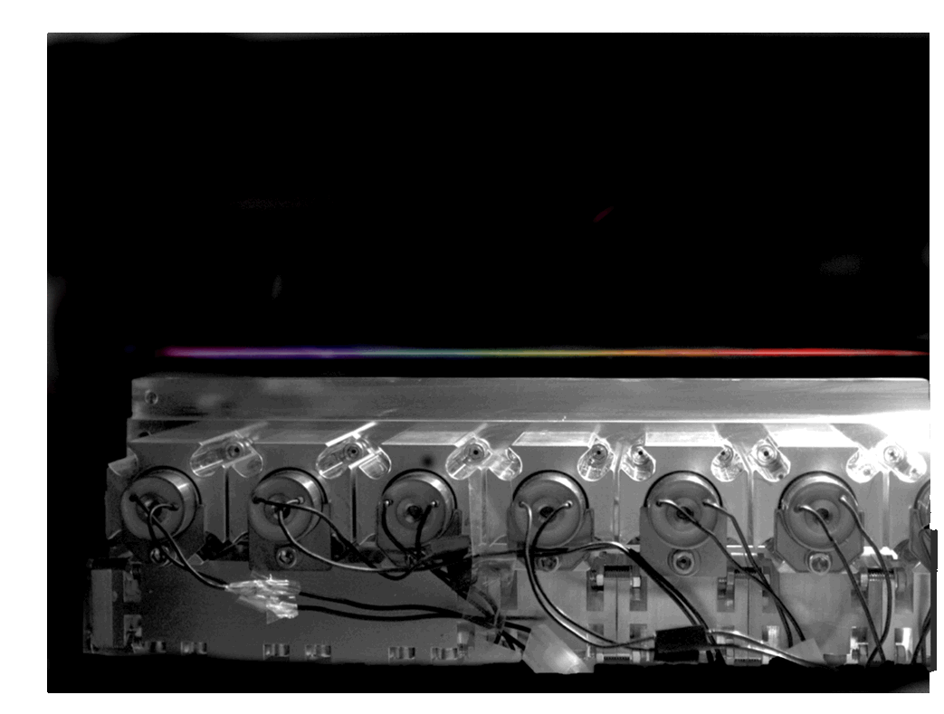
Modular gas jets
H₂ plasma fluorescence above 1 meter jet
Localized injection section (N₂)
1 m log axicon used to make the plasma
Local axial control of plasma parameters and mode properties (gas species, density)
Arbitrarily extendable, with log axicon enabling >1 meter channel lengths
B. Miao et al., Rev. Sci. Instrum. 96, 043003 (2025)
E. Rockafellow et al., Phys. Plasmas 32, 053102 (2025)

