Slide 1
PIConGPU
Coupling HPC and AI for
Laser-Plasma Simulations
Michael Bussmann · HZDR

Slide 2
Parallel programming
TWEAC
Travelling Wave Electron ACceleration
SIMT

Slide 3
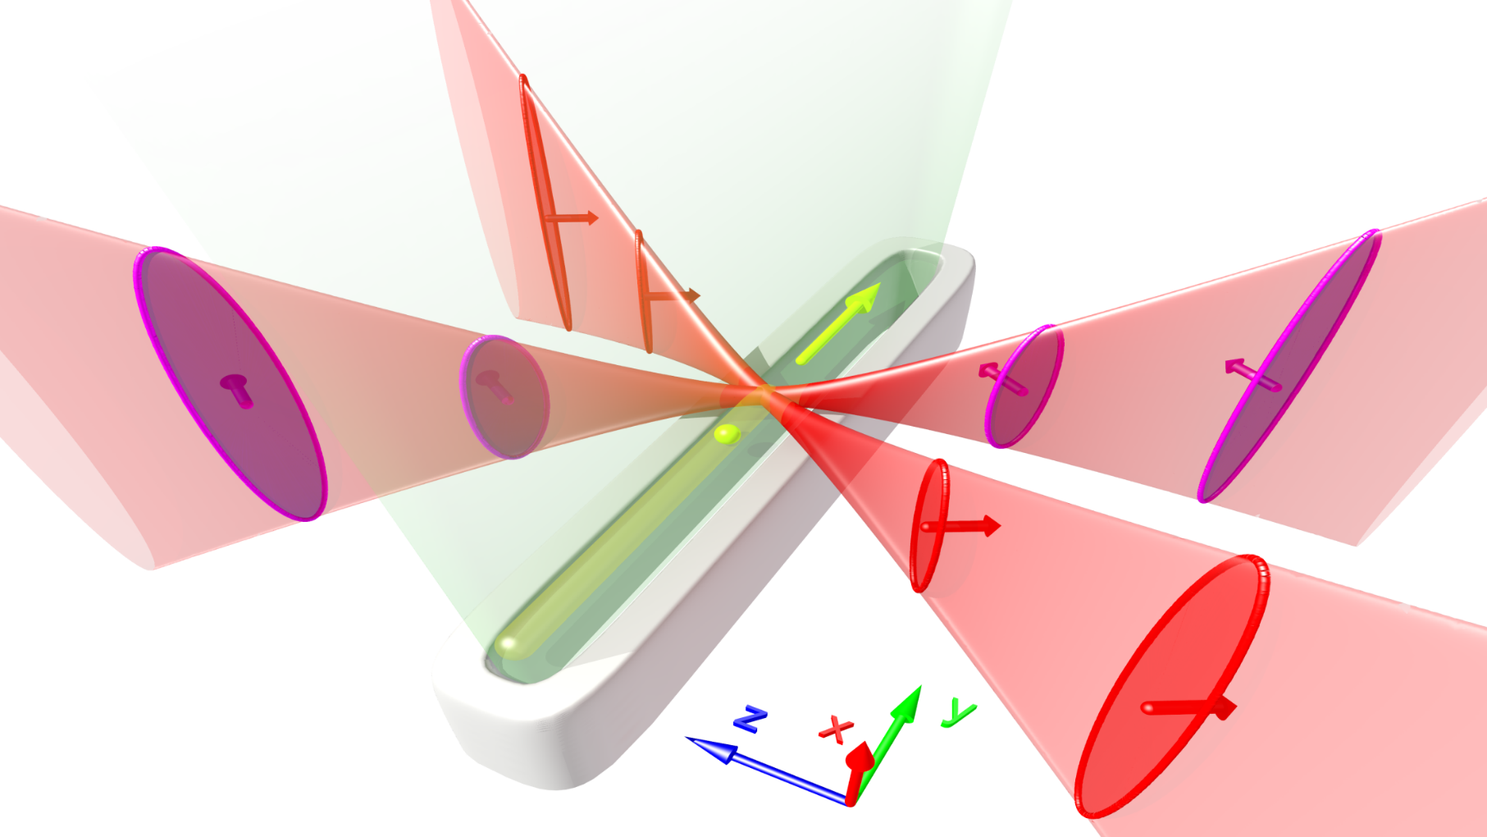
Travelling-Wave Electron Acceleration (TWEAC)
No dephasing, little self modulation

Slide 4
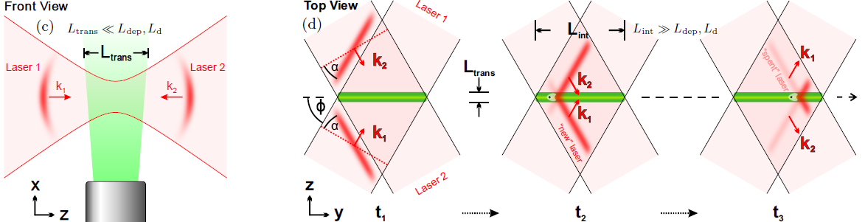
Travelling-Wave Electron Acceleration (TWEAC)
No dephasing, little self modulation

Slide 5
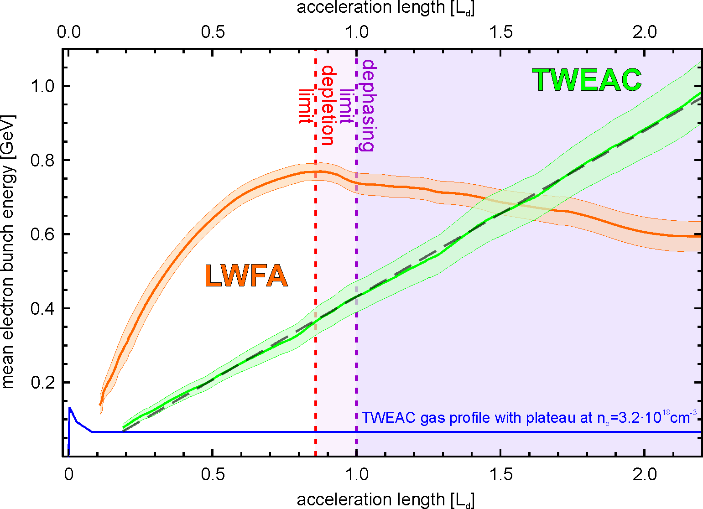
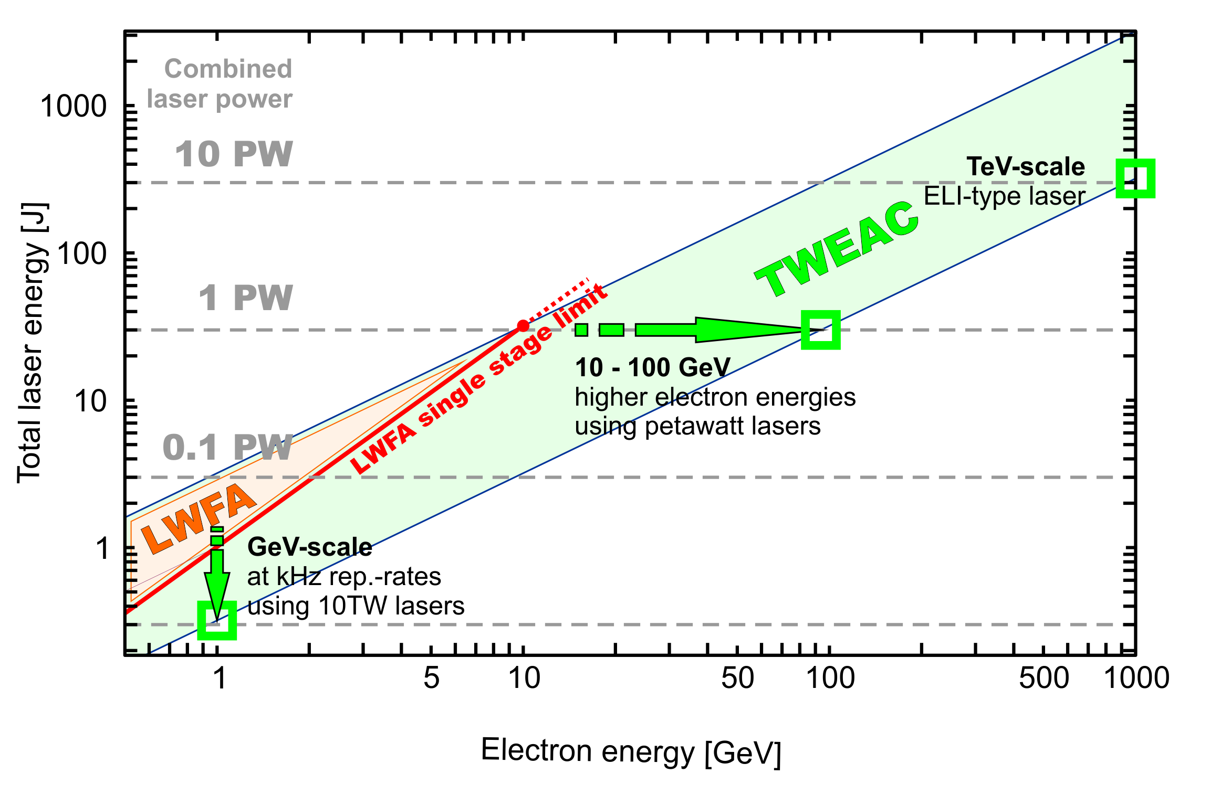
Travelling-Wave Electron Acceleration (TWEAC)
No dephasing, little self modulation

Slide 6
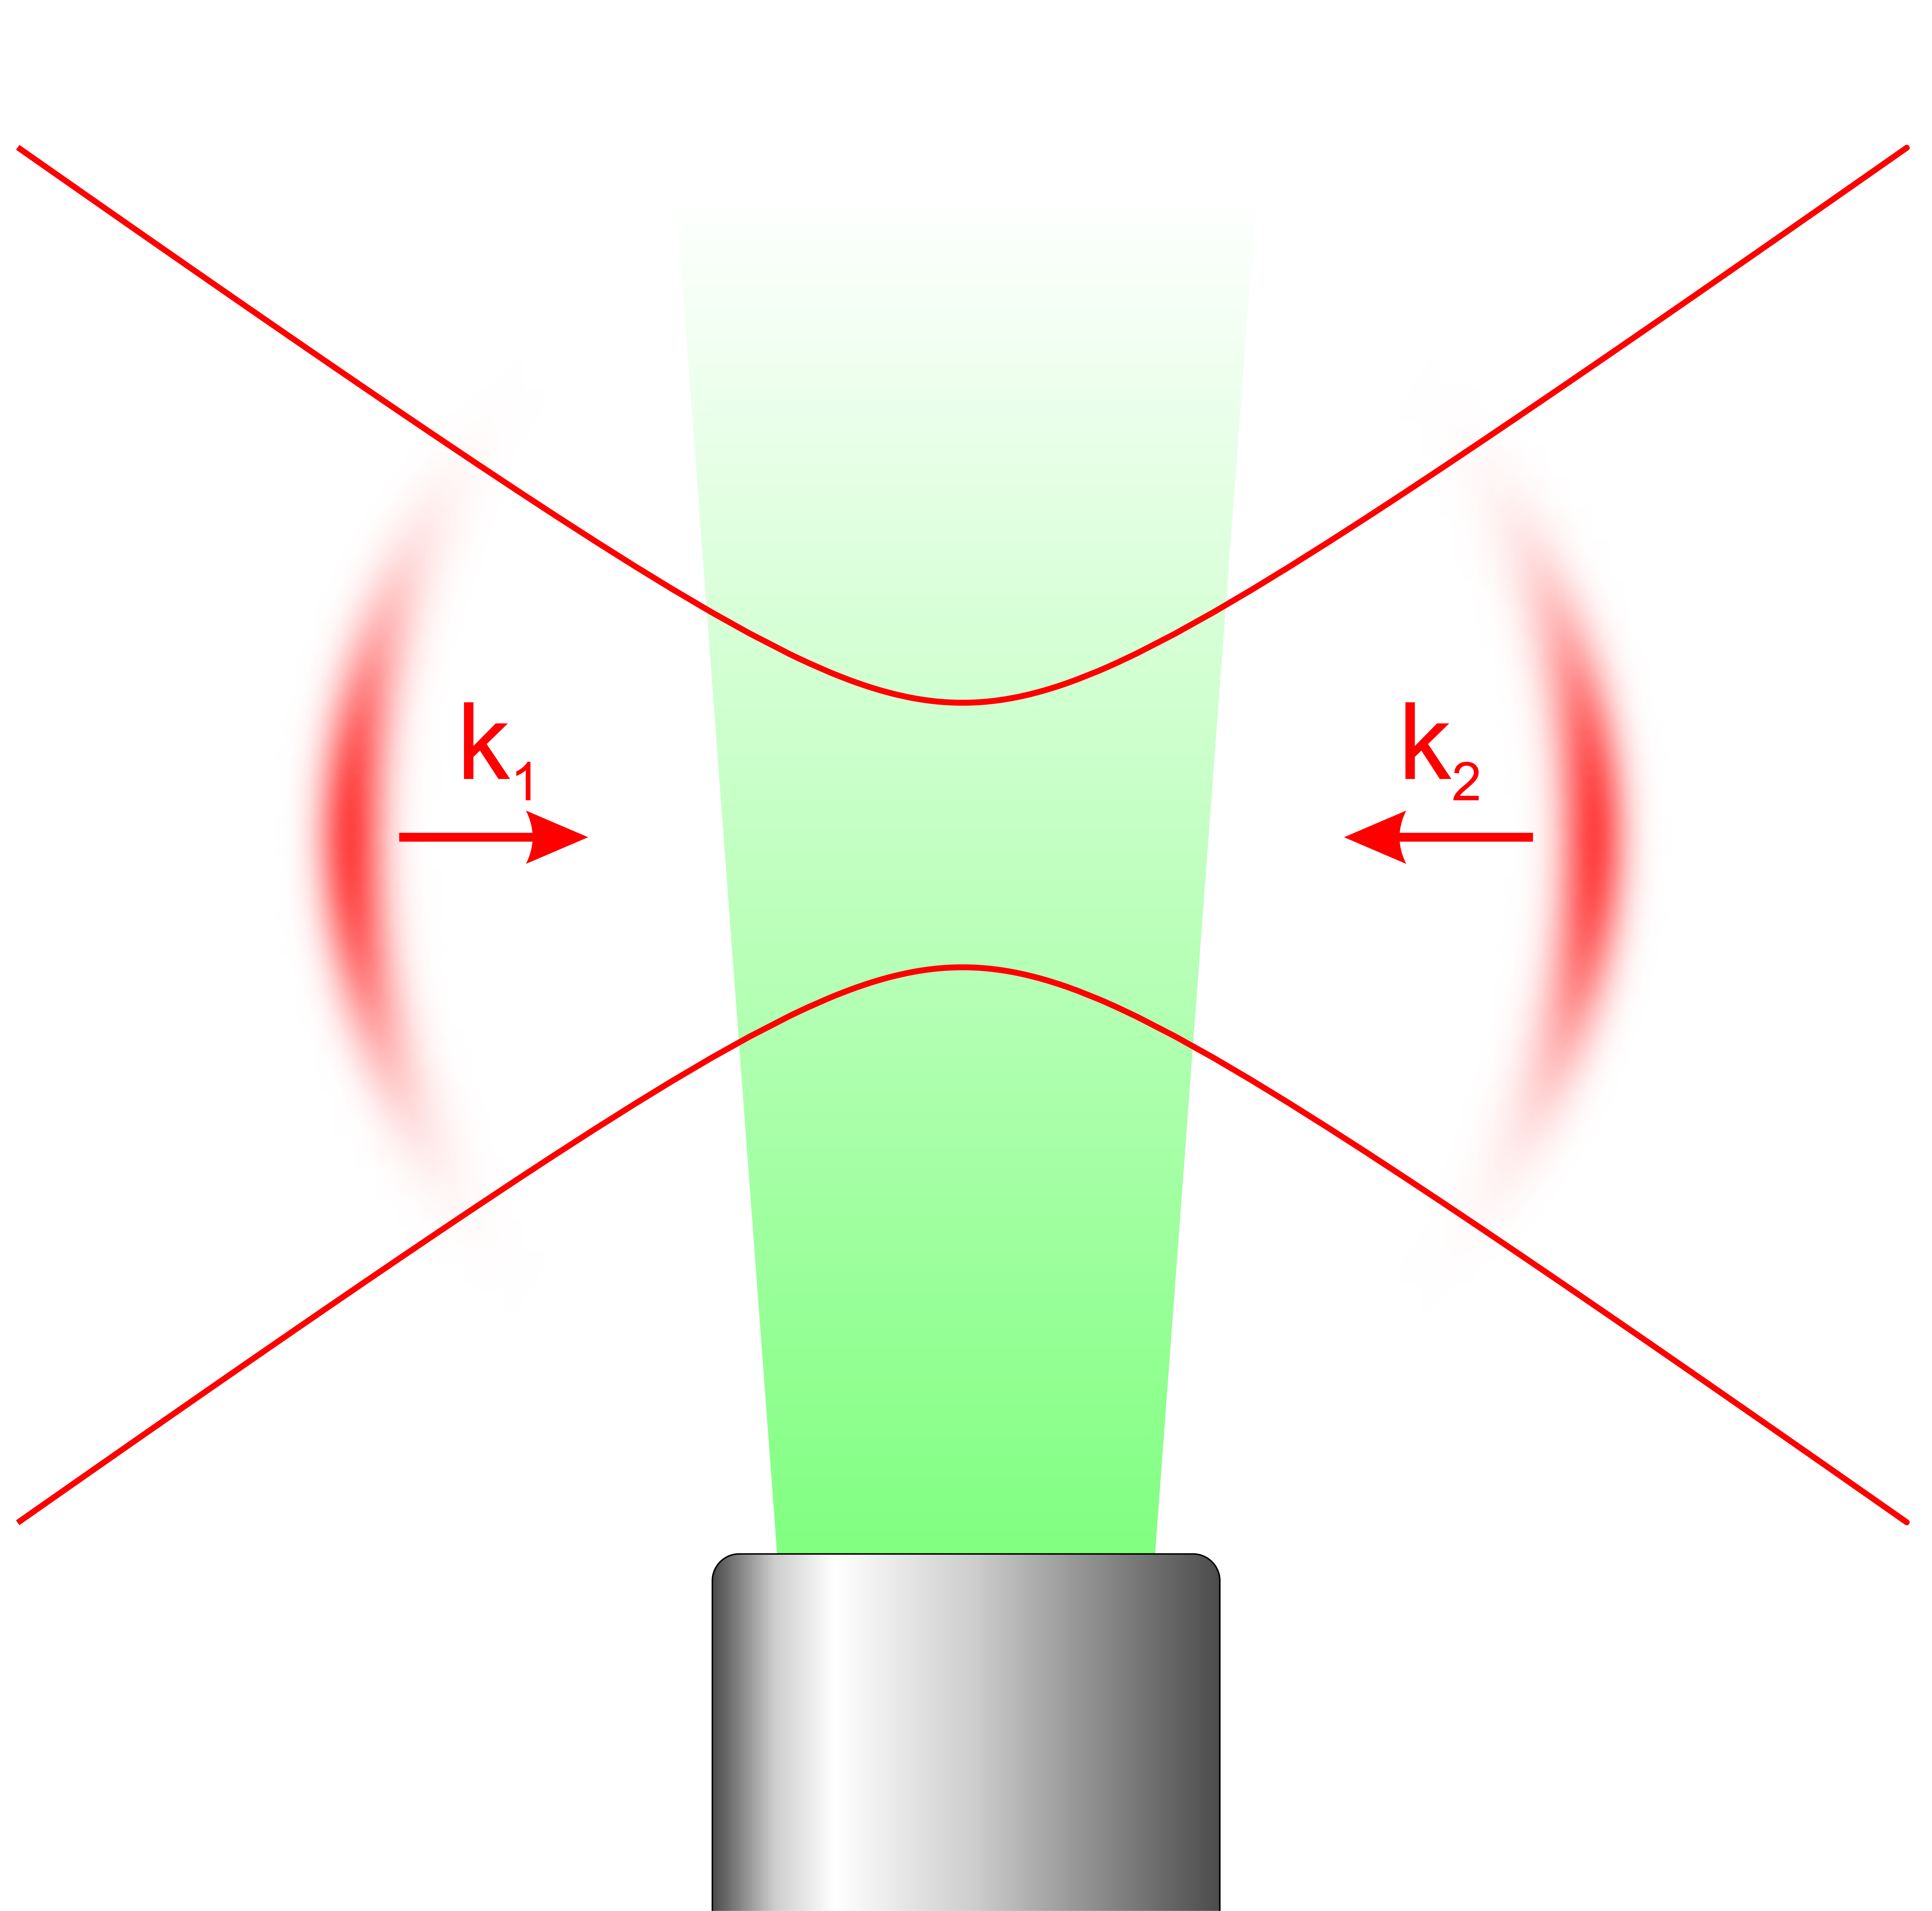
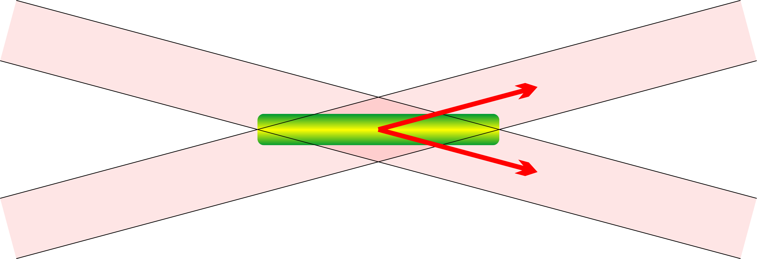
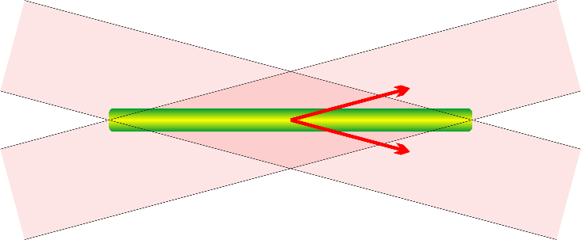
Travelling-Wave Electron Acceleration (TWEAC)
No dephasing, little self modulation
Strictly lateral, laser in- and out coupling
Stationary propagation distances to center of interaction.
Geometrically enforces stationary acceleration conditions.
No geometric occlusion from gas nozzle or scrapers.
Reduces need to ionize an extended plasma volume
compared to axial laser-coupling.
Easier accelerator scaling: Subsequent stages can be placed right after one another. Length of stages depends on available lasers.

Slide 7
Travelling-Wave Electron Acceleration (TWEAC)
From LWFA to TWEAC Staging
LWFA
PWFA
TWEAC + 10 GeV
TWEAC + 10 GeV

Slide 8
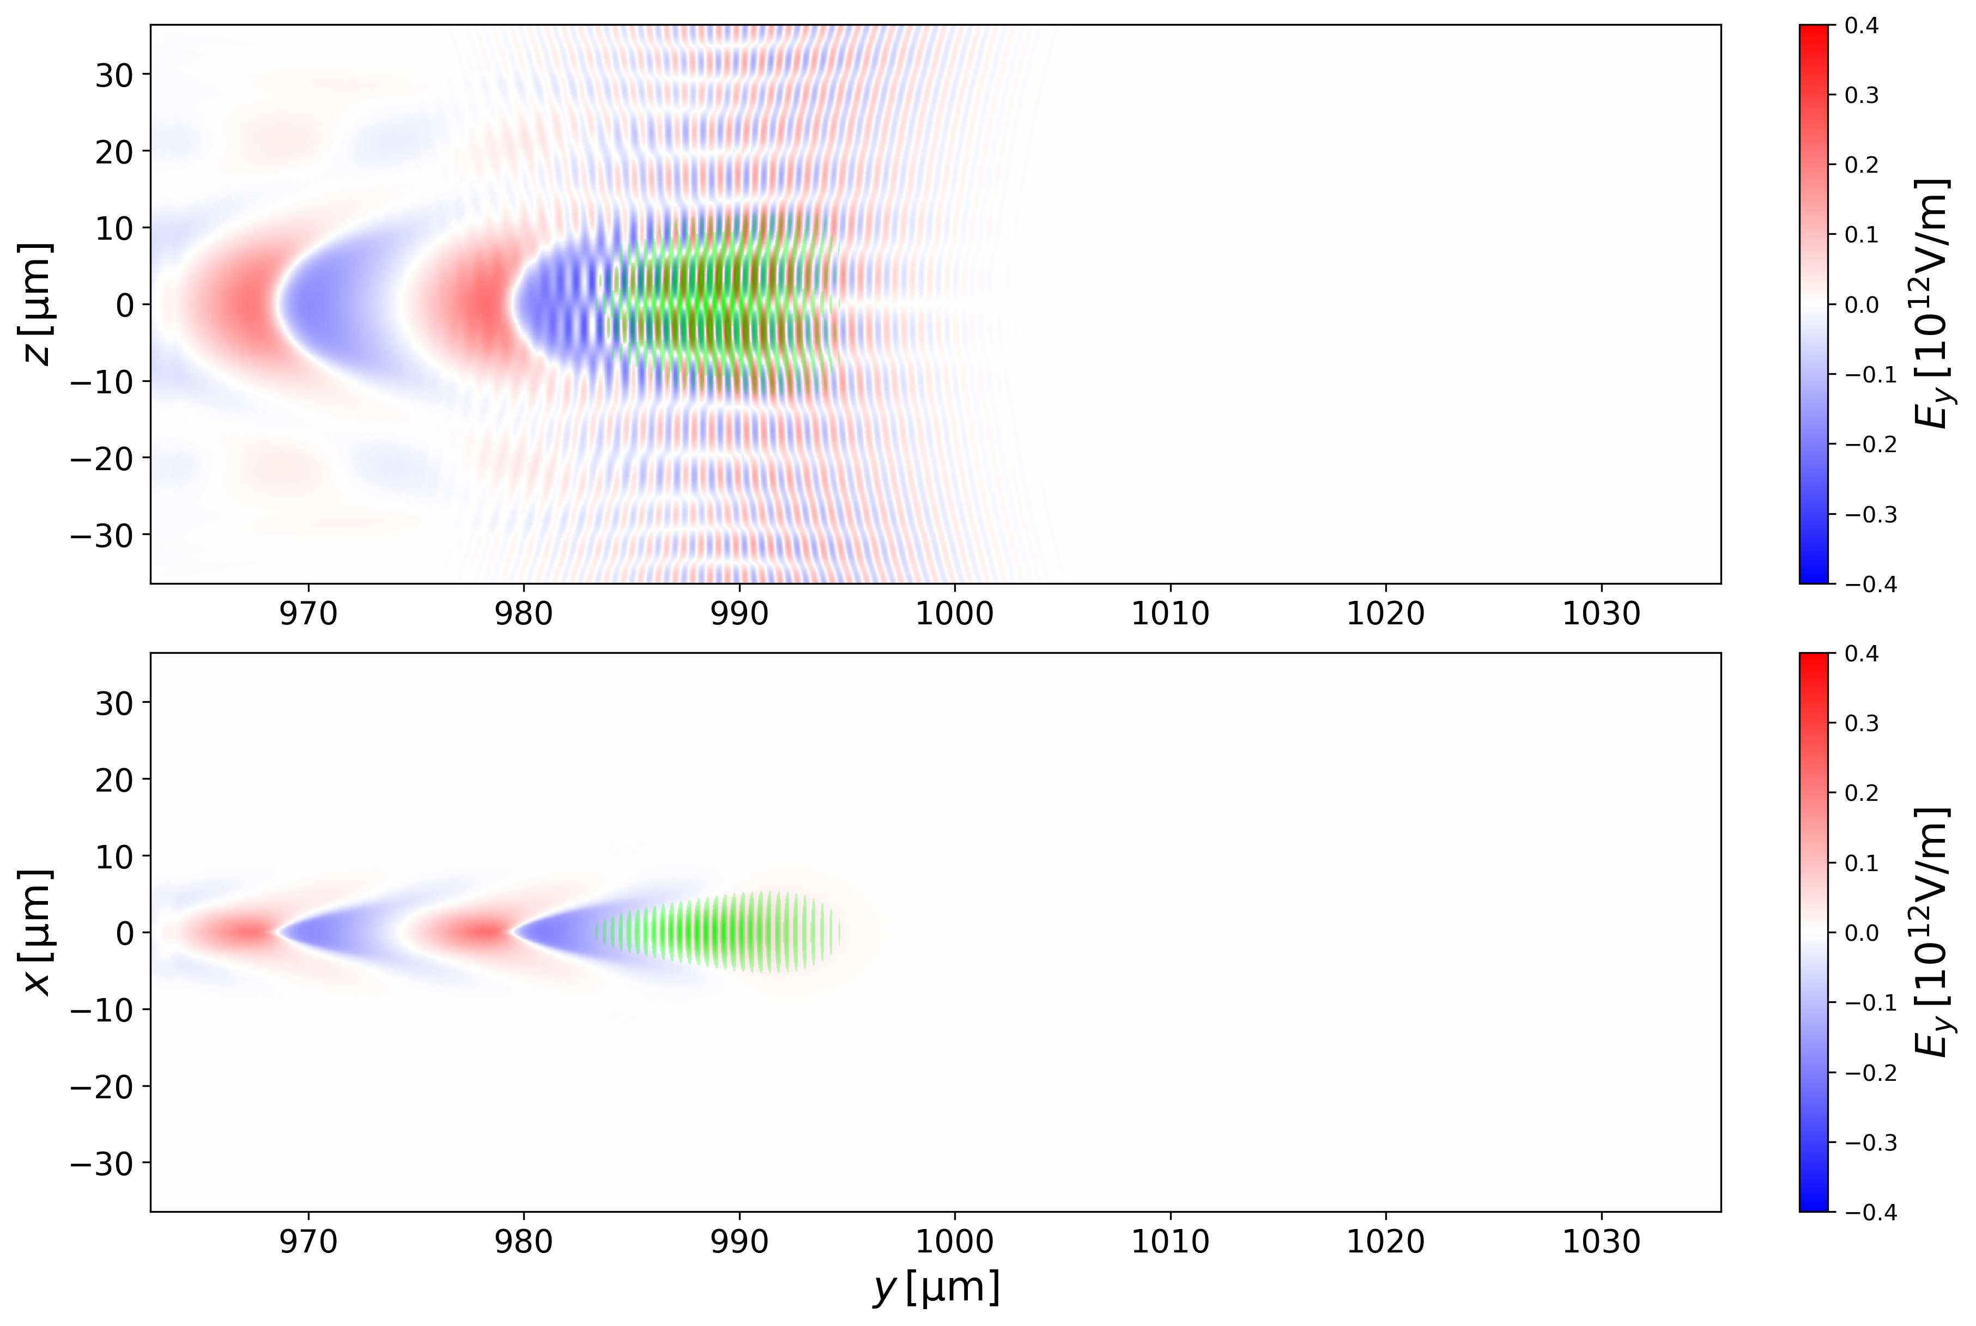
Travelling-Wave Electron Acceleration (TWEAC)
EuroHPC-Application on JUPITER BOOSTER
Symmetric cavities also after extended simulation.
Well-formed cavities without
leaky-modes or parasitic injection.
Transversely narrow cavities <20µm.
Nonlinear wakefields with acceleration gradients of >200 GV/m and linear focusing fields.

Slide 9
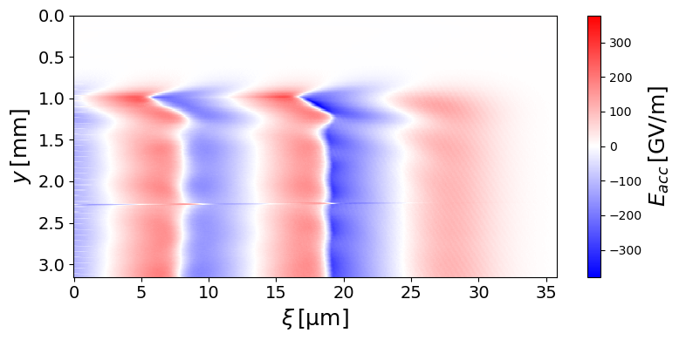
Travelling-Wave Electron Acceleration (TWEAC)
EuroHPC-Application on JUPITER BOOSTER
E_{acc}-lineouts over time
Field reaches steady-state in accelerating field after 0.75 mm and remains constant far beyond LWFA dephasing and depletion lengths.
Some reflections from boundaries still exist
→ Need to further reduce PML reflections.
acceleration distance [mm]

Slide 10
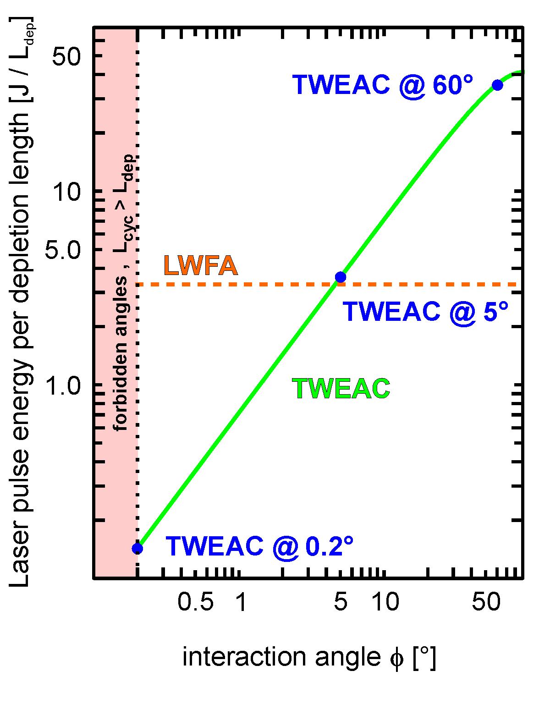
Travelling-Wave Electron Acceleration (TWEAC)
Exascale LWFA simulations
High-density plasmas have more pronounced plasma dynamics on smaller spatial and shorter time scales.
Greatly reduces simulation time for exploring the regime.
Benefits on controlling dephasing, depletion and diffraction
are seen earlier.
Experimental perspective of proof-of-principle experiments by lower laser energy requirements.
Speeds up learning curve by exposing potential problems
earlier, such as blowing up plasma dynamics,
code numerics or both.
same laser
energy

Slide 11
Parallel programming
HPC + AI
Optimizing for applications, democratizing HPC simulations
SIMT

Slide 12


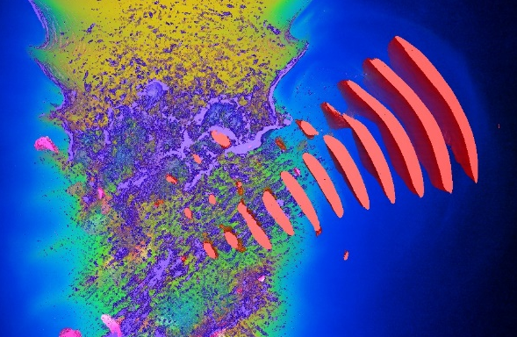
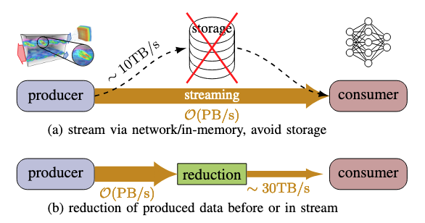
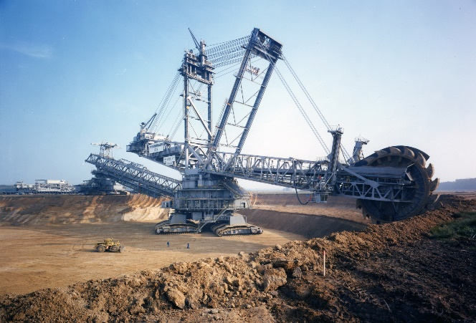


Data storage is a thing of the past!
Data rates become too high, volumes too large for storage
0.6 PetaByte / s
0.1TB/s GPU to GPU 16GB/s internode
file System: 679 PB
full in 100s
but simulation runs longer

Slide 13
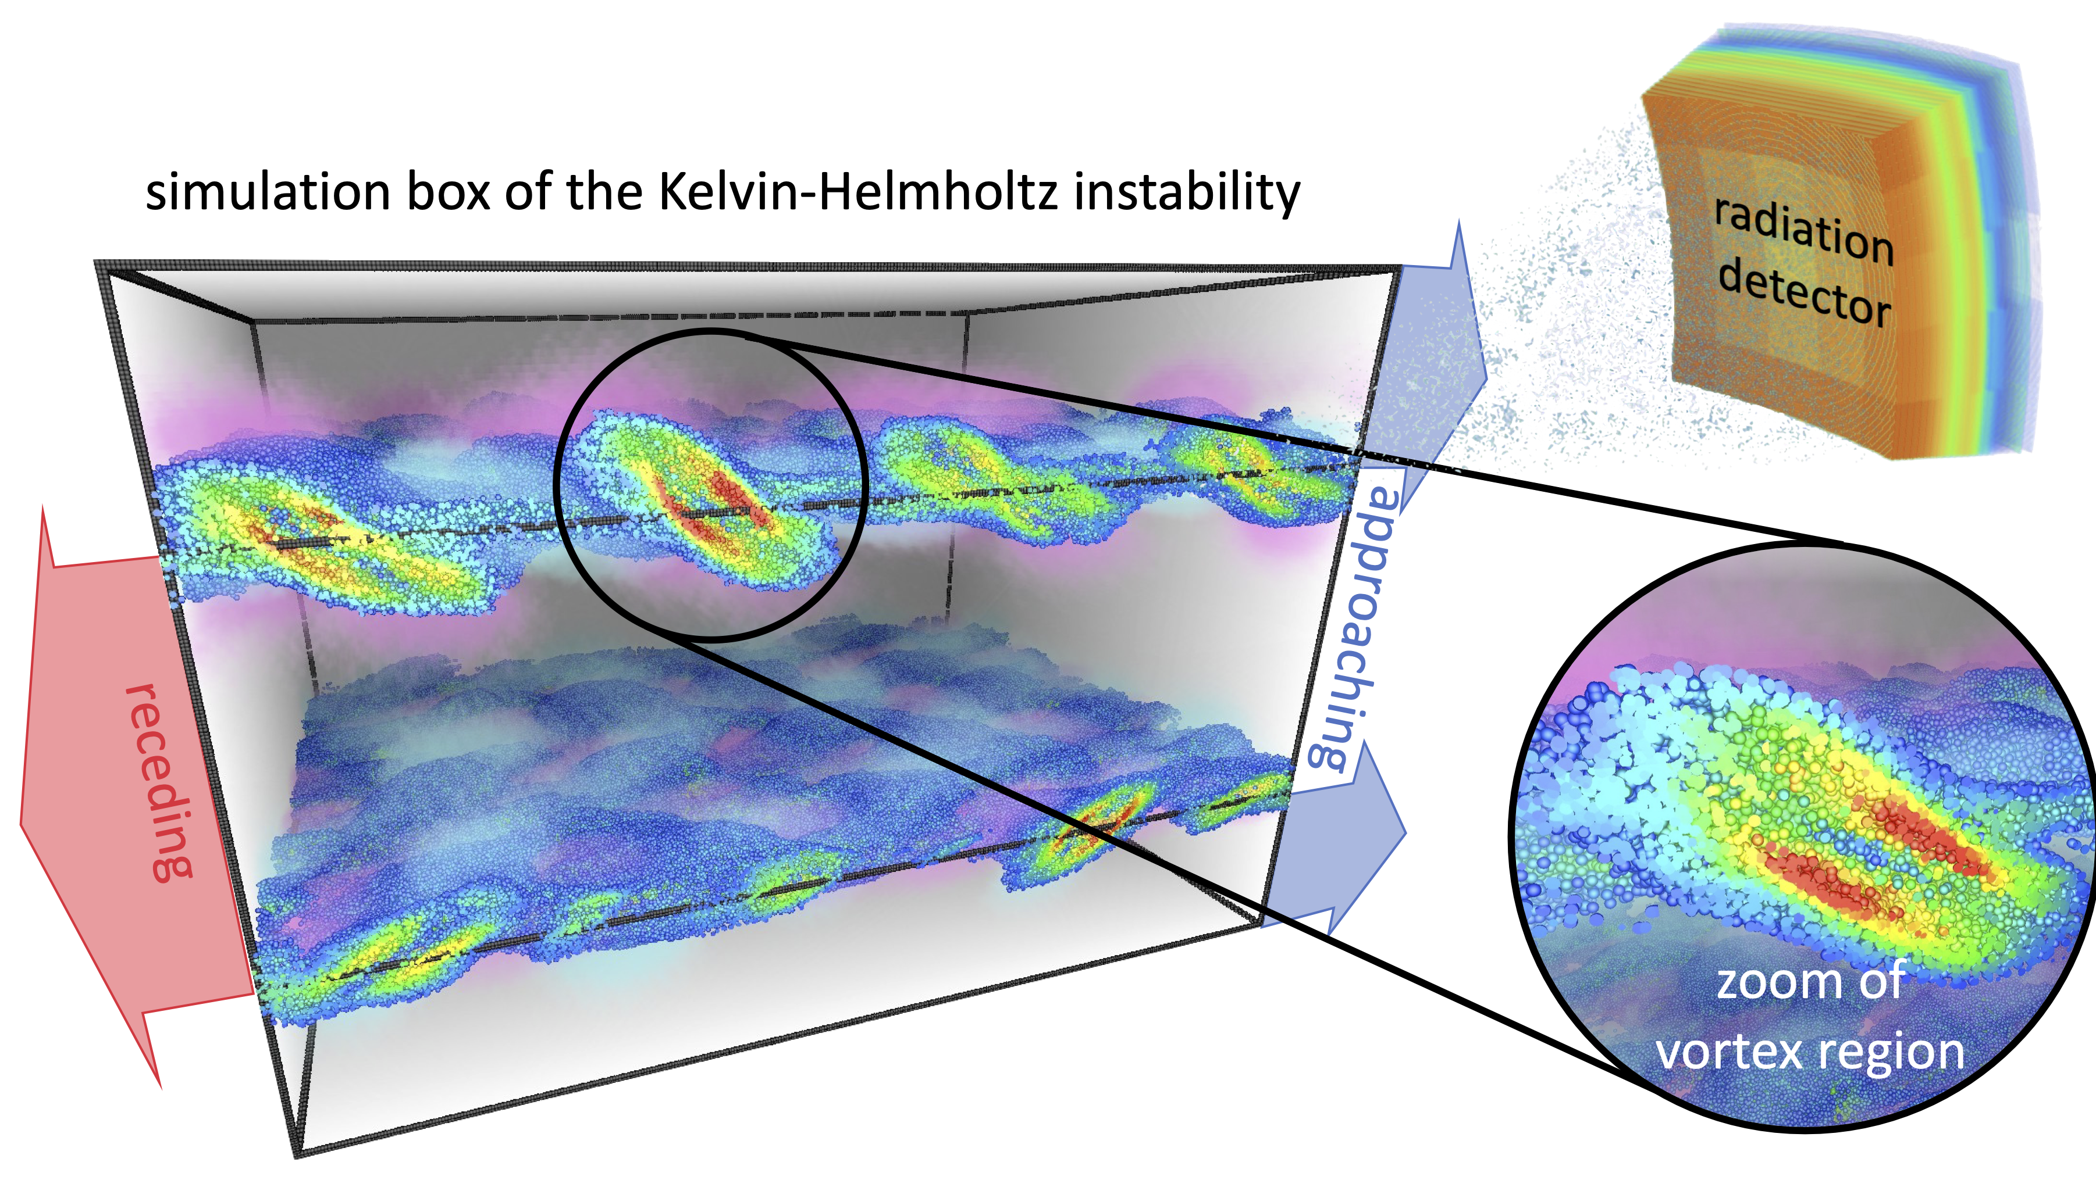
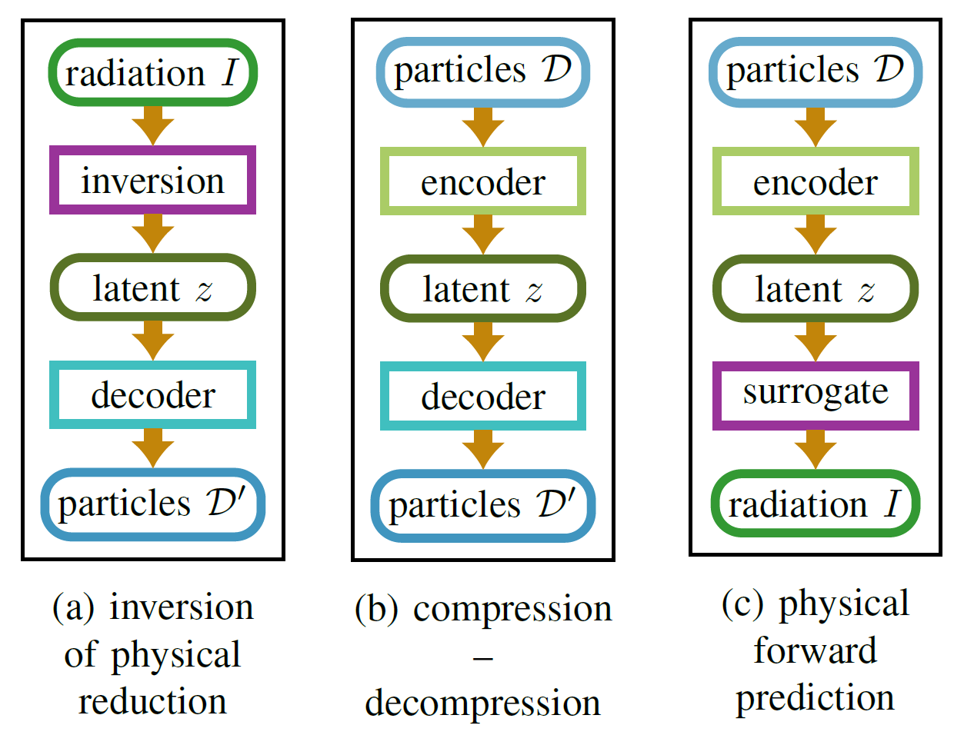
Coupling HPC with AI training at Exascale
Training of a large-scale invertible AI model with streaming simulation data
Train neural networks for:
Forward problem:
particle to radiation
Compression:
particle to particle latent space
Inverse problem:
radiation to particle

Slide 14
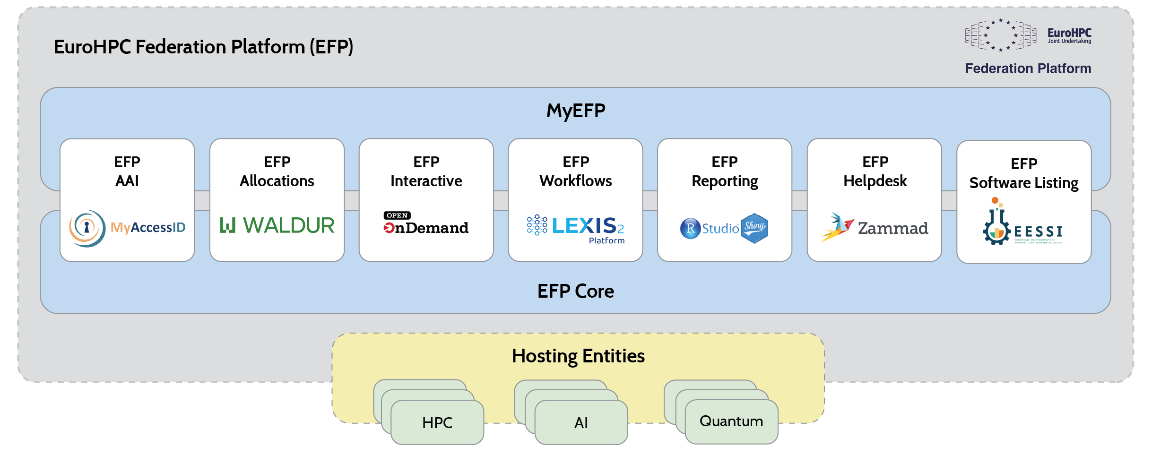
EuroHPC deployment and standardization
Why do we still use the shell? Ah, because OpenOnDemand DOES NOT HAVE A REST-API!!!

Slide 15
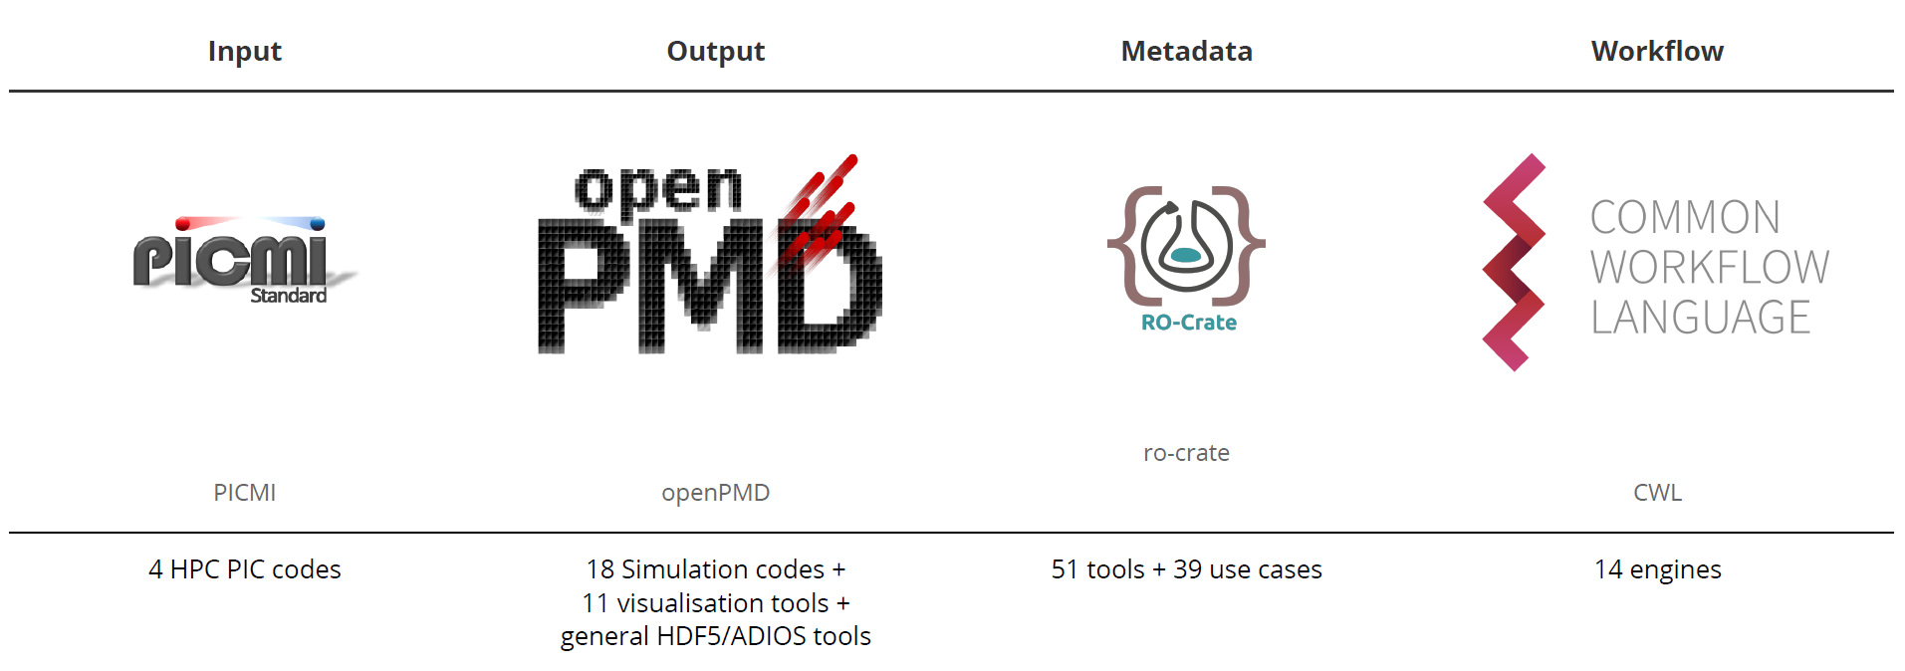
EuroHPC deployment and standardization
The power of standardization and interoperability

Slide 16
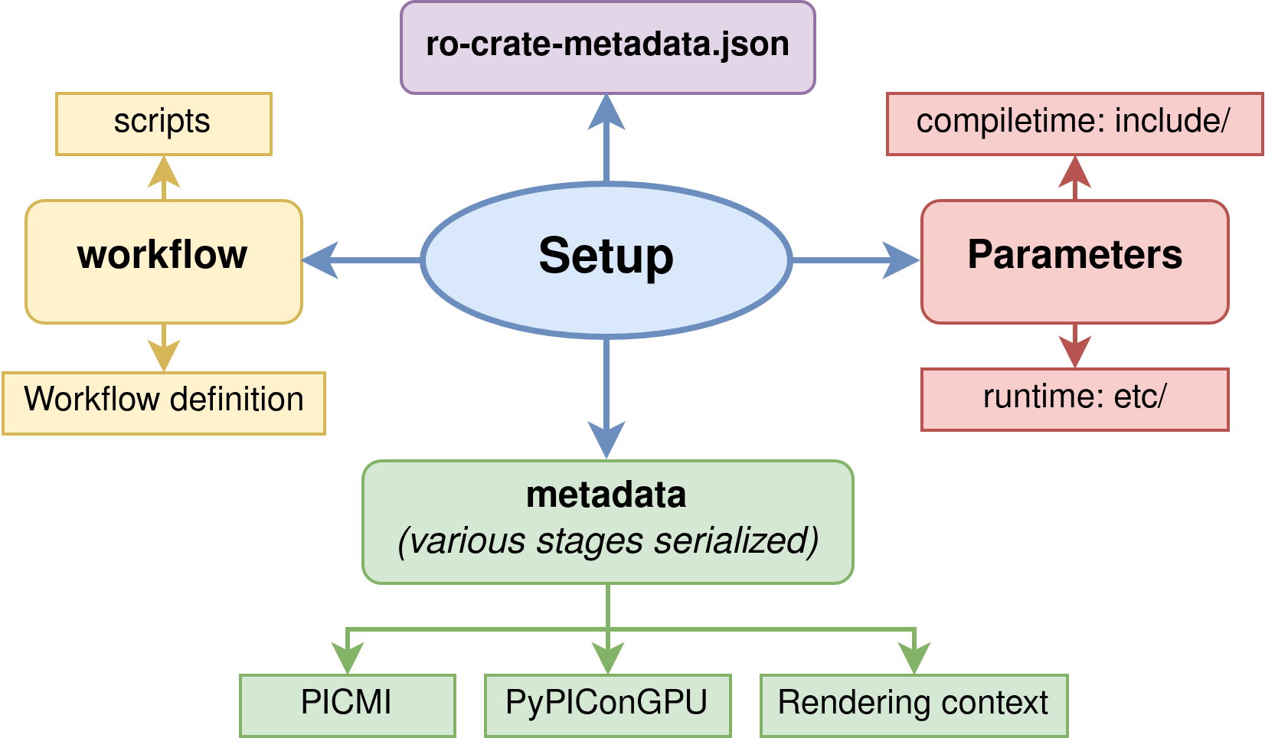
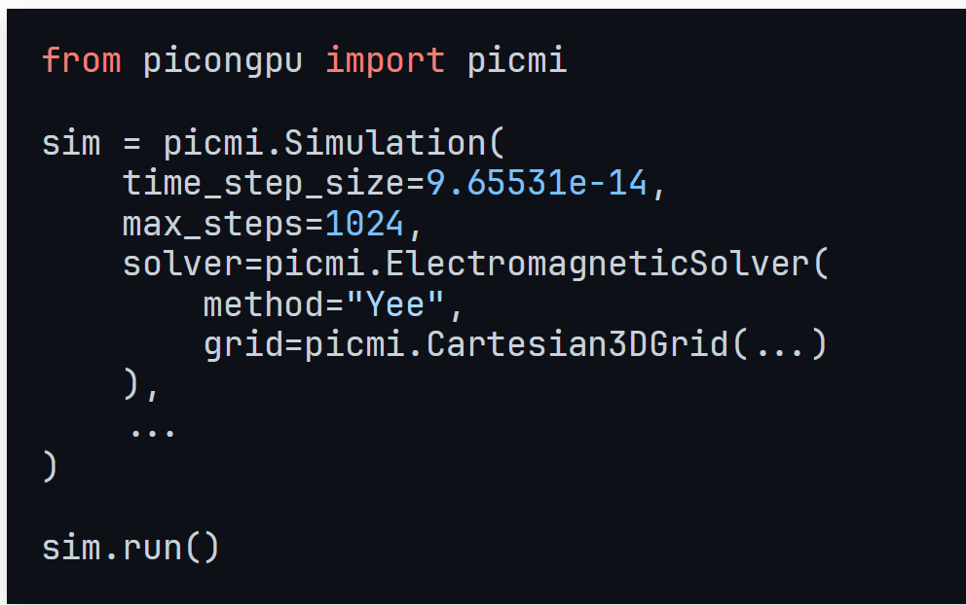
EuroHPC deployment and standardization
Include all (meta)data relevant for defining and executing a simulation

Slide 17
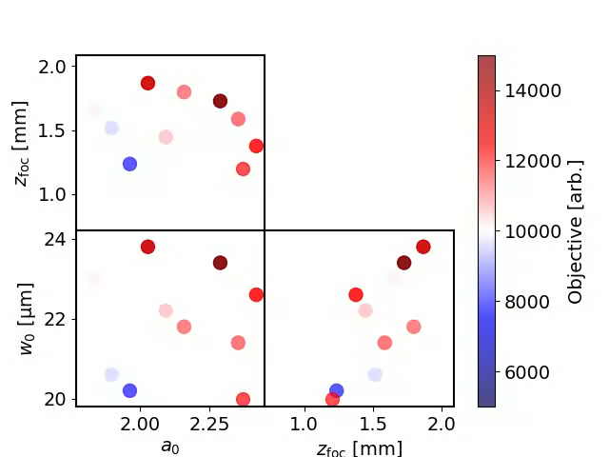
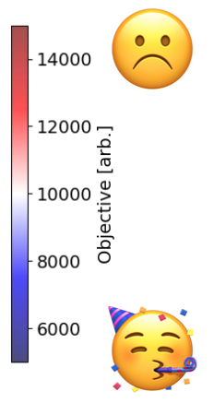
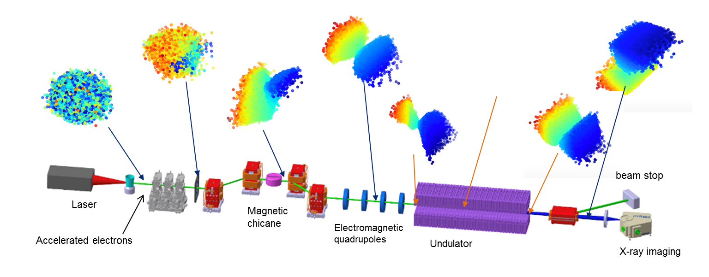
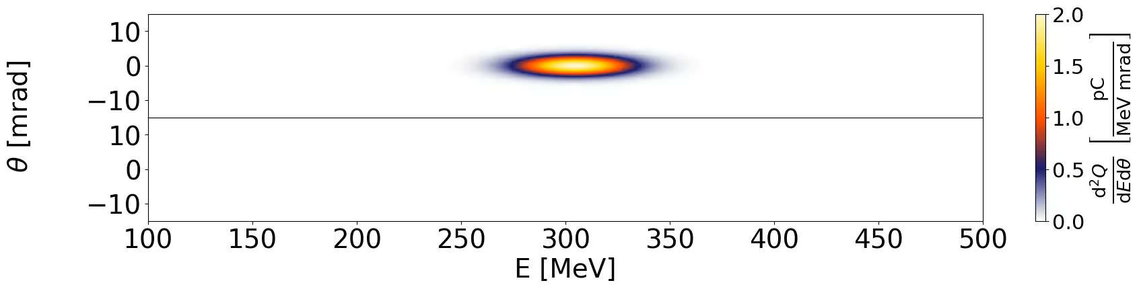
World models combining experiment and simulation
Digitalization of facility operation and experiments: Campaign-driven optimized operation
Each dot represents a
full-scale HPC simulation

Slide 18
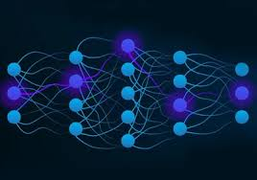
Online training of streaming data @ Exascale
Why use files when you have neural networks?
Inform parameter scan
and FM training
Stream into Model
Multi-modal
World Model
Intelligent parameter scan
Check and train on existing data
Check on existing data and write to repository
F.A.I.R. data repositories

Slide 19





Frontier computing for frontier science
Joining forces in Europe, bringing together magnetic and laser-driven fusion
EuroHPC Center of Excellence for Plasma Simulations PLASMA-PEPSC
    Brings laser fusion and magnetic fusion community together
    Common modeling efforts for atomic physics, looking at plasma-wall interaction (magnetic fusion) and radiation transport (laser fusion)

