Slide 1



Controlled Electron Injection using a Segmented Capillary Gas-Cell in LWFA
Inhyuk Nam
Department of Physics, UNIST, Republic of Korea

Slide 2
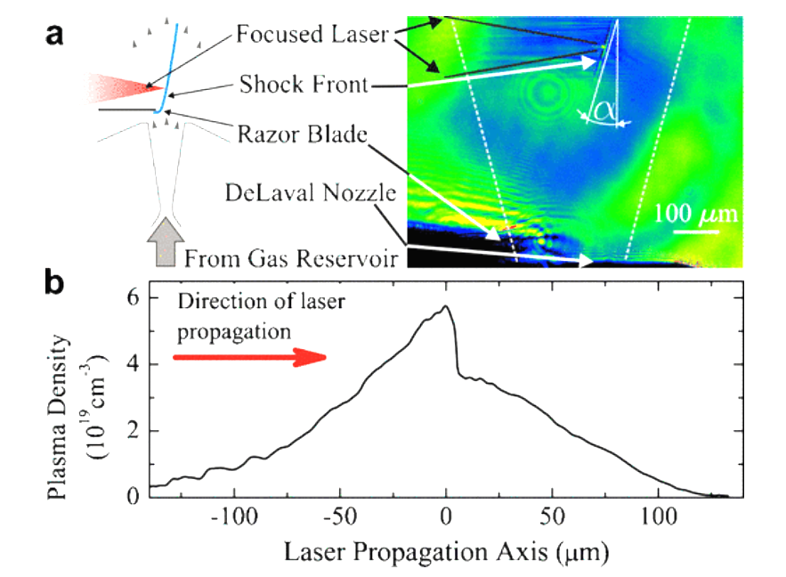
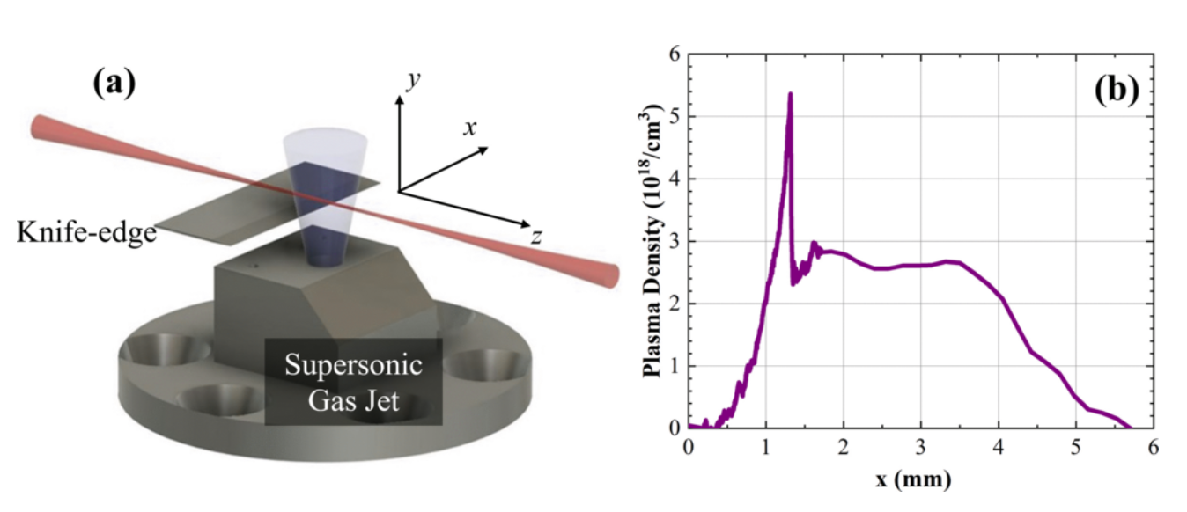
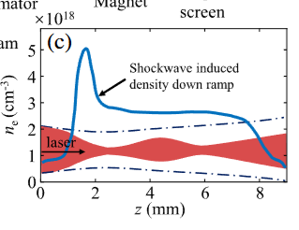
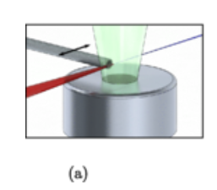
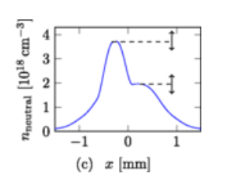
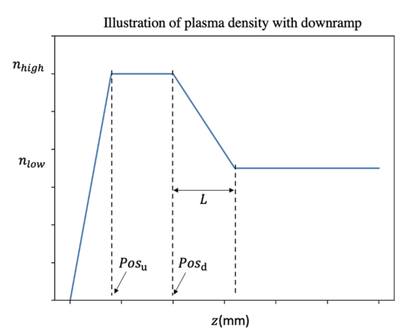
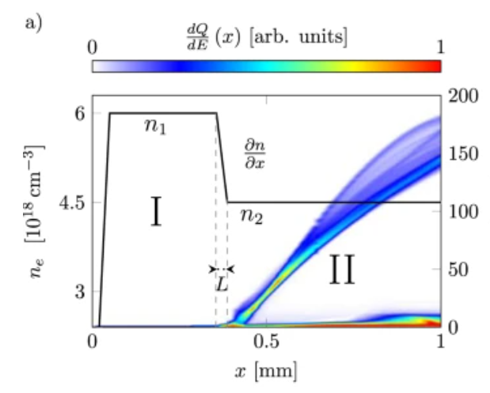
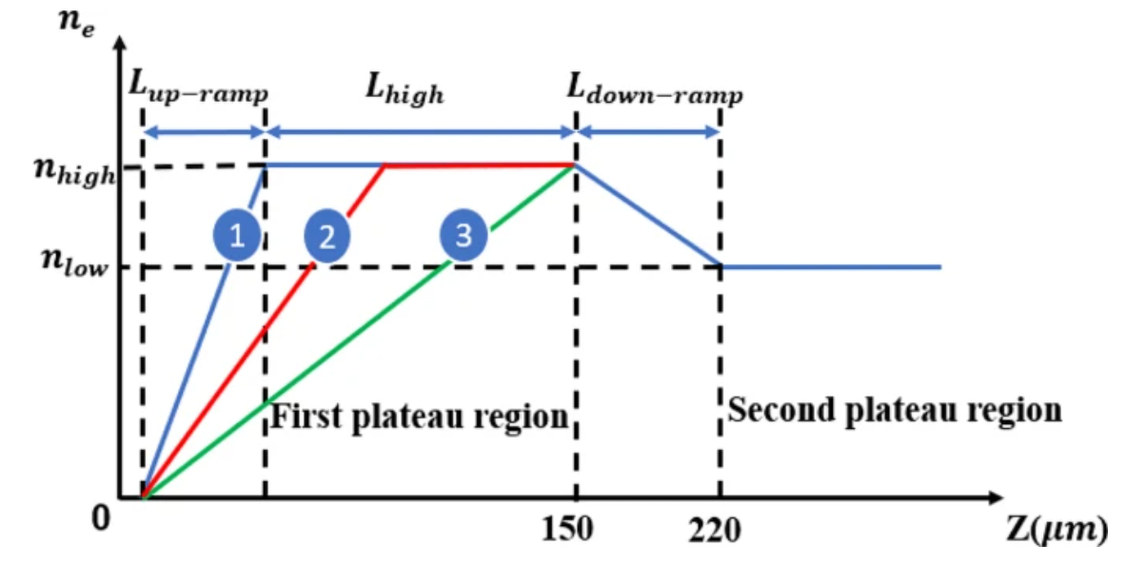
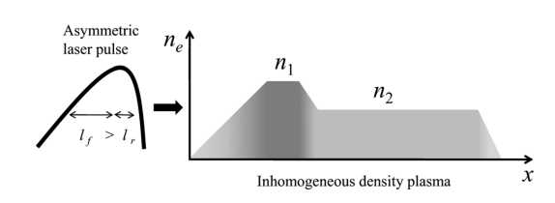
Down-ramp injection to control e-beam for LWFA
Experiments
Advantages: reduce energy spread, control charge, reproducibility
Limitations: rising density up to down-ramp, longer acceleration length
Phys. Rev. ST Accel. Beams 13, 091301 (2010)
Phys. Rev. Research 8, 013207 (2026)
Phys. Rev. Lett. 126, 214801 (2021)
Phys. Rev. ST Accel. Beams 18, 071303 (2015)
Simulations
Phys. Plasmas 18, 043107 (2011)
Sci. Rep. 7, 12229 (2017)
Sci. Rep. 16, 8592 (2026)
Matter Radiat. Extremes 8, 024401 (2023)
Control knobs: length and density for first, second plateau, location of down-ramp
Fine tuning: beam charge, emittance, energy, energy spread
Notes:
Gas jet using a blate, shock wave, very sharp density gradient

Slide 3
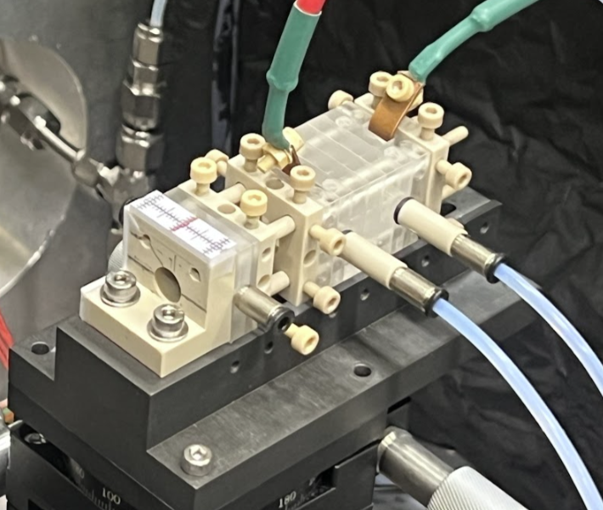
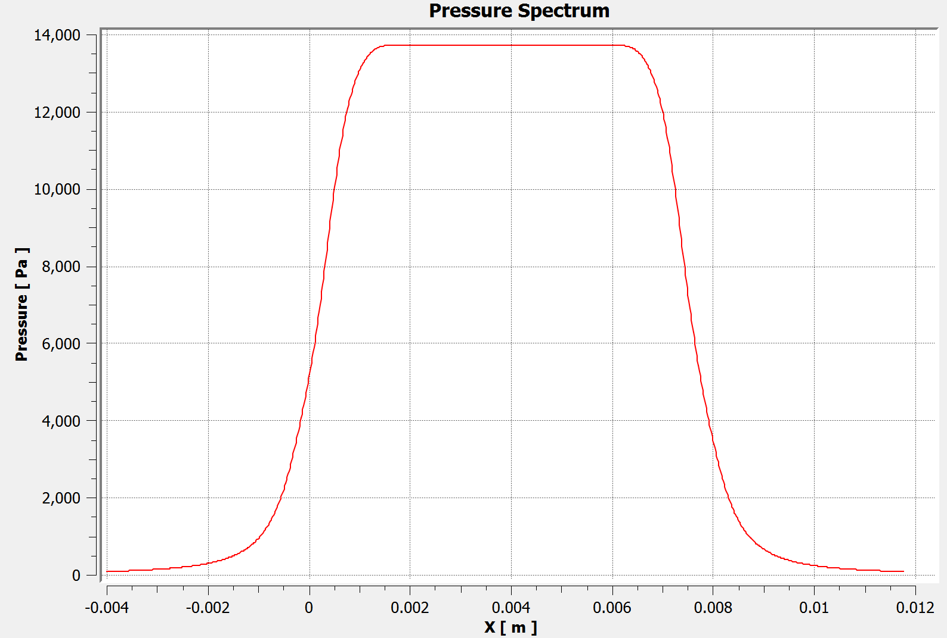
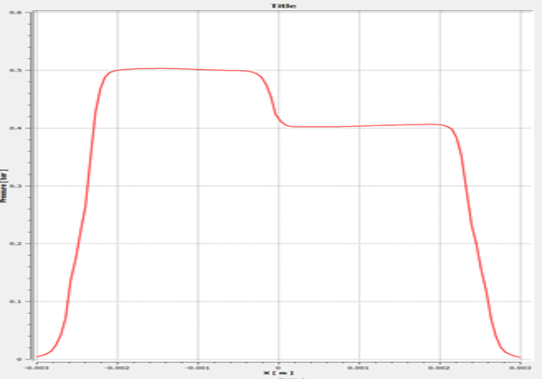
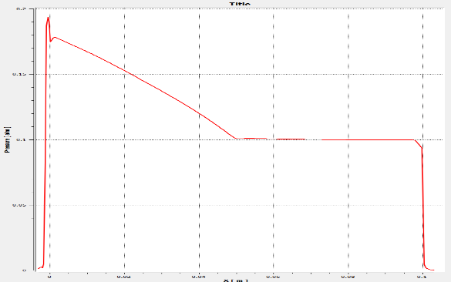
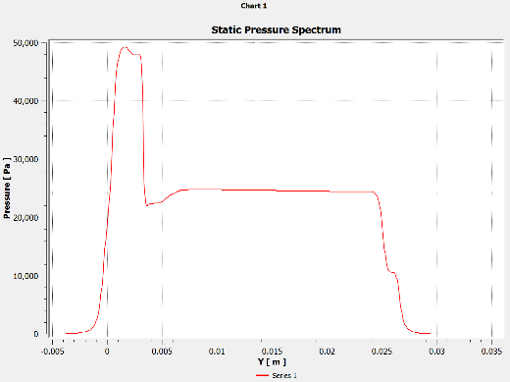
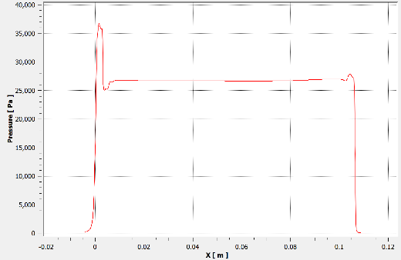
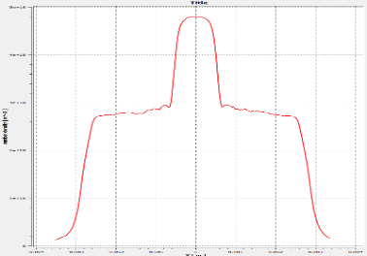
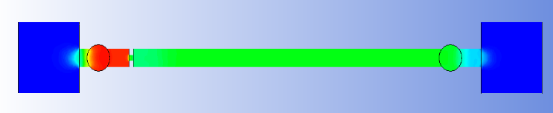
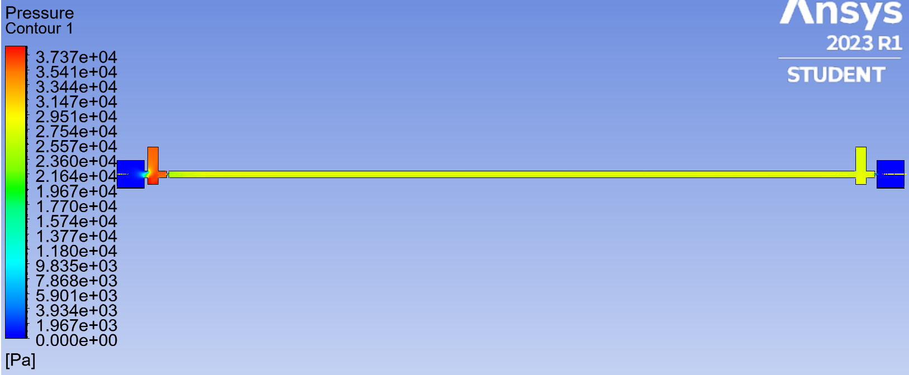
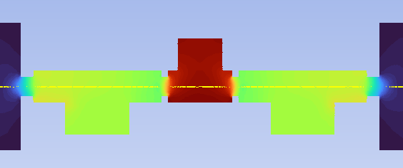
New plasma target source
New plasma target: Variable longitudinal plasma density profile
25 mm
100 mm
Segmented capillary plasma target

Slide 4
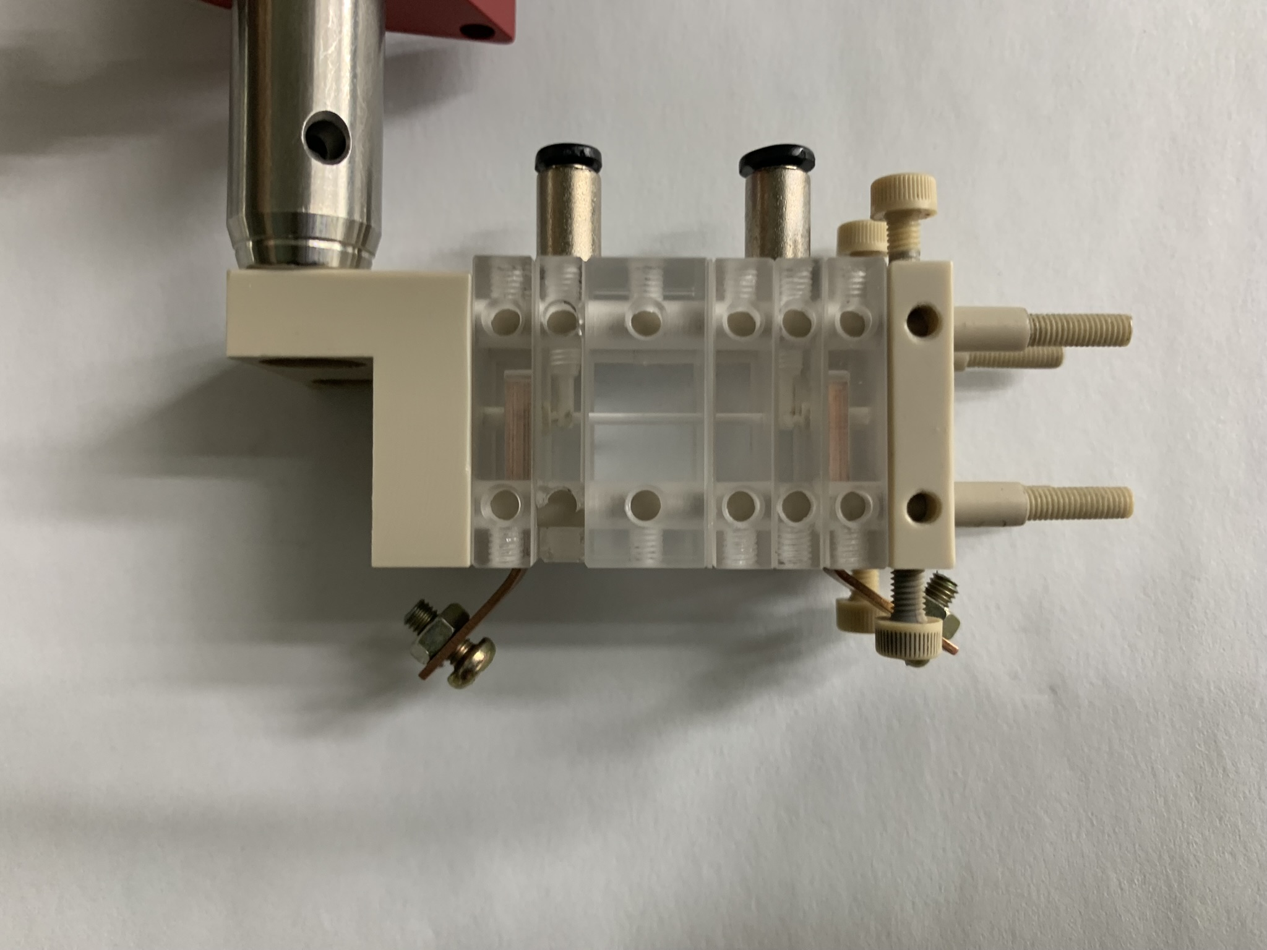
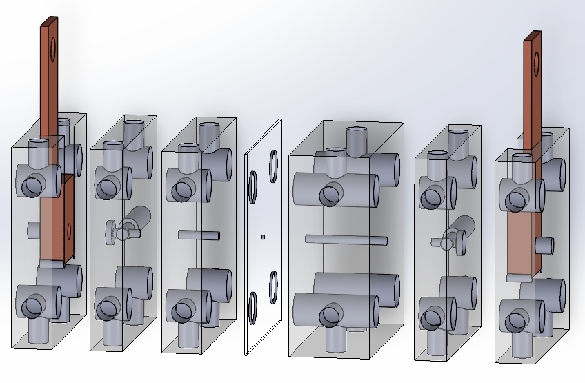
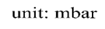
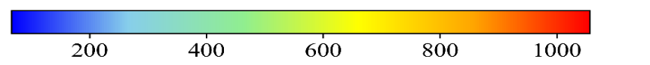
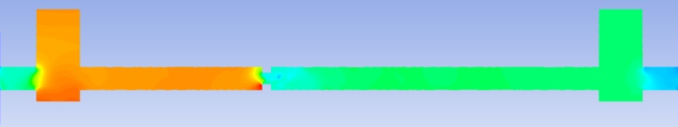
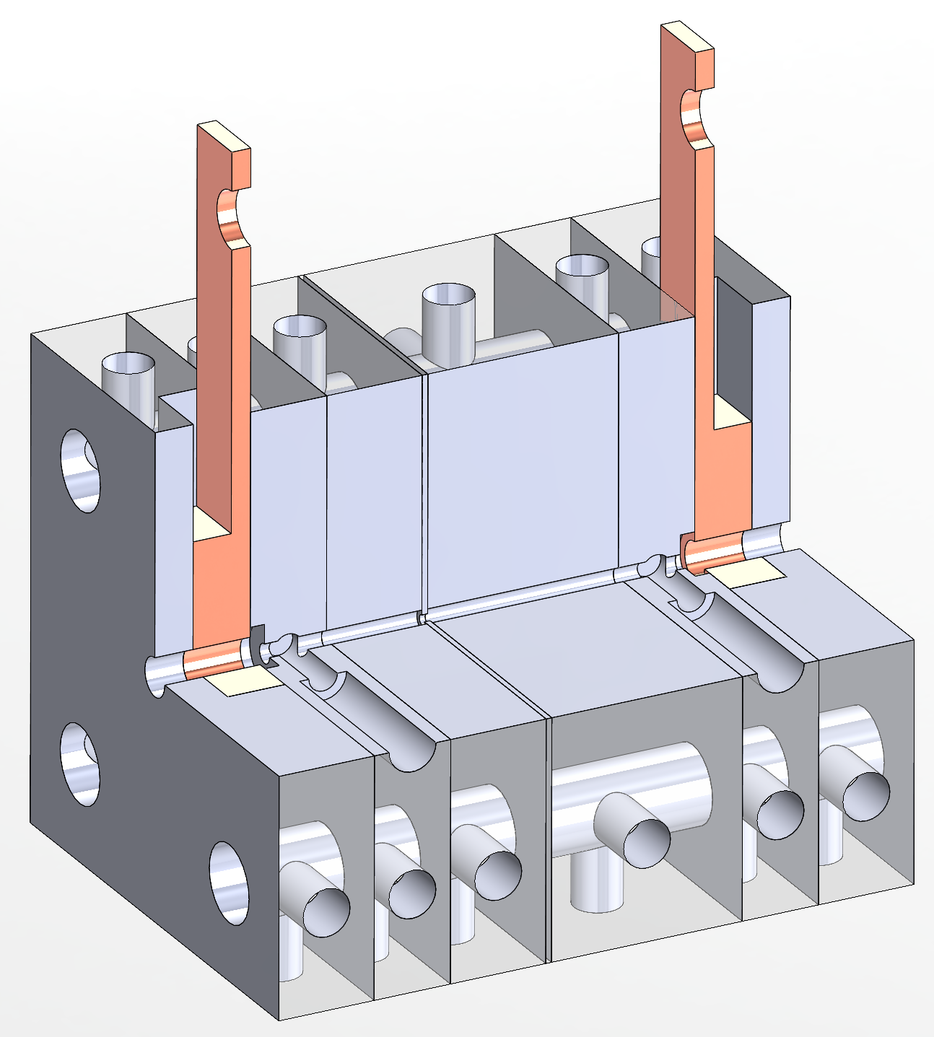
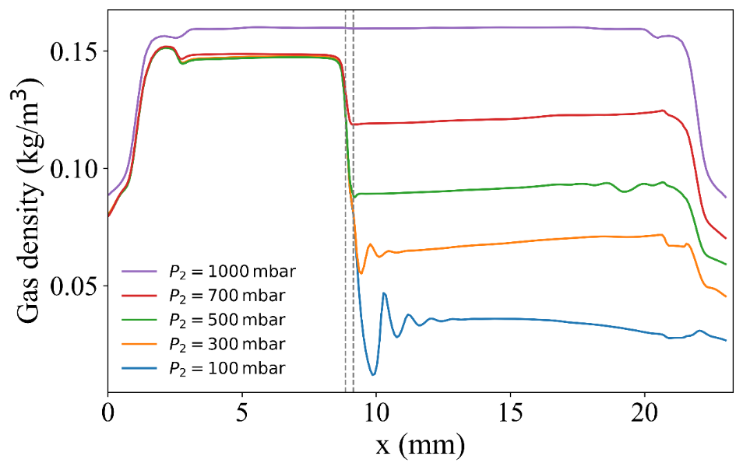
Segmented capillary with an orifice for down-ramp
(a)
(b)
Down-ramp
1 mm
0.5 mm
Venturi effect
Segmented discharge capillary plasma source
Easy to assemble: different length and functions by adding special blocks
Controlled injection & reliable operation: Controllable longitudinal density profile for downgradient injection
Enhance beam energy using waveguide: Discharge plasma with a transverse quadratic density structure for the laser guiding
Plasma lens: Focus electron beam using radial magnetic fields by discharged plasma current

Slide 5
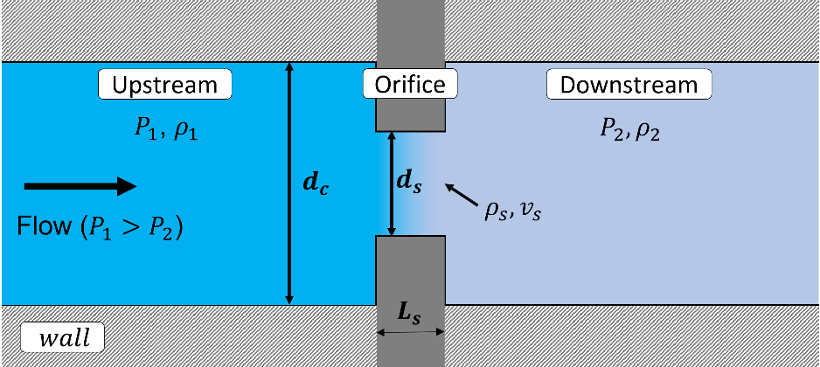
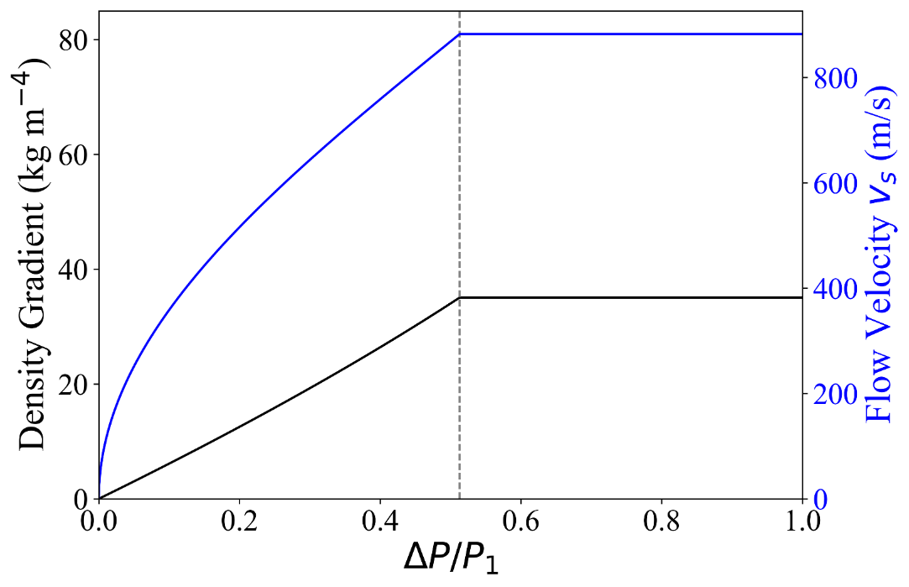





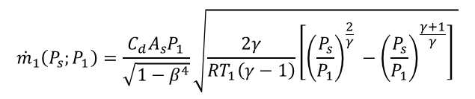




Gas flow dynamics
Plasma density can be tailored by introducing flow restriction through an orifice
$ṁ = ρ₁v₁A₁ = ρₛvₛAₛ = ρ_{2}v_{2}A_{2}$,
Mass conservation (compressible flow)
$$Aₛ\text{ (}\text{orifice}\text{) < }A₁ (capillary)$$
$${\dot{m}}_{1}\left(P_{s};P_{1}\right)=\frac{C_{d}A_{s}P_{1}}{\sqrt{1−β^{4}}}\sqrt{\frac{2γ}{RT_{1}\left(γ−1\right)}\left[{\left(\frac{P_{s}}{P_{1}}\right)}^{\frac{2}{γ} }−{\left(\frac{P_{s}}{P_{1}}\right)}^{\frac{γ+1}{γ}}\right] }$$
$$β=\frac{d_{s}}{d_{c}}$$
$\frac{P_{s}}{P_{1}}={\left[1+\frac{γ−1}{2}M^{2}\right]}^{−\frac{γ}{γ−1}}$, $\frac{ρ_{s}}{ρ_{1}}={\left(\frac{P_{s}}{P_{1}}\right)}^{\frac{1}{γ}}$
Isentropic relation
Chocked flow condition
$$M=1$$
$$v=Ma=M\sqrt{γRT}$$
Maximum flow speed is limited by choked condition
$$\frac{d\dot{m}}{dM}=0→M=1$$
$${\dot{m}}_{crit}=K_{s}P_{1}$$
$${\left(\frac{P_{s}}{P_{1}}\right)}_{crit}={\left(\frac{2}{γ+1}\right)}^{\frac{γ}{γ−1}}$$
Limited pressure ratio P₂/P₁ = 0.487

Slide 6

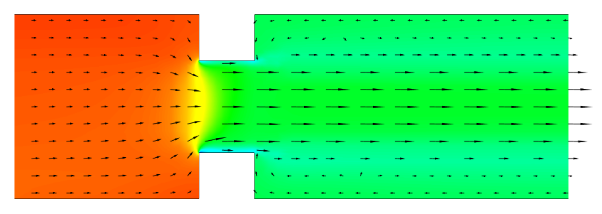
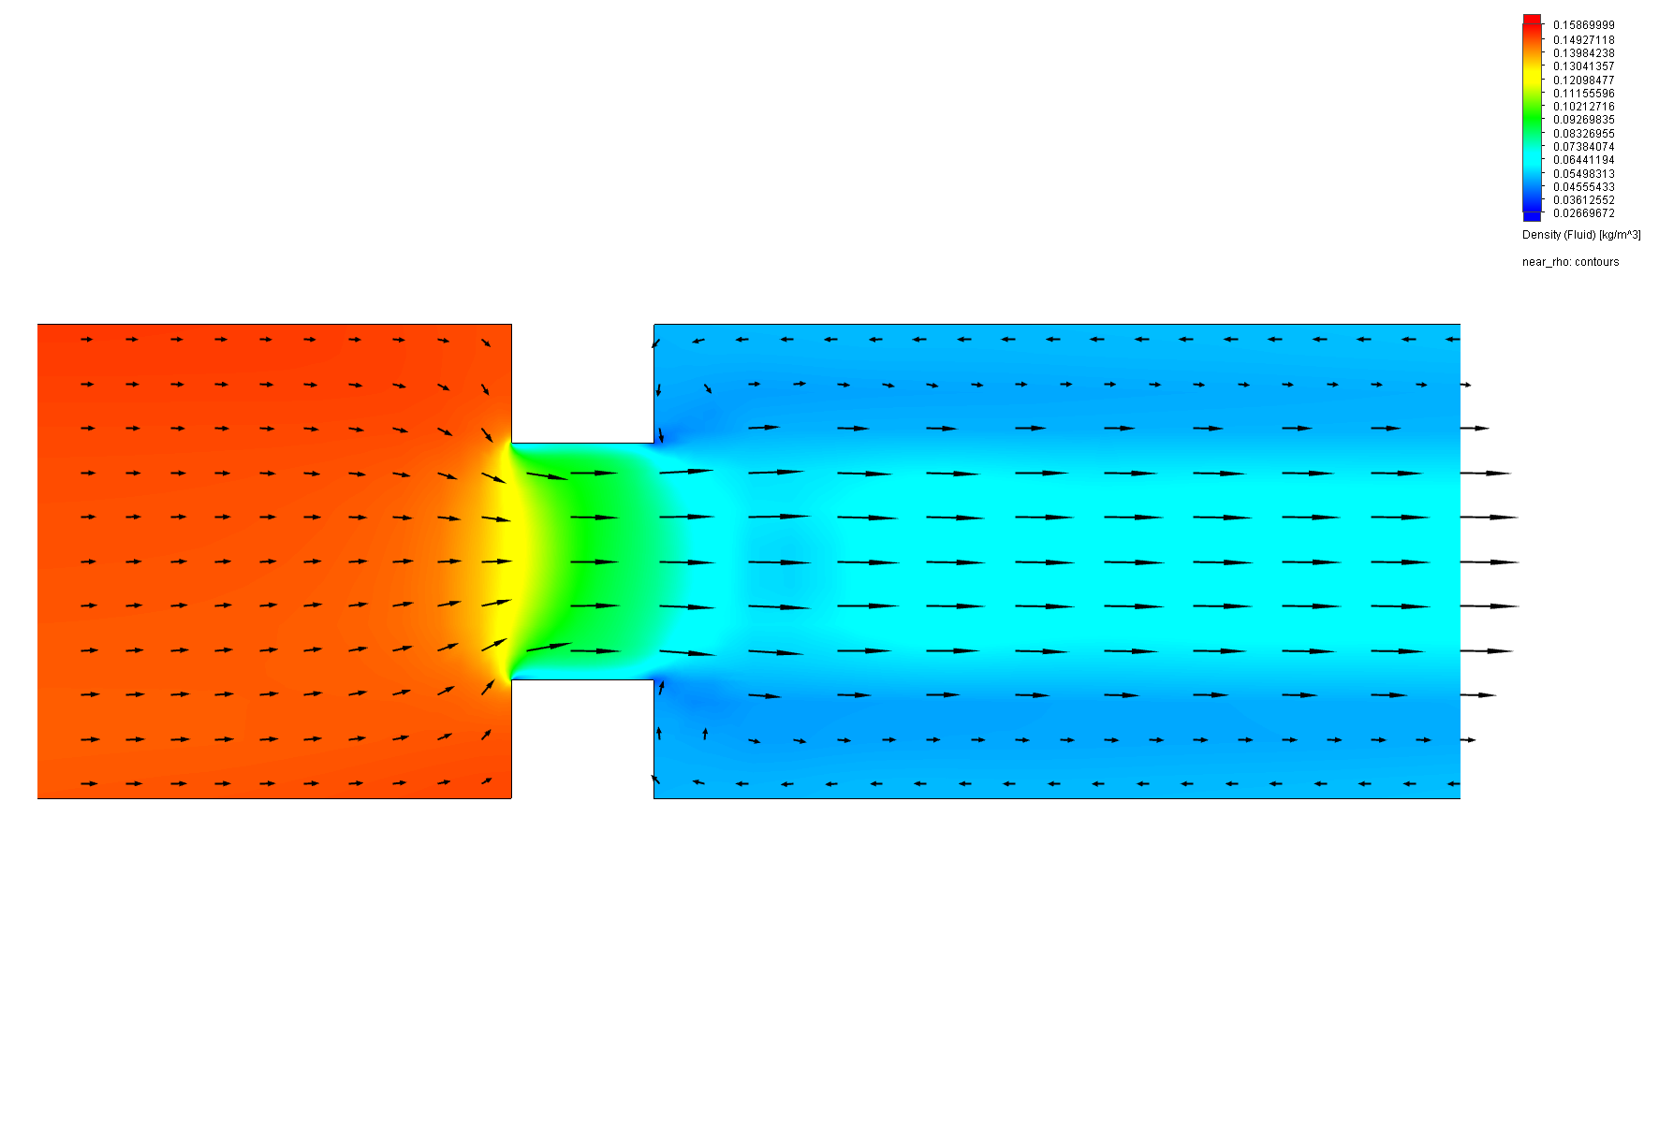
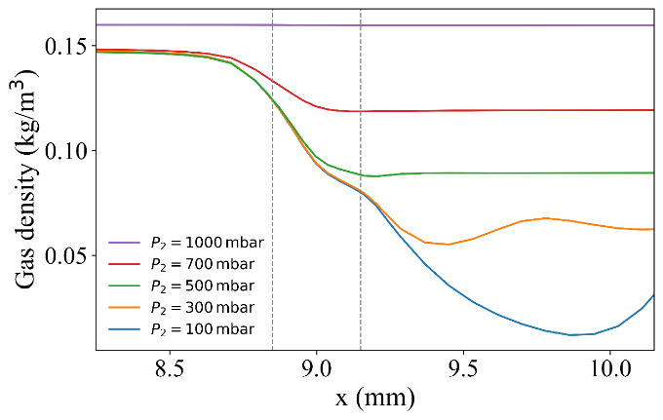
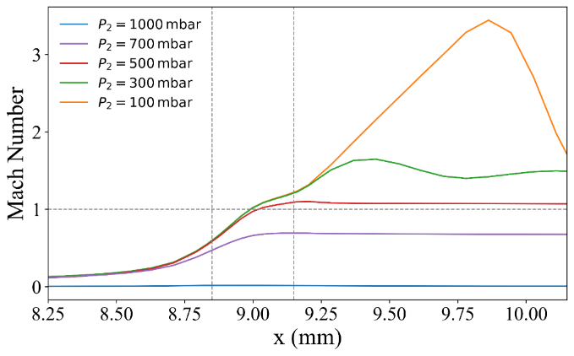
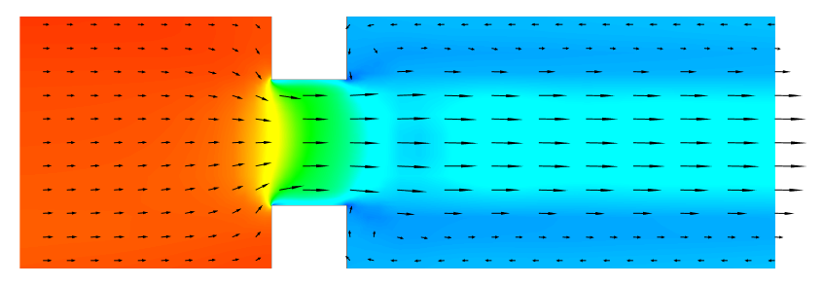

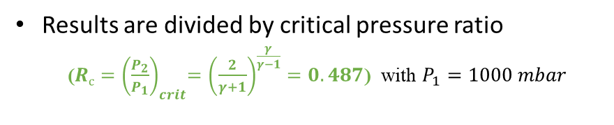
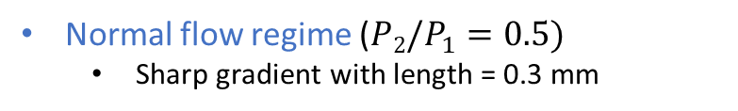
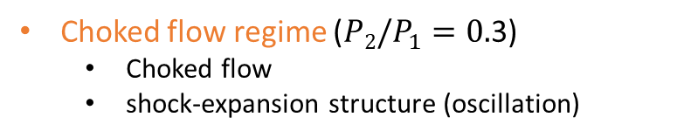

CFD simulation results
Results are divided by critical pressure ratio
  (${Rc{=\left(\frac{P_{2}}{P_{1}}\right)}_{crit}=\left(\frac{2}{γ+1}\right)}^{\frac{γ}{γ−1}}=0.487$) with $P_{1}=1000 mbar$
normal flow regime
Choked flow regime
Normal flow regime (${P2/P}_{1}=0.5)$
  Sharp gradient with length = 0.3 mm
$$kg∙m^{−3}$$
1000 / 500 (mbar)
0.16
0.11
0.06
Choked flow regime (${P2/P}_{1}=0.$3)
  Choked flow
  shock-expansion structure (oscillation)
0.02
P1
Choked flow
Saturation
P2
1000 / 300 (mbar)
X
Down ramp length: 300 $μ$m
Pressure fluctuates: Over shooting

Slide 7
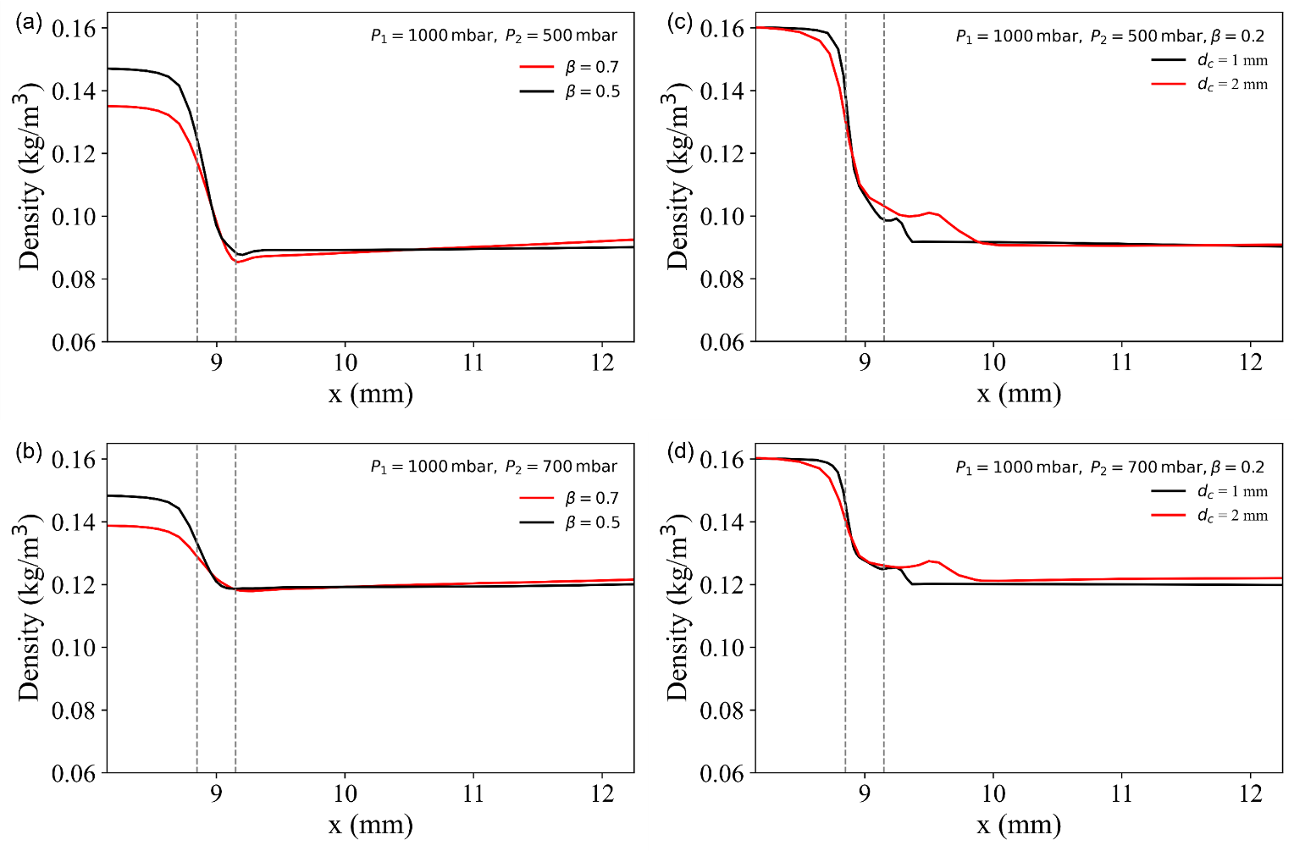
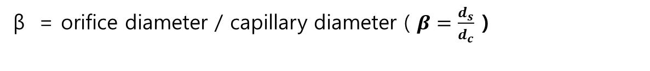
Effect of diameter ratio of β
β = orifice diameter / capillary diameter ( $β=\frac{d_{s}}{d_{c}}$ )
Hole size ratio β controls effective flow rate
Decreasing β (Orifice hole diameter decreases)
  Restricted flow
  Higher upstream density

Slide 8
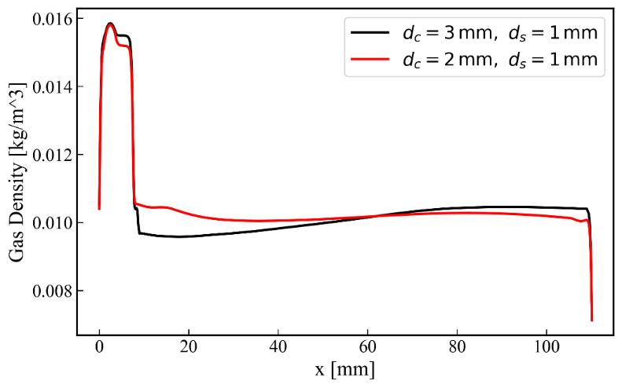
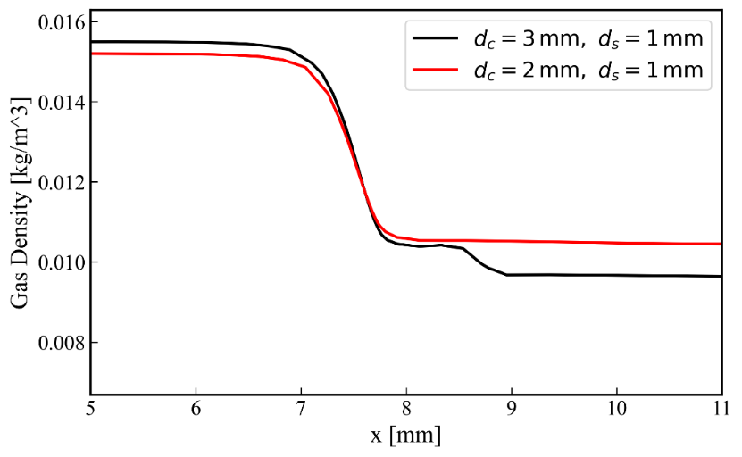
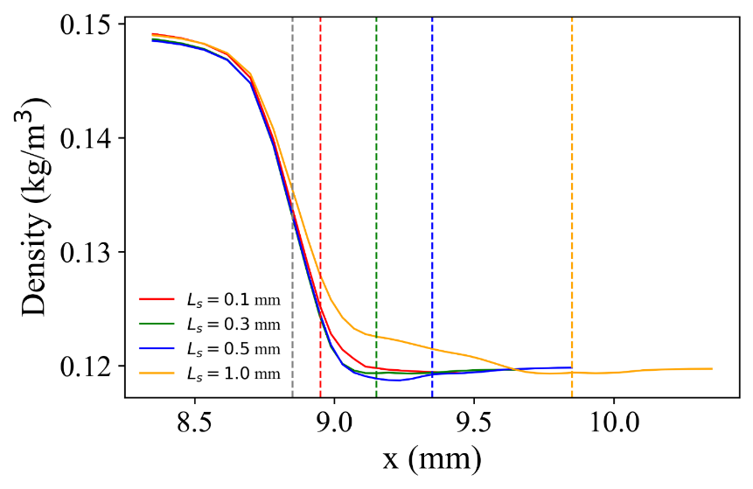

Effect of various orifice diameter, orifice thickness
Scaled up capillary also show same performance with normal size one
Orifice diameter is 1 mm, capillary diameter is 3 mm for PW laser system
Reducing the orifice slit thickness has no effect on improving the density gradient
0.1 mm
1 mm
Down-ramp is produced at front of the orifice

Slide 9
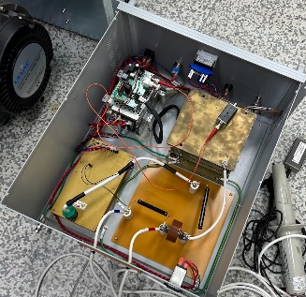
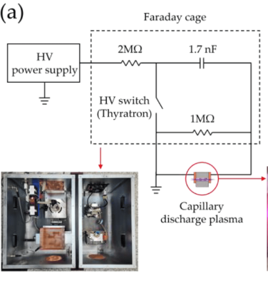
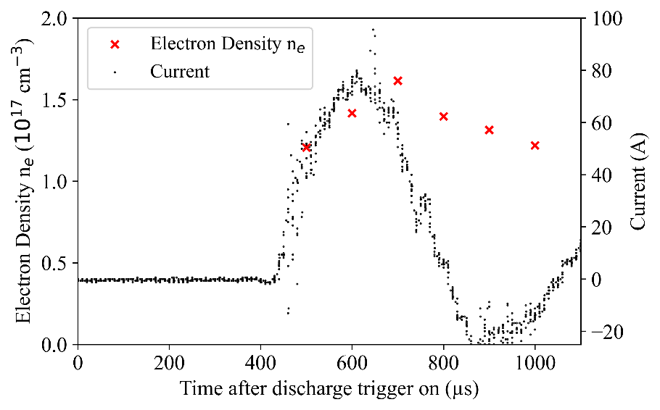
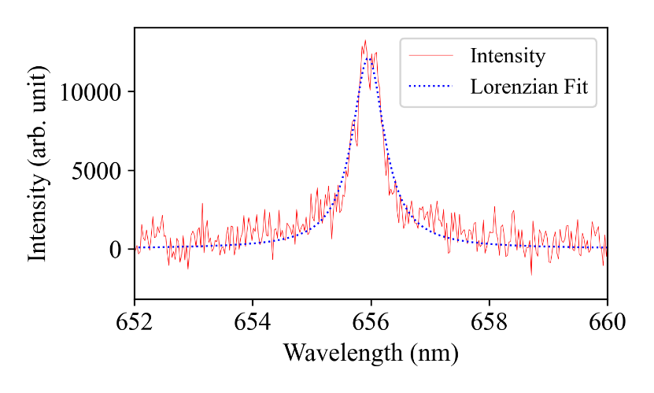
Diagnostic of electron density
The Stark broadening of the Hydrogen alpha line is used to measure electron density.
ICCD spectrometer gating time = 25 ns
Spectrum was measured at 650 ns after HV applied
Pulsed high voltage system using solid state switch
Voltage = 15 kV
Pulse duration = 10 μs
Size = 40 x 50 x 30 cm³
(a) Segmented capillary
Gas (He: 95%, H₂:5%)
P₁
P₂
Vacuum chamber
SS
HV
slit
SSD type High voltage power supply
Optical fiber
Current evolution profile
H-alpha Spectrum
∆λ(nm) = α (n_{e}, T) n_{e} (10¹⁸cm⁻³)^{2/3}
Spectrometer
α (n_{e}, T) = 5.4
Gated ICCD
Time (ns)

Slide 10
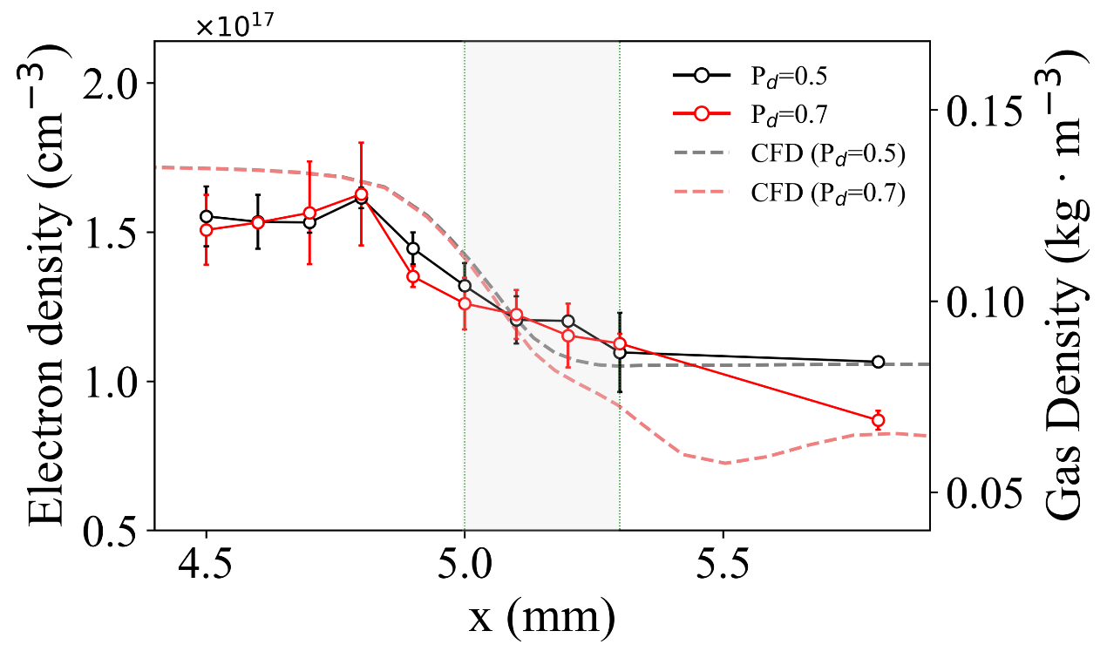
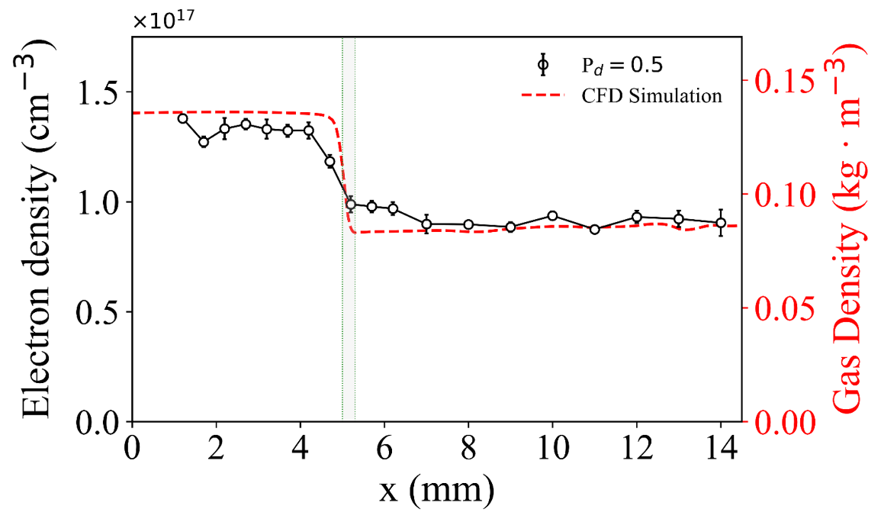
Measured longitudinal density profiles
Un-Choked flow regime
- P1 and P2 are smoothly connected
Plateau 1
Density down-ramp: ~ 300 um
P1
Plateau 2
P2
Down-ramp
Choked flow regime
- Pressure is limited
P2
Overshot fluctuation
  Down-ramp profiles for P_{d} = 0.5, P_{d} = 0.7 (Choked)
  In the choked case, the density is saturated in the orifice region, then fluctuated after exiting of the orifice
  Un-choked region P_{d} = 0.5
  Deconvoluted down-ramp length: ~ 0.3 mm
Preliminary results
J. Jeong et el., in preparation

Slide 11
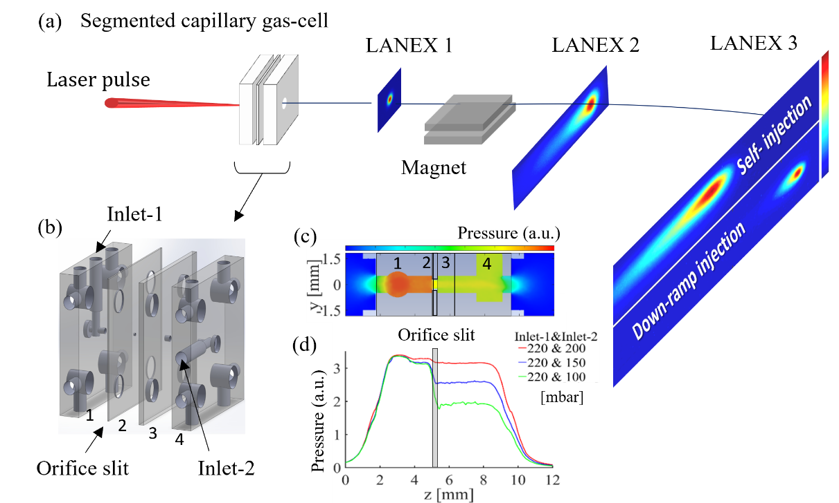
Experimental setup for LWFA using SC gas-cell
CoReLs IBS at GIST, Korea
150 TW laser system
Pulse energy: ~ 4 J
Pulse length: 25 fs (FWHM)
Acceleration length: ~ 4 mm

Slide 12
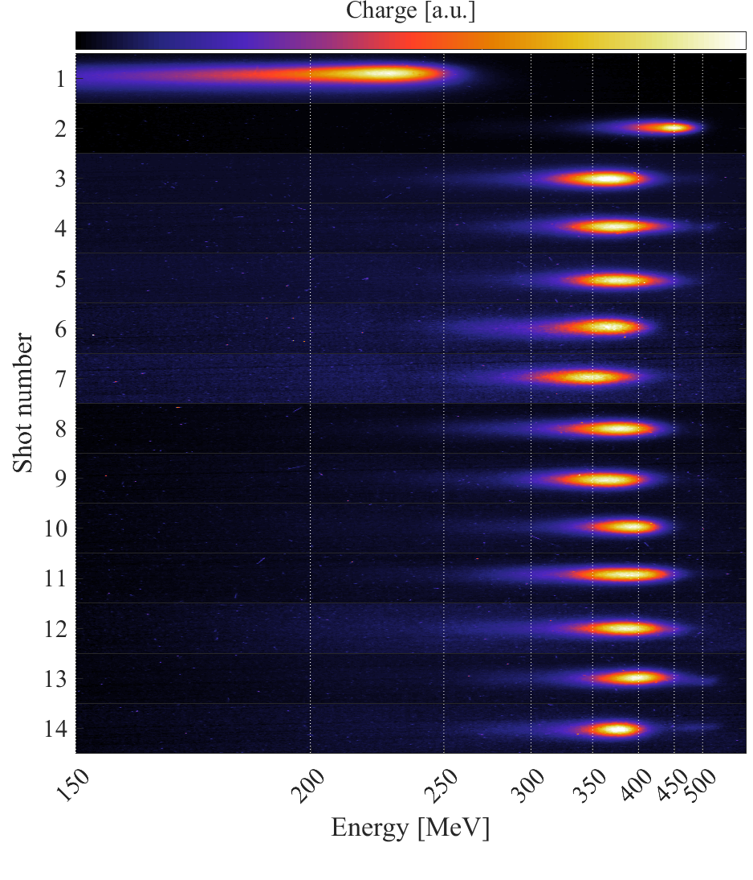



Preprimary experimental results
Laser: 150 TW, 25 fs, f/20
Flat density
Gas: He
Flat density
Flat density P1 = P2
$n_{e}=\sim 5$x 10¹⁸$cm^{−3}$
Down gradient injection P1 > P2:
$n_{e_1}=\sim 5$x 10¹⁸$cm^{−3}$
$n_{e_2}=\sim 3.5$x 10¹⁸$cm^{−3}$
Down gradient injection
Electron beam characteristics
Beam divergence (FWHM) : ~1 mrad (Down gradient)
Energy spread (FWHM) : ~5 % (Down gradient), ~35 % (Flat density)
- Peak energy: 348 (3.2% rms jitter) (Down gradient), 300 MeV (Flat density)
Down gradient injection
Consecutive shots
Electron beams with a dark-current free with a energy spread of ~ 5%

Slide 13


Preprimary experimental results
L1
L2
L3
S. Lee et al., in preparation

Slide 14







PIC simulation results
$$3.8γ_{0}<R^{2}F^{2}$$
Condition for injection
Energy spread: ~1%
$$r_{m}\sim \frac{2\sqrt{a0}}{k_{p}}=R_{u} \\ R_{u}k_{p}=2\sqrt{a_{0}}$$
$$γ_{0}={\left(\frac{2d(2R)}{dt}\right)}^{−1/2}$$
$$F=\frac{E_{u} \left|e\right|}{m_{e}cω_{p}}$$
$$\frac{dR_{u}}{dt_{u}}\frac{1}{c} > 0.9\frac{\left(1+\frac{a_{0}^{2}}{2}\right)}{a_{0}^{6}}$$
Injection
Preliminary results

Slide 15




Application 1 using SC target
Combined capillary gas-cel:
Acceleration + Plasma lens
Plasma lens
Discharge current
~ 280 A
~ 200 ns
Plasma lens
Acceleration
Electron beam can be focused by a radial magnetic field induced from discharged current
2026 March IBS Experiment
Argon gas, 100 mbar
HV: 15 kV
Rising: 200 ns
Max current: 300 A
Planed experimental campaign at 2027 (IBS 150 TW)

Slide 16




Application 2 using SC target
Proposed two-stage waveguide with a down ramp
Beam injection in low density using a down ramp
Acceleration in long distance using a waveguide

Slide 17



PIC simulation results
Electron beam energy evolution
Laser pulse and spot size evolution
70 pC
Preliminary results
$$n_{e1}=4×{10}^{17}/cm^{3},n_{e2}=4×{10}^{17}/cm^{3}$$
Plasma density:
Laser parameters:
$a_{0}=2.0,w_{0}=45 μm$ $τ=40 fs$
Electron beam energy of 5 GeV with energy spread 1.3 % and 70 pC
H. Jeoung et al., in preparation

Slide 18
Summary
Developed segmented capillary gas-cell for down-ramp injection with a flat density profile
Measured down-ramp profile in the SC discharge plasma using optical emission spectroscopy
Dark current free electron beams with low energy spread are generated by SC using 150 TW laser at IBS, GIST
Proposed applications
  Combined Segmented capillary target: Acceleration + Plasma lens
  Two-staged discharged segmented capillary waveguide with a density down-ramp
Thank you for your attention

Slide 19










Collaborators
Minsup Hur, Dongsu Ryu, Jayoung Kim, Gujin Gwak, Hyeong-Ryeol Park
Hyyong Suk
PAL-XFEL team, eLABs, Heejun Shin, Minjae Kim
Kyung Taek Kim, Jaehee Sung, Mohammad Mirzaie
Hyung Tak Kim, Leejin Bae
Kyung Nam Kim
Jahoon Kim
Sung hee Park, Sihyeon Lee
Alexei Sytov
Mose Jung, Gunsu Yun
Jaehoon Cha

