Slide 1
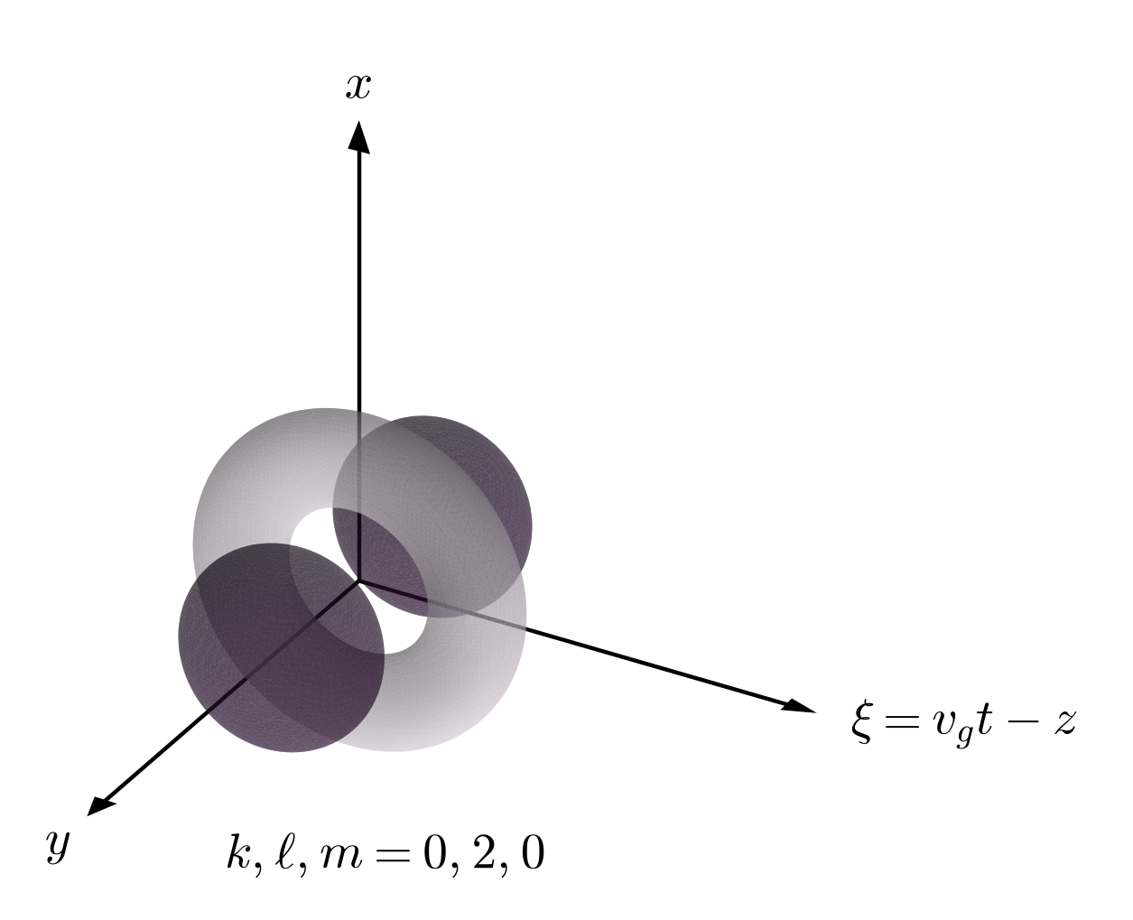
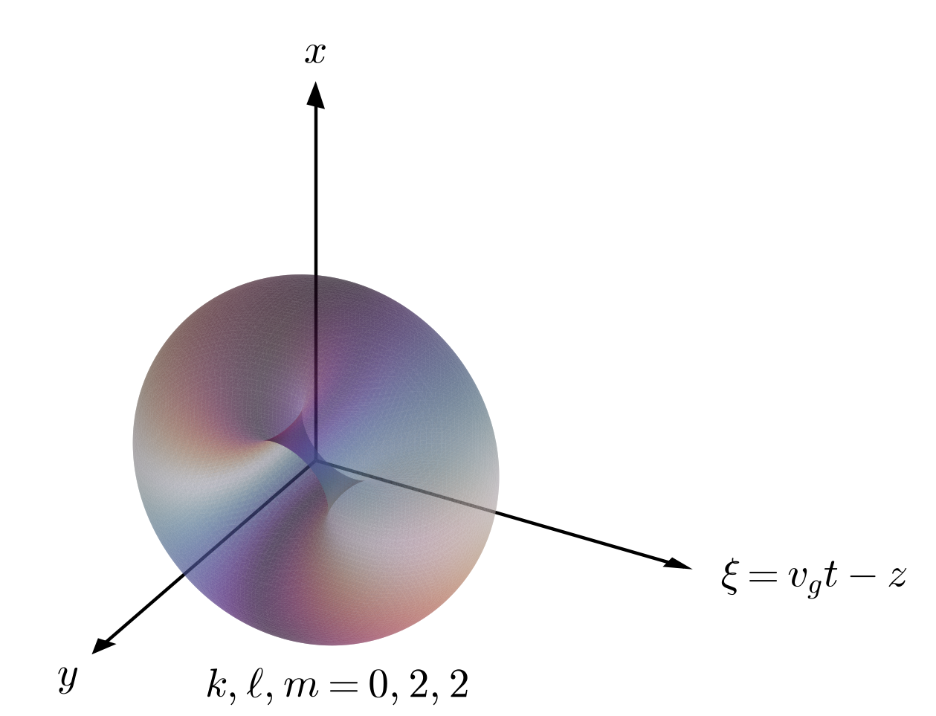
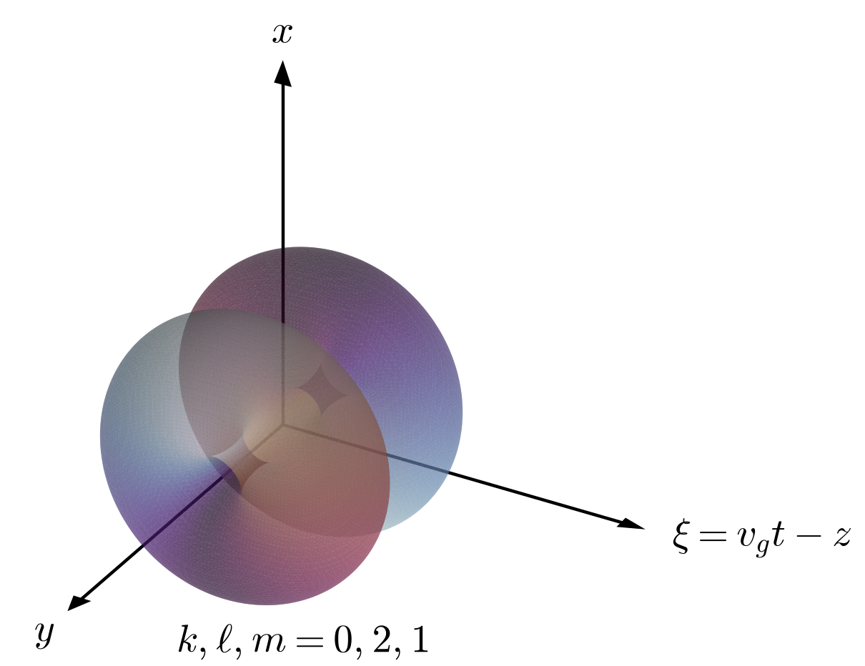

Nonlinear Propagation of Spatiotemporal Optical Vortex Pulses in Plasma
Abram Konzel
Advanced Accelerator Concepts 2026
Notes:
Hello, my name is… from… and today I will be presenting on the nonlinear propagation of spatiotemporal optical vortices in plasma.
Plotted here are isocontours of the normalized vector potential of a special class of three-dimensionally structured spatiotemporal optical vortex pulses that carry generalized orbital angular momentum. The pulses are colored by their envelope phase with \xi being the longitudinal or temporal coordinate in the moving pulse frame.

Slide 2


Collaborators
J.P. Palastro and D. Ramsey
University of Rochester Laboratory for Laser Energetics
R.R. Almeida and J. Vieira
Instituto Superior Técnico, Universidade de Lisboa
This work is supported by the Office of Fusion Energy Sciences under Award Numbers DE-SC0021057, the Department of Energy National Nuclear Security Administration under Award Number DE-NA0004144, the University of Rochester, and the New York State Energy Research and Development Authority.
Notes:
Before we begin I would like to acknowledge and thank my collaborators John Palastro and Dillon Ramsey at the LLE and Rafael Almeida and Jorge Vieira at IST Lisbon

Slide 3
The nonlinear optical response of plasma modifies the propagation of STOVs
Spatiotemporal optical vortices (STOVs) are spatiotemporally structured pulses that carry orbital angular momentum (OAM) transverse to the propagation direction
The standard two-dimensional STOV structure can be extended to a full three-dimensional structure with generalized spatiotemporal OAM
Plasma waveguides with moving density depressions allow guiding of STOV pulses and protect against self-focusing collapse
The novel topology of STOVs present new opportunities to revisit established laser-plasma interactions
Notes:
To summarize, spatiotemporal optical vortices (abreviated as STOVs), are spatiotemporally structured pulses that carry an OAM component transverse to propagation axis.
Three-dimensionally structured STOVs are an extension of conventional STOV pulses that fully utilize three dimensional spatial symmetries to carry generalized spatiotemporal OAM.
Three-dimensional plasma waveguides such as those generated by a driven plasma wake allow guiding of STOV pulses and provide robust protection against self-focusing collapse.
With all of this work is motivated by the opportunity to revisit established laser-plasma interactions with STOV pulses.

Slide 4
Outline
Background and motivation
Linear propagation of STOVs
Nonlinear propagation model
Nonlinear stability analysis of structurally invariant STOVs
Notes:
I will begin with some background and motivation to further clarify what are conventional STOVs and three-dimensional STOVs

Slide 5
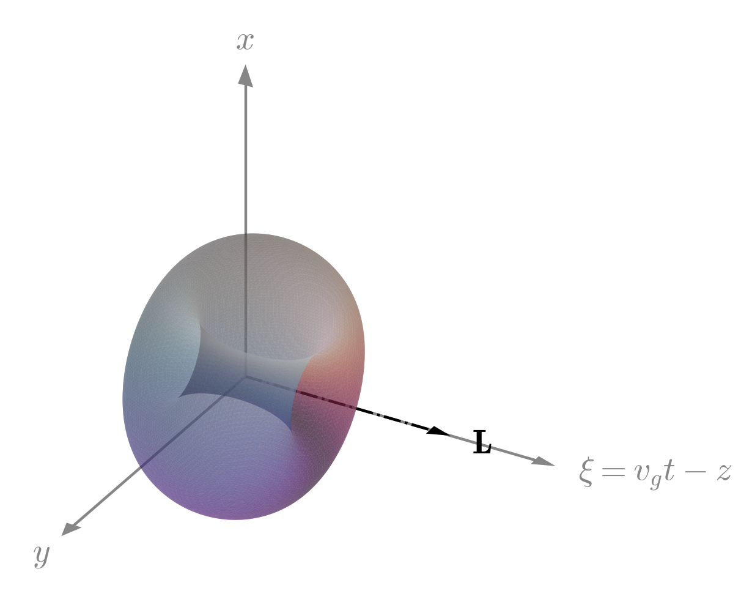
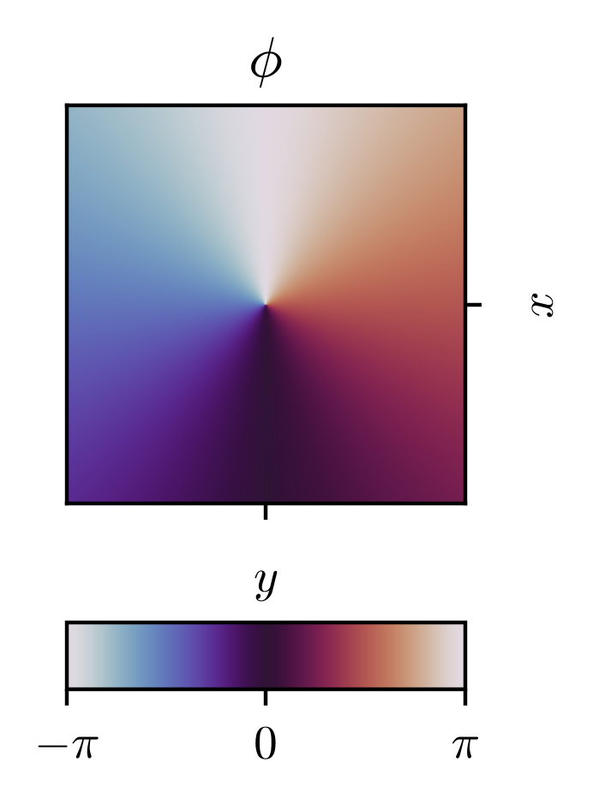
Spatiotemporal control of laser pulse amplitude and phase can produce non-trivial electromagnetic topologies
Longitudinal OAM (spatial structure)
Notes:
Plotted on the left is a standard Laguerre-Gaussian pulse, sometimes refereed to as an optical vortex pulse due to the circulation of the envelope phase in the transverse plane. Due to this phase structure, the optical vortex pulse carries OAM directed along the propagation axis.

Slide 6
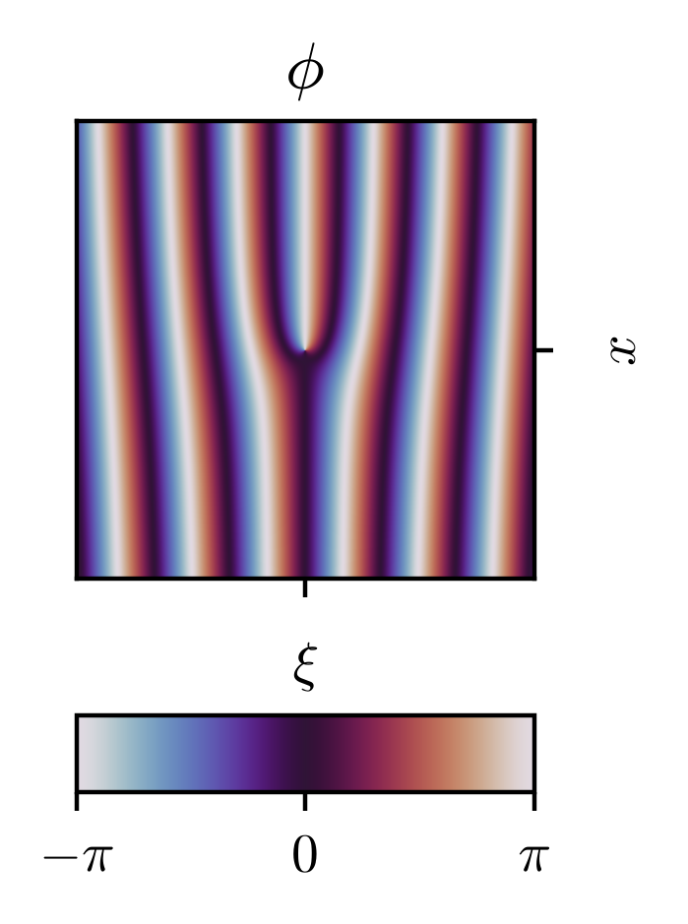
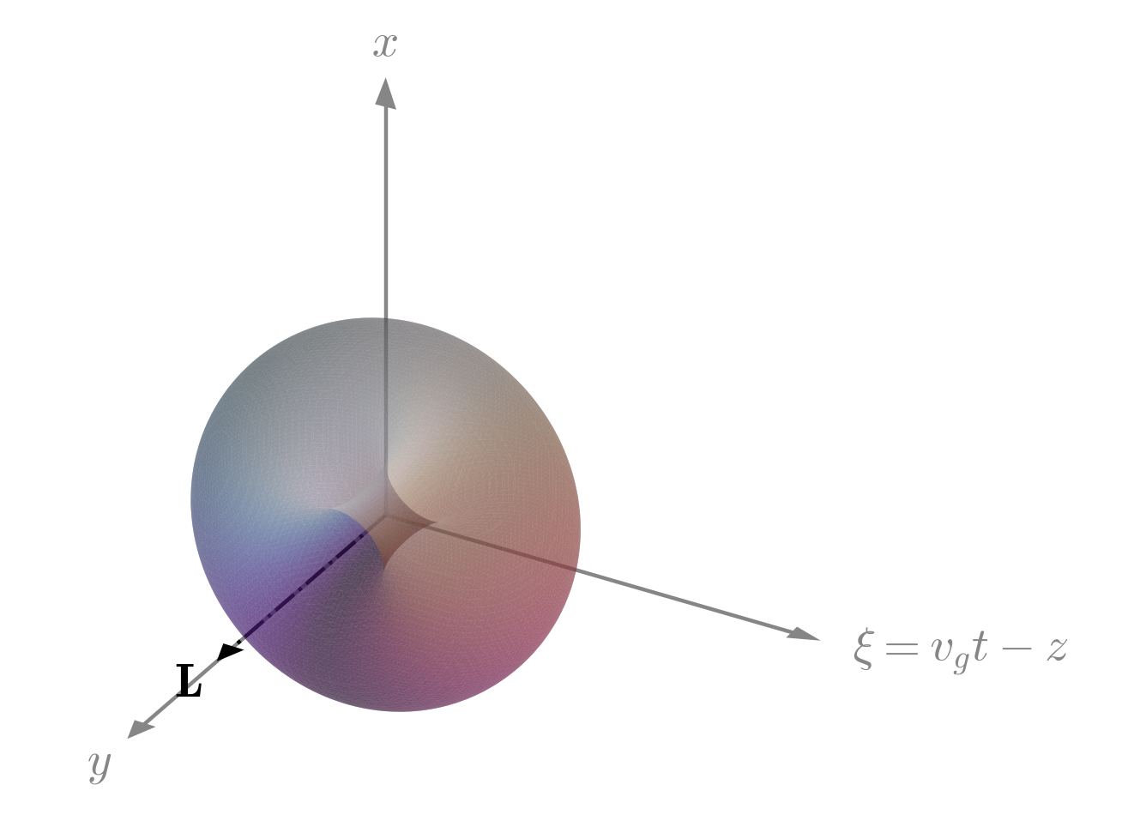
Spatiotemporal control of laser pulse amplitude and phase can produce non-trivial electromagnetic topologies
Longitudinal OAM (spatial structure)
Transverse OAM (spatiotemporal structure)
Notes:
On the right is a STOV pulse containing this same structure, but rotated such that the vortex structure is embedded in the spatiotemporal plane, plotted here with the carrier phase included to display the characteristic forked phase structure of STOVs. As a consequence of its’ spatiotemporal structure, this pulse carries OAM perpendicular to the propagation axis.
Another useful property of STOV pulses is that since they inherit the modality of the Laguerre-Gaussian pulses, they also form a complete and orthogonal basis that can be used to represent arbitrary pulse structures.

Slide 7
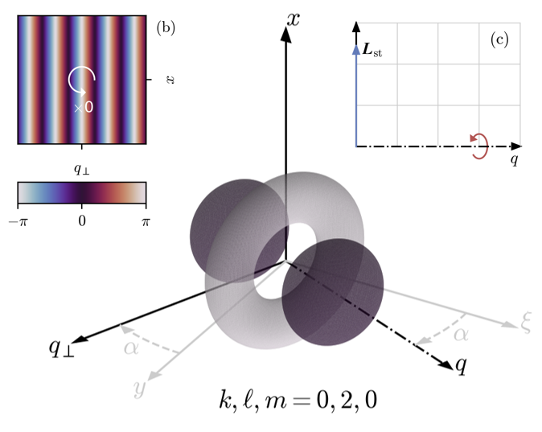
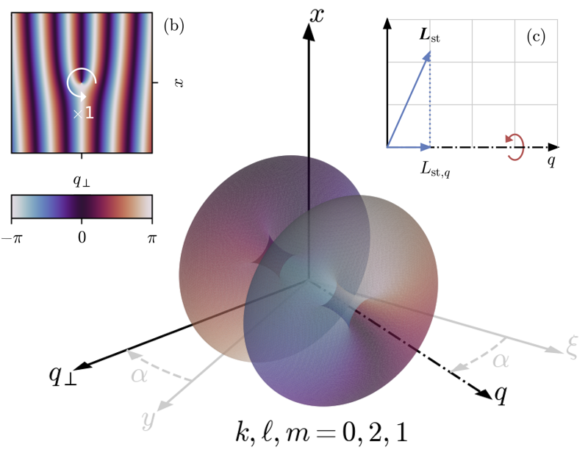
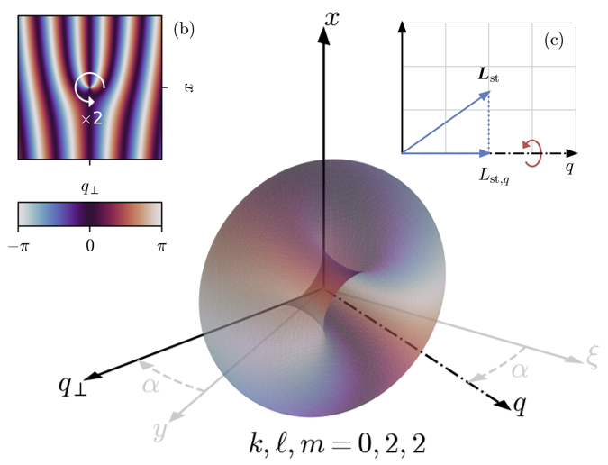
STOV structures can be generalized to three dimensions
Full three-dimensional structuring provides additional flexibility for tailoring laser pulses for applications
Notes:
Going further, pulses can be structured to utilize the three spatial degrees of freedom granted by the two transverse dimensions and the temporal dimension. The STOV pulses pictured here are interesting in particular because they contain OAM about a specified axis (here labeled as q) like Laguerre-Gaussian STOVs. However unlike Laguerre-Gaussian STOVs, they also contain an OAM component in the plane perpendicular to this axis. These STOVs also form a complete basis for general pulse structures.

Slide 8
Outline
Background and motivation
Linear propagation of STOVs
Nonlinear propagation model
Nonlinear stability analysis of structurally invariant STOVs
Notes:
Now that you have some context for the spatiotemporal structure of STOVs, I will move onto their linear propagation behavior and the conditions required for the preservation of this spatiotemporal structure.

Slide 9
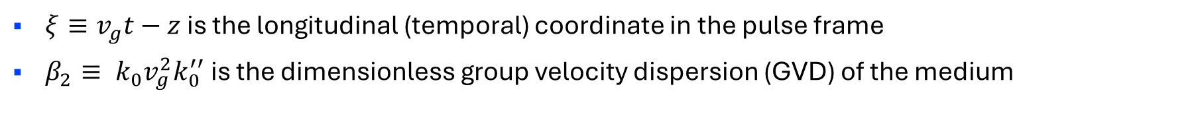
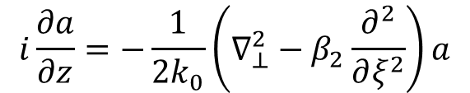
STOV structure is not generally preserved throughout propagation
Dispersive paraxial wave equation
transverse diffraction
$$i\frac{∂a}{∂z}=−\frac{1}{2k_{0}}\left(∇_{⊥}^{2}−β_{2}\frac{∂^{2}}{∂ξ^{2}}\right)a$$
temporal dispersion
$ξ≡v_{g}t−z$ is the longitudinal (temporal) coordinate in the pulse frame
$β_{2}≡ k_{0}v_{g}^{2}k_{0}^{′′}$ is the dimensionless group velocity dispersion (GVD) of the medium
S. W. Hancock, S. Zahedpour, and H. M. Milchberg, Phys. Rev. Lett., 127, 193901 (2021)
Notes:
The propagation of STOV pulses in a dispersive medium can be modeled by the paraxial wave equation with an additional second-order derivative in \xi introduced to capture temporal dispersion. The dispersion is controlled by the value and sign of the dimensionless group velocity dispersion of the propagation medium, \beta_2.

Slide 10
STOV structure is not generally preserved throughout propagation
Dispersive paraxial wave equation
transverse diffraction
$$i\frac{∂a}{∂z}=−\frac{1}{2k_{0}}\left(∇_{⊥}^{2}−β_{2}\frac{∂^{2}}{∂ξ^{2}}\right)a$$
temporal dispersion
$ξ≡v_{g}t−z$ is the longitudinal (temporal) coordinate in the pulse frame
$β_{2}≡ k_{0}v_{g}^{2}k_{0}^{′′}$ is the dimensionless group velocity dispersion (GVD) of the medium
Preservation of STOV structure requires matching the rate of diffraction and dispersion
S. W. Hancock, S. Zahedpour, and H. M. Milchberg, Phys. Rev. Lett., 127, 193901 (2021)
Notes:
The transverse Laplacian drives transverse broadening and compression of the pulse envelope, while the dispersion drives longitudinal broadening and compression. The asymmetry introduced by beta_2 causes these effects to occur at different rates, causing the spatiotemporal structure of the STOV pulse to distort as it propagates. However, it is possible to balance these effects and preserve the spatiotemporal structure under certain conditions.

Slide 11
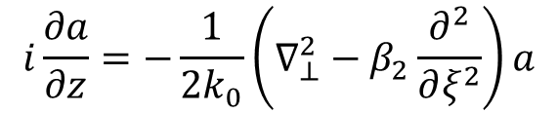
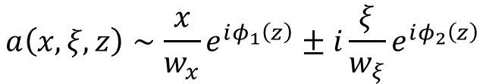
Preservation of STOV structure requires balancing the rates of diffraction and dispersion
Example STOV pulse
$$a\left(x,ξ,z\right)∼\frac{x}{w_{x}}e^{iφ_{1}\left(z\right)}±i\frac{ξ}{w_{ξ}}e^{iφ_{2}\left(z\right)}$$
Dispersive paraxial wave equation
diffraction
$$i\frac{∂a}{∂z}=−\frac{1}{2k_{0}}\left(∇_{⊥}^{2}−β_{2}\frac{∂^{2}}{∂ξ^{2}}\right)a$$
dispersion
S. W. Hancock, S. Zahedpour, and H. M. Milchberg, Phys. Rev. Lett., 127, 193901 (2021)
Notes:
To illustrate this effect, let us again consider the lowest order Laguerre-Gaussian STOV whose structure is written in simplified form as a superposition of two modes, each with their own associated z-dependent phase.

Slide 12
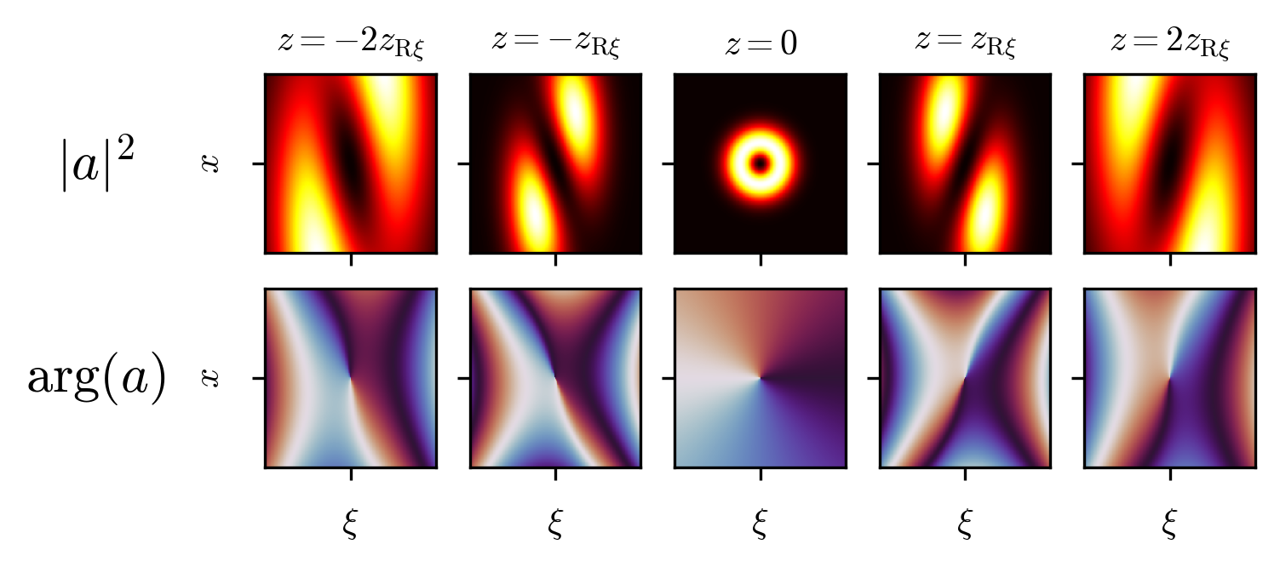


Preservation of STOV structure requires balancing the rates of diffraction and dispersion
Example STOV pulse
$β_{2}>0$ (normal dispersion)
$$a\left(x,ξ,z\right)∼\frac{x}{w_{x}}e^{iφ_{1}\left(z\right)}±i\frac{ξ}{w_{ξ}}e^{iφ_{2}\left(z\right)}$$
Dispersive paraxial wave equation
diffraction
$$i\frac{∂a}{∂z}=−\frac{1}{2k_{0}}\left(∇_{⊥}^{2}−β_{2}\frac{∂^{2}}{∂ξ^{2}}\right)a$$
$$φ_{1}\left(z\right)≠φ_{2}\left(z\right)$$
dispersion
S. W. Hancock, S. Zahedpour, and H. M. Milchberg, Phys. Rev. Lett., 127, 193901 (2021)
Notes:
When \beta_2 is positive as would be the case for media with normal dispersion, the phases of each mode will rotate in opposite directions to one another. We can think of this situation like a clock with two hands that rotate opposite to each other. Although it is possible for the hands to be aligned at one location in z, it is impossible for the hands to remain aligned generally.
The plot on the right contains slices of intensity and phase of the example STOV pulse at different z values around focus. Here I have chosen the phases to align properly at focus. Away from focus, the phases walk off distorting the spatiotemporal intensity profile and causing hyperbolic phase curvature.

Slide 13
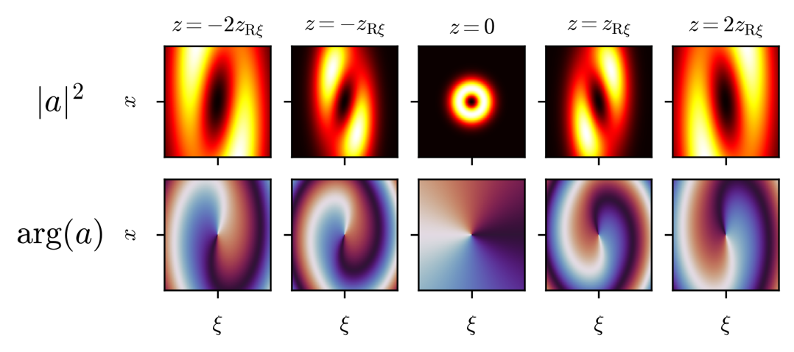

Preservation of STOV structure requires balancing the rates of diffraction and dispersion
Example STOV pulse
$β_{2}<0$ (anomalous dispersion)
$$a\left(x,ξ,z\right)∼\frac{x}{w_{x}}e^{iφ_{1}\left(z\right)}±i\frac{ξ}{w_{ξ}}e^{iφ_{2}\left(z\right)}$$
Dispersive paraxial wave equation
diffraction
$$i\frac{∂a}{∂z}=−\frac{1}{2k_{0}}\left(∇_{⊥}^{2}−β_{2}\frac{∂^{2}}{∂ξ^{2}}\right)a$$
$$φ_{1}\left(z\right)≠φ_{2}\left(z\right)$$
dispersion
S. W. Hancock, S. Zahedpour, and H. M. Milchberg, Phys. Rev. Lett., 127, 193901 (2021)
Notes:
If \beta_2 is made negative as would be the case in anomalous media, the situation improves somewhat. The phase fronts are now helical, and the intensity profile is somewhat less distorted away from focus. This arrangement is analogous to the clock hands rotating in the same direction, but at different rates. Again, they may be aligned at one location in z but only then.

Slide 14
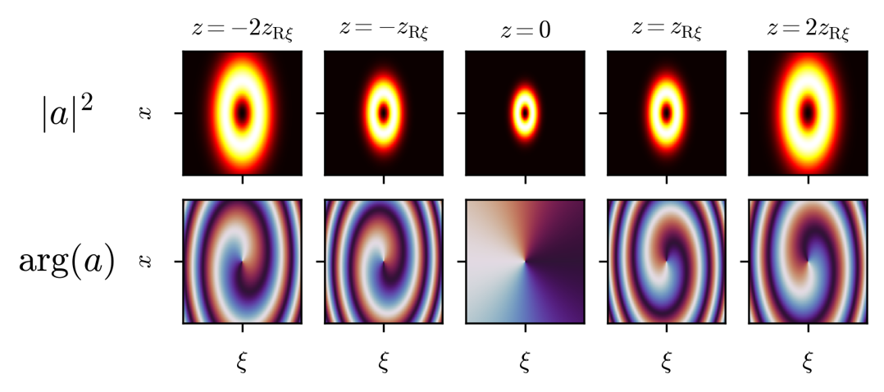

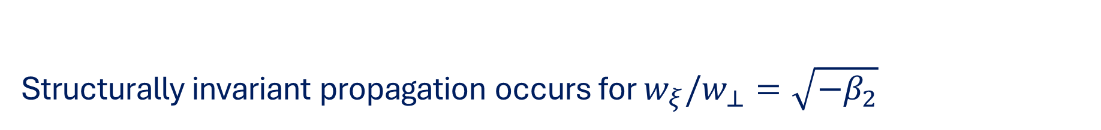
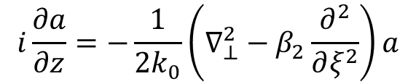
Structurally invariant propagation occurs for $w_{ξ}/w_{⊥}=\sqrt{−β_{2}}$
Example STOV pulse
$β_{2}<0$ (anomalous dispersion)
$$a\left(x,ξ,z\right)∼\frac{x}{w_{x}}e^{iφ_{1}\left(z\right)}±i\frac{ξ}{w_{ξ}}e^{iφ_{2}\left(z\right)}$$
Dispersive paraxial wave equation
diffraction
$$i\frac{∂a}{∂z}=−\frac{1}{2k_{0}}\left(∇_{⊥}^{2}−β_{2}\frac{∂^{2}}{∂ξ^{2}}\right)a$$
$$w_{ξ}/w_{⊥}=\sqrt{−β_{2}} ⇒ φ_{1}\left(z\right)=φ_{2}\left(z\right)$$
dispersion
S. W. Hancock, S. Zahedpour, and H. M. Milchberg, Phys. Rev. Lett., 127, 193901 (2021)
Notes:
For the STOV structure to be preserved, \beta_2 must be negative, and the pulse length must have proportionality with the transverse waist set by the value of \beta_2. A STOV pulse with this specific spatiotemporal eccentricity will retain its structure as it propagates.
Although this arrangement allows for preservation of the STOV pulse structure, the pulse is still subject to changes in scale from diffraction and dispersion.

Slide 15
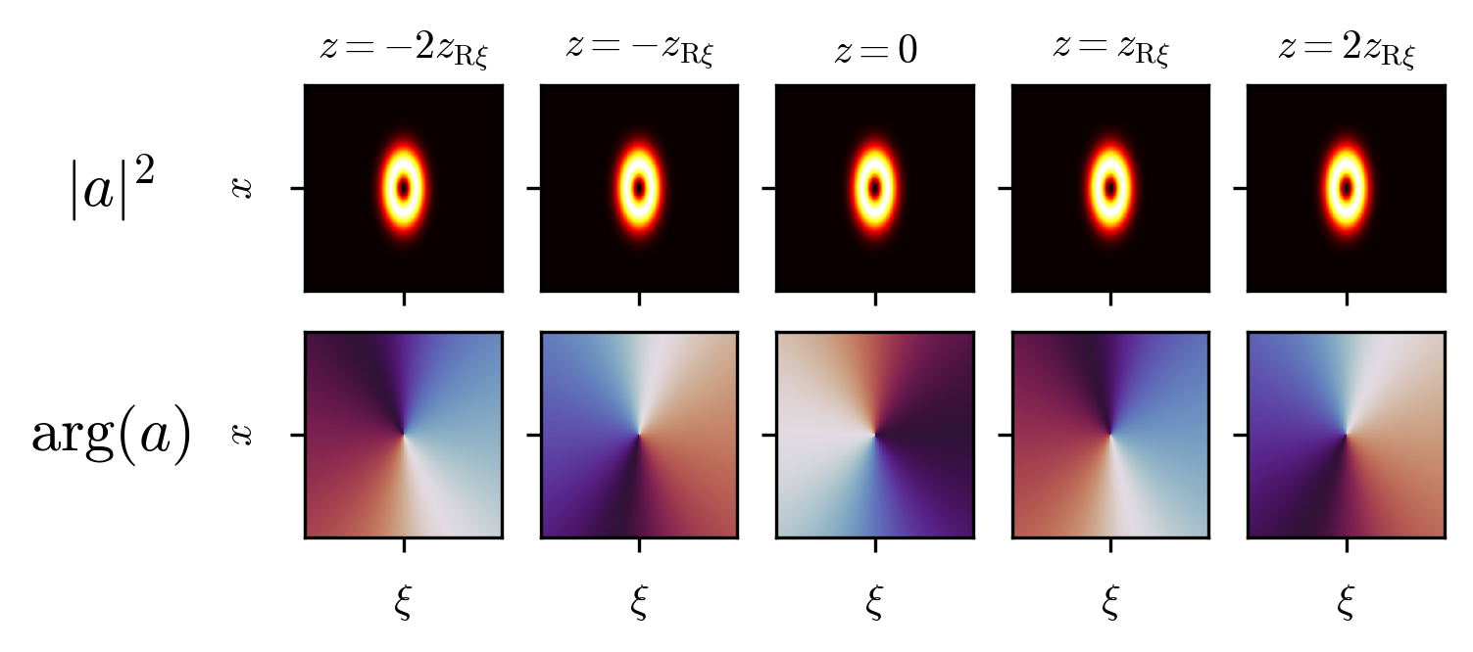
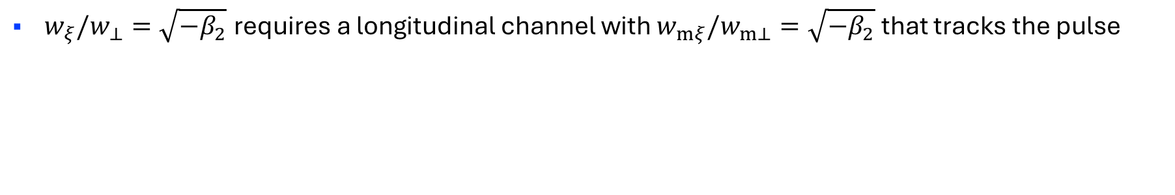
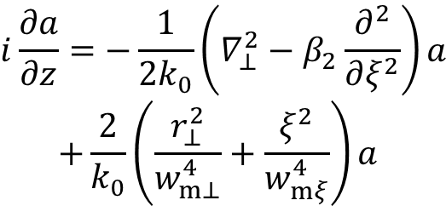
Plasma guiding structures allow control of diffraction and dispersion
$$i\frac{∂a}{∂z}=−\frac{1}{2k_{0}}\left(∇_{⊥}^{2}−β_{2}\frac{∂^{2}}{∂ξ^{2}}\right)a$$
$$+\frac{2}{k_{0}}\left(\frac{r_{⊥}^{2}}{w_{m⊥}^{4}}+\frac{ξ^{2}}{w_{mξ}^{4}}\right)a$$
transverse guiding
temporal guiding
$w_{ξ}/w_{⊥}=\sqrt{−β_{2}}$ requires a longitudinal channel with $w_{mξ}/w_{m⊥}=\sqrt{−β_{2}}$ that tracks the pulse
Notes:
If we want to remove the waist evolution of the pulse, we require some form of guiding structure. For pulses with spatiotemporal structure, this manifests as a temporal guiding structure that travels at the group velocity of the pulse in addition to a standard transverse guiding structure. A quadratic channel term has been included into the dispersive paraxial wave equation to capture guided dynamics, written in terms of transverse and temporal matched channel sizes. Unguided dynamics are recovered in the limit that channel widths become infinite.

Slide 16
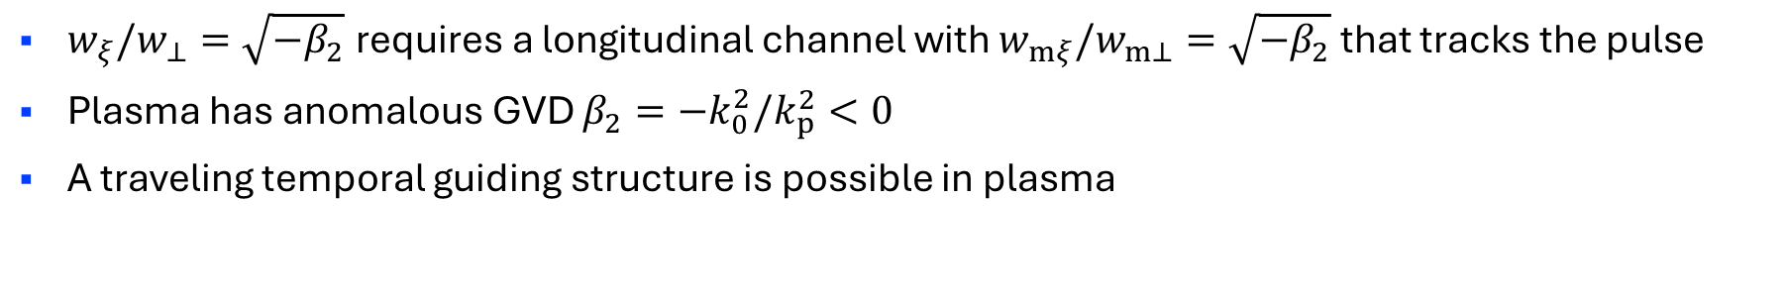
Plasma guiding structures allow control of diffraction and dispersion
$$i\frac{∂a}{∂z}=−\frac{1}{2k_{0}}\left(∇_{⊥}^{2}−β_{2}\frac{∂^{2}}{∂ξ^{2}}\right)a$$
$$+\frac{2}{k_{0}}\left(\frac{r_{⊥}^{2}}{w_{m⊥}^{4}}+\frac{ξ^{2}}{w_{mξ}^{4}}\right)a$$
transverse guiding
temporal guiding
$w_{ξ}/w_{⊥}=\sqrt{−β_{2}}$ requires a longitudinal channel with $w_{mξ}/w_{m⊥}=\sqrt{−β_{2}}$ that tracks the pulse
Plasma has anomalous GVD $β_{2}=−k_{0}^{2}/k_{p}^{2}<0$
A traveling temporal guiding structure is possible in plasma
Plasma is an ideal medium for structure and scale invariant STOV propagation
Notes:
Plasma emerges as an idea medium for structurally invariant STOV propagation, since it has both negative GVD and the ability to embed traveling, three-dimensional guiding structures. As an example, using a traveling density depression produced by a driven plasma wake.

Slide 17
Outline
Background and motivation
Linear propagation of STOVs
Nonlinear propagation model
Nonlinear stability analysis of structurally invariant STOVs
Notes:
Having established the principals of linear propagation, we can move to nonlinear propagation

Slide 18
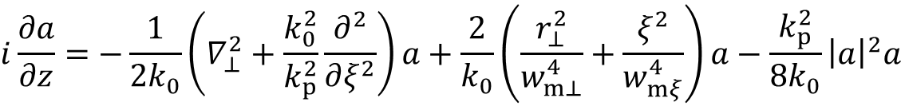
Nonlinear optical response of plasma modifies the propagation behavior of STOVs
diffraction
transverse guiding
nonlinearity
$$i\frac{∂a}{∂z}=−\frac{1}{2k_{0}}\left(∇_{⊥}^{2}+\frac{k_{0}^{2}}{k_{p}^{2}}\frac{∂^{2}}{∂ξ^{2}}\right)a+\frac{2}{k_{0}}\left(\frac{r_{⊥}^{2}}{w_{m⊥}^{4}}+\frac{ξ^{2}}{w_{mξ}^{4}}\right)a−\frac{k_{p}^{2}}{8k_{0}}{\left|a\right|}^{2}a$$
dispersion
temporal guiding
In the steady-state limit, plasma has an effective instantaneous nonlinearity
Notes:
In the steady-state limit, plasma obtains an effective instantaneous nonlinearity due to the relativistic oscillation of electrons. Potential high-energy applications of STOVs in plasma therefore require effective modeling of this nonlinearity. The nonlinear effect is included in the dispersive paraxial wave equation as a cubic nonlinearity in the normalized vector potential.

Slide 19
Nonlinear optical response of plasma modifies the propagation behavior of STOVs
diffraction
transverse guiding
nonlinearity
$$i\frac{∂a}{∂z}=−\frac{1}{2k_{0}}\left(∇_{⊥}^{2}+\frac{k_{0}^{2}}{k_{p}^{2}}\frac{∂^{2}}{∂ξ^{2}}\right)a+\frac{2}{k_{0}}\left(\frac{r_{⊥}^{2}}{w_{m⊥}^{4}}+\frac{ξ^{2}}{w_{mξ}^{4}}\right)a−\frac{k_{p}^{2}}{8k_{0}}{\left|a\right|}^{2}a$$
dispersion
temporal guiding
In the steady-state limit, plasma has an effective instantaneous nonlinearity
No closed-form solutions in three dimensions
Simulating nonlinear STOV propagation requires numerical approaches and/or approximation techniques
Notes:
The resulting nonlinear equation does not posses exact analytic solutions in three-dimensions, requiring numerical approaches and/or approximation techniques to model nonlinear propagation.

Slide 20
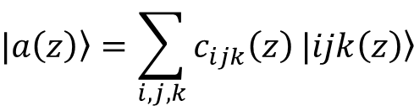


Nonlinear solutions can be approximated by a superposition of STOV basis states
$z$-dependent coefficients
$$|\left.a\left(z\right)\right\rangle =\sum_{i,j,k}{c_{ijk}\left(z\right)}\left.|ijk\right\rangle$$
$$|\left.a\left(z\right)\right\rangle =\sum_{i,j,k}{c_{ijk}\left(z\right)}\left.|ijk\left(z\right)\right\rangle$$
orthogonal STOV basis
Notes:
A common approach to approximating such solutions is to employ a superposition of orthogonal basis states with arbitrary complex coefficients. By projecting the superposition onto the nonlinear equation, the dynamics can be reduced to a finite set of coupled differential equations for the coefficients. For modeling the nonlinear propagation of STOV pulses, a basis of orthogonal STOV states is an ideal choice.

Slide 21
Nonlinear solutions can be approximated by a superposition of STOV basis states
Method I
Linear waist scaling
Advantages:
Straightforward numerical implementation
Captures linear diffraction/dispersion
Disadvantages:
Inefficient at capturing nonlinear collapse, structure distortions
$z$-dependent coefficients
$$|\left.a\left(z\right)\right\rangle =\sum_{i,j,k}{c_{ijk}\left(z\right)}\left.|ijk\right\rangle$$
$$|\left.a\left(z\right)\right\rangle =\sum_{i,j,k}{c_{ijk}\left(z\right)}\left.|ijk\left(z\right)\right\rangle$$
orthogonal STOV basis
Notes:
One implementation of this approach incorporates the linear propagation behavior of the STOV basis such that the coefficient evolution is driven purely by nonlinear effects. This approach is straightforward and “free” to implement since as we have established the linear evolution is known a priori. However, this method requires many basis states to resolve certain nonlinear effects like nonlinear contributions to the scaling of the pulse waists and higher-order nonlinear distortions of the STOV pulse structure.

Slide 22
Nonlinear solutions can be approximated by a superposition of STOV basis states
Method I
Method II
Linear waist scaling
Nonlinear waist scaling
Advantages:
Straightforward numerical implementation
Captures linear diffraction/dispersion
Disadvantages:
Inefficient at capturing nonlinear collapse, structure distortions
Advantages:
Captures linear diffraction/dispersion; nonlinear collapse
More efficient capture of structure distortion
Disadvantages:
More complex numerical implementation
$z$-dependent coefficients
$$|\left.a\left(z\right)\right\rangle =\sum_{i,j,k}{c_{ijk}\left(z\right)}\left.|ijk\right\rangle$$
$$|\left.a\left(z\right)\right\rangle =\sum_{i,j,k}{c_{ijk}\left(z\right)}\left.|ijk\left(z\right)\right\rangle$$
orthogonal STOV basis
Notes:
A second method addresses this issue by including the nonlinear contributions to the pulse waist evolution in the basis. The coefficient equations then only need to capture the higher-order structure distortions driven by the nonlinearity, requiring fewer basis states in general to maintain accuracy. However, this method is more difficult to implement because it requires self-consistently simulating the nonlinear waist evolution along with the coefficient equations.

Slide 23
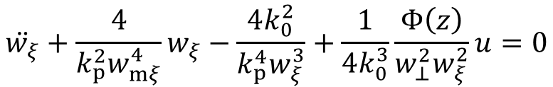
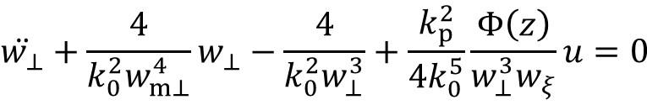
Nonlinear plasma response modifies linear waist evolution
Transverse waist equation
Temporal waist equation
diffraction
dispersion
$$\ddot{w_{⊥}}+\frac{4}{k_{0}^{2}w_{m⊥}^{4}}w_{⊥}−\frac{4}{k_{0}^{2}w_{⊥}^{3}}+\frac{k_{p}^{2}}{4k_{0}^{5}}\frac{Φ\left(z\right)}{w_{⊥}^{3}w_{ξ}}u=0$$
$$\ddot{w_{ξ}}+\frac{4}{k_{p}^{2}w_{mξ}^{4}}w_{ξ}−\frac{4k_{0}^{2}}{k_{p}^{4}w_{ξ}^{3}}+\frac{1}{4k_{0}^{3}}\frac{Φ\left(z\right)}{w_{⊥}^{2}w_{ξ}^{2}}u=0$$
transverse guiding
nonlinear contribution
temporal guiding
nonlinear contribution
$Φ\left(z\right)$ is a dynamic factor that depends on the pulse structure ($c_{ijk}\left(z\right)$ equations)
$u=U/U_{0}$ is the pulse energy normalized by $U_{0}≡ε_{0}c^{2}/k_{0}{\left(m_{e}c^{2}/e\right)}^{2}$
Including nonlinearity in the waist equations reduces the modes required to capture nonlinear structural distortions
Notes:
Continuing with this second approach, we can write the waist equations including the terms contributed by the nonlinearity. The nonlinear terms couple the waist equations to each other and to the dimensionless “structure” parameter \Phi which has implicit dependence on the coefficients of the expansion. The overall pulse energy modulates the strength of the nonlinear contribution.

Slide 24

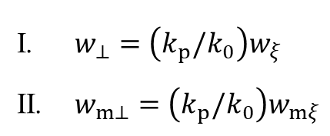
Nonlinear waist dynamics simplify under structurally invariant propagation of individual STOV pulses
Assumptions:
$w_{⊥}=\left(k_{p}/k_{0}\right)w_{ξ}$
$w_{m⊥}=\left(k_{p}/k_{0}\right)w_{mξ}$
linear
structural invariance
Approximations:
nonlinear
structural invariance
$Φ$ constant (single STOV)
Notes:
Although this system accurately captures the nonlinear evolution, it is intractable to derive analytic results when working with many coupled equations. In order to reduce the number of equations, we make the approximation that the STOV structure does not evolve.

Slide 25
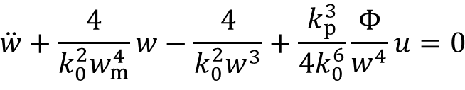
Nonlinear waist dynamics simplify under structurally invariant propagation of individual STOV pulses
Assumptions:
$w_{⊥}=\left(k_{p}/k_{0}\right)w_{ξ}$
$w_{m⊥}=\left(k_{p}/k_{0}\right)w_{mξ}$
Unified waist equation
linear
structural invariance
diffraction/dispersion
$$\ddot{w}+\frac{4}{k_{0}^{2}w_{m}^{4}}w−\frac{4}{k_{0}^{2}w^{3}}+\frac{k_{p}^{3}}{4k_{0}^{6}}\frac{Φ}{w^{4}}u=0$$
Approximations:
nonlinear
structural invariance
guiding
nonlinear contribution
$Φ$ constant (single STOV)
Notes:
This reduces the coupled spot size equations to a single equation with a constant structure parameter. In essence we have restricted the nonlinear dynamics to non-evolving STOV structures. In order to make this approximation in the nonlinear case, we must at minimum enforce structural invariance in the linear case.

Slide 26

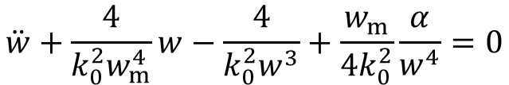
Nonlinear waist dynamics simplify under structurally invariant propagation of individual STOV pulses
Assumptions:
$w_{⊥}=\left(k_{p}/k_{0}\right)w_{ξ}$
$w_{m⊥}=\left(k_{p}/k_{0}\right)w_{mξ}$
Unified waist equation
linear
structural invariance
diffraction/dispersion
Approximations:
$$\ddot{w}+\frac{4}{k_{0}^{2}w_{m}^{4}}w−\frac{4}{k_{0}^{2}w^{3}}+\frac{w_{m}}{4k_{0}^{2}}\frac{α}{w^{4}}=0$$
nonlinear
structural invariance
guiding
nonlinear contribution
$Φ$ constant (single STOV)
$${α≡k}_{p}^{3}Φu/\left(k_{0}^{4}w_{m}\right)$$
Notes:
For simplicity, we introduce the dimensionless parameter \alpha, which encapsulates the total strength of the nonlinear influence.

Slide 27
Outline
Background and motivation
Linear propagation of STOVs
Nonlinear propagation model
Nonlinear stability analysis of structurally invariant STOVs
Notes:
We can now proceed to the analysis of this simplified nonlinear model.

Slide 28
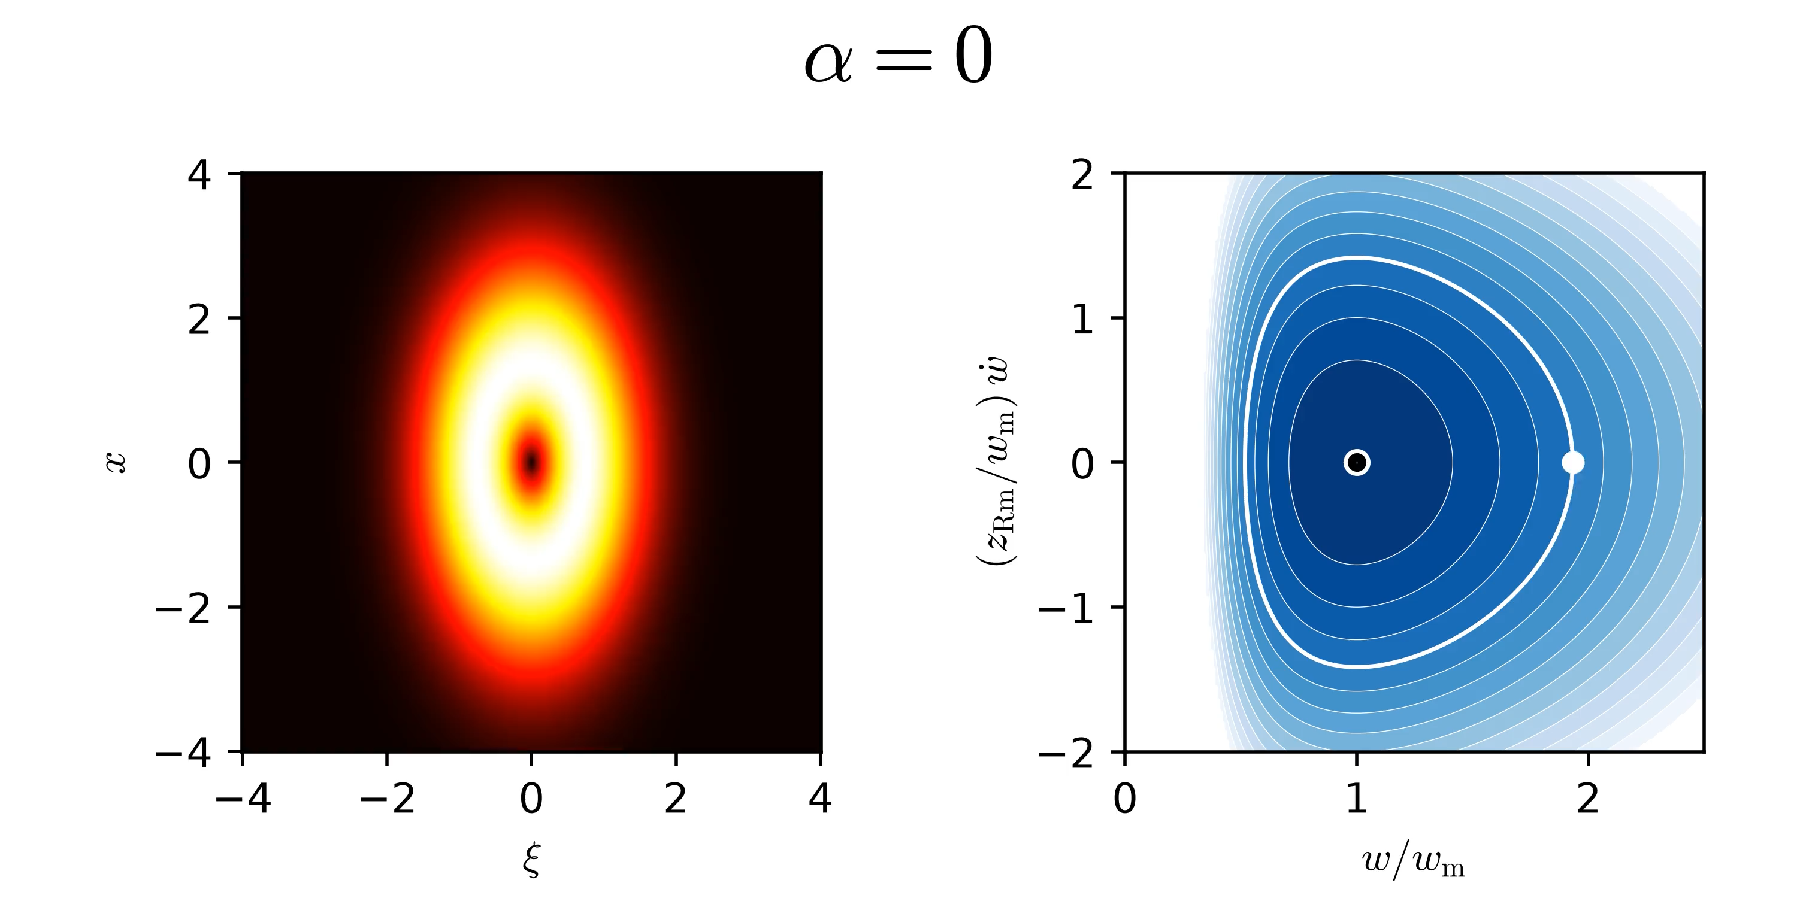

Plasma waveguides induce stable guiding in the linear limit
$${α≡k}_{p}^{3}Φu/\left(k_{0}^{4}w_{m}\right)$$
For $α=0$, the waist has a stable equilibrium at the matched channel waist $w=w_{m}$
Away from $w_{m}$, the waist undergoes periodic oscillation due to the guiding effect of the channel
Notes:
In the limit that the nonlinear strength is zero, linear guiding dynamics are recovered. The plot on the right gives the evolution of an oscillating guided pulse in phase space. A feature of this phase space is the stable equilibrium at the matched channel waist. Around this stable equilibrium, the unified pulse waist oscillates in a stable and periodic manner.

Slide 29
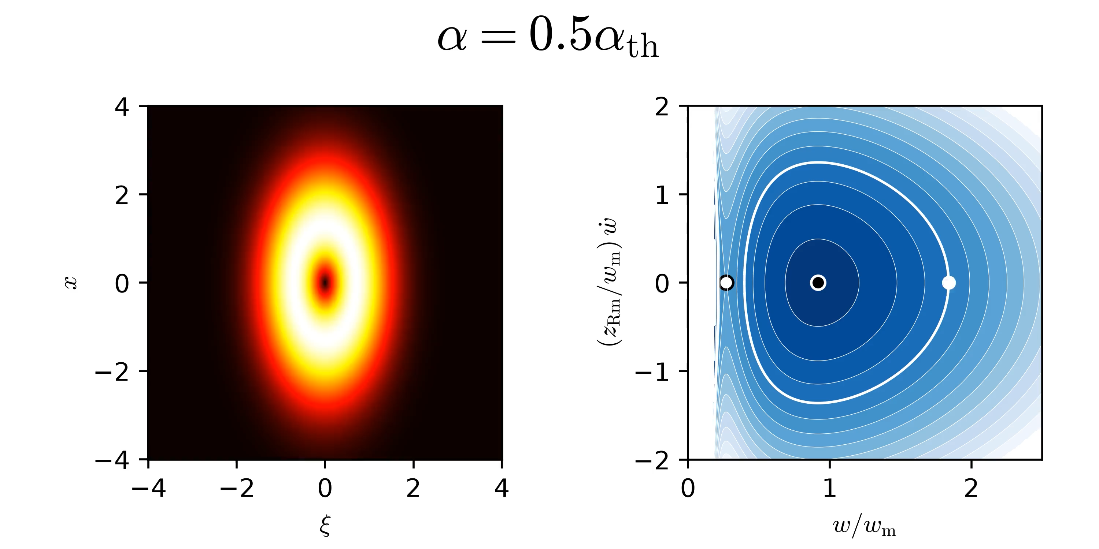
Below a threshold nonlinearity strength, stable guiding remains possible
$${α≡k}_{p}^{3}Φu/\left(k_{0}^{4}w_{m}\right)$$
Guiding remains possible for $0<α< α_{th}≈8.6$
The stable equilibrium is shifted inward while an unstable equilibrium appears
Notes:
Increasing the nonlinear strength somewhat introduces an unstable equilibrium to the phase space. This unstable equilibria corresponds to self-guiding of the pulse. Stable guiding is still possible in the neighborhood of the stable equilibria due to the guiding effect of the channel.

Slide 30
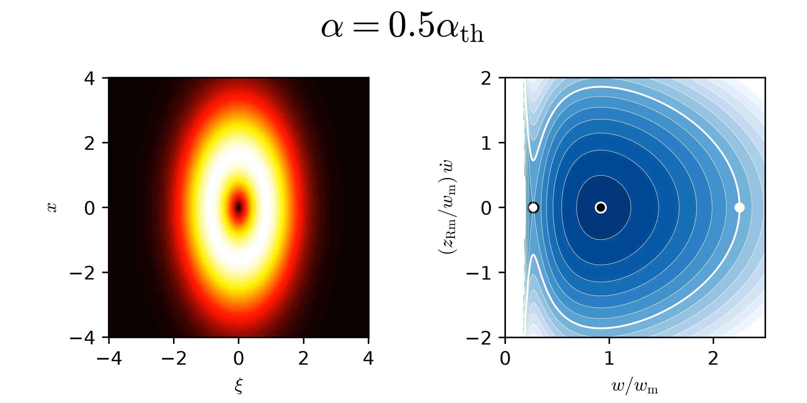
Below a threshold nonlinearity strength, stable guiding remains possible
$${α≡k}_{p}^{3}Φu/\left(k_{0}^{4}w_{m}\right)$$
Some trajectories remain periodic while others result in collapse
Notes:
However, certain trajectories become unstable if they are outside the potential well produced by the channel guiding. Such trajectories succumb to self-focusing collapse.

Slide 31
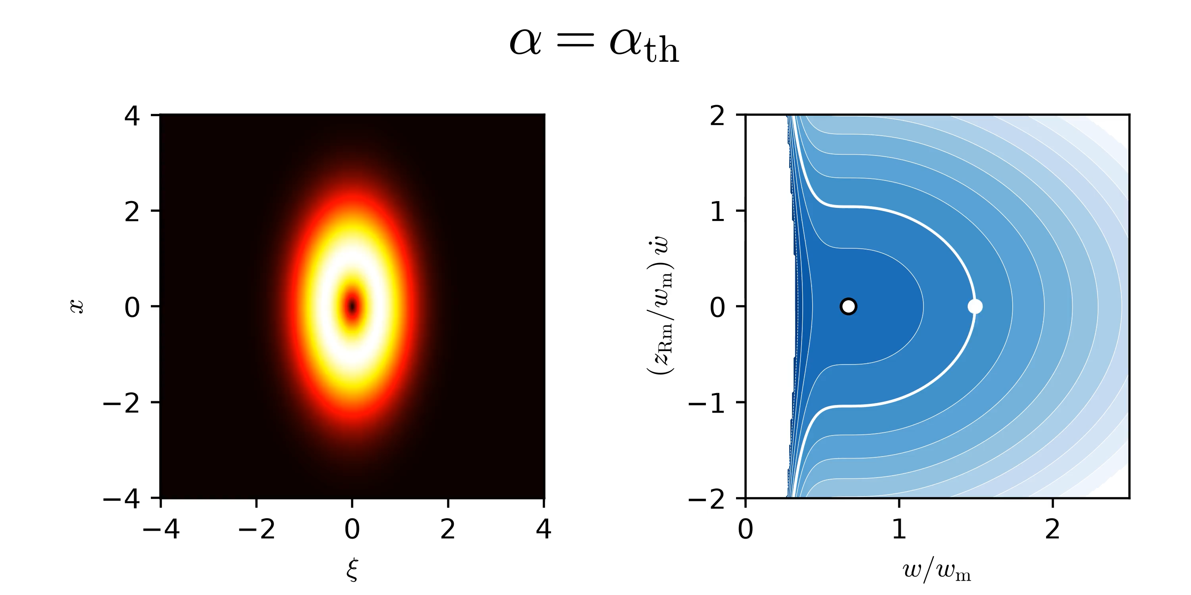
Stable guiding behavior disappears above a threshold nonlinearity strength
$${α≡k}_{p}^{3}Φu/\left(k_{0}^{4}w_{m}\right)$$
At $α= α_{th}≈8.6$, the stable and unstable equilibria coincide
All trajectories result in collapse other than fixed propagation at the single equilibrium
Notes:
If the strength of the nonlinearity is increased to a threshold value, the stable and unstable equilibria merge to produce a saddle-point equilibria. At this value of \alpha, all trajectories will result in collapse other than fixed propagation at the single equilibria.

Slide 32
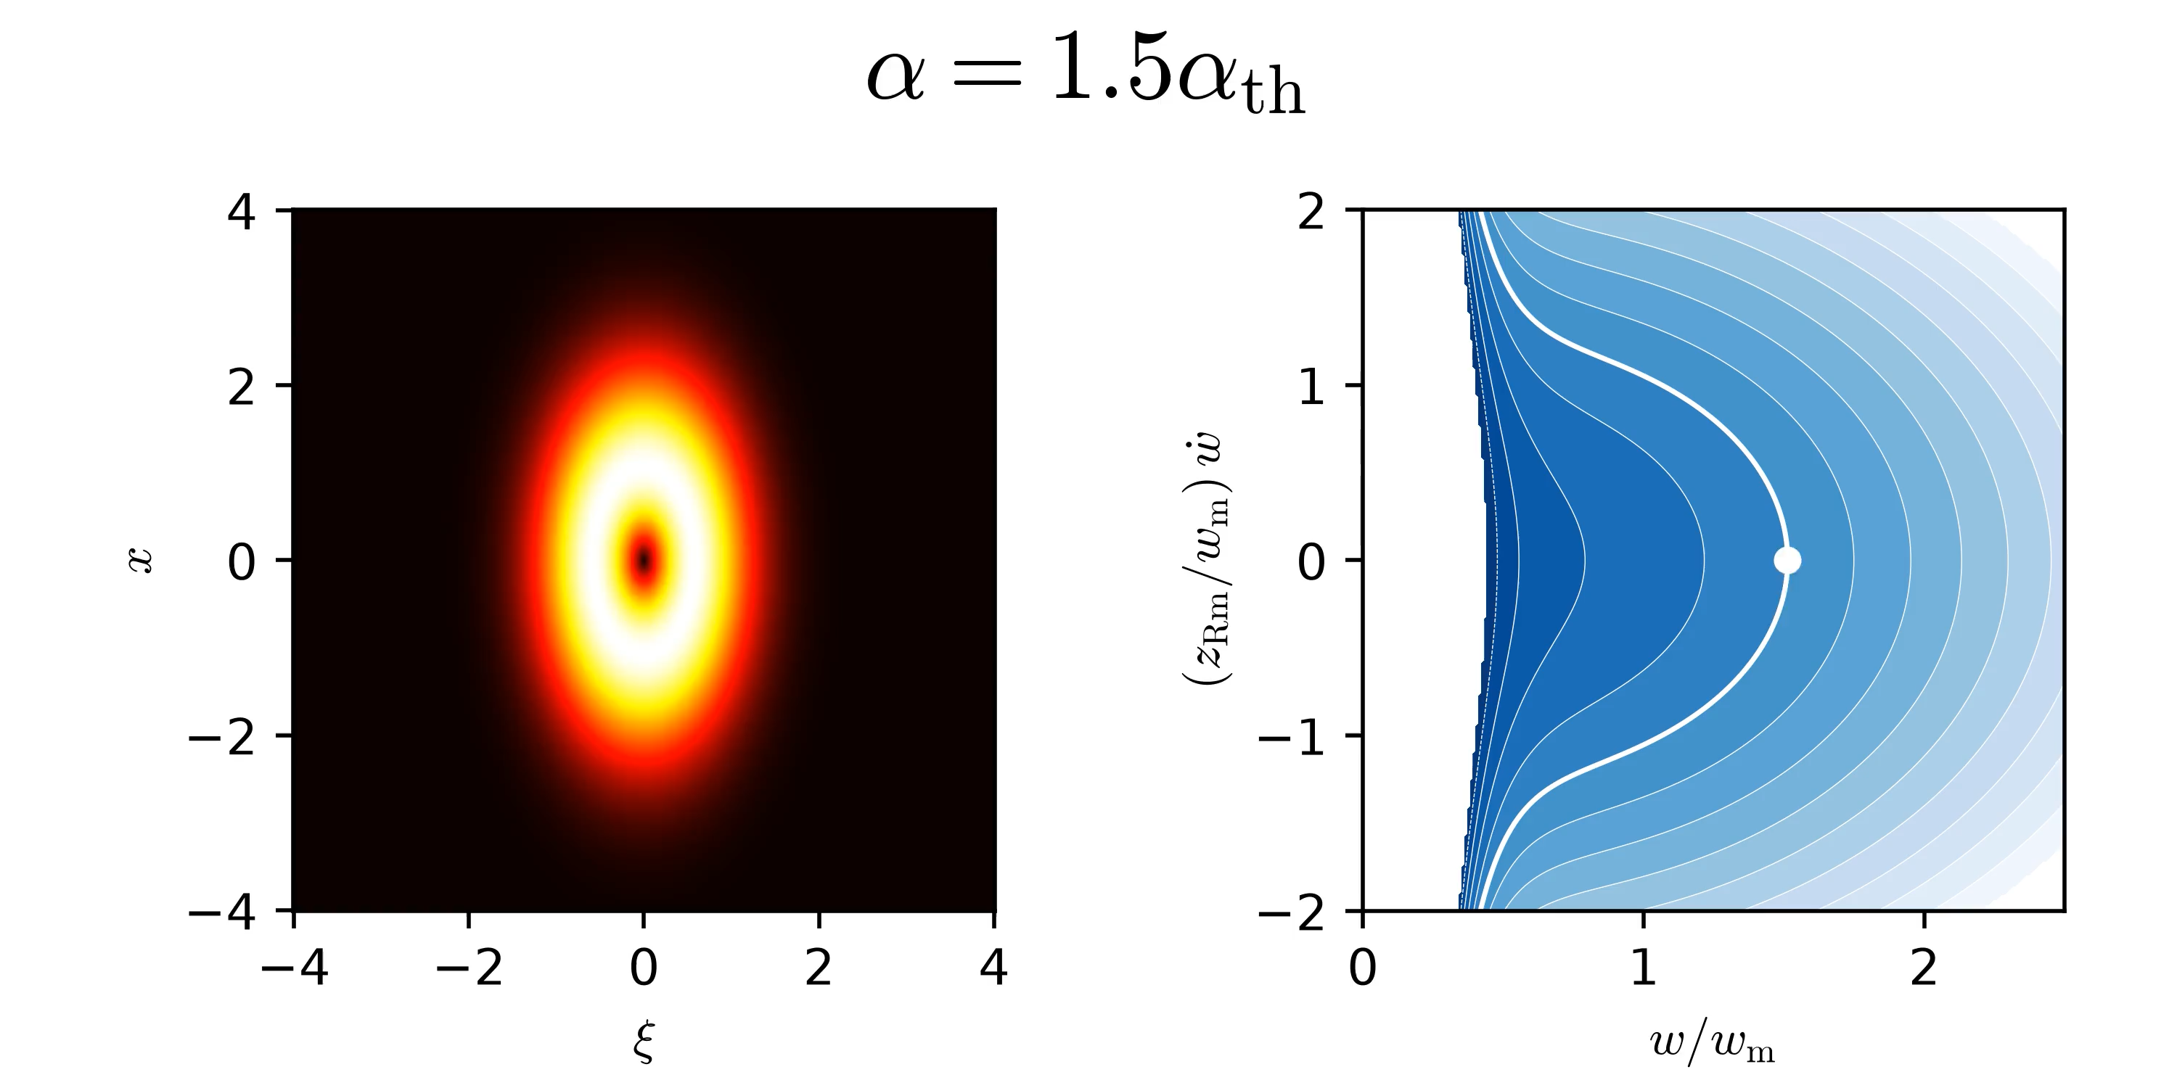
Stable guiding behavior disappears above a threshold nonlinearity strength
$${α≡k}_{p}^{3}Φu/\left(k_{0}^{4}w_{m}\right)$$
No equilibria exist for $α> α_{th}≈8.6$.
All trajectories result in collapse
Notes:
Increasing the nonlinear strength further eliminates all equilibria. Even with a guiding structure, self-focusing collapse becomes unavoidable.

Slide 33
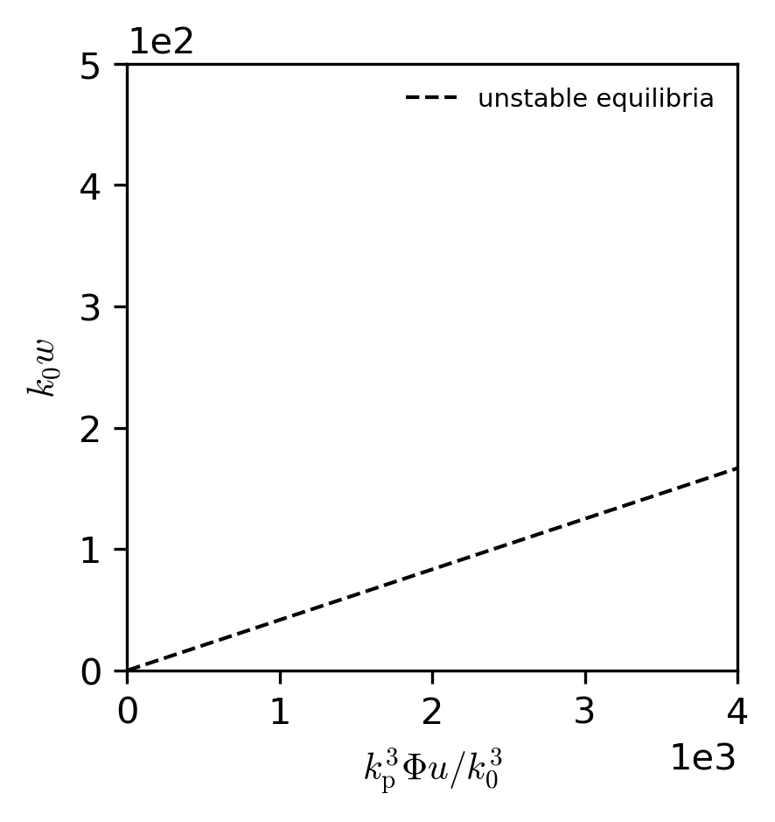
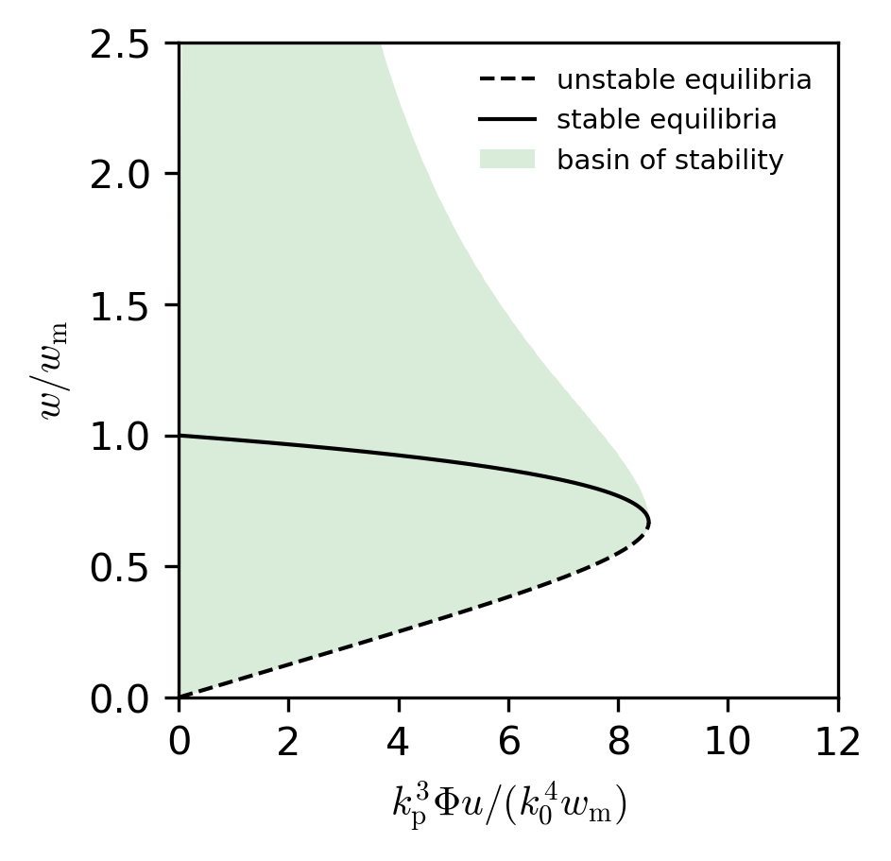
Plasma waveguides offer protection against self-focusing collapse
With plasma waveguide
Without plasma waveguide
channel guiding
self-guiding
self-guiding
Notes:
The complete behavior can be summarized by plotting the location of the equilibria against the strength of the nonlinearity. Increasing the nonlinearity pulls the location of the stable channel equilibria inward toward smaller waist sizes while shifting the unstable self-guiding equilibria outward towards larger waists. At large enough nonlinearity, the equilibria coincide and annihilate. Overlaid is the basin of stability produced by the channel guiding. A collimated pulse entering the channel within this region will not collapse.
We contrast this behavior to the unguided case on the right. The absence of the guiding structure enables only unstable self-guiding that is not robust to perturbation.

Slide 34
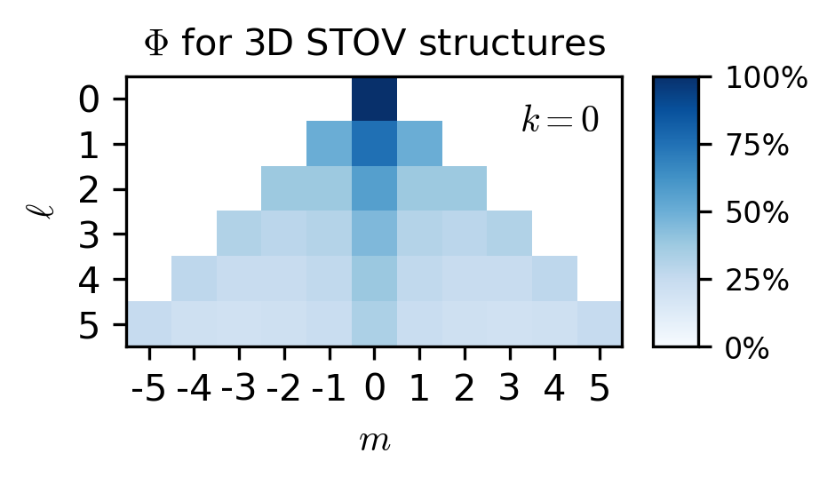
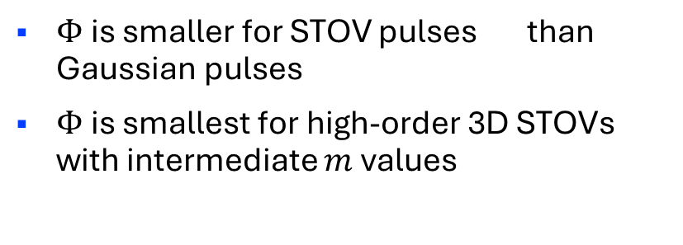
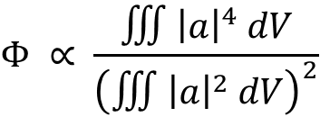
Spatiotemporal structure abates nonlinear self-focusing
$$Φ ∝ \frac{∭{\left|a\right|}^{4} dV}{{\left(∭{\left|a\right|}^{2} dV\right)}^{2}}$$
$Φ$ is smaller for STOV pulses than Gaussian pulses
$Φ$ is smallest for high-order 3D STOVs with intermediate $m$ values
3D STOV pulses are less influenced by nonlinearity than Gaussian pulses at the same energy and waist size
Notes:
The overall influence of the nonlinearity depends on the value of the dimensionless structure constant \Phi. Plotted on the right is the magnitude of this constant for some selected three-dimensionally structured STOV modes, with the three modes featured in this talk overlaid by stars. At lowest order, the modes reduce to a standard Gaussian structure which is shown by the diamond. The smaller value of \Phi for these modes indicate they are less susceptible to self-focusing than Gaussian pulses of the same energy and waist sizes.

Slide 35
The nonlinear optical response of plasma modifies the propagation of STOVs
Spatiotemporal optical vortices (STOVs) are spatiotemporally structured pulses that carry orbital angular momentum (OAM) transverse to the propagation direction
The standard two-dimensional STOV structure can be extended to a full three-dimensional structure with generalized spatiotemporal OAM
Plasma waveguides with moving density depressions allow guiding of STOV pulses and protect against self-focusing collapse
The novel topology of STOVs present new opportunities to revisit established laser-plasma interactions

