Slide 1




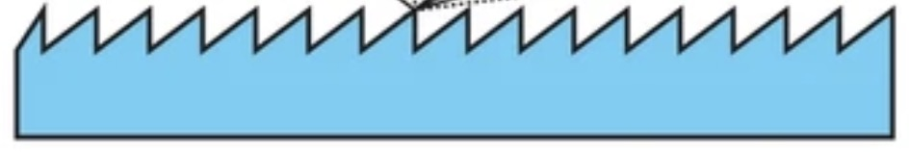
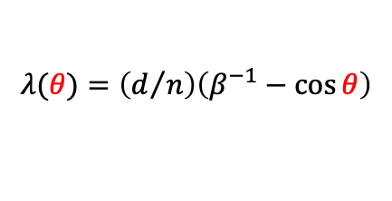
CSPR:
𝜆 > 𝜎_{z}
$$λ(θ)=\left(d/n\right)\left(β^{−1}−\cos{θ}\right)$$
SPR
synchronized
secondary fs X-rays
(betatron, ICS, brems)
N-electron-bunch
𝜎_{z}
grating
1
Coherent Smith-Purcell Radiation
from plasma-accelerated electrons:
a synchronized strong-field THz radiation source
2
Mike Downer, R. Rudzinsky, Z. Ouyang, J. Brooks, B. Dinh, L. Zhang, A. Raka, E. Martinez, R. Zgadzaj
The University of Texas at Austin
M. LaBerge, Y.-Y. Chang, A. Debus, J. M. Klopf, F. M. Herrmann, P. Ufer, S. Schöbel, T. E. Cowan, A. Irman, U. Schramm
Helmholtz-Zentrum Dresden-Rossendorf (HZDR)
Previous AAC 2026
presentations:
• Rudzinsky, The role of CSPR for LWFA beam diagnosis, WG5 Tu 13:50
• Rudzinsky, CSPR from plasma-accelerated electron bunches, M poster
• Martinez, Reconstructing LWFA e-bunch longitudinal profiles from CSPR, Tu poster.
• Raka, Reshaping CSPR from fs LWFA e-bunches into strong-field THz pulses, M poster.
¹ S. J. Smith and E. M. Purcell, Phys. Rev. 92, 1069 (1953)
² R. Rudzinsky et al., Optica 13 (5), 810-821 (2026)
Advanced Accelerator Concepts (July 30, 2026)

Slide 2
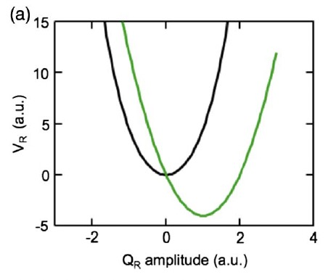
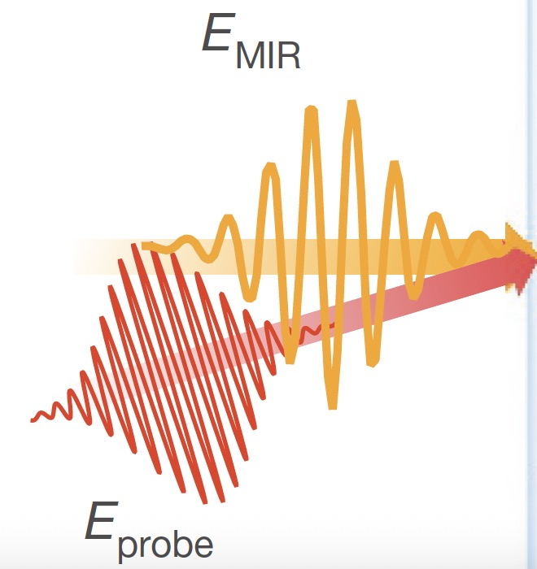
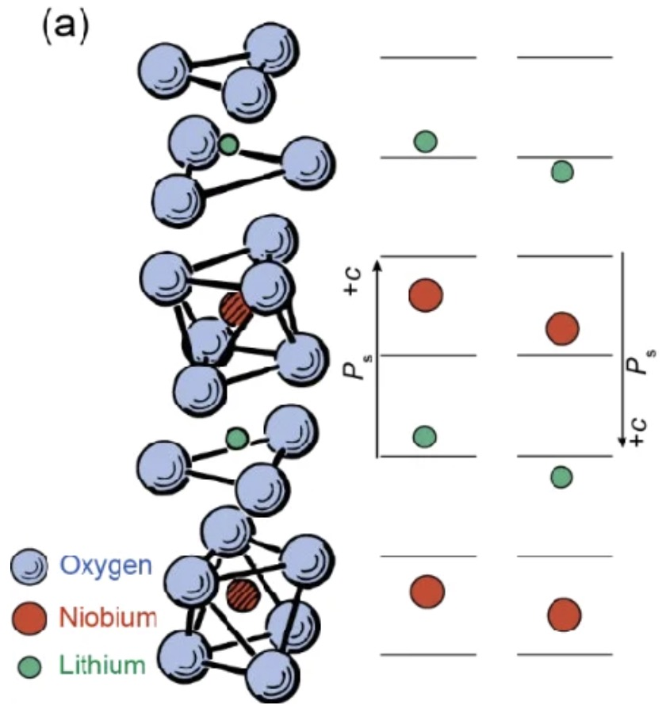
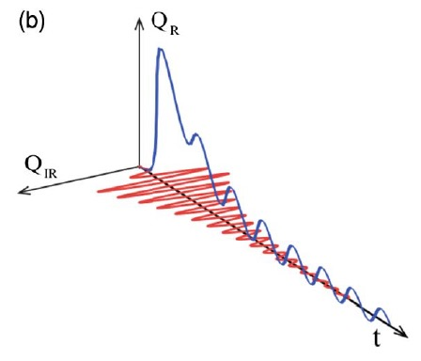
Nonlinear phononics: controlling matter w. THz light
Nicoletti & Cavalleri, Adv. Opt. Phot. 8, 403- (2016)
1) Strong THz pulse (≳ 1 GV/m) resonantly drives
IR-active lattice vibration Q_{IR} to high amplitude.
2) Anharmonic lattice potential rectifies that vibration into displace-
ment along another structural coordinate Q_{R}, producing a tran-
sient crystal with different electronic & magnetic properties.
Strong THz sources:
e.g.
• insulator → metal
• antiferromagnet → magnetically disordered
• normal → superconducting
• charge-ordered → charge-disordered
• ferroelectric polarization reversal
• laser-based
1
• accelerator-based
E_{THz}
2
strong THz
Ferroelectric polarization
reversal in LiNbO₃ via strong
resonant excitation of IR-
active phonon.
Q_{R}
+P
2
Q_{IR}
Mankowsky, PRL 118, 197601 (2017)
Types of fs probes:
• optical
• X-ray
• electron
1
-P
probes of
structural
change, if synchronized with THz pump

Slide 3
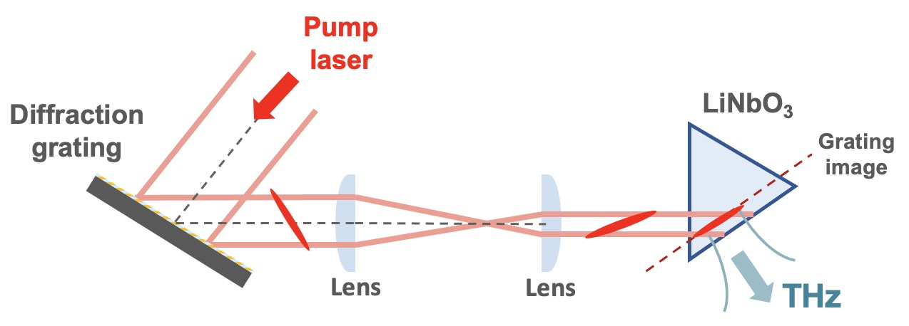
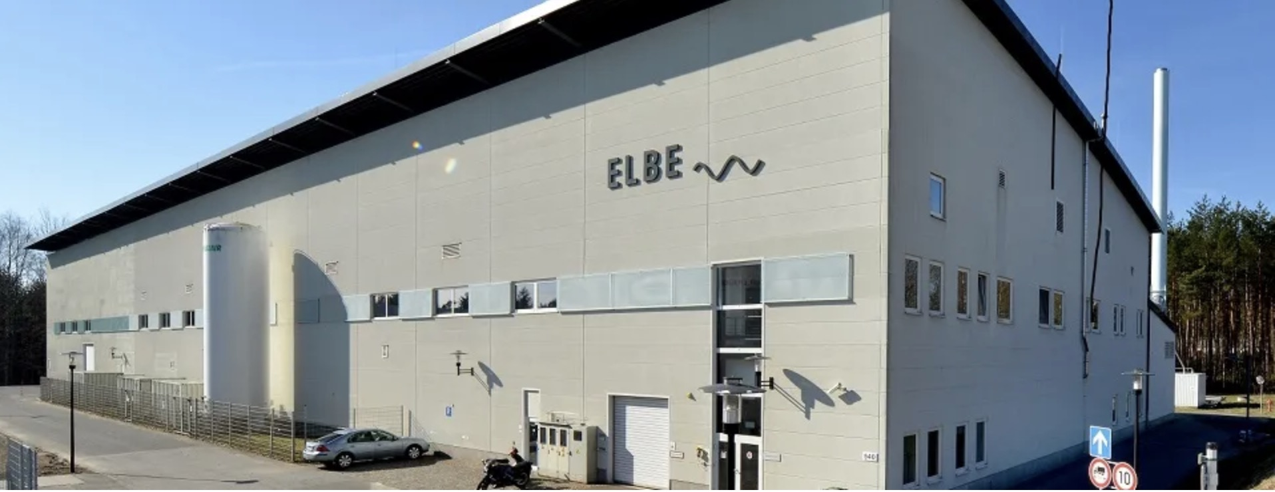
Existing strong-field THz sources & fs LWFA-driven CSPR
Preliminary comparison
 | Laser-Driven Sources |  | RF Accelerator-Driven Sources |  |  | fs CSPR
THz property | Mid-IR [1,2] (Organic X-tals) | Near-IR [3-5] (TPF, LiNbO₃) | RF: FELBE/TELBE [6,7] U37 U100 U300 |  |  | LWFA-driven [8] (this work)
wavelength [µm] | 30-3000 | 120-3000 | 5-40 | 18-250 | 120-3000 | 5 -30
frequency [THz] | 0.1 - 10 | 0.1 - 3 | 7.5 - 60 | 1.2 - 17 | 0.1 – 2.5 | 10 - 60
time-synched to... | drive laser |  | drive e-bunch and secondary X-rays
scale | tabletop |  | large user facility |  |  | tabletop
Near-IR
• configurable
• transportable
Tilted Pulse Front (TPF)
[1] Vicario, PRL 112, 213901 (2014)
[2] Gollner, APL Photonics 6, 046105 (2021)
[3] Hebling, JOSA B 25, B6 (2008)
[4] Tóth, Light Sci. Appl. 12, 256 (2023)
[5] Kroh, Opt. Express 30, 24186 (2022)
[6] Green, Sci. Rpts. 6, 22256 (2016)
[7] Helm, Eur. Phys. J. Plus 138, 158 (2023)
[8] Rudzinsky,
Optica 13, 810 (2026)

Slide 4
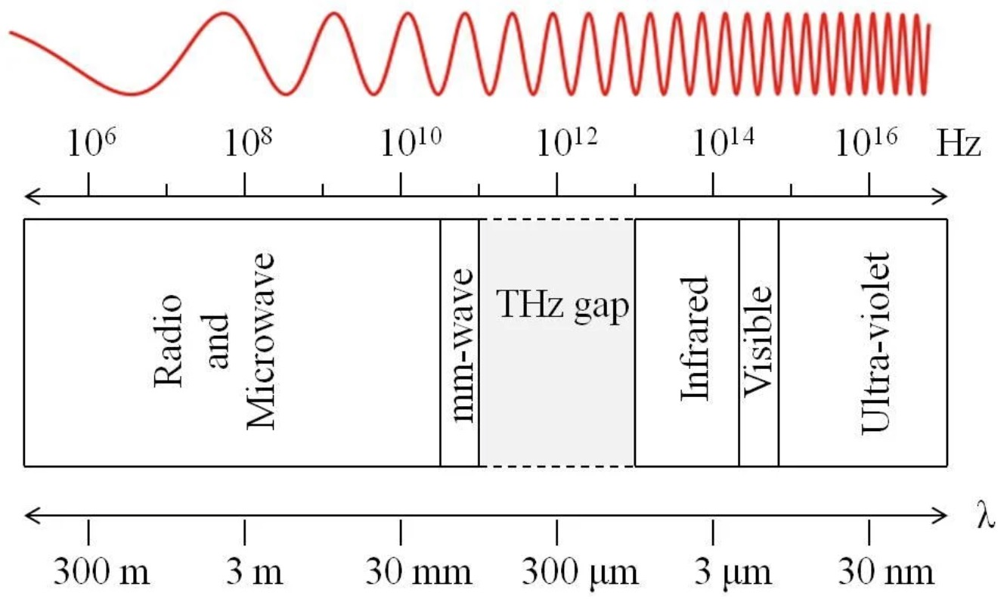

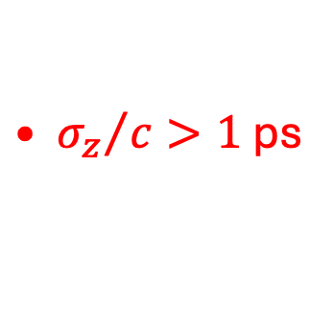
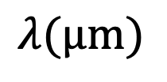





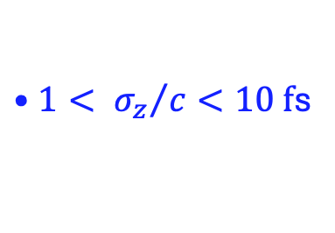
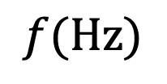


Coherent SPR (CSPR)...
$${10}^{10}$$
$${10}^{11}$$
$${10}^{12}$$
$${10}^{13}$$
*
$${10}^{14}$$
$${10}^{15}$$
$$f(Hz)$$
...from RF accelerators:
...from LWFAs:
THz band
Infrared
Visible
• $σ_{z}>300 µm$
mm-wave
• ${0.5< σ}_{z}<3 µm$
${{• σ}_{z}}/c>1$ps
${{•1< σ}_{z}}/c<10 f$s
30,000
3,000
300
30
10
3
0.3
$$λ(µm)$$
*
Rudzinsky et al.,
Optica 13, 810 (2026)
4

Slide 5
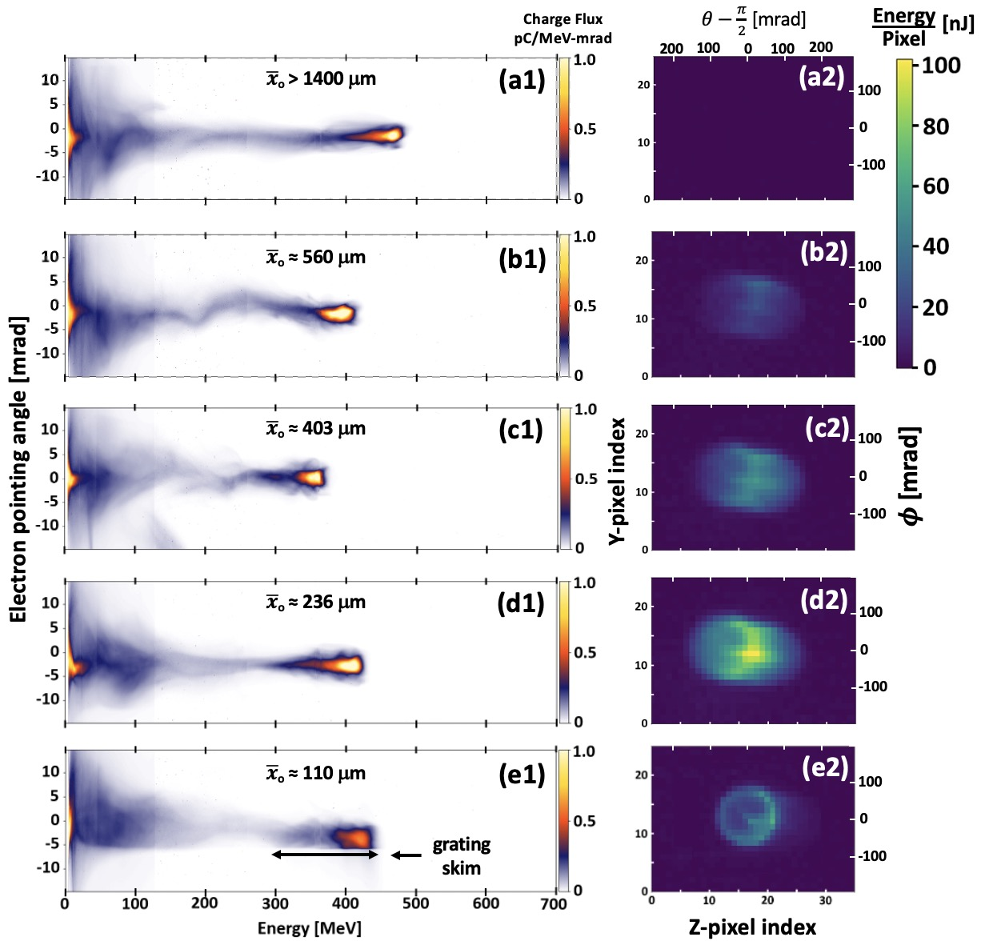
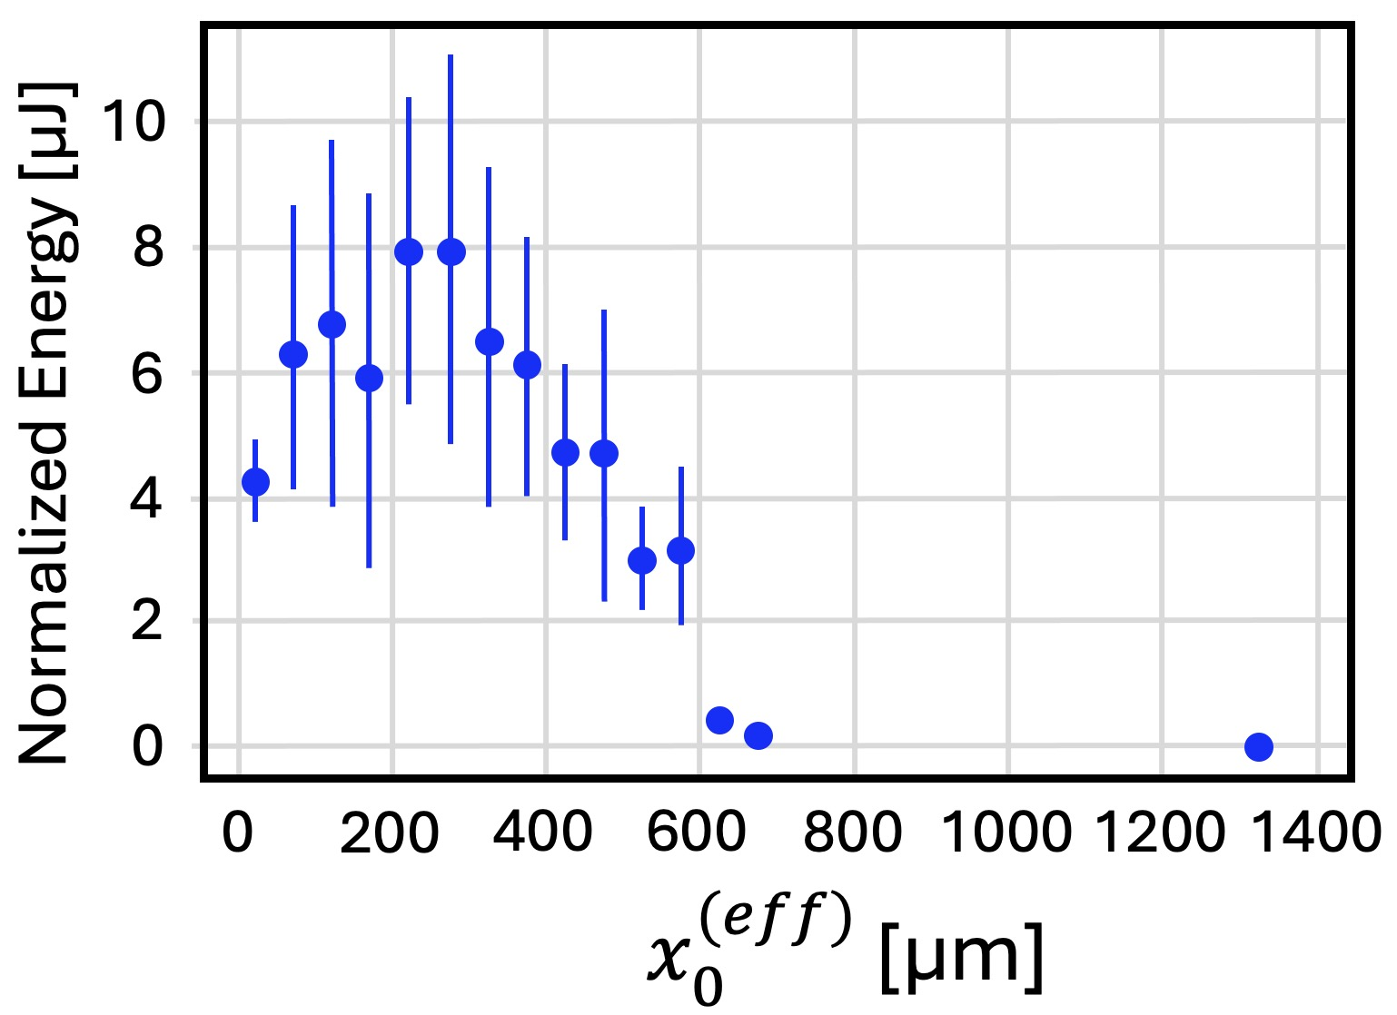

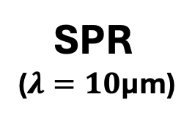
SPR
($λ=10$µm)
pyro-
electric
detector
CSPR Experimental
Results at 𝜆 = 10 µm
e-spectra
diamond
window
Q ≈ 0.4 nC
8 mrad
Rudzinsky et al., Optica 13, 810-821 (2026)
The good agreement with calculated
energy shows that the SPR is
fully coherent at 𝜆 ≈ 10 µm.
grating
skim
calibrated/
measured
CSPR energy
basic CSPR
theory
+ Fresnel
diffraction
$$50 µm$$
e⁻
2.5 cm
11
d = 10 µm

Slide 6
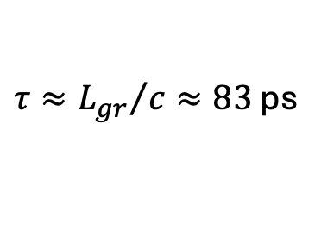



CSPR pulses have complicated space-time structure...
$$x$$
9.83
µm
1st step
• angular chirp
• transverse spatial chirp
• longitudinal chirp
$$θ$$
10 µm
$$z$$
$τ≈{L_{gr}}/c≈83$ ps
10.17
µm
window
For CSPR pulses to be useful for
strong-field THz experiments, we
must remove these chirps.
1.5 m
Doing so requires
precise phase control
⇒
e-bunch
• Radiation must be highly coherent
grating
• Losses must be minimized
L_{gr} = 2.5 cm
d = 10 µm

Slide 7
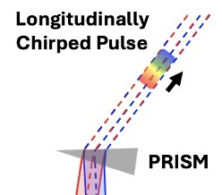
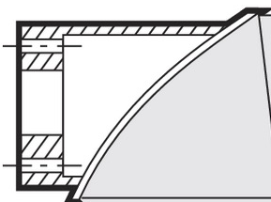

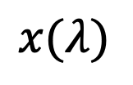
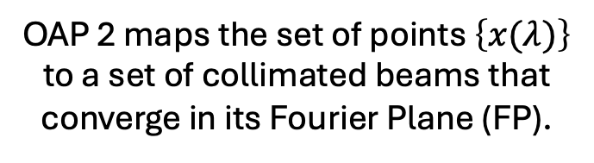
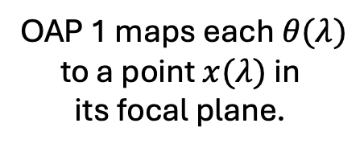
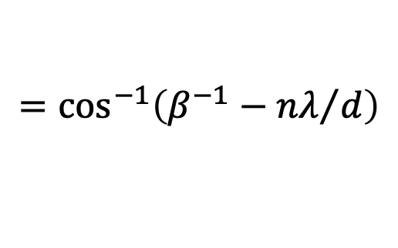
4f SPR dechirper
PRISM
Prism combines beams
to a common path...
FP
transverse
OAP 2 maps the set of points $\left\{x(λ)\right\}$
to a set of collimated beams that
converge in its Fourier Plane (FP).
See Raka poster for
analysis of prism.
OAP 1 maps each $θ(λ)$
to a point $x(λ)$ in
its focal plane.
OAP 1
...thereby removing angular
& transverse spatial chirp,
but leaving longitudinal chirp.
OAP 2
$$x(λ)$$
Inverse
Czerny-Turner
spectrometer
fs e⁻
bunch
$$θ\left(λ\right)$$
$$=\cos^{−1}\left(β^{−1}−{nλ}/d\right)$$
grating

Slide 8
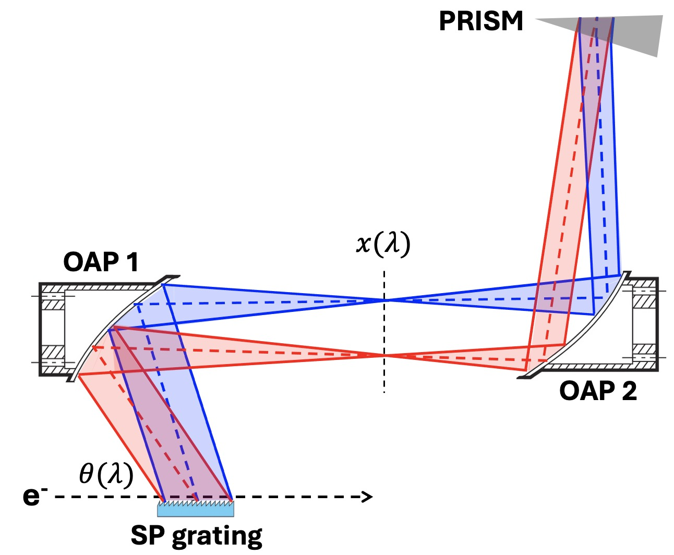
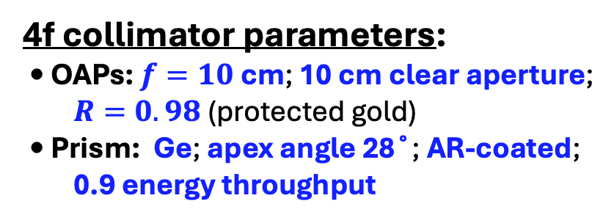

4f SPR transverse dechirper: numerical example
Longitudinally
Chirped Pulse
CSPR source parameters:
• grating length $L$: 12.5 mm
• groove spacing: $d=$ 10 µm
• collection angles: $θ=$ 90˚, $φ=$0˚
• collected cone: $∆θ=∆φ=$ 15 mrad
e.g. 2.5 cm diam. window 50 cm from grating
• collected energy: $ℇ_{CSPR}=$17.5 µJ
• collected $λ$: 9.85 - 10.15 µm
4f collimator parameters:
• OAPs: $f=10$ cm; 10 cm clear aperture;
$R=0.98$ (protected gold)
• Prism: Ge; apex angle 28˚; AR-coated;
0.9 energy throughput
PRISM
⇒
Ray-tracing / Fourier optics simulation
⇒
Output pulse parameters:
• collimated, 3 cm diam.
• duration: ~ 40 ps
• chirp: -7.4 ps²
• energy: 15 µJ
window
(86% throughput)

Slide 9
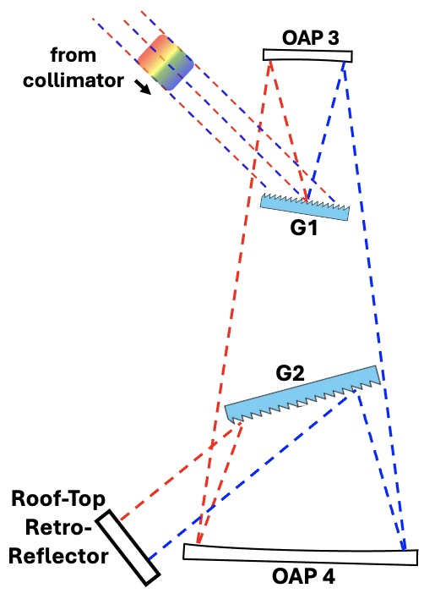
Compressing -7.4 ps², 40 ps pulses at 𝜆₀ ≈ 10 µm
40 ps
(tilts beam ↑)
→
-7.4 ps²
Options in principle:
Pick-Off
Mirror
Bulk GDD > 0 THz-transparent material
☐ several m. of e.g. Ge, ZnSe needed
☐ high absorption losses + TOD
✗
FINAL
FOCUS
✗
Chirped Mirrors
☐ not available at high THz frequencies
☐ insufficient positive GDD
✗
✗
Prism Compressor
OAP 5
☐ insufficient positive GDD at small separations
✗
Martinez “stretcher”
(compressor for GDD < 0 input)
Martinez, IEEE J. Quant. Electron. 23, 1385 (1987)
✓
☐ readily achieves positive 5-10 ps²
☐ manageable loss, TOD
✓
(steps beam ↓)

Slide 10
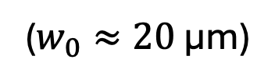
Martinez compressor: numerical example
(tilts beam ↑)
Input pulse parameters:
ℇ = 15 µJ; 𝜆 ≈ 10 µm;
D ≈ 6 cm; 𝜏 ≈ 40 ps; GDD ≈ -7.4 ps²
Pick-Off
Mirror
Compressor parameters:
• Gratings: 100 lines/mm (1st order); R ≈ 0.8 each;
2-pass throughput 0.4 – 0.5
FINAL
FOCUS
• OAPs 3,4: same as for OAPs 1,2
• 3 Flat Mirrors: R ≈ 0.98 each
Simulated output beam parameters:
OAP 5
• Duration: 0.6 < 𝜏 < 1 ps (FWHM, intensity)
(f = 20 cm; NA = 0.15)
• Energy: 4.5 < ℇ < 7 µJ (25-40% total thru-put)
• Final Focus: 0.6 < I₀ < 1.6 x 10¹⁶ W/m²
2 < E_{peak} < 4 GV/m
($w_{0}≈20$ µm)
(steps beam ↓)

Slide 11
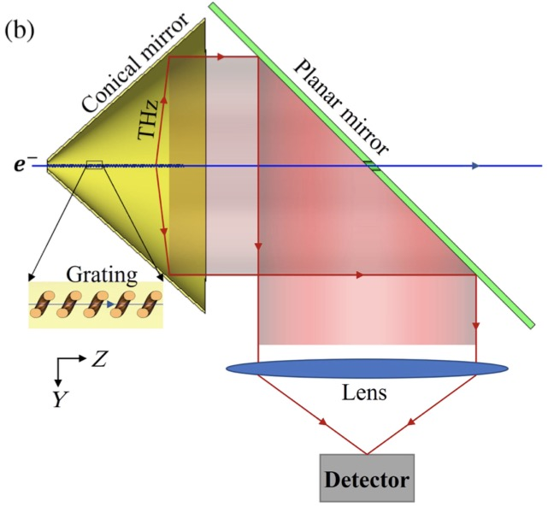
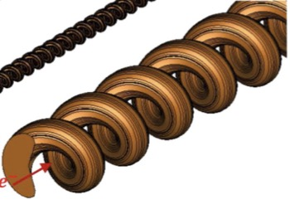
Existing strong-field THz sources & fs LWFA-driven CSPR
Further comparison
 | Laser-Driven Sources |  | RF Accelerator-Driven Sources |  |  | fs CSPR
THz property | Mid-IR [1,2] (Organic X-tals) | Near-IR [3-5] (TPF, LiNbO₃) | RF: FELBE/TELBE [6,7] U37 U100 U300 |  |  | LWFA-driven [8] (this work)
Pulse duration [ps] | 0.1 - 10 | 0.3 - 10 | 1 - 5 | 2.5 - 30 | 0.5 - 10 | 0.6 -1
Pulse energy [µJ] | < 100 | < 14,000 | < 2 | < 2 | < 10 | 5 – 7 ^{c}
E_{peak} [GV/m] ª | < 4 | < 0.5 | < 3 ^{b} | < 0.5 | < 0.18 | 2 - 4
Rep. rate | 10 - 1000 | 10 - 10⁵ | 13 x 10⁶ | 13 x 10⁶ | 0.5 x 10⁶ | 1 – 10 ^{d}
ª Peak focused field for Gaussian pulse focused to beam waist w₀ = 2𝜆.
^{b} Varies with 𝜆; value for 𝜆 = 10 µm is 1 GV/m, assuming 2 µJ energy.
^{c} 3D grating & SPR collection geometries can potentially approach mJ energy
e⁻
T. Zhang, R. Ischebeck, et al., “Boosting the efficiency of narrowband
THz radiators via 3D emission-collection,” PR-AB 28, 054501 (2025)
e⁻

Slide 12
Existing strong-field THz sources & fs LWFA-driven CSPR
Further comparison
 | Laser-Driven Sources |  | RF Accelerator-Driven Sources |  |  | fs CSPR
THz property | Mid-IR [1,2] (Organic X-tals) | Near-IR [3-5] (TPF, LiNbO₃) | RF: FELBE/TELBE [6,7] U37 U100 U300 |  |  | LWFA-driven [8] (this work)
Pulse duration [ps] | 0.1 - 10 | 0.3 - 10 | 1 - 5 | 2.5 - 30 | 0.5 - 10 | 0.6 -1
Pulse energy [µJ] | < 100 | < 14,000 | < 2 | < 2 | < 10 | 5 – 7 ^{c}
E_{peak} [GV/m] ª | < 4 | < 0.5 | < 3 ^{b} | < 0.5 | < 0.18 | 2 - 4
Rep. rate | 10 - 1000 | 10 - 10⁵ | 13 x 10⁶ | 13 x 10⁶ | 0.5 x 10⁶ | 1 – 10 ^{d}
ª Peak focused field for Gaussian pulse focused to beam waist w₀ = 2𝜆.
^{b} Varies with 𝜆; value for 𝜆 = 10 µm is 1 GV/m, assuming 2 µJ energy.
^{c} 3D grating & SPR collection geometries can potentially approach mJ energy [Zhang et al., PR-AB 28, 054501 (2025)]
^{d} LWFAs operating at 100 Hz exist [Eichner et al., Opt. Lett. 50, 4890 (2025)].
LWFAs operating at 1 kHz are under development:
• Rovige et al., Phys. Rev. Accel. Beams 23, 093401 (2020)
• Salehi et al., Phys. Rev. X 11, 021055 (2021)].

Slide 13
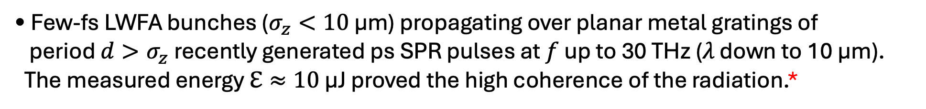
SUMMARY
• Few-fs LWFA bunches ($σ_{z}<10$ µm) propagating over planar metal gratings of
period $d>σ_{z}$ recently generated ps SPR pulses at $f$ up to 30 THz (𝜆 down to 10 µm).
The measured energy $ℇ≈10$ µJ proved the high coherence of the radiation.*
* Rudzinsky et al., Optica 13, 810 (2026)
• Simulations show that selected cones of the CSPR “fan” can be de-chirped, compressed
to 𝜏 < 1 ps, and focused to E_{peak} ~ several GV/m using standard CPA optics.
Presented scheme not optimized; many improvements possible.
• Since these pulses
1) originate from a table-top source; 2) readily reach tens-of-THz frequency; and
3) are intrinsically synchronized with the fs LWFA e-bunch & its secondary X-rays,
they offer unique capabilities for ultrafast high-field THz spectroscopy that complement
existing laser-based and RF accelerator-based THz sources.
Funding:
U. S. Dept. of Energy, Office of HEP (DE-SC0011617)
Helmholtz Association (Matter & Energy)

Slide 14
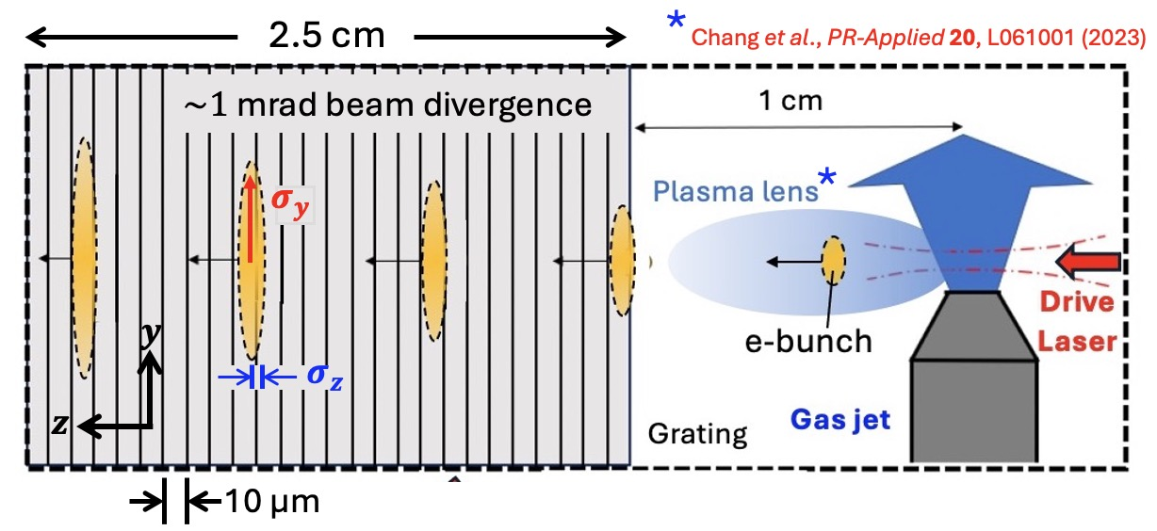
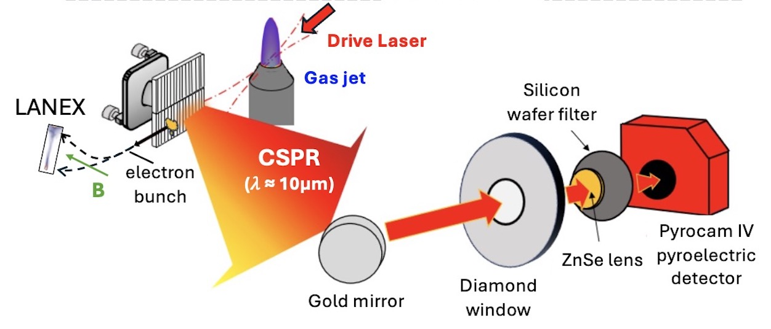
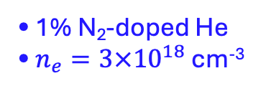

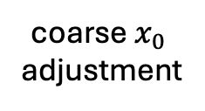
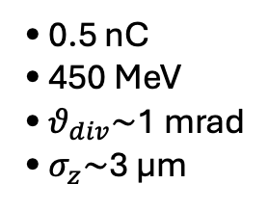
1st Generation SPR
Experimental Setup
Rudzinsky et al., Optica 13, 810-821 (2026)
coarse $x_{0}$
adjustment
• 1% N₂-doped He
• $n_{e}=3×{10}^{18}$ cm⁻³
fine $x_{0}$
jitter
measure-
ment
• 0.5 nC
• 450 MeV
• $θ_{div}\sim$1 mrad
• $σ_{z}\sim$3 µm
10

Slide 15
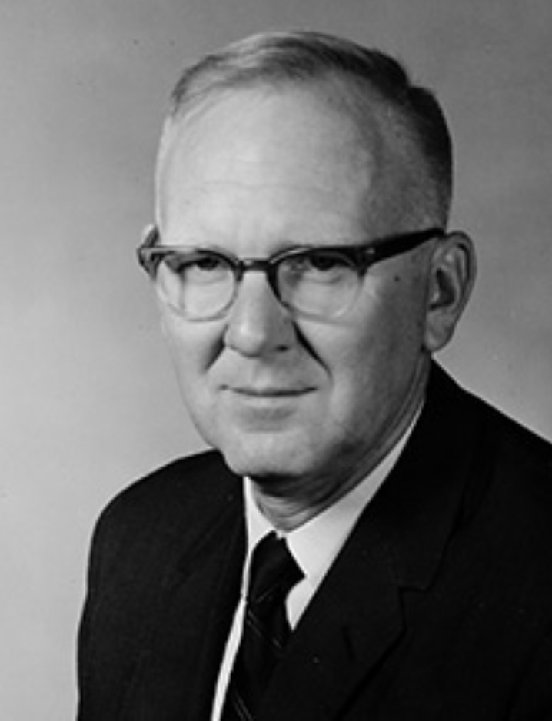
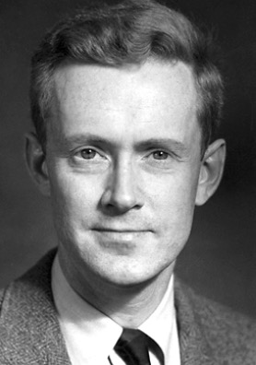
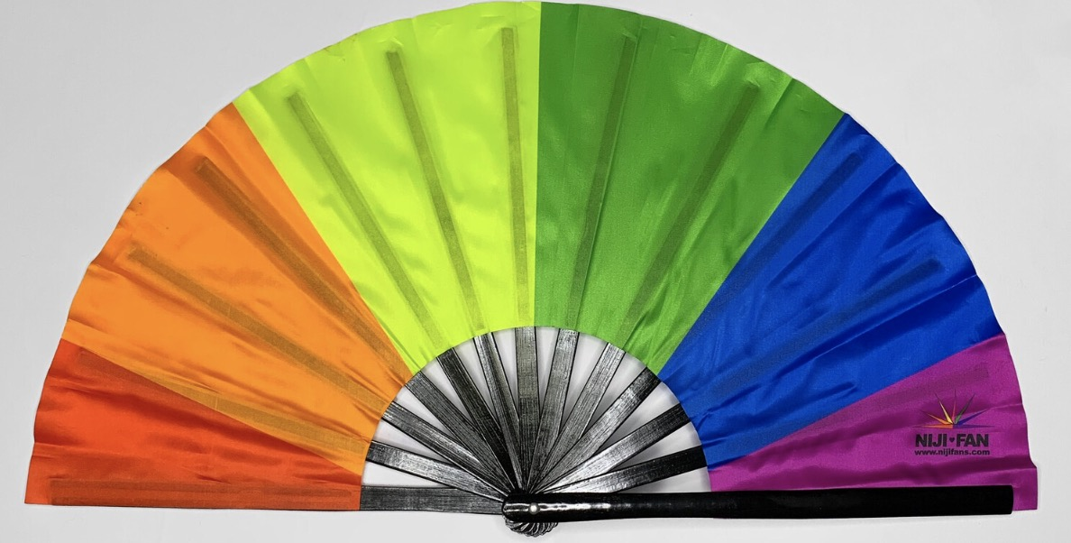
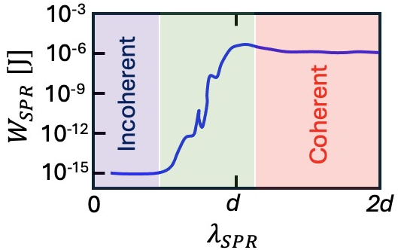


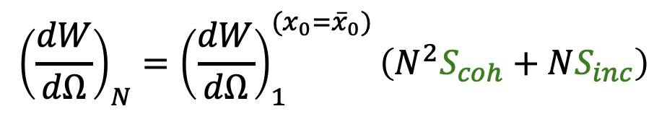
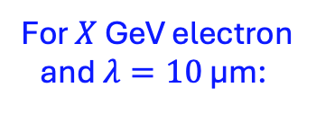


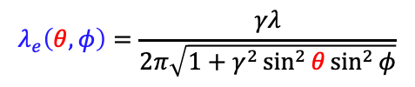




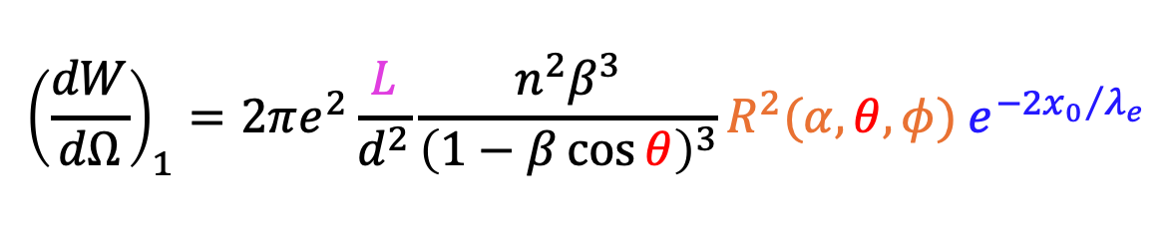



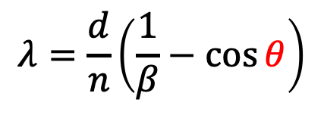
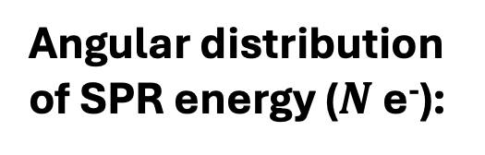
Smith-Purcell Radiation (SPR)
S. J. Smith and E. M. Purcell, “Visible light from localized surface charges moving across a grating,”
Phys. Rev. 92, 1069 (1953).
$$λ_{SPR} \sim σ_{z}$$
$$λ≈d$$
longitudinal
bunch-profile
diagnostic
band
PRIDE* fan:
$$λ>d$$
$$λ<d$$
*Purcell Radiation
Into Directions
according to Energy
Stephen J. Smith
1925-2017
$$λ_{SPR}< σ_{z}$$
Edward M. Purcell
1912-1997
e⁻
(EMP PhD student)
$$α$$
$$d$$
For $X$ GeV electron
and $λ=10$ µm:
$$L$$
measured from e⁻ propagation direction
$$λ=\frac{d}{n}\left(\frac{1}{β}−\cos{θ}\right)$$
$λ_{e}\left(θ,φ=0\right)=X$ mm
Dispersion relation:
grating efficiency
factor
evanescent field length:
$$λ_{e}\left(θ,φ\right)=\frac{γλ}{2π\sqrt{1+γ^{2}\sin^{2}{θ\sin^{2}{φ}}}}$$
Angular distribution
of SPR energy (1 e⁻):
$${\left(\frac{dW}{dΩ}\right)}_{1}=2πe^{2}\frac{L}{d^{2}}\frac{n^{2}β^{3}}{{\left(1−β\cos{θ}\right)}^{3}}R^{2}(α,θ,φ){ e}^{−{2x_{0}}/{λ_{e}}}$$
Brownell, Phys. Rev. E 57, 1975 (1998)
distance from e⁻ to grating
Angular distribution
of SPR energy ($N$ e⁻):
$${\left(\frac{dW}{dΩ}\right)}_{N}={\left(\frac{dW}{dΩ}\right)}_{1}^{(x_{0}={\overline{x}}_{0})}\left(N^{2}S_{coh}+NS_{inc}\right)$$
Brownell, Phys. Rev. E 57, 1975 (1998)
$$σ_{z}$$
$${2σ}_{z}$$
5

