Slide 1




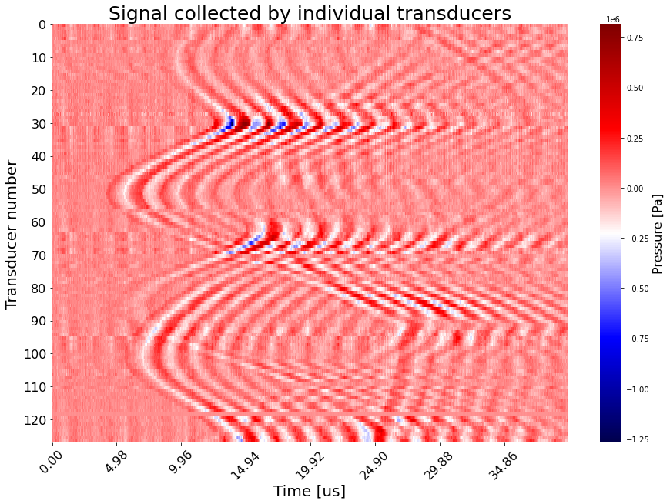
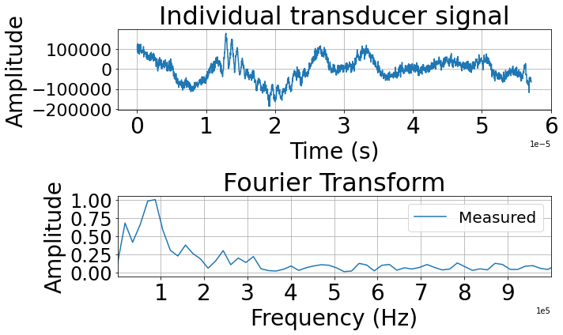
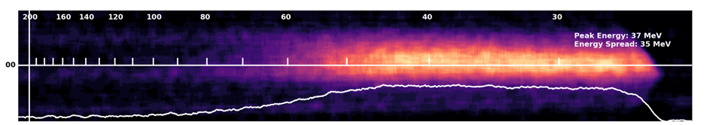
Medical applications of Ultrasound from Plasma-accelerated electrons
José Franco Altamirano¹, ²Yuchen Yan, C. Hojbota¹, P. Franke⁴,
E. McCary⁴, ²Liangzhong Xiang, M. Hegelich¹ Michael Downer¹
¹Department of Physics, The University of Texas at Austin, US,
²Department of Radiological Sciences, University of California, Irvine,
³Tau Systems Inc., Austin, US
Signal collected by the array
1e6
Water
tank
10
75
Transducer
array
30
25
50
Pressure [Pa]
Transducer number
-25
70
Electron
beam
90
-75
110
-100
Gas jet
10
20
30
Time [μs]
60
40
30
[MeV]
[MeV]
Laser
1J, 30fs
30

Slide 2
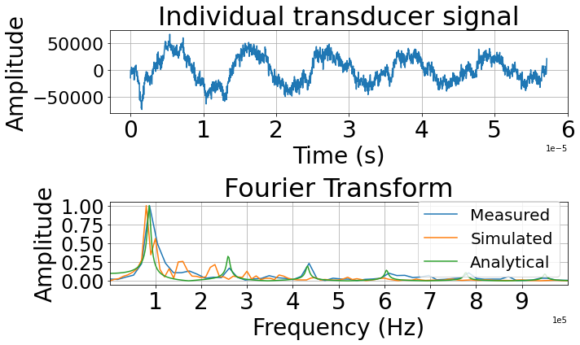
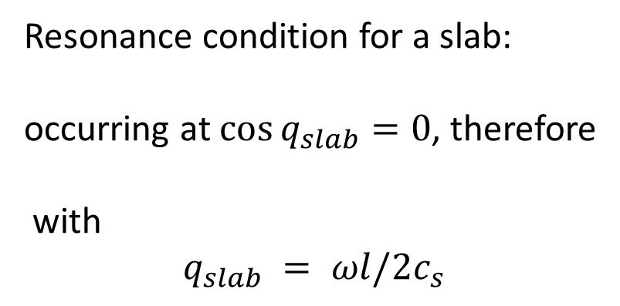


Material Characterization: Slab
For symmetrical objects, the acoustic emission can
Be treated analytically [1]
Detectors
1e5
5cm
1e5
5cm
Resonance condition for a slab:
occurring at $\cos{q_{slab}}=0$, therefore
with
$$q_{slab} = ωl/2c_{s}$$
1.3cm
$$\sin{q_{slab}+i}\hat{c}q_{slab}\cos{q_{slab}}=0$$
Electron beam
$q_{slab}=nπ/2$ ($n=1,3,5…)$
[1] L. V. Wang, Photoacoustic Imaging and Spectroscopy, CRC Press, 2009. Chapter 1.

Slide 3
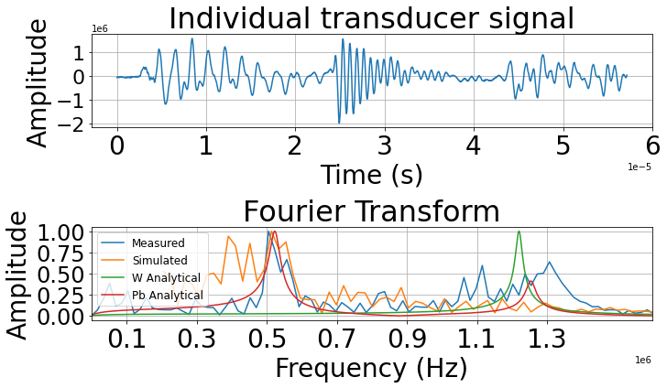
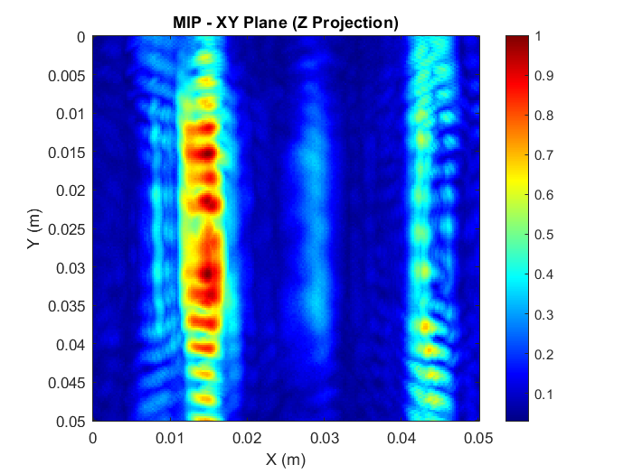


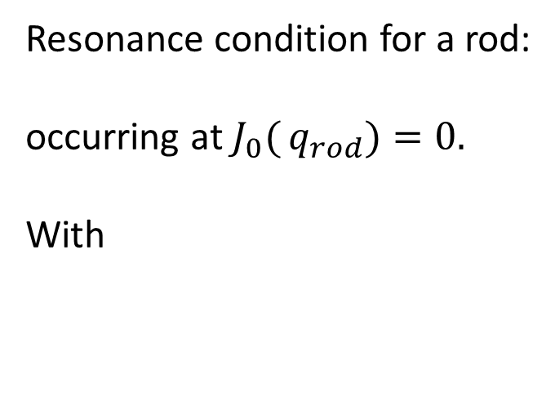
Material Characterization: Rods
Detectors
W
3mm
Cu
1e5
Pb
Electron beam
1e5
Resonance condition for a rod:
occurring at $J_{0}({q_{rod})}=0.$
With
$$J_{0}({q_{rod})−}\hat{c}J_{1}(q_{rod})/q_{rod}=0$$
$$q_{rod} =\frac{ωa}{c_{s}}$$

Slide 4
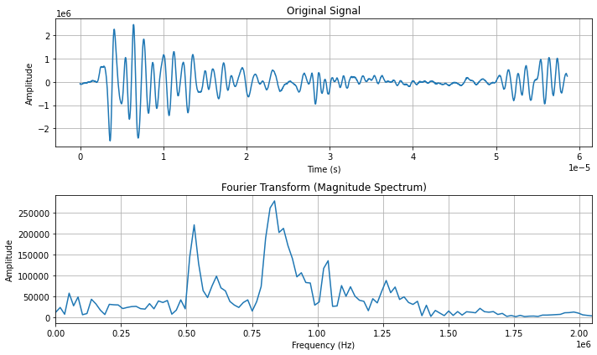

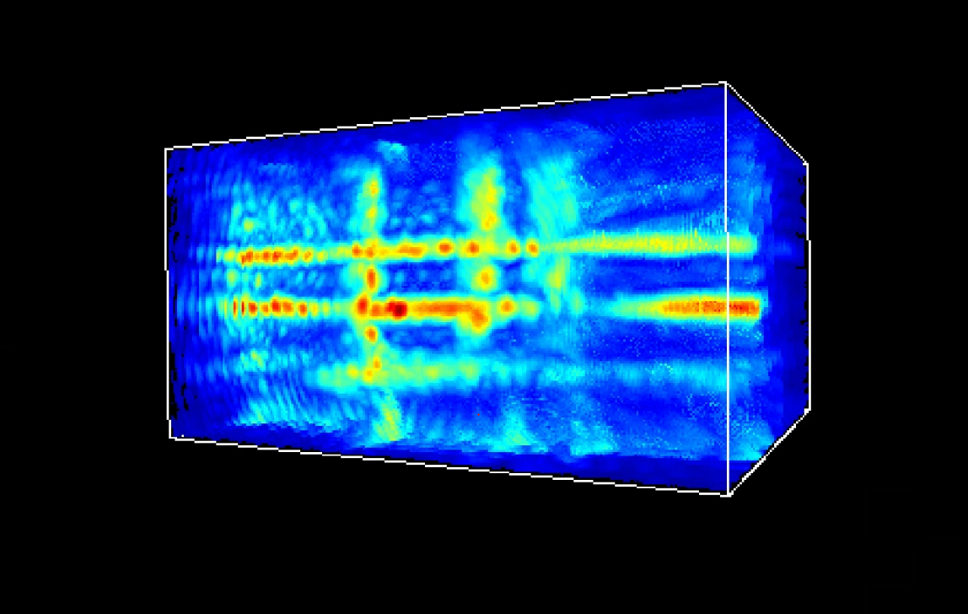
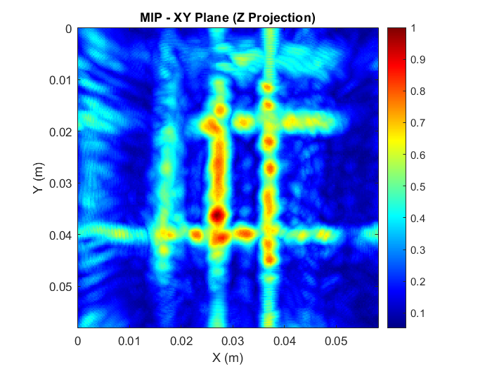
Imaging of complex targets
1.1 cm
2.2 cm
1.1 cm
1mm
1.6mm
2mm
3mm
1mm
3mm
1.6mm
m1
m2
m1
m1
2mm
m1
m2
m3
3mm
Diameter [mm] | m = 1 [MHz] | m = 2 [MHz] | m = 3 [MHz]
1 | 1.65 | 3.8 | 5.95
1.6 | 1.02 | 2.3 | 3.7
2 | 0.83 | 1.9 | 2.97
3 | 0.55 | 1.27 | 1.98
FIG 3, Irradiation of Pb rods with different thicknesses . a, schematic of Pb mesh target; (b1) 3-dimensional
and (b2) 2-dimensional reconstruction of mesh: (c1) Signal acquired by an individual transducer, and (c2) its Fourier transform of it.
Eigenfrequencies marked in red for 3mm rod, light blue for 2mm rod, yellow for 1.6mm and green for 1mm.

Slide 5

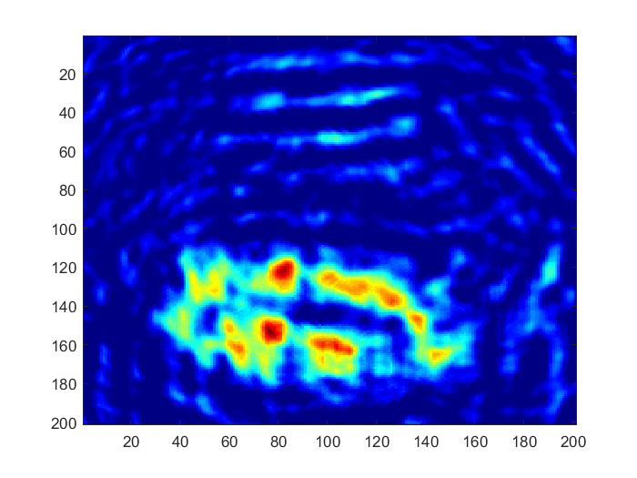
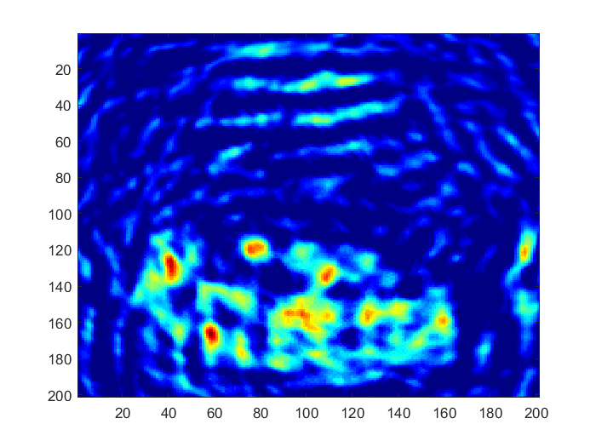
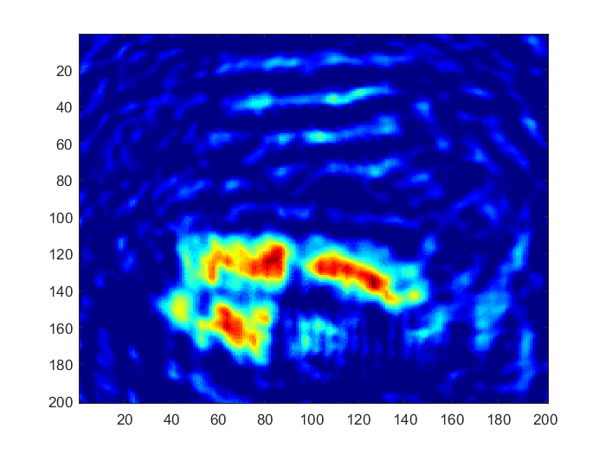
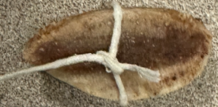
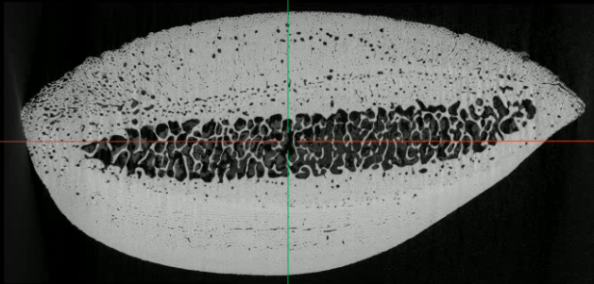
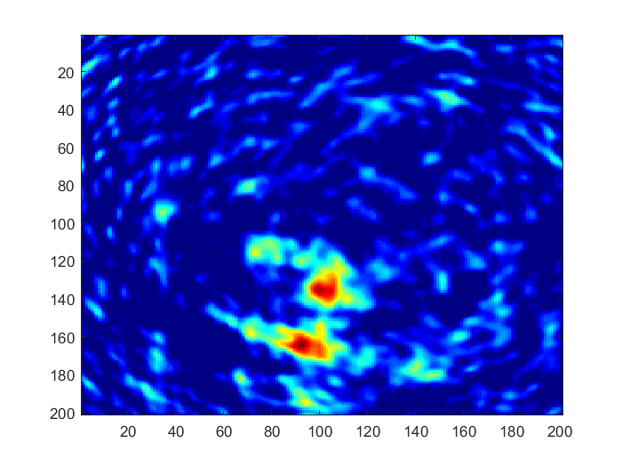
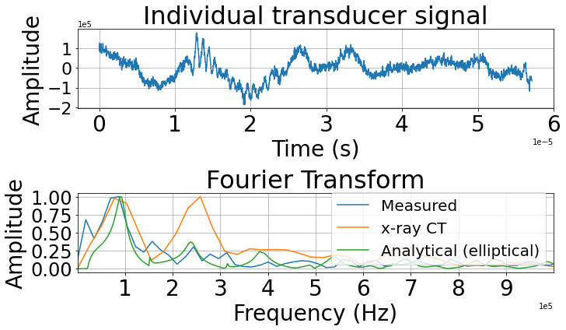
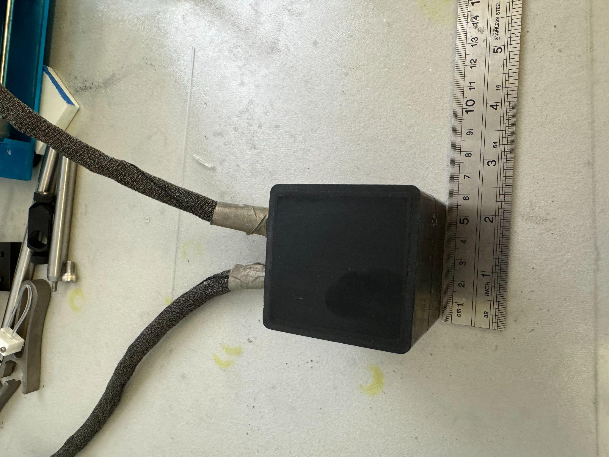
Irradiation of a bovine bone
Slice 30
Slice 1
Depth 1.5cm
(a)
1e-5
5cm
5cm
(b)
1e5

Slide 6
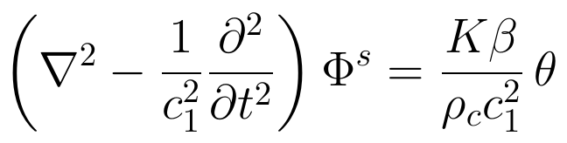
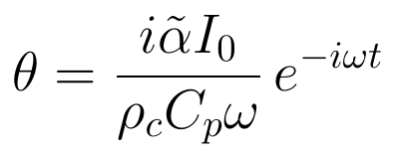
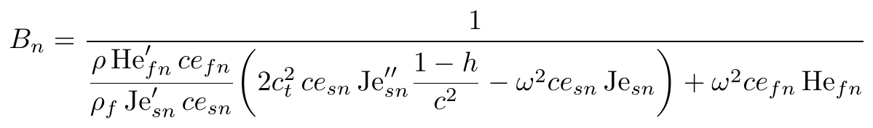
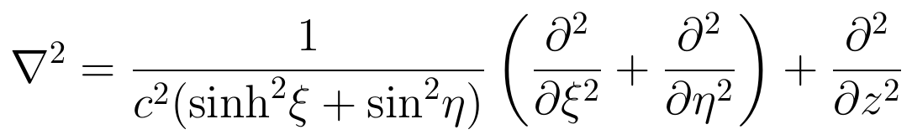
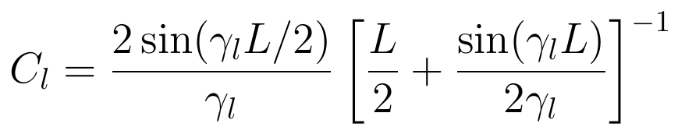


Elliptical Solutions (?)
Work of Leslie Zhang*
The acoustic emission is governed by:
The pressure outside the bone is:
$$P_{f}=\sum_{l=0}^{∞}{\sum_{n=0}^{∞}{B_{n}}}C_{l}Φ_{0}ρ_{f}ω^{2}ce_{fn}\left(η\right)⋅Je_{fn}\left(ξ\right)⋅\cos\left(γ_{l}.z\right).e^{−iwt}$$
,
Wave equation
Source
Heating
VHEE dose
Where
In elliptical coordinates:
Resonance condition
and
with:

Slide 7
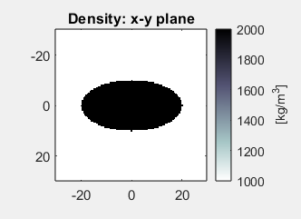
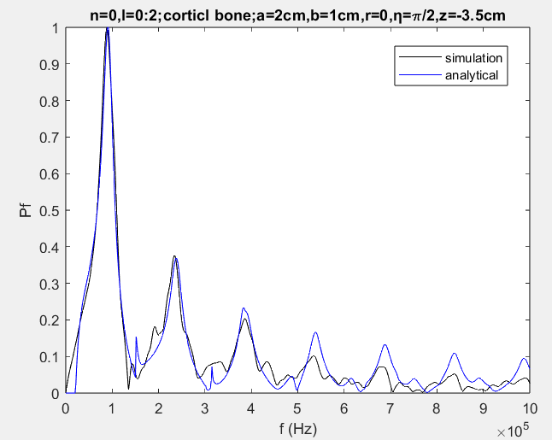
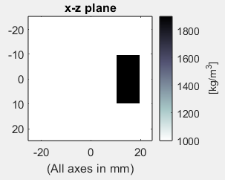
Acoustic simulation for Elliptical bone
Detector

Slide 8
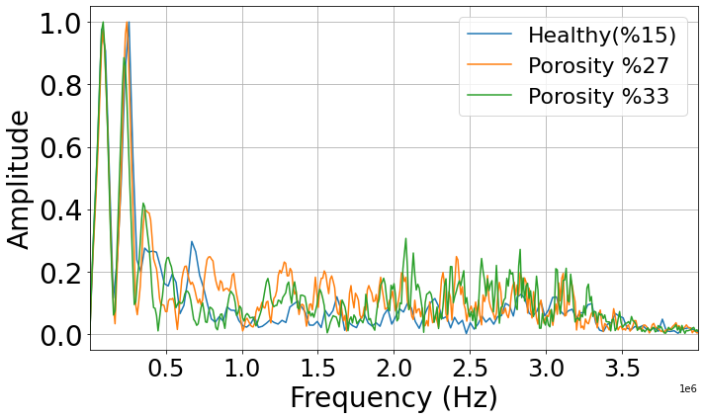
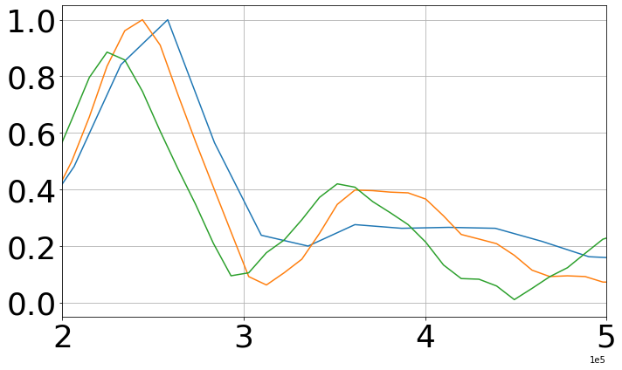
Diagnostic tool for Osteoporosis?
Simulations by Bryan Dinh*
Increased porosity in bones is associated with bone cancer.
Porosity was artificially added to the simulations to study detection feasibility for osteoporotic bone. Preliminary results indicate higher frequency components and a shift of higher amplitudes towards lower frequencies.

Slide 9
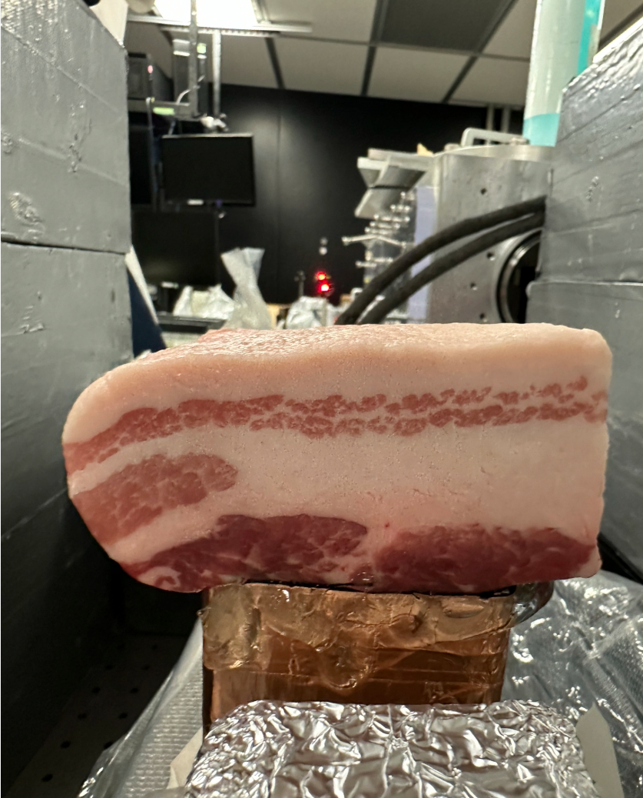

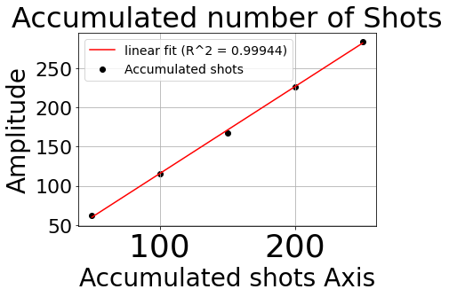


In-situ Dosimetry
# of shots
(b2) side view
10e5
(a)
(c)
250
150
Dosimetry in real time, especially in medical settings, is a challenging problem. Here, we irradiated a fatty tissue (pork belly) (a). Over multiple shots, imaging of complex structures is possible (b1),(b2) and (b3). Also importantly, accumulated signal (c) scales linearly with number of shot (d), meaning this technique has potential for dosimetry in real time.
4
200
100
2
50
0
Signal [V]
-2
-4
25
50
75
100
Time [μs]
(b1) 3D view
(b3) top view
(d)

Slide 10
Conclusions
LWFA’s are a well suited to perform acoustic computed tomography due to their inherent bunch duration and their energy tunability.
Acoustic computed tomography is a robust imaging technique that also allows retrieval of material properties such as density and speed of sound.
Medically, this modality allows for different type of studies, such like bone health and in-vivo dosimetry.
Not a conclusions but repeating the experiments with x-rays should be straightforward. Samples in this presentation work as for a proof-of-concept. Next experiments should be done with medically graded targets.
Acknowledgments
This material is based upon work supported by the National Science Foundation under Grant No. PHY-23008921 and by the Department of Energy under Grant No. DE-SC0011617

Slide 11
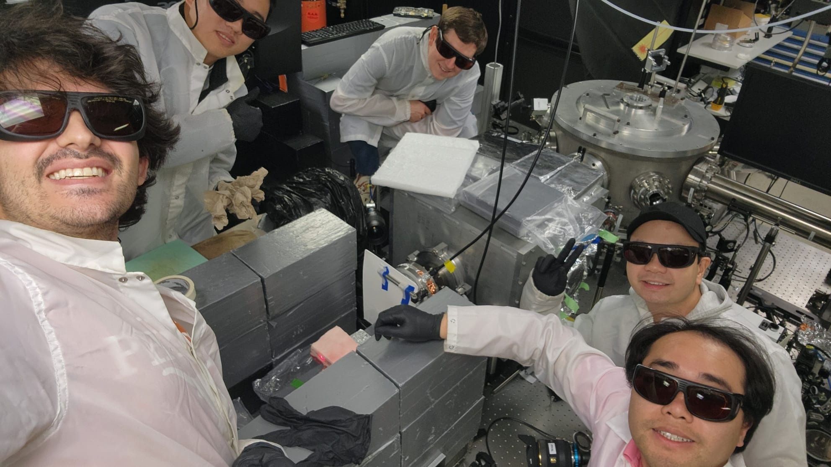
Thank you!

