Slide 1



A laser-based high average yield neutron source for medical applications
Károly Osvay
Advanced Accelerator Concepts
UCLA, LA, USA
28th July, 2026

Slide 2
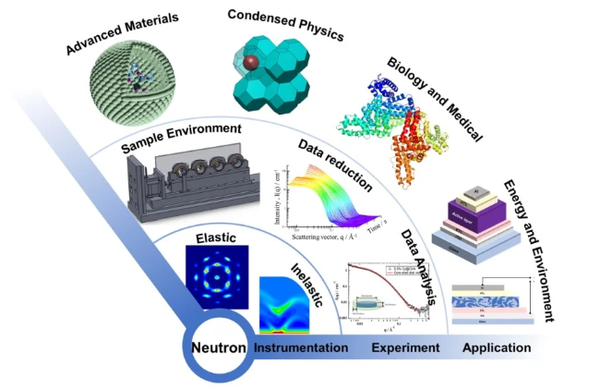
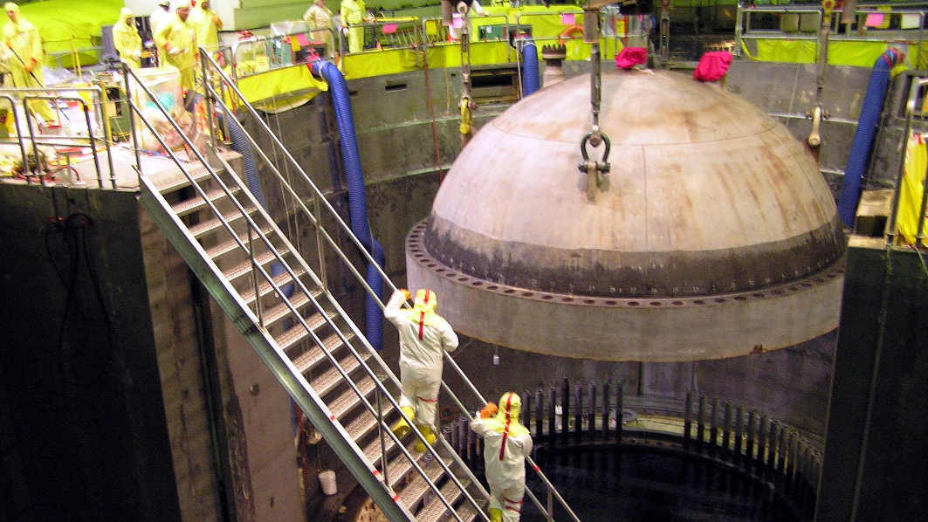
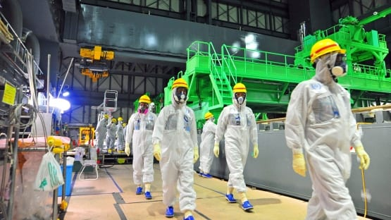
Motivation
Neutron
High penetration in material
Direct interact with nuclei
The number of neutron facilities sources is decreasing
reactors are aging, and closing down.
big sources are delayed.
Specialities of a laser-based neutron source
neutrons are generated in ultrashort bunches
the ”machine” (laser) and the ”source” can be separated
the laser is not a nuclear device
https://www.mdpi.com/journal/applsci/special_issues/7KCJK80OJJ

Slide 3
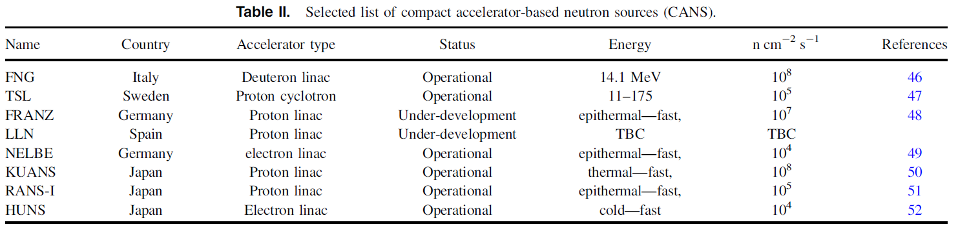
A room for laser-based neutron sources
Many emerging applications call for neutron sources with
a yield of 10⁶ n/s - 10¹⁰ n/s;
relaxed safety and security (compared to reactors);
compact, efficient;
reliable.
Mirfayzi et. al., Jpn.J.Appl.Phys. 64 (2025) 010002

Slide 4
A room for laser-based neutron sources
Many emerging applications call for neutron sources with
a yield of 10⁸ n/s - 10¹¹ n/s;
relaxed safety and security (compared to reactors);
compact, efficient;
reliable.
Specialities of a laser-based neutron source
neutrons are generated in ultrashort bunches;
the ”machine” (laser) and the ”source” can be separated;
the laser is not a nuclear device.

Slide 5
Laser-based neutron sources
Multi-J (PW)-class lasers – current situation
Photonuclear
Accelerate electrons
Brehmstralung and high Z converter: (γ,n)
Highest efficiency experiment
2.9×10⁷ n/J
~ 10⁵ n/s
Günther et al., Nat. Com.13 (2022) 170
Neutron spectra: continous
Pomerantz et al., PRL 113 (2014) 184801
Papp et al., Photonics 9 (2022) 826

Slide 6
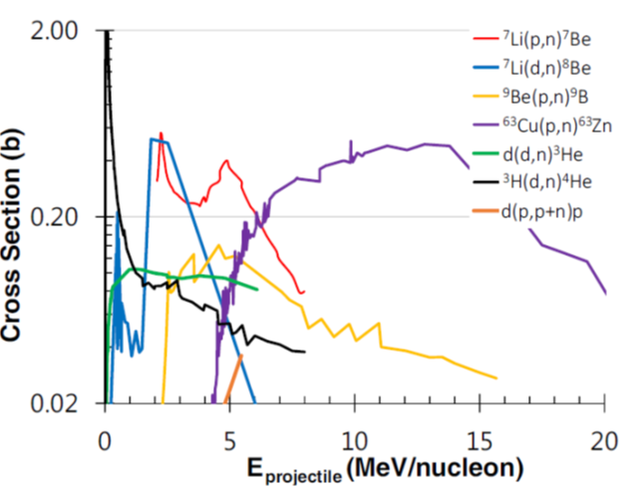
Laser-based neutron sources
Multi-J (PW)-class lasers – current situation
PhotoFusion
Accelerate ion (proton, deuterium)
Make fusion: Be(p,n), Li(p,n), D(d,n) (T)d,n)
Highest efficiency experiment
69×10⁷ n/J
2×10⁶ n/s
Günther et al., Nat.Com. 13 (2022) 170
Pitcher-catcher:
Complicated, but higher neutron yield
Neutron spectra: continous or quasi-monochromatic
Kleinschmidt et al, Phys.Plasmas 25 (2018) 053101
Alvarez et al., Phys.Procedia 60 ( 2014) 29
Alejo et al., Il Nuovo Cimento 38 C (2015) 188

Slide 7
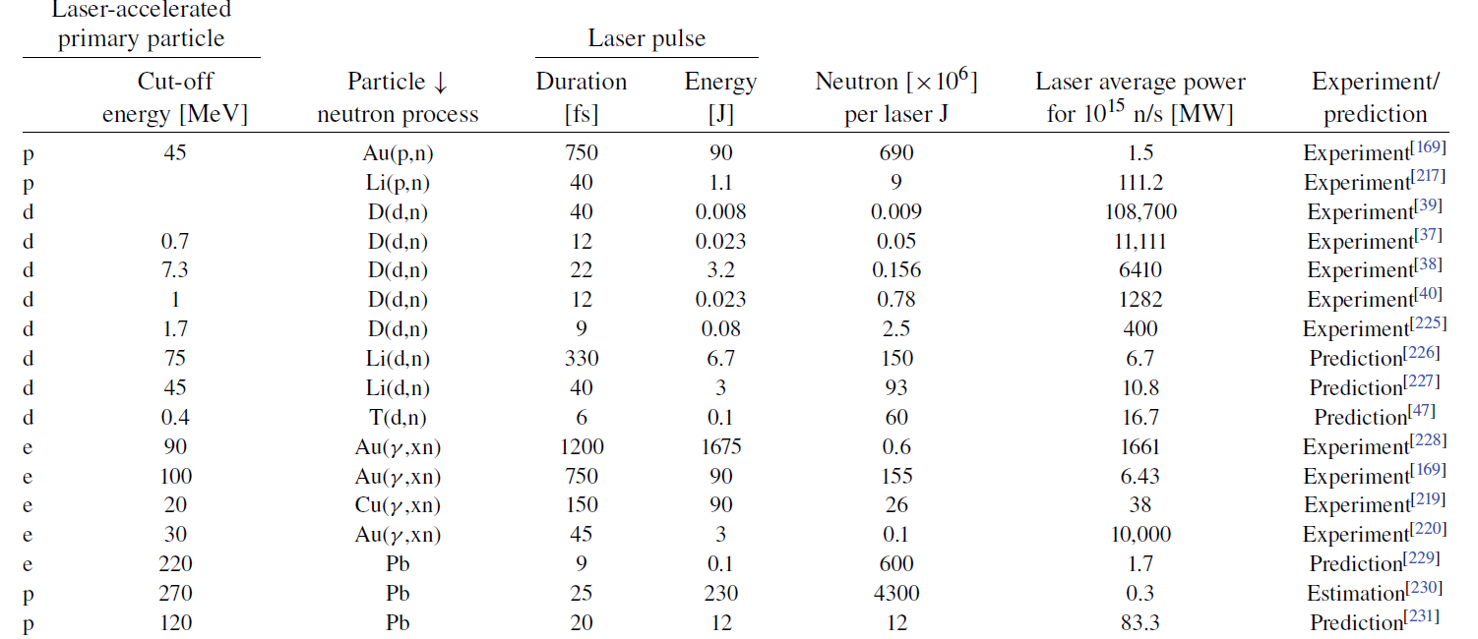
State-of-the-art laser-based neutron sources
Canova et al., HPLSE 13 (2025) e79

Slide 8

Strategies ”en large”
for a laser driven particle (neutron) source
NLTL approach
Existing 100 W lasers
Peak intensity issues
Physics with low pulse energy
Continuous operation
Neutron yield for application regime > 10⁷ n/s
Data aquisition, monitoring and control
High repetition rate target development
Increase pulse energy
Use T(P)W lasers from single shot mode
Contrast issues
Curiosity-driven research
Full understanding physics
Proof-of-principle experiments
Increase laser repetition rate
Target development
Both paths would lead to a laser accelerator based particle source…
… with differences especially in early stage

Slide 9
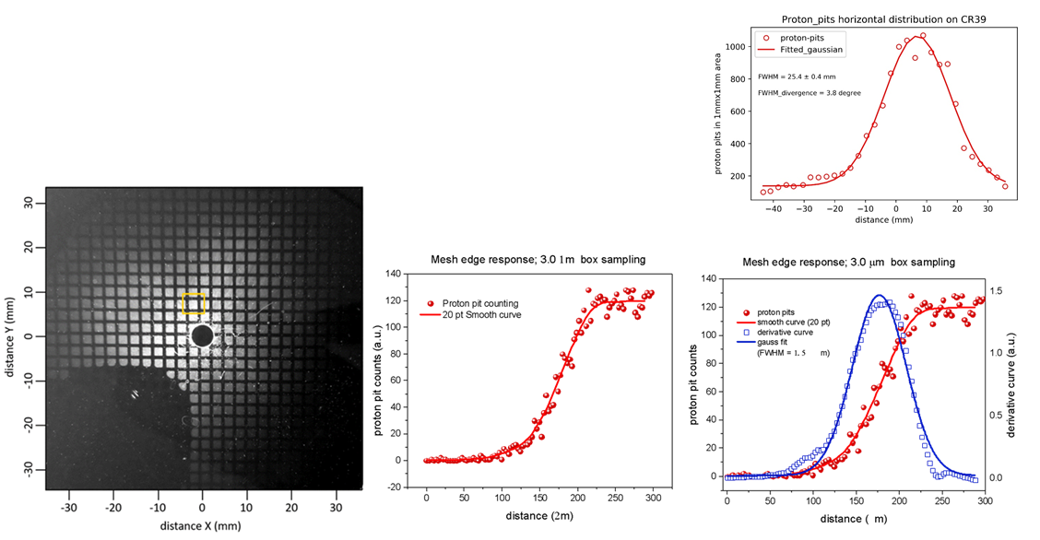
Challange 1
What are the properties of ion acceleration by
few-cycle lasers pulses?
Study of ion acceleration by few-cycle pulses from ultrathin foils
Large number of low energy protons
(above 100keV: 10¹⁰/shot)
Ter-Avetisyan et al., PPCF 65 (2023) 085012
Small beam divergence (<65mrad for protons > 250 keV)
Small emittance 0.00032 π-mm-mrad
Singh et al., Sci.Rep. 12 (2022) 8100

Slide 10
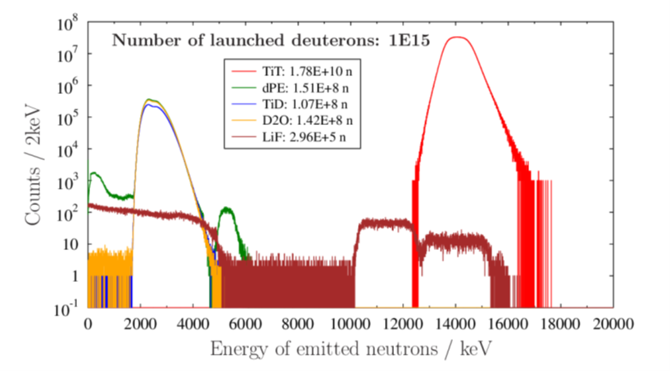
Challenge 2
Match the material of the catcher to the ion spectra for
The highest neutron yield
Characterisation of ion acceleration
most common: cut-off (attractive, but… )
Practically what matters (NOT only for neutron generation!)
mean kinetic energy
bunch energy
(conversion from laser to total particle energy)
Higginson et al., Nat.Commun. 9 (2018) 724
d(d,n)³He
Osvay et al., EPJ Plus 139 (2024) 574

Slide 11

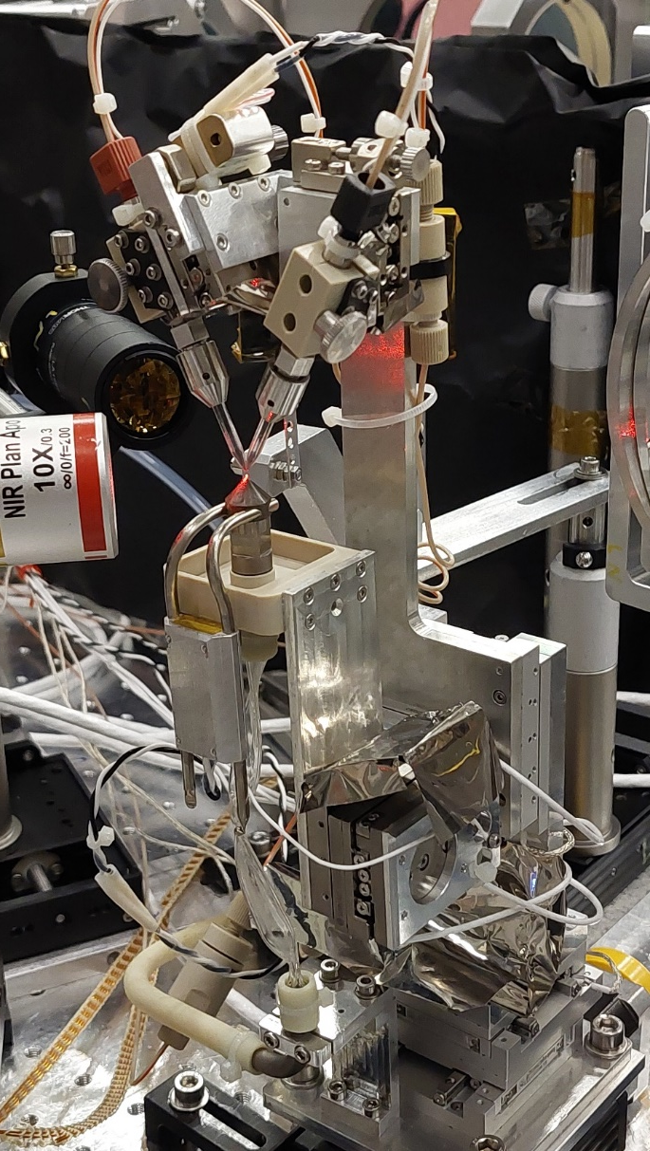
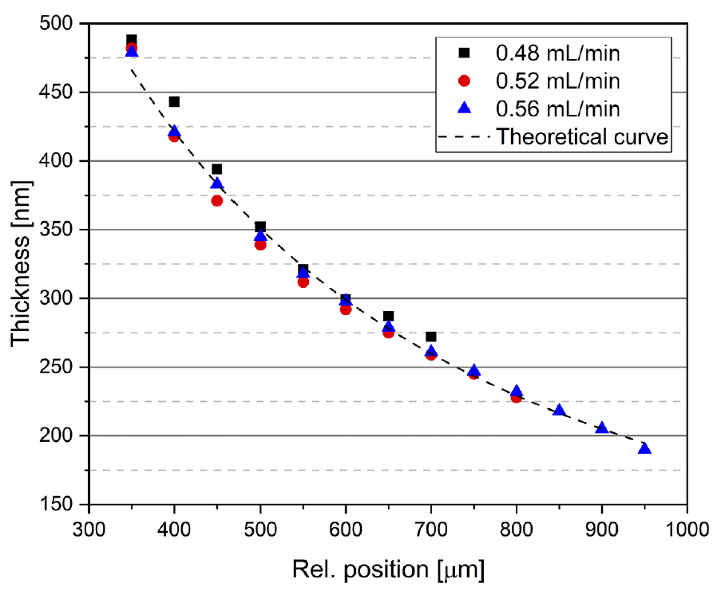
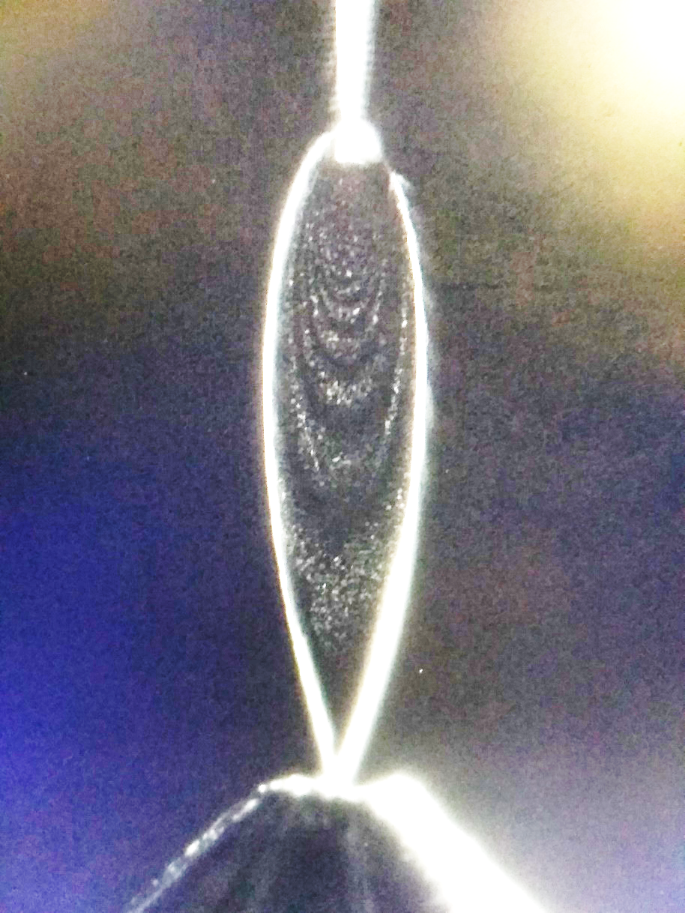
Challenge 3
High repetition rate target systems
Development of a colliding jet liquid leaf system
Two liquid jets collide from two glass nozzles
Pulsation damping system for stability
Recirculation system for continous operation
Thicknesses measured in vacuum (!)
Thinnest liquid sheet is 190 nm
Füle et al., HPLSE 12 (2024) e37

Slide 12
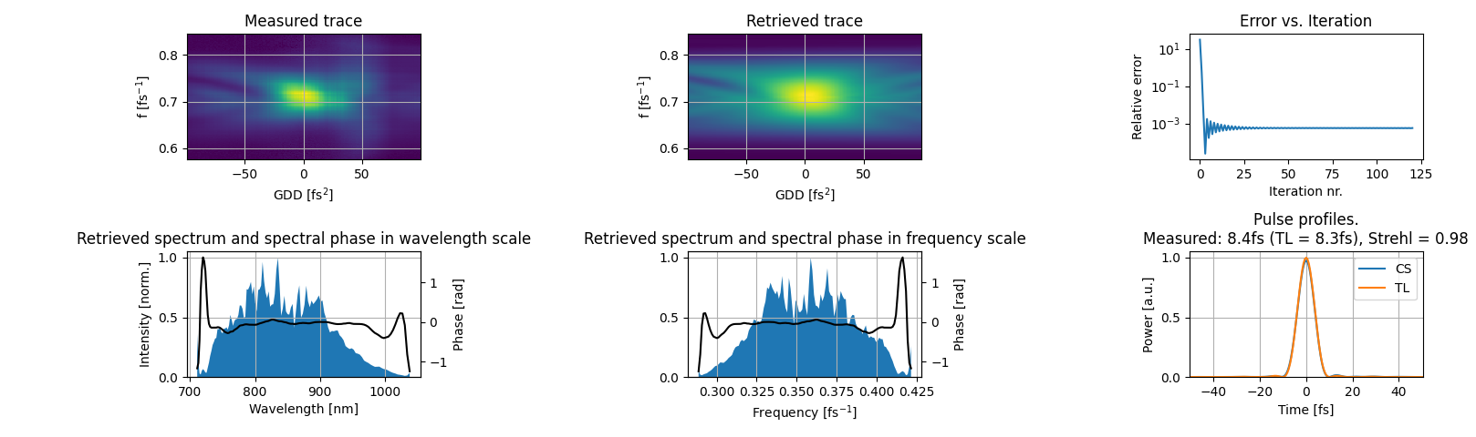
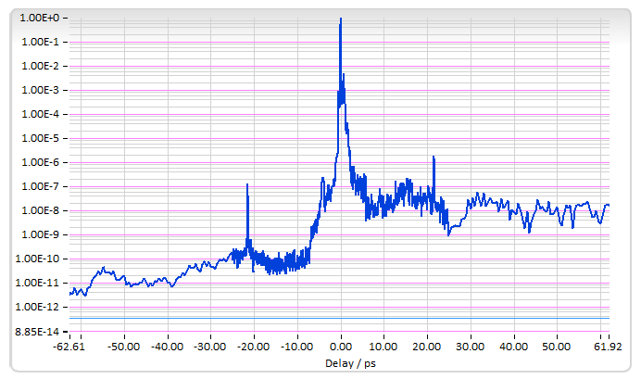
S3 laser (1 kHz, OPCPA) of ELI-ALPS
parameters measured on target
Pulse energy: ~80 mJ
(105 mJ in laser)
Laser pulse duration: 8.4 fs
(measured in vacuum, after OAP, with disp scan)
Central wavelength: 826nm
artifacts
Focal spot FWHM: 2.9×2.6 µm²
Peak intensity in focus: 2×10¹⁹ W/cm² (a₀~2.2)
Temporal contrast
*peak at +-22ps is a post-pulse from the variable density filter in the diagnostics arm, not in the main output

Slide 13
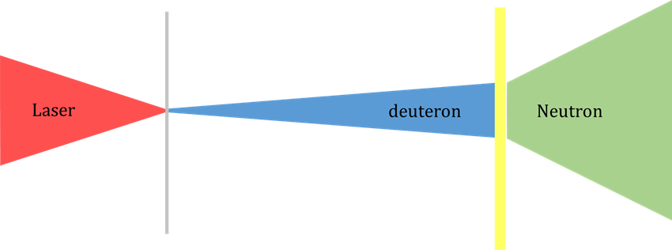
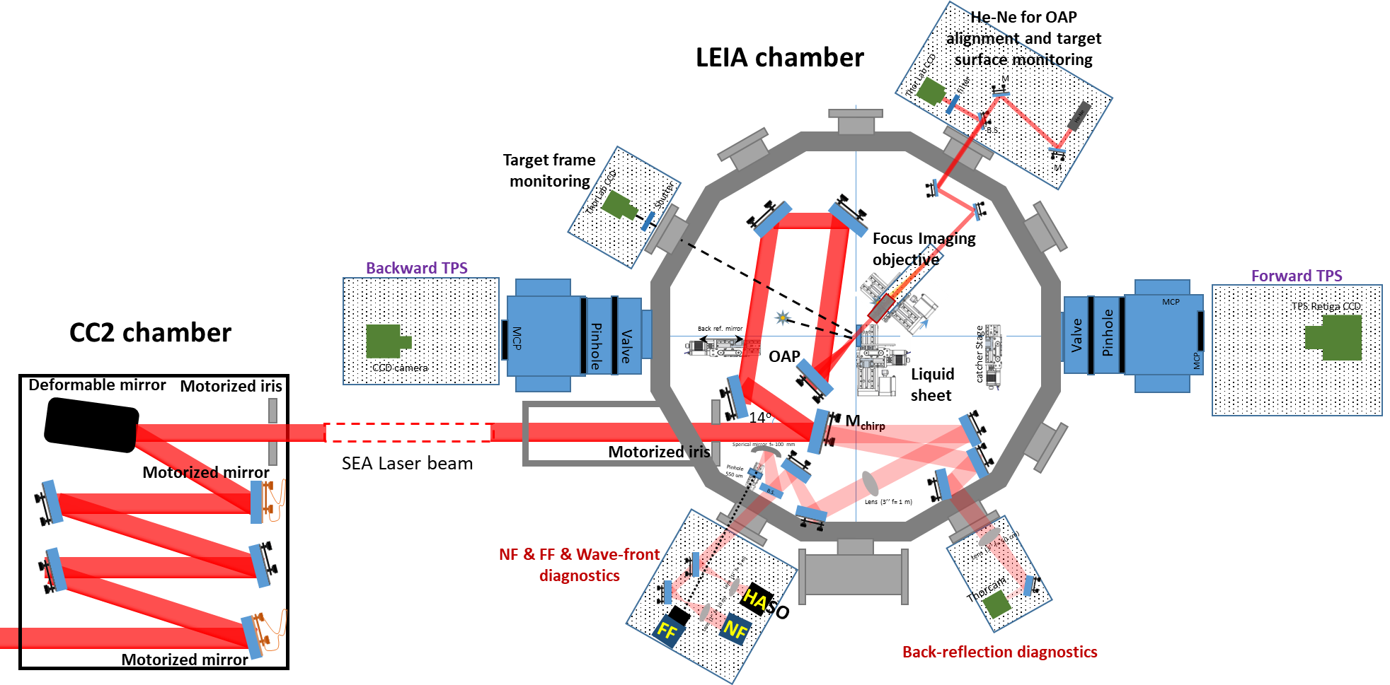
Neutron generation – experimental setup

Slide 14


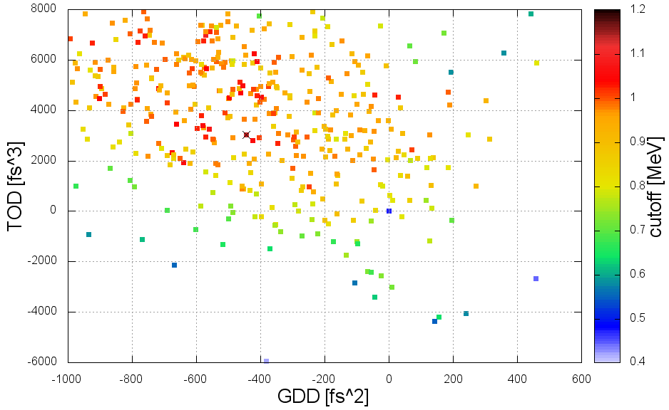
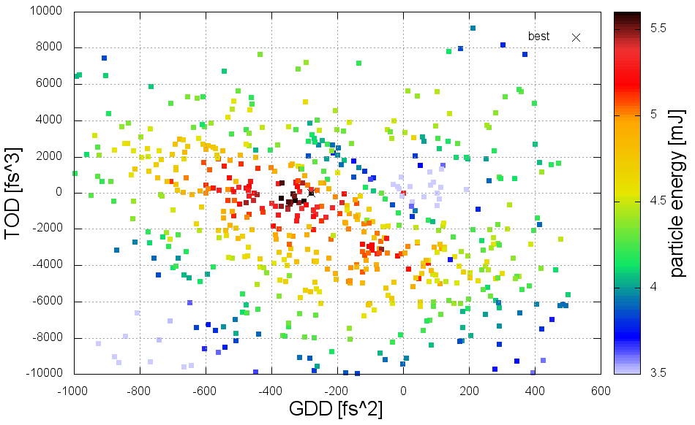
Low-Energy Ion Acceleration beamline
for high average power ion beam
Peak ion beam Performance
Ion (p⁺,d⁺) cutoff: > 2.5 MeV (±6% rms)
Ion average current ~20 μAmp
Ion peak current ~20 kAmp (10¹¹ ions/pulse)
Ion beam divergence: <5°
Emittance: 0.00032 π-mm×mrad
Regular stable operation: > 6 h
Singh et al., Sci.Rep. 12 (2022) 8100
Ter-Avetisyan et al., PPCF 65 (2023) 085012
Füle et al, HPLSE 12 (2024) e37
Varmazyar et al, Comm.Phys. 8 (2025) 350
Unique Specs
Single-shot – kHz repetition rate
On target, TL pulse duration: 4 fs – 12 fs
On target, energy: 12 mJ – 80 mJ
Angle of incidence: 2° - 75°
Solid-state targets, XYZ stages
Liquid sheet (H₂O, D₂O): 200 nm – 1 μm
Thomson Parabola Spectrometers, e⁻ (in prog.)
Back-reflection diagnostics
Markov-chain Monte-Carlo optimisation for an ion parameter
(at a laser pulse energy, liquid, thickness, and ion; <15 min)
60mJ, D₂O, d⁺, 760nm, cutoff
80mJ, H₂O, p⁺, 300nm, bunch energy
T. Gilinger’s talk, WG2 Thu 16:20

Slide 15
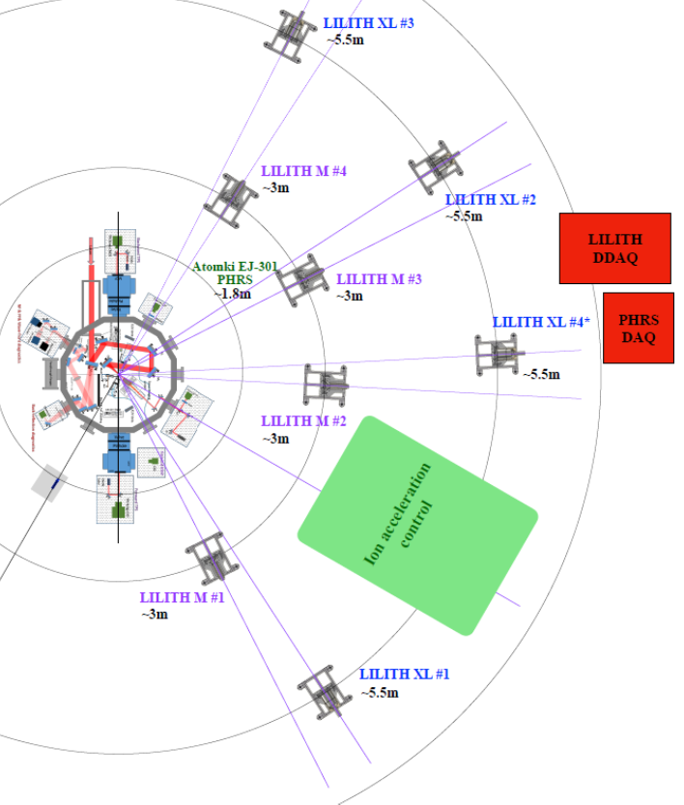
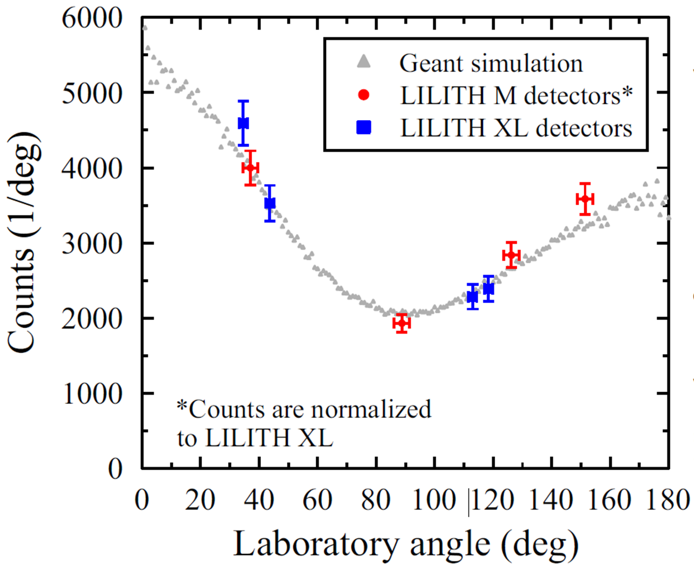
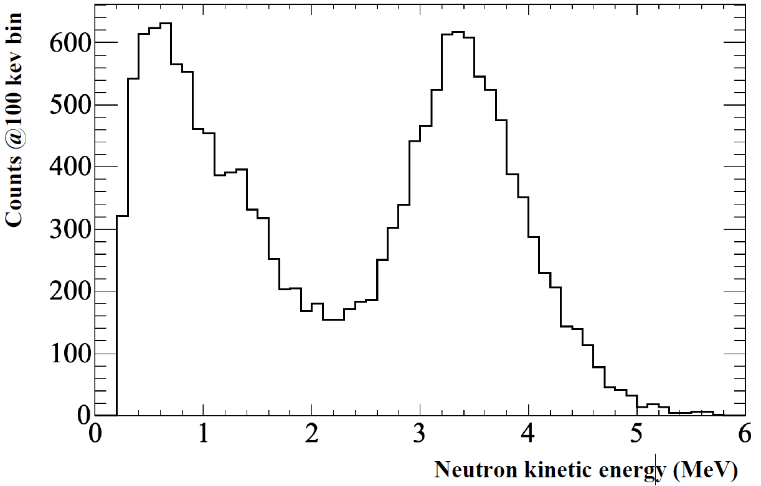
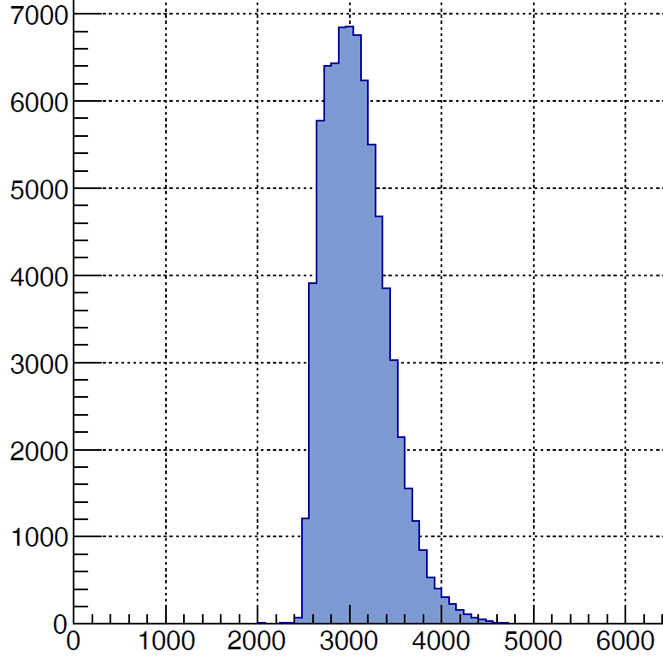
DIAGNOSTICS – neutron
Two independent systems
Outside the chamber
Plastic scintillators: LILITH M, XL systems
Liquid scintillator: PHRS system
Osvay et al., EPJ Plus 139 (2024) 574
Neutron angular
distribution
Neutron energy spectrum
Measured outside At the source
Quasi-monoenergetic

Slide 16
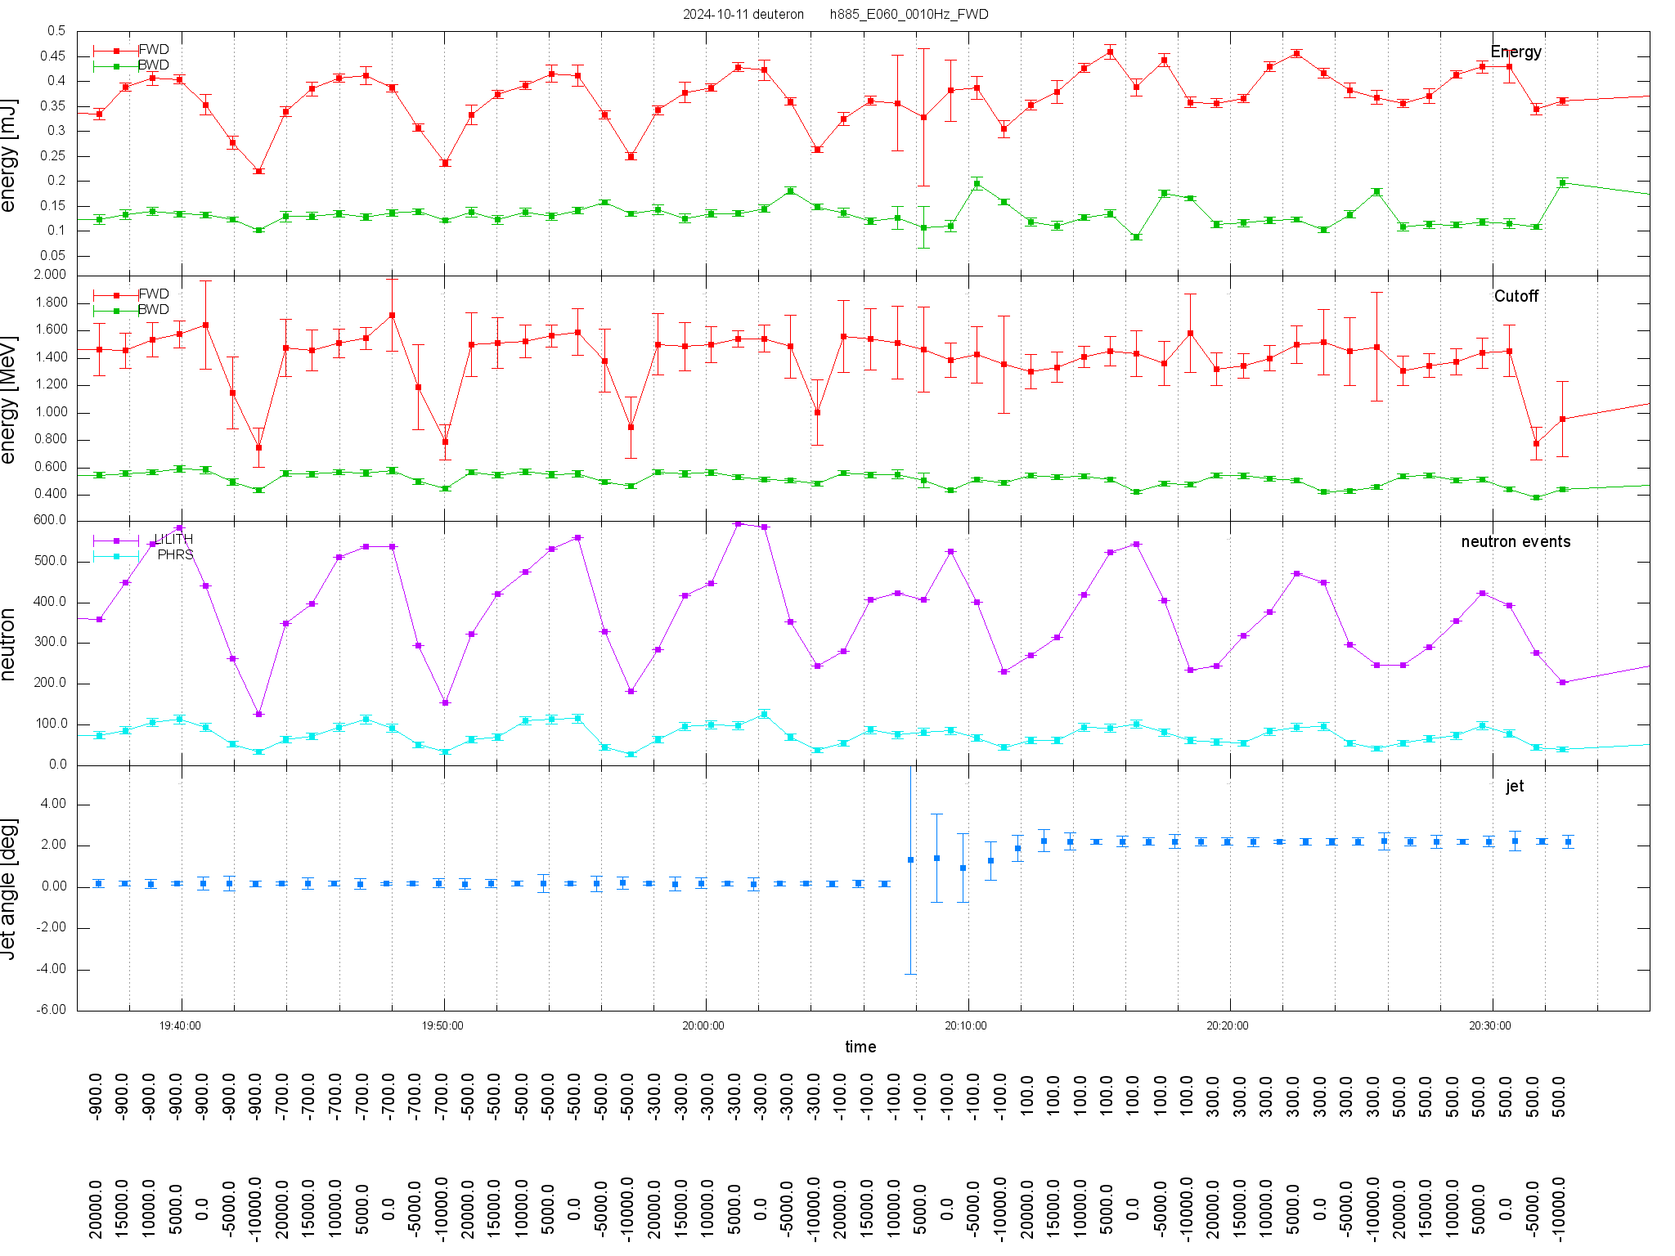
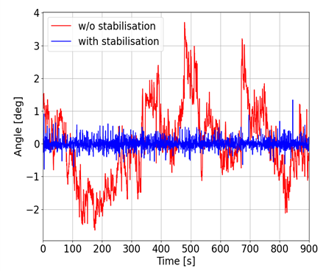
Control and log of (almost) all parameters upon operation
Bunch energy
of deuteron
Cutoff energy
deuterons
Neutron event
LILITH
Liquid Scint
Stability
of liquid jet

Slide 17
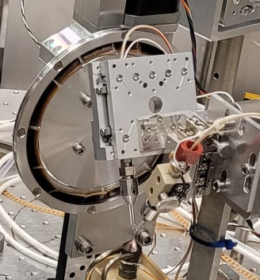
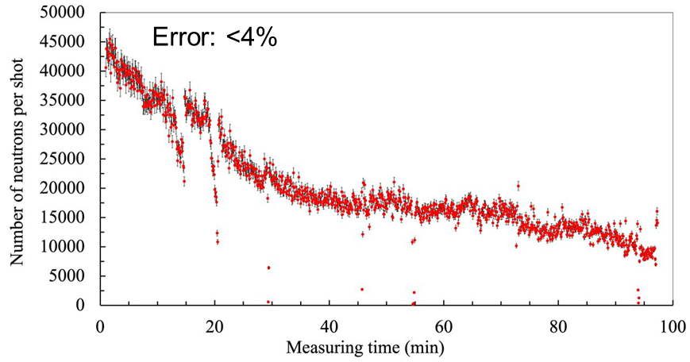
Neutron generation at 1kHz repetition rate
dPE neutron converter
Neutron generation: 450nm D₂O leaf + 1mm C₂D₄
7×10⁷ n/s
Peak yield detected at 1kHz :
1.5×10⁷ n/s
Average yield over 1 hour at 1kHz :
2×10⁷ n/cm²/s
Average neutron flux at 1kHz :
Peak neutron flux rate / shot:
Ageing (burning) of the dPE
> 10¹³ n/cm²/s
Irradiation demonstrated: 3×100 min/day (exchange of dPE)

Slide 18
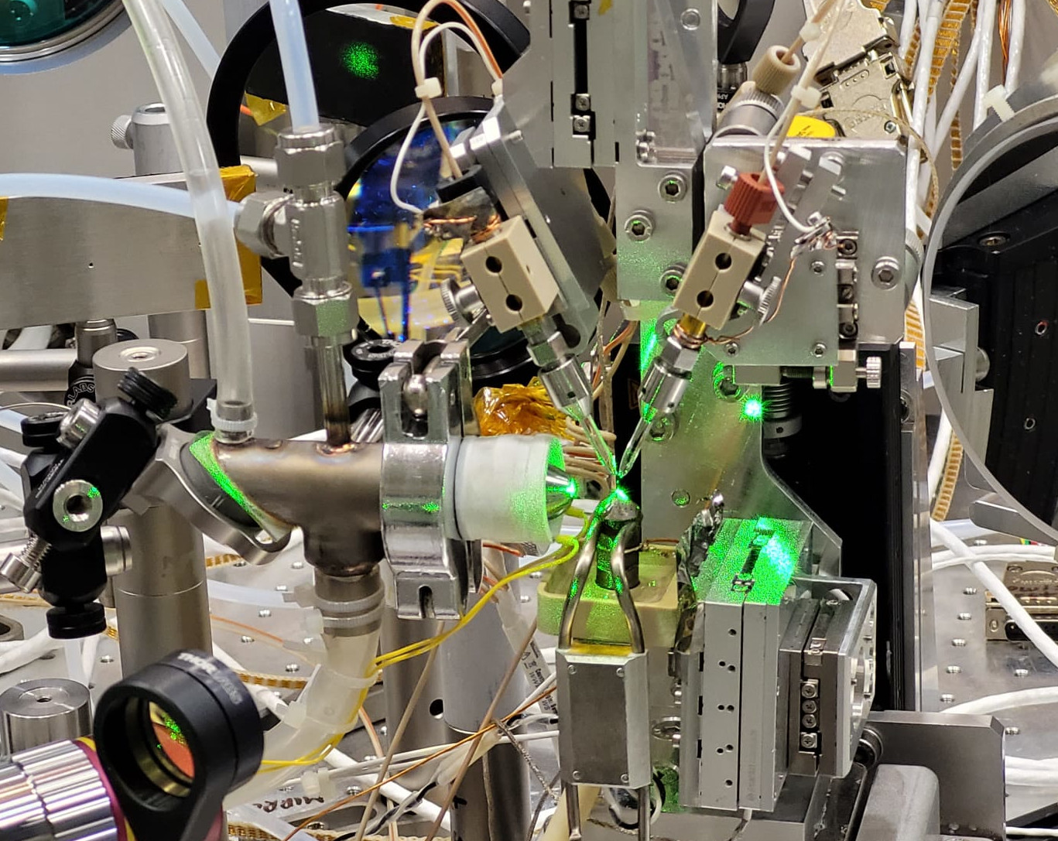
Neutron generation at 1kHz repetition rate
D₂O neutron converter
Neutron generation: 410nm D₂O leaf + 0.5 mm D₂O
4×10⁷ n/s
Peak yield detected at 1kHz :
Average yield over 1 hour at 1kHz :
4×10⁷ n/s, 1.7% rms
~10⁸ n/cm²/s
Average neutron flux at 1kHz :
Peak neutron flux rate / shot:
> 10¹³ n/cm²/s
Irradiation demonstrated: 210 min continous
Osvay et al., patent pending

Slide 19
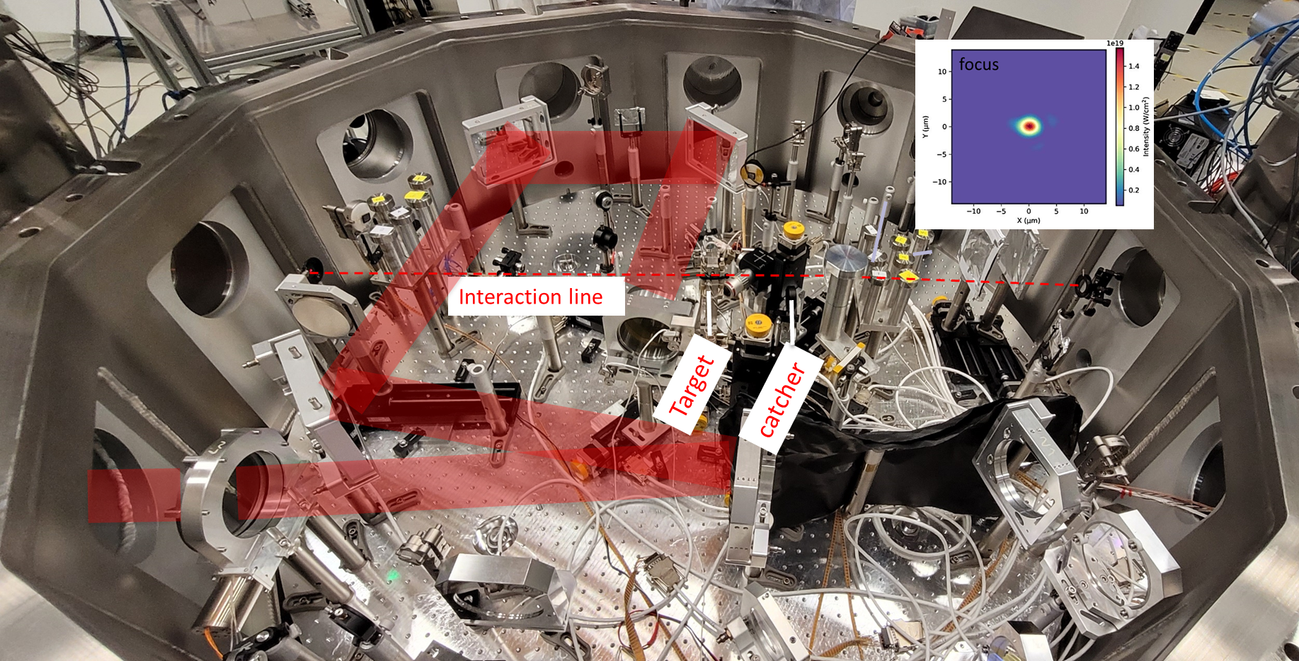

LEIA-n(eutron) beamline
Pitcher-Catcher scheme
Neutron spectrum and
angular distribution
D⁺ acceleration
d(D,n)3He fusion
Osvay et al., EPJ Plus 139 (2024) 574
Neutron Performances
Catcher: rotating dPE, flowing D₂O
Peak neutron yield (kHz): 10⁸ n/sec
Peak neutron flux-rate: 10¹³n/cm²/shot
Operation (±3% rms): > 6 h @10 Hz
Regular operation: >2 Gy/h, @ 1kHz
Osvay et al., Sci.Rep. 14 (2024) 25302
Stuhl et al, PRR 7 (2025) 023137
Osvay et al., in prep
Applications & user experiments
Radiobiology of ultrashort, fast neutron pulses
Neutron-induced therapy
Medical isotope production
Material science for IFE
Plastic scintillators EJ-240, 4 pcs.
Liquid scintillator EJ-309, 4 pcs.
Bubble-detector neutron spectrometer

Slide 20
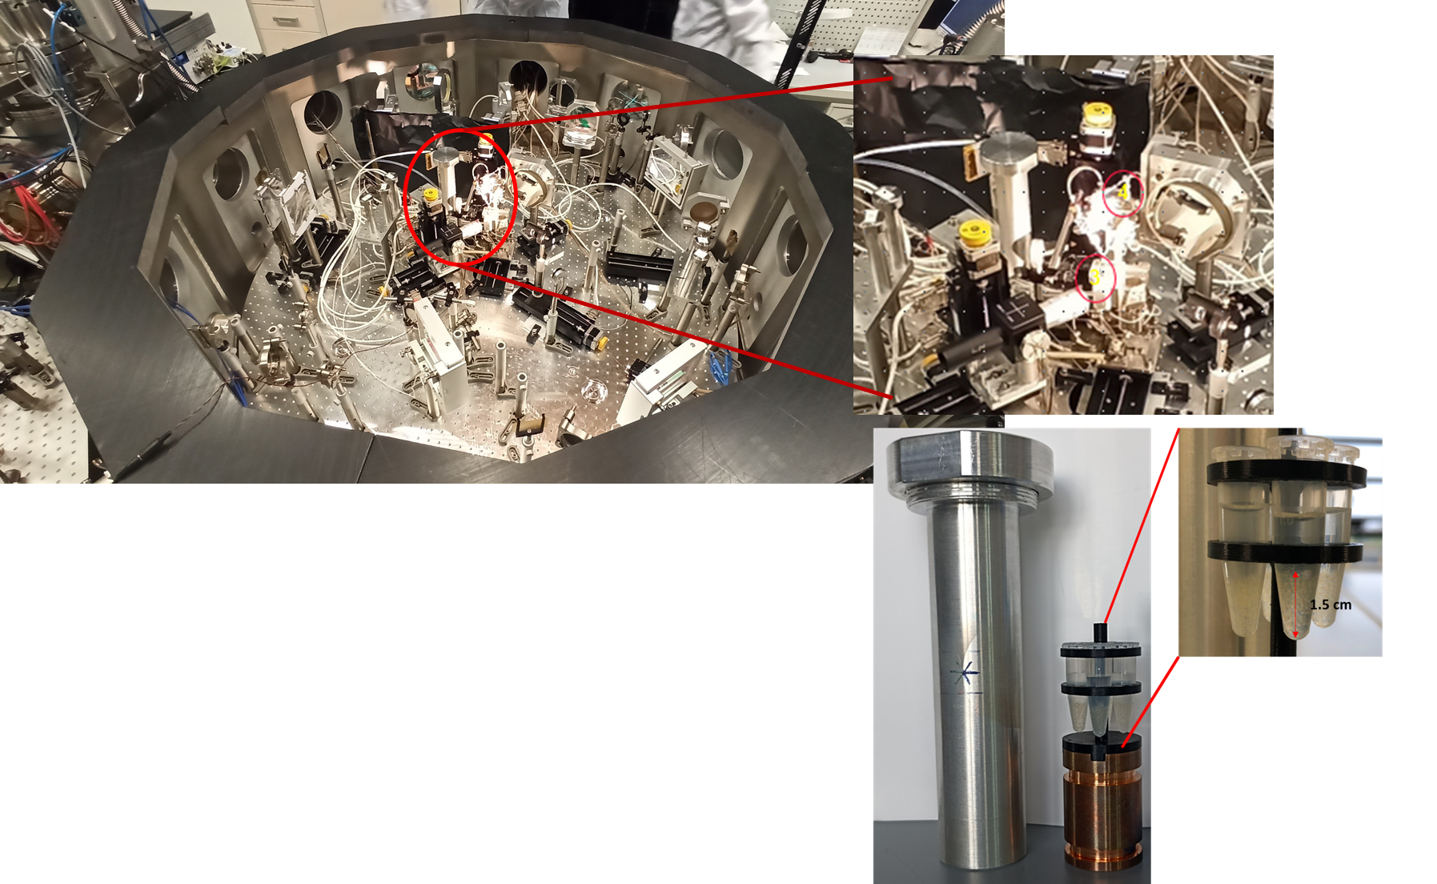
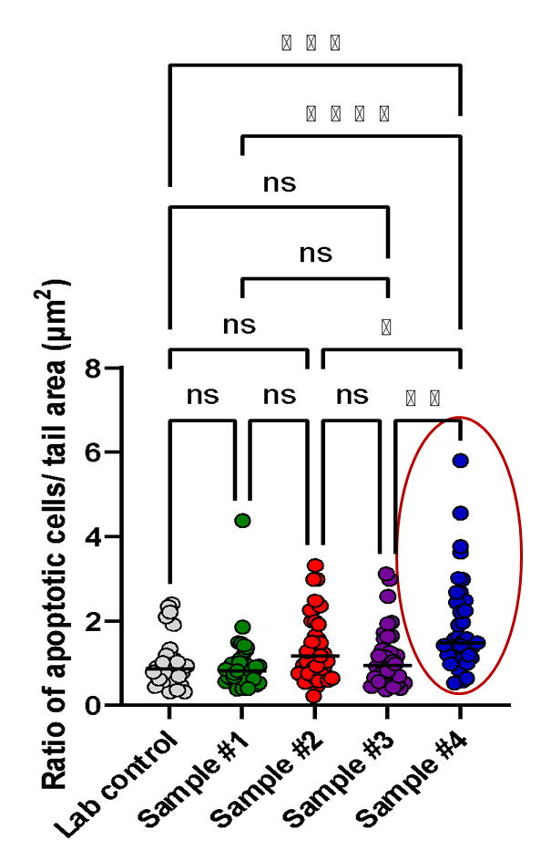
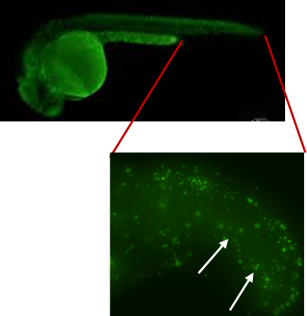
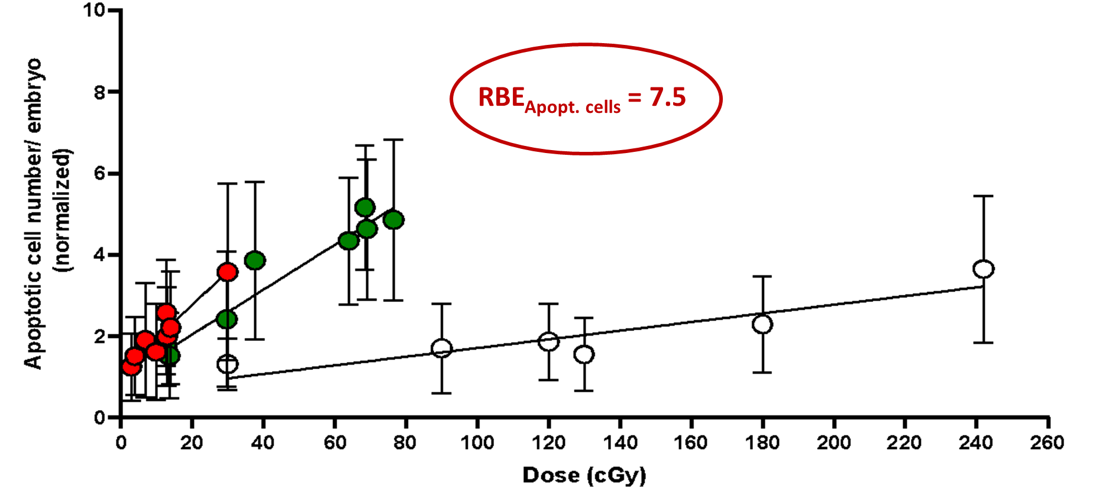
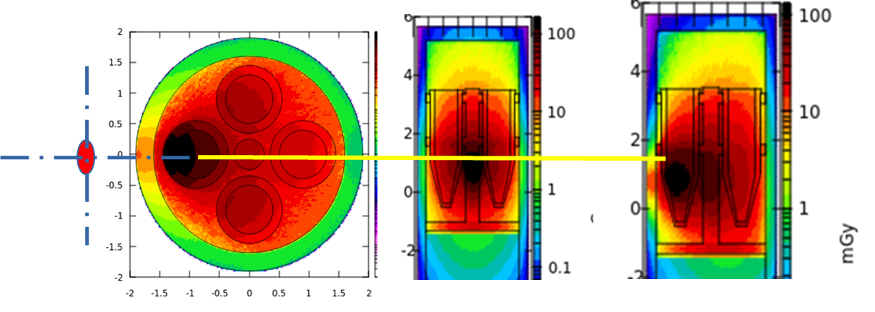
First radiobiology experiments with laser-generated
fast neutrons
PI: Katalin Hideghety
Apoptotic cell density measurement after irradiation
Experimental chamber…
…. Zebrafish embryos in
a vacuum tight container
Neutron dose simulation

Slide 21

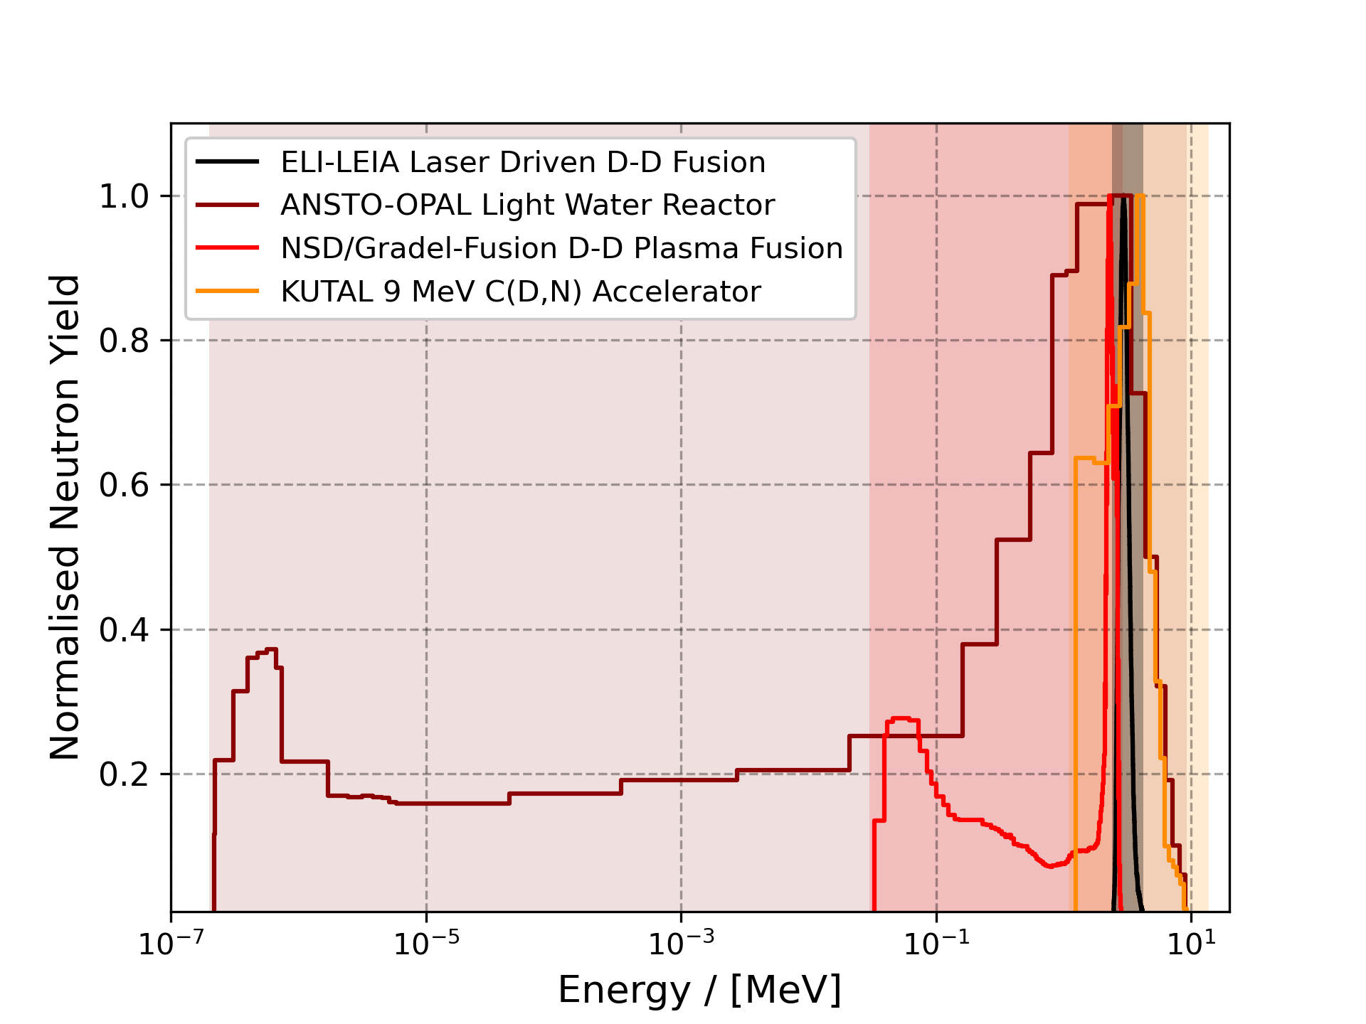
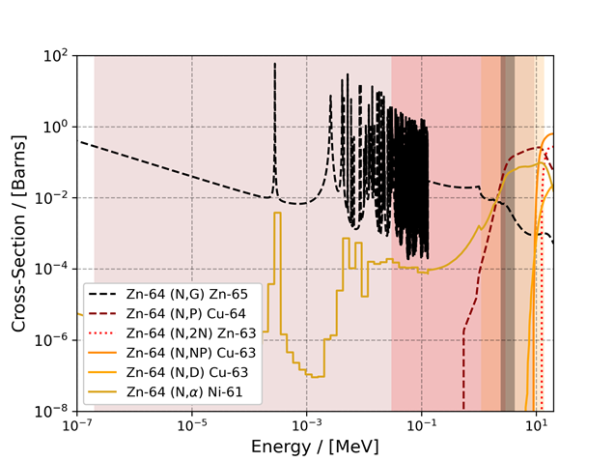
Direct Production of >99.95% Radioisotopic
Pure Cu-64 from Natural Zinc Targets
PI: Jeremy Brown
Comparison of neutron spectra of different kinds of sources
Comparison of neutron spectra of different kinds of sources

Slide 22
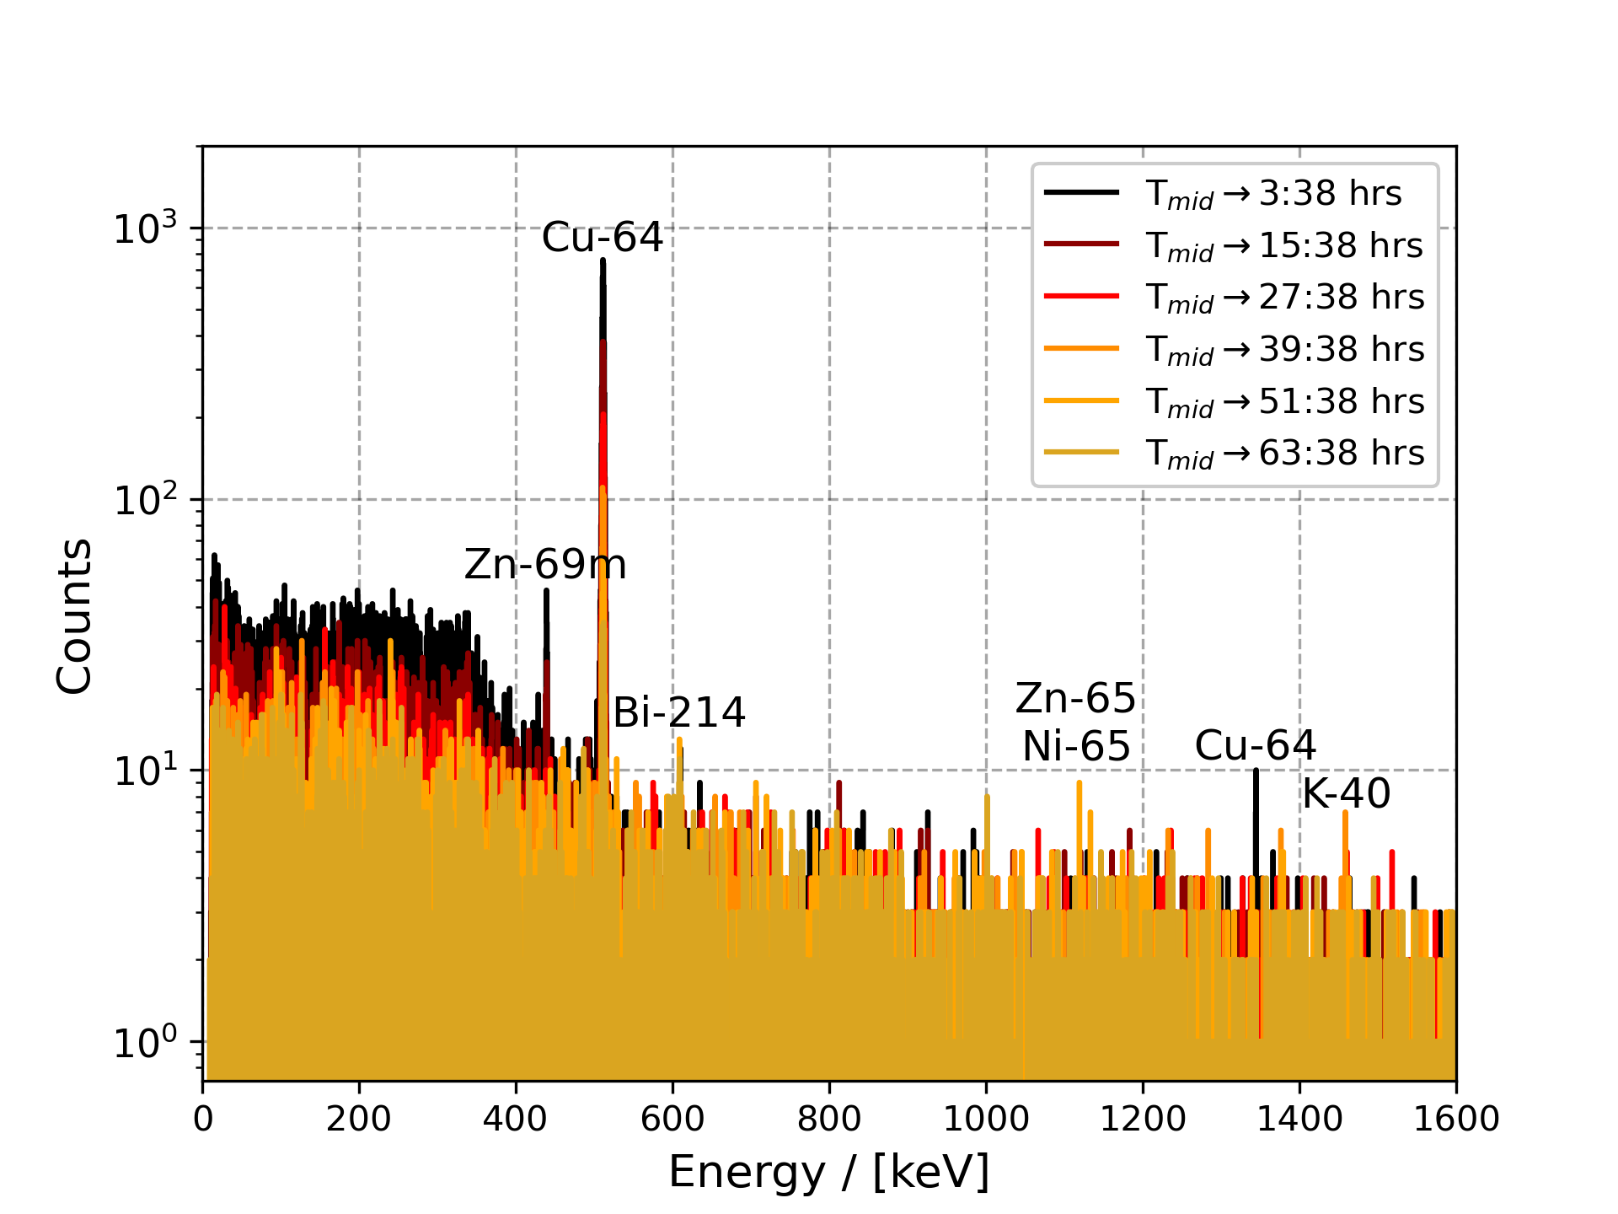
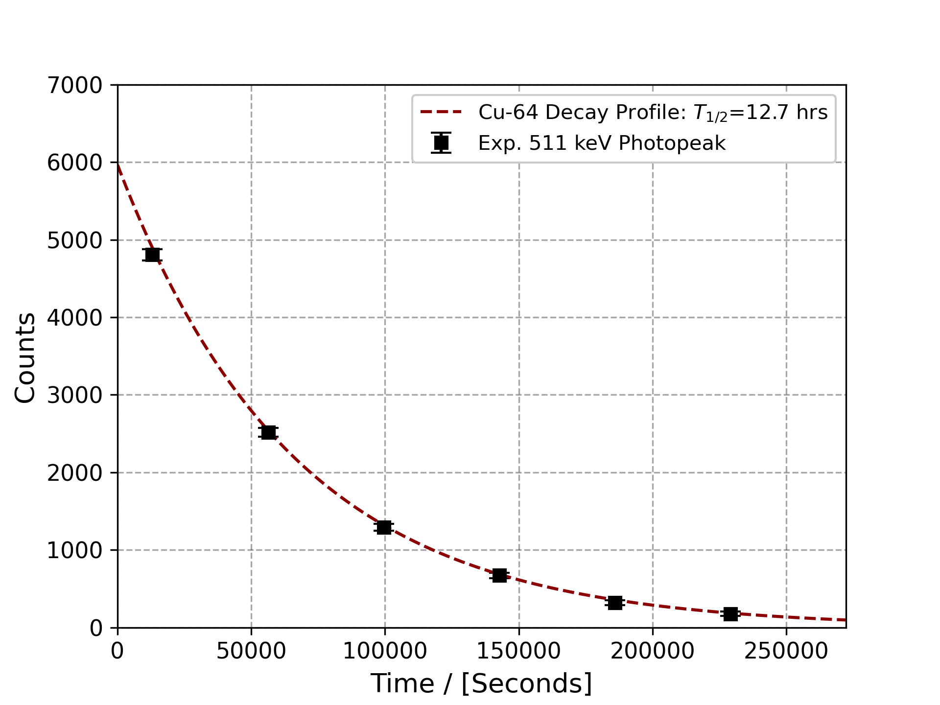
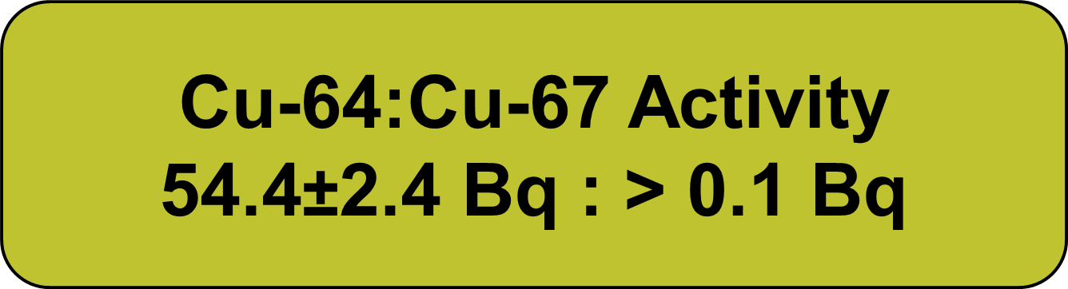
Direct Production of >99.95% Radioisotopic
Pure Cu-64 from Natural Zinc Targets
Background Corrected Gamma-Spectra
511 keV Photopeak Half-Life

Slide 23
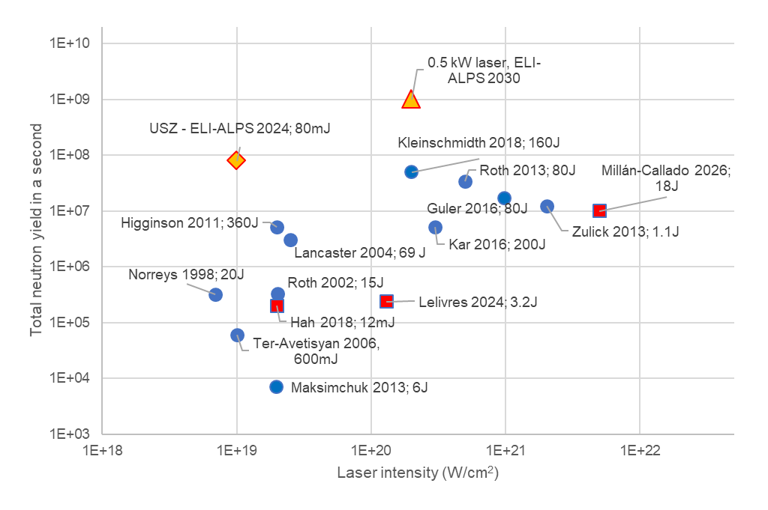
State-of-the-art
High average power ion acceleration
Neutron yield per second
Measured!
Estimated or calculated
Real practical breakthrough is expected for once the average power
of high peak power lasers reaches kW level – foreseen in 3-5 years.

Slide 24
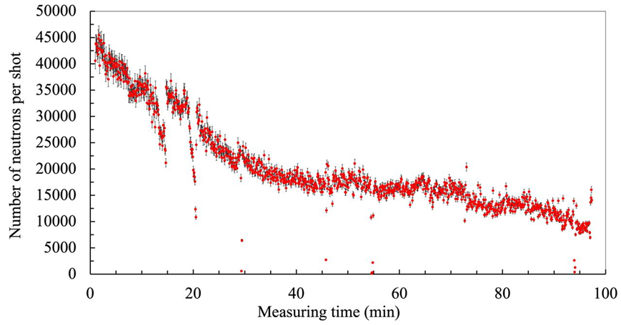
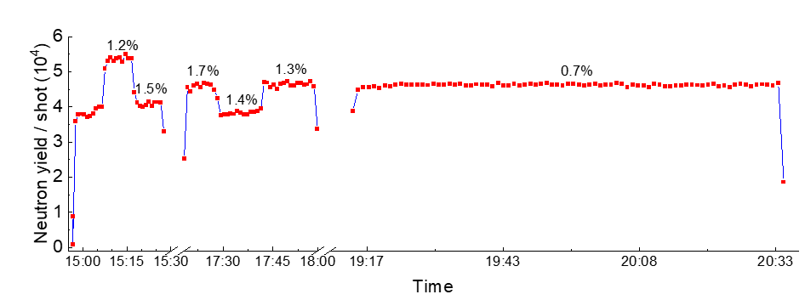
Summary
Neutron generation from dPE @ 1 kHz, 80 mJ (2024)
- at 1 kHz (continous)
- 450 nm D₂O leaf + 1mm C₂D₄
Neutron generation from D₂O @ 1 kHz, 80mJ (2025)
- at 1 kHz (continous)
- 420 nm D₂O leaf + D₂O
Future work:
- optimisation directly for neutron yield
- increase stability (below 1%)
- increase trouble-free continous operation (>6 h)
- use high(er) average power laser(s)
Peak yield: 7×10⁷ n/s
~10⁷ n/s, 3x100min
Peak yield: 4×10⁷ n/s
4×10⁷ n/s, hours

Slide 25
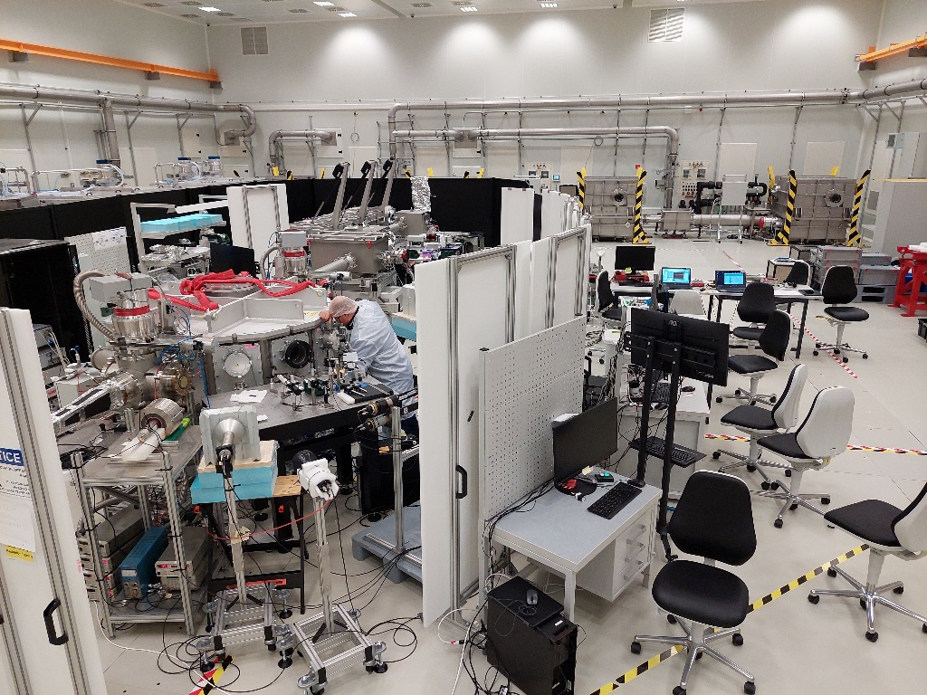

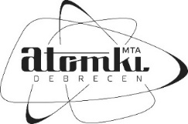


B. Bencsik, E. Buzás, K. Farkas, T. Gilinger, Z. Jäger, M. Karnok, A. Kovács,
A. Mohácsi, P. Varmazyar
J. Csontos, K. Hideghéthy, A. Ebert, P.P. Geetha, A. Mohácsi,
R. Molnar, R. Polanek, T. Somoskői, R.E. Szabó, Sz. Tóth
B. Biró, L. Csedreki, Z. Elekes, Z. Halasz, A. Fenyvesi, Zs. Fülöp, L. Stuhl
J. Brown, H. Huang, S. Juodkazis
D. Gailevicius, M. Grigalavicius, M. Vengris
Hungarian Government: ITM 1096/2019. (III.8.)
National Research, Development and Innovation Office
NKFIH-877-2/2020, NKFIH-476-4/2021, NKFIH-476-16/2021
Multiscan 3D H2020 project: 101020100

