Slide 1



Applications of a Compact Positron Source as a Source of Entangled Photons
Sophie Crisp, Spencer Gessner
scrisp11@slac.stanford.edu
sgess@slac.stanford.edu
July 28, 2026

Slide 2
Acknowledgements
PI: Spencer Gessner (SLAC, Stanford)
Undergraduates: Ryland Goldman (UCLA), Arif Ismail (Stanford University), Julia Marrinan (Brown University)
This work was supported by the Department of Energy, Laboratory Directed Research and Development program at SLAC National Accelerator Laboratory, under contract DE-AC02-76SF00515.

Slide 3
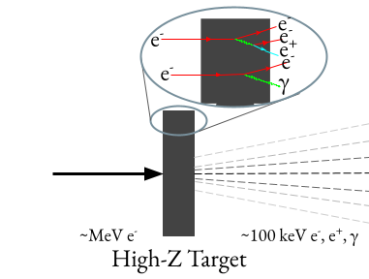
Outline
Motivation
Positron Generation at the XTA beamline at SLAC
Near Term Experimental Opportunities
Notes:
By the end of this talk, I hope I convince you that A) positrons are useful for lots of things, beyond that which you might initially suppose. and B) there are near term things we could do at SLAC, or some other facility, to bring those applications to the US

Slide 4
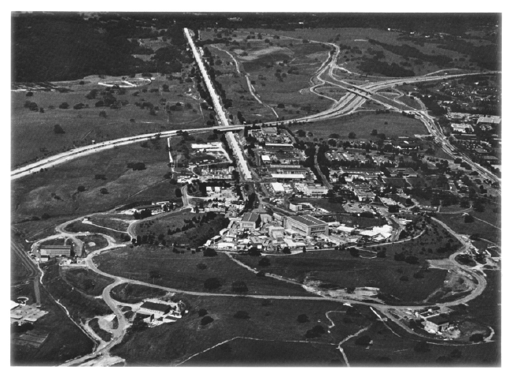
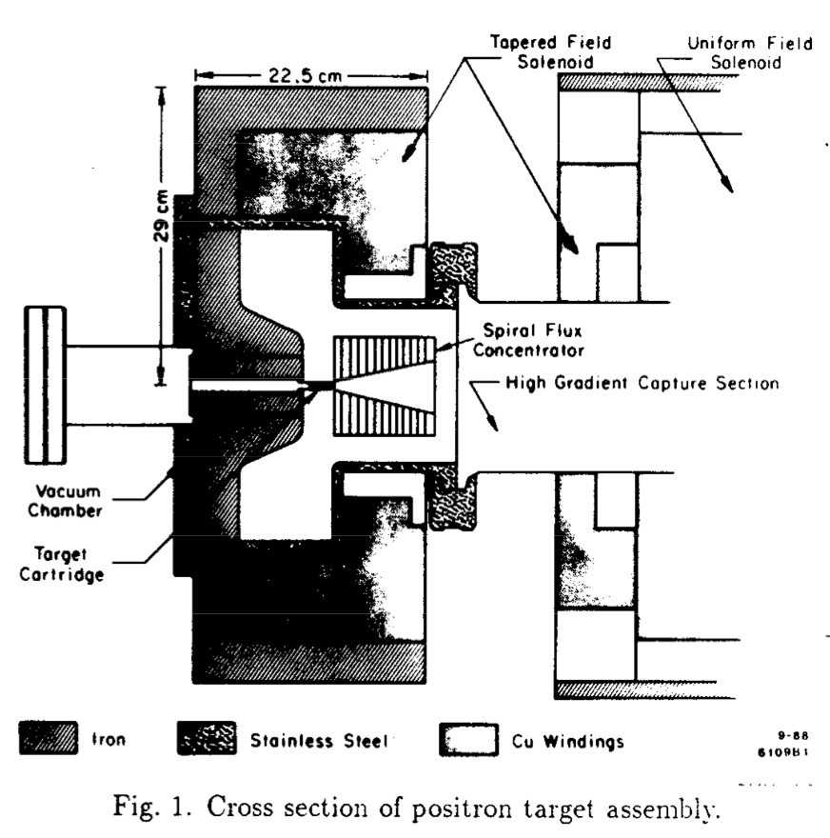
SLAC Once Hosted the World’s Highest Intensity Positron Source
SLC Positron Target
How can we leverage this expertise and apply it to new scientific challenges?

Slide 5
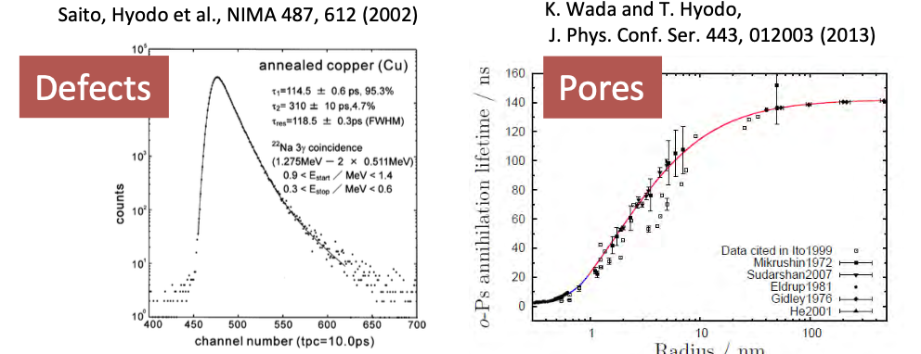
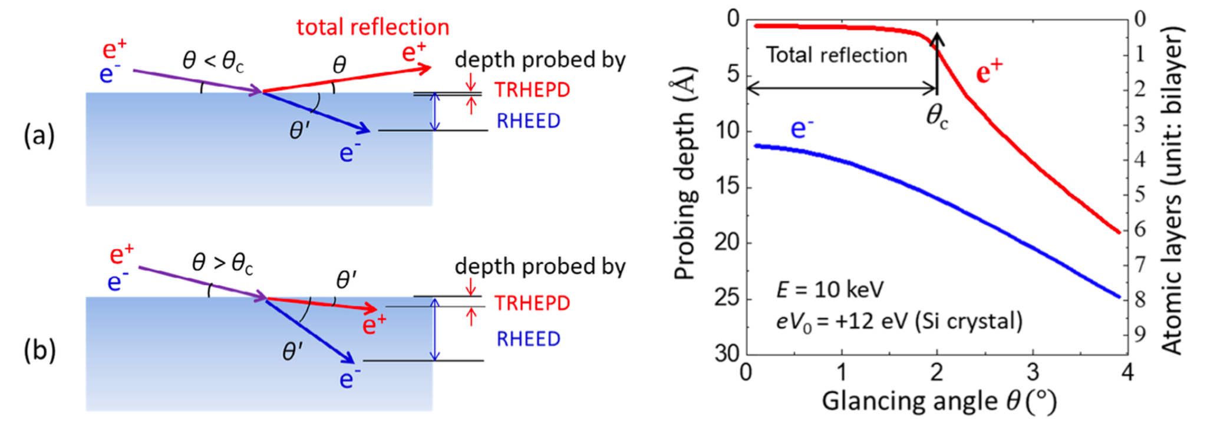
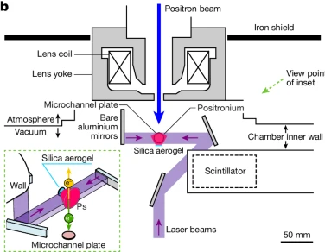
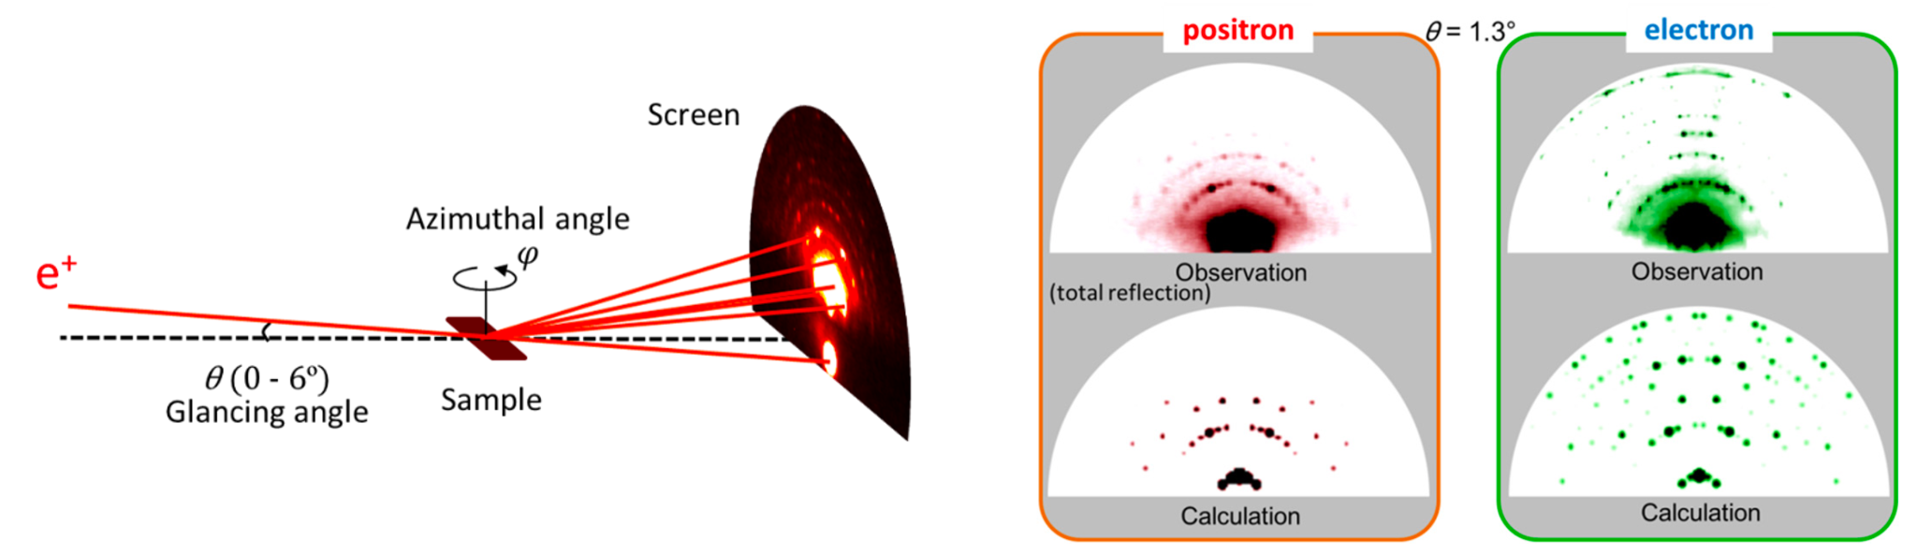
Positrons for Basic Research
Positron Annihilation Lifetime Spectroscopy
Total Reflection High Energy Positron Diffraction
Y. Fukuya, J. Phys. D: Appl. Phys. 52, 013002
Laser Cooled Positronium
K. Shu et al., Nature 633, 793–797 (2024)
Positrons enable exciting scientific opportunities, but positron sources have limitations.

Slide 6
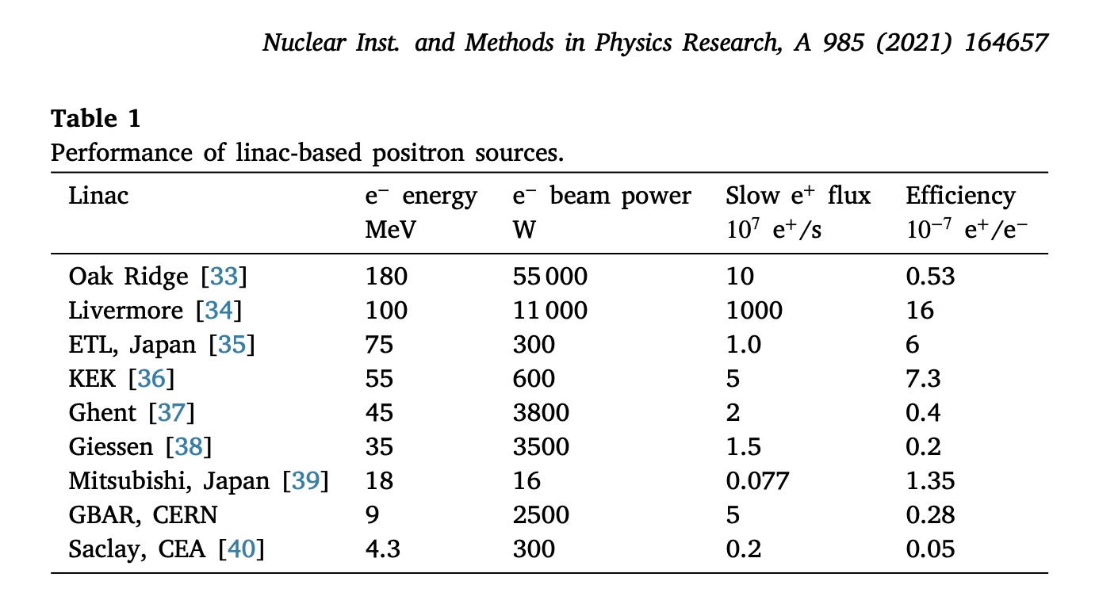
Current Positron Sources are Limited by Efficiency
Arguably the biggest issue in having accessible positron sources is that the yield of e+/e- is extremely low
The reason for this is moderation, which takes a beam with large energy and divergence and produces a quasi-monoenergetic beam with large spot size and low divergence
x 10
* This is just linac sources, but you get the idea
Notes:
This is a chart of various positron sources, past and present. The Oak Ridge and Livermore facilities are no longer in operation, so currently the highest intensity source for slow positrons in the slow positron facility at KEK, which continues to be upgraded in order to provide more and more flux for user experiments. The most recent upgrade is simply increasing the electron beam power, but we are getting to a fundamental limitation in terms of the amount of beam power you can put on a target without it melting. The biggest issue, as can be seen at right, is therefore the efficiency.

Slide 7
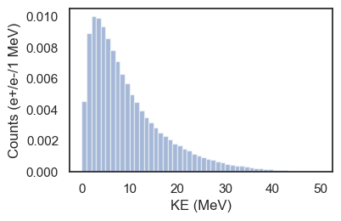
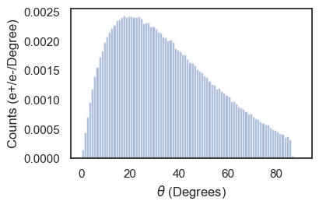
Positrons can be Produced by Colliding a High Energy Electron Beam on a Dense Target
For an incident 65 MeV e- Beam:
Positron Energy After Target
Positron Divergence After Target
For the applications previously mentioned, the positrons out of the target are not high enough quality.
Notes:
So what happens at the target when you ram an electron beam into it. Well, nothing particularly good. Inside the target the electrons emit bremsstrahlung radiation, which can then pair produce to create an electron/positron pair. So out of the target you get a shower of electrons, positrons, and gamma rays. At the bottom here, you can see that the energy spread and beam divergence of these positrons can hardly be regarded as a ‘beam’, and this is the challenge of linac based positron sources.

Slide 8
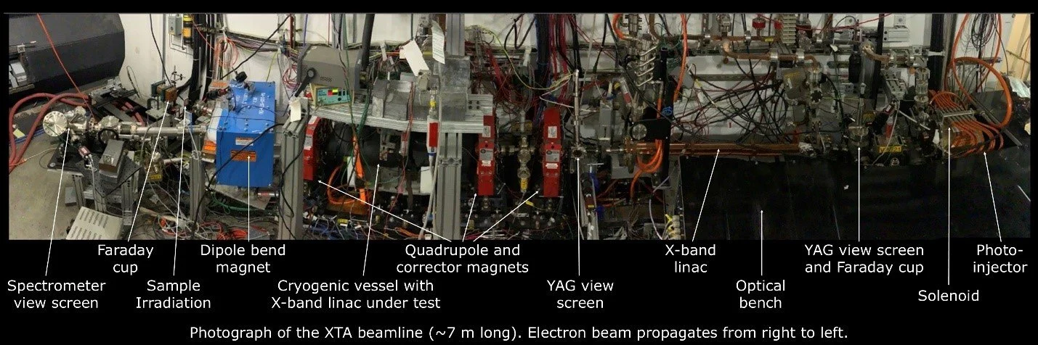


The XTA Accelerator at SLAC is an Ideal Testbed for Positron Research
XTA can provide a 65 MeV, 100 pC, 30 Hz e- beam with <10ps pulse length
Notes:
As I said earlier, the process of positron generation is rather simple, even if it is inefficient, and any electron beam of sufficient energy is capable of producing positrons. In our case, we have access to the XTA accelerator at SLAC, which is a 65 ish MeV x band accelerator which can produce beams of about 100 pC at about 30 Hz, with picosecond scale bunch length. By the way, I’m also an active operator of this facility, and so I simply must plug that we are open for proposal right now via beamnet and if you too would like to use this accelerator or the larger bunker facility, NLCTA, feel free to talk to me about that. But back to positrons, we are currently in an installation phase at XTA.

Slide 9
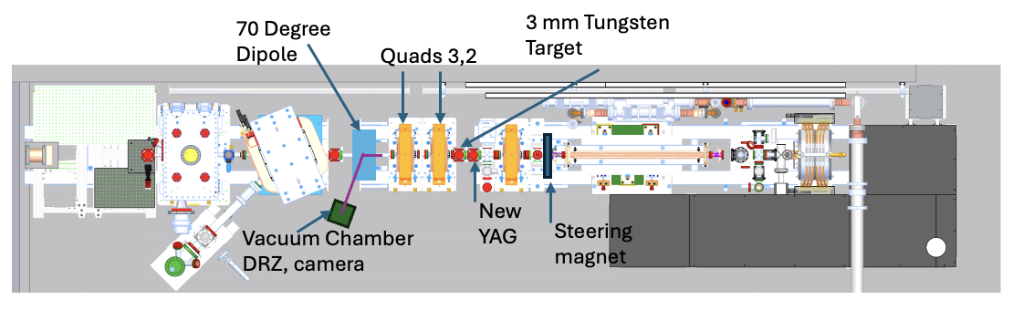
Initial XTA Facility Positron Upgrade
Positron Energy: 1-5 MeV (@ central energy 3 MeV, +-200 keV)
Spot Size: 5 mm x 50 mm
Pulse length: <100 ps (@ central energy 3 MeV, 40 ps)
Charge: 1 fC/s - 30 fC/s

Slide 10
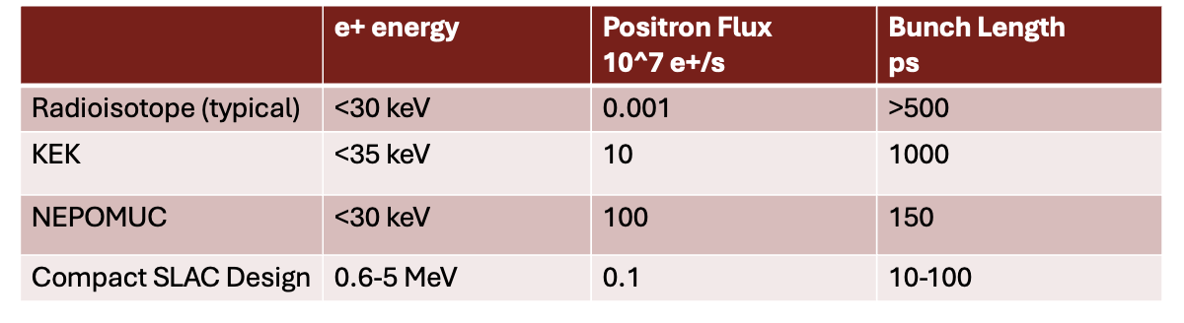
Comparison of positron sources
Ultrashort positron bunches will enable new science.

Slide 11
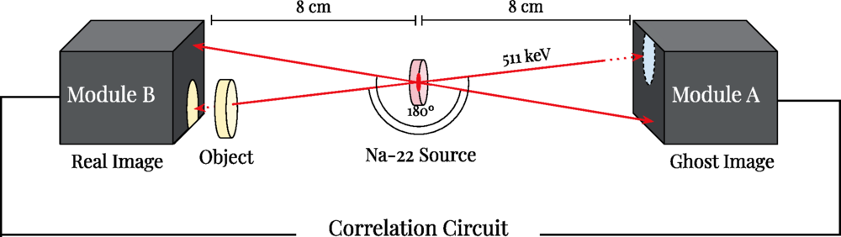
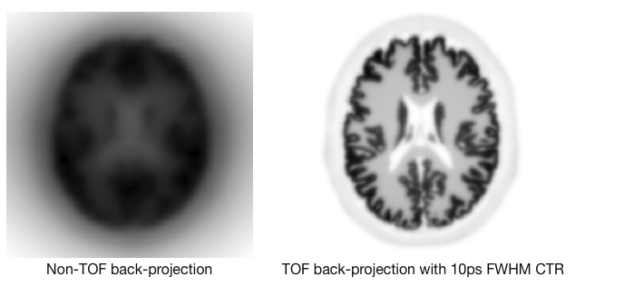
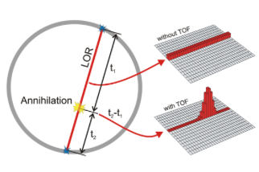
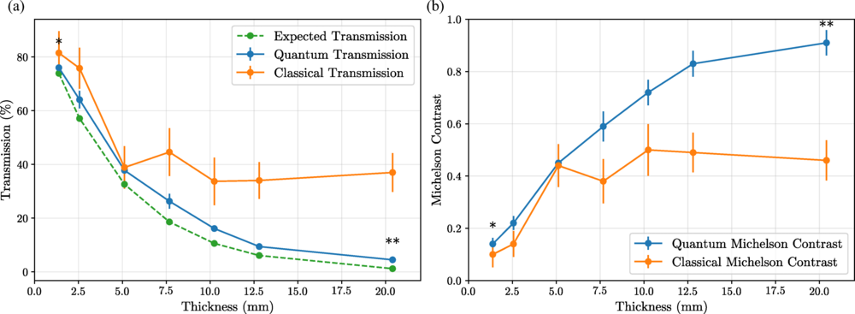
First Science with the SLAC Compact Positron Source
Time of Flight PET Detectors
Ghost Imaging with Gamma Rays
10 ps Time of Flight resolution for PET detectors would enhance the SNR, enabling lower dose and quicker measurements
Utilizing the entangled nature of the emitted gamma rays enables imaging of dense materials
Utilize well-timed positrons.
Schneider et al., Phys. Rev. A 113, 013715 (2026)
Notes:
One big issue with detector testing: radioisotope sources are not timed
which either reduces measurement time or radiation dose requirements - next generation PET

Slide 12
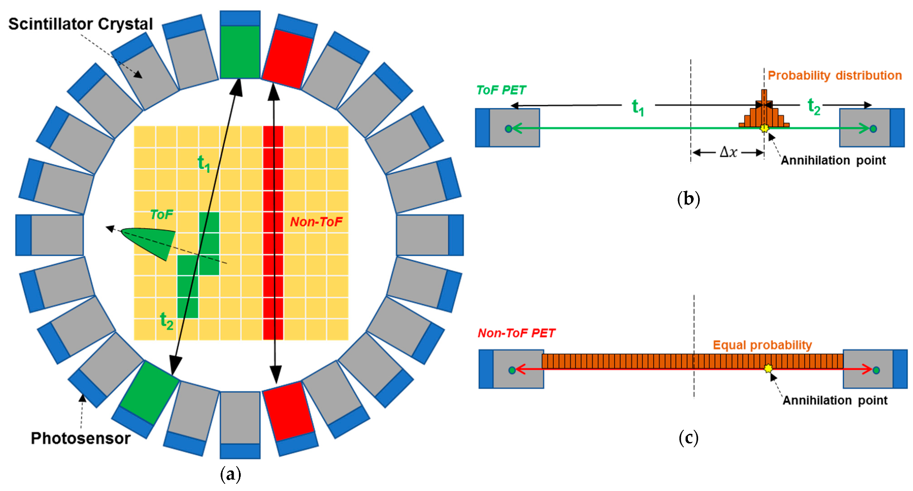
Time of Flight (ToF) Positron Emission Tomography
Gamma Ray Timing Resolution → Spatial Resolution
Notes:
comparison of tof vs conventional. currently tof is limited to several hundred picoseconds. Since the spatial res of pet is directly related to the temporal resolution of the detectors, advancements in this space are critical to the imaging.

Slide 13
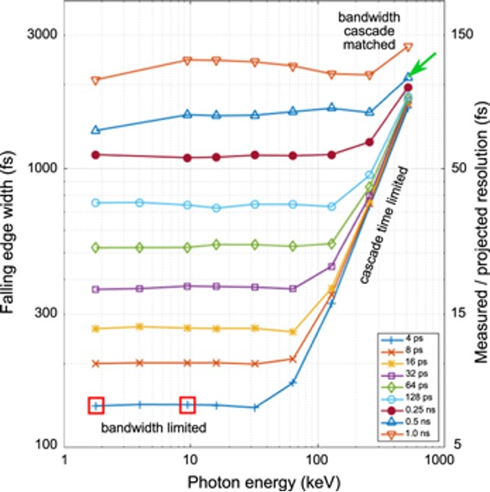
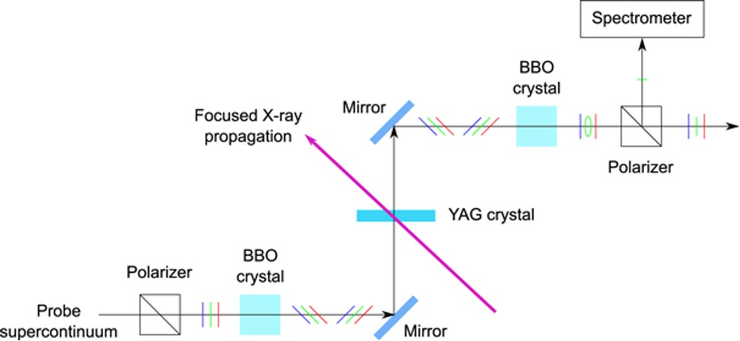
Novel Laser Based Gamma Ray Detector Could Enable High Resolution PET
Traditional detectors are scintillator based, but novel laser scheme could enable resolution <100 ps
Positrons/ 511 keV photons
Unlike radioisotope based source, the XTA linac source is inherently laser timed.
Currently discussing with C. Levin (Stanford), R. Coffee (SLAC)
Li Tao et al 2021 Phys. Med. Biol. 66 045032
D. Jeong et al. Nature Photonics volume 20, pages 686–692 (2026)
Notes:
Collaborators at slac and stanford are interested in a novel laser based scheme which should enable down to 50 ps resolution. (Explain). But the development of this is challenging without the availability of a timed gamma ray source. So in this case, our time positron beam can be used as a source of timed gamma rays to enable the further development of this novel detector.

Slide 14
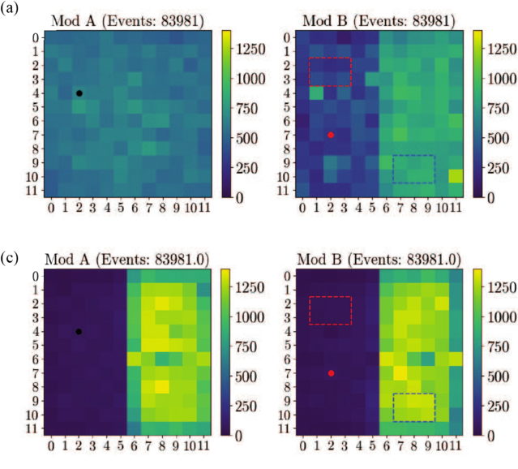
Quantum Ghost Imaging for Dense Materials
Early experimental results indicate ghost imaging can make significant improvements to SNR in the imaging of dense objects
Classical
W Target
e+ into page
Quantum Filtered
Schneider et al., Phys. Rev. A 113, 013715 (2026)
Notes:
Another near term application is to make full use of the the intrinsic entanglement of the emitted photons from annihliatino. An experiment was recently conducted using a radioisotope source which saw significant improvements in noise through the use of quantum filtering.

Slide 15
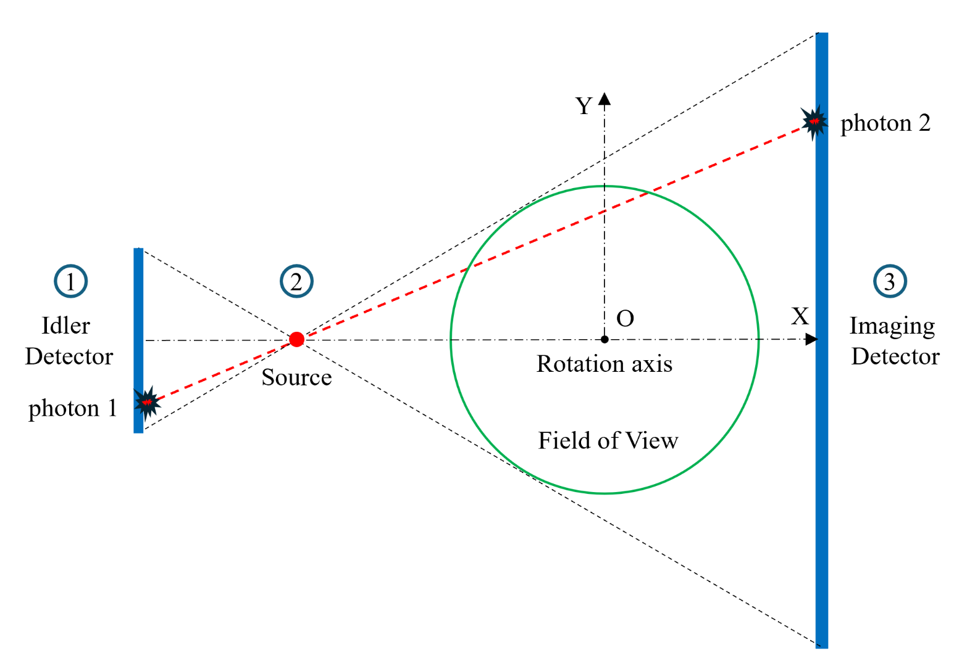
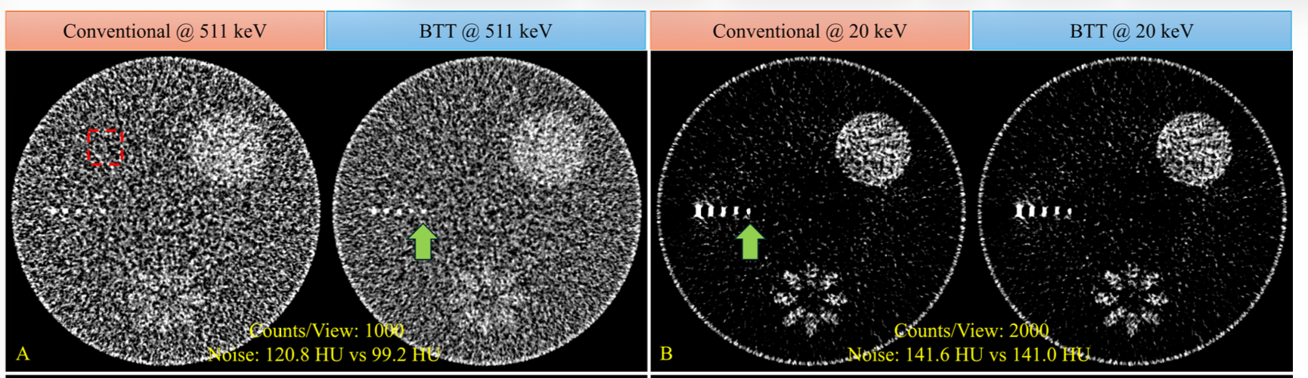
Ghost Imaging for Direct Breast Tomography
Simulations indicate that ghost imaging with 511 keV photons could reduce noise by 22%.
Yu et al., Proc. SPIE 13924, Medical Imaging 2026: Physics of Medical Imaging, 139241D (2 Apr 2026)
A timed source will enable gating, further reducing noise.
Notes:
And another recent publication indicates that these 511 keV photons may actually have superior imaging capabilities with reduced irradiation for direct imaging of tumors. We believe that using the timed source at XTA, we will further be able to reduce noise and therefore the dose required for imaging.

Slide 16
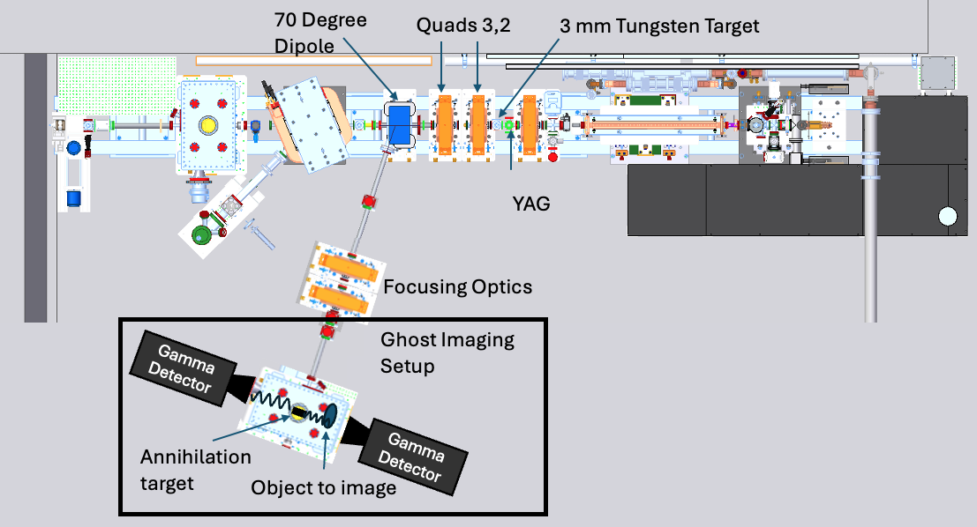
Ghost Imaging at XTA
XTA can be a testbed of novel gamma ray detectors and imaging enabling technology
Notes:
This is what the proposed setup would look like, and we are currently in the process of obtaining the detectors necessary for running it.

Slide 17
Roadmap for a SLAC Positron Facility
Phase 1: MeV Positron Source
Phase 2: Ultrashort Positron Bunches
Phase 3: Ultrashort, High Brightness Positron Facility
Utilize existing infrastructure to generate 100 ps positron bunches.
Enable PET detector, ghost imaging, and basic positron studies.
Utilize magnetic and RF bunching to create sub-picosecond positron pulses.
Enable pump-probe positron science.
Utilize historic SLAC infrastructure to enable average power, high peak power positron source.
Enable pump-probe positron diffraction, laser-cooled positronium electron positron pair plasma studies.
This talk!
Notes:
Imminently: 1-5 MeV positron production, low current, high emmitance
Nearterm upgrade: Ultrashort bunches
Far Far upgrade: Bright positron source for pump-probe e+ diffraction

Slide 18
Conclusion
Thanks for your attention!
Positrons are for more than colliders!
At the XTA beamline at SLAC, we can produce a positron source of up to 1e6 e+/s, 10x more than radioactive source capabilities, in an ultrashort pulse
In the near term, positron production at SLAC will enable testing of novel PET detectors, high SNR ghost imaging, and the optimization of positron sources for basic science

Slide 19
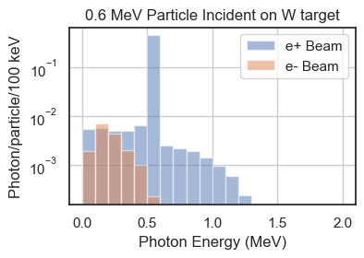
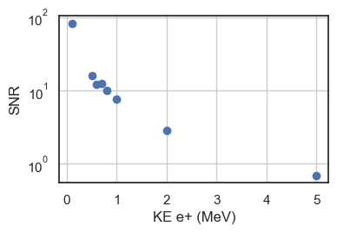
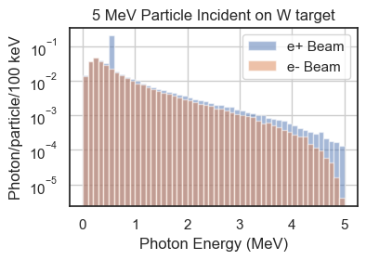
Background Depends on Incident Positron Energy
If we stay below 800 keV e+,>10x as many 511 keV gamma rays as not
SNR = (# 511 keV)/(total photons)
*assumes 1:1 signal/photon regardless of energy

