Slide 1
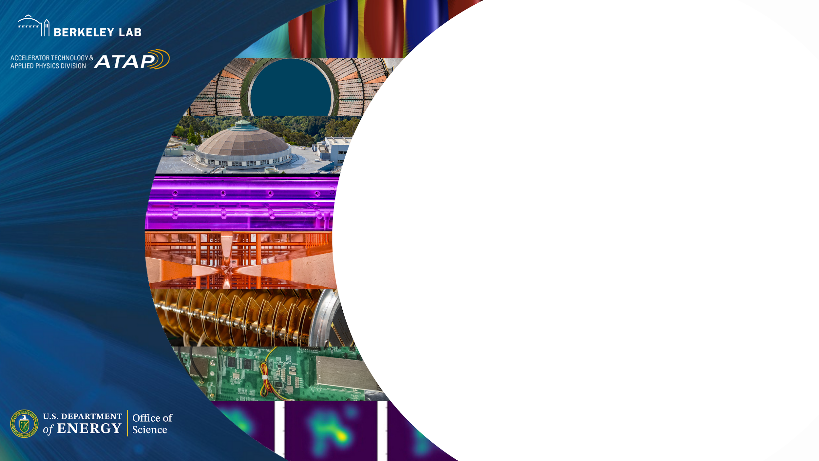
Energy-resolved measurement of individual GeV muons from the BELLA PW Laser-Plasma Accelerator
Davide Terzani
Advanced Accelerator Concepts 2026
July 30th, 2026
This work was supported by DARPA, and by the U.S. Department of Energy (DOE) Office of Science under Contract DE-AC02-05CH11231
Notes:
- Last result of the DARPA MuS2 program

Slide 2
Contributors
Theory and modeling (BELLA center)
D. Terzani, S. Kisyov, C. Benedetti
LPA electrons (BELLA center)
A. Picksley, J. Stackhouse, H-E. Tsai, R. Li, E. Park, K. Nakamura, A. J. Gonsalves
Muon detection (Physical Science)
L. Le Pottier, P. Manov, R. Heller, M. Mironova, T. Heim, M. Garcia-Sciveres
Supervision (BELLA center and LBNL)
J. Valentine, J. van Tilborg, C. B. Schroeder, E. Esarey, C. G. R. Geddes
+ all the technical staff!

Slide 3
Outline
Motivations
Overview of the experimental setup
Description of muon telescope
Muon identification and detector calibration
Energy of muons produced via LPA
Summary and next steps

Slide 4
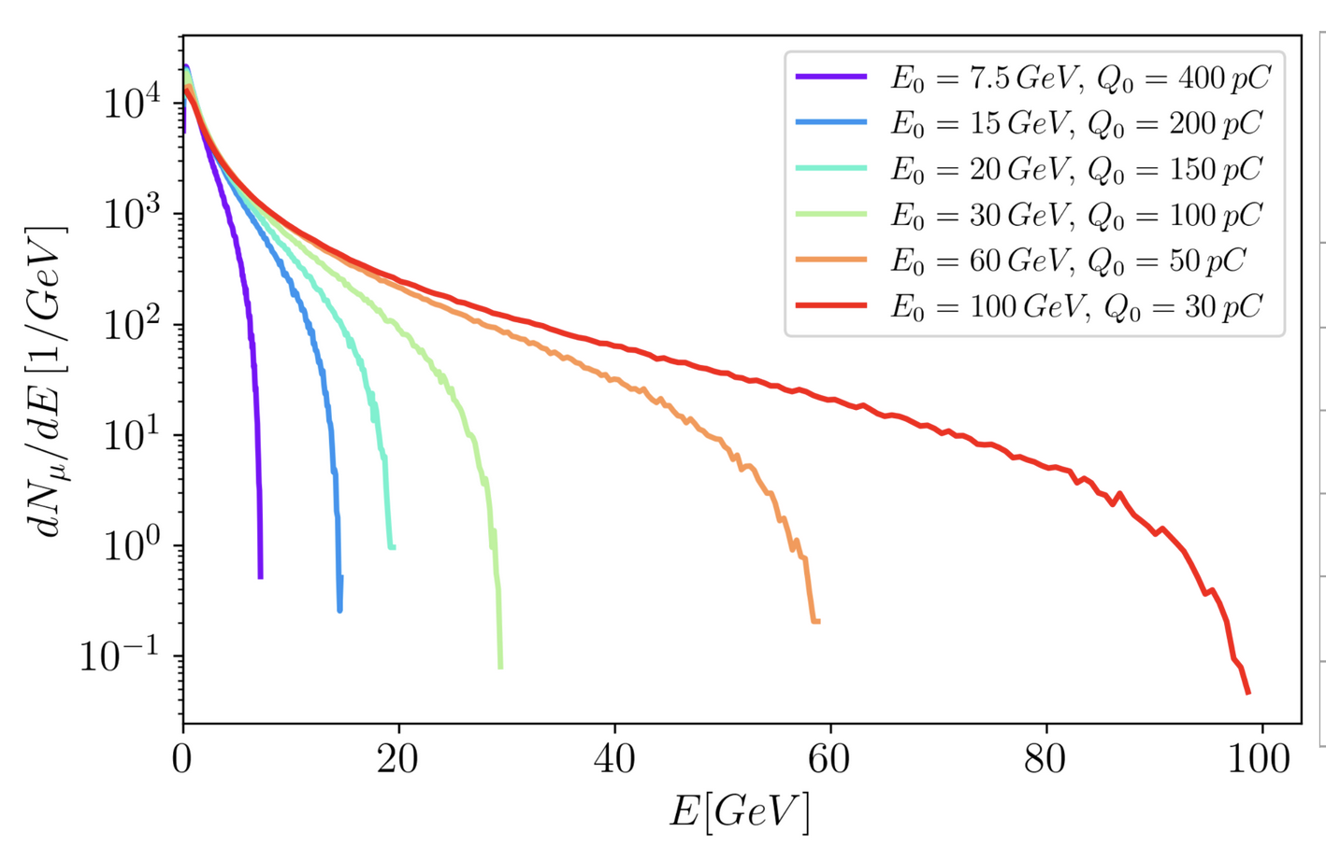
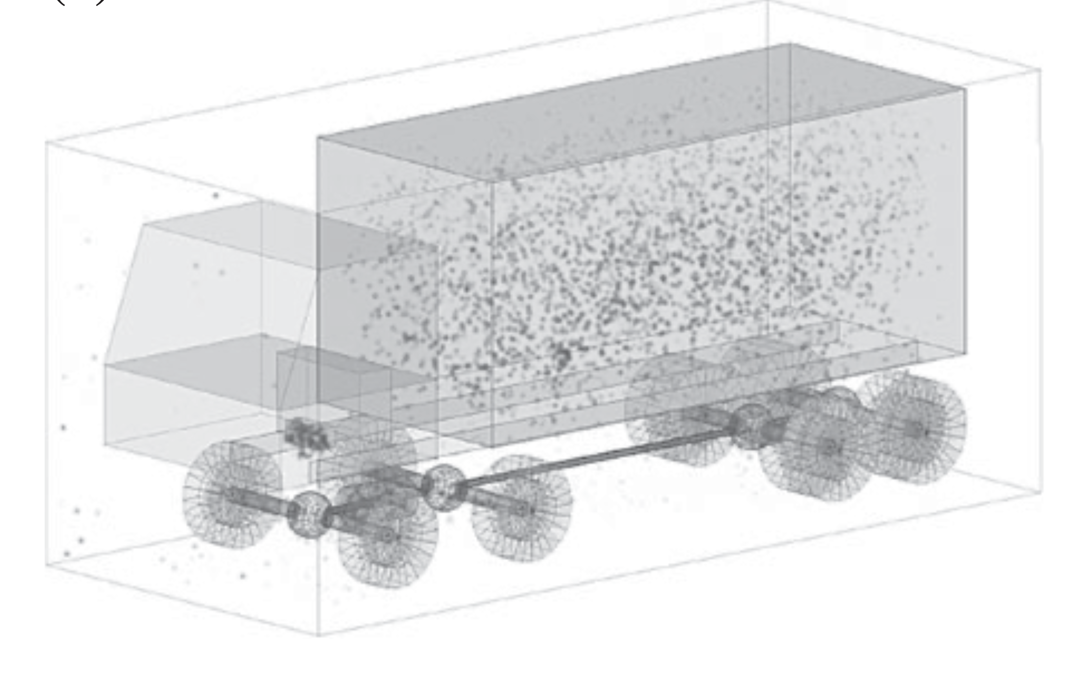
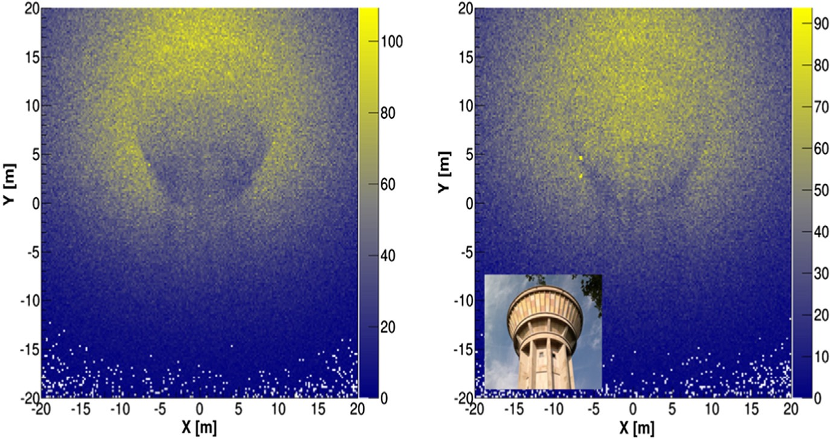
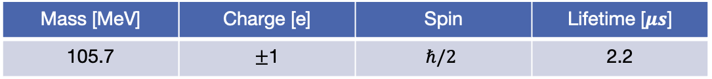
Imaging applications benefit from a compact muon source
Muon
Mass [MeV] | Charge [e] | Spin | Lifetime [$μs$]
105.7 | $±$1 | $$ℏ/2$$ | 2.2
Reduced Bremsstrahlung
Interacts with detectors
At the present time, only few facilities (e.g., MICE, Fermilab) produce muons, other applications rely on cosmic rays $→$ ~1 particle/(min cm²)
Muography
Muon spectra from e- beams
Penetration of high-Z materials
Imaging of large objects
[S. Vanini, et al., Philosophical Transactions of the Royal Society A377, 20180051 (2018)]
[S. Bouteille, et al., Nucl. Instrum. Methods A 834 (2016) 223]
Notes:
Muon heavier cousin of electron, large penetration because of reduced Bremsstrahlung
Muography requires tracking incoming and outgoing muon

Slide 5
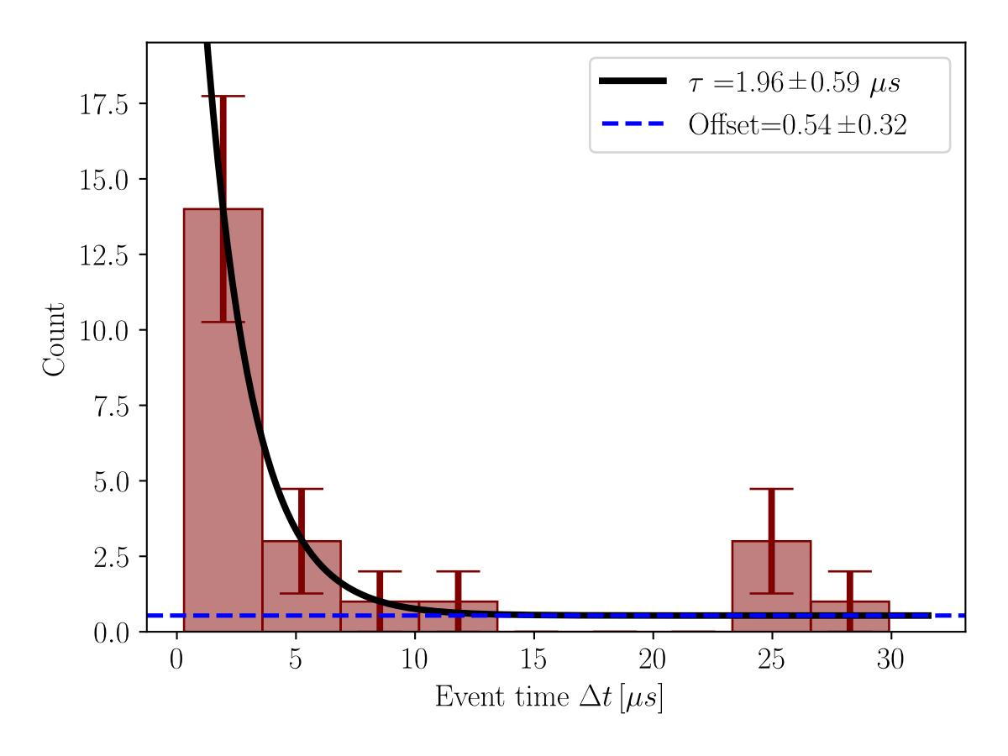
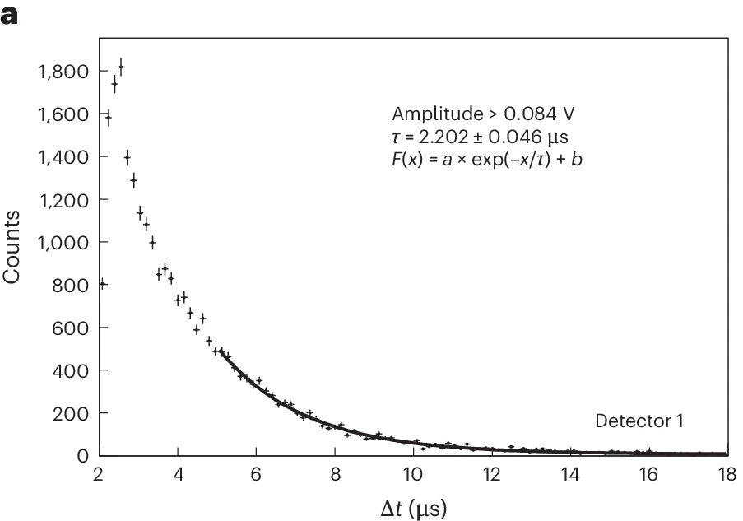
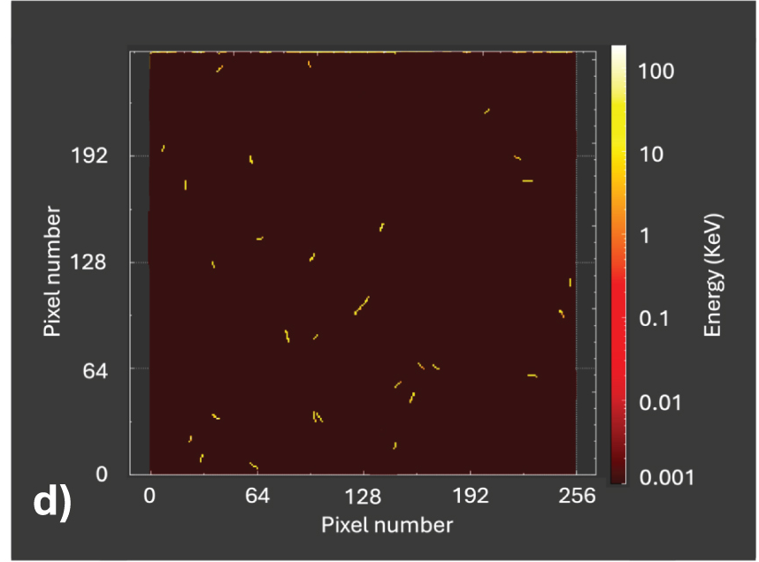
No single-muon tracking and energy measurement was ever attempted
At the moment of preparing this presentation, 3 recent paper investigated LPA-based muon production
[D. Terzani, et al., PRAB, 2025]
[F. Zhang, et al., Nature Physics, 2025]
[L. Calvin, et al., PPCF, 2026]
Muon identified via decay time in scintillators
Muon identified via decay time in scintillators
Used single pixelated silicon detector, but background dominated
All previous attempts relied on statistical identification over many shots, shot-by-shot analysis not available
At the BELLA Center, we performed experiments using a novel diagnostic to measure the energy and propagation direction of the high-energy component of the muon spectrum.
Notes:
Idea was known, but only relatively recently enabled by LPA progress
Last two years three works published, all have in common that muons were identified via statistical averaging

Slide 6
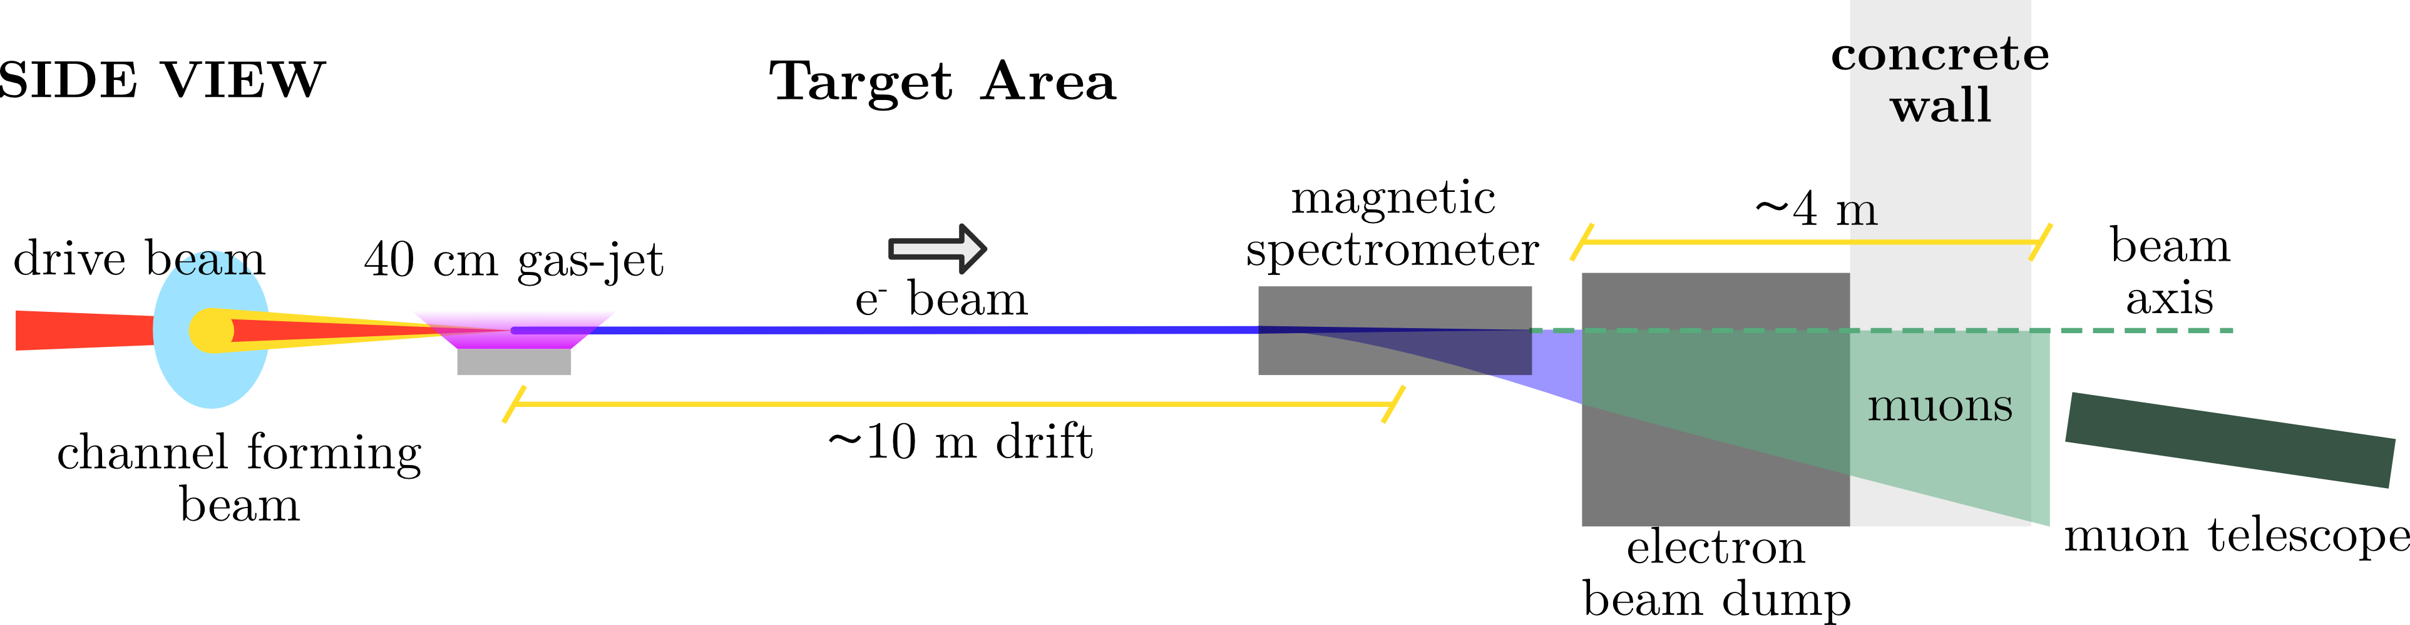
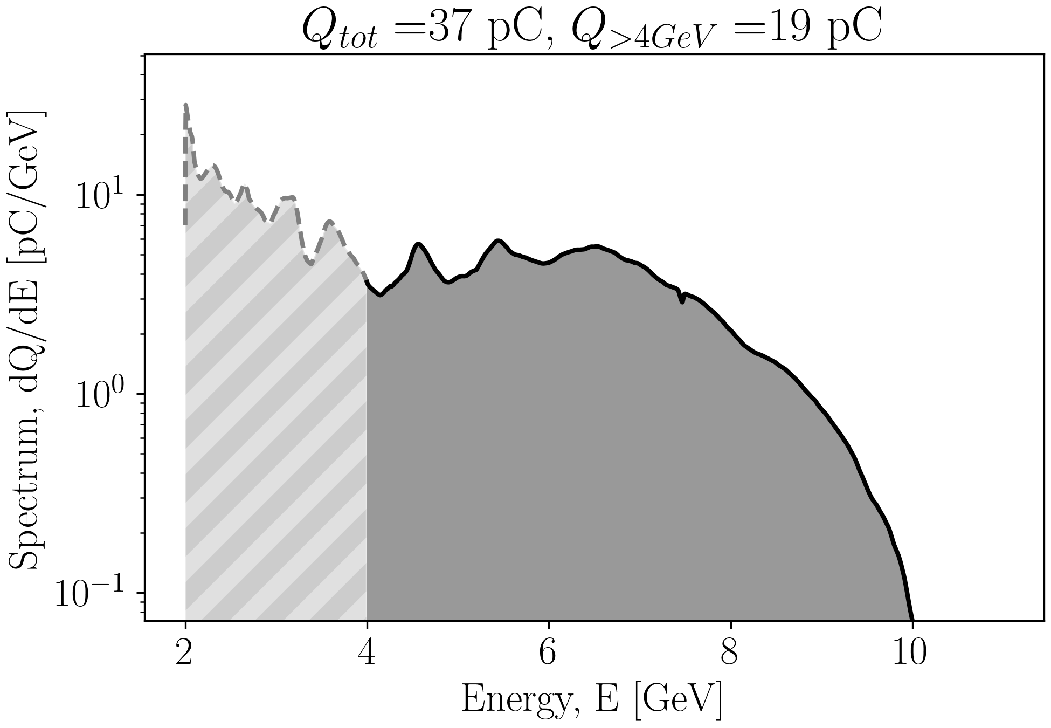

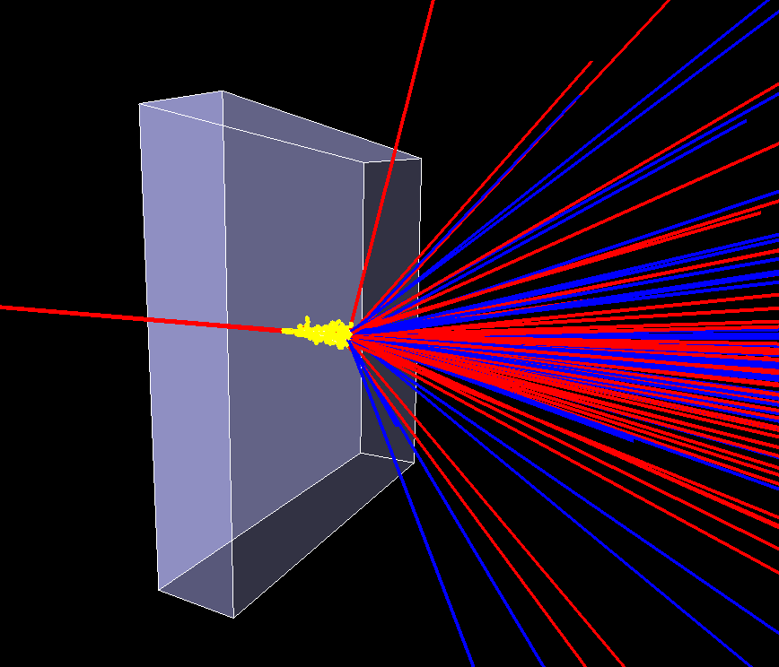
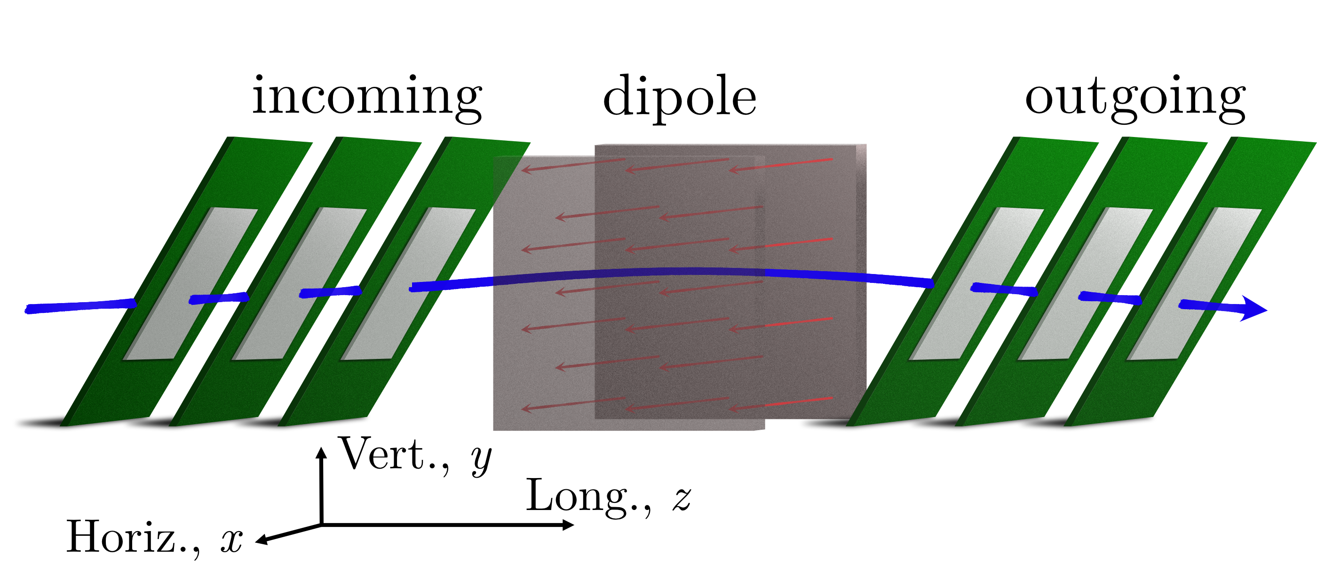
10 GeV e- beams were converted into highly penetrating muons
Axicon lens
Line focus forming long plasma column
Presented by A. Picksley on Monday
Notes:
General setup, performed these measurements during the campaign to obtain 10 GeV electrons
HOFI channel to generate 10 GeV electrons
Electrons with up to 10 GeV
Muon telescope aligned to catch the highest number of high energy muons

Slide 7
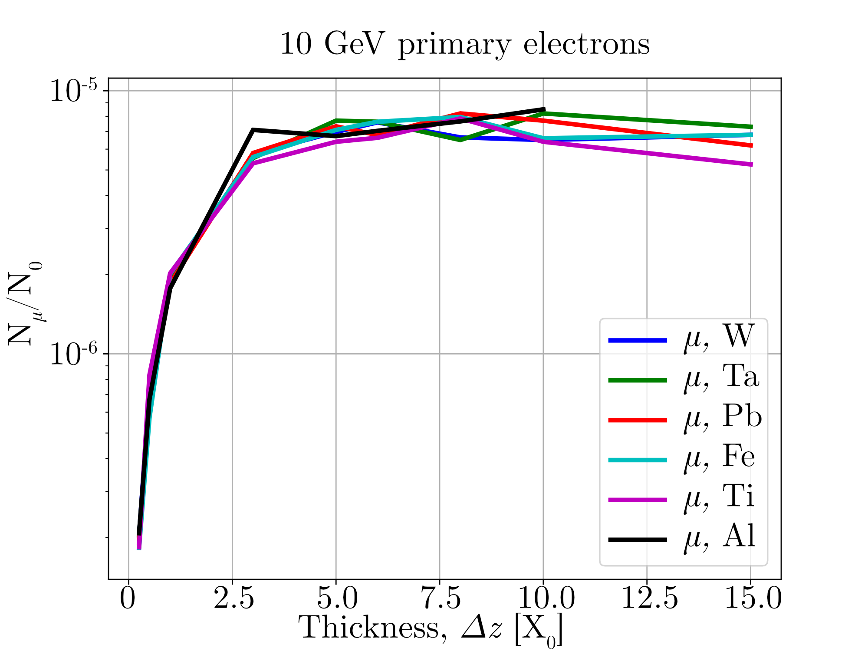
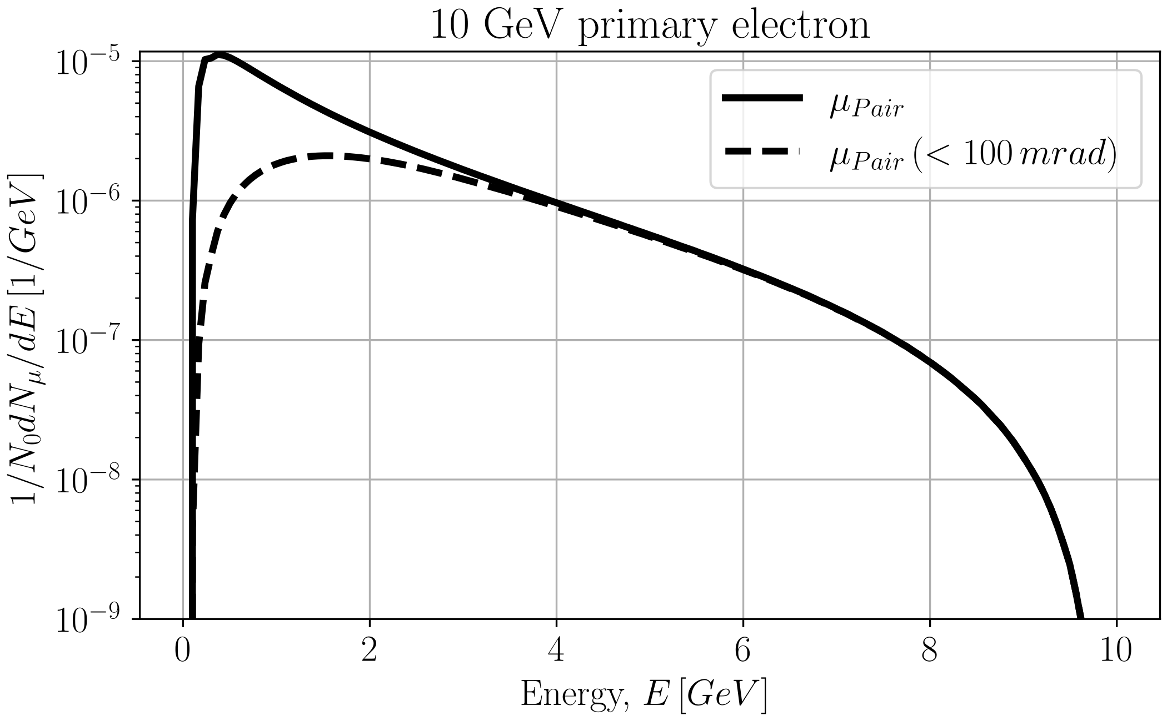
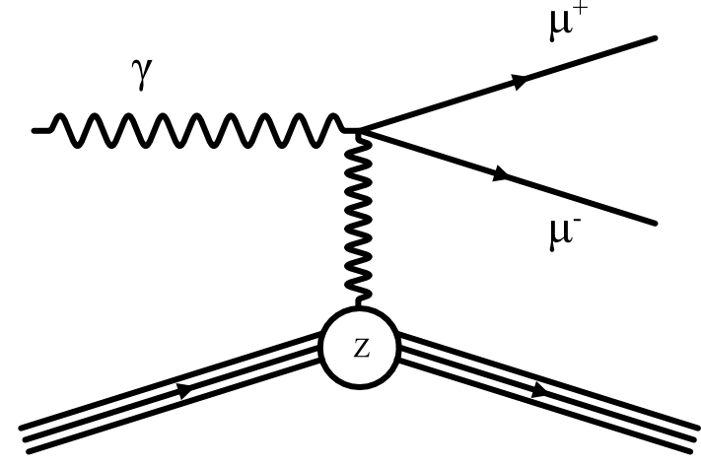
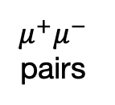
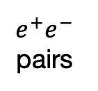
High-energy electron beams produce muons in high-Z materials
$X_{0}$ Radiation length: the mean distance over which an electron loses all but $1/e$ of its energy by Bremsstrahlung
The dominating process is the production of gammas via Bremsstrahlung
Muon yield produced in different materials as a function of the thickness
$e^{+}e^{−}$ pairs
$μ^{+}μ^{−}$ pairs
Pairs are produced over a 1/γ (<< 0.1 rad) cone
Bethe-Heitler process
Notes:
Electrons produce Bremsstrahlung in high-z material
Photons are very directional and converted in lepton pairs
Energy goes up to the initial e-beam energy
High penetration power

Slide 8
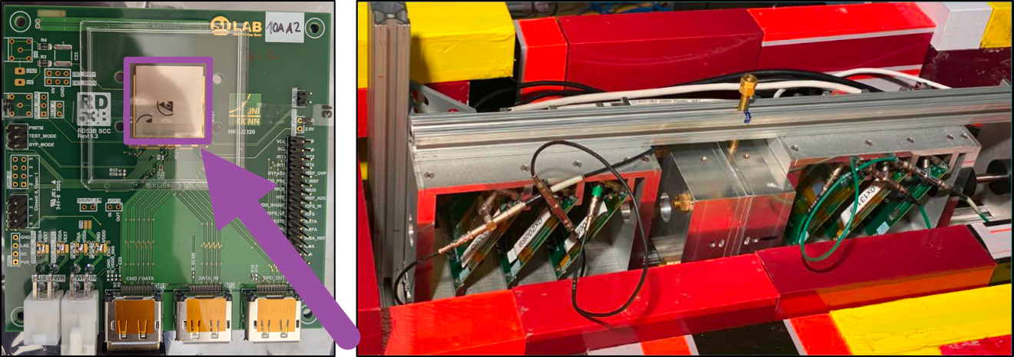
We stacked multiple silicon-based trackers to build a muon telescope
ITkPixV2 chips:
Pixel size: 50 μm
Chip area: 2x2 cm
Readout rate: > 1MHz
Efficiency: 99% for minimum ionizing particles
Telescope:
6 chips, 3 per stack
(removable) Halbach magnet B=0.53 T
Tilt in bending direction improves geocenter determination
Self triggered system if 1st and 3rd chip in stack register hit (protection from background)
[D. Terzani, et al., submitted]

Slide 9
Muons are identified within a single stack by their cluster size and straight trajectories
ITkPixV2 is very sensitive to charged particles. Although photon detection is less efficient, a large photon flux generates substantial background
electrons, positrons: Cluster size of a few pixels, they scatter and do not follow straight trajectories
Ions (heavy charged particles): Their energy deposition saturates pixels. The excess charge diffuses in the system in a very large, quasi-round pattern (we detected none)
We tag a muon event if a straight trajectory passes through all three detectors of one of the two stacks
Photons: Indirectly detected via Compton scattered electrons, their signal is usually a single pixel (very small cluster)
Muons: Cluster size of a few pixels, always minimum ionizing (highest detection efficiency), do not scatter significantly
Single stack
Notes:
- Single stack identifies muons and discards background

Slide 10
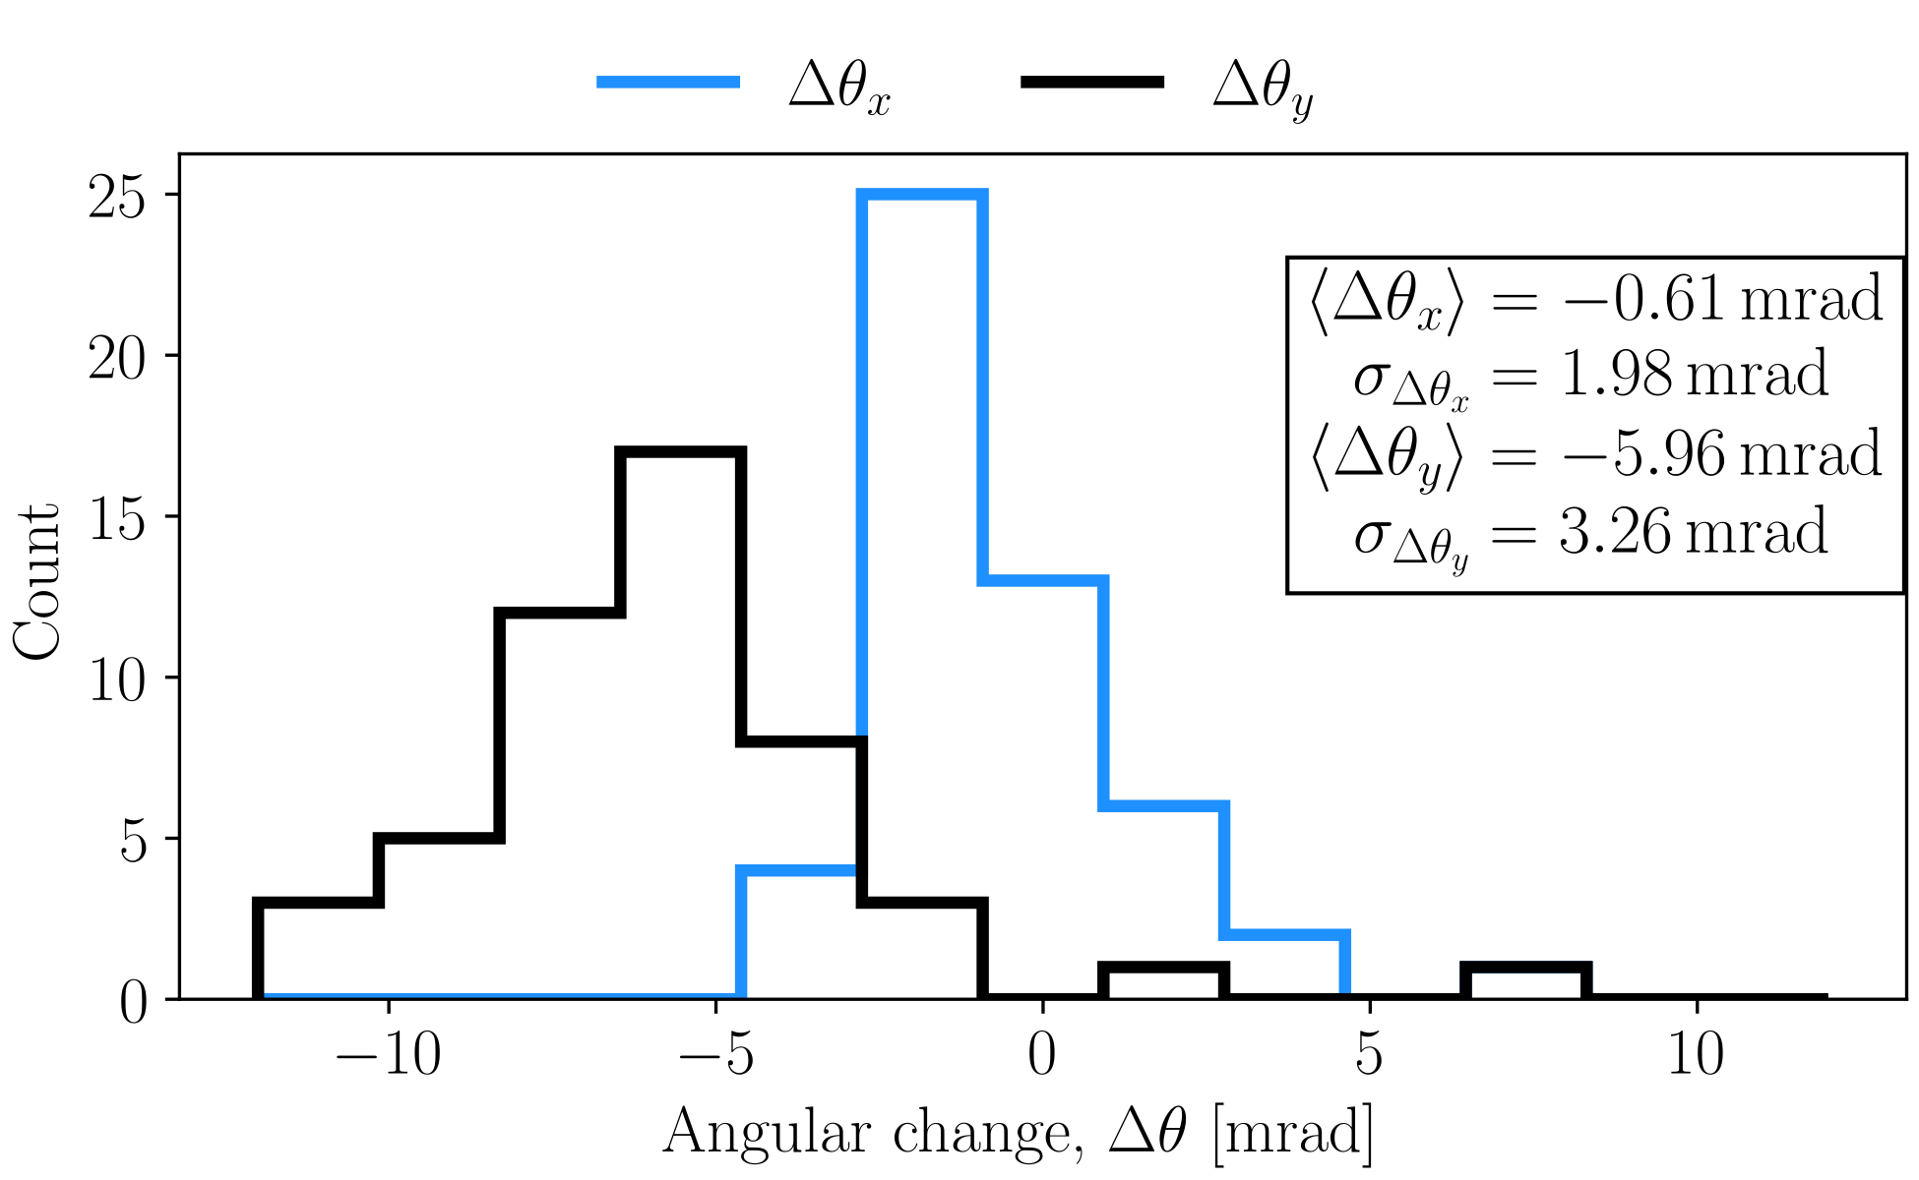

We used cosmic rays to calibrate the trajectories and align the detectors
Pre LPA run
Muon
Telescope oriented vertically to capture cosmic rays as they provide clean signal
Single stack events:
Provide residuals and inter-stack alignment
~1-month continuous operation, captured:
O(10³) events per stack
~50 full-stack events
Full stack events:
Provide angular offsets and relative distance
Detectors within stacks, and the two stacks, may be misaligned
Corryvreckan:
Load raw data
Cluster hits
Fit tracks
Align detectors
Calculate track angles
Front
Side
[D. Dannheim et al., JINST, 2020]
Notes:
Aligned vertically for cosmic rays, we removed the magnet
Corryvreckan
Plot shows the difference in angles measured in stacks, shows possible misalignment

Slide 11
We aligned the detector with the expected path of directional muons
LPA run: The telescope was oriented horizontally, aligned with the e-beam axis, and the dipole inserted
~4 m
LPA
Magnetic
spectrometer
Dipole
Beam dump and wall
Muon beam size: ~1m²
Detector surface: 4cm²
Notes:
Oriented telescope horizontally, re-inserted magnet. This changed the stack angular offset
Muons lose ~3.5 GeV in shielding, so GeV muon events are really multi-GeV muons at creation
Muon beam size 1 m^2, but detector size 4 cm^2, so limited number of events expected

Slide 12
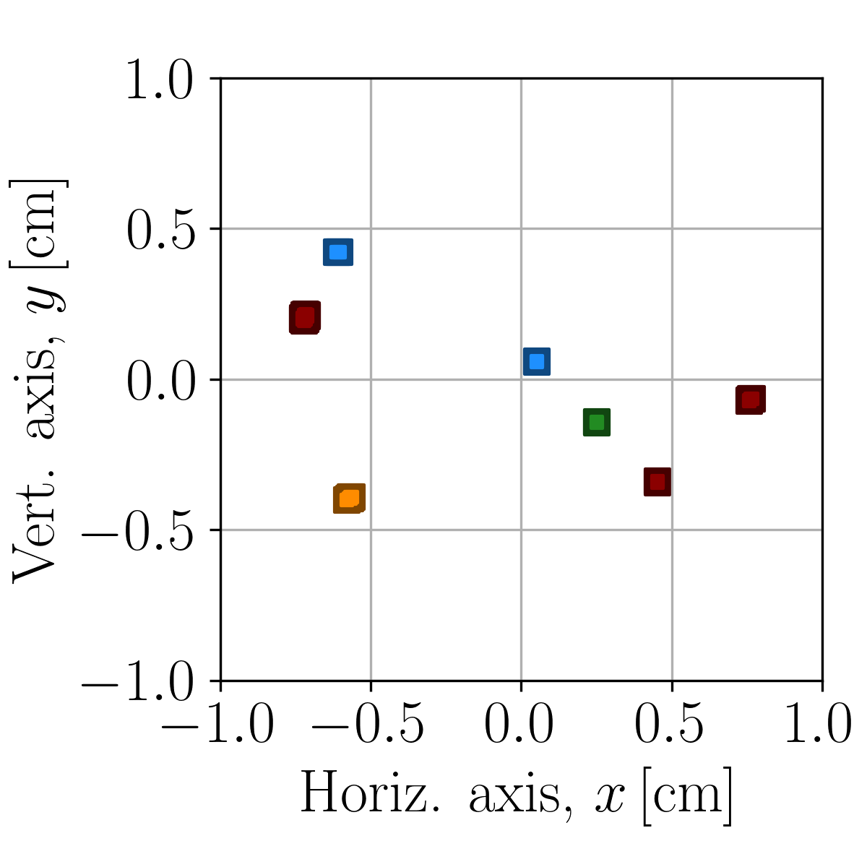
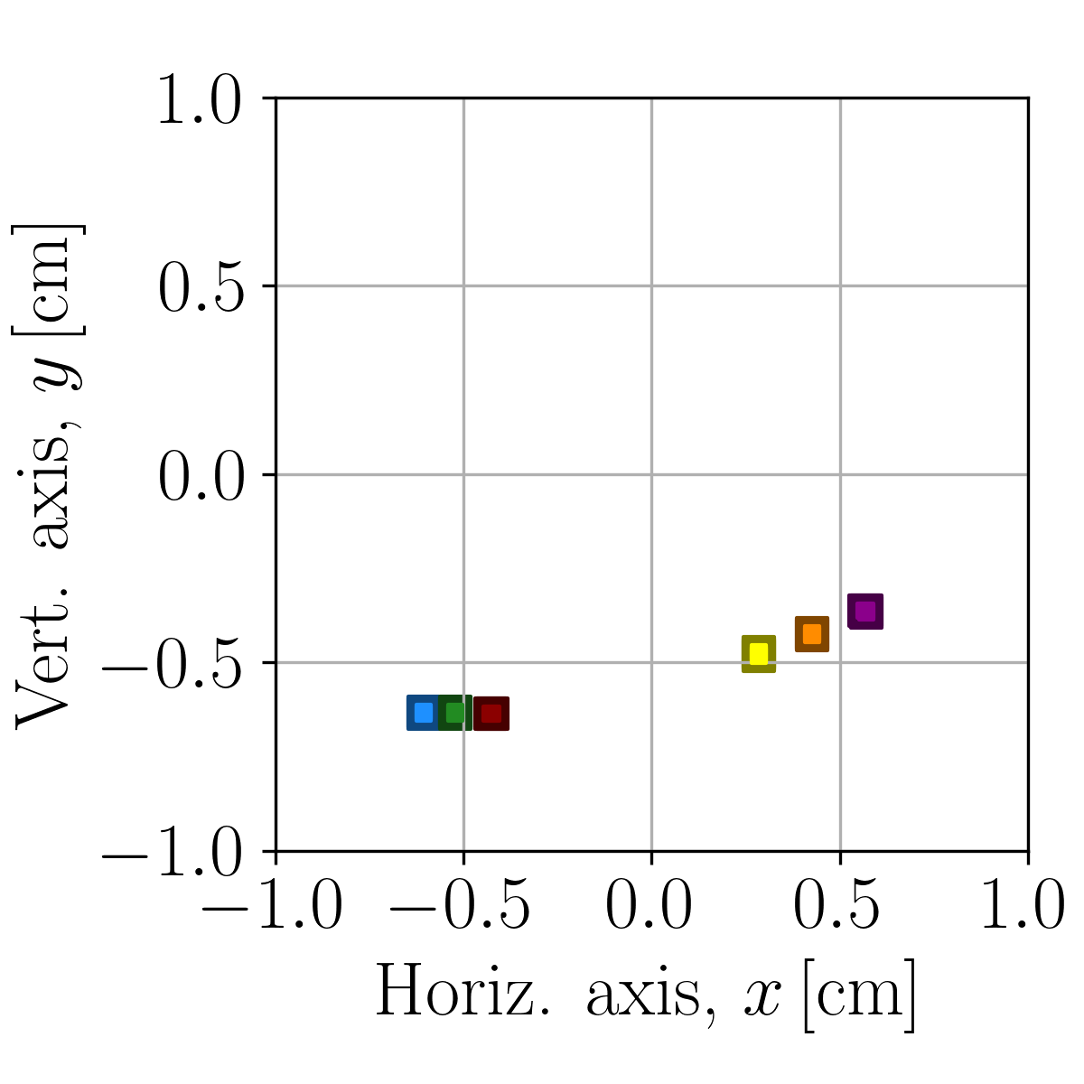
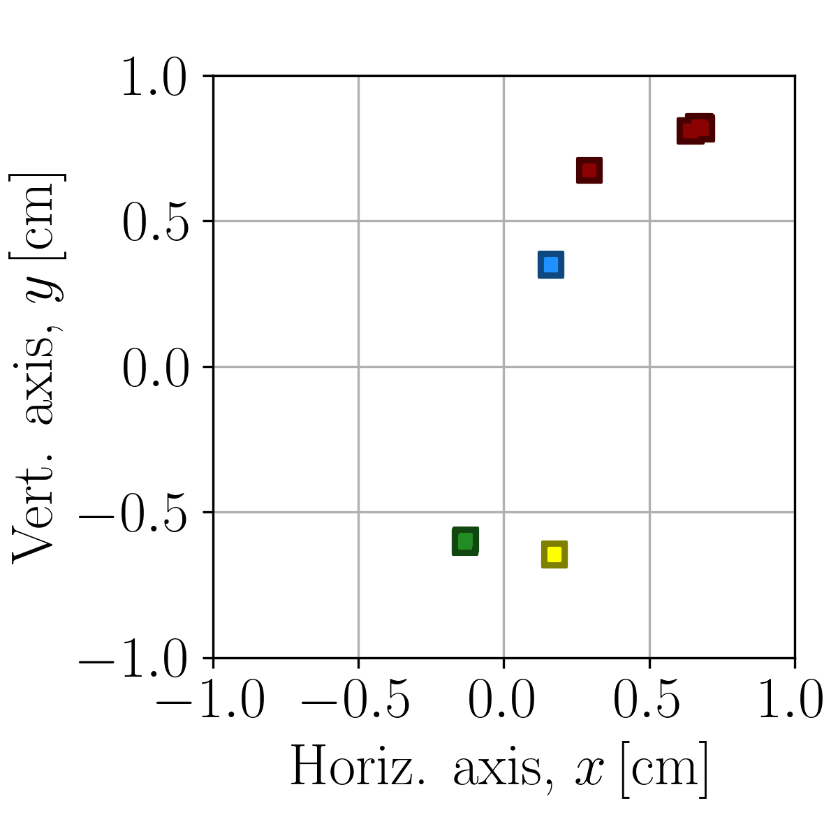
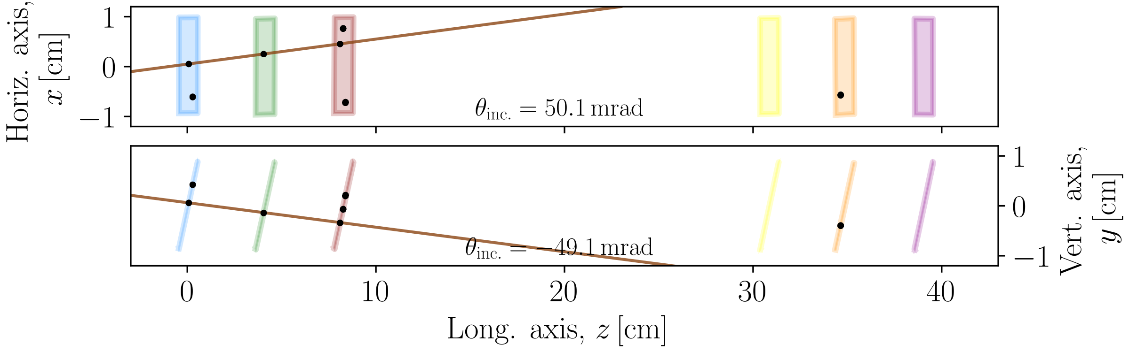
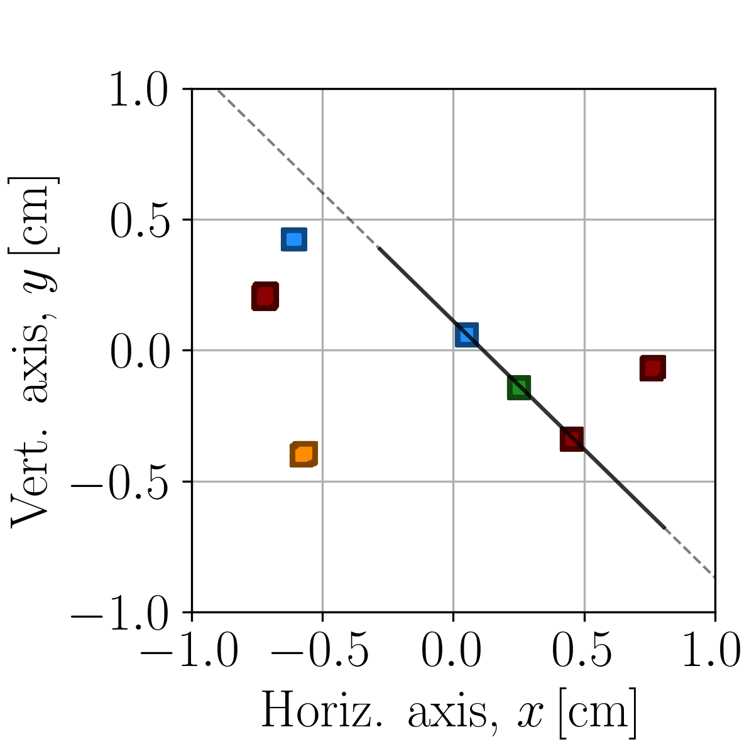
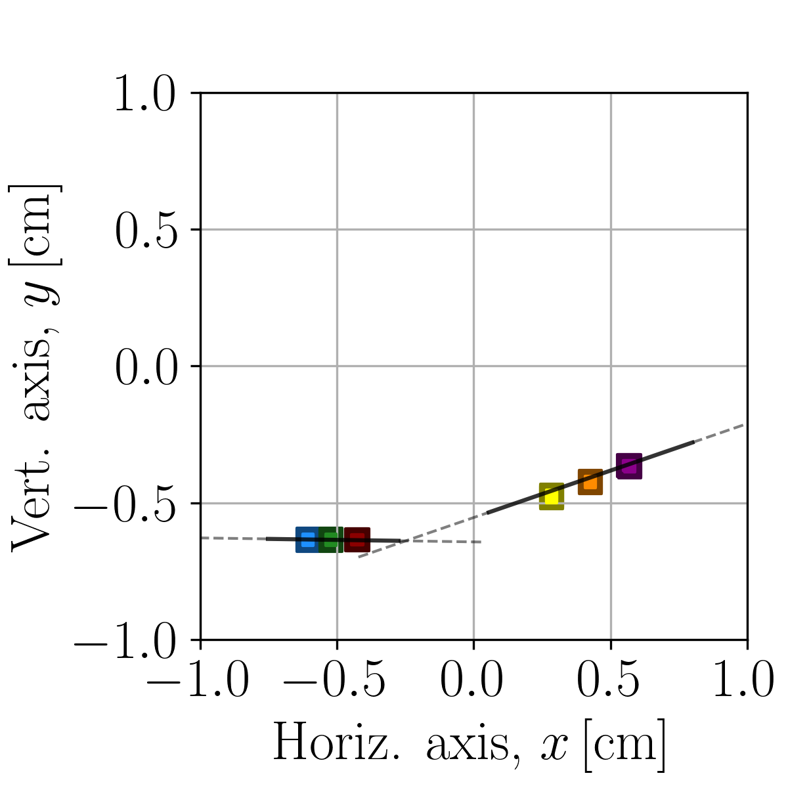
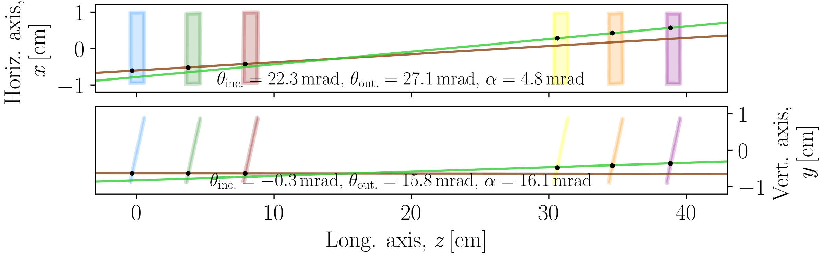
We identified LPA-generated muons that traversed at least one stack
BELLA radiation shielding, 10-cm lead shield and appropriate trigger substantially limited background
Single-stack event
Full-stack event
No muon
Notes:
Identified muons that traversed at least one stack
Signal shows projection on the x-y plane of the cumulative signal from all detectors per each event
Right, no muon
Left, single stack
Center, full-stack. The y-z plane gives us the bending angle to measure the energy

Slide 13
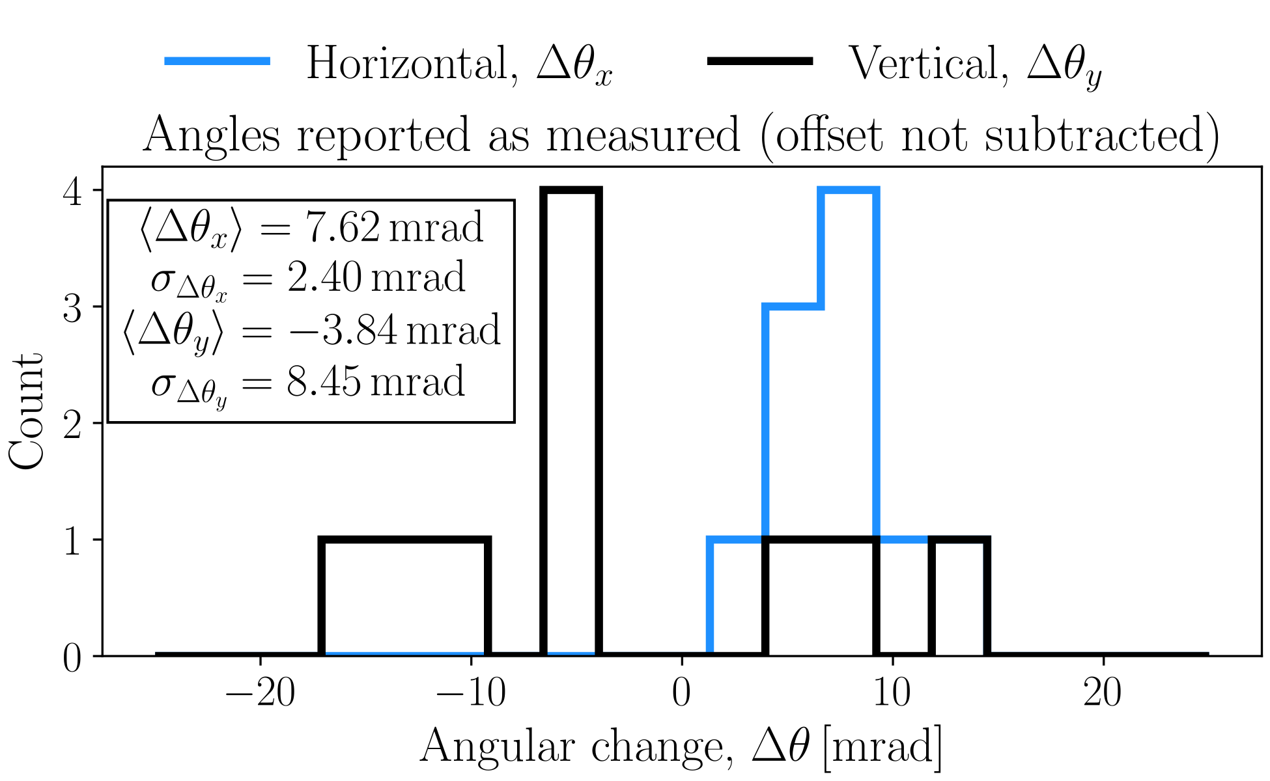
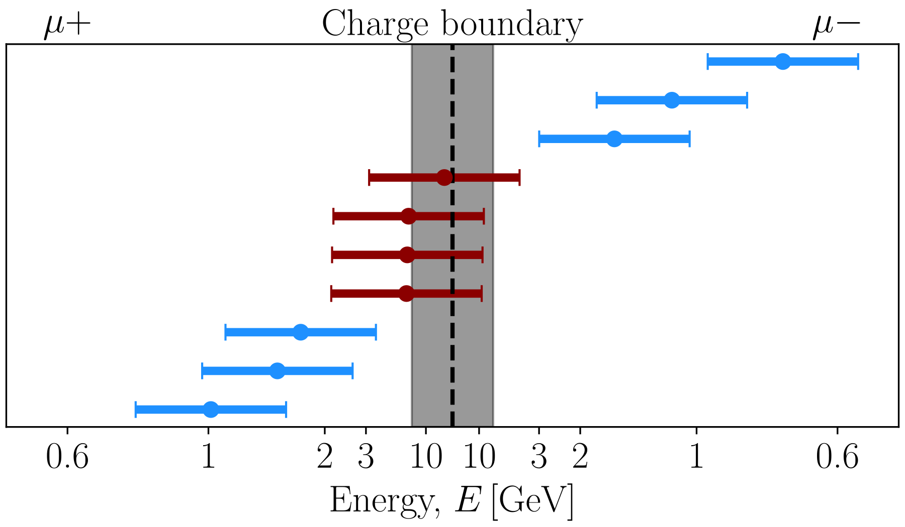
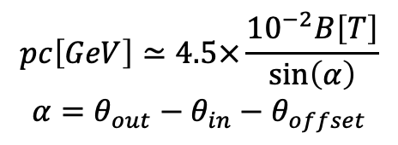
Energy measurement demonstrated GeV muon production
Detector positioning for LPA run changed angular offset between stacks
From the 361 electron beams, we measured 39 muon tracks, 10 of which traversed both stacks of the telescope
$$pc\left[GeV\right]≃4.5×\frac{{10}^{−2}B\left[T\right]}{\sin\left(α\right)}$$
$$α=θ_{out}−θ_{in}−θ_{offset}$$
[D. Terzani, et al., submitted]
Notes:
Offset identified from the 10 full-stack events. Largest source of error in the measurements
Nonetheless, muons identified and energies measured.
Plot parametrized by 1/sin(alpha) because easier to highlight the large source of error. Errorbars +- 1 sigma offset
Energies are compatible with GeV muon events, not accounting for energy losses in shielding, and charges can be identified

Slide 14
Conclusions and next steps
Conclusions
We developed a new diagnostics that enables performing single-muon, shot-by-shot trajectory reconstruction and energy measurement
We calibrated the detectors using cosmic rays
We measured 39 total muon tracks and measured the energy of 10 of them
We demonstrated production of GeV-scale muons from an LPA
Paths for improvement
Increase detector acceptance, by either bringing it closer or by using larger chips (development being discussed)
Avoid to do re-calibration after change in telescope orientation by changing mounting
Swap bending axis to horizontal, to reduce interference of gravitational effects on telescope

