Slide 1
Experimental demonstration of high-repetition-rate isolated attosecond pulses from an X-ray free-electron laser
AAC 2026
Veronica Guo
SLAC National Accelerator Laboratory
07/27/2026

Slide 2
Overview
Attosecond pulse generation at LCLS-II
Experimental method
Pulse reconstruction
Attosecond science experiment
Notes:
Overview: I will start by introducing how we generate attosecond pulses at LCLS-II, then I will talk about our experimental setup for performing time domain characterizations and the method and results of pulse reconstruction, finally I will talk about the demonstration of applying this source in an attosecond science experiment

Slide 3
Overview
Attosecond pulse generation at LCLS-II
Experimental method
Pulse reconstruction
Attosecond science experiment
Notes:
We will start with a little bit of FEL physics on generating attosecond pulses.

Slide 4
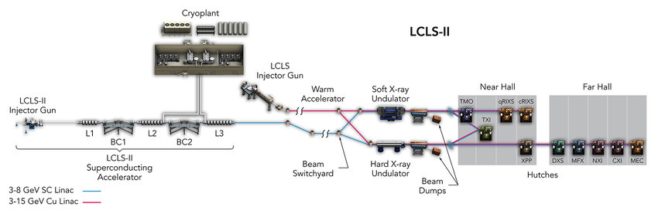
Attosecond mode (XLEAP) at LCLS-II
120 Hz
Designed for 1 MHz
X-ray Laser Enhanced Attosecond Pulse generation
Produce attosecond x-ray pulses
Tunable photon energy (200 eV – 1 keV soft x-rays, 7 keV – 15 keV hard x-rays)
Currently under upgrade: LCLS-II HE, 8 GeV beam energy
Notes:
I will start by briefly introducing our attosecond mode from our x-ray free electron laser, the linac coherent light source, or LCLS at SLAC. At LCLS, we have two beamlines. The first one is the normal conducting copper beamline that has been in operation since 2009. It operates at 120 Hz and currently delivers to the hard x-ray undulators, which sends the x-rays to the far experimental hall. LCLS-II is the superconducting upgrade to LCLS, it is designed to operate at 1 MHz and delivers to the soft x-ray line for the near experimental hall. My talk will focus on the data from LCLS-II.
Our attosecond mode is called XLEAP, which stands for x-ray laser enhanced attosecond pulse generation. In this mode, we can produce attosecond x-rays with tunable photon energy, between 200 eV to 1 keV on the soft x-ray line and between 7 keV to 15 keV on the hard line. Currently LCLS-II is undergoing an upgrade to reach a higher beam energy, currently we operate at 4 GeV, the upgrade will bring us to 8 GeV, which will allow us to reach the harder x-ray energies.

Slide 5
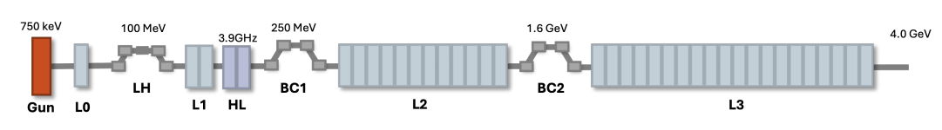
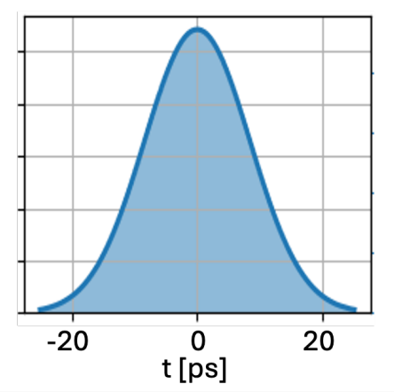
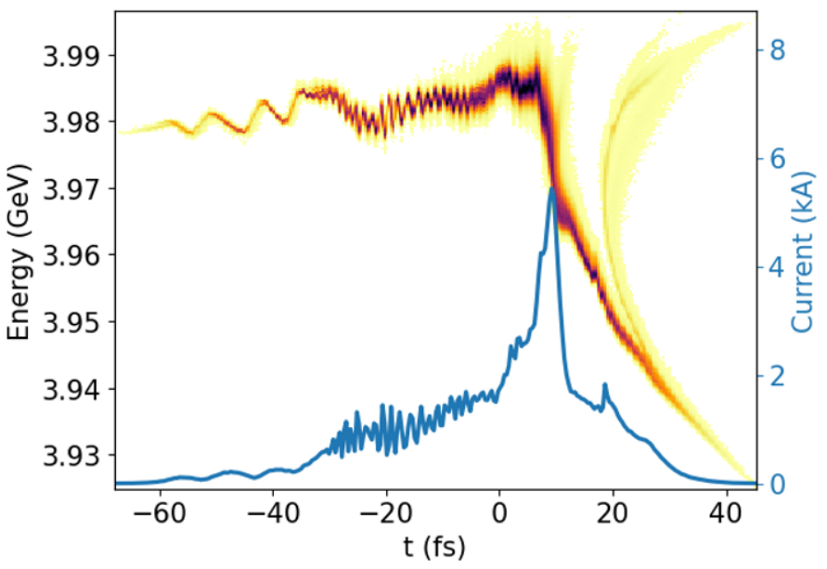
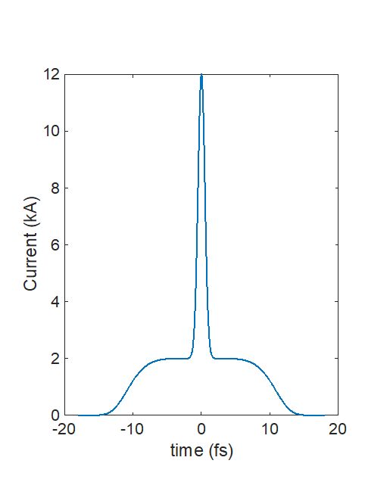
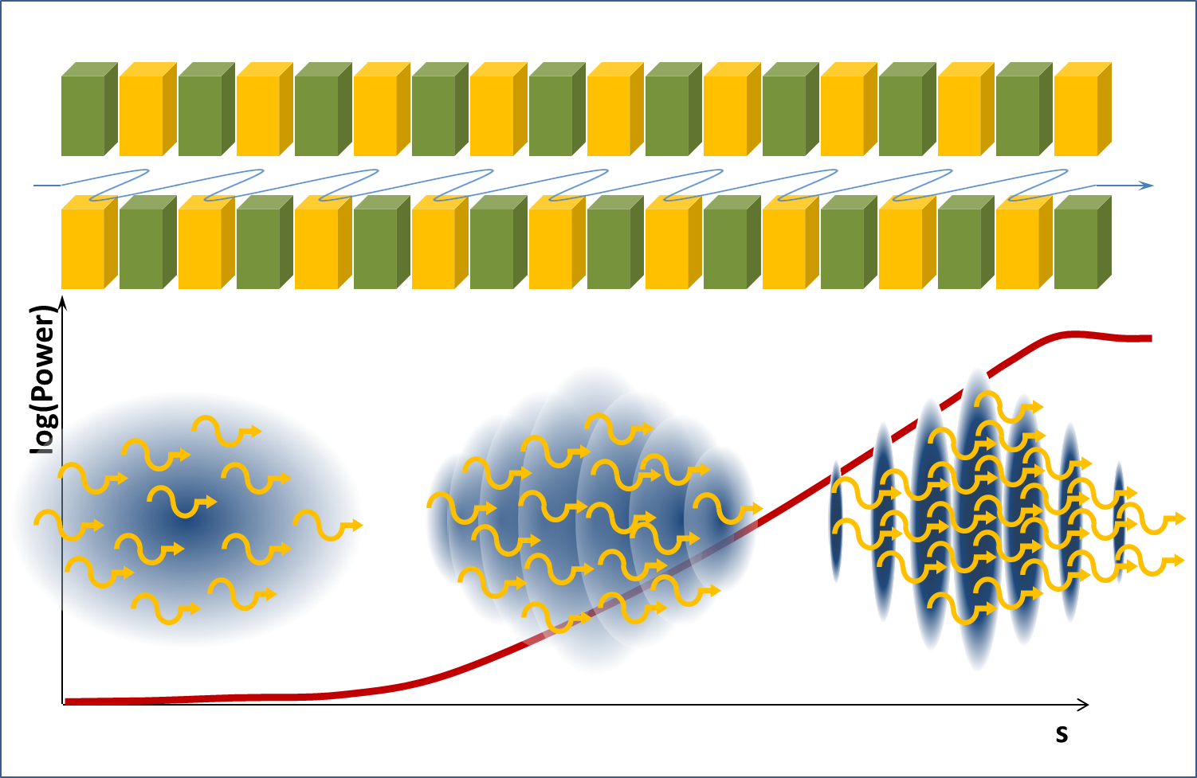
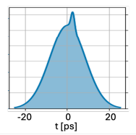
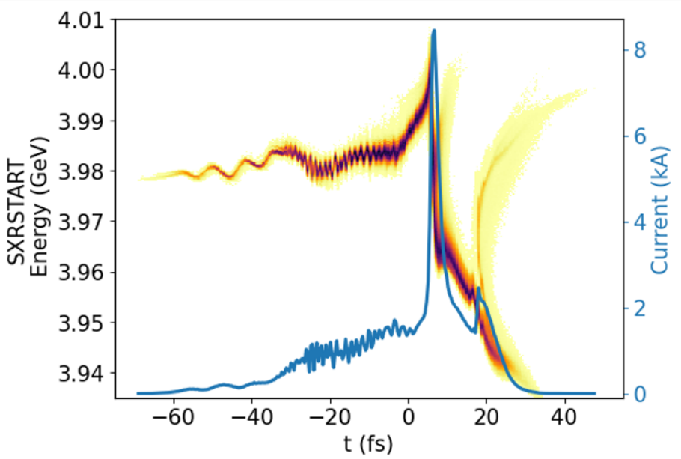
Enhanced self-amplified spontaneous emission (ESASE)
Cathode laser distribution
Beginning of undulator
Gain suppressed outside spike
Shorter gain length -> shorter pulses
Nominal
ESASE
Incoherent
Radiation
Coherent
Radiation
P. Franz
Notes:
How we generate XLEAP attosecond pulses is using a method called enhanced self-amplified spontaneous emission. In our normal SASE operation mode, a gaussian cathode laser distribution generates electron bunches out of the gun and forms a current spike down the line to be lased on. In ESASE, we have an additional R&D laser that we overlap with the injector laser to create this small density modulation in the electron beam. This small density modulation then turns into energy modulation and gets amplified down the beamline through drift and compression. Here I am showing the electron phase space of the two modes. As you can see here, the ESASE mode generates a much shorter, much higher current. Then, when the electron beam goes into the undulators, the high current spike will lase, and lasing will be mostly suppressed outside the current spike. Since gain length is proportional to cooperation length, shorter, higher current spike means shorter gain length, which means shorter pulses, and that is how we generate attosecond x-ray pulses.

Slide 6
Overview
Attosecond pulse generation at LCLS-II
Experimental method
Pulse reconstruction
Attosecond science experiment
Notes:
Now, I will talk a little bit about the experimental techniques for pulse characterization.

Slide 7
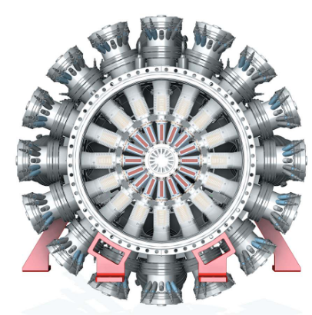
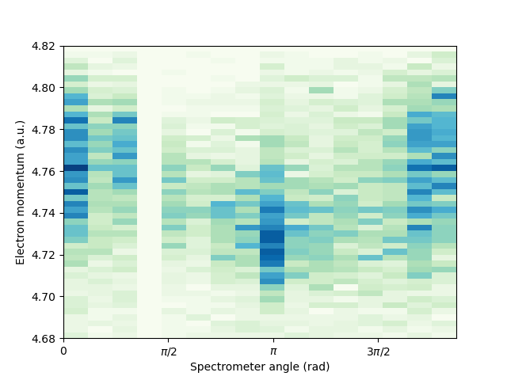

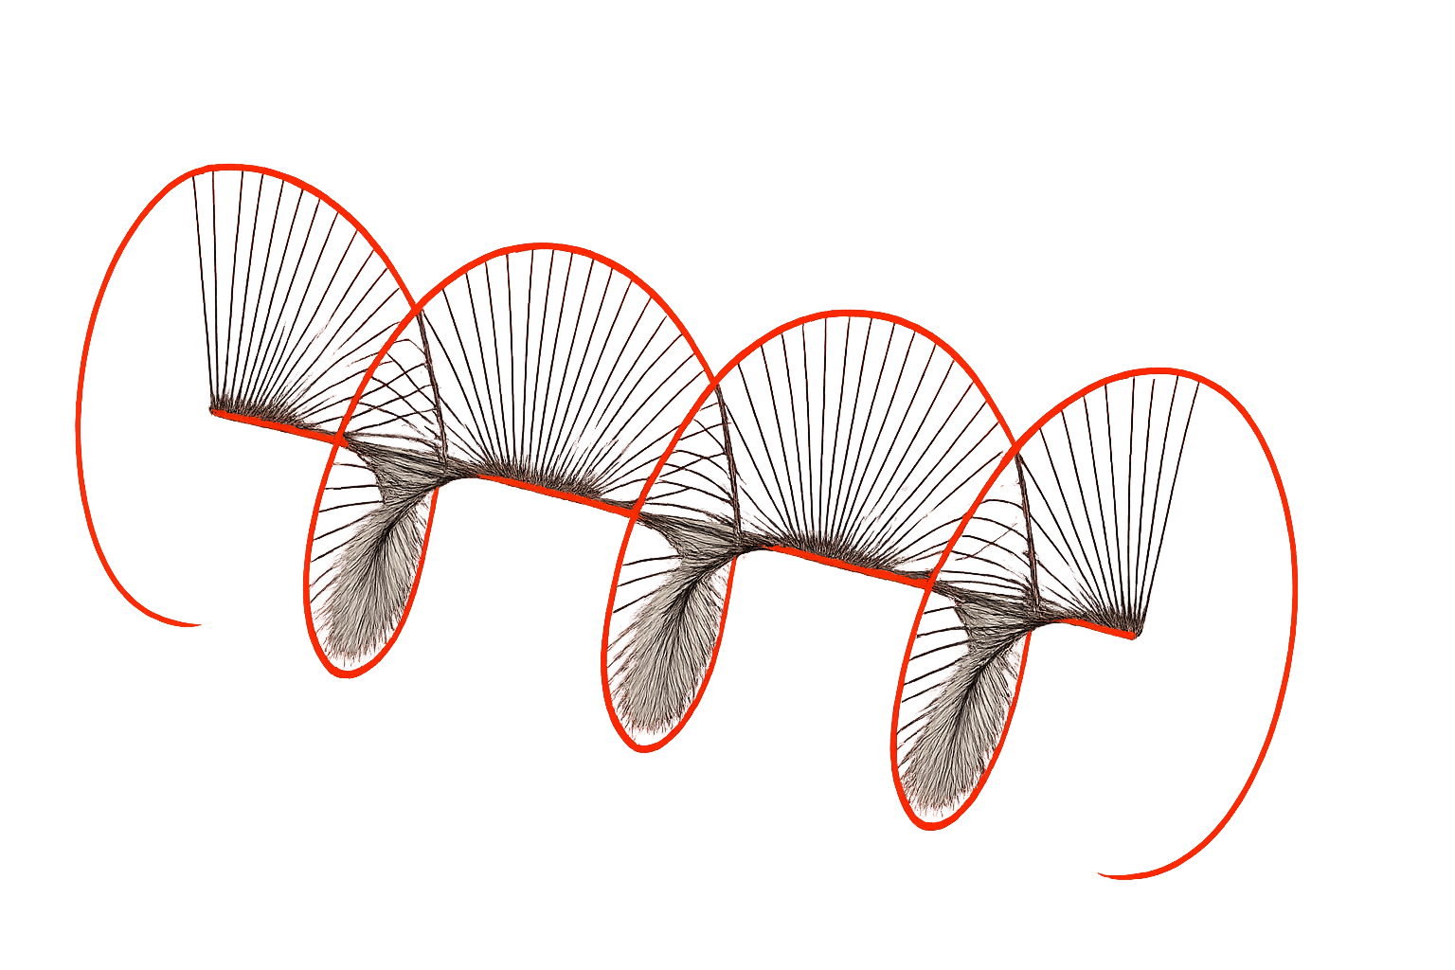
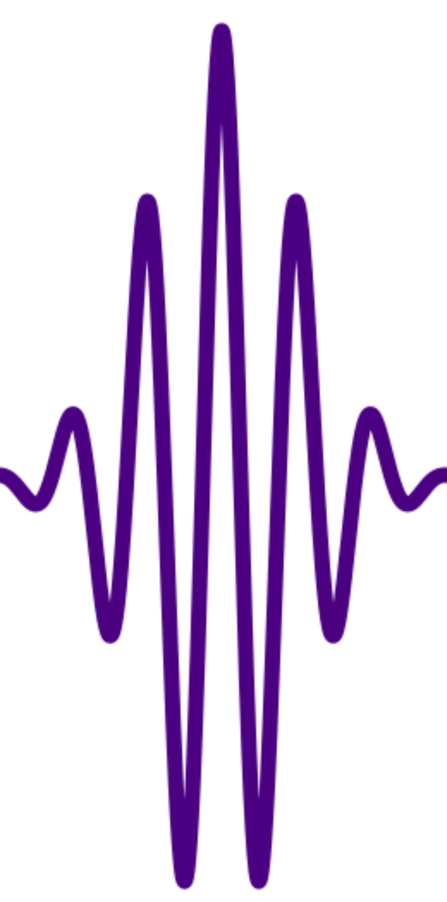
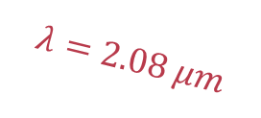
High-repetition angular streaking measurements
$$λ=2.08 μm$$
X-ray
IR
Animation by R. Robles
Notes:
To fully characterize our pulse, we need to perform time-domain analysis, but the duration of an x-ray pulse cannot be easily measured directly. Therefore, we characterize the time domain profile of our X-ray pulses by performing angular streaking measurements with an electron spectrometer instrument, which consists of 16 time of flight arrays of time of flight spectrometers arranged in a circle.
At the interaction point of this instrument, the x-ray ionizes a gas sample, then we use a circularly polarized IR laser timed with the x-ray to streak the photoelectrons.
On the right is an animation of electron density distribution from a phase scan of the x-ray arrival time with respect to the laser.

Slide 8
Full experimental setup
Notes:
Then the full experimental setup for time domain measurement of our high rep rate attosecond pulses basically puts together the previous two techniques, we have at the beginning of the beamline the laser cathode modulation setup, with a short UV shaping laser pulse overlapping the normal photocathode UV laser to create the slight modulation in the electron beam, that then gets amplified down the beamline into this high current spike that we can see in this recorded XTCAV image showing the electron beam phase space. Then the beam continues down to the undulator to laser a short attosecond X-ray pulse, that then gets overlapped with a circularly polarized laser as we talked about and ionizes a gas sample in the electron spectrometer called the MRCO. We record the photoelectron distribution, an example data image is shown here, and then we record the X-ray spectral intensity as well with a Fresnel zone plate spectrometer.

Slide 9
Overview
Attosecond pulse generation at LCLS-II
Experimental method
Pulse reconstruction
Attosecond science experiment
Notes:
Now I will talk a bit about our pulse reconstruction analysis on the data

Slide 10
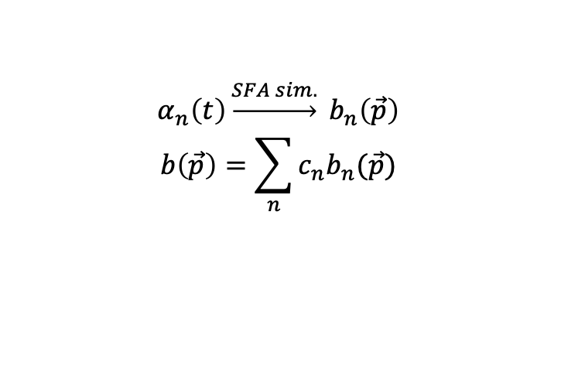
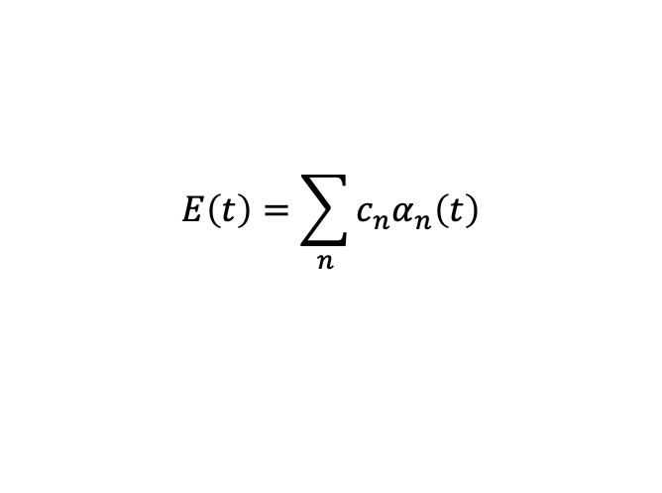
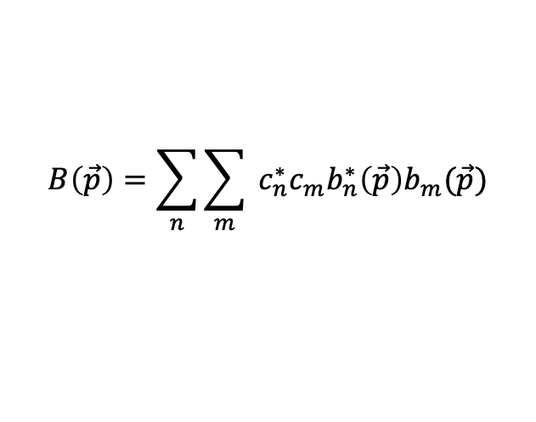
Example reconstruction of simulated chirped Gaussian pulse
$α_{n}\left(t\right)\underset{→}{SFA sim.} b_{n}\left(\vec{p}\right)$
$$b\left(\vec{p}\right)=\sum_{n}{c_{n}b_{n}(\vec{p})}$$
$$E\left(t\right)=\sum_{n}{c_{n}α_{n}\left(t\right)}$$
$$B\left(\vec{p}\right)=\sum_{n}{\sum_{m}{ c_{n}^{∗}c_{m}b_{n}^{∗}\left(\vec{p}\right)b_{m}(\vec{p})}}$$
Strong-Field Approximation (SFA) simulation
Raw data
Reconstruction
Reconstructed time-domain profile
Reconstructed spectral profile
Notes:
Once we record angular streaking data, we use that to perform reconstruction to recover to time-domain pulse profile. How we perform this reconstruction is with a gradient descent optimizer combined with a basis set. How it works is we first select a basis set that describes the space of isolated attosecond pulses. The choice of basis is flexible. We use orthogonal sinc functions based on the nyquist shannon sampling theorem.
Once we have a basis, we can perform strong field approximation, or SFA simulations to obtain the electron momentum probability distribution bns.
Then the probability amplitude for finding an electron with momentum p can be expanded into a linear combination of the same coefficients.
The measured angular streaking intensity is just the square of the probability distribution, shown here as the capital B(p) formula, and the reconstruction problem is reduced to finding the coefficient cns.
Using a gradient descent optimizer, we can then search for the optimal coefficients for the basis based on the recorded streaking image and x-ray spectral intensity.
Here, at the bottom I am showing a single shot representative reconstruction from our data: panel (b) shows the simulated momentum distribution that best matches the data in panel (a) and panels (c) and (d) show the temporal and spectral domain profile of the X-ray pulse.
**In SFA, we calculate the amplitude for an electron to be ionized and end up with final momentum p. Since ionization can happen at any time, we integrate over all possible ionization times, each weighted by a quantum phase (the action). After ionization we assume the electron only feels the laser field, not the ion, so its final momentum is tied to the vector potential A(t) at the moment it's born. For circular polarization, A(t) rotates in time, so the emission angle tells us when the electron was ionized—that's the streaking clock. The simulation loops over final momenta, evaluates this integral (often via saddle-point), and squares the amplitude to get the measurable momentum distribution.

Slide 11
Pulse statistics at 8 kHz and 400 eV
Median pulse duration: 516 as FWHM, median bandwidth: 3.69 eV FWHM, median pulse energy: 22.8 μJ
Time-bandwidth product median: 1.97 eV-fs, KDE density peaks at 1.80 eV-fs (matches Gaussian)
Notes:
With the reconstruction method, we can obtain pulse statistics in this operation mode at high rep rate.
For every individual FEL shot, the algorithm is randomly seeded with different initial conditions to test the convergence, and only converged reconstructions are used in our analysis. The green curves in Fig. 3 (a) and (b)
show the reconstruction for different initial seeds, and the black-dashed curve shows the most probable reconstruction in both the temporal- and spectral-profile. Fig. 3 (c) and (d) show the measured distribution of
pulse duration vs. spectral bandwidth (panel (c)) and pulse duration vs. pulse energy (panel (d)).
The data show a median pulse duration of 516 as full-width half max, with a median bandwidth of 3.69 eV and a median pulse energy of 22.8 μJ at a photon energy of 400 eV. The peak of the distribution corresponds to a Gaussian pulse with a 1.80 eV·fs time-bandwidth product and has a median of 1.97 eV·fs (shown as a red-dashed curve). Panel (d) shows that there is no correlation (Spearman coefficient ρ = −0.008) between pulse duration and pulse energy. This is similar performance to what was reported using the normal conducting accelerator at the LCLS facility, but now the repetition rate can be more than 100-times larger, enabling a wide-range of pump/probe experiments, or other nonlinear spectroscopic methods.

Slide 12
Overview
Attosecond pulse generation at LCLS-II
Experimental method
Pulse reconstruction
Attosecond science experiment
Notes:
To end, I will talk about the application of this source to attosecond science experiments

Slide 13
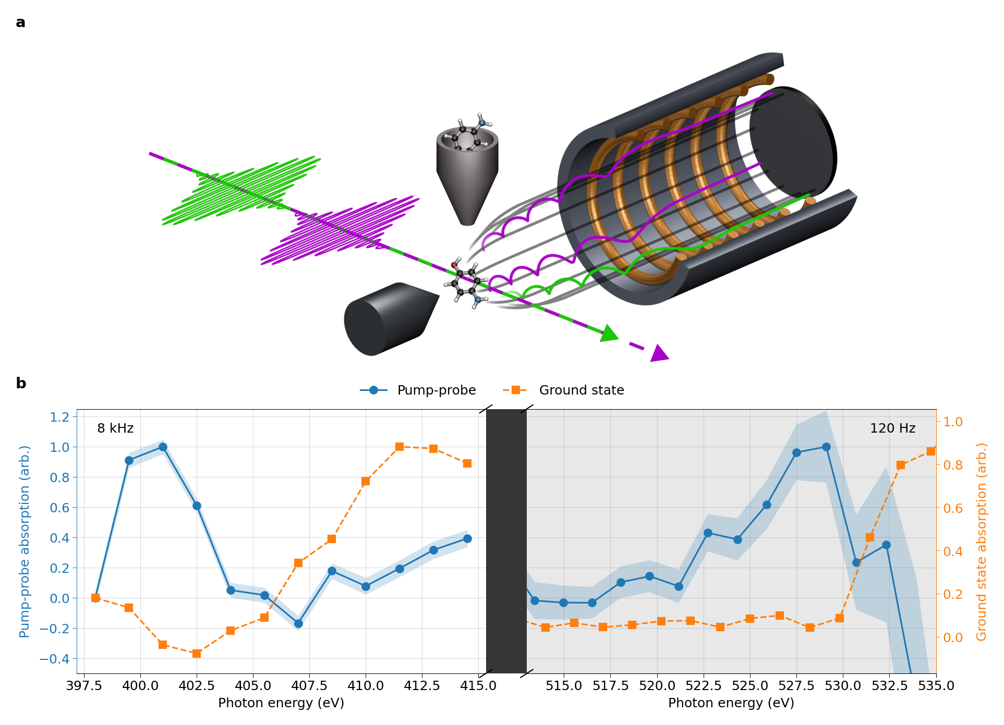
Demonstration of attosecond X-ray pump-probe
Ultrafast electronic transient induced by ionization of para-aminophenol
200 eV attosecond pump, 400 eV attosecond probe
Improvement of two orders of magnitude in data acquisition time for attosecond science experiments
  enables multidimensional nonlinear X-ray spectroscopy
  improves attosecond science experiment feasibility
5 minutes
6 hours
Analysis by E. Isele
Notes:
As a demonstration of the applicability of this source to pump-probe experiments, we performed an attosecond X-ray pump/attosecond X-ray probe experiment. The experiment considered the ultrafast electronic transient
induced by ionization of para-aminophenol (pAp, OH-C6H4-NH2).We generated a 200 eV pump pulse and a 400 eV attosecond probe pulse using the harmonic split-undulator technique, which produces two attosecond X-ray pulses separated by a delay that can be controlled with an accuracy of hundreds of attoseconds.
On the top right we see the experimental schematic. The green and magenta pulses are our two attosecond X-ray pulses—the pump and the probe—separated by a controllable delay. They're focused onto the para-aminophenol molecules at the interaction point. The ejected electrons are collected by the magnetic bottle spectrometer—that's the coil structure on the right—which guides them down the flight tube so we can measure their energies and extract the absorption spectra.
On the bottom right is the actual measurement. We show two absorption edges side by side: the nitrogen K-edge on the left, taken with our new source at 8 kHz, and the oxygen K-edge on the right, taken at 120 Hz.
The orange curve is the ground-state absorption—the molecule before anything happens. The blue curve is the pump-probe signal, after the pump has ionized the molecule, with the shaded band showing our uncertainty.
The key thing to look at is the blue peak that appears where the orange ground state is flat. This is our transient feature—a new core-to-valence transition that only opens up because the pump removed a valence electron, creating a hole the core electron can now transition into. So this peak is a direct fingerprint of the ionization dynamics.
The pump/probe data on the left for Nitrogen was collected over 5 minutes at 8 kHz. The previous measurement on the right was performed with the same molecule at the oxygen K-edge, where we collected data over the course of 6 hours to achieve comparable signal-to-noise for a single pump/probe delay. This shows that with our new source, we are able to achieve comparable signal-to-noise with a reduction of 2 orders of magnitude in the acquisition time, demonstrating that we have achieved similar peak intensity at the interaction point to our previous work, but with much higher repetition rate. This will enable data to be collected with much higher dimensionality.
**The nominal pump/probe delay in this measurement was 0.88 fs.
The orange line shows the absorption of the ground state molecule below the nitrogen K-edge, measured using the 400 eV probe pulse only. The blue line shows the transient X-ray absorption spectrum of the molecule when the pump pulse is used to excite the molecule. We assign the transient feature to a core-to-valence transition that is opened up due to valence ionization by the pump pulse.

Slide 14




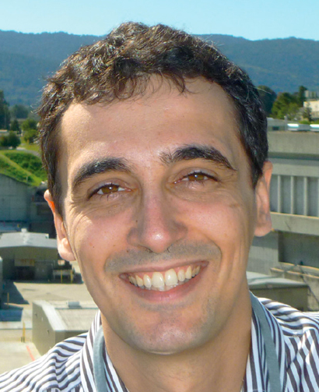
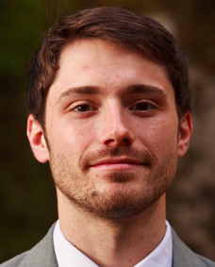








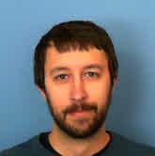
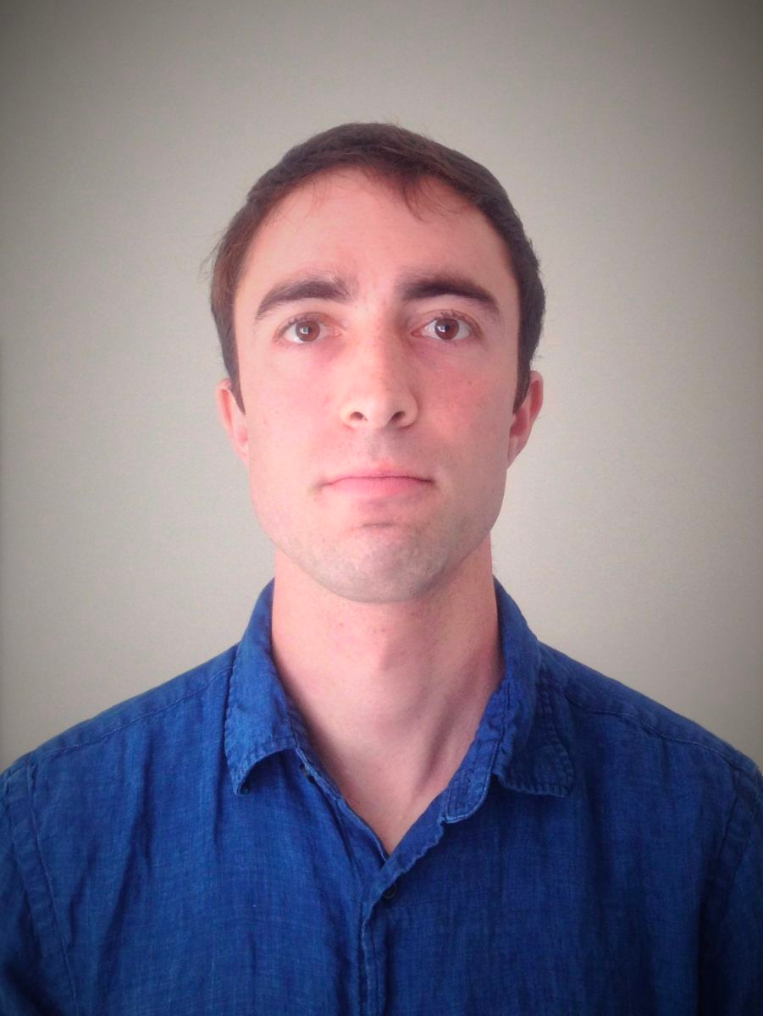
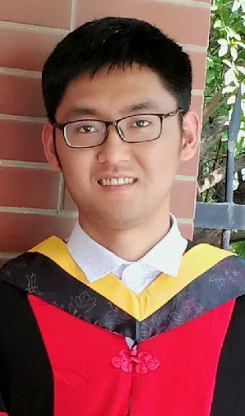
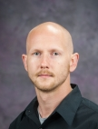











Attosecond Science Group @ PULSE
Stanford Graduate Students
Collaborations
Principal Investigators
E. Thierstein
Applied Physics
V. Guo
Applied
Physics
J. Walters
Chemistry
J. Ohara
Applied Physics
A. Marinelli
J. Cryan
SLAC Staff/Postdocs (SLAC/Stanford)
S. Beauvarlet
J. Wang
T. Driver
P. Bucksbaum
N. Sudar
D. Cesar
Z. Zhang
K. Borne
F. Vismarra
E. Isele
R. Robles
- Accelerator and detector research program Field Work Proposal 100317;
- Chemical Sciences, Geosciences, and Biosciences Division, FWP SCW0063;
- Use of the Linac Coherent Light Source (LCLS), SLAC National Accelerator Laboratory, is supported by the U.S. Department of Energy, Office of Science, Office of Basic Energy Sciences under Contract No. DE-AC02-76SF00515.
Z. Guo
P. Franz
Notes:
Finally, I would like to thank the collaborators from the attosecond science group at SLAC, and thank you all for your attention.

Slide 15
Backup slides

Slide 16
Reconstruction workflow

Slide 17
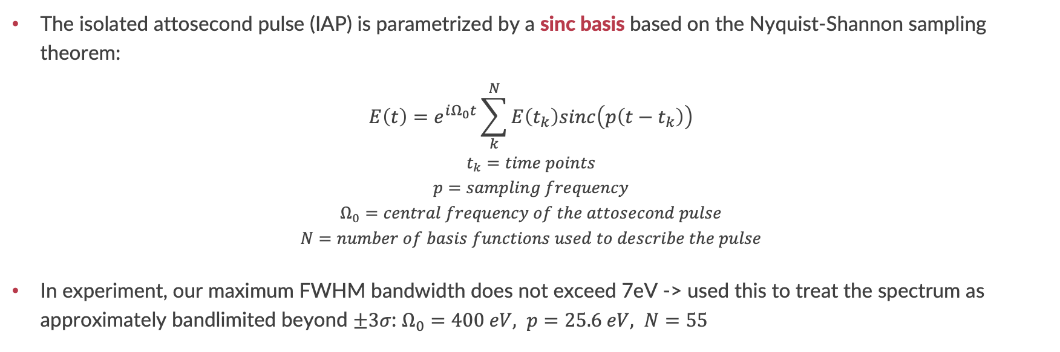
Basis representation of IAPs
The isolated attosecond pulse (IAP) is parametrized by a sinc basis based on the Nyquist-Shannon sampling theorem:
$$E\left(t\right)=e^{iΩ_{0}t}\sum_{k}^{N}{E\left(t_{k}\right)sinc\left(p\left(t−t_{k}\right)\right)}$$
$$t_{k}=time points$$
$$p=sampling frequency$$
$$Ω_{0}=central frequency of the attosecond pulse$$
$$N=number of basis functions used to describe the pulse$$
In experiment, our maximum FWHM bandwidth does not exceed 7eV -> used this to treat the spectrum as approximately bandlimited beyond $±3σ$: $Ω_{0}=400 eV, p=25.6 eV, N=55$
Strong-Field Approximation (SFA) simulation

Slide 18
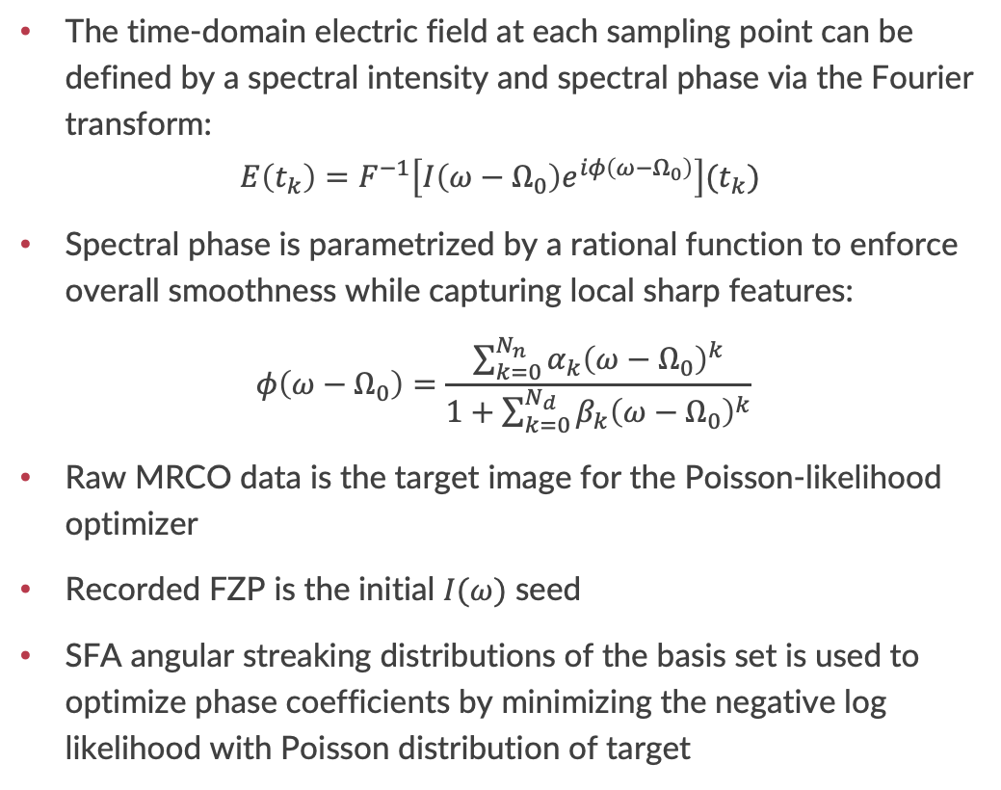
Optimization
The time-domain electric field at each sampling point can be defined by a spectral intensity and spectral phase via the Fourier transform:
$$E\left(t_{k}\right)=F^{−1}\left[I\left(ω−Ω_{0}\right)e^{iφ\left(ω−Ω_{0}\right)}\right](t_{k})$$
Spectral phase is parametrized by a rational function to enforce overall smoothness while capturing local sharp features:
$$φ\left(ω−Ω_{0}\right)=\frac{\sum_{k=0}^{N_{n}}{α_{k}{\left(ω−Ω_{0}\right)}^{k}}}{1+\sum_{k=0}^{N_{d}}{β_{k}{\left(ω−Ω_{0}\right)}^{k}}}$$
Raw MRCO data is the target image for the Poisson-likelihood optimizer
Recorded FZP is the initial $I(ω)$ seed
SFA angular streaking distributions of the basis set is used to optimize phase coefficients by minimizing the negative log likelihood with Poisson distribution of target

Slide 19
Clustering
Identify connected structure in the coefficient space -> seed convergence
Select lowest cost cluster as solution

Slide 20
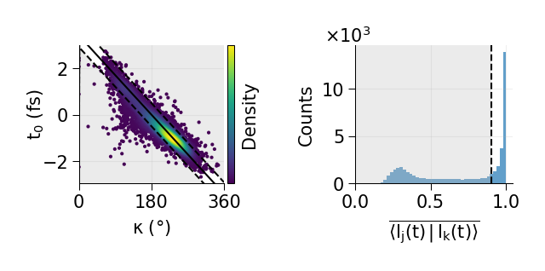
Filtering
Final filter on arrival time of the X-ray pulse and cluster convergence
Arrival time filter: compare streakfinder’s arrival time with reconstructed arrival time and filter out shots where the two results don’t match
Inner product filter: take the average overlap between the reconstructed time-domain intensity profiles in the selected cluster, filter out shots where the cluster has low overlap

Slide 21
Simulation: effect of Poisson sampling

Slide 22
Simulation: effect of discrete angles (number of ToFs)

Slide 23
Phase parametrization error

Slide 24
Effect of number of phase coefficients

Slide 25
Kneedle: defining cluster neighborhood parameter $ε$
Knee locating algorithm: using distance of the 10th nearest neighbor (10-NN) to define cluster width

Slide 26
Effect of inner product threshold

