Slide 1

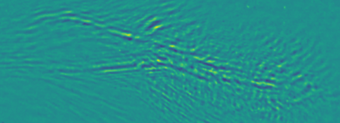
Diagnosing near-critical-density laser plasma interaction and ion acceleration using dynamic optical probing
N.P. Dover, O.E. Ettlinger, Z. Najmudin
John Adams Institute for Accelerator Science, Imperial College London, UK
M. Babzien, W. Li, M.N. Polyanskiy, I. Pogorelsky
Accelerator Test Facility, Brookhaven National Laboratory, USA

Slide 2
Diagnosing near critical density laser plasma interactions - tough to do in the lab
Most experiments with near critical density plasmas use near-IR laser drivers

Slide 3
Diagnosing near critical density laser plasma interactions - tough to do in the lab
Most experiments with near critical density plasmas use near-IR laser drivers
Time
Length
Density
Typical dynamical scales
~10 fs
~1 μm
>~10²¹ cm⁻³
Can we diagnose it?
Too quick
Too short
Too dense
☹️
☹️
☹️

Slide 4
Diagnosing near critical density laser plasma interactions - tough to do in the lab
Most experiments with near critical density plasmas use near-IR laser drivers
Time
Length
Density
Typical dynamical scales
~10 fs
~1 μm
>~10²¹ cm⁻³
Can we diagnose it?
Too quick
Too short
Too dense
☹️
☹️
☹️
Rely on simulations, many assumptions
Uncertainty over experimental parameters
Can only verify by looking at time integrated outputs e.g. generated particles / radiation

Slide 5
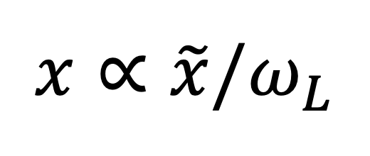
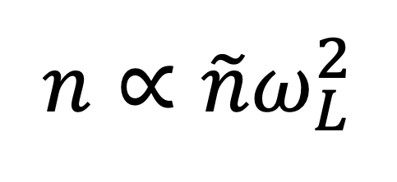
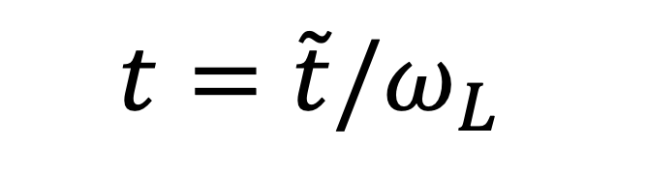
Exploiting dimensional scaling of collisionless laser-plasmas
Collisionless laser plasmas can be scaled using reference frequency*:
Time
Length
Density
$$t=\tilde{t}/ω_{L}$$
$x∝$ $\tilde{x}/ω_{L}$
$n$ $∝{\tilde{n}ω}_{L}^{2}$
near-IR
~10 fs
~1 μm
>~10²¹ cm⁻³
☹️
*if e.g. ionisation/QED not important

Slide 6

Exploiting dimensional scaling of collisionless laser-plasmas
Collisionless laser plasmas can be scaled using reference frequency*:
Time
Length
Density
$$t=\tilde{t}/ω_{L}$$
$x∝$ $\tilde{x}/ω_{L}$
$n$ $∝{\tilde{n}ω}_{L}^{2}$
near-IR
~10 fs
~1 μm
>~10²¹ cm⁻³
☹️
longwave-IR
~100 fs
~10 μm
>~10¹⁹ cm⁻³
😃
Resolvable
Resolvable
Ideal for optical probing
*if e.g. ionisation/QED not important

Slide 7
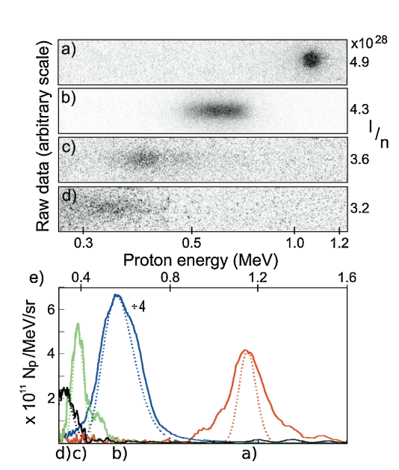
Collisionless shockwave acceleration with longwave-IR drives
BNL
Palmer+, Phys. Rev. Lett. 106, 014801 (2011)

Slide 8
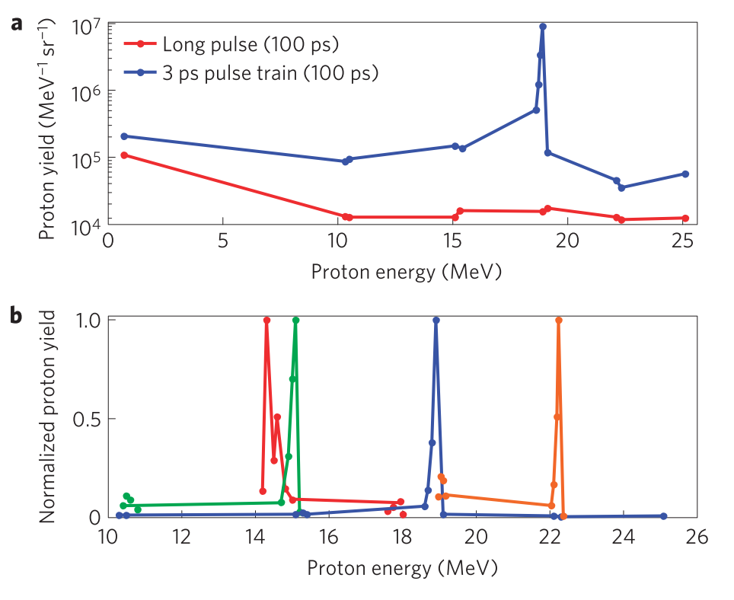
Collisionless shockwave acceleration with longwave-IR drives
BNL
UCLA
Haberberger+, Nat. Phys. 8, 95 (2012)
Palmer+, Phys. Rev. Lett. 106, 014801 (2011)

Slide 9
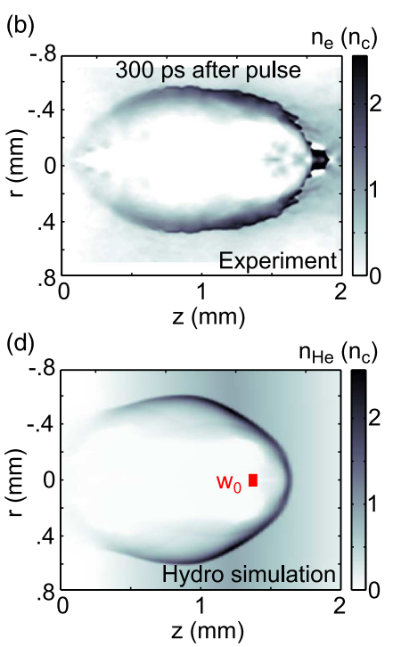
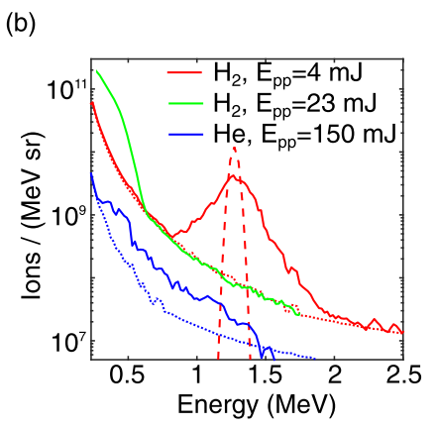
Collisionless shockwave acceleration with longwave-IR drives
BNL
UCLA
BNL
Haberberger+, Nat. Phys. 8, 95 (2012)
Tresca+, Phys. Rev. Lett. 115, 094802 (2015)
Palmer+, Phys. Rev. Lett. 106, 014801 (2011)

Slide 10
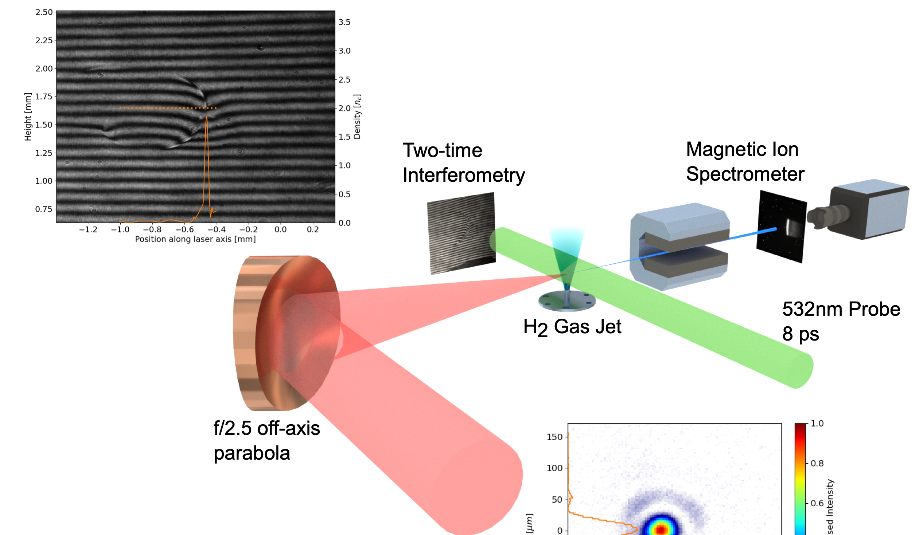
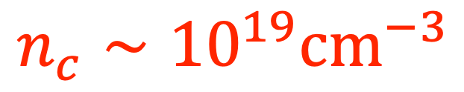
A facility enabling direct dynamic optical measurement of near-critical density plasmas
Polyanskiy+, OSA Continuum 3, 459 (2020)
Two time shadowgraphy & interferometry
High power CO2 drive laser:
t_{L} ~ 2 ps
λ_{L} ~ 9 μm
Beam profiler
$$n_{c}∼{10}^{19}{cm}^{−3}$$
Dover+, J. Plasma Phys. 82, 415820101 (2016)
Gas jet
Ti:Sapphire probe pulse
LWIR beam
λ_{L}~9.2 μm
τ_{L} ~ 2 ps
r_{L} ~ 65 μm
a₀ ~ 1.5

Slide 11
A facility enabling direct dynamic optical measurement of near-critical density plasmas
Polyanskiy+, OSA Continuum 3, 459 (2020)
Two time shadowgraphy & interferometry
High power CO2 drive laser:
t_{L} ~ 2 ps
λ_{L} ~ 9 μm
Nearly all high power lasers are in the near-IR -
but not all!
Beam profiler
$$n_{c}∼{10}^{19}{cm}^{−3}$$
Dover+, J. Plasma Phys. 82, 415820101 (2016)
Gas jet
Ti:Sapphire probe pulse
Equivalent NIR beam
LWIR beam
λ_{L}~0.8 μm
τ_{L} ~ 170 fs
r_{L} ~ 5.6 μm
a₀ ~ 1.5
λ_{L}~9.2 μm
τ_{L} ~ 2 ps
r_{L} ~ 65 μm
a₀ ~ 1.5

Slide 12
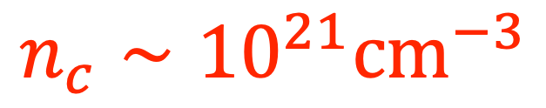
A facility enabling direct dynamic optical measurement of near-critical density plasmas
Polyanskiy+, OSA Continuum 3, 459 (2020)
High power CO2 drive laser:
t_{L} ~ 2 ps
λ_{L} ~ 9 μm
Nearly all high power lasers are in the near-IR -
but not all!
Two time shadowgraphy & interferometry
$$n_{c}∼{10}^{19}{cm}^{−3}$$
Beam profiler
Dover+, J. Plasma Phys. 82, 415820101 (2016)
Optical probe:
Ti:Sapphire:
t_{L} ~ 100 fs
λ_{L} ~ 800 nm
Gas jet
Ti:Sapphire probe pulse
$$n_{c}∼{10}^{21}{cm}^{−3}$$
Equivalent NIR beam
LWIR beam
Optically probe near and over-critical LPI
Measure intrapulse dynamics
λ_{L}~0.8 μm
τ_{L} ~ 170 fs
r_{L} ~ 5.6 μm
a₀ ~ 1.5
λ_{L}~9.2 μm
τ_{L} ~ 2 ps
r_{L} ~ 65 μm
a₀ ~ 1.5

Slide 13
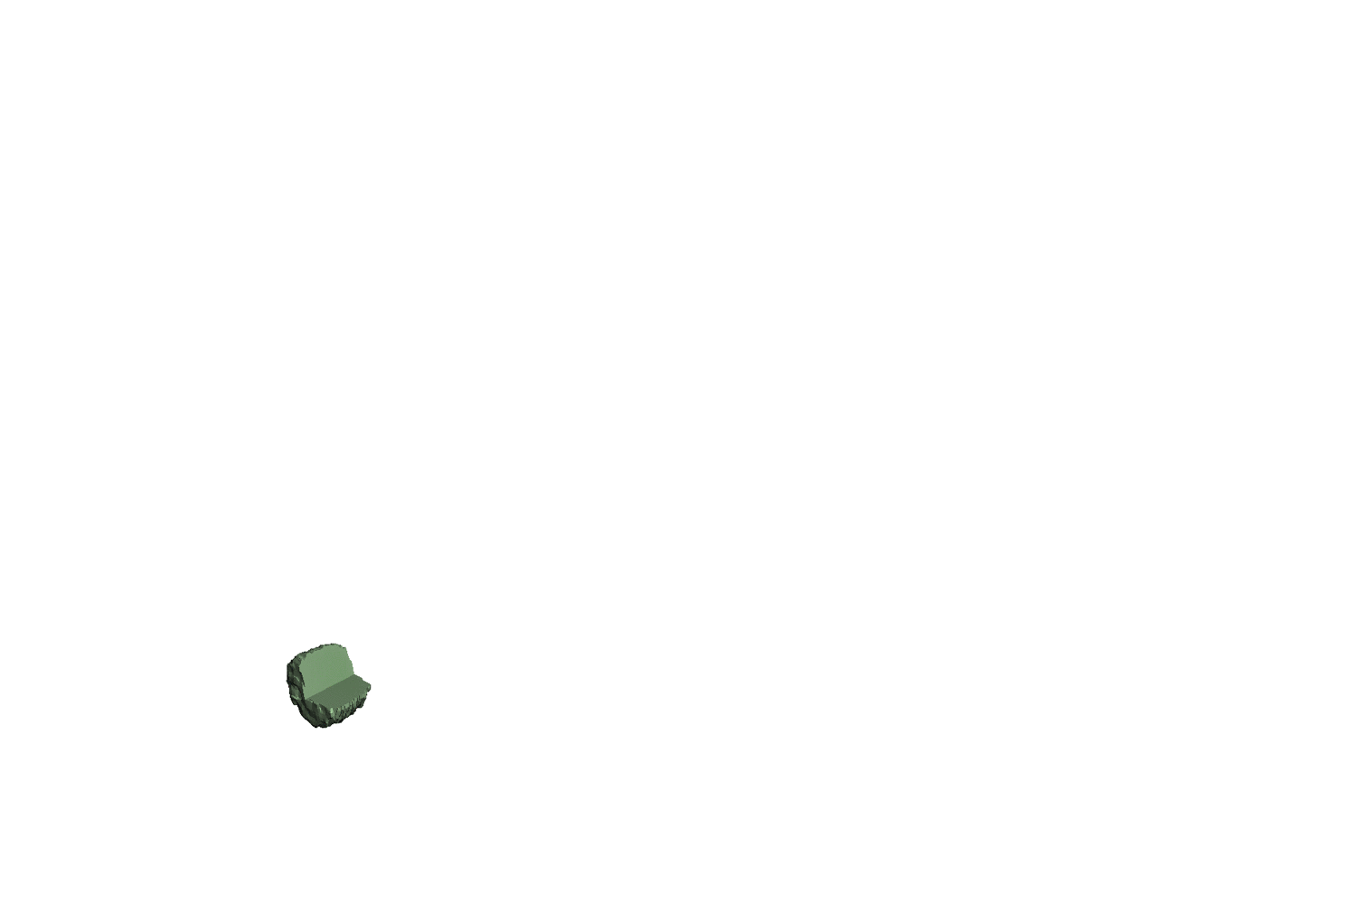
Plan to investigate channeling in near critical density plasma

Slide 14
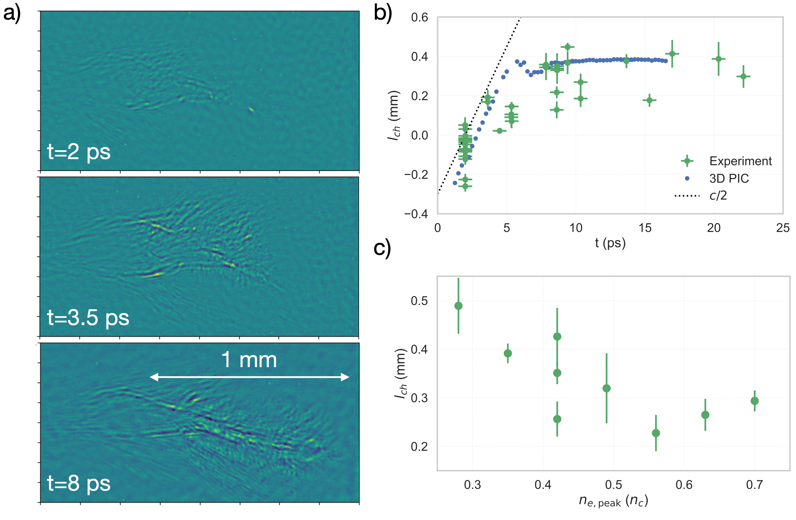
Development of channel in near-critical density plasma
ne = 0.5 nc

Slide 15
Development of channel in near-critical density plasma
ne = 0.5 nc

Slide 16
Development of channel in near-critical density plasma
ne = 0.5 nc

Slide 17
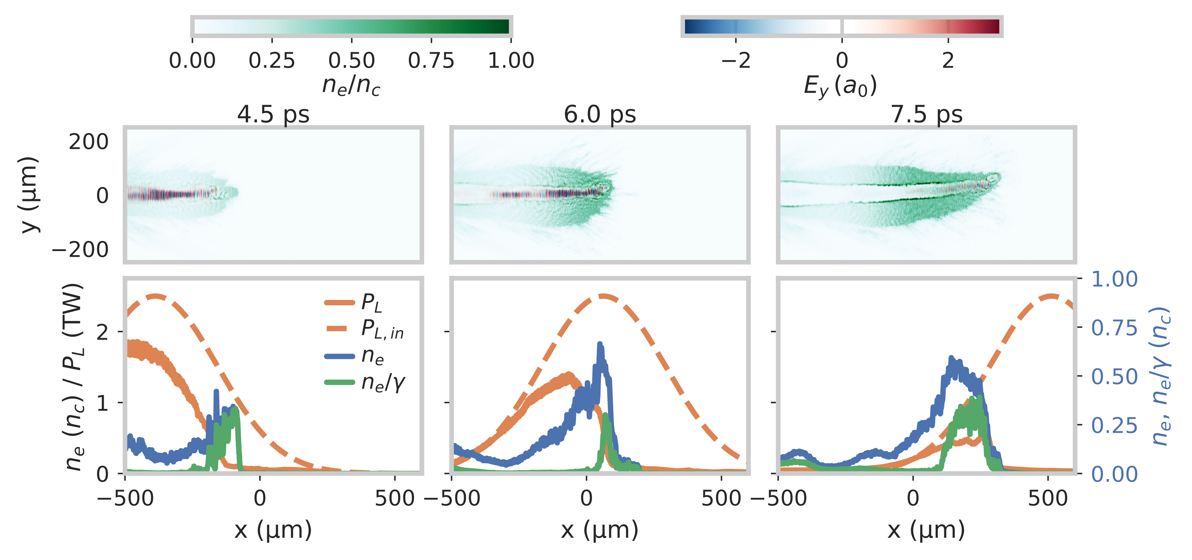
Depletion of laser in channel – etching from the front of the pulse

Slide 18
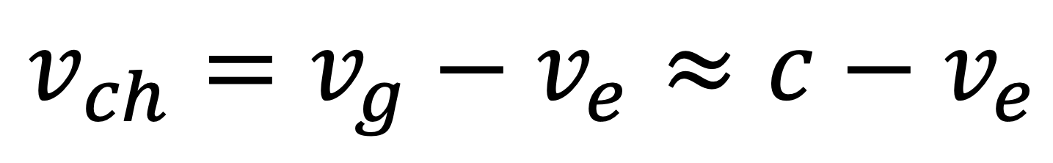
What determines the channeling propagation?
$$v_{ch}=v_{g}−v_{e}≈c−v_{e}$$
Local depletion
Laser
Downstream plasma
vg
ve

Slide 19
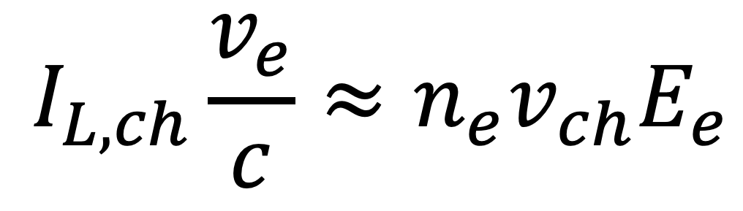
What determines the channeling propagation?
Robinson+ PPCF 53, 065019 (2011)
$$I_{L,ch}\frac{v_{e}}{c}≈n_{e}v_{ch}E_{e}$$
Average electron energy
$$v_{ch}=v_{g}−v_{e}≈c−v_{e}$$
Local depletion
Intensity in channel after self focusing
Laser
Downstream plasma
Equate loss of laser energy to gain in KE of plasma electrons in channel
vg
ve

Slide 20
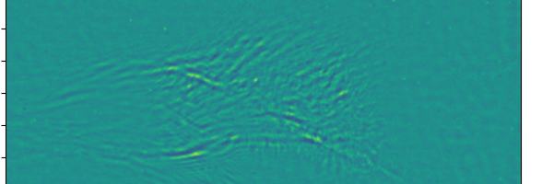
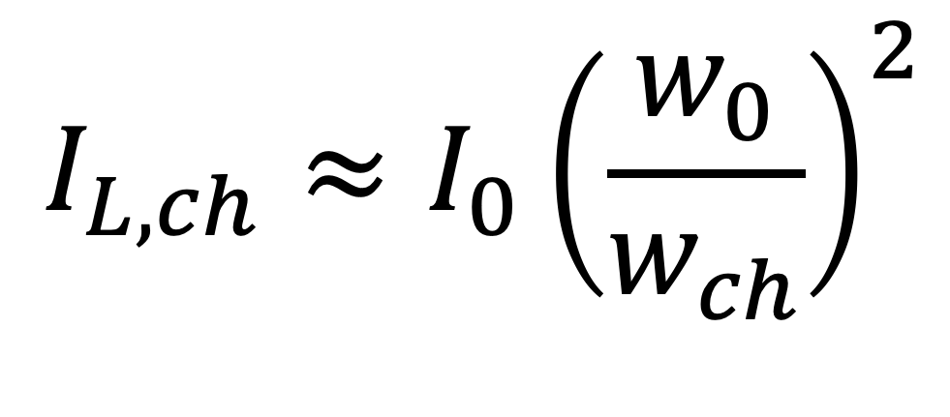


What determines the channeling propagation?
$$I_{L,ch}\frac{v_{e}}{c}≈n_{e}v_{ch}E_{e}$$
$$v_{ch}=v_{g}−v_{e}≈c−v_{e}$$
$$I_{L,ch}≈I_{0}{\left(\frac{w_{0}}{w_{ch}}\right)}^{2}$$
$$w_{0}≈65μm$$
$$w_{ch}≈40μm$$
We experimentally measure self focusing - implies intensity in channel

Slide 21
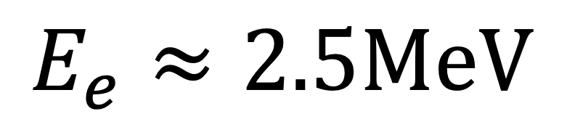
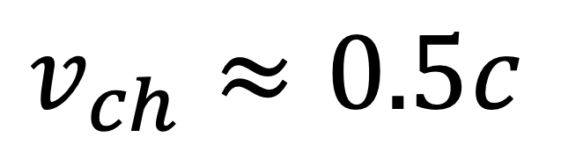

What determines the channeling propagation?
$$I_{L,ch}\frac{v_{e}}{c}≈n_{e}v_{ch}E_{e}$$
$$v_{ch}=v_{g}−v_{e}≈c−v_{e}$$
$$I_{L,ch}≈I_{0}{\left(\frac{w_{0}}{w_{ch}}\right)}^{2}$$
$$w_{0}≈65μm$$
$$w_{ch}≈40μm$$
$$w_{ch}≈40μm$$
$$E_{e}≈2.5MeV$$
$$v_{ch}≈0.5c$$
Significantly higher than ponderomotive scaling (Epond ~ 0.8 MeV)

Slide 22
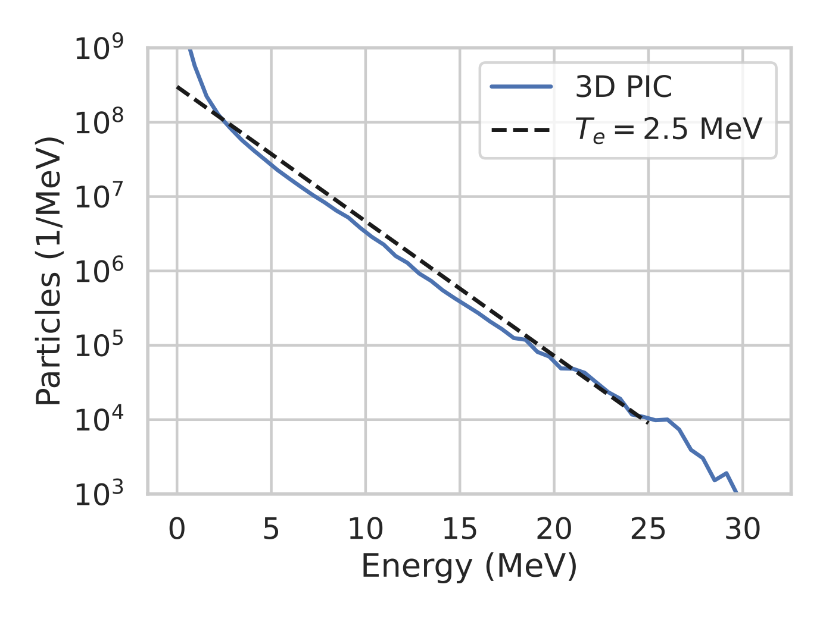
What determines the channeling propagation?
$$w_{ch}≈40μm$$
$$E_{e}≈2.5MeV$$
$$v_{ch}≈0.5c$$
Significantly higher than ponderomotive scaling (Epond ~ 0.8 MeV)

Slide 23
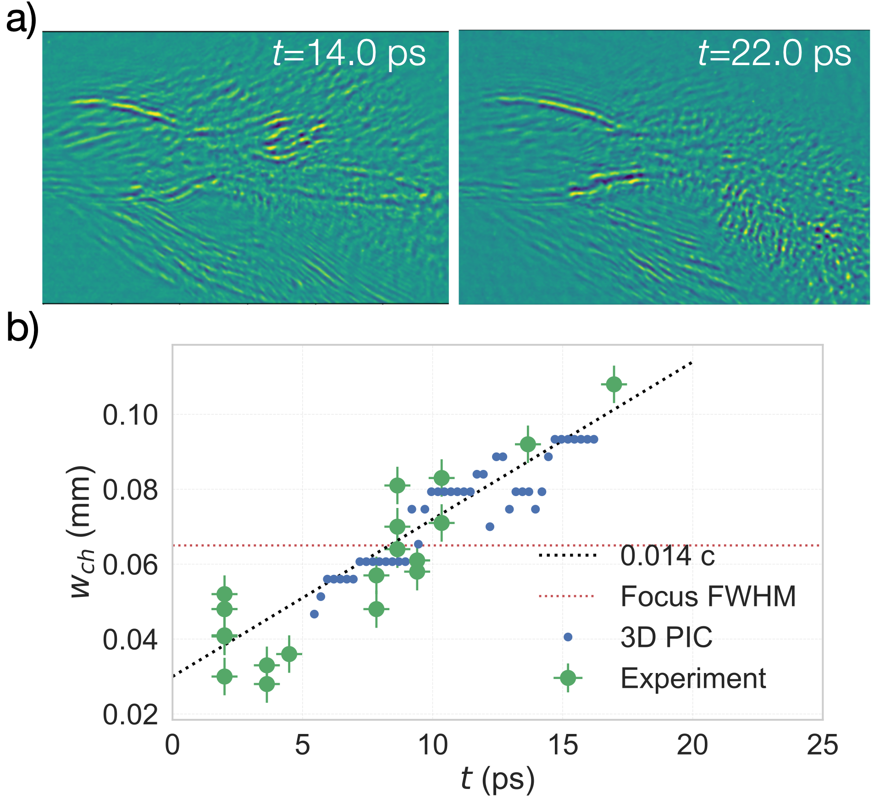
Evolution of the channel width
Channel expands transversely even after end of interaction
After ~20 ps, the channel structure starts to dissipate

Slide 24
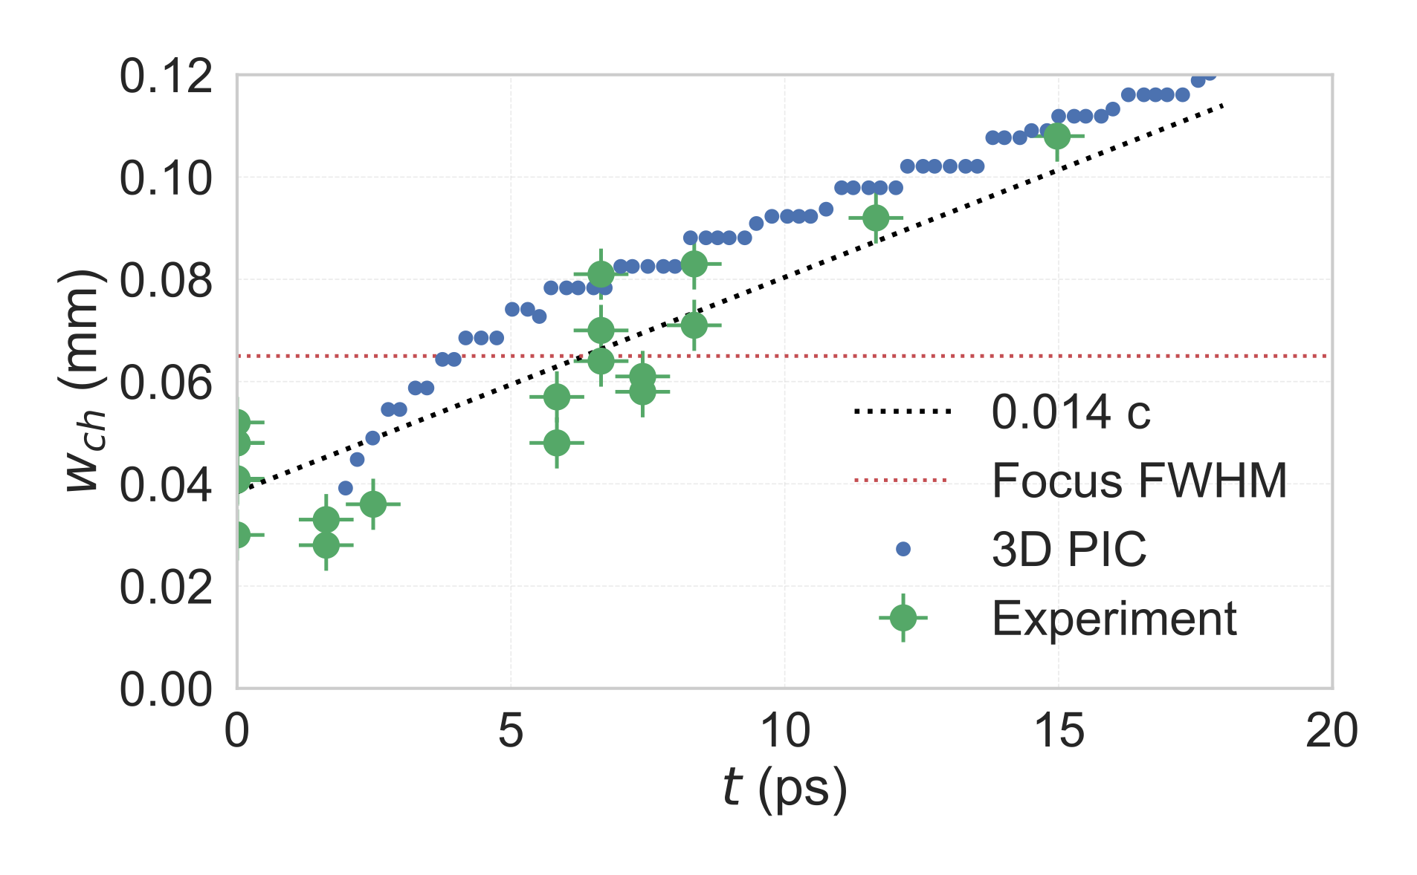
Evolution of the channel width
Channel expands transversely even after end of interaction
After ~20 ps, the channel structure starts to dissipate
Channel wall velocity approximately 0.07c

Slide 25
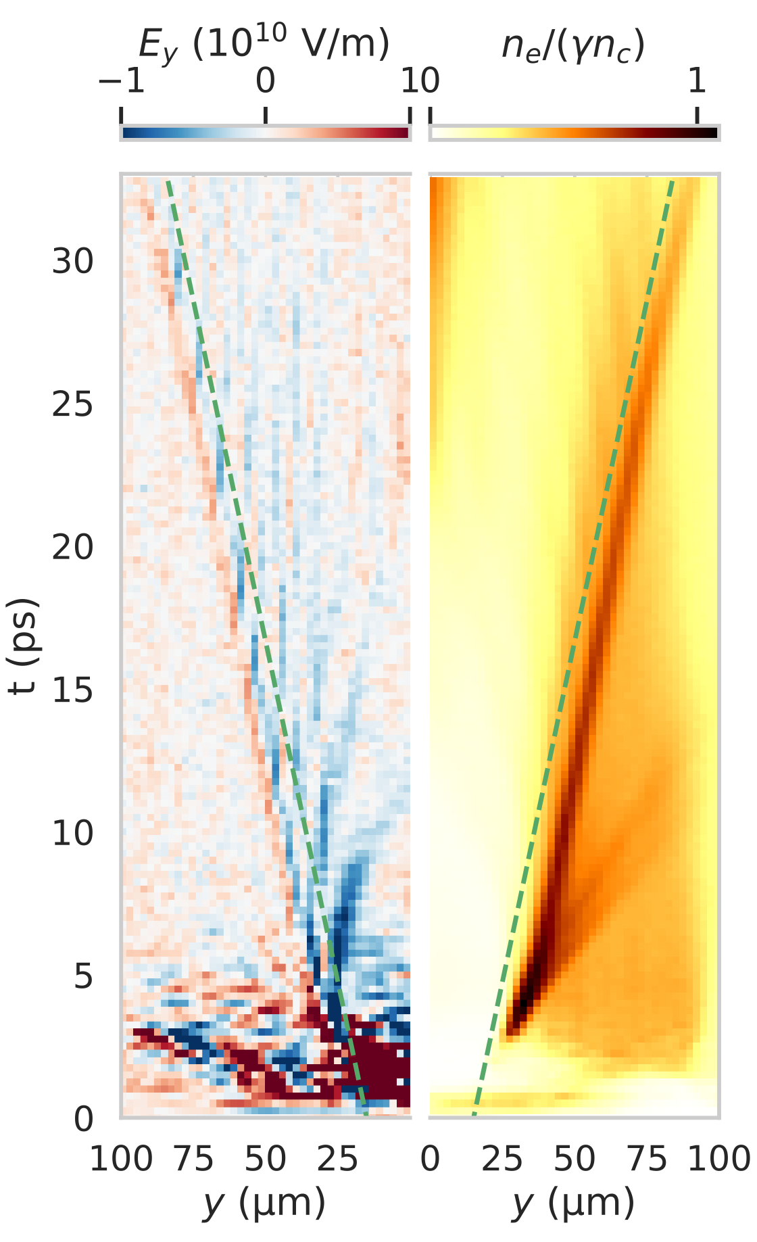
Transverse structure inferred to be collisionless shock, weakening to solitary wave

Slide 26
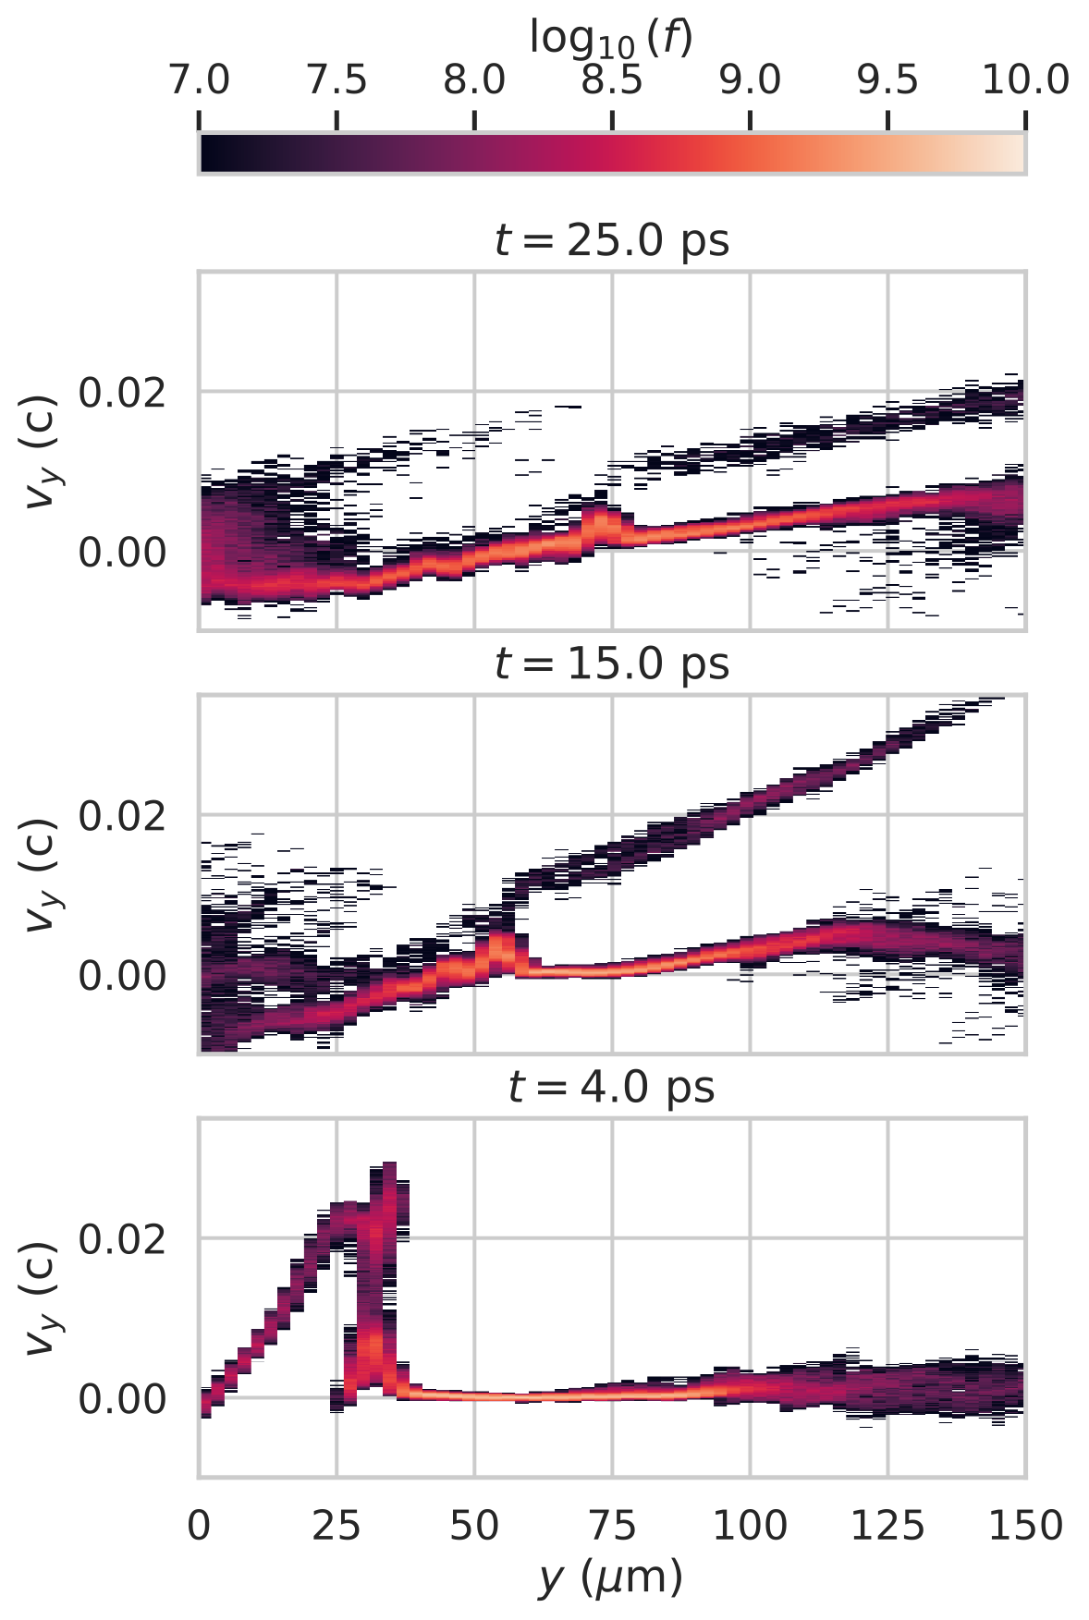
Transverse structure inferred to be collisionless shock, weakening to solitary wave
Early: Collisionless shockwave & acceleration from channel

Slide 27
Transverse structure inferred to be collisionless shock, weakening to solitary wave
Mid: Collisionless shock weakens to solitary wave (MS~1.2)
Early: Collisionless shockwave & acceleration from channel

Slide 28
Transverse structure inferred to be collisionless shock, weakening to solitary wave
Late: Strong gradients dissipate; channel fills in -> lower shadowgram visibility
Mid: Collisionless shock weakens to solitary wave (MS~1.2)
Early: Collisionless shockwave & acceleration from channel

Slide 29
Transverse structure inferred to be collisionless shock, weakening to solitary wave
See also eg: Wei+ PRL 93 (2004); Singh+ Sci. Rep. 10:18452 (2020)
Late: Strong gradients dissipate; channel fills in -> lower shadowgram visibility
Mid: Collisionless shock weakens to solitary wave (MS~1.2)
Early: Collisionless shockwave & acceleration from channel

Slide 30
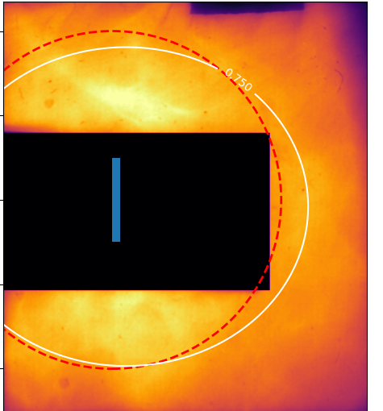
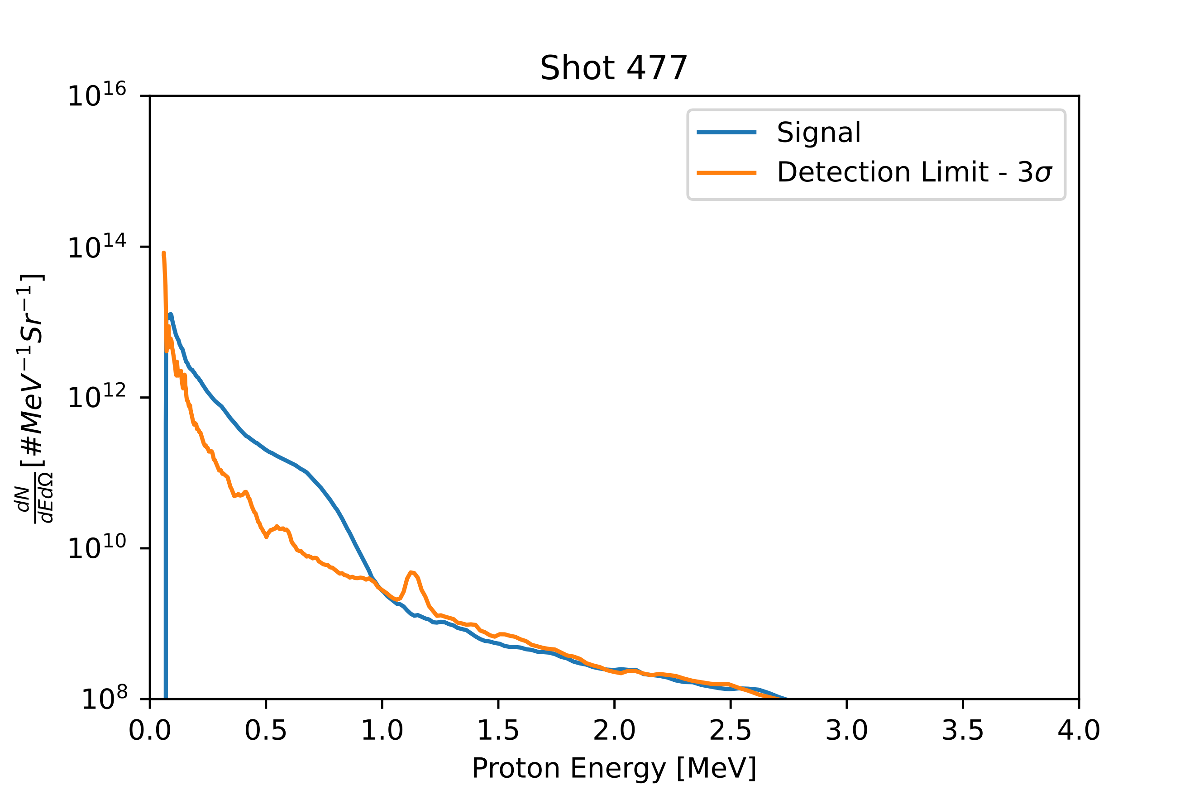
Forward going accelerated ions observed at the same time - despite no CSA / hole boring!
Proton beam spatial profile
Typical proton spectra
75% contour
Protons
10¹²
Background
Particles / MeV sr
10¹⁰
20º cone
10⁸
0
0.5
1
1.5
Energy (MeV)
Protons > 250 keV
Proton beams are:
    Highly divergent (>30º FWHM)
    Quasi-thermal
    Relatively low energy (max ~1 MeV)

Slide 31
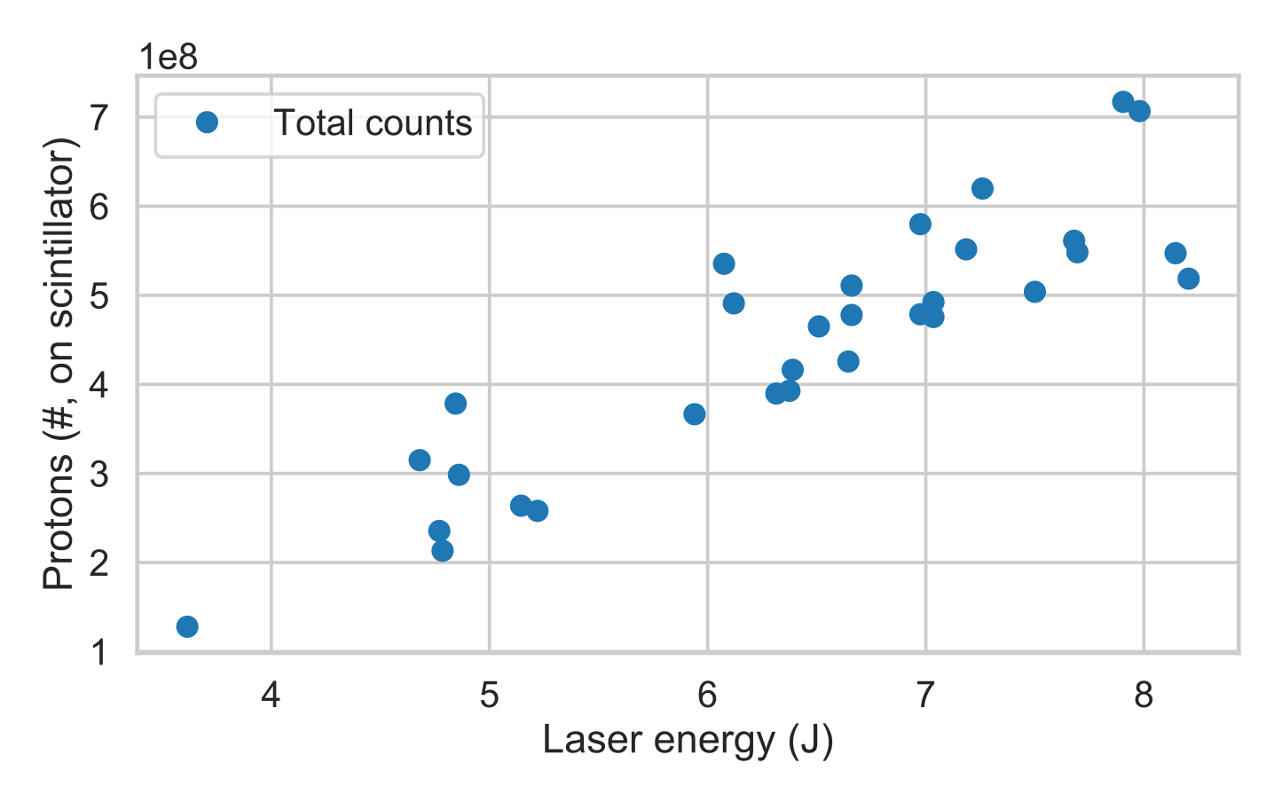
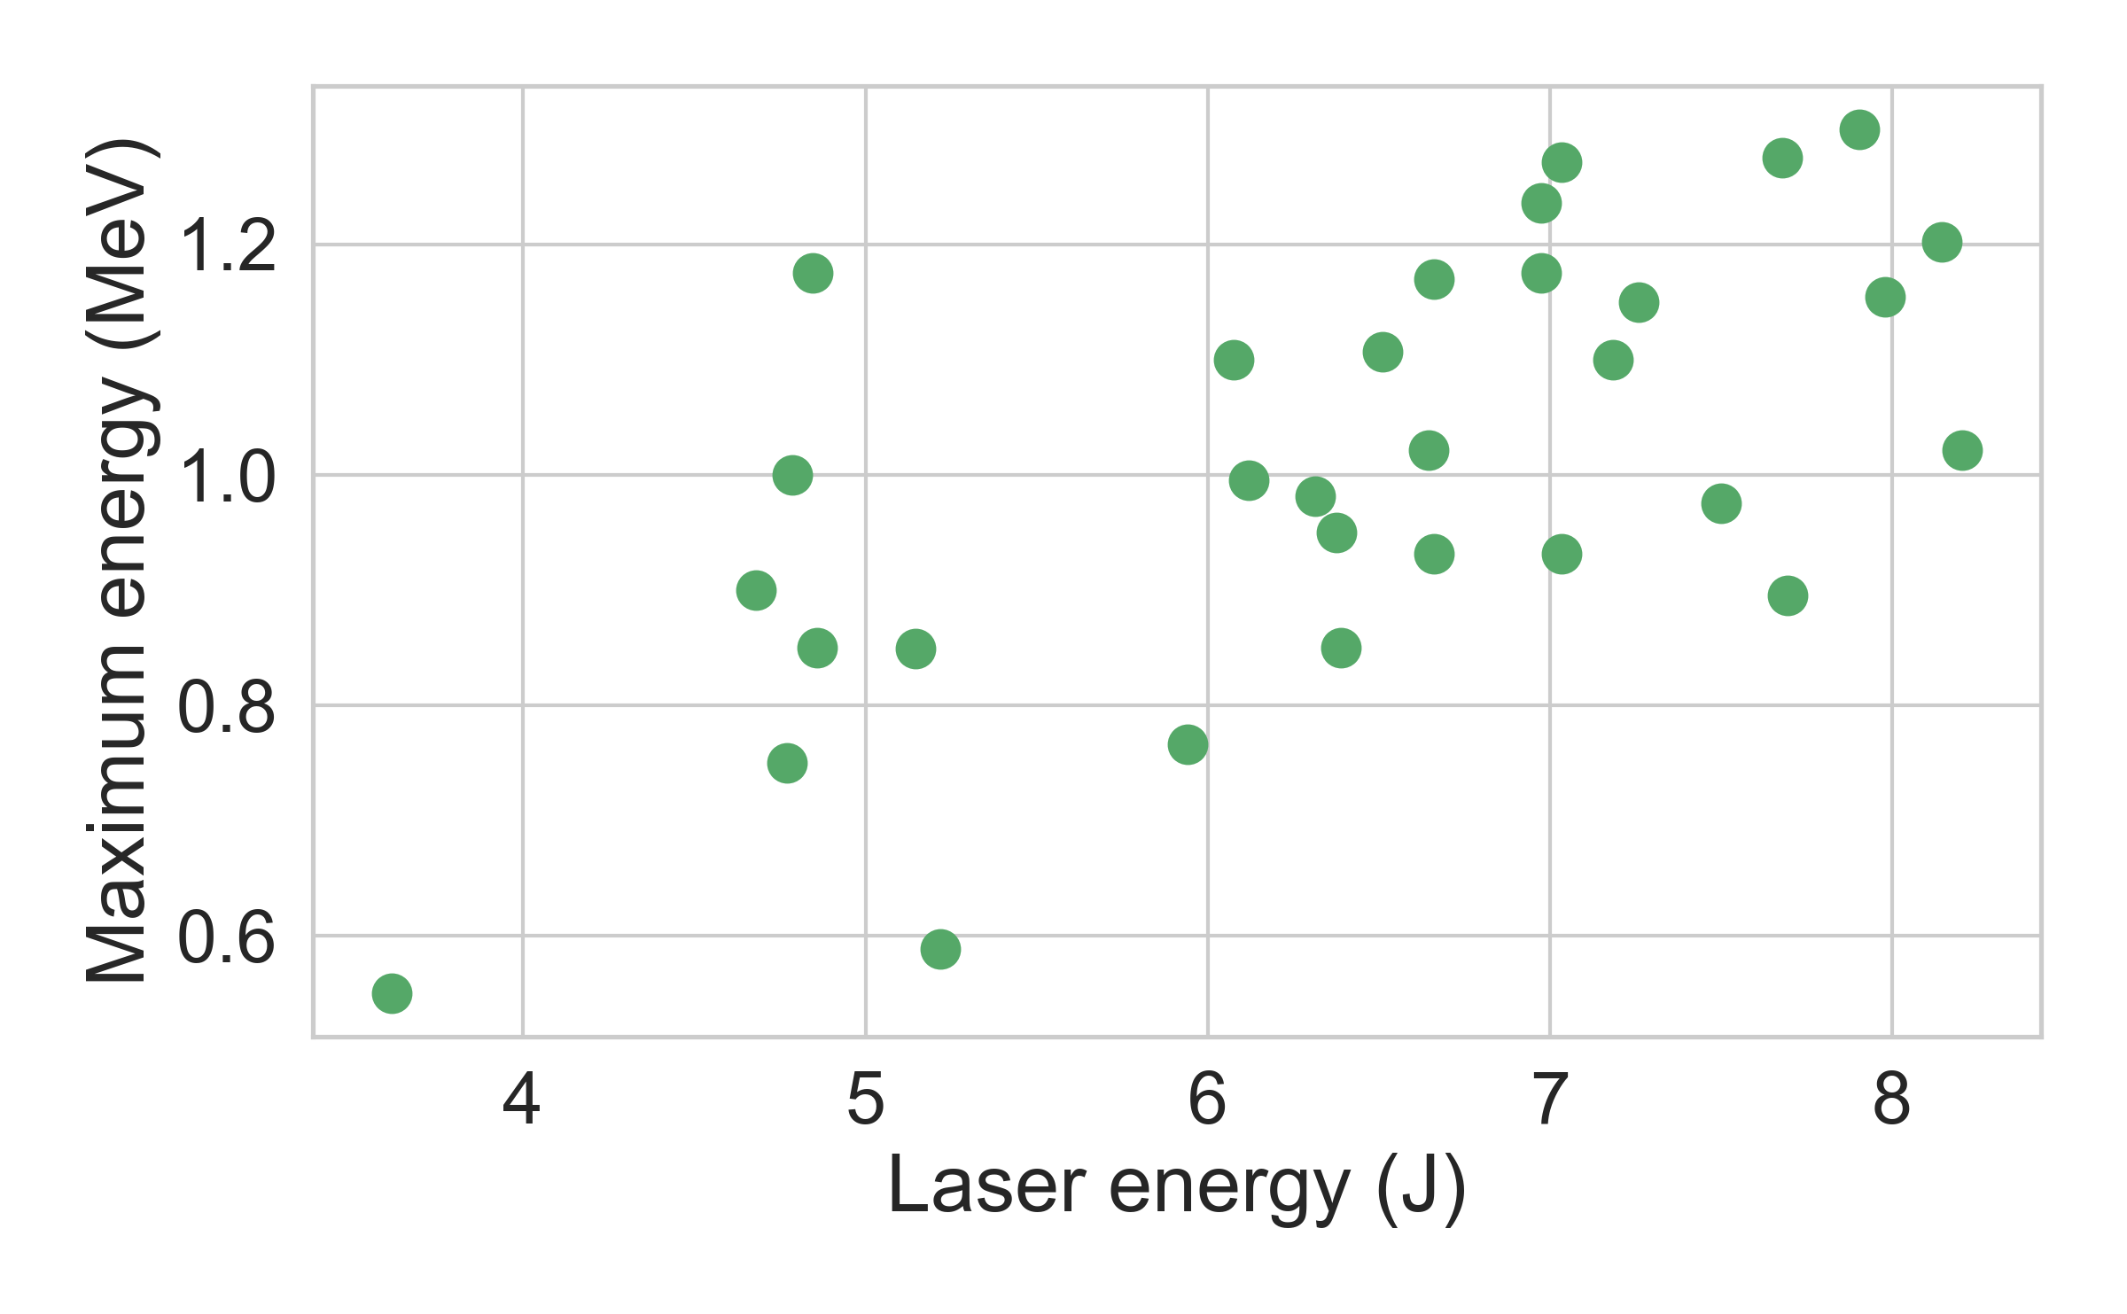
  Forward going accelerated ions observed at the same time - despite no CSA / hole boring!
Proton beam spatial profile
Typical proton spectra
75% contour
Protons
10¹²
Background
Particles / MeV sr
10¹⁰
20º cone
10⁸
0
0.5
1
1.5
Energy (MeV)
Protons > 250 keV
Proton beams are:
    Highly divergent (>30º FWHM)
    Quasi-thermal
    Relatively low energy (max ~1 MeV)

Slide 32
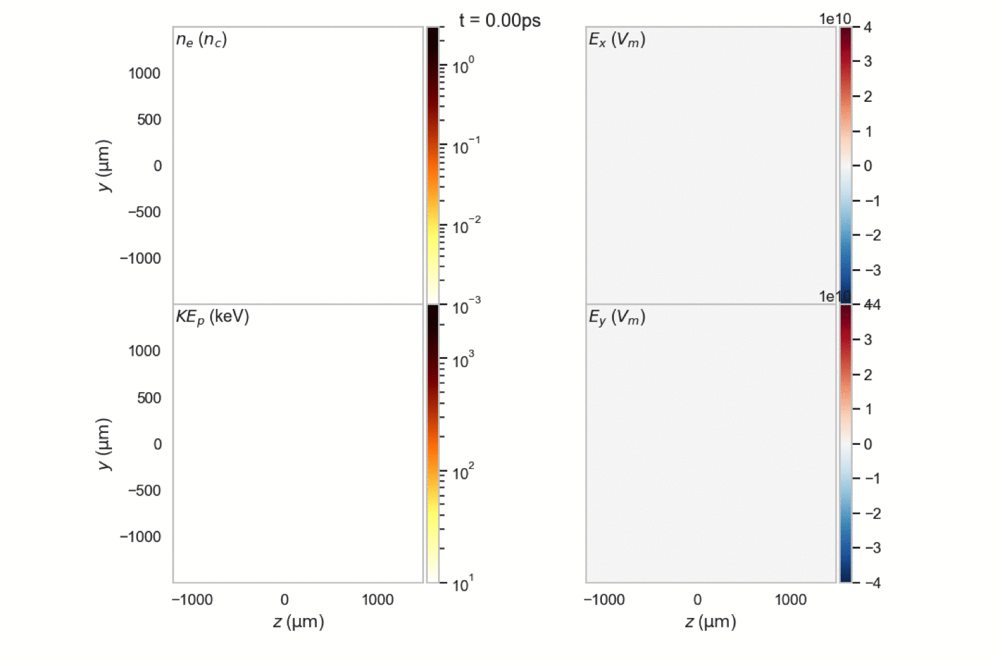
Simulations infer sheath acceleration at ionisation front in under-ionised gas jets

Slide 33
Simulations infer sheath acceleration at ionisation front in under-ionised gas jets
Field in acceleration region is ~2x10¹⁰ V/m, the field ionisation threshold for hydrogen
Ion acceleration from sheath at ionisation front - divergent but good stability

Slide 34
Summary
  Platform for near-critical density LPI using LWIR drive
  Investigated channeling in near critical density plasmas:
    Channeling velocity, inferring super-ponderomotive heating
    Transverse expansion of collisionless shock / solitary wave
  Ions simultaneously accelerated at the ionisation front
75% contour
20º cone
Protons > 250 keV
11

