Slide 1




A Scintillator-Based High Repetition Rate Diagnostic for Multi-Energy Proton Beam Imaging & Probing
Veronica Contreras
Advanced Accelerator Concepts - 2026

Slide 2
Acknowledgements
Collaborators
  Dr. Paul T. Campbell
  Dr. Yong Ma
  Dr. Anatoly Maksimchuk
  Dr. Heath LeFevre
  Dr. Milos Burger
  Dr. Qian Qian
  Jeremy Rebenstock
  Che-Hao Chang
  Ryuya Yamada
  Prof. Alec Thomas
  Prof. Karl Krushelnick
  Prof. Carolyn Kuranz
  Prof. Louise Willingale
ZEUS Engineering & Data Team
  Grant Young
  Richard Anthony
  Will Likes
  Qing Zhang
ZEUS Laser Team
  John Nees
  Galina Kalinchenko
  Bixue Hou
  Gregg Sucha
  Rick Van Camp
  Jeff Xia
  Yana Kleimenova
This work is funded by the U.S. Department of Energy NNSA Center of Excellence under cooperative agreement number DE-NA0004146 and by the National Science Foundation through award number 2408410. This research was conducted at the ZEUS facility which is supported by the National Science Foundation under award 2126181.

Slide 3
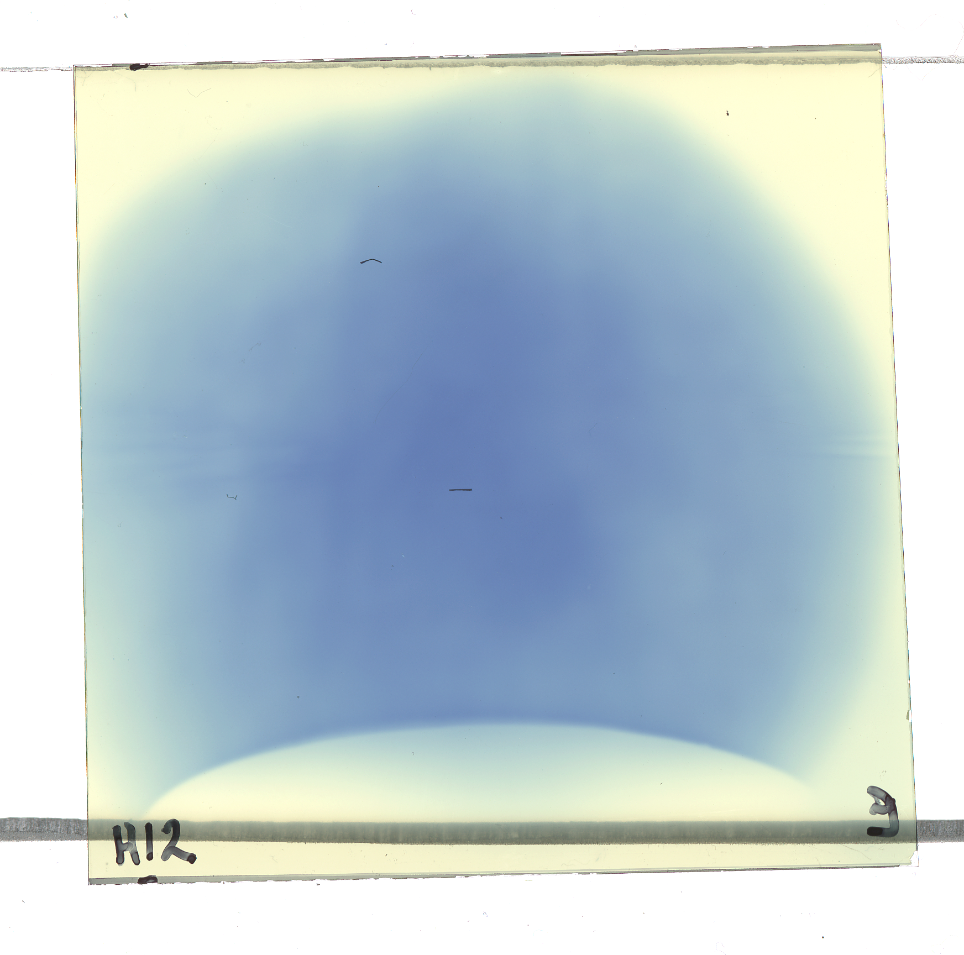
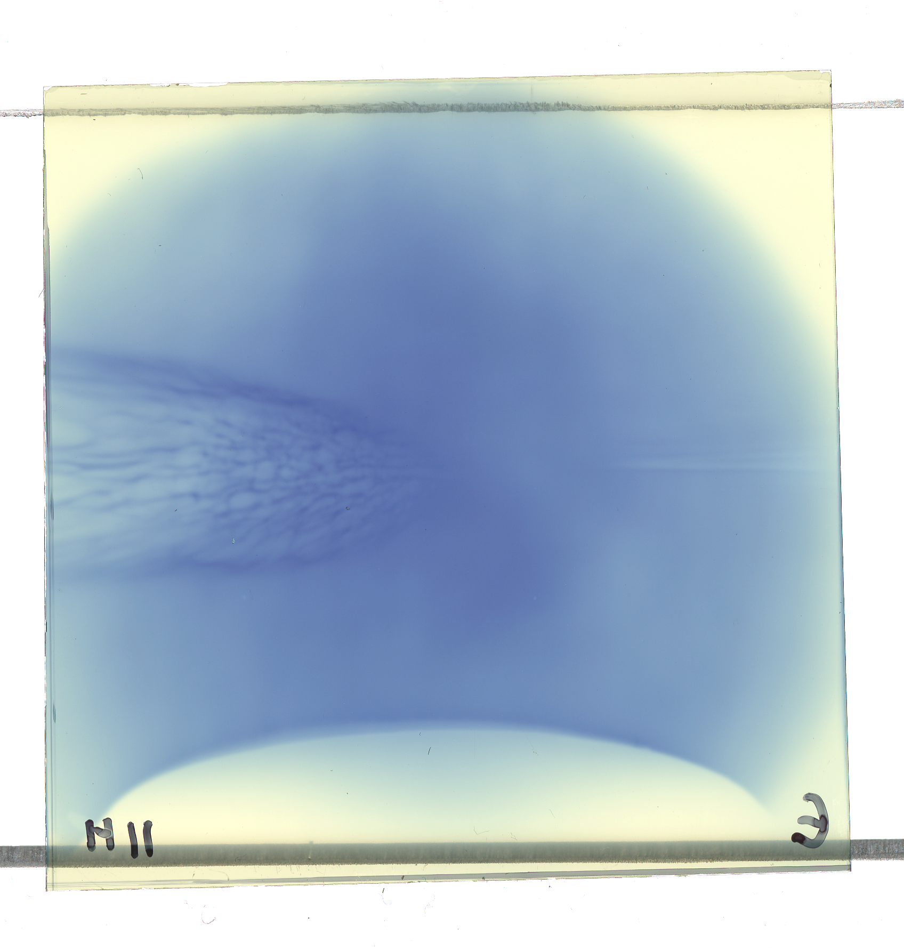
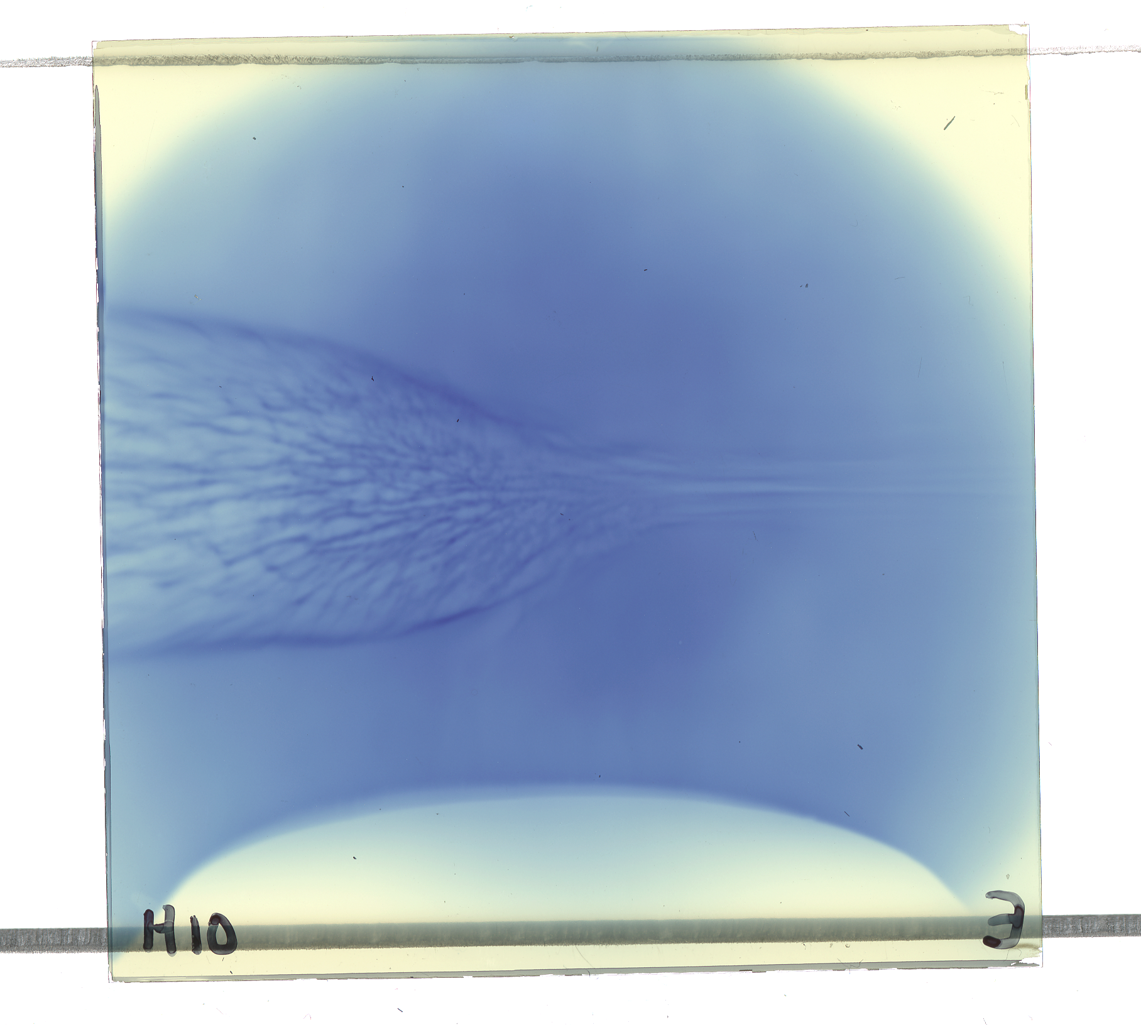
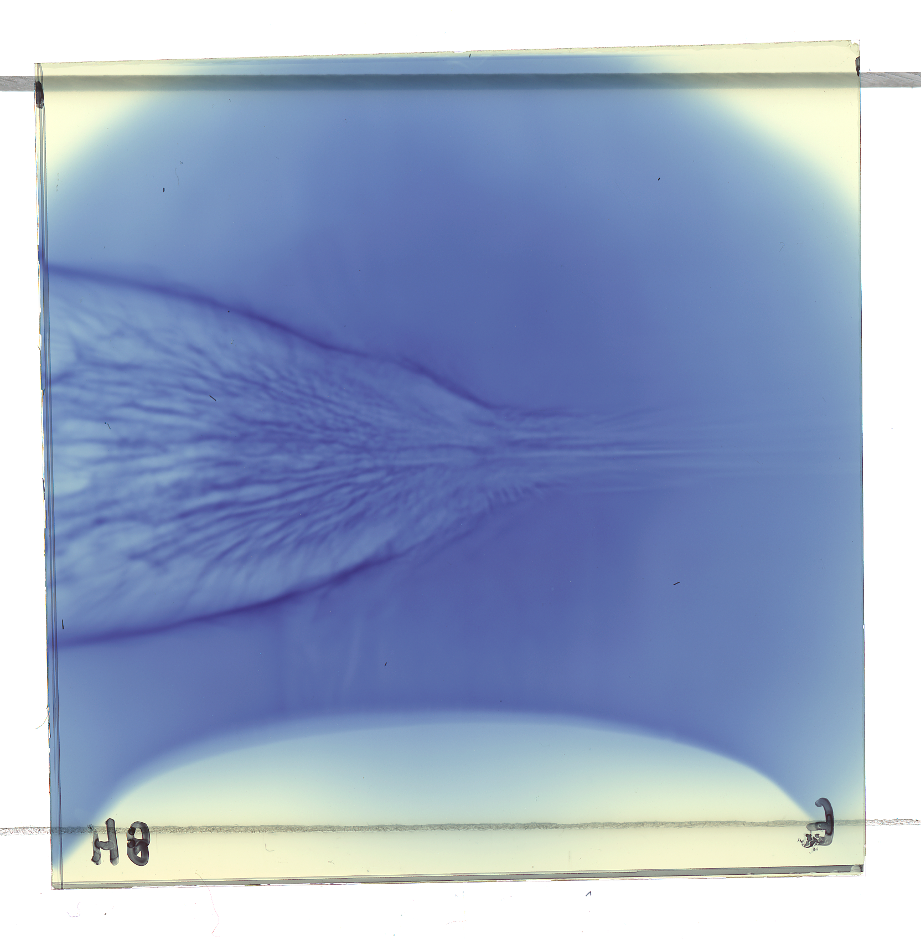
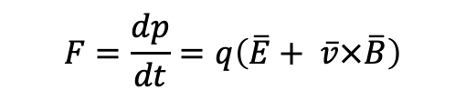
Proton deflectometry
Sample RCF stack
TNSA proton beam is accelerated in the electric sheath field:
Laminar acceleration → good spatial resolution
Short acceleration time → good temporal resolution
Maxwellian-like spectra
high energy
(early in time)
Thin foil
Laser
Time-of-flight provides image sequence on film layers
Detector stack
Quasi-static electric or magnetic fields deflect protons
Electron cloud generates a sheath field
Force on a charged particle
lower energy
(later in time)
$$F=\frac{dp}{dt}=q\left(\overline{E}+ \overline{v}×\overline{B}\right)$$
M Borghesi et al, Rev Sci Inst, 74, 1688 (2003); Laser and Part Beams, 20, 269 (2002); Slide design: L. Willingale
Notes:
Ps temporal resolution
Maxwellian – time –resolved data

Slide 4
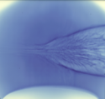
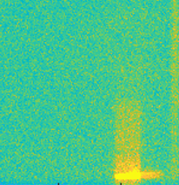
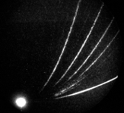
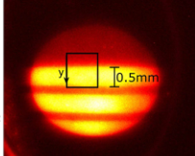
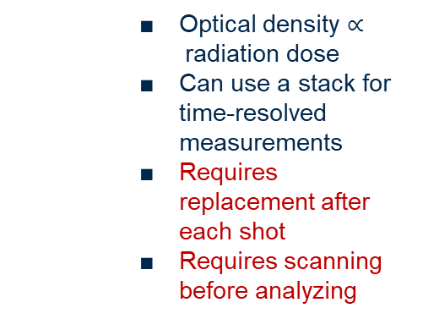
Proton detectors
Reusable Detectors
Single-Use Detectors
Not Suitable for High Rep-Rate
Suitable for High Rep-Rate
Radiochromic Film
CR-39
Image Plate
MCP
Scintillator
    Optical density $∝$radiation dose
    Can use a stack for time-resolved measurements
    Requires replacement after each shot
    Requires scanning before analyzing
    Detection efficiency ~100%
    Requires replacement after each shot
    Time-consuming etching process before scanning and then analyzing
    Multi-use
    Requires removing from vacuum and scanning after each shot
    Stringent vacuum requirements
    Not suitable for time-resolved proton imaging
    High spatial resolution⁵
    Can be used in a stack for time-resolved measurements (similar to RCF)
    Can have thick active layer
⁵H. Tang, et al, Rev. Sci. Instrum. 91, 123304 (2020)
Notes:
Thicker active layer means drop in the spatial resolution because you have more overlapping deflections
Thicker active layer also means that you have a drop in your temporal resolution because youre capturing more energies on that specific layer so you have a wider range of times you’re looking at.

Slide 5
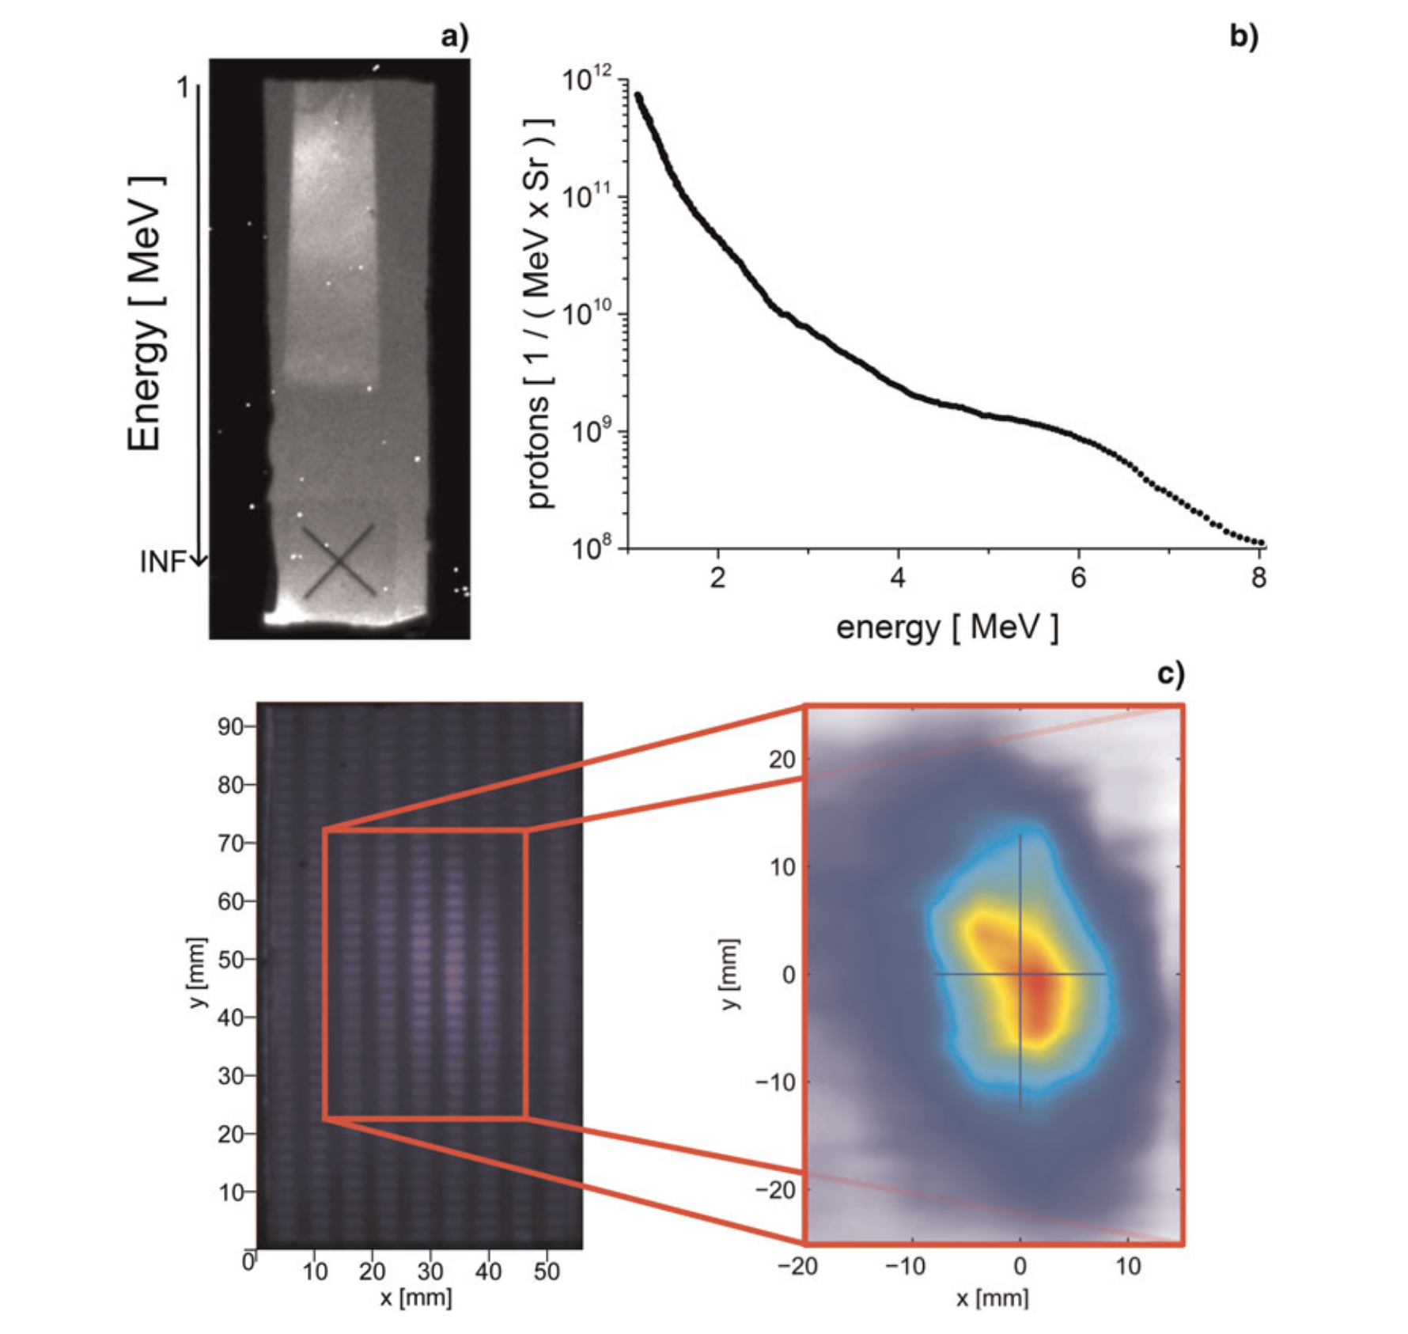
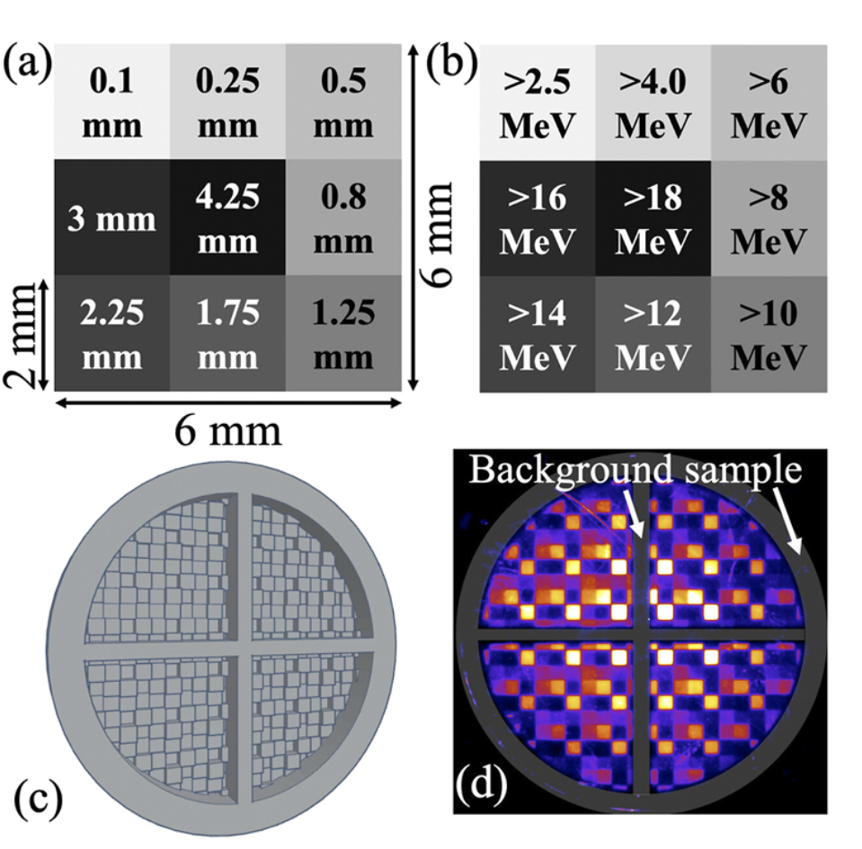
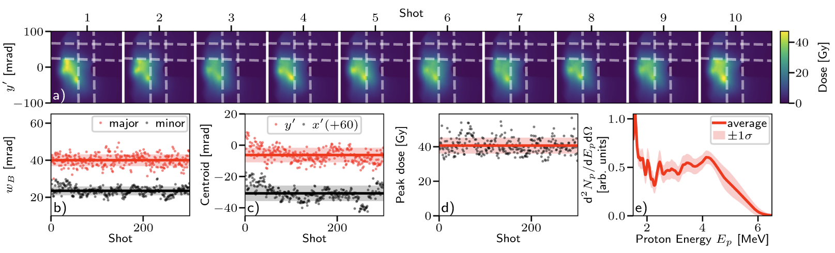
High rep rate proton beam profiling diagnostics
Single detector concepts
  Aurand et. al
    Al grid filter
    Interpolate beam profile
  Mariscal et. al : PROBIES (Proton Beam Imaging Energy Spectrometer)
    3D-printed repeated grid pattern
    Requires high confidences in print precision / repeatability
    Interpolate beam profiles
  Streeter et. al
    EJ 440, thin phosphor detector
Aurand, B., et al. Laser and Particle Beams 33, no. 1 (2015).
D. A. Mariscal, et. al, Rev. Sci. Instrum. 94, 023507 (2023)
M. J. V. Streeter, et. al, Nature Communications 16, no. 1 (2025).

Slide 6
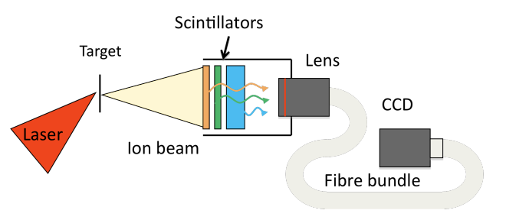
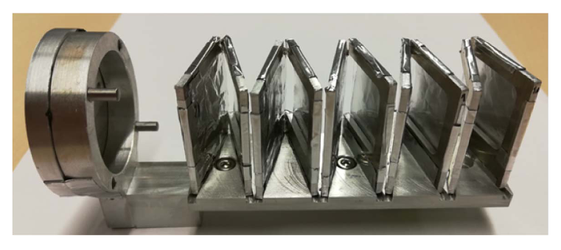
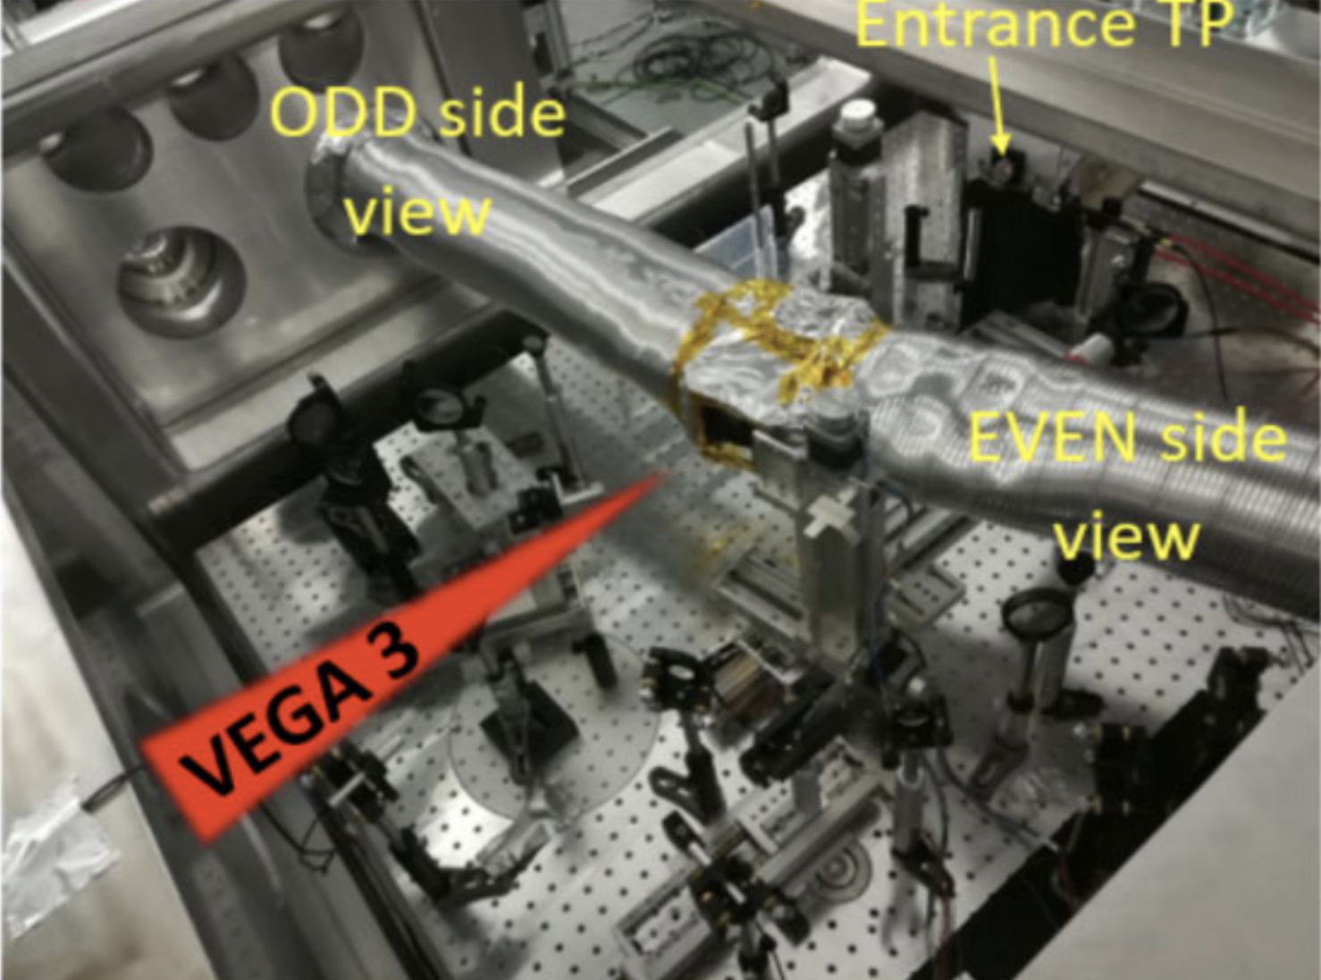
High rep rate proton beam profiling diagnostics
Multi-detector concepts
  Green et. al
    Varied wavelength scintillating stack
  Huault et. al
    Accordion-style scintillator stack, image from the sides
    Requires light-tight shielding to capture scintillator images
J. Green, et al, SPIE Proc. 8079, 807991 (2011).
M. Huault, et al, High Power Laser Science and Engineering, Vol. 7, e60. (2019); M. Huault, et. al, IEEE Trans. on Instrumentation and Measurement 73 (2024).

Slide 7
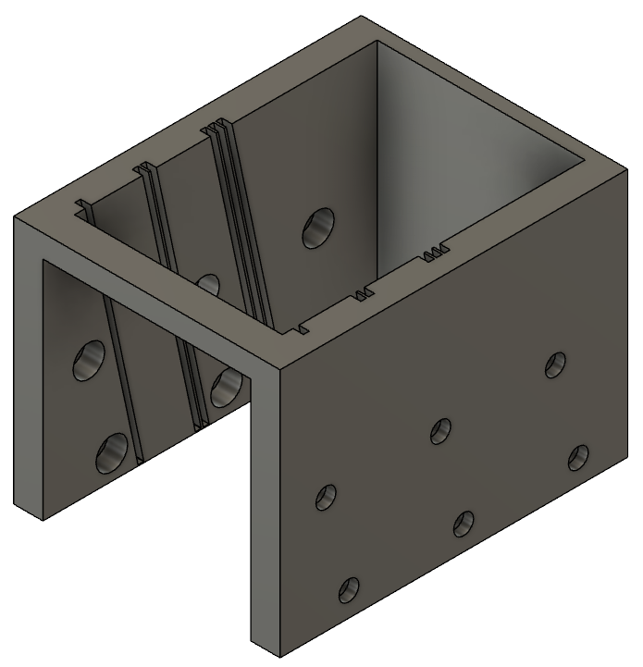
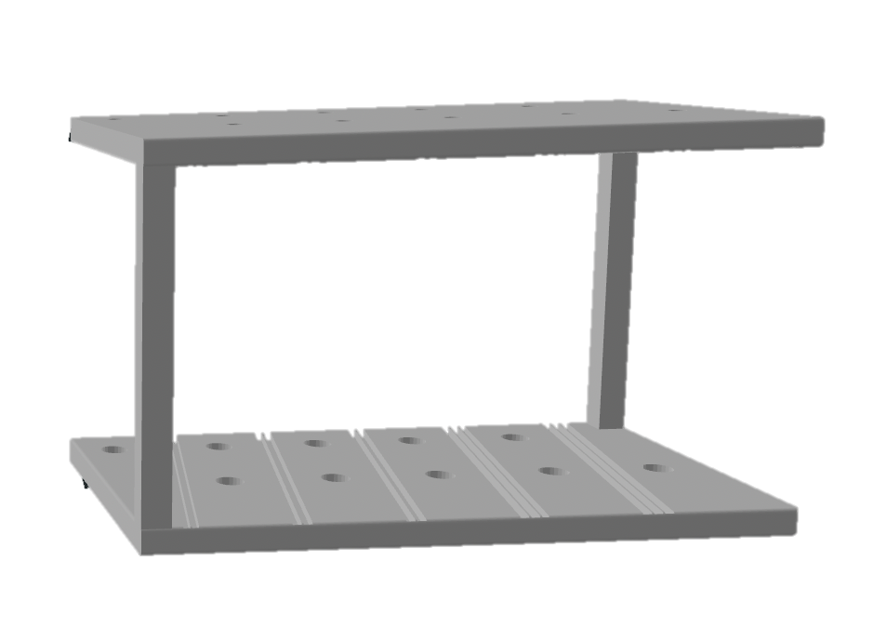
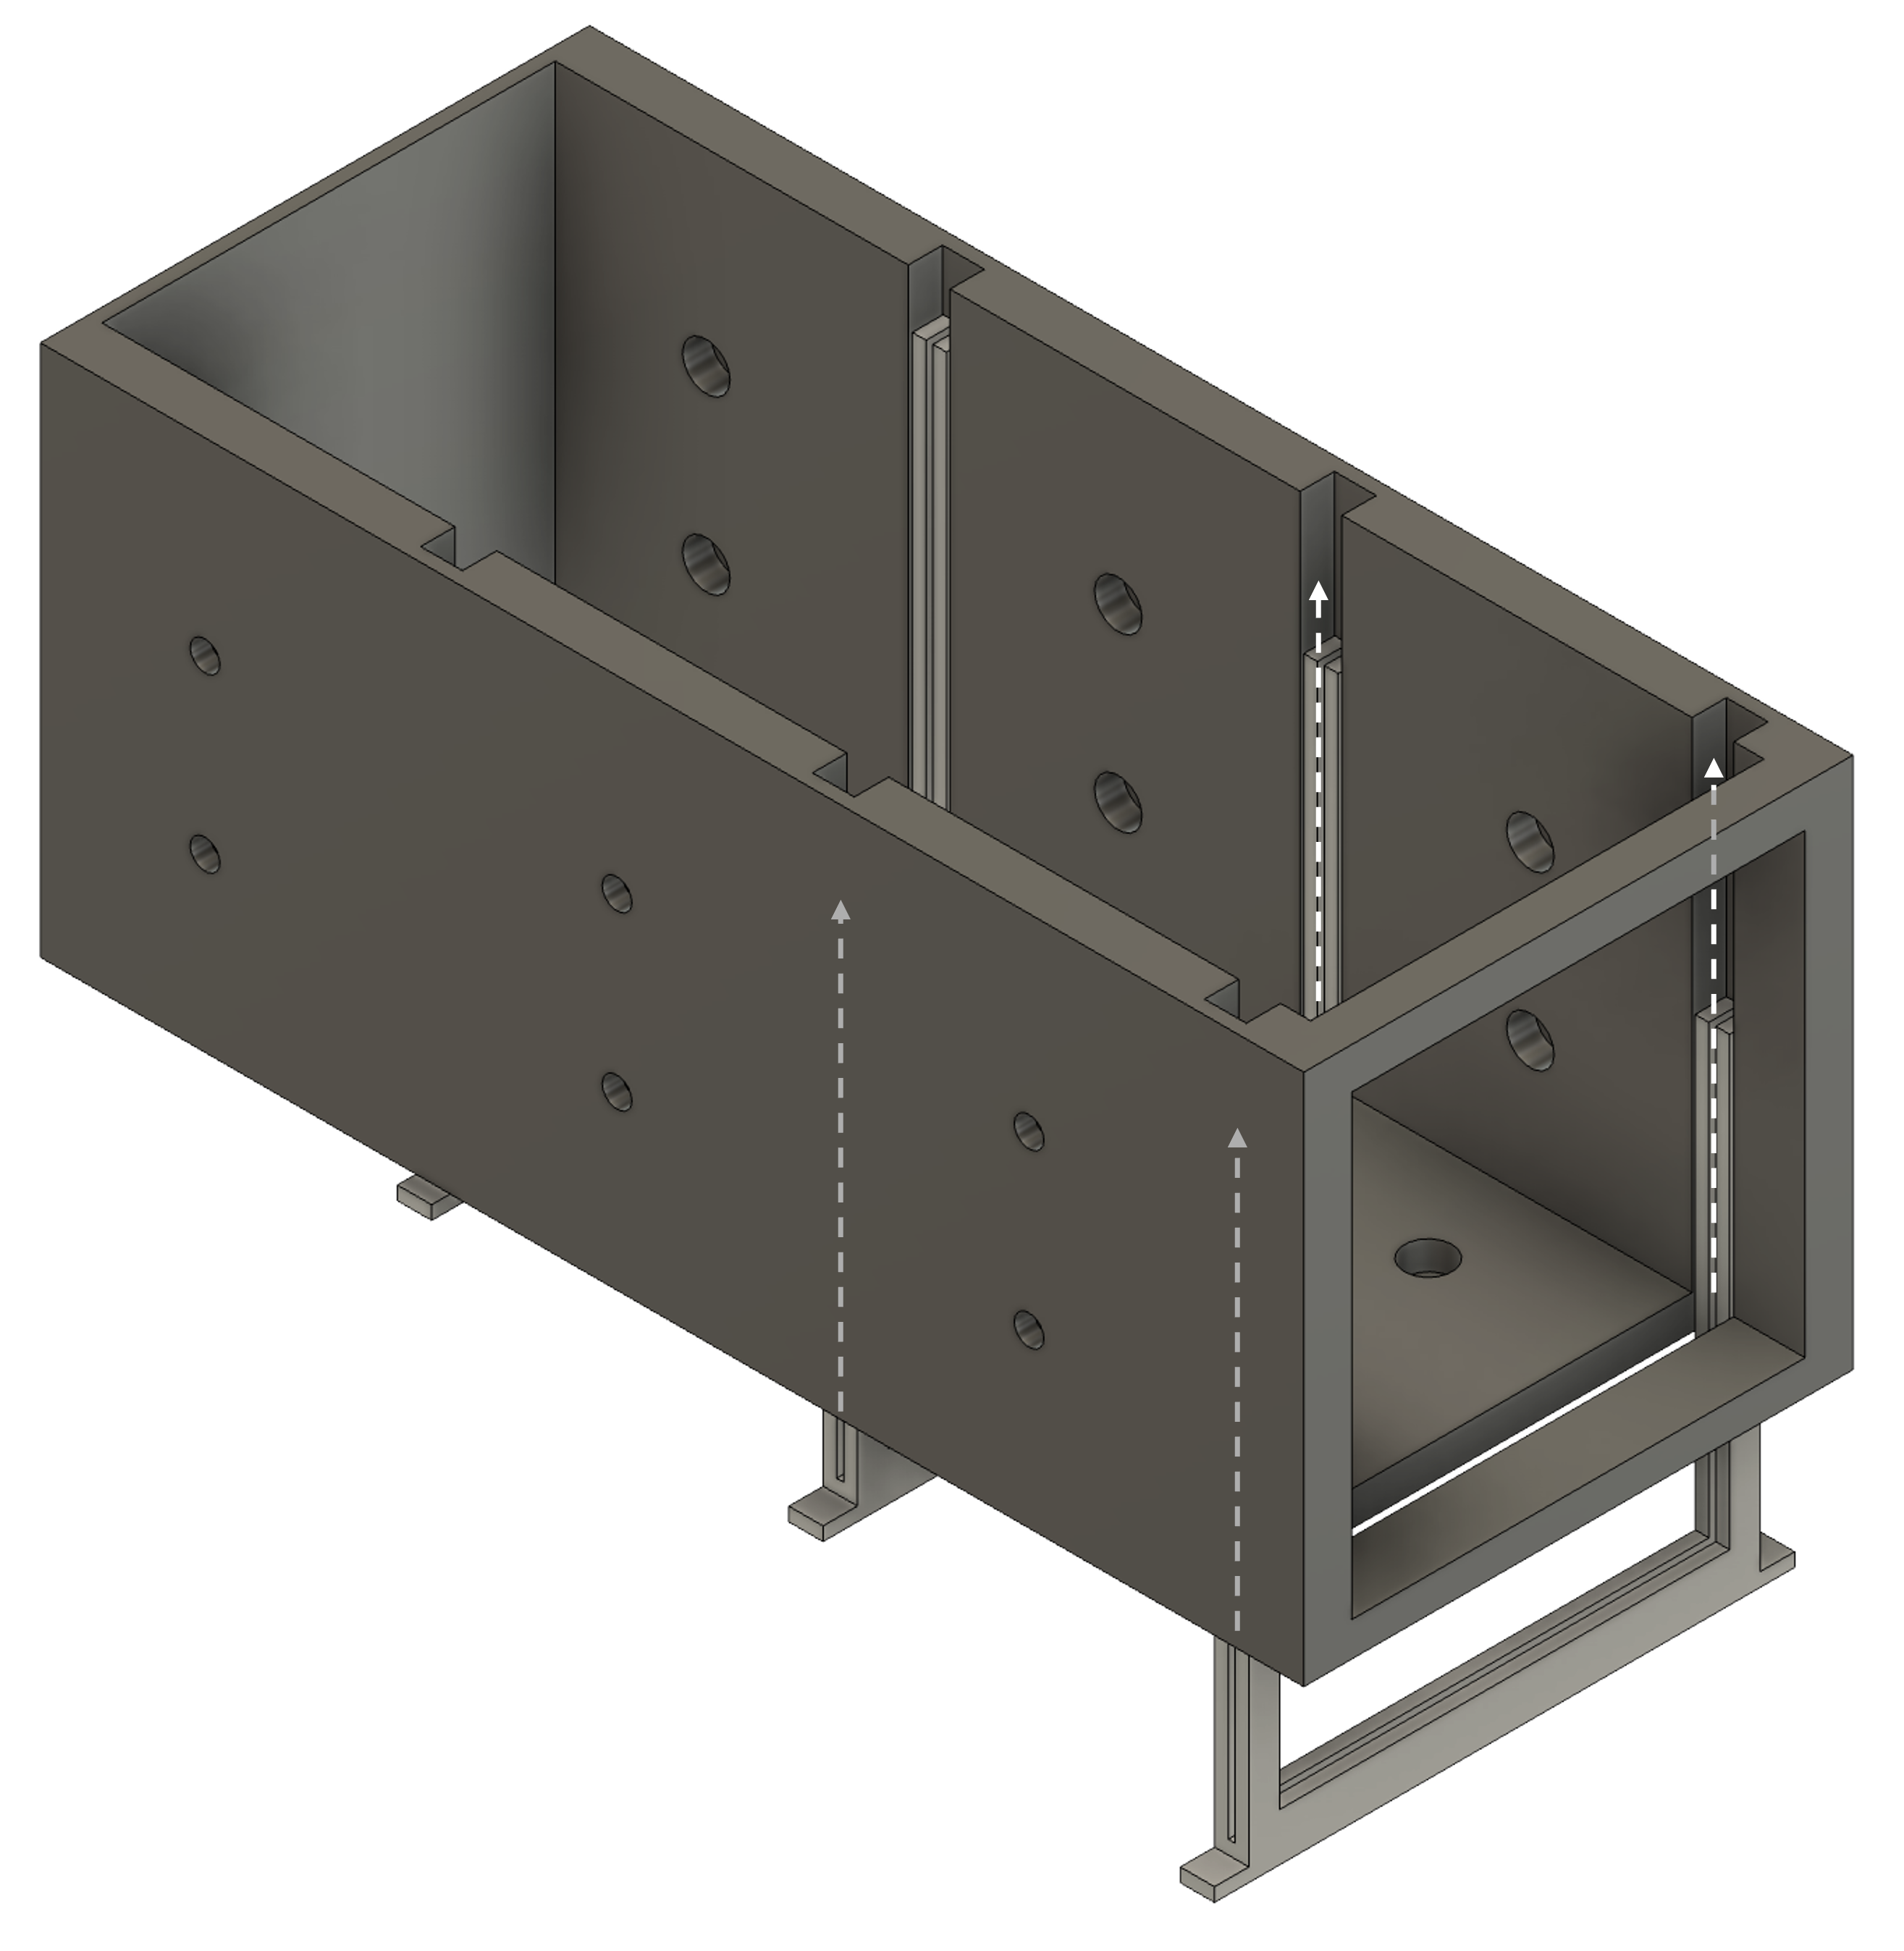
Glowing On-shot Scintillator Stack for Imaging Protons (GOSSIP)
High-repetition rate
Allows for beam profile, pointing, and divergence measurements
Time-resolved interaction information
Image above stack → maximizes horizontal resolution
3D-printed housing
Simple & reconfigurable
Top half, full beam imaging
Camera
Proton Source
Scintillator Stack
Side beam imaging
Mirror
GOSSIP Image
Scintillator Stack
Proton Source
Pinhole
Full beam imaging
To TPS

Slide 8
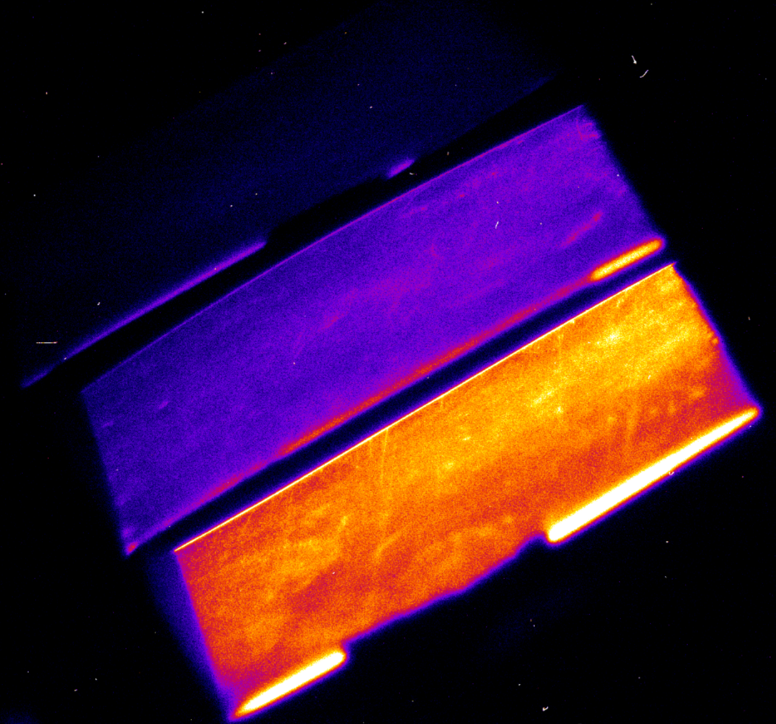
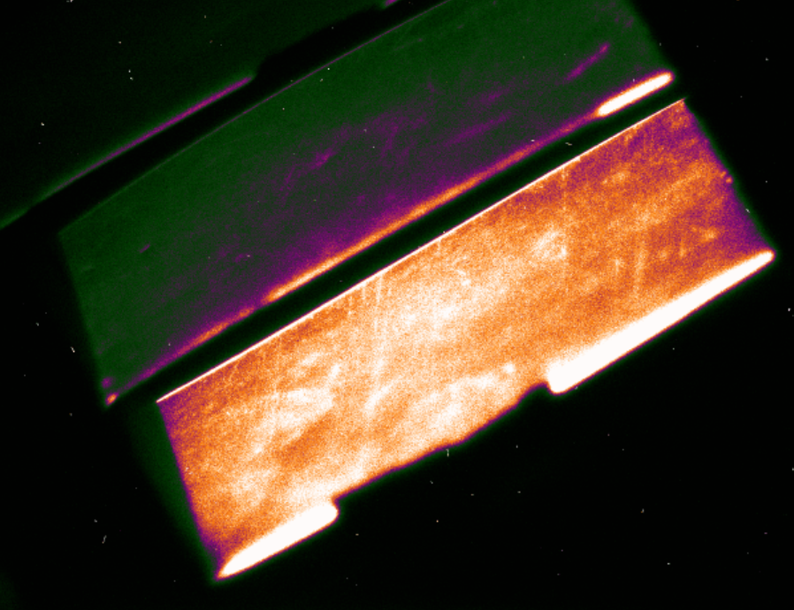
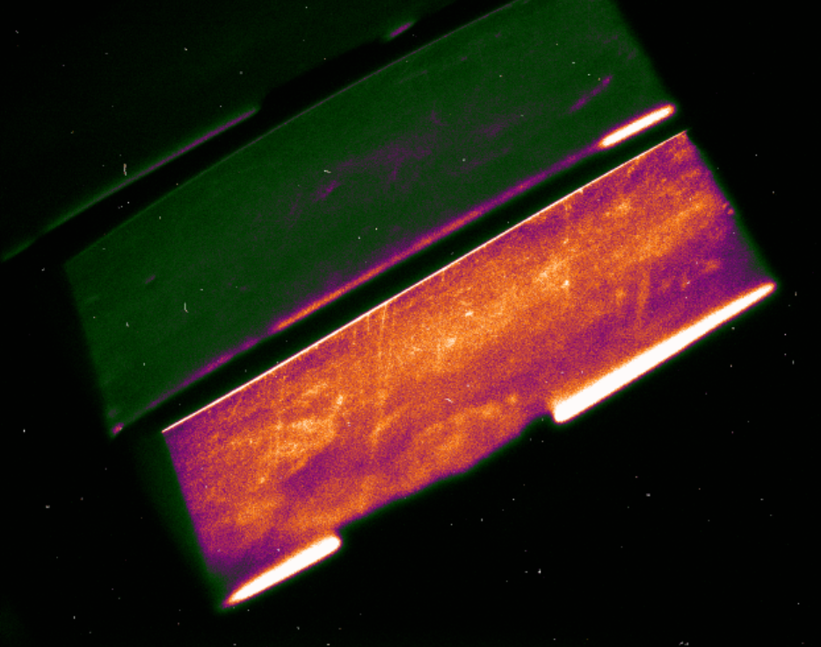
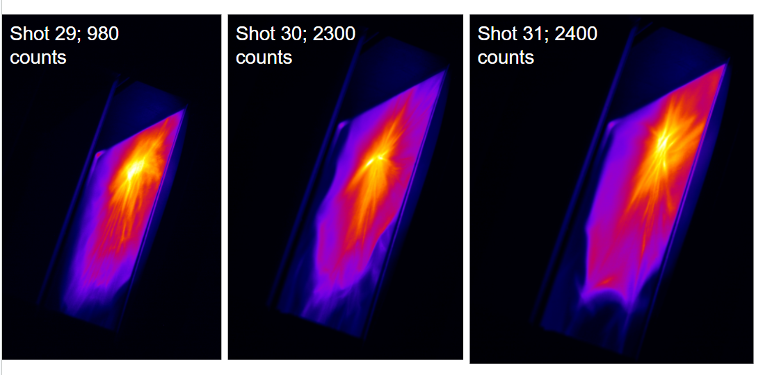
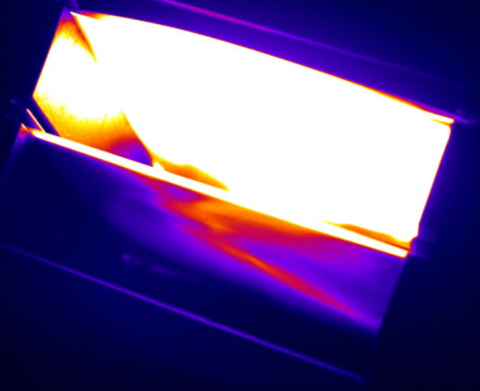
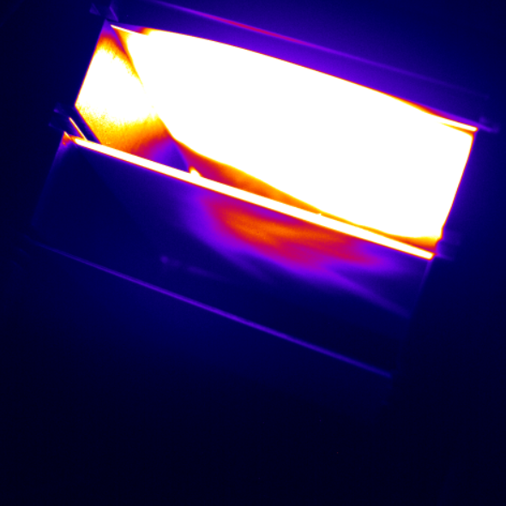
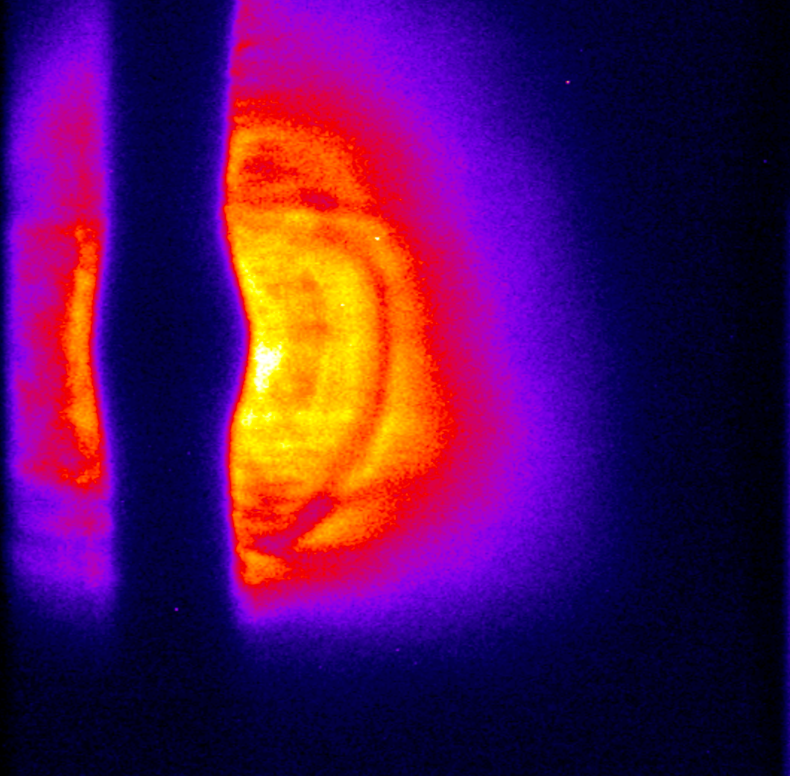
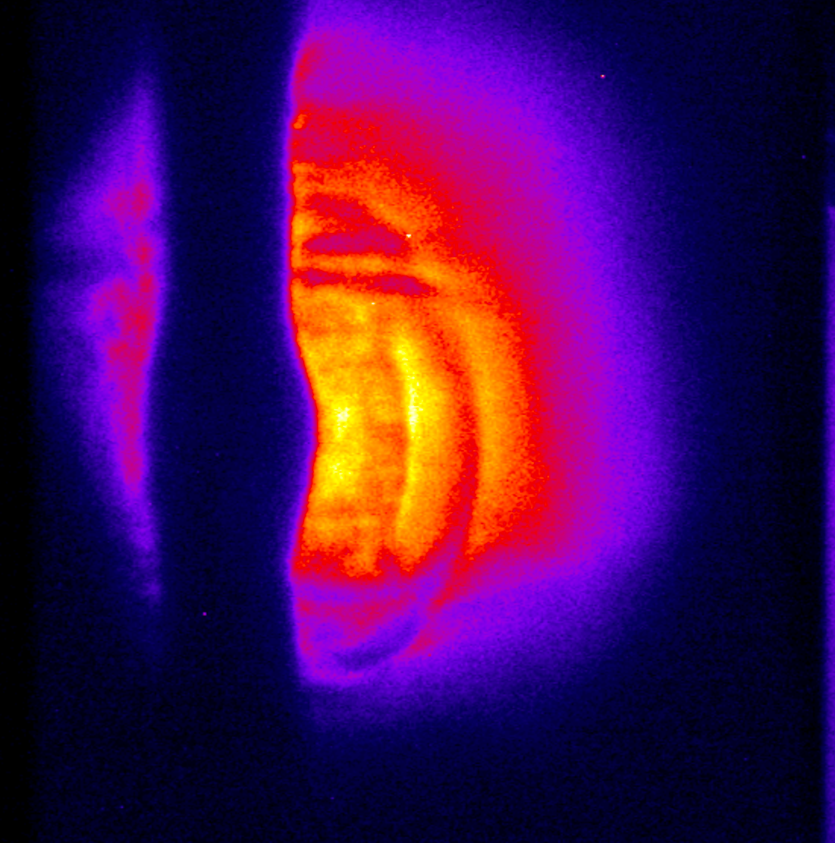
Experiments with GOSSIP
Raw GOSSIP Data
ZEUS January 2025
  Flat foil targets
  GOSSIP (top half) + TPS
  EJ 204 scintillators
    Scratches scatter light
ZEUS TA2 April 2025 Liquid sheet targets
  Full beam on GOSSIP
  EJ 440 scintillators
    Signal balance required
ZEUS TA1 March 2026 Proton probing
  1 camera / detector
  First demonstration of fs HRR proton probing on scintillators at ZEUS
  Scattering between layers is significant
3.3 MeV
3.3 MeV
3.3 MeV
4.6 MeV
4.6 MeV
4.6 MeV
1.5 MeV
1.5 MeV
1.5 MeV
1.5 MeV
5.6 MeV
5.6 MeV
3.2 MeV
3.2 MeV

Slide 9
ZEUS TA1: Proton Probing Experiment
Experiment Aims
Characterize proton beam on GOSSIP with TEM grid
Achieve high shot rate proton probing measurements at ZEUS with GOSSIP

Slide 10
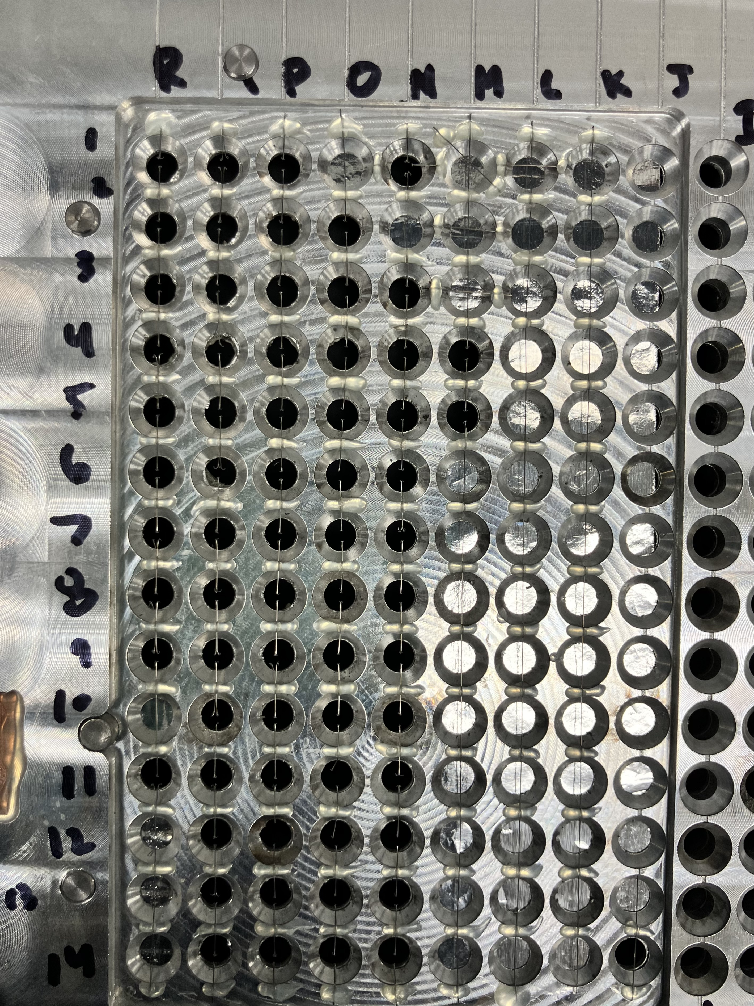
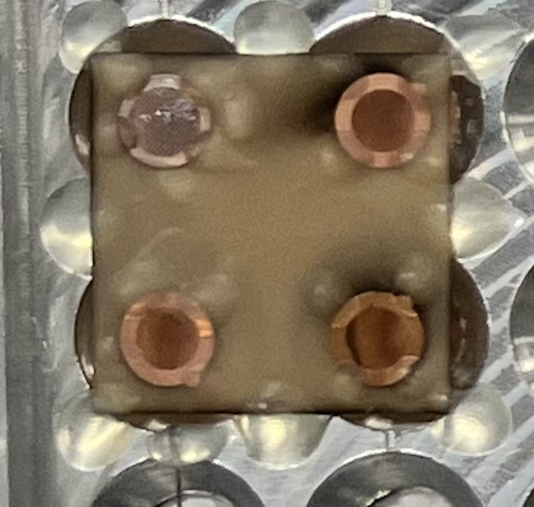
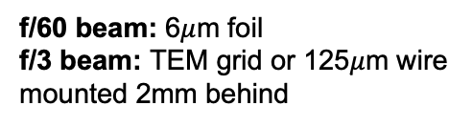
ZEUS TA1: Proton Probing Experiment Setup
f / 3, 5.5 J, 30 fs
Targets
Beam Path
f/60 beam: 6$μ$m foil
f/3 beam: TEM grid or 125$μ$m wire mounted 2mm behind
Delay
Stage
f / 60, 30 J, 40 fs
Proton
Beam
GOSSIP
S2: 3.7 MeV
S3: 5.3 MeV
S1: 3.3 MeV
f/3
OAP

Slide 11
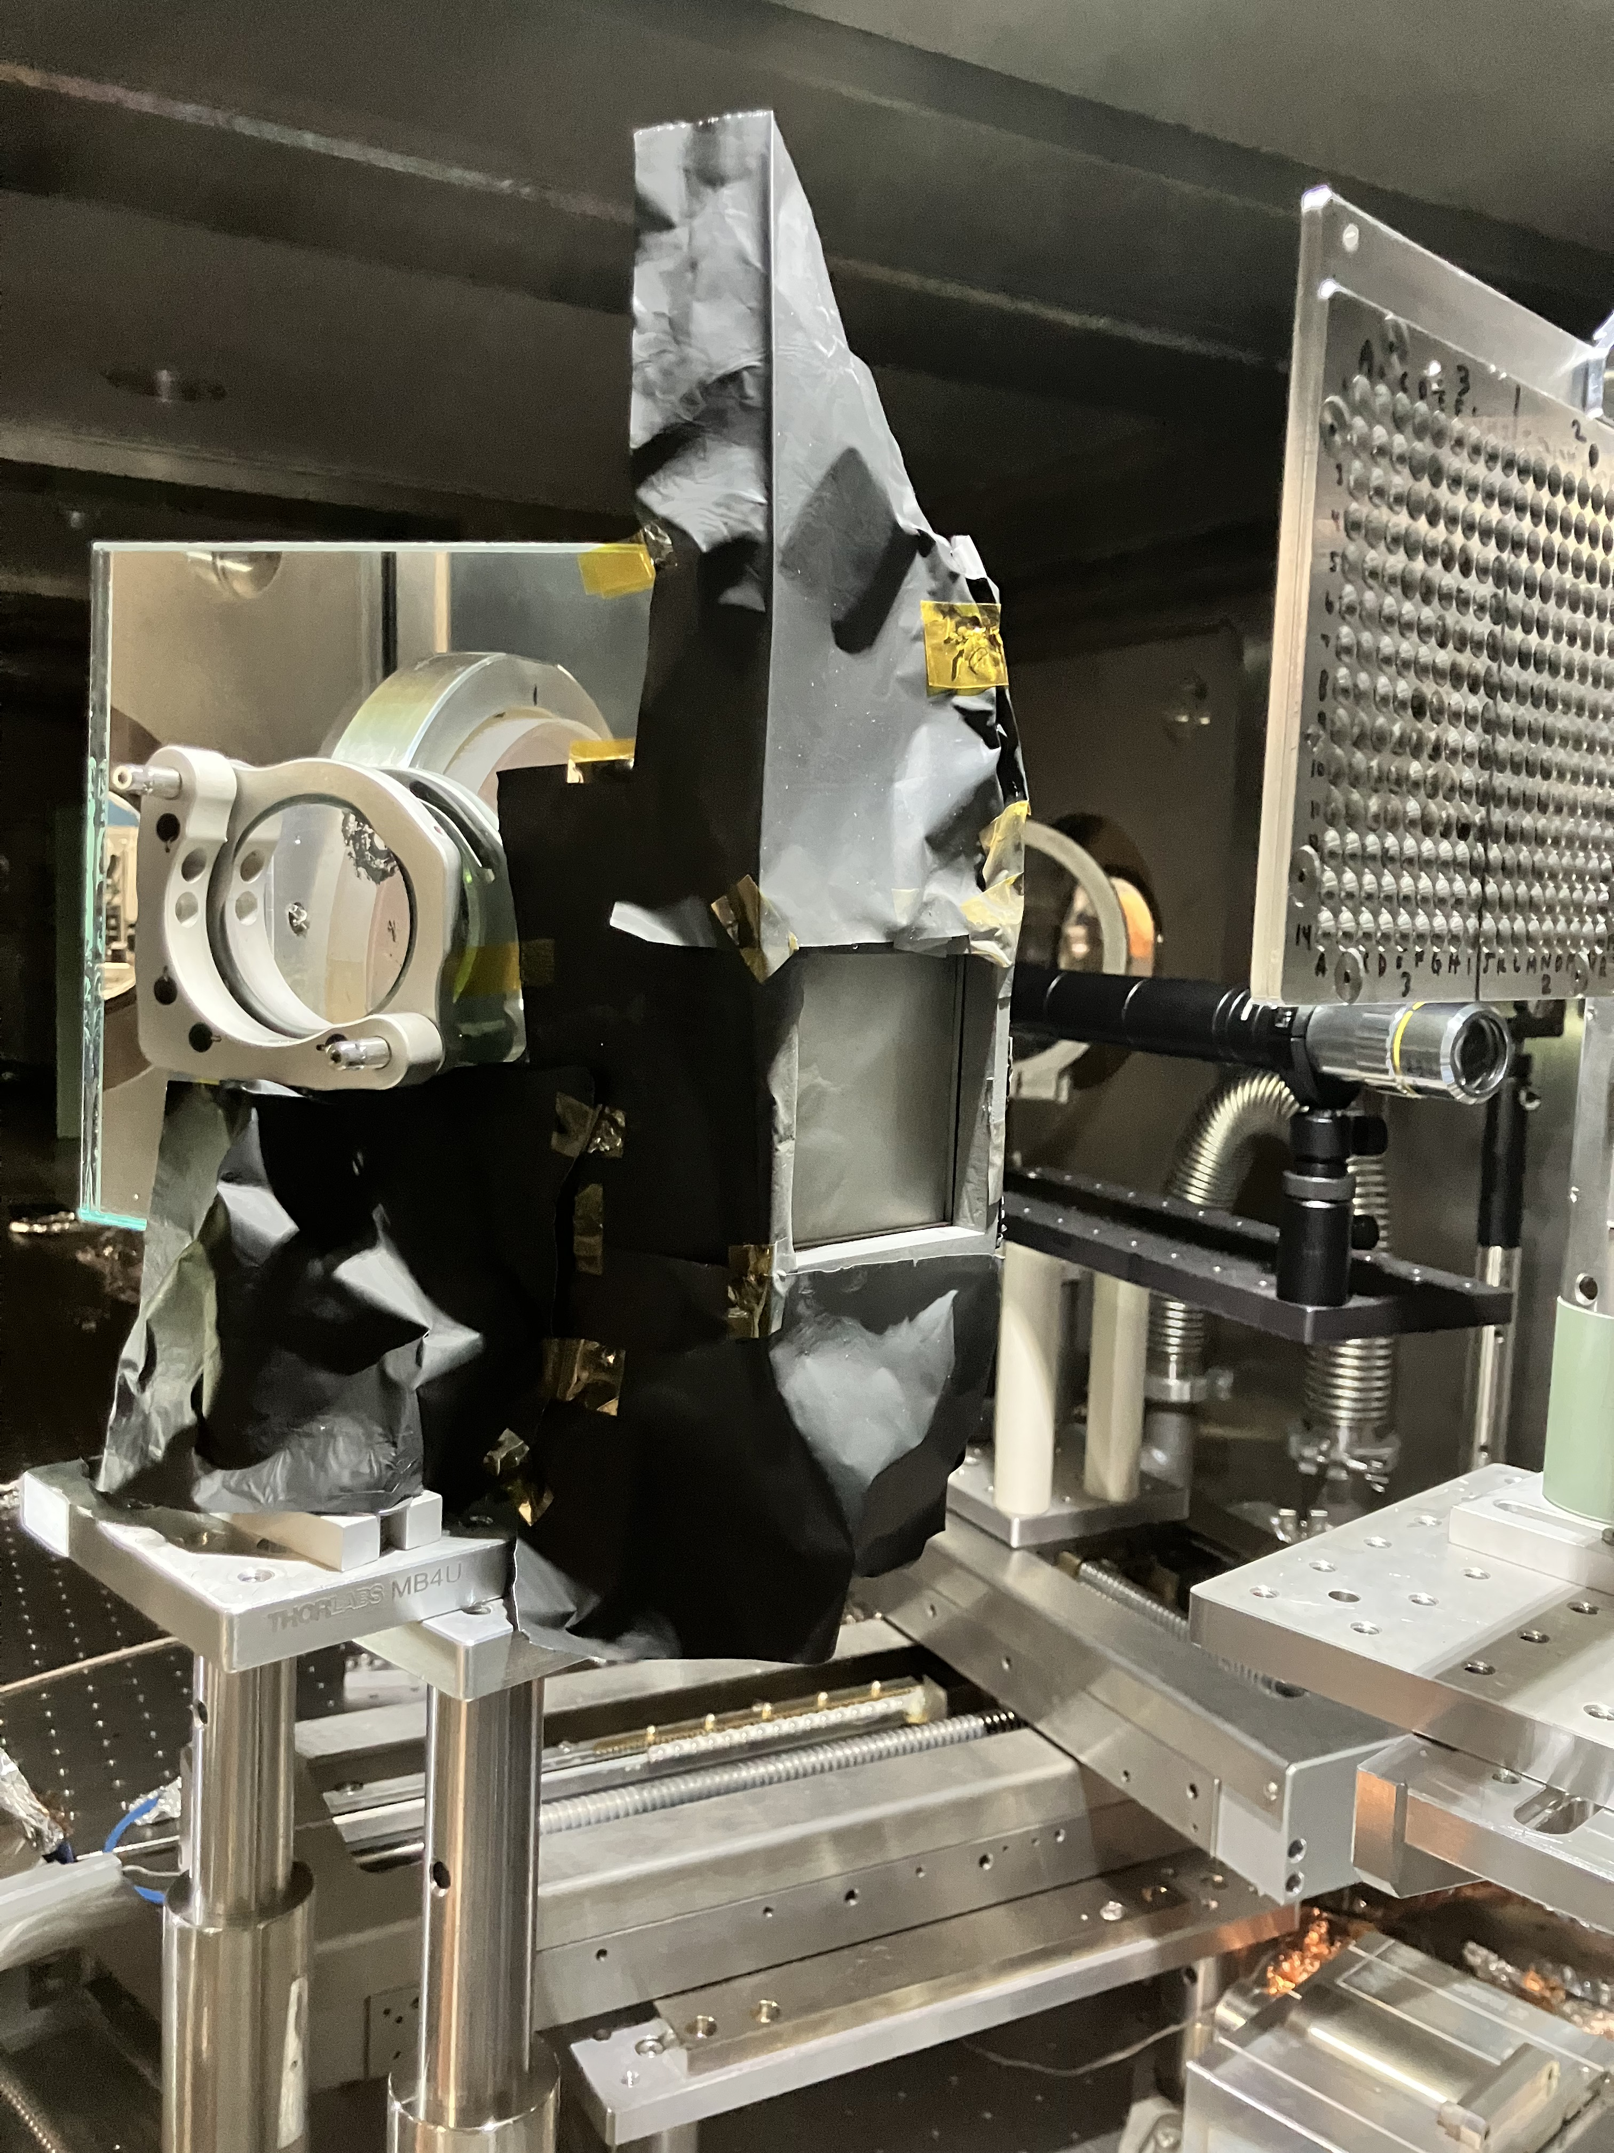
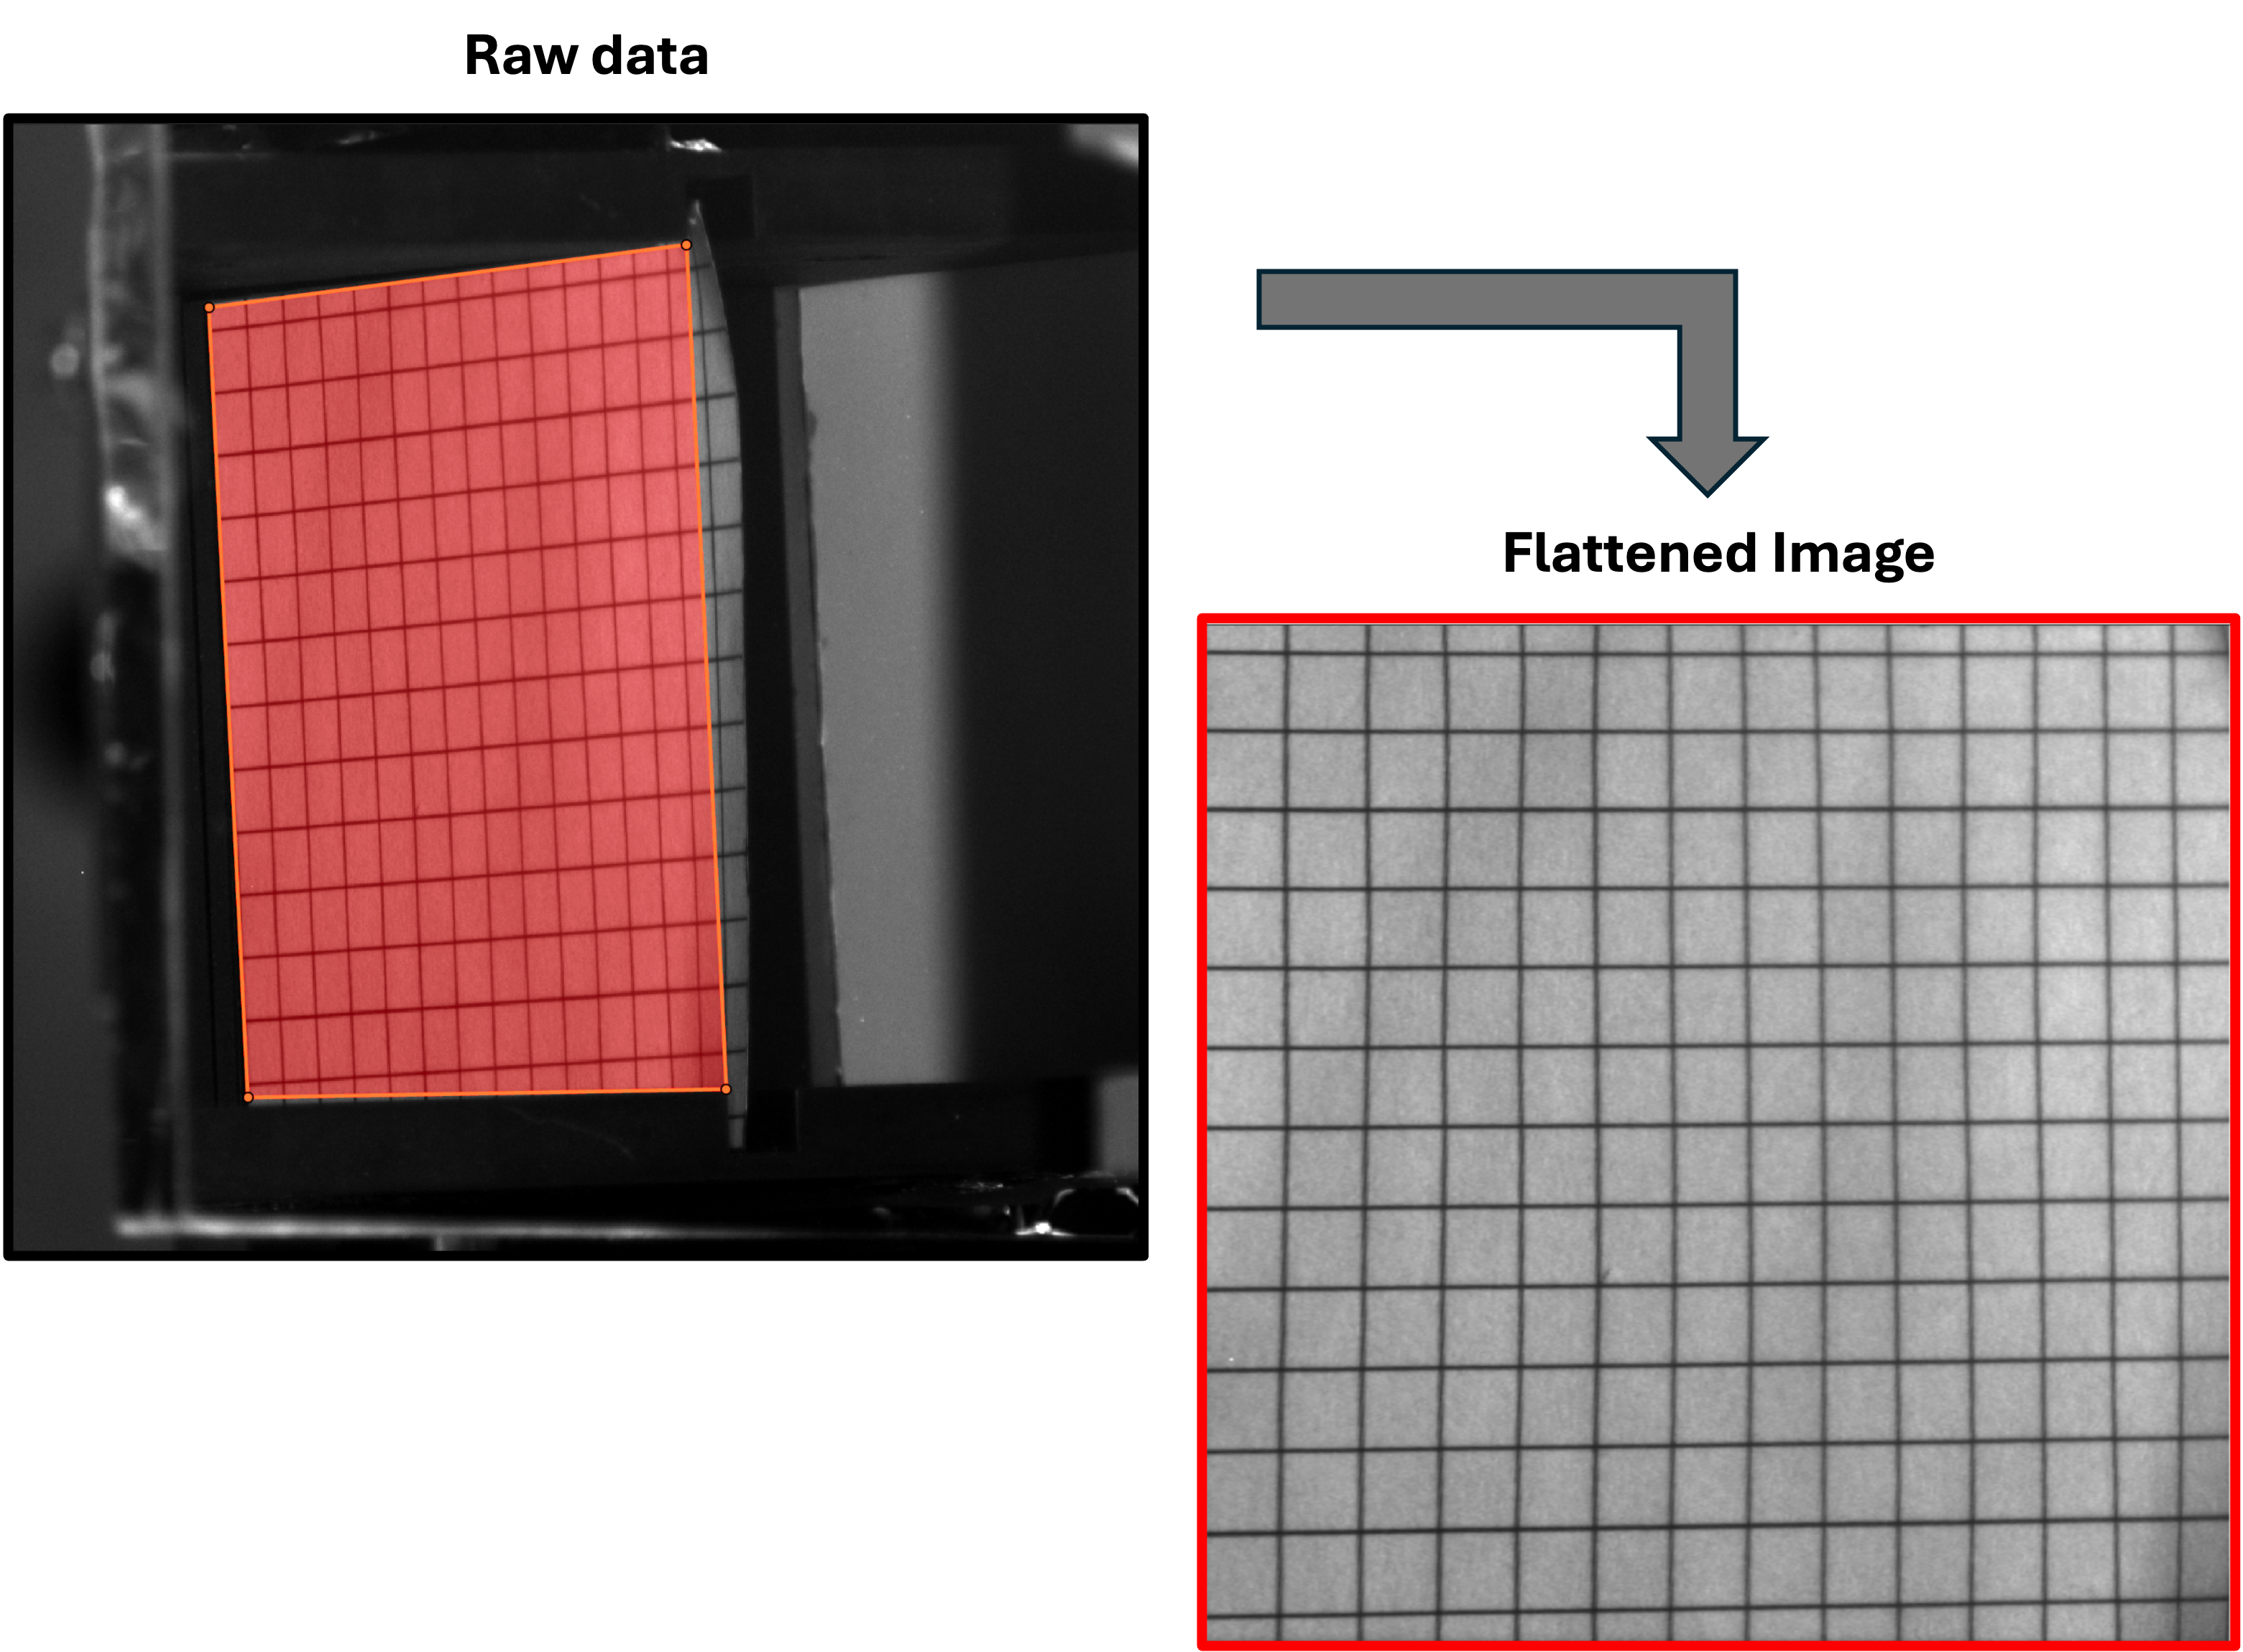
ZEUS TA1: Proton Probing Experiment Setup
In-chamber setup
Post-processing
Targets
Light
shielding
GOSSIP
Protons
6.5 cm
6.5 cm

Slide 12
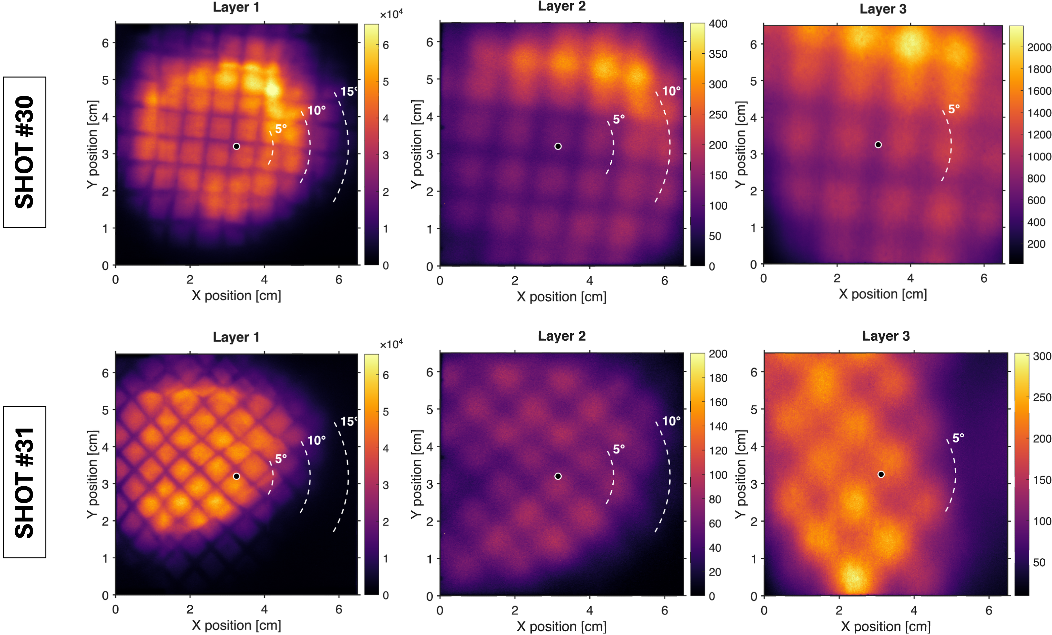
ZEUS TA 1: Proton Probing Experiment Results - Characterization
Shot A
Shot B

Slide 13
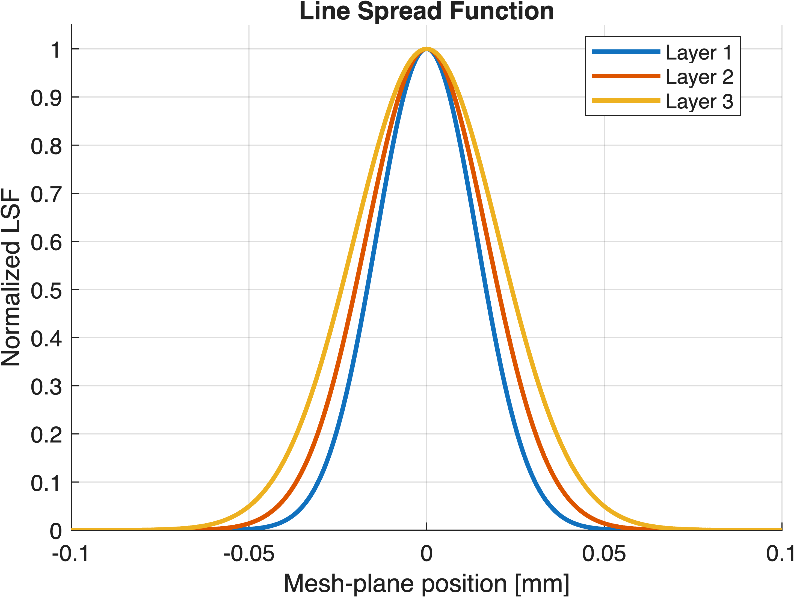
Investigating the observed image blurring effect in the data
Line Spread Function
Shot A
Normalized LSF
Take the same, well-defined mesh edge near the center of each detector image
Resulting fit is used to calculate the line spread function
Fit an error function to the measured edge spread function
Mesh-plane position [mm]
Narrow peak → better localization of proton signal
Broader peak → increased blur
Notes:
This slide investigates the origin of the image blur we observe.
For each detector layer, I selected the same well-defined mesh edge near the center of the image.
An error function was fit to the measured edge spread function, and the resulting fit was used to calculate the line spread function and modulation transfer function.

Slide 14
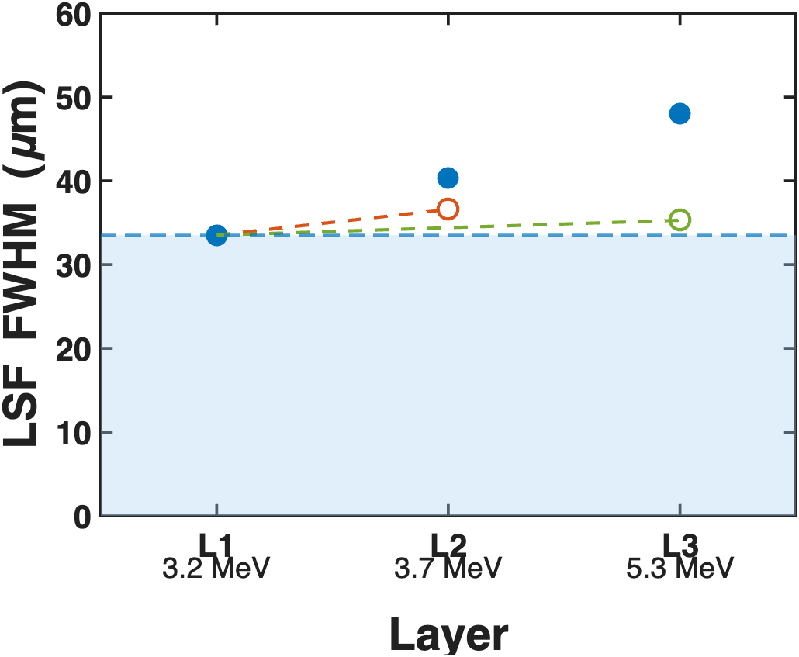
Image blurring effect is partially due to small-angle scattering in the detectors.
Measured LSF FWHM compared with TRIM-predicted broadening
Modeling in TRIM
 | Lateral Range
3.7 MeV (Layer 2) | 3.0°
5.3 MeV (Layer 3) | 1.8°
Measured LSF FWHM
Baseline resolution
TRIM-predicted scattering by L1 on L2
TRIM-predicted scattering by L1+L2 on L3
3.2 MeV
3.7 MeV
5.3 MeV
Notes:
To understand what causes this image degradation, we modeled proton transport through the detector stack using TRIM.
TRIM is a monte carlo code that predicts the lateral spread of protons as they traverse the detector materials. Both the lateral range and lateral straggle increase the size of the proton distribution on the scintillator, reducing image sharpness.
The lateral range = average lateral distance from the central beam axis
Lateral straggling = average deviation from the lateral range
TAKEAWAY: The experimental broadening measured by the ESF, LSF, and MTF is consistent with the scattering predicted by the TRIM simulations, indicating that scattering within the detector stack is a dominant contributor to the loss of spatial resolution.

Slide 15
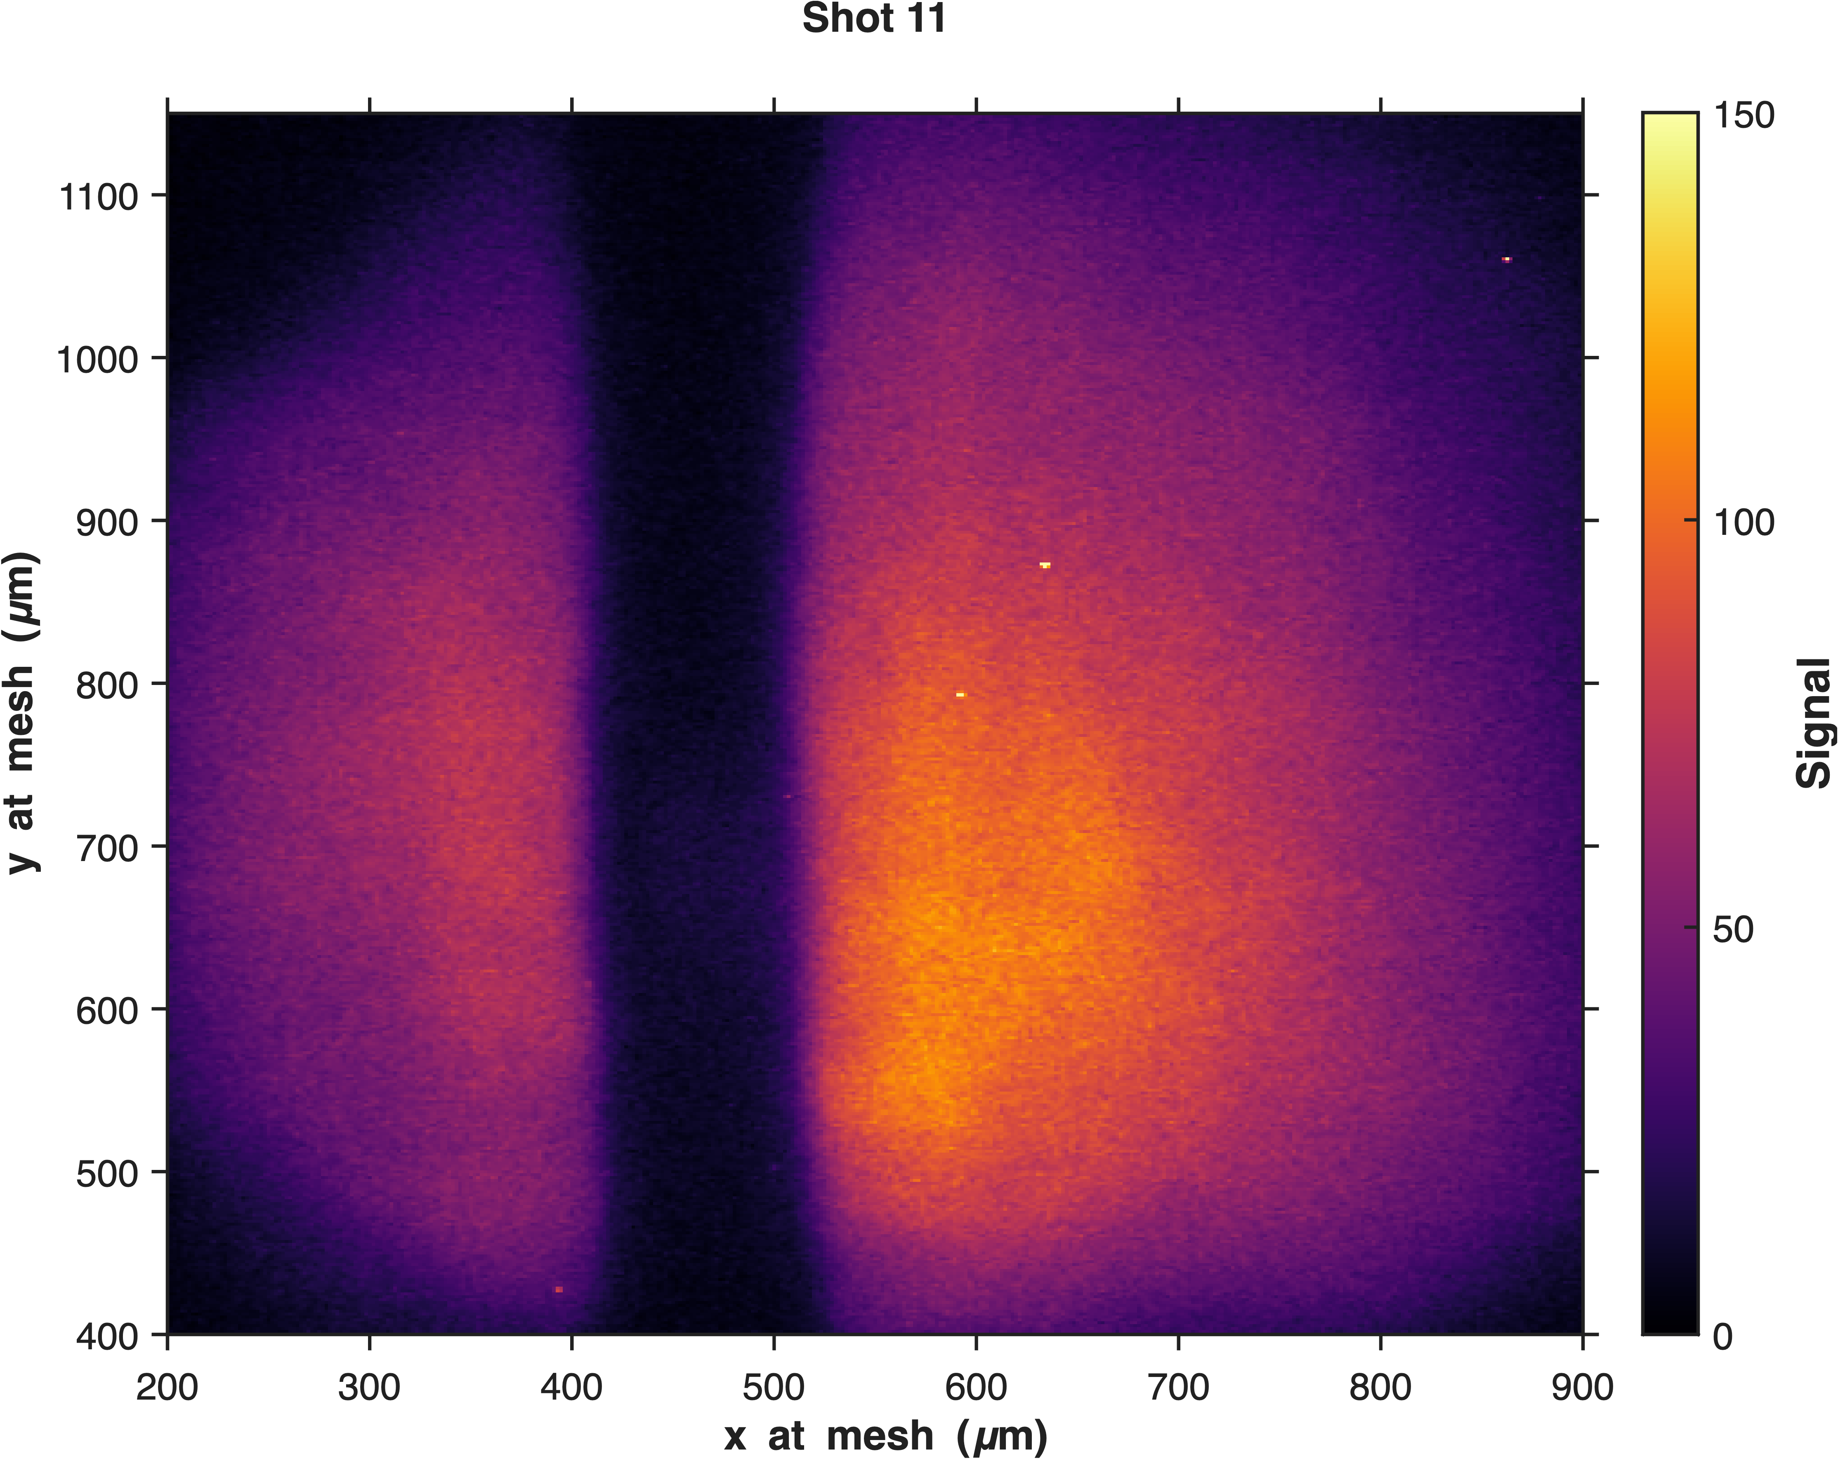
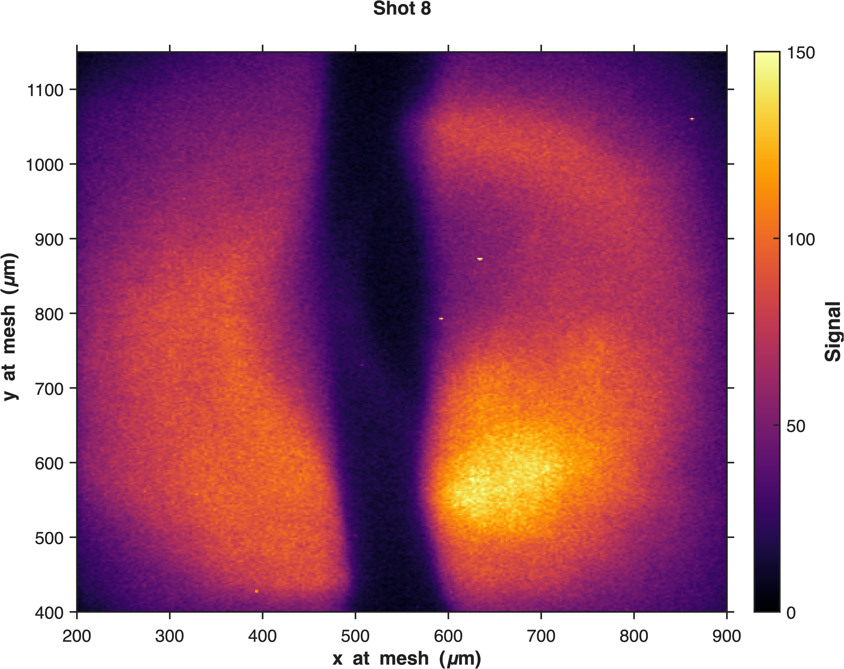
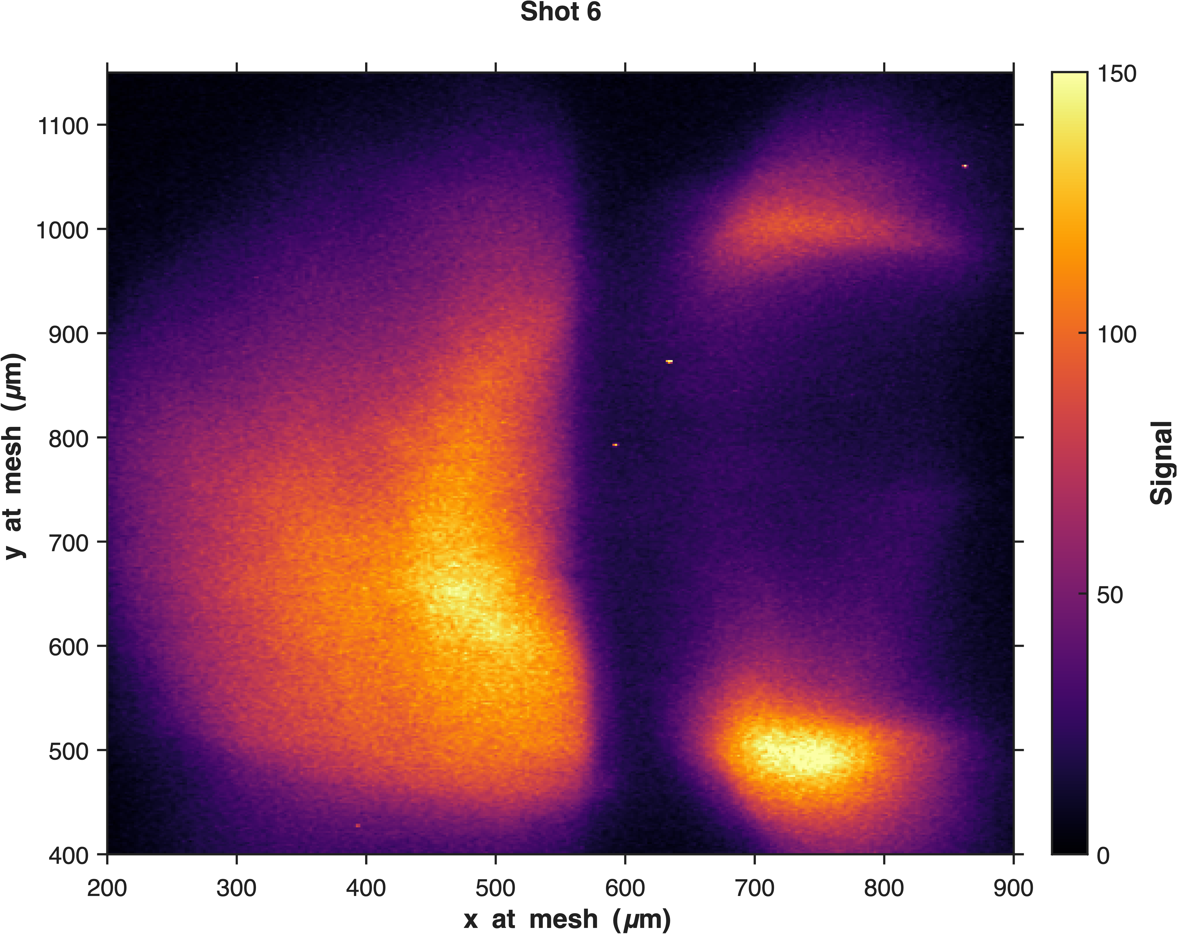
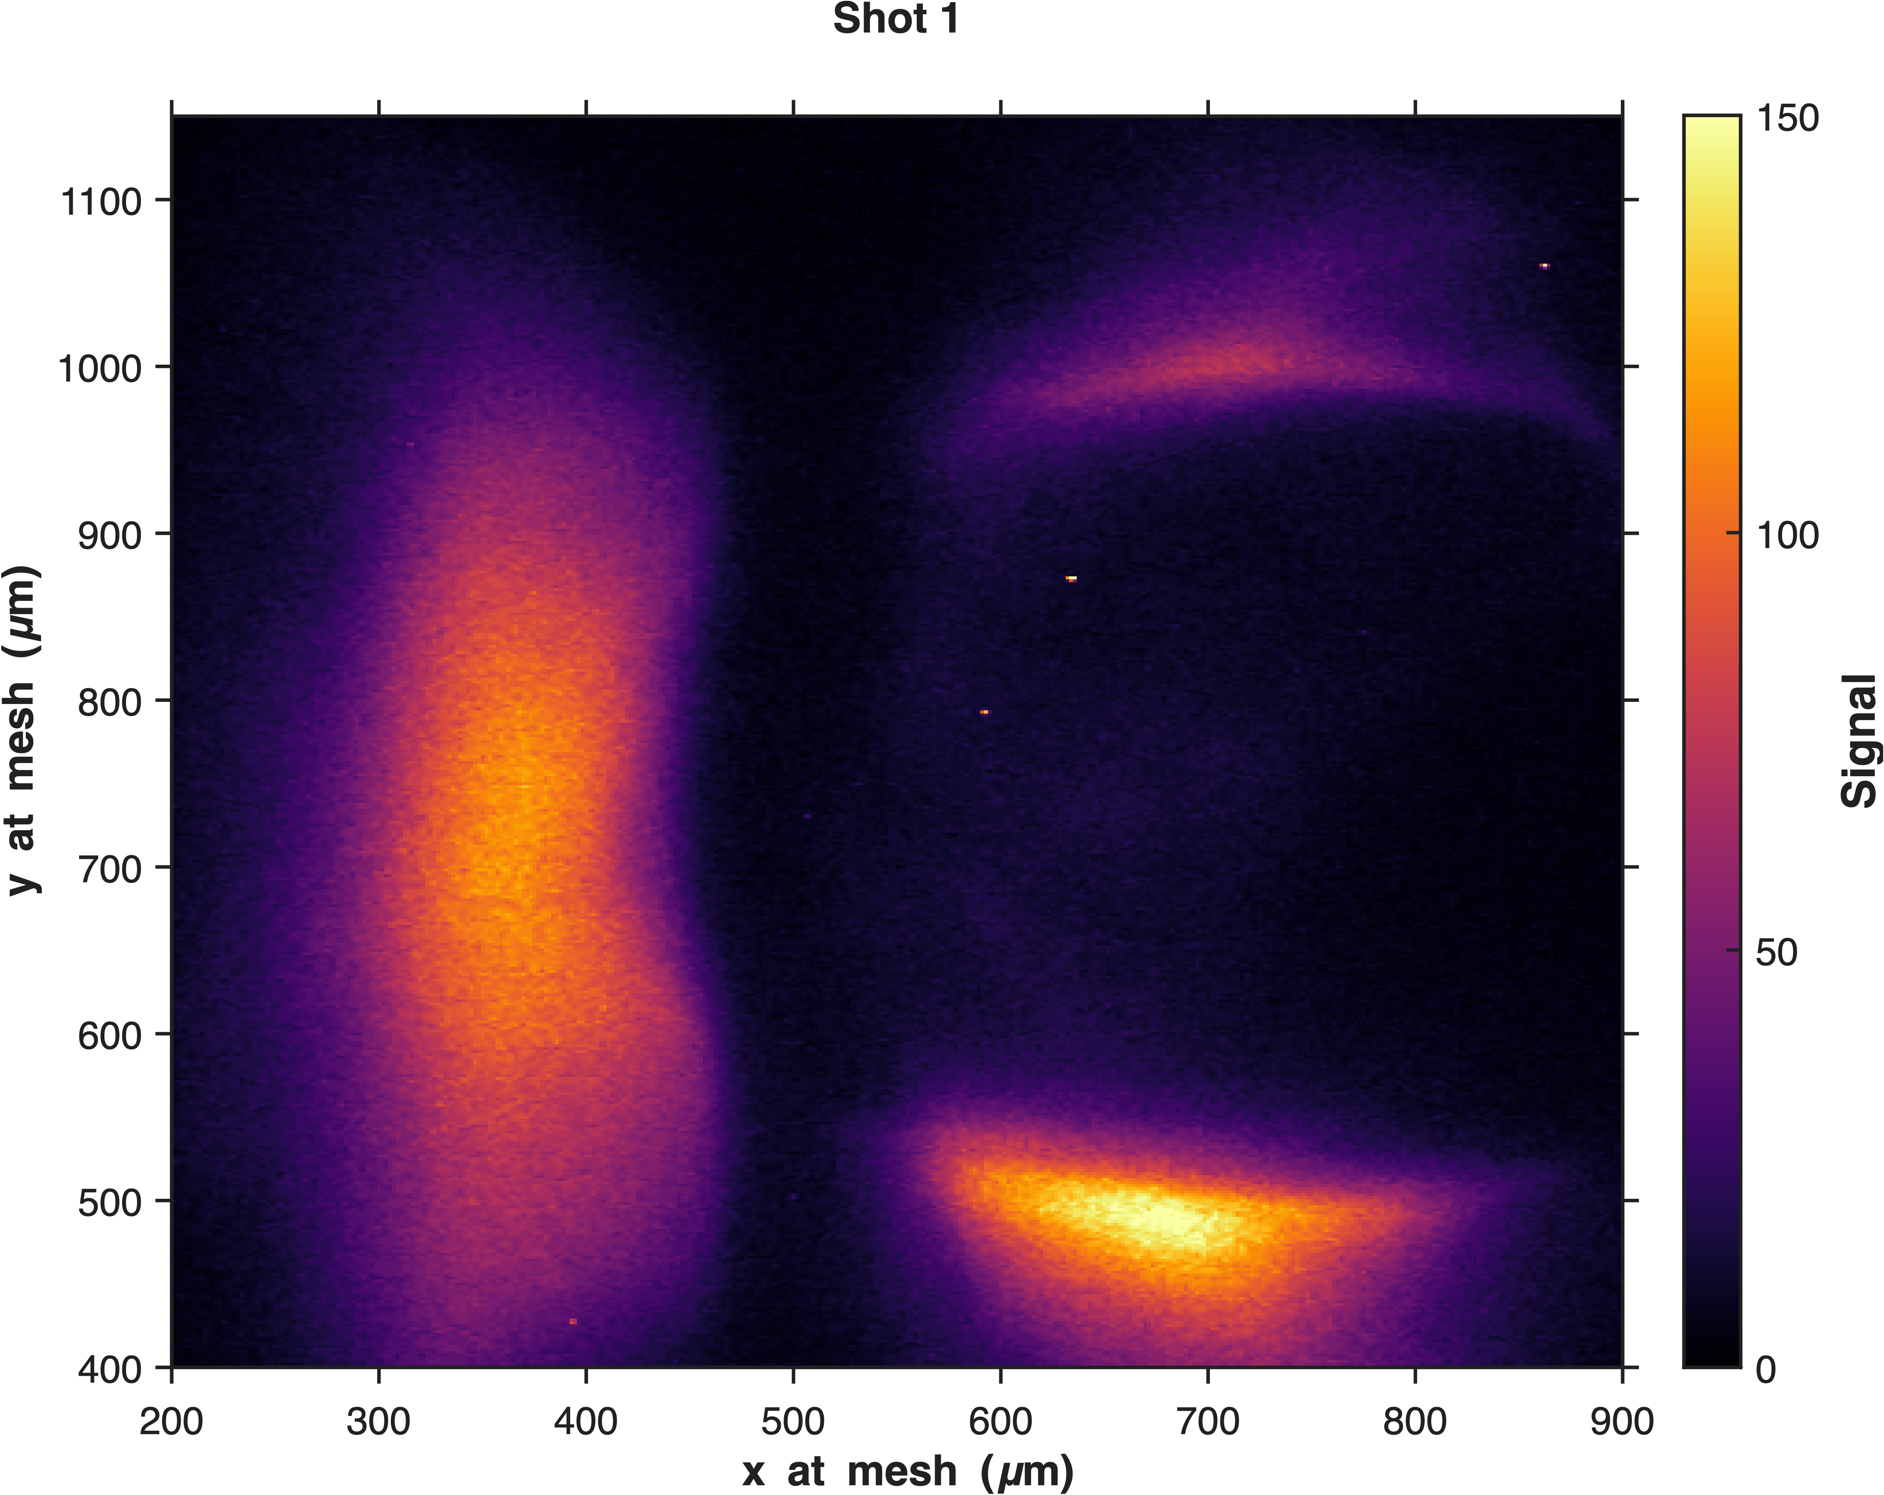
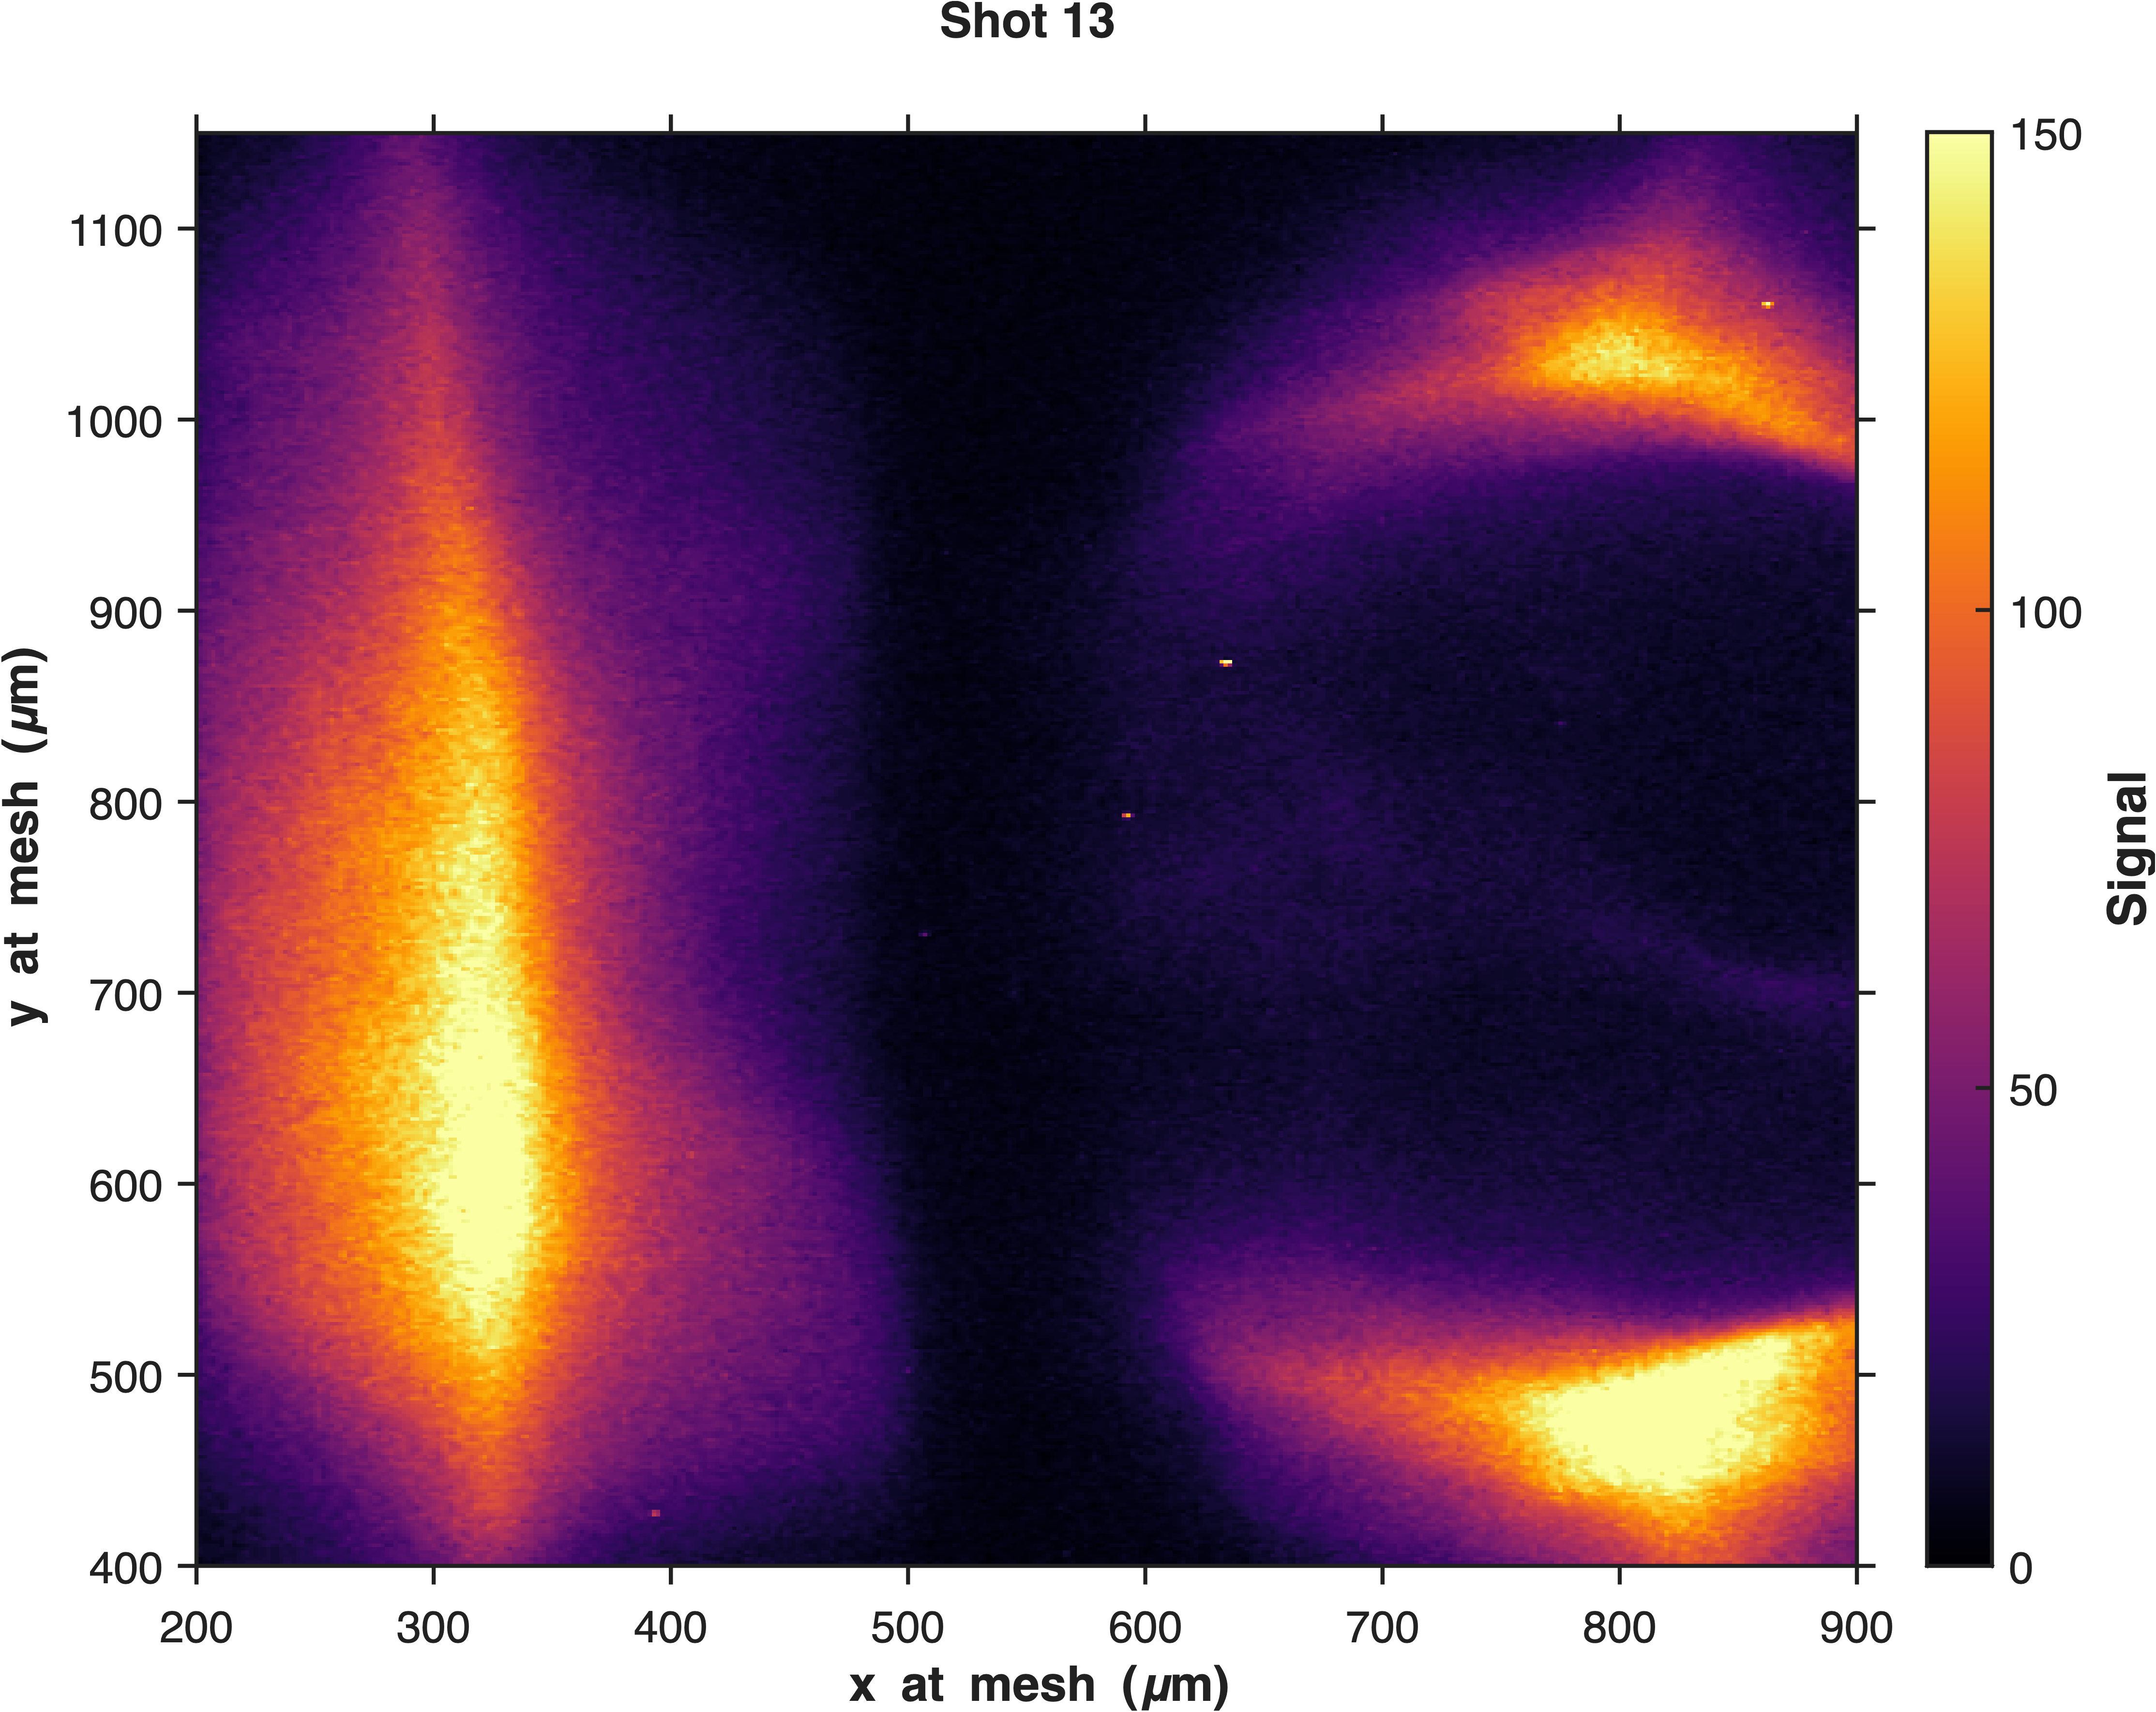
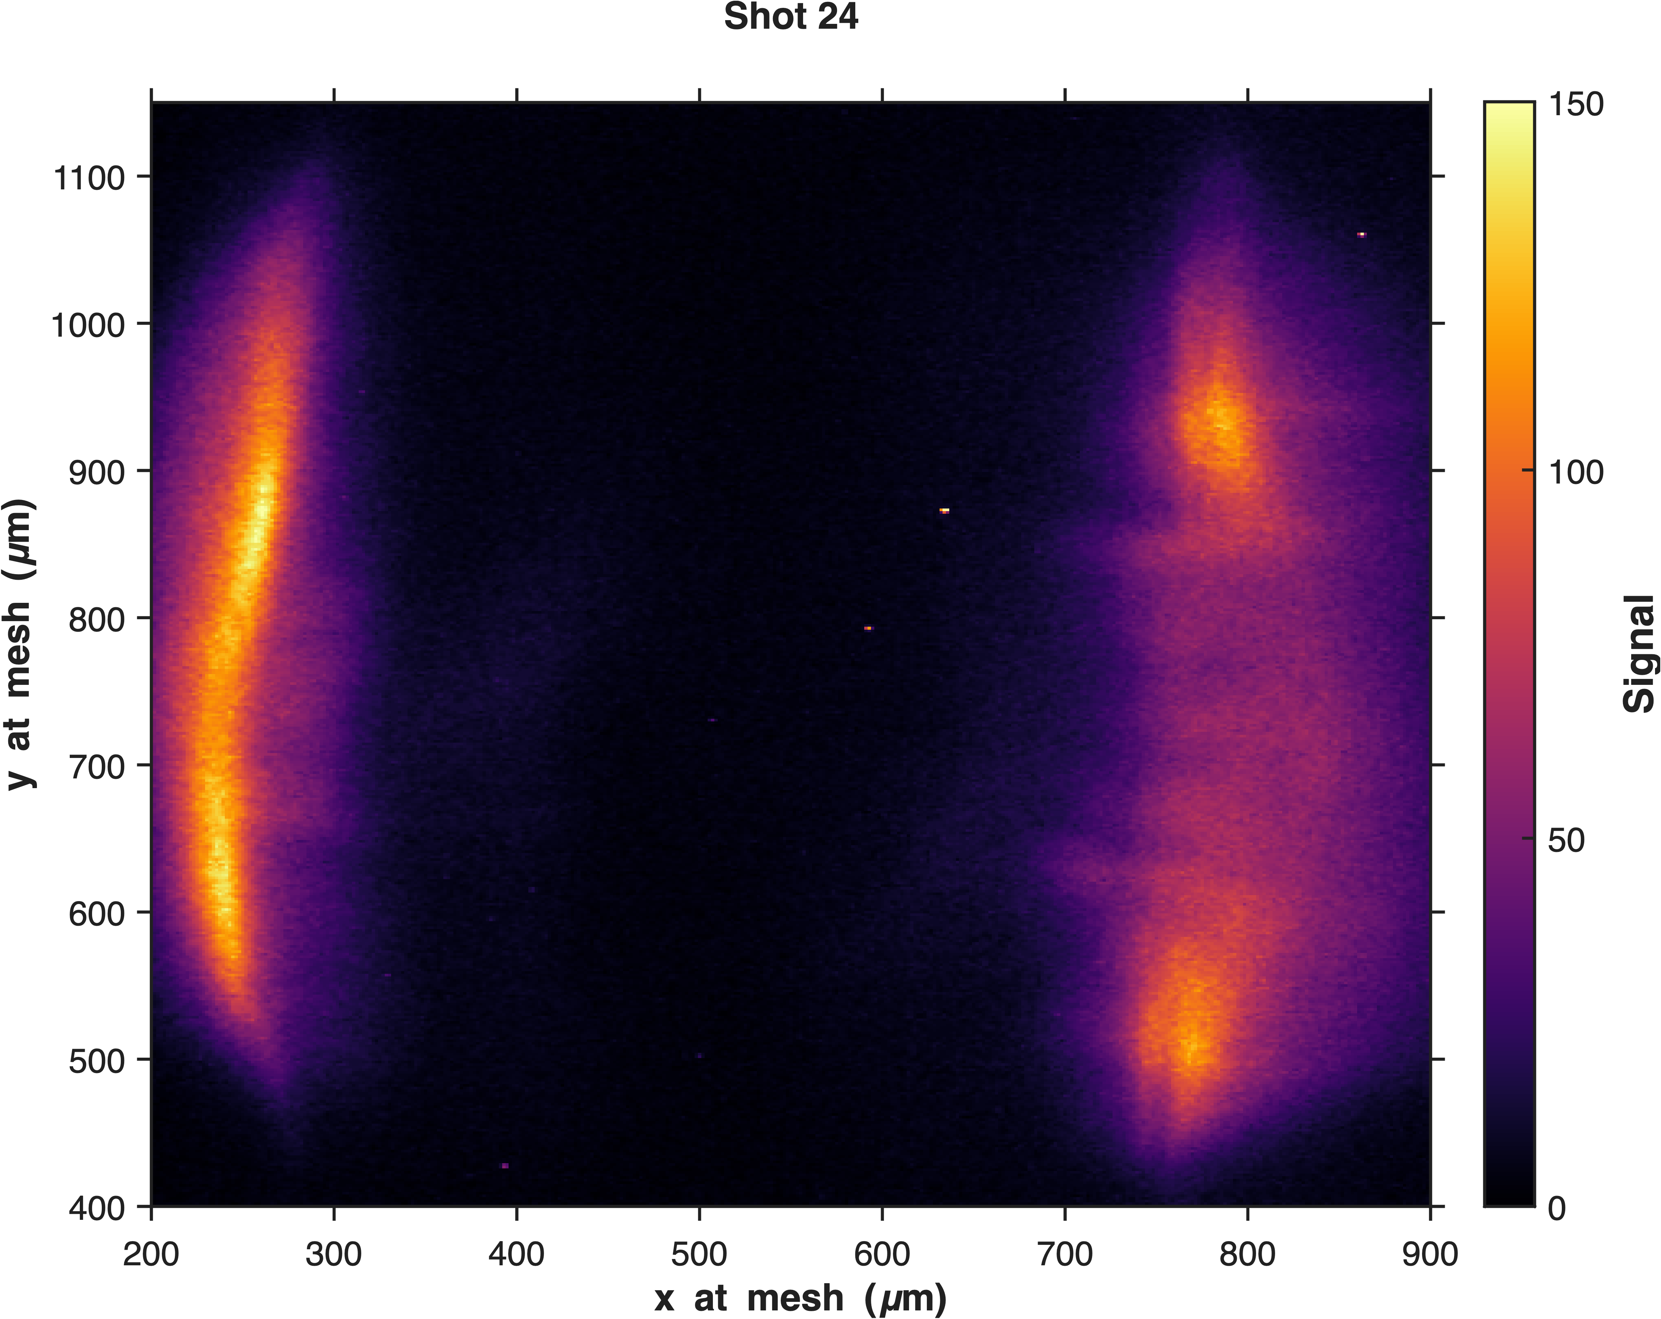
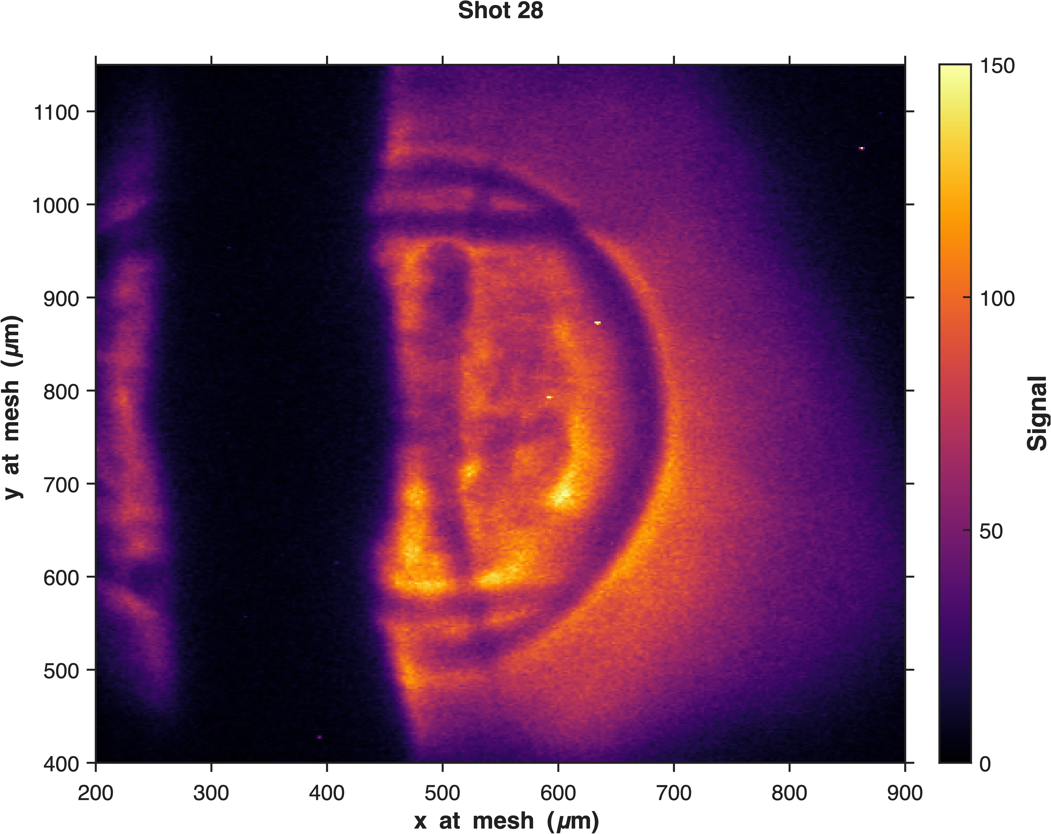
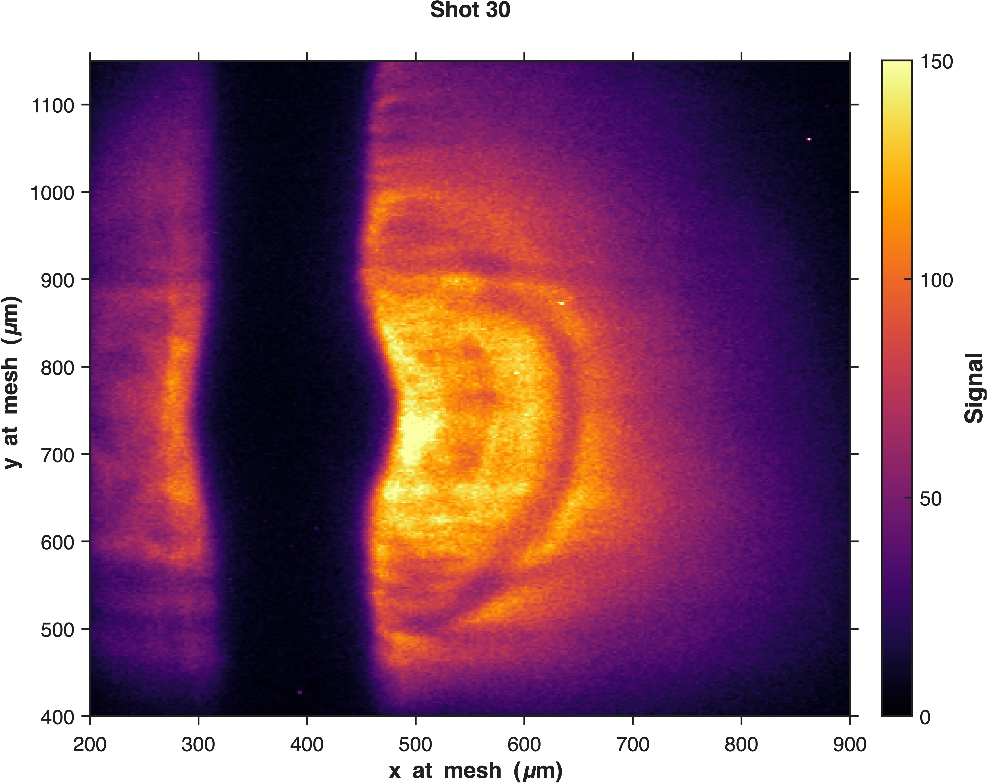








Preliminary Proton Probing Results: 3.3 MeV
Low energy (PW: ~12J, TW: ~2 J)
$$Before laser$$
$$Effects of prepulse$$
$$t_{0}± 2.5ps$$
$$t_{0} + 5 ps$$
y at mesh (µm)
x at mesh (µm)
x at mesh (µm)
x at mesh (µm)
x at mesh (µm)
$$t_{0} + 10 ps$$
$$t_{0} + 20 ps$$
$$t_{0} + 30 ps$$
$$t_{0} + 40 ps$$
y at mesh (µm)
x at mesh (µm)
x at mesh (µm)
x at mesh (µm)
x at mesh (µm)

Slide 16
Preliminary Proton Probing Results: 3.3 MeV
Low energy (PW: ~12J, TW: ~2 J)
$$Before laser$$
$$Effects of prepulse$$
$$t_{0}± 2.5ps$$
$$t_{0} + 5 ps$$
y at mesh (µm)
Original wire
Original wire
Original wire
Original wire
x at mesh (µm)
x at mesh (µm)
x at mesh (µm)
x at mesh (µm)
$$t_{0} + 10 ps$$
$$t_{0} + 20 ps$$
$$t_{0} + 30 ps$$
$$t_{0} + 40 ps$$
y at mesh (µm)
Original wire
Original wire
Original wire
Original wire
x at mesh (µm)
x at mesh (µm)
x at mesh (µm)
x at mesh (µm)

Slide 17
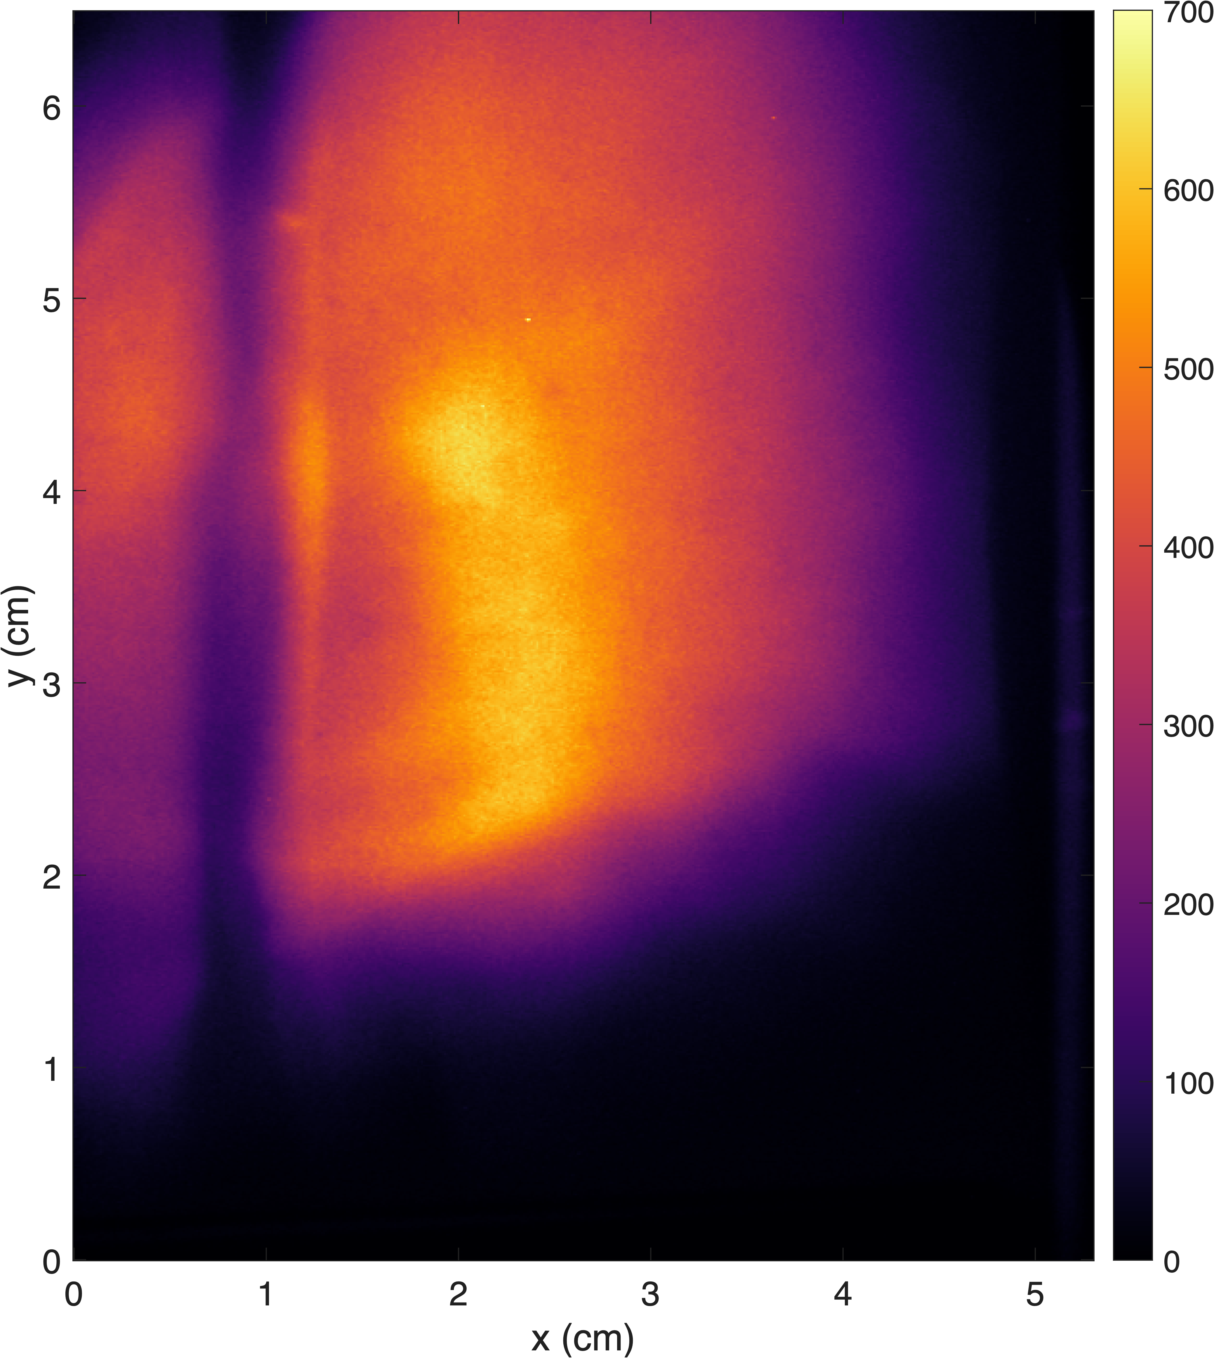
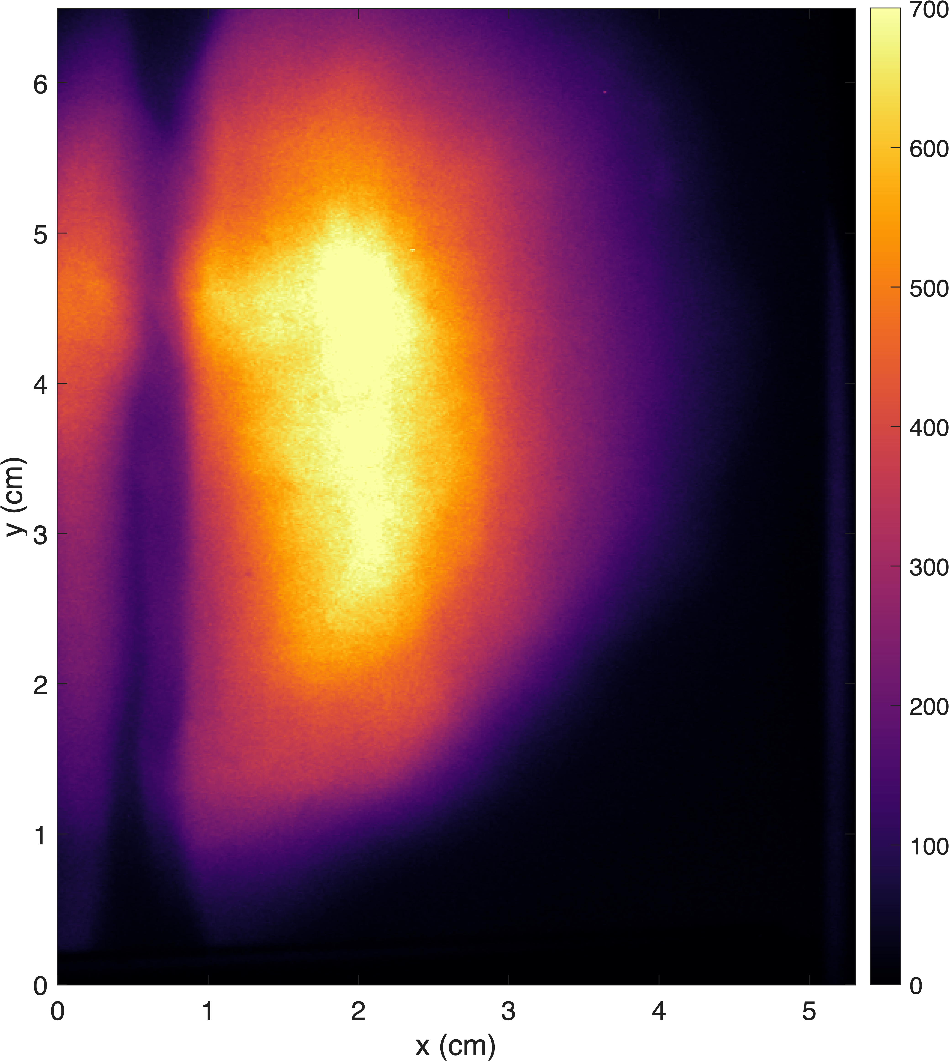
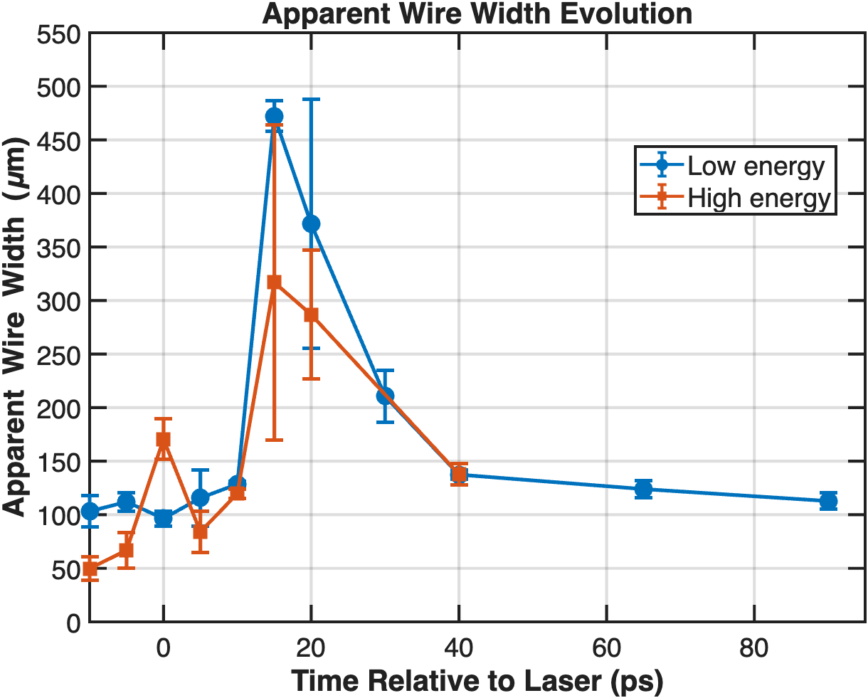
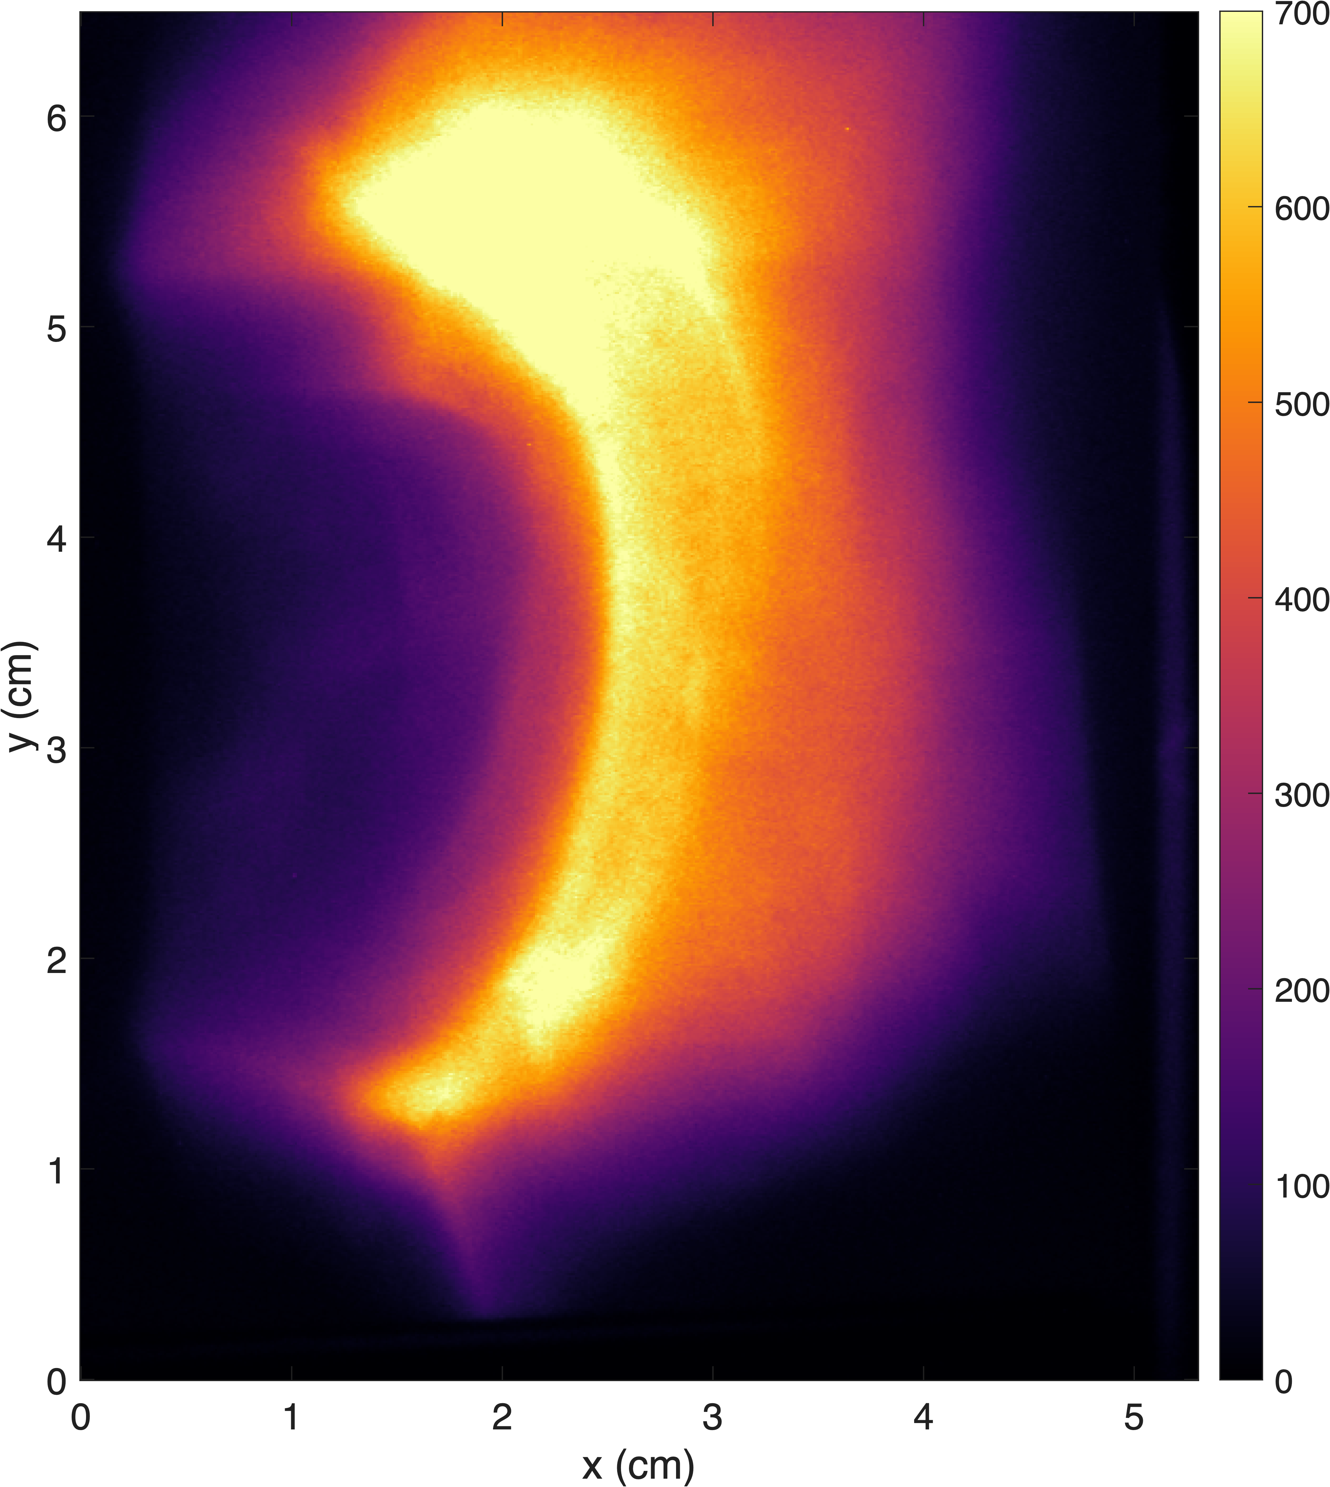
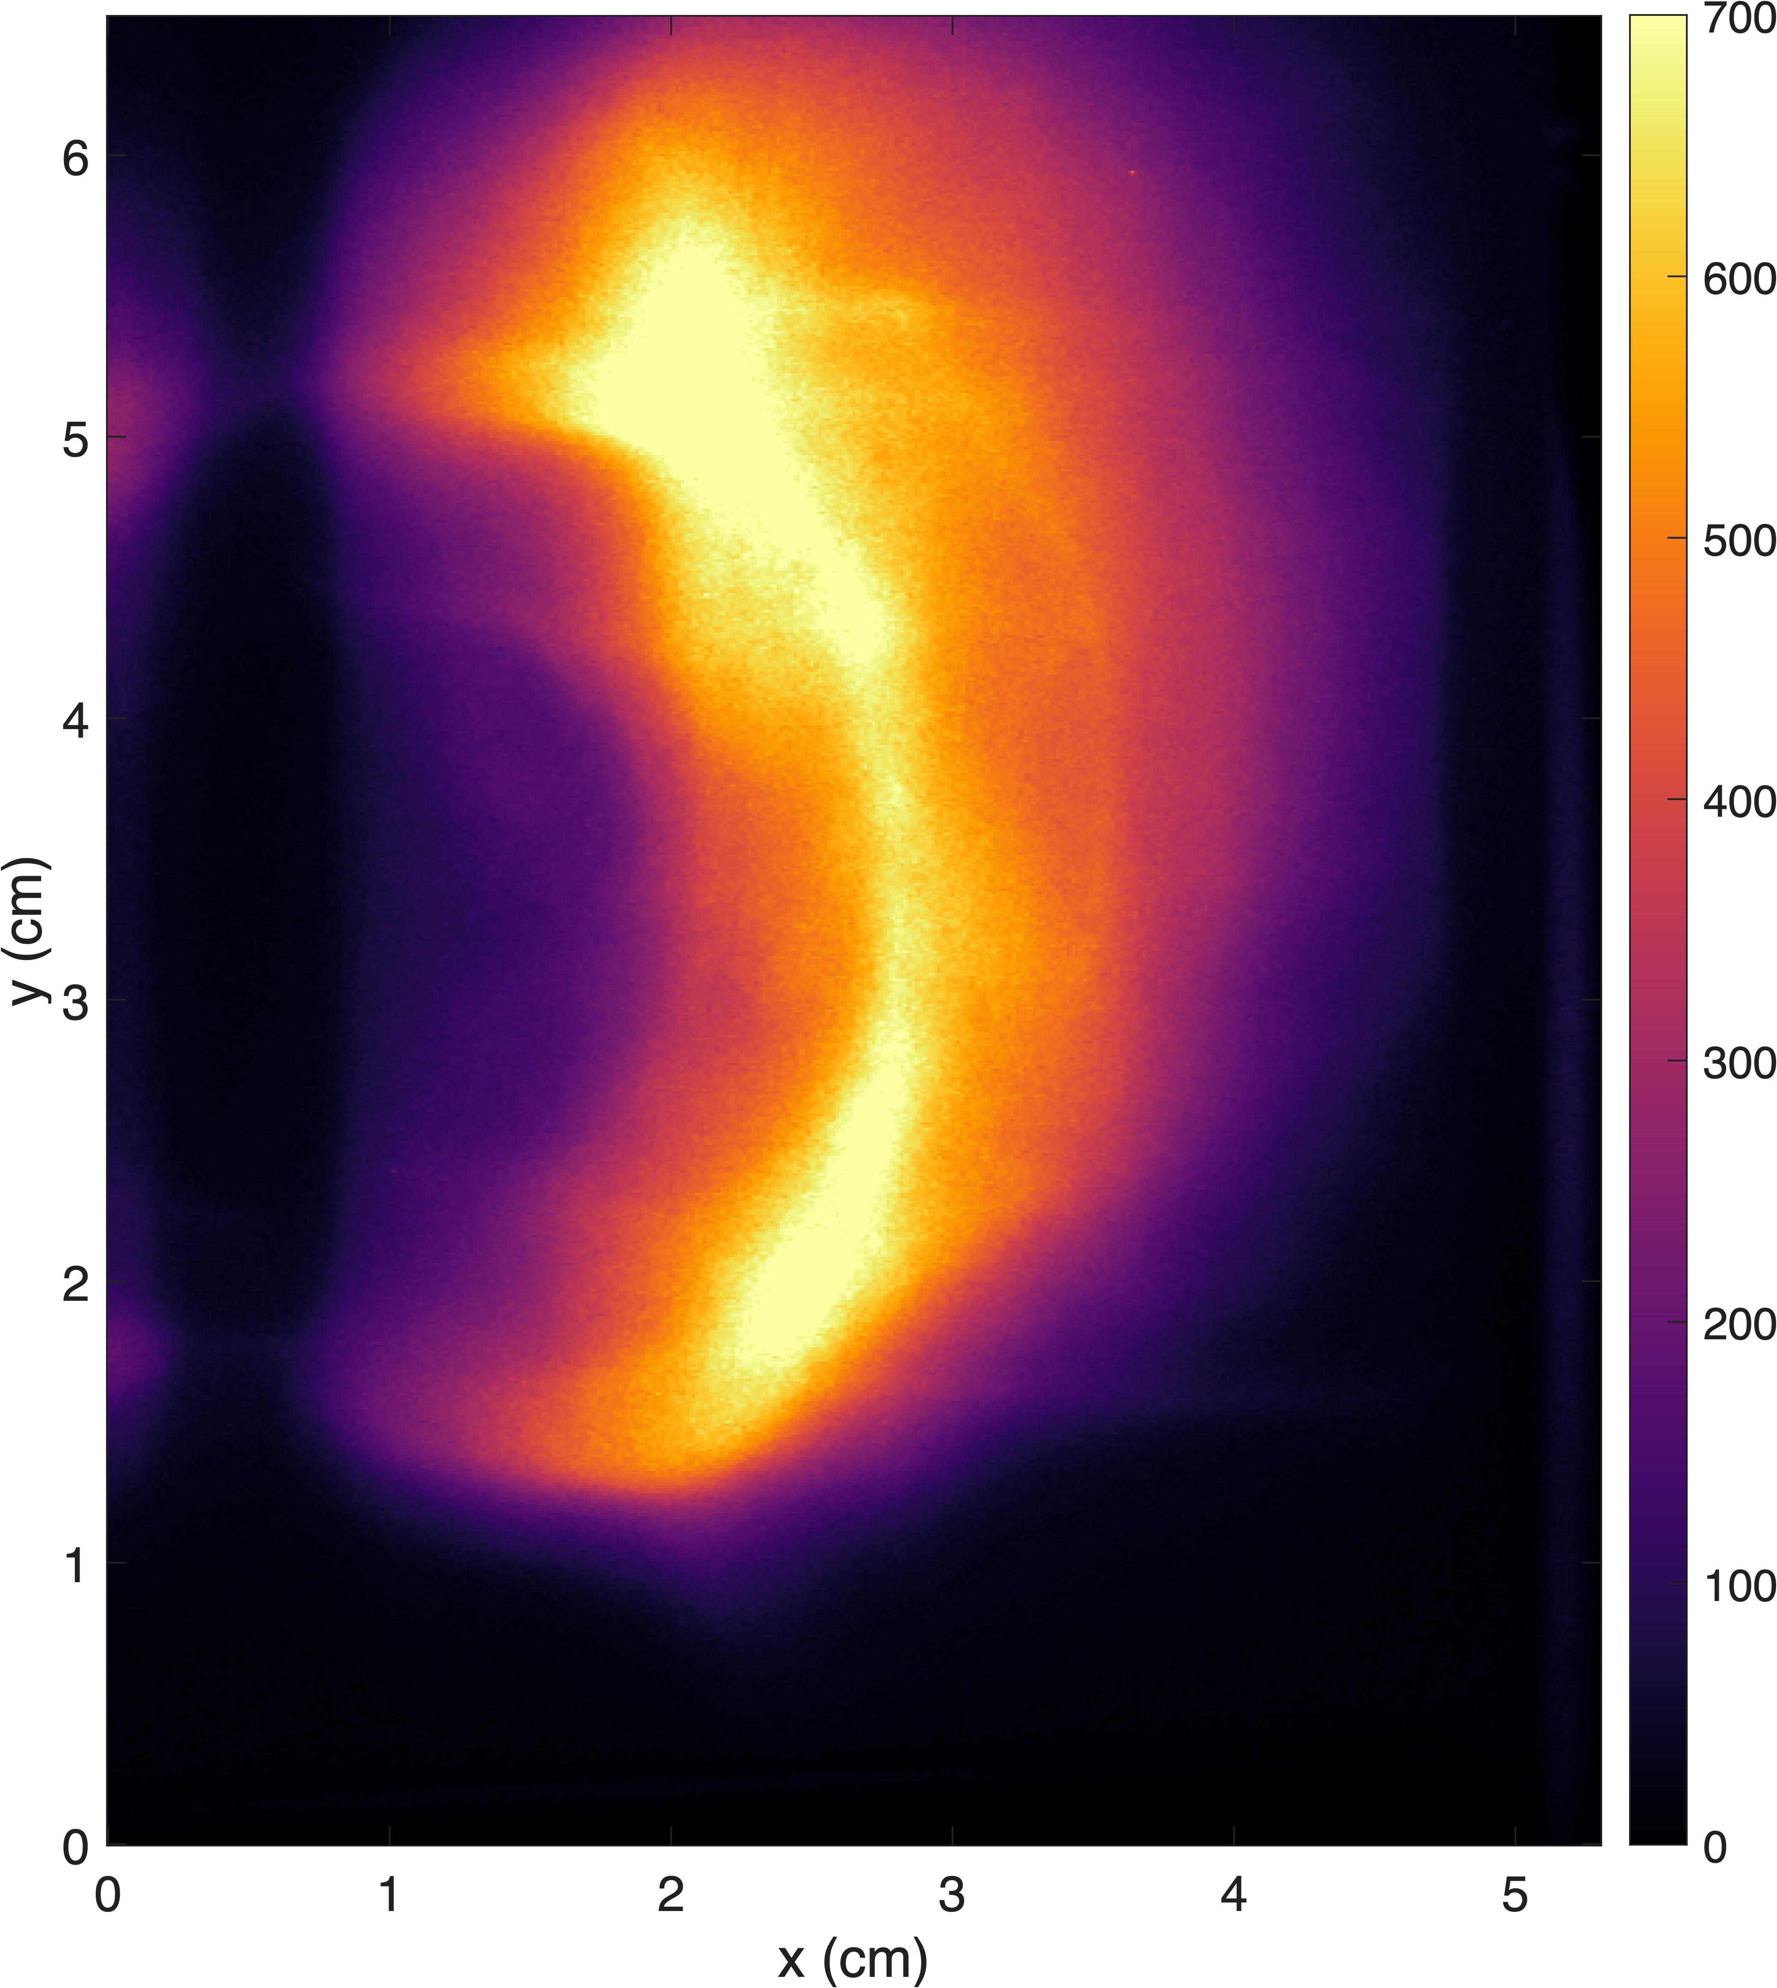
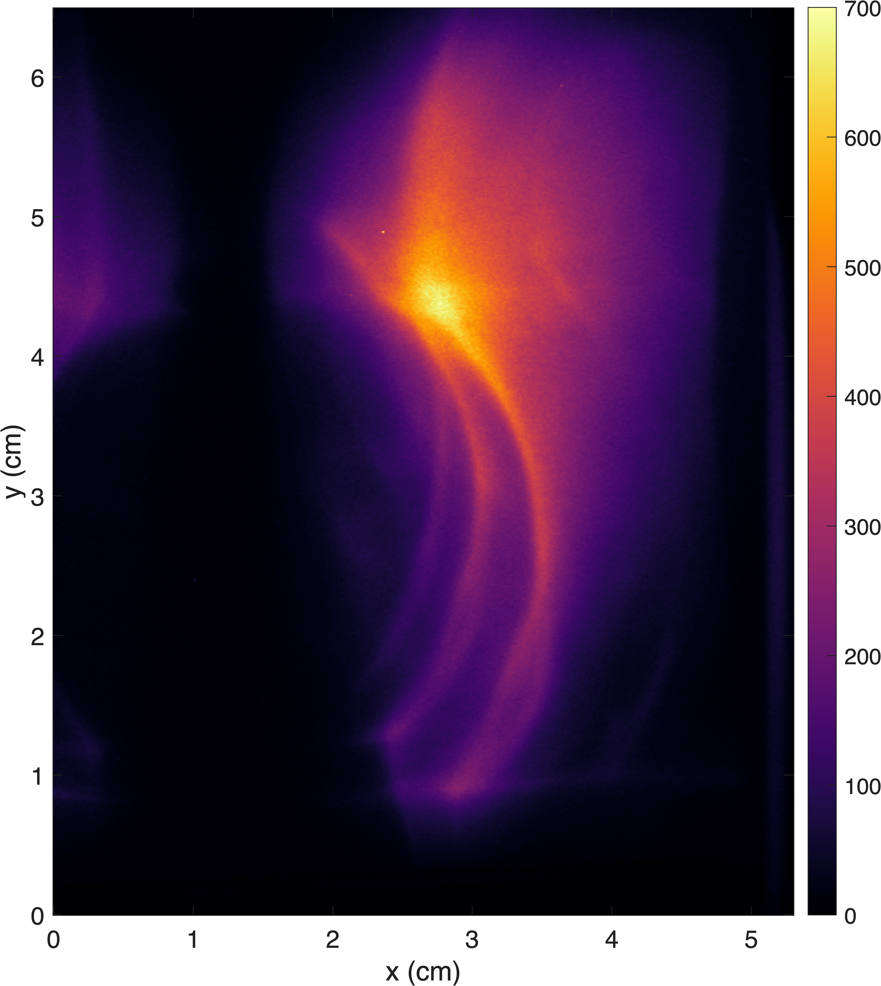
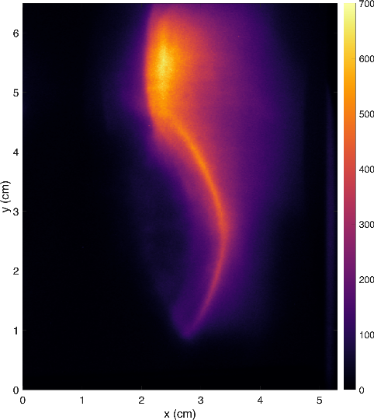


Preliminary Proton Probing Results: 3.3 MeV
High energy Snapshot:
PW: ~31J, TW: ~5.5 J
Parameters:
Low energy
PW: 12J, TW: 2 J
High Energy
PW: 31J, TW: 5.5 J

Slide 18




Time-resolved data snapshot
Layer 2: 3.7 MeV
Layer 1: 3.3 MeV
Shot A
t₀ - 1 ps
t₀ + 5 ps
Shot B
t₀ + 34 ps
t₀ + 40 ps

Slide 19





Conclusions
GOSSIP – Glowing On-shot Scintillator Stack for Imaging Protons
  3D-printed, simple, easily reconfigurable holder
  Allows for simultaneous beam profile, pointing, and divergence measurements
  Stack can provide time-resolved interaction information with sufficient proton beam energy
Measurements taken at ZEUS with
  Grids for diagnostic characterization
  fs proton deflectometry
Next steps
  Field inversion for probe data

Slide 20

Questions
Email: vacontre@umich.edu

Slide 21
Image blurring effect is due to small-angle scattering in the detectors.
Line Spread Function
Shot A
Normalized LSF
Take the same, well-defined mesh edge near the center of each detector image
Resulting fit is used to calculated the line spread function
Fit an error function to the measured edge spread function
Mesh-plane position [mm]
Narrow peak → better localization of proton signal
Broader peak → increased blur
Notes:
This slide investigates the origin of the image blur we observe.
For each detector layer, I selected the same well-defined mesh edge near the center of the image.
An error function was fit to the measured edge spread function, and the resulting fit was used to calculate the line spread function and modulation transfer function.

Slide 22


Scattering-induced image blur
ZEUS TA 1: Proton Probing Experiment Results - Characterization
Shot A
Experimental Data
Normalized Intensity
Normalized LSF
MTF
Mesh-plane position [mm]
Mesh-plane position [mm]
Spatial frequency [lines/mm]
ESF:
As edge becomes less sharp, transition broadens → loss of spatial resolution
LSF:
Narrow peak → better localization of proton signal
Broader peak → increased blur
MTF:
Higher MTF at a given spatial frequency → finer image detail
Notes:
This slide investigates the origin of the image blur we observe.
For each detector layer, I selected the same well-defined mesh edge near the center of the image.
An error function was fit to the measured edge spread function, and the resulting fit was used to calculate the line spread function and modulation transfer function.

Slide 23

ZEUS TA1: Proton Probing Characterization for Scattering

Slide 24


Contrast
ZEUS TA 1: Proton Probing Experiment Results - Characterization
Contrast tells how well the detector can distinguish adjacent mesh wires and openings
  $$Contrast = \frac{I_{max}− I_{min}}{I_{max}+I_{min}}$$
Shot A
Average over a small region
Identify peaks and valleys
Calculate contrast for each period (wire)

Slide 25






Contrast
ZEUS TA 1: Proton Probing Experiment Results - Characterization
Horizontal Results Summary
Layer | Mean Contrast | Standard Deviation
1 | 0.245 | 0.101
2 | 0.235 | 0.077
3 | 0.283 | 0.102
Horizontal
Vertical
Vertical Results Summary
Layer | Mean Contrast | Standard Deviation
1 | 0.225 | 0.093
2 | 0.240 | 0.106
3 | 0.232 | 0.052
Notes:
The differences in mean contrast are fairly modest
contrast varies substantially across each detector, motivating the spatial heat-map analysis instead of relying on a single average value.

Slide 26
Contrast
ZEUS TA 1: Proton Probing Experiment Results - Characterization
Horizontal Results Summary
Local contrast measurements show non-uniform imaging performance across each scintillator layer.
Measured contrast can be influenced by:
  Proton scattering within the detector stack
  Camera imaging conditions (e.g., ND filtering/camera settings)
  Local detector response
Together, the horizontal and vertical analyses suggest that the measured contrast depends on the orientation of the mesh features.
Layer | Mean Contrast | Standard Deviation
1 | 0.245 | 0.101
2 | 0.235 | 0.077
3 | 0.283 | 0.102
Vertical Results Summary
Layer | Mean Contrast | Standard Deviation
1 | 0.225 | 0.093
2 | 0.240 | 0.106
3 | 0.232 | 0.052

Slide 27

ZEUS TA1: Proton Probing Experiment Setup
Layer 1: 3.2 MeV (+ 5.7 ps)
Layer 2: 3.7 MeV (+ 12.5 ps)
Layer 3: 5.3 MeV

Slide 28

GOSSIP design
Values from TRIM
J. F. Ziegler, et. al, Nuclear Instruments and (2010).

