Slide 1


On-line optimization of a high average power laser-driven ion source using Markov Chain Monte Carlo algorithm
T. Gilinger, Z. Jäger, E. Buzás, Á. Kovács, P. Varmazyar, B. Bencsik and K. Osvay
Advanced Accelerator Concepts 2026

Slide 2
Outline
Introduction
Bayesian Optimization - the Gold standard
Markov-Chain Monte Carlo algorithm
Application of the MCMC
Summary and outlook

Slide 3
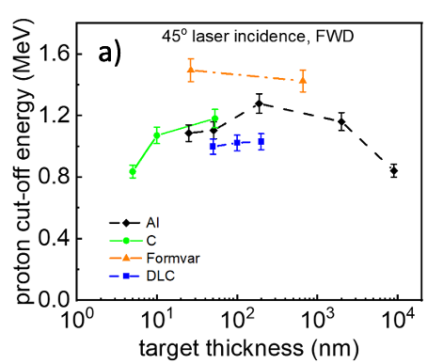
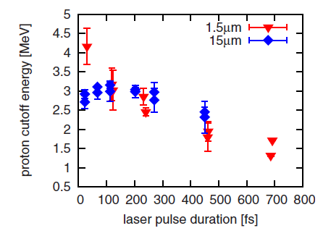
Laser-Plasma ion acceleration
Early-stage investigation of laser-driven plasma ion accelerators (LPIAs)
Maximum ion energy depends on
Target (material, thickness…)
Laser pulse parameters (wavelength, energy, duration, temporal contrast, wavefront…)
Macchi et al., Rev. Mod. Phys. 85 (2013) 751
Flacco et al., PRE 81 (2010) 036405
Ter-Avertisyan et al., Plasma Phys. Control. Fusion 65 (2023) 085012
Takagi et al., PRR 3 (2021) 043140

Slide 4
How to find the maximum?
(cutoff, bunch energy, ….)

Slide 5
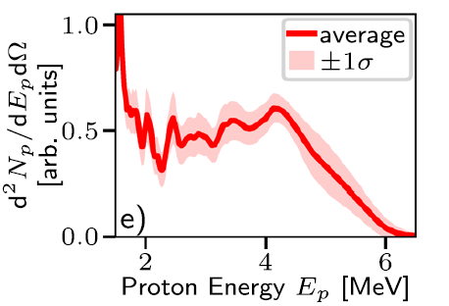
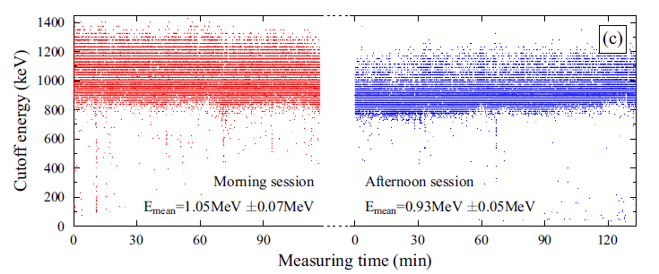
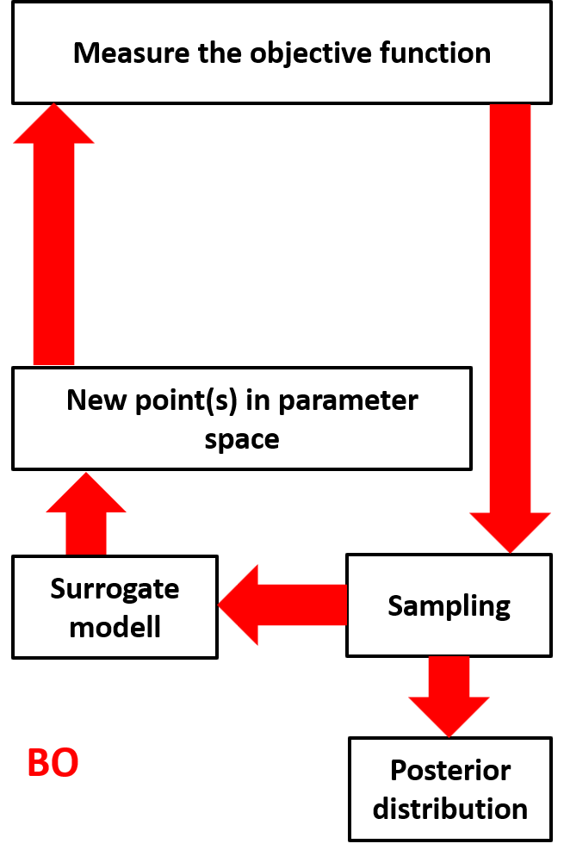
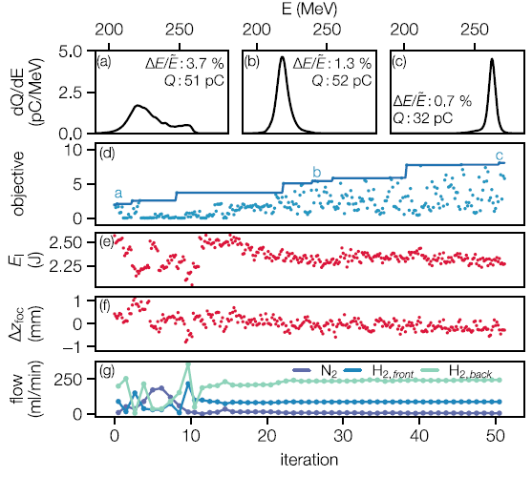
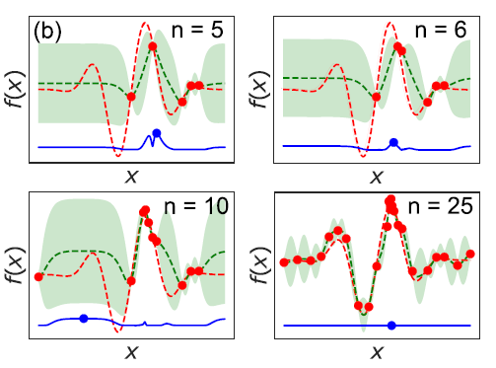
Optimization history so far…
Streeter et al., Nat Commun 16 (2025) 1004
Evolution of high peak power laser technology
  Higher repetition rate (few Hz)
  Increased pulse-to-pulse stability
  Joule-class laser systems
Quasi-continuous, stable performance
Bayesian optimization (BO)
  Surrogate model
  Sampling the parameter space (up to few tens/hundreds of points)
  Predict the performance and
  explore physics
Stuhl et al., PRR 7 (2025) 023137
Optimization algorithms
Jalas et al., PRR 126 (2021) 104801
Optimization via
  Wavefront control
  Pulse duration control
Dolier et al., New J. Phys. 24 (2022) 073025
Loughran et al., HPLSE 11 (2023) 35

Slide 6
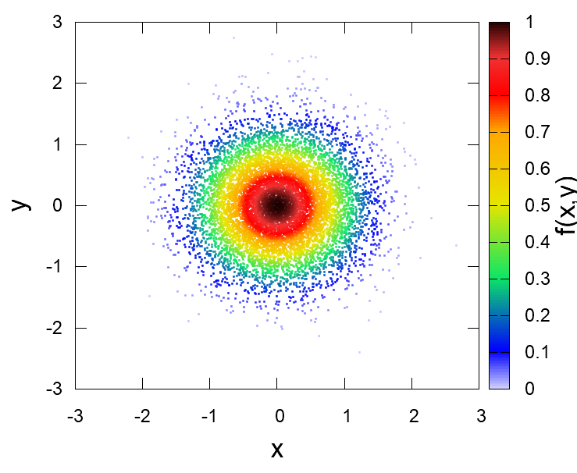











What if we have more points?
$$E$$
$$E\left(x_{3}\right)$$
$$\frac{E\left(x_{2}\right)}{E\left(x_{1}\right)} \begin{matrix}? \\ ≥ \\ \end{matrix} 1$$
New optimization method:
Markov-Chain Monte Carlo (MCMC)
5.
$$E\left(x_{2}\right)$$
$$E\left(x_{1}\right)$$
  Step: Choose a random x = x₁
  Step: Measure E(x₁)
  Step: From x₁ make a random step
  (using e.g., Gaussian distribution)
  Step: Measure E(x₂)
  Step: Comparison: E(x₂)/E(x₁) ≥ 1?
    If ≥ 1 -> Accept the step – new origin is x₂
    If < 1 -> Choose U[0,1] randomly
      If E(x₂)/E(x₁) ≥ U ->Accept the step…
      If E(x₂)/E(x₁) < U -> Reject the step – new origin is x₁
  Step: From x₂ (if x₂ accepted) or x₁ (if x₂ rejected) make a random step …
4.
Energy
2.
$$E\left(x\right)$$
6.
3.
1.
$$X$$
$$x_{3}$$
$$x_{2}$$
$$x_{1}$$
The distribution of the sample points is similar to the measured function: n(x) ~ E(x)
$$E\left(x,y\right)$$
More points in the higher energy regime!

Slide 7
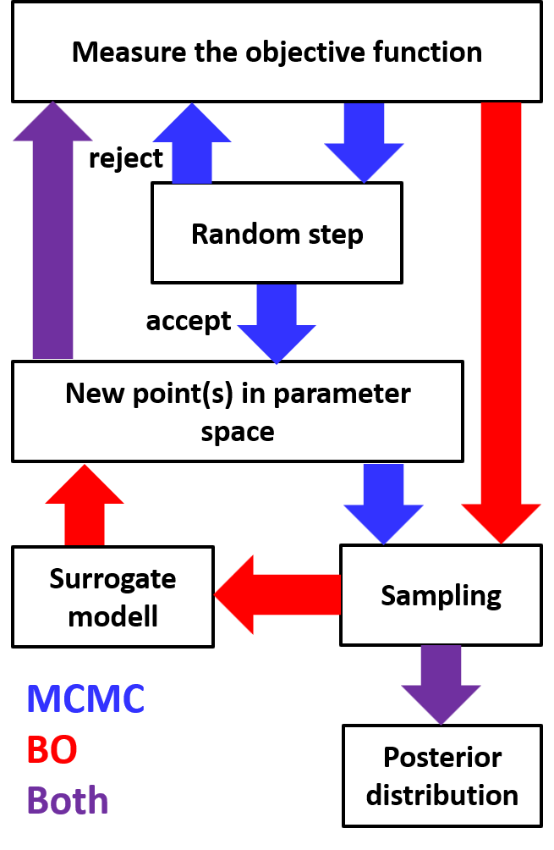
What if we have more points?
BO vs. MCMC
Method | BO | MCMC
Optimum | From multiD function | Converging
Physics | Explore “on-line” | “off-line”
Necessary data points for convergence (N) | 10-100 | 100-1000
Computational complexity | ~N³ | ~N
Configurable parameters | Few (1-6) | Large number
Time required | 30-60 min | ?

Slide 8
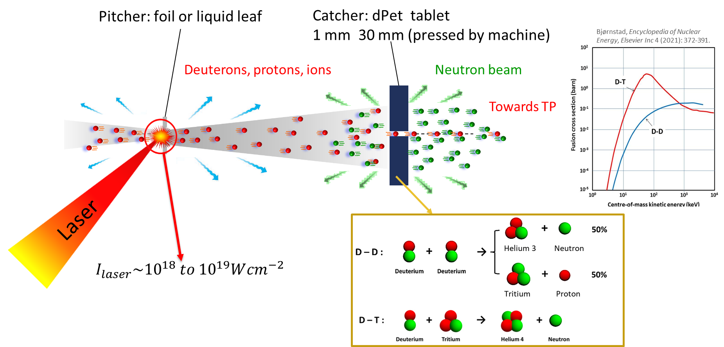
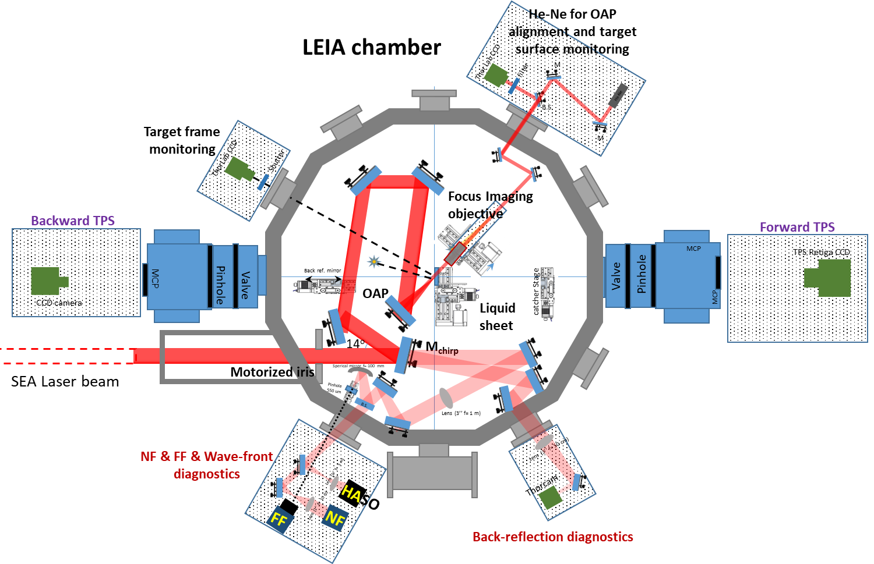
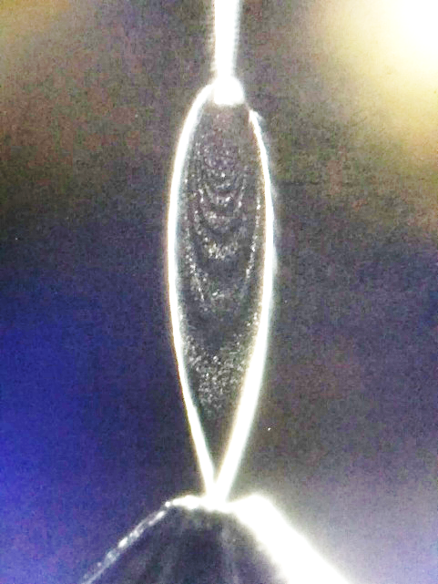
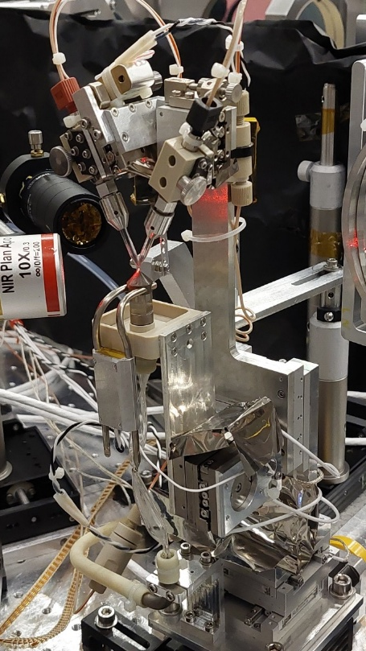
The Low-Energy Ion Acceleration (LEIA) Beamline
Karoly Osvay’s talk on Tue WG6
Stuhl et al., PRR 7 (2025) 023137
Füle et al., HPLSE 12 (2024) e37

Slide 9
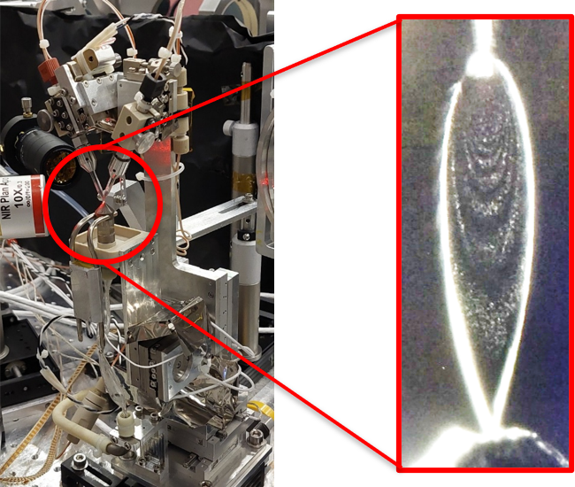
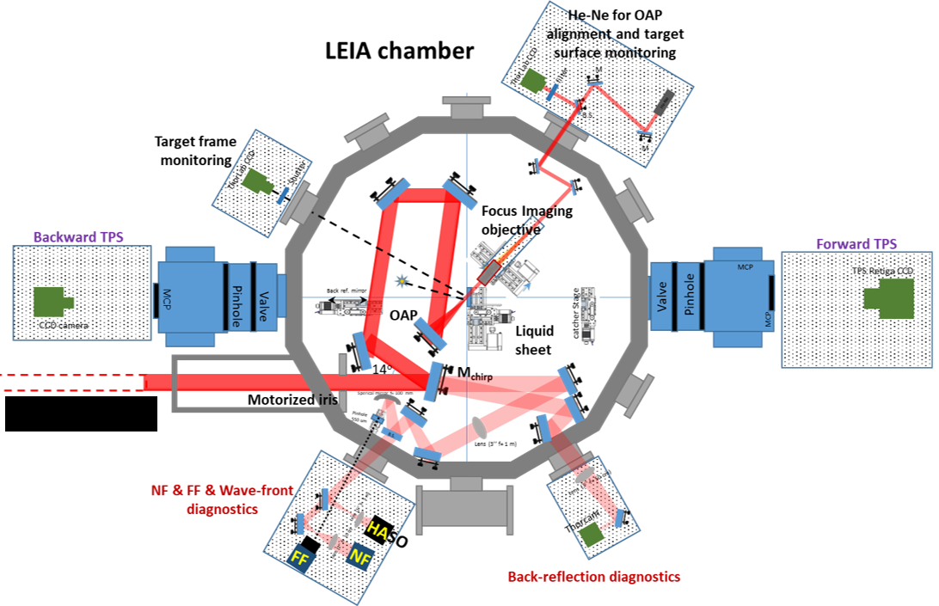
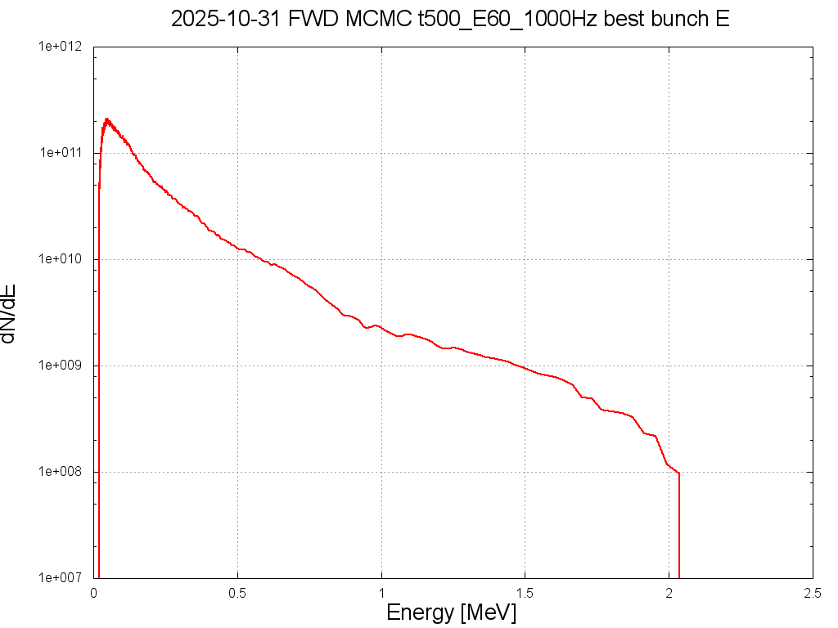
Ion spectra evaluation & optimization
Thomson Parabola Spectrometer
Laser system
Data transfer
Pulse
Ions
D⁺
24 ms!
O²⁺
O¹⁺
O³⁺
Control
O⁴⁺
Dazzler
MCMC
Command
Results
Cutoff
Bunch
Fast evaluation

Slide 10
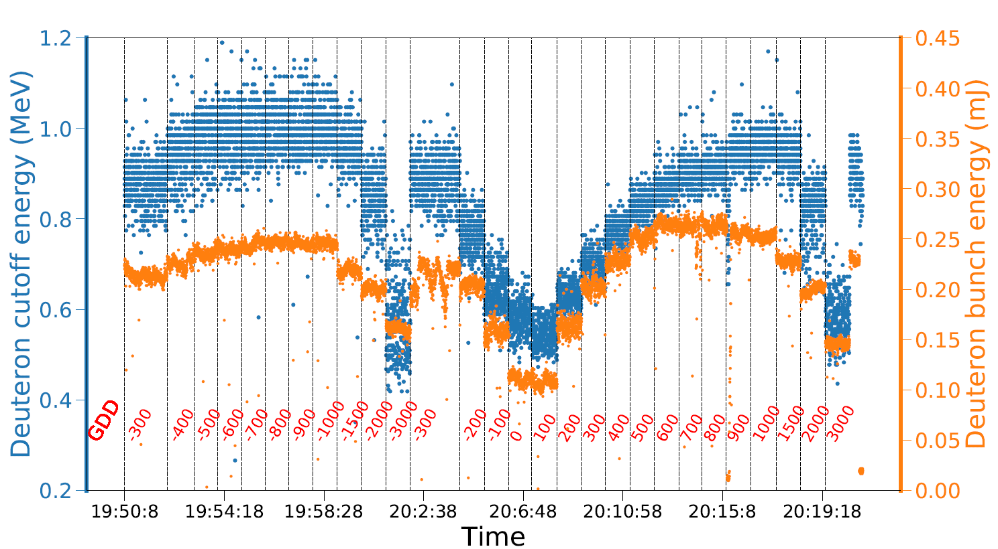
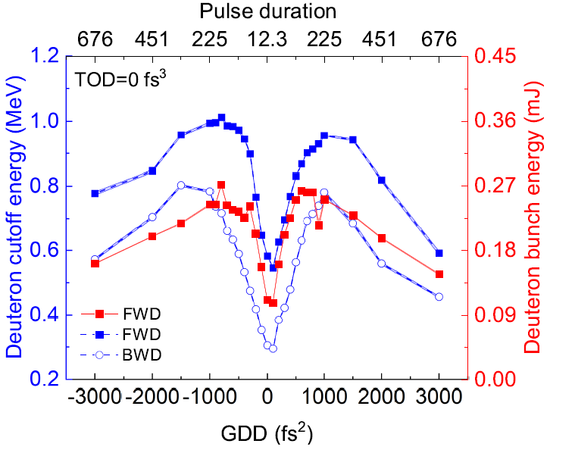
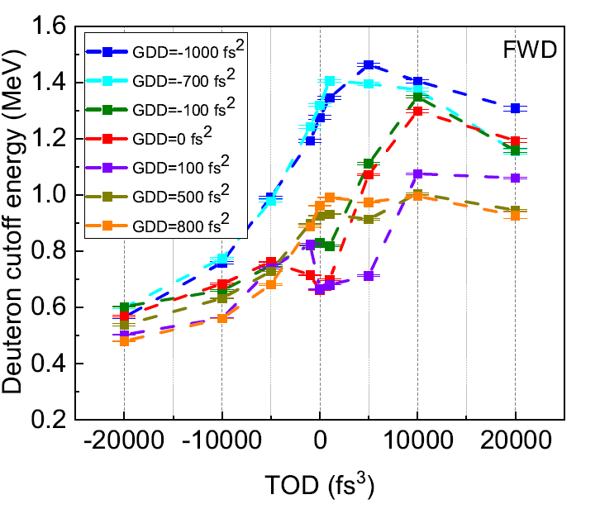
Interaction optimization via spectral phase shaping
@10 Hz
Liquid leaf of heavy water: 230 nm
Scanning GDD
and TOD
Each point: average of 600 shots
Varmazyar et al, Comm.Phys. 8 (2025) 350
Optimization of the spectral phase:
change GDD and TOD simultaneously!

Slide 11
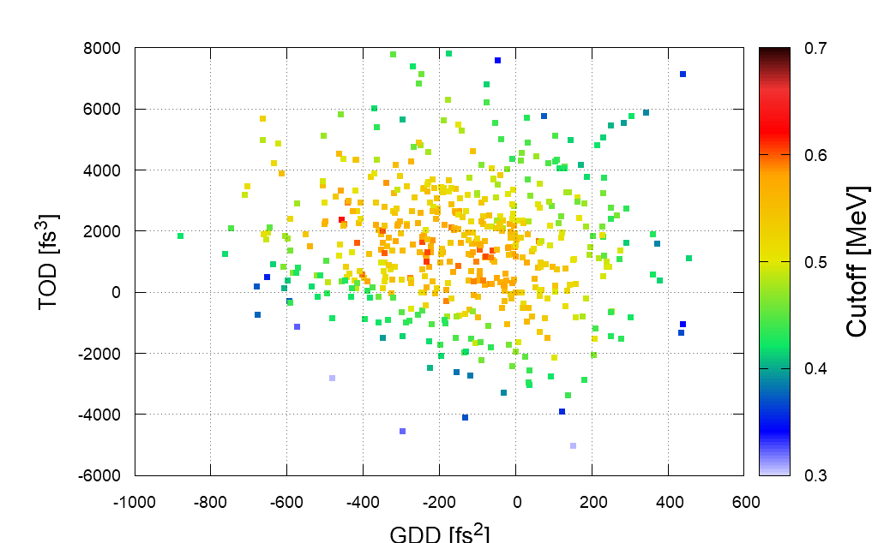
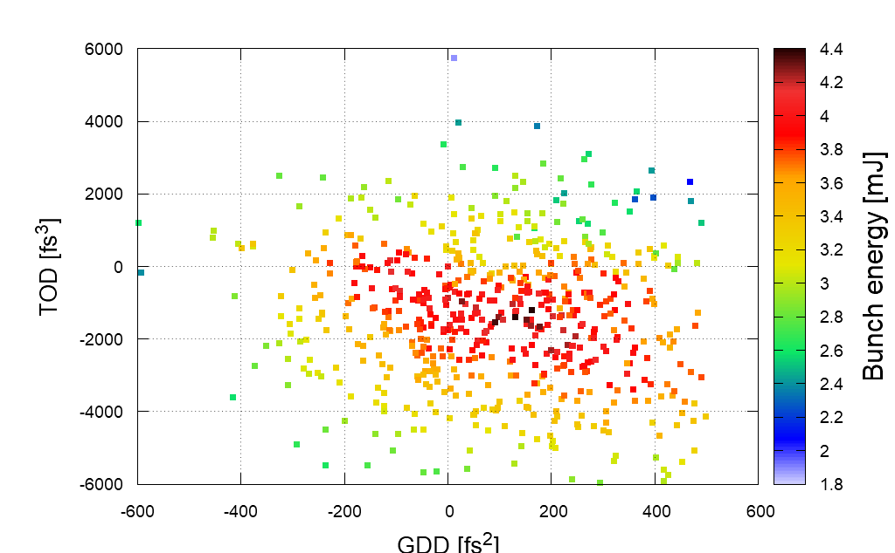
First application of MCMC
Target:
Water leaf
Thickness ~ 410 nm
Laser:
Energy: 24 mJ
Sampling rate: 10 Hz
Spot size: 2.9×2.6 µm²
Optimization of acceleration:
One point: average of 10 spectra –> 1 s
Cutoff energy
Bunch energy
One optimization process:
900 points = 15 min
GDD: -195 fs²
TOD: 1402 fs³
GDD: 104 fs²
TOD: -1287 fs³

Slide 12
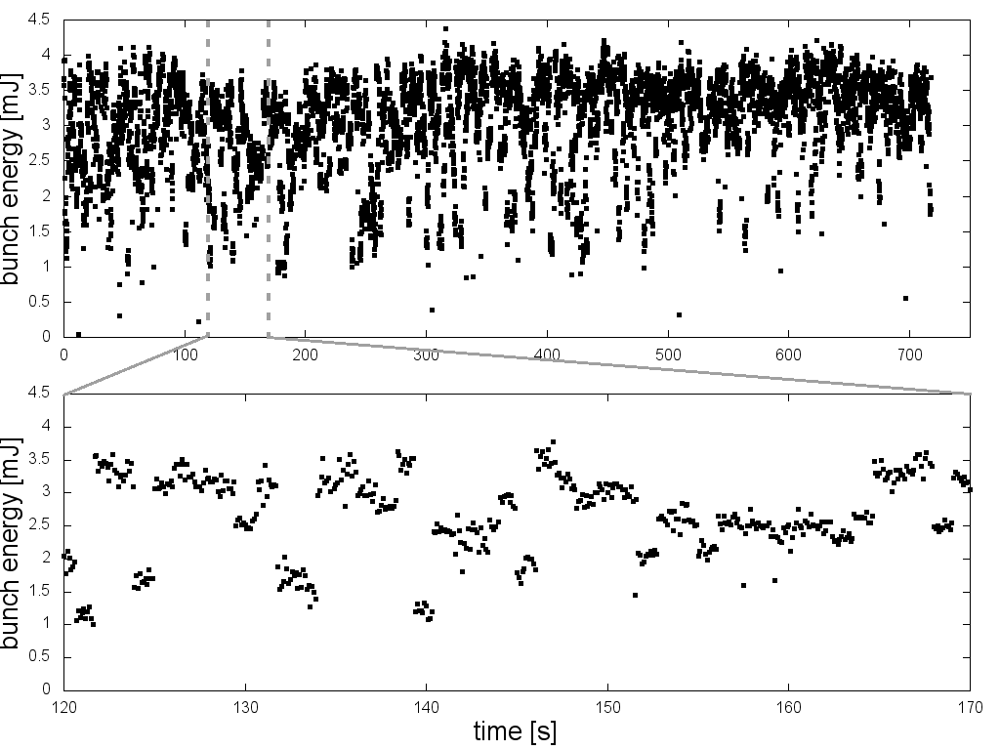
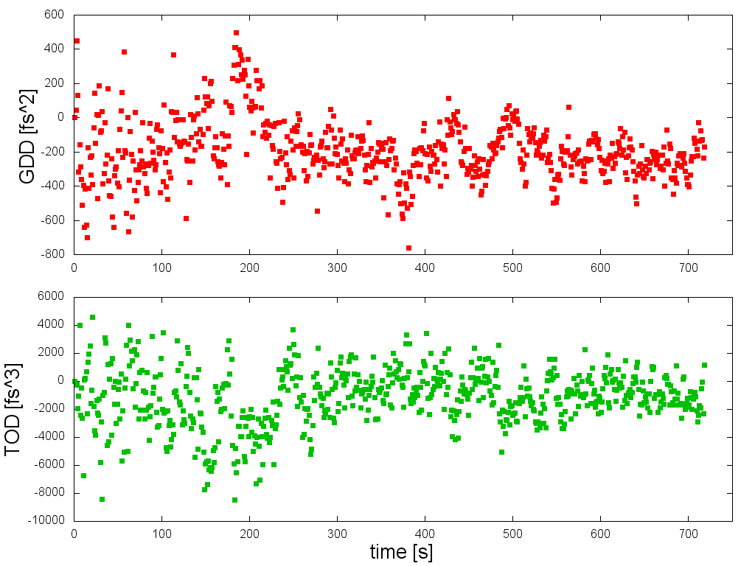
First application of MCMC
Evolution in time
Bunch energy vs. time
Convergence
GDD/TOD vs. time
Each point: 1 spectrum
GDD and TOD change: after 10 shots
Each point: average of 10 spectra

Slide 13
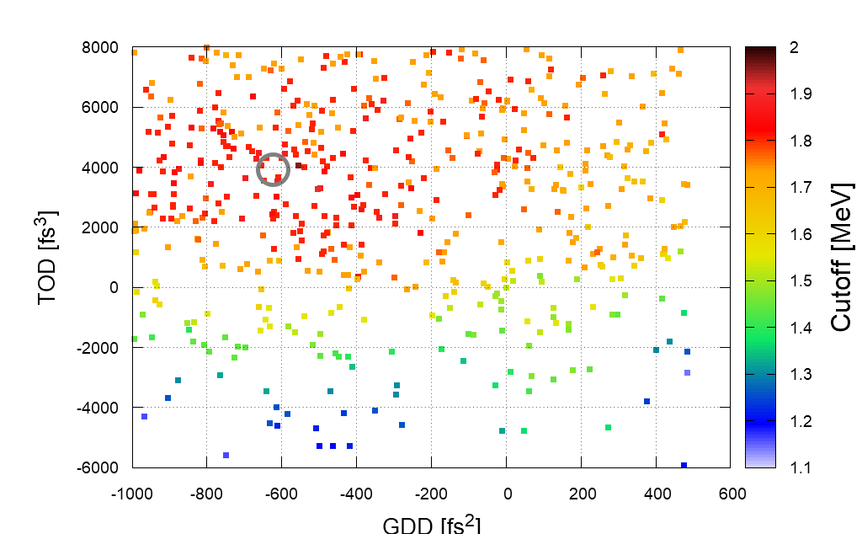
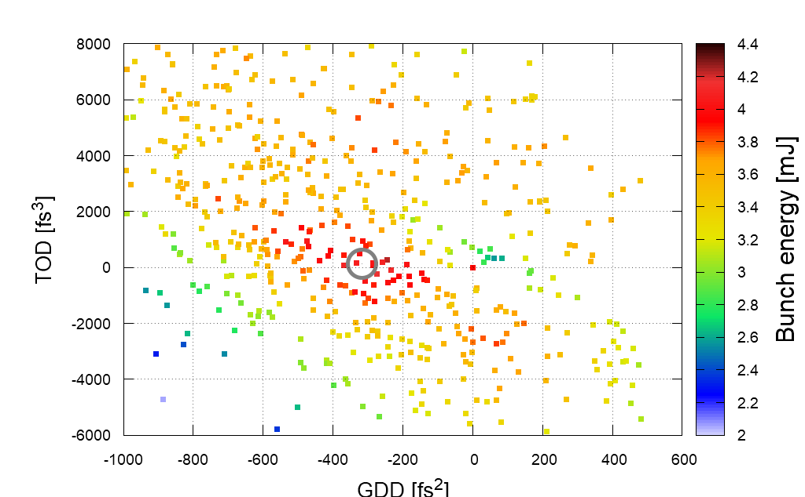
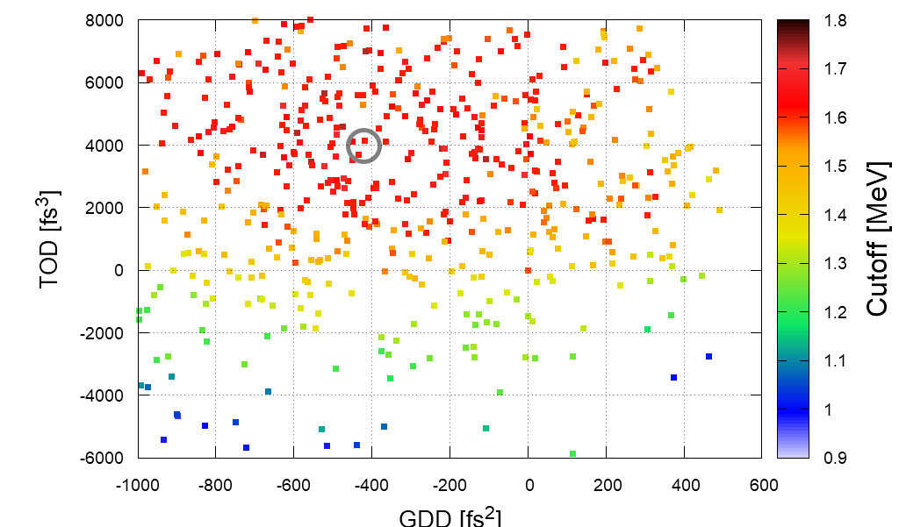
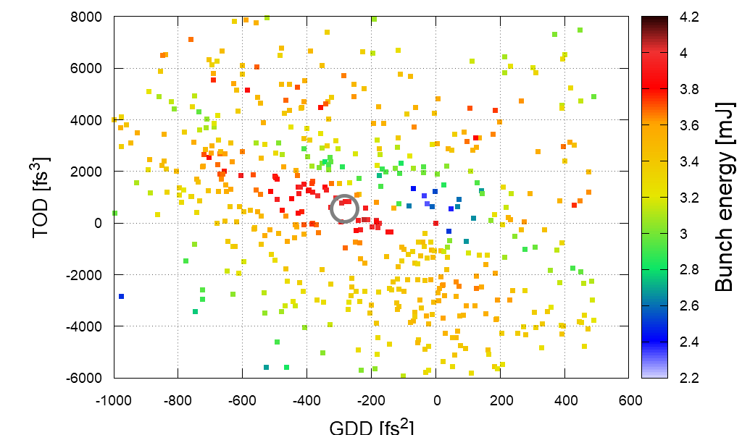
Measurement with MCMC
Thickness, D⁺, 80 mJ
410 nm
760 nm

Slide 14
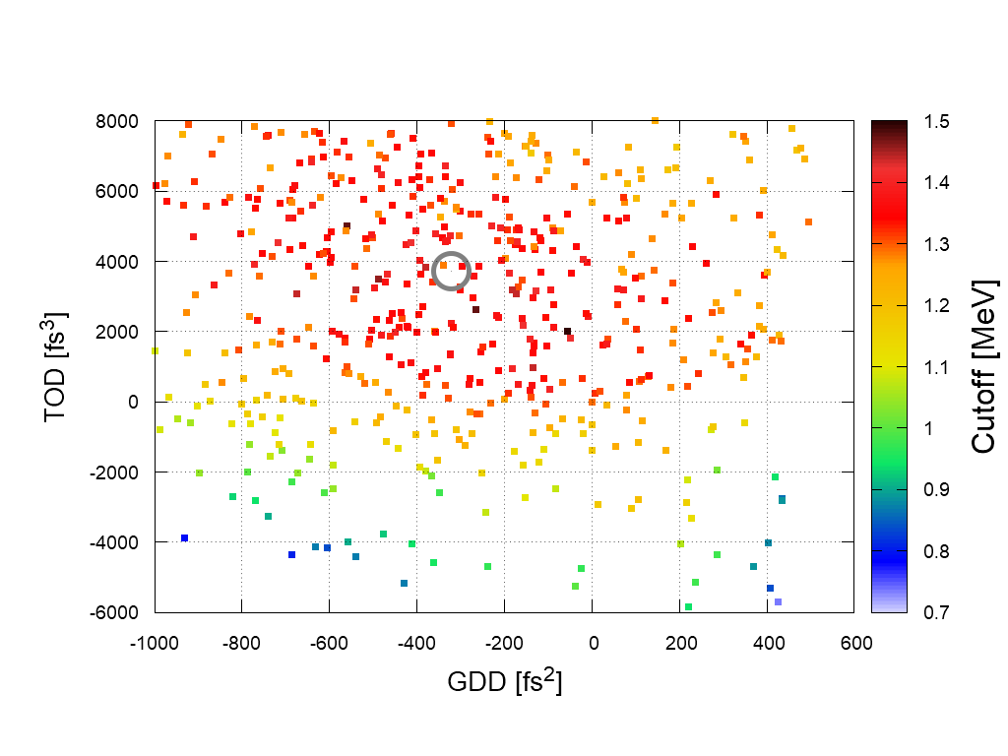
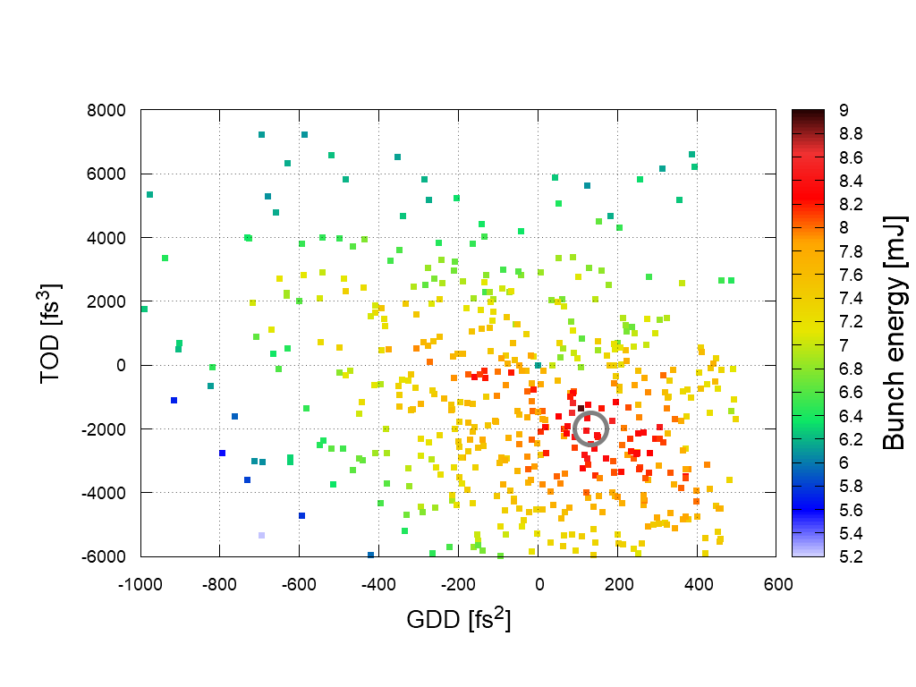
Measurement with MCMC
410 nm, Ion, 80 mJ
deuteron
proton

Slide 15
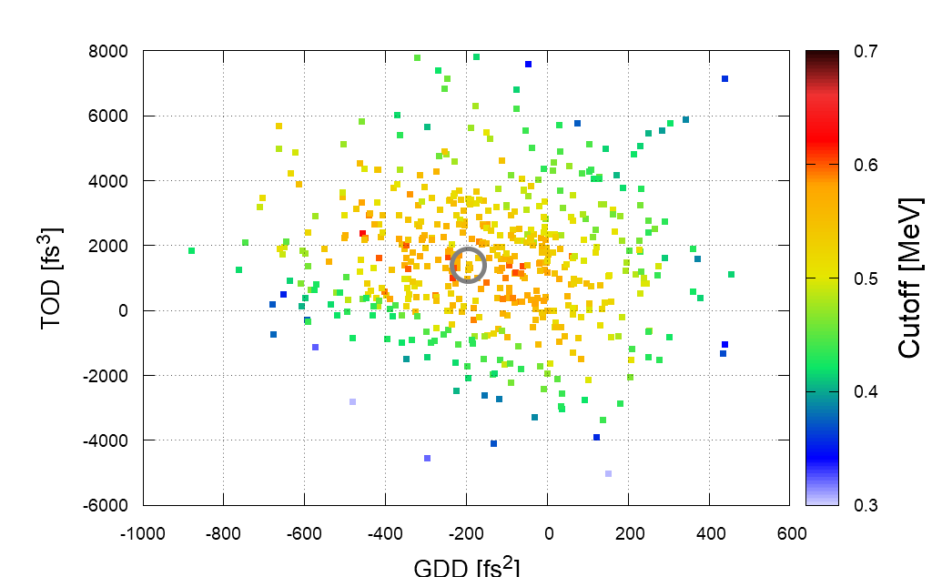
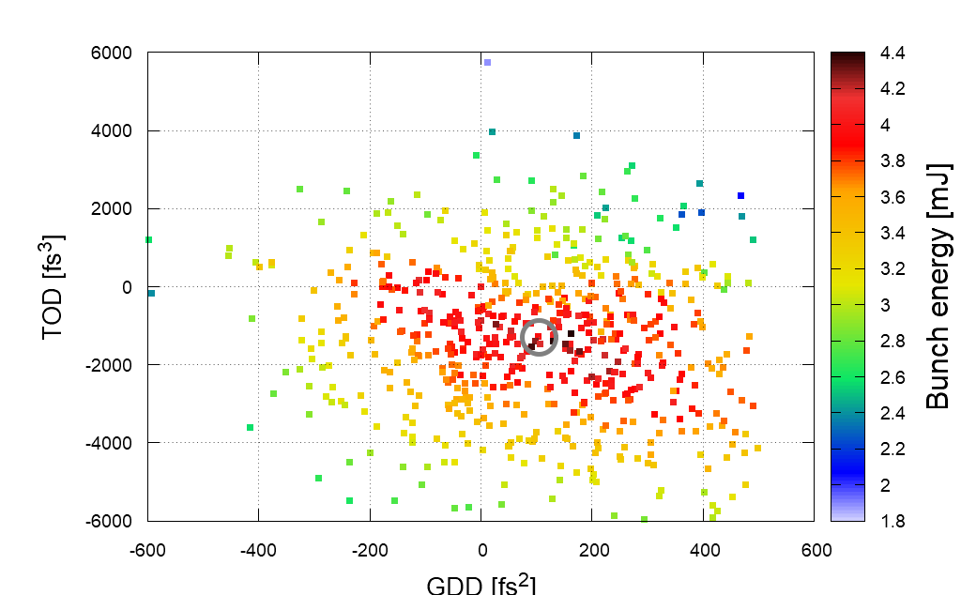
Measurement with MCMC
410 nm, P⁺, Energy
24 mJ
80 mJ

Slide 16
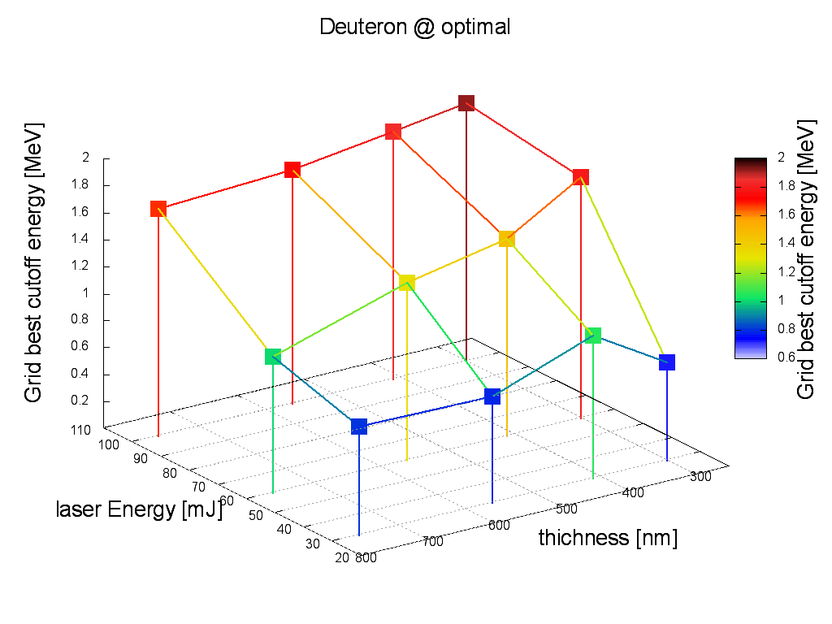
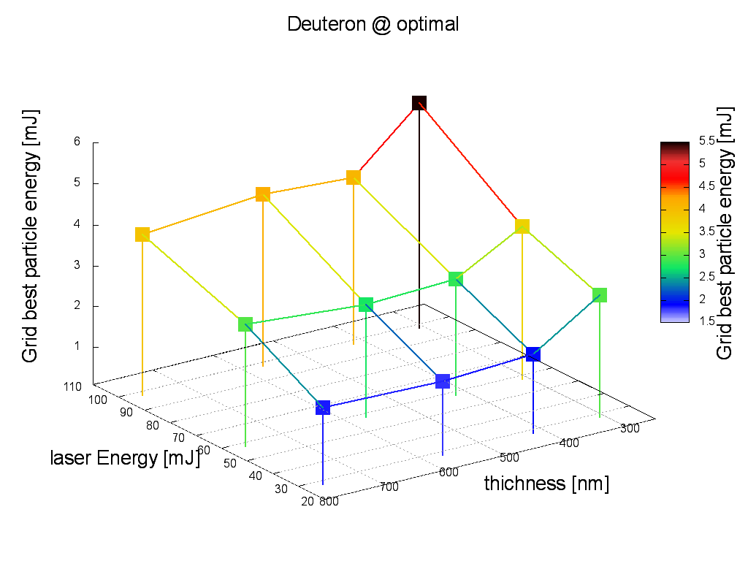
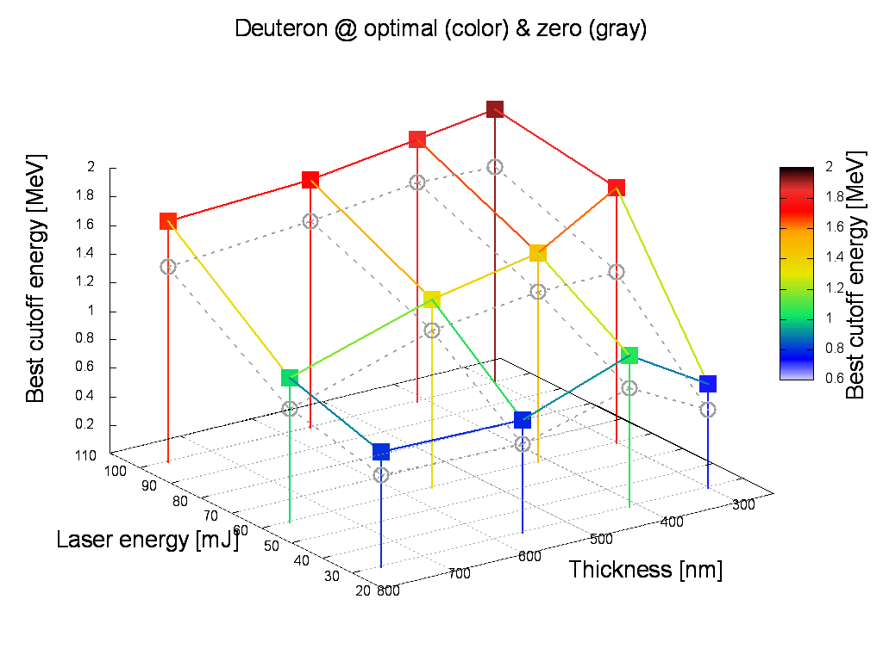
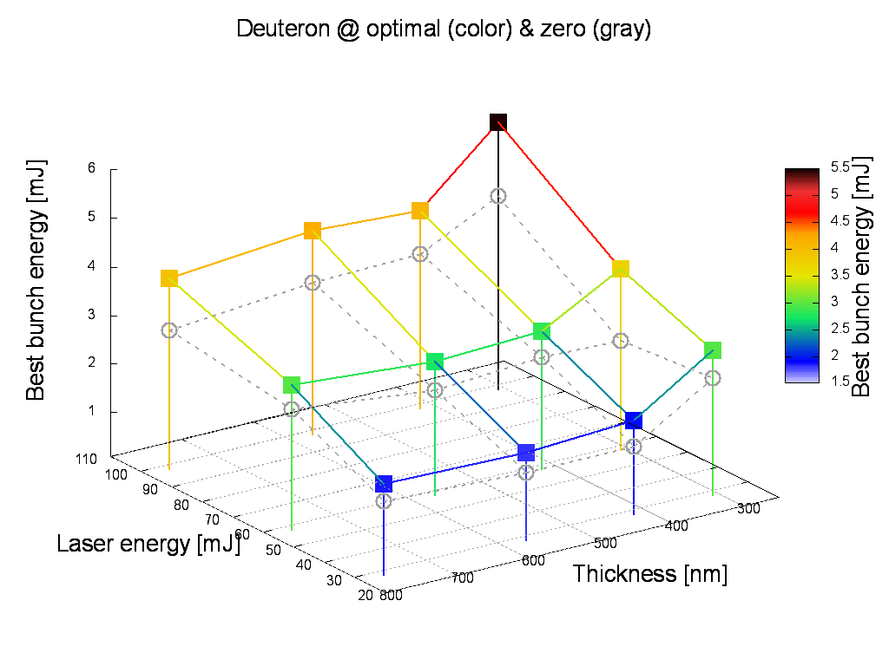
Cutoff and bunch energy maps
Best cutoff energy
Best bunch energy
Deuteron @ optimal (color) & transform limited (gray)
Deuteron @ optimal (color) & transform limited (gray)

Slide 17

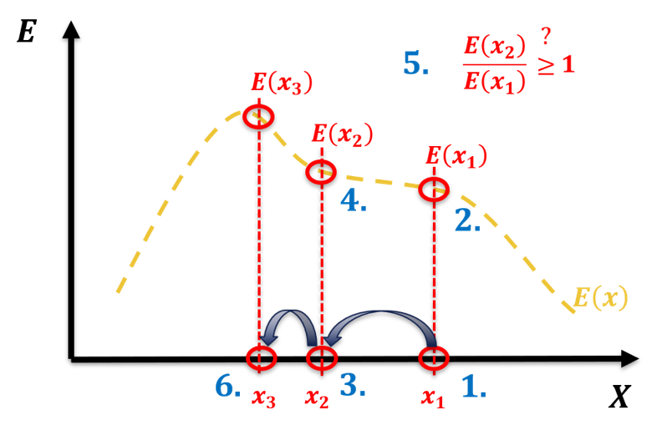
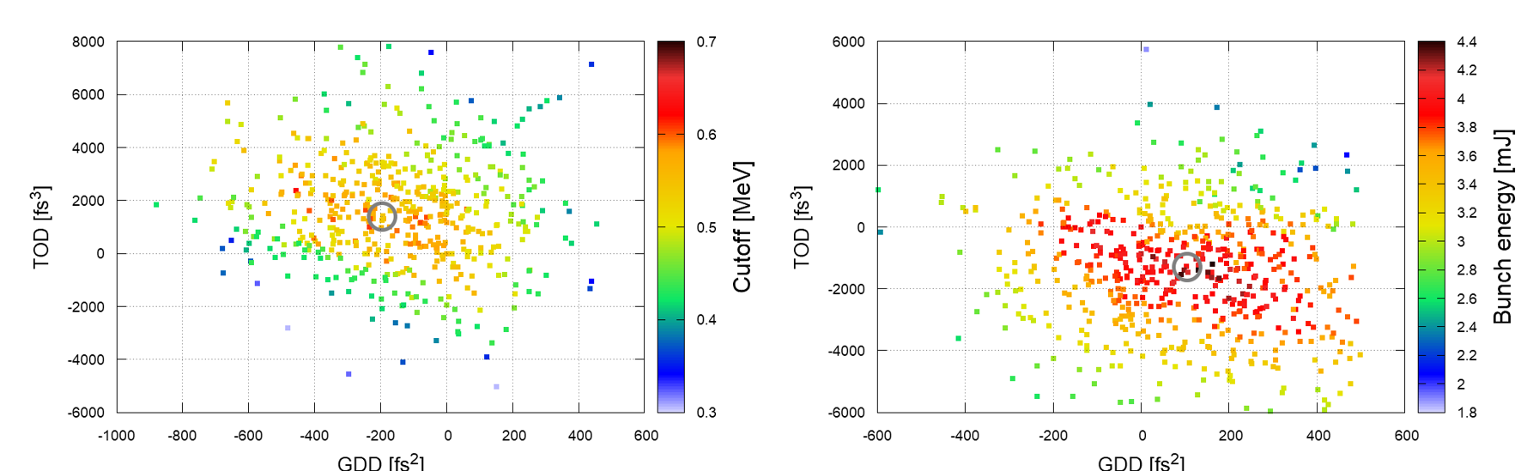
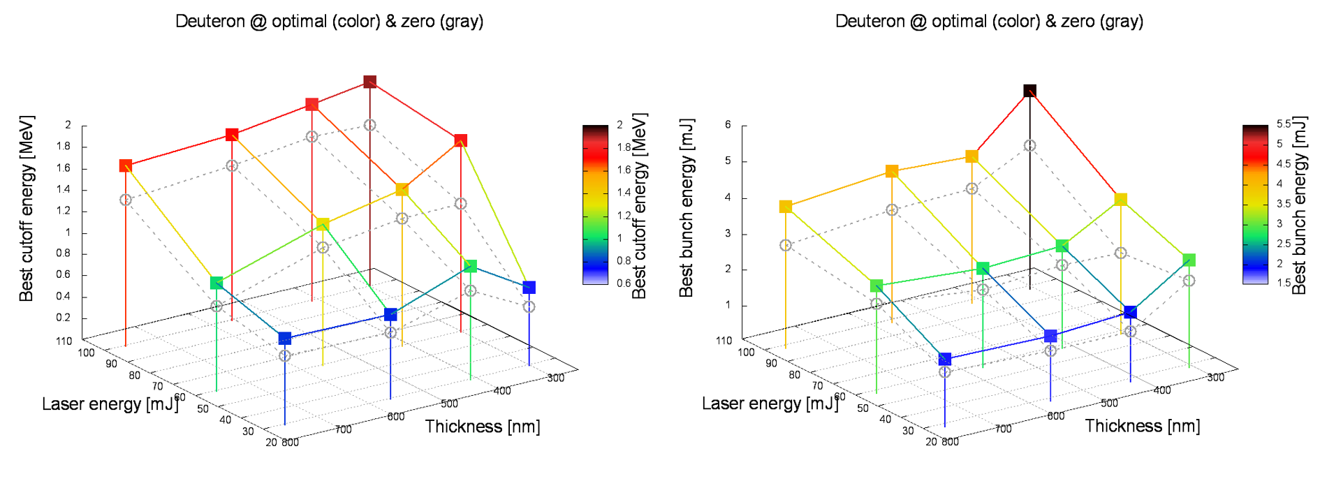
Summary
MCMC – possible alternative (?)
It can be an effective tool for optimization
Suitable for large number of sample points
Implementation
MCMC algorithm to optimize performance
Controlling the spectral phase - Dazzler
Measurement with MCMC
Map the parameter space - different target thickness, material, and pulse energy
Online optimization of the performance within 15 min (900 points)

Slide 18
Future plans
Measurement on a larger scale
~Joule-class laser pulses
<<300 nm thick target
Reveal physics
Explore the theoretical background of the measured distributions
More parameters/ions
Add wavefront and target position to the parameter space
Optimize for other ions
Higher sampling rate
Replace the TPS cameras
Up to 100 Hz
Faster optimization/
more data

Slide 19
Thank you for your attention!

Slide 20


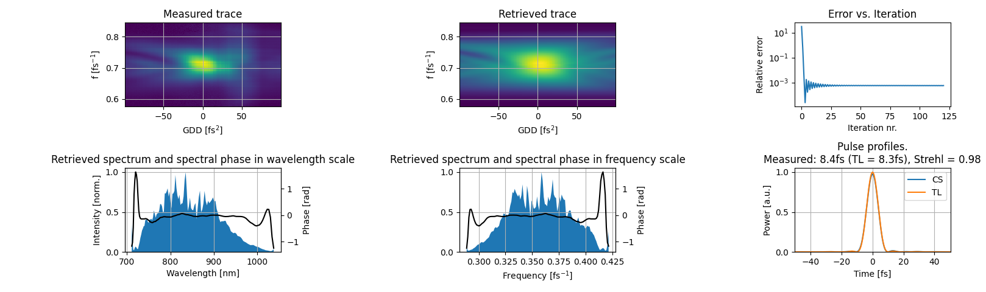
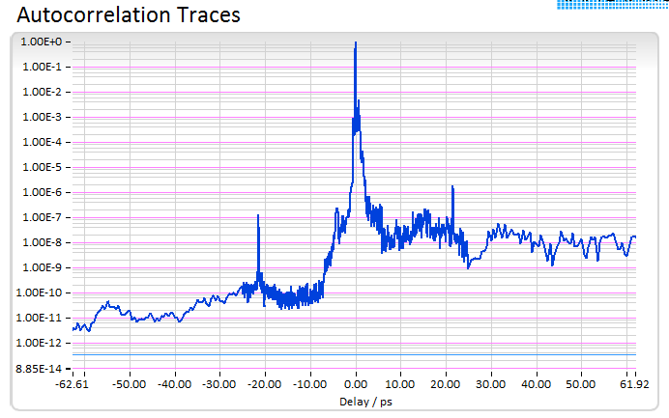
LASER
S3 laser (1 kHz, OPCPA) of ELI-ALPS parameters on target
Pulse energy: ~80 mJ
(average measurement of
10k shot)
Laser pulse duration: 8.4 fs
(measured in vacuum, after OAP, with disp scan)
Central wavelength: 826nm
Focal spot FWHM: 2.9×2.6 µm²
Peak intensity in focus: 1×10¹⁹ W/cm² (a₀~2.2)
Temporal contrast
*peak at +-22ps is estimated to be post-pulse from the variable density filter in the diagnostics arm, not in the main output

