Slide 1



Low-Density
Plasma Focussing
of High Repetition
Rate Ion Sources
Jimmy Weeks –
(they/them)
Advanced Accelerator
Concepts
Work Group 2
27/08/2026
Notes:
Today I will be talking about the challenges in making laser-driven ion sources practical for applications
as well as how we can fully exploit new high rep rate laser facilities

Slide 2

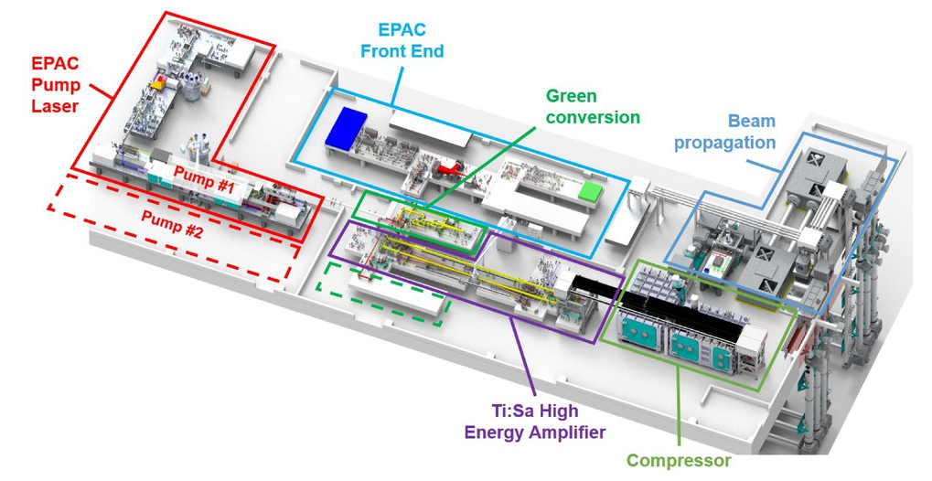
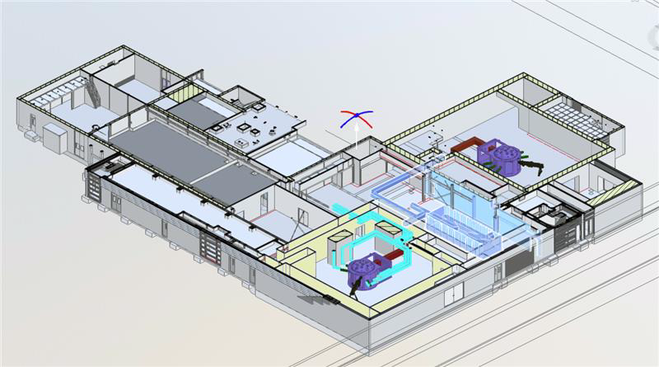

1: Introduction
Modern high-power laser science is pushing us in two directions
  Applications!
    Multi-Hz sources
  Ultra high-intensities!!
    Order of 10²³ W/cm²
In this talk, we will focus on the multi-Hz sources
  Where do they stand currently?
  What is holding them back?
  How do we get past that?
EPAC 5-10 Hz laser
Vulcan 20-20
Notes:
Modern high-powered laser science is heading in two directions….
The application of laser-driven radiation sources – such as x-ray imaging, proton radiography, material studies and radiobiology
And this is being pursued at facilities such as EPAC, a 10 Hz PW facility being commissioned at the Rutherford Appleton Laboratory
And then the ultra-high intensity regime, with energies in the kilojoules
Like Vulcan 20-20, aiming for 20 kJ in a picosecond. Which is in the process of being built also at RAL which is where I am based currently
In my talk today, we will be focusing on the application sides, specifically laser driven proton sources
Where are we with them
What is holding them back
And how do we get around these challenges

Slide 3
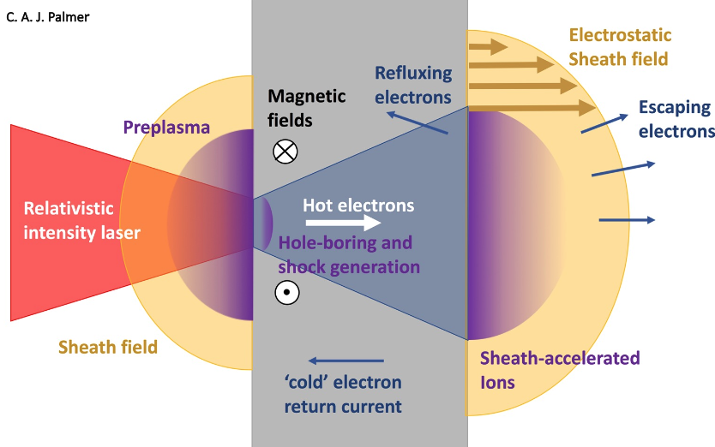
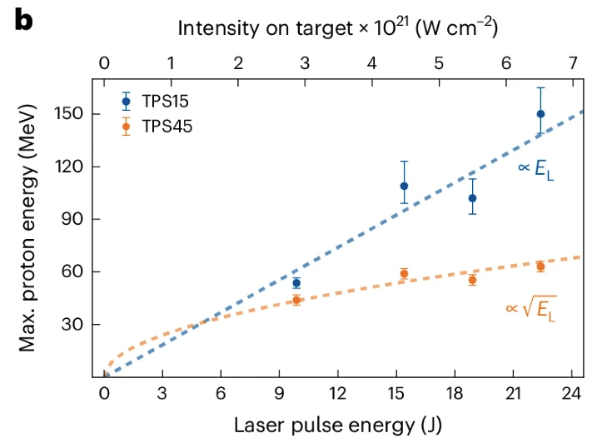
2: Laser-Driven Ion Sources
Relativistic laser interactions with solid density targets accelerates protons
  Sheath fields ~ TV/m along target normal (TNSA)
These proton beams have:
  Short pulse durations (ps)
  High currents (100 A)
  High energies
The current maximum energy published is 150 MeV [1]
[1]
[1] Ziegler, T et al (2024). Laser-driven high-energy proton beams from cascaded acceleration regimes. Nature Physics doi:https://doi.org/10.1038/s41567-024-02505-0.
Notes:
So, we shall begin with the sources them selves and how they work
When a laser interacts with a solid target, a plasma is formed on the front surface
This plasma couples the laser energy into the electrons which are accelerated through our target via the pondermotive force
They escape by the rear surface, inducing massive sheath fields on the order of TV/m
This ionises the rear surface and accelerates ions along the target normal direction
Hence the name…. TNSA
And when it comes to applications they posses some quite interesting properties such as high currents, energies and short pulse durations
Which for radiotherapy is really unique as you begin to enter the FLASH regime of high dose in a short time

Slide 4
3: Why Are We Not Using Them
Repetition rate compatibility
Shot-to-shot stability and reproducibility
Cut off energies and energy spectrum spread
Beam divergence and emittance
Target fabrication
Debris and damage to optics
Laser contrast requirements
Diagnostics and real-time feedback
Notes:
So, we shall begin with the sources them selves and how they work
When a laser interacts with a solid target, a plasma is formed on the front surface
This plasma couples the laser energy into the electrons which are accelerated through our target via the pondermotive force
They escape by the rear surface, inducing massive sheath fields on the order of TV/m
This ionises the rear surface and accelerates ions along the target normal direction
Hence the name…. TNSA
And when it comes to applications they posses some quite interesting properties such as high currents, energies and short pulse durations
Which for radiotherapy is really unique as you begin to enter the FLASH regime of high dose in a short time

Slide 5
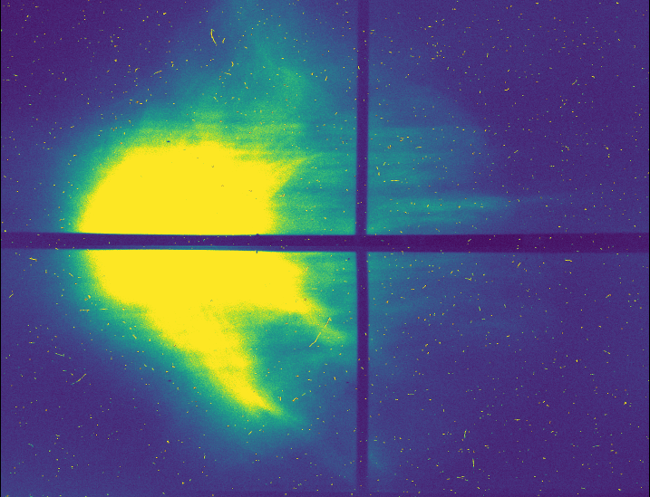

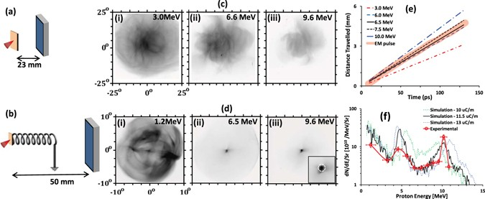
4: Beam Divergence
TNSA beams have an inherently large divergence (10s – 100s mrad)
For high flux applications or beam capturing this presents an issue
Sophisticated targetry such as coils can be used reduced this divergence
  Currently incompatible with high repetition rates
~ 50 mrad
[2]
[2] Ahmed, H. et al. (2017). Scientific Reports, 7(1). doi:https://doi.org/10.1038/s41598-017-06985-4.
Notes:
But, they do however posses large divergences upwards of 100 mrads
Which for radiography of a sample is ideal, you’ll be able to cover your entire image
however for applications with a high flux or if you want to capture your beam using magnets, this is an issue
So we have our first problem, we need low divergence + high flux beams
talk about the coil

Slide 6


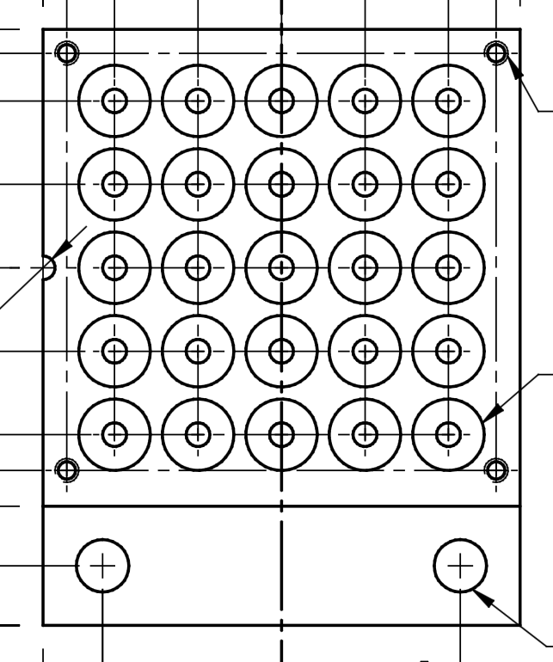
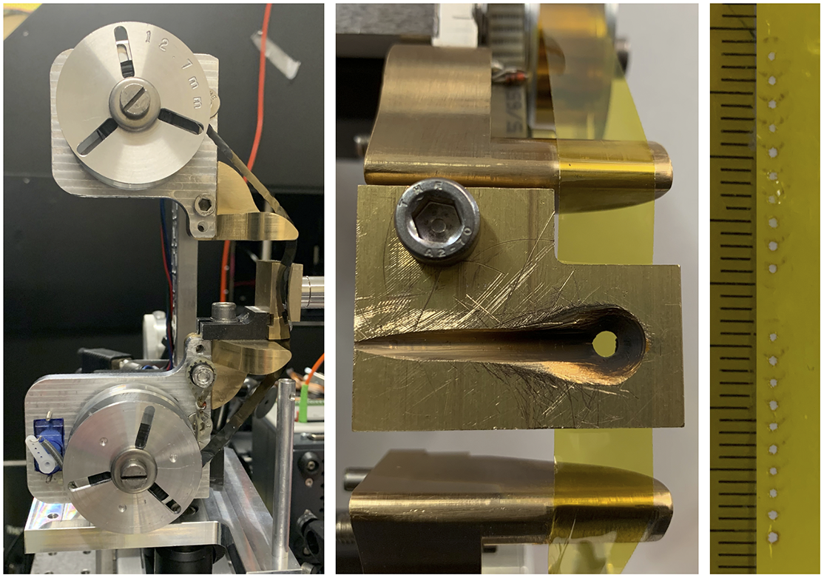
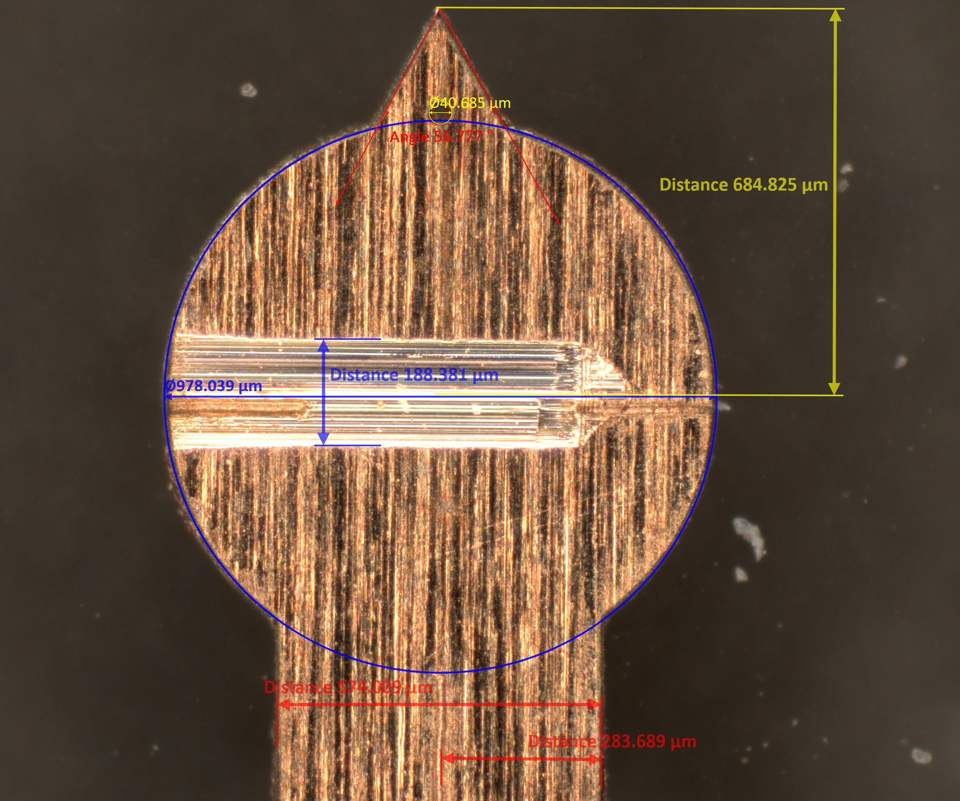
5: The Push for High-Repetition-Rates
There is a need for targetry that can fully exploit these new facilities i.e. EPAC
Targets such as tape-drives have been demonstrated to operate at 5 Hz [3]
Spool
[3]
[3] Xu, N. et al. (2023) High Power Laser Science and Engineering, 11, p. e23. doi:10.1017/hpl.2023.27.
Laser Focus
Notes:
How do we get these proton sources to a point where we can reach the full potential of these new facilities
Typical foil targets are mounted in a raster array
And we can see the evolution of these here
We start with single foils, these can be intricately structured but are a single shot only
Then we push to a scannable puck, they can be like this 5x5 rack or much larger on the scale of 10s x 10s
But these pucks will be burned through in a matter of seconds
And no one wants to be opening the chamber up every few minutes to change their targets
This leads us to the tape drive target
These are tapes that are spooled between two reels and held under tension the entire time
These have been demonstrated at 5 Hz but can operate at 100 Hz

Slide 7
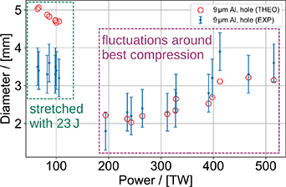
6: The Debris Problem
The interaction produces debris that is sent into the chamber
This debris coats the chamber, burns onto optics and poses a risk for the vacuum system
Hole size vs laser power
[4]
[3]
[4] Ehret, M et al (2024) Plasma Physics and Controlled Fusion, 66(4), p.045003. doi:https://doi.org/10.1088/1361-6587/ad2690.
Notes:
But the debris from a laser-solid target interaction is a problem, you begin to coat your optics with carbon which then burns in your laser
As well as posing a hazard for the health of the chamber and its systems like pumps
And we can see here the holes left from the laser on the tape, that debris has gone into our system
With increasing laser power the size of theses holes grows as well, for EPAC which is going to operate at double these powers
And just to put this into perspective, for a typical tape drive spool of 100 m you will have 7.8 g of tape be sent into your chamber which is the equivalent of a newborn rat, house key or a phone charger
The target fab team at the CLF are hoping to get into the km length’s which then pushes this the mass of debris to 897 bees or a pack of cards
Those don’t really put it into perspective, so this is the debris shield of the Visar at the EuXFEL after 3 days using a tape drive

Slide 8
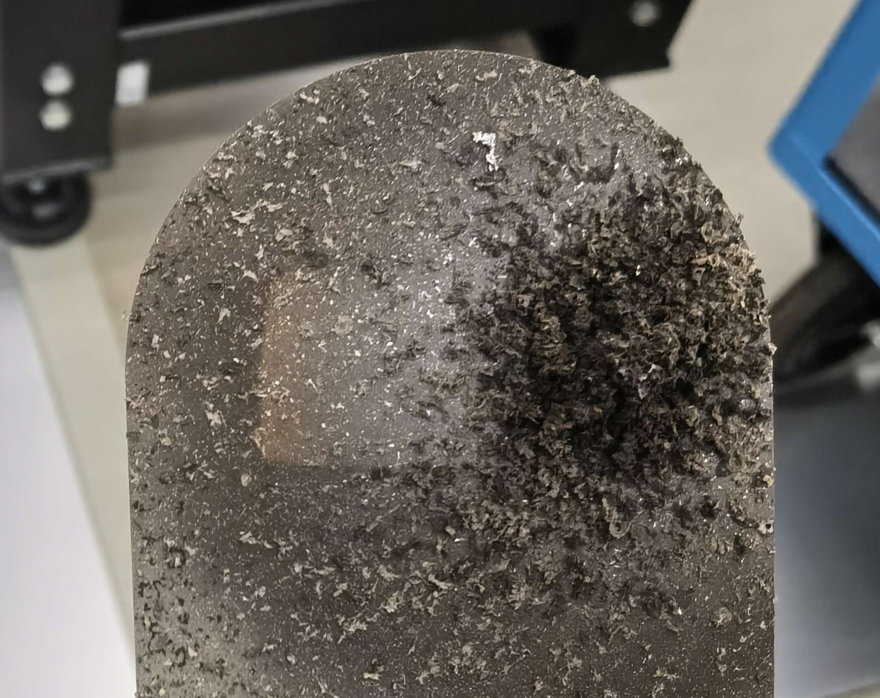
6: The Debris Problem
The interaction produces debris that is sent into the chamber
This debris coats the chamber, burns onto optics and poses a risk for the vacuum system
M. Tang, EuXFEL
Hole size vs laser power
[4]
[3]
[4] Ehret, M et al (2024) Plasma Physics and Controlled Fusion, 66(4), p.045003. doi:https://doi.org/10.1088/1361-6587/ad2690.
Notes:
Those don’t really put it into perspective, so this is the debris shield of the Visar at the EuXFEL after 3 days using a tape drive

Slide 9
7: Solving Both
~ 50 mrad
M. Tang, EuXFEL
Notes:
I don’t like the saying killing two birds with one stone but our solution for this fits it very nicely

Slide 10
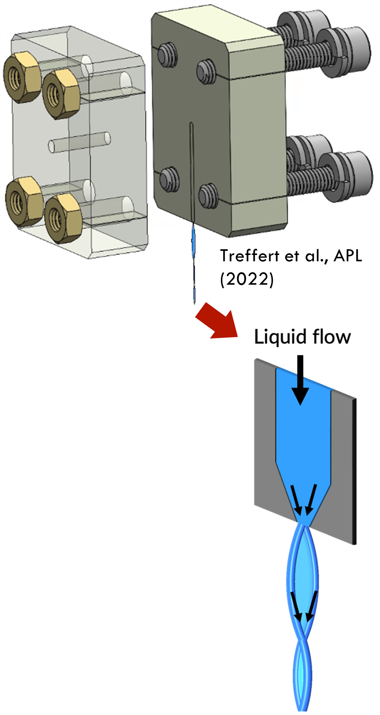
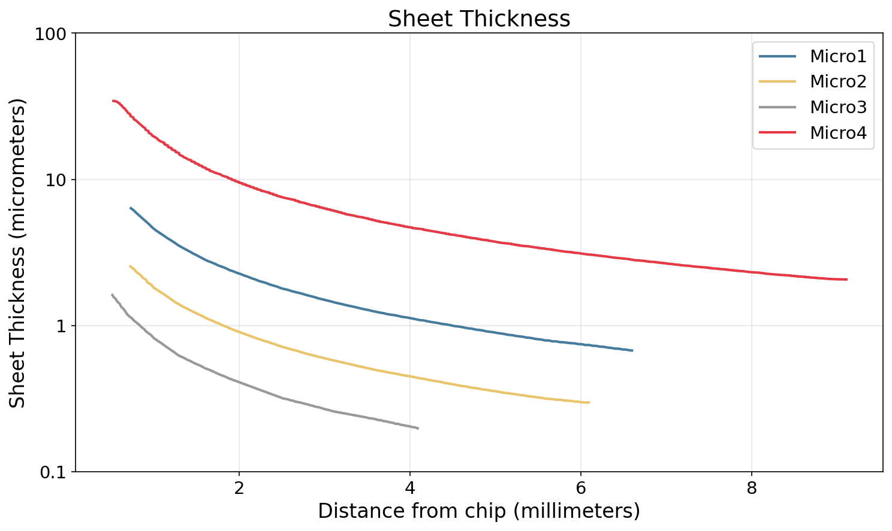

8: The Liquid - Sheet
The liquid-sheet is varying thickness target created by converging the flow of water [5]
Liquid-sheets formed from a colliding micro channel design have been demonstrated in the kHz regime [6]
They are both low-debris and stable, with position fluctuations of < 5 µm [7]
[5] Crissman, C.J et al. (2022) Lab on a Chip, 22(7), pp.1365–1373. doi.:10.1039/d1lc00757b.
[6] Morrison, J.T et al, 2018. New Journal of Physics, 20: doi:10.1088/1367-2630
[7] Treffert, F. et al. (2022), Physics of Plasmas, doi:10.1063/5.0097857.
Notes:
This comes in the form of the liquid-sheet target,
so as an overview
It is a solid target with varying thickness along its length shown in the bottom right
Thickness can vary from 2 µm down to hundreds of nm
It is formed by converging the flow of water in a nozzle that forms sets of orthoganol sheets
While they are beautiful, what’s more importantly for us is that they are high-rep-rate compatible and have been demonstrated upto khz for ion sources
And also they are low debris due to containing low carbon
So that covers the debris issue, but what about the divergence

Slide 11
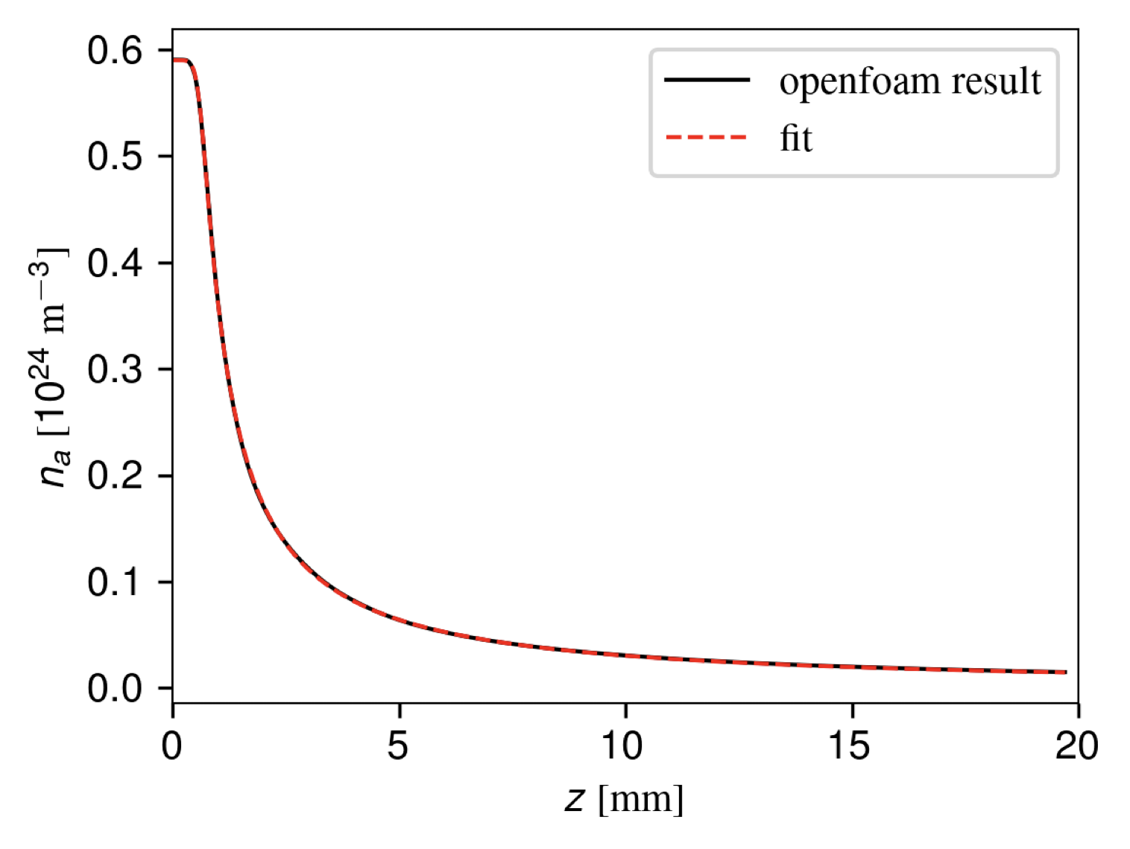
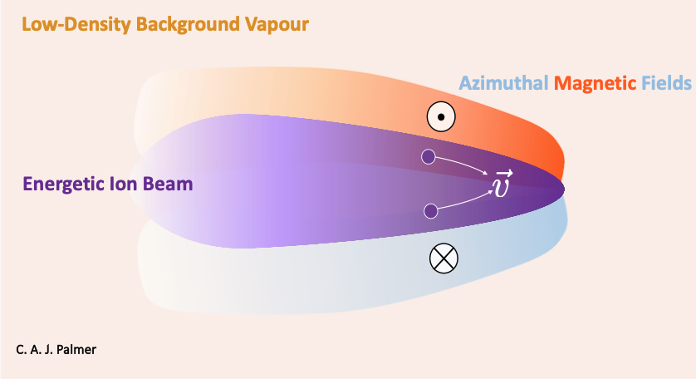
9: Proton Focusing in Low-Density Plasma
The liquid-sheet produces a vapour due to surface evaporation
Particles accelerated into this vapour ionise it to form a plasma
This plasma supports the generation of beam currents
  Two stream instability strips electrons from the beam
  These currents give rise to magnetic fields which act to focus the protons
[8]
[8] Streeter, J. V. M, et al (2025) Nature Communications, 16(1). doi:https://doi.org/10.1038/s41467-025-56248-4.
Notes:
When the liquid sheet is operated in vacuum, a vapour forms around it due to the evaporation on its surface
This profile has been modelled in OpenFOAM which has this drop in density as distance from the sheet increases
So how does this plasma reduce our beam divergences?
Well, our co-propagating electrons initially travel alongside the proton beam
These electrons get pushed outwards by the electrons in the plasma
Effect 1: The lateral electron current generates azimuthal magnetic fields → oriented to focus the proton beam
Effect 2: With electrons redirected away, proton beam current is no longer fully neutralized → resulting self-generated magnetic fields also focus the beam
Net result: Magnetic focusing forces dominate over (reduced) space-charge defocusing → proton beam is focused

Slide 12
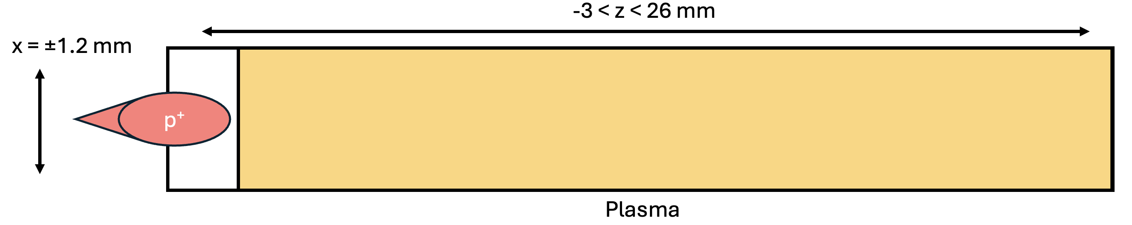
10: Exploring this Effect in WarpX
Simulate a proton beam (w/ co-propagating electrons) into a plasma
  The beam has some time to expand in vacuum
  The plasma has a sharp boundary with the vacuum, and a constant density throughout the simulation
Notes:
We can use particle-in-cell simulations to investigate this effect in more detail
So here we are using warpX, generating a proton beam in vacuum which propagates into a preionised, constant density plasma with a sharp boundary
We then track the proton beam size across the simulation, so if we take a look at one of our simulations
And just a note, the parameter space of what we can simulate here is massive. I am only going to be showing a snippit of what we’ve done but by all means come and find me after and ask about some of the other parameters

Slide 13
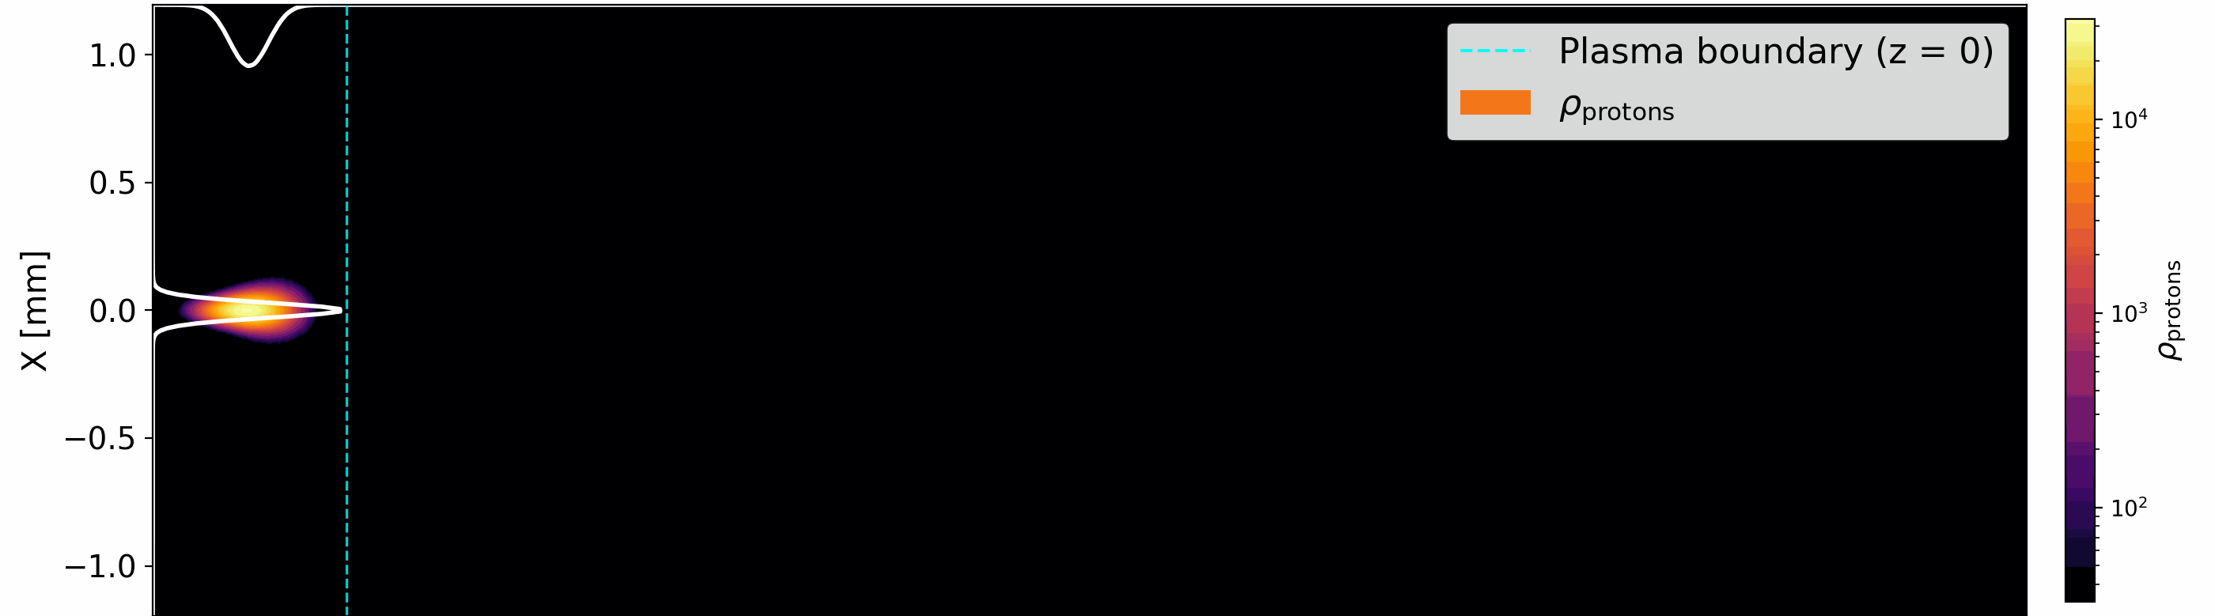
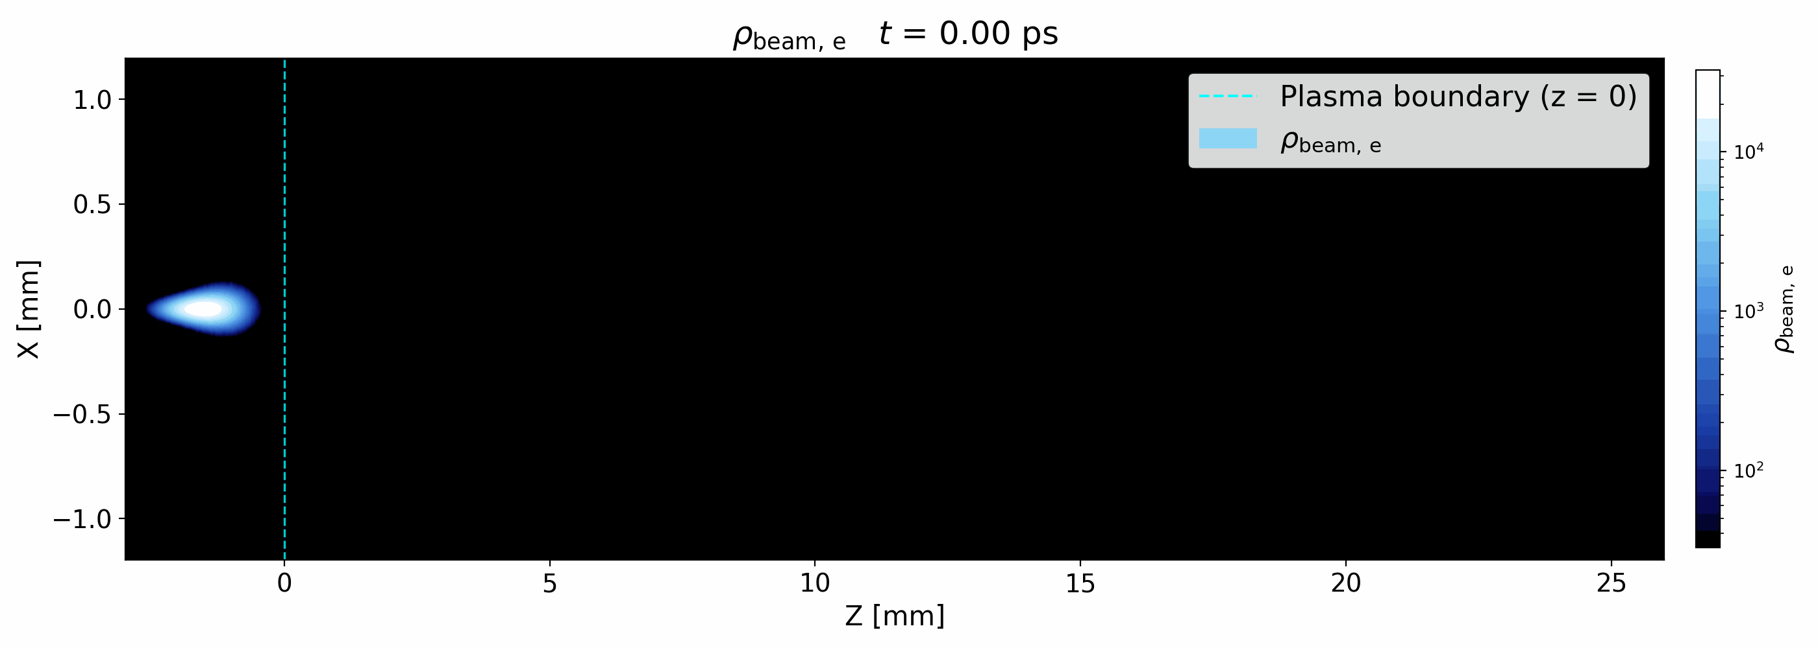
11: What Do We See?
Notes:
We see the proton beam expand initialy due to its initialised divergence, but then this core begins to grow and gain protons as it travels, so more and more protons are being focussed
And for the electron side of things, we see that they do not get very far into the plasma before dispersing into the background
they scatter away from our proton beam leaving this gap in their density that matches the shape of the protons
So if our focussing fields are not being established we should see the proton beam explode due to the Coulomb force.
I want to point out the white profile on the proton figure, specifically the y-axis (labelled x)
For most of the results, when referring to the FWHM, this is found from this profile.

Slide 14


11.1: Simulation Output - Stills
Beams expand in vacuum
Notes:
We see the proton beam expand initialy due to its initialised divergence, but then this core begins to grow and gain protons as it travels, so more and more protons are being focussed
And for the electron side of things, we see that they do not get very far into the plasma before dispersing into the background
they scatter away from our proton beam leaving this gap in their density that matches the shape of the protons
So if our focussing fields are not being established we should see the proton beam explode due to the Coulomb force.
I want to point out the white profile on the proton figure, specifically the y-axis (labelled x)
For most of the results, when referring to the FWHM, this is found from this profile.

Slide 15
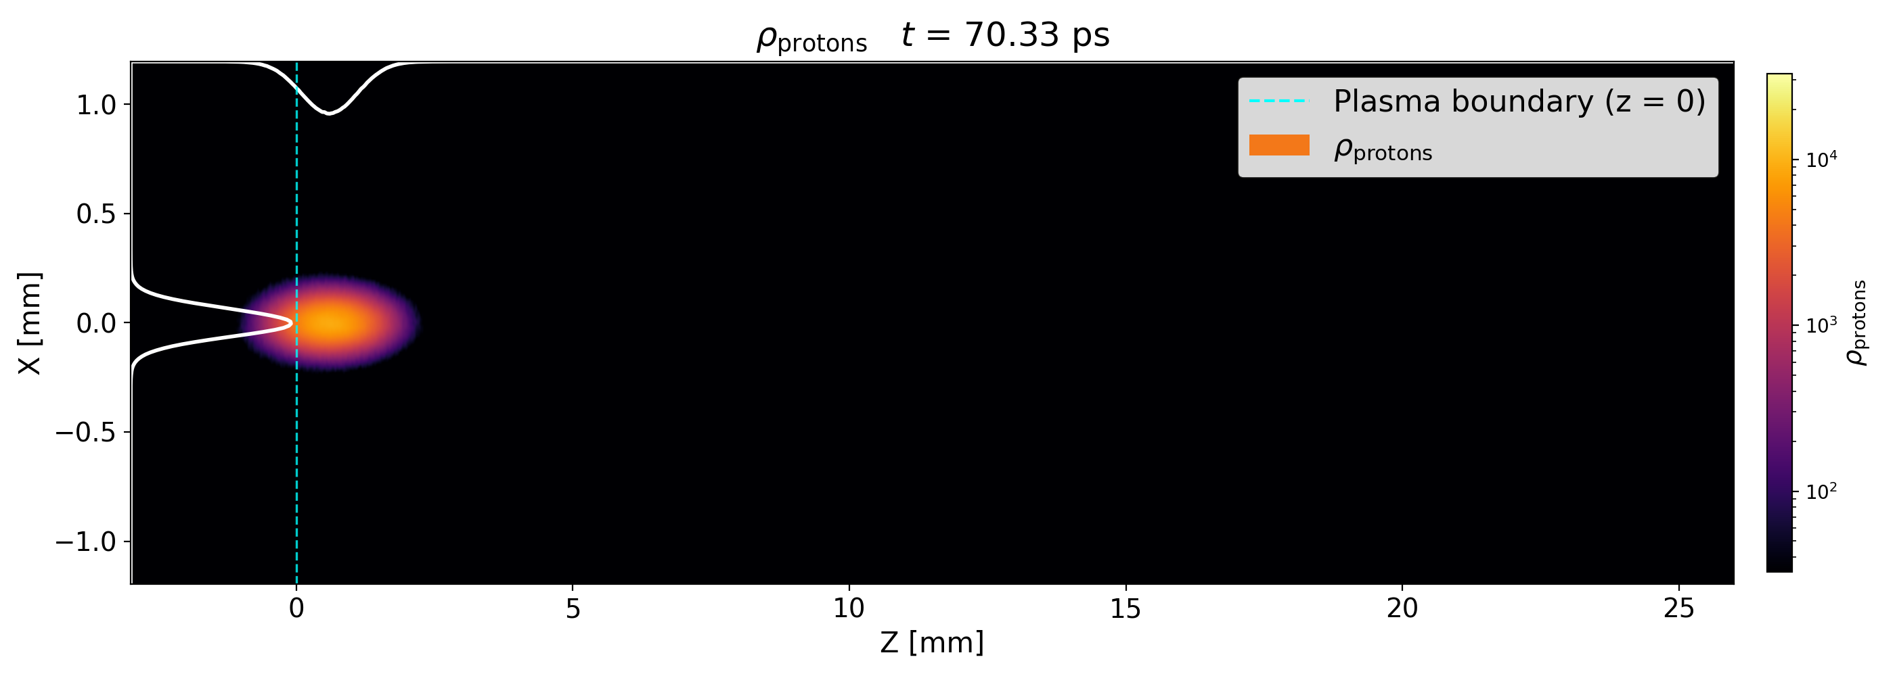
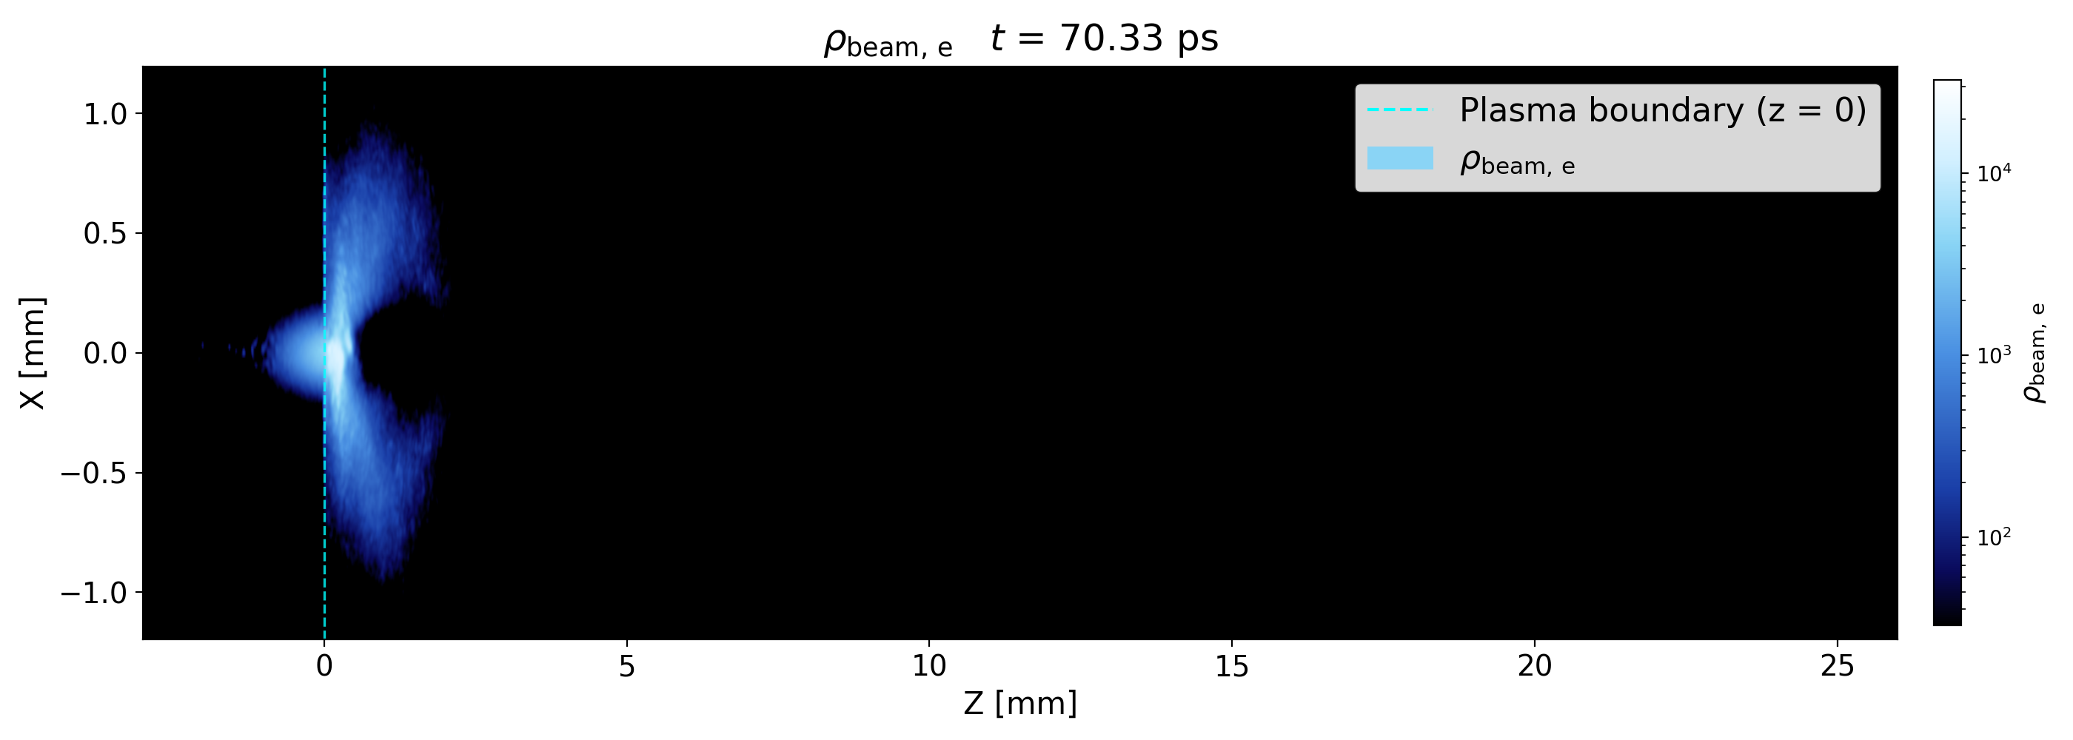
11.2: Simulation Output - Stills
Beams expands ballistically
Electrons move away
from proton beam
Notes:
We see the proton beam expand initialy due to its initialised divergence, but then this core begins to grow and gain protons as it travels, so more and more protons are being focussed
And for the electron side of things, we see that they do not get very far into the plasma before dispersing into the background
they scatter away from our proton beam leaving this gap in their density that matches the shape of the protons
So if our focussing fields are not being established we should see the proton beam explode due to the Coulomb force.
I want to point out the white profile on the proton figure, specifically the y-axis (labelled x)
For most of the results, when referring to the FWHM, this is found from this profile.

Slide 16
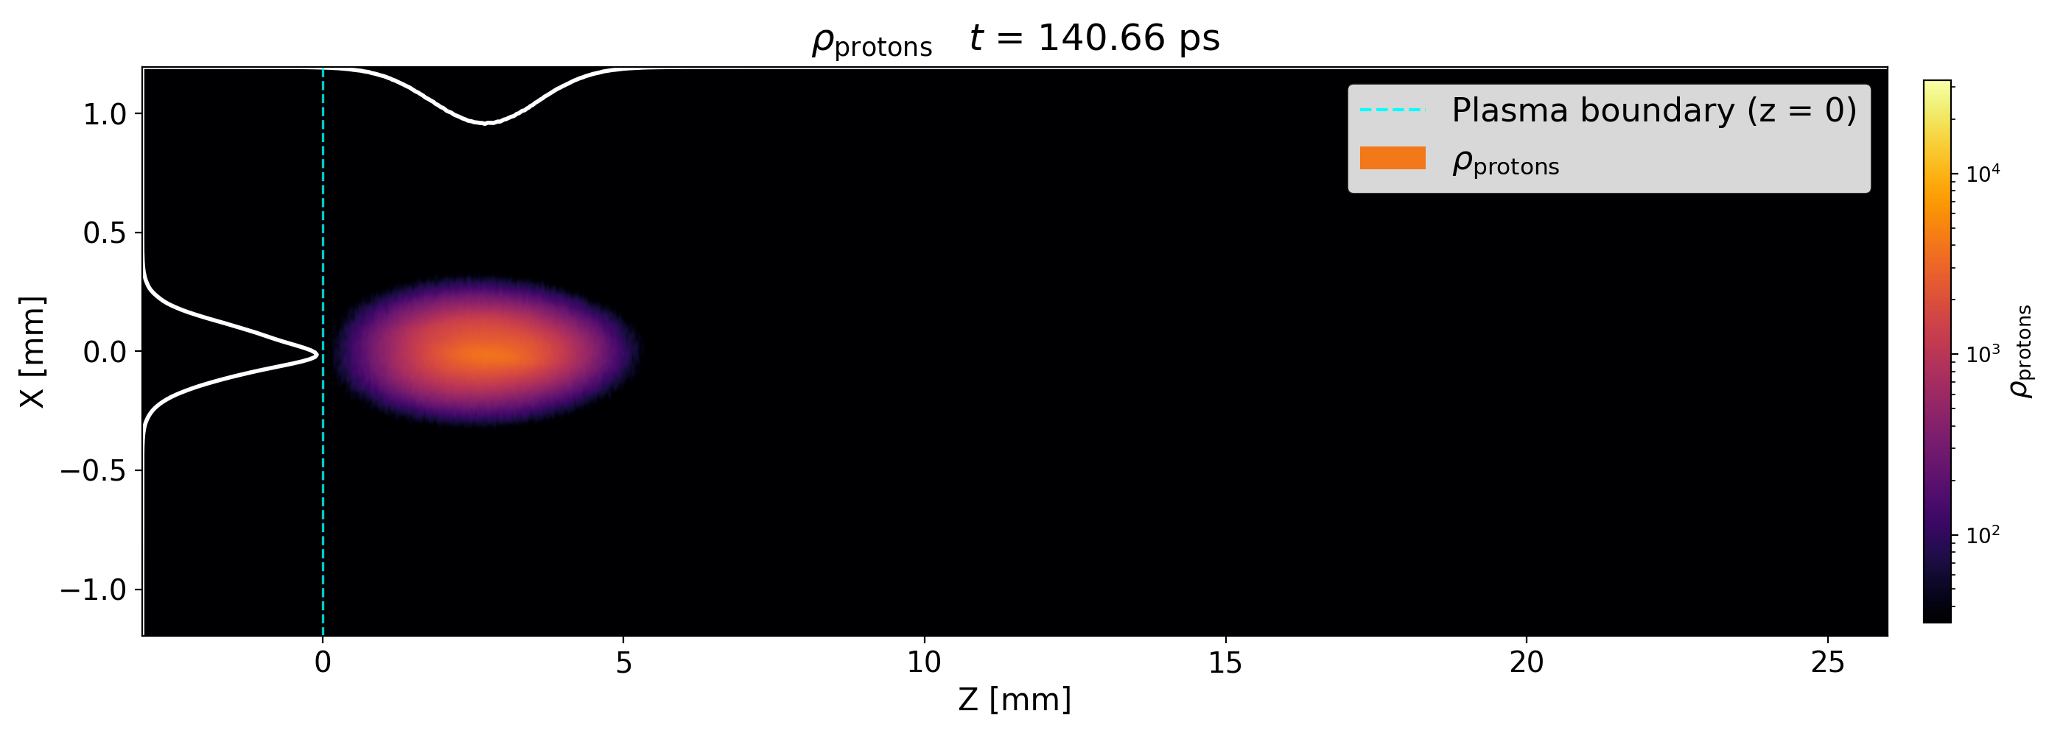
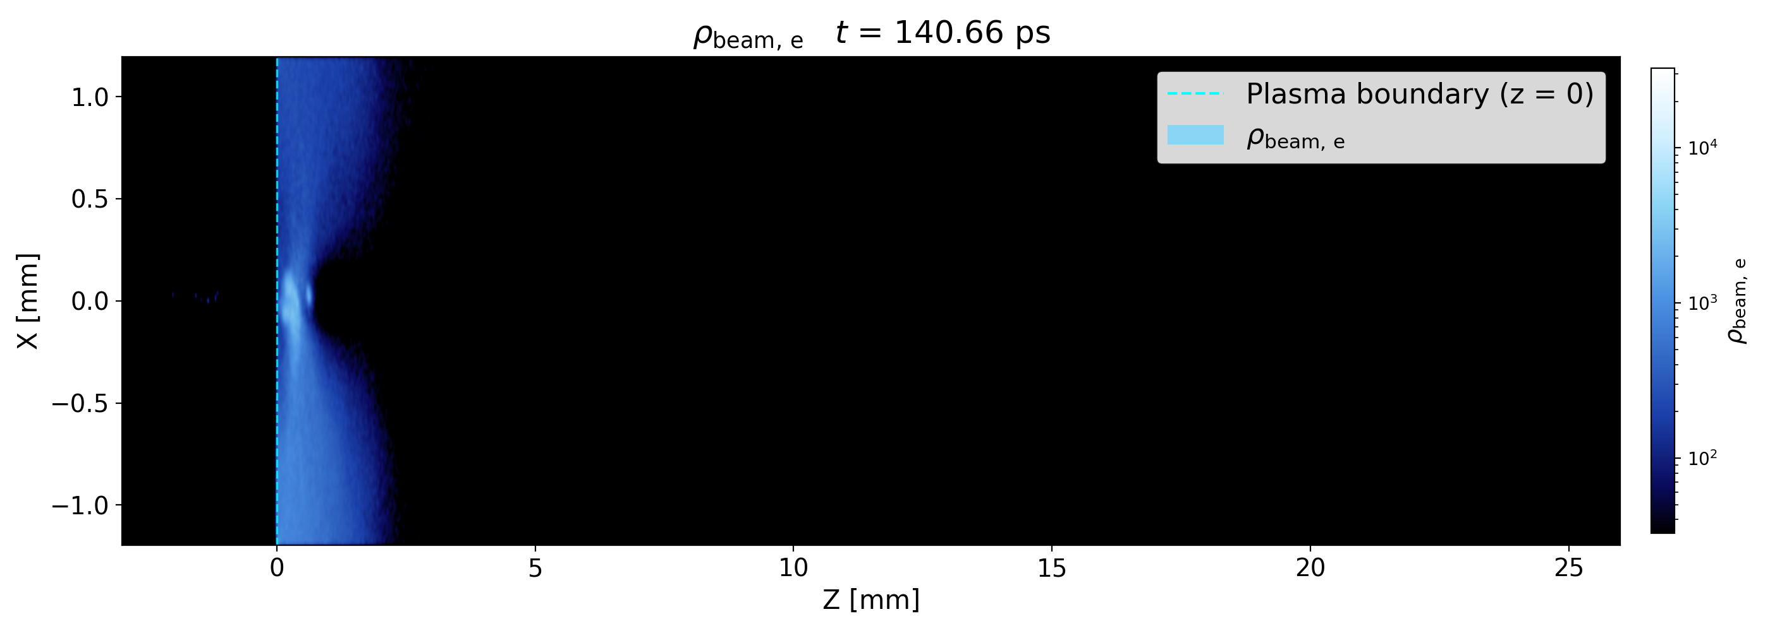
11.3: Simulation Output - Stills
Electrons move away
from proton beam
Electrons remain of axis but begin to disperse into the background
Notes:
We see the proton beam expand initialy due to its initialised divergence, but then this core begins to grow and gain protons as it travels, so more and more protons are being focussed
And for the electron side of things, we see that they do not get very far into the plasma before dispersing into the background
they scatter away from our proton beam leaving this gap in their density that matches the shape of the protons
So if our focussing fields are not being established we should see the proton beam explode due to the Coulomb force.
I want to point out the white profile on the proton figure, specifically the y-axis (labelled x)
For most of the results, when referring to the FWHM, this is found from this profile.

Slide 17
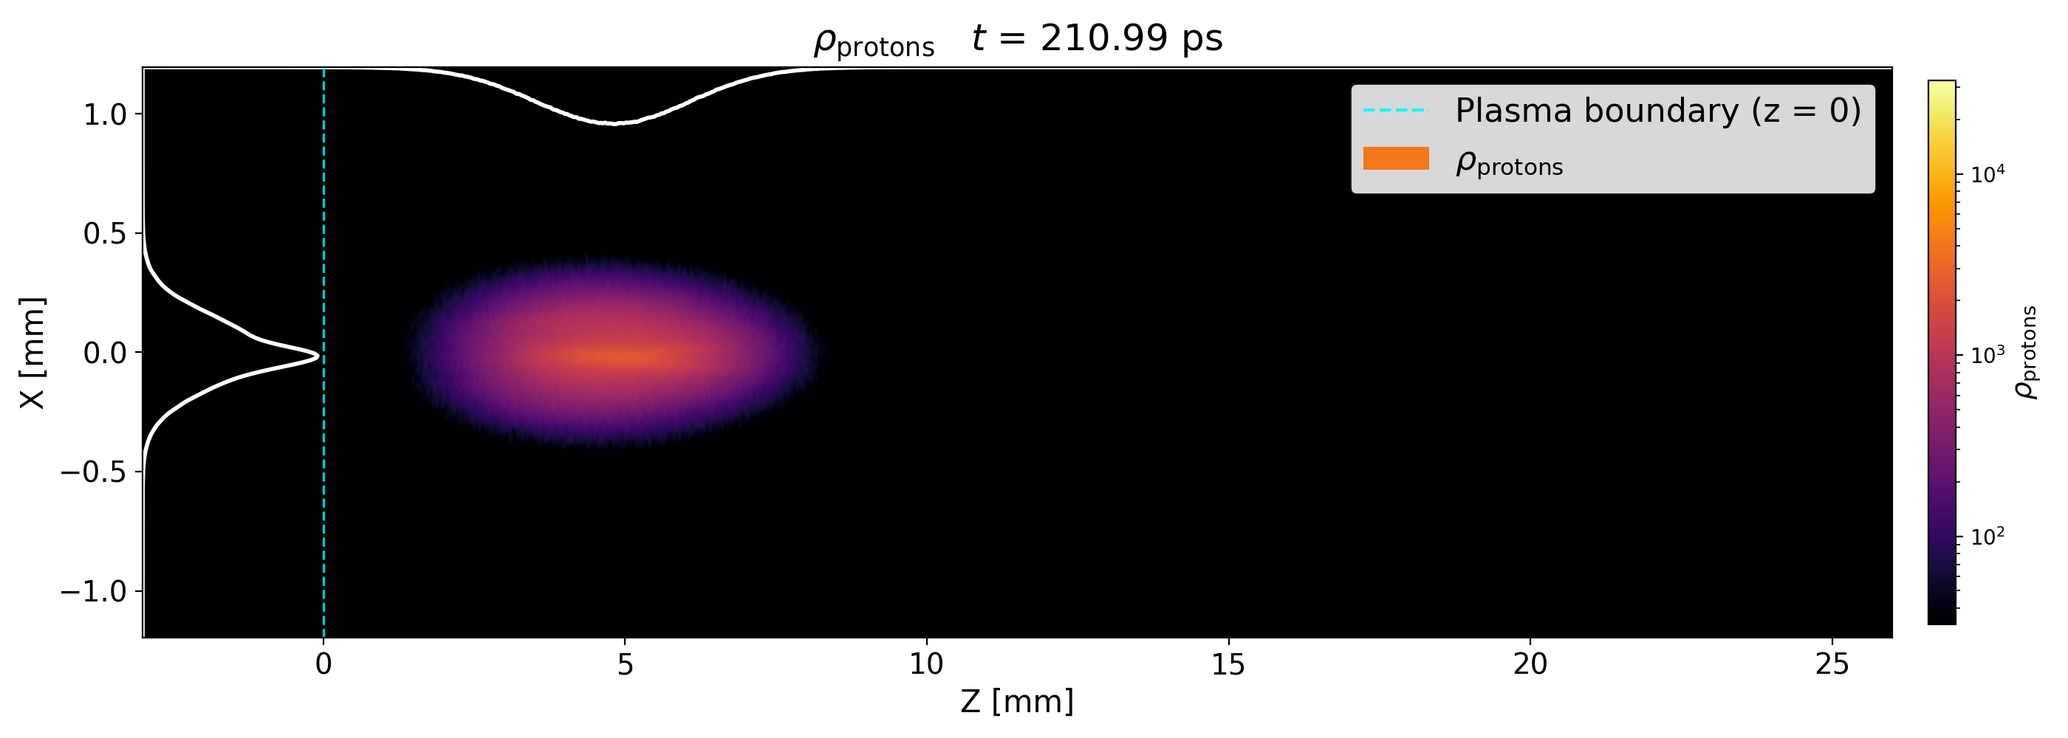
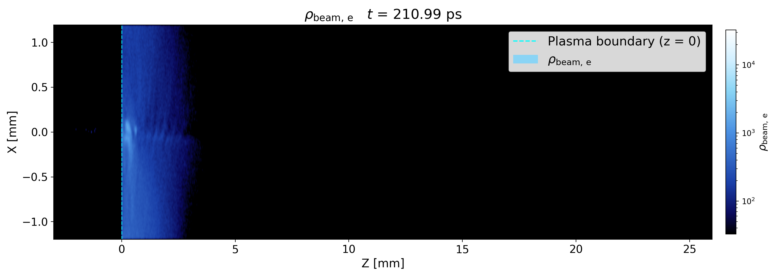
11.4: Simulation Output - Stills
Proton beam centre becomes more dense…. focussing
Electrons move away
from proton beam
Electrons disperse into background
Notes:
We see the proton beam expand initialy due to its initialised divergence, but then this core begins to grow and gain protons as it travels, so more and more protons are being focussed
And for the electron side of things, we see that they do not get very far into the plasma before dispersing into the background
they scatter away from our proton beam leaving this gap in their density that matches the shape of the protons
So if our focussing fields are not being established we should see the proton beam explode due to the Coulomb force.
I want to point out the white profile on the proton figure, specifically the y-axis (labelled x)
For most of the results, when referring to the FWHM, this is found from this profile.

Slide 18
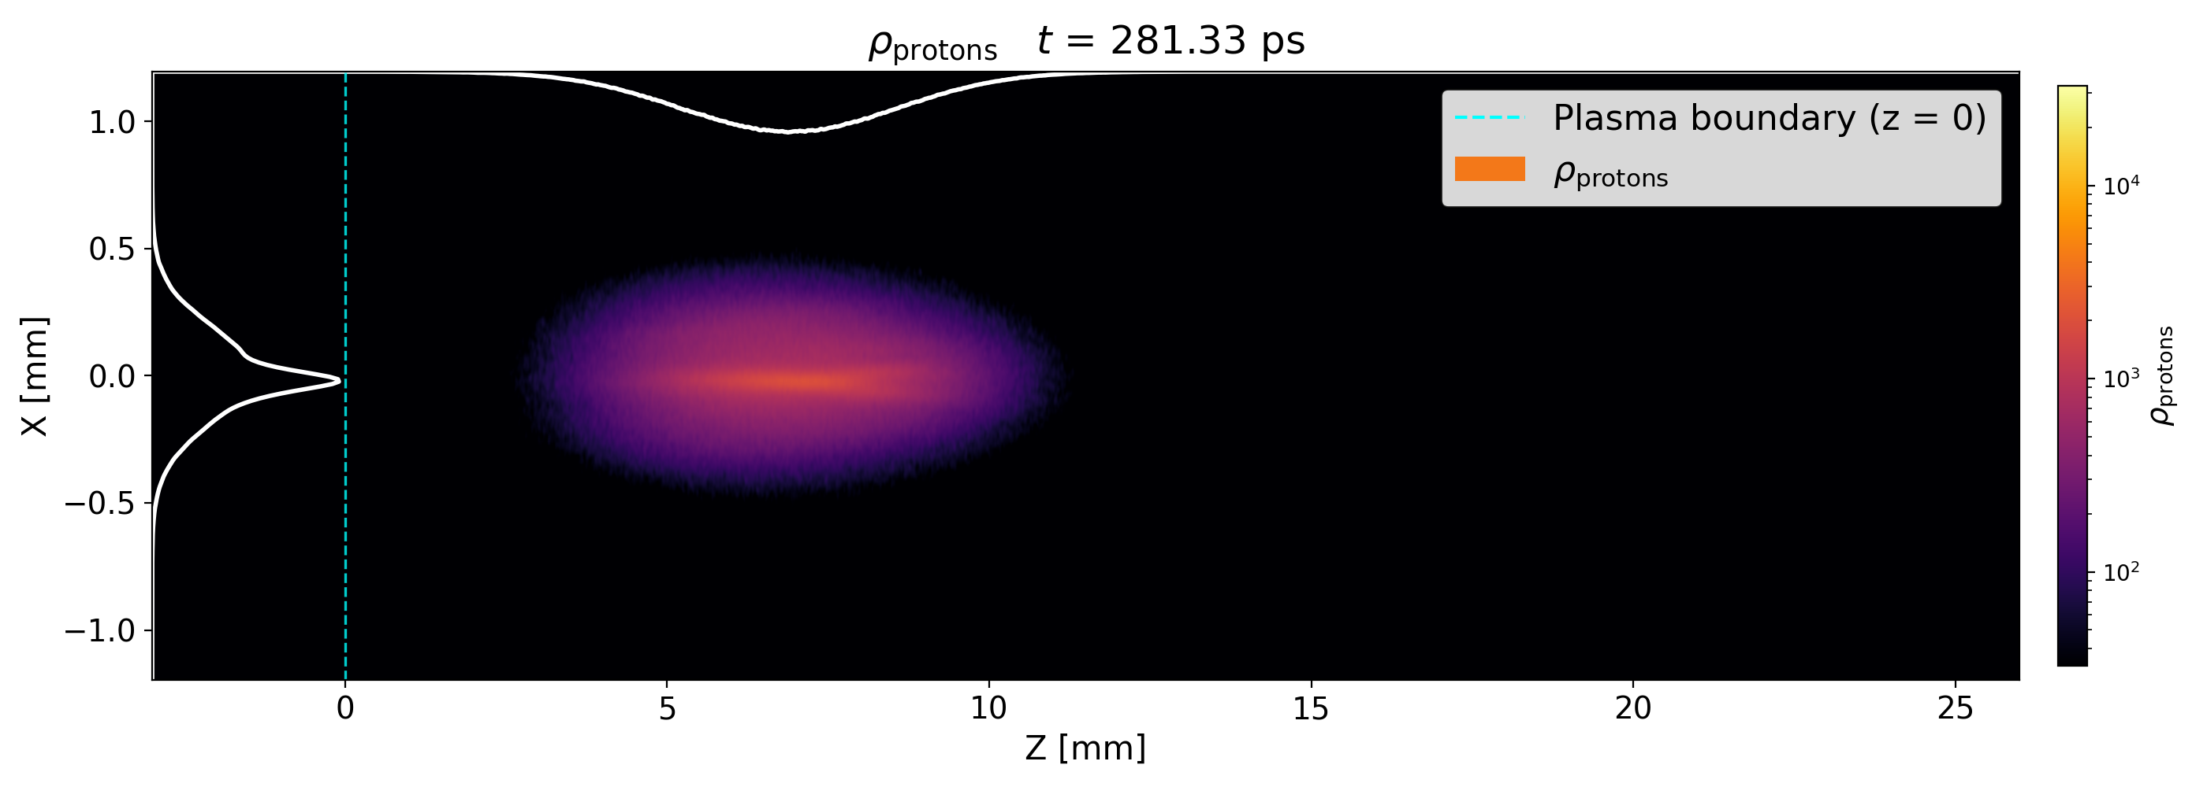
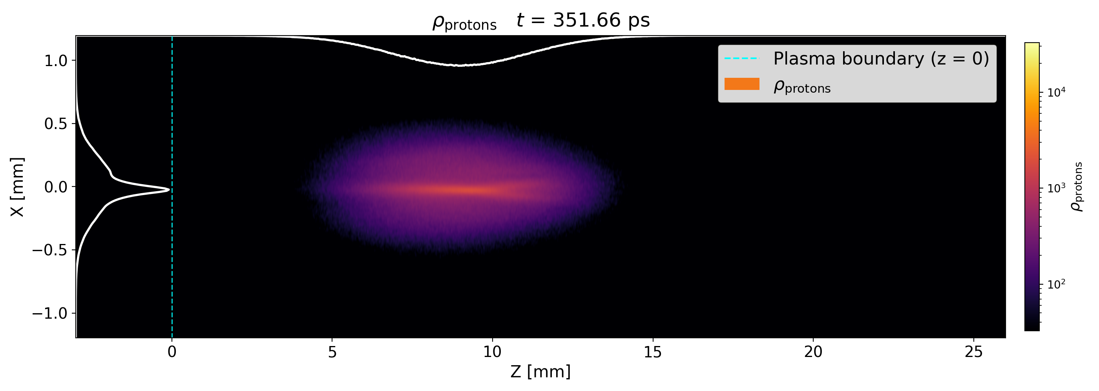
11.5: Simulation Output - Stills
Proton beam centre becomes more dense…. focussing
This effect continues as the beam propagates
Electrons move away
from proton beam
Electrons disperse into background
Notes:
We see the proton beam expand initialy due to its initialised divergence, but then this core begins to grow and gain protons as it travels, so more and more protons are being focussed
And for the electron side of things, we see that they do not get very far into the plasma before dispersing into the background
they scatter away from our proton beam leaving this gap in their density that matches the shape of the protons
So if our focussing fields are not being established we should see the proton beam explode due to the Coulomb force.
I want to point out the white profile on the proton figure, specifically the y-axis (labelled x)
For most of the results, when referring to the FWHM, this is found from this profile.

Slide 19
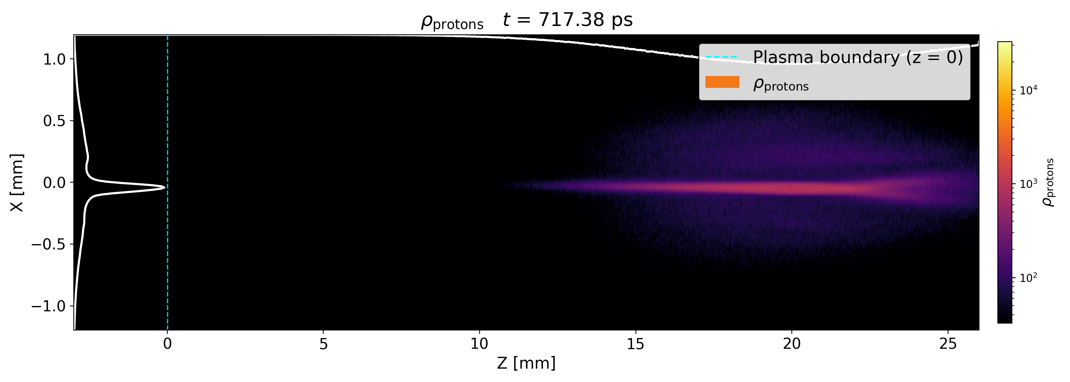
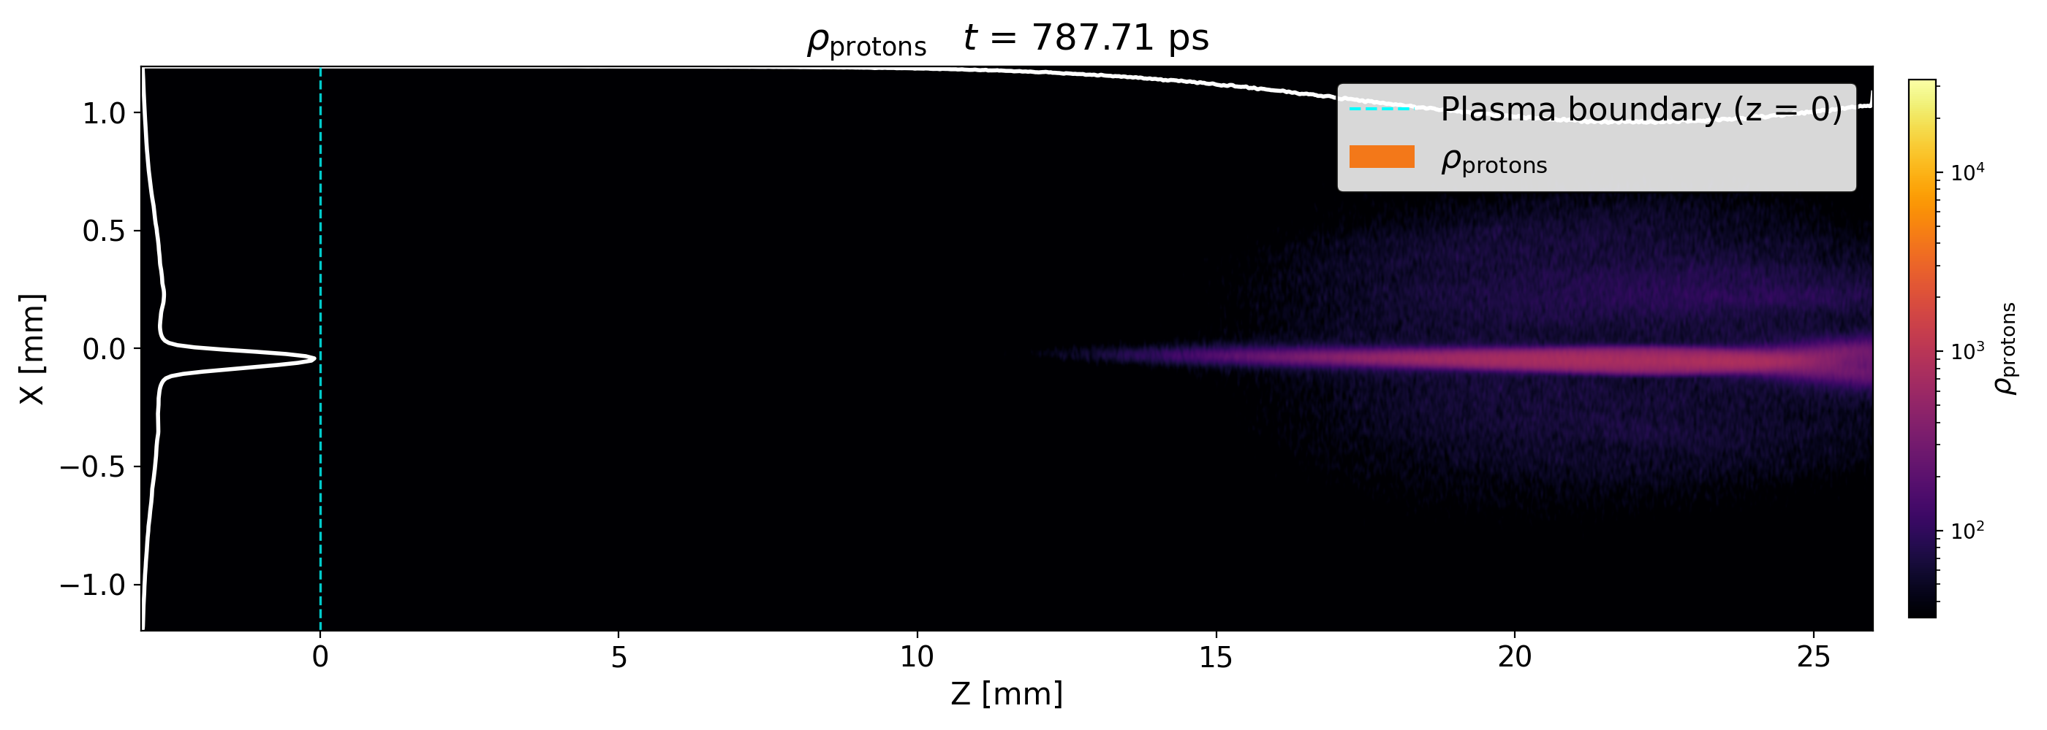
11.6: Simulation Output - Stills
Skipping forward in time
Proton beam centre becomes more dense…. focussing
This effect continues as the beam propagates
Electrons move away
from proton beam
Electrons disperse into background
Notes:
We see the proton beam expand initialy due to its initialised divergence, but then this core begins to grow and gain protons as it travels, so more and more protons are being focussed
And for the electron side of things, we see that they do not get very far into the plasma before dispersing into the background
they scatter away from our proton beam leaving this gap in their density that matches the shape of the protons
So if our focussing fields are not being established we should see the proton beam explode due to the Coulomb force.
I want to point out the white profile on the proton figure, specifically the y-axis (labelled x)
For most of the results, when referring to the FWHM, this is found from this profile.

Slide 20
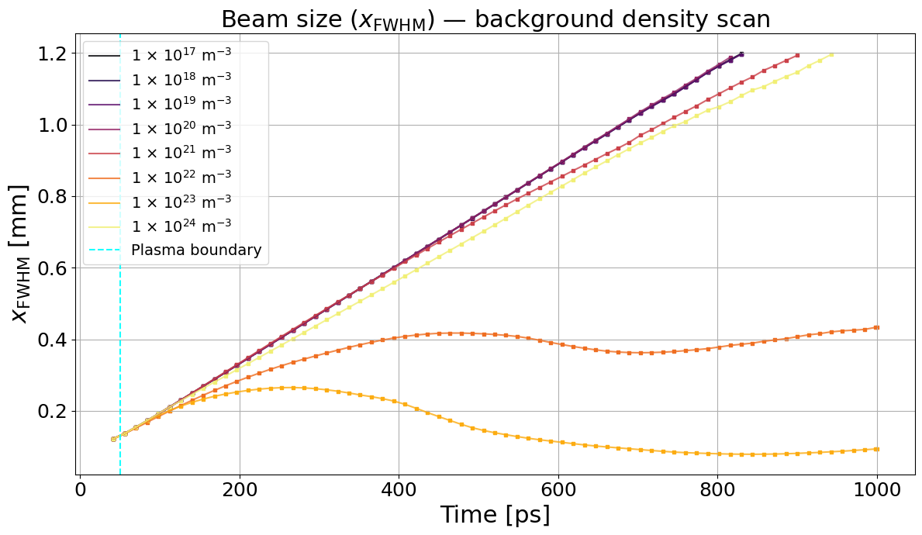
12: Background Plasma Density
Scanning through the electron density of the background plasma
50 nC beam, 20 mrad initial divergence
Bouncing effect caused by some beam leaving the box
Notes:
So we will begin by scanning the background plasma density for a constant beam charge of 50 nC
For the lowest and highest density cases, we don’t see much of an effect, because either the co-propagating electrons keep travelling with the protons
But there is a sweet spot, around 10 too the 23 per meter cubed, or 10 too the 17 per cm cube
We see for the ideal case that the beam size platueus, this is because the remaining protons that have not been focussed are too divergent
We can see this in the previous slide actually
Okay, so now lets try a different charge proton beam`

Slide 21
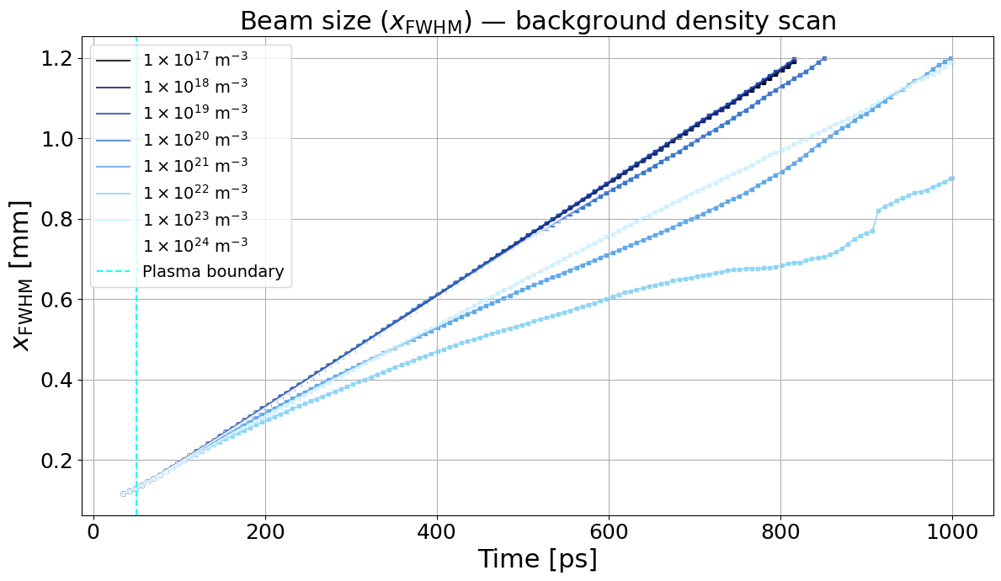
13: Background Plasma Density
Scanning through the electron density of the background plasma
10 nC beam, 20 mrad initial divergence
Background electrons move in reducing focussing
Notes:
But now if we go to a beam with 10 nC, we see that the ideal density has changed to be 10 too the 21
But note the amount of focussing is noticeably less
We see in these simulations that the background electrons move to shield the formation of currents around the proton beams
So obviously the beam charge has an impact on this effect so lets look at that

Slide 22
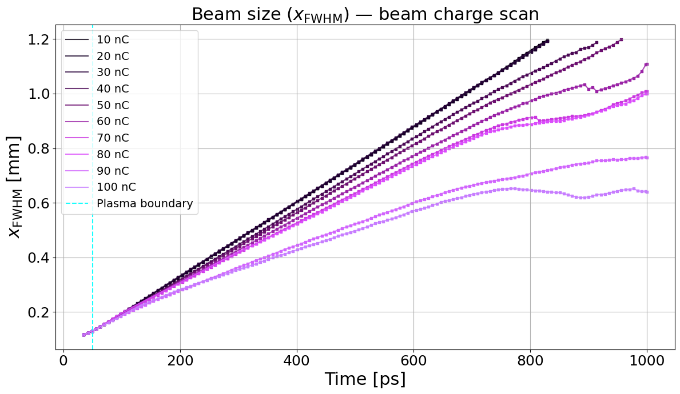
14: Beam Charge
The beam has an initialised charge (q_{p} = - q_{e})
  Changing this in action changes the beam density
Notes:
Running a scan of the beam charge, for a constant density of 10 too the 24, we can see that 100 nC has the biggest reduction in its beam size
So we can maybe begin to see that maybe these two are linked.
And in fact the way that warpx changes the beam charge is to increase the number of particles in the beam.
And by preforming a large scan across both parameter spaces and taking the ratio of the plasma density to beam density we get this

Slide 23
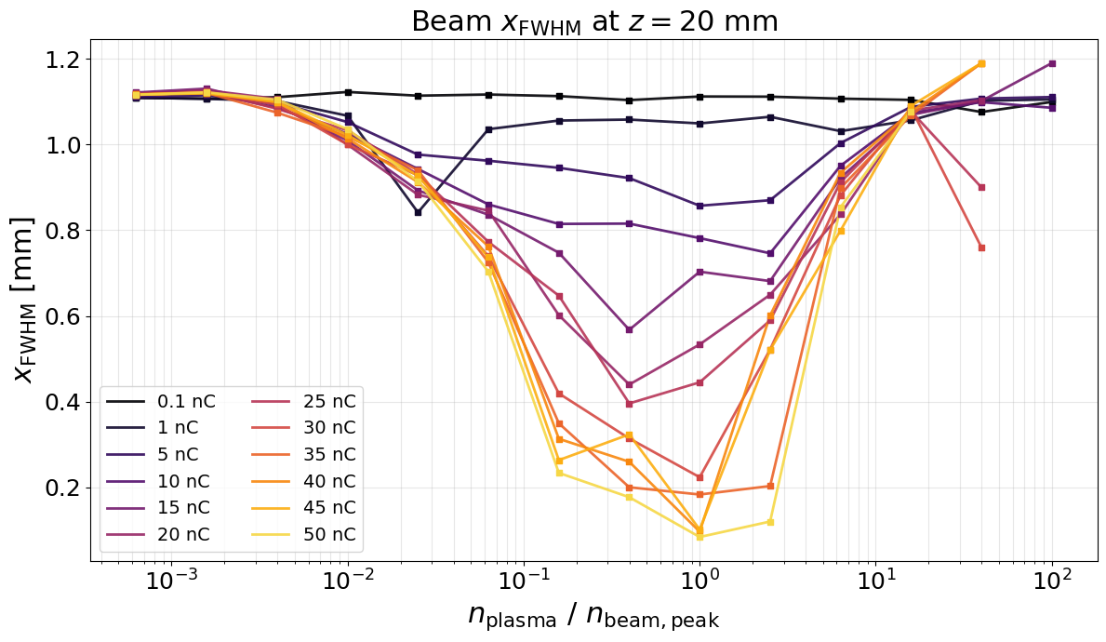
15: Beam Charge and Background Density
Beam size at 20 mm propagation
Higher charges show larger reductions around a ratio of 1
Beam filamenting into smaller bunches that are being focussed
Notes:
And what we see is that they are definitely linked
For simulations where the electron density of the plasma is similar to the density of the proton beam,
The focussing effect is greater
And that for higher charges, the effect is also stronger, due to th e background electrons not neutralising the beam
Its important to note that when changing the beam charge, the charge of the copropagating electron beam is also changed to be the same,

Slide 24
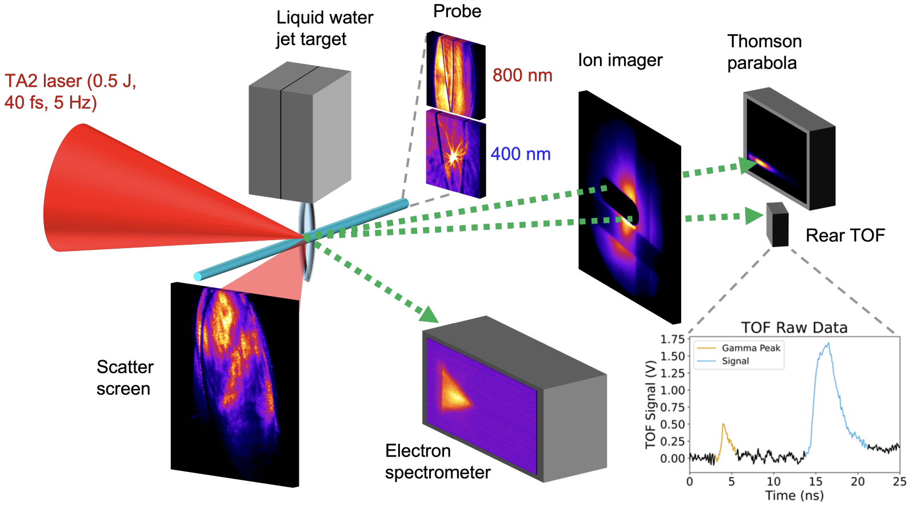
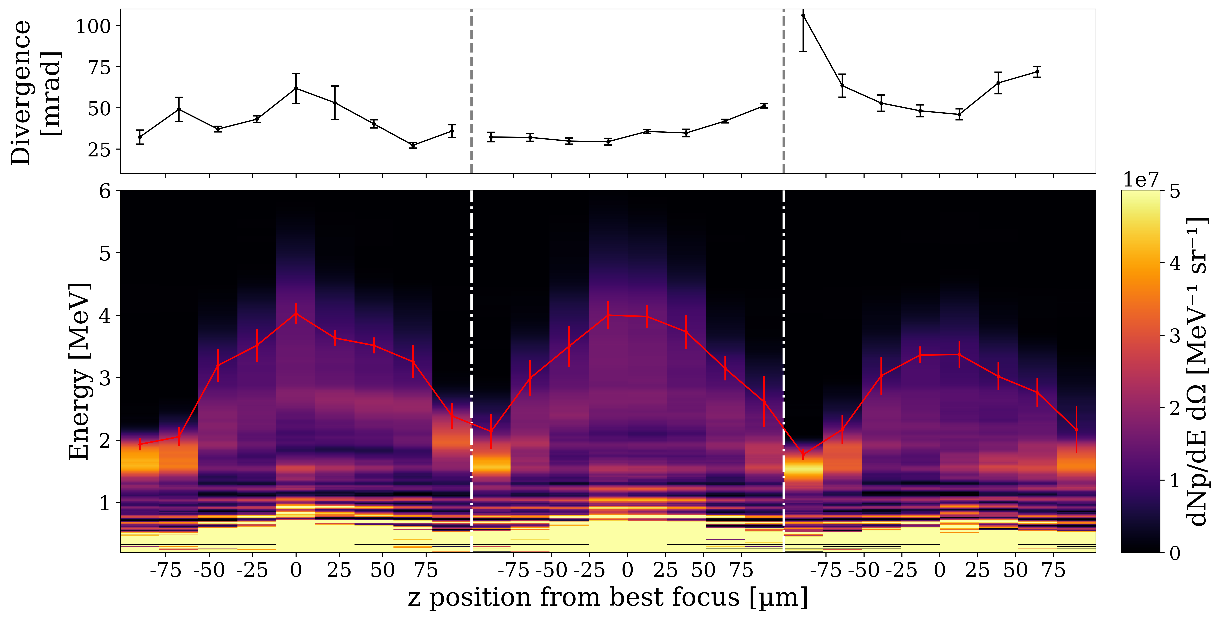

16: Achieving This On Campaign
Come and see my poster!!! (the red one)
-3000 fs²
Best Comp
+3000 fs²
Notes:
youll have to come see my poster for that

Slide 25
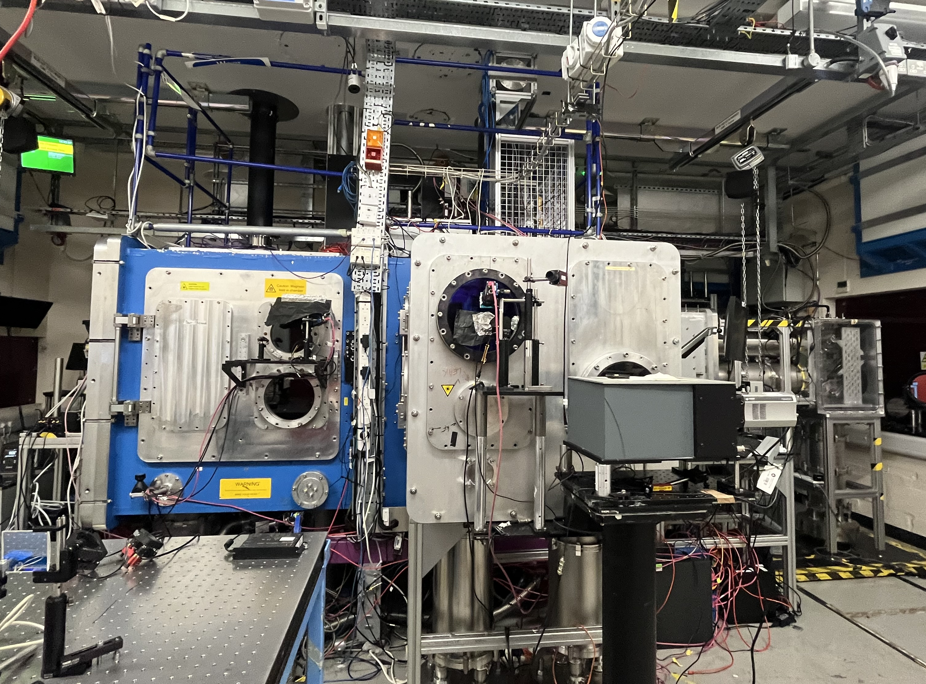
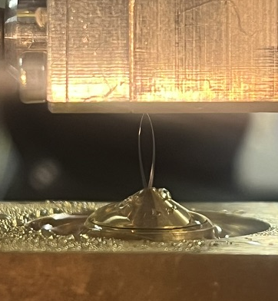
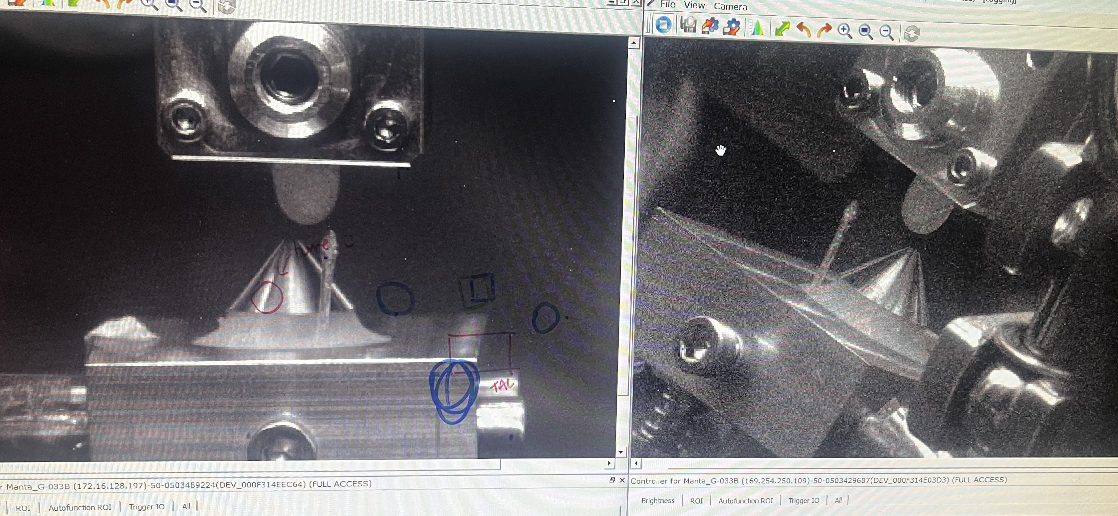
What Next?
Expand on experimental data sets with a campaign at BELLA next week
Characterise the vapour profile of the liquid-sheet to inform simulations at the CLF
Investigate the fields using LWFA electrons and the liquid-sheet in Gemini at the CLF
Debug the use of the sheet

Slide 26
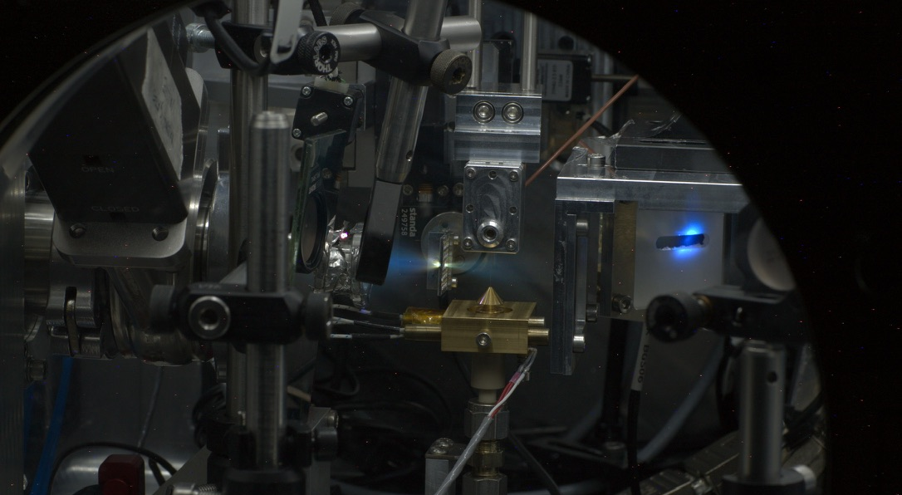
With thanks too:
QUB: D. Molloy, M. J. V. Streeter, B. Loughran, J. P. Kennedy, C. J. R. Fitzpatrick, C. I. Prestwood, P. Parson, C. J. A. Palmer
SLAC: G. Griffin, G. Gain, M. Gauthier, S. H. Glenzer
CLF: S. Astrbury, N. Bourgeois, H. Ahmad, S. J. D. Dann, J. S. Green, D. Symes
LLNL: F. Treffert
UMich: A. G. R. Thomas
ICL: N. P. Dover
ELI-Beamlines: L. Giuffrida

