Slide 1


Demonstration of Plasma-Based Beam Compression
AAC 2026
Rafi Hessami / Graduate Student / SLAC National Accelerator Laboratory
July 2026, Los Angeles, California

Slide 2
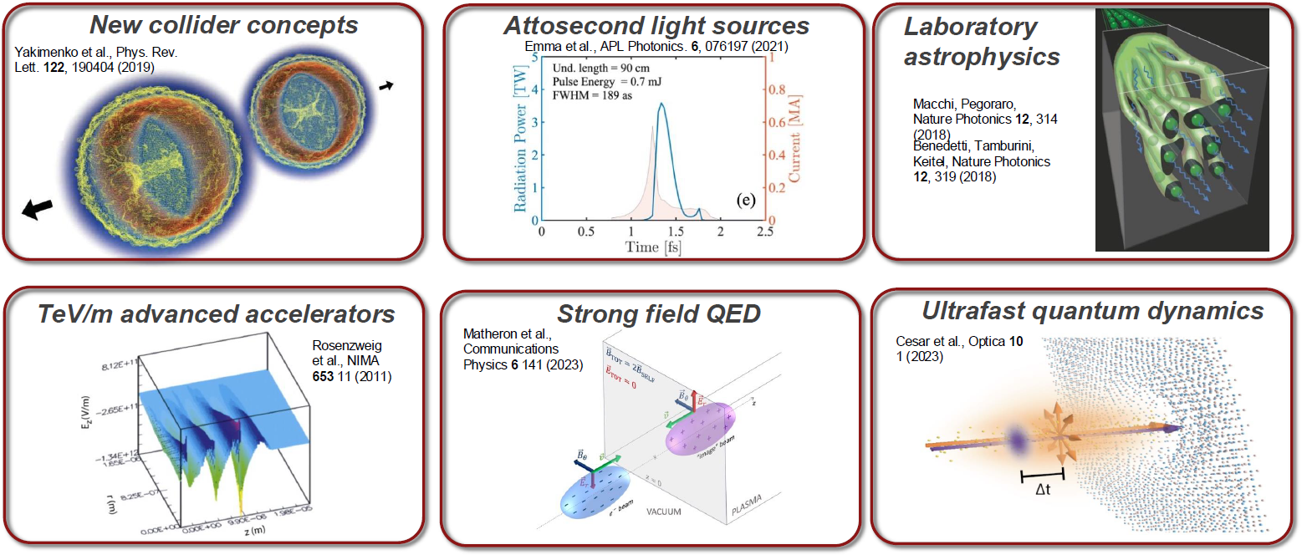
A Need for Compressed Beams
There is a need for short, high current beams to enable next-generation experiments in accelerator physics
The DOE Roadmap specifically highlights this
Driver, T., Guo, Z., Isele, E. et al. Nat. Phys. (2026).
DOE ABP Roadmap 2023

Slide 3
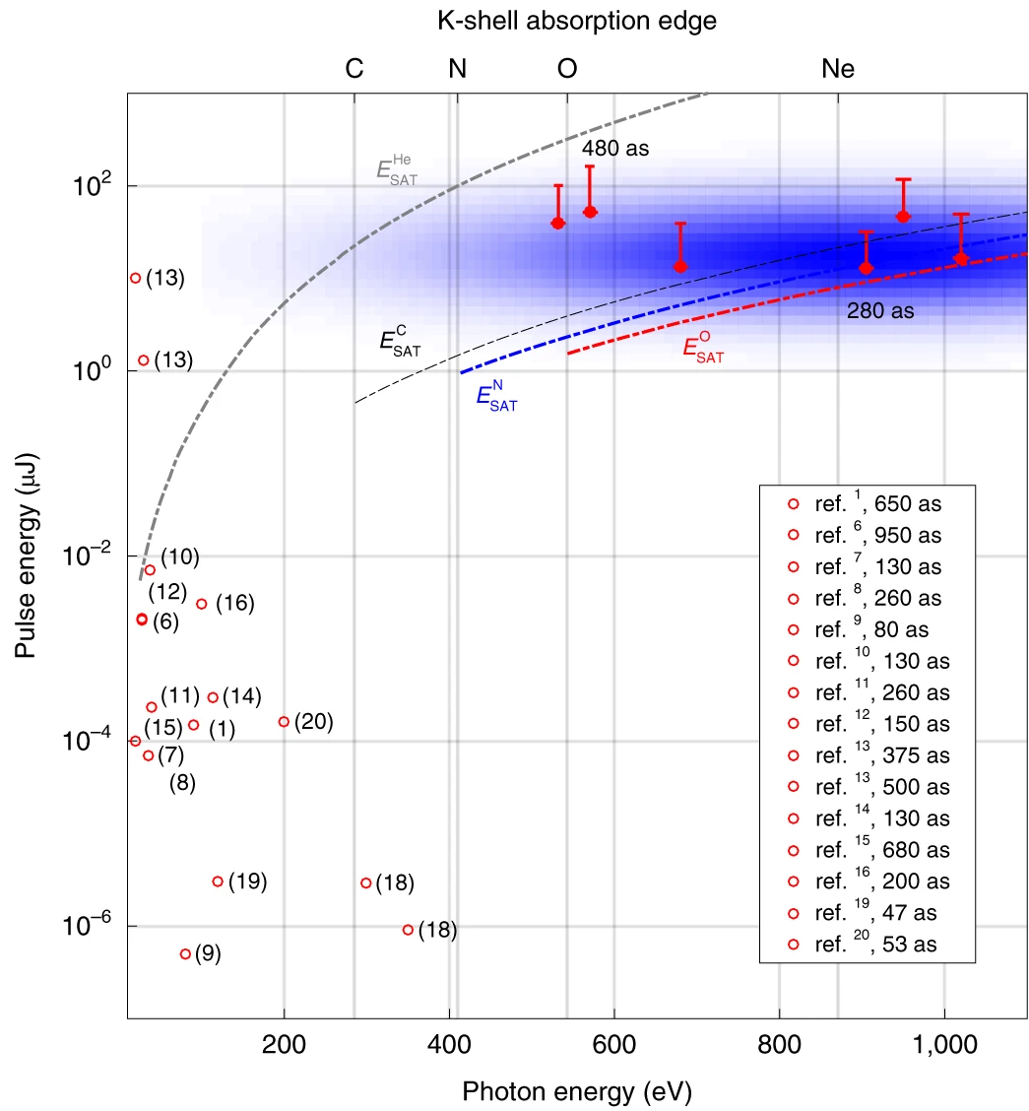
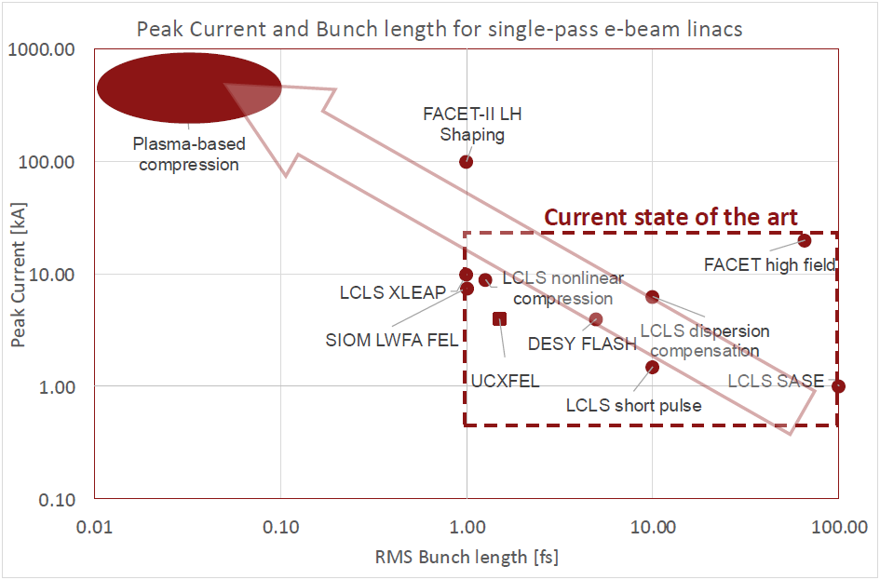
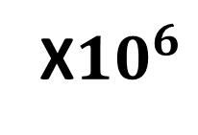
Current State of the Art
J. Duris et al. Nat. Photonics 14, 30–36 (2020)
PAX
XFEL
X$10^{6}$
See K. Swanson talk
Thursday 10:45-11:15
HHG
Plasma-based compression allows for unprecedented peak currents and bunch lengths

Slide 4
SPARC Experimental Setup
Conventional RF acceleration to reach 100 MeV
Plasma to chirp the witness beam
Chicane to compress the witness beam
Undulator to produce a coherent pulse
The SPARC experimental setup provides a perfect opportunity to test plasma-based beam compression
Notes:
Explain B^2 in the undulator

Slide 5
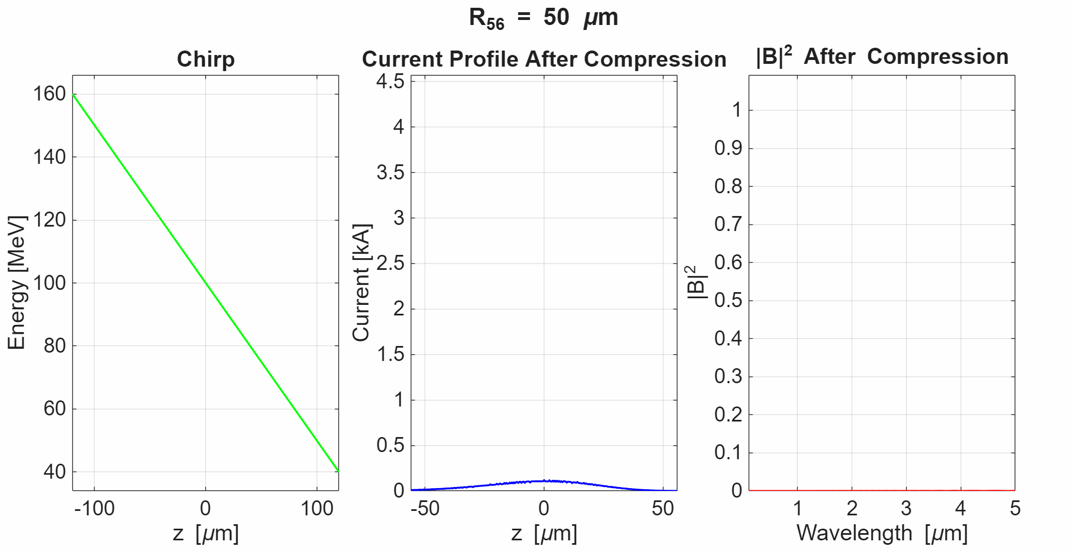
Experimental Demonstration at SPARC
Measure beam chirp
Generate + measure a compression-dependent signal
Measure and control the undulator spectrum
The PAX principle uses the beam’s chirp to compress it

Slide 6
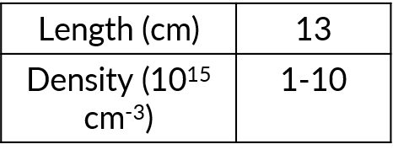
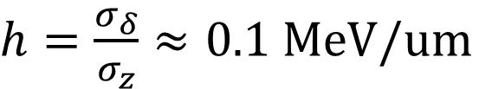
Chirp Measurements
Chirp is measured by combining the energy spread measurement with the bunch length measurement
Chirp estimated as:
Capillary discharge parameters
$h=\frac{σ_{δ}}{σ_{z}}≈0.1 MeV/um$
Chirp measurements need refinement

Slide 7
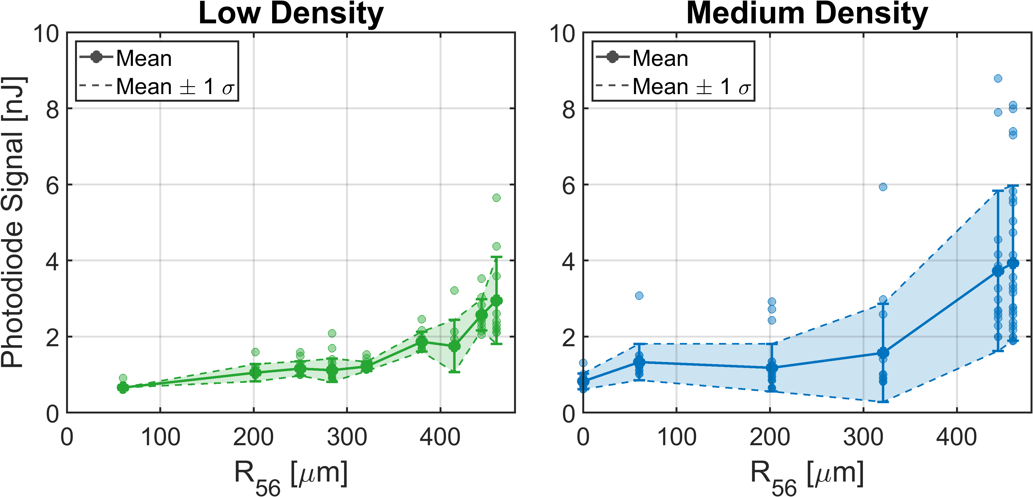
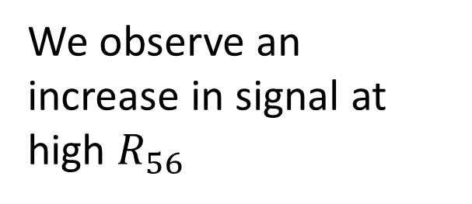
Photodiode Measurements
We observe an increase in signal at high $R_{56}$
Adjusting plasma density is a viable way to control compression
Photodiode measurements suggest total signal at optical wavelengths responds to changing plasma density
Notes:
Knob is plasma density

Slide 8
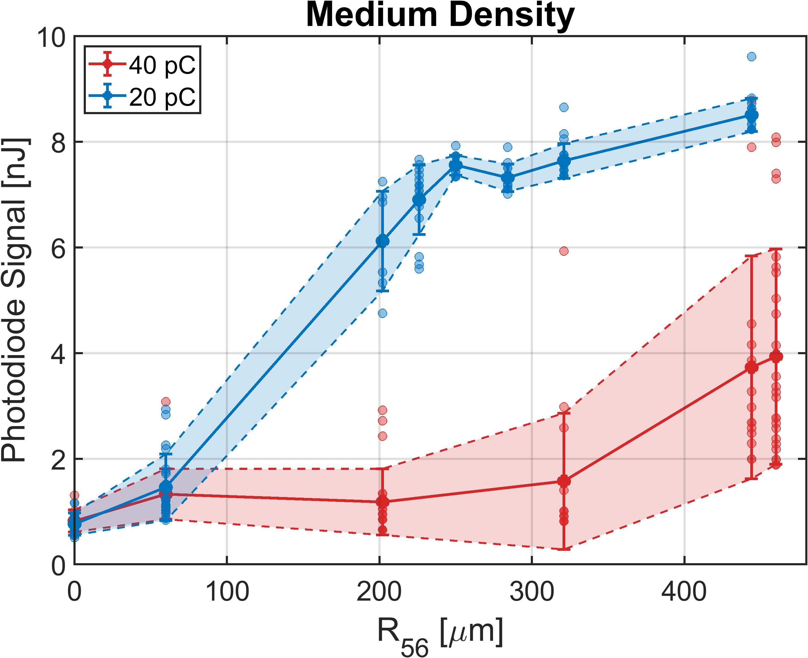
Photodiode Measurements
Reducing the beam charge from 40 pC to 20 pC drastically increased signal
Beamloading is another tool to control compression
Beamloading can be used to control chirp and compression

Slide 9
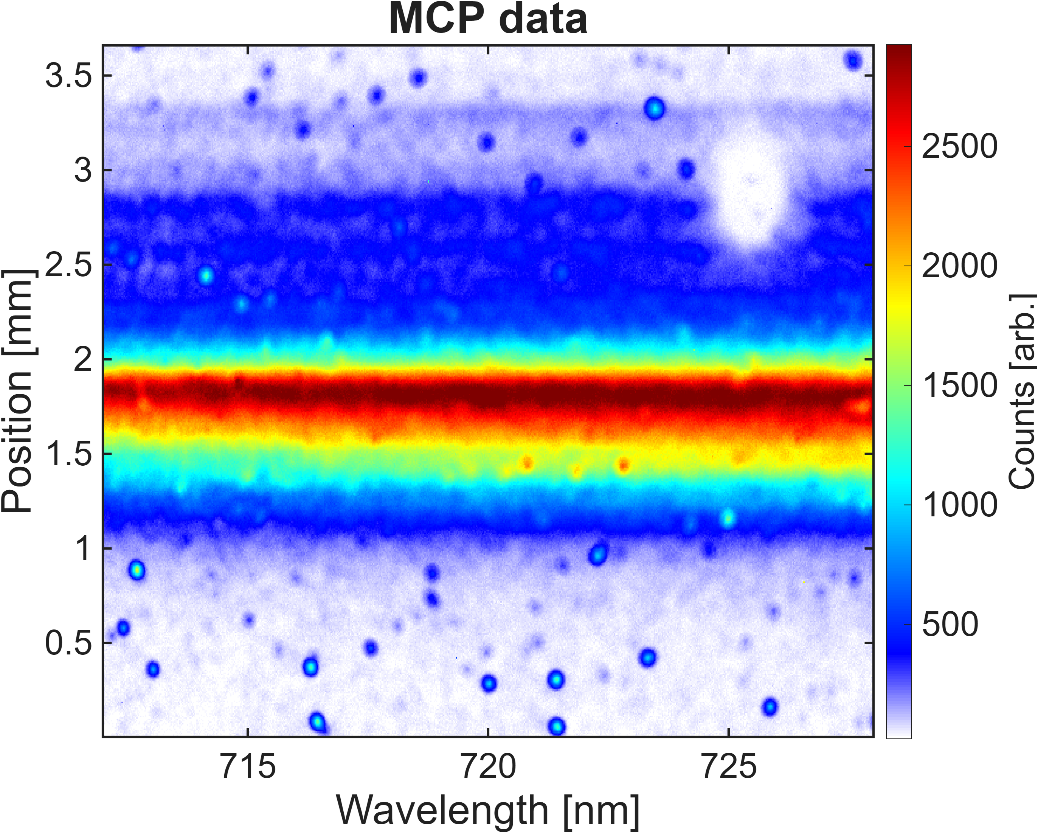
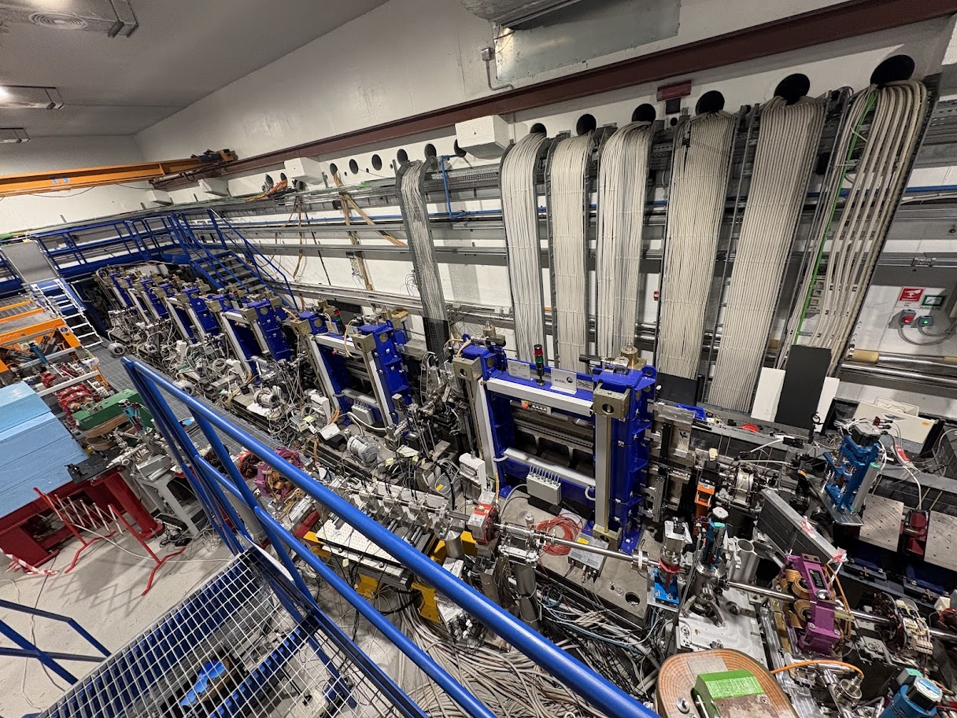
Undulator Measurements
SPARC Undulators
SPARC observed 27 nJ after all 7 undulators previously
Pompili, R., Alesini, D., Anania, M.P. et al. Nature 605, 659–662 (2022).
The SPARC undulators allow us to see how the spectrum can be controlled

Slide 10
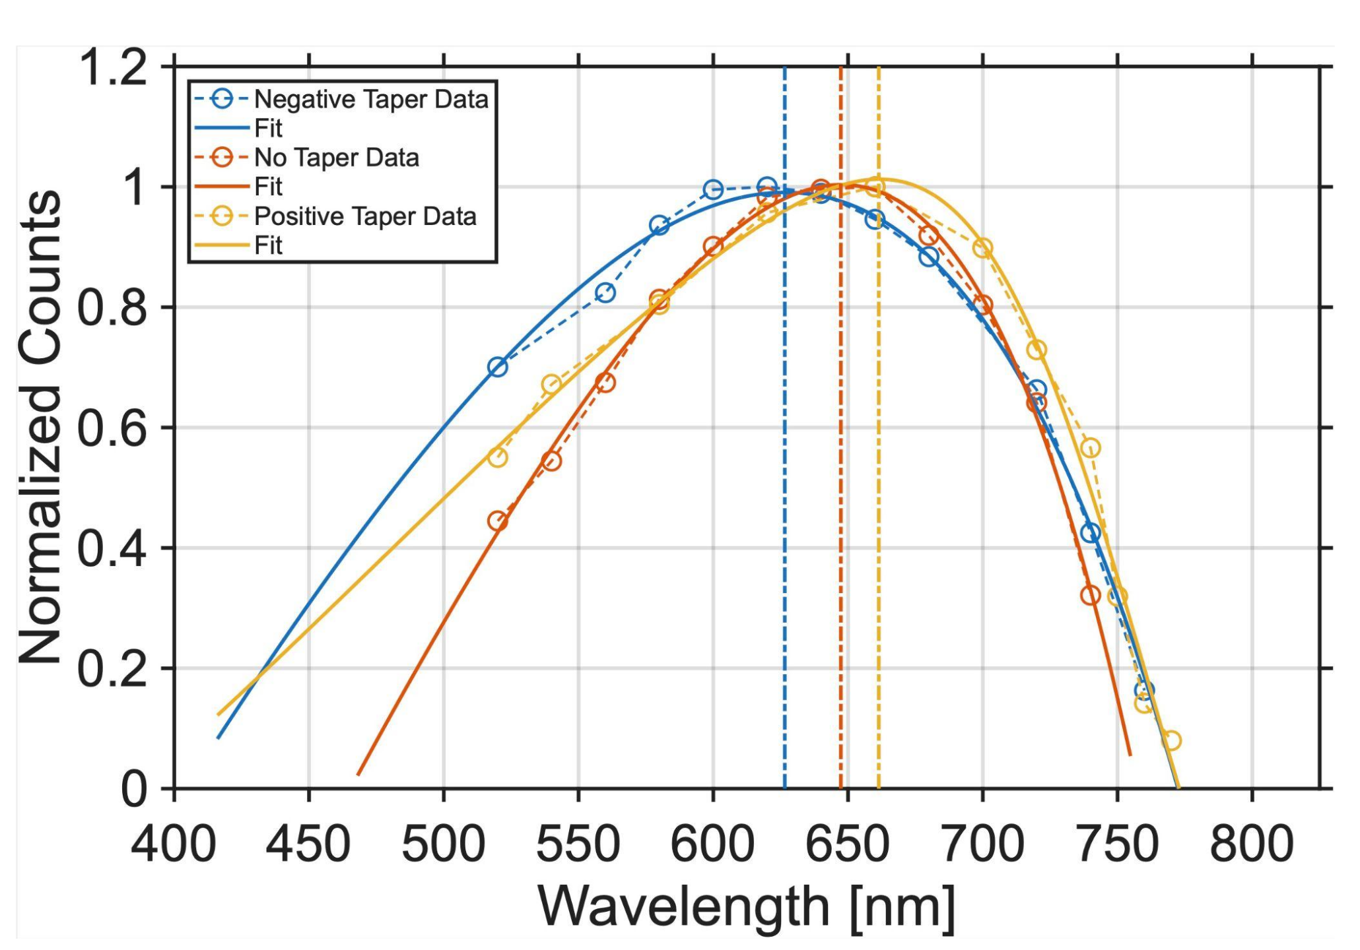
Undulator Measurements
We observe a shift in the spectrum peak in the expected direction when applying a multi-% taper!
This chirp would destroy SASE
Tapering can be used to manipulate the spectrum
Notes:
Widening is another tool to control the spectrum

Slide 11
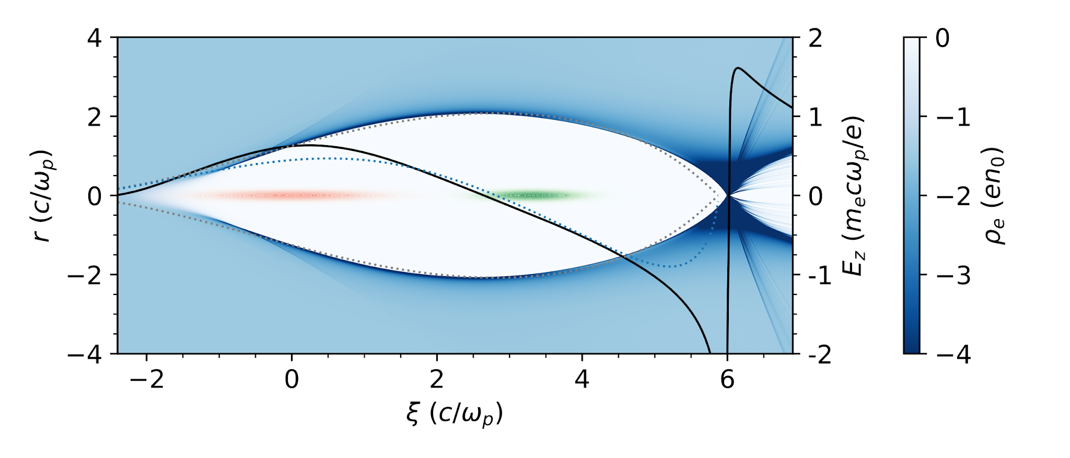
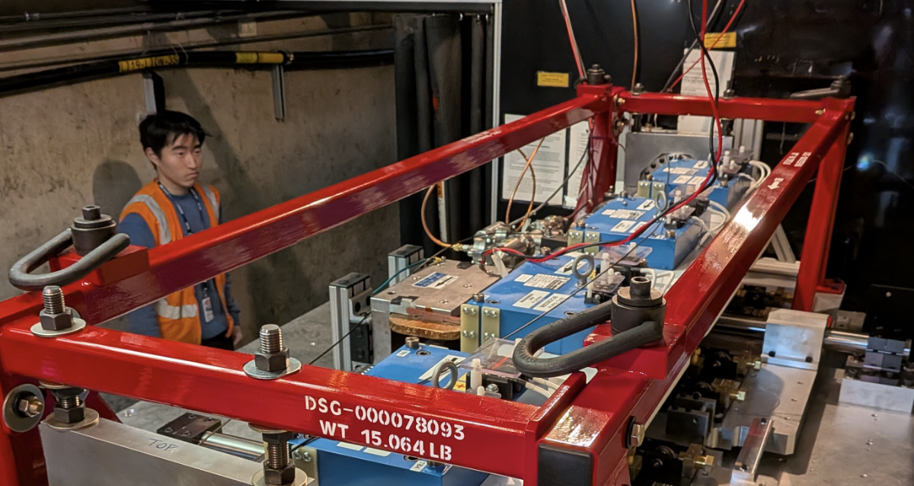
Conclusion
Compressed electron beams are important for next-generation experiments
Observed evidence for plasma-based beam compression and radiation
  Found 3 knobs to control it: witness charge, plasma density, undulator K
Witness charge controls beamloading
Plasma density controls chirp
Undulator K controls output spectrum
Motivates further research into plasma-based compression, e.g. PAX at FACET-II
See C. Emma poster
Tuesday
See K. Swanson talk
Thursday 10:45-11:15
SPARC is an excellent testbed for plasma-based beam compression!

Slide 12
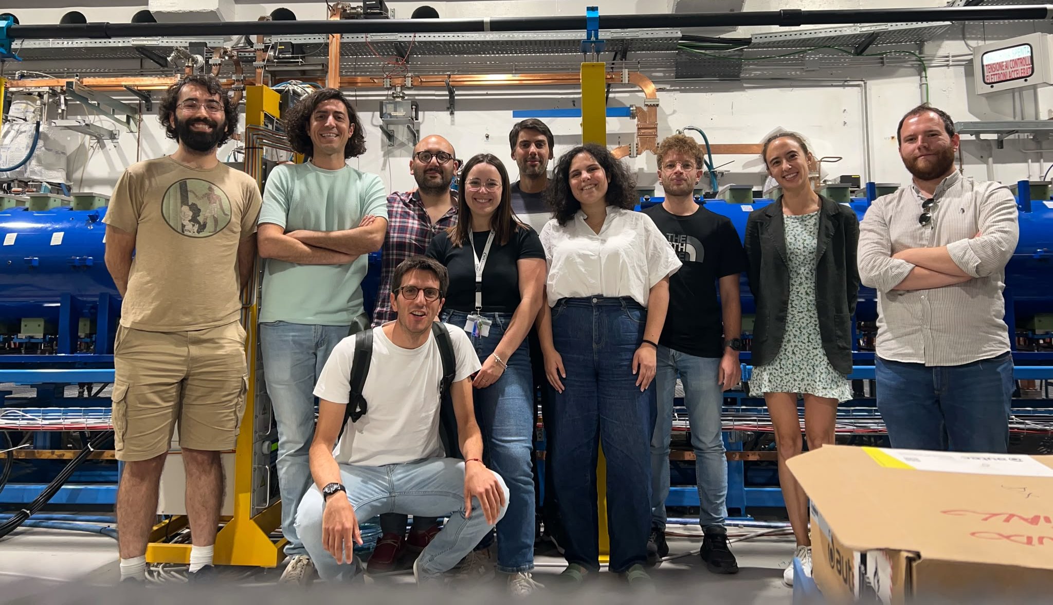
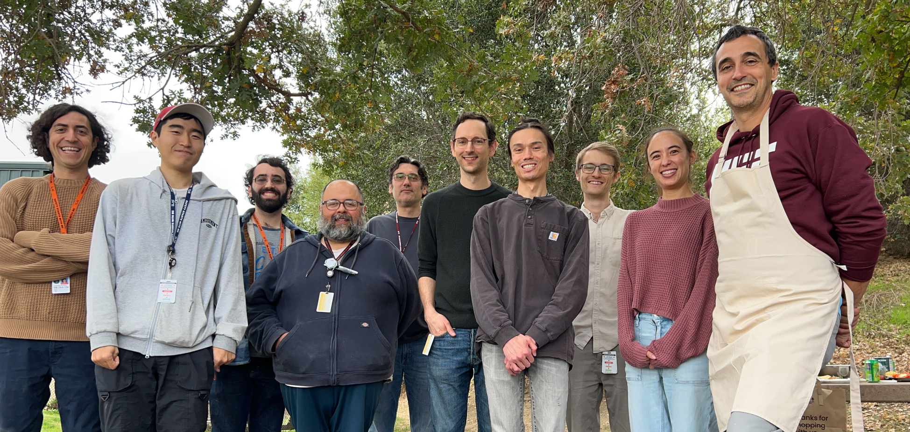
The SPARC and PAX Teams
Thank you for your attention!

Slide 13
Acknowledgments
Collaborators
SLAC: C. Emma, K. Swanson, R. Hessami, A. Marinelli
INFN-LNF: M. Galletti, L. Verra, R. Pompili, and all of the SPARC operations staff
Thank you for your attention!

Slide 14
Backup Slides

Slide 15
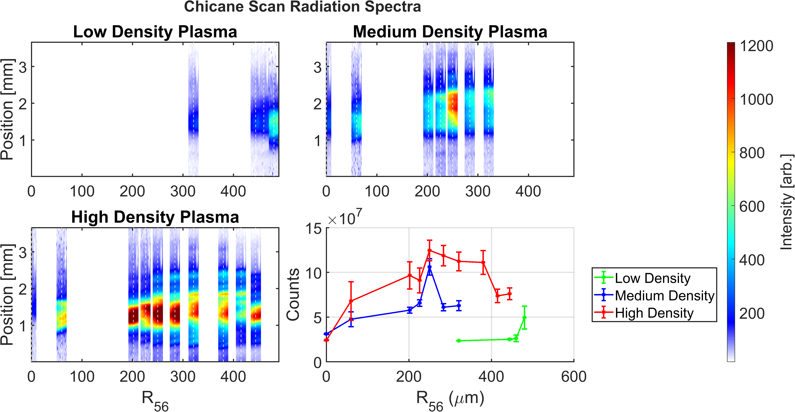
Chicane Scans

Slide 16
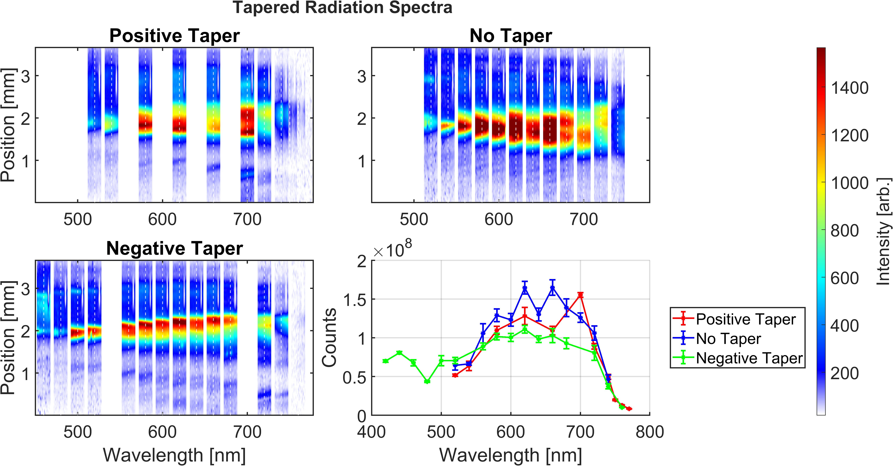
Wavelength Scans

Slide 17
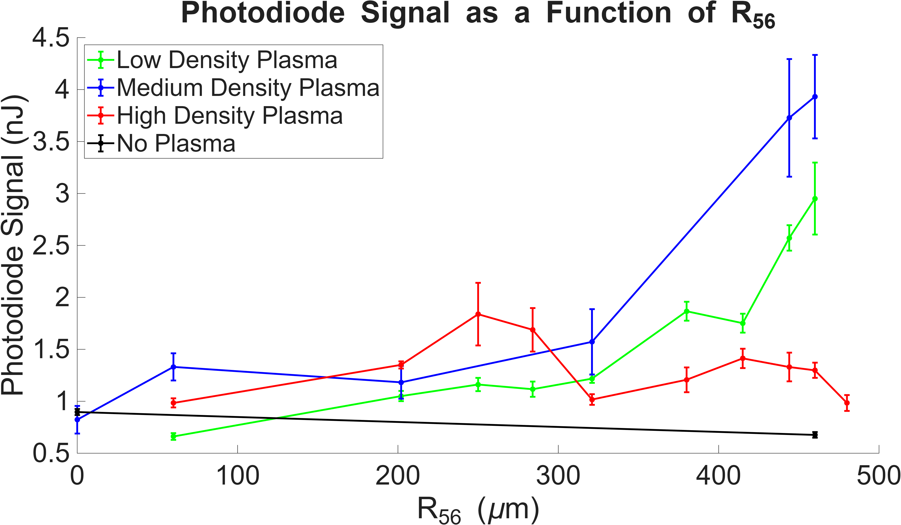
Photodiode Comparison

Slide 18
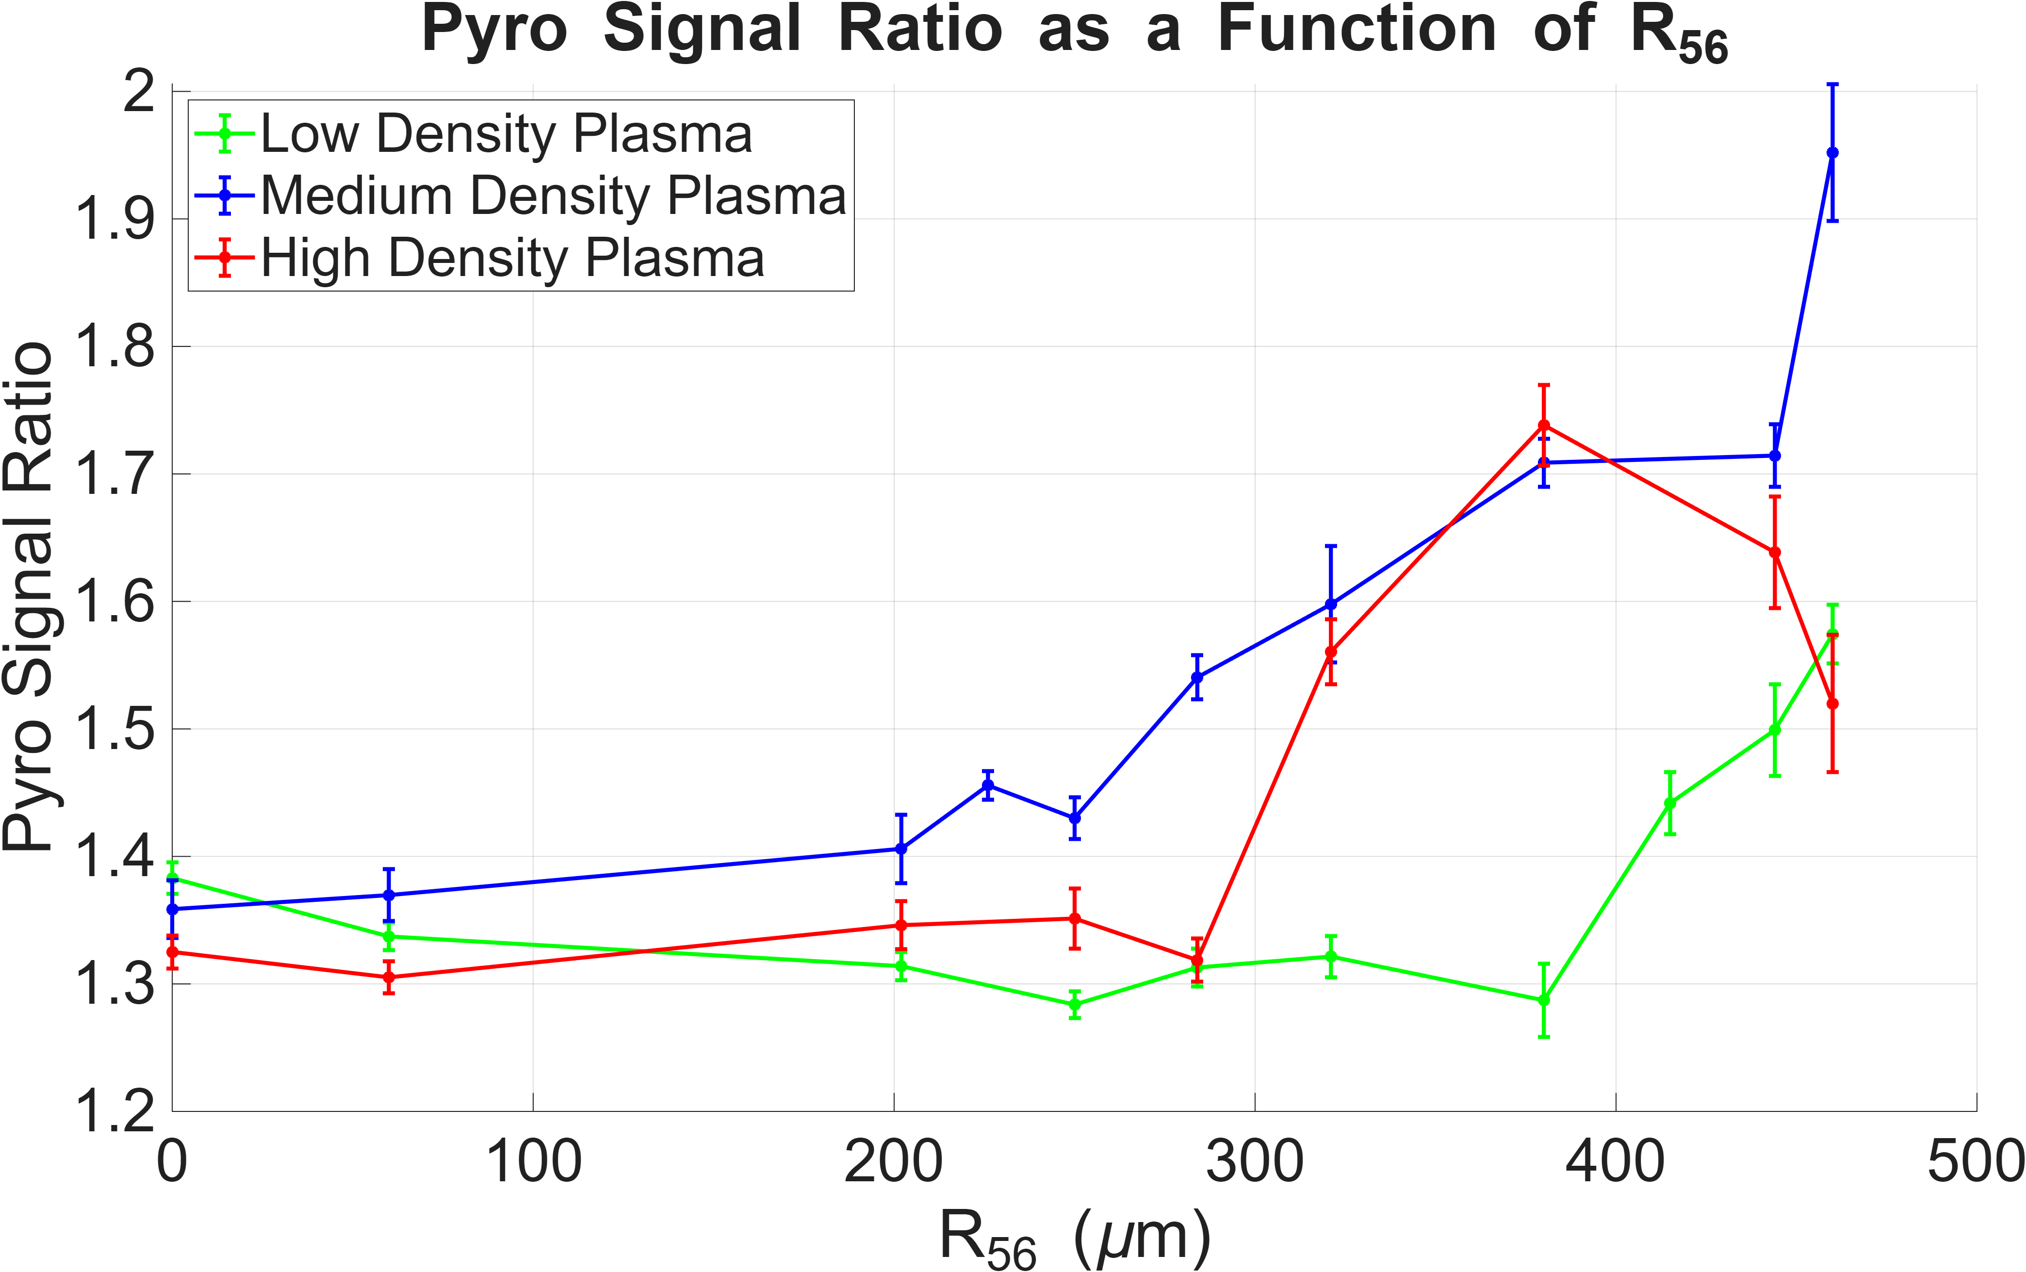
Pyro Comparison

Slide 19
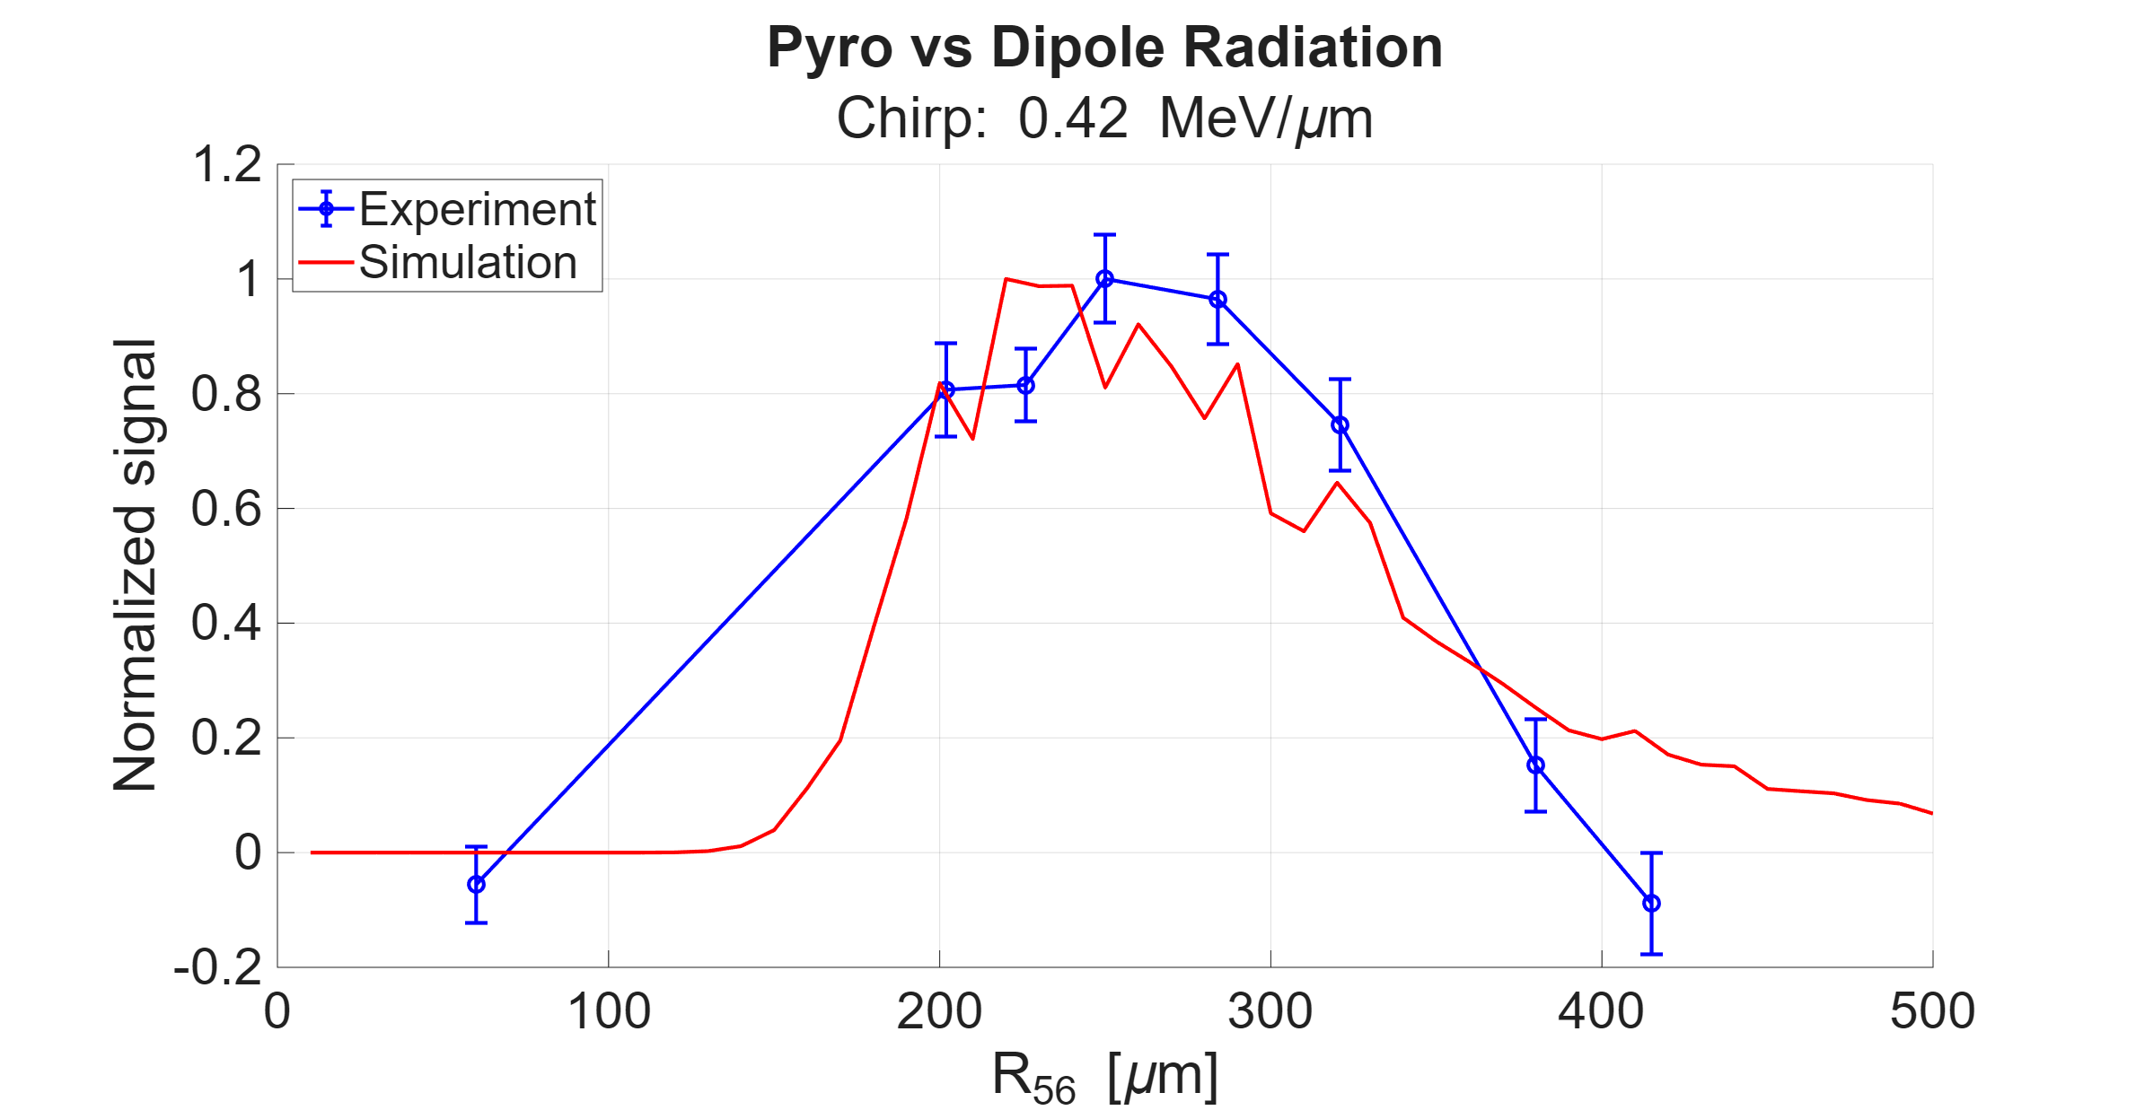
Pyro Simulation Comparison

Slide 20
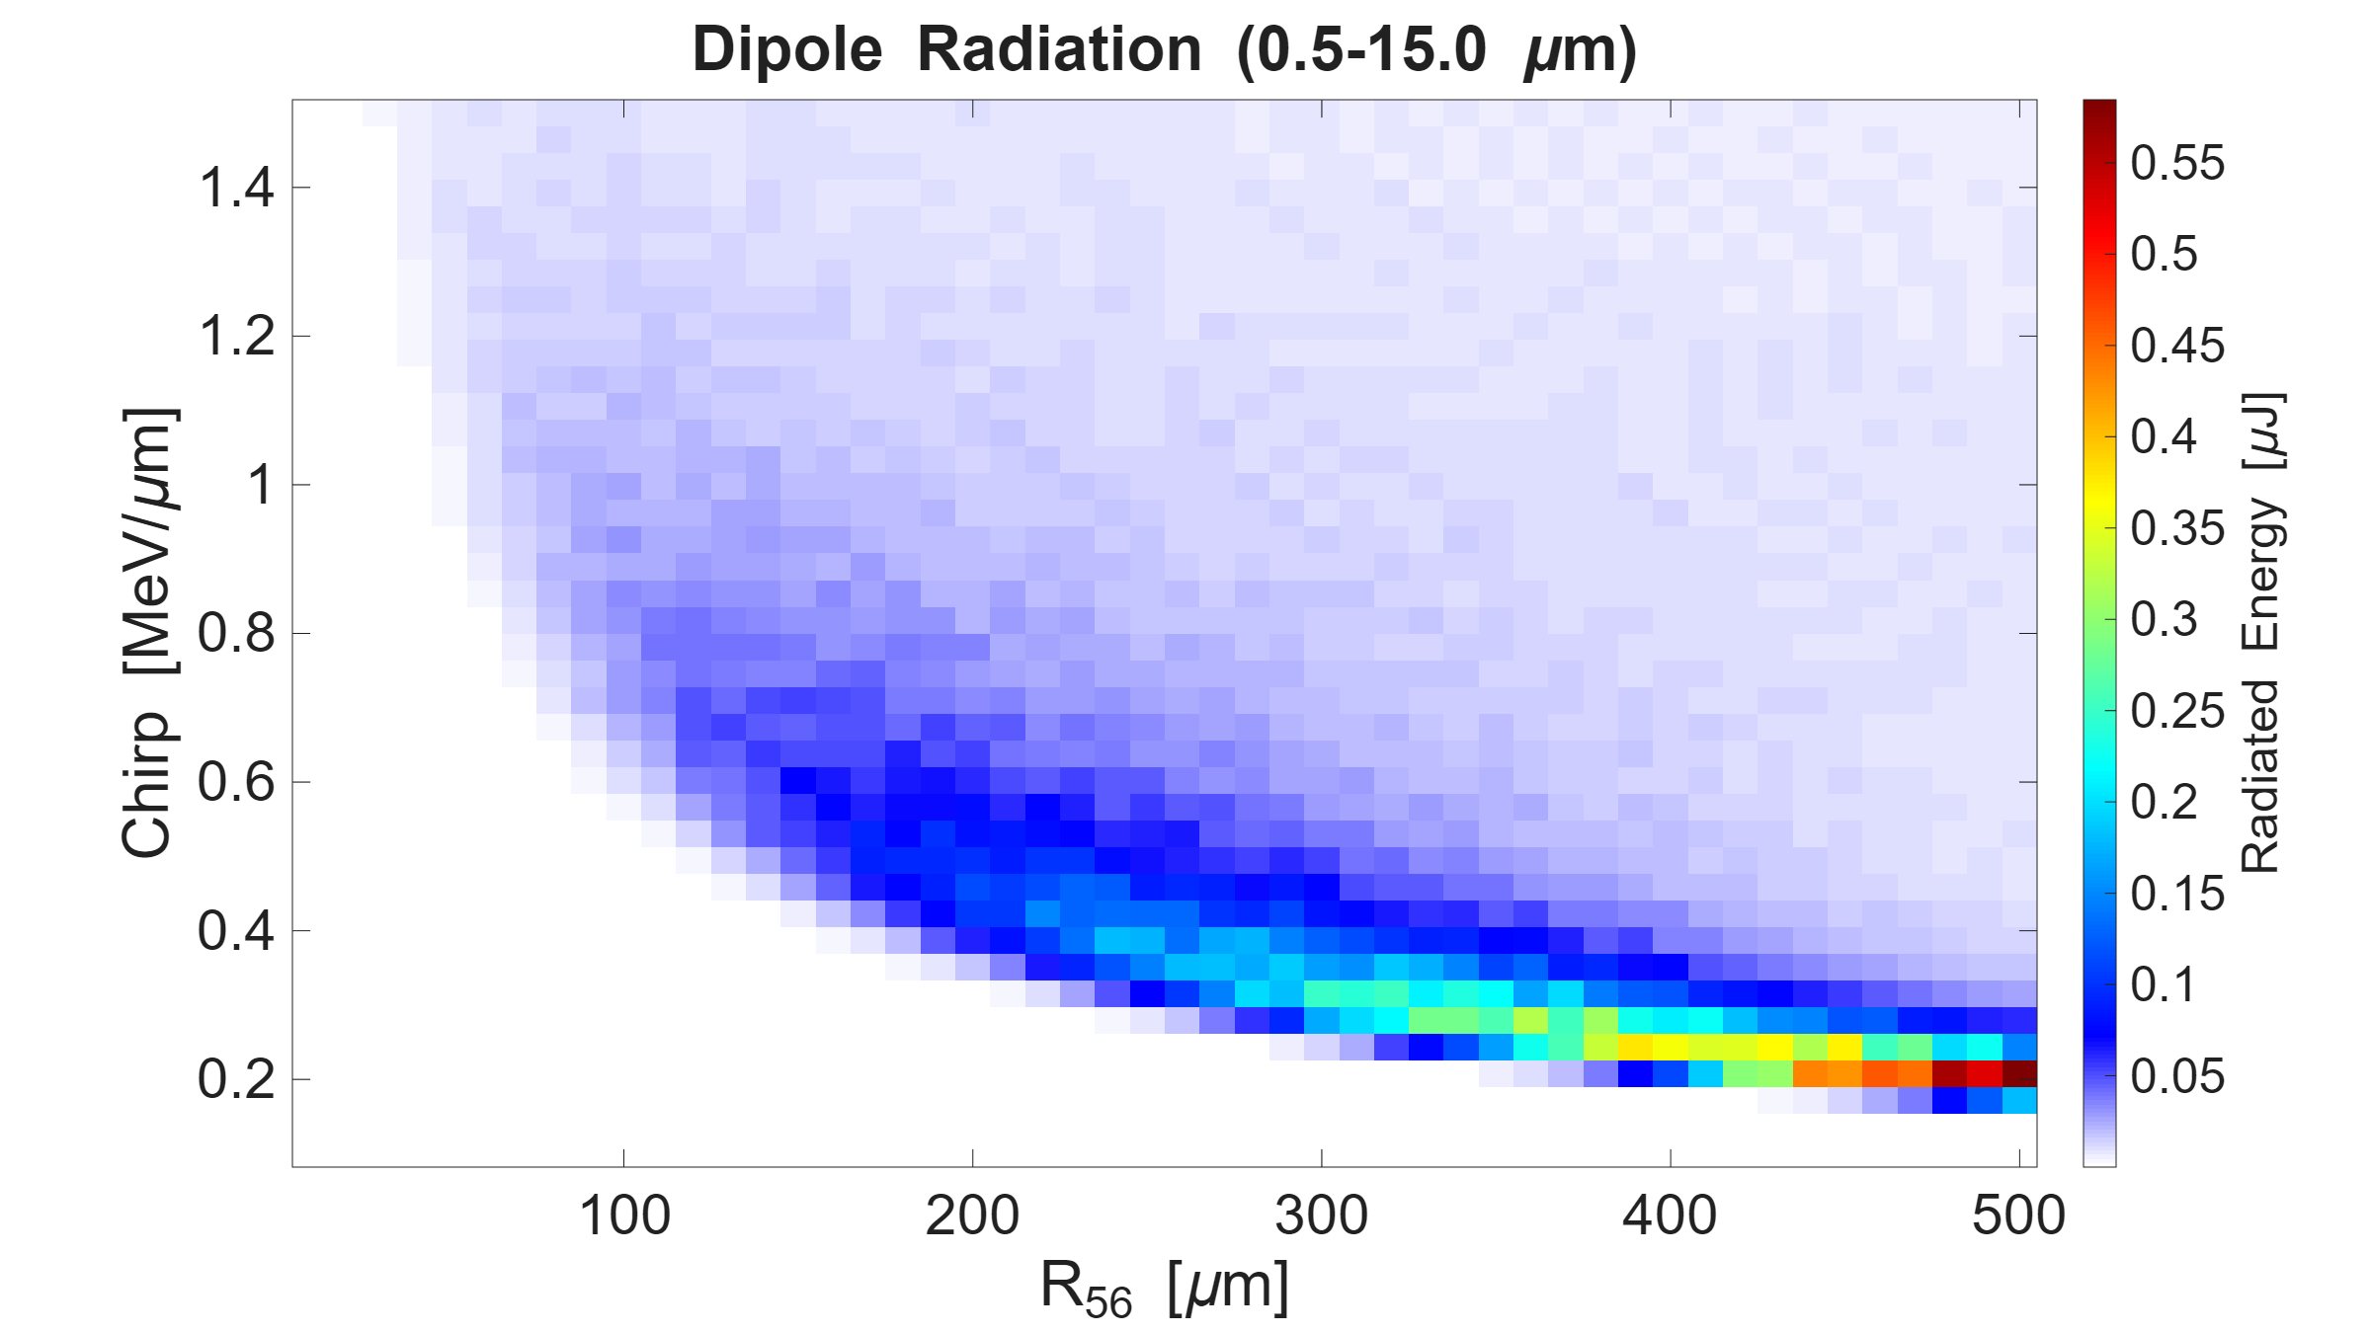
Pyro Comparison

Slide 21
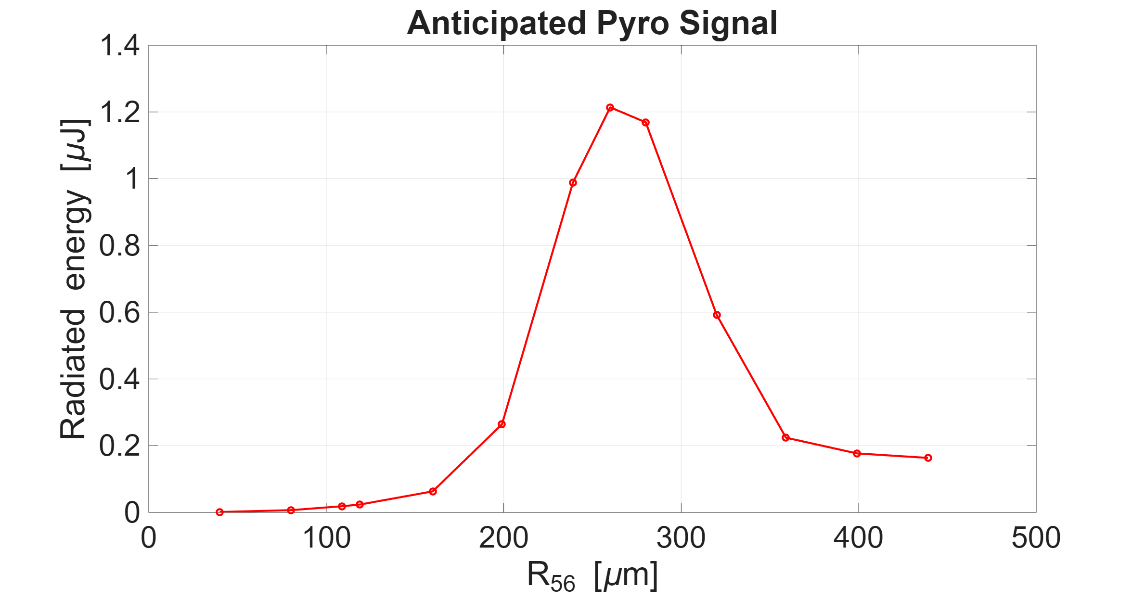
Pyro Comparison

Slide 22
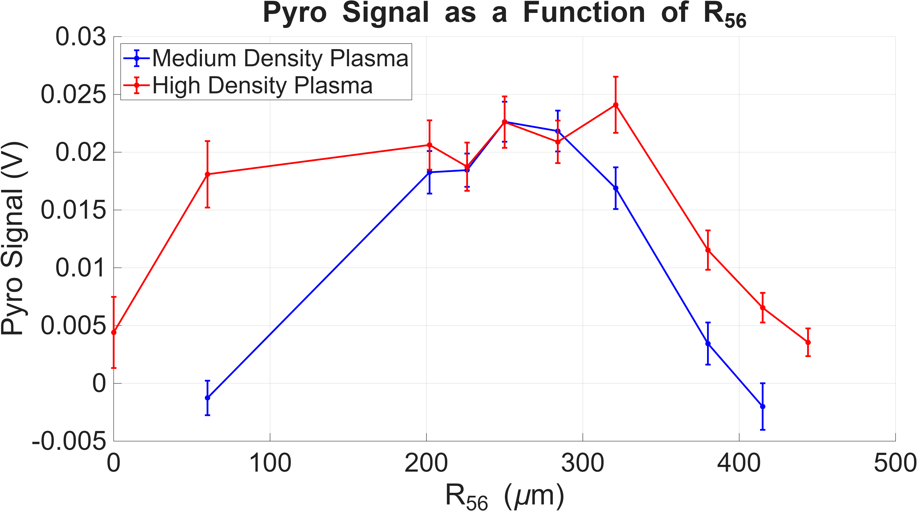
Pyro Comparison

Slide 23
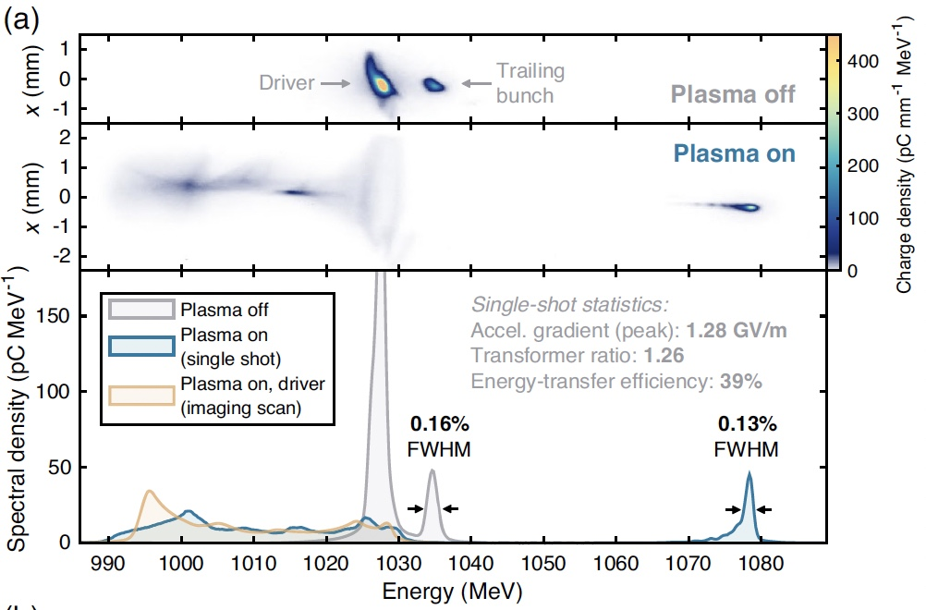
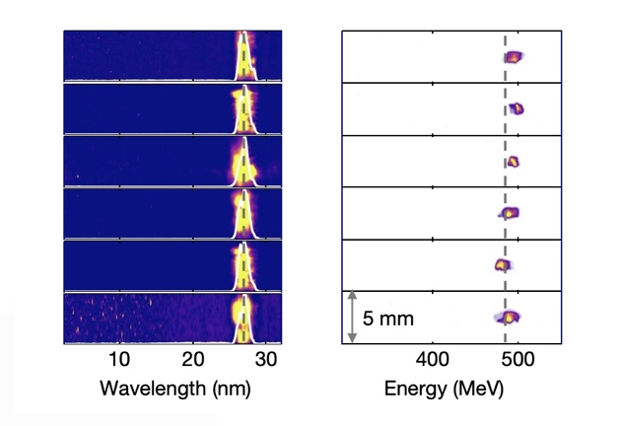
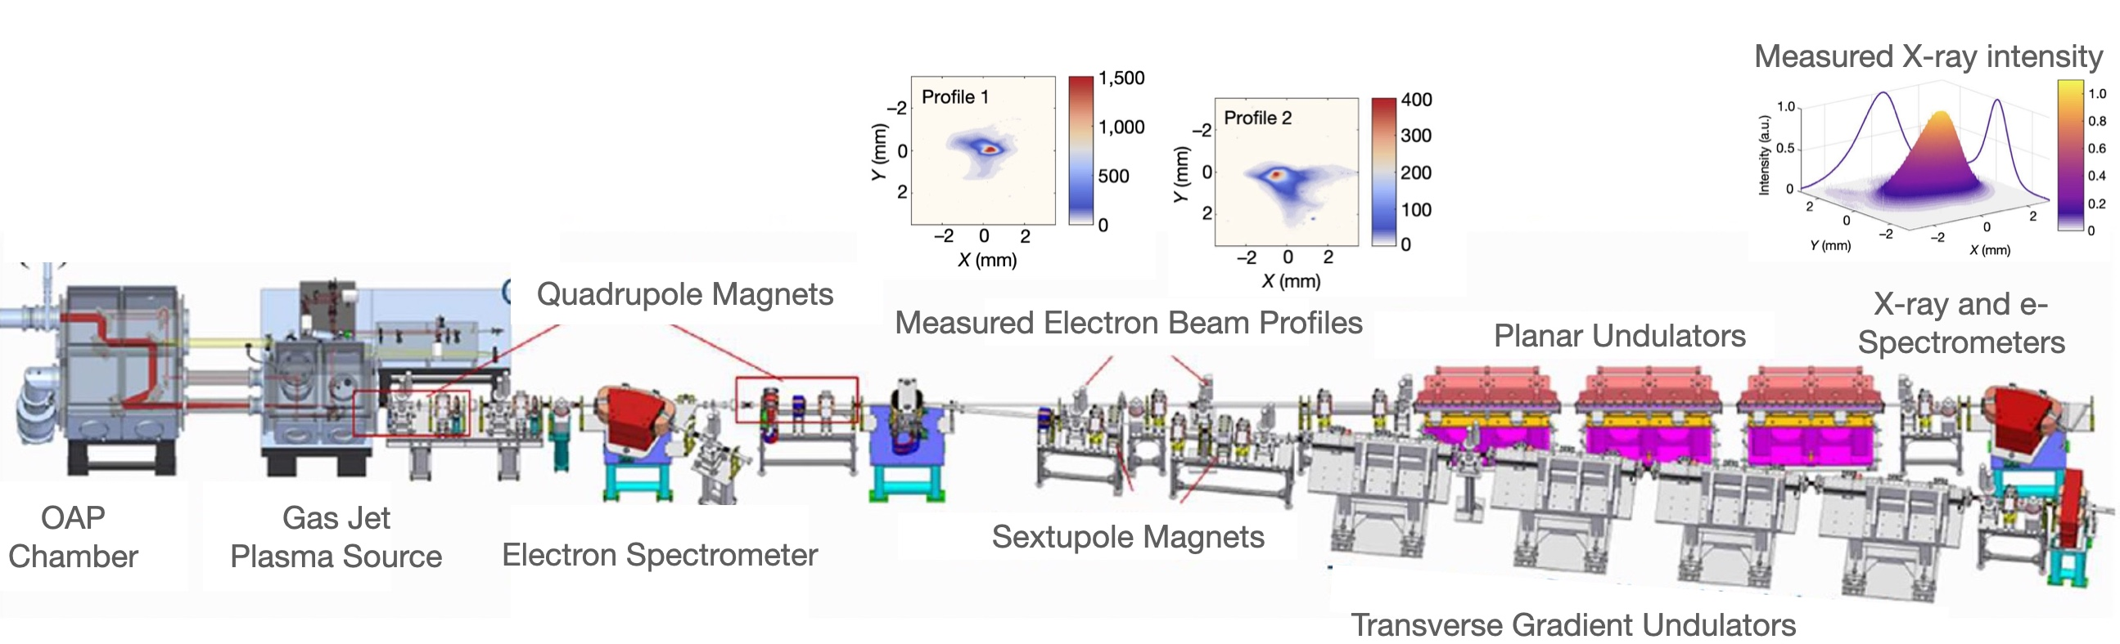
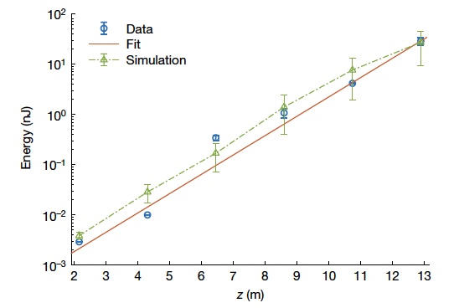
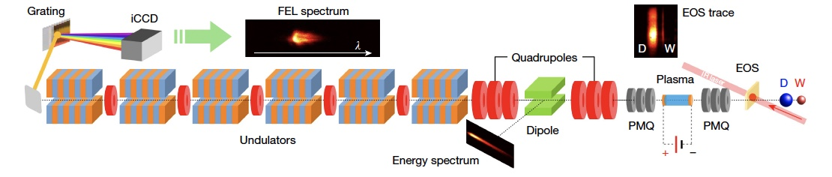
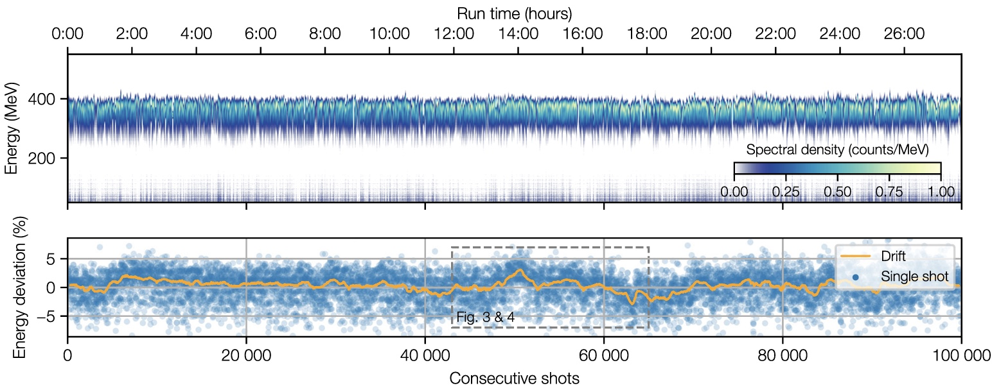
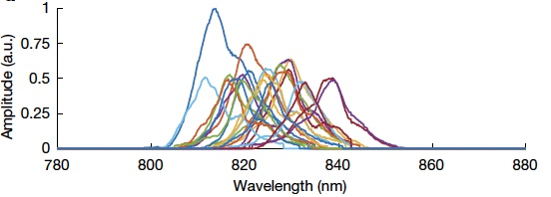
Plasma-Accelerators: Recent Highlights
Sub-% energy spread preservation
FEL gain demonstrations
W. Wang et al., Nature, 595, 516–520 (2021)
C. Lindstrom et al., PRL 126, 014801 (2021)
Day-long operation stability
R. Pompili et al., Nature, 605, pages659–662 (2022)
A. Maier et al., PRX 10, 031039 (2020)
Plasma accelerators are now making beams with the quality and stability needed for applications
Notes:
Remind ppl of the Snowmass paper C. Emma J. Van Tilborg et al., HPLSE 9 e57 (2021)

Slide 24
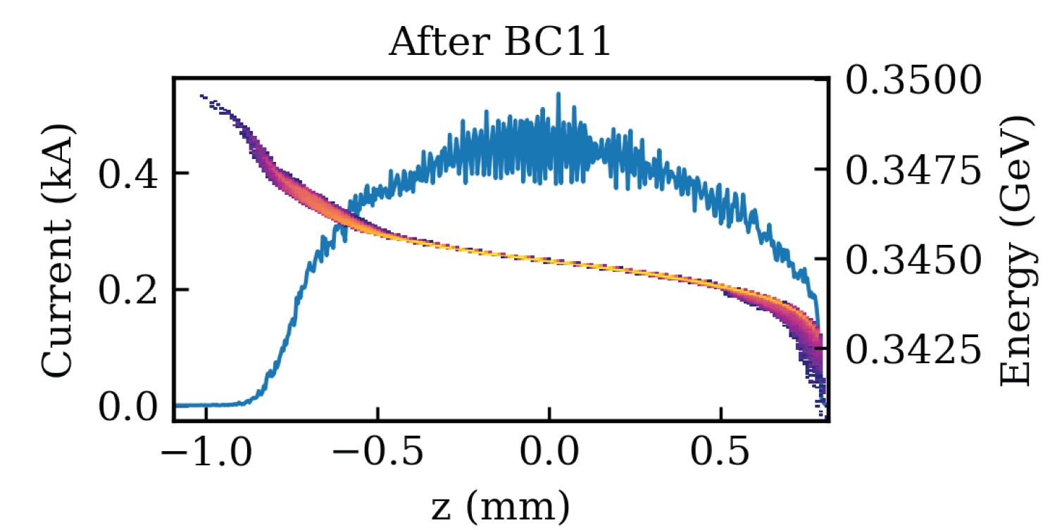
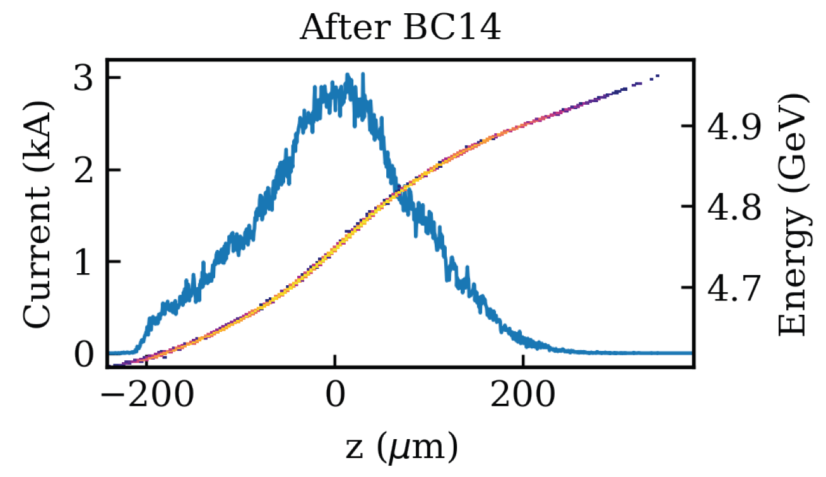
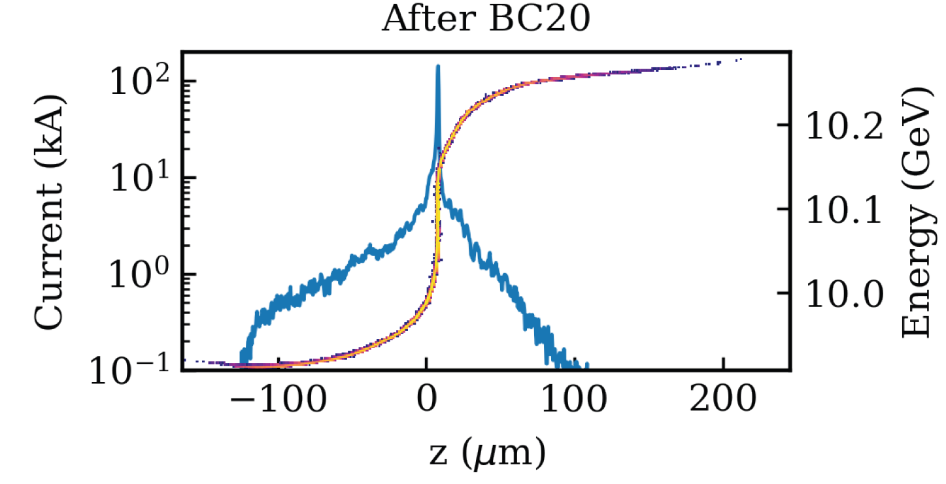
Plasma-Based Injectors

Slide 25
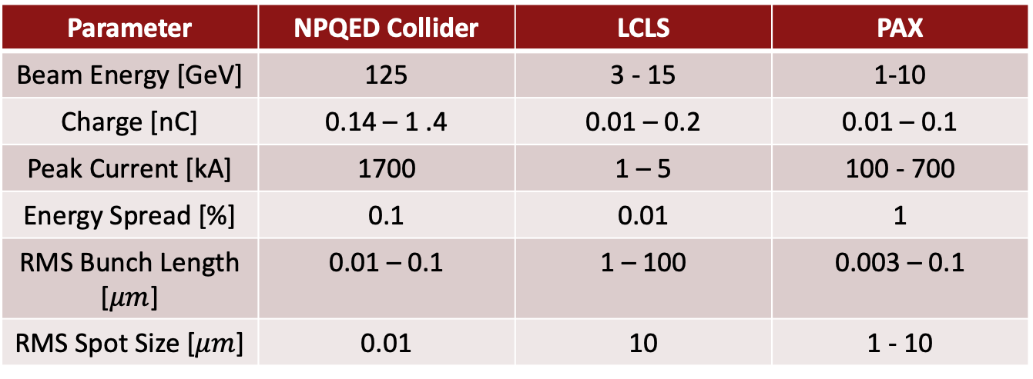
Attosecond E-beams for short bunch colliders
Parameter | NPQED Collider | LCLS | PAX
Beam Energy [GeV] | 125 | 3 - 15 | 1-10
Charge [nC] | 0.14 – 1 .4 | 0.01 – 0.2 | 0.01 – 0.1
Peak Current [kA] | 1700 | 1 – 5 | 100 - 700
Energy Spread [%] | 0.1 | 0.01 | 1
RMS Bunch Length [$μm$] | 0.01 – 0.1 | 1 – 100 | 0.003 – 0.1
RMS Spot Size [$μm$] | 0.01 | 10 | 1 - 10
V. Yakimenko et al. Prospect of Studying Nonperturbative QED with Beam-Beam Collisions, PRL. 122, 190404 (2019).
G. White and V. Yakimenko, Ultra-Short-Z Linear Collider Parameters, Workshop on Future Linear Colliders (LCWS2018),
HEP GARD Accelerator and Beam Physics: Community-driven strategic Roadmap Workshop, LBNL December 2019
Ultra-short bunches (attosecond level) are being considered for next generation e+/e- colliders due to reduced beamstrahlung.
State-of-the-art high brightness e-beam facilities typically operate with 1-2 orders of magnitude less compression.
PAX allows the study of MA-compression relevant for short-bunch colliders

Slide 26
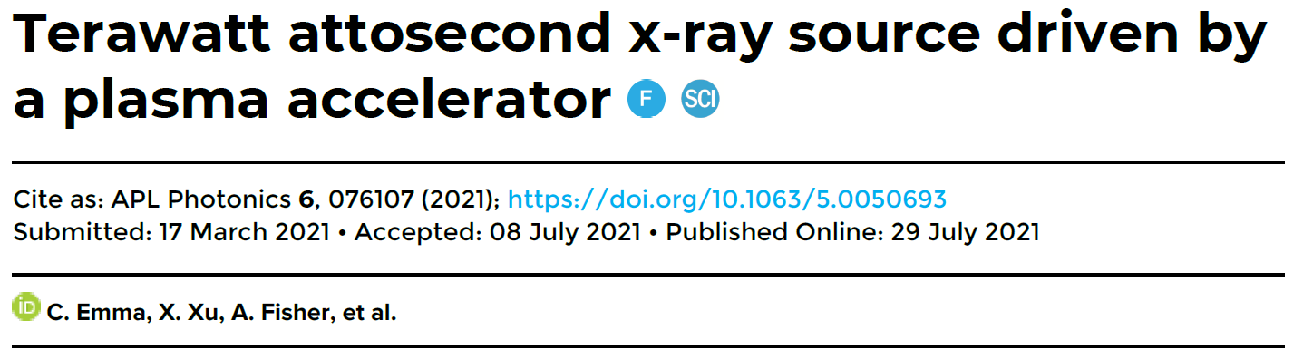
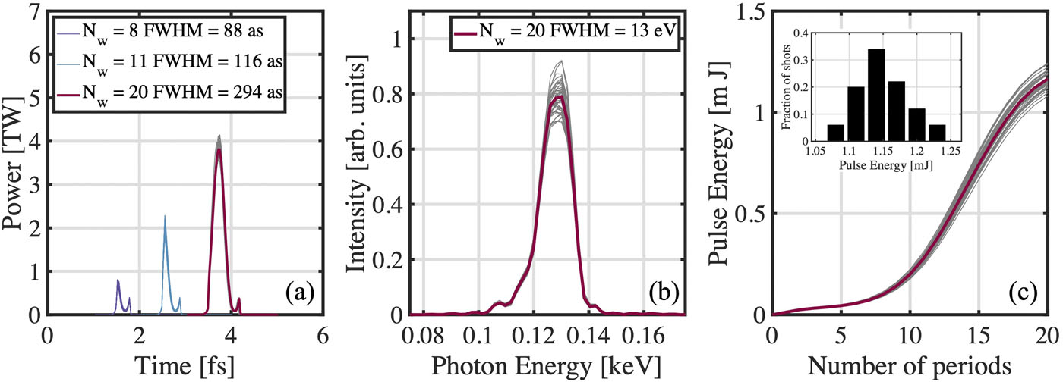
Adding a 10 nm Undulator
PAX plans to compress a PWFA beam with a large chirp to 10s of nm, producing radiation at that scale.

Slide 27
Coherent Harmonic Generation
K1
K2
ω0
Nω0
First conceived of by Schneidmiller, Yurkov, and Saldin
Notes:
Actually shoutout schneidmiller and yurkov
Note: didn’t actually see Saldin in the paper, should he be shouted out?
Link:
chrome-extension://efaidnbmnnnibpcajpcglclefindmkaj/https://accelconf.web.cern.ch/FEL2014/papers/mop054.pdf

Slide 28
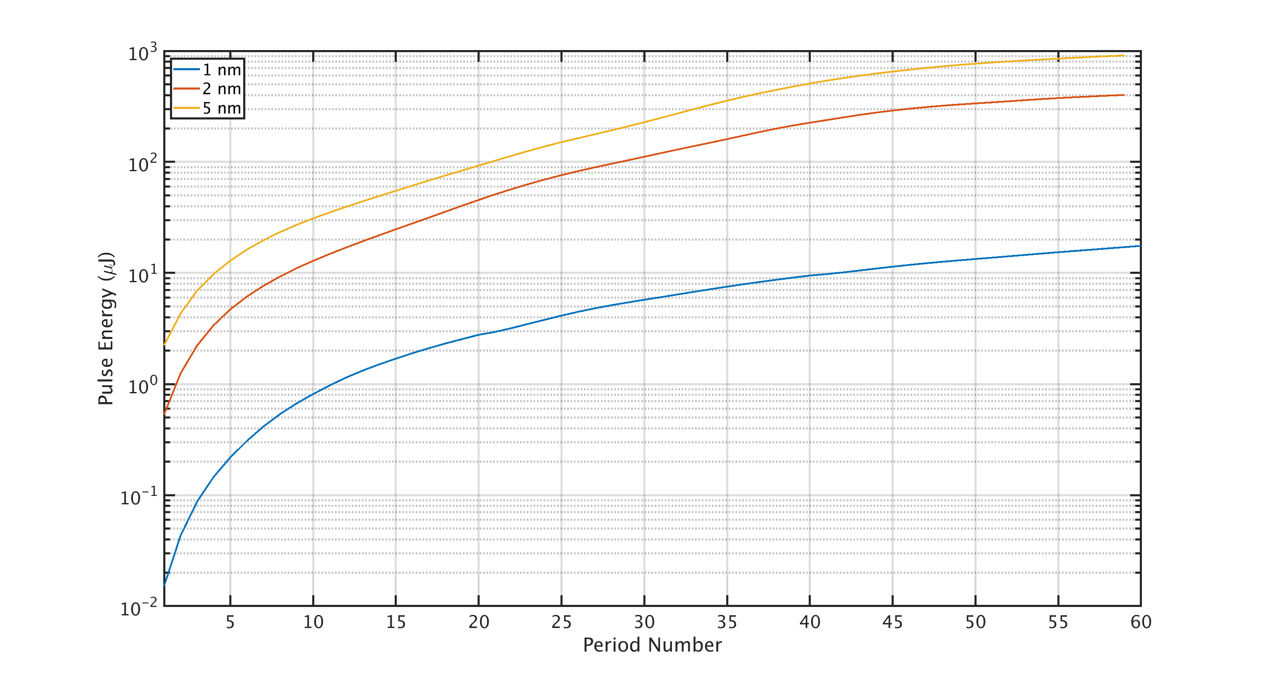
Single Stage Wavelength Limit

Slide 29
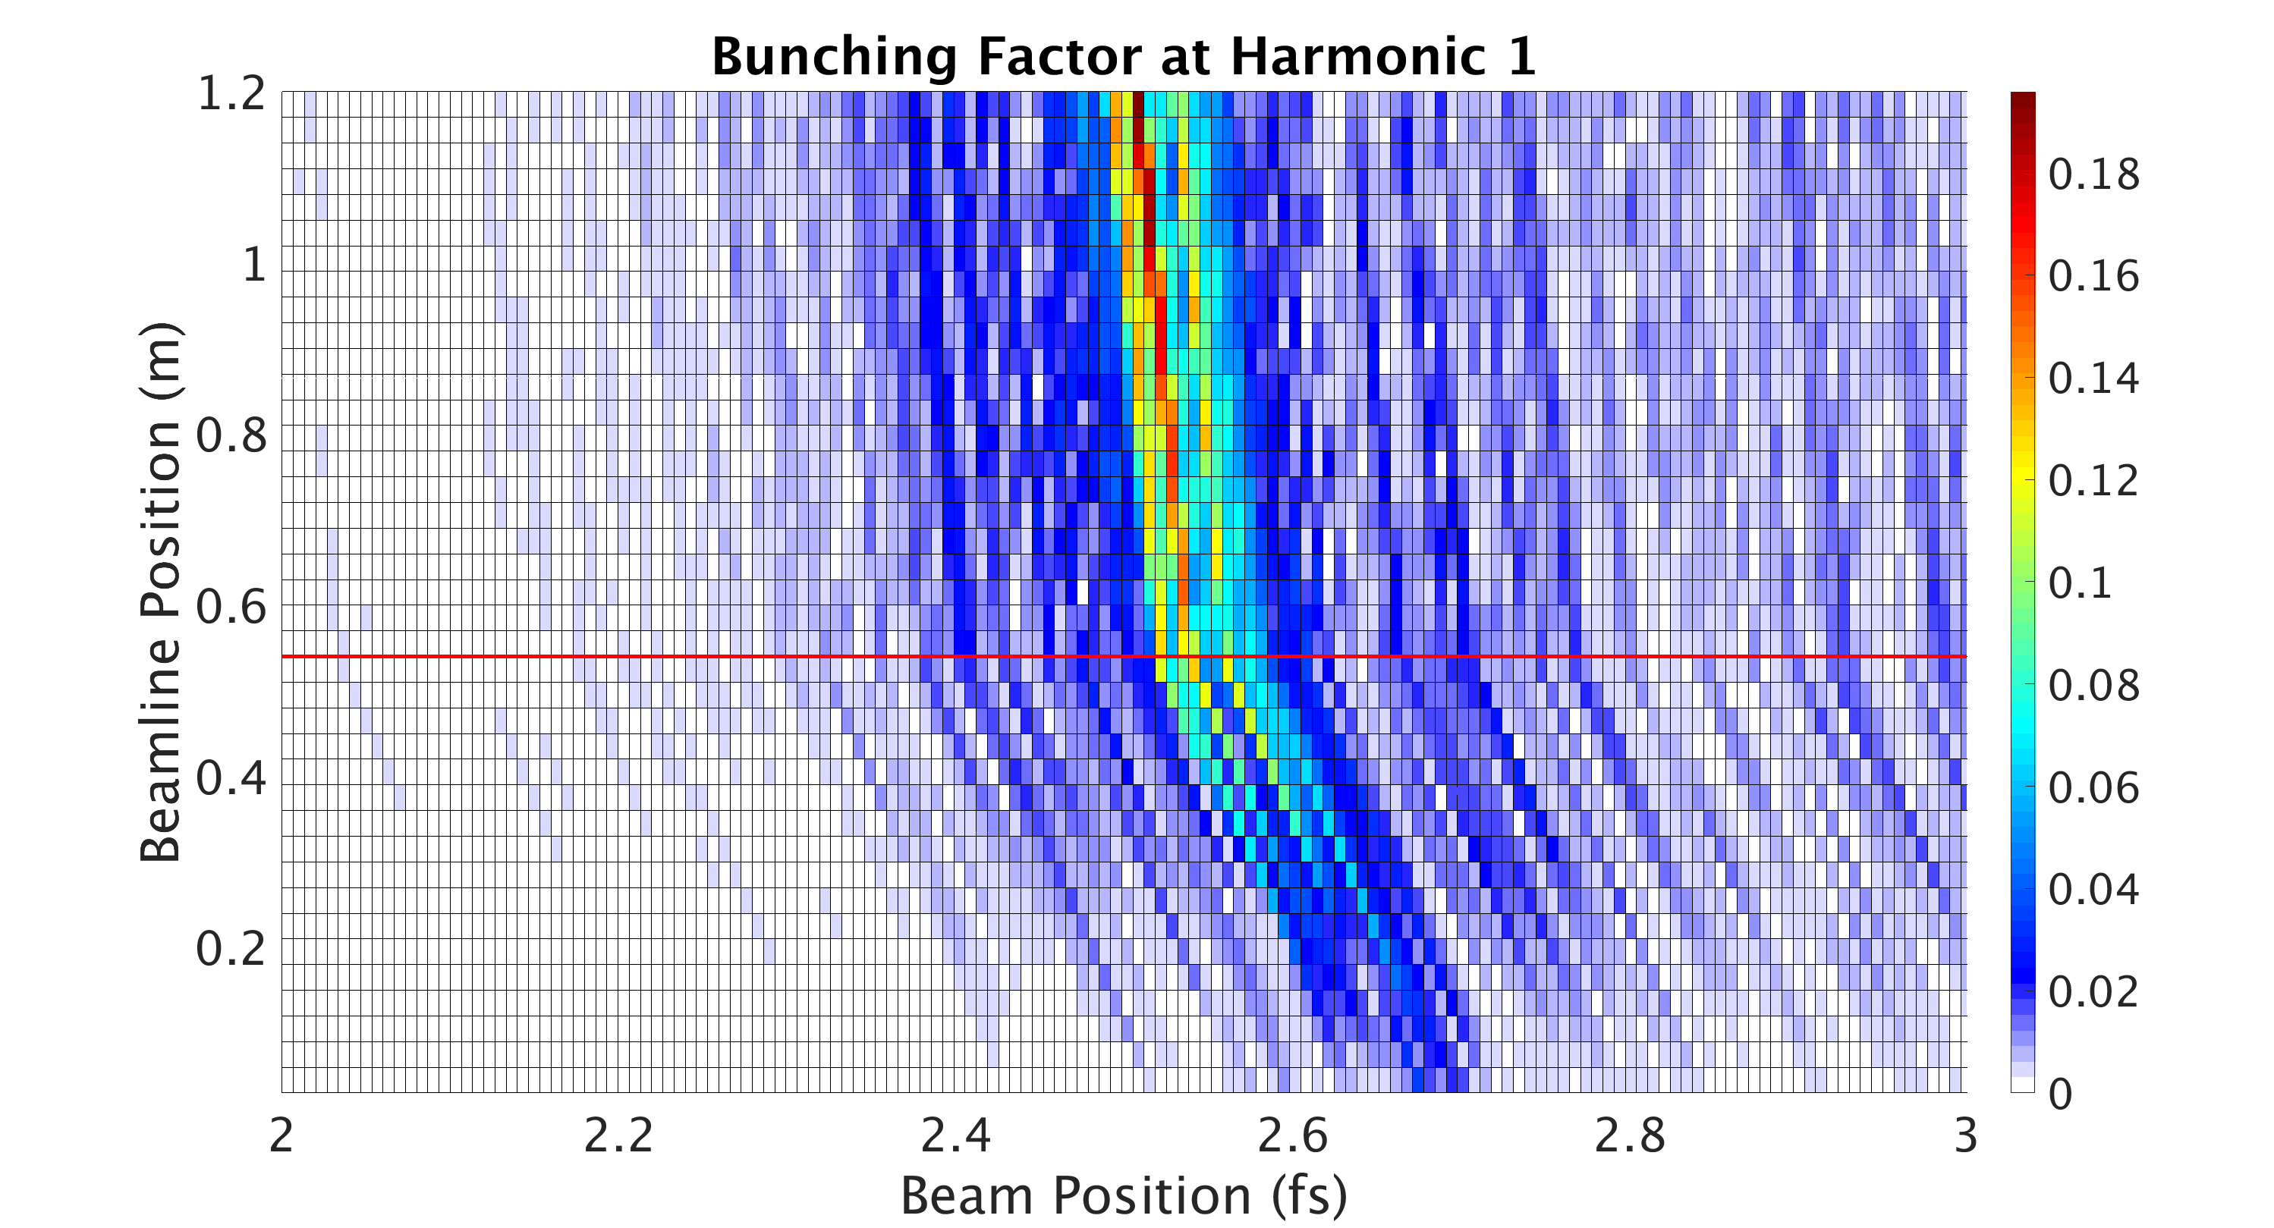
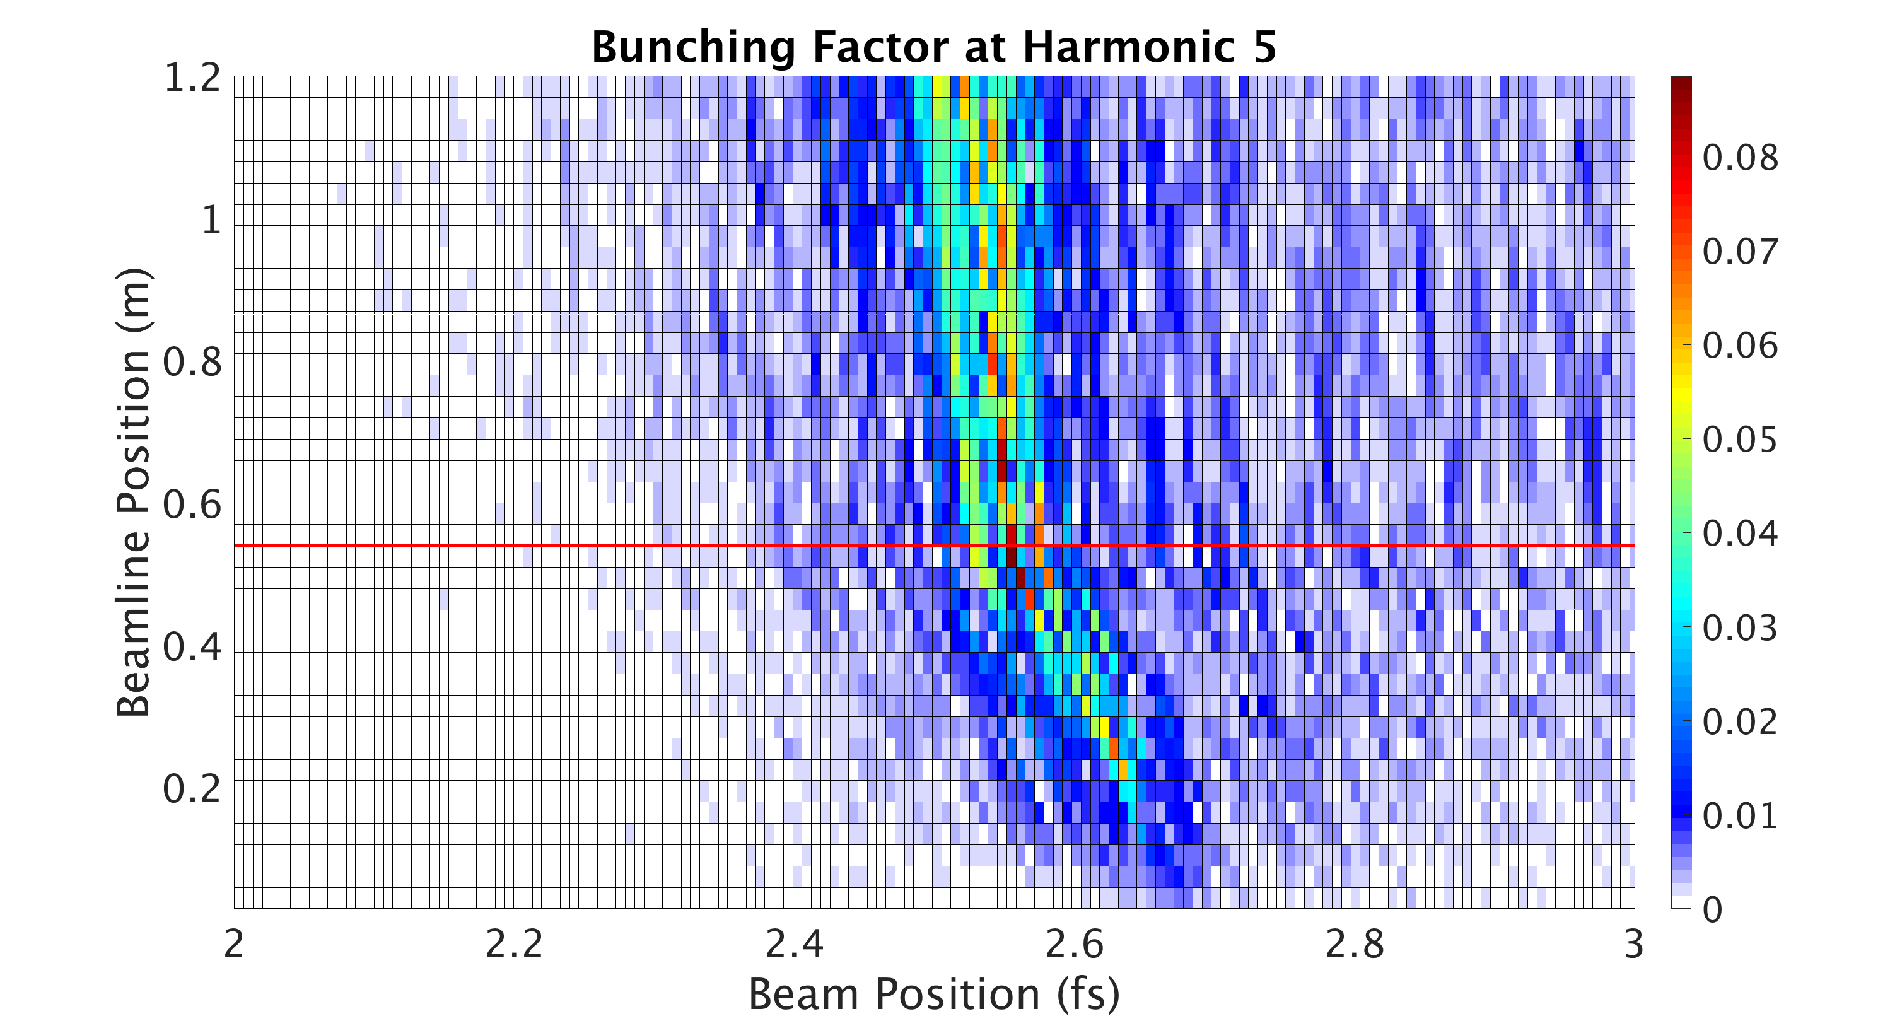
Coherent Harmonic Generation Bunching Factor

Slide 30
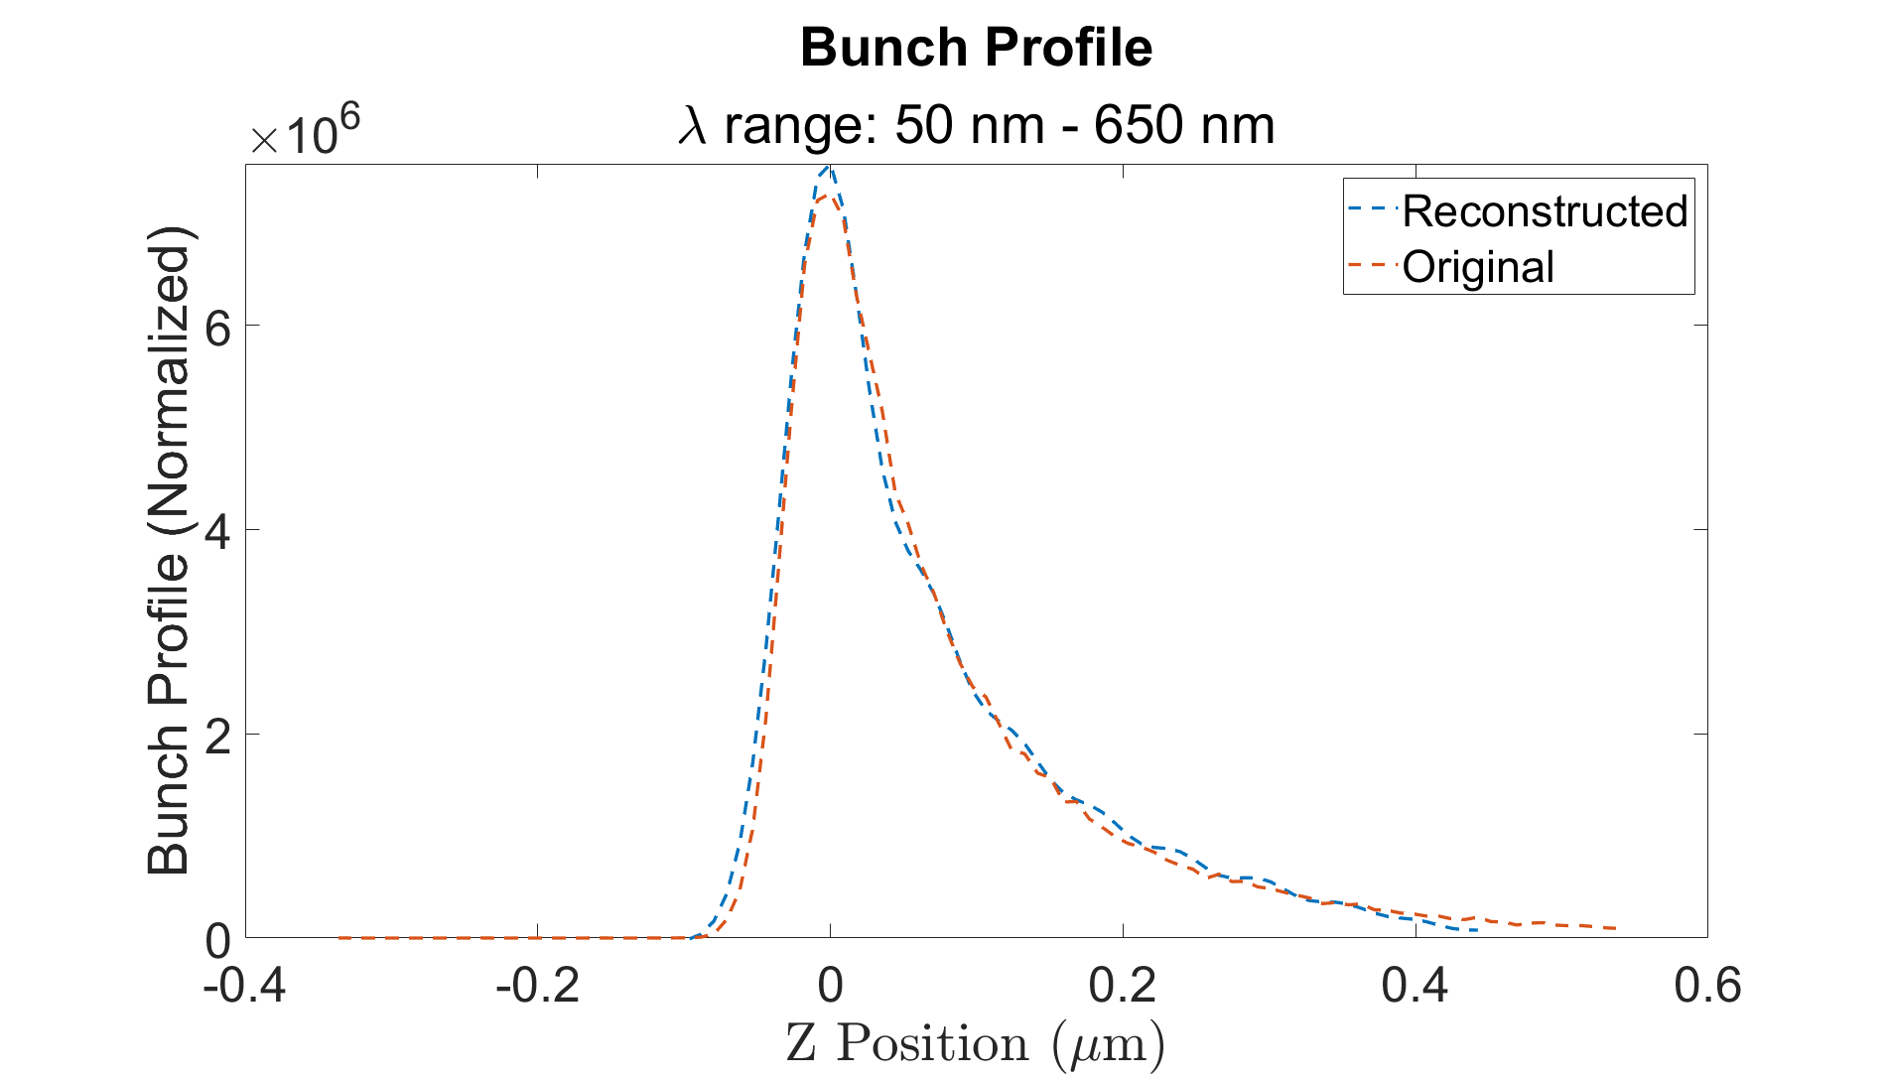
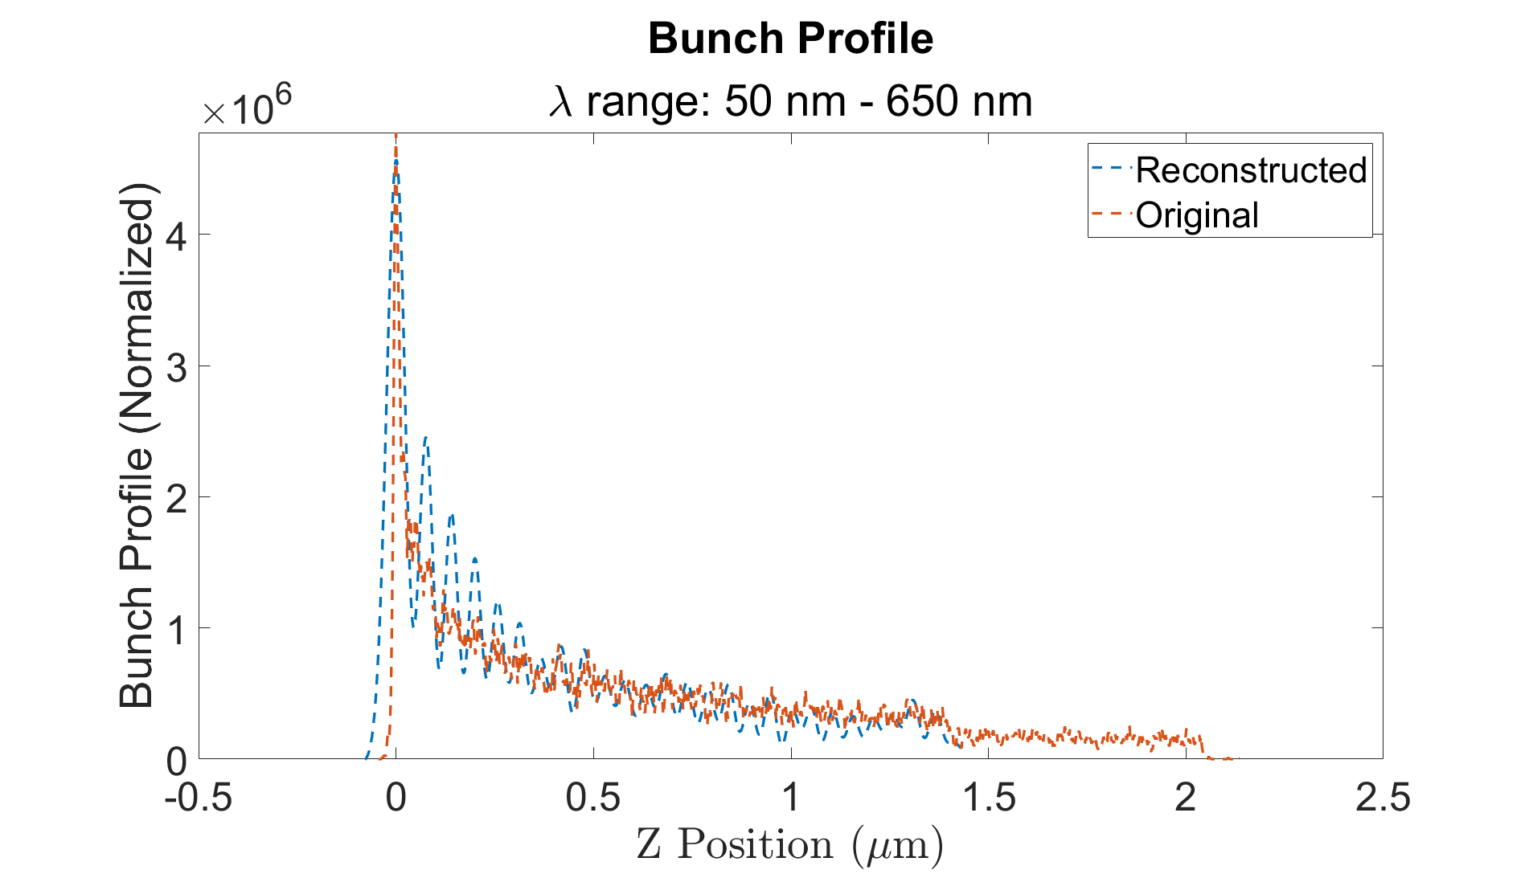
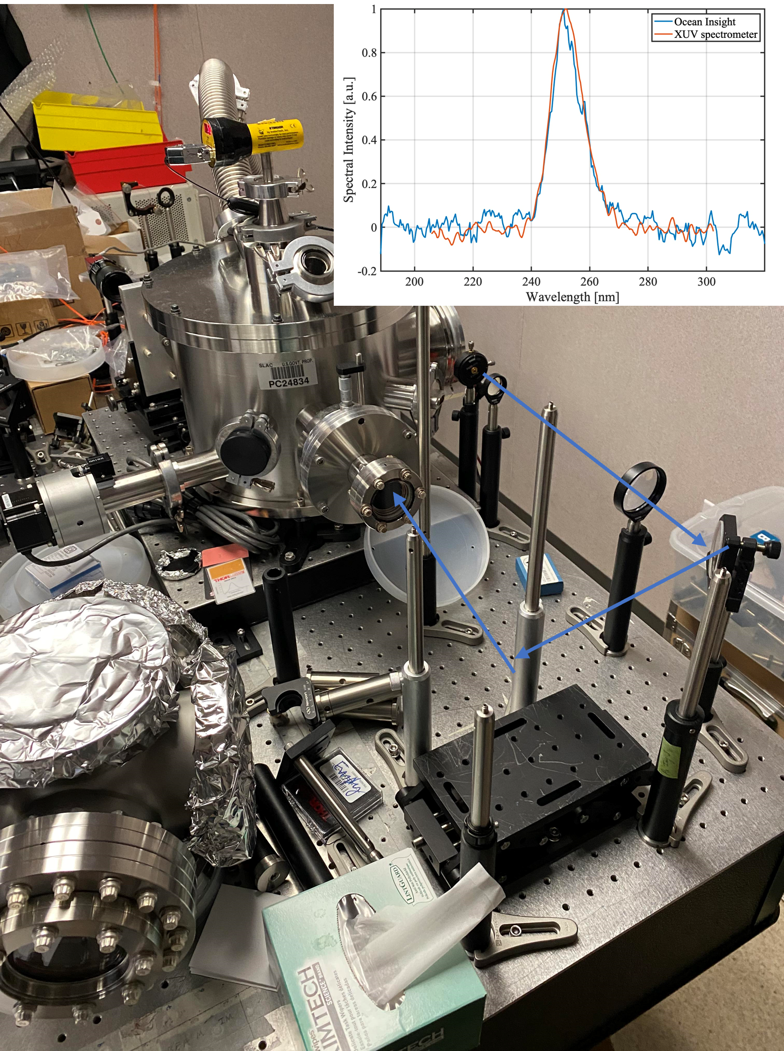
XUV Work and Kramers-Kronig Method
FWHM Reconstructed: 97.35 nm
FWHM Original: 97.35 nm
FWHM Reconstructed: 54.63 nm
FWHM Original: 19.55 nm
Can resolve beam features down to ~50 nm very well!
Notes:
People will ask lots of questions
“can’t do 1D phase retrieval uniquely”
Take a cleaner photo
Label stuff in the photo (maybe Claudio knows where a nice one is)
Possibly remove or combine with slide 9

Slide 31
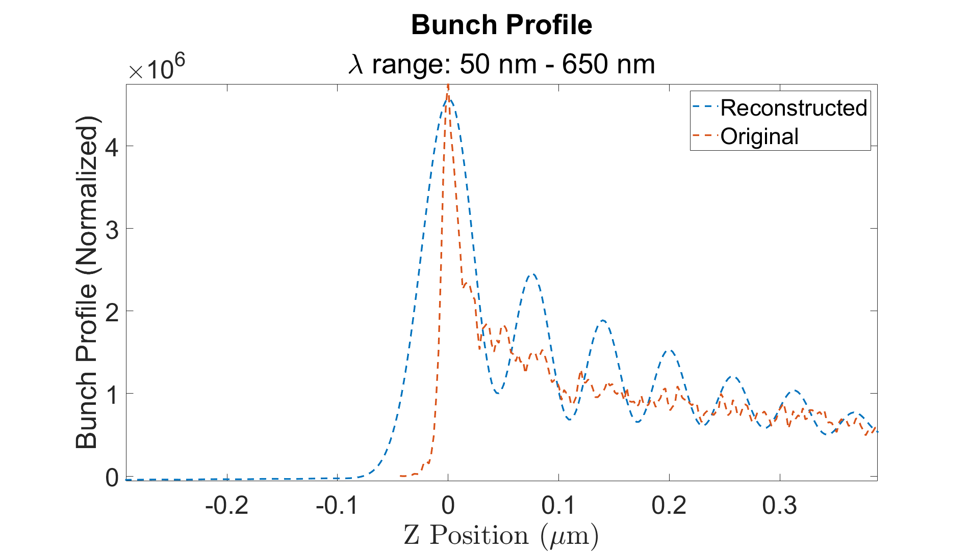
Kramers-Kronig Ringing

