Slide 1
Progress on a High-Gradient Booster Linac for Multi-GeV Proton Radiography at LANSCE
Haoran Xu (Co-PI), John L. Schmidt (Co-PI), Yuri K. Batygin, Michael Kaemingk, Evgenya I. Simakov, and Sergey S. Kurennoy (PI)
July 30, 2026
LA-UR-26-26332
Advanced Accelerator Concepts 2026
July 26-31, 2026
UCLA

Slide 2





Acknowledgments
Work supported by U.S. Department of Energy through the Laboratory Directed Research and Development program of Los Alamos National Laboratory, under project numbers 20210048ER and 20260012DR.

Slide 3
Outline
Proton Radiography at LANSCE
High-energy booster linac
Theory and cavity prototyping
  Room-temperature test
  Liquid-nitrogen-temperature test

Slide 4
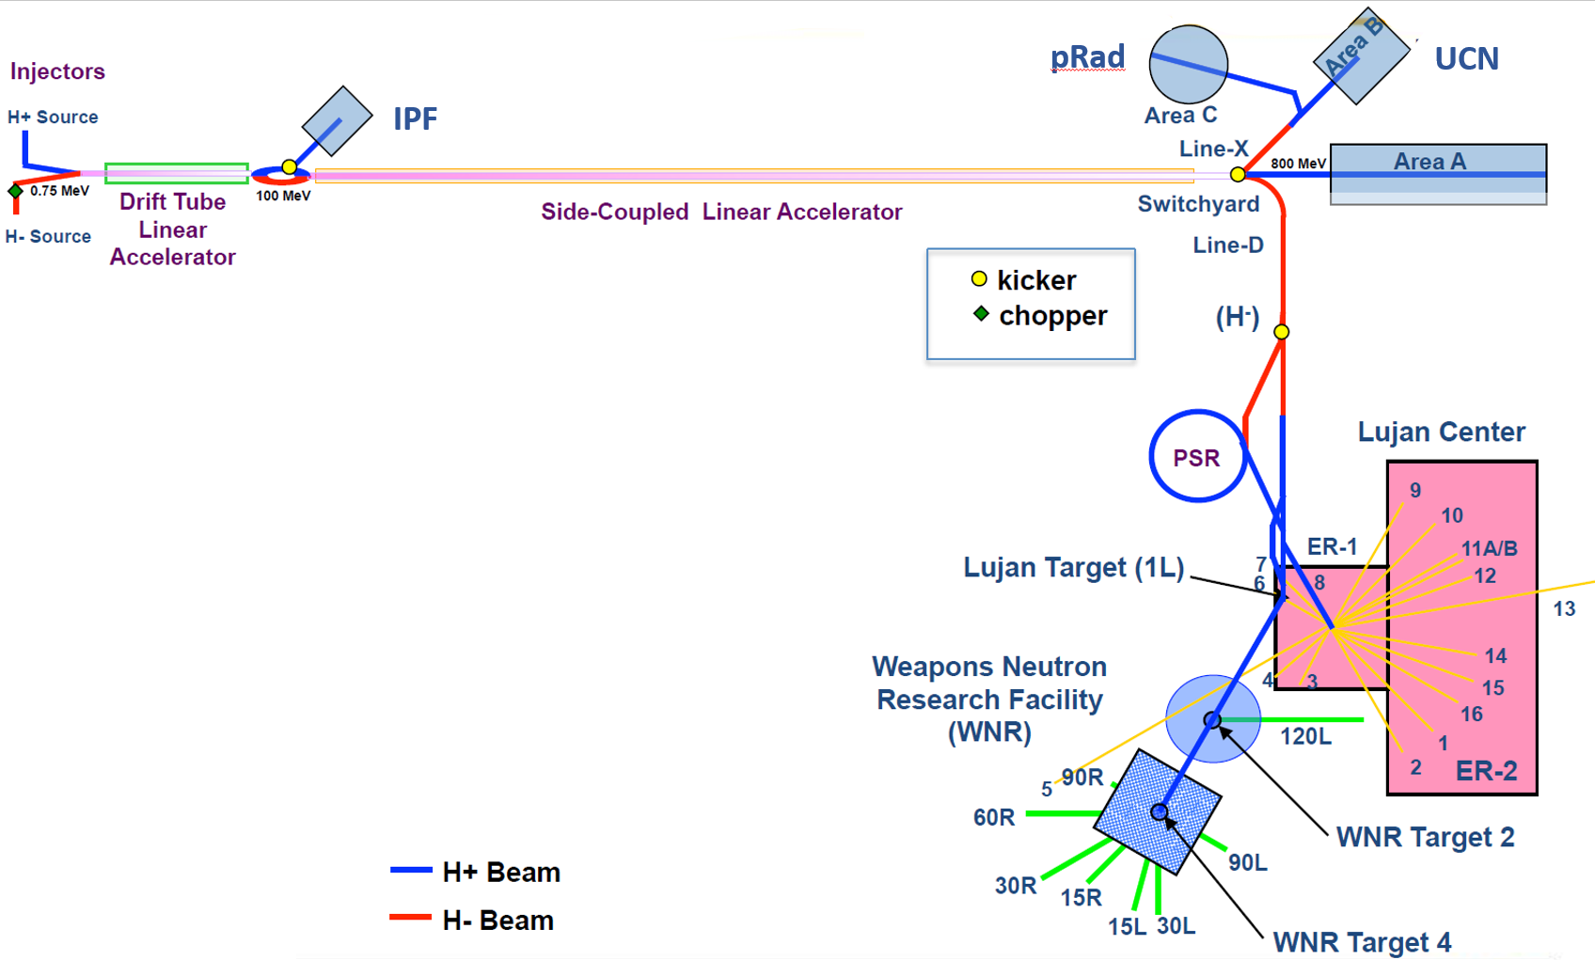
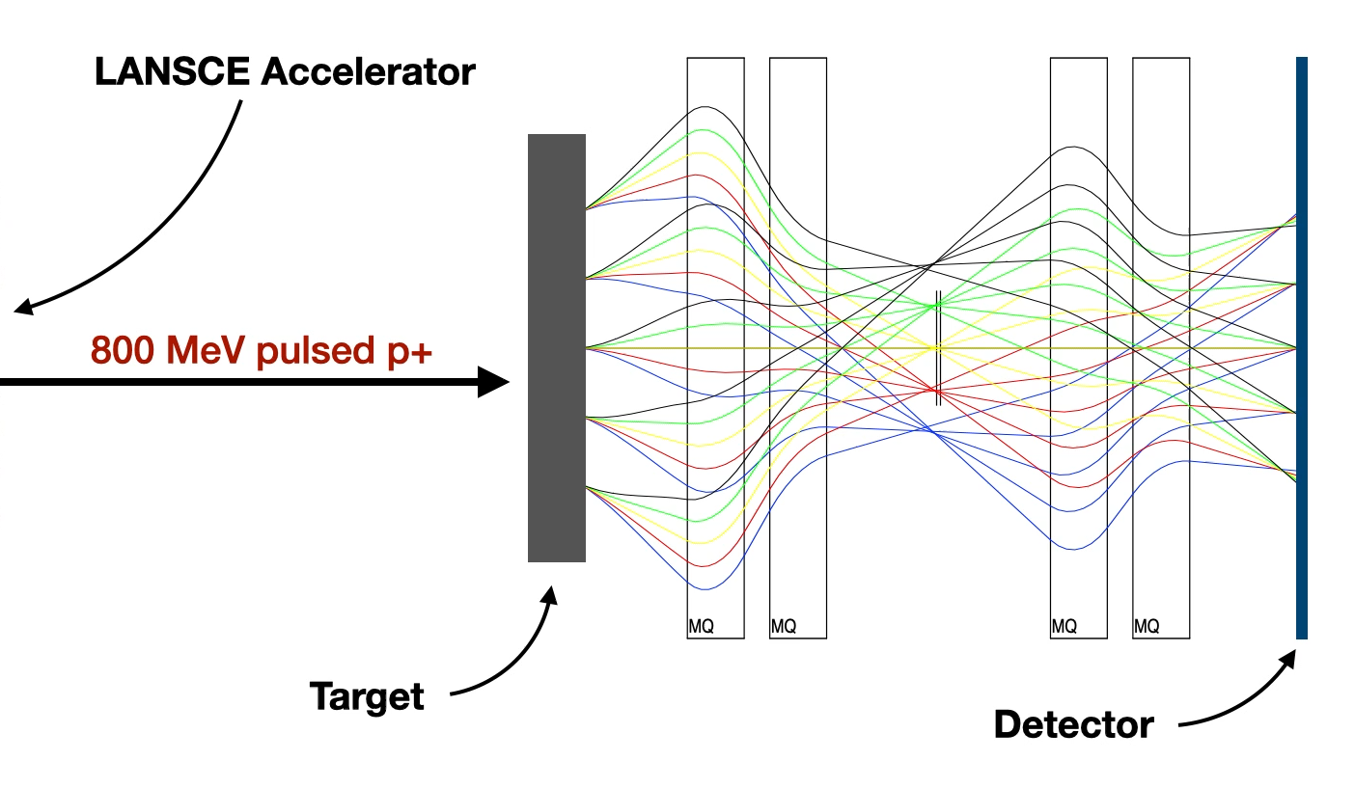
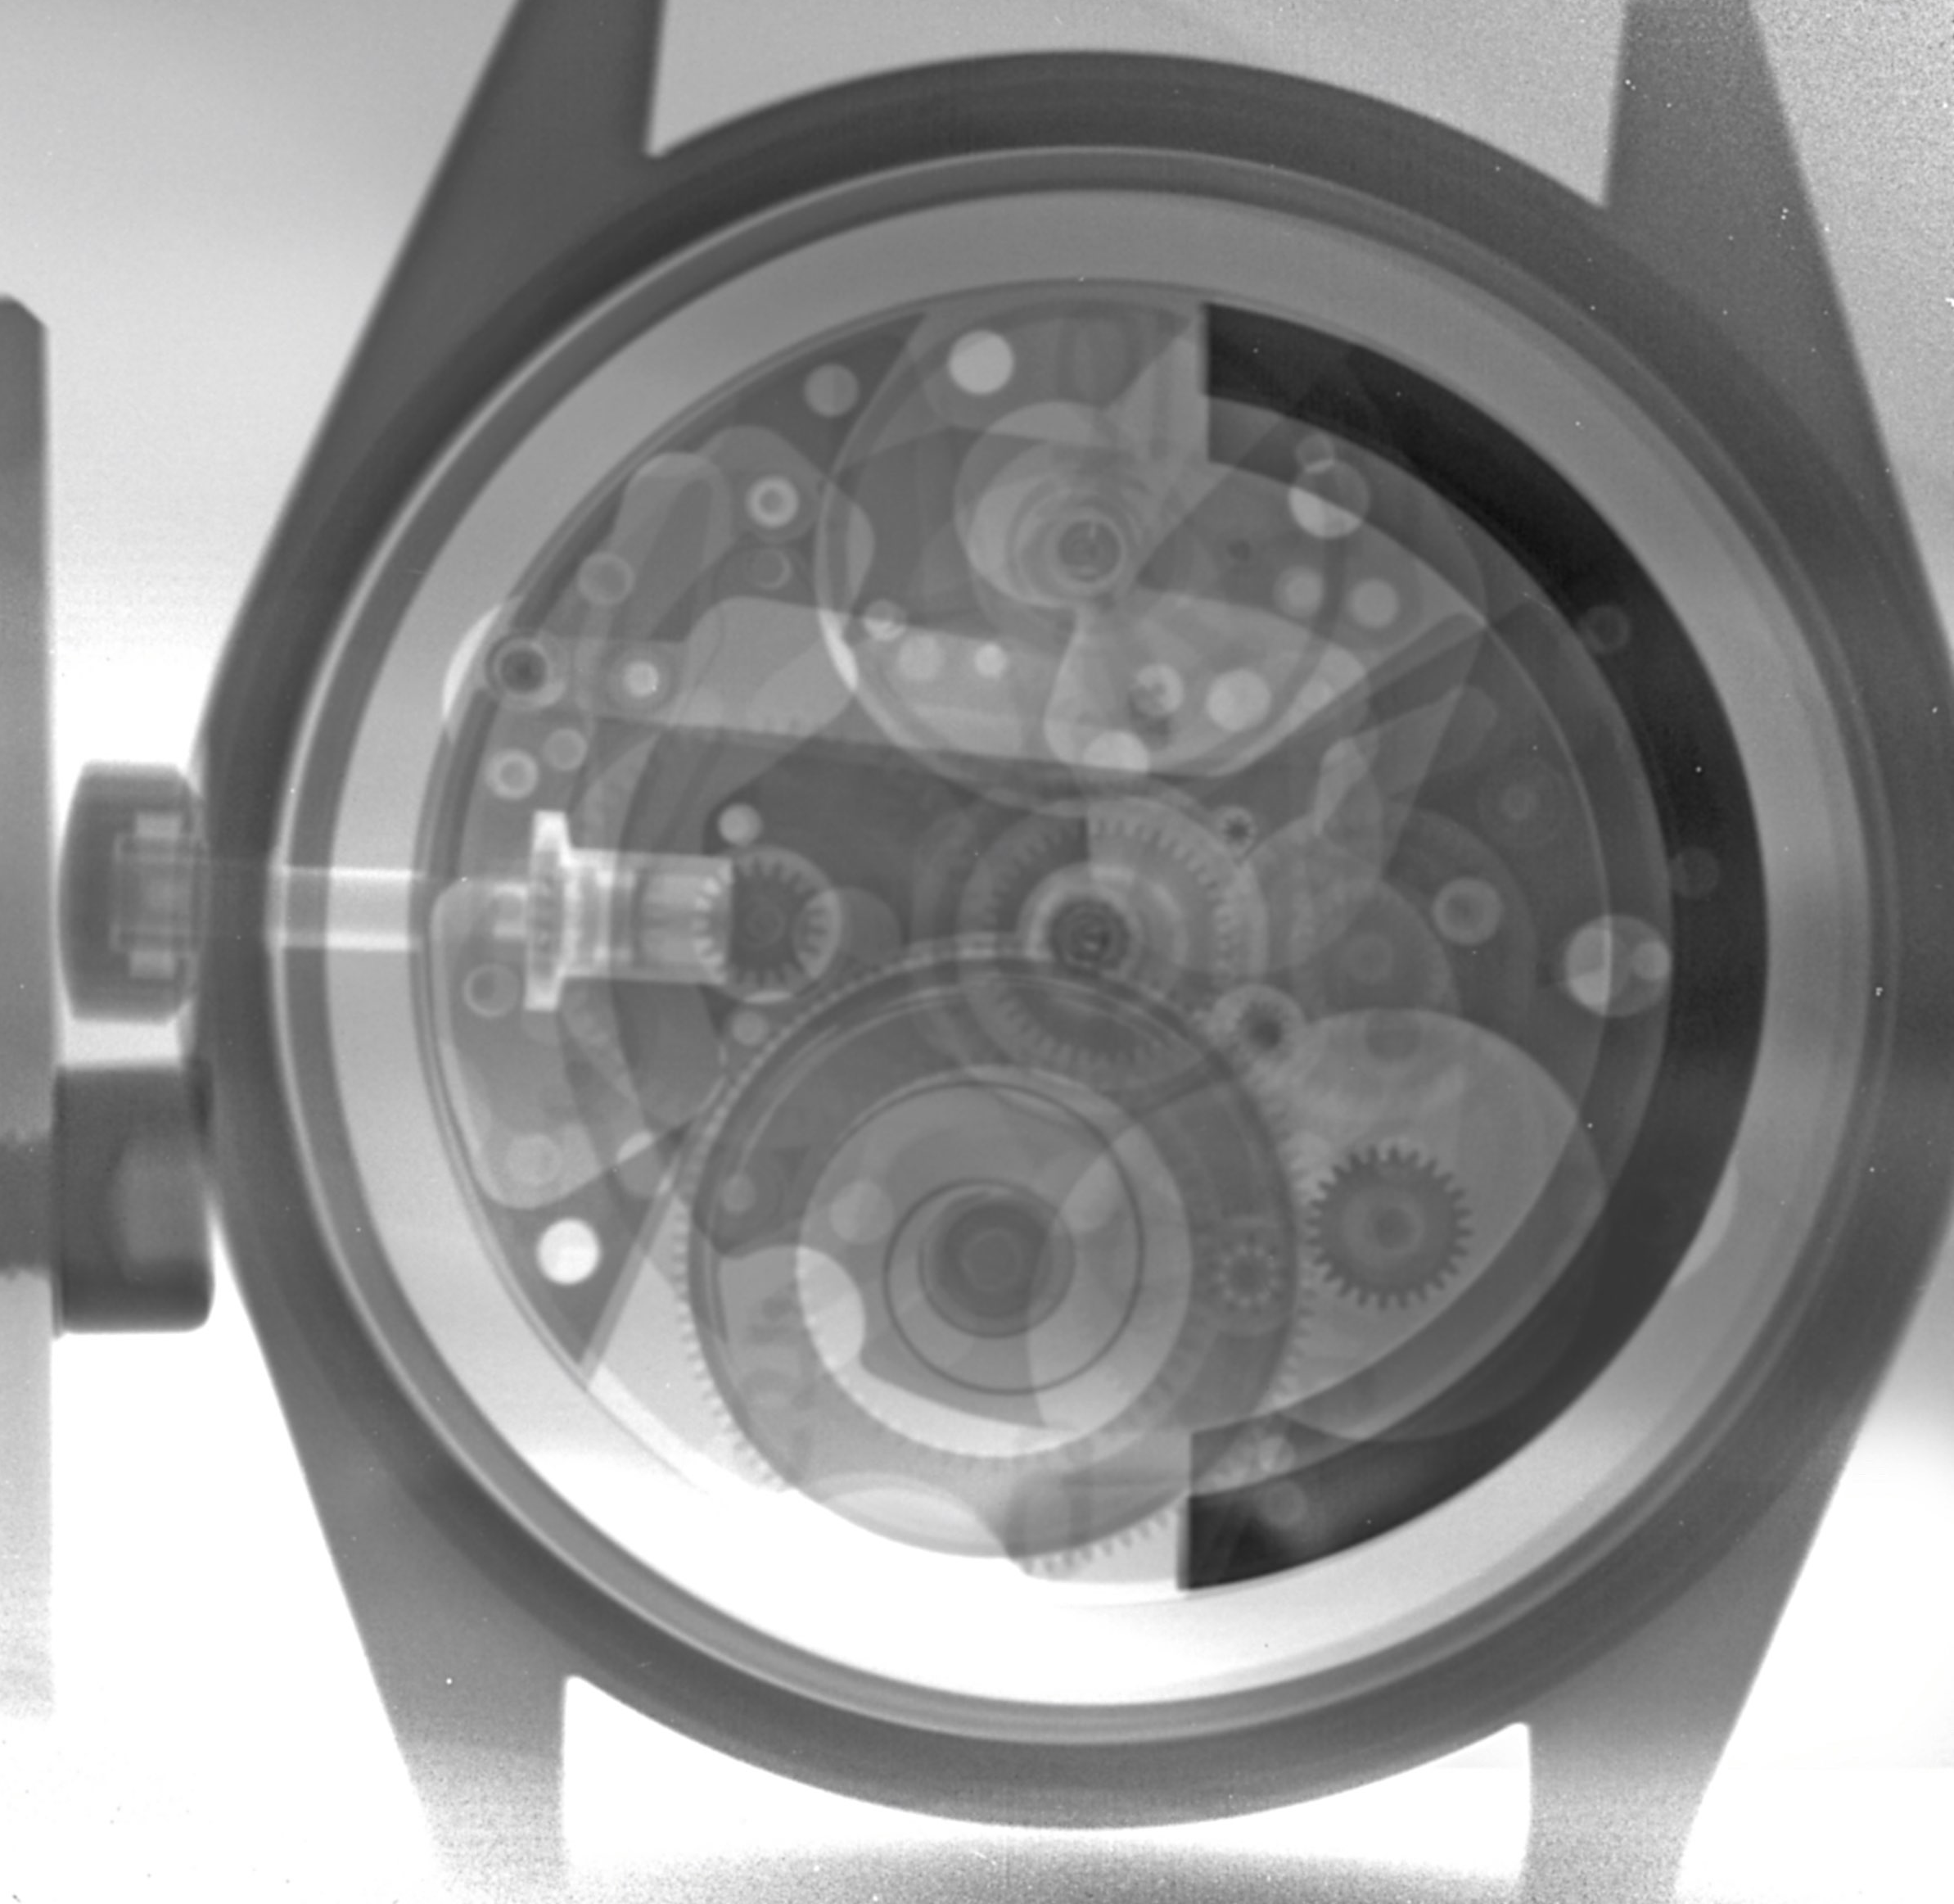
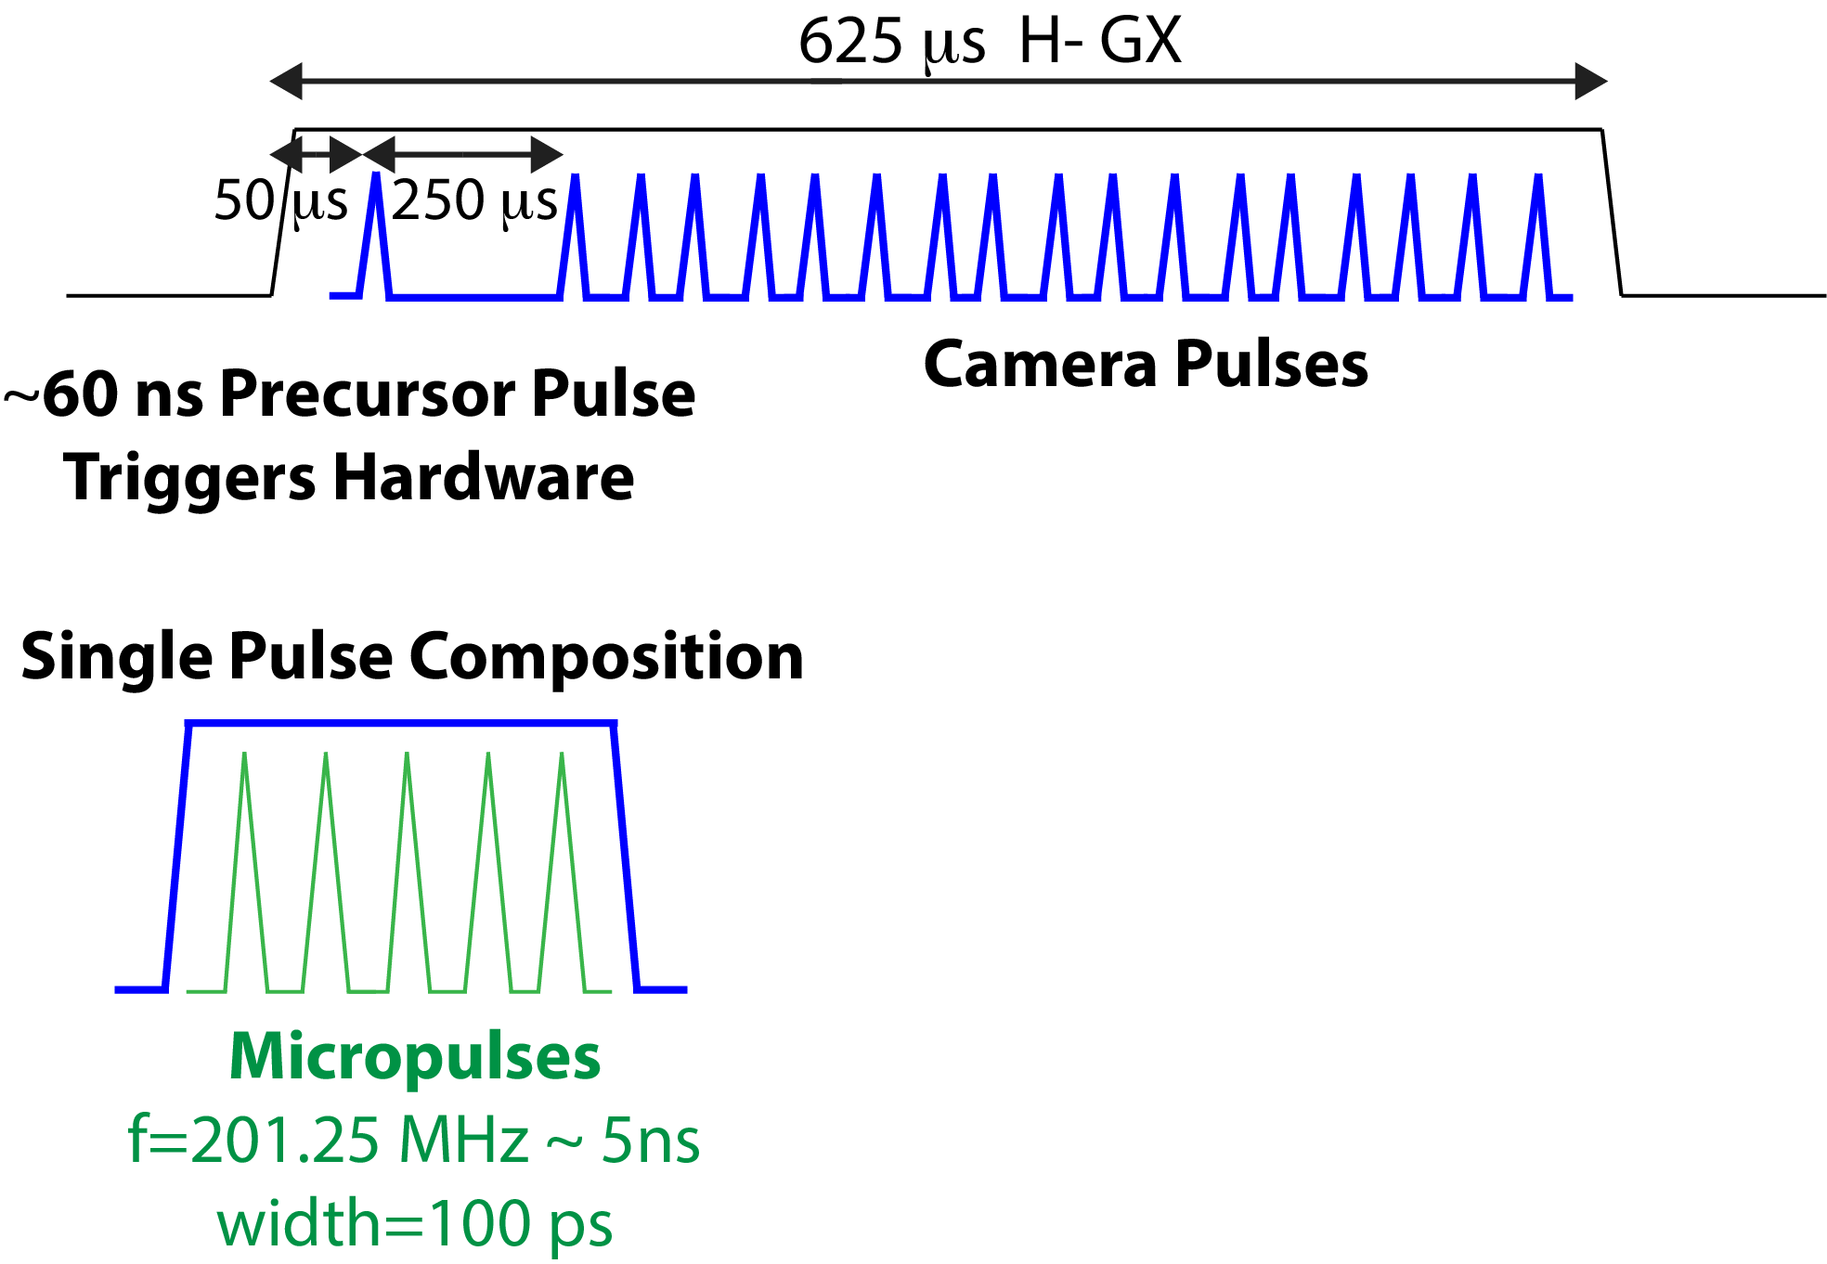
Proton Radiography (pRad) at LANSCE
HG pRad 3–5 GeV
H+ beam
H- beam
Scope of Front-end
pRad: Multi-frame film; very low duty: a few events per day.

Slide 5
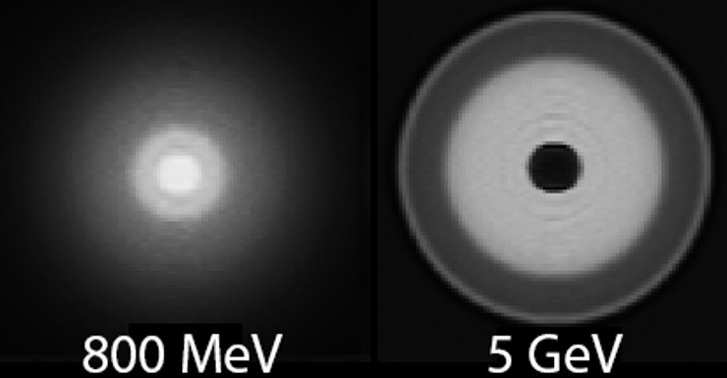
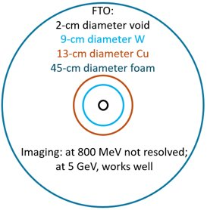
Proton Radiography vs Beam Energy​
“French Test Object”
Beam energy increase from 800 MeV to 3–5 GeV enhances pRad resolution by one order of magnitude
* J. L. Schmidt et al., “Adjustable collimation for dark-field proton radiography
contrast enhancement,” Rev. Sci. Instrum. 97:053304 (2026).

Slide 6
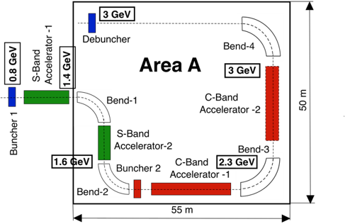
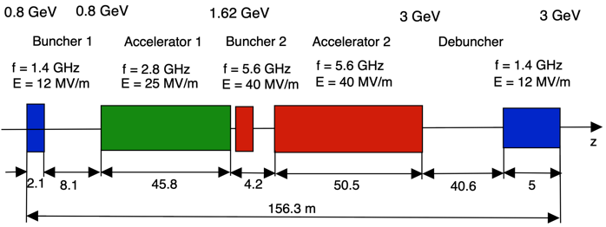
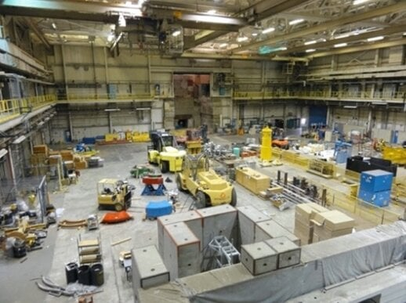
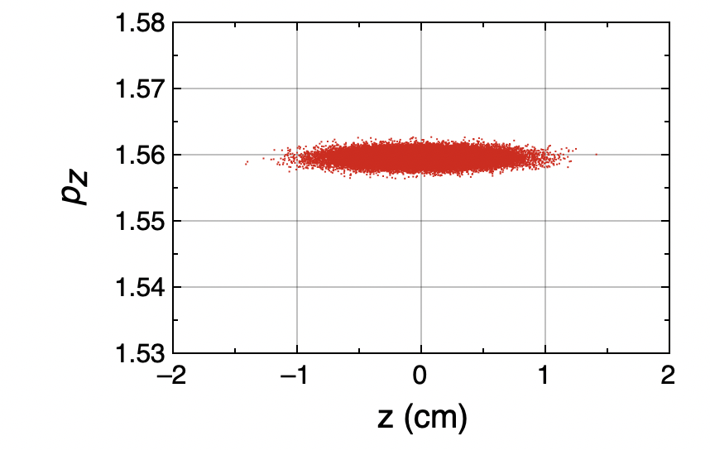
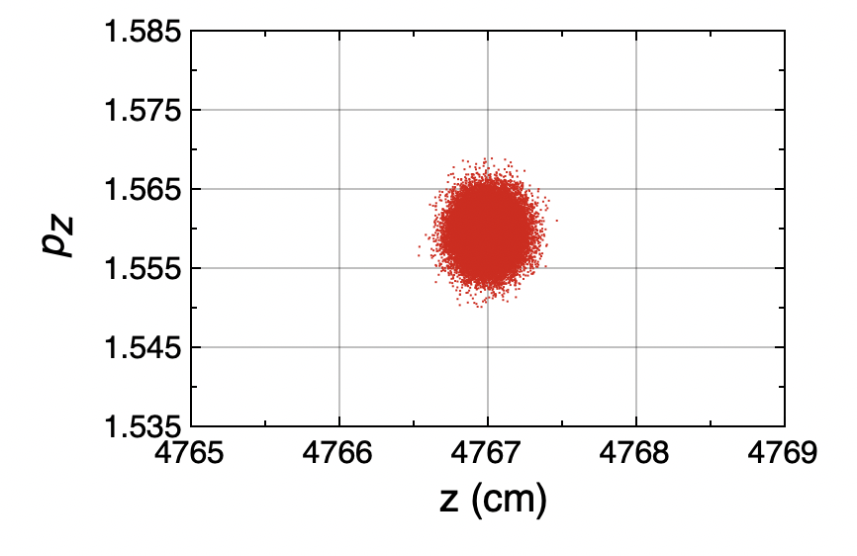
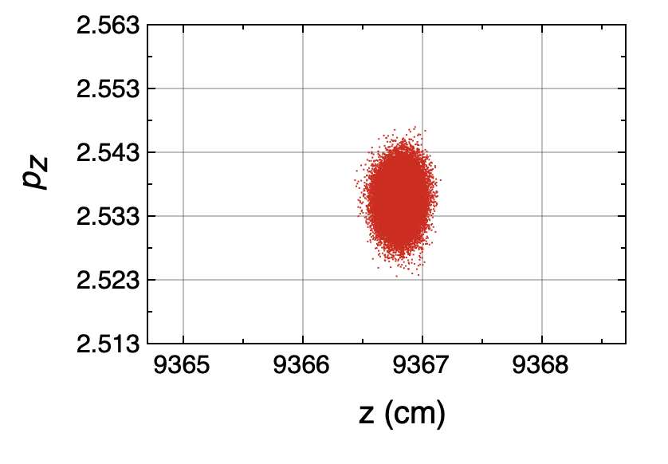
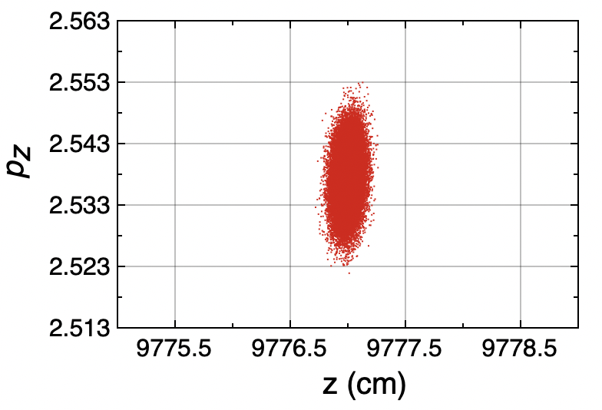
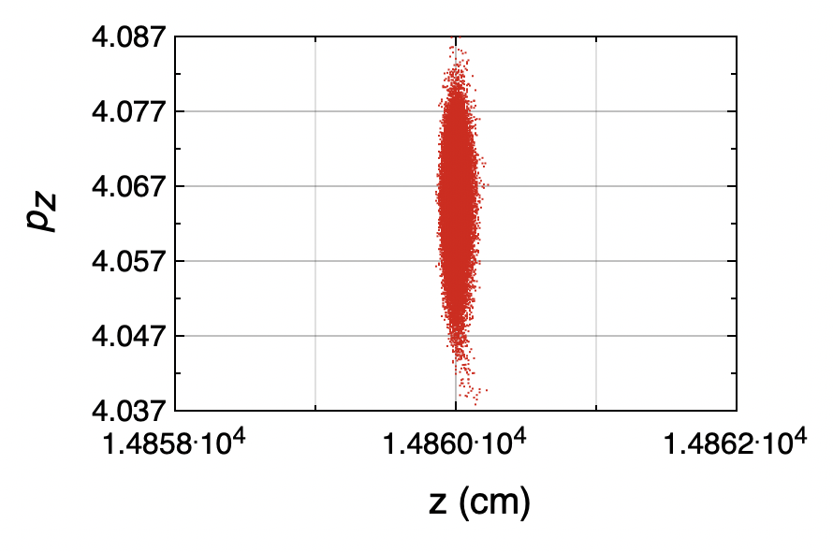
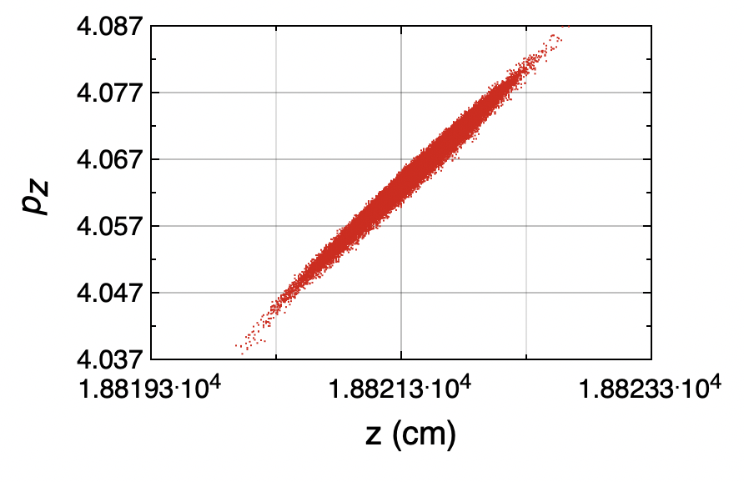
pRad Energy Booster Linac: 3 GeV
Beamline layout
Evolution of longitudinal phase space:
Experimental Area A
* S. S. Kurennoy et al., "Accelerating structures for high-gradient proton radiography
booster at LANSCE," in Proc. NAPAC2022, pp. 894-896 (2022).

Slide 7
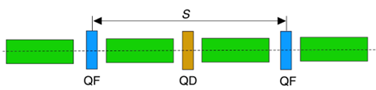
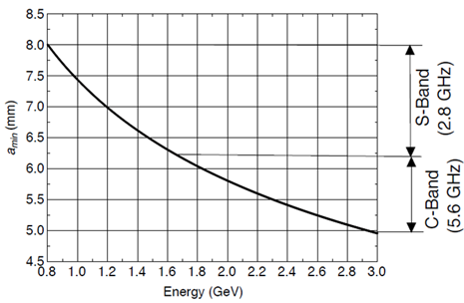
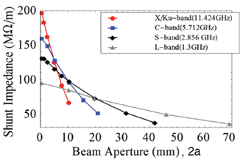
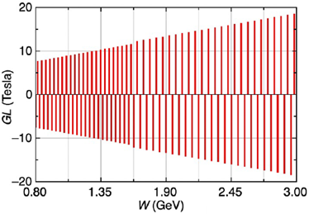



pRad Energy Booster Linac: Design Considerations
Shunt impedance and acceptance:
  Beam aperture
  RF frequencies
FODO focusing (S = 2 m)
Transverse acceptance at LANSCE CCL exit: 3.5 π⋅cm⋅mrad
Minimum aperture: $a_{min}=10⋅{\left(βγ\right)}^{−1/2}$ [mm]
* Y. K. Batygin and S. S. Kurennoy, "Design of 3-GeV high-gradient booster for upgraded
proton radiography at LANSCE," in Proc. NAPAC2022, pp. 891-893 (2022).

Slide 8
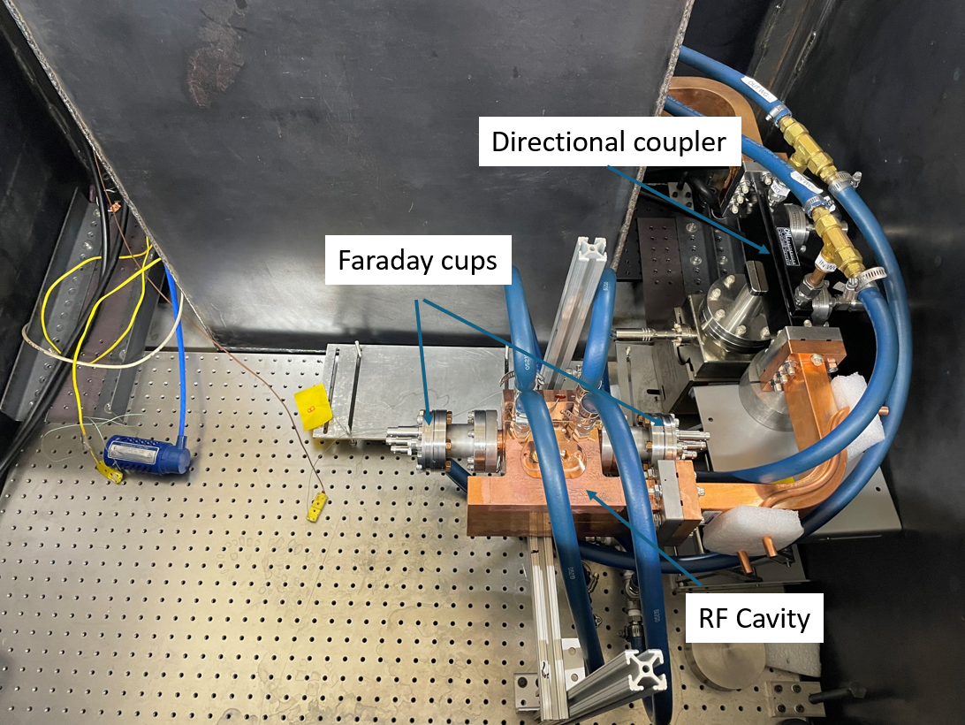
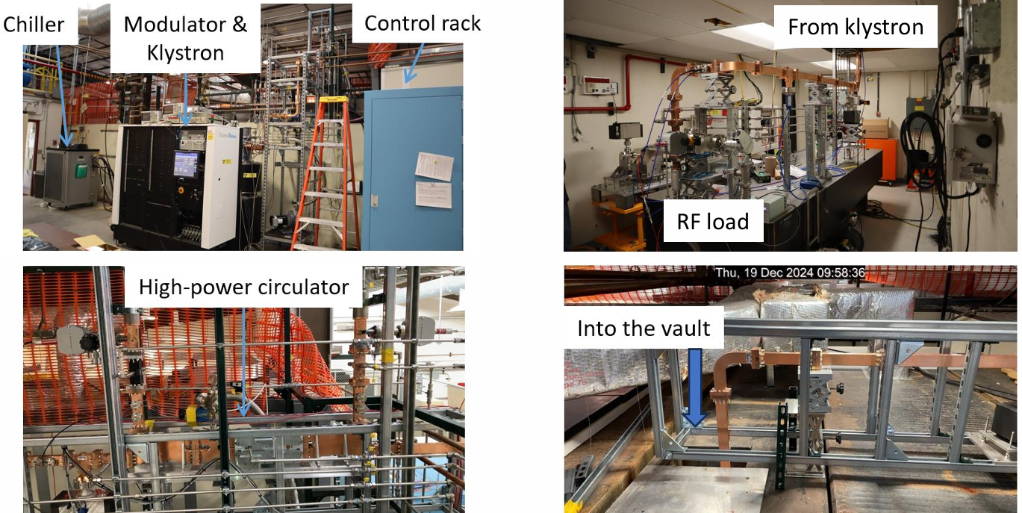
LANL C-Band Test Stands
CERF-NM
CARIE
* E. I. Simakov et al., “Status of the CARIE high gradient photocathode test facility at LANL,” in Proc. IPAC2026,
pp. 1731–1734 (2026).
* E. I. Simakov et al., “High gradient testing of a two-cell C-band accelerator cavity with NiCr higher-order mode
absorbers,” in Proc. IPAC2026, pp. 1727–1730 (2026).

Slide 9
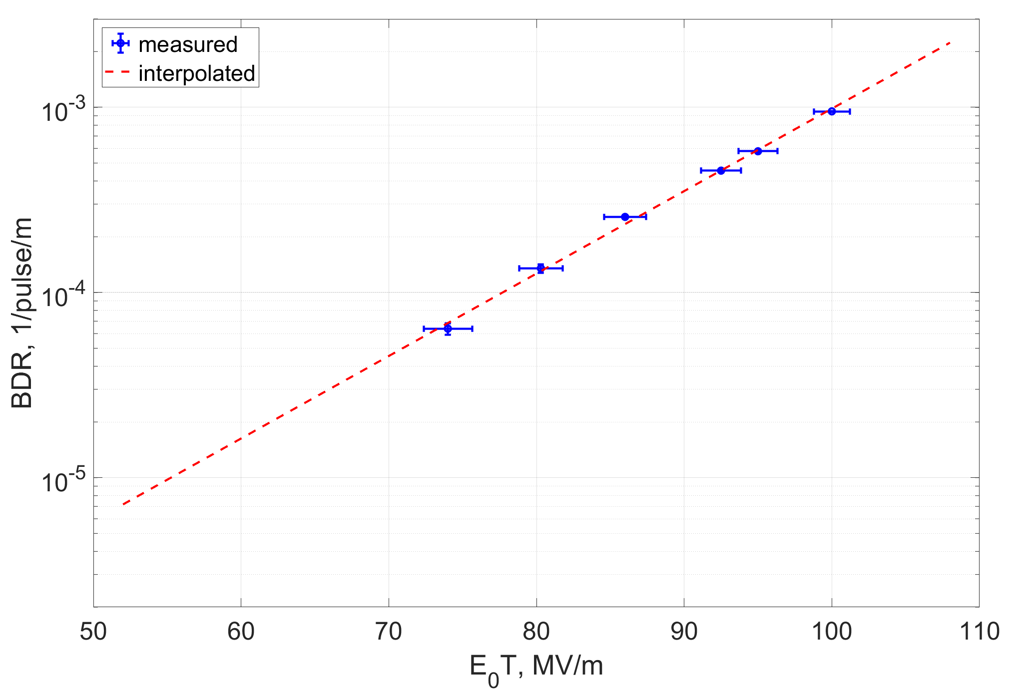
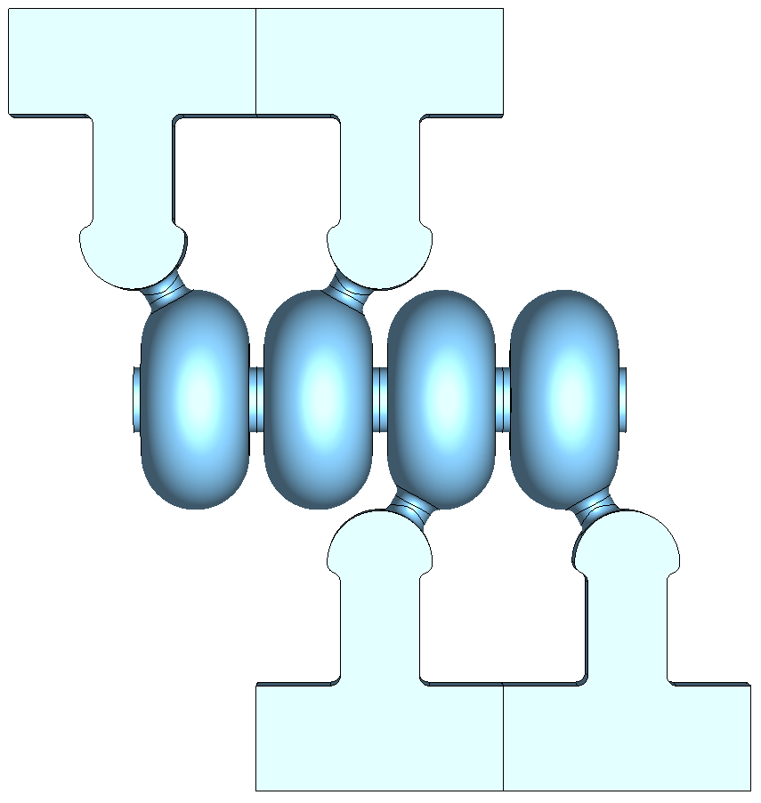
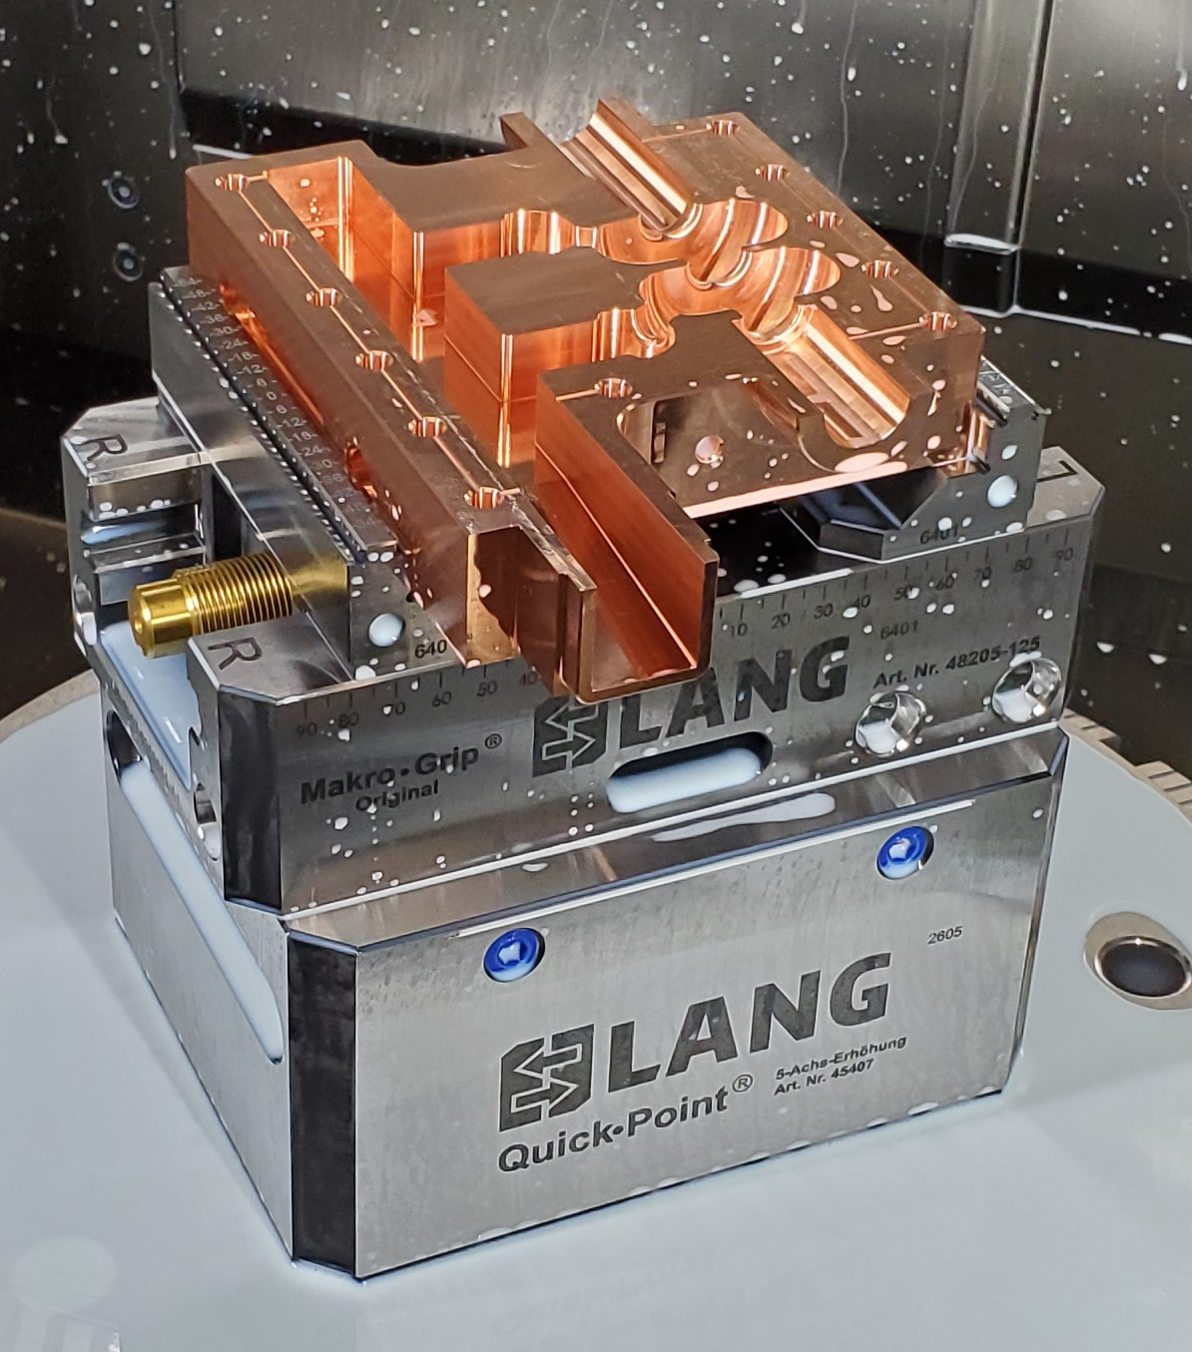
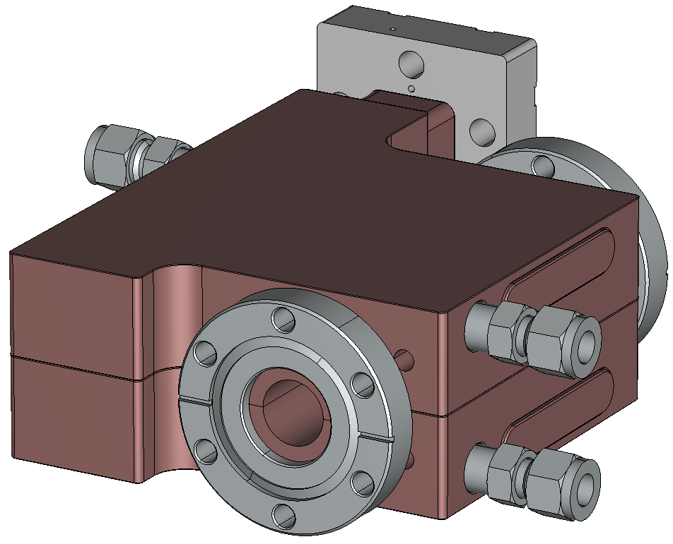
Prototyping: Theory and Room-Temperature Test
Distributed coupling
Subrelativistic structure
λ_{g}/2
CERF-NM test stand
L_{c}
L_{c}
λ_{g}/2
* M. Zuboraj et al., “High-gradient performance of a prototype accelerator cavity for a 3 GeV
proton radiography booster,” Phys. Rev. Accel. Beams 27:021001 (2024).

Slide 10
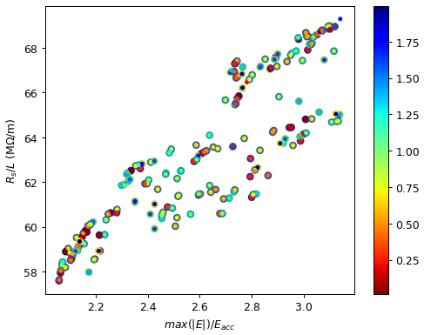
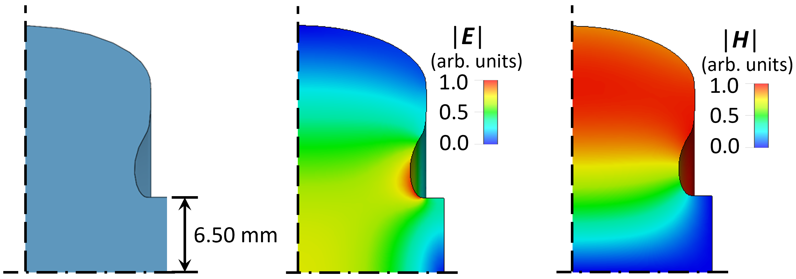
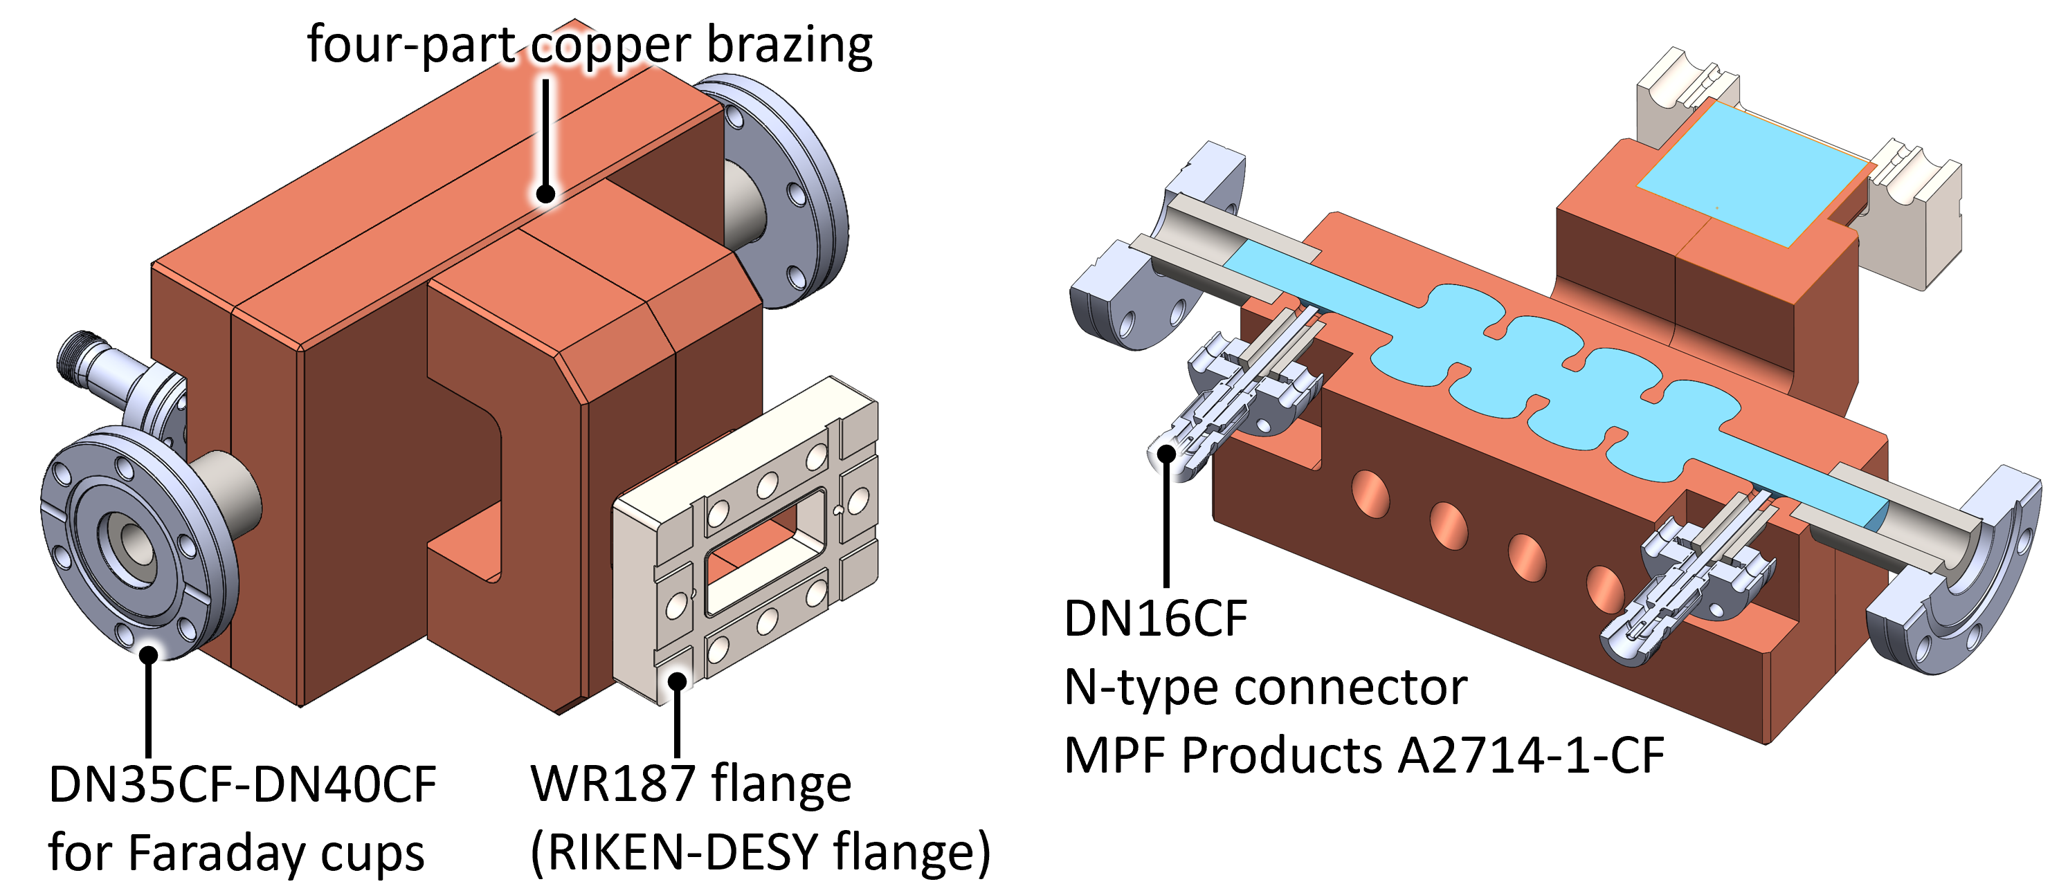
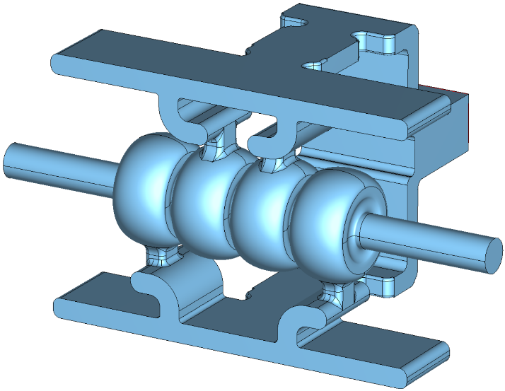
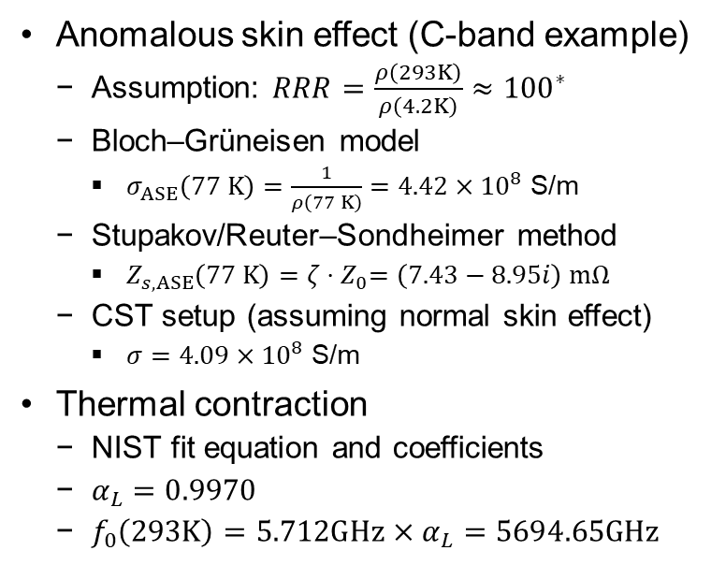
Prototyping: S- and C-Band for Liquid-Nitrogen T.
Anomalous skin effect (C-band example)
  Assumption: $RRR=\frac{ρ\left(293K\right)}{ρ\left(4.2K\right)}≈{100}^{∗}$
  Bloch–Grüneisen model
    $σ_{ASE}\left(77 K\right)=\frac{1}{ρ\left(77 K\right)}=4.42×{10}^{8}$ S/m
  Stupakov/Reuter–Sondheimer method
    $Z_{s,ASE}\left(77 K\right)=ζ{⋅Z}_{0}=\left(7.43−8.95i\right) mΩ$
  CST setup (assuming normal skin effect)
    $σ=4.09×{10}^{8}$ S/m
Thermal contraction
  NIST fit equation and coefficients
  $α_{L}=0.9970$
  $f_{0}\left(293K\right)=5.712GHz×α_{L}=5694.65GHz$
RF design at LANL (four-cell)
  Multi-Objective Genetic Algorithm (Xopt) driving Superfish on LANL HPC.
  CST Eigenmode & High-Frequency Solvers
Pareto front
individual-cell profile
* M. Kaemingk et al., “Genetic optimizations of RF cell profile using Superfish,” in Proc. IPAC2026, pp. 473–476 (2026).

Slide 11
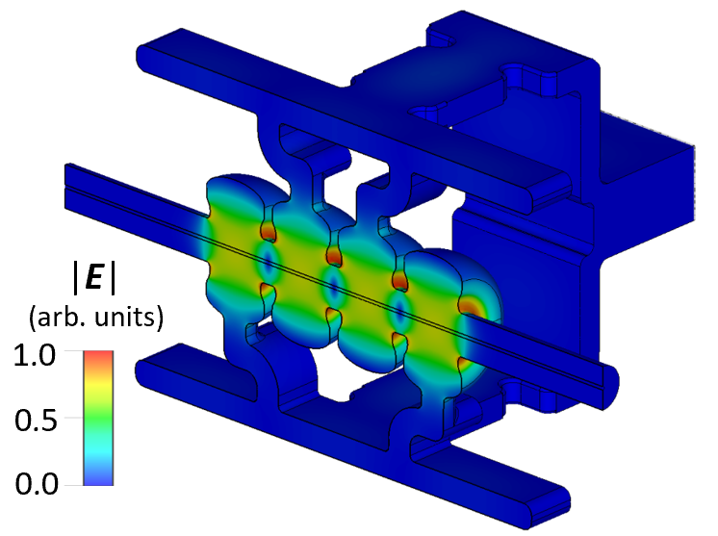
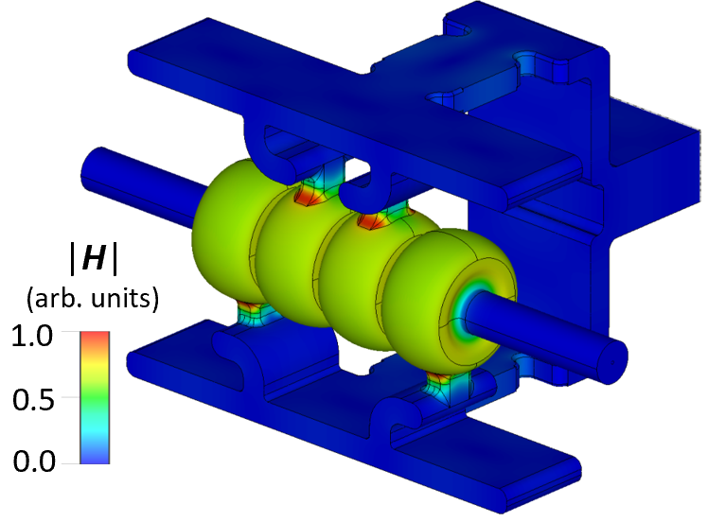
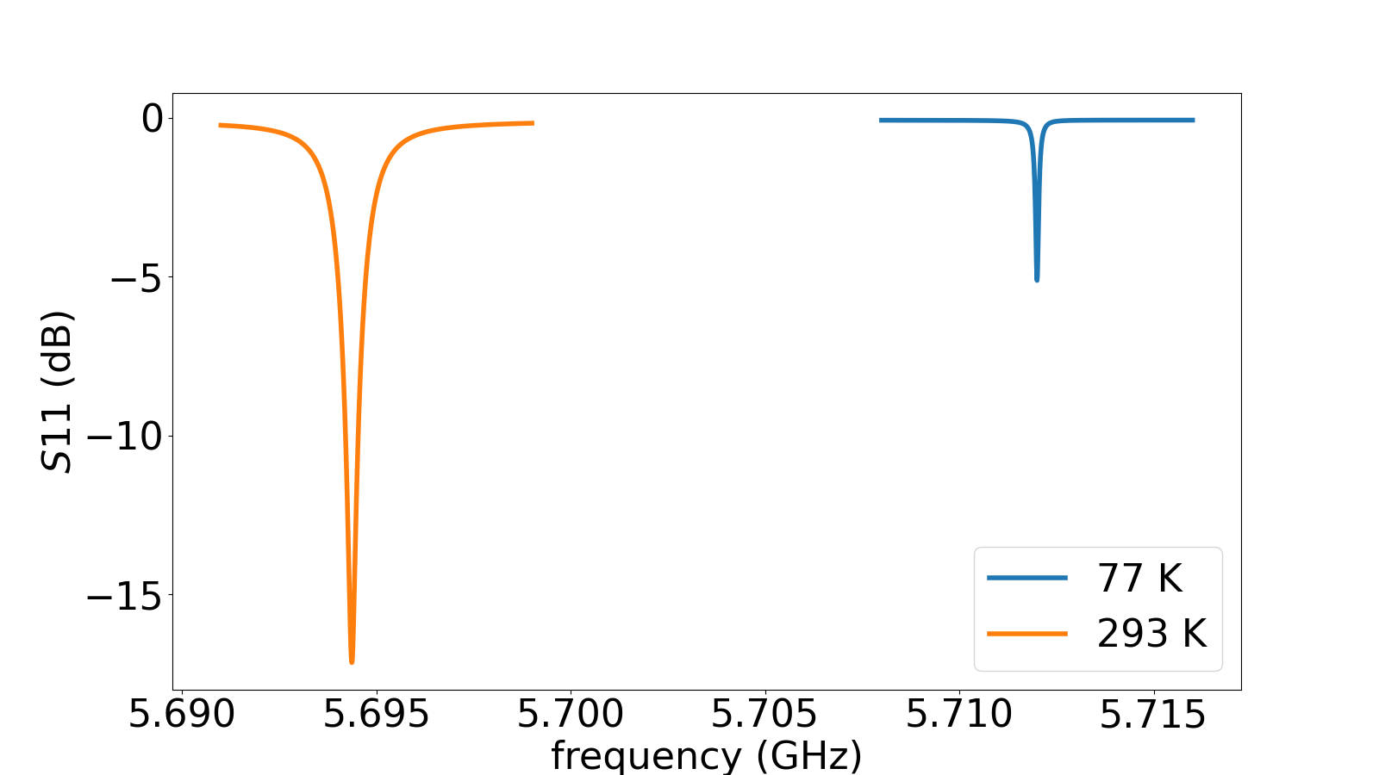
Prototyping: S- and C-Band for Liquid-Nitrogen T.
S-band (0.8-GeV H–): eng., fab., and tests at RadiaBeam Technologies, LLC.
C-band example
reso. freq. | 2.856 MHz | shunt imp. | 172 MΩ/m
293K-70K R_{s} fac. | 2.69 | power avail. | 5 MW
CST elec. cond. | 4.21e8 S/m | max gradient | 69 MV/m
unloaded Q | 46259 | norm. peak E-fld | 2.41
coupl. fac. | 1.00 | norm. peak H-fld | 1.30
C-band (1.6-GeV H–): eng. and fab. at Dymenso, LLC; tests at LANL’s CARIE.
reso. freq. | 5.712 MHz | shunt imp. | 187 MΩ/m
293K-70K R_{s} fac. | 2.65 | power avail. | 12 MW
CST elec. cond. | 4.09e8 S/m | max gradient | 121 MV/m
unloaded Q | 32605 | norm. peak E-fld | 2.50
coupl. fac. | 3.49 | norm. peak H-fld | 1.63
* S. S. Kurennoy et al., “High-gradient booster linac for multi-GeV proton radiography at LANSCE,” in Proc. IPAC2026, pp. 2428–2431 (2026).
* H. Xu et al., “Plans for cryogenic C-band prototype tests for LANL pRad booster linac,” in Proc. IPAC2026, pp. 2410–2413 (2026).

Slide 12
Summary
Higher-energy Proton Radiography is desired for enhanced imaging resolution.
Cryo-cooled RF linac is under investigation as a candidate technology for increasing Proton Radiography beam energy from 800 MeV to 3–5 GeV at LANSCE.
A 3-GeV energy booster linac was conceptualized for fitting inside LANSCE Area A.
Room-temperature 2-cell C-band prototyping and testing was successful.
Liquid-nitrogen temperature 4-cel S- and C-band prototyping and testing are underway, at LANL and with industrial partners.

