Slide 1

High Gradient Testing of a Two-Cell C-band Accelerator Cavity with NiCr Higher-Order Mode Absorbers
Evgenya Simakov, W. Brian Haynes, Dongsung Kim, Deepak Rai, and Haoran Xu
Los Alamos National Laboratory
Zenghai Li and Emilio Nanni
SLAC National Accelerator Laboratory
7/28/2026
Managed by Triad National Security, LLC., for the U.S. Department of Energy’s NNSA.

Slide 2
Outline of this talk
Introduction and LANL C-band research and its alignment with DOE HEP high gradient research in other laboratories
LANL C-band Engineering Research Facility CERF-NM
High gradient tests of the two-cell cavity with NiCr absorbers
Summary and near-term plans

Slide 3
LANL High Gradient C-band research
The goals for LANL’s high gradient research are evolving
To build a C-band (5.712 GHz) high gradient rf breakdown study facility (2019-2022).
To build a C-band cryo-cooled photoinjector study facility (2022-2025).
To conduct research in collaboration with other DOE research laboratories and universities in particular as a part of C3 efforts.
Los Alamos National Laboratory internal funding comes from LANL Laboratory Directed Research and Development (LDRD) program, LANL Internal Infrastructure Investments, and Technology Evaluation and Development (TED) funds.
Los Alamos National Laboratory external funding comes from the DOE HEP.

Slide 4
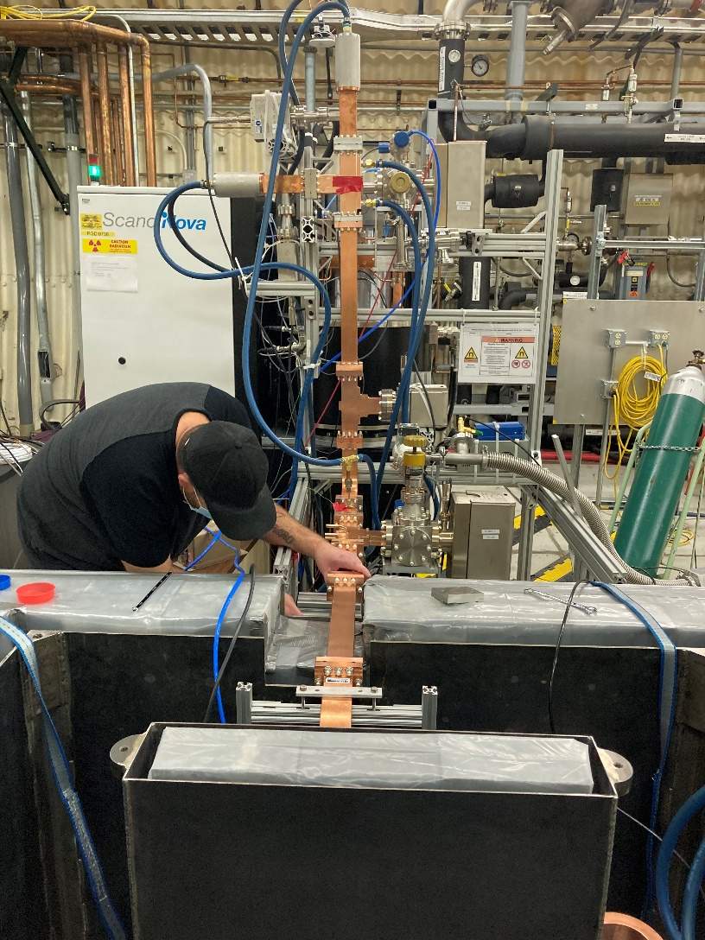
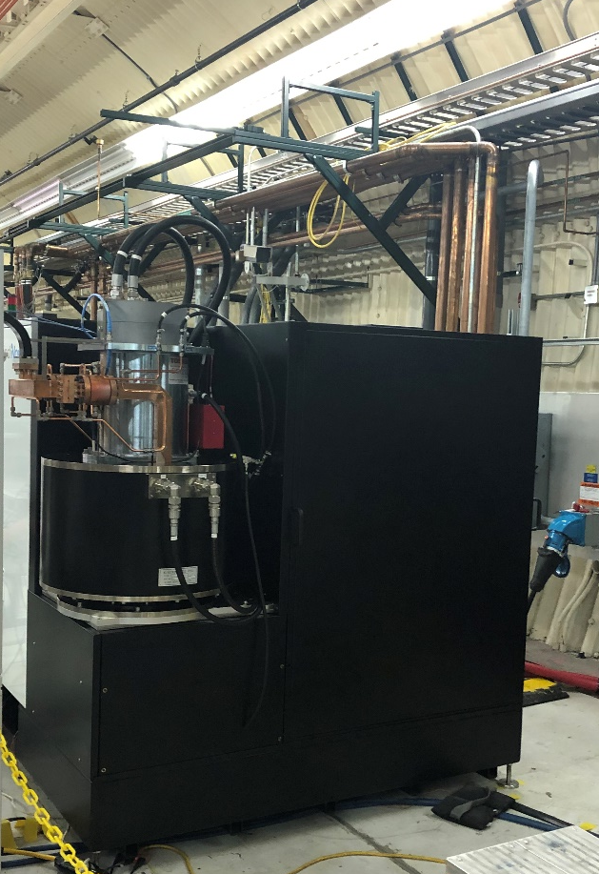
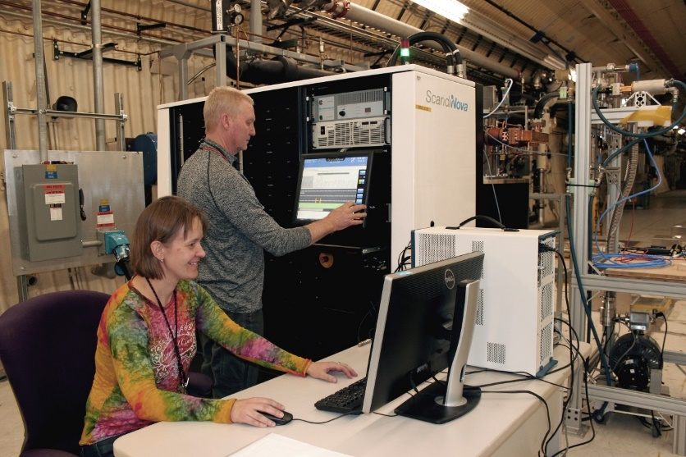
LANL C-band Engineering Research Facility (CERF-NM)
CERF-NM was built with $3M of LANL’s internal infrastructure investment.
Powered with a C-band Canon klystron
Conditioned to 50 MW
Frequency 5.712 GHz
300 ns – 1 µs pulse length
Rep rate up to 200 Hz (typical 100 Hz)
Nominal bandwidth 5.707-5.717 GHz

Slide 5
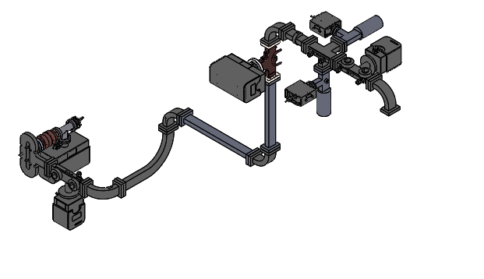
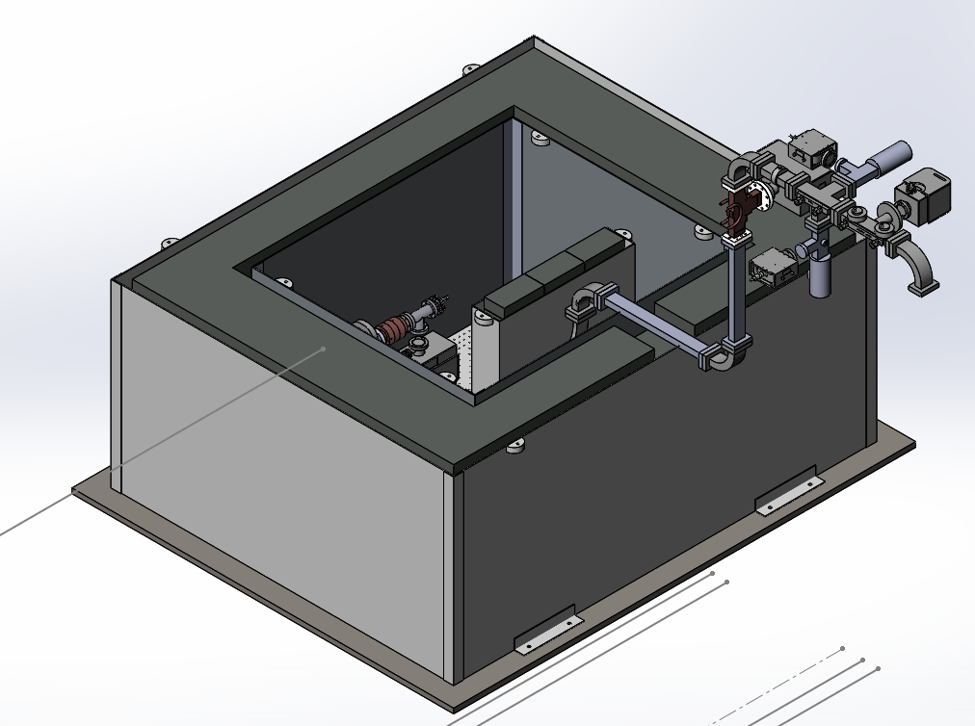
Schematic of CERF-NM test stand
Radiologically certified for dark currents up to 5 MeV and 10 μA.
Ion pump and ion gauge
Cavity
FC1
Mode launcher
FC2
Dir coupler (FWD, REV)

Slide 6
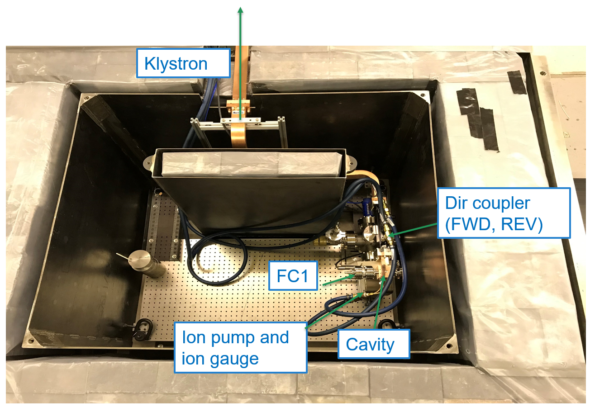
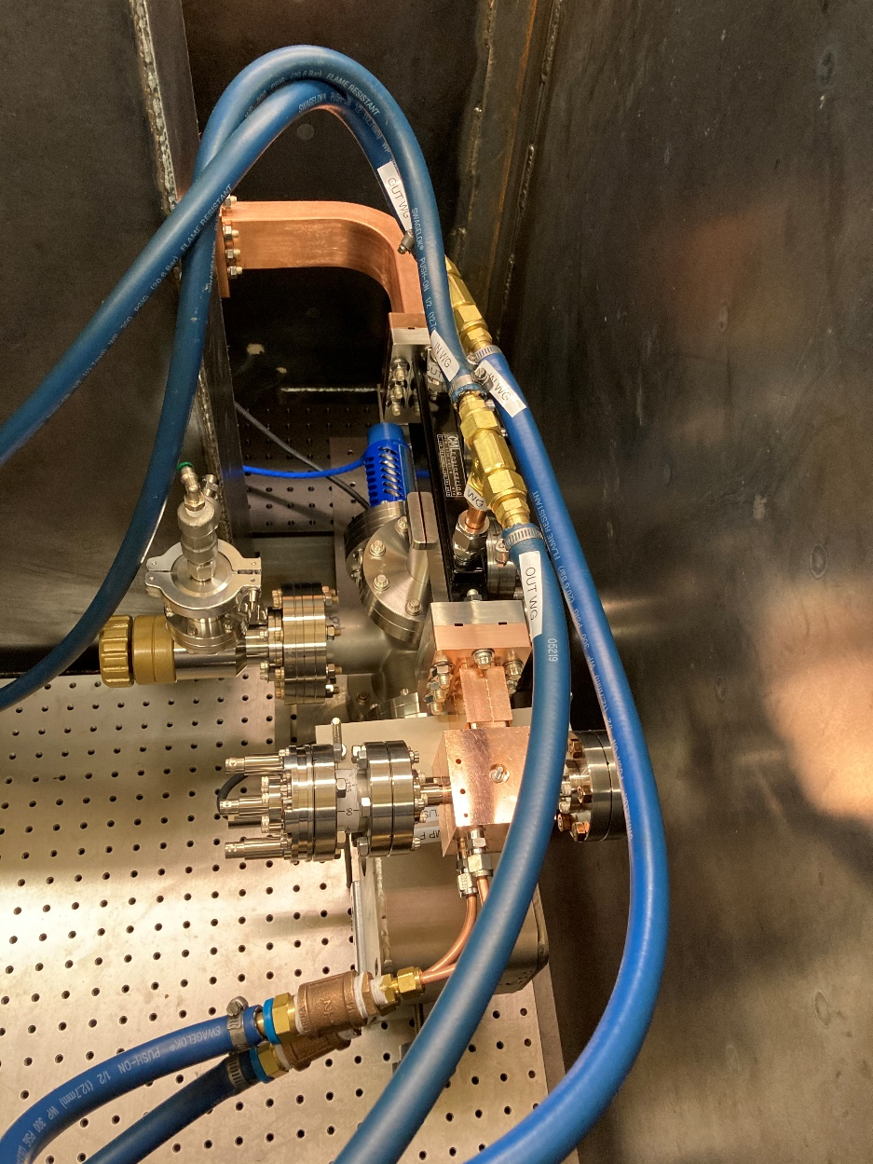
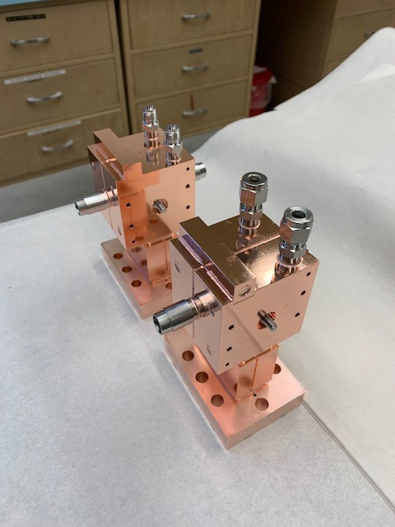
The first two high gradient cavities were tested at CERF-NM in FY21
This C-band high gradient test facility is nationally unique. The first cavities tested at CERF-NM were manufactured at SLAC.

Slide 7
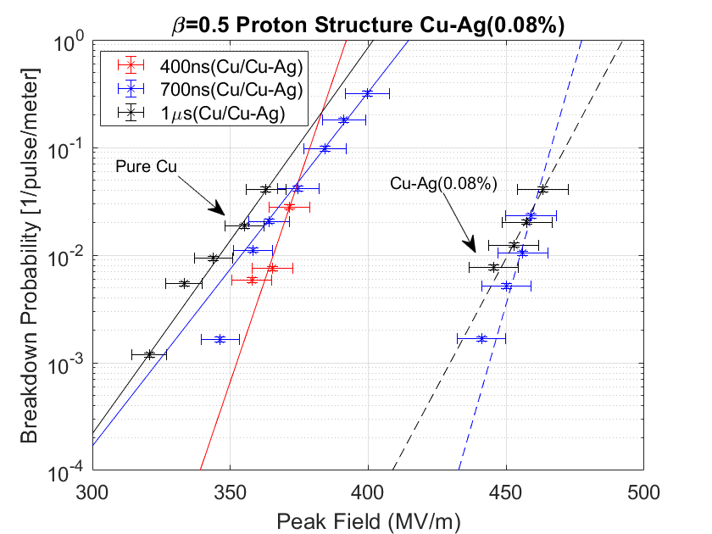
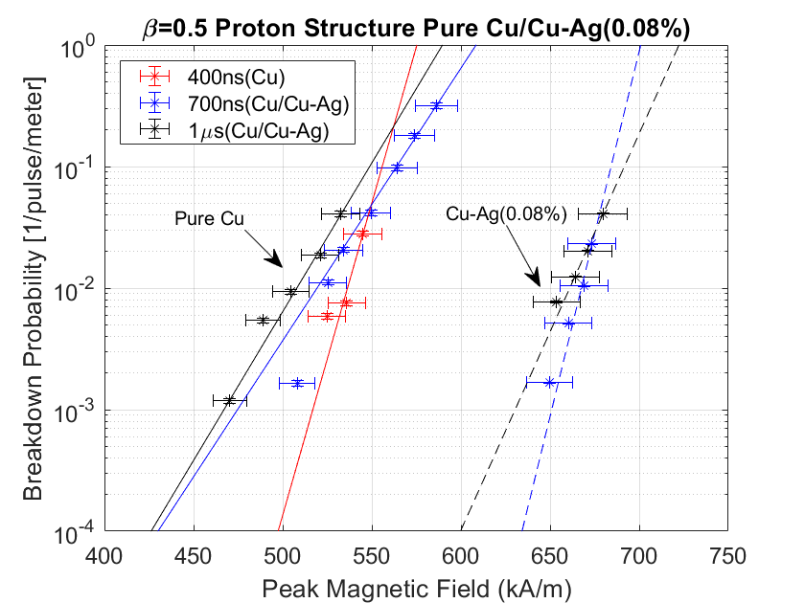
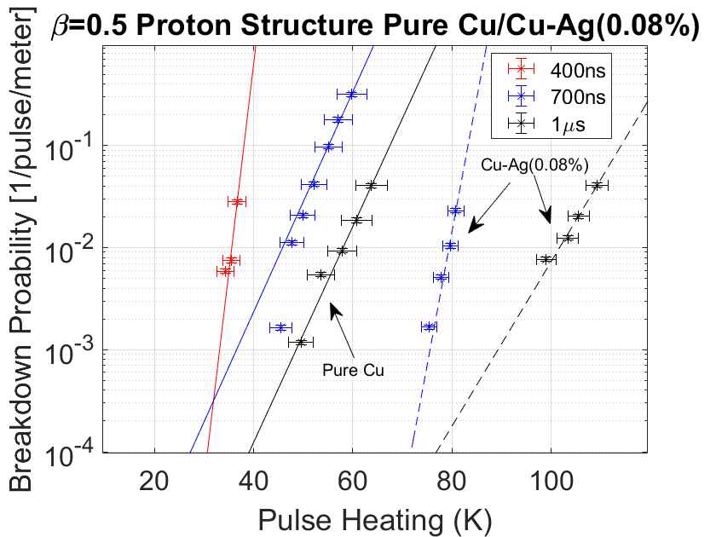
Peak surface electric fields in excess of 300 MV/m demonstrated in high gradient tests
Breakdown probabilities were recorded for three different pulse lengths for copper and copper-silver cavities.

Slide 8
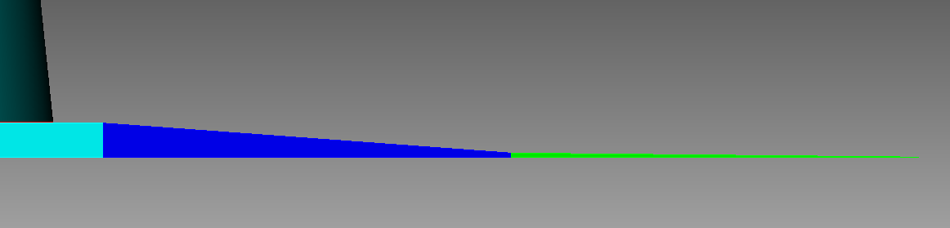
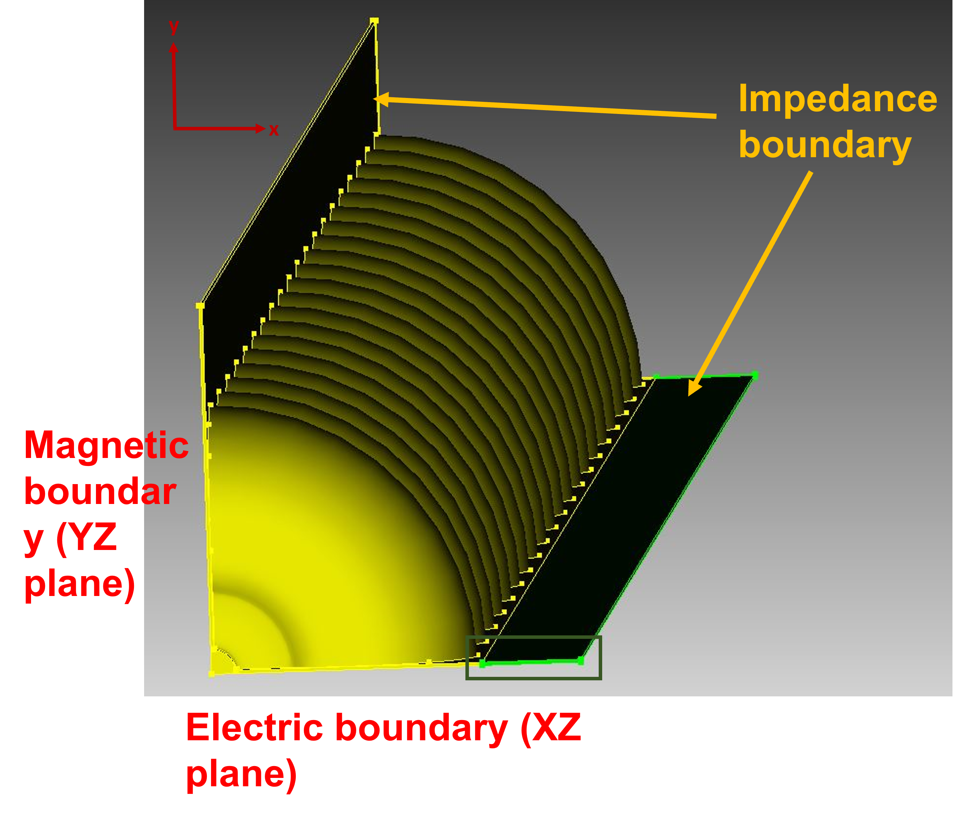
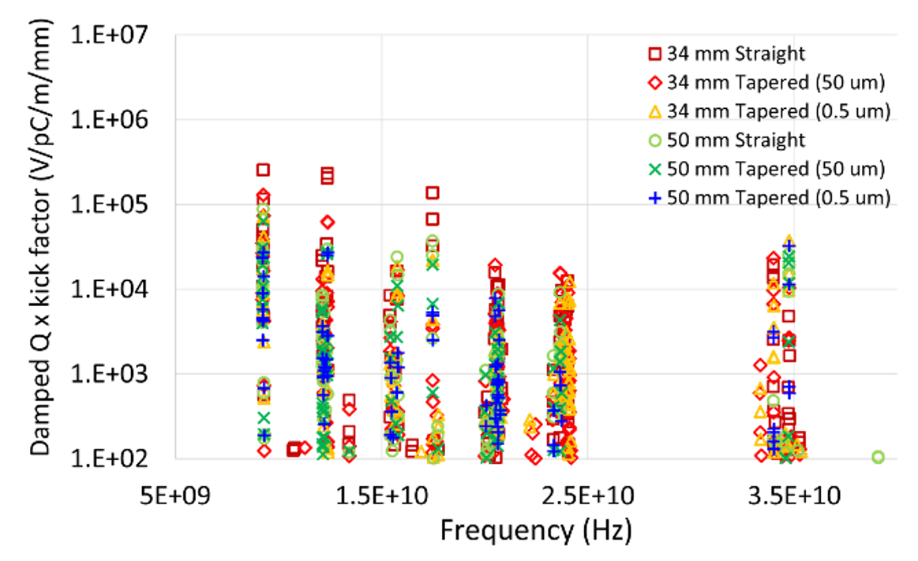
NiCr absorbers for HOM suppression
We conducted extensive optimizations of HOM suppression in a 20-cell C-band accelerating structure with NiCr absorbers.
L_wg1
L_wg2
t₁
t₂
t₃

Slide 9
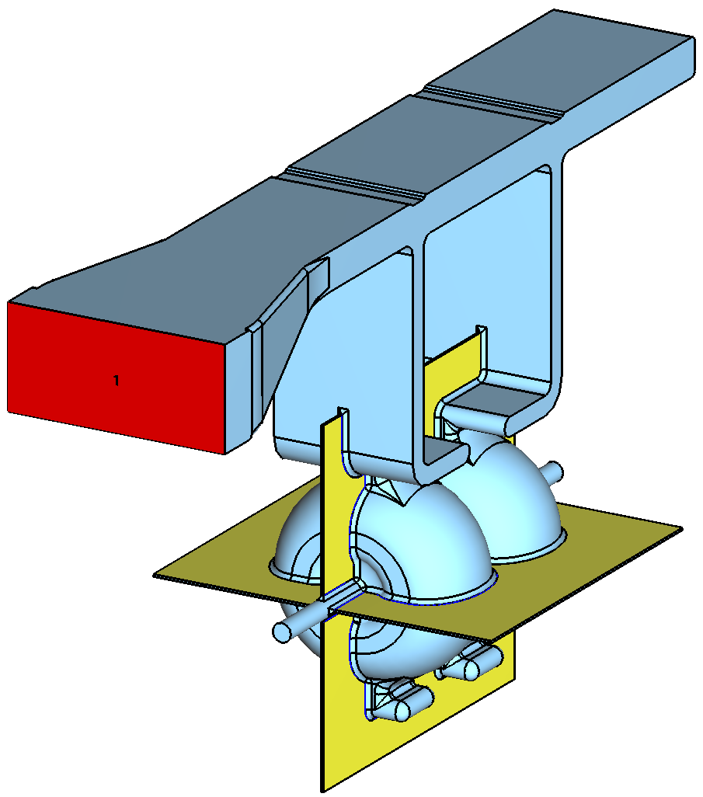
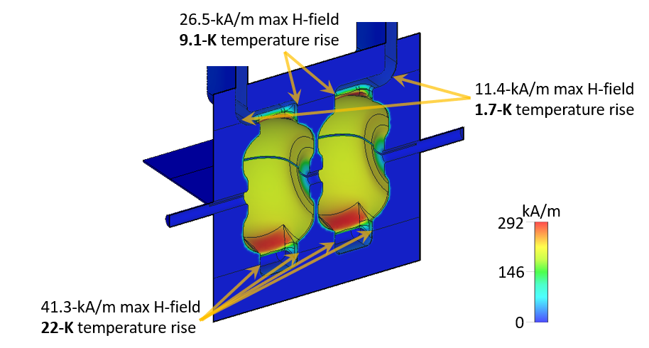
Two-cell test cavity with NiCr absorbers
A two-cell cavity was designed to test if a structure with NiCr absorbers can be conditioned to high gradients.
Issues to be studied: pulse heating, HOM generation during breakdown.
NiCr

Slide 10
Q-factors of HOMs in two-cell cavity with HOM slots
CST without damping |  | CST with straight damping slots
Frequency (GHz) | Q-factor | Frequency (GHz) | Q-factor
9.3730 | 11521 | 9.3728 | 8239
12.250 | 8489 | 12.249 | 3292
17.509 | 7295 | 17.509 | 5382
17.569 | 10466 | 17.570 | 4442

Slide 11
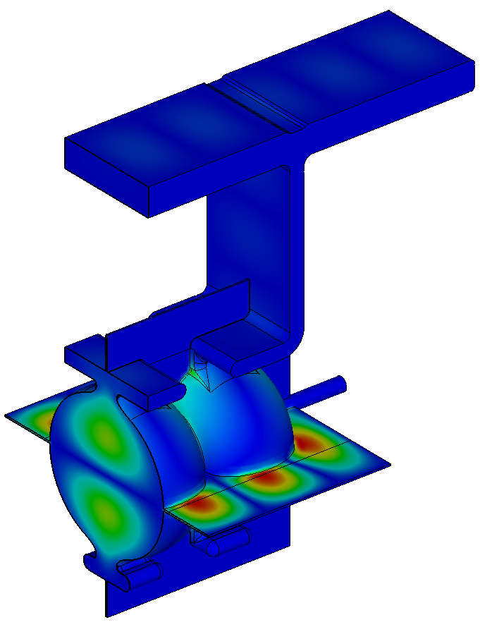
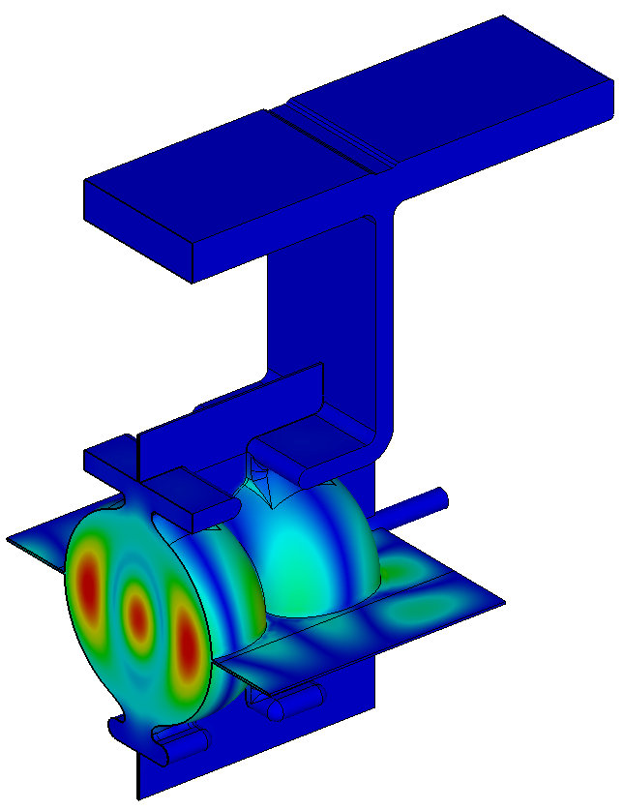
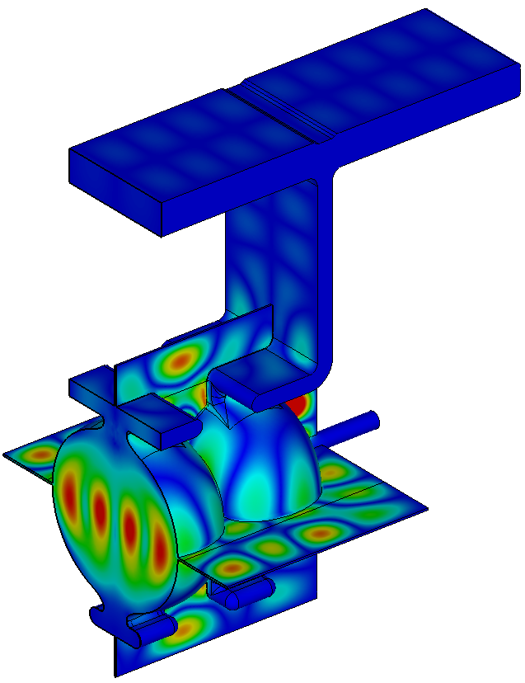
Various HOMs
TM110 mode
9.21 GHz
TM021 mode
12.31 GHz
TM121 mode
17.62 GHz

Slide 12
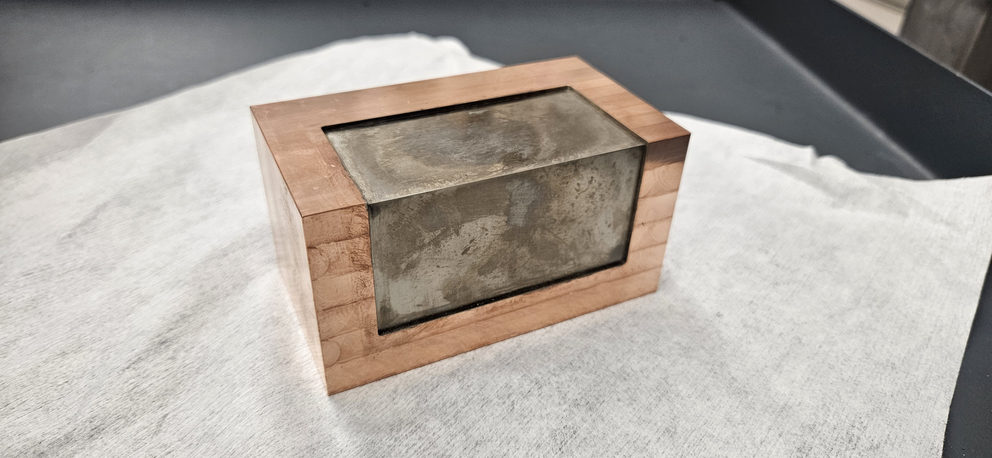
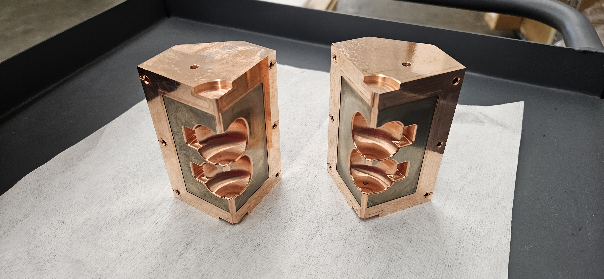
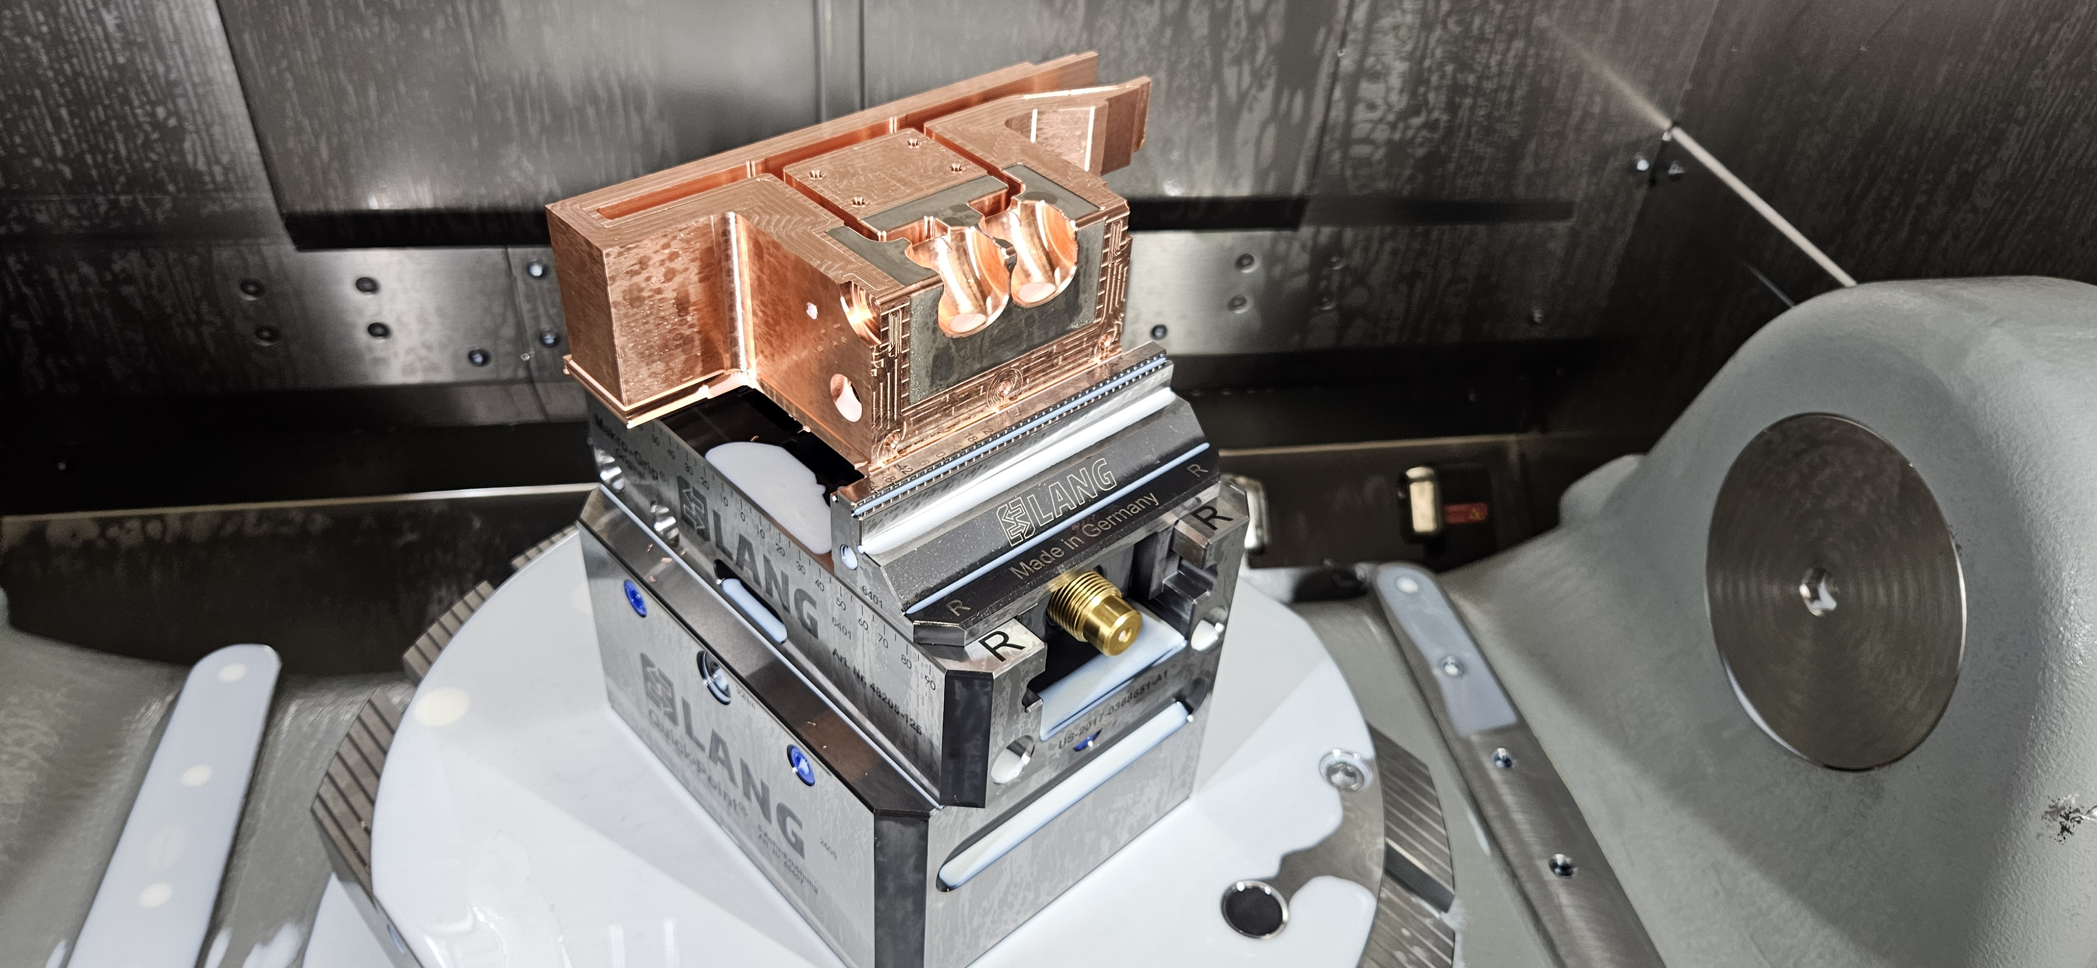
Fabrication process
Pre-fabrication, and Nickel and chromium deposition performed.
Cells were machined.
Brazing and annealing step to follow.
Absorber slots will be covered with NiCr

Slide 13
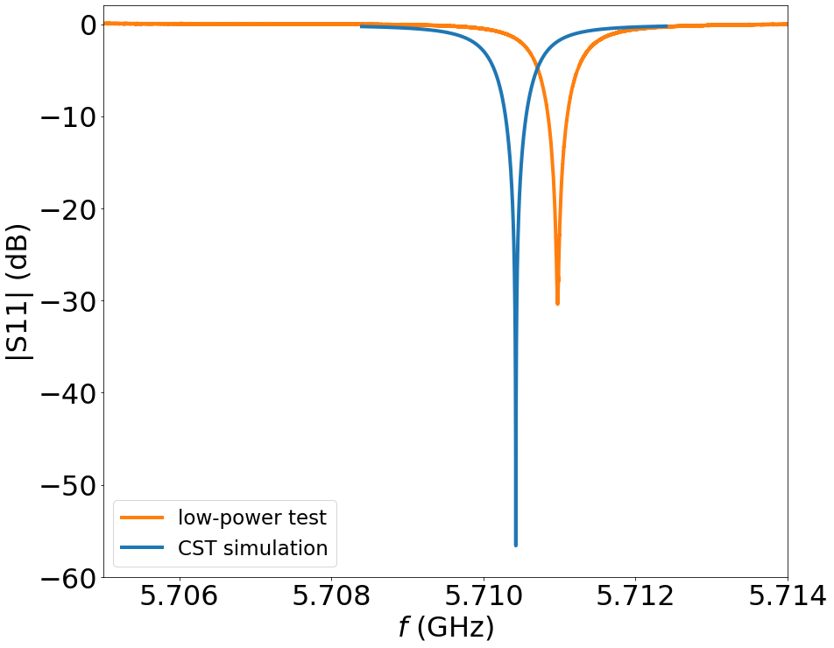
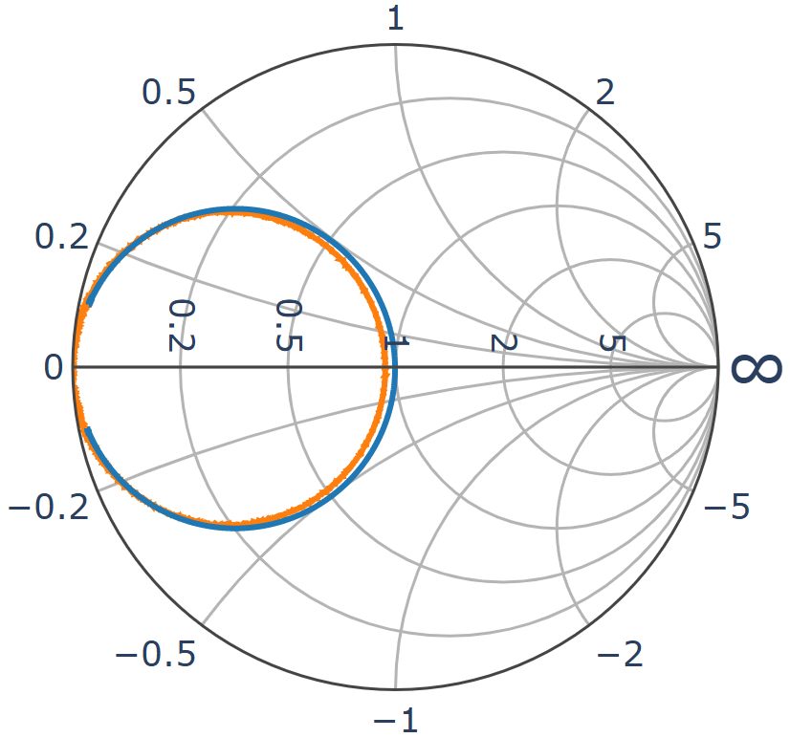
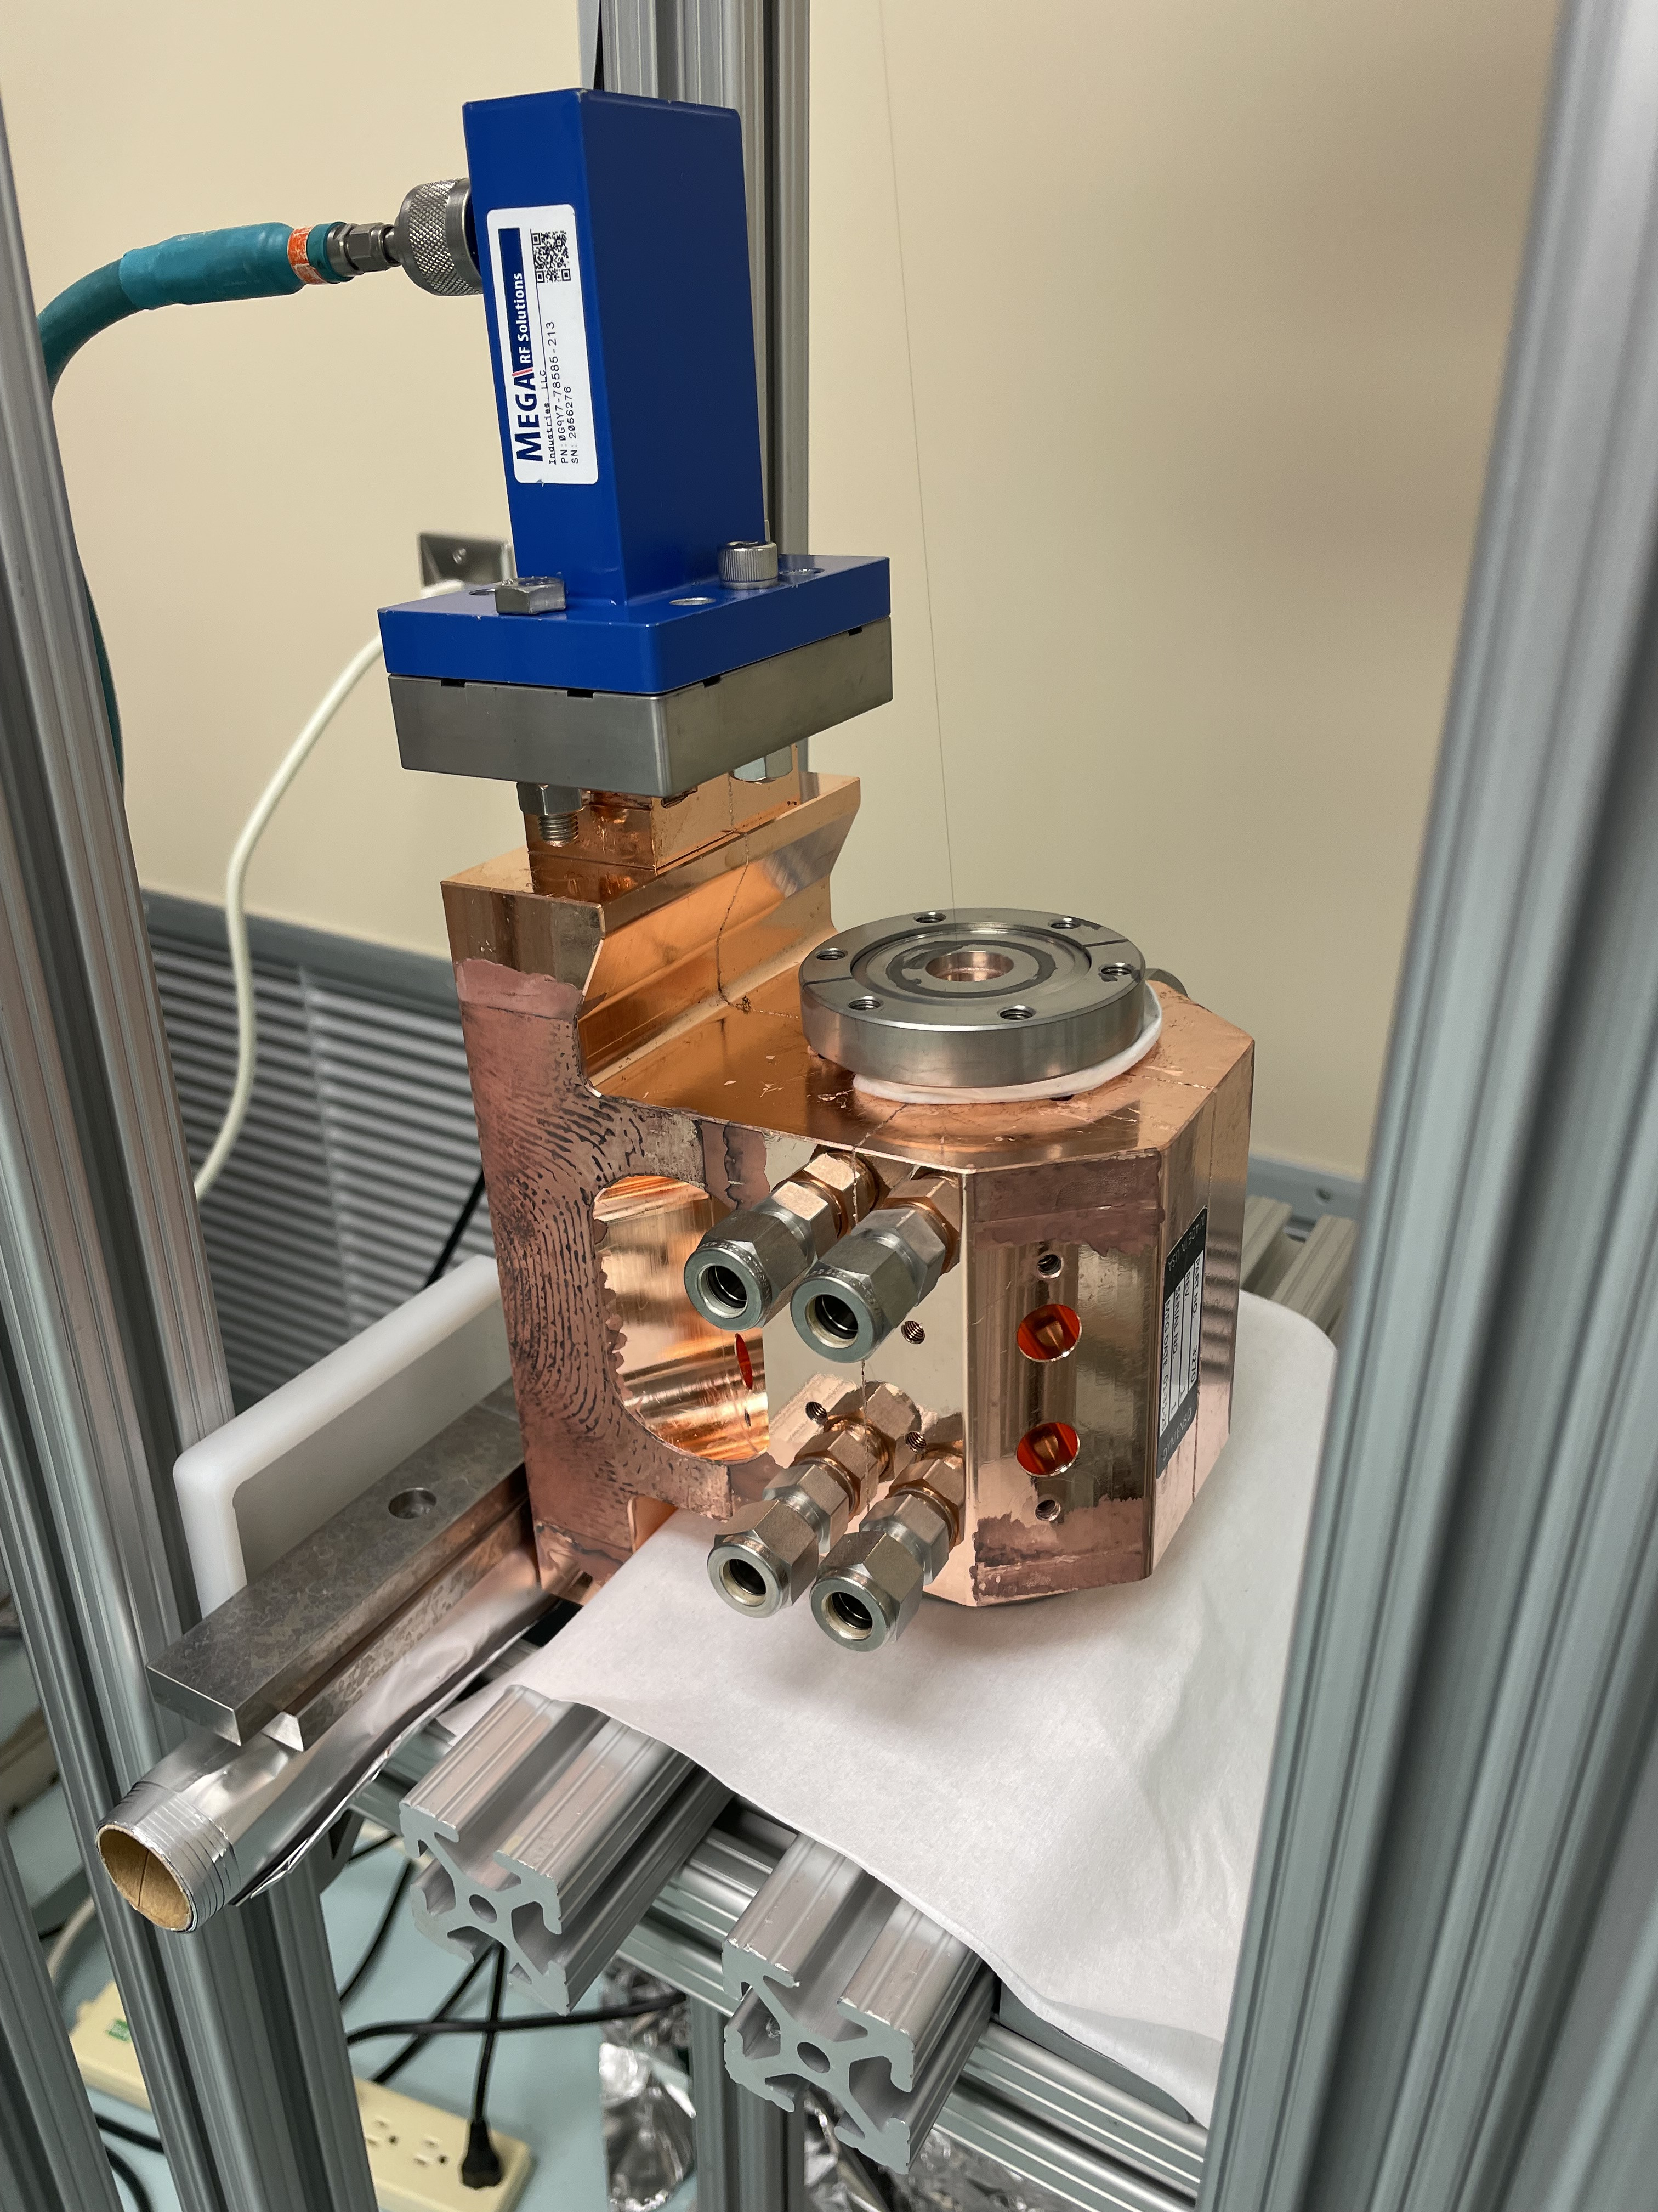
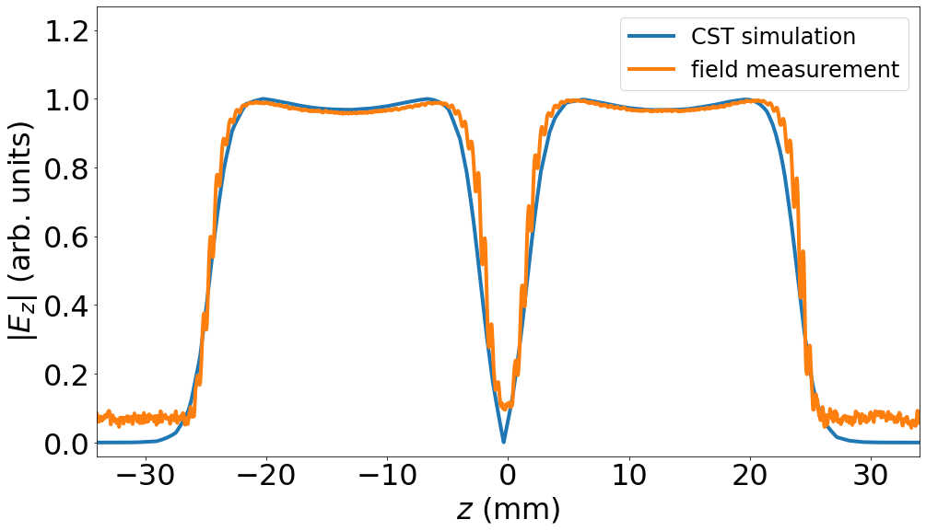
Cold-testing and tuning
The cavity was received at LANL, cold-tested in March of 2025 and tuned in September of 2025.
Bead-pull results:
Im{z}
Re{z}
f=5.7111 GHz in air

Slide 14
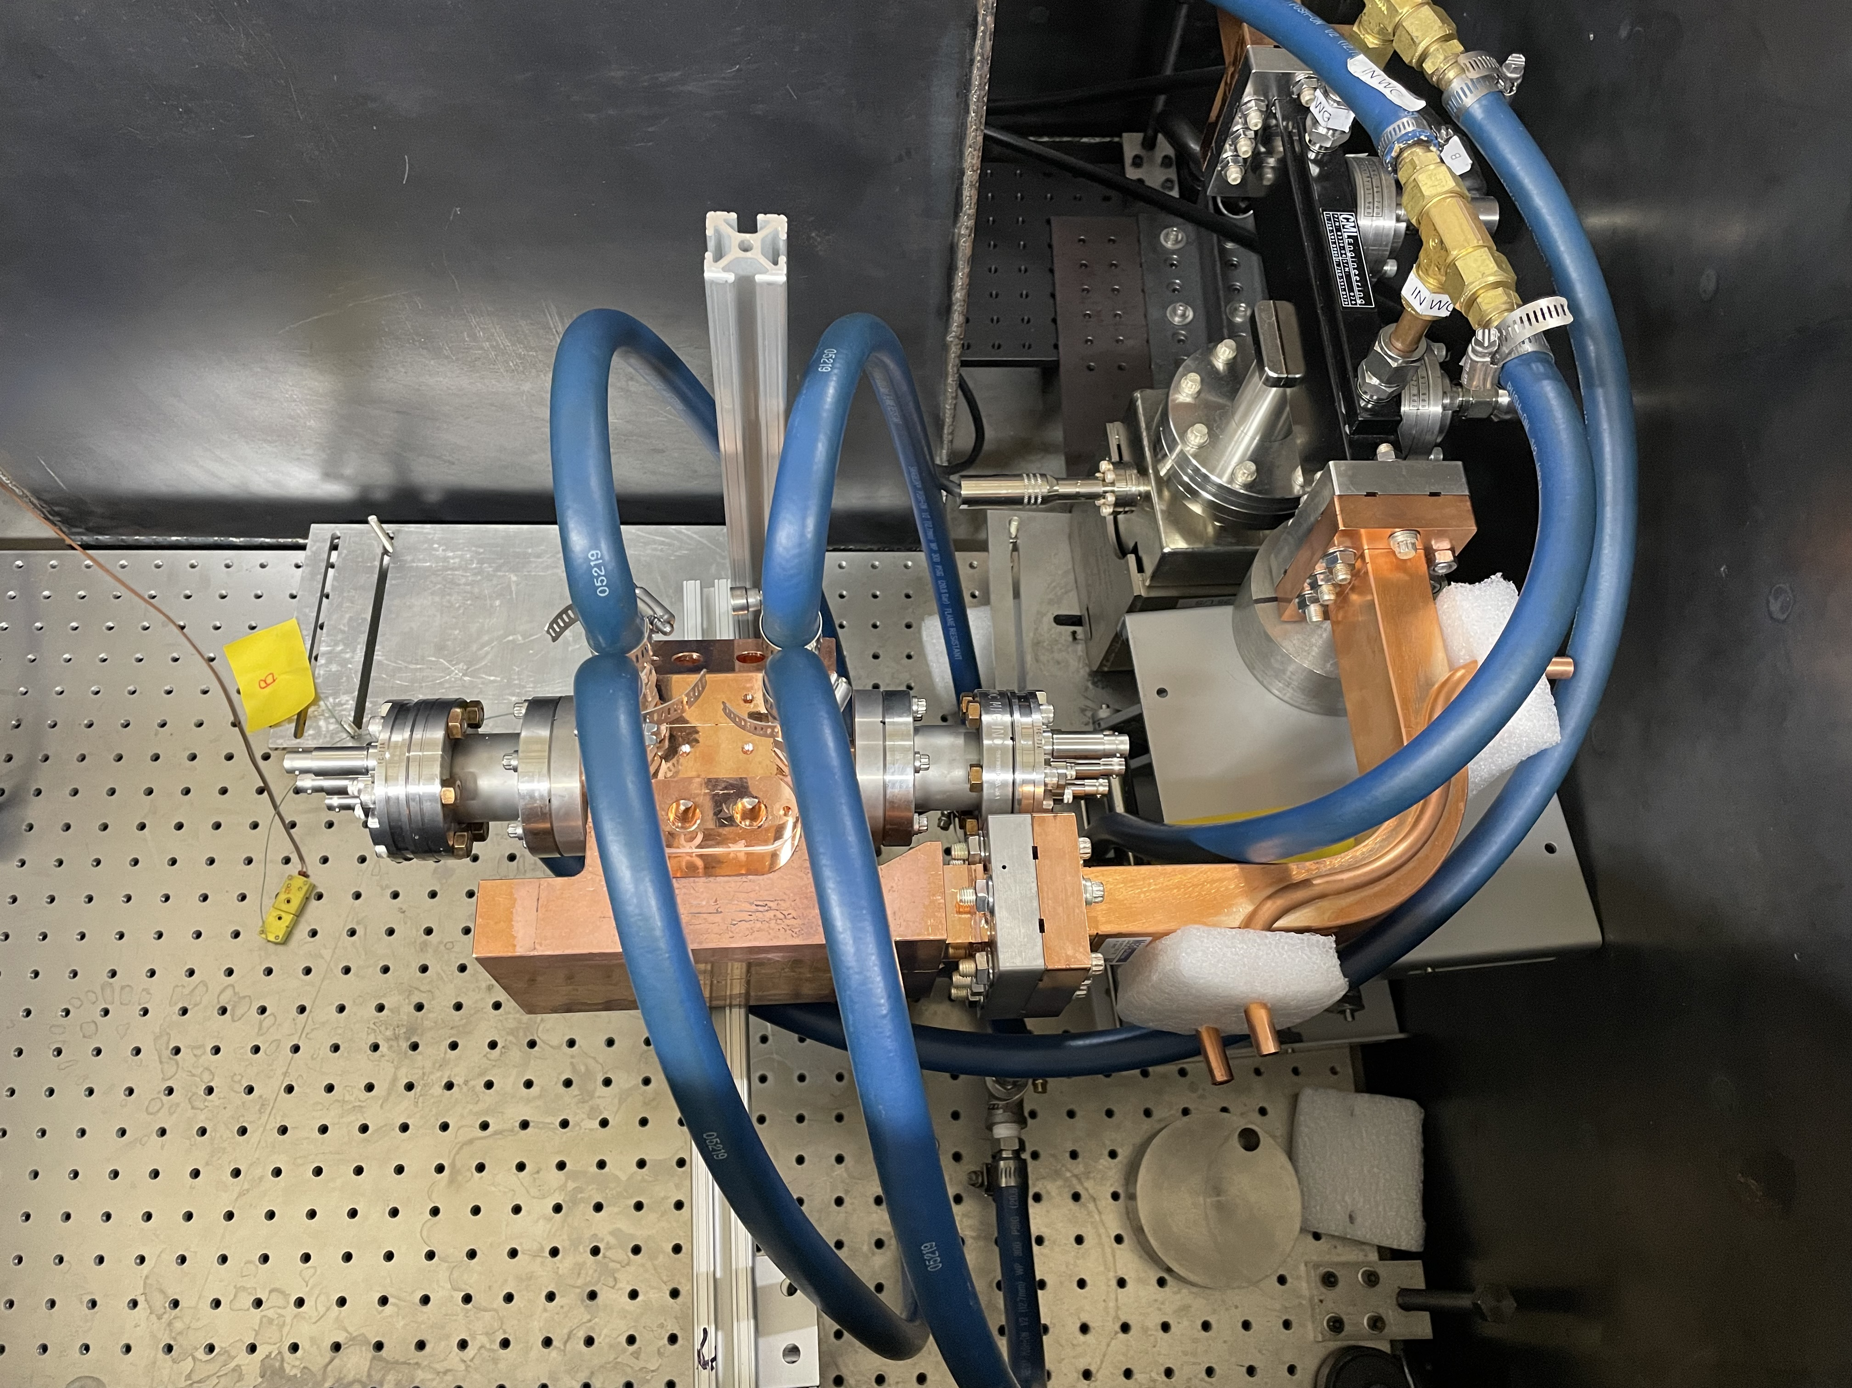
Two-cello cavity installed at CERF-NM
This is a photograph of the installation inside of the lead box at CERF-NM.
Directional coupler
Faraday cups
Test structure

Slide 15
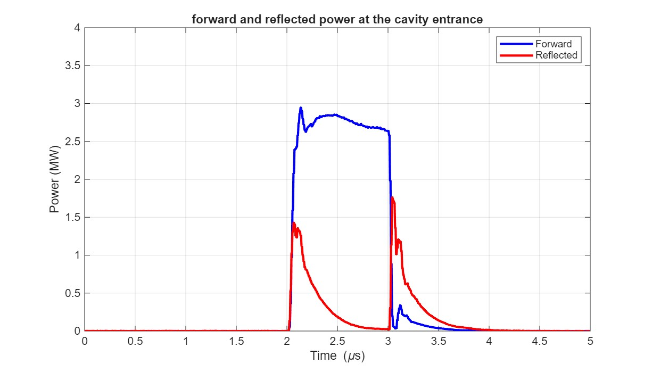
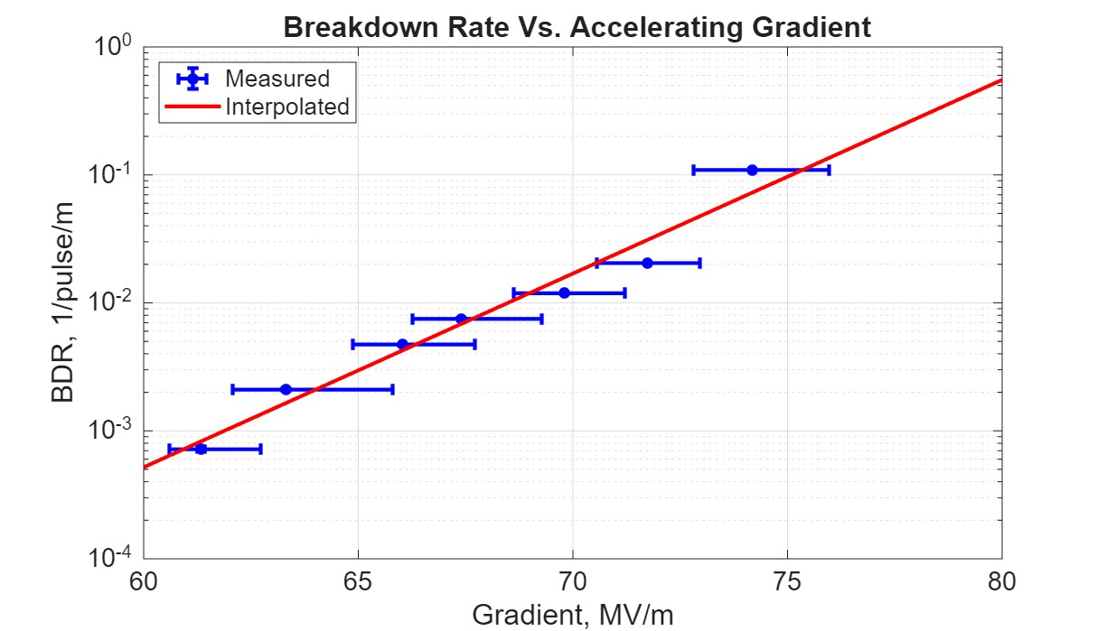
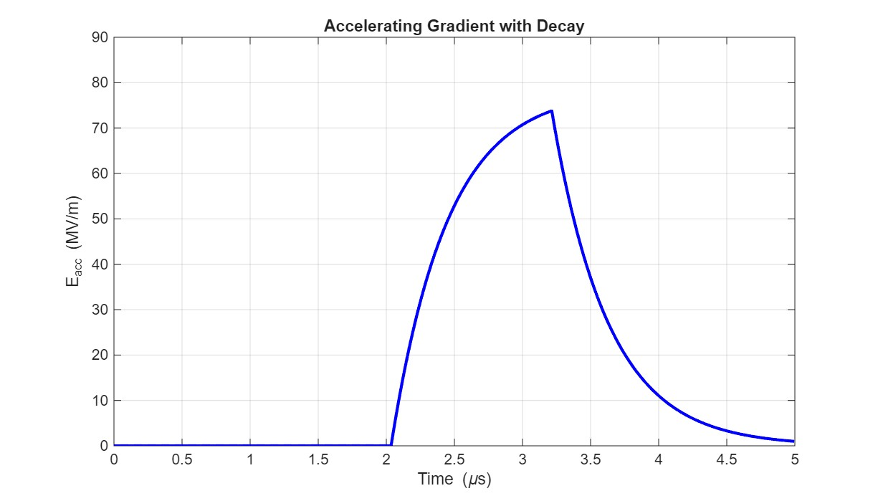
The final results of high-gradient tests of the structure with NiCr absorbers
The final gradients achieved in the structure with NiCr absorbers were limited to 75 MV/m.

Slide 16
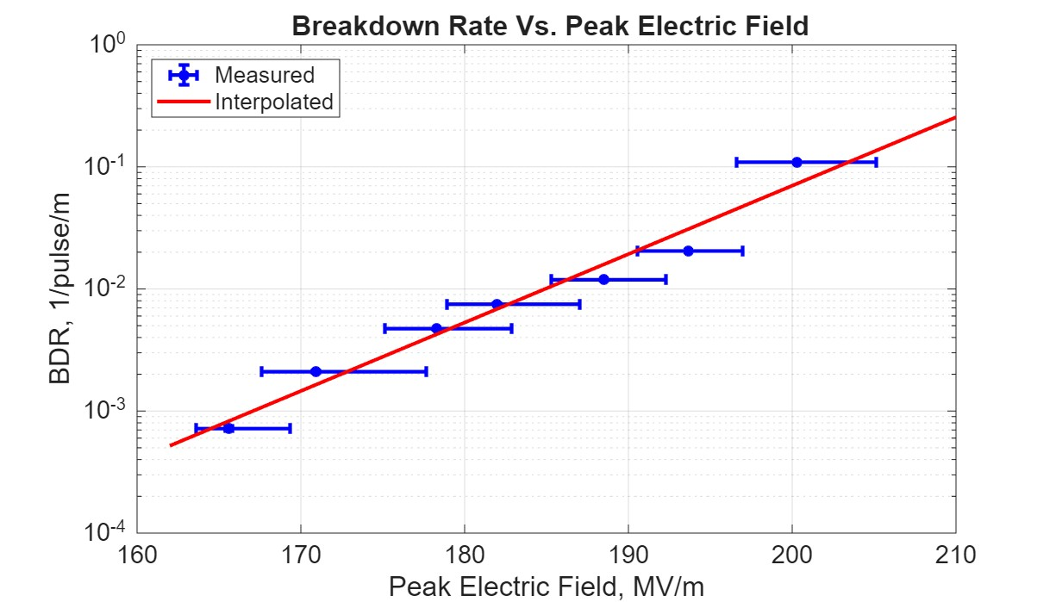
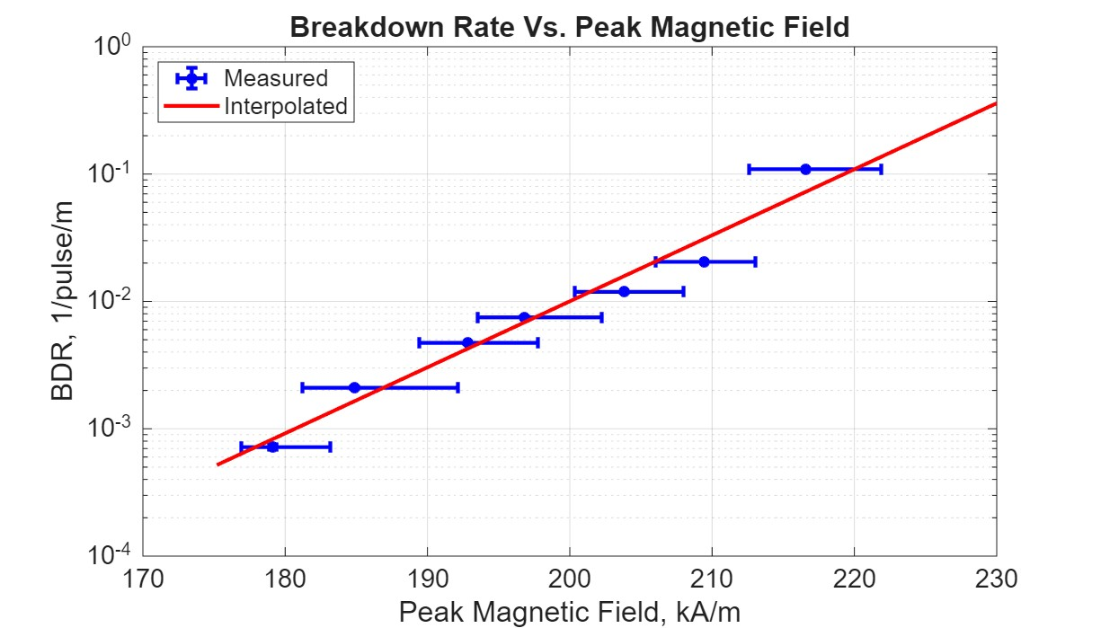
The final results of high-gradient tests of the structure with NiCr absorbers: peak fields
The final peak electric fields in the cavity were close to 200 MV/m. The final peak magnetic fields were below 220 kA/m.

Slide 17
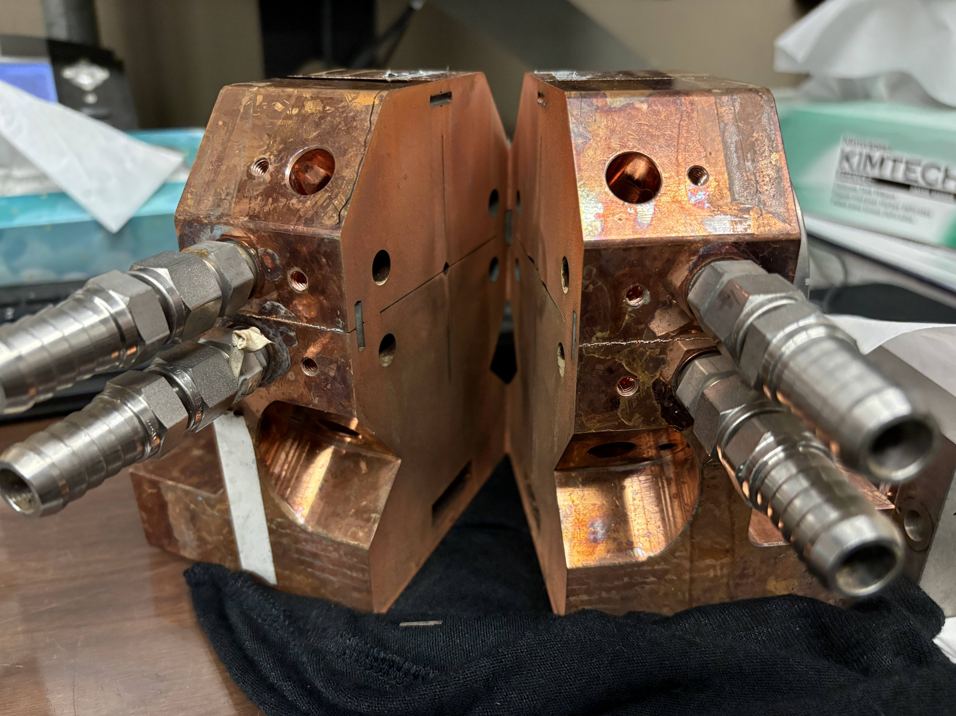
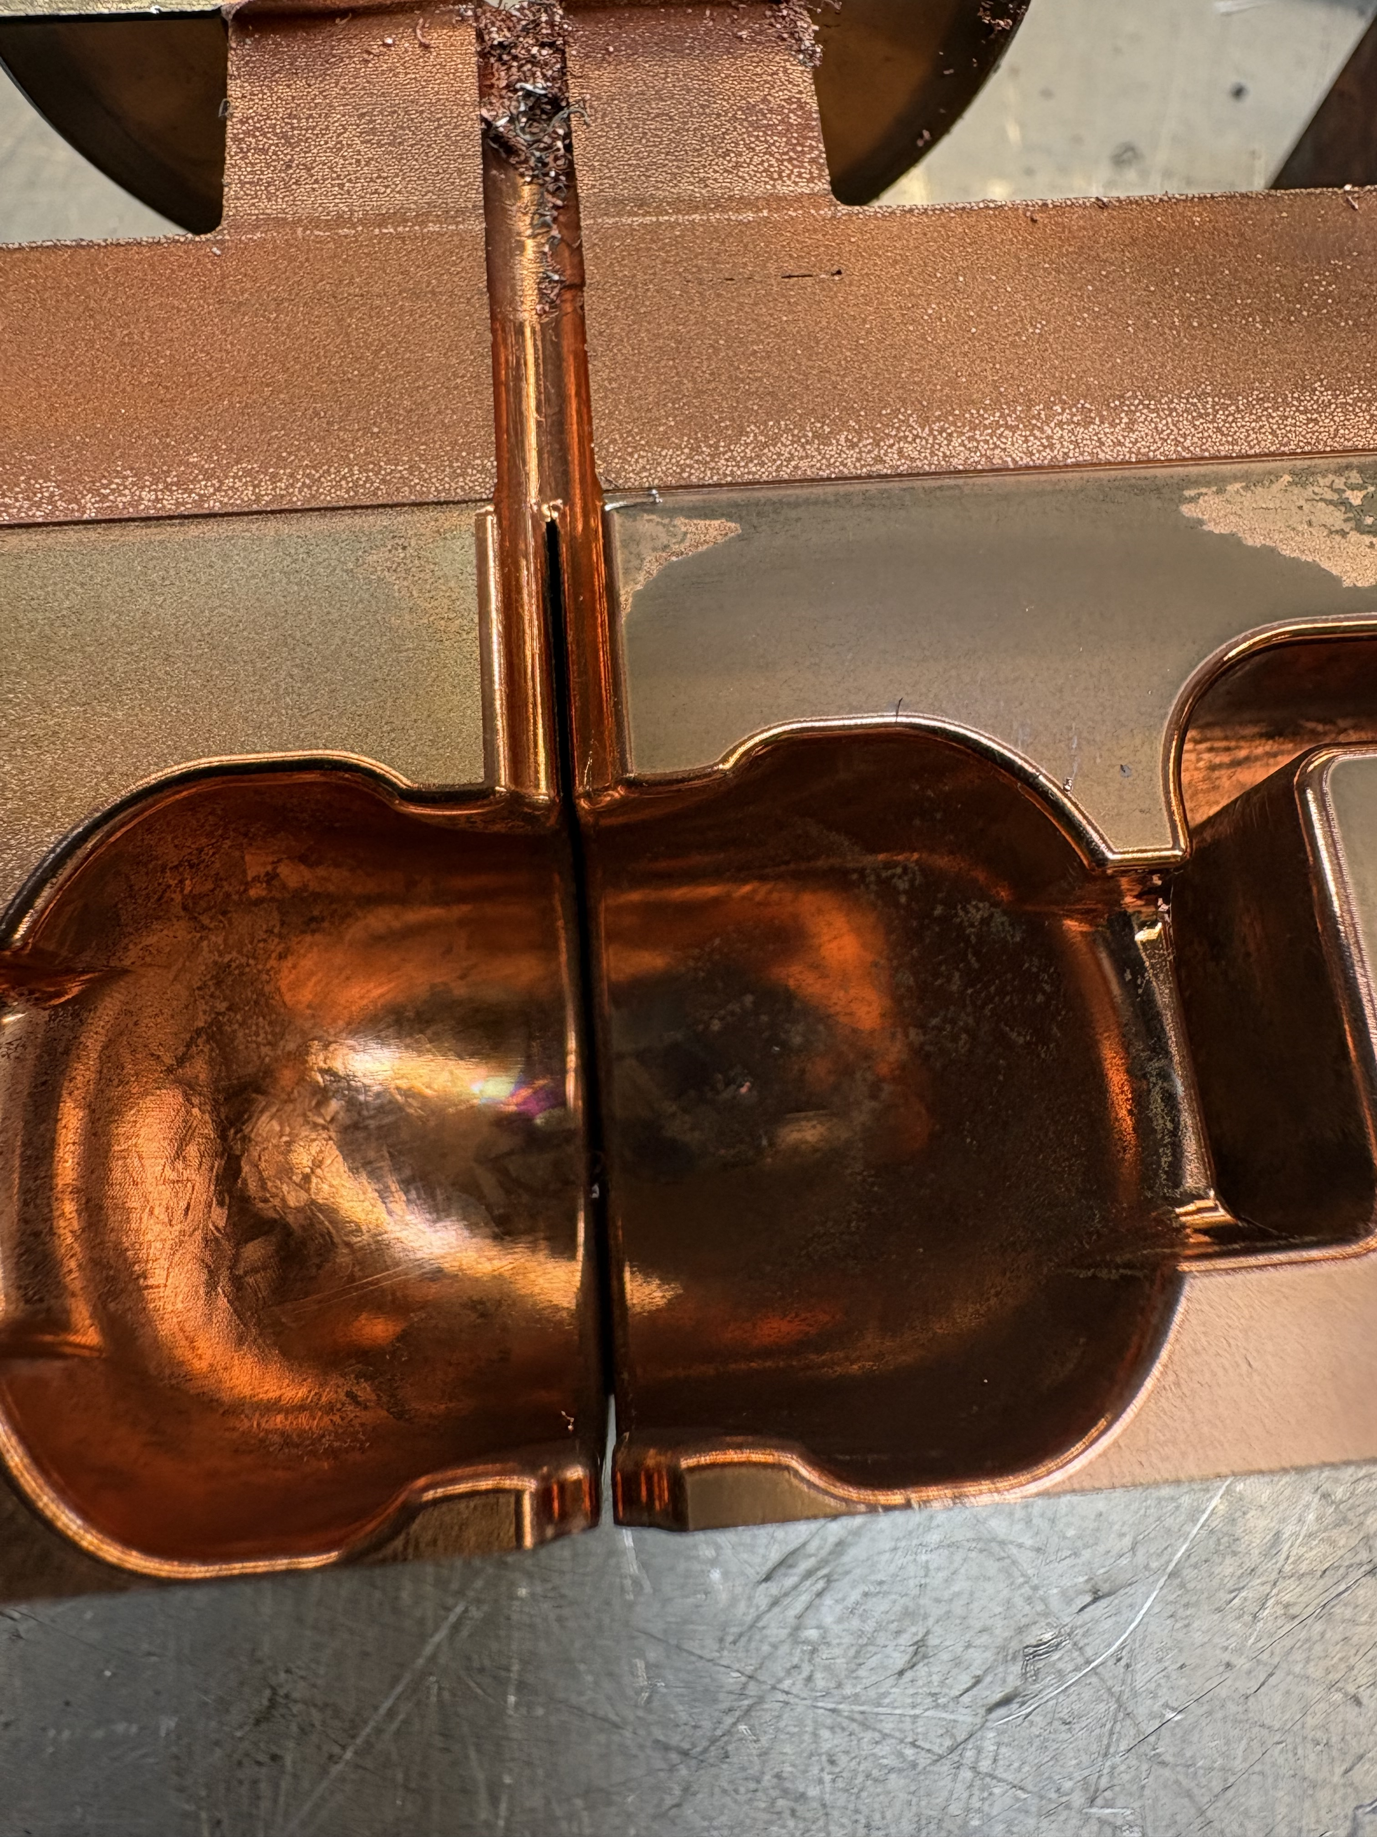
Plans for the SEM inspection
The cavity is being cut with wire EDM to do the SEM inspection of the inside surfaces.

Slide 18
Conclusions and future plans
LANL just concluded the high gradient testing of the two-cell structure with NiCr absorbers in July of 2026.
Conditioning to higher gradients was slow and difficult due to very strong vacuum spikes during breakdowns.
We are dissecting the cavity to study the damage to the cavity and NiCr absorbers under an SEM.
Next step: design the cavity with NiCr absorbers for cryogenic testing.

