Slide 1

High Gradient Testing of the C-band 1.6 cell all-copper photoinjector
Evgenya Simakov, Wonjin Choi, W. Brian Haynes, Sergey Kurennoy, Vitaly Pavlenko, Deepak Rai, and Haoran Xu,
Los Alamos National Laboratory
7/28/2026
Managed by Triad National Security, LLC., for the U.S. Department of Energy’s NNSA.

Slide 2
Outline of this talk
LANL C-band research overview and its alignment with 2026 LANL agenda
LANL C-band electron beam test facility CARIE
1.6-cell all-copper photoinjector: status of the tests
Summary and near-term plans

Slide 3
LANL High Gradient C-band research
The goals for LANL’s high gradient research are evolving
To build a C-band (5.712 GHz) high gradient rf breakdown study facility (2019-2022).
To build a C-band cryo-cooled photoinjector study facility (2022-2025).
To conduct research relevant to LANL applications and Laboratory Agenda (2025 – forward).
Los Alamos National Laboratory internal funding comes from LANL Laboratory Directed Research and Development (LDRD) program, LANL Internal Infrastructure Investments, and Technology Evaluation and Development (TED) funds.

Slide 4
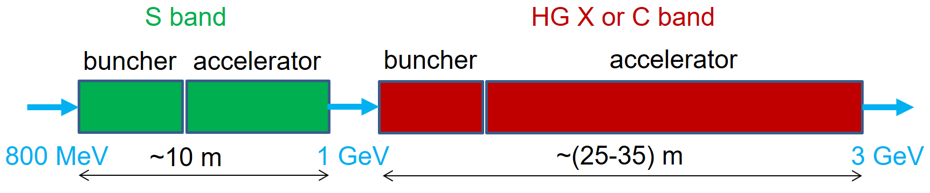
High gradient technology application: compact high-gradient booster for Enhanced Proton Radiography
What: High-gradient (HG) linear accelerator (linac) after the existing LANSCE linac to increase the proton beam energy from 800 MeV to 3 GeV.
Why: This increases proton radiography (pRad) resolution 10 times.
How: Compact 3-GeV high-gradient pRad booster:
  Will be based on S- & C-band HG structures adapted for protons (v/c = 0.84 – 0.97). Prototype high-gradient proton C-band cavities will be tested at LANL.
  Will have an optimal beam-physics design based on front-to-end modeling.
  Fits the site and can be used in parallel with the existing 800-MeV pRad.
  Can be the first-ever high-gradient normal-conducting proton linear accelerator.

Slide 5
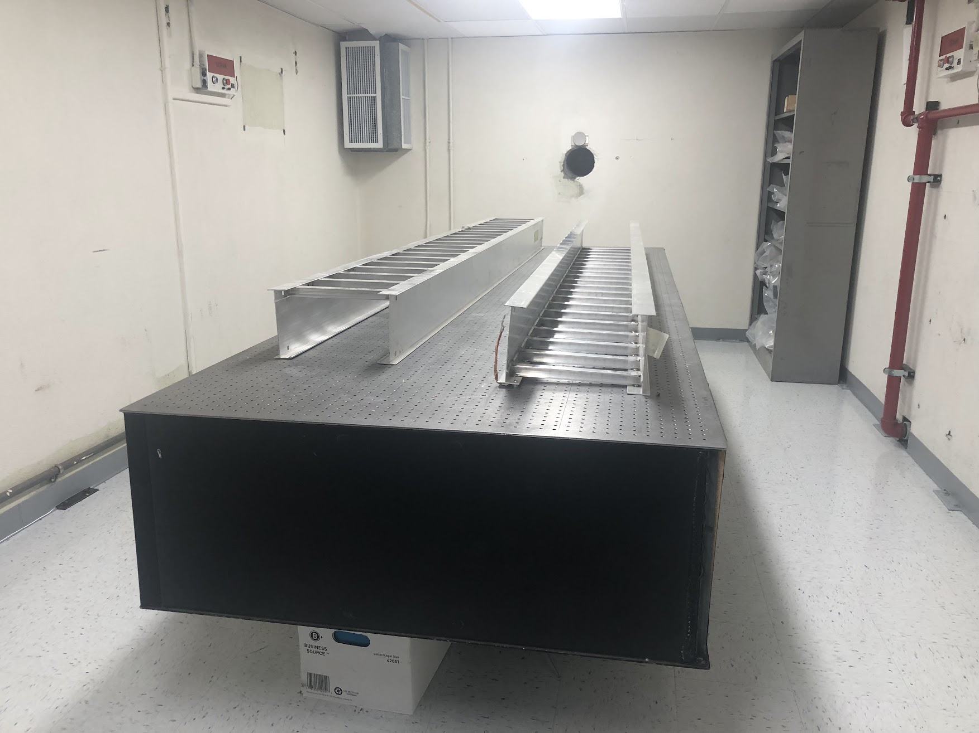
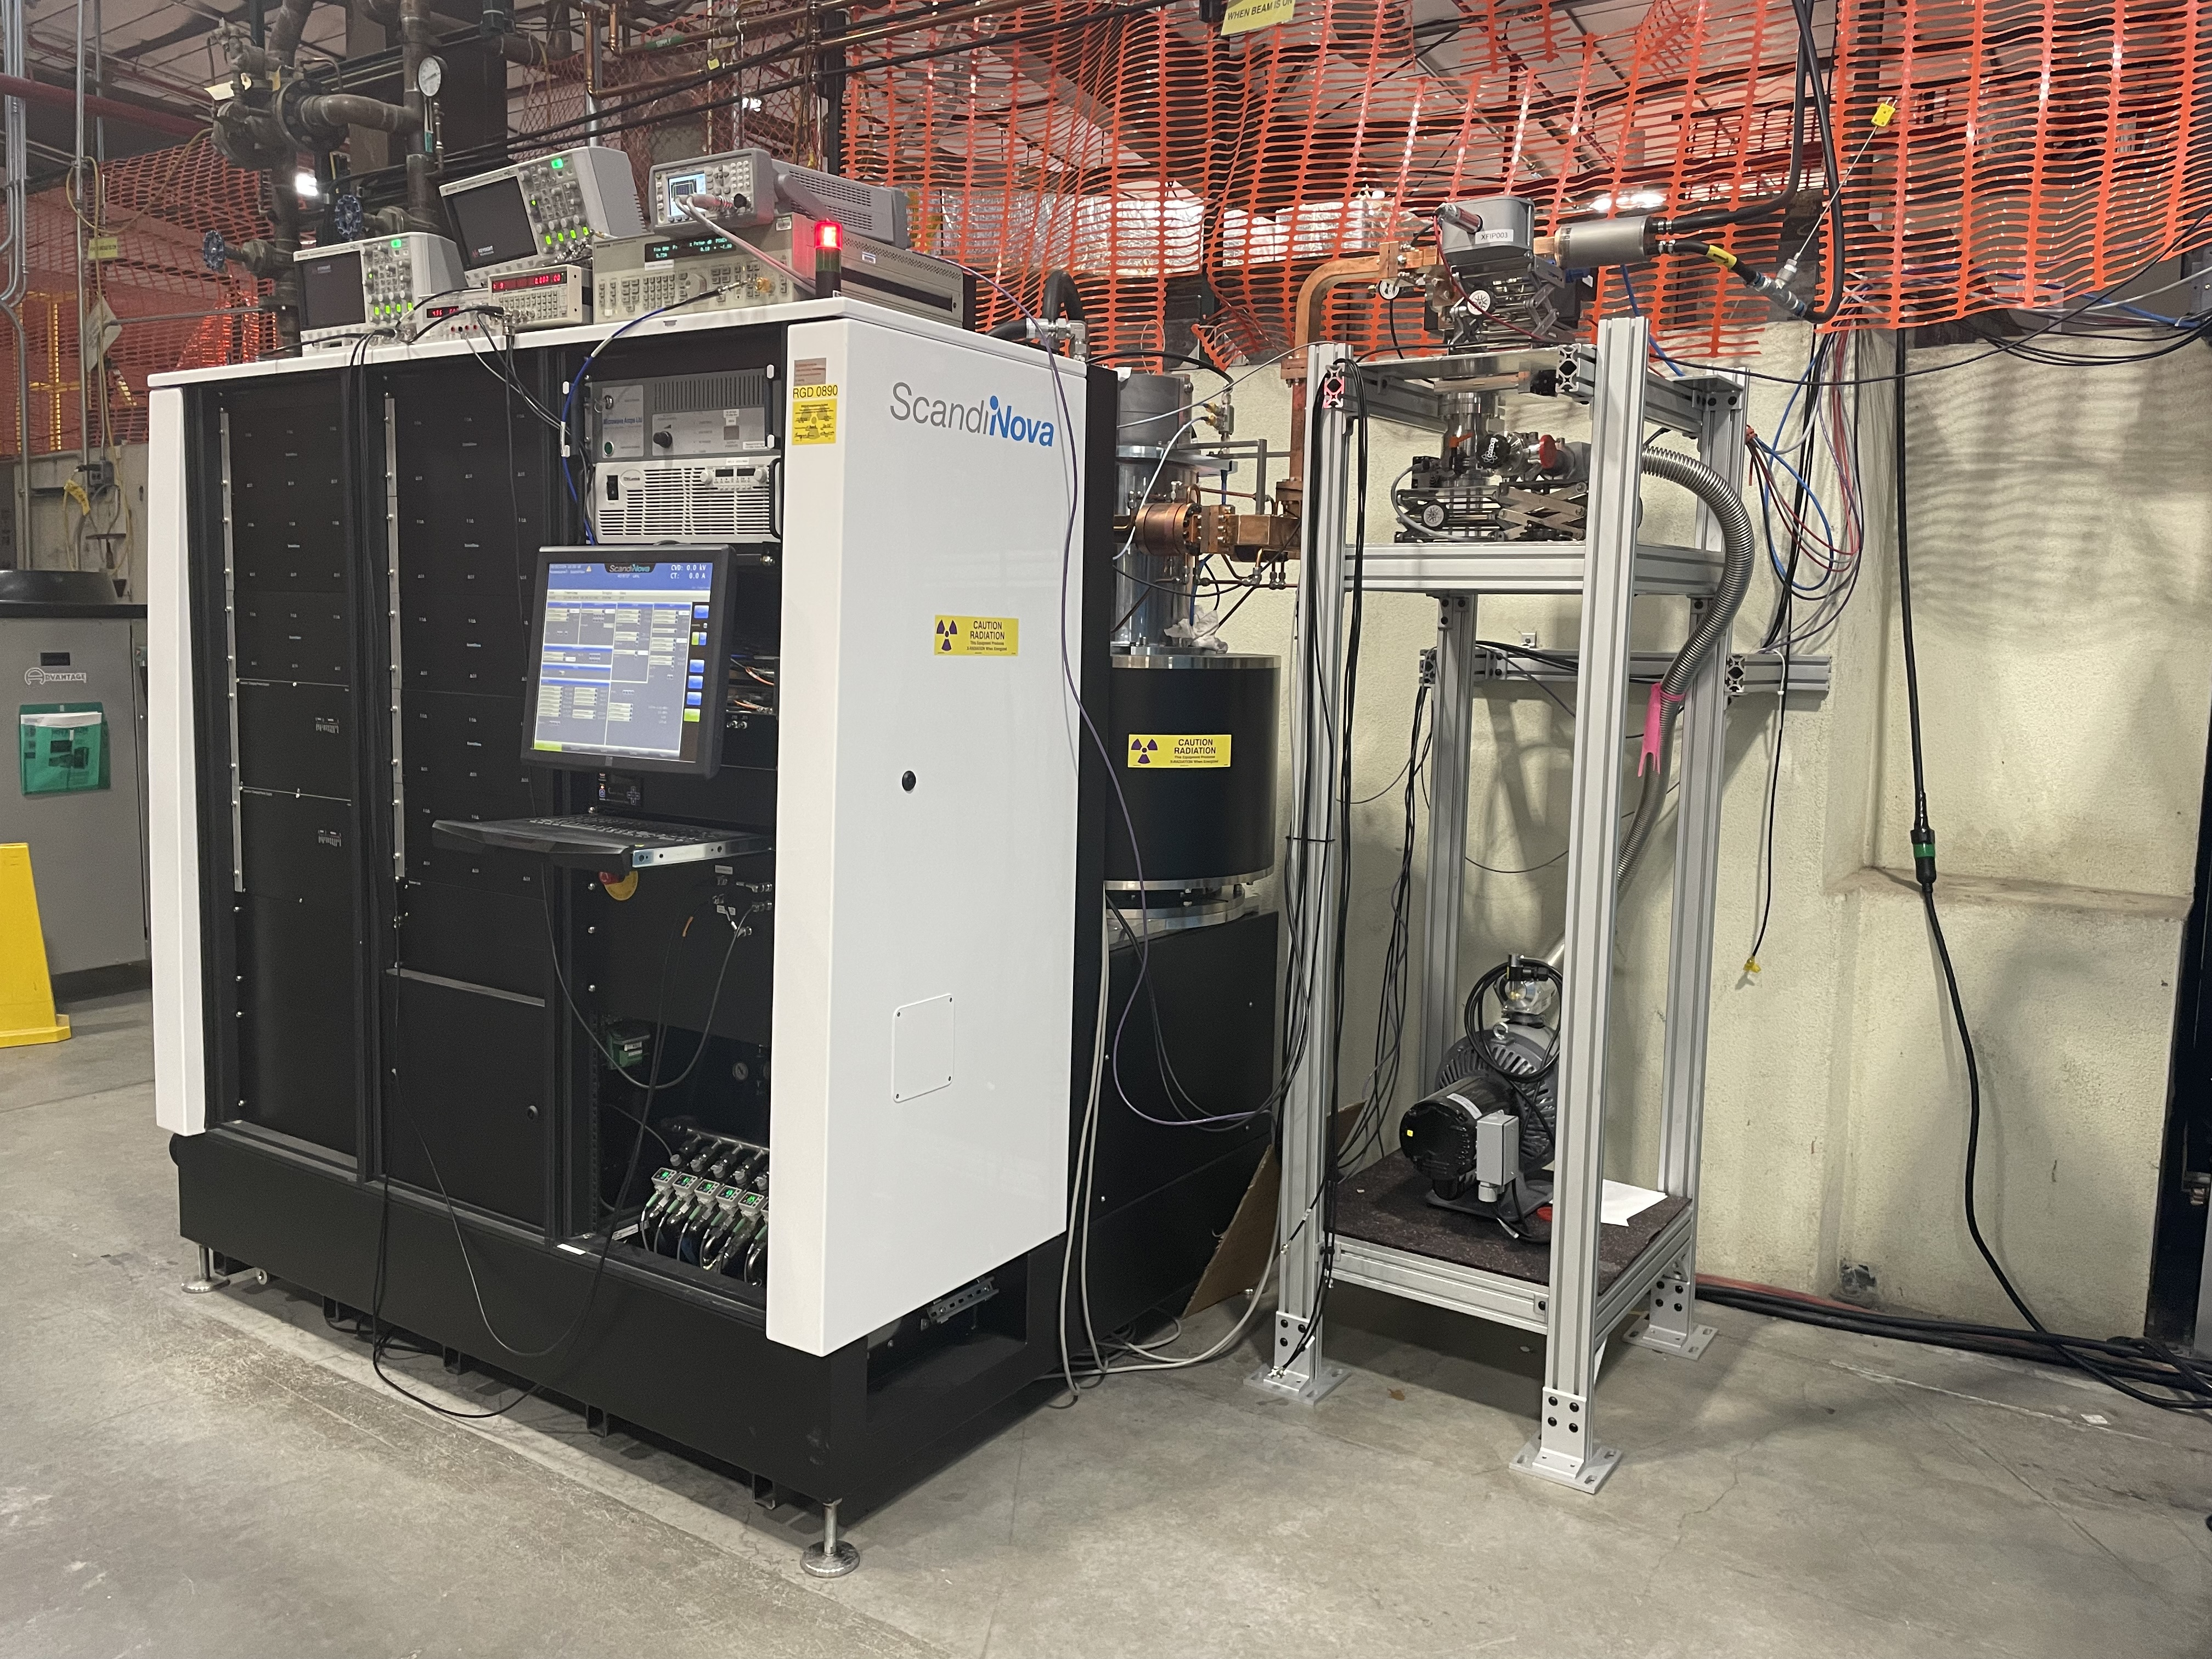
CARIE vault
A location was identified on LANSCE mesa that can accommodate a 20 kW electron beam.
The vault was cleaned for the new experiment.
A modulator for the 50 MW C-band klystron has finally arrived.
The klystron is installed. Conditioned to 35 MW of the output power, 1.5 µs pulse width, 50 Hz rep rate.

Slide 6
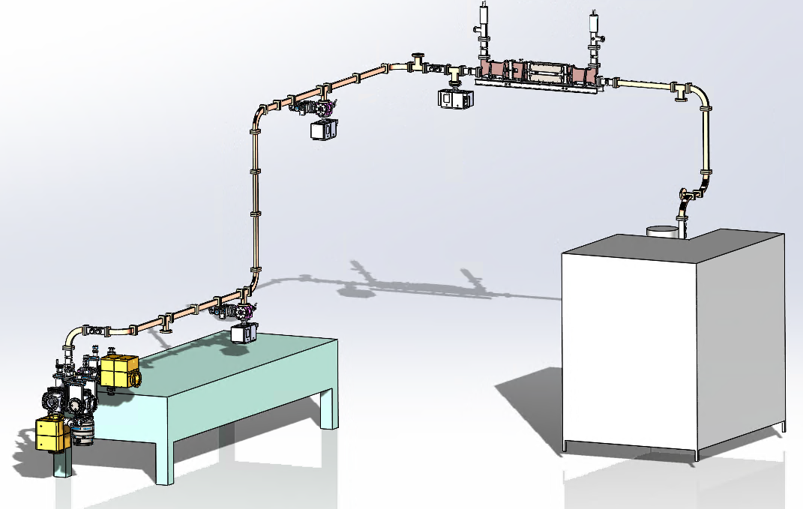
CARIE vault facility layout
High-power
circulator
Modulator &
klystron
Concrete vault
Photoinjector

Slide 7
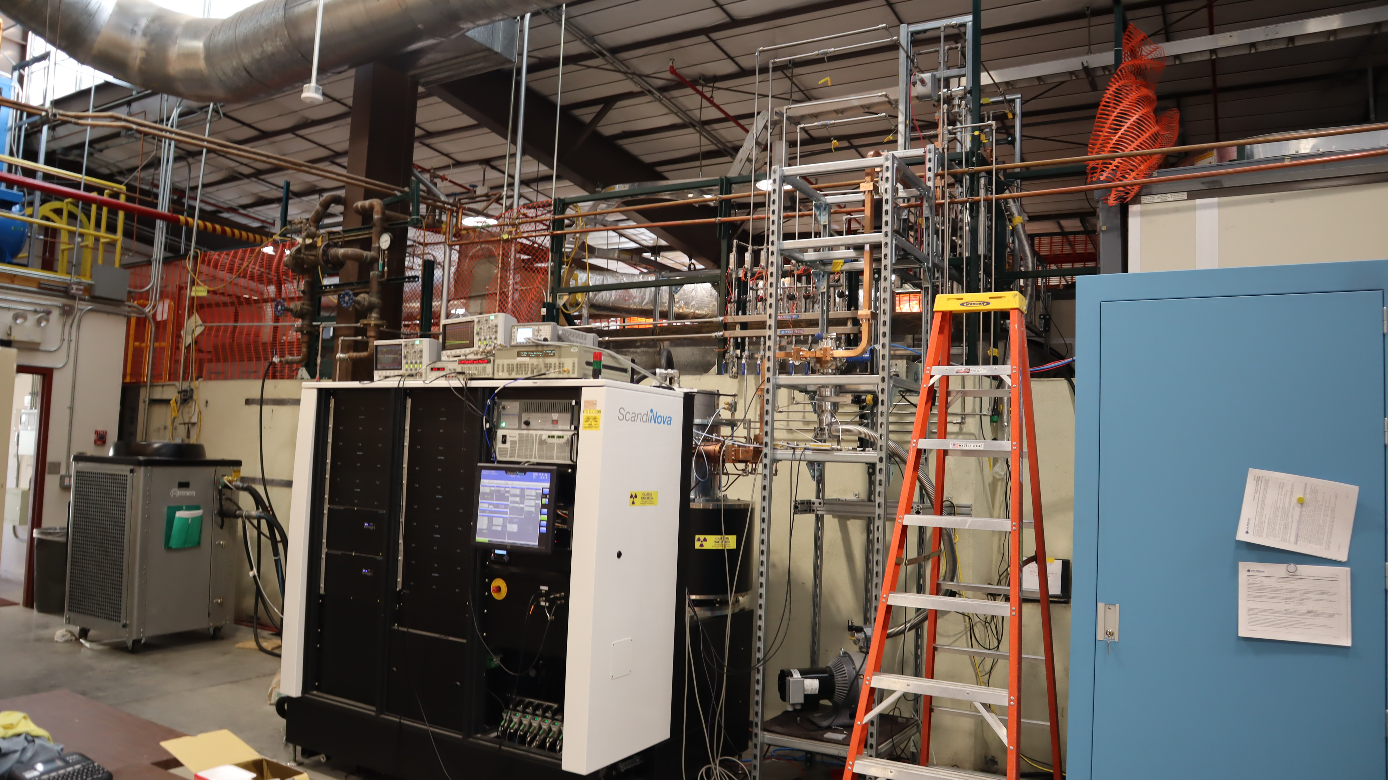
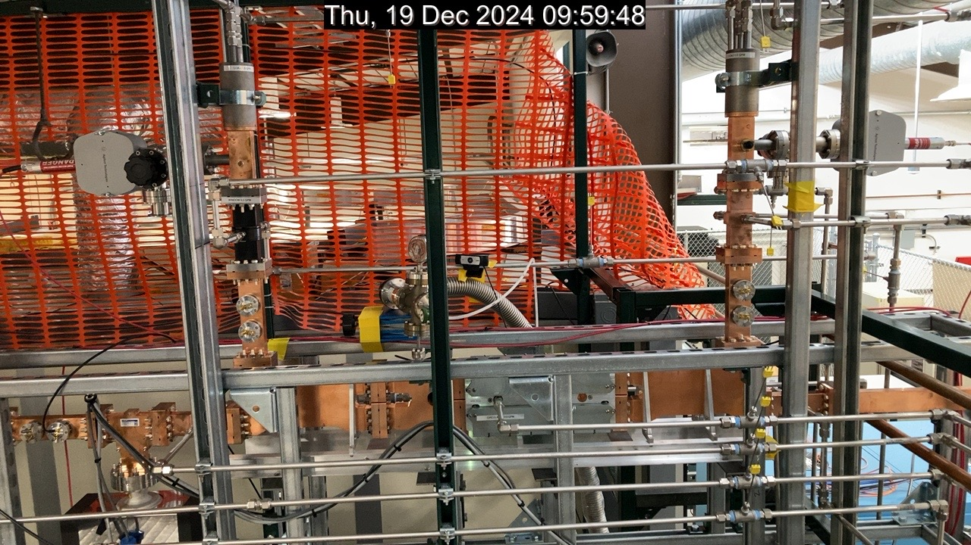
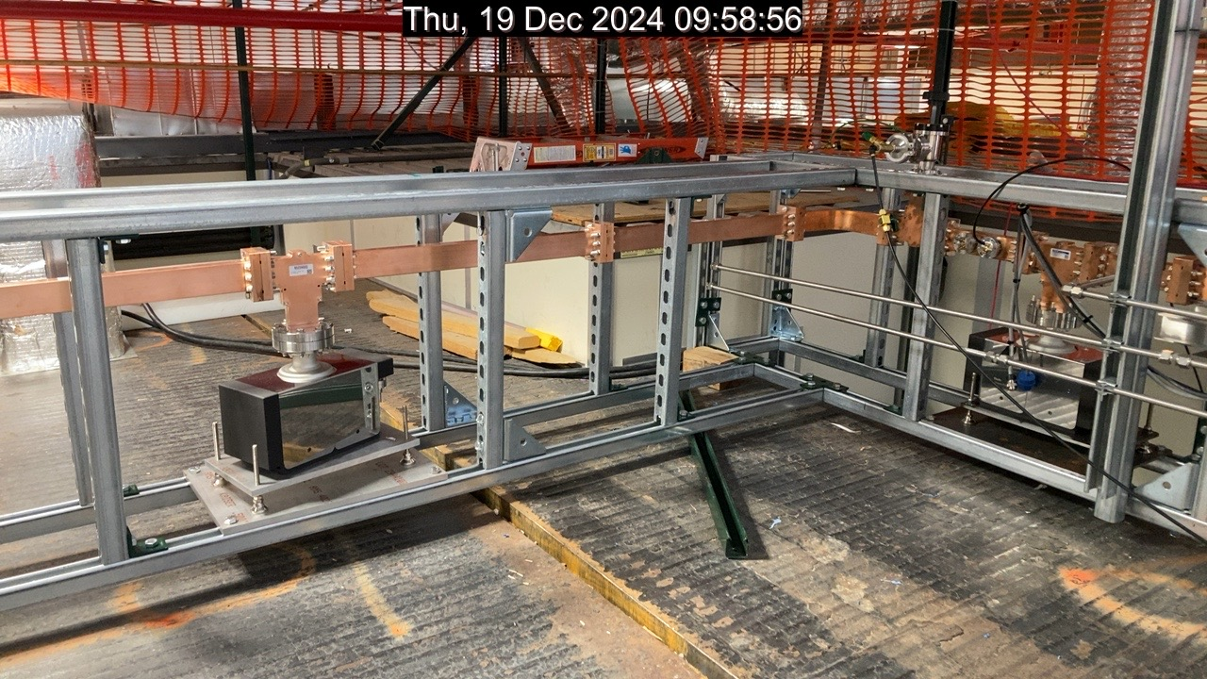
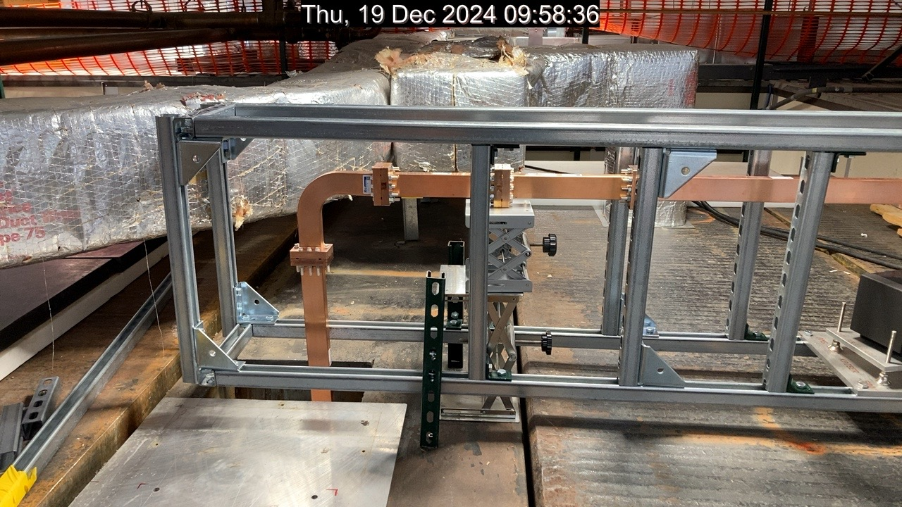
Photographs of the installation
Chiller
Modulator &
Klystron
Control rack
High-power circulator
Into the vault

Slide 8
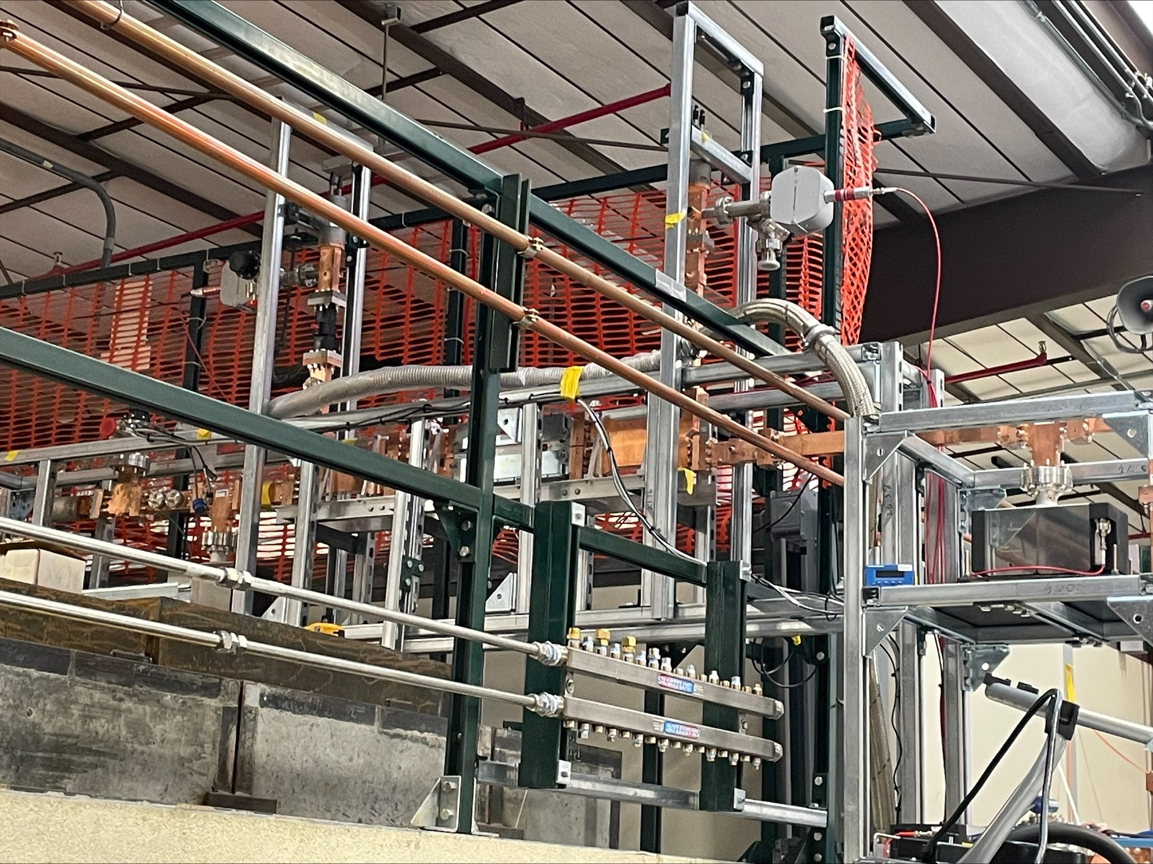
50 MW power circulator for CARIE
Fabricated by Microwave Techniques LLC.
Received at LANL in January, 2024.
Designed to operate at 50 MW of power, 1 µs pulse, 100 Hz repetition rate.
Must be filled with SF6 at 55 psi.
Problem: CML WR187 windows are designed for 40 psi, Microwave Techniques WR187 windows are designed for 35 psi.
Microwave Techniques states that if filled to 30 psi, should operate up to 10 MW of power.
High gradient conditioning of the circulator was done in November 2024.
Microwave Techniques since then sent paperwork certifying their windows to 55 psig. Higher powers may be possible for future experiments.

Slide 9
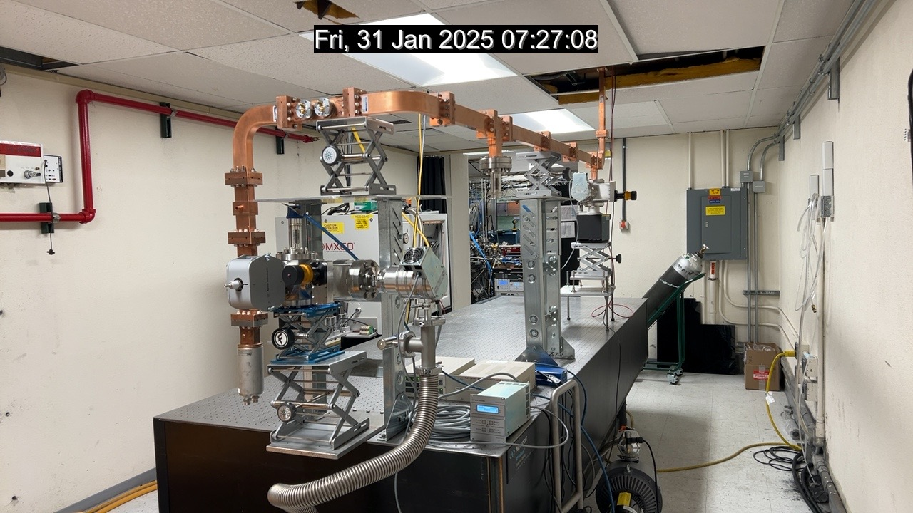
Photographs of the installation inside the vault (prior to injector installation)
From the klystron
RF load

Slide 10
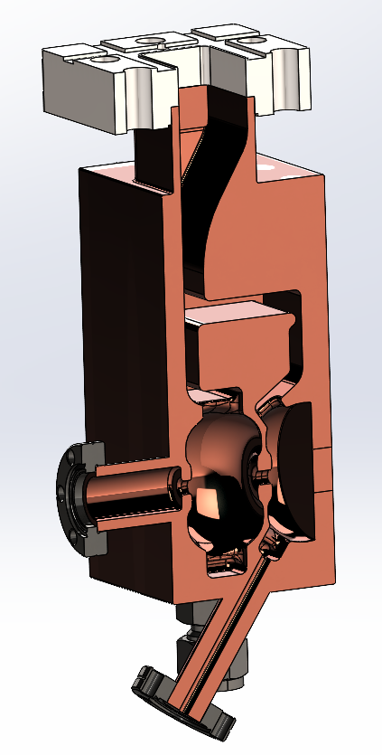
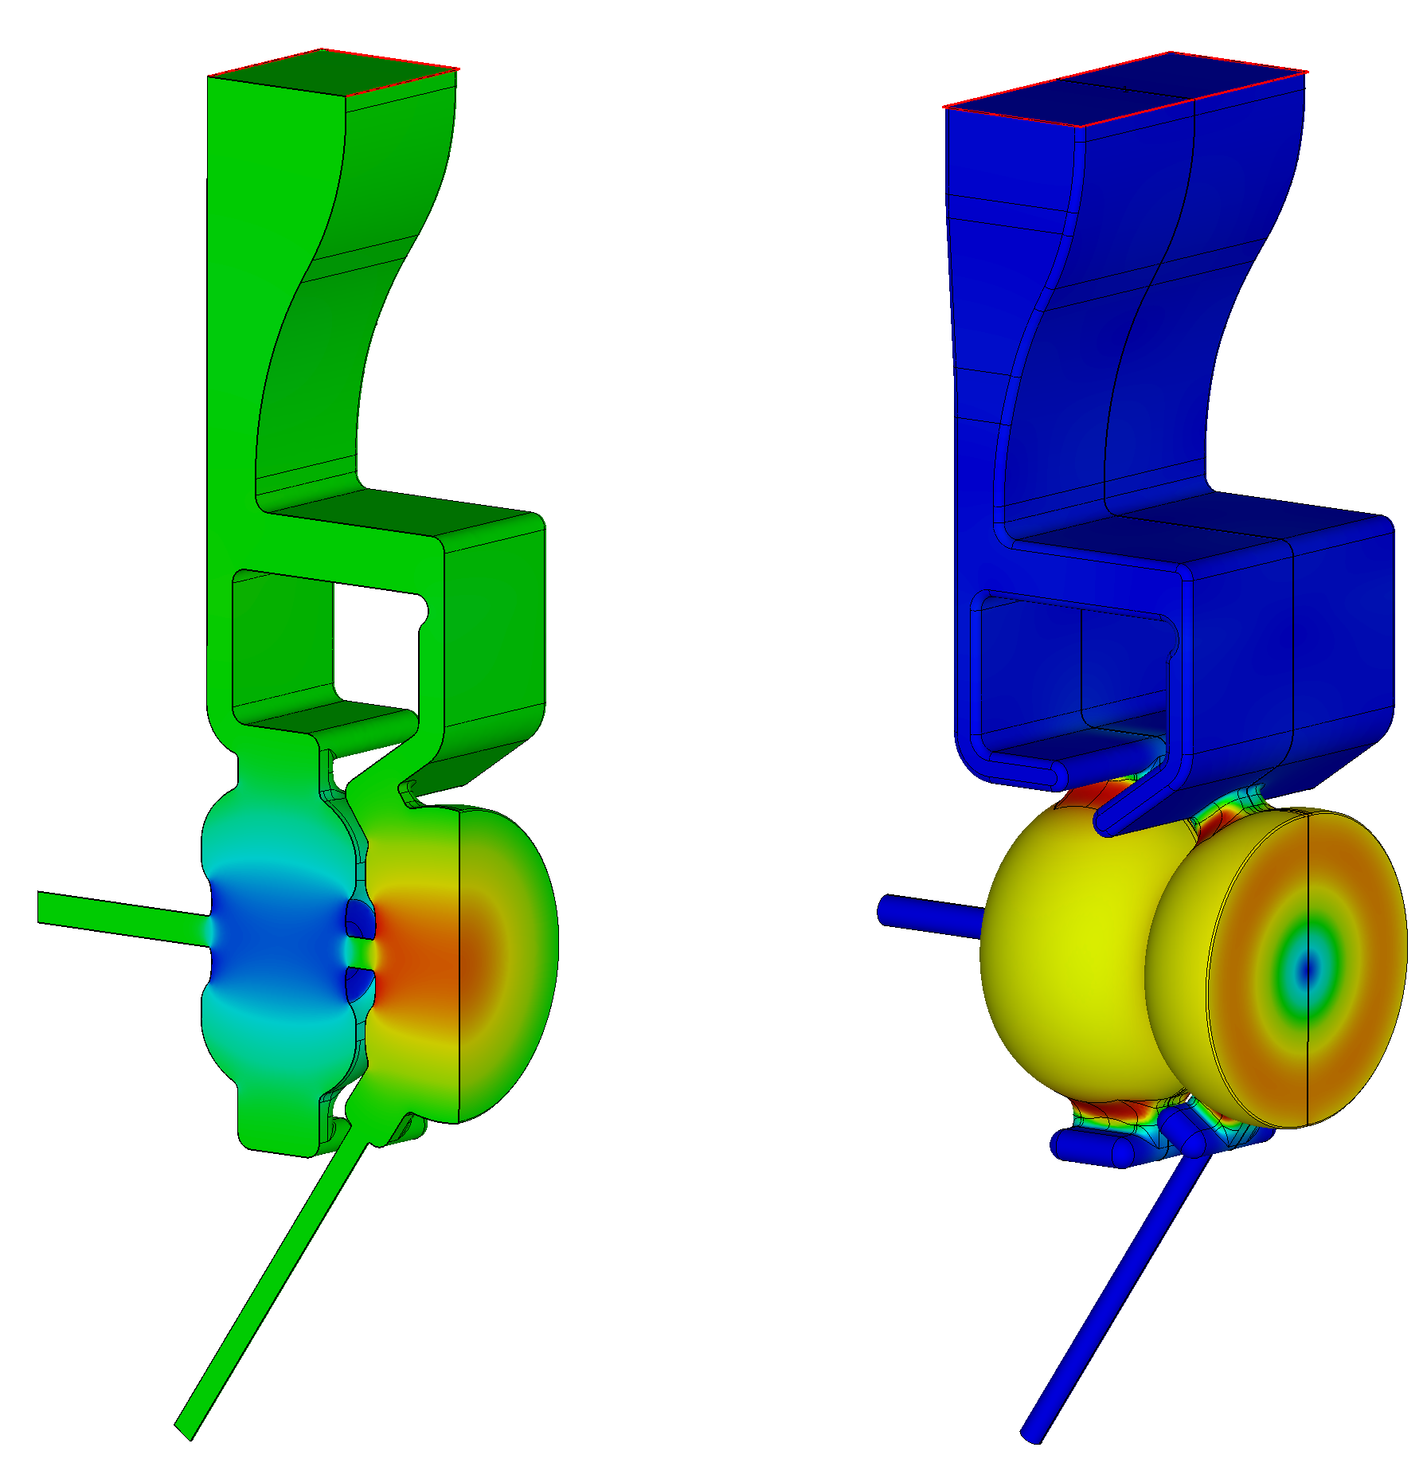
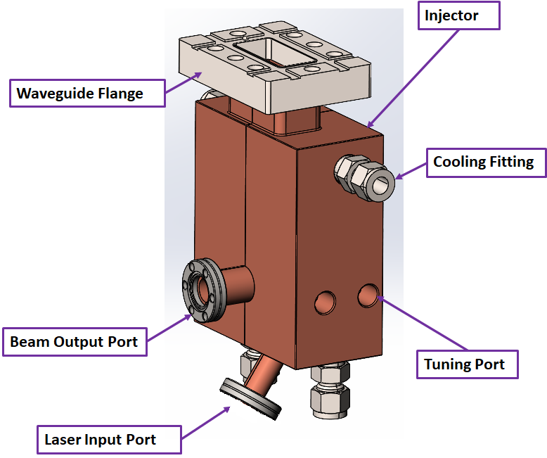


All-copper RF photoinjector design
We start with an all-copper injector with no cathode plug.
1.6 cell photoinjector. Two waveguides couple the half-cell and the full cell with 180⁰ phase advance.
Power for E_{cath}= 240 MV/m is about 8 MW.

Slide 11
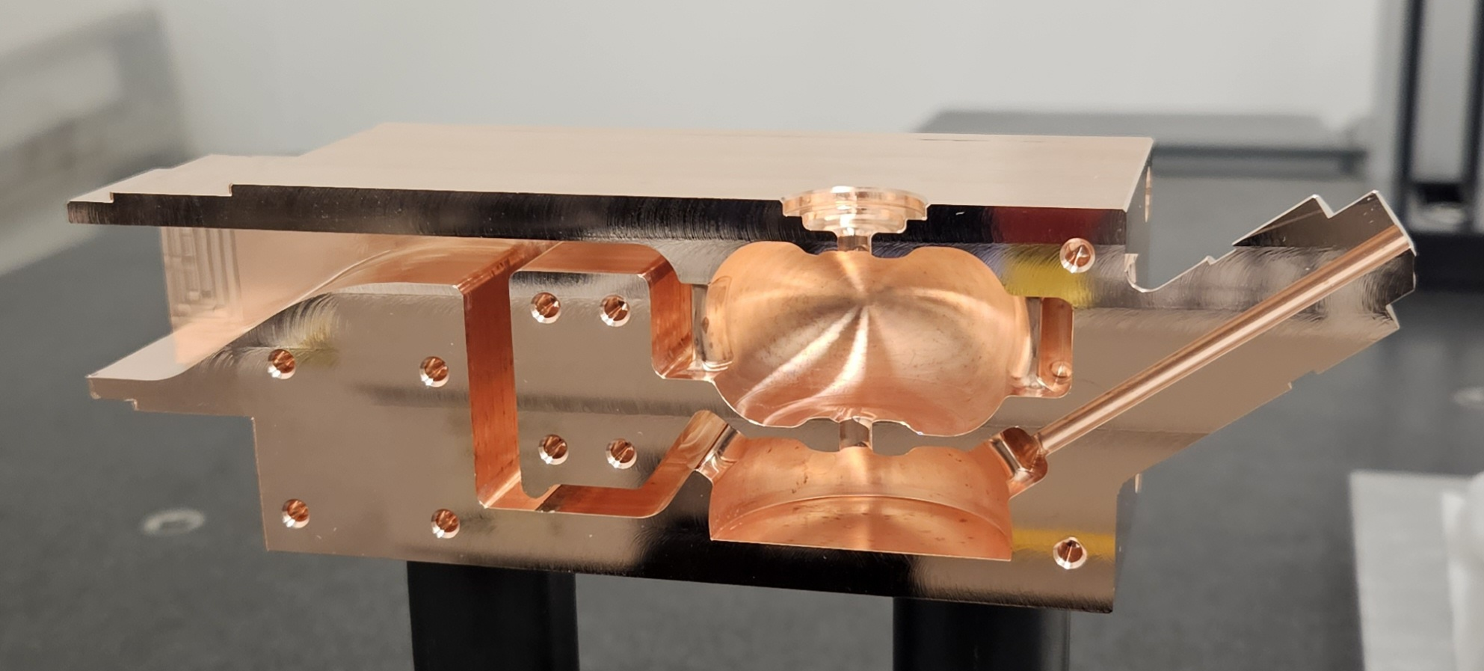
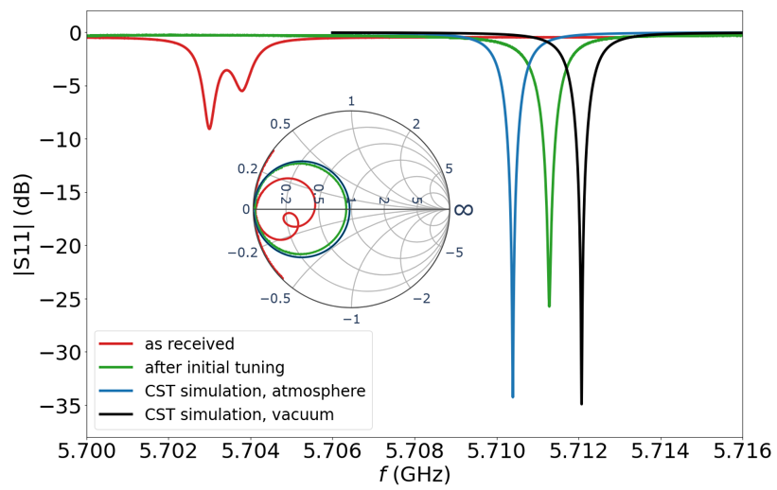
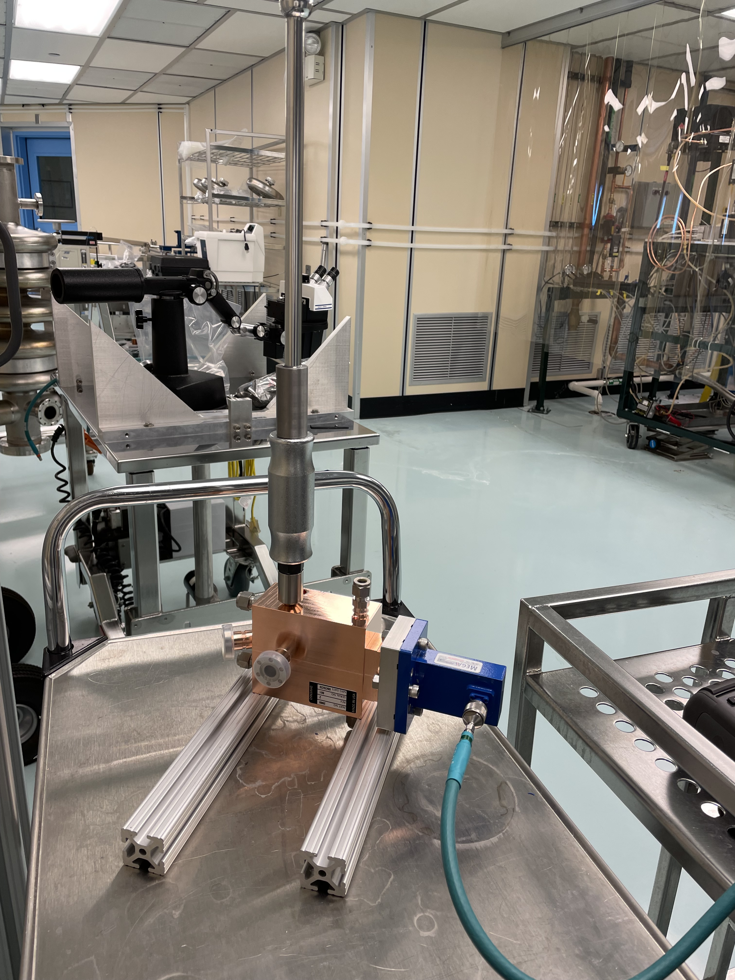
RF photoinjector cold testing
Tuning of the photoinjector was successful.
Tuned frequency 5710.53 MHz in air (5712.15 MHz in vacuum).
Measured Q-factor 11869 (computed Q-factor 11934).

Slide 12
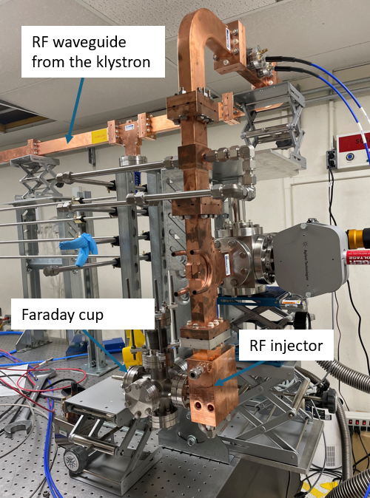
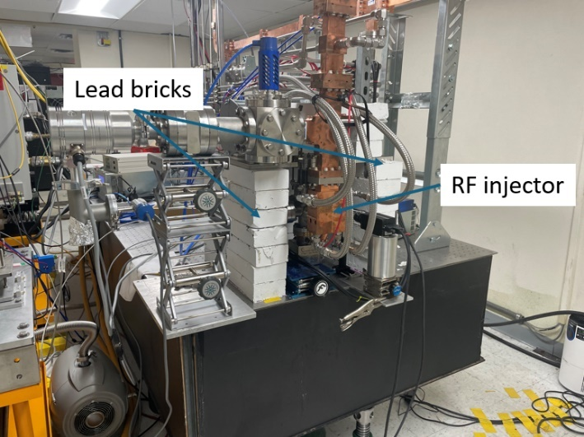
RF photoinjector installation on the waveguide line
RF injector with a copper cathode was installed at the end of the waveguide line in September of 2025.

Slide 13
Radiation protection issues at the CARIE test stand
Calculated 3D radiation dose map with no shielding igloo in place
Radiation safety simulations were conducted with MCNP code to ensure adequate radiation protection with the expected dark current:
As a worst-case scenario, we simulated 7 MeV, 1 µA average dark current.
To protect the possible workers on the roof of the building from the radiation exposure, it was recommended to construct an igloo with 4-inch-thick walls.
The addition of the lead igloo reduced calculated dose rates to 8 mrem/hr.
Calculated 3D radiation dose map with a shielding igloo in place

Slide 14
Issues on the CARIE test stand since 2025
While constructing the igloo, we had to deal with the weight limitations of the laser table.
We had to deal with multiple interlock issues of the CARIE vault due to aging infrastructure and changing requirements (e.g., we had to ensure no access to the roof of the vault during operations).
We had to deal with multiple issues with the C-band Scandinova klystron. The latest issue – failed trigger board.

Slide 15
Conclusions and future plans
Conditioning of the waveguide line at CARIE is complete.
CARIE test stand seems to be fully operational and approved as of July 17, 2026.
All-copper RF injector is installed on the waveguide line.
All-copper RF injector high-power testing will happen in 2026.
Starting in 2026, LANL C-band high gradient research is focused on proton structures for the pRad booster.
Test structure is limited to 4 cells due to available power and is currently under design.
4-cell proton C-band structure will be tested at CARIE.

