Slide 1




ASTERIX: Development of TIG-Welded Four-Quadrant
X-Band RF Accelerating Structures at INFN.
Luigi Faillace
INFN – LNF, Frascati (Rome), Italy

Slide 2
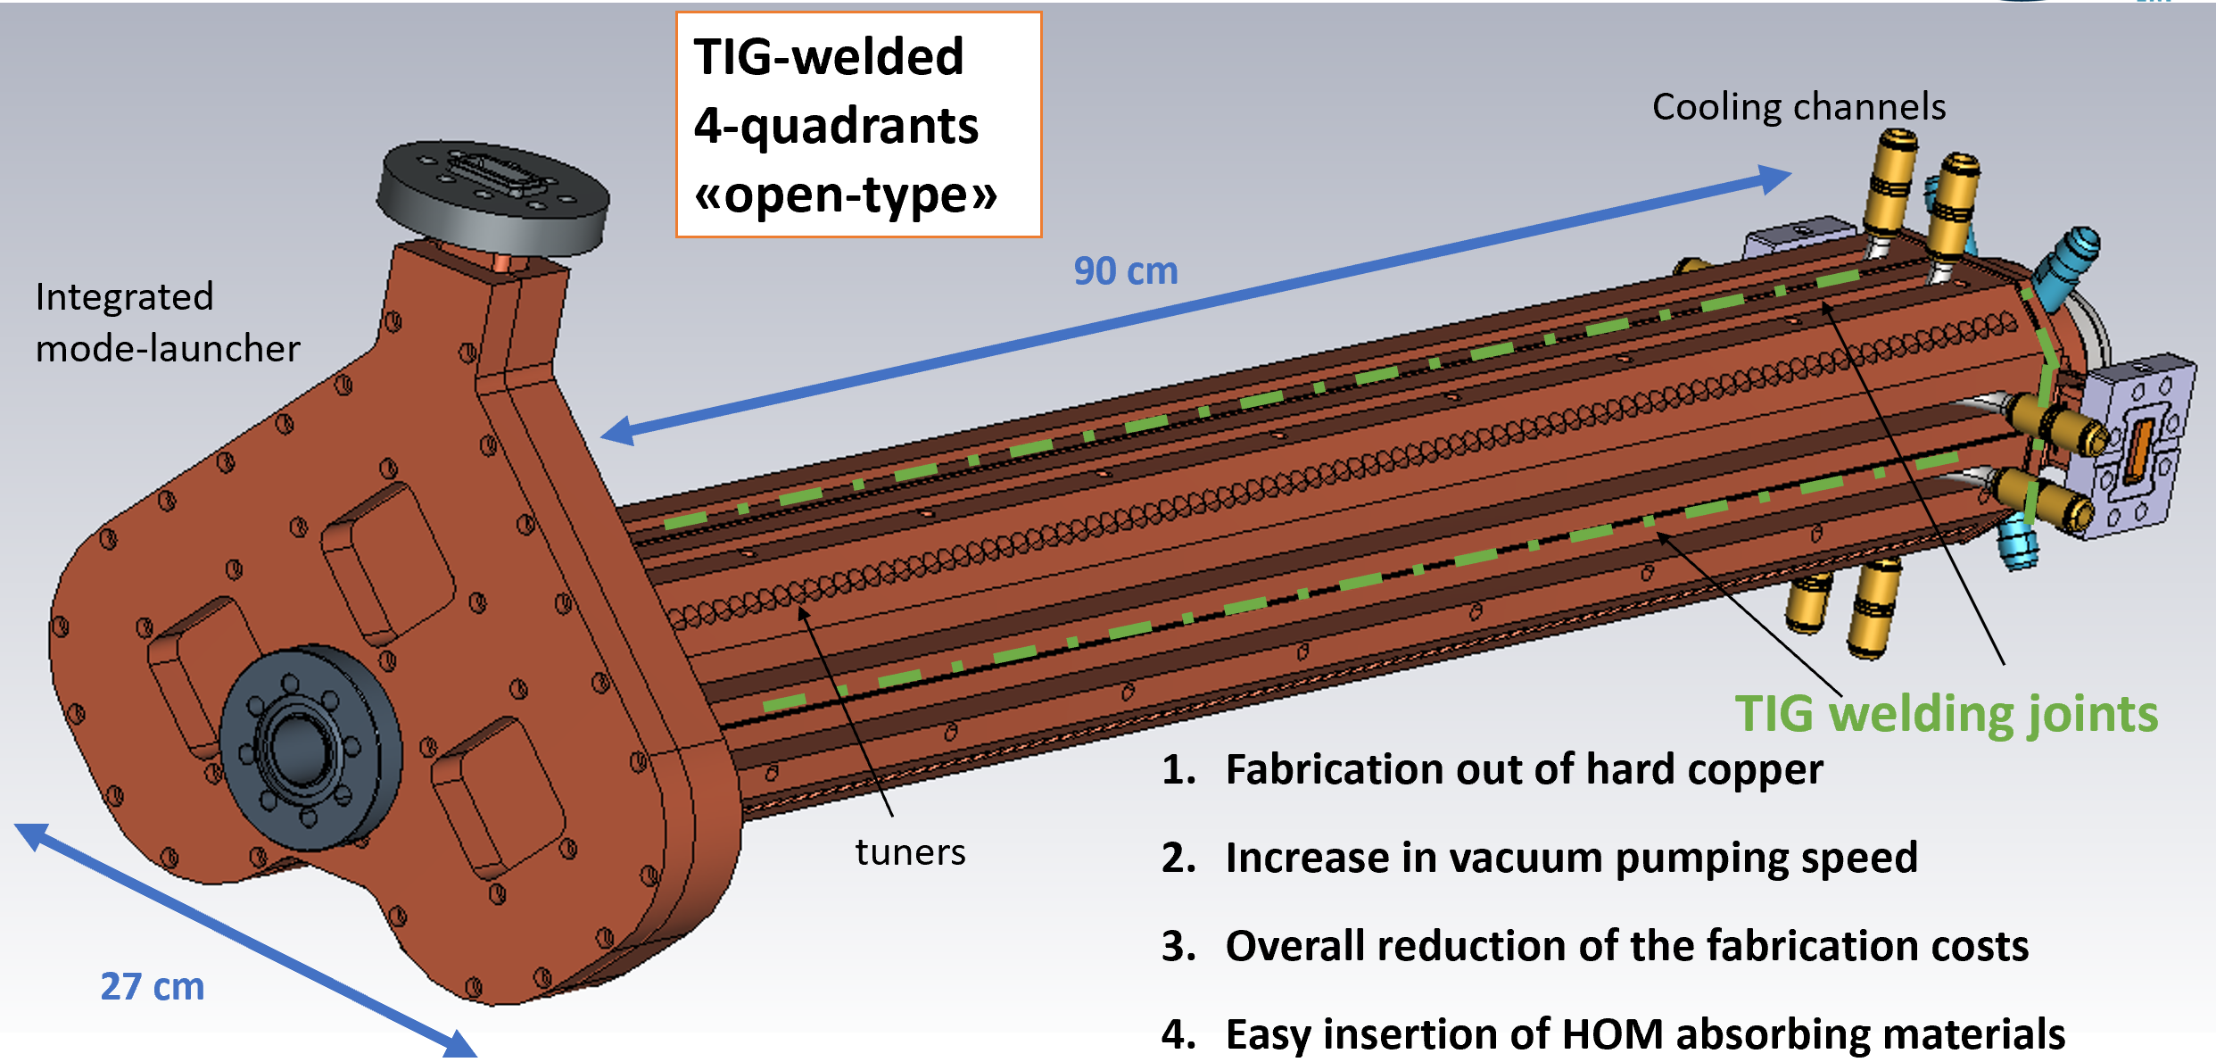
Project Overview
The main goal of ASTERIX is the design, fabrication and high-power RF testing of a practical meter-long, four-quadrant, “open-type” X-band accelerating structure made of hard copper, joined and vacuum-sealed by TIG welding — a braze-free technique — targeting gradients above 100 MV/m.
high accelerating gradients (>100 MV/m)
composed of four-quadrants (“open-type”)
made out hard copper
joined and vacuum sealed by using TIG welding (“braze-free” technique)
90 cm, four-quadrant, TIG-welded “open-type” structure with integrated mode-launcher, cooling channels and tuners.
ASTERIX (Accelerating STructures made of multiplE sectoRs In X-Band)
PI: Luigi Faillace INFN-LNF
3 years (2025-2027)
Total budget = 400 kEuros
Funded by Scientific Committee 5 of INFN
Collaboration
LNF coordination · mechanical & RF design
LNS RF couplers · multiphysics simulation
Roma1 wakefield & HOM characterisation

Slide 3

ASTERIX INFN- team
LNF | FTE | LNS | FTE | Roma1 | FTE
L. Faillace (Resp. Naz.) | 0.3 | G. Torrisi (RL) | 0.1 | L. Ficcadenti (RL) | 0.3
D. Alesini | 0.2 | D. Mascali | 0.05 | M. Petrarca | 0.2
M. Bellaveglia | 0.05 | G. Mauro | 0.1 | M. Migliorati | 0.2
S. Bini | 0.2 | G. Sorbello | 0.2 | G. Silvi | 0.2
F. Cardelli | 0.3 | T. Isernia | 0.3 | L. Palumbo | 0.4
M. Carillo | 0.2 | R. Palmeri | 0.3
E. Chiadroni | 0.2 | A. Locatelli | 0.1
A. Falone | 0.2 | C. De Angelis | 0.1
A. Gallo | 0.15 | L. Vincetti | 0.1
A. Giribono | 0.2
A. Liedl | 0.1
L. Piersanti | 0.1
S. Pioli | 0.2
B. Spataro | 0
C. Vaccarezza | 0.2
Tot./Unit | 2.6 |  | 1.35 |  | 1.3
LNF
Roma1
LNS
Advanced Accelerator Concepts 2026, Jul 26 – 31 Luskin Conference Center, UCLA
L. Faillace

Slide 4
Contributors
This work is made possible by the efforts :
INFN
Laboratori di Frascati, Roma1 (Sapienza University) and Laboratori del Sud (Catania)
SLAC(USA)
External Collaborators: V. Dolgashev (SLAC), Tetsuo Abe (KEK)
KEK (JAPAN)
USTC (CHINA)
University of Science and Technology of China: Yelong Wei, PhD student Zhicheng Huang in Frascati.

Slide 5
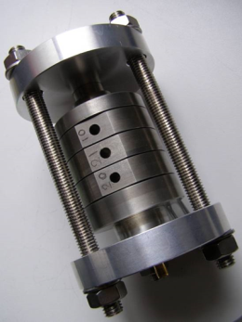
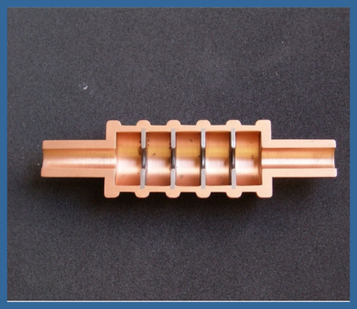
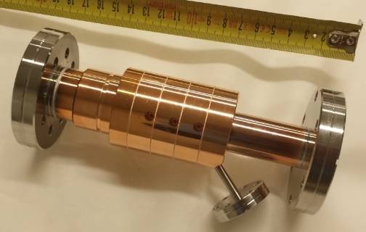
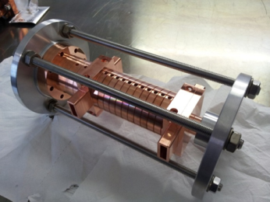
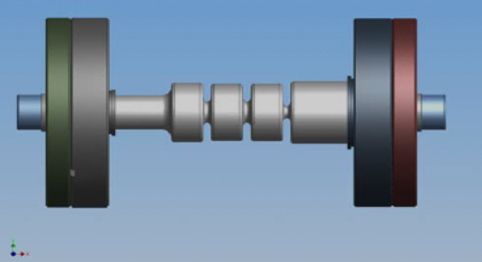
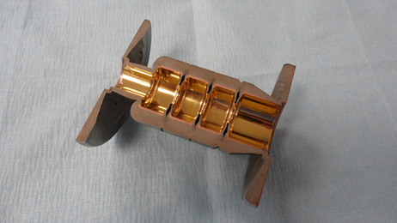
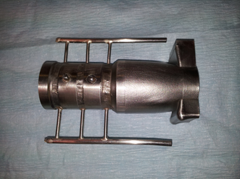
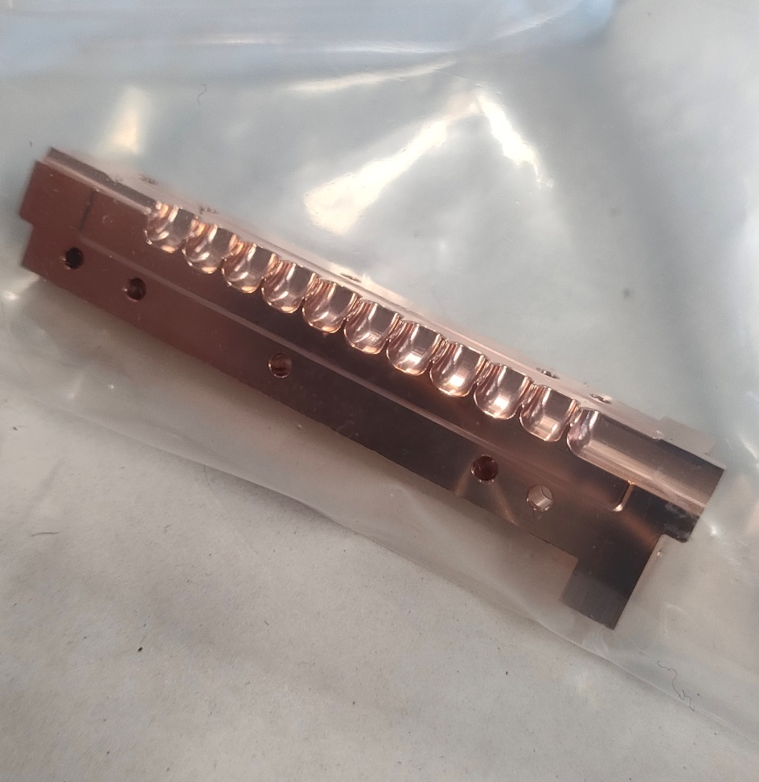
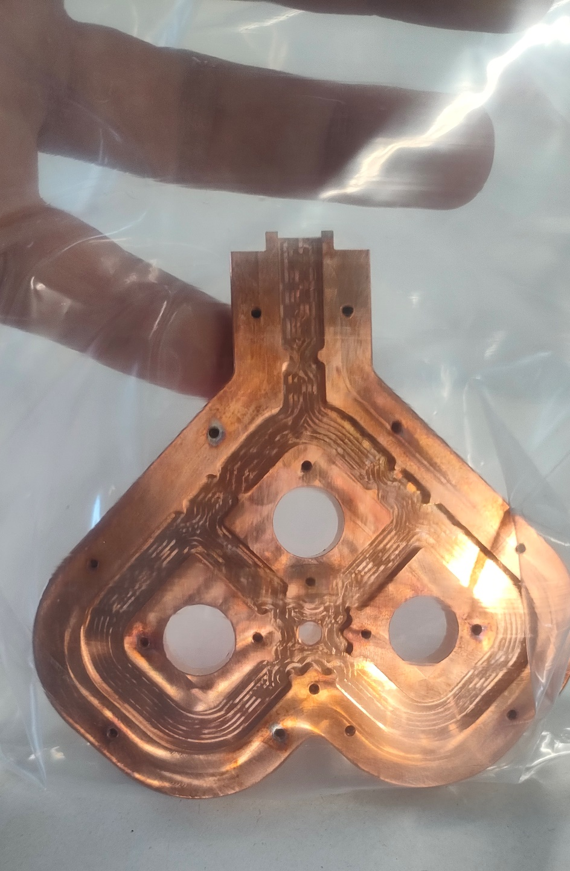
History
MOU between SLAC and INFN-LNF within the world-wide collaboration on studies of RF breakdown physics in RF accelerating structures:
    from X-band (11-12 GHz) to other
    frequencies (S, C, Ka, W) .
DEMETRA (2016-18)
ARYA (2020-23)
MICRON (2022-24)
    Ka-band structures
    made of four quadrants
Resp. Loc. L. Faillace - LNF
Funded by
CSN5 (V. Bonvicini)
Courtesy of B. Spataro
ASTERIX
62,52 mm
Accelerating Structures
made of multiplE sectoRs
In X-Band
RF power
Coupler:
4-port Mode Launcher
Single quadrant
Funded by CSN5 (A. Quaranta)

Slide 6
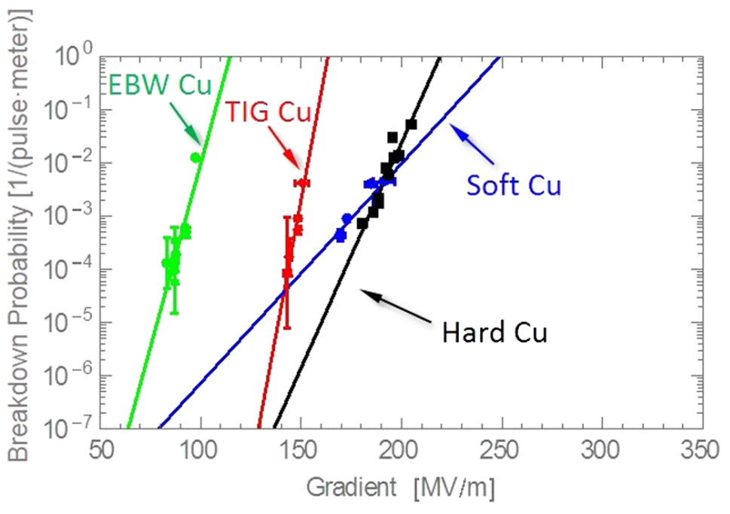
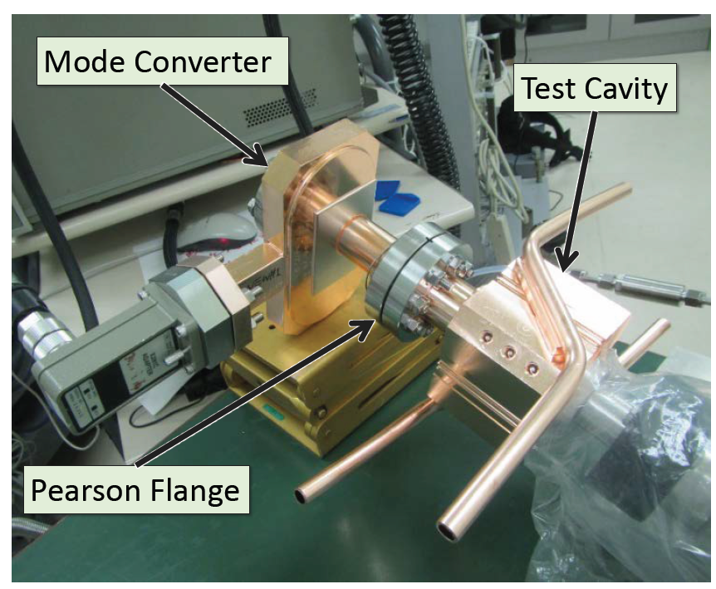
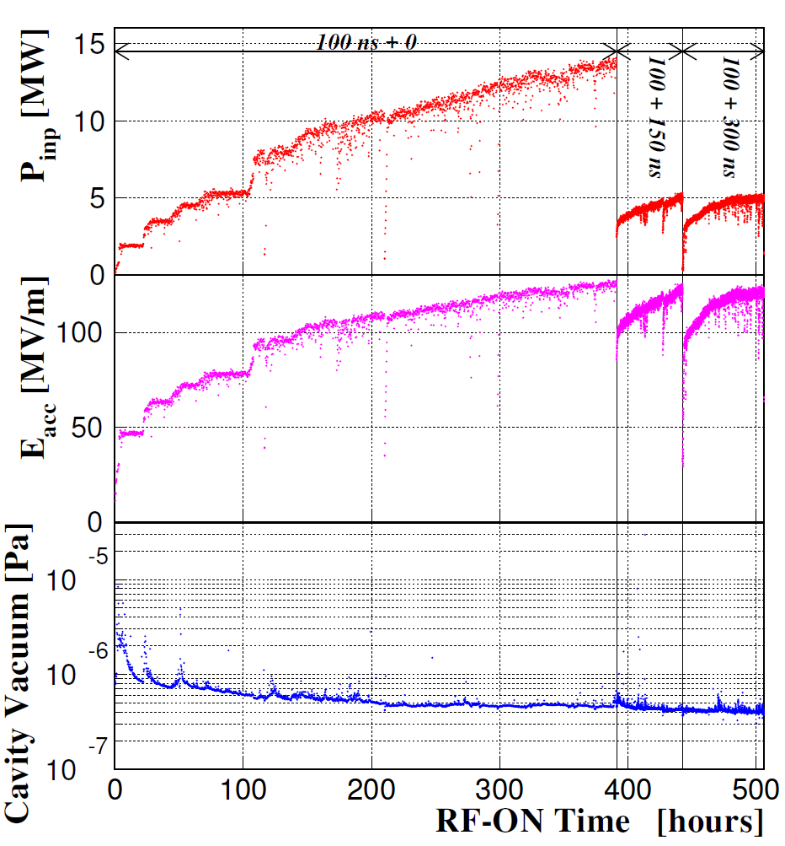
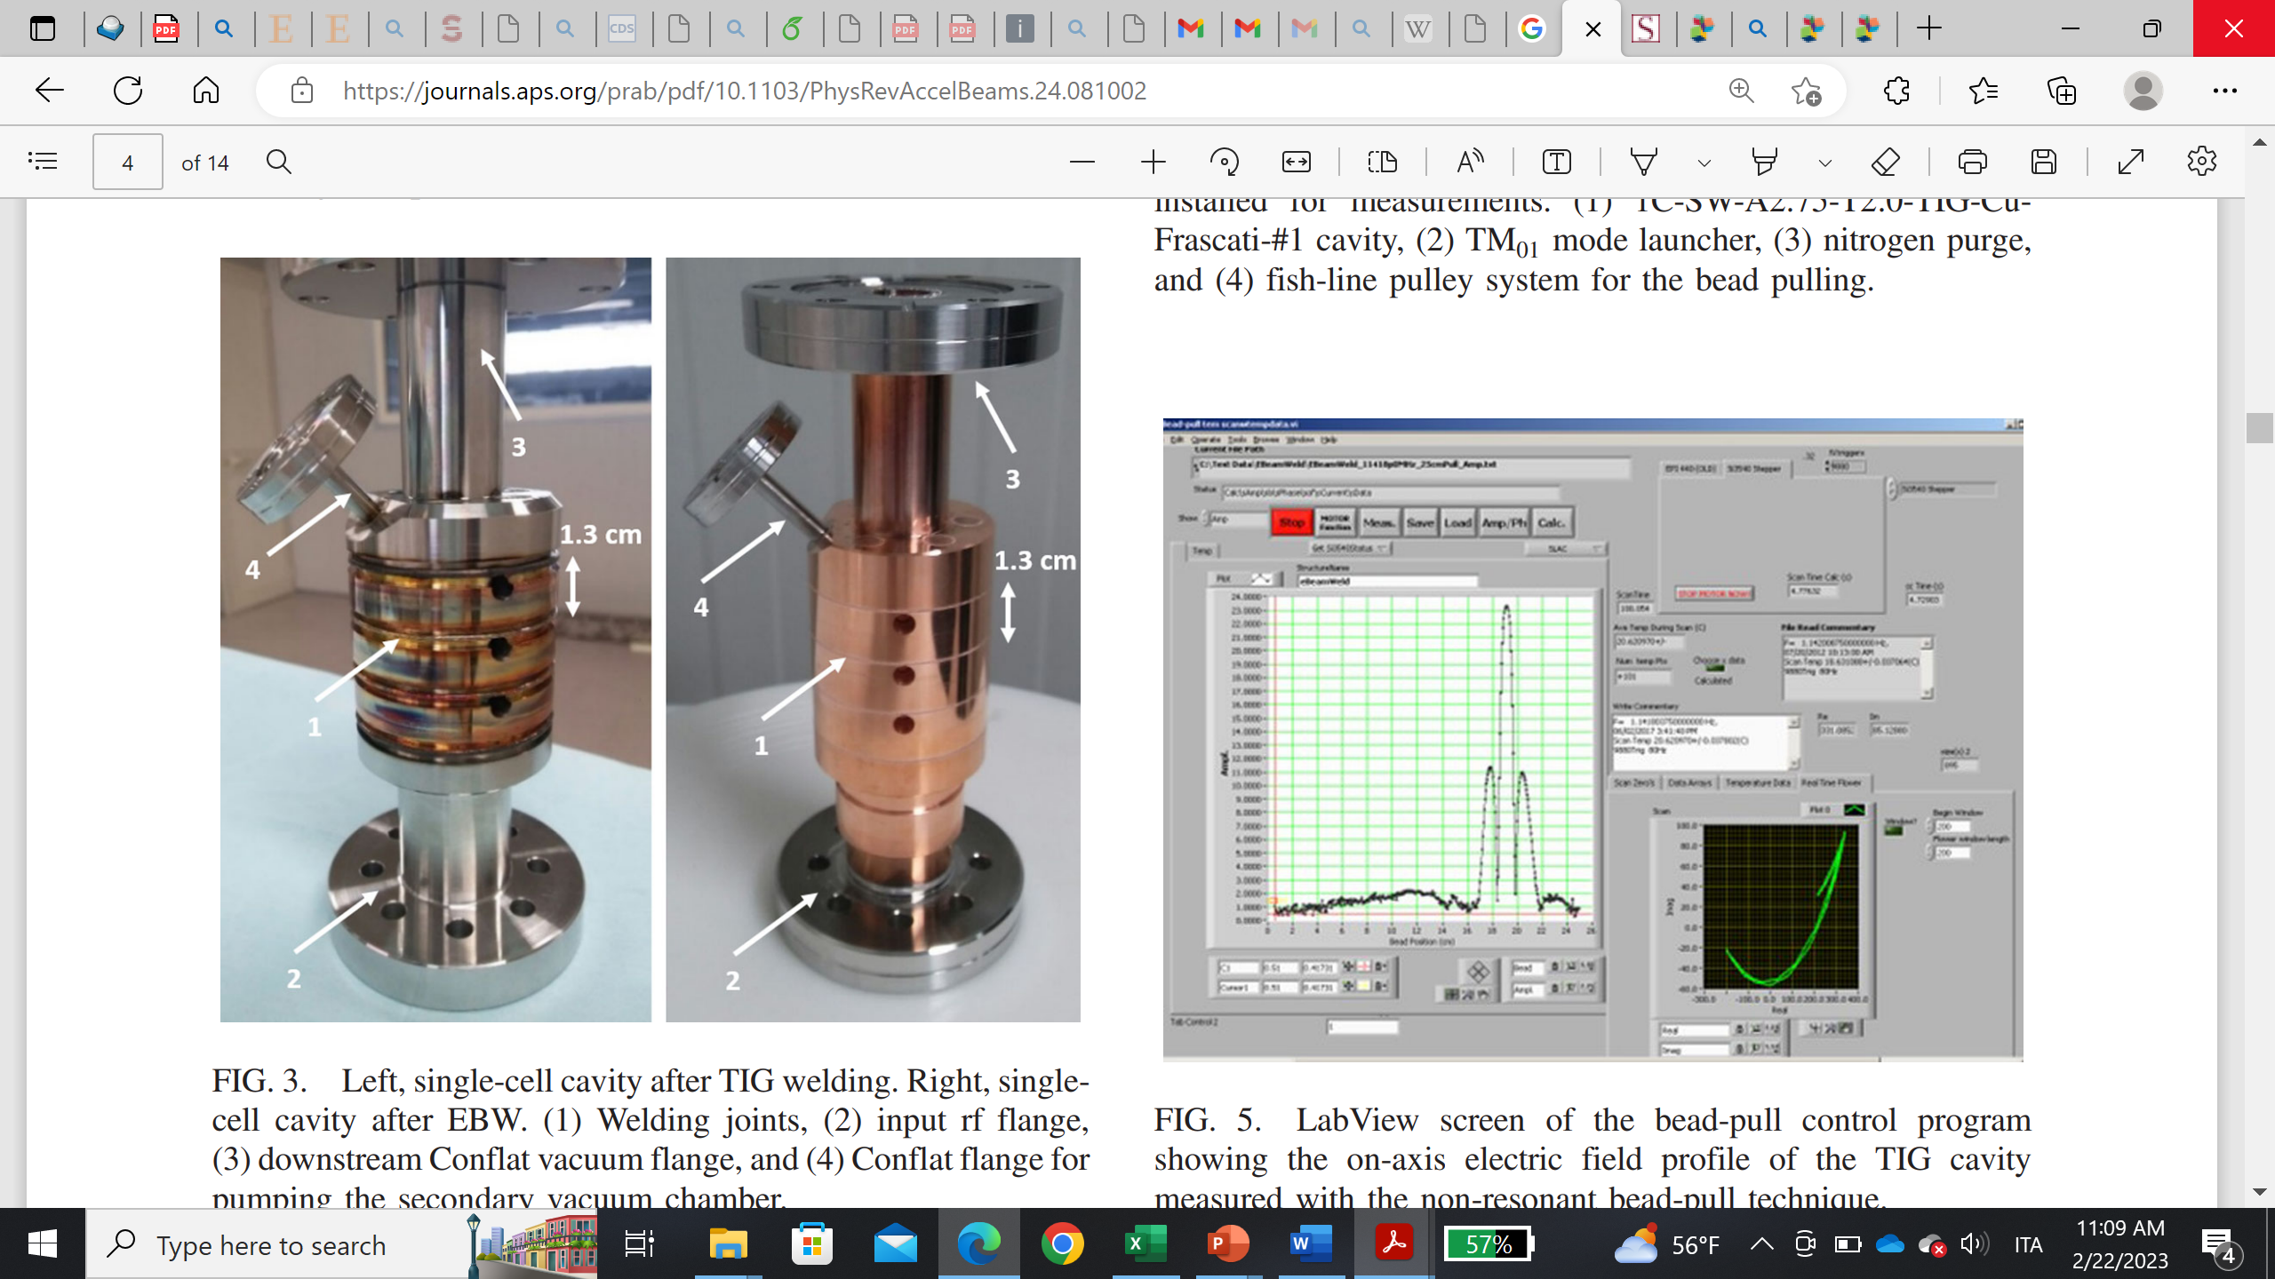
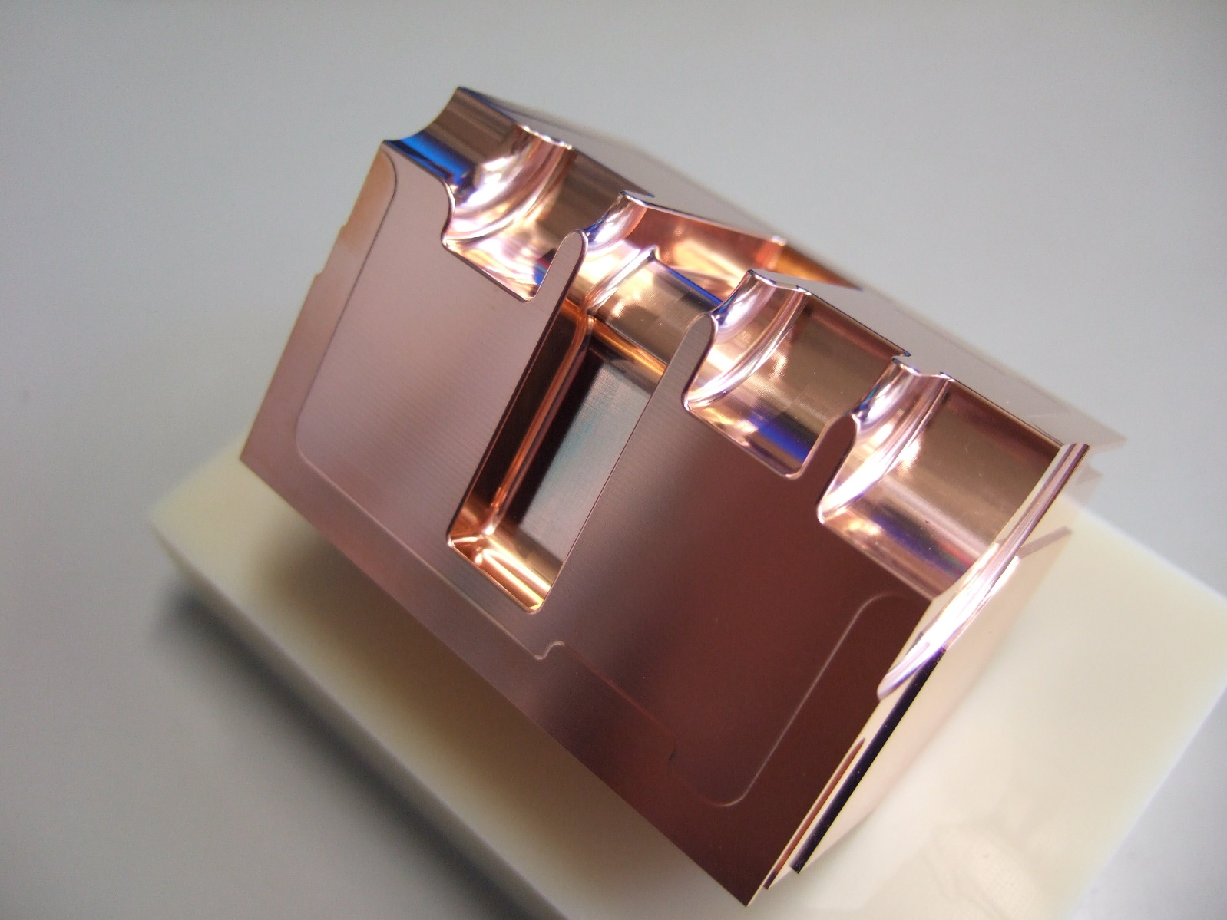
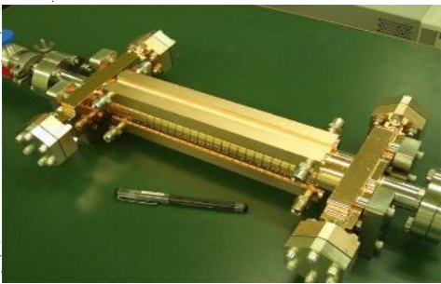
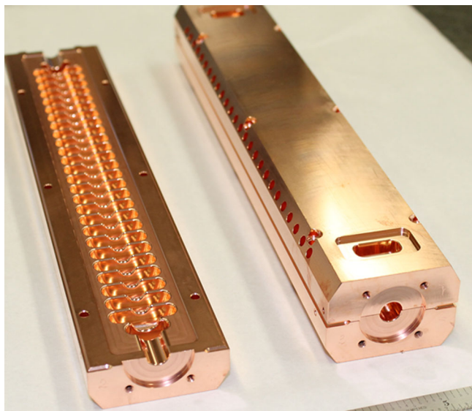
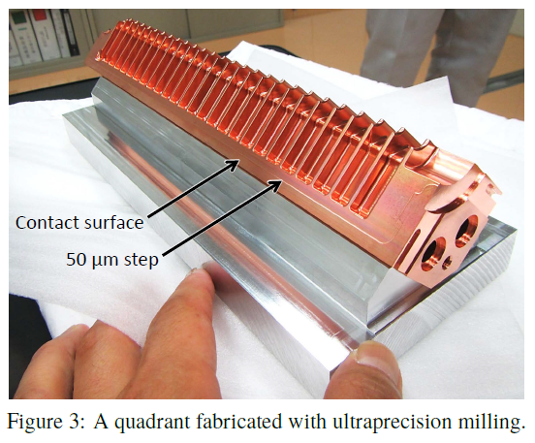
State-of-the-art
“Single-cell” cavities (open and closed; disk-type and multi-sector)
TW multi-cell structures (open and closed; disk-type and multi-sector)
Open-type multi-sector cavities, typically of small lengths (20-30 cm).
TIG
EBW
open
62.448 mm
One quadrant
T. Abe, et al., High-gradient test results on a quadrant-type X-Band single-cell structure.
Dolgashev VA, Faillace L, Spataro B, Tantawi S, Bonifazi R. High-gradient rf tests of welded X-band accelerating cavities. Physical Review Accelerators and Beams. 2021 Aug 10;24(8):081002.
30 cm
SLAC/CERN 2018 (Grudiev, Wuensch et al)
X-band
2 halves, open structure
Brazed
High-power tested:
→ Gradient: 100 MV/m with 200 ns pulse length.
KEK (Tetsuo Abe) 2023
X-band
4 quadrants
EBW welding
To be High-power tested.
(T. Abe)
22 cm
CERN 2007 (Dobert, Grudiev, Wuensch et al)
X-band
4 quadrants
Clamped, high T-treated
High-power Tested:
→ Gradient: 80 MV/m with 40 ns pulse length.
CLIC-G-OPEN
26 cm
30 cm

Slide 7
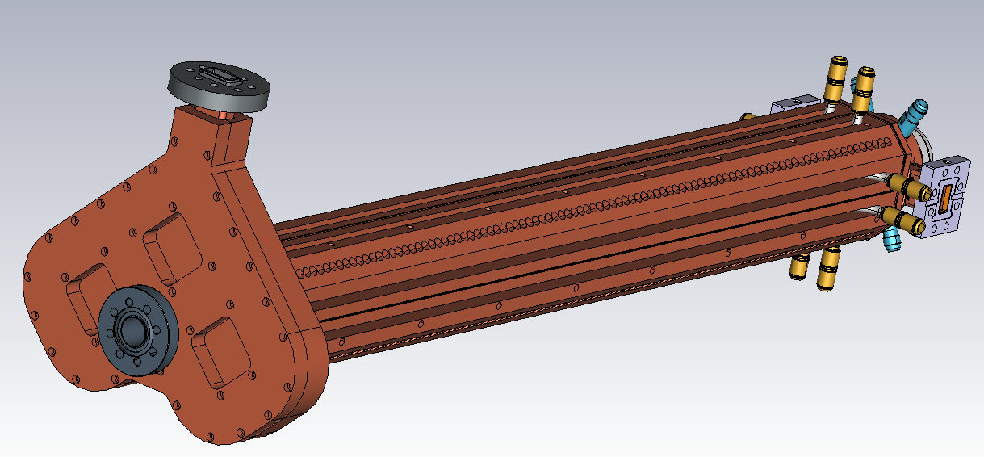
Full TW multi-cell X-band structure
TIG-welded
4-quadrants
«open-type»
Cooling channels
90 cm
Integrated
mode-launcher
TIG welding joints
Fabrication out of hard copper
Increase in vacuum pumping speed
Overall reduction of the fabrication costs
Easy insertion of HOM absorbing materials
tuners
27 cm

Slide 8
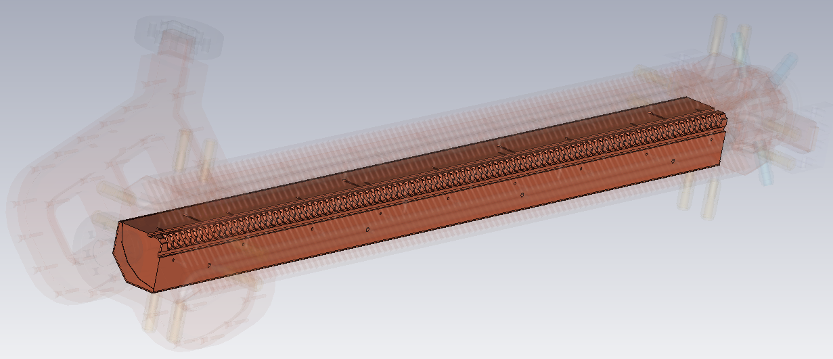
Full TW multi-cell X-band structure
Secondary vacuum chamber (extra pumping, easy insertion of HOMs absorbers in multi-bunch operation,…)
Single quadrant
TIG welding joints
Alignment pins
Engineering in collaboration with the manufacturing company Comeb srl, Rome.

Slide 9
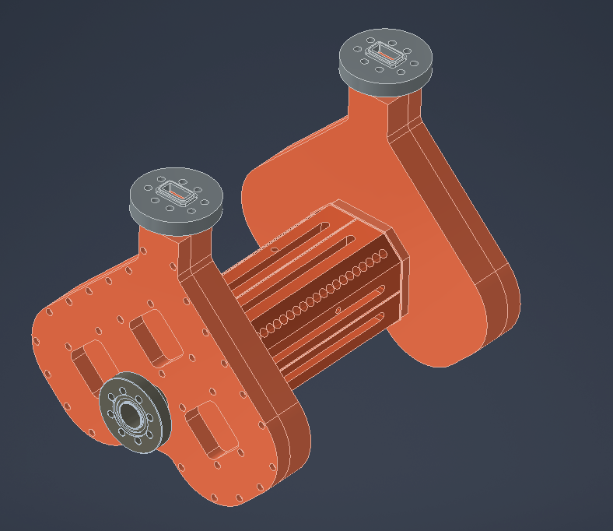
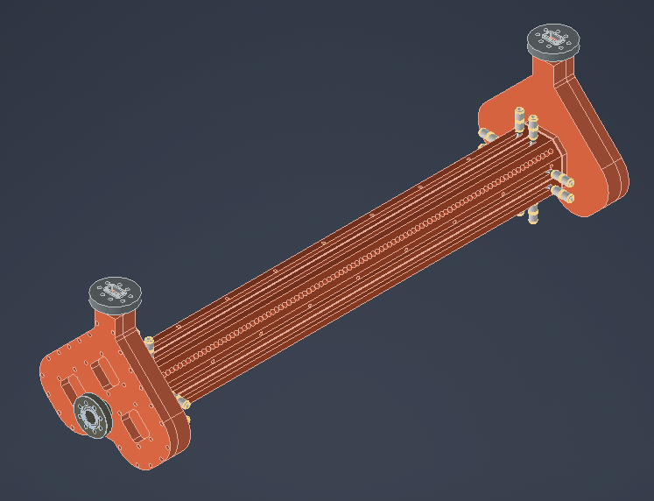
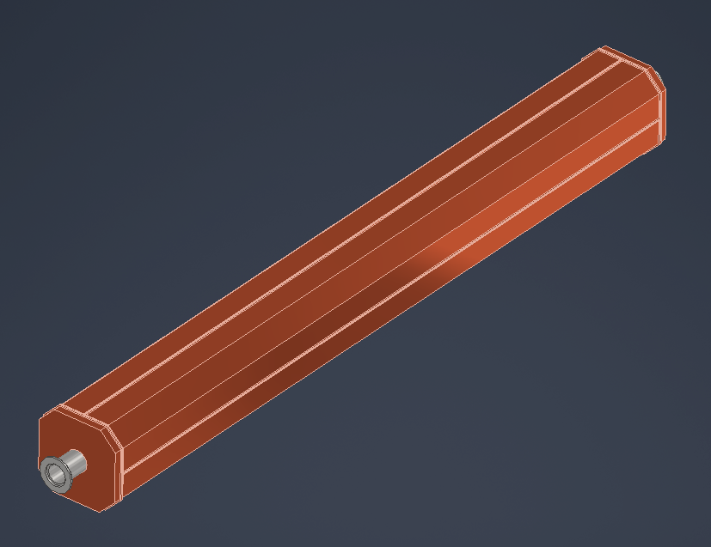
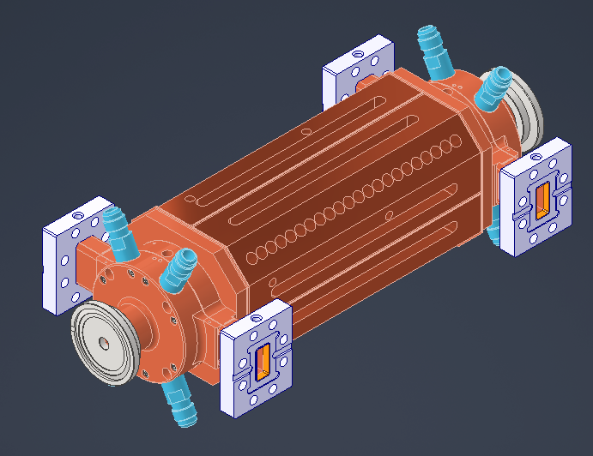
4-port Mode-launchers (already INFN –
CSN5)
Fabrication of final
Full-scale structure and Mechanical Validation
Fabrication of small-scale
prototypes/mechanical Validation
4-port Mode-launchers (already INFN – CSN5)
RF and Wakefields/HOMs Optimization
Low-precision Full-scale fabrication/mechanical characterization
Low and High RF power testing of small-scale protoypes
Low and High-power Testing of Final full-scale structure
quadrant straightness and alignment
TIG welding process
vacuum tightness
30 cm
Standard couplers
90 cm
90 cm
Report 1
Report 2
Report 3
Report 4
Report 5
Report 6
30 cm
Start
2025
End
2025
End
2026
End
2027
Feasibility Study
Prototyping Activity
Final full-structure Tests
Report of the Feasibility Study (RF and Wakefields/HOMs);
Report of the Mechanical Engineering of the low-precision prototype with standard RF couplers for Mechanical, TIG welding and vacuum testing;
Report of the Mechanical Engineering of the small-scale structures with ad-hoc integrated RF Mode Launcher couplers;
Report of the low/high RF power testing of the small-scale structures;
Report of the Mechanical Engineering of the Full Structure with with ad-hoc integrated RF Mode Launcher couplers;
Final Report of low and High RF power testing of final full-scale structure.
7 Milestones
6 Deliverables

Slide 10
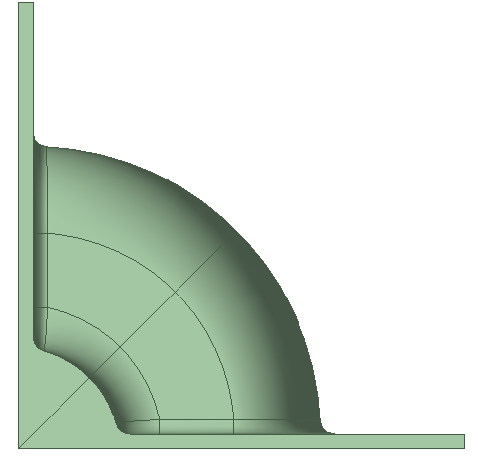
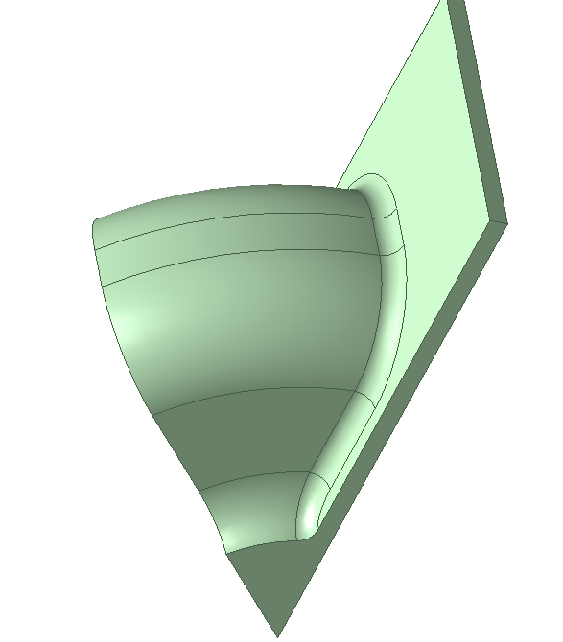

ASTERIX cell geometry for single-bunch mode
Gap/2
Rounding: 0.5mm
R
ae
be
b
a
d
Arc center

Slide 11
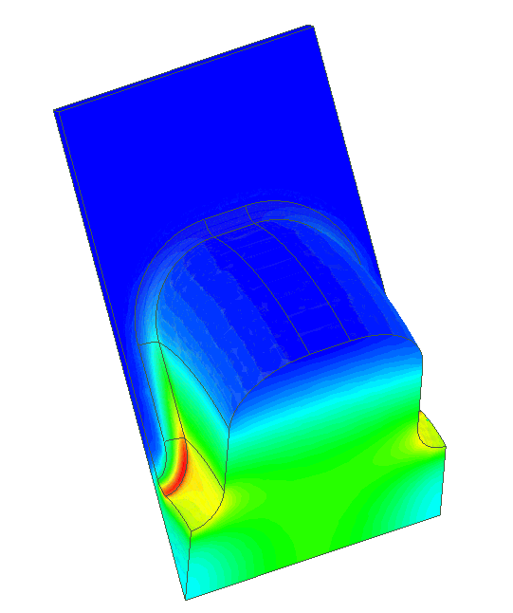
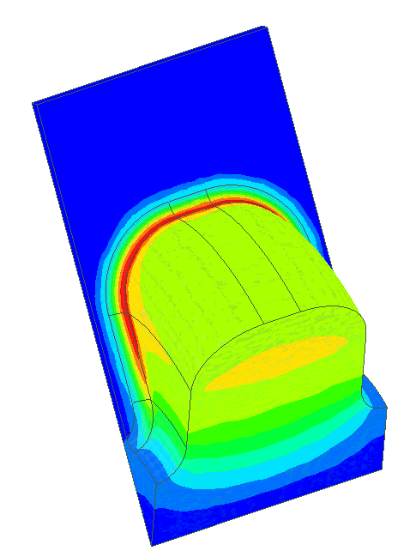
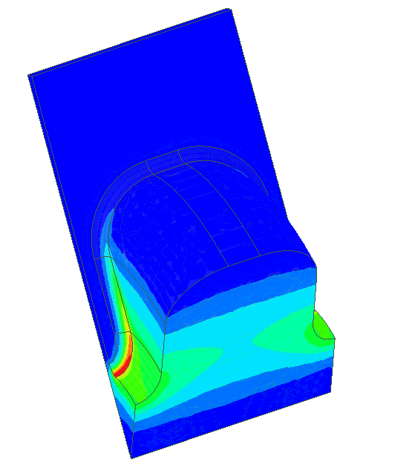
Cell Optimization
Optimization Target:
Low peak electric field Ep, magnetic field Hp, modified Poynting vector Sc
High shunt impedance Rsh and Q
Elliptical ratio → Ep, Sc
Rounding top → Hp
Iris radius fixed at a = 3.5mm
Conventional disk-loaded structure:
Ep/Eacc ≈ 2.1
Hp/Eacc ≈ 2.6 mA/V
Sc/Eacc^2 ≈ 0.6 mA/V
Q = 6800-7500 (different rounding)
Rsh = 105MΩ/m
3.8mA/V
Ep/Eacc
Hp/Eacc
Sc/Eacc^2
The value will be shown later

Slide 12
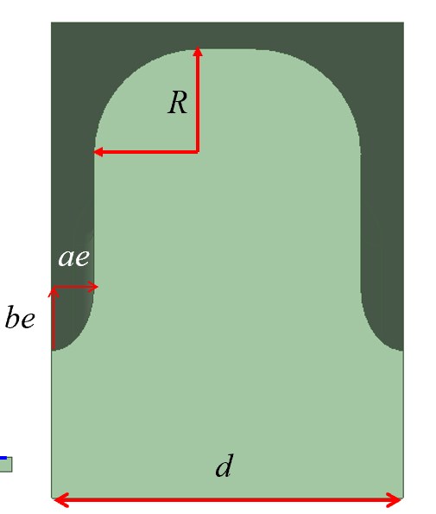
Modified Poynting Vector and Peak E field
Sc/Eacc^2 (mA/V)
Ep/Eacc
Sc/Eacc^2 (mA/V)
Ep/Eacc
Sc/Eacc^2 (mA/V)
Ep/Eacc
be (mm)
be (mm)
be (mm)
t=2ae=2mm, gap = 0.5mm
t=2ae=2mm, gap = 1mm
t=2ae=2mm, gap = 1.5mm
Optimal value: Sc/Eacc^2 = 0.694 Ep = 2.26
Desired point: be = 1.7mm
Optimal value: Sc/Eacc^2 = 0.827 Ep = 2.44
Desired point: be = 1.5-1.6mm
Optimal value: Sc/Eacc^2 = 0.963 Ep = 2.60
Desired point: be = 1.6mm

Slide 13
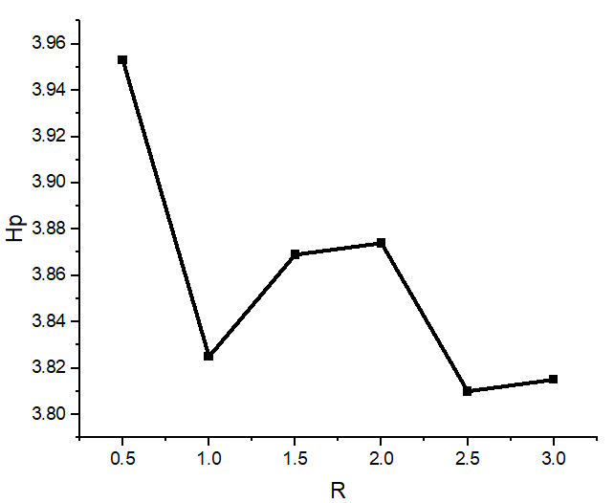
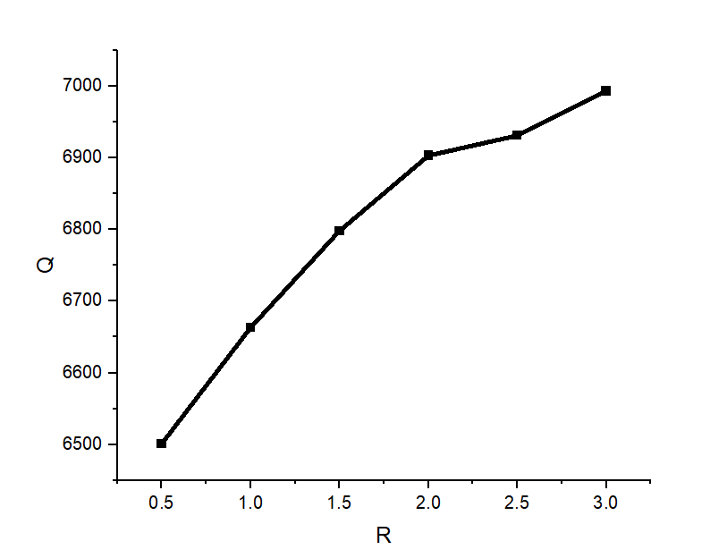
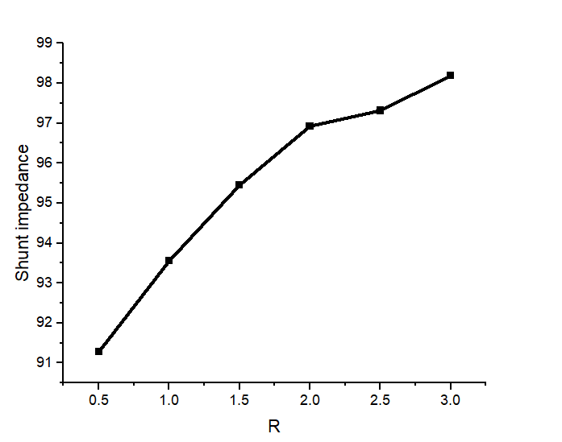
Hp, Rsh and Q for gap=1mm
Hp/Eacc (mA/V)
Eff. Shunt imp. Rsh (MΩ/m)
Quality factor Q
R (mm)
R (mm)
R (mm)
t=2mm, gap = 1mm
t=2mm, gap = 1mm
t=2mm, gap = 1mm
No significant influence
Optimal Q :7000
Optimal impedance: 98.21MΩ/m
Hp is hard to be reduced !!

Slide 14
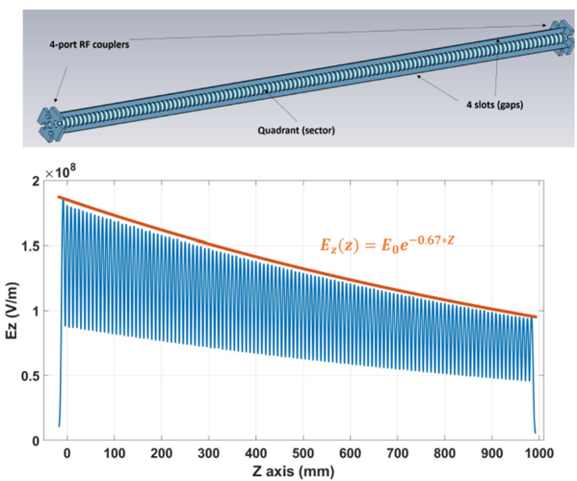
RF design of the full-scale structure
Parameter | Value
Frequency | 11.994 GHz
Accelerating gradient | 100 MV/m
Input power | 77 MW
Operating mode | 2π/3
Number of cells | 120
Full structure length | 1 m
Quality factor | 6931
Shunt impedance | 97.3 MΩ/m
Peak surface field, Ep | 245 MV/m
Top: full 1-metre-long, four-quadrant structure model. Bottom: on-axis electric-field profile.

Slide 15
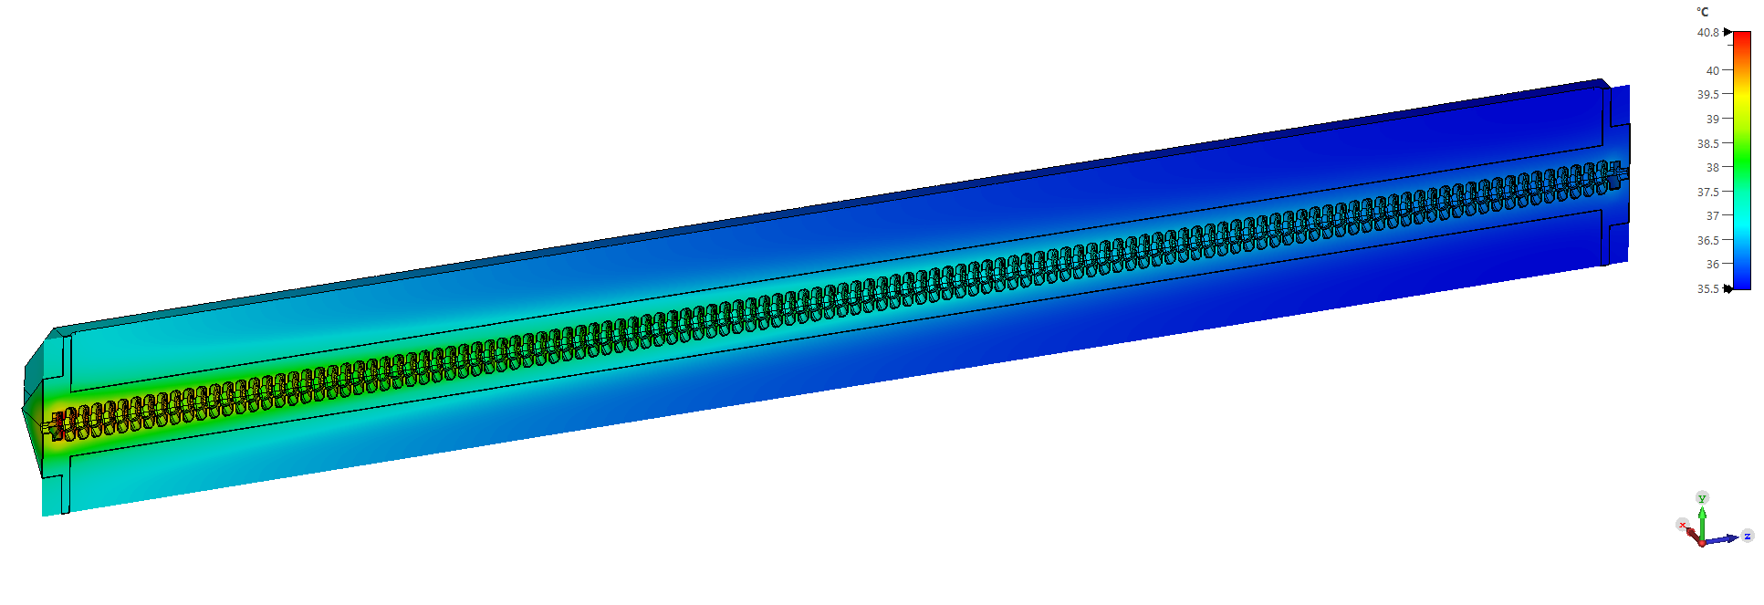
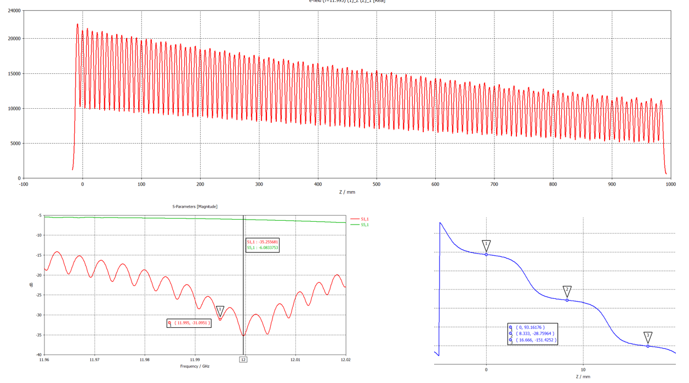
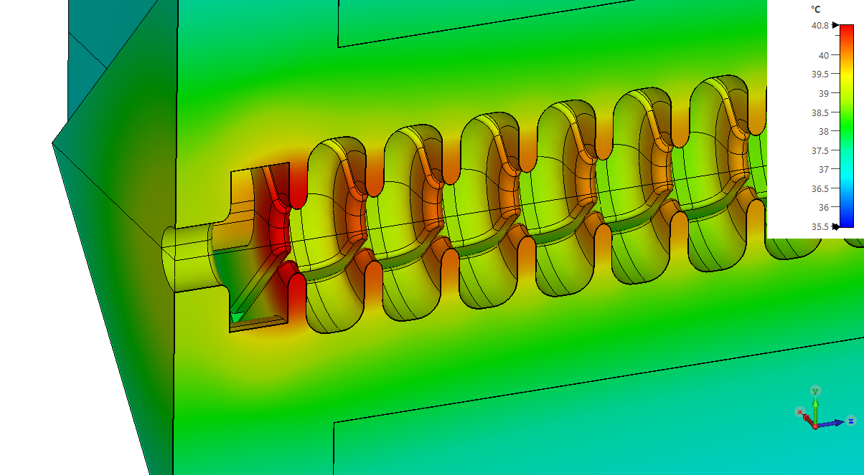
RF–thermal–mechanical multiphysics
Closing the loop between RF losses, cooling, deformation and RF detuning
1 RF baseline
field profile
phase advance
2 Thermal
wall losses
temperature map
3 Mechanical
thermal expansion
deformation
4 RF feedback
S-parameters
field profile
CST/COMSOL cross-check: temperature distributions agree within about 1 °C.
Frequency and field profile/Phase show negligible variation due to temperature gradient distribution along structure

Slide 16
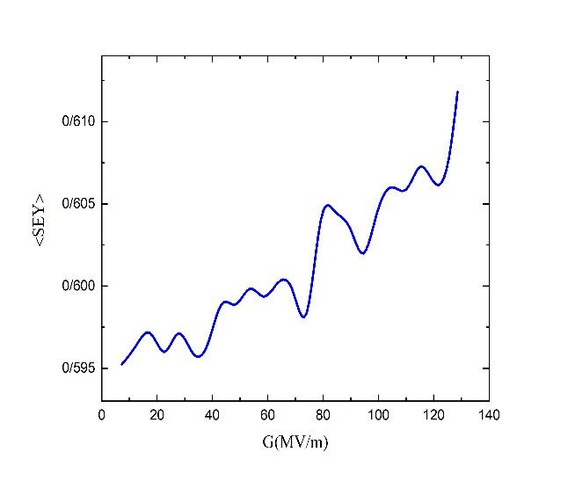
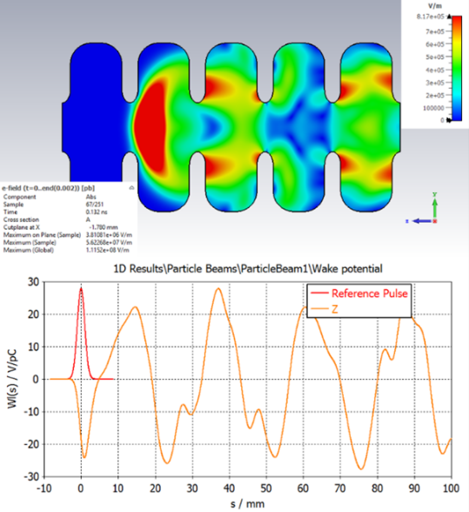
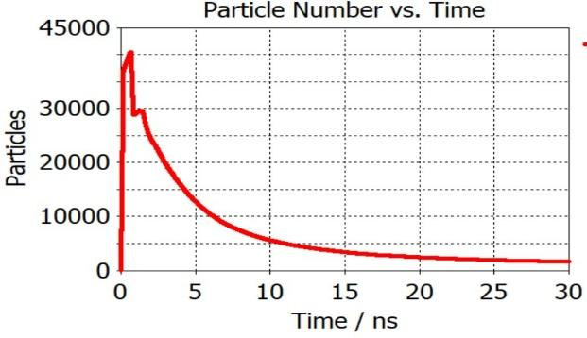
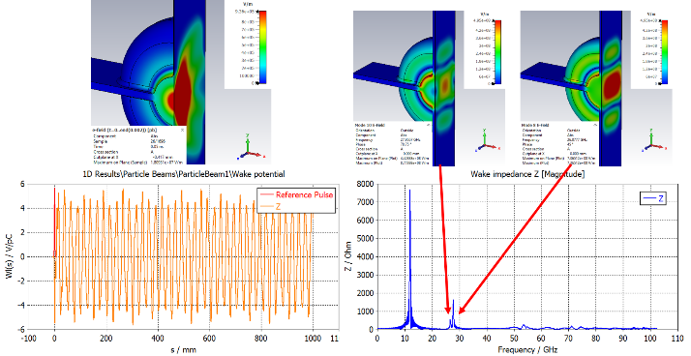
Multipacting, wakefields and HOM studies
Risk reduction before high-power operation
Multipacting analysis
Wakefields / HOM optimization
single- and multi-bunch operation considered
HOM mitigation compatible with open-sector concept
gradient scan on full quarter-cell model
gap-size study in internal technical report
electron population decays in simulations (no MP)
no critical multipactor observed in investigated range 0.1 mm – 1mm gap (the average SEY remains below unity across the explored gradient range, and the mean collision energy stays below the SEY-unity threshold)
single-bunch case, a Gaussian beam with 1 mm rms bunch length and 200 pC of charge → 1keV energy spread

Slide 17
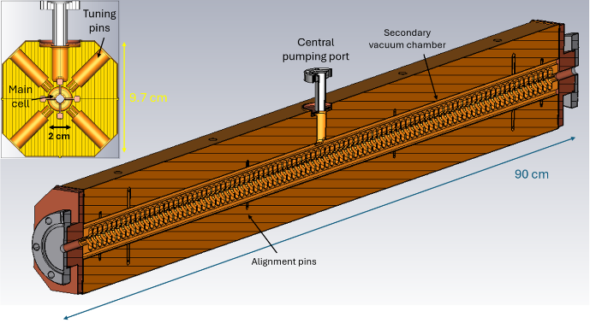
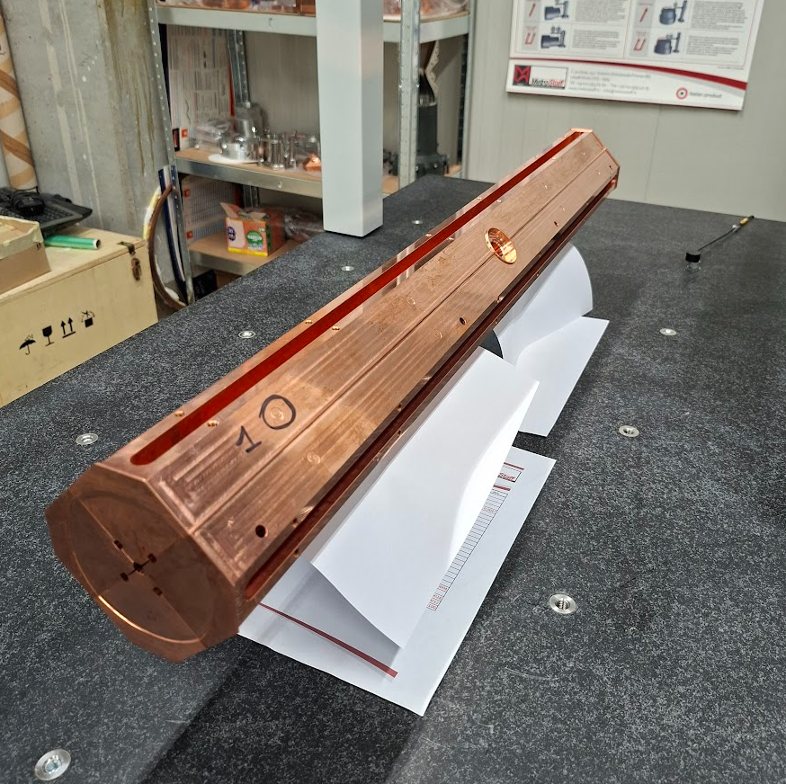
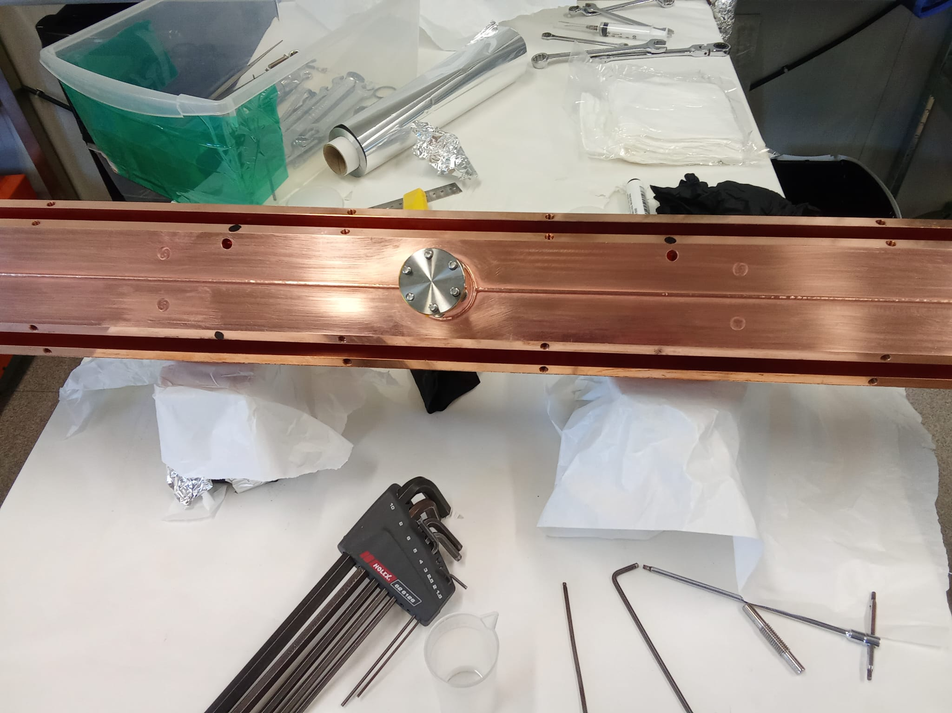
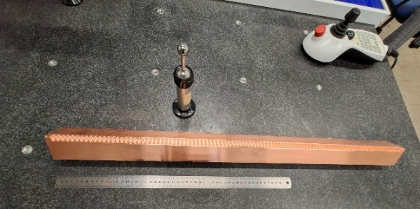
Mechanical design & prototype fabrication
During the first project year, LNF completed the mechanical drawings and engineering of the full-scale structure (without RF couplers), fabricated to validate:
TIG-welding process
Structure straightness & quadrant alignment
Vacuum performance
Machining — complete
Final CAD model — tuning pins, alignment pins, welding teeth, central pumping port and secondary vacuum chambers.
Machine: Doosan DNM 750L CNC
Roughness: Ra < 1 um
All four quadrants machined on a single CNC capable of hosting the full-length parts.
One quadrant on the inspection table (left); close-up showing individual machined cells (right).

Slide 18
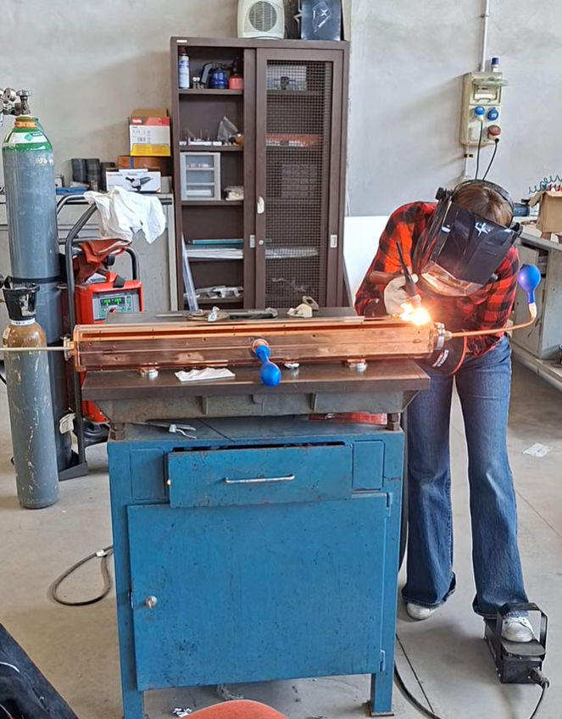
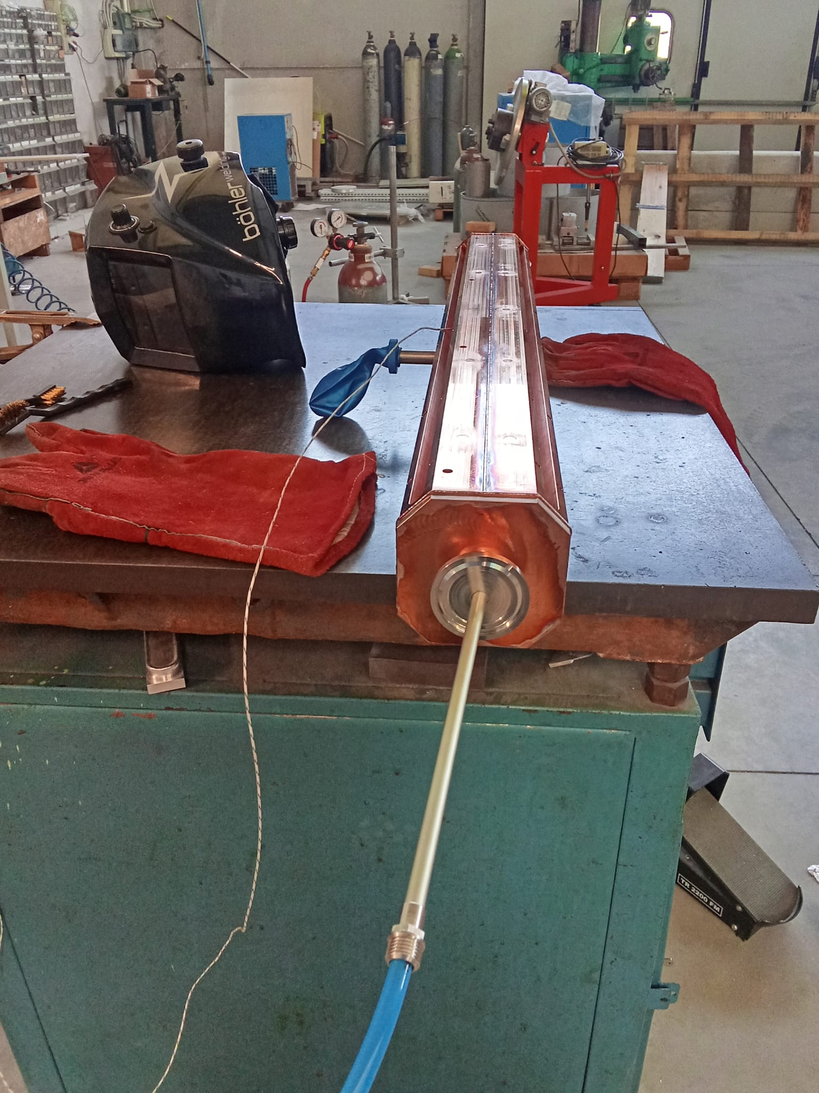
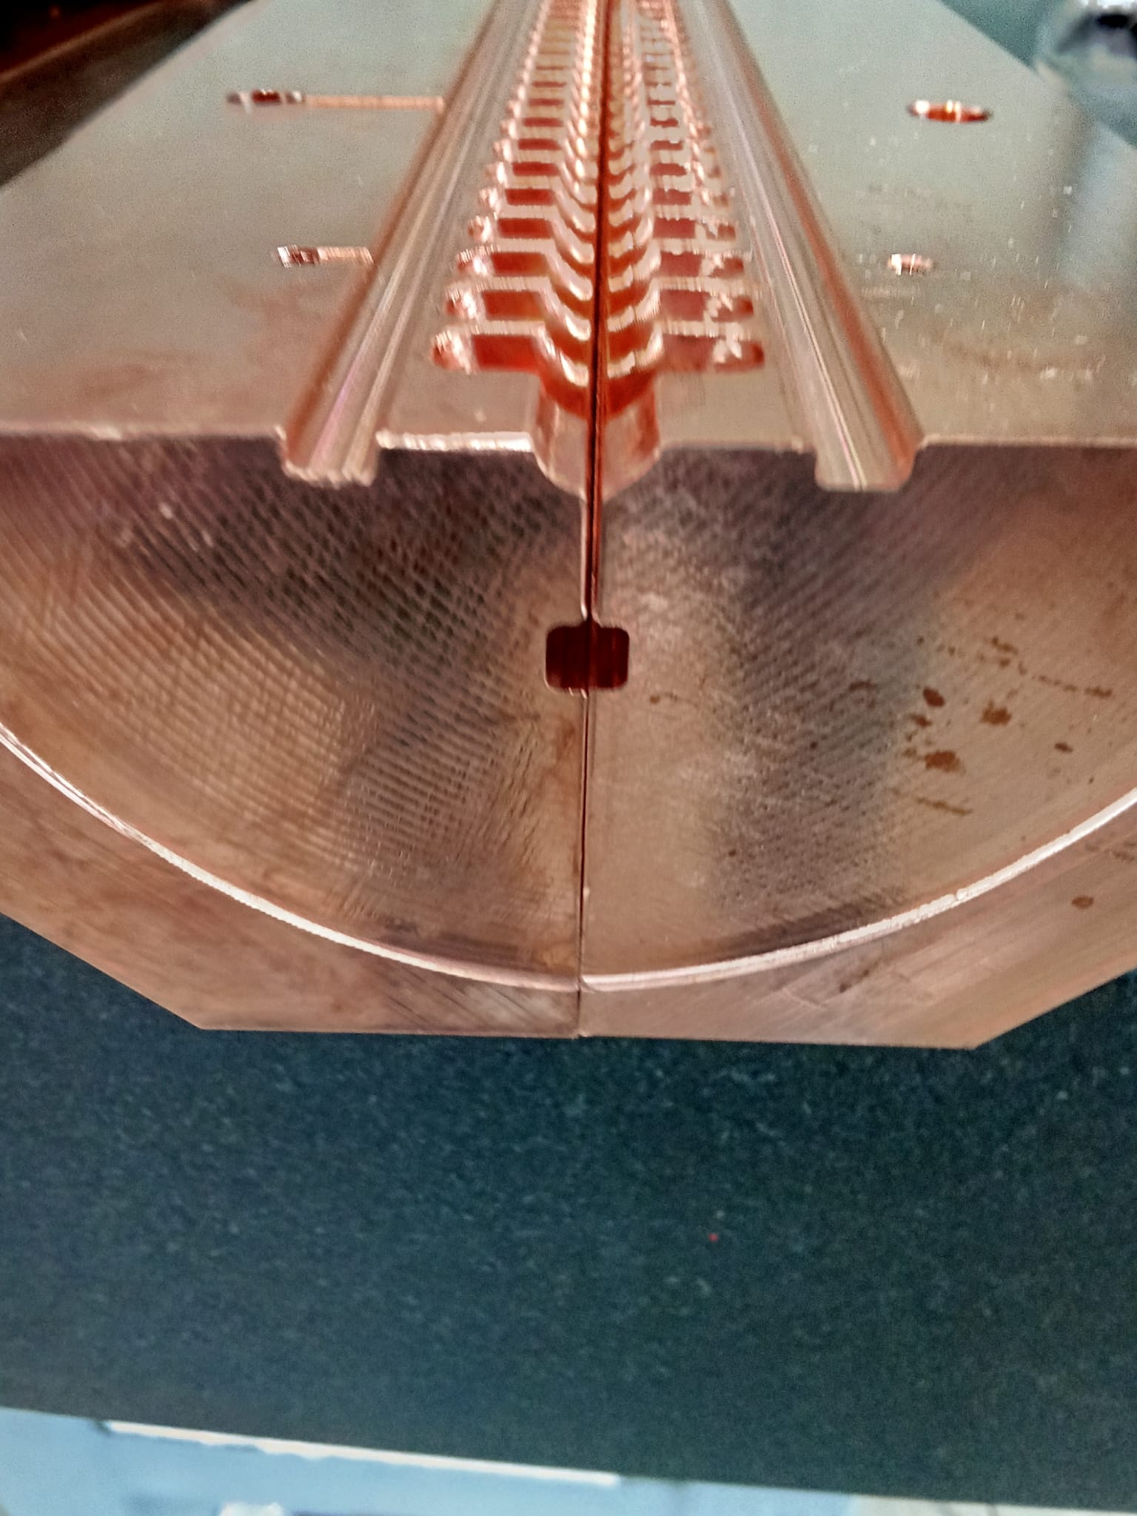
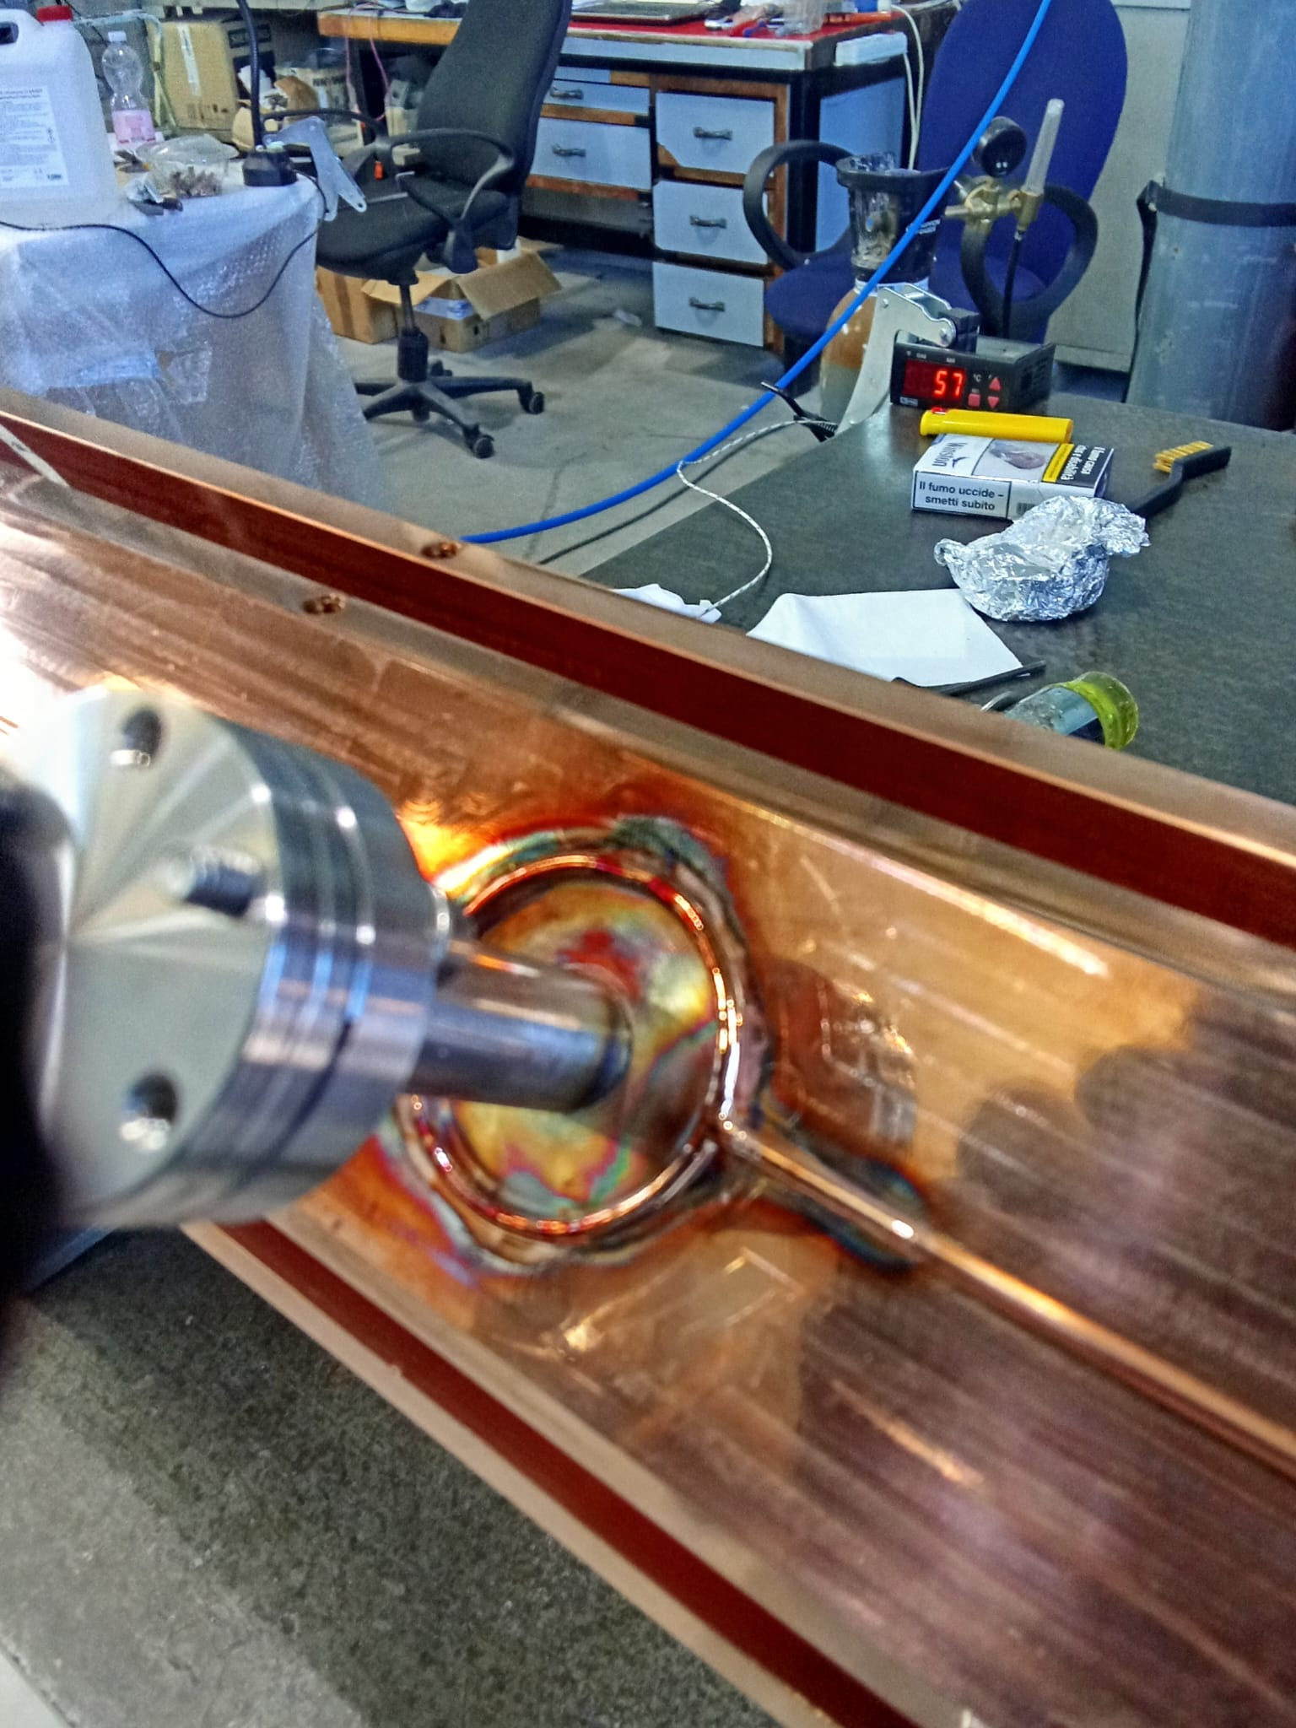
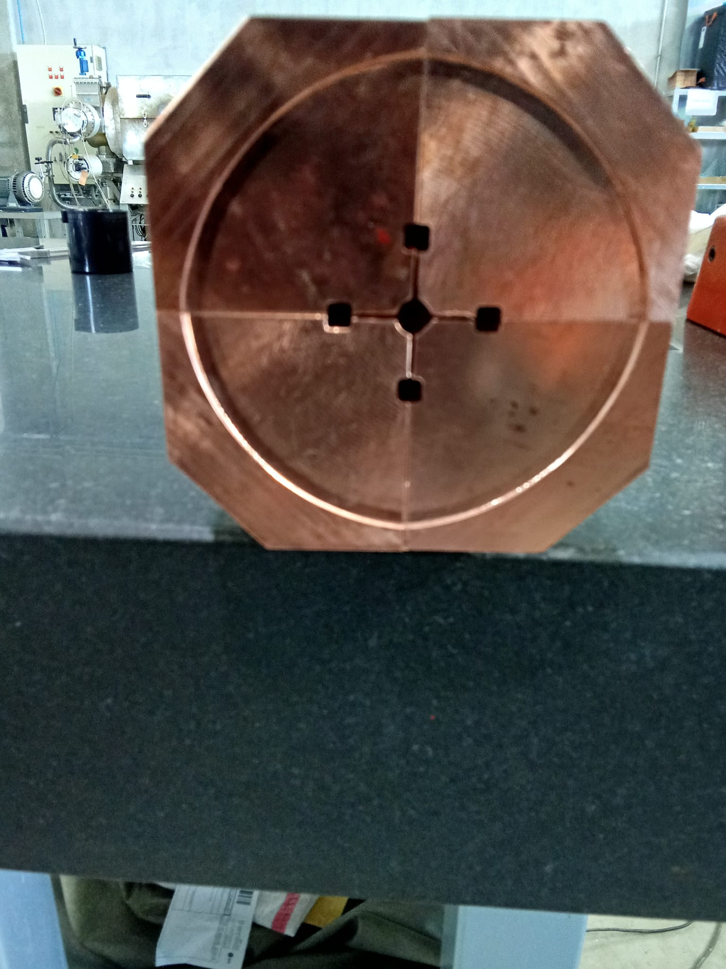

Joining and welding
The quadrants were joined by TIG welding, with inert gas flushed during the process to protect the weld and preserve the internal vacuum surfaces — the “braze-free” approach central to ASTERIX.
Left: ASTERIX prototype being TIG welded. Right: TIG-welded prototype on the CMM table for mechanical characterization.

Slide 19



Qualification status
A comparison of the dimensional measurements acquired before and after the welding process indicates only minor deviations at the inspected locations:
→ straightness max error 20 um, over 1 m.
The observed dimensional variations are minimal and within the expected process capability
→ the welding operation preserved the dimensional integrity of the component and was successfully completed without introducing significant deformation.
Vacuum Leak Check
Result: Positive
Mechanical and vacuum tests on the welded prototype were performed and produced a positive outcome.

Slide 20


Conclusions and Future Work
Two small-scale prototypes, in single-bunch geometry, to be LOW and HIGH power tested in 2026.
Low RF power measurements are performed at the INFN LATINO Lab.
Full length structure (single-bunch mode) to be machined and high RF powered tested at TEX Facility in Frascati by the end of 2027.
90 cm
Thanks for your attention!

