Slide 1


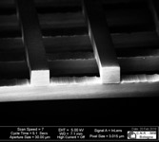
Co-propagating Dielectric Laser Accelerators
for compact high-gradient particle acceleration
Giuseppe Torrisi • INFN–LNS, Catania, Italy
G. S. Mauro, D. Mascali (INFN-LNS), A. Bacci (INFN-Milano)
R. Palmeri (UniRC), A. Locatelli (UniBS), L. Vincetti (UniMoRe), G. Sorbello (UniCT)
Advanced Accelerator Concepts 2026 • UCLA

Slide 2
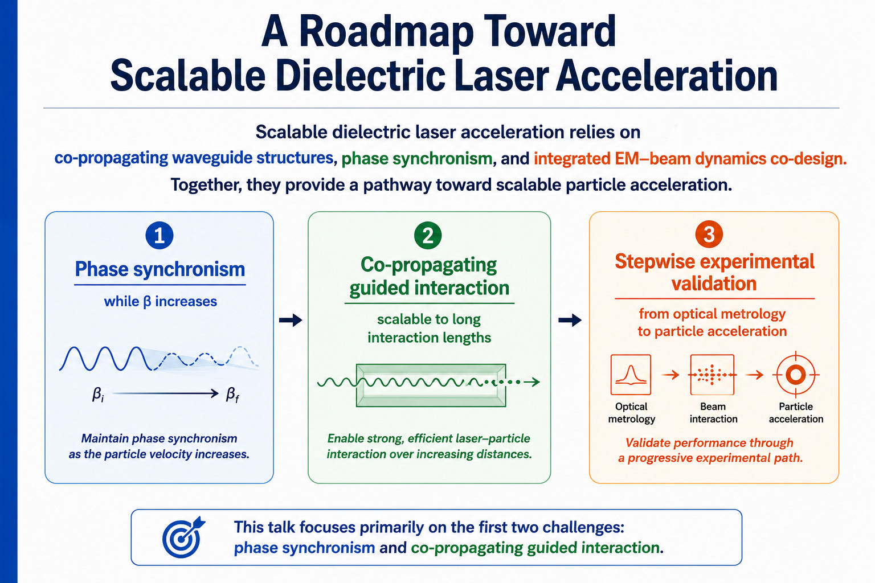

Slide 3
Why co-propagating DLA?
RF / microwave
Optical DLA
10–100 MV/m
large cavities
GV/m fields
micro/nano structures
micro/nano-fabricated “chip-scale” Dielectric (typically silicon) Acceleration structures
conventional ultrafast (fs) infrared (1-5 µm) lasers (solid state)
accelerating gradient up to 2 orders of magnitude greater conventional RF accelerators.
Cross-propagating architectures have demonstrated DLA physics, but extending the interaction or staging many periods requires increasingly complex side power-delivery networks.
Co-propagating guided structures offer a quasi-1D scaling path: the optical mode and the particle beam share the same axis enabling a travelling-wave-like interaction
Principle
Giuseppe Torrisi • INFN-LNS

Slide 4
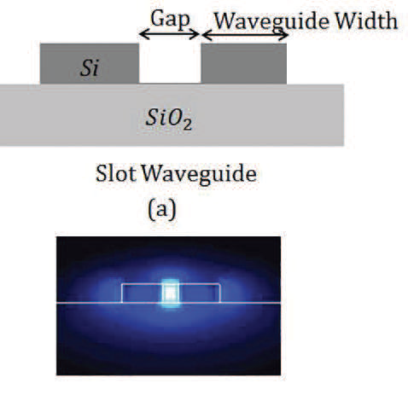
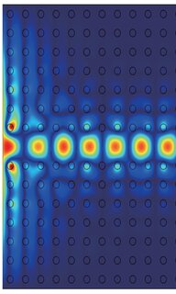
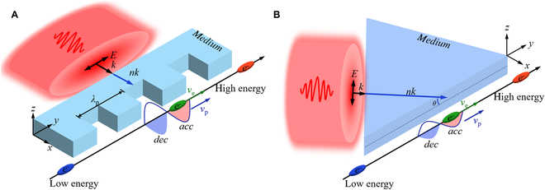
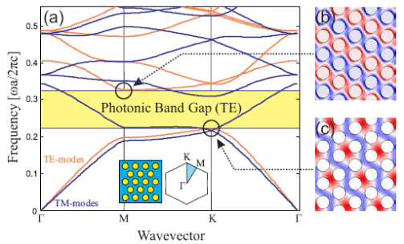
Dielectric Laser Guiding strategies
(This Talk)
Cross-propagating / side-pumped
Co-propagating / guided
Slot Waveguides
Hollow-core photonic crystals
Hybrid phase-matched structures
Inverse Smith–Purcell
Inverse Cherenkov
Dual-grating with PFT / SLM
Strength: ✔ experimental maturity
Challenge: scaling interaction length
Strength: natural scalabity
Challenge: experimental validation
phase and group velocity control
fabrication tolerances

Slide 5
From AAC 2024 to AAC 2026
The previous WG4 summary defines the scaling problem we want to address.
AAC 2024 WG4 identified
Our work
1
interaction-length limitation
longitudinal/transverse beam dynamics
phase and group-velocity control
co-propagating guided modes
slot + suspended slot • hollow-core PhC structures
geometry-controlled phase velocity;
2
3
4
6
[G. Andonian and E. Snively, “Summary of Working Group 4: Novel Structure Acceleration,” NIM A 1072, 170132 (2025)]
From peak gradient → controlled, extended and scalable energy gain

Slide 6
State of the Art of Dielectric Laser Acceleration
2013 First acceleration
↓
2018 Sub-relativistic DLA
↓
2024–26 Programmable optics (mm interaction)
Scheme | Beam | Gradient | Length | ΔE | Charge | Ref.
ISP (rel.) | Rel. (MeV beam) | 0.3–0.8 GV/m | 10–100 μm | ~10–100 keV | fC | Cesar et al., 2018
Dual grating + PFT | Rel. (UCLA linac) | ~0.5 GV/m | 0.5–1 mm | ~100–300 keV | fC | Cesar et al., 2018; Crisp et al., 2024
Inverse Cherenkov | Rel. (MeV beam) | >1.6 GV/m | 0.1–0.3 mm | ~100 keV | fC | Breuer & Hommelhoff, 2013
On-chip photonics | Sub-rel. (keV beam) | ~1–2 GV/m | 50–200 μm | ~10–50 keV | sub-fC | Sapra et al., 2020; Nature 2024
APF structures | Sub-rel. (keV beam) | 30–50 MeV/m | ~0.7 mm | ~keV | fC | Niedermayer et al., 2018
Slot waveguide (Theory + numerical tracking) | Sub-rel. (keV beam) | 333 MV/m (Predicted) | 30 μm | 10 keV |  | Zhao et al., Opt. Express 26 2018

Slide 7
State of the Art of Dielectric Laser Acceleration
2013 First acceleration
↓
2018 Sub-relativistic DLA
↓
2024–26 Programmable optics (mm interaction)
Scheme | Beam | Gradient | Length | ΔE | Charge | Ref.
ISP (rel.) | Rel. (MeV beam) | 0.3–0.8 GV/m | 10–100 μm | ~10–100 keV | fC | Cesar et al., 2018
Dual grating + PFT+SLM | Rel. (UCLA linac) | ~0.5 GV/m | 0.5–5 mm | ~100–500 keV | fC | Cesar et al., 2018; Crisp et al., 2024 Crisp, et al., Nature Comm., in press (2026)
Inverse Cherenkov | Rel. (MeV beam) | >1.6 GV/m | 0.1–0.3 mm | ~100 keV | fC | Breuer & Hommelhoff, 2013
On-chip photonics | Sub-rel. (keV beam) | ~1–2 GV/m | 50–200 μm | ~10–50 keV | sub-fC | Sapra et al., 2020; Nature 2024
APF structures | Sub-rel. (keV beam) | 30–50 MeV/m | ~0.7 mm | ~keV | fC | Niedermayer et al., 2018
Slot waveguide (Theory + numerical tracking) | Sub-rel. (keV beam) | 333 MV/m (Predicted) | 30 μm | 10 keV |  | Zhao et al., Opt. Express 26 2018
Starting point for our work

Slide 8
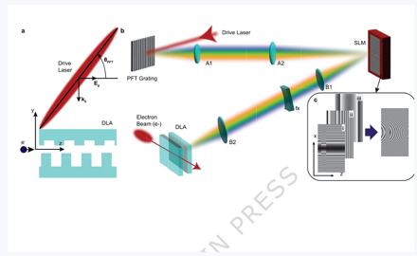
Programmable Optics + Structure-Based Phase Control?
Programmable optical control
Structure-based phase control
control applied to the drive laser
control embedded in the guided eigenmode
+
laser mode + electron beam share the same axis
S. Crisp, R. J. England, A. Ody, P. Musumeci, Nature Communications, in press (2026)
✓ Co-propagating guided modes
control
layer
UCLA/SLAC benchmark
✓ Geometry-tuned phase velocity
✓ Integrated EM–beam-dynamics co-design
✓ >4 mm phase-matched interaction
✓ up to 0.55 ± 0.05 MeV energy gain
route investigated in this work
✓ phase / amplitude shaping with PFT + SLM
Programmable optics controls the drive; structural engineering controls the guided mode.

Slide 9
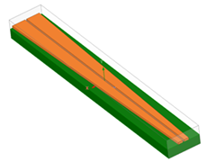
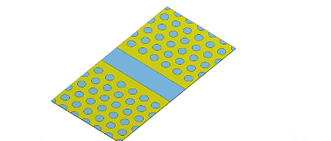
A multi-stage velocity-matched architecture
Different photonic platforms can cover different β-ranges and be cascaded.
Tapered
suspended slot
Hollow-core
PhC taper
Relativistic
module / woodpile
β ≈ 0.4–0.65
β ≈ 0.7–1
β ≈ 1
Design principle: adapt the photonic environment so that the guided mode remains synchronous with the accelerating particle.
[R. Palmeri et al., Opt. Express 31, (2023)]
[R. Palmeri et al., IEEE Photon. Technol. Letters, 38, 7, (2026)]
[D. Guarnera et al., EuCAP, 2025]
[G. Torrisi et al., IEEE MWCL, 30, 4, (2020)]
[G. S. Mauro et al., IEEE MTT, 68, 5, (2020)]
[G.S. Mauro et al., M Opt Tech Lett. (2019)]
Approach
Giuseppe Torrisi • INFN-LNS

Slide 10
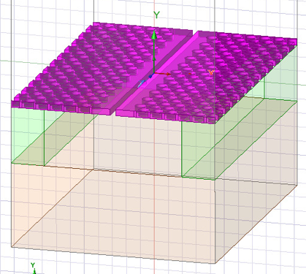
A multi-stage velocity-matched architecture
Different photonic platforms can cover different β-ranges and be cascaded.
Tapered
suspended slot
Hollow-core
PhC taper
hybrid structure:
photonic-slot waveguide
β ≈ 0.4–0.65
β ≈ 0.7–1
β ≈ 1
Design principle: adapt the photonic environment so that the guided mode remains synchronous with the accelerating particle.
Giuseppe Torrisi • INFN-LNS

Slide 11
Part I — Slot waveguides

Slide 12
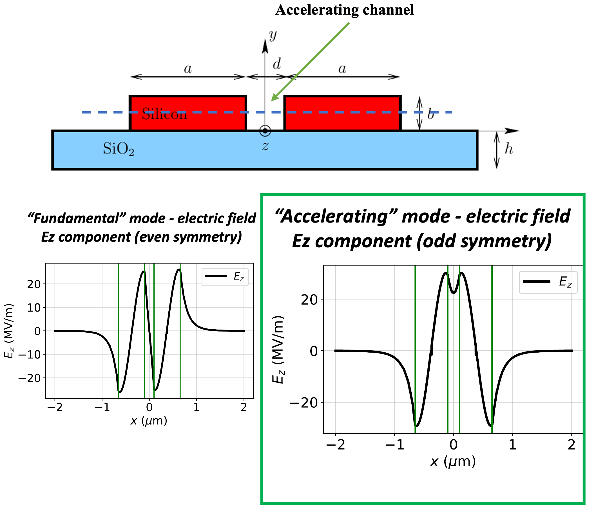
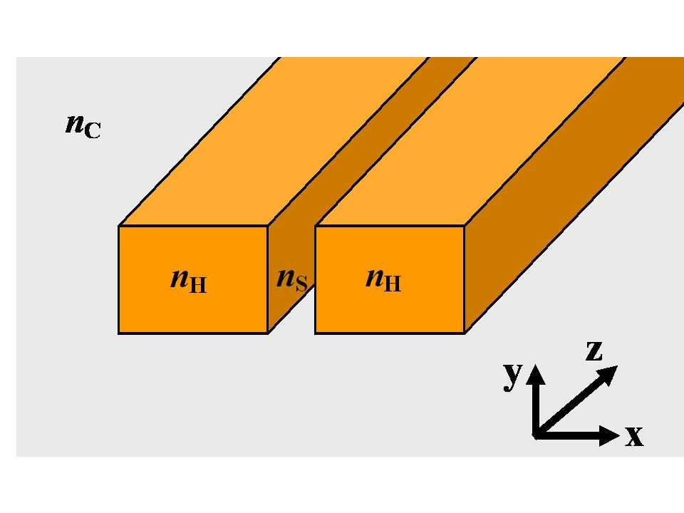
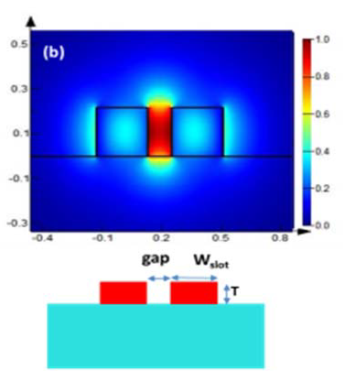
slot waveguide design: geometry
  High-index strips separated by a small gap
  Selective excitation of the accelerating mode
  Tuning of cross section to synchronize sub-relativistic particles
Schematic of a slot waveguide

Slide 13

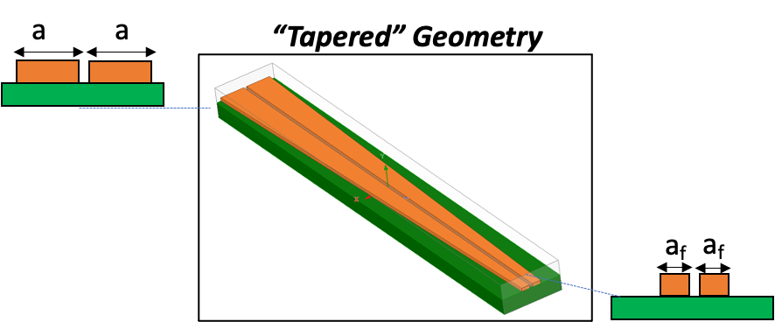


Accelerating slot waveguide design
Synchronicity
For a varying particle velocity, we need a non-uniform slot waveguide
Electron traveling with velocity v_{e}(z)
SYNCHRONOUS CONDITION
non-uniform slot waveguide
Notes:
The core equation is simple. Maximum acceleration requires the phase velocity of the optical mode to match the particle velocity. In a sub-relativistic accelerator, the particle velocity is not constant. Therefore a uniform waveguide is not enough. We need to taper the waveguide and use its geometry to control the effective index and the accelerating field.

Slide 14
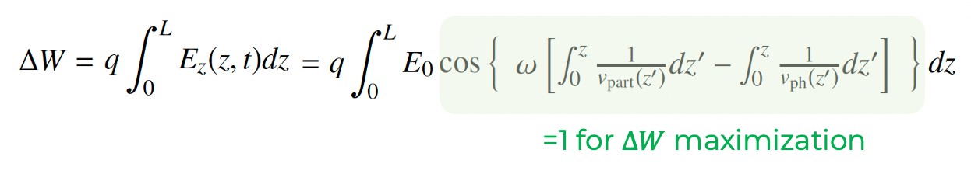
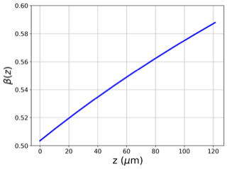
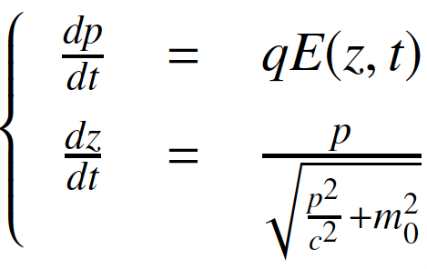

Physics-based design steps
Slot waveguide [0.4<𝛽<0.65]
STEP 1: Relativistic dynamic evaluation
E(z,t)=E₀ @ 1st STEP 1
$$→p\left(z,t\right)→v$$
Theoretical ideal
BD result
Giuseppe Torrisi

Slide 15
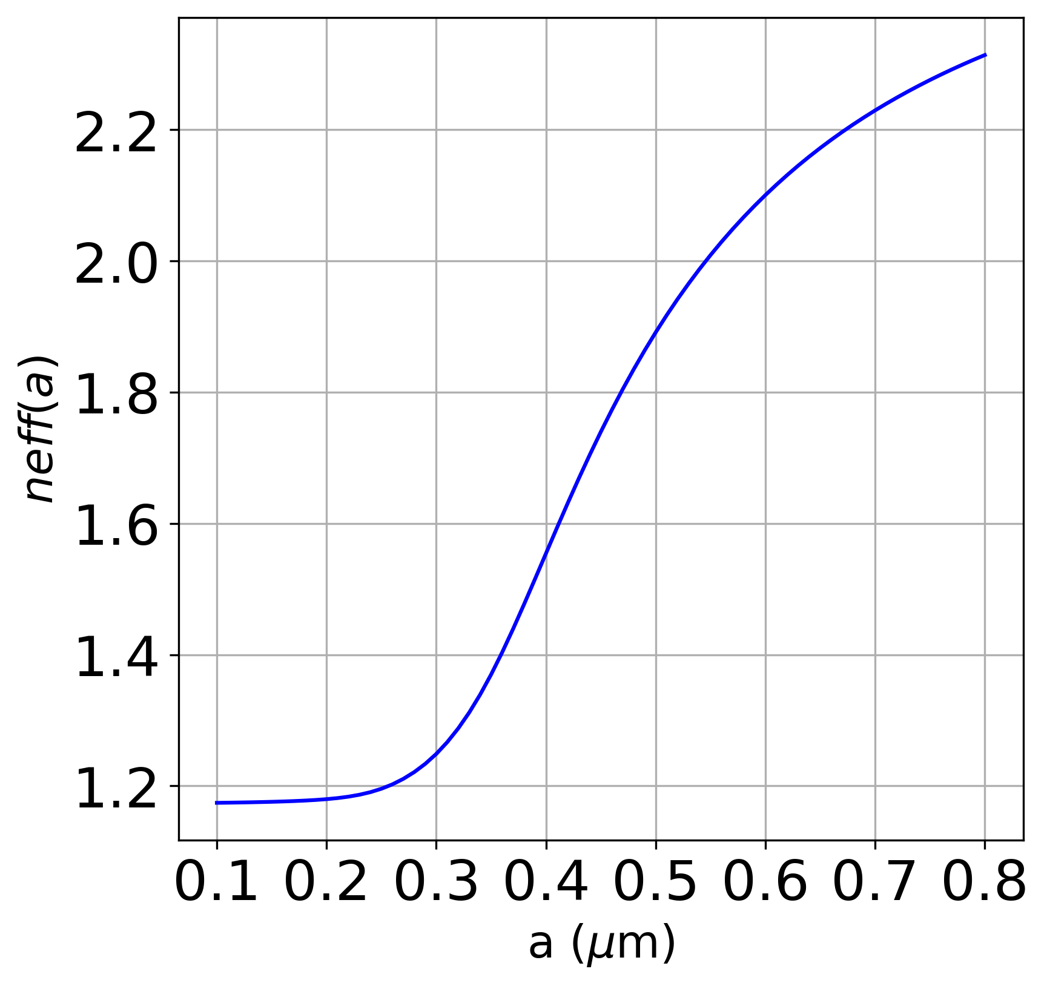
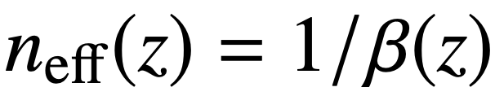
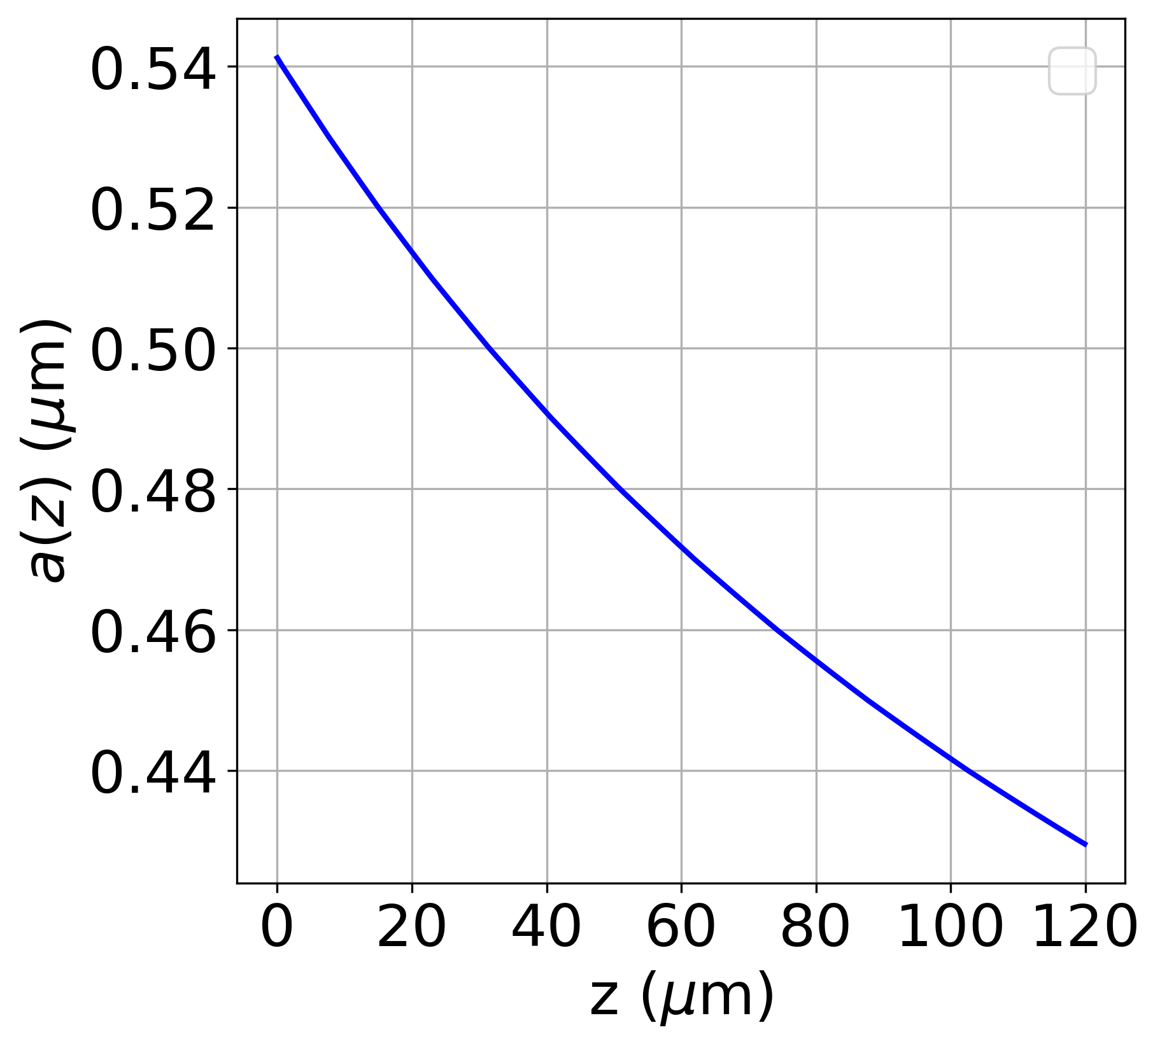
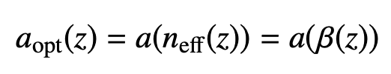
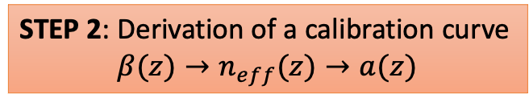
Physics-based design steps
STEP 2: Derivation of a calibration curve
$$β(z)→n_{eff}(z)→a(z)$$
Slot waveguide [0.4<𝛽<0.65]
STEP 1: Relativistic dynamic evaluation
parametric study in COMSOL
Calibration Curve
E(z,t)=E₀ @ 1st STEP 1
$$→p\left(z,t\right)→v$$
Theoretical ideal
BD result
OPTIMAL TAPER
Giuseppe Torrisi

Slide 16
Physics-based design steps
STEP 2: Derivation of a calibration curve
$$β(z)→n_{eff}(z)→a(z)$$
Slot waveguide [0.4<𝛽<0.65]
STEP 1: Relativistic dynamic evaluation
parametric study in COMSOL
parametric study in COMSOL
Calibration Curve
E(z,t)=E₀ @ 1st STEP 1
$$→p\left(z,t\right)→v$$
Theoretical ideal
BD result
OPTIMAL TAPER
E(z,t)
STEP 3: Testing of the taper (3D)
through EM COMSOL simulation
Giuseppe Torrisi

Slide 17
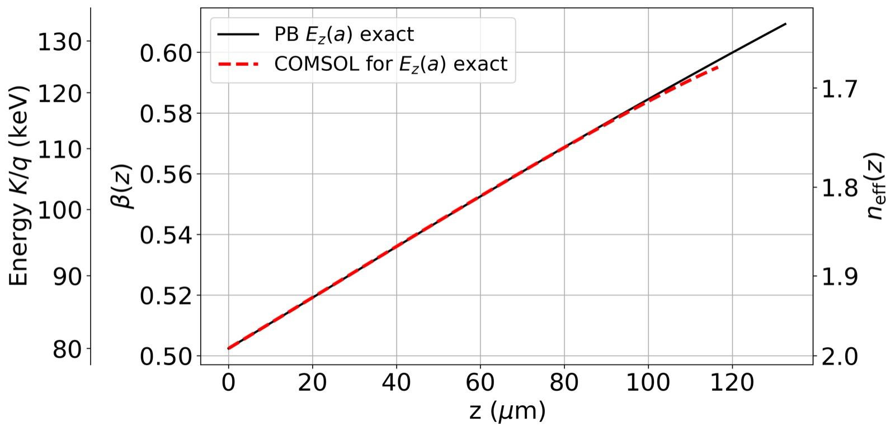
Physics-based design steps
STEP 2: Derivation of a calibration curve
$$β(z)→n_{eff}(z)→a(z)$$
Slot waveguide [0.4<𝛽<0.65]
STEP 1: Relativistic dynamic evaluation
parametric study in COMSOL
parametric study in COMSOL
Calibration Curve
Excellent agreement!
-Theoretical ideal
vs
---Numerical
BD result
OPTIMAL TAPER
E(z,t)
STEP 3: Testing of the taper (3D)
through EM COMSOL simulation
Giuseppe Torrisi

Slide 18
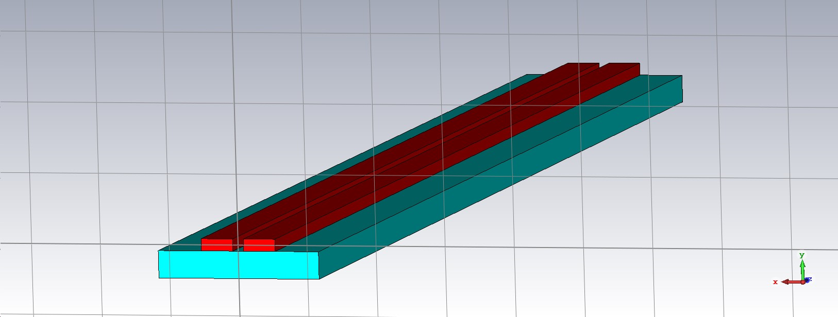
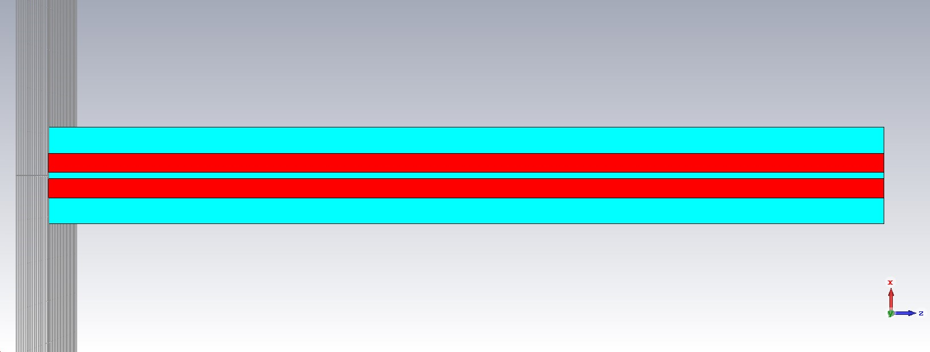
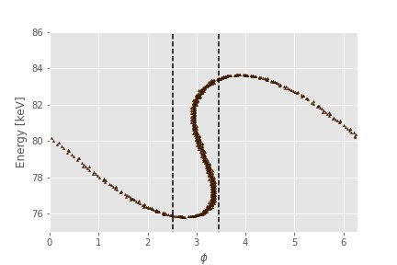
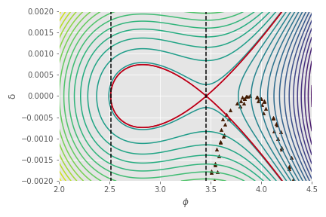
What happens for a uniform (NON-TAPERED) slot waveguide?
Slot waveguide [0.4<𝛽<0.65]
No particle in the accelerating RF bucket!
PHASE SPACE AT ACCELERATOR’S EXIT

Slide 19
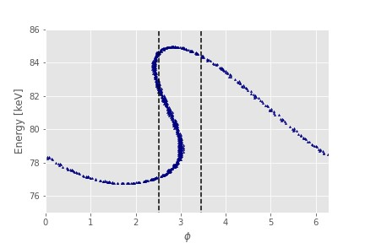
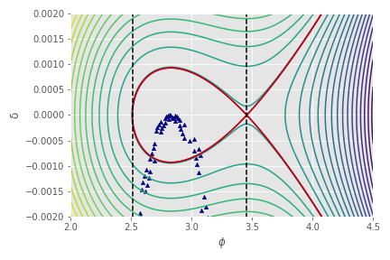
TAPERED SLOT WAVEGUIDE
Slot waveguide [0.4<𝛽<0.65]
Electron phase space after acceleration.
High-density of points inside the separatrix.
electrons phase space

Slide 20
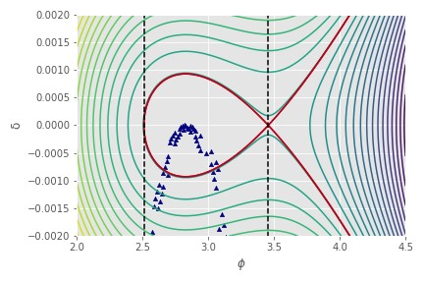
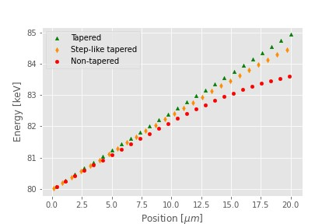
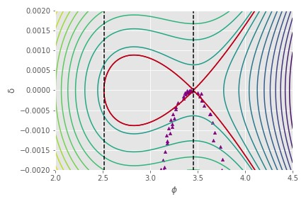
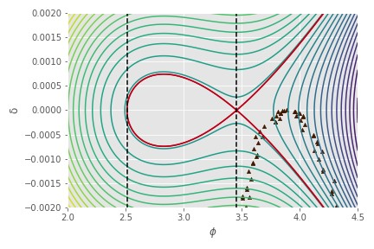
Performance comparison
Slot waveguide [0.4<𝛽<0.65]

Slide 21
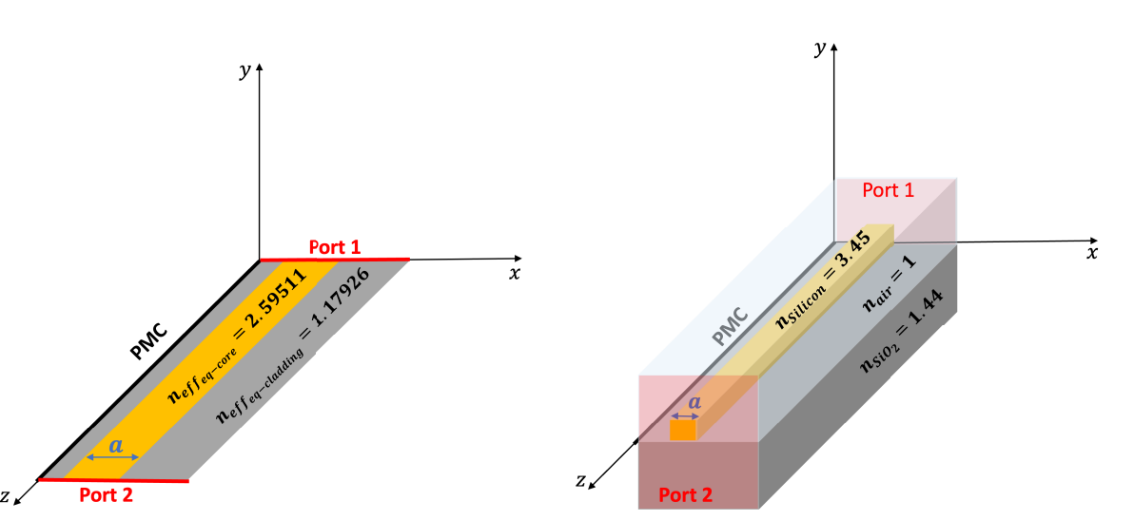
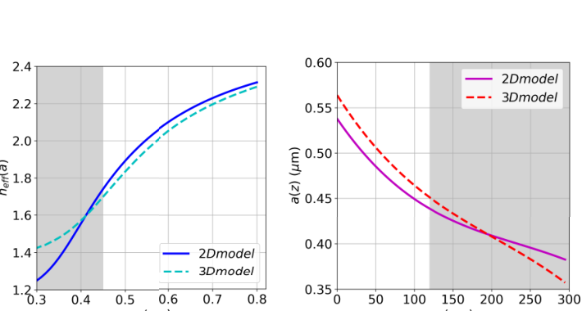
2D reduced model → enables rapid taper optimization before full 3D validation
The reduced model enables rapid design-space exploration.
[R. Palmeri et al., Optics Express 31, 38891–38909 (2023).]
Giuseppe Torrisi • INFN-LNS

Slide 22
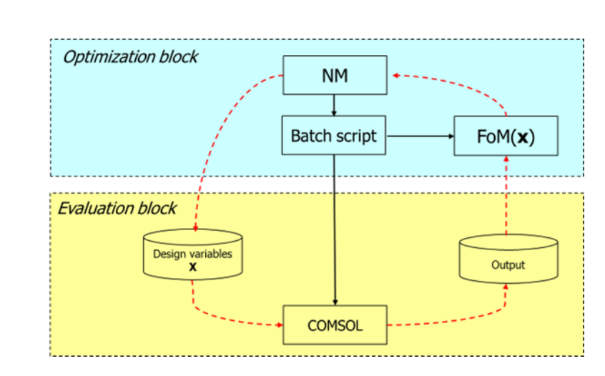
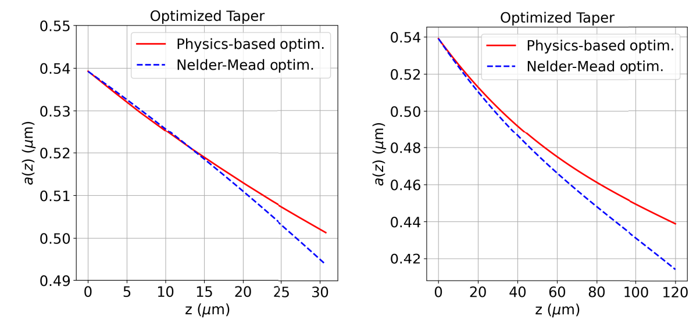
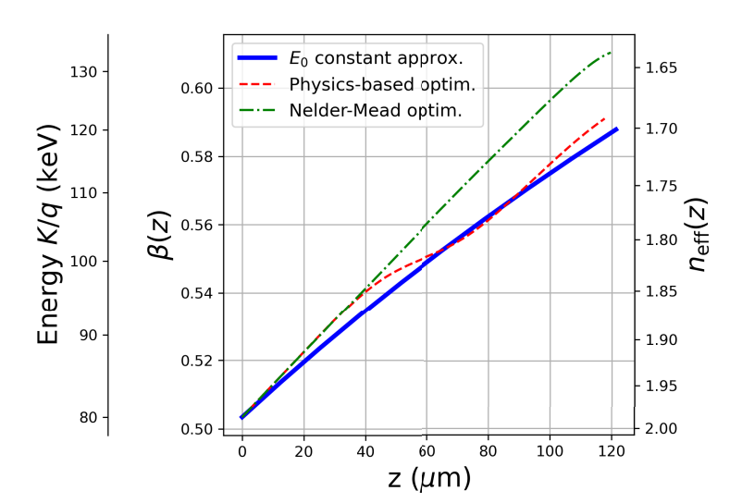
Nelder_Mead method optimization
(also called downhill simplex method)
algorithm used to find the optimum (minimum or maximum) of an objective function or a FoM in a multidimensional space
a higher output energy
more stable and monotonic acceleration

Slide 23
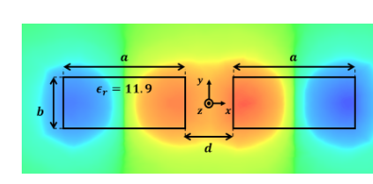
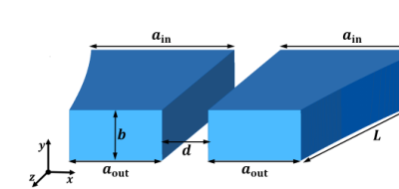
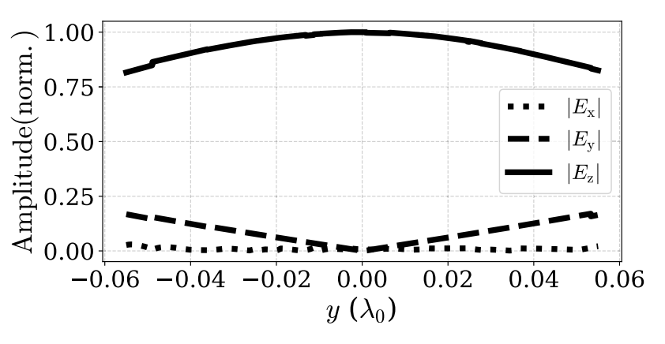
Suspended slot waveguide: extending the accessible β range
Why suspended?
no SiO₂ substrate losses
vertical symmetry
Cross-section overlaid with of E_{z} for the second (odd) mode
3D view of the designed suspended
Slot waveguide
smaller transverse force components
lower n_{eff} accessible → higher v_{ph}
better compatibility with β increase
1D cut of the electric field component
[R. Palmeri, G. Torrisi et al., IEEE Photonics Technology Letters 38(7), 475–478 (2026).]
Giuseppe Torrisi • INFN-LNS

Slide 24
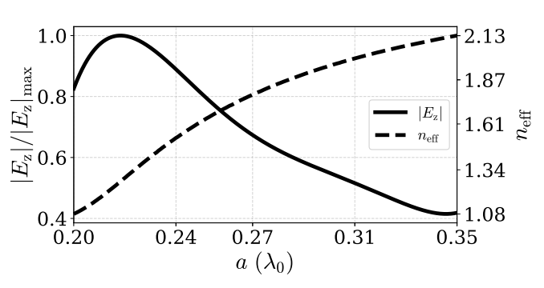
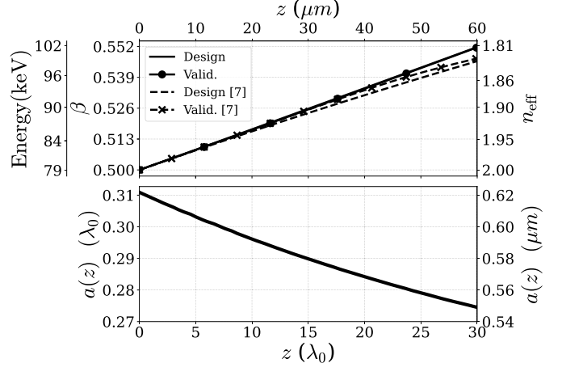
Physics-assisted design: calibration curves drive the taper
Calibration Curve
Optimal taper
Improvement over the earlier model
The taper accounts not only for n_{eff}(a),
but also, for the slow variation of E_{z}(a)
along the structure.
Physics-based optimization results with numerical validation and comparison to the previous approach
R. Palmeri et al., IEEE Photonics Technology Letters 38(7), 475–478 (2026).
Giuseppe Torrisi • INFN-LNS

Slide 25
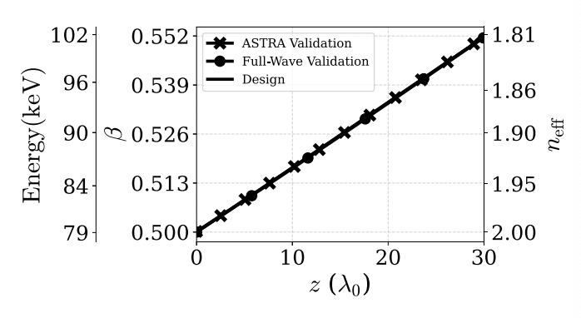
Continuous acceleration with physics-designed suspended slot taper
Key numbers
Input energy
79 keV
Output energy
102 keV
Net gain ≈ 23 keV
≈20% improvement vs constant-field model
EM fields: HFSS
Beam dynamics: ASTRA
Continuous synchronism maintained
New feature: unlike the 2023 model, the taper simultaneously accounts for phase velocity and local accelerating-field variation, leading to a self-consistent taper desig
R. Palmeri et al., IEEE Photonics Technology Letters 38(7), 475–478 (2026).

Slide 26
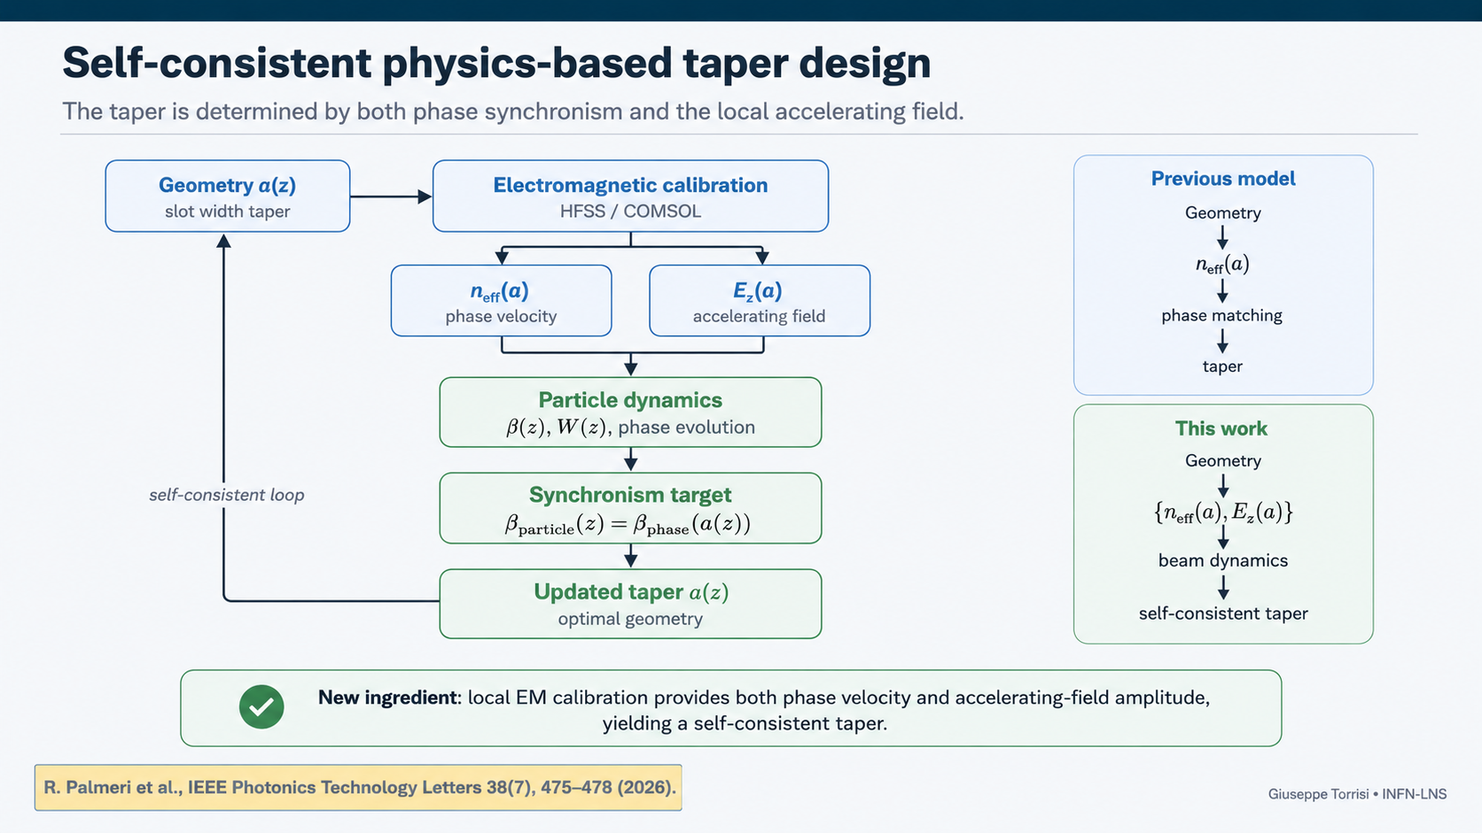
Notes:
.

Slide 27
Part II — Pulsed operation
Under pulsed excitation, the structure is not designed from phase velocity alone: the pulse envelope and the particle are advanced together along z.

Slide 28
Under pulsed excitation, phase matching alone is not enough
The particle samples a moving envelope, not only a phase-matched carrier.
Carrier phase
Envelope walk-off
Dispersion + taper
v_{g} ≠ v_{particle}
short pulses can outrun or lag the particle
k₂, k₃ and field-amplitude changes reshape the pulse
v_{ph}(z) must follow v_{particle}(z)
Therefore, the taper must be co-determined with the actual pulse propagation and particle dynamics.
Pulsed model
Giuseppe Torrisi • INFN-LNS

Slide 29

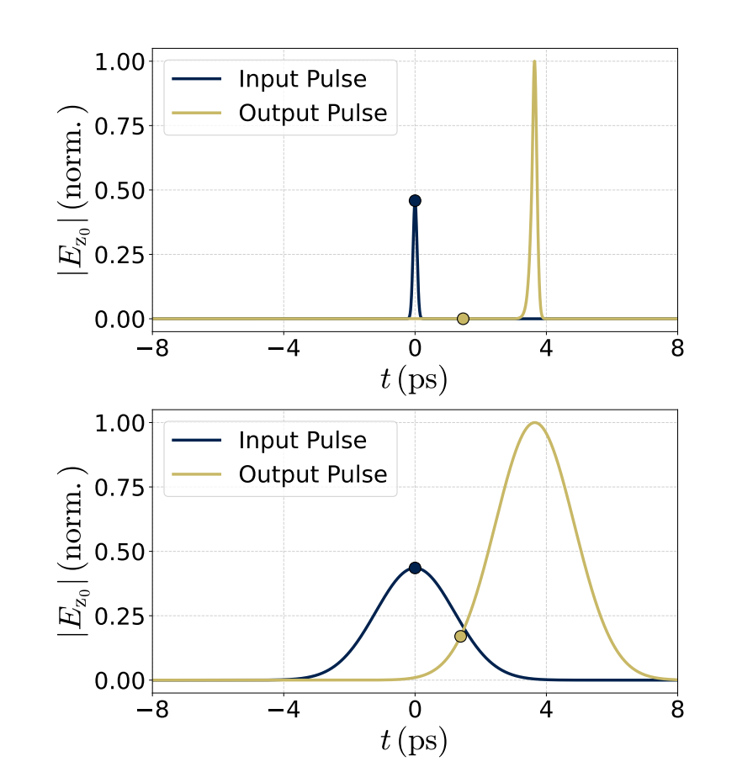
Self-consistent time-domain modeling
A fast BPM propagates the pulse envelope while particle dynamics updates the taper.
Model ingredients
Beam Propagation Method for the pulse envelope
local vg, k₂, k₃ from modal calibration
taper-induced field-amplitude variation
relativistic single-particle dynamics
self-consistent update of a(z)
Current status: manuscript in preparation / internal validation.
D. Guarnera et al., “Self-Consistent Time-Domain Modeling of Pulsed Dielectric Laser Accelerators,” manuscript in preparation (2026).
Pulsed model
Giuseppe Torrisi • INFN-LNS

Slide 30
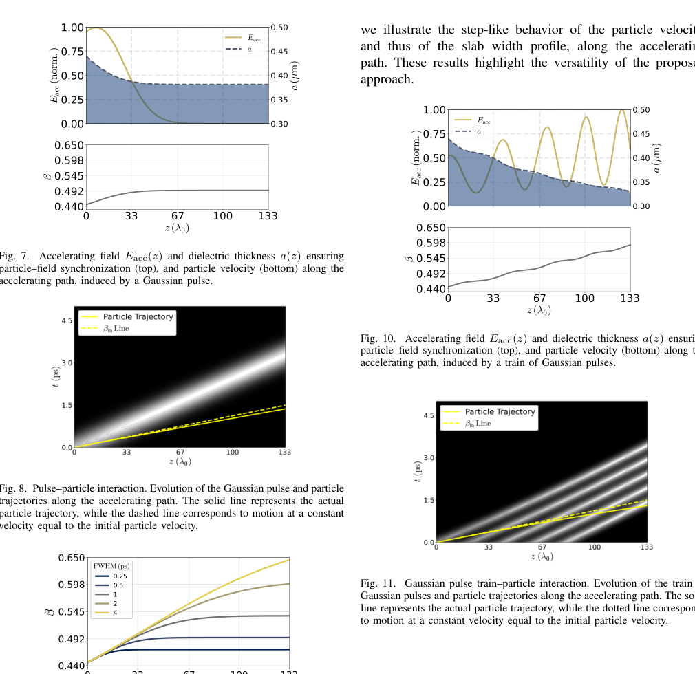
Single pulses versus pulse trains
Pulse duration and pulse timing directly control the usable interaction length.
Practical meaning
Shorter pulse → higher peak field but shorter useful overlap.
Longer pulse → better overlap but lower peak intensity for fixed energy.
Pulse trains can restore interaction regions while keeping fs-scale fields.
D. Guarnera et al., manuscript in preparation (2026).
Pulsed model
Giuseppe Torrisi • INFN-LNS

Slide 31
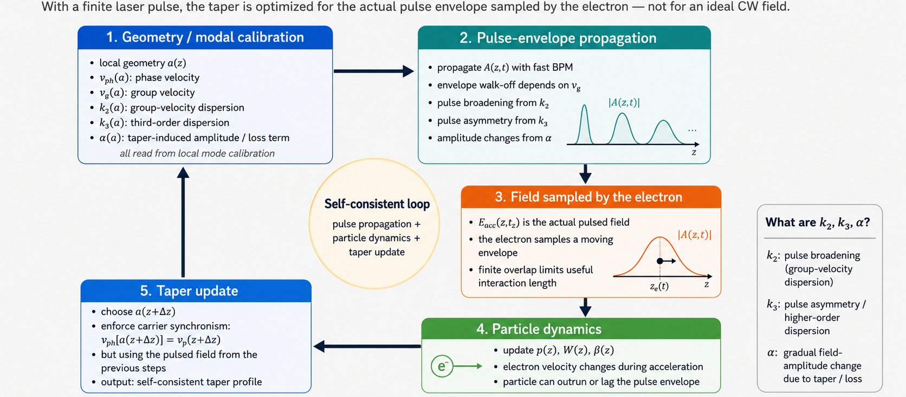
PULSE MODEL
In pulsed operation the taper is optimized considering the finite pulse envelope, dispersion, walk-off, and the actual field experienced by the electron.

Slide 32
Part II — Pulsed operation
The CW design optimizes only the phase velocity.
Phase matching is necessary, but in pulsed operation the useful acceleration length is set by envelope walk-off and dispersion
Our pulsed model solves self-consistently the propagation of the optical pulse, dispersion, envelope walk-off, particle dynamics and taper evolution.
As a result, the taper is optimized for the actual field experienced by the electron, not for an ideal continuous-wave field.

Slide 33
Part III — Hollow-core photonic crystal waveguides
A second structural branch to bridge from β ≈ 0.7 toward β = 1.

Slide 34

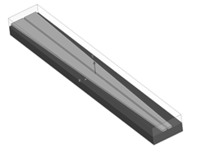

INFN contribution: Co-propagating Tapered Design
Multi-stage velocity-matched architecture
→ enables scalable, phase-synchronized acceleration
We consider different regimes based on particle velocity 𝛽=vp/c:
Slot waveguide [0.4<𝛽<0.65]
Photonic Crystal (PhC) waveguide [0.7<𝛽<1]
Woodpile [𝛽=1]
Giuseppe Torrisi

Slide 35
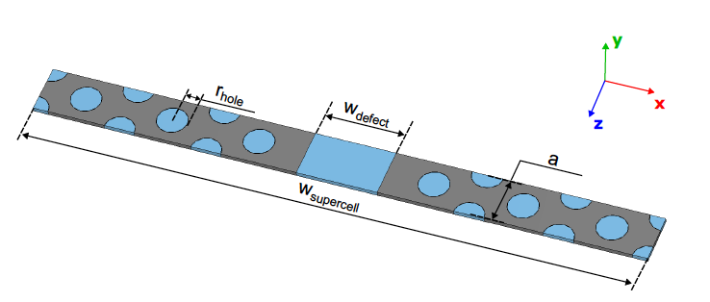
Hollow-core PhC waveguide for β ≈ 0.7 → 1
A triangular lattice creates a bandgap;
triangular lattice
bandgap
air holes
silicon ϵ_{r} = 11.9
Operating point: confined TM₀₁-like mode, with longitudinal E_{z} dominant in the hollow channel.
G. S. Mauro et al., “Design of a Tapered Triangular-Lattice Hollow-Core PhC Waveguide,” manuscript in preparation (2026).
PhC branch
Giuseppe Torrisi • INFN-LNS

Slide 36
Photonic Crystal Waveguide supercell for Acceleration
A triangular lattice creates a bandgap; a central defect traps a TM-like accelerating mode.
triangular lattice
central defect
bandgap
waveguide
air holes
silicon ϵ_{r} = 11.9
defect region/
particle beam channel.
Giuseppe Torrisi

Slide 37

Band Diagram & Operating Point
Intersection @ f₀ between
the synchronous mode and the light line
Light line
v_{p}=c
At this frequency, the mode becomes synchronous with relativistic electrons.
Giuseppe Torrisi

Slide 38



2D photonic crystal waveguide design procedure
a) computation of the band diagram of the triangular lattice primitive cell
b) computation of the projected band diagram of a triangular lattice supercell
c) add a hollow-core linear defect to the supercell
r
d
Giuseppe Torrisi
Creating the Accelerating Waveguide
Giuseppe Torrisi

Slide 39
2D photonic crystal waveguide design procedure
a) computation of the band diagram of the triangular lattice primitive cell
b) computation of the projected band diagram of a triangular lattice supercell
c) add a hollow-core linear defect to the supercell
r
d
Giuseppe Torrisi
Creating the Accelerating Waveguide
Giuseppe Torrisi

Slide 40

2D photonic crystal waveguide design procedure
a) computation of the band diagram of the triangular lattice primitive cell
b) computation of the projected band diagram of a triangular lattice supercell
c) add a hollow-core linear defect to the supercell
r
d
Giuseppe Torrisi
Creating the Accelerating Waveguide
Giuseppe Torrisi

Slide 41

2D photonic crystal waveguide design procedure
a) computation of the band diagram of the triangular lattice primitive cell
b) computation of the projected band diagram of a triangular lattice supercell
c) add a hollow-core linear defect to the supercell
r
d
Giuseppe Torrisi
Creating the Accelerating Waveguide
Giuseppe Torrisi
Notes:
We start from a photonic crystal lattice, which creates a bandgap.
Then we move to a supercell configuration to analyze the dispersion.
Finally, by introducing a central defect, we create a guided mode suitable for acceleration.”

Slide 42






2D photonic crystal waveguide
x
z
Confined TM01-like mode
Phase of E_{z} along z vs. $\frac{ω}{c}z$
|E_{z}|
|E_{x}|
|E_{z}|
|E_{x}|
z
x
z
Giuseppe Torrisi

Slide 43
2D photonic crystal waveguide
x
z
the structure supports a confined TM-like accelerating mode
How do we control the phase velocity to match the particle?

Slide 44

Tuning Phase Velocity via Defect Width
Increasing W → Increasing β
Giuseppe Torrisi

Slide 45
Tuning Phase Velocity via Defect Width
Increasing W → Increasing β
Giuseppe Torrisi
Notes:
By varying the width of the defect region, we can tune the phase velocity of the guided mode.
As the defect size increases, the phase velocity increases, allowing us to match different particle velocities.

Slide 46


Adiabatic Taper for continuous Phase Matching
parametrized taper by a progressive shift of the lattice
Structure adapts to keep phase synchronism
N is fixed by the taper length
w_{p} is the padding width to obtain a specific β
shift of the air rods along the transversal direction.
$$δ_{i}=\frac{i}{N}\frac{w_{p}}{2}$$

Slide 47

Confined Accelerating Mode
Eigenmode Simulation
nearby rods are shifted to tune the guided mode.
Hollow-core channel
Strong E_{z} field
G. S. Mauro et al., “Design of a Tapered Triangular-Lattice Hollow-Core PhC Waveguide,” manuscript in preparation (2026).

Slide 48

Longitudinal Field Dominates
Ez >> Ex
E_{z} (accelerating)
E_{x} ≈ 0

Slide 49

Phase Adaptation Along the Taper
β ≈ 0.7
β ≈ 1
Mode phase
(v_{p} = c)
(v_{p} = 0.7c)

Slide 50


Driven validation: side-coupler and TM-like mode conversion
Tapered waveguide with 𝜷=[𝟎.𝟕, 𝟎.𝟖𝟒], feeded by a 90-deg I/O side coupler.
Guided accelerating field
Particle path
G. S. Mauro et al., “Design of a Tapered Triangular-Lattice Hollow-Core PhC Waveguide,” manuscript in preparation (2026).

Slide 51

Driven validation: side-coupler and TM-like mode conversion
Tapered waveguide with 𝜷=[𝟎.𝟕, 𝟎.𝟖𝟒], feeded by a 90-deg I/O side coupler.
Guided accelerating field
Particle path
TE-like side-guide modes to-the-central TM-like accelerating mode.
G. S. Mauro et al., “Design of a Tapered Triangular-Lattice Hollow-Core PhC Waveguide,” manuscript in preparation (2026).
Side-coupler tuning element

Slide 52

Driven Response

Slide 53


Field and Phase Consistency

Slide 54

Fabrication of the Slot waveguide (INFN-Torino, CNR, INRIM and CNRS-C2N)
fabrication feedback
SOI stack tests initially considered
device-layer thickness tolerance can be limiting
a-Si deposition on SiO₂ may give better process control
thermal conductivity and optical losses remain to be tested
Notes:
This slide should make clear that fabrication is not an afterthought. The design has already generated feedback on wafer stacks and process control. If the silicon thickness after etching is not sufficiently controlled, deposited amorphous silicon may be a better route. This is also why the optical test structures should include converters and launcher coupons, not only the final accelerating geometry.

Slide 55
Fabrication of the Slot waveguide (INFN-Torino, CNR, INRIM)
The work has been focused on Si on SiO2 stack tests in order to identify the optimal process.
The goal is to print the first selected accelerating structure, the slot waveguide (λ = 2 µm).
  • D​i​s​p​l​a​y​e​d​ ​W​i​d​t​h​:​ ​5000 nm
  • L​a​y​e​r​ ​1​:​ ​SiO2
  • T​h​i​c​k​n​e​s​s​:​ ​2 µm
  • L​a​y​e​r​ ​2​:​ ​Si
  • T​h​i​c​k​n​e​s​s​:​ ​500 µm
  • L​a​y​e​r​ ​3​:​ ​SiO2
  • T​h​i​c​k​n​e​s​s​:​ ​2 µm
  • L​a​y​e​r​ ​4​:​ ​Si
  • T​h​i​c​k​n​e​s​s​:​ ​2 µm
SiO2
Si
Starting from a commercial structure, the goal was to try to etch some thickness to layer 4 in order to get to the wanted thickness for the structure (250 nm).
Etch results: the tollerance in the device layer thickness (± 10%) do not allow for a good control of the final Si layer thickness.

Slide 56

Fabrication of the Slot waveguide (INFN-Torino, CNR, INRIM)
Solution: avoid etching the Si of the layer given by the supplier and make the two waveguides by Si deposition on the SiO2 layer 3.
This way can be pursued by using amorphus Si (instead of polycristalline Si). This shall not impact on the material electric properties ($ε_{r}$, $tangδ$).
SiO2
Si

Slide 57


SLOT WAVEGUIDE Fabrication (CNRS/C2N)
reality check: nm-scale tapering
CNRS/C2N processed an INFN slot-waveguide test with a nominal width variation of only 3 nm
Key numbers
• SOI: 220 nm Si on 2 µm SiO₂
• 100 keV EBL, positive ZEP resist
• standard ICP etch; no Si smoothing
• measured width difference ≈ 2.7–3.0 nm
Conclusion: 3 nm variation is processable and measurable; roughness must still be improved.
Giuseppe Torrisi • INFN-LNS

Slide 58
Part IV — Experimental coupling strategy
A realistic route from optical to accelerating-mode validation.

Slide 59
Experimental strategy at 2 µm
1
End-fire / cut-back
2
Two-arm phase-controlled coupling
3
Future pulsed DLA roadmap
T(λ), cutoff, propagation loss α(λ), converter loss
grating efficiency, Δφ=0/π, mode selection
Satsuma pump → OPA/OPG at 2 µm, fs diagnostics, e-beam integration
Notes:
For the experimental part, I would emphasize the staged logic. First, measure the passive optical platform: transmission, cutoff and propagation loss using end-fire and cut-back structures. Then move to a Zhao-like two-arm architecture to test phase conditions and modal selection. Only later does it make sense to move to a pulsed DLA experiment with 2 micron femtosecond light and electron beam integration.

Slide 60

INFN-LNS laser roadmap: Satsuma is the first-light platform
The 1030 nm system is operational
Satsuma X-28 available at LNS
1030 nm source: first-light and pump laser
~420 fs pulses, ~30 W average power class
2 µm DLA test requires OPA/OPG or equivalent source
The 1030 nm Satsuma X-28 is installed, commissioned and already usable for first-light work.
The acceptance report confirms sub-500 fs pulses, about 30 W average power, and excellent 11.3 h power stability.
For the DLA experiment, the key point is that this is the near-term beam-delivery and diagnostics platform;
Giuseppe Torrisi • INFN-LNS

Slide 61

EPITA context
WP5 laser-driven acceleration is one of the EPITA technology areas.

Slide 62

INFN-iDLA and EU-HE-EPITA: from design to prototype and test
The activity is embedded in INFN CSN5 and in the
European WP5 laser-driven acceleration roadmap.
EPITA WP5 — Task 5.5
Co-propagating DLA structure
Partners
INFN/LNS, PSI, FAU/LMU, SENSIC
Prototype goal:
enhanced DLA performance through co-propagating dielectric structure
[from EPITA WP5 introduction slides, A. Maier (DESY), 13.05.2026]
Notes:
The final scientific roadmap is not only internal. EPITA WP5 includes a task on co-propagating DLA structures, with INFN-LNS and the listed partners. the activity has an experimental and collaborative trajectory beyond a single simulation paper.

Slide 63
Conclusion
1
2
3
Phase matching engineered
Co-propagation offers a scaling route
Real operation requires coupled modeling and experiments
For sub-relativistic electrons, β changes and the structure must adapt.
Slot and hollow-core PhC structures provide guided interaction along the beam path.
Pulses, fabrication, coupling and beam dynamics must be designed together.
Co-propagating hybrid tunable phase-matched structures are a realistic path from local high gradients to controlled energy gain.
Giuseppe Torrisi • INFN-LNS
Notes:
I would close with these three messages. First, phase matching is a design problem, especially below the relativistic regime. Second, co-propagating structures give a natural scaling route. Third, the next step requires coupled modeling and experiments: pulsed laser dynamics, fabrication constraints, optical coupling and beam dynamics have to be considered together.

Slide 64
Co-propagating Dielectric Laser Accelerators for compact high-gradient particle acceleration
Thank you
Giuseppe Torrisi • INFN–LNS, Catania, Italy
G. S. Mauro, D. Mascali (INFN-LNS), A. Bacci (INFN-Milano)
R. Palmeri (UniRC), A. Locatelli (UniBS), L. Vincetti (UniMoRe), G. Sorbello (UniCT)
Advanced Accelerator Concepts 2026 • UCLA

