Slide 1

High Power Test of Ultra-Short High Gradient Cavities by RF Pulse Compression
Ankur Dhar, Wei-Hou Tan, Juan Hernandez, Emilio Nanni
AAC 2026
July 28th, 2026

Slide 2
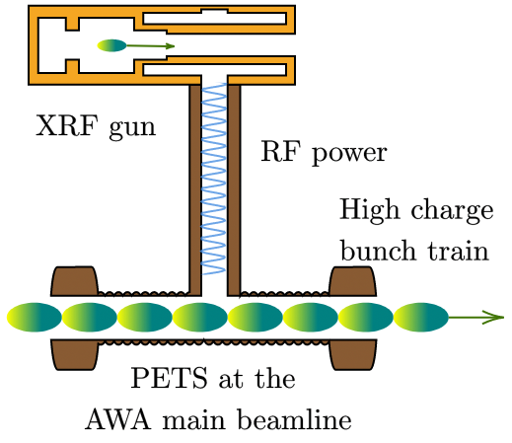
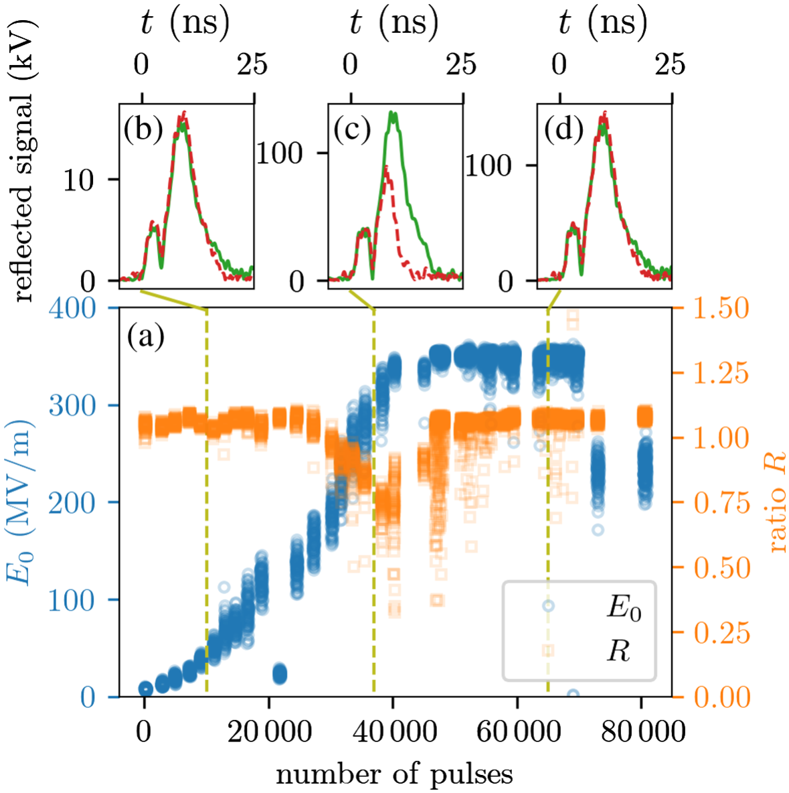
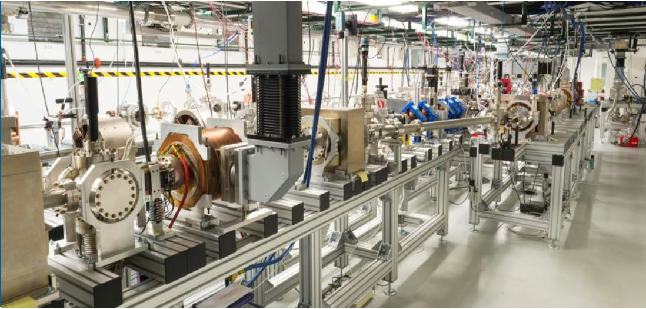
Higher Brightness through High Gradient
Previous work at Argonne Wakefield Accelerator (AWA) used ultrashort (<20 ns) RF pulses to achieve surface fields <400 MV/m for a 10X improvement in beam brightness and very low dark current.
Ultrashort RF Pulses
AWA Approach: Requires Stand Alone High-Charge Linac and Power Extraction Transfer Structure (PETS)
Increased Surface Fields
Tan et al., PRAB 25, 2022.
RF pulse compression, a SLAC expertise, provides similar high peak power.

Slide 3
Compressed Ultrashort Pulse Injector Demonstrator
Developing higher brightness photo-injectors is a crucial R&D focus for increasing our facilities’ scientific reach
One method to enable higher brightness beams is by increasing the electric field on cathode
Ultrashort RF pulses (<20ns) can produce these higher cathode fields with fewer breakdowns
We can utilize a novel ultrashort RF pulse compression network within TID to test this concept directly
Goal within two years is to design, build and test a RF gun cavity powered by an RF pulse compression network
Simulations of a full photoinjector show an order of magnitude increase in hard x-ray (40 keV) performance
High power testing of cavities with pulse compression has demonstrated cathode gradients of 400 MV/m.
RF Pulse
Compression
Higher
Cathode Field
Higher
Brightness
Greater
Science Reach
X. Wang, P. Musumeci, E. Lessner, and J. Goldstein, 2016.

Slide 4
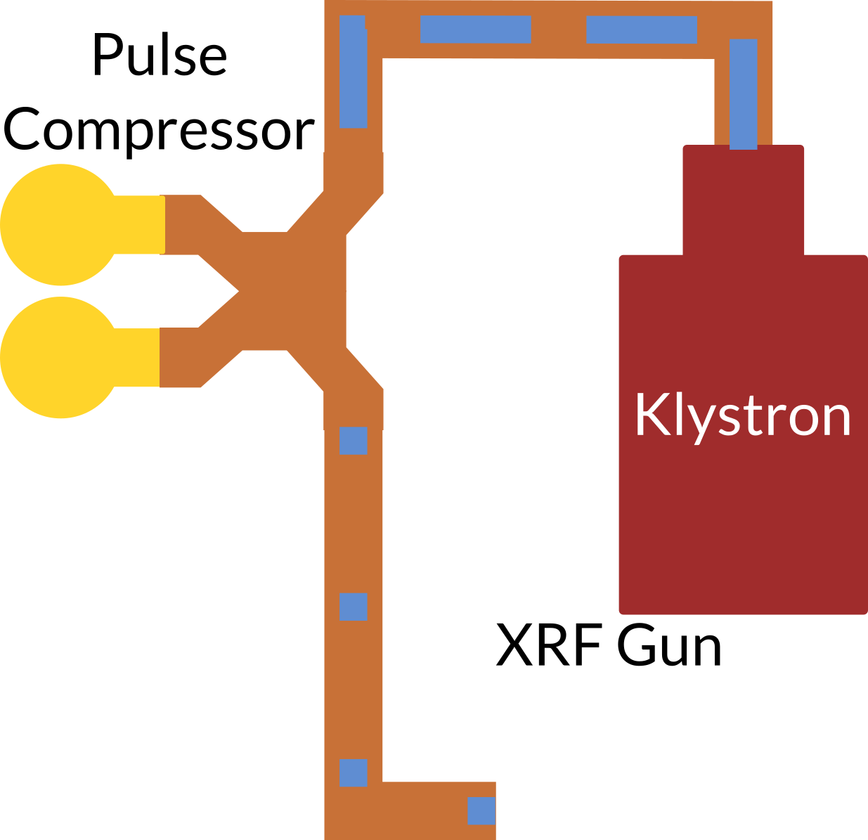
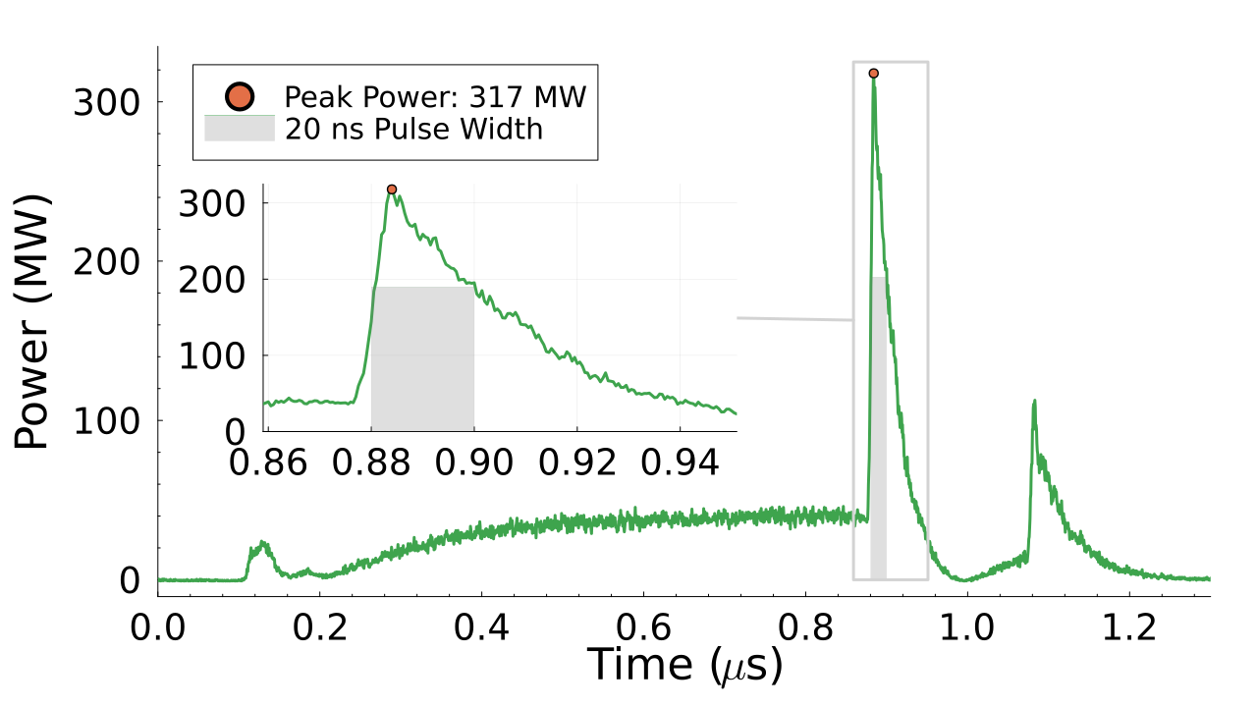
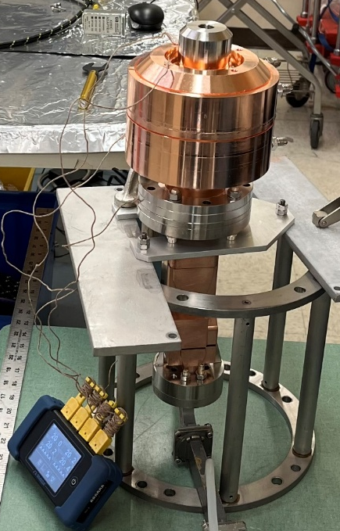
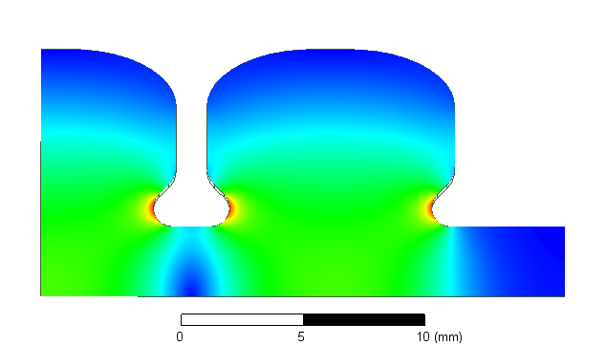
RF Pulse Compression
Utilizing a compact SLAC Energy Development (SLED) by filling a high Q resonator with energy over several µs
This energy is then released over a much shorter interval by flipping the RF phase, resulting in a net power gain of 6-8X
Our work is based on systems used for the TCAV project
Pulse from recent work
Franzi et al., PRAB 19, 2016
Wang et al., PRAB 20, 2017
A. Dhar et al., arXiv (2026)
SLED Cavity

Slide 5
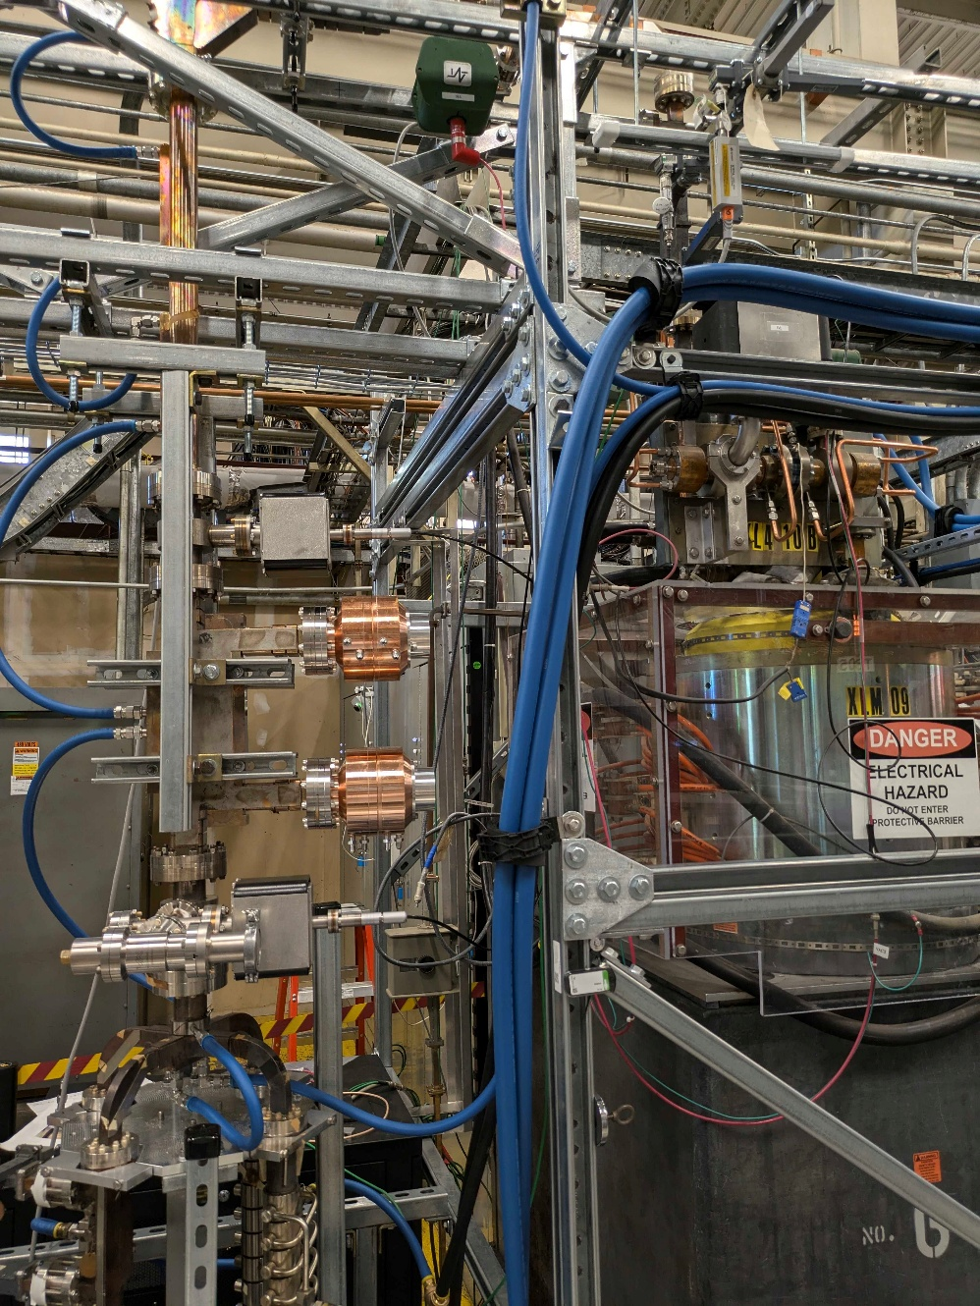
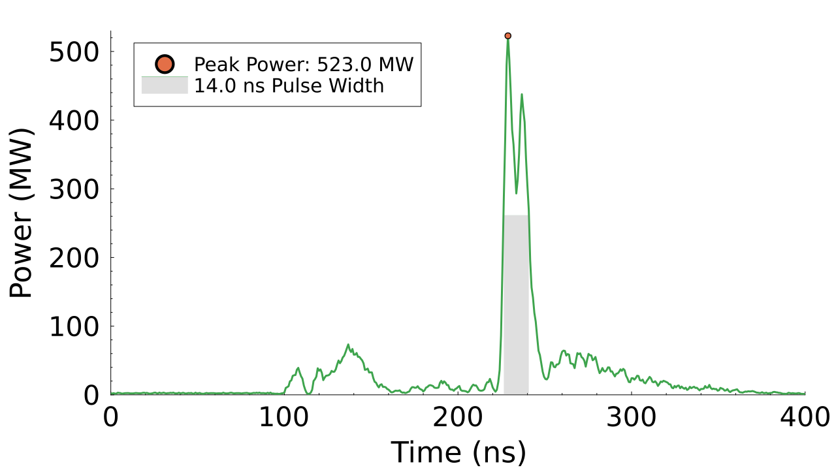
RF Pulse Compression Network at SLAC
50 MW
XL-4 klystron
50 MW
XL-4 Klystron
Directional
Coupler
High Power Hybrid
RF Load
High Power hybrid
SLED
Spherical cavities
RF Load
Klystron
SLAC-built RF pulse compression system recently used to compress pulses from 50 megawatts over 1 µs to 317 megawatts over 2 ns.
Further development power combining two 50 MW klystrons has produced up to 510 MW.
System used to high power test short-pulse gun cavities
Load
Examples of compressed RF pulses

Slide 6
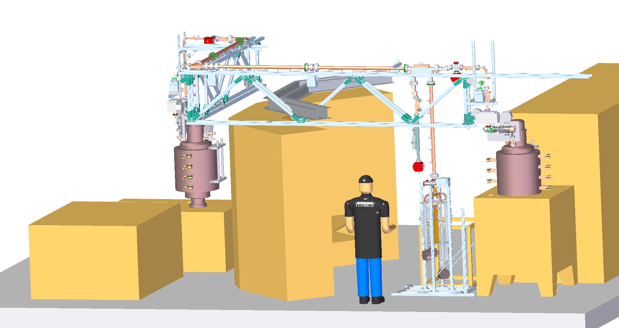
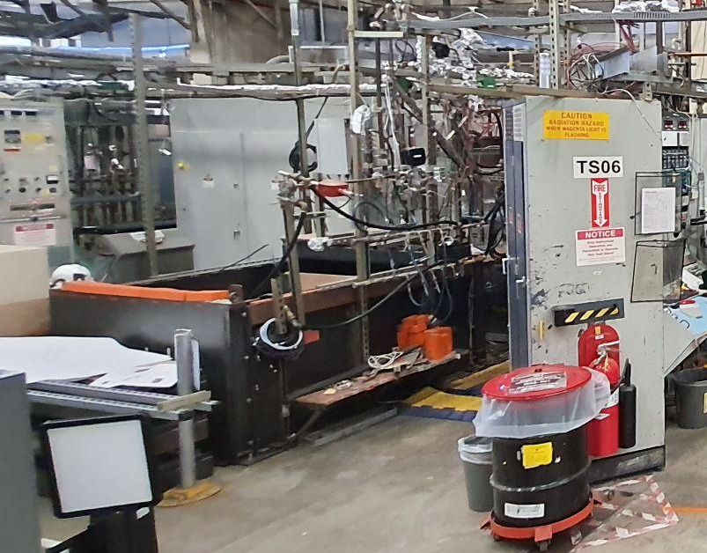
Capabilities for High Power Testing
A lead-shielded radiation enclosure is available to house the gun cavity while under high power testing.
Enclosure
Controls
TS04
TS06
Pulse Compressor
Enclosure

Slide 7
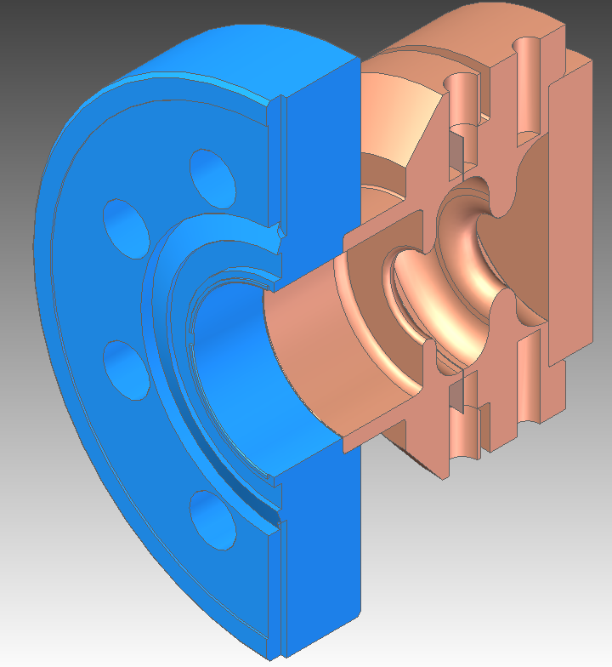
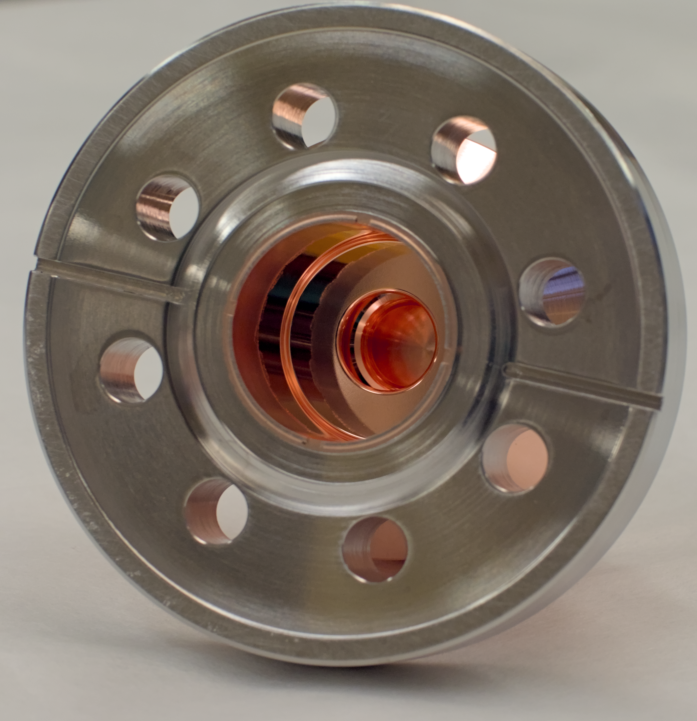
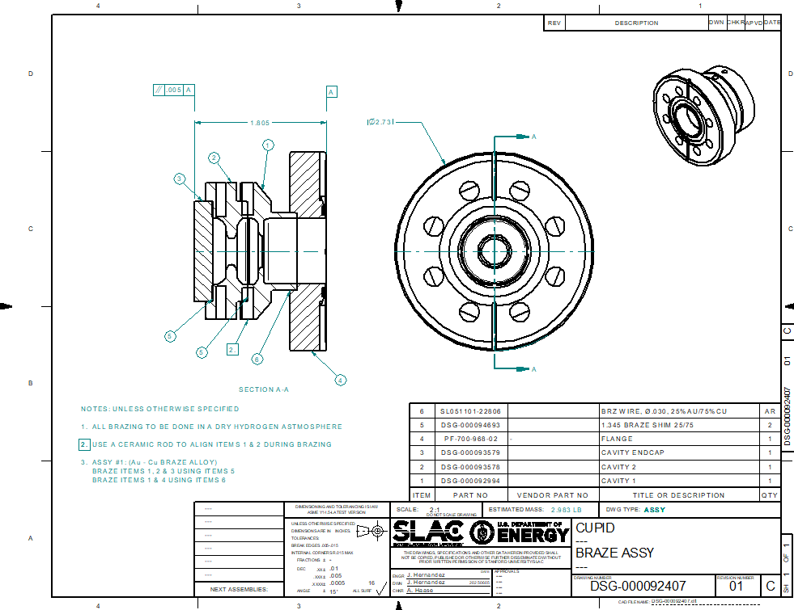
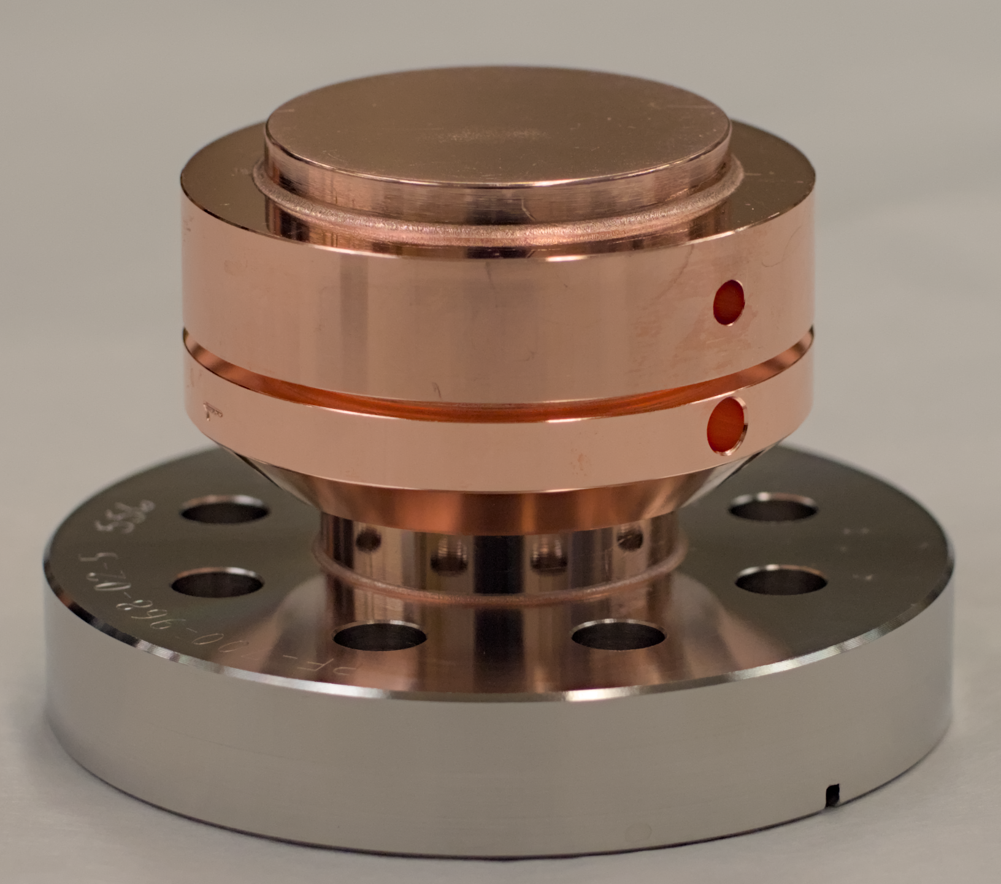
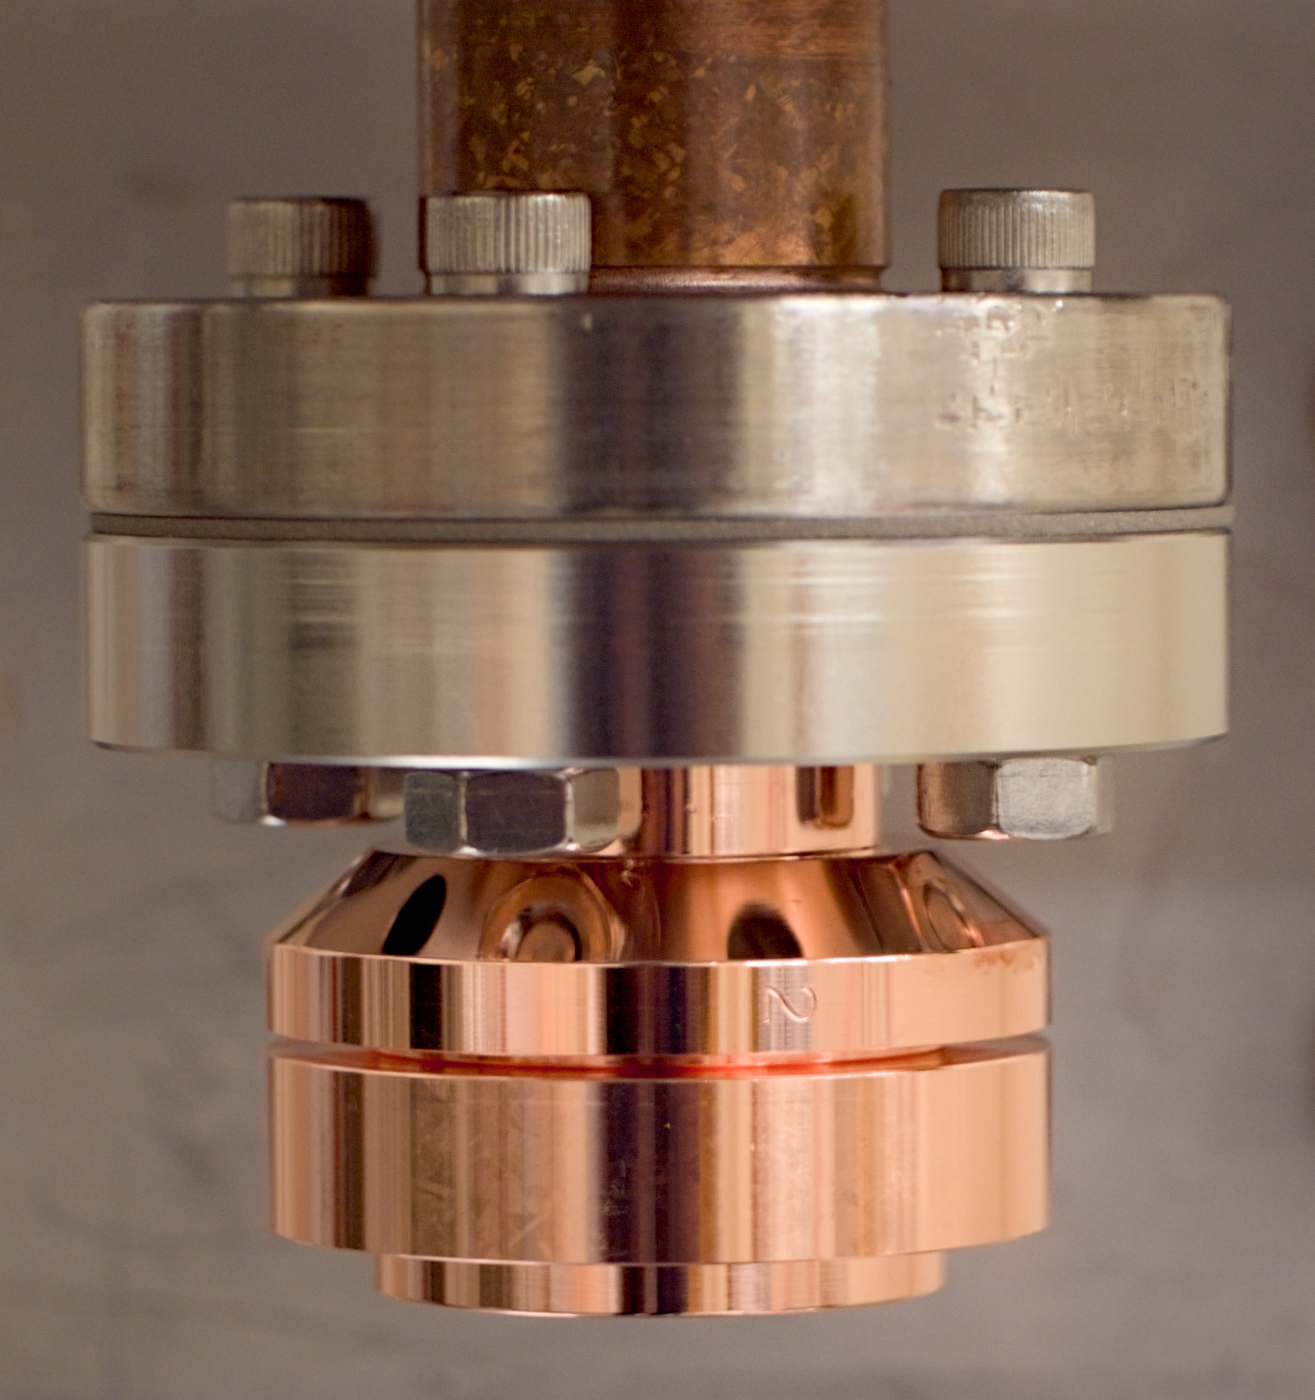
Mechanical Details of the Cavity and Assembly
Diffusion bonded assembly of 1.5 Cells

Slide 8
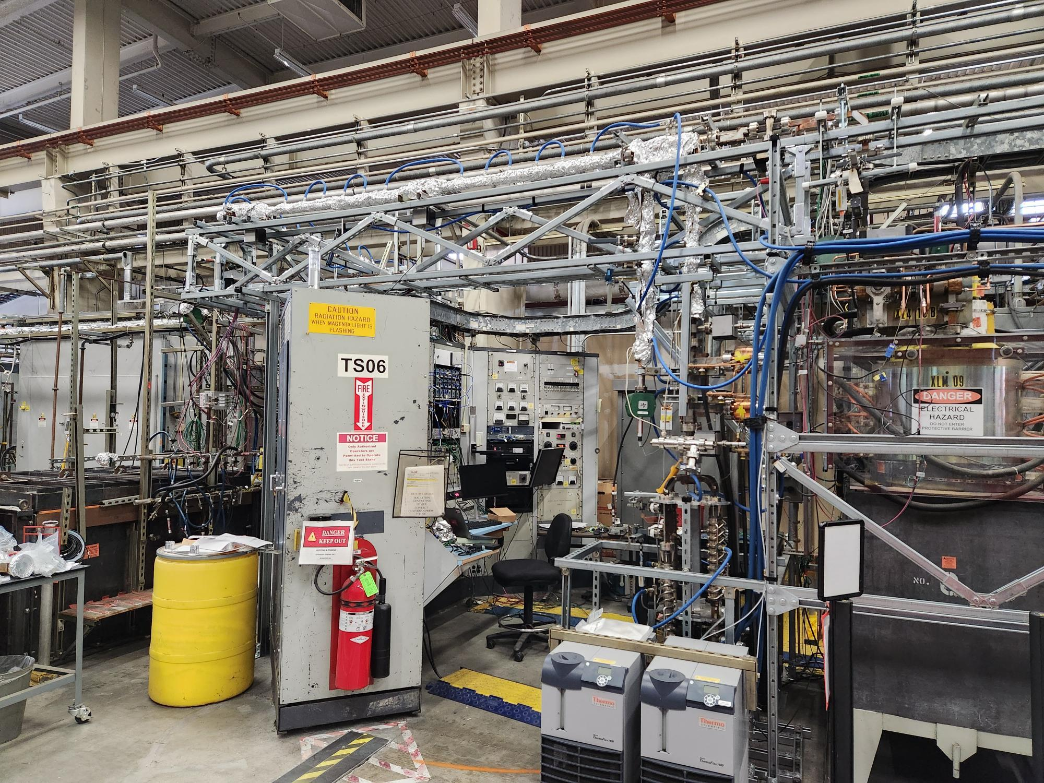
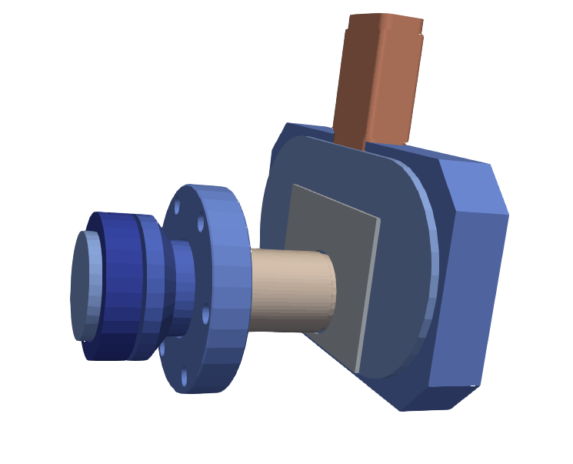
Installation for High Power Testing
Waveguide is routed overhead and down into enclosure, building upon current scaffolding.
Waveguide hybrid is used to protect reflected power from going back to klystron.
Cavities are powered by TM01 mode launcher used for previous single cavity experiments
Faraday cup is installed to measure dark current emitted by cavity
Waveguide
TM01 mode launcher
CUPID electron gun
Klystron
Enclosure

Slide 9
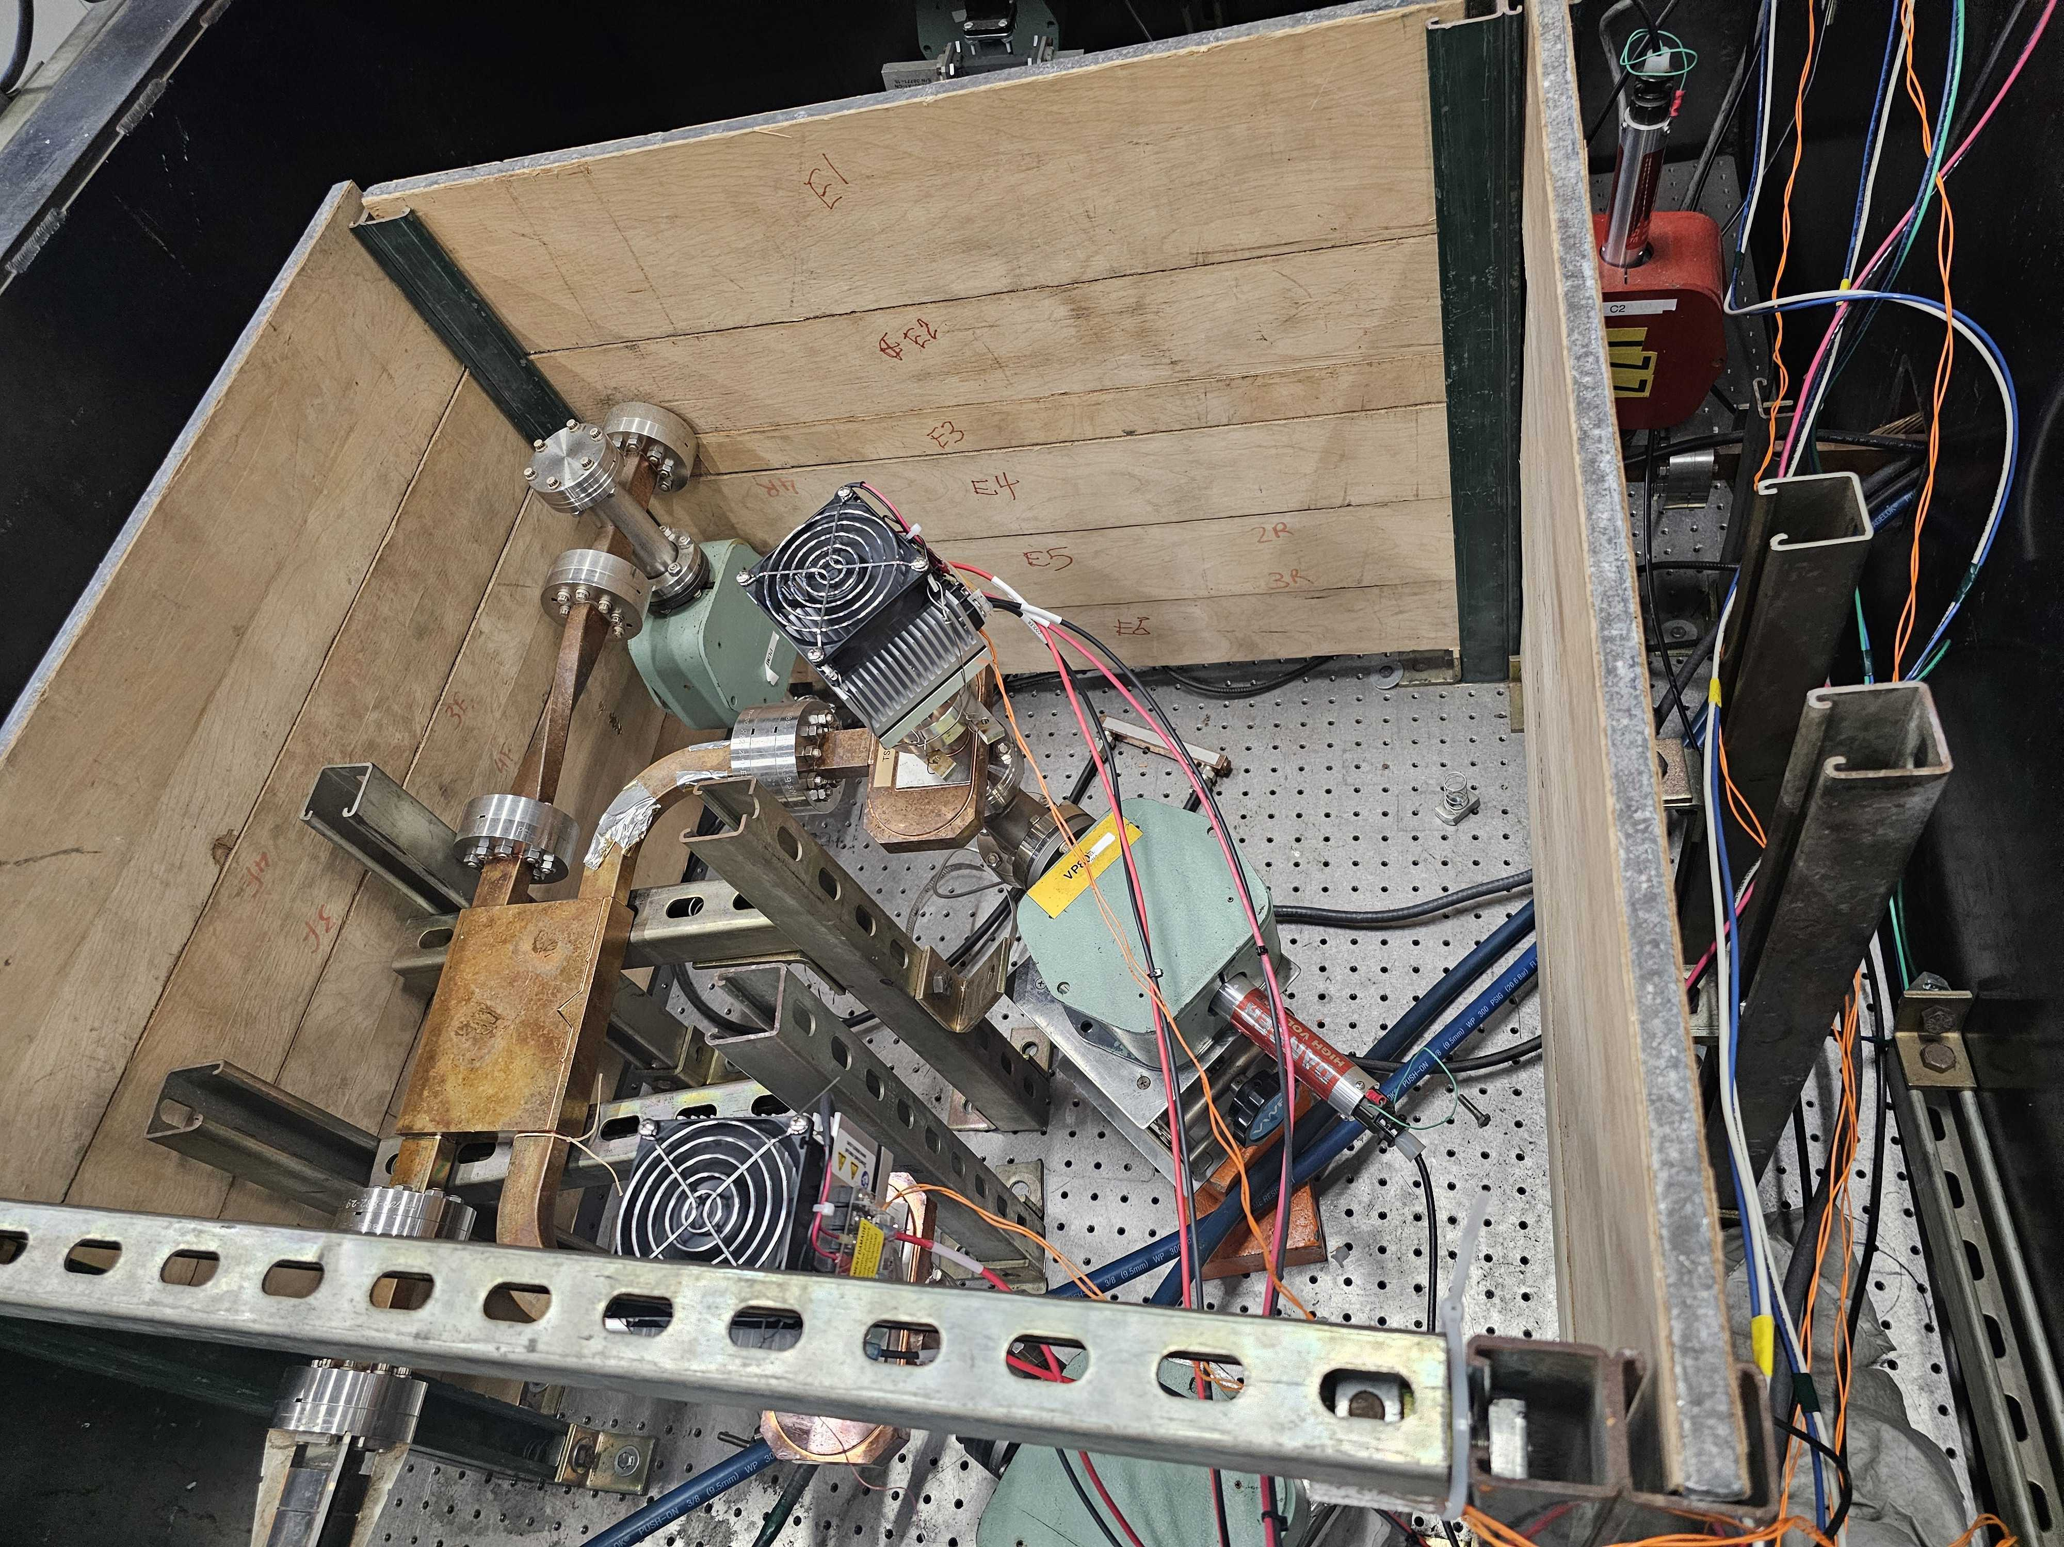
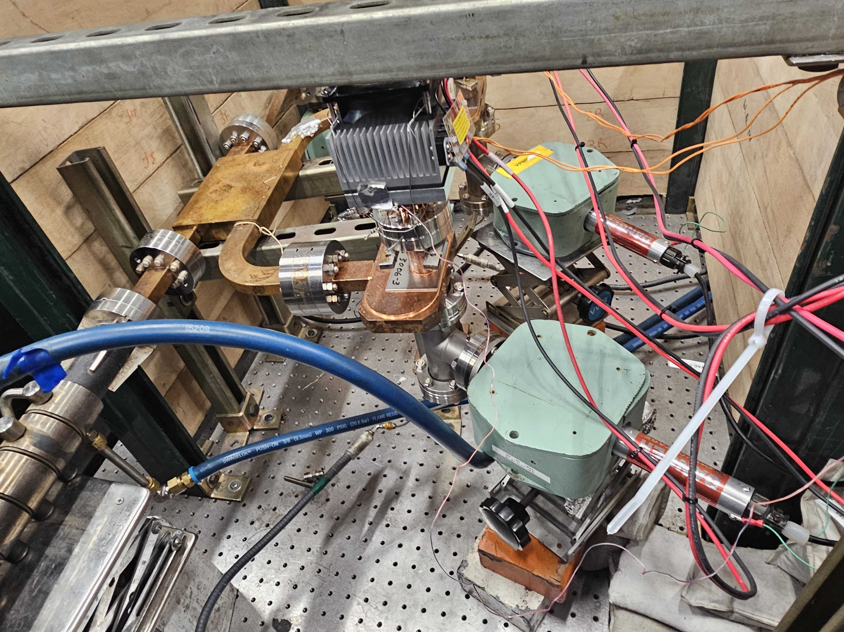
Installation for High Power Testing
Second hybrid is used to protect reflected power from going back to SLED, two cavities tested at once.
Cavities are attached to thermoelectric coolers for temperature stability up to 30 W average power
Initially we would limit testing to 10 Hz to ensure both cavities remains in tune
Thermoelectric Cooler
Thermoelectric Cooler with Cavity
Hybrid
TM01 Mode Launcher

Slide 10
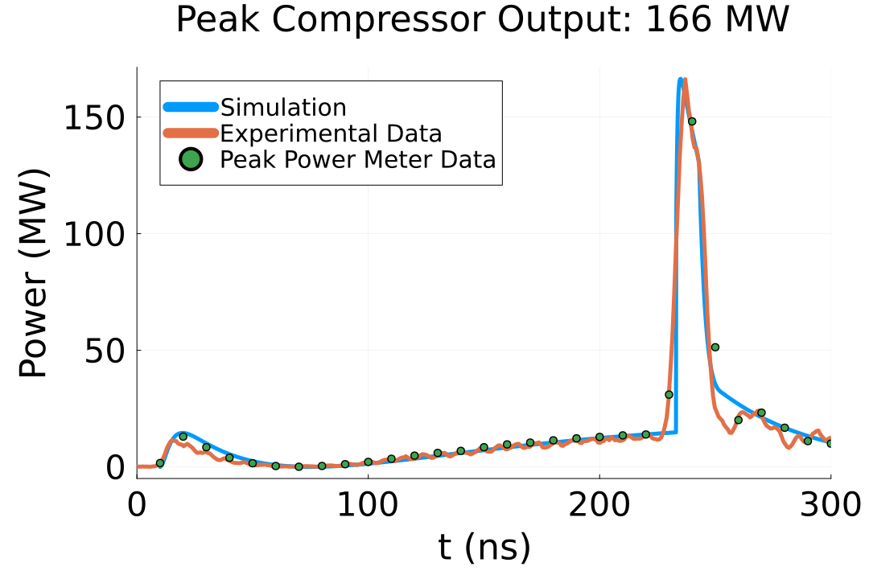
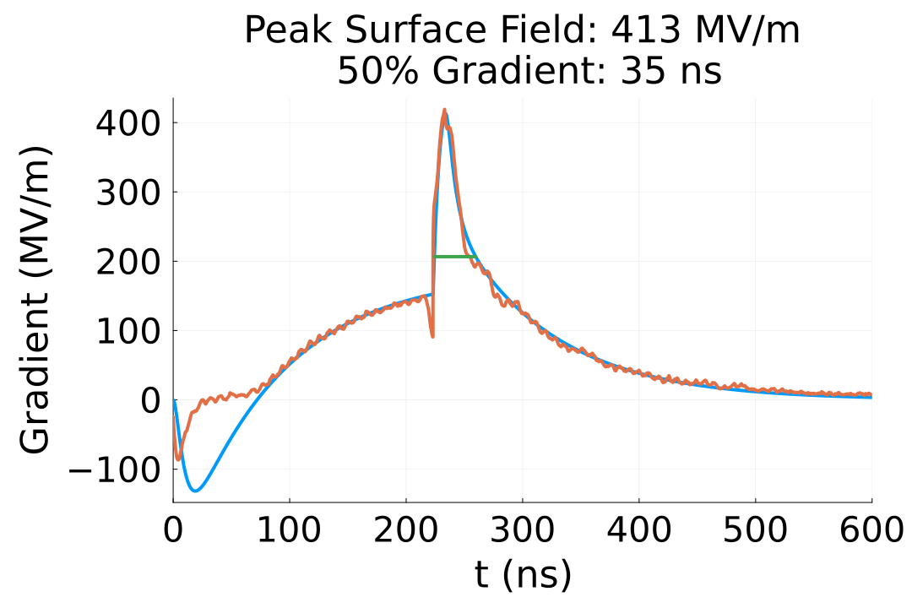

Demonstration of High Power Short Pulses at SLAC
Fabricated test cavity after diffusion bonding
Compressed RF power into a single cavity
Surface field on cathode for single cavity
Cavity Assembly
  RF pulse compression system was used to compress pulses from 55 MW over 300 ns to 330 MW over
  35 ns FWHM to power two test cavities in parallel.
  Based on cold test measurements and cavity simulations, surface fields in each cavity have reached 400 MV/m.
  In a full photo-injector, this could provide an output emittance of 90 nm for 100 pC bunch (more info in talk by W.H. Tan.
Faraday Cup
Test cavities installed in lead enclosure

Slide 11
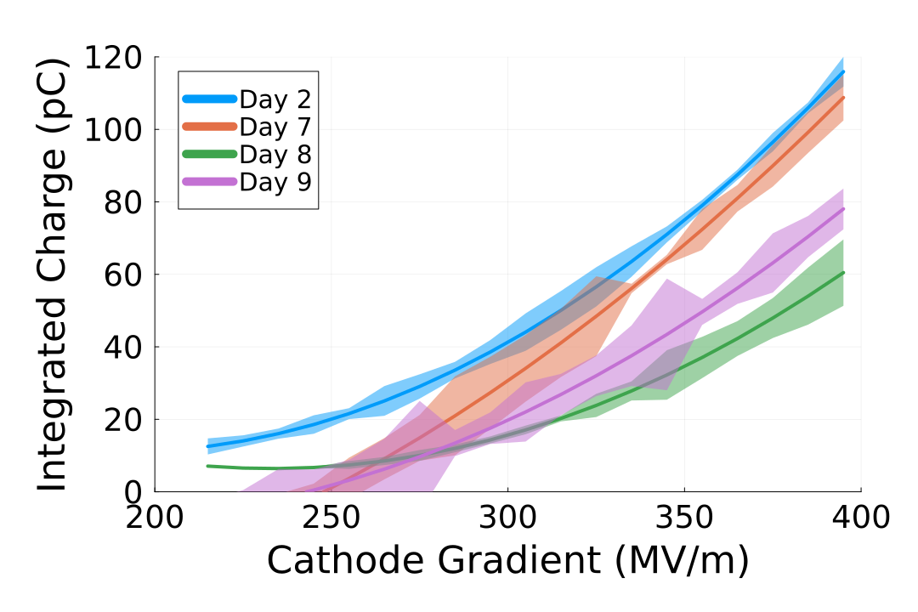
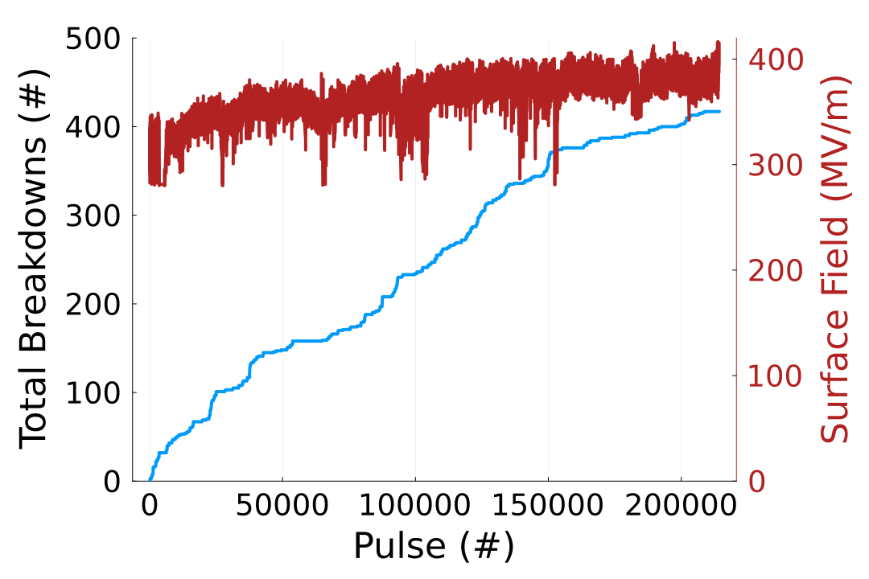
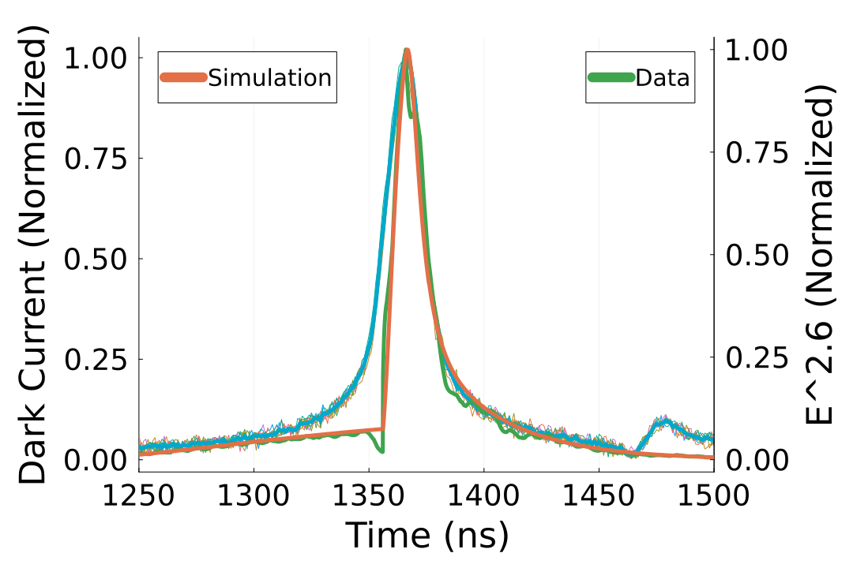
Dark Current Charge Quantification
Data from one faraday cup collected over 7 days, with a total of over 295997 pulses in that time
Emission rose on final day due to aggressive conditioning to reach 400 MV/m
Dark current approximately follows E^{2.6} scaling, fit based on normalized data and fall time
Time response of faraday cup seems too slow for rise time, more studies required to understand this temporal response accounting for capture, emission physics, and instrumentation
Dark Current Charge versus
Cathode Gradient per Day
Breakdown Summary over 7 Days
Dark Current Pulse versus
Normalized Cathode Gradient

Slide 12
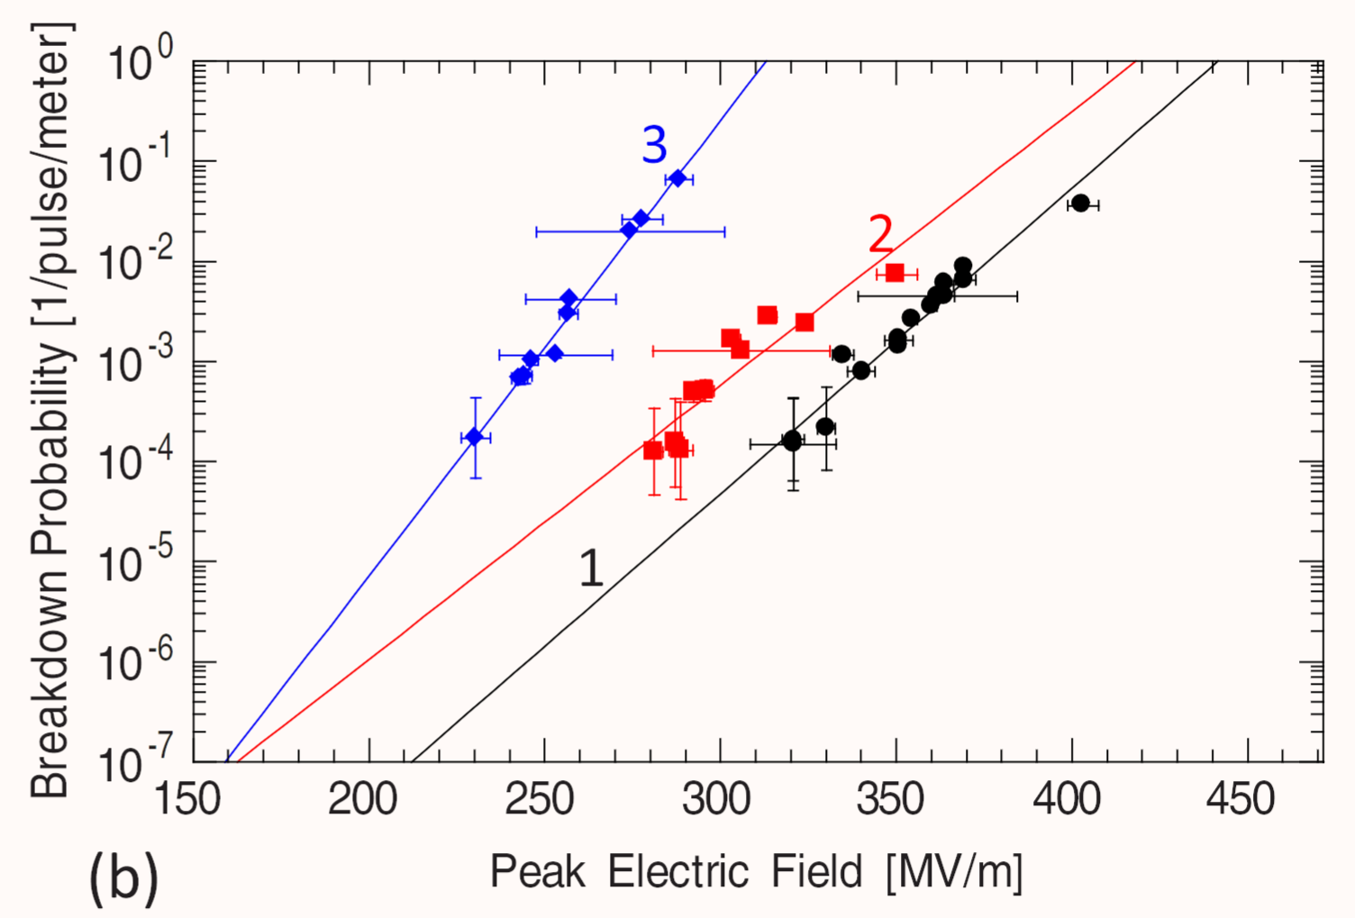
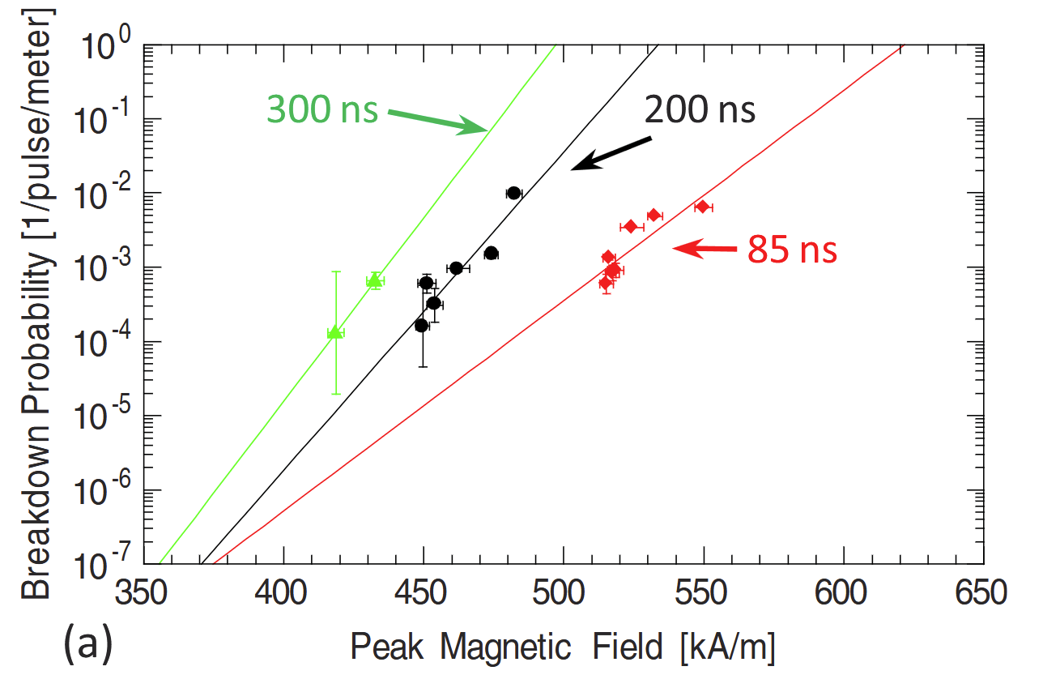
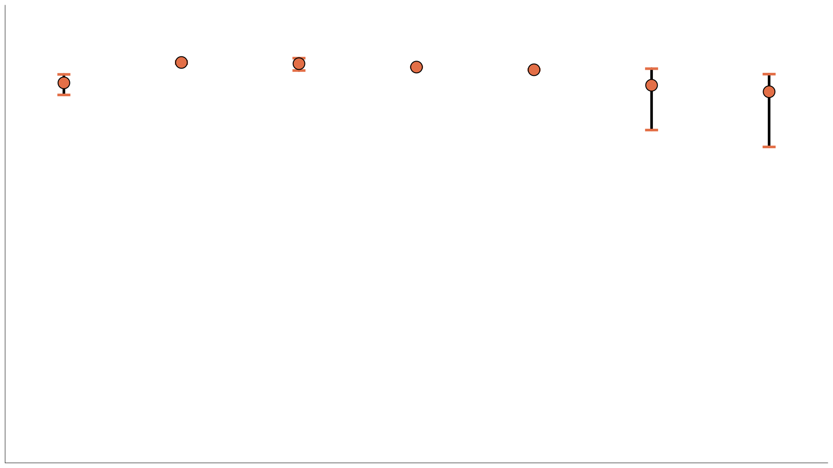
Breakdown Statistics Estimate
Comparing breakdown rate to peak H field shows current rate around 0.05 between 600 to 700 kA/m
This sets an upper bound on attainable breakdown rate compared with previous single cell tests at SLAC
For comparison, these previous measurements used 10⁷ pulses, whereas we are at 3x10⁵ pulses
Peak pulsed surface heating is around 35° C based on a similar pulse shape with 35 ns FWHM
CUPID
35 ns
https://pubs.aip.org/aip/apl/article/97/17/171501/121358/Geometric-dependence-of-radio-frequency-breakdown

Slide 13
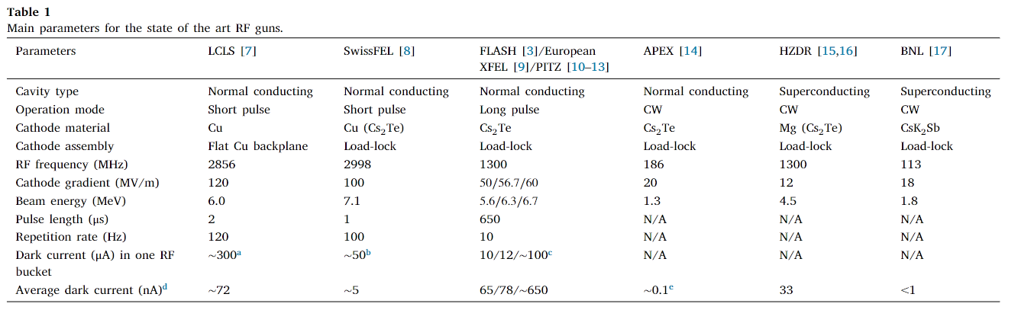
Comparison to Other Photo-guns
Assuming the following:
Dark current charge of 60 pC
120 Hz rep rate
Average dark current becomes 7.2 nA,
However, these values were collected with a solenoid to maximize dark current on Faraday cup, so average dark current may be higher in operational conditions
https://doi.org/10.1016/j.nima.2021.165546

Slide 14
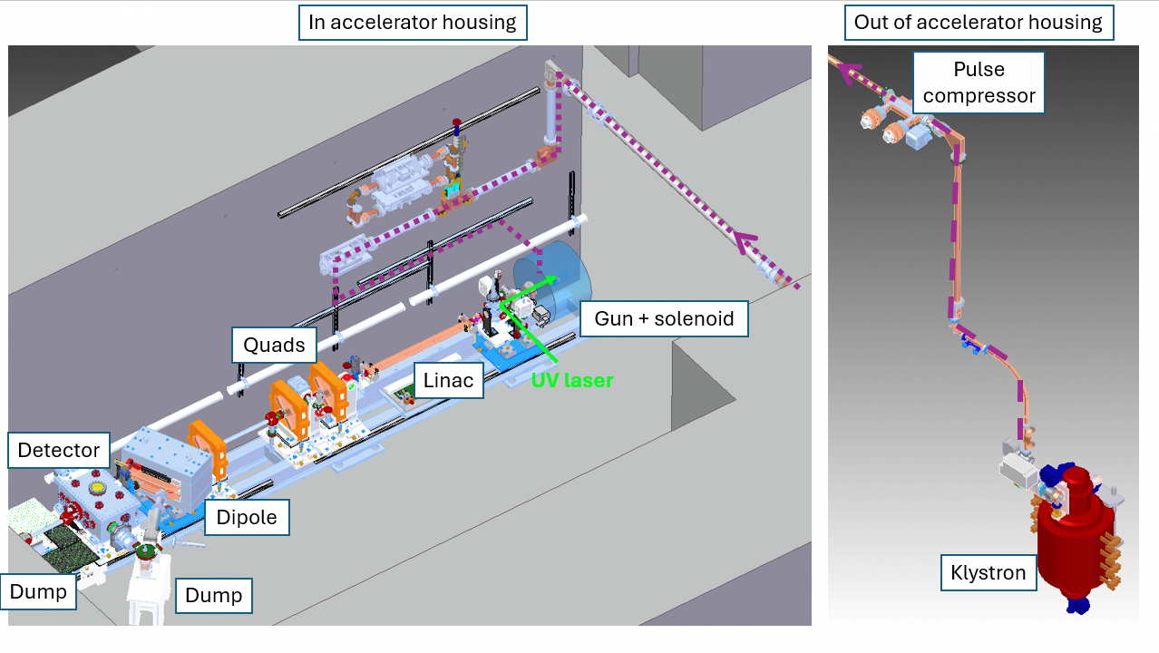
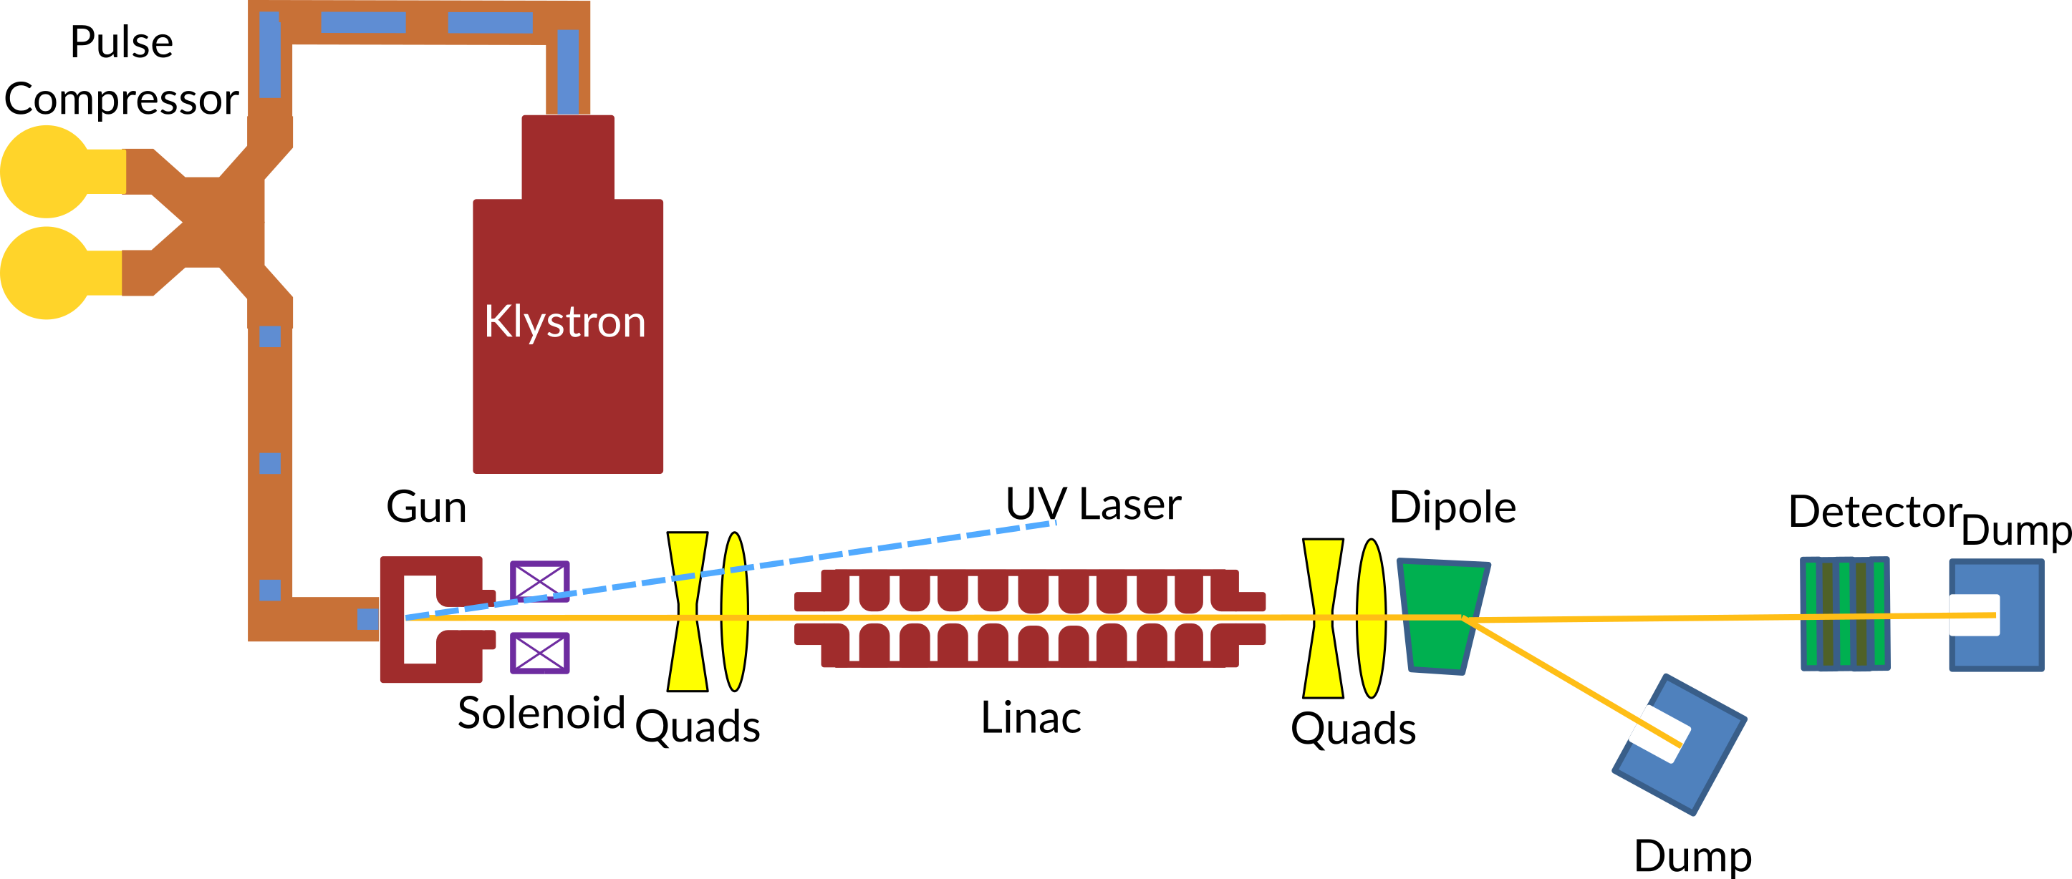
Phase II: Objectives and Resources
Based on our current design study, we would aim to build a photo-injector capable of <90 nm emittance, enabling a transformative improvement over existing performance at LCLS-I and UED.
This photoinjector would require the following key components:
New RF gun cavities with integrated coupler (built at SLAC)
UV laser for photoemitted electron bunch (repurposed at SLAC)
Solenoid for focusing electron bunch (procurement)
RF source: 50 MW X-band klystron (repurposed at SLAC)
RF pulse compression system (built at SLAC)
Low-level RF system to enable pulse compression (COTS plus SLAC development)
Linac for emittance compensation out of the gun (repurposed at SLAC)
Diagnostics for beam characterization (repurposed at SLAC)
Could be sited at FACET-II or NLCTA

Slide 15
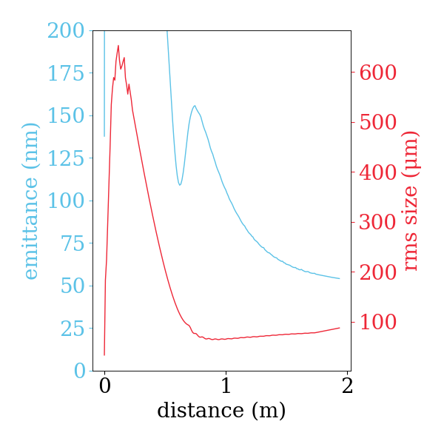
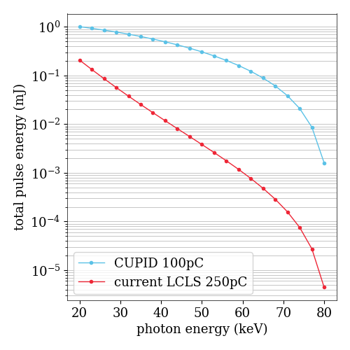
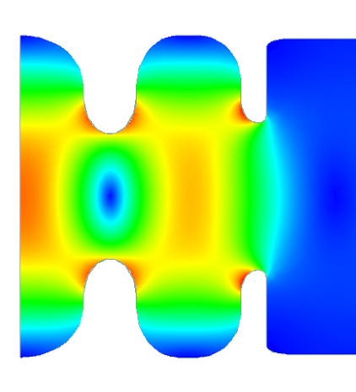
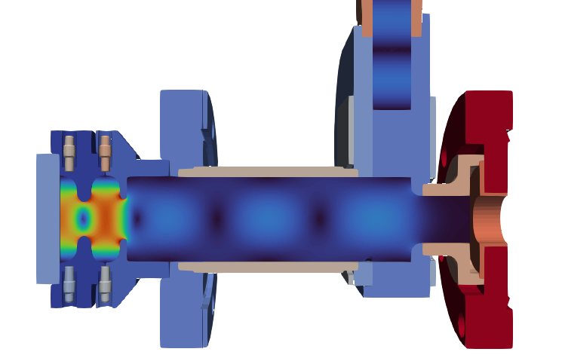
Major Takeaways
Using RF pulse compression can leverage existing SLAC expertise and infrastructure to generate brighter beams, which will dramatically advance the science reach of our facilities
RF Pulse
Compression
Higher
Cathode Fields
Higher
Brightness
Greater
Science Reach
See Next Talk for more information on CUPID

Slide 16
Questions?

Slide 17
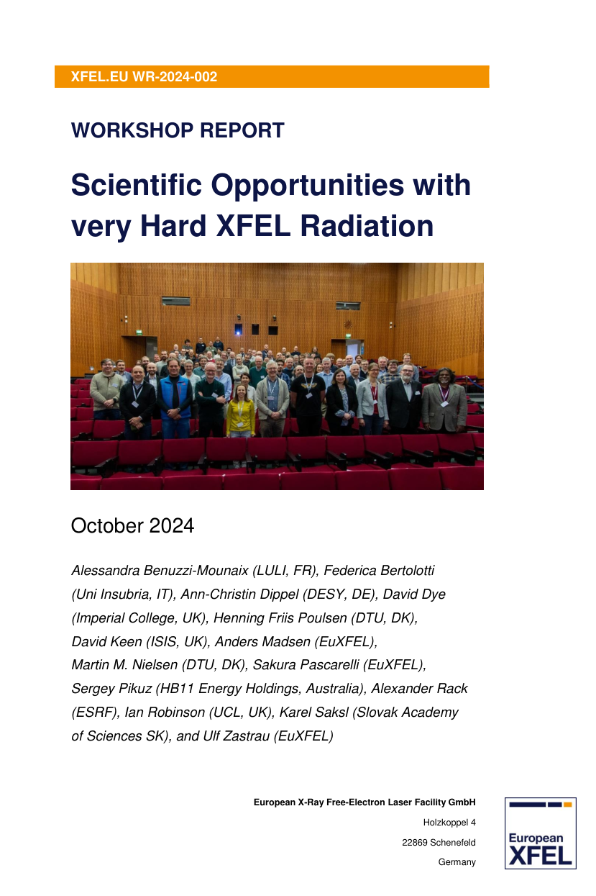
Science Drivers for Hard X-ray Photons at LCLS
Pushing to high energy photons enables larger penetration depth for complex sample environments
Mesoscale measurements of material structure and damage mechanisms for programs of national interest
Studying structural dynamics in disordered materials that cannot be measured in reciprocal space
Core-level spectroscopy of heavier elements and nuclear resonances
Reduced radiation damage for high repetition rate tracking of pumped dynamics
Benuzzi-Mounaix, A. et al. Scientific Opportunities with Very Hard XFEL Radiation. https://xfel.tind.io/record/3917 (2024) doi:10.22003/XFEL.EU-WR-2024-002.

Slide 18
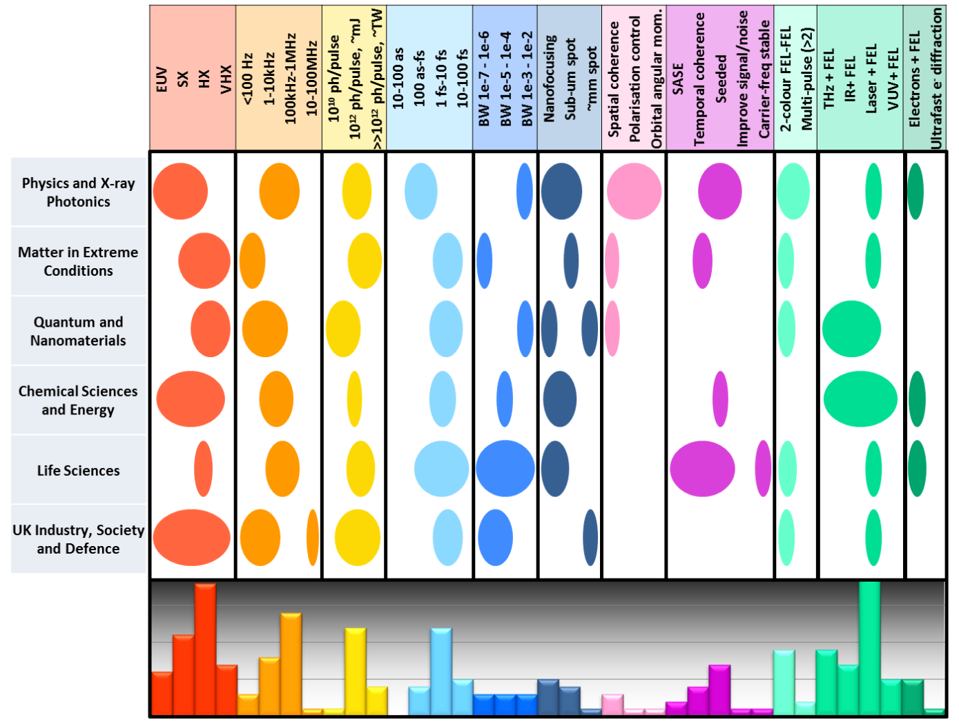

Science Drivers for Hard X-ray Photons at LCLS
Burnett, A., . et al. (2020). UK-XFEL Science Case. https://eprints.soton.ac.uk/451571/

