Slide 1



Towards Generation of Orbital Angular Momentum THz Radiation via Dielectric Wakefield Acceleration
Jack Rozells, Gerard Andonian, Brian Naranjo, Oliver Williams, Atsushi Fukasawa, Sergio Carbajo, and James Rosenzweig
Electrical & Computer Engineering, UCLA
Physics & Astronomy, UCLA
07/27/2026
email : Jrozells@ucla.edu
http://pbpl.physics.ucla.edu

Slide 2
Outline
Background
Experimental Layouts (Spiral Phase Plate)
Simulation Results
Helical Structures and further exploration
Summary & Outlook

Slide 3
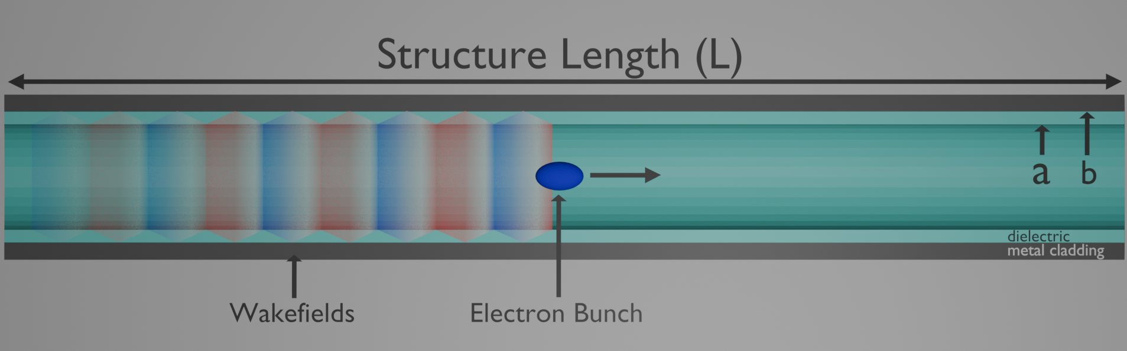
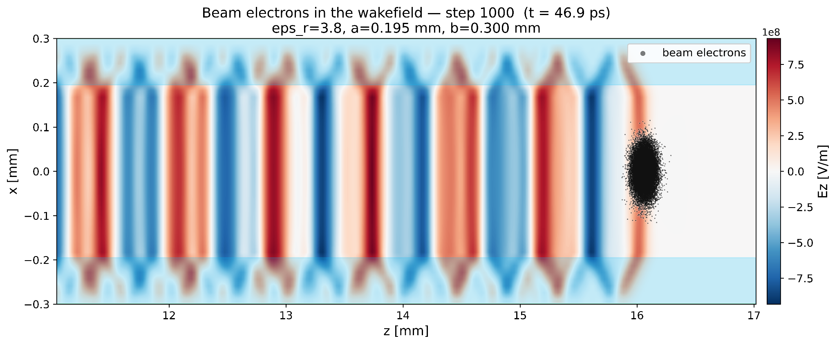
Background: Dielectric Wakefield Acceleration
Dielectric Wakefield Acceleration
  A form of Structure Wakefield acceleration using a dielectric lined waveguide-Wenzel
  Within the waveguide a THz wakefield is generated from CCR as a relativistic electron bunch passes through.
Beam Breakup Instabilities (BBU)
  BBU is a consequence of Panofsky-Wenzel
  Beam breakup is a key instability limiting Dielectric Wakefield Accelerators.
  BBU limits efficiency/transformer ratio of the structure
High power THz generation
  Applications in spectroscopy, medical imaging and beam acceleration
  De-chirping and shaping using the THz wakefield
Dielectric Wakefield Accelerator
Notes:
(Shorten) DWA is a form of structure wakefield acceleration using a dielectric lined waveguide as a relativistic electron beam passes through the dielectric lined waveguide the phase velocity of the field exceeds the speed of light in that material and we generate CCR wakefields. But this is plagued by Beam breakup instability. BBU is a consequence of panofsky wenzel when the structure couples into quadrupole or dipole modes that transversely deflect the beam.
I am going to address two methods usages of the THz radiation one for spectroscopy and materials studies, and another that is geared towards beam acceleration and shaping using the THz wakefield.

Slide 4
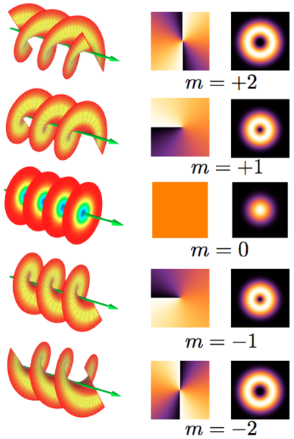
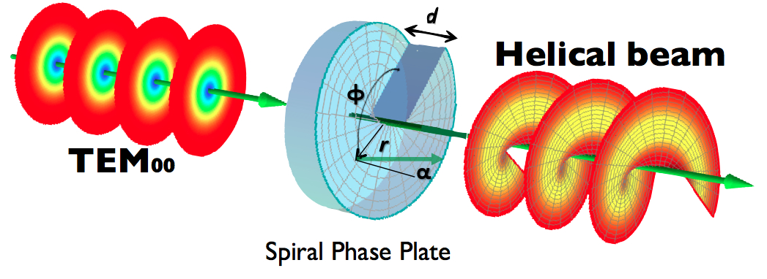
Background: Orbital Angular Momentum
Orbital Angular Momentum
  OAM beams carry an azimuthal phase variation e^{mɸ} where m is an integer representing the topological charge
  Defined phase singularity on the OAM beams axis
Orbital Angular Momentum THz
  OAM THz enables long interaction lengths and predictable mode profiles through BBU damping structures
  Spiral Phase Plate can convert TEM₀₀ gaussian beam into a helical beam dependent upon the design
Forbes, A., Mkhumbuza, L. & Feng, L. Orbital angular momentum lasers. Nat Rev Phys.
Notes:
Both of my methods utilize Orbital Angular Momentum for the spectroscopy or acceleration. To give some background OAM is a beam that carries an azimuthal phase variation of some topological charge m. This creates a defined phase singularity at the core and null on axis when taking a field profile of the beam.
The most common method for generating OAM laser beams is a Spiral phase plate, which we use in upcoming slides for spectroscopy.

Slide 5
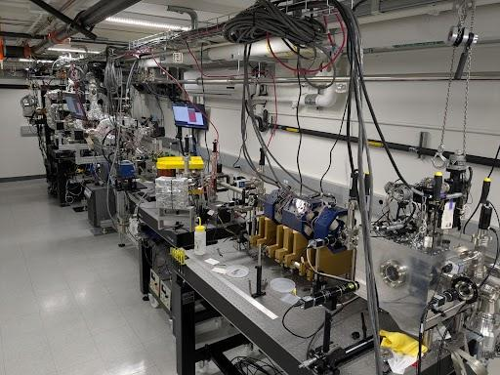
How this is being explored at MITHRA?
Notes:
So we wanted to explore this at out facility here at UCLA MITHRA

Slide 6
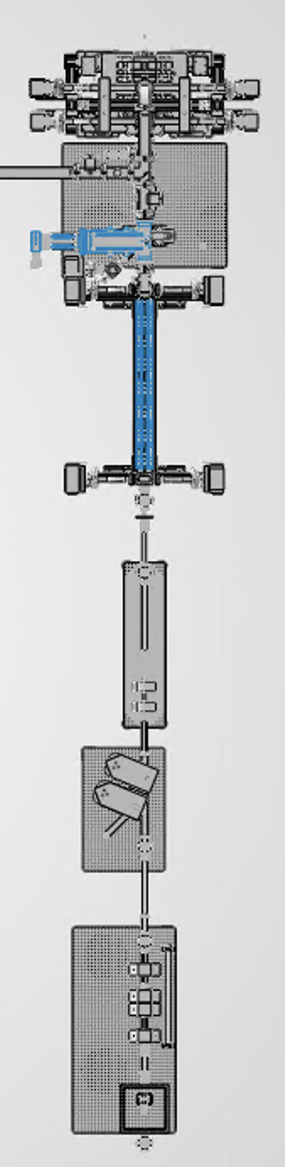
MITHRA Beamline
MITHRA is a high brightness beamline at UCLA (and you can tour it during AAC). Designed to go up to 80 MeV, But currently operating at:
30 MeV · 200 pC · 150 fs · 50 µm rms e⁻ beam)
Vitara Ti:sapphire drive laser — 800 nm, compressed to 40 fs
S-band Hybrid Photoinjector — RF photoinjector with velocity buncher
1.5m LINAC — accelerated beam from ~6 MeV to 30 MeV
QUADS + steering magnets — focusing beam prior to experimental chamber
Plans to upgrade to 80 MeV in early 2027
LINAC
Quads
S Band Photoinjector
Chamber

Slide 7
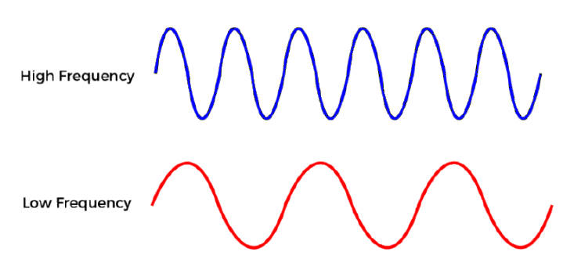
Experimental Configuration 1: Spiral Phase Plate (SPP)
Simple experimental layout
  E-beam and dielectric only, triggering needed to cue wavefront sensor.
  High Q beam to drive wakefields in the dielectric generating a powerful wakefield
Vlasov Antenna/Cut
  The THz beam is out-coupled at an angle through the Vlasov Antenna
Diagnostics
  Field Profile and Phase - Shack Hartmann Wavefront Sensor
  Pulse Energy - Pyro Detector
  Spectral Profile - Interferometer
  Beam Energy - BPT Spectrometer
Au OAP
THz Beam
PMQs
e-beam
Yag
Yag
Ag Mirror
Phase Plate
Wavefront Sensor
Notes:
Because THz is so important for materials research we wanted to start build a layout to generate a OAM THz source for materials research.

Slide 8
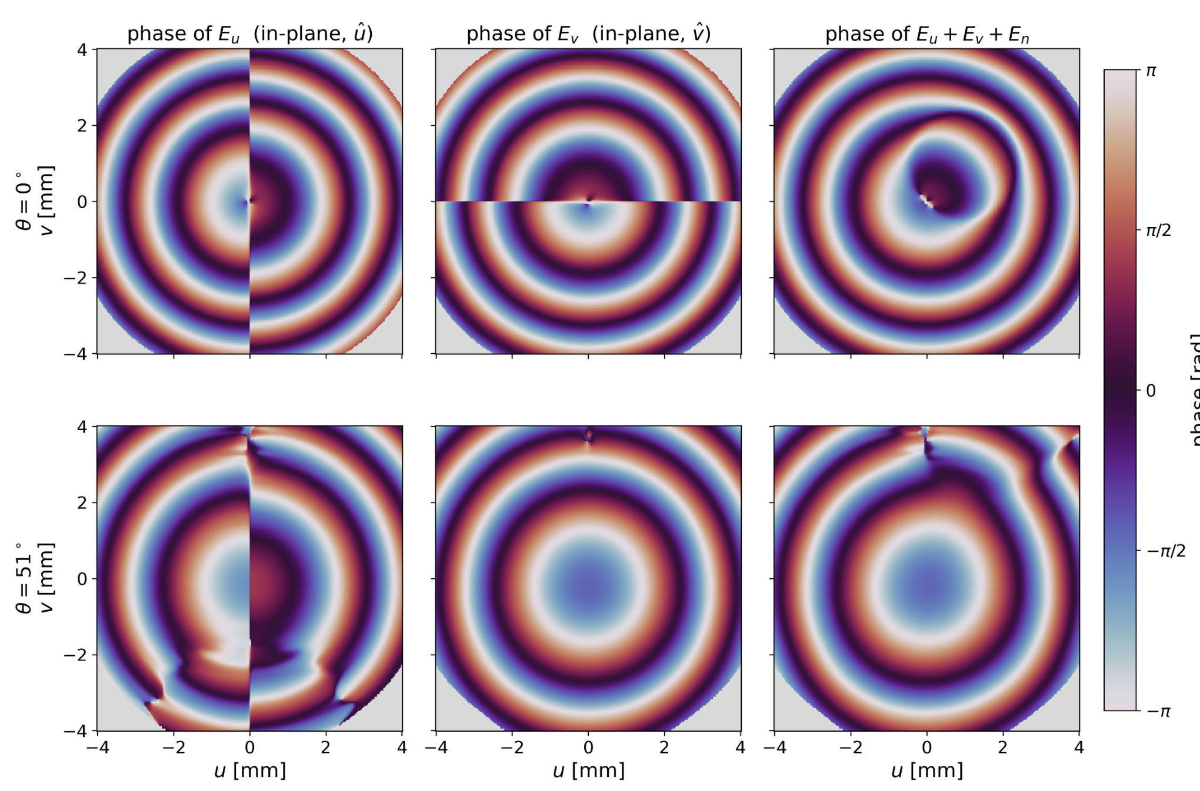
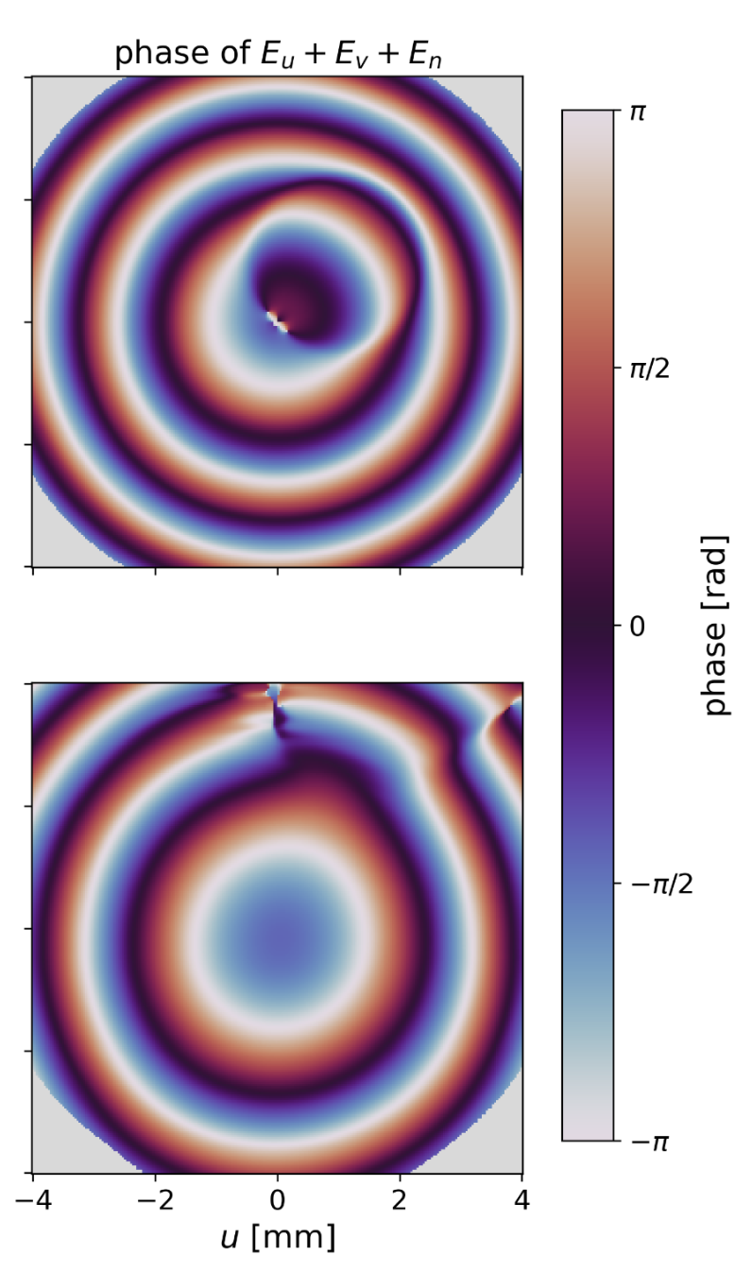
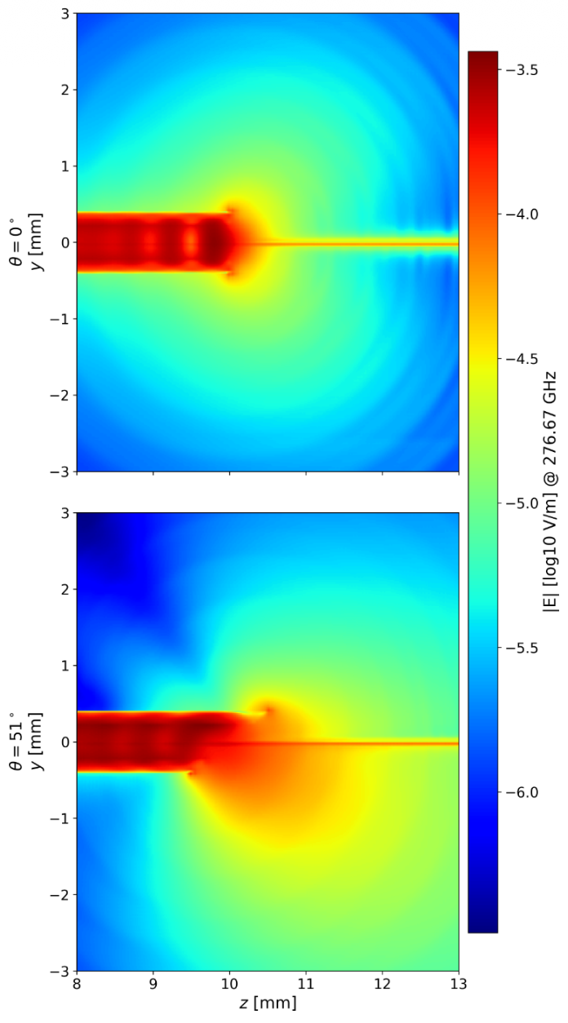
Experimental Configuration 1: Spiral Phase Plate (SPP)
Uncut Waveguide
  Outcouples as a non gaussian beam which reduces the efficiency of the conversion within the Spiral Phase Plate
  Beam spreads out conically from the end of the waveguide.
Output of Vlasov Cut Waveguide
  Vlasov cut mode converts THz into a free space propagating quasi gaussian mode.
  SPP converts to LG₀₁ OAM mode
Credit: Outcoupling of Coherent Cherenkov Radiation Using an Oblique Vlasov Antenna, R. Saraswat et al

Slide 9
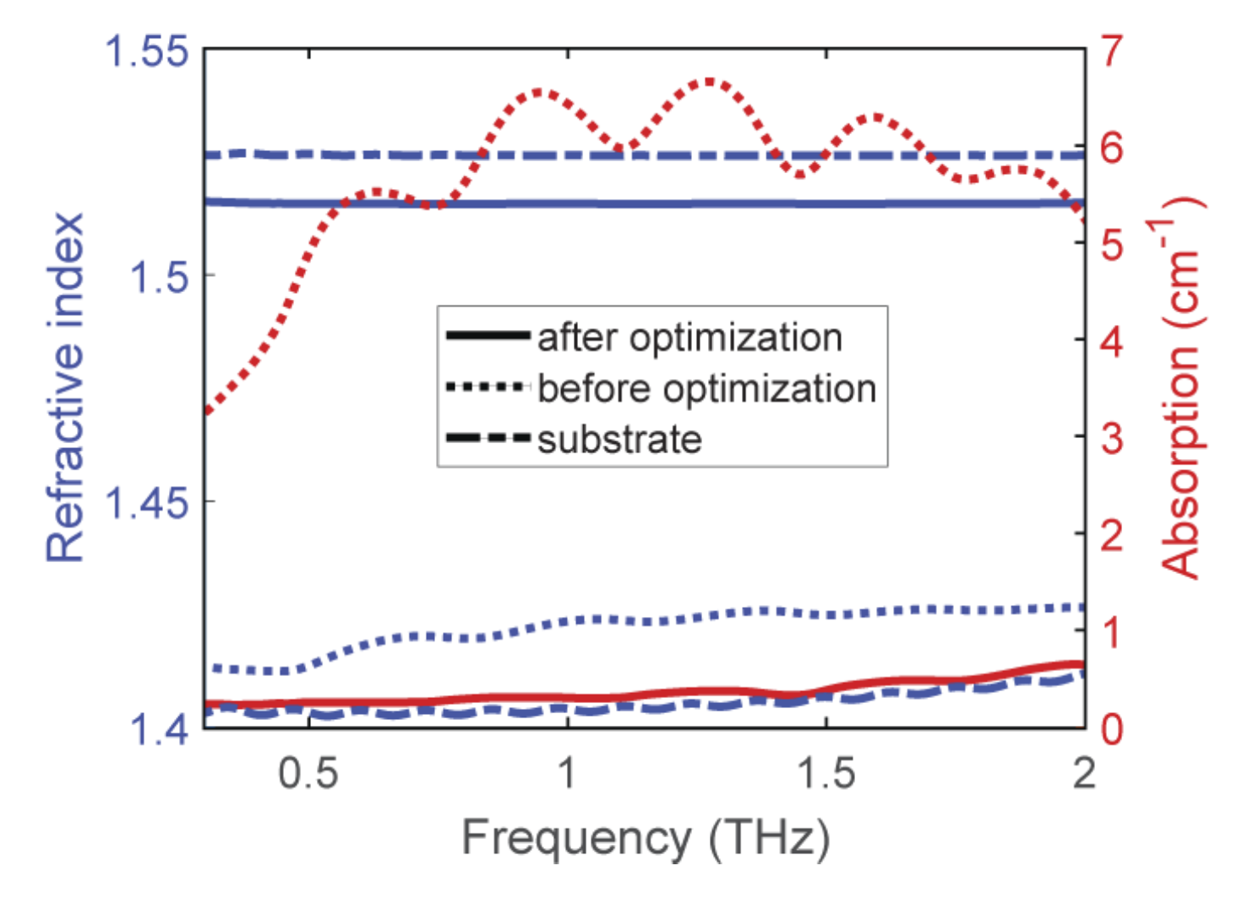
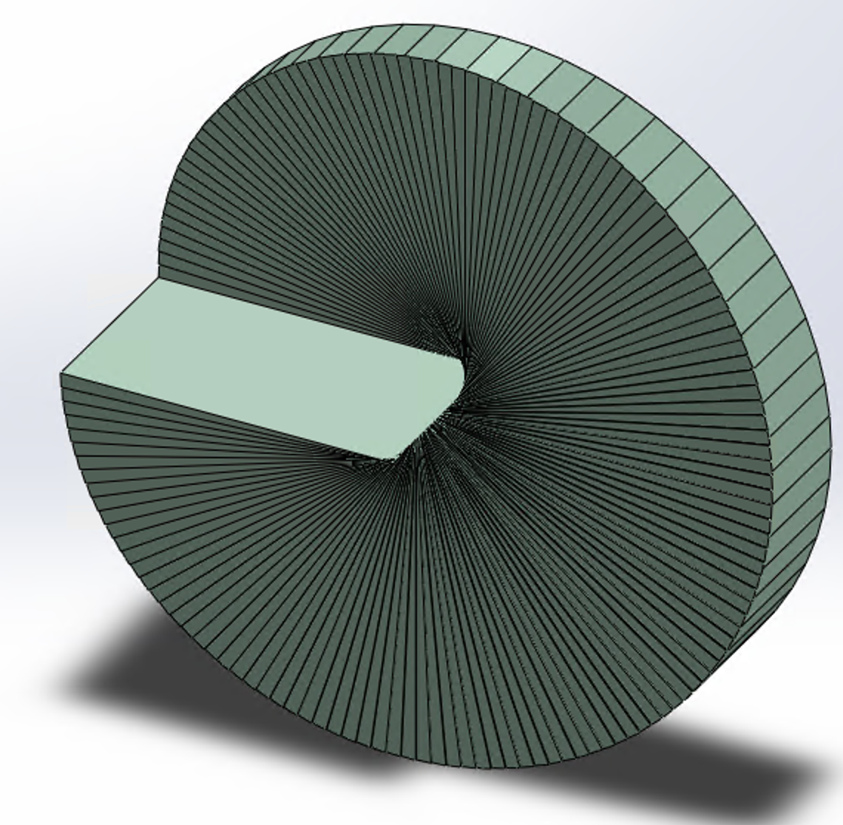
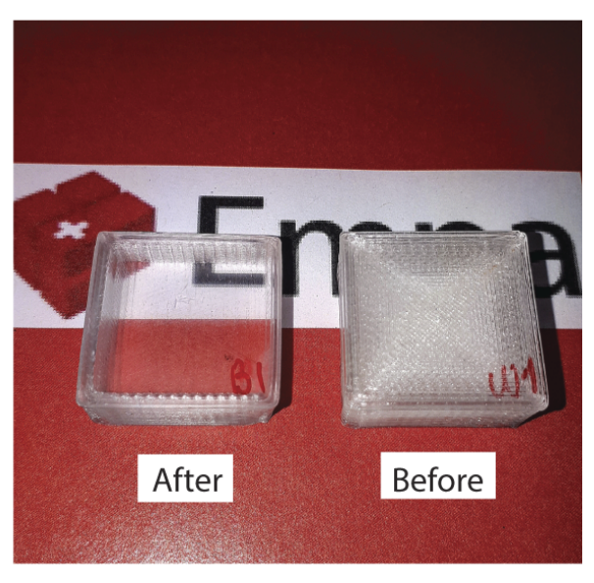
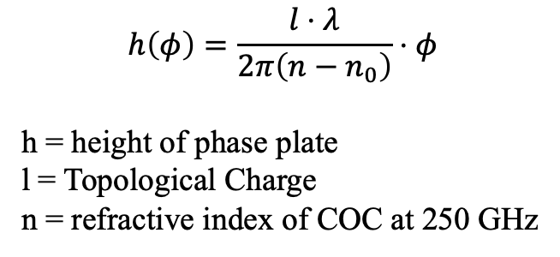
Experimental Configuration 1: Spiral Phase Plate (SPP)
Fabrication of Spiral Phase Plates
  Made with a Cyclic Olefin Copolymer (COC TOPAS)
  3d printing enables efficient fabricating of variable phase plate designs.
3D printing
  Can be printed on a standard filament printer with 80 um vertical resolution and 50 um horizontal resolution
  Previous studies show designs of 8 wedges show ~80% coupling to the OAM mode
  Previous work shows optimization up to an average n = 1.52
h
r
Also its vacuum friendly!
David Rohrbach, Bong Joo Kang, and Thomas Feurer, "3D-printed THz wave- and phaseplates," Opt. Express 29, 27160-27170 (2021)

Slide 10
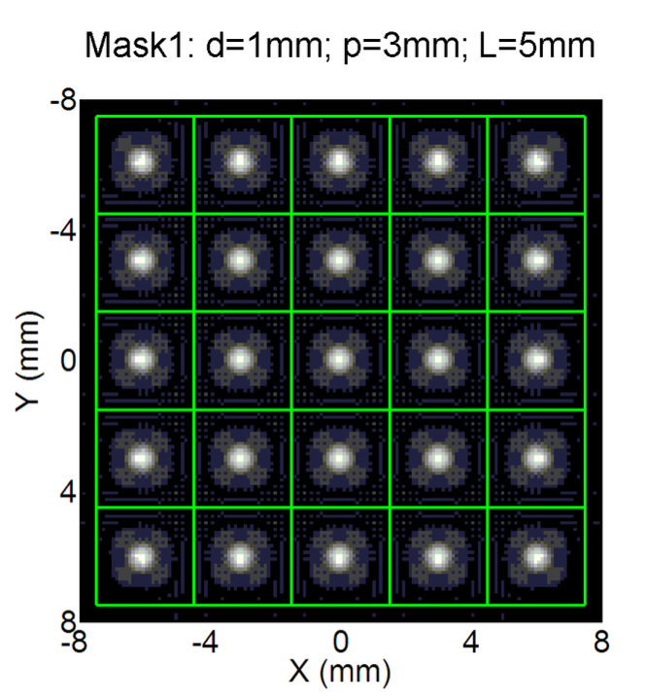
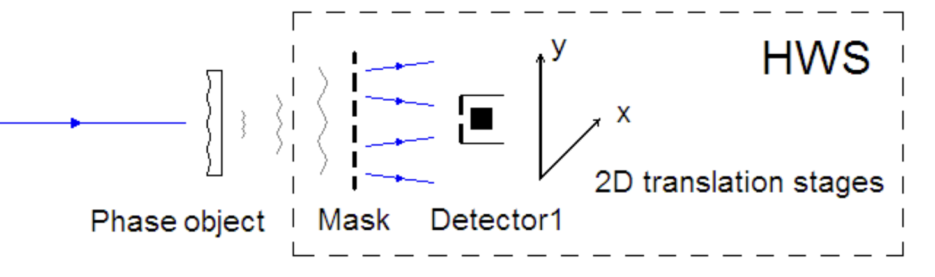
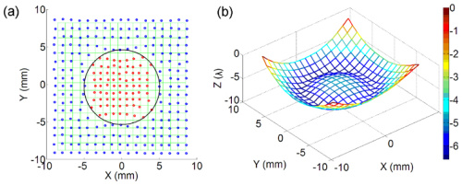
Experimental Diagnostic: Wavefront Sensor
Shack Hartmann Wavefront Sensor
  A 2D camera sensor to determine the wavefront of the beam
  Uses center of gravity calculations to determine offset of sections of the beam after aperture
  Subsections or “pixels” detected by a pyroelectric detector.
  Pyro mounted to 2D translation stages that scans across each hole in the mask.
  Mask 1: Metal copper with apertures of diameter d Gives an array of individual points and pyro intensity detection at each point.
Pyro
THz Beam
Aperture Mask
M. Cui, J. N. Hovenier, Y. Ren, A. Polo, and J. R. Gao, "Terahertz wavefronts measured using the Hartmann sensor principle," Opt. Express 20, 14380-14391 (2012)

Slide 11
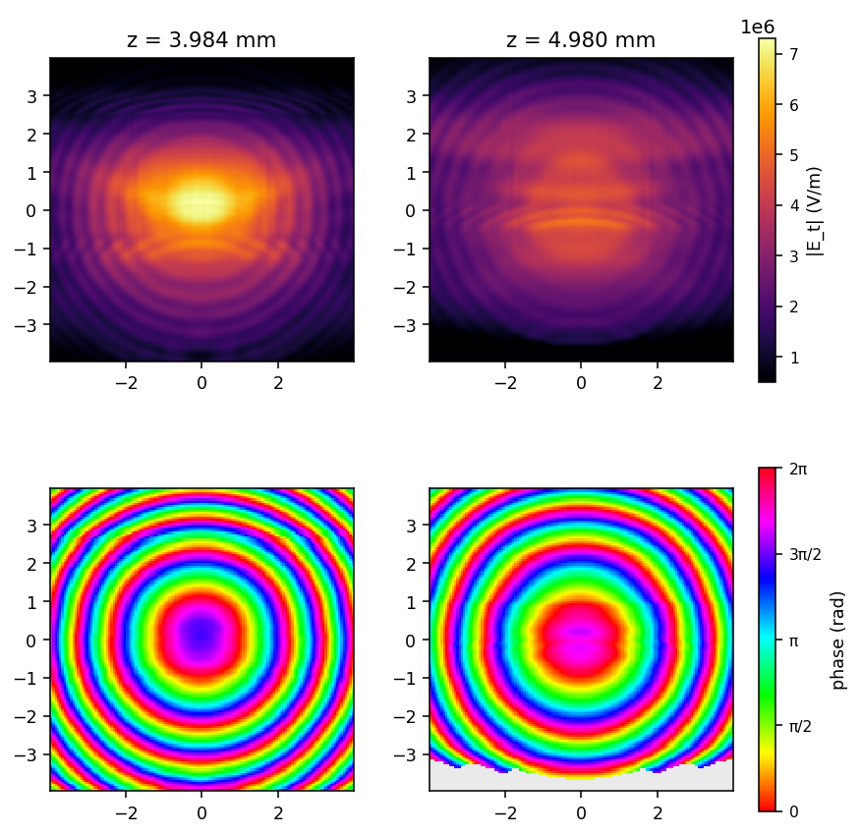
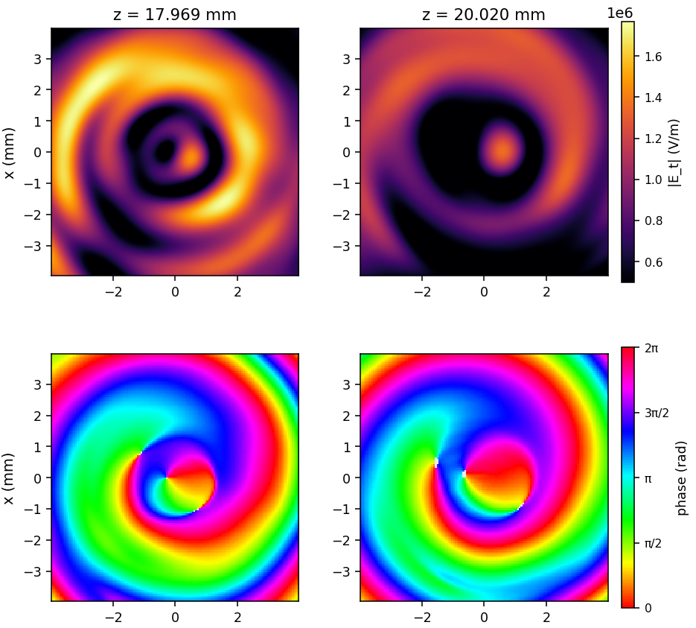
Simulated results: Spiral Phase Plate
Simulated transverse field upstream of the SPP
Cycle Averaged Field and Phase
Simulated transverse field downstream of SPP
Cycle Averaged Field and Phase at 17.969mm and 20.02mm
*All simulations were done in WarpX with parameters matching the MITHRA beam
Notes:
I use rainbow for cycle averaged results which will feature a singularity at the core in OAM or remain almost identical for the gaussian case

Slide 12
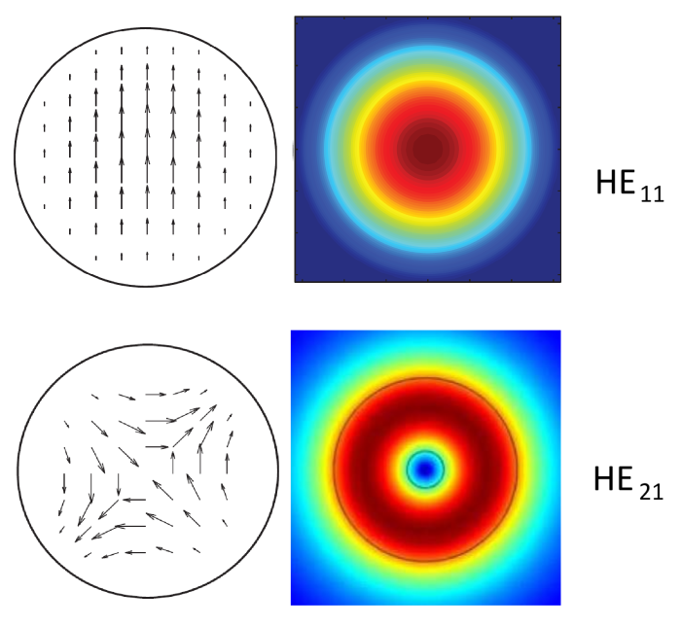
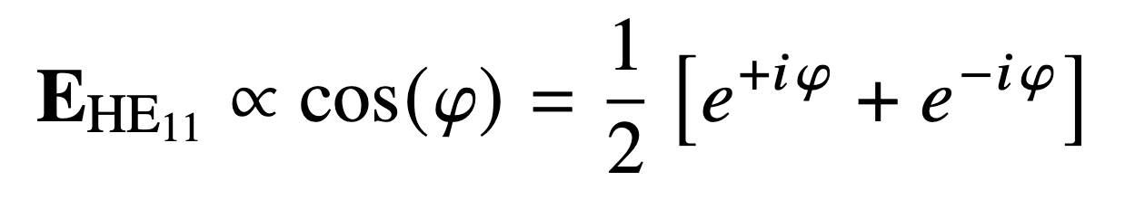
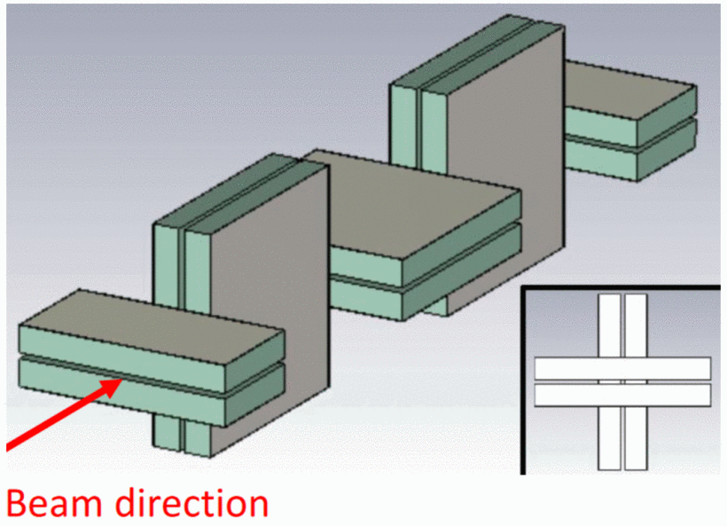
Background: Why Orbital Angular Momentum reduces BBU
BBU is caused by Hybrid modes (HE₁₁ and HE₂₁)
  HE₁₁ - Dipole mode
  HE₂₁ - Quadrupole mode
Each mode contains OAM eigenstates:
  Structures can be designed to radiatively damp one of the underlying eigenstates.
Using the Quadrupole mode:
  Damping out an individual state defines quadrupole direction.
  Enables staged layouts of periodic structures like ADWA has shown in slab structures. Where shifting quadrupole modes are used to focus witness beams.
Image Credit: https://www.everythingrf.com/community/higher-order-waveguide-modes
W. Lynn et al., "Transverse Stability in an Alternating Gradient Planar Dielectric Wakefield Structure," 2022 IEEE Advanced Accelerator Concepts Workshop (AAC), Long Island, NY, USA, 2022, pp. 1-4, doi: 10.1109/AAC55212.2022.10822968.
Notes:
Before i get into our next structure it is important to understand the makeup of our dipole and quadrupole modes. The two hybrid modes each are superpositions of OAM eigenstates and so if you can radiately damp a single mode the remaining mode in the structure will be solely that OAM mode. This also was briefly covered in brian naranjos talk prior to me. What I wanted to explore with this is reducing BBU and possible transversely focusing an electron beam similar to what was done with AGDWA shown here which uses the orientation of the quad mode in slabs and alternating structure orientations to create quad pairs to maintain beam quality

Slide 13
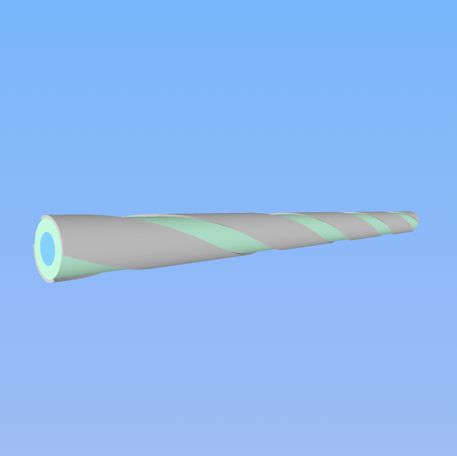
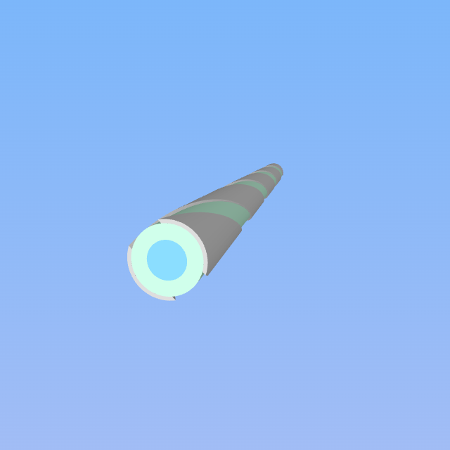
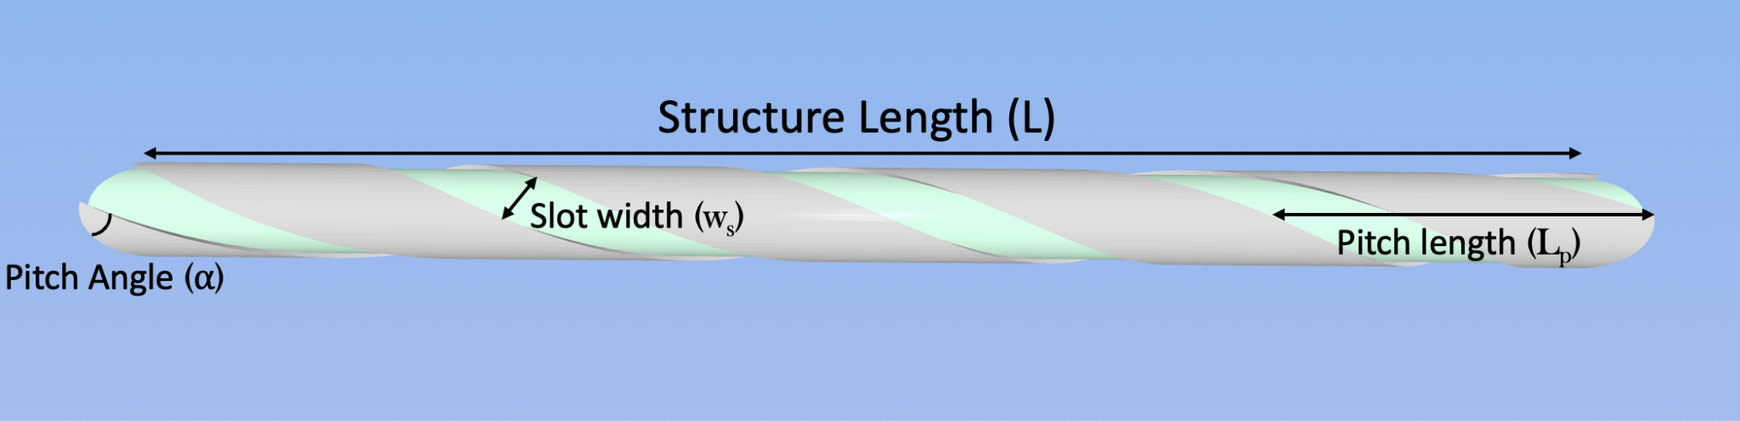
Experimental Configuration 2: Helical Structure
Helical layout
  Helical layout allows radiative damping to be used to damp out Dipole and Quadrupole hybrid modes.
  Generates an internally rotating LG₀₁-like mode
Notes:
I can specify the reason I say and LG like mode is that a laguerre gaussian mode is commonly defined as a solution to the paraxial free space equation that carries orbital angular momentum and is a superposition of a hermite gaussian mode. But in this waveguide the solution is to the heimholtz equation which isn’t fully defined for OAM modes.

Slide 14
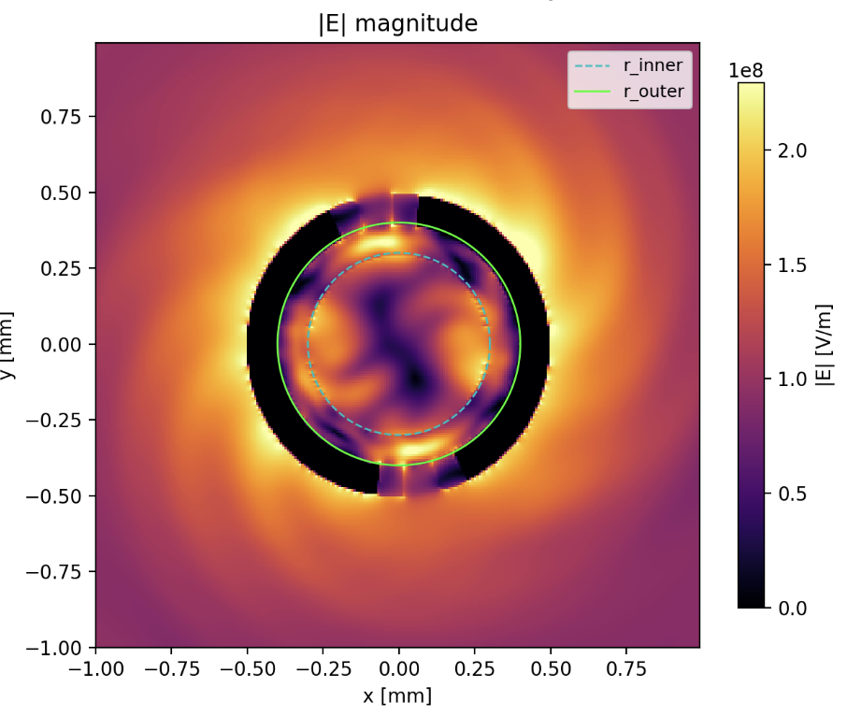
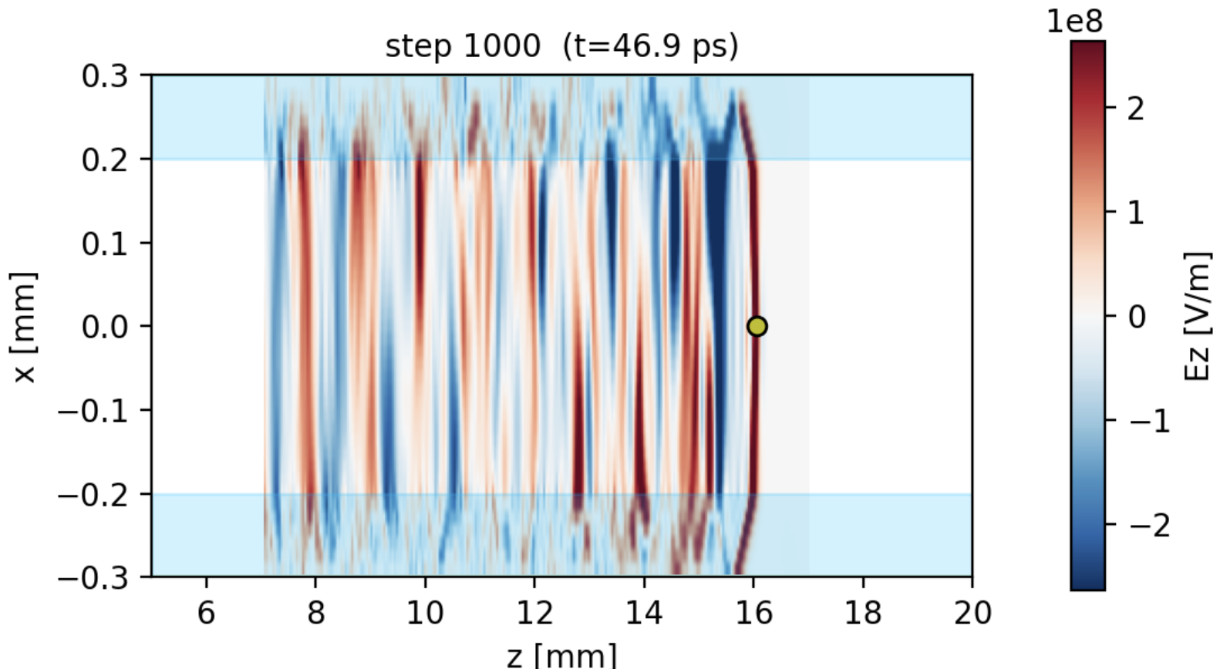
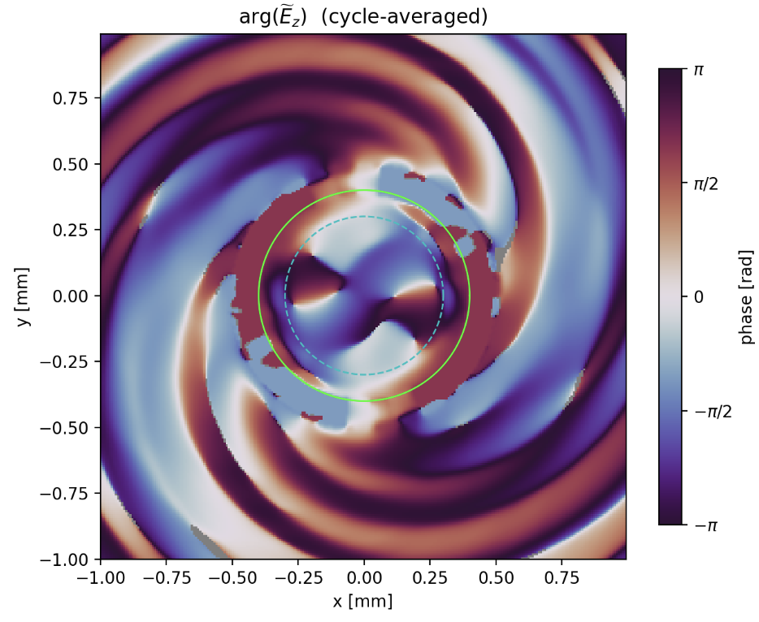
Orbital Angular Momentum THz beams from helical structures
Accelerating Field Ez of Helical Structure
Shown within the waveguide damping

Slide 15
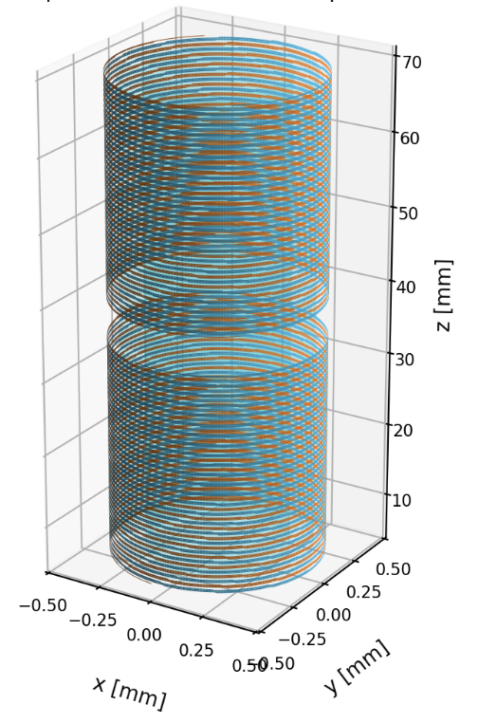
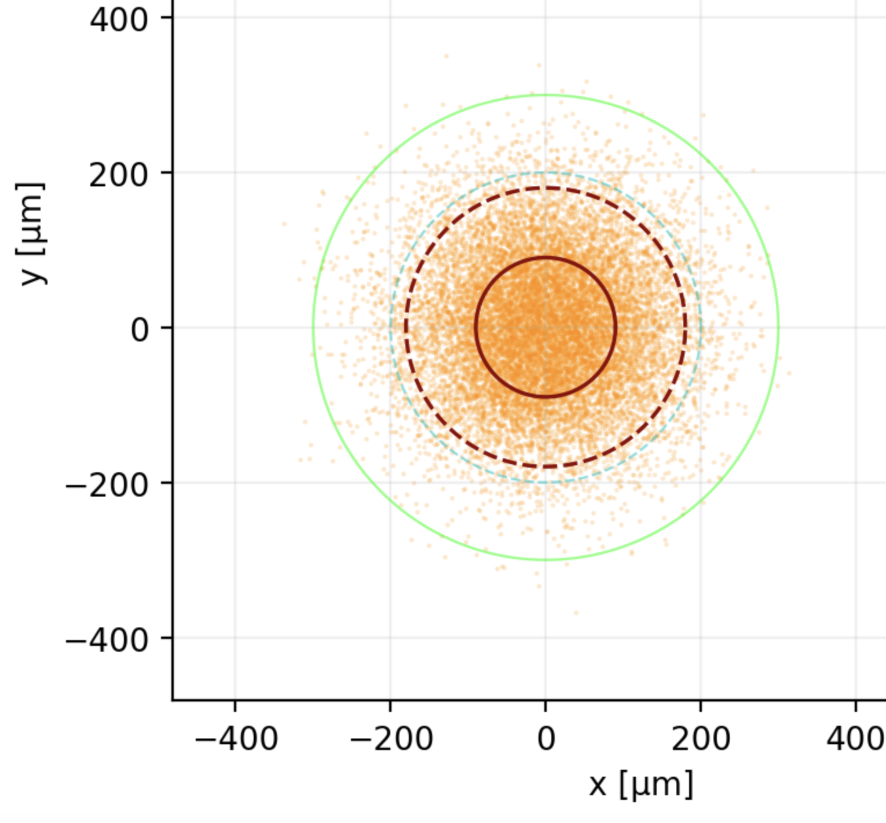
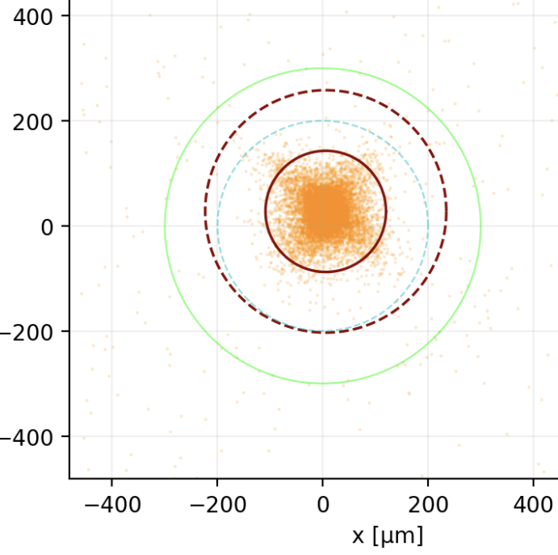
Future Direction: Multi Sectioned Helical Structure
Stacked Helical Layout:
  Allows for control of the LG mode by rotating the helical structure.
  An offset of 90 degree phase allows for two quad mode structures enabling transverse focusing
  Requires a drift length between the two structures where a beam offset can enable
Limitations:
  This only applies to the witness beam, radiative damping requires a couple of wavelengths to damp out the dipole mode and quad mode into the LG mode.
  Fabrication for structures like this is difficult due to small slotting along the structure and susceptibility to decoupling from small shifts in damping slots
Before
After
Notes:
This needs to be further explored as we have just begun to be able to see transverse focusing of a beam through these structures and there is still some amount of the dipole mode present within the structures

Slide 16
Outlook & Summary
Next Steps
  Install the spiral phase plate design to generate high power OAM THz beams and begin to examine material interactions
  Investigate the other modes that are coupled by the helically radiating structure
  Continue to investigate multi sectional helical structures as possible opportunities for reduction of BBU
  Fabricate a helical structure to radiatively damp and generate OAM beams within the waveguide
Goals
  Generate and characterize OAM THz from a spiral phase plate using the designed wavefront sensor.
  Successfully show acceleration of a witness beam within a helical waveguide using a mix of TM₀₁ and LG₀₁ modes.
Key Takeaways
  High Power OAM THz for materials experiments can be generated from Dielectric Wakefield configurations
  OAM can reduce BBU by radiatively damping out the dipole and quadrupole mode on the witness beam.
  Helical DWA structures can be used as smith-purcell radiators to create an OAM source.

Slide 17



Acknowledgements
Direct Contributors: J. Rozells, G. Andonian, B. Naranjo, O. Williams, A. Fukasawa, S. Carbajo, and J. Rosenzweig,
Thank you to all of the members of the Particle Beam Physics Lab for helping put this work together!
• Work Supported by DOE DE-SC0024907and NSF PHY-1549132

Slide 18

Orbital Angular Momentum generated from a helical structure

Slide 19
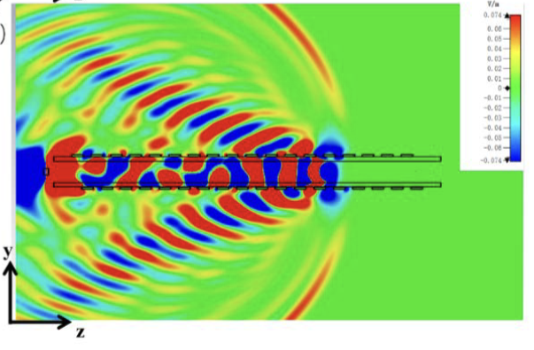
Extra Slide: Helical Structures experimental layout
PMQs
Au OAP
e-beam
Yag
Yag
THz Beam
Layout vastly simplifies optics
Can directly sample the leaked radiation to confirm the internal oam mode of the beam.
Wavefront Sensor
Zhenpeng Zhang, Zonglin Mao, Xueer Wang, Chengyu Zhang, Ping Zhang, and Yaxin Zhang, "Terahertz vortex radiation source based on Cherenkov wakefields," Opt. Express 34, 18569-18581 (2026)

