Slide 1
Copper Coated PEEK Based RF Cavity Power and Q Factor Testing
Benjamin Sims (AOT-AE)
John W. Lewellen (LAMP)
WG4 4:00pm 7-27-2026
LA-UR-26-26233

Slide 2
E Field
B Field
Polyether Ether Ketone (PEEK) Based Cavities
Copper coated polymer structures have been implemented in many radiofrequency applications
Examples include
  Lightweight and unique antennas
  Waveguides
  Prototype and Cold test RF structures
Copper Layer
PEEK
Simple PEEK Cavity Diagram

Slide 3
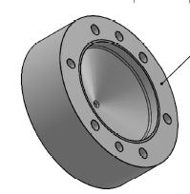
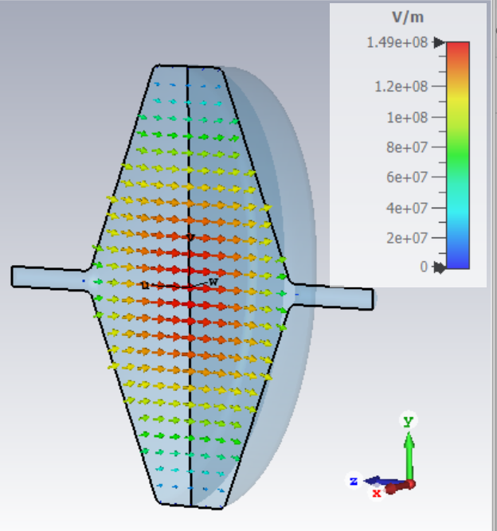
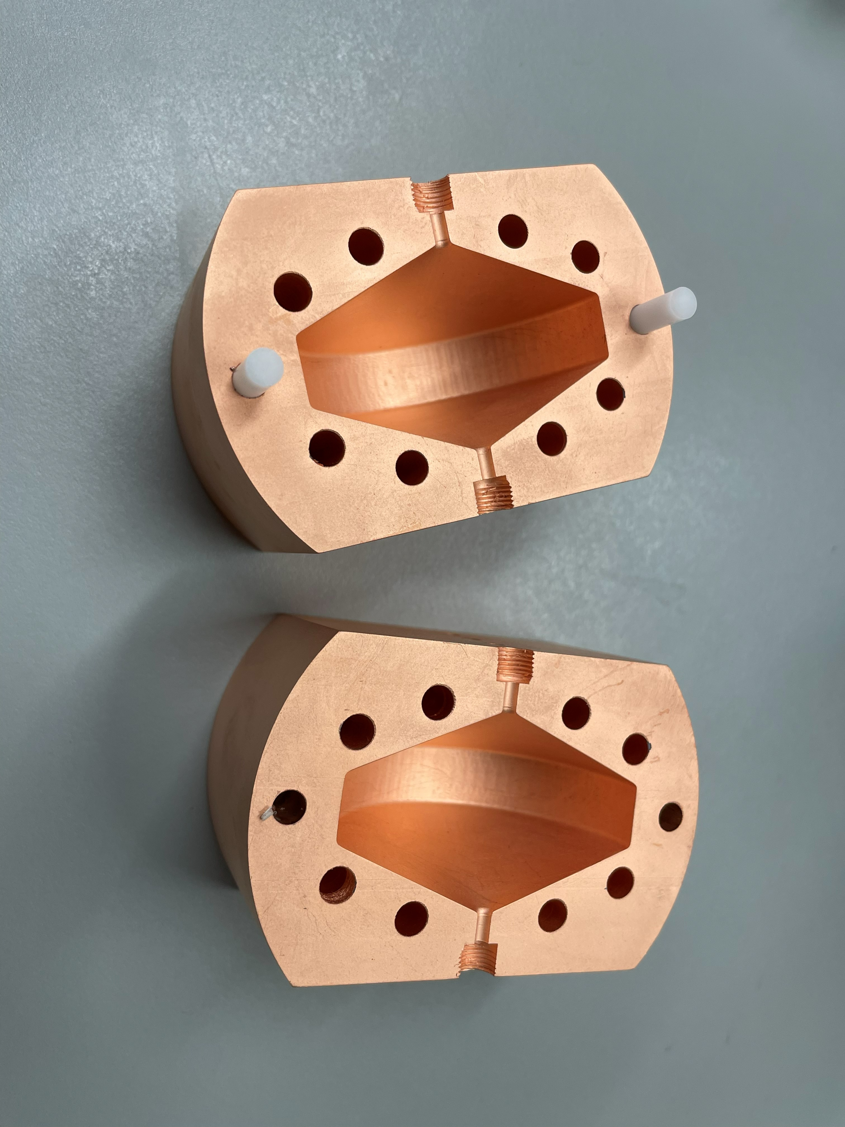
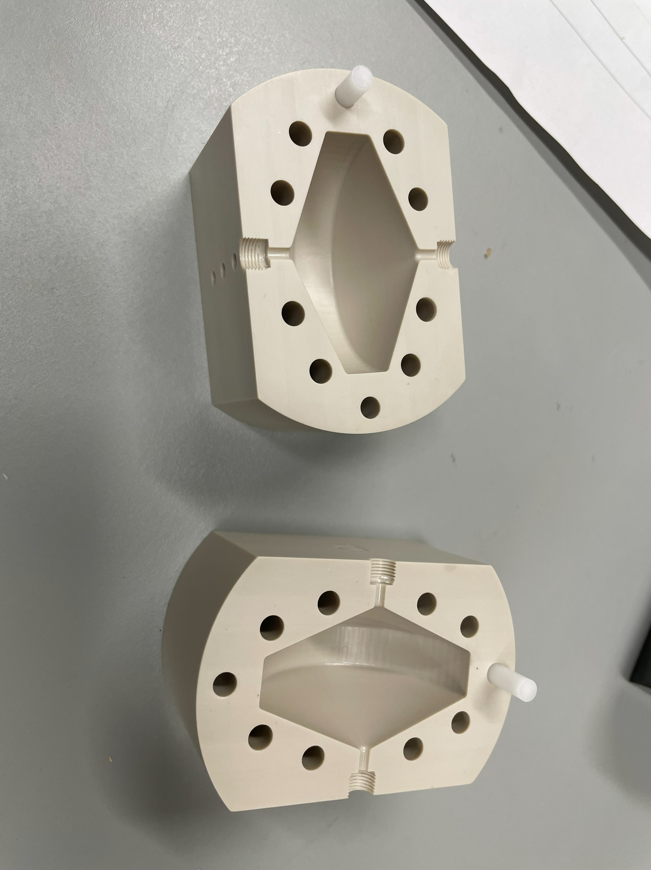
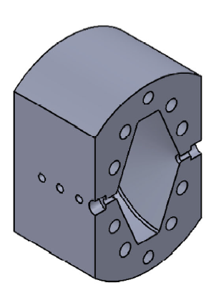
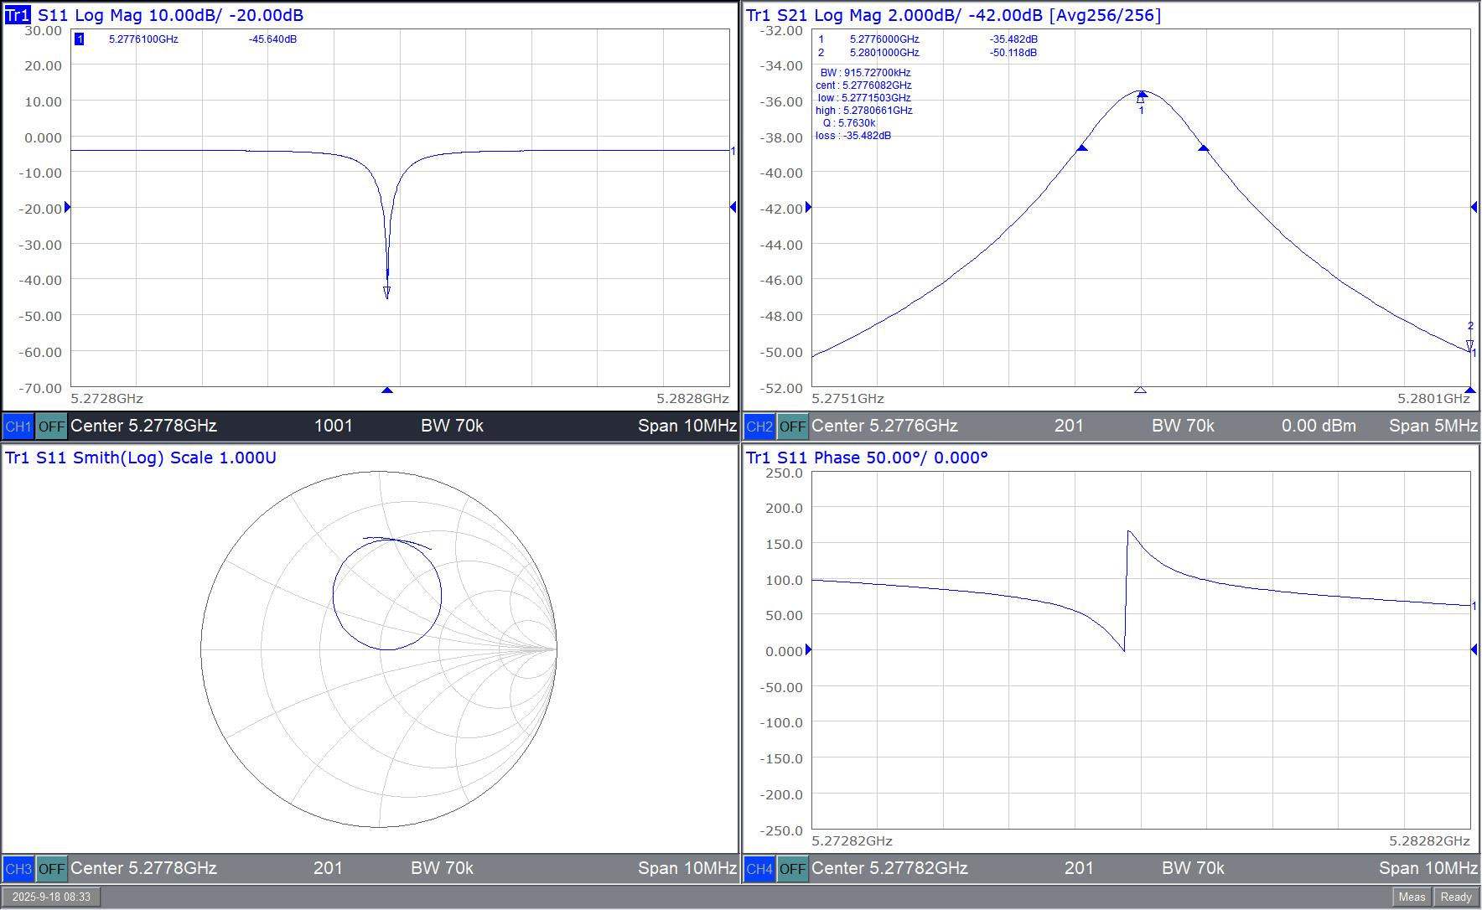
Designing and Building Cavities
Fabrication designs
Fabrication
Simulation
Plating
10 micron
thickness
Characterization
Cavity Simulation to Characterization

Slide 4
Simulation and Fabrication designs
Designed in CST
Cavity Cuts
  Equatorial Cut
    Typical design approach
    RF currents cross cavity cut
  Longitudinal Cut
    Emerging approach for high-gradient cavities
    RF currents do not cross the cavity cut
      Currents move parallel to cut line

Slide 5
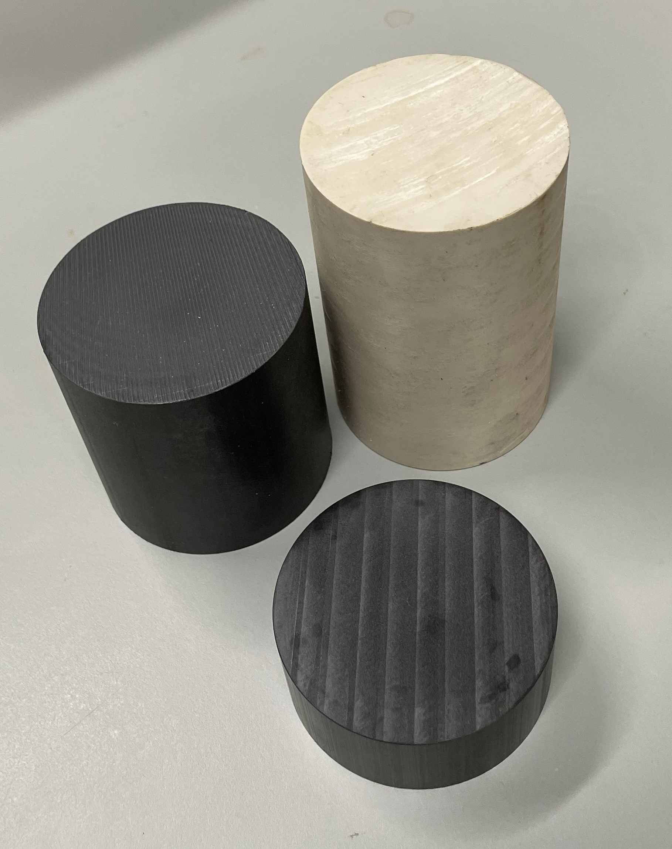
Testing a verity of materials
PEEK
Commercial off the Shelf (COTS) materials
3 Different Types of PEEK were tested
  Basic PEEK plastic
  30% glass-filled PEEK
  30% carbon fiber-filled PEEK
30% Carbon Filled PEEK
30% Glass Filled PEEK
COTS PEEK

Slide 6
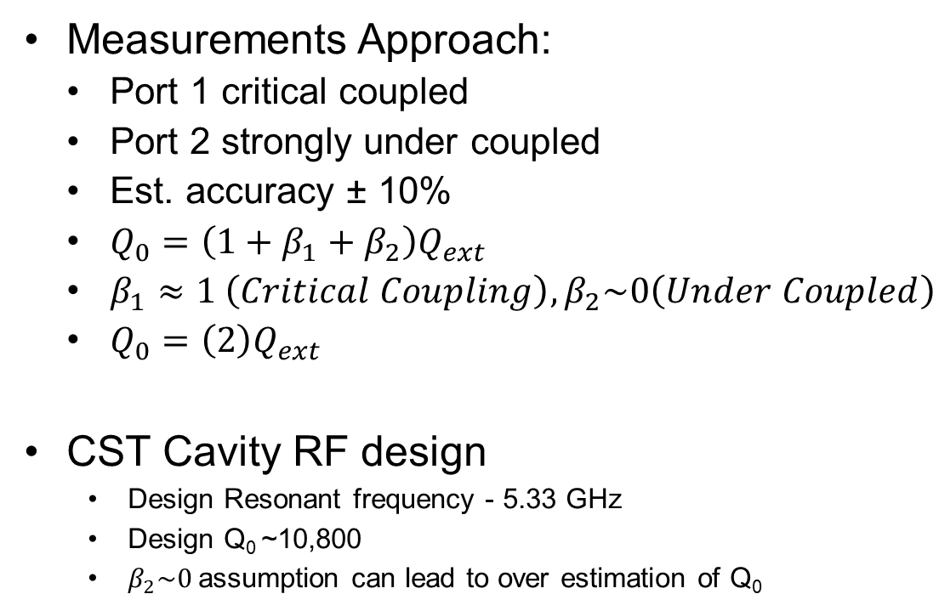
Cavity Characterization
Measured Frequency
 | PEEK [GHz] | 30% GF PEEK [GHz] | 30% CF PEEK [GHz]
Equatorial | 5.29 | 5.29 | 5.29
Longitudinal | 5.27 | 5.29 | 5.28
Measurements Approach:
  Port 1 critical coupled
  Port 2 strongly under coupled
  Est. accuracy ± 10%
  $Q_{0}=\left(1+β_{1}+β_{2}\right)Q_{ext}$
  $β_{1}≈1 \left(Critical Coupling\right), β_{2}\sim 0\left(Under Coupled\right)$
  $Q_{0}=\left(2\right)Q_{ext}$
CST Cavity RF design
  Design Resonant frequency - 5.33 GHz
  Design Q₀ ~10,800
  $β_{2}\sim 0$assumption can lead to over estimation of Q₀
Measured Q₀
 | PEEK | 30% GF PEEK | 30% CF PEEK
Equatorial | 9,400 | 9,840 | 13,500
Longitudinal | 11,200 | 9,440 | 10,070
Quality Factor and Resonant Frequency Data Tables

Slide 7
RF Power Testing
Envelope Detector Diodes
Measures RF power sent to, and reflected from, cavity.
Power Amplifier
Provides high average power to cavity
Directional Coupler
Diverts a small fraction of forward and reflected power
Signal generator
Gated to provide pulsed power to cavity
Adjusted to match cavity frequency as the cavity expanded under RF heating
Circulator
Directs reflected power from cavity into a load
Protects amplifier from sudden cavity failure
RF Power diagram
From Polymer Accelerator Structures, J. Lewellen

Slide 8
Power Testing Levels
2 μs
8 μs
5 W
1 W Average, 5 W Peak, 20% Duty Factor, 10-minute duration
10 W average power, 20 W peak, 50% Duty Factor, 10-minute duration
20 W Average Power, 40 W Peak, 50% Duty Factor, 30-minute duration
5 μs
5 μs
20 W
5 μs
5 μs
40 W
Power Delivered to Cavities

Slide 9
Cavity temperature rise
Biggest Temperature change of ~70°F
20W Avg, 40W Peak
RF Power turned off at 30 min
Cooled down for 5 min
Input frequency was monitored and modified to deliver critical coupling while cavity was in use
20 W Average Power Testing Data

Slide 10
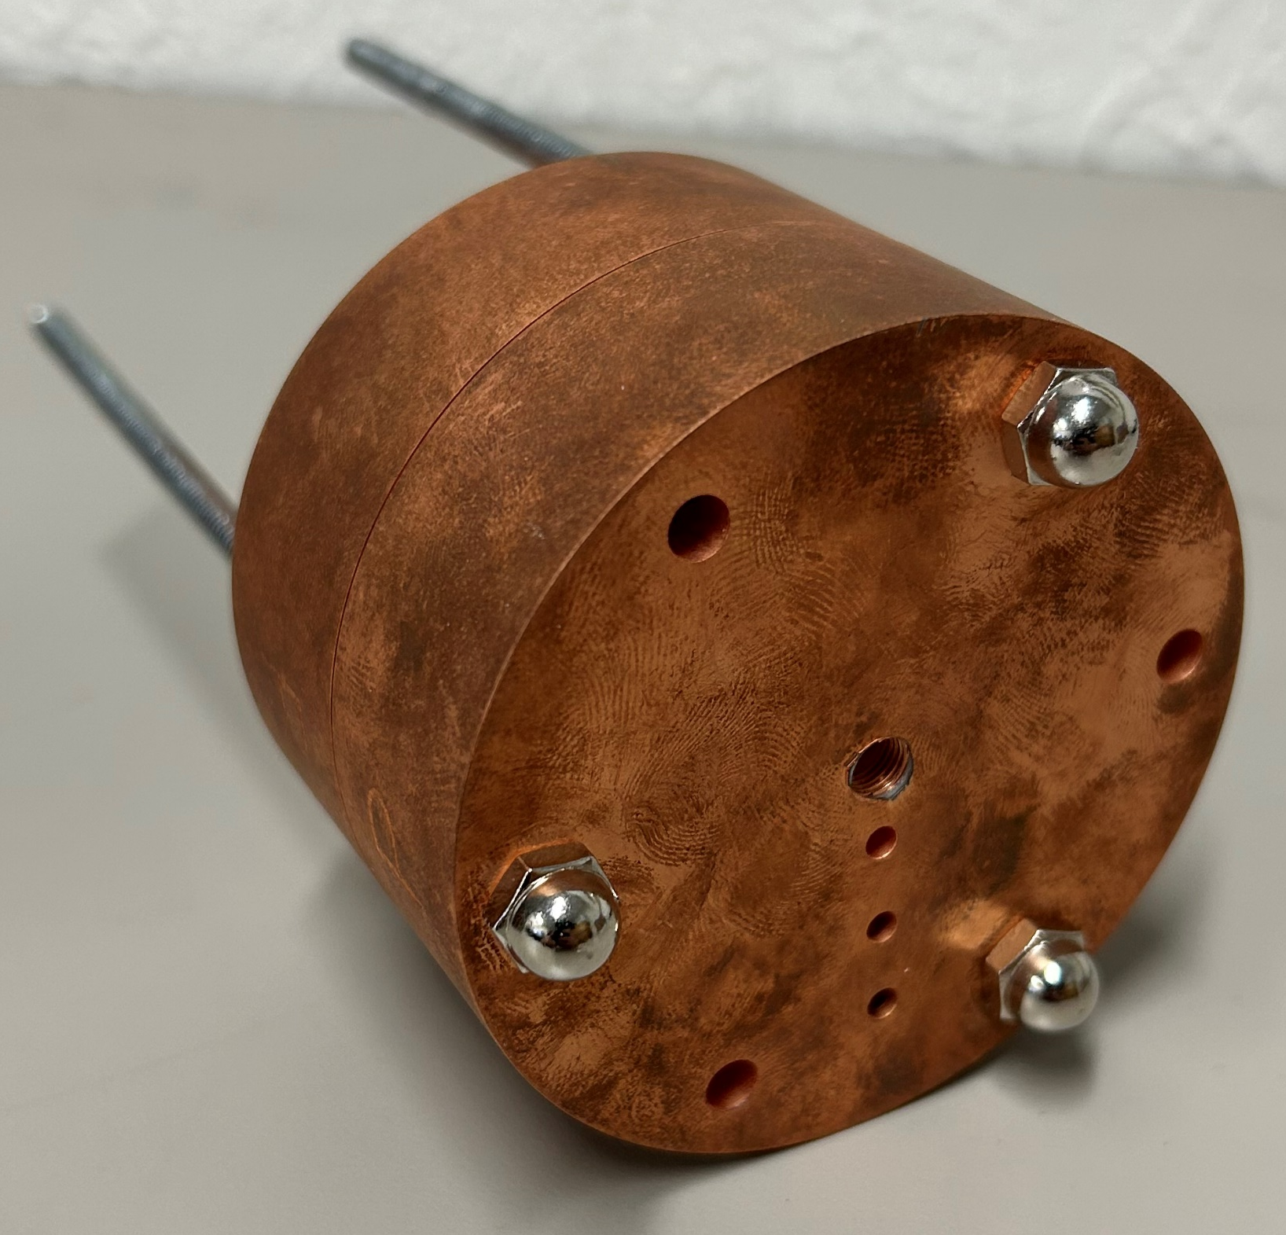
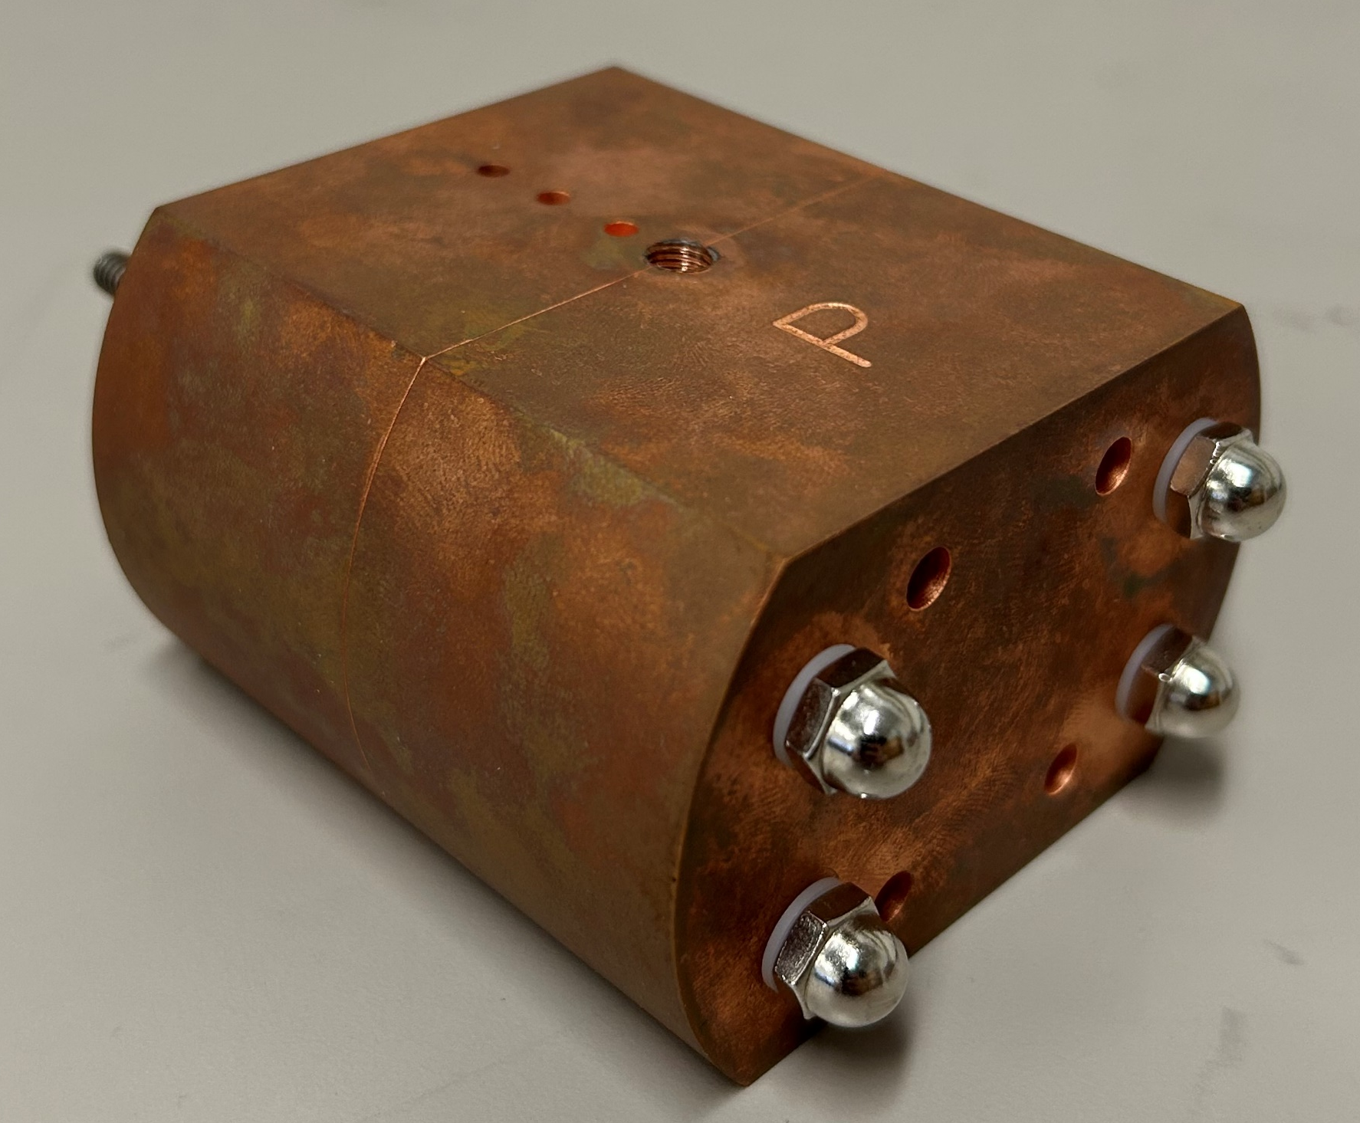
Material Comparison
No large discernable changes between materials
CF cavities cooled slightly faster
PEEK Cavities cooled the slowest
CF Cavities had the least resonant frequency change while heating
PEEK Cavities had the largest resonant frequency change while heating
Inner coating unblemished on all cavities
No, we did not use gloves
Post Testing Cavity

Slide 11
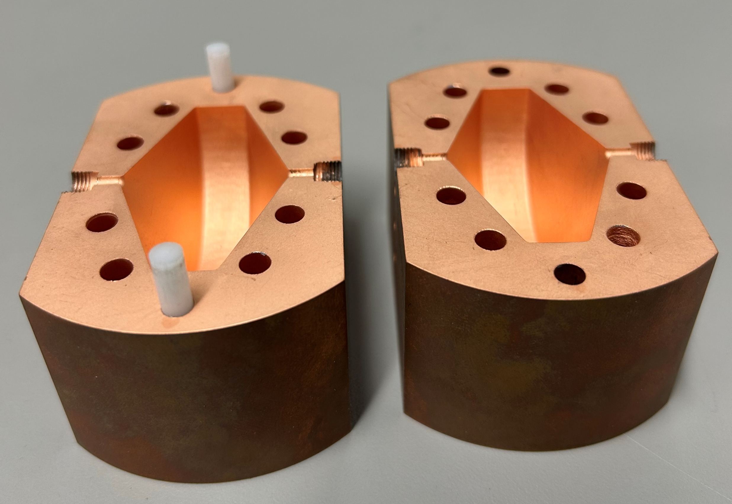
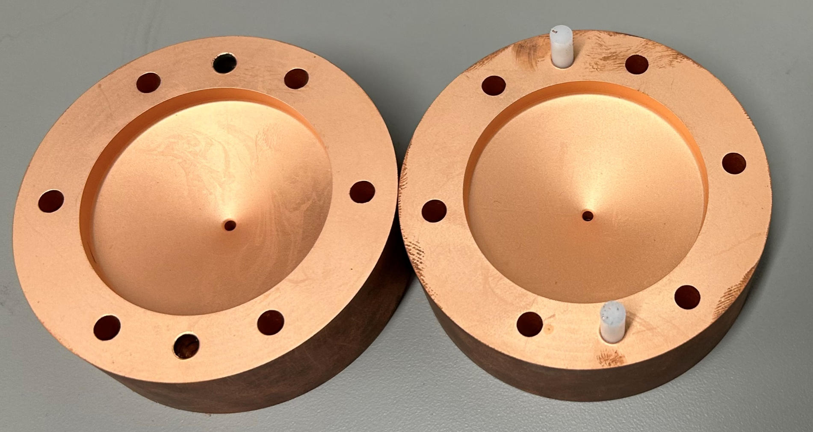
Undamaged inner surface
Repeated use led to coating removal from some threads
PEEK Cavities after all testing
PEEK Cavities Internal Post Testing

Slide 12
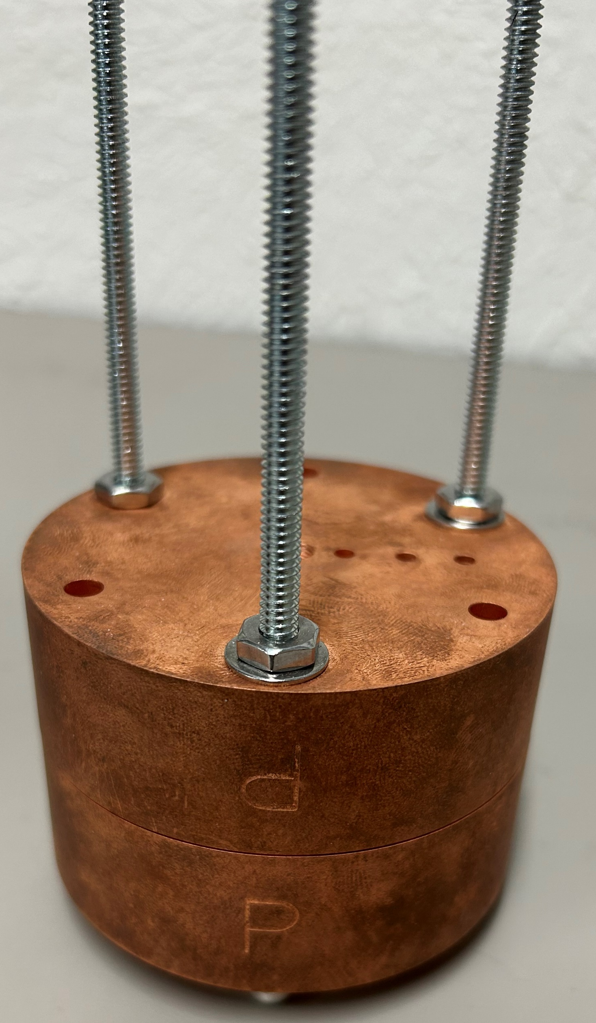
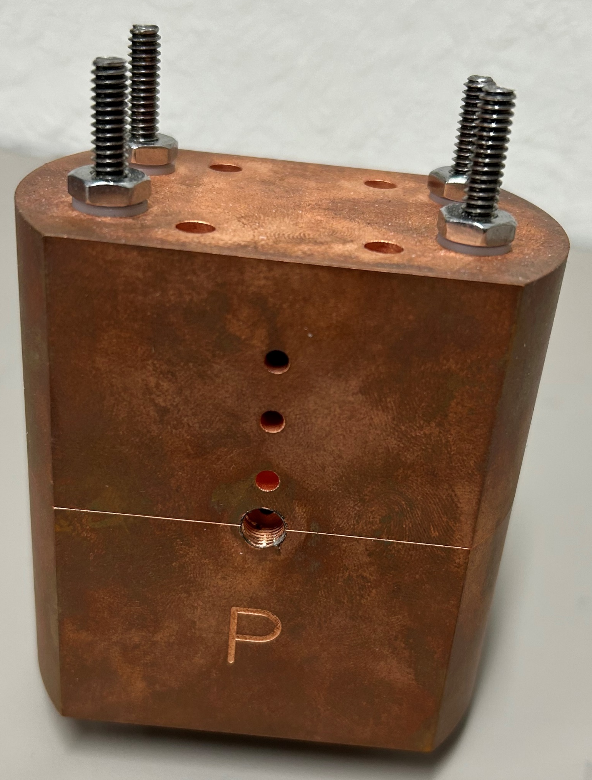
Cavity compression
Repeated heating and cooling caused bolts to loosen
Resulted in a Q Factor drop following tests only for elliptical cut cavities
Tightening bolts restored Q factor to pre-power delivery levels
Assembled PEEK Cavity

Slide 13
Conclusion
Parameter | PEEK CAVITY / COPPER CAVITY
Fabrication Time | 1/4
Cost | 1/10
Weight | 1/10
Yield Strength | 2.5
Q Factor | Equal
No permanent deterioration in performance in any cavity following power testing
  Equatorial cut showed the largest degradation in performance due to expansion at the joint causing loosening over time
  Longitudinal cut performed better overall

Slide 14
Questions?
Thank you for your time.

