Slide 1

2026-07-30
AAC LA
WG #1
Proposal for FACET-III
Bernhard Hidding et al.
or
Continue FACET
as High-Brightness Pivot Facility

Slide 2
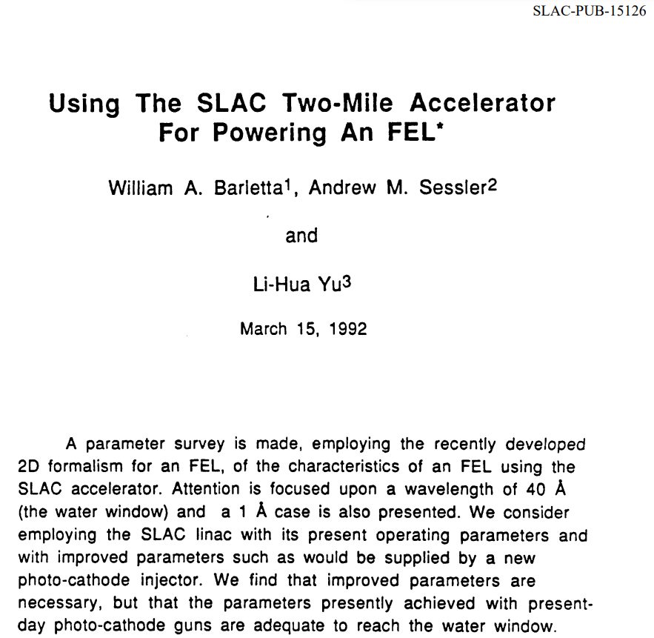
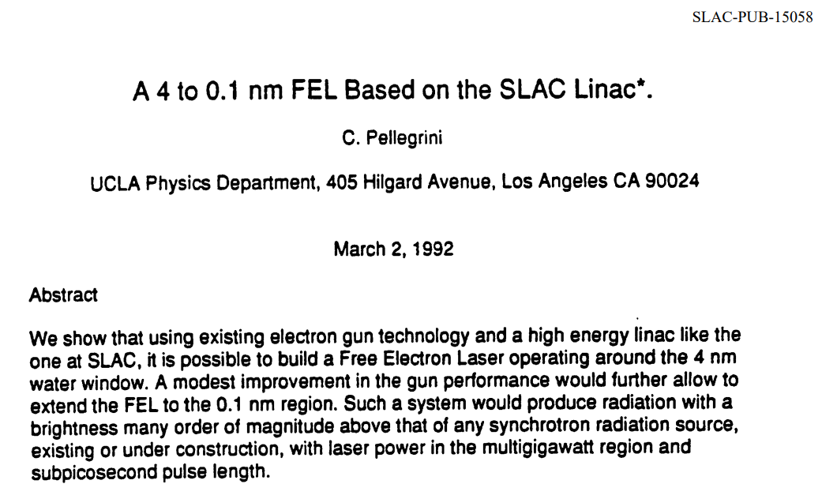

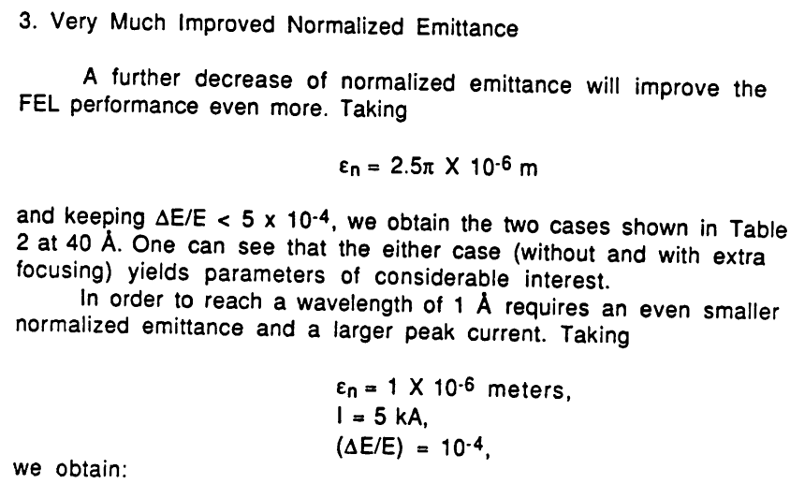
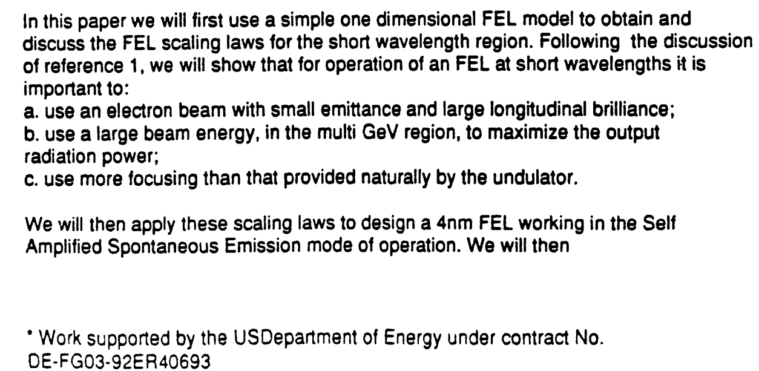

Bold step by DoE and SLAC in 1992 proposal: “Low emittance beams from photocathode linacs will enable LCLS”
Notes:
Latex2image
\definecolor{myblue}{RGB}{0,106,179}
\textcolor{myblue}{B_\mathrm{6D} = \frac{I}{\epsilon_\mathrm{n}^2 \cdot 0.1\%\sigma\mathrm{w}}}

Slide 3
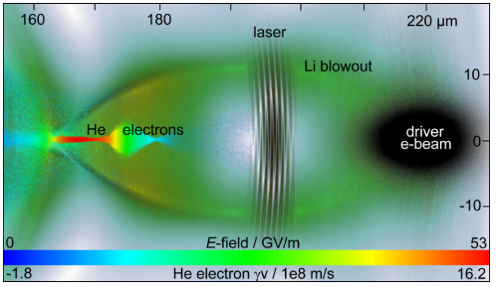
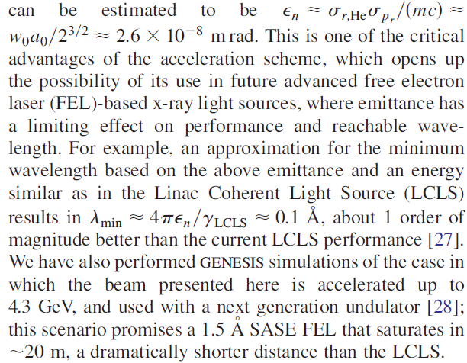
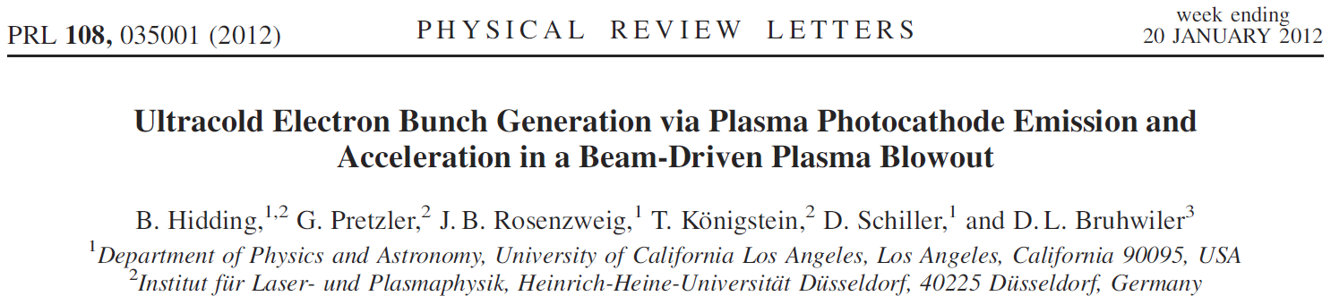
Plasma photocathode aka Trojan Horse: 10 nanometre-rad scale normalized emittance?

Slide 4

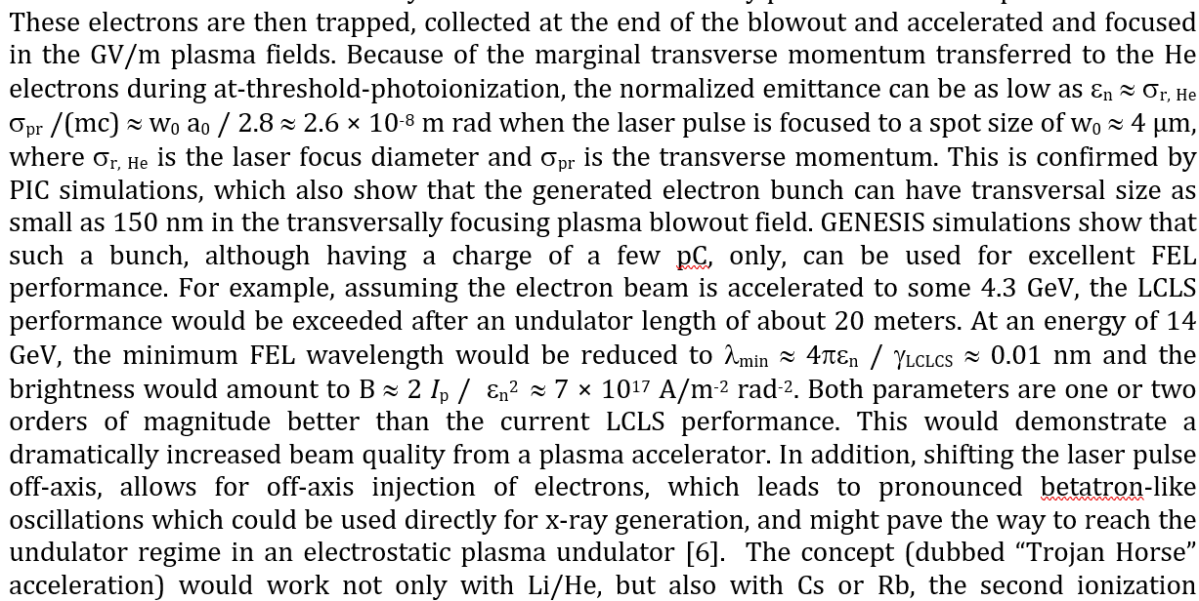
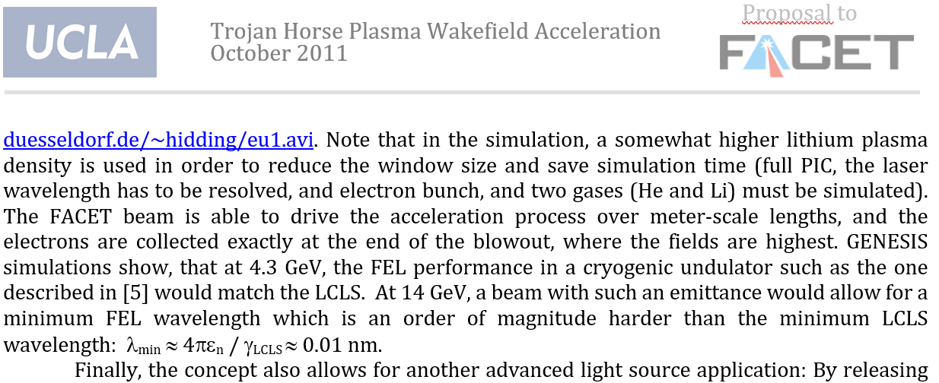
Bold step by DoE and SLAC in 2011:
“Trojan Horse Plasma photocathode will enable next-generation XFELs”
Notes:
Latex2image
\definecolor{myblue}{RGB}{0,106,179}
\textcolor{myblue}{B_\mathrm{6D} = \frac{I}{\epsilon_\mathrm{n}^2 \cdot 0.1\%\sigma\mathrm{w}}}

Slide 5
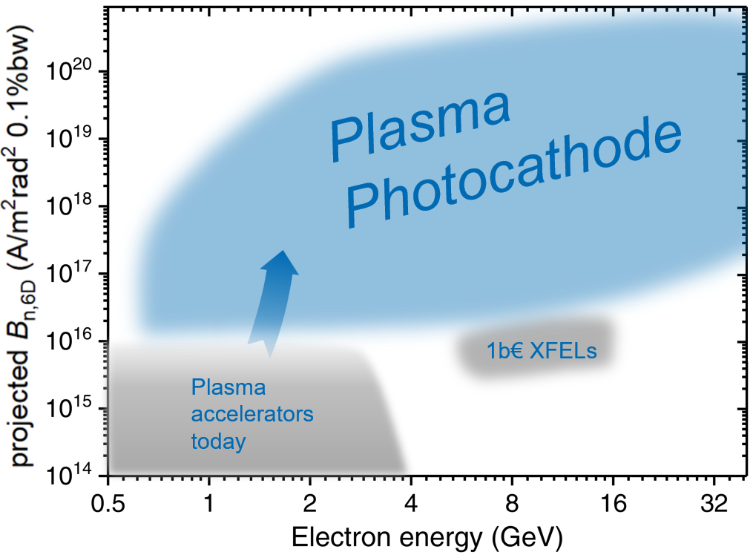
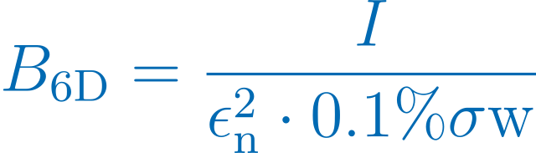

Linac photocathode and 10x brighter beams: enabled LCLS
Plasma acceleration: 1000x smaller accelerators
Plasma photocathode: 100,000x brighter beams?
Linac photocathode
Notes:
Latex2image
\definecolor{myblue}{RGB}{0,106,179}
\textcolor{myblue}{B_\mathrm{6D} = \frac{I}{\epsilon_\mathrm{n}^2 \cdot 0.1\%\sigma\mathrm{w}}}

Slide 6
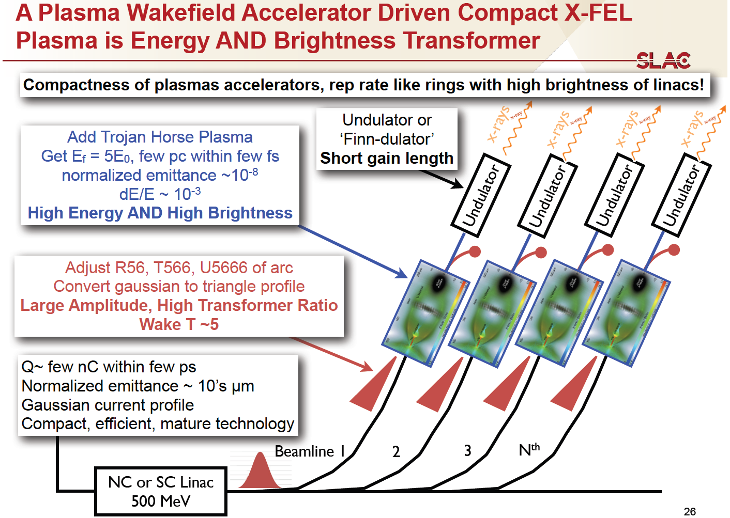
Hybrid Trojan Horse-based Future FEL facility?
w/ M. Hogan (SLAC) et al., 5th Generation Light Source Workshop, 2013
Notes:
Latex2image
\definecolor{myblue}{RGB}{0,106,179}
\textcolor{myblue}{B_\mathrm{6D} = \frac{I}{\epsilon_\mathrm{n}^2 \cdot 0.1\%\sigma\mathrm{w}}}

Slide 7
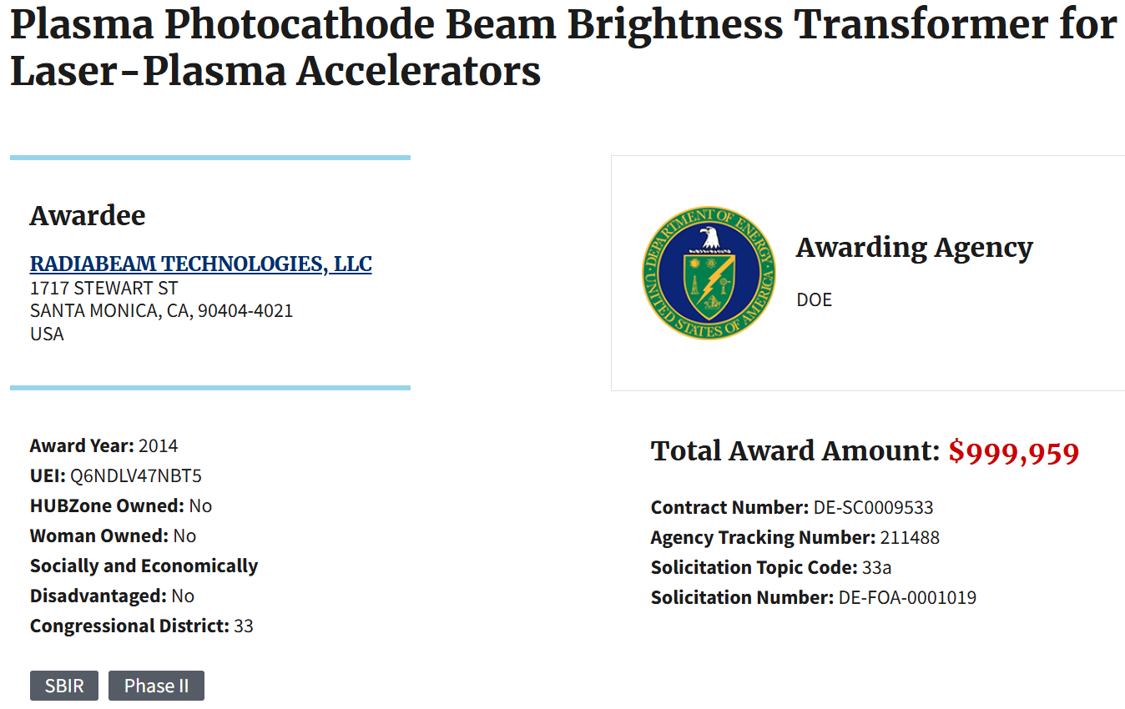

DoE co-funded
E-210: Trojan Horse Underdense Photocathode at FACET
Notes:
Latex2image
\definecolor{myblue}{RGB}{0,106,179}
\textcolor{myblue}{B_\mathrm{6D} = \frac{I}{\epsilon_\mathrm{n}^2 \cdot 0.1\%\sigma\mathrm{w}}}

Slide 8
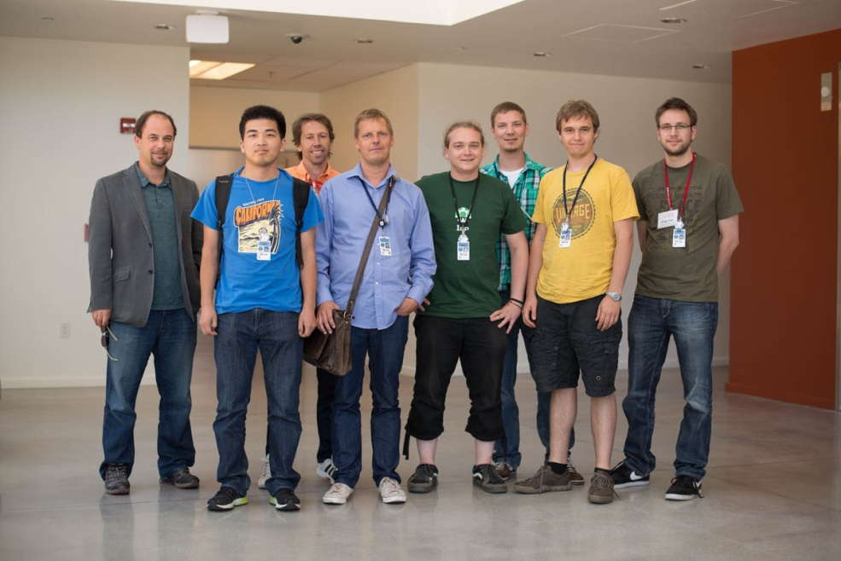
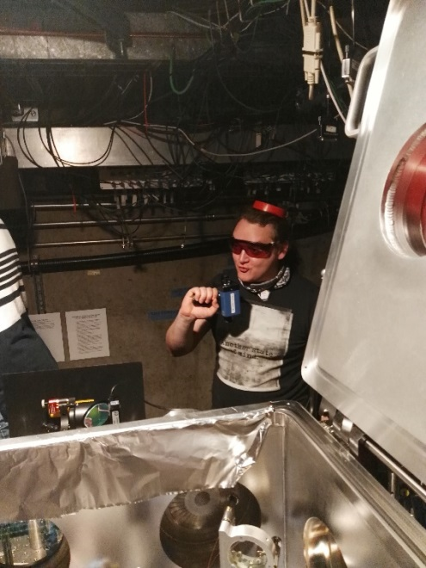
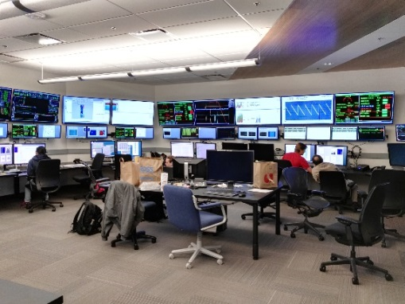
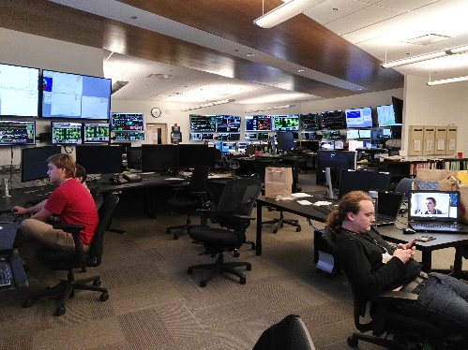
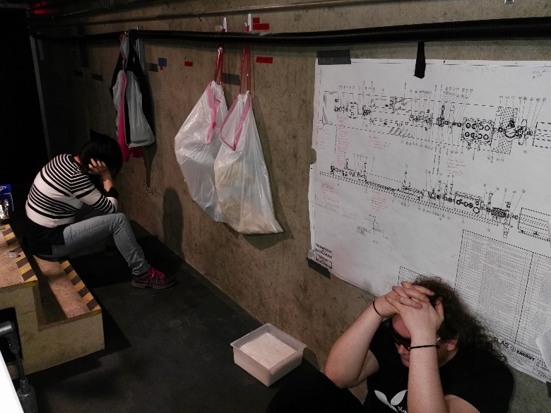
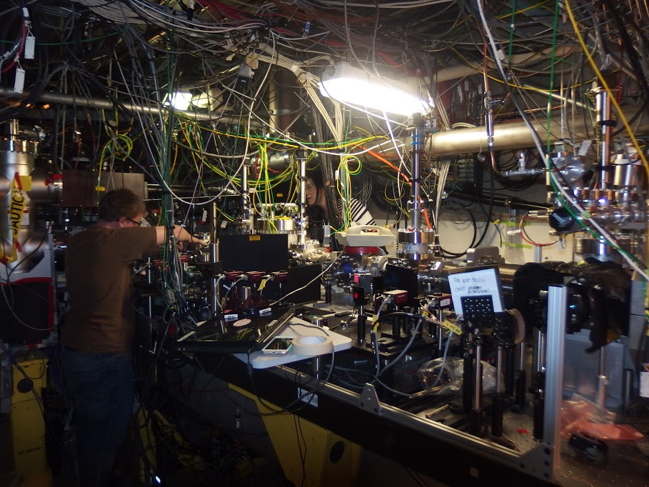
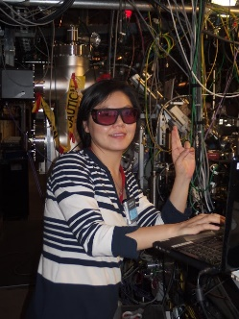
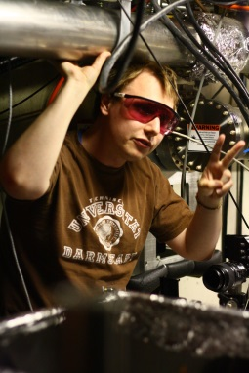
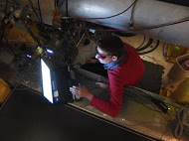
E210 international team: >20 Professors, Post-docs, PhD-Students from 6 universities in 4 countries (UCLA, Strathclyde, Hamburg, Austin, Oslo, Boulder) + industry (RadiaBeam + Tech-X + Radiasoft) + SLAC FACET team
2013 at SAREC – cautiously optimistic
From “University Users at FACET” slides for 2016-06-08 DoE Review, B. Hidding et al.
2015 in tunnel: plasma still stubborn
2016: light at the end of the „tunnel“
Success..
..at last!

Slide 9
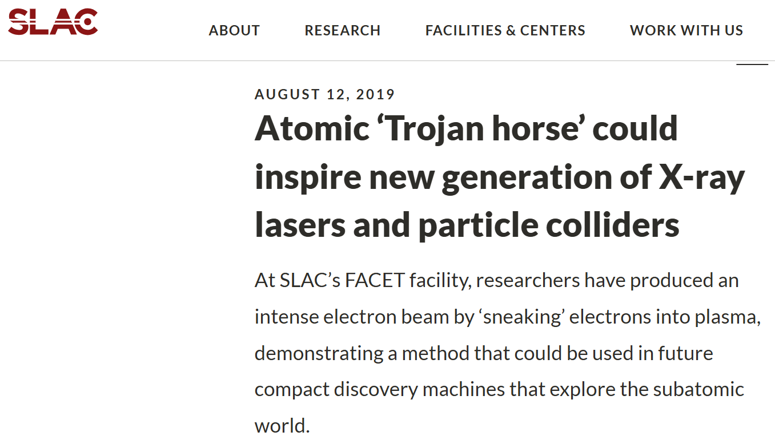

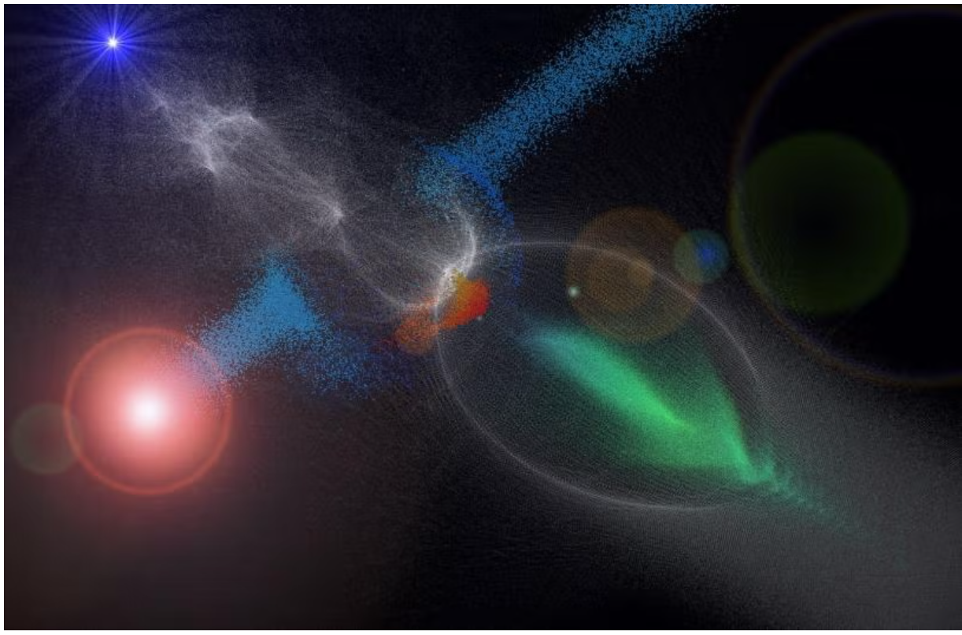
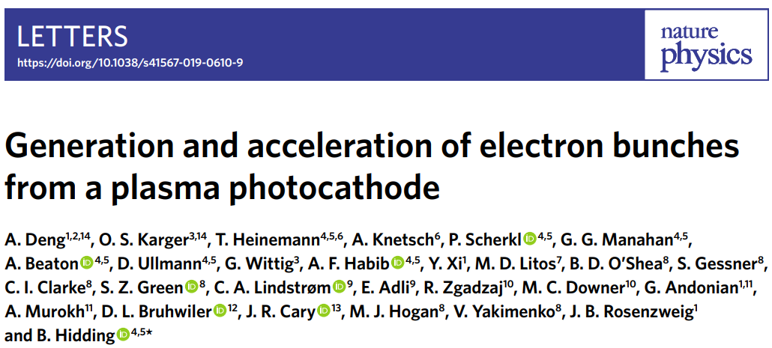
Pellegrini:
Notes:
Latex2image
\definecolor{myblue}{RGB}{0,106,179}
\textcolor{myblue}{B_\mathrm{6D} = \frac{I}{\epsilon_\mathrm{n}^2 \cdot 0.1\%\sigma\mathrm{w}}}

Slide 10
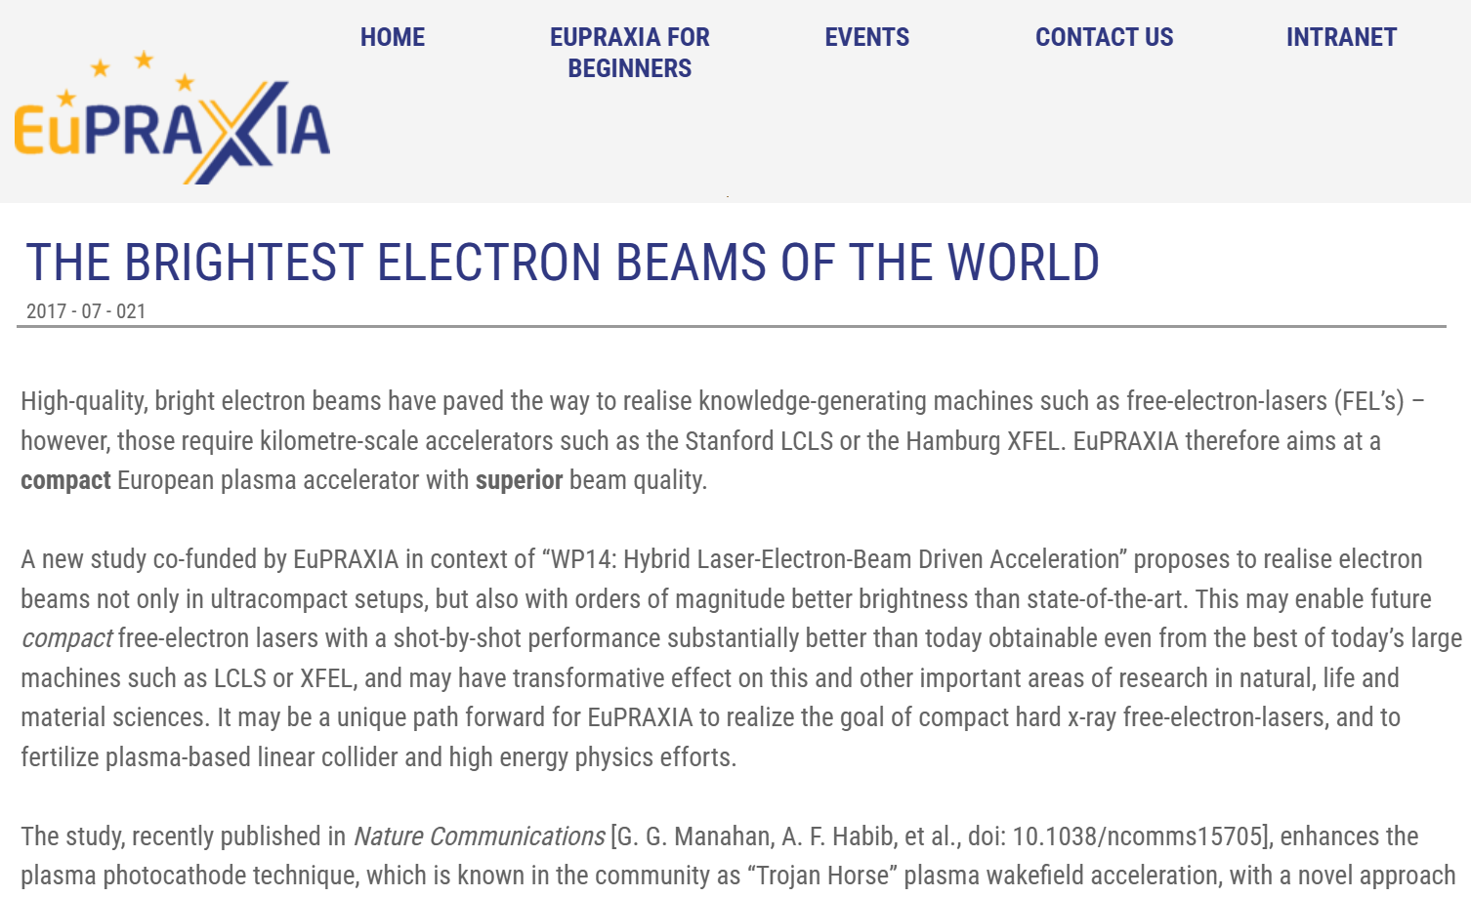
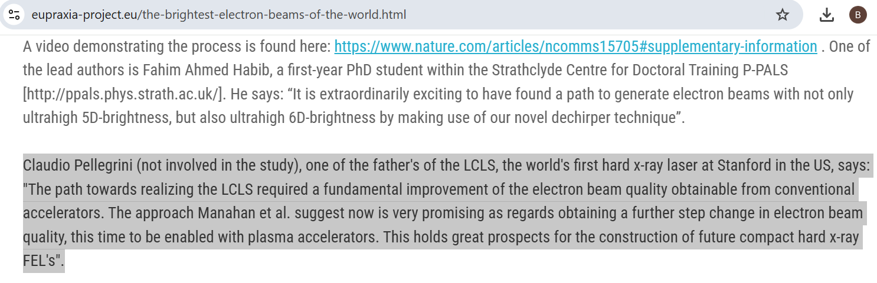

Pellegrini:
Notes:
Latex2image
\definecolor{myblue}{RGB}{0,106,179}
\textcolor{myblue}{B_\mathrm{6D} = \frac{I}{\epsilon_\mathrm{n}^2 \cdot 0.1\%\sigma\mathrm{w}}}

Slide 11

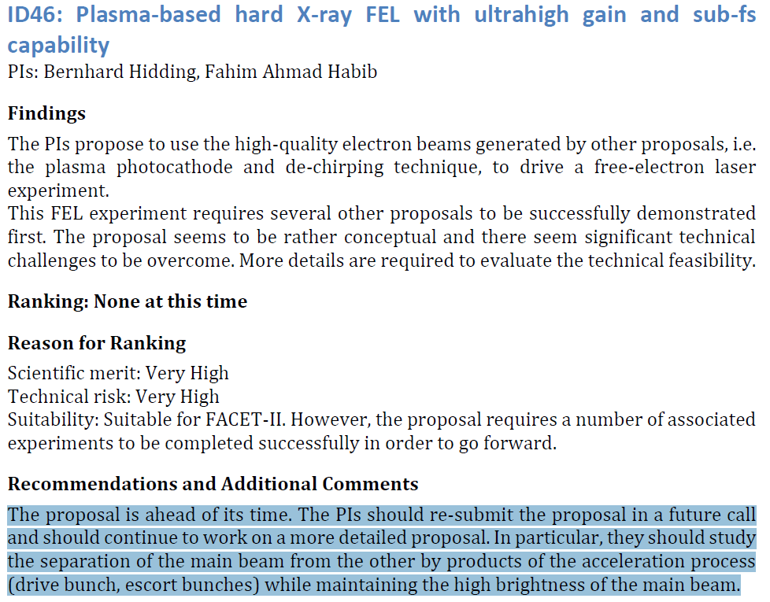
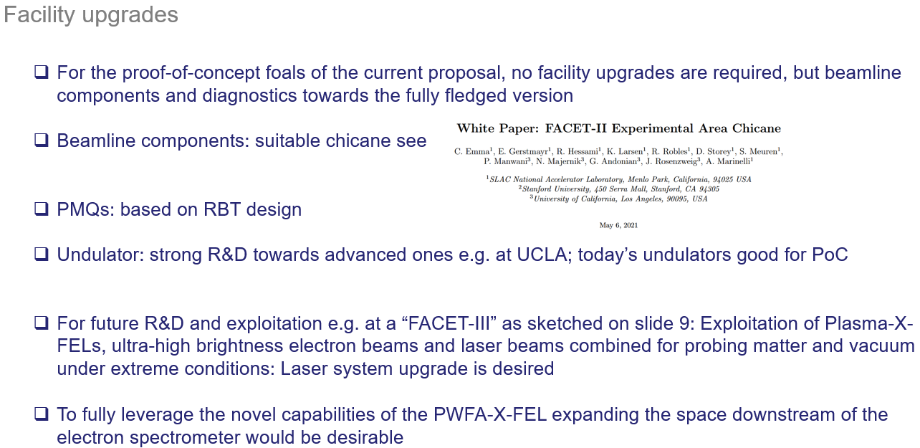
PWFA-X-FEL proposals in 2018 and 2022: Ahead of its time?
Notes:
Latex2image
\definecolor{myblue}{RGB}{0,106,179}
\textcolor{myblue}{B_\mathrm{6D} = \frac{I}{\epsilon_\mathrm{n}^2 \cdot 0.1\%\sigma\mathrm{w}}}

Slide 12
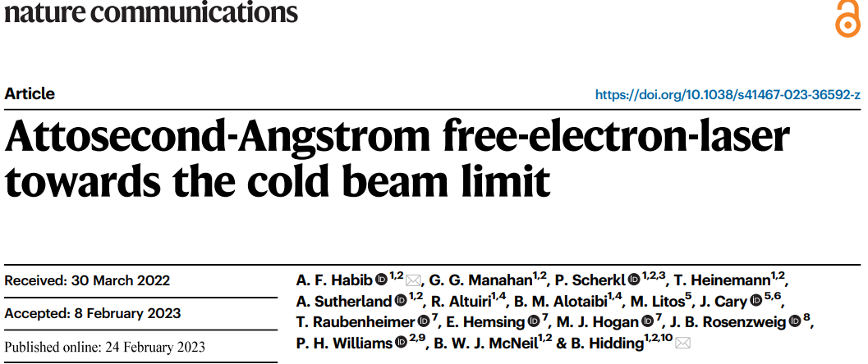
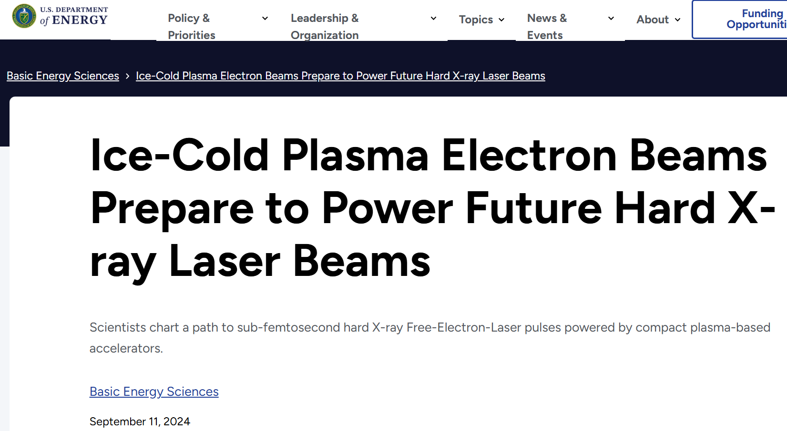
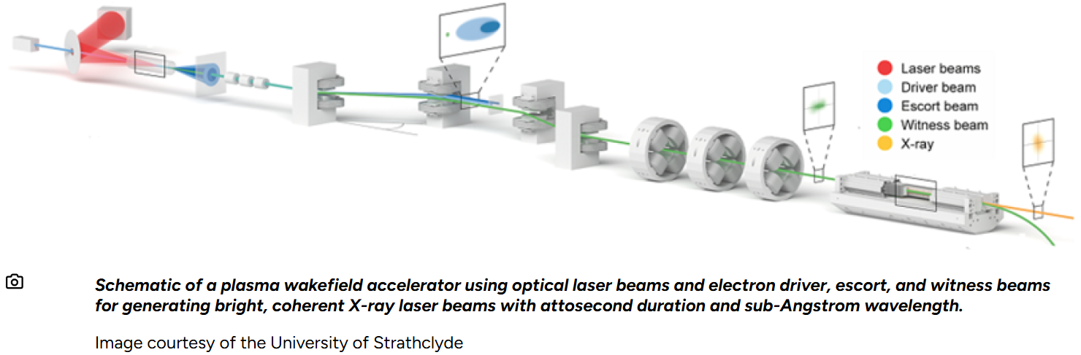
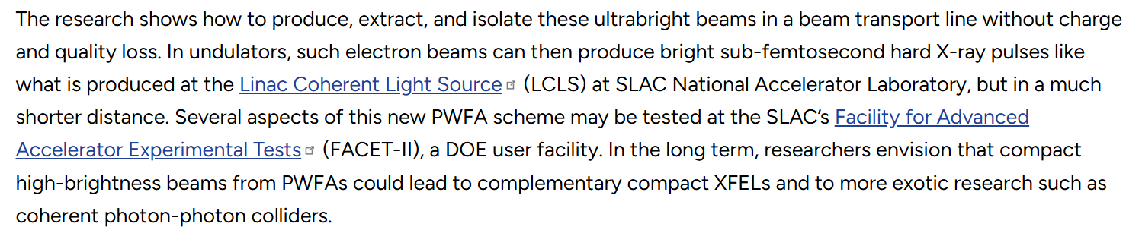

DoE Basic Energy Sciences Highlight in 2024
Notes:
Latex2image
\definecolor{myblue}{RGB}{0,106,179}
\textcolor{myblue}{B_\mathrm{6D} = \frac{I}{\epsilon_\mathrm{n}^2 \cdot 0.1\%\sigma\mathrm{w}}}

Slide 13
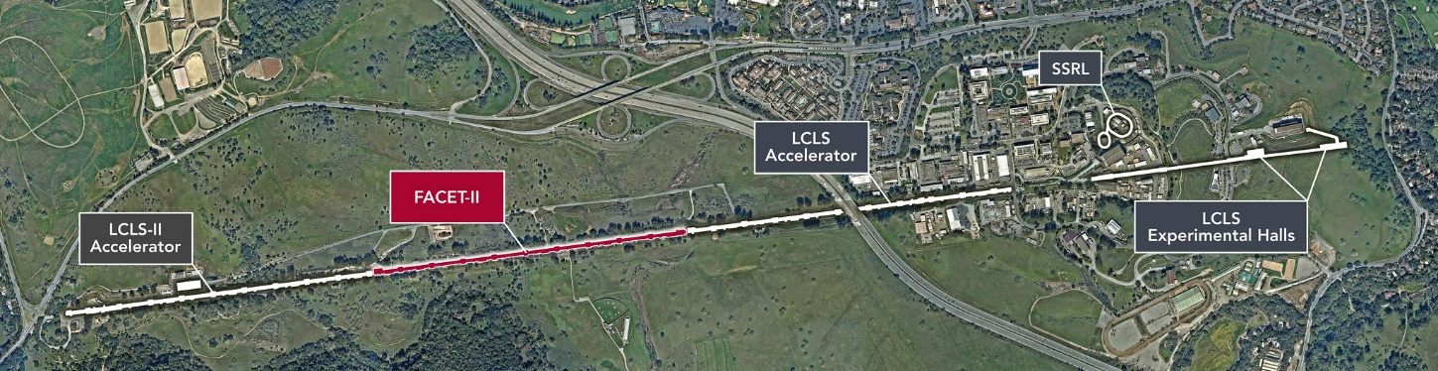
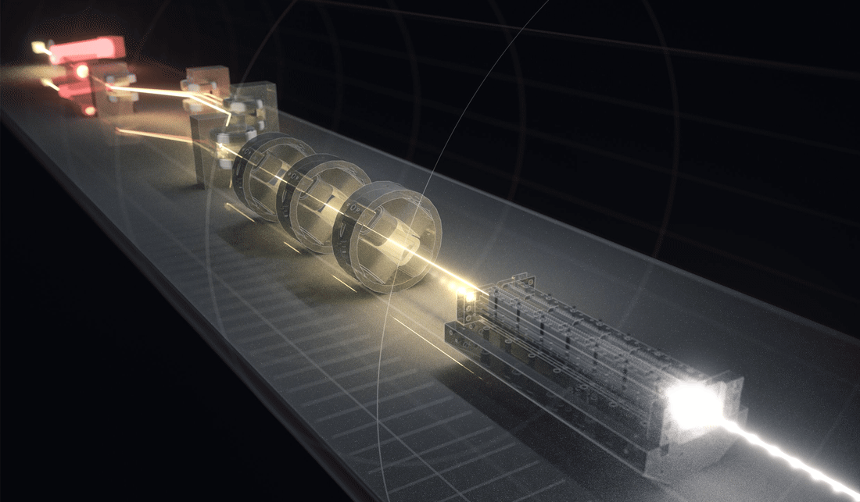
DoE BES is in an outstanding position to continue the global leadership on high-brightness and XFEL at SLAC
10-fold electron brightness increase has enabled LCLS and changed the world
Plasma photocathode could increase brightness by 100,000x. This would transform the XFEL landscape
Plasma photocathode proof-of-concept was realized at FACET during the last weeks of its operation
FACET-II has now regained improved capabilities to demonstrate Trojan Horse-II, and the full potential of collinear plasma photocathodes with 10’s nm rad scale emittance for XFEL
FACET-II, co-located with LCLS, is the ideal location to produce the next generation of XFELs that will truly democratize X-ray lasers and provide capabilities thus far impossible
By funding FACET-II(I), DoE BES can continue its global leadership on high-brightness science and applications
By ending FACET-II prematurely, DoE would risk losing its global leadership on high-brightness science and next-generation XFELs and their application
Notes:
Latex2image
\definecolor{myblue}{RGB}{0,106,179}
\textcolor{myblue}{B_\mathrm{6D} = \frac{I}{\epsilon_\mathrm{n}^2 \cdot 0.1\%\sigma\mathrm{w}}}

Slide 14
Backup
Notes:
Latex2image
\definecolor{myblue}{RGB}{0,106,179}
\textcolor{myblue}{B_\mathrm{6D} = \frac{I}{\epsilon_\mathrm{n}^2 \cdot 0.1\%\sigma\mathrm{w}}}

Slide 15
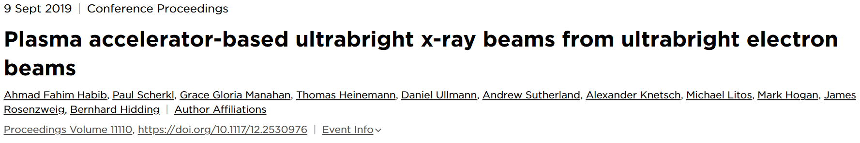
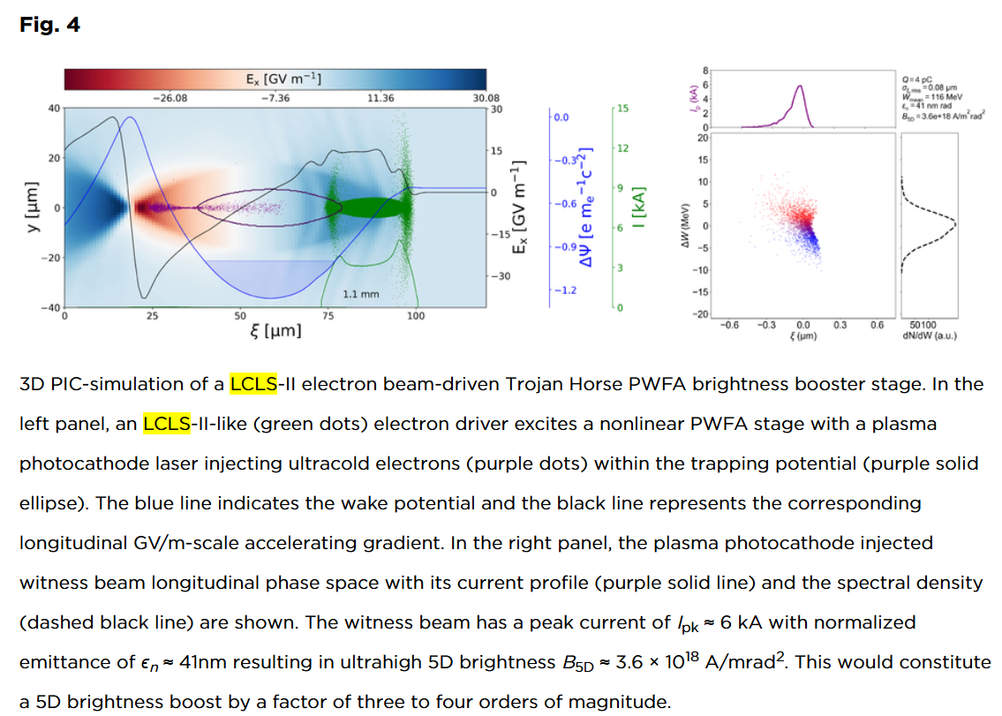

LCLS
Notes:
Latex2image
\definecolor{myblue}{RGB}{0,106,179}
\textcolor{myblue}{B_\mathrm{6D} = \frac{I}{\epsilon_\mathrm{n}^2 \cdot 0.1\%\sigma\mathrm{w}}}

