Slide 1



Nonlinear Theory for Plasma Wakefield Produced by Elliptical Beams via Data-Driven Physical Modeling
Tony Griffin¹, Thamine N. Dalichaouch², Paulo Alves², Lance Hildebrand², Warren B. Mori^{2,3}, Qianqian Su⁴
¹ ODU, School of Data Science
² UCLA, Department of Physics and Astronomy
³ UCLA, Department of Electrical and Computer Engineering
⁴ ODU, Department of Electrical and Computer Engineering
Work at UCLA supported by DOE through DE-SC0025612 and DE-SC0010064. This work is also supported by the Old Dominion University Division of Research and Economic Development (DivRED) Stimulating Transdisciplinary Research (STaR) seed fund.
Notes:
Hello everybody, my name is Tony Griffin. I am a graduate student with the School of Data Science at Old Dominion University and today I will be sharing our research focusing on developing a nonlinear theory for the plasma wakefields produced by elliptical beams through the use of machine learning.
This work is a joint effort between Old Dominion University and UCLA.
TARGET: 15 seconds (0:15)

Slide 2
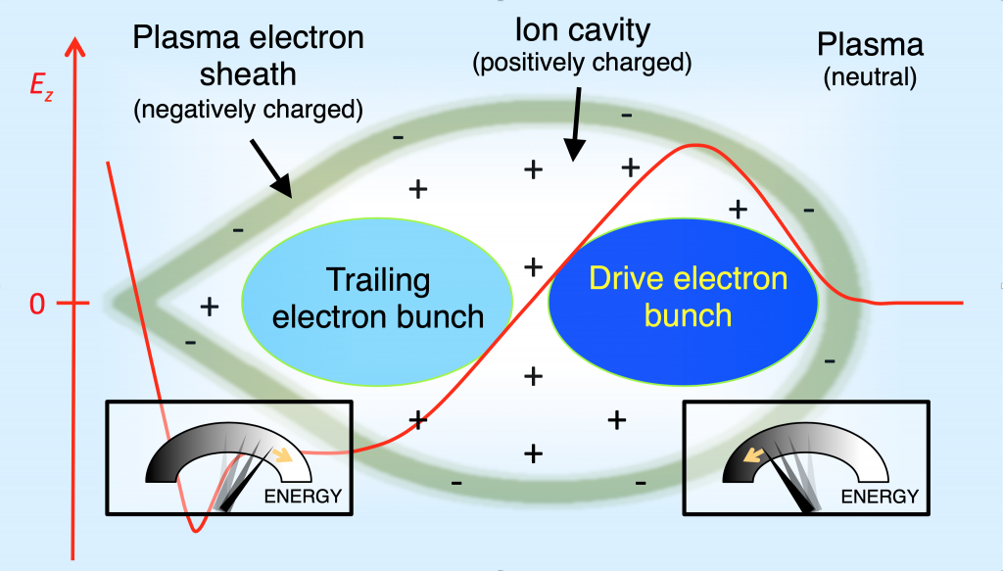
The Blowout Regime and Plasma Wakefields
Plasma wakefield acceleration (PWFA) is a promising candidate for future linear colliders
Electron beam traverses underdense plasma, expelling plasma electrons
When these electrons are pulled back, a wake is formed
A trailing beam accelerates from this wake to reach relativistic speeds
Characterizing this wakefield is of the utmost importance!
Chen, et al, Phys. Rev. Lett. 55, 1537, 1985
Rosenzweig, et al, Phys. Rev. A 44, R6189(R), 1991
Lindstrøm, et al, arXiv:2504.05558, 2025
Visualization from Laboratoire d’Optique Appliquée
Notes:
Plasma wakefield acceleration offers an exciting method for the development of more efficient linear colliders due to the larger acceleration gradients offered compared to radio-frequency counterparts.
Our research focuses on the nonlinear blowout regime, wherein a drive electron bunch travels through underdense plasma.
In this visualization, we see the drive bunch moving to the right and as it is traveling, it expels all plasma electrons radially, forming a plasma ion cavity surrounded by a plasma electron sheath.
These ions will eventually pull the electrons back in, overshoot, and cause the formation of a nonlinear plasma wakefield, which is denoted by the red line.
A trailing electron bunch is loaded at the back of the bubble and is able to surf the wakefield to experience the accelerating and focusing fields and gain transferred energy from the drive bunch.
Characterizing this plasma wakefield is incredibly important for plasma-based accelerator operations and is the focus of our research efforts.
TARGET: 30-45 seconds (1:00)
Notes:
Drive bunch decel, trailing bunch accel
Longitudinal wakefield - accel
Transverse wakefield - focus

Slide 3
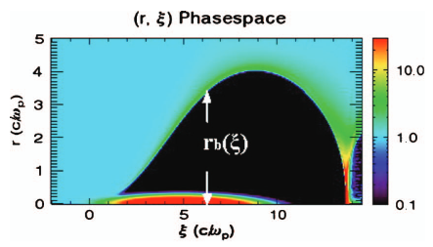
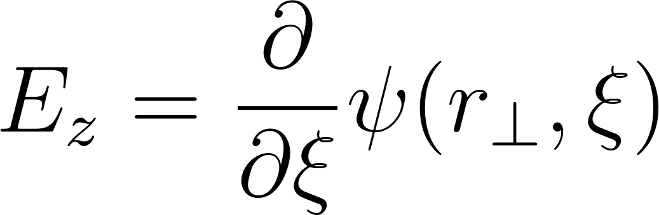
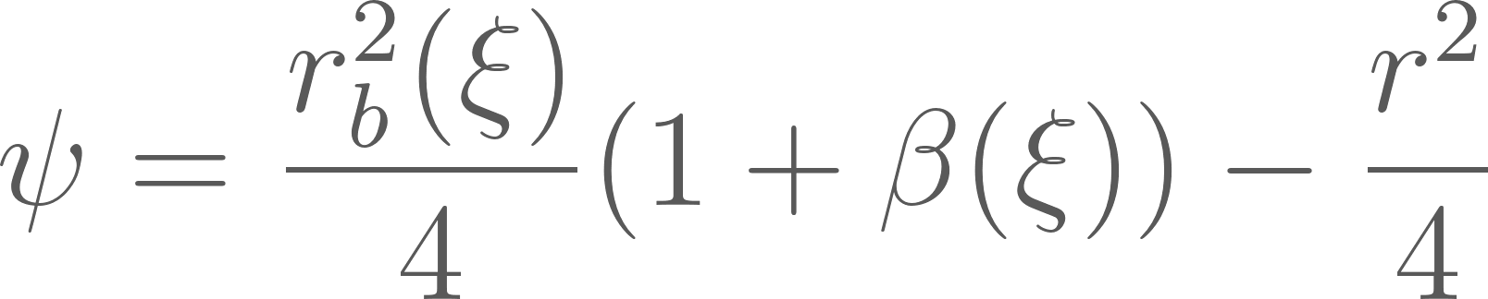
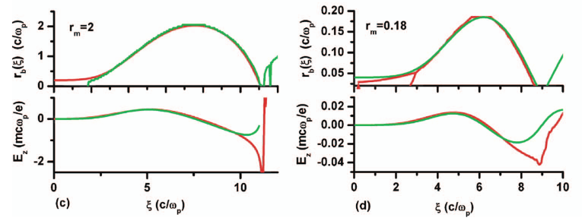
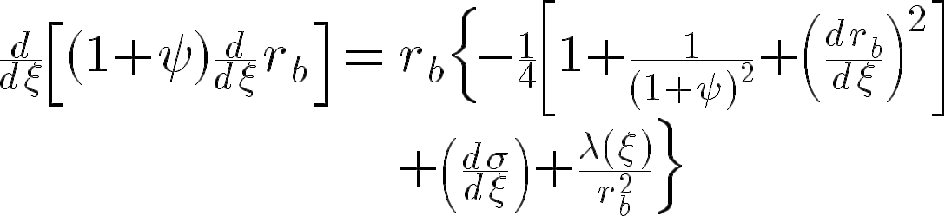
Nonlinear Theory of Symmetric Driver Beams
Wakefield Equation:
(1)
Wake Potential Equation:
(2)
Blowout Trajectory Equation:
(3)
Lu, et al, Physics of Plasmas 13, 056709, 2006
Golovanov et al. Physical review letters 130, 105001 2023
Notes:
Work has been done for characterizing the wakefield, specifically those created by axisymmetric drive beams.
Notably, Lu et al developed a predictive model for both the blowout trajectory and the wakefields under the blowout regime.
In this work they expressed the wakefields completely in terms of the wake potential, psi.
In turn, using a model for the surrounding electron sheath, psi is expressed in terms of the blowout trajectory, rb, shown in the top left visualization forming as the drive bunch is propagating to the left.
Consequently, solving for this blowout trajectory allows the wake potential and associated accelerating and focusing fields to be calculated.
Equation 3 is particularly useful as it provides a function for our beam parameters, sigma and lambda, to determine the blowout trajectory.
So by a series of computations, we are able to predict the wakefield using the drive bunch parameters; which is a foundational finding to our research.
As seen in the bottom left figures, this model shows great agreement between prediction and simulation, both for blowout trajectories and wakefields, particularly at the front and center of the simulation.
This model also shows correct structure of the blowout trajectory and the wakefields towards the rear of the blowout, but work was required to increase the predictive quality within that region.
TARGET: 1 ½ min (2:30)
Notes:
Sigma & lambda define the beam params
Lambda = A * sigma values (beam sizes)
Wake potential eq
First part (r_b^2…\beta(\xi)) is \psi_0
\beta
Relates sheath parameters to the blowout trajectory

Slide 4
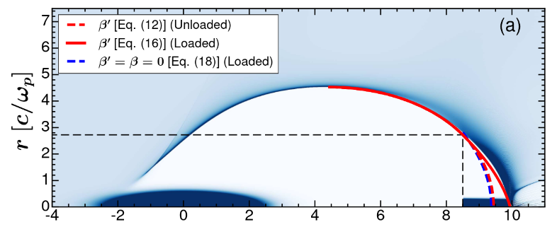
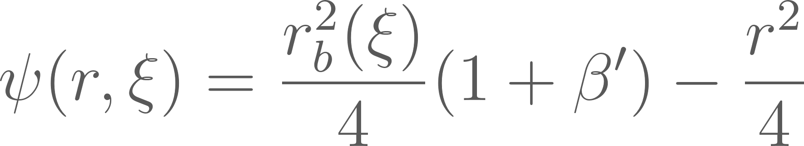

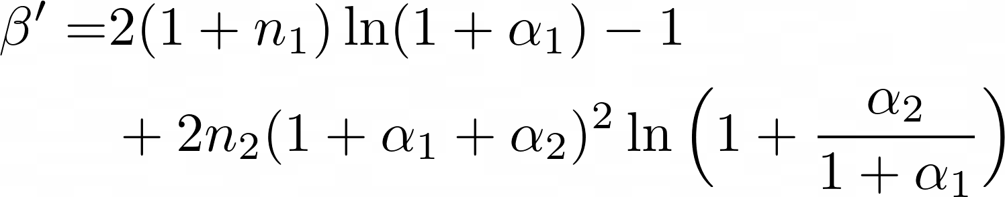
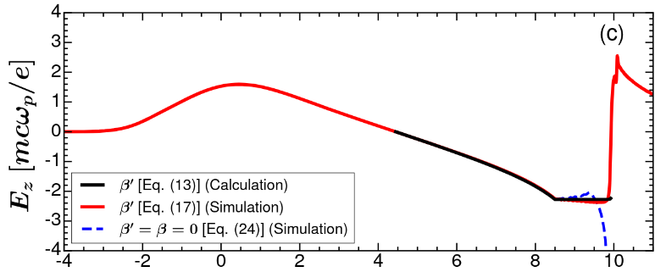
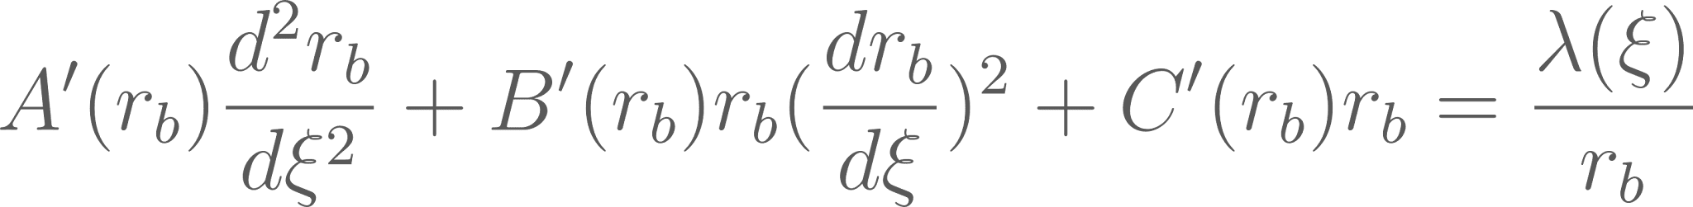
Multi-Sheath Model of Symmetric Driver Beams
Updated Wake Potential:
(4)
Refined Equation:
(5)
Updated Blowout Trajectory:
(6)
Dalichaouch, et al, Physics of Plasmas 28, 063103, 2021
Notes:
The reason for the discrepancy at the rear of the blowout was that the original model used a single-sheath description that constrains the wake potential to remain nonnegative; which is a reasonable approximation for the front of the blowout, but one that does not hold towards the rear, where it is expected to approach -1.
As such, the predictive ability degrades in that region for both the blowout trajectory and the wakefield.
Dalichaouch et al. addresses this limitation while preserving the Lu-style wake potential form by replacing the single-sheath beta with a multi-sheath beta prime, made possible from a source model that can be negative in regions outside the ion cavity.
As beta defines how the sheath parameters modifies blowout trajectory, it is vitally important to have an accurate model for this term.
The result of this shows a notable improvement in predictive quality for the blowout trajectory and the wakefield and maintains structural accuracy.
TARGET: 1 min (3:30)
Notes:
Eq 6 is reduced form of eq 3 previous slide; only change is beta

Slide 5
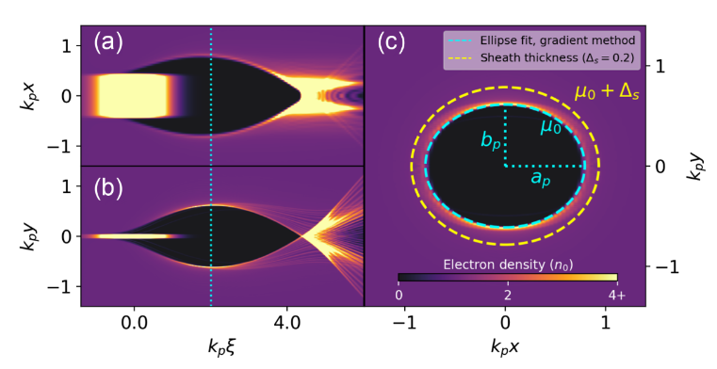
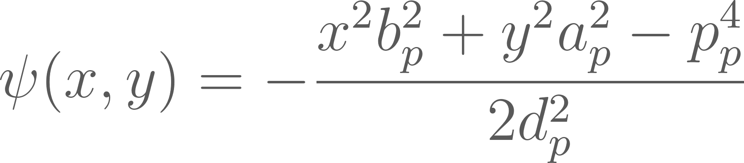
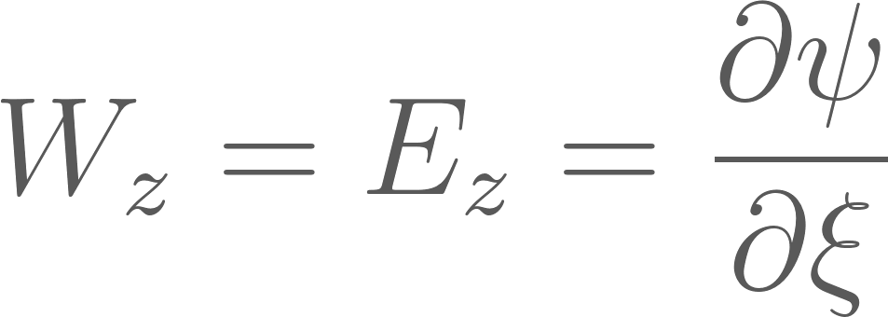
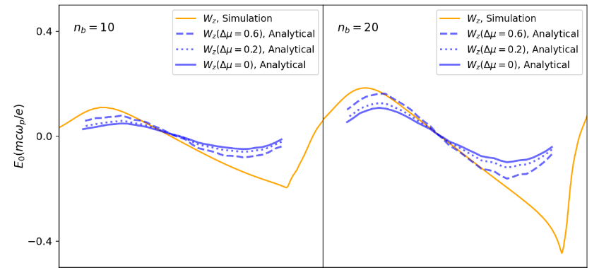
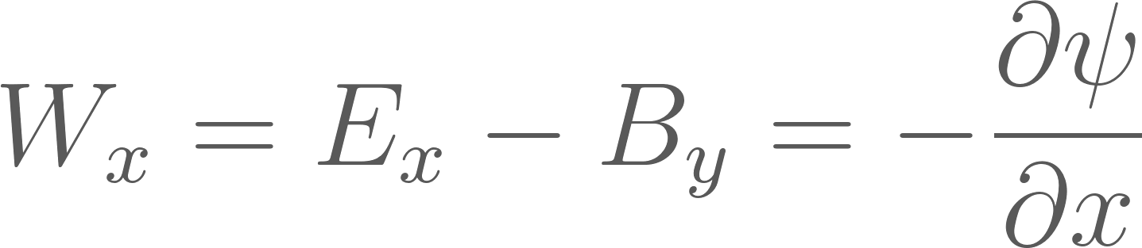
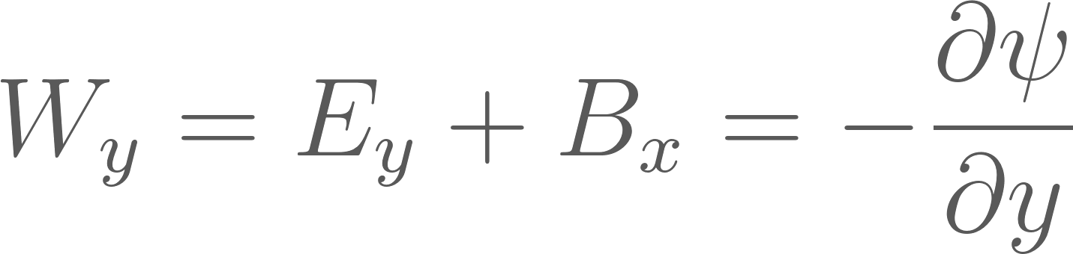
Elliptical Driver Beam Theory
Wake Potential:
(7)
Accelerating Wakefield:
(8)
Focusing Wakefield:
(9)
(10)
Manwani et al, Phys. Rev. Lett. 135, 095001, 2025
Notes:
Up to this point, the models I have discussed assume axisymmetry, where the blowout can be described by a single radius rb.
For a transversely asymmetric drive beam, that assumption breaks down as the plasma cavity is no longer circular, and the wakefields are no longer uniform across axes.
Through simulation, however, it was determined by Manwani et al that the asymmetric cross section of the blowout can be approximately treated as an ellipse, described by two semi-axes, ap and bp.
The key result for our work is the resulting definition of the wake potential, psi, shown in equation 7, and which will depend on x and y quadratically.
This is important because once psi is known, the wakefields follow from its derivatives: the transverse gradients give the focusing fields in equations 9 and 10, and the longitudinal derivative gives the accelerating field in equation 8.
This elliptical model gives good agreement for the cavity structure and transverse wakefields, as shown by the comparison between the fitted elliptical boundary and simulation in the top figure.
However, disagreement exists between this model and the longitudinal wakefield shown in the bottom figure.
As such more work is needed to model this longitudinal wakefield, which we believe machine learning can aid in.
TARGET: 1 ½ Min (5:00)
Notes:
Acceleration & Focusing field equations are general, not specifically from paper
p_p^2 = a_p * b_b
d_p^2 = a_p^2 + b_p^2
Their rb is extracted from simulation, not from DE

Slide 6
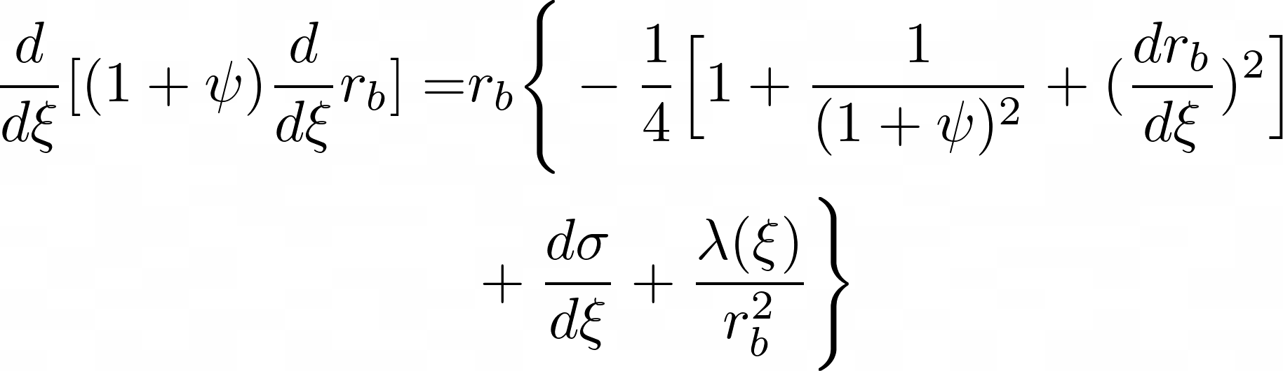
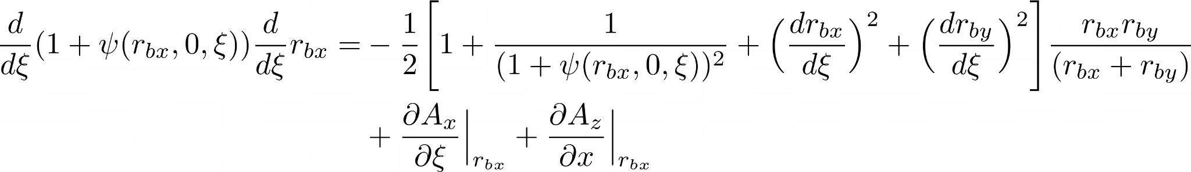
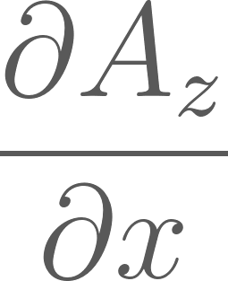

Equation of Blowout Trajectory
Lu, et al
Model
Our
Model
Now, we require an analytical form for both and
Notes:
With the elliptical wake-potential form established, we can now transition from the existing Lu model to the one for the blowout trajectory caused from asymmetric beams.
In particular, we utilize the asymmetric psi function to determine a new form of the blowout trajectory and use the python symbolic library, SymPy, to perform some of the mathematical derivation automatically.
The overall workflow remains the same: solve for the blowout trajectory, then use that trajectory to determine the wake potential and wakefields.
The difficulty is that the asymmetric trajectory differential equation at the bottom contains terms that are not available in a simple analytical form.
Thus to solve this differential equation, we must find usable forms for both the psi0 term for a complete form of psi and Az, which is the longitudinal vector component from the drive bunch.
It is also important to note that the equation shown here is for the x-axis; to solve for the y-axis, we edit two terms.
First, psi’s inputs are changed to set rbx to 0 and rby is passed in; then, Ax towards the end is altered to Ay.
In this way, we receive equations for both axes.
TARGET: 1 min (6:00)
Notes:
dAx/dxi uses a simplified model similar to the symmetric case

Slide 7
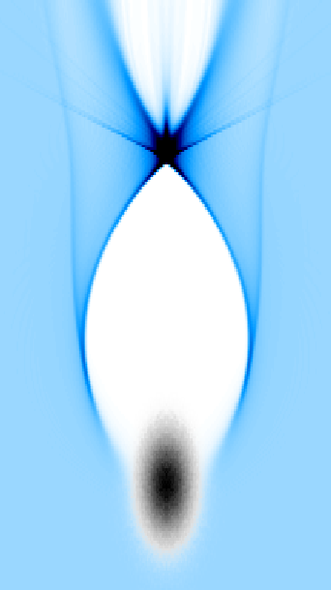


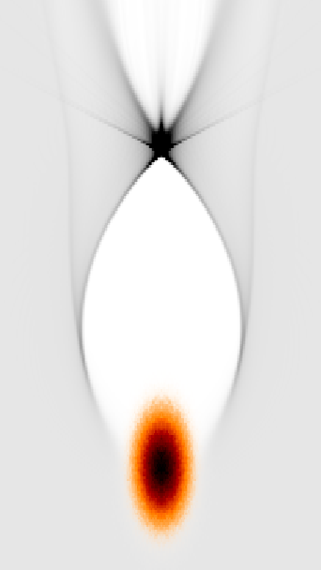


Introduction of QuickPIC
Quasi-Static Approximation
Quasi-Static Loop
Beam frozen, plasma & field evolves
3D Loop
Plasma & field frozen, beam evolves
Huang, et al, Journal of Computational Physics 217 658–679, 2006
Weiming, et al, Journal of Computational Physics 250 165-177, 2013
Su, et al, Journal of Computational Physics 539 114225, 2025
Notes:
To solve this differential equation, we utilize QuickPIC, the quasi-static, particle in cell simulation code to generate training and testing data.
This code uses the quasi-static approximation, wherein it is presumed that the plasma wake oscillation is substantially greater than the beam evolution, which has the effect of a slower beam evolution in comparison to the plasma evolution.
With this assumption, QuickPIC will transform cartesian coordinates into co-moving coordinates and all quantities are separated into two time scales, xi and s.
When it comes time to solve the wake, we assume the beam quantities are frozen and solve the 2D poisson equations backward at each slice.
Upon completion of these plasma quantities, the results are then used to solve for the beam quantities, and continue to the next loop.
Recently, mesh refinement has also been implemented to further optimize the computational demands
TARGET: 1 min (7:00)
Notes:
Mesh refinement implemented for computation improvement

Slide 8

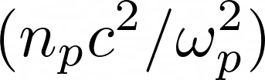




QuickPIC Dataset for Asymmetric Blowout Modeling
100 one-step 3D simulations from QuickPIC, the quasi-static, Particle-in-Cell simulation code
256x256x256 grid space spanning 3 dimensions
Randomized asymmetric drive beam values selected from a Gaussian distribution
Resulting dataset offers a range of blowout shapes and wakefield responses to act as training data
Beam Parameters in Dataset
Variable | Range | Description
 | [4.0, 8.0] | Normalized beam current
 | [0.1, 2.0] | Beam size in the x-axis
 | [0.1, 2.0] | Beam size in the y-axis
 | [0.4, 0.8] | Beam size in the z-axis
Huang, et al, Journal of Computational Physics 217 658–679, 2006
Weiming, et al, Journal of Computational Physics 250 165-177, 2013
Su, et al, Journal of Computational Physics 539 114225, 2025
Notes:
With that background in mind, to model the missing terms in the asymmetric blowout equation, we generated a dataset using QuickPIC, made up of 100 simulations.
Each simulation is a one-step, three-dimensional simulation of an asymmetric Gaussian drive bunch on a 256 cubed grid space.
The beam’s geometry is randomly varied through controlling sigmax and sigma_y, whose values are in the range of 0.1 to 2, and sigma_z which sits in the 0.4 to 0.8 range; all of which are sampled from a normal distribution.
A lambda value is sampled between 4 and 8 as well to control the beam strength and calculate the beam amplitude, a value which is passed to QuickPIC.
By varying these the beam geometry and strength, we generate a range of asymmetric blowout shapes and wakefield responses to act as high-fidelity training data for modeling the missing terms and validating results.
Here we assume strong blowout cases; however, future work will see us expand this dataset into other regimes to validate further results.
TARGET: 1 min (8:00)
Notes:
Short beam regime as sigma_z < 1
A = lambda / (sigma_x * sigma_y)
Plasma density = 10^{17}cm^{-3}

Slide 9
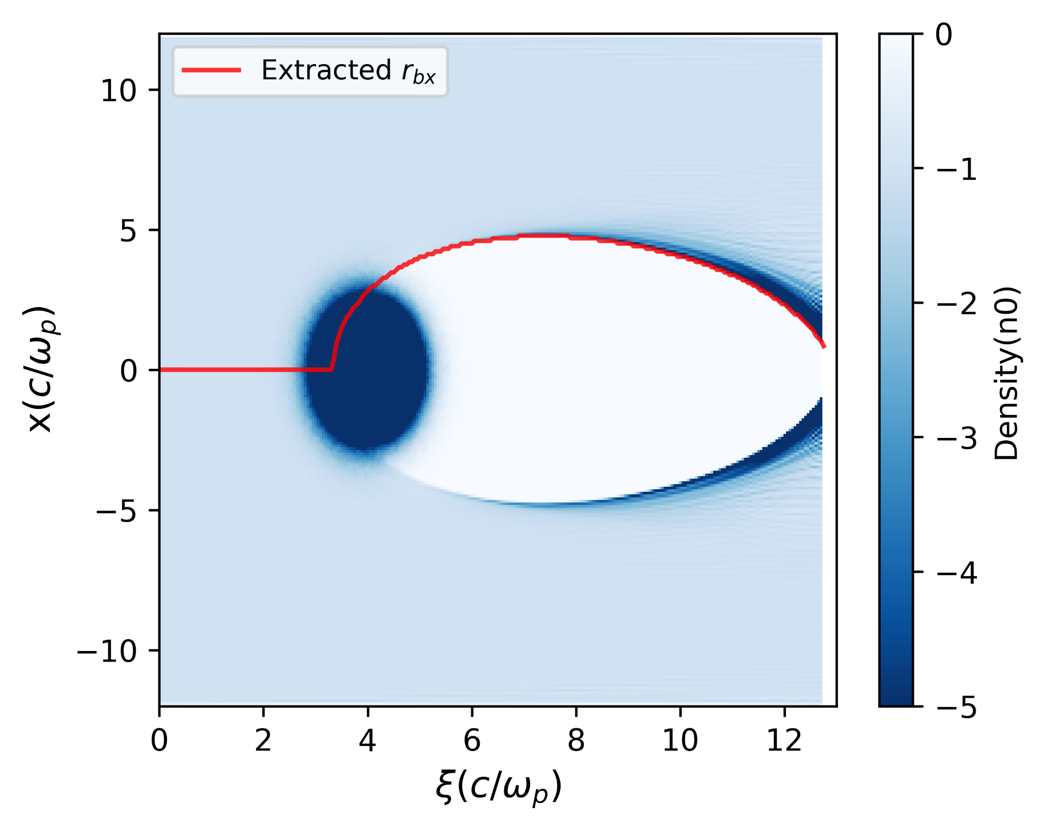
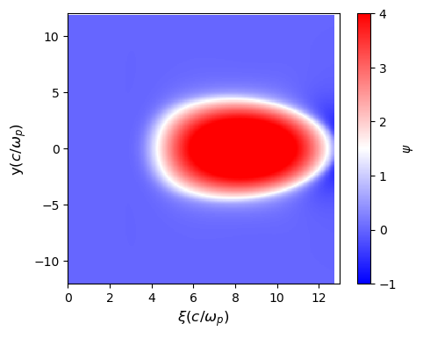
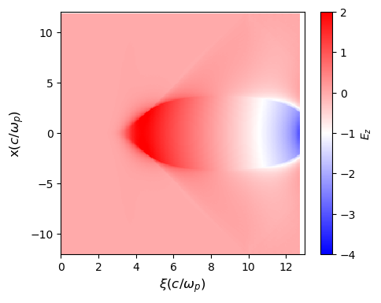
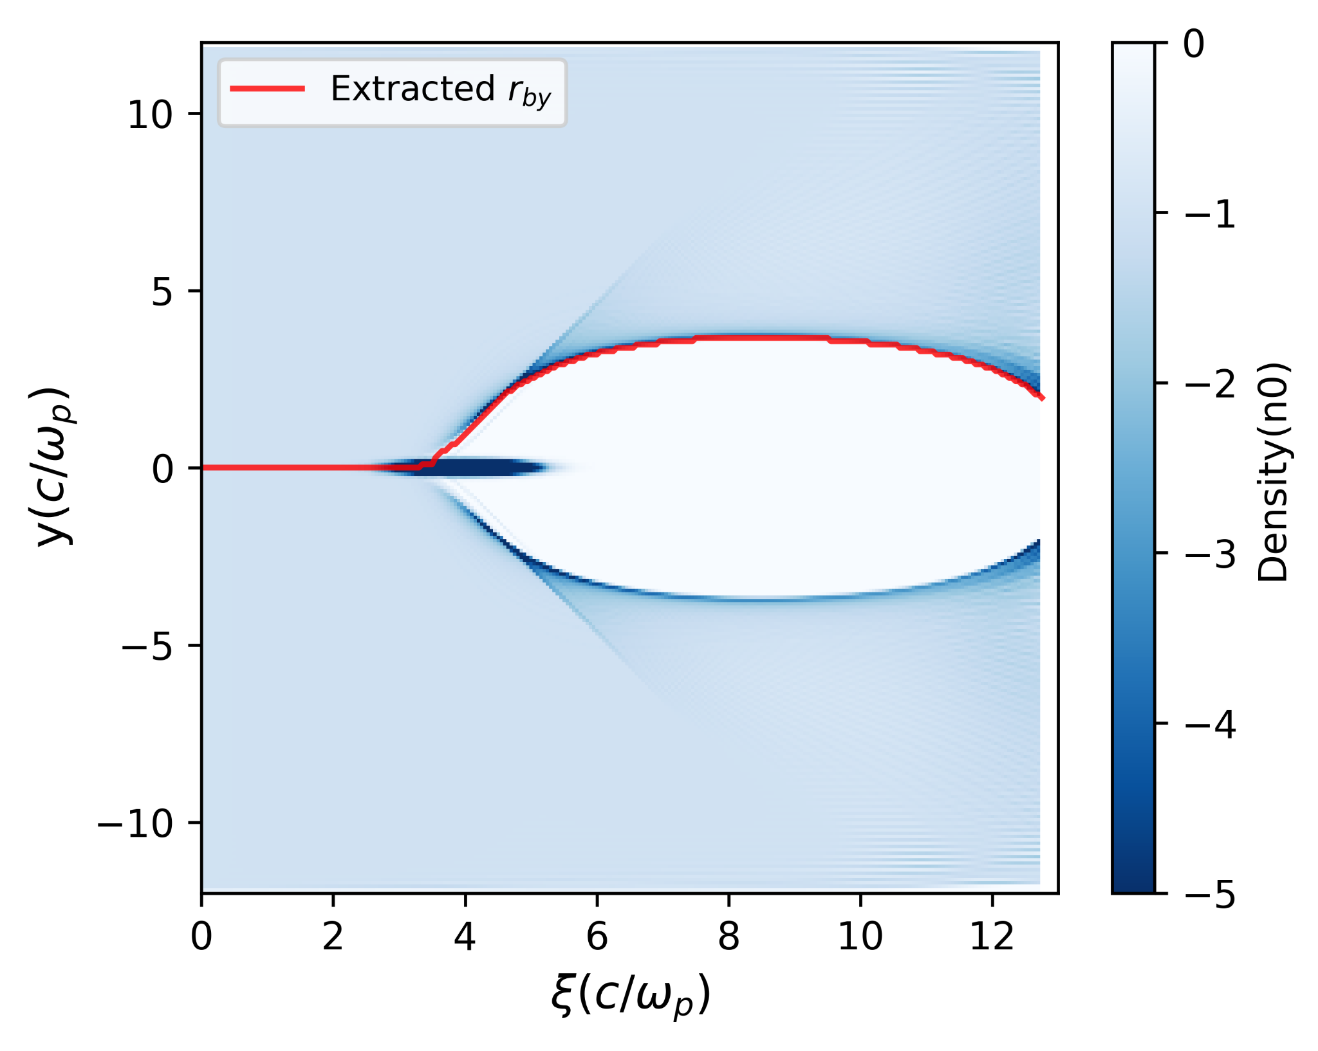
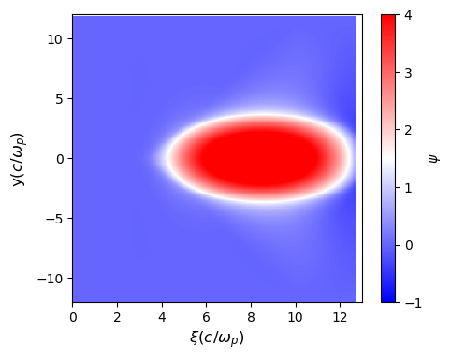

Targeted Quantities from QuickPIC
Notes:
From each QuickPIC simulation, we extract the quantities needed to connect the simulation data back to the analytical trajectory model.
The red curve on the left-most visualizations shows the extracted blowout trajectory for the x and y axes that we are currently attempting to model using the earlier differential equation.
Once this blowout trajectory has been solved for from start to finish, we can move onto the next step of determining a model for psi; and from psi calculate the accelerating and focusing wakefields.
In this sense, we follow the same workflow as the Lu et al model to calculate the wakefield from the beam parameters.
All of these targeted quantities from each simulation will be used as supervised learning training data as well as test data to validate the results.
TARGET: 1 min (9:00)

Slide 10

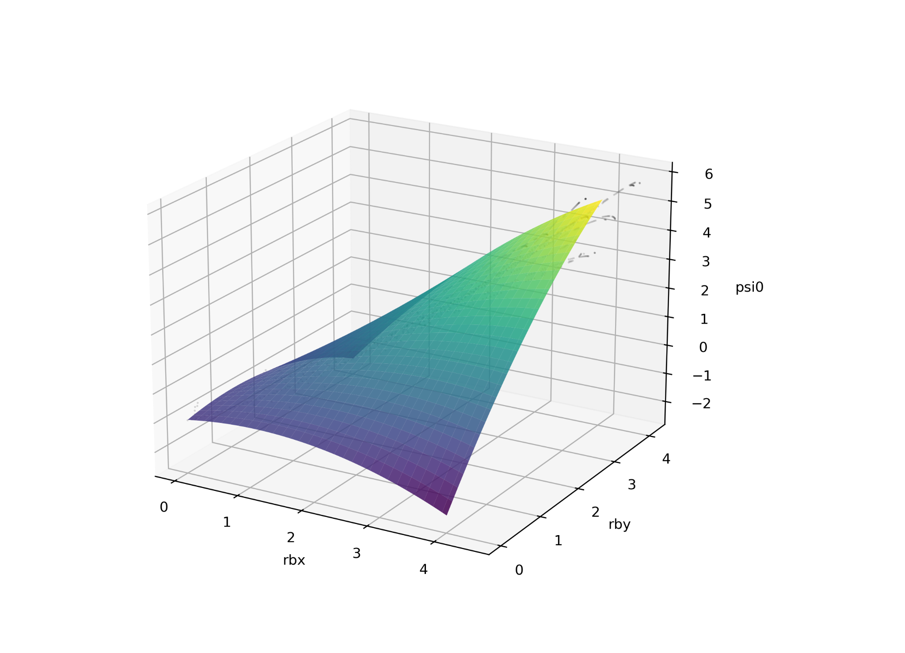


Term Modeling
Utilized 10 simulations from QuickPIC augmented with multi-sheath theory to perform polynomial regression for
With this form, we can add it to established asymmetric theory to determine a form of
Later work could open up other beam parameters
Notes:
The first missing term we model is psi0​, the on-axis wake potential.
For this initial model, we fit psi0​ as a function of rbx and rby extracted from 10 QuickPIC simulations
Then, the dataset is augmented with known symmetric theory points from the multi-sheath model.
This gives the regression both simulation information from asymmetric cases and physically motivated behavior in the symmetric case.
The fitted model uses polynomial combinations of the two blowout radii to acquire a usable approximation, from which, we can then combine with the asymmetric theory to determine the wake potential.
This equation can then be utilized when solving the blowout trajectory.
In the future, we hope to replace this regression model with a physics informed neural network to improve accuracy, factor field information into the model, and extract any unknown parameters.
TARGET: 1 min (10:00)

Slide 11
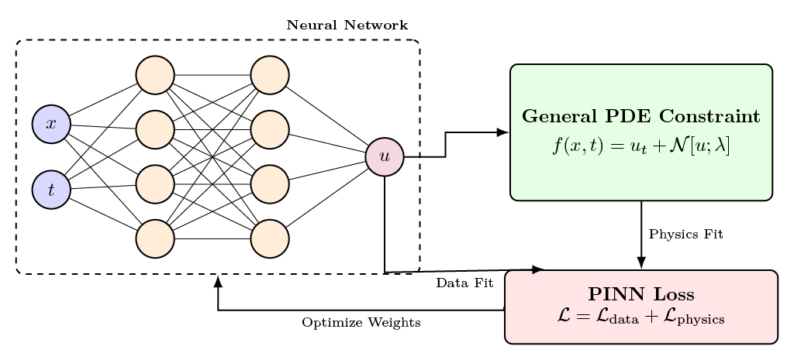
Machine Learning and Physics Informed Neural Networks
Neural network training is a global optimization problem
Physics-Informed Neural Networks (PINNs) provide means to encode physical laws into neural networks
This approach allows for more accurate surrogate models with a substantially lower dataset requirement
Raissi et al, Elsevier Volume 378 686-707, 2019
Notes:
For the remaining Az term, simple regression is not be flexible enough; particularly as it requires spatial coordinates and beam parameters as input.
This motivates the use of neural networks, and specifically physics-informed neural networks.
Neural networks present a method of nonlinear function fitting through the updating of weights and biases.
These weights and biases are updated based on the given input data to match the ground truth target; however, in physical domains where functions become more complex, they require a great deal of data to learn from.
For computationally demanding simulations like QuickPIC, this becomes a prohibitive factor for utilizing neural networks.
A physics-informed neural network helps address this by adding known physical constraints directly into the training loss; so, instead of training only on simulation data, the model is also penalized when it violates the governing equation.
By incorporating this prior information, this acts as a physics-based regularizer in that it reduces the space of possible neural-network outputs and allows limited QuickPIC data to be used more effectively.
This is essential for development of a complete blowout theory as the field from the driver and sheath is inherently difficult to model; we will utilize machine learning to utilize both high fidelity data and current theory to compensate for the missing parts.
TARGET: 2 min (12:00)

Slide 12

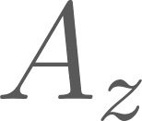
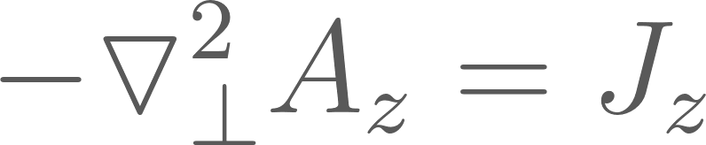
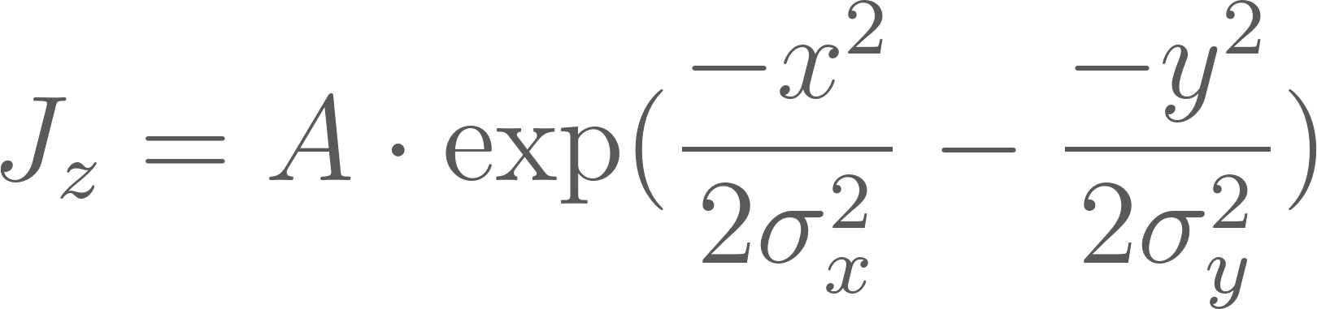
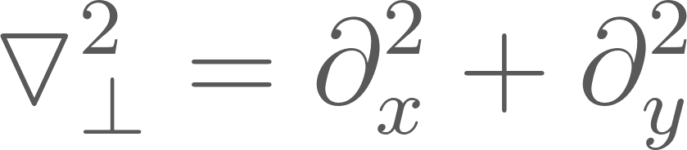
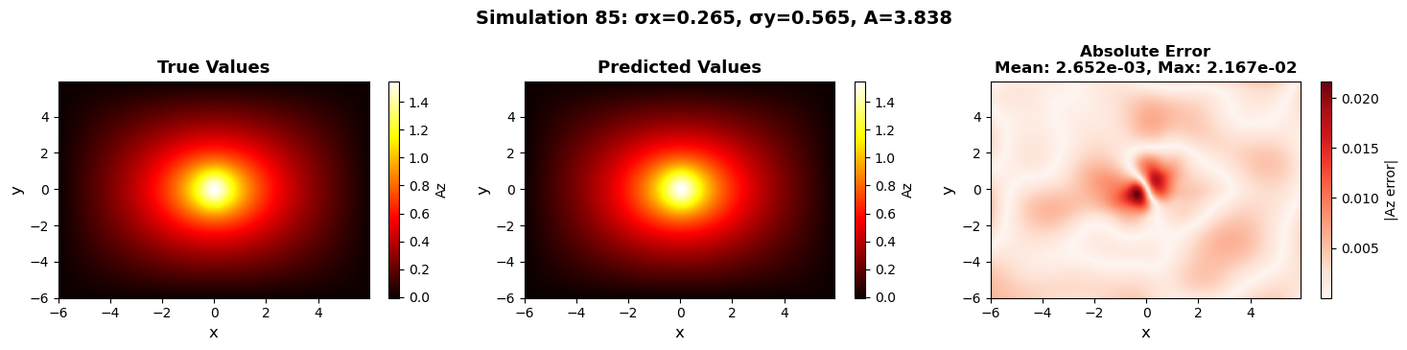
Modeling - Physics Informed Neural Network
For the analytic function, , we solve the 2D Poisson equation:
wherein the beam current takes the form of:
and transverse laplacian operator:
We model this function using a Physics-Informed Neural Network
Notes:
With that background, we utilize a physics-informed neural network trained with PyTorch for the modeling of our second missing component, the longitudinal vector component Az.
This term is important as it is the term responsible for giving a kick to the blowout formation at the start.
To begin, our model, a fully-connected neural network, takes in 2 dimensional spatial coordinates, x&y, and the beam parameters sigma_x, sigma_y, and the beam amplitude as input and will output the resulting prediction for Az.
To train the model, QuickPIC simulation data is used to determine the target for the predicted field and the physics loss constrains the network toward solutions that satisfy the governing Poisson equation.
In particular, the physics loss term for this equation will minimize the residual of the negative transverse Laplacian of Az​ minus the beam current of the driver, Jz.
Through training with this constraint, the network learns from both data and the underlying physics.
We see a high degree of function fitting that can make predictions at rapid speed even when run with parameters not seen during training, as the bottom visualization shows.
Improvement can be had, though, particularly around the center through either an architecture that can support more parameters, longer training time, or another point sampling strategy.
In order to utilize this model in the solving of the blowout trajectory, we make use of PyTorch’s automatic differentiation library to calculate fast gradients for our equation, giving us dAz/dx and dAz/dy, which are inserted into the corresponding trajectory equation.
TARGET: 2 min (14:00)
Notes:
Az relates to the drive bunch info; magnetic vector potential, gives a “kick” to the blowout
Jz is the beam current of the driver

Slide 13
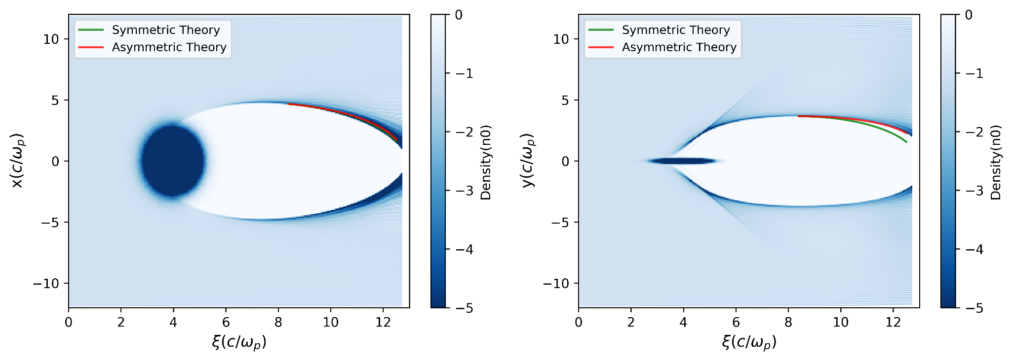
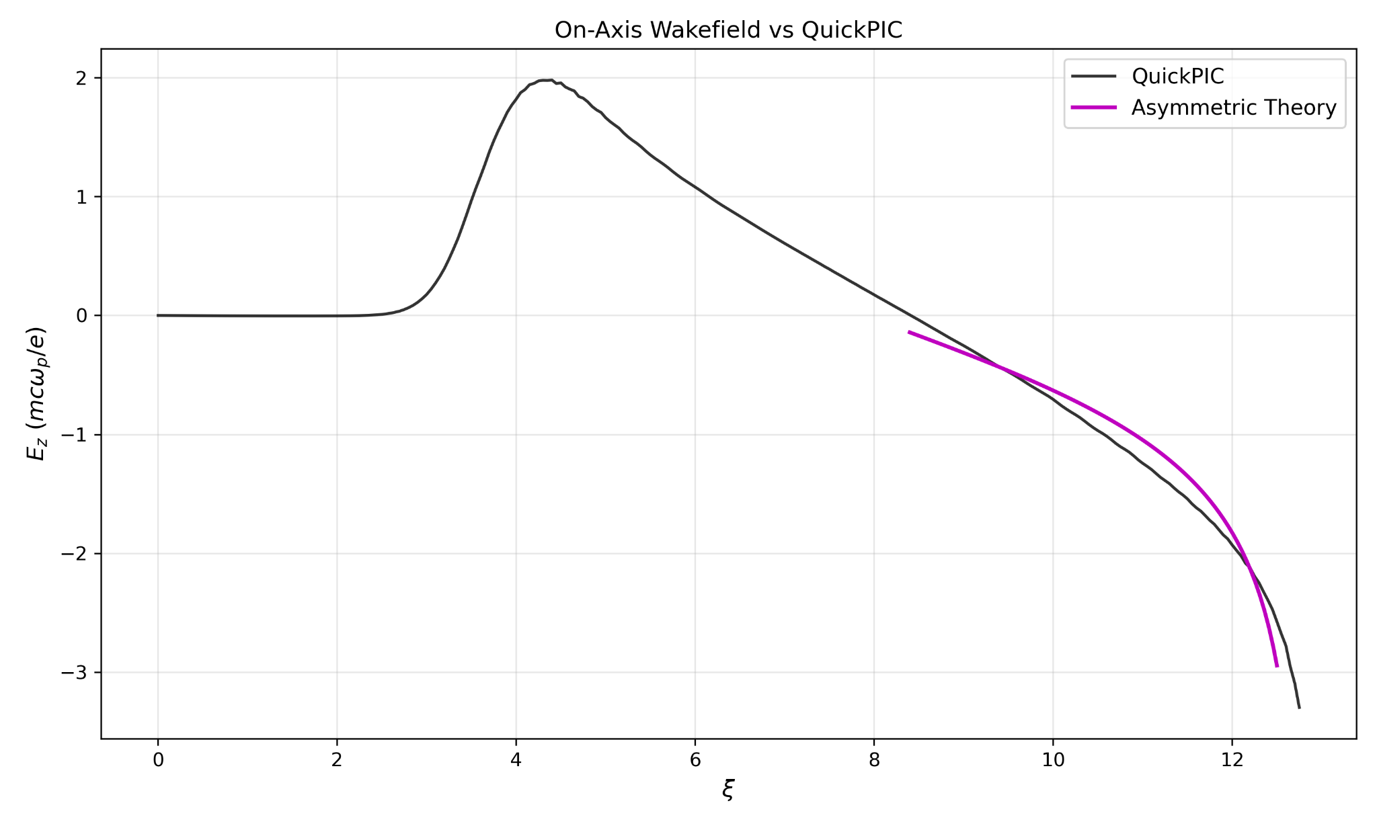
Blowout Trajectory - Center of the Blowout Predictions
Notes:
With the psi0 approximation available, we can perform an initial test of the blowout trajectory solver, starting from near the center of the blowout.
We start from the center for this test as this allows us to test whether the modeled psi0​ term can reproduce the rear portion of the blowout trajectory, which is a challenging region to model.
Additionally, the drive beam is not taken into account in this region, meaning we can isolate the psi0 results first before moving on.
The initial conditions are extracted from the simulation data and tested in both the asymmetric and symmetric case with the red line representing the asymmetric and green representing the symmetric.
We can see great agreement with simulation results and improvement over the symmetric case in that we are able to determine the blowout trajectory for both axes, particularly for the y axis.
We also show, in the bottom visualization, the resulting on-axis wakefield prediction in comparison with the ground truth from QuickPIC.
In the rear region where the blowout trajectory has been solved for, it shows general agreement with the structure of the wakefield but will require further improvement.
One means of improvement could come from reintroducing our psi term as a physics informed neural network over polynomial regression to infer any additional parameters influencing the results.
TARGET: 1 min (15:00)

Slide 14
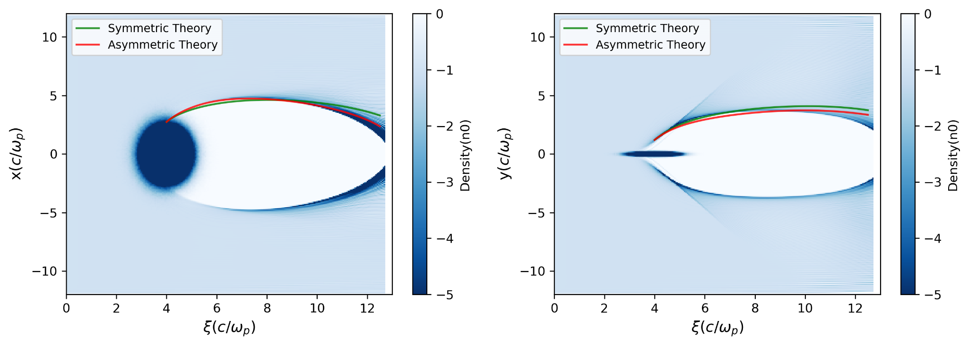
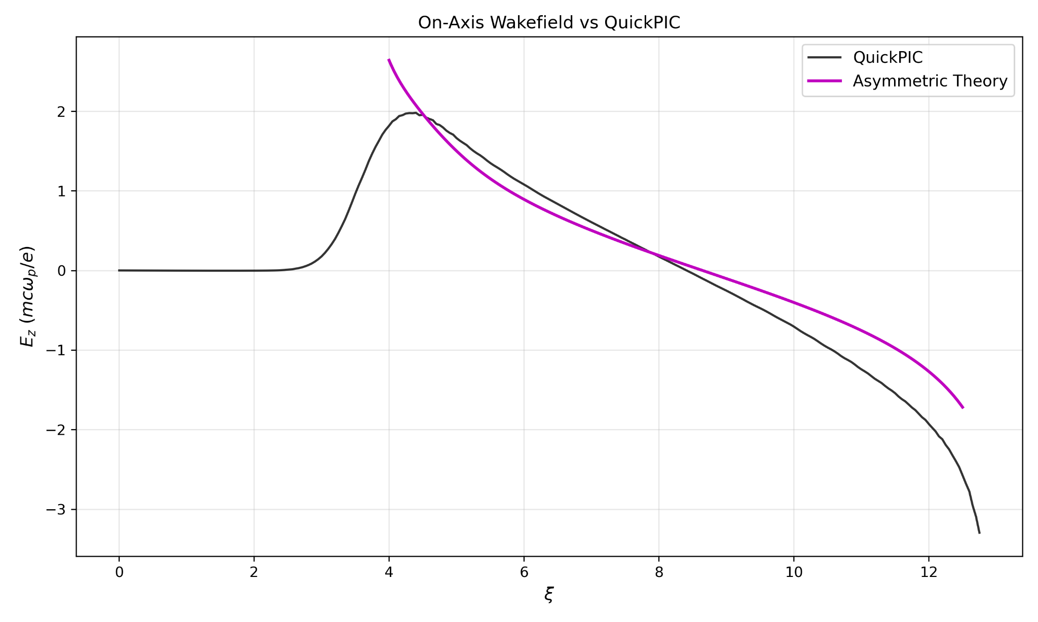
Blowout Trajectory - Start of the Blowout Results
Notes:
We then move from the center-starting test to now integrating the trajectory from the center of the drive bunch, where our Az term has the most effect.
This is a particularly challenging starting point as the initial conditions are substantially harder to acquire as there naturally exists a sharp spike in electron density forming the sheath, making accurate gradient information hard to acquire.
These results in the top most visualizations show decent results for the x-axis, which outperforms symmetric theory; however, we see notable disagreement in the y-axis
This disagreement extends to the wakefield; as the error accumulated, the effect is seen in the wakefield.
Nevertheless, we compare our neural network based results for the asymmetric case against the symmetric baseline for Az and we see improvement in some regions.
TARGET: 1 min (16:00)

Slide 15
Conclusion & Future Work
We leveraged data from QuickPIC simulations to model components of the blowout trajectory
There are good preliminary results on modeling the blowout trajectory with machine learning and neural network components
Now, we move to modeling the full blowout trajectory and creating a standalone machine learning model for this trajectory based on input beam parameters
This will unlock the ability to model the wakefield and develop a complete blowout theory
Thank you for your attention! Questions?
Notes:
To summarize, this work focuses on developing a predictive model for nonlinear plasma wakefields driven by asymmetric beams and leverages existing theory gives us a strong foundation: Lu provides the axisymmetric blowout framework, Dalichaouch improves the sheath closure near the rear of the bubble, and Manwani extends the wake-potential description to elliptical cavities.
However, for asymmetric drivers, several terms needed to close the blowout trajectory equation remain difficult to model analytically; which we address by using QuickPIC simulation data, then applying regression and physics-informed neural networks to model the missing terms.
Our preliminary results show that the learned psi0 term can reproduce important rear-of-bubble trajectory behavior and that our Az physics informed neural network provides a path to fully model the blowout trajectory.
Moving forward, the goals are to finalize full front-to-back blowout trajectory prediction, validate the resulting accelerating field against simulation, and develop a standalone machine-learning model for asymmetric wakefield prediction from which we hope to extract unknown parameters to develop a predictive nonlinear theory.
Thank you all, any questions?
TARGET: 1 min (17:00)

Slide 16
Backup Slides

Slide 17
Nonlinear Theory of Symmetric Driver Beams
In the 3D blowout regime, we can predict the wakefield by modeling the blowout trajectory!
Wakefield Equation:
(1)
Blowout Trajectory Equation:
(2)
Lu et al, Physics of Plasmas 13, 056709, 2006

Slide 18
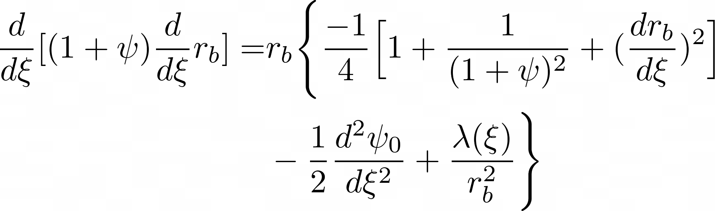
Lu et al Equation (Other Form From Letter, eq9)

Slide 19

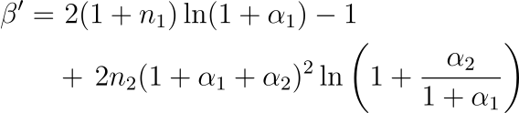
Multi-Sheath Model of Symmetric Driver Beams
Wake Potential Equation:
(3)
Refined Equation:
(4)
Updated Wake Potential:
(5)
Dalichaouch et al, arXiv:2103.12986, 2021

Slide 20
Equation of Blowout Trajectory
Lu, et al
Model
Our
Model
Now, we require an analytical form for both and

Slide 21
QuickPIC Dataset for Asymmetric Blowout Modeling
100 one-step 3D simulations from QuickPIC, the quasi-static, Particle-in-Cell simulation code
256x256x256 grid space spanning 3 dimensions
Randomized asymmetric drive beam values selected from a Gaussian distribution
Resulting dataset offers a range of blowout shapes and wakefield responses to act as training data
Beam Parameters in Dataset
Variable | Range | Description
 | [4.0, 8.0] | Normalized beam current
 | [0.1, 2.0] | Beam size in the x-axis
 | [0.1, 2.0] | Beam size in the y-axis
 | [0.4, 0.8] | Beam size in the z-axis
Huang, et al, Journal of Computational Physics 217 658–679, 2006
Weiming, et al, Journal of Computational Physics 250 165-177, 2013
Su, et al, Journal of Computational Physics 539 114225, 2025

Slide 22

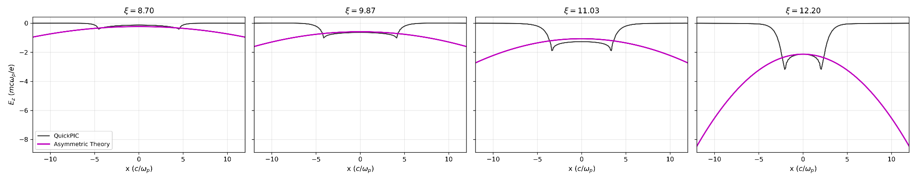
Rear of Beam Wakefields

