Slide 1

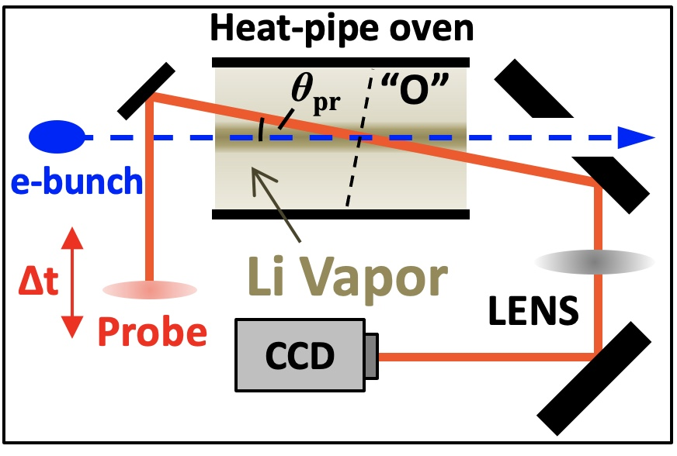
New light on wakefield longevity
Jason Brooks, Rafal Zgadzaj, Timothy Araujo, Robert Ariniello, Michael Downer
Experiment Goal: observe, analyze, understand post-wake plasma recovery and its potential bearing on accelerator repetition rates

Slide 2

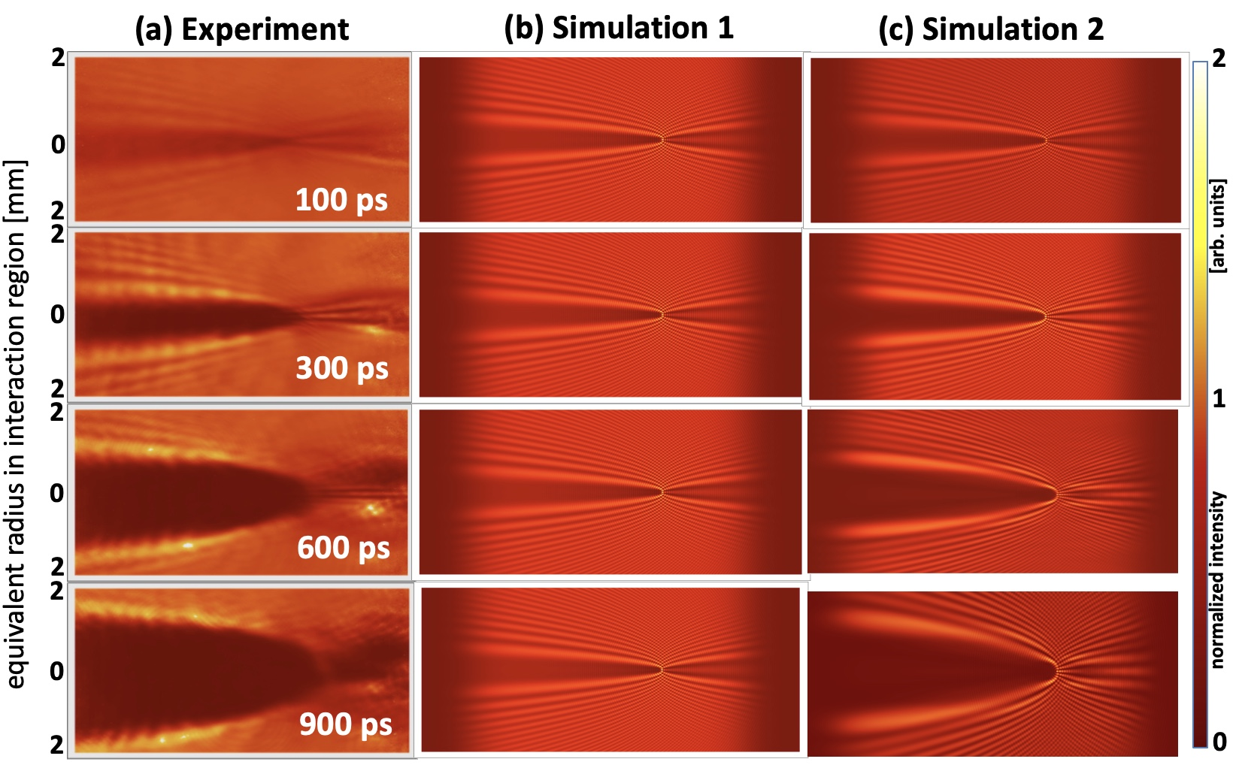
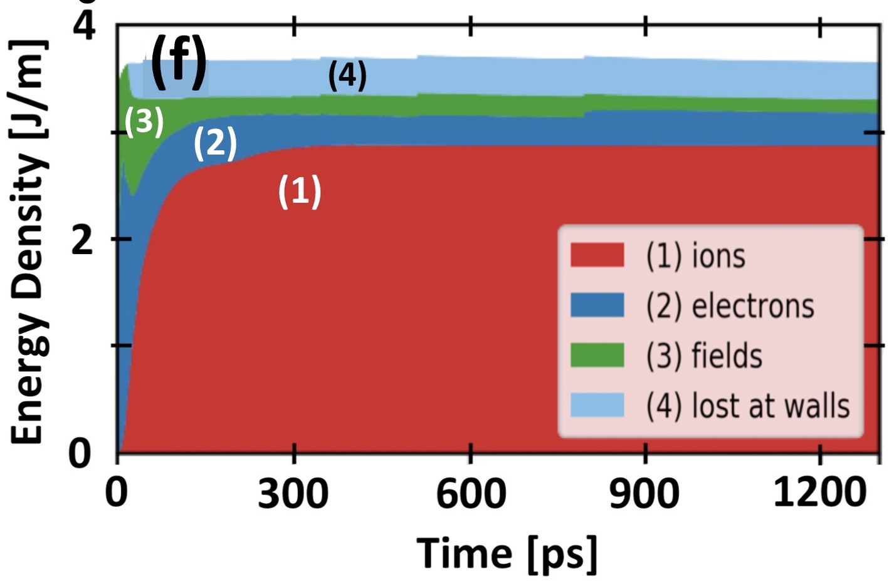
We documented up to 1.5 ns
of NL-wake → plasma energy-transfer physics
Zgadzaj et al., “Dissipation of e-beam-driven plasma wakes,” Nat. Commun. 11, 4753 (2020)
Khudyakov et al., "Ion dynamics driven by strongly nonlinear plasma wake," PPCF 64, 045003 (2022).
OSIRIS¹
LCODE²
¹ Fonseca, PPCF 55, 124011 (2013)
² Lotov, NIM-A 829, 350 (2016).
on-axis
ion-density
structures form
10s keV ions
stream radially
outward
ion-impact
ionization
drive
bunch
< 1ps
~10 ps
wake breaks,
ejects fast e⁻
10s ps
100s ps
1.5 ns
?
PWFA
Zgadzaj et al. FACET-I experiments
current
expts
20 GeV, 2 nC e-bunches

Slide 3
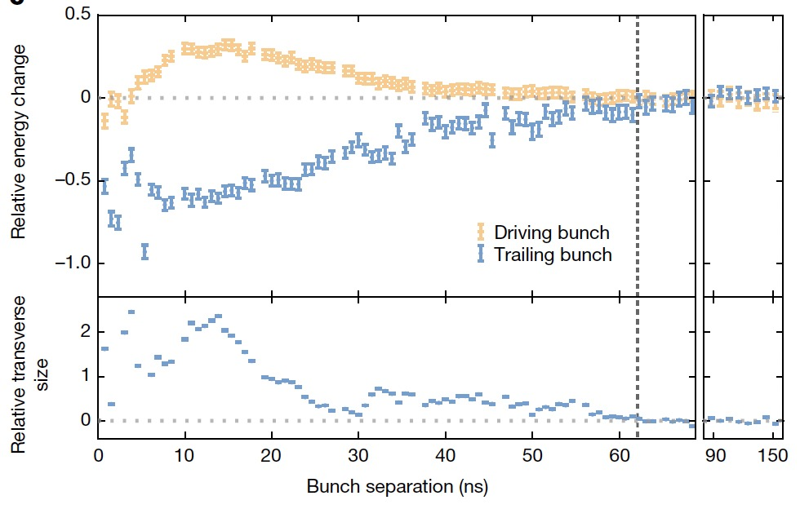
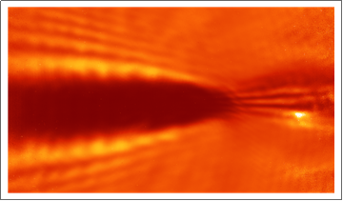
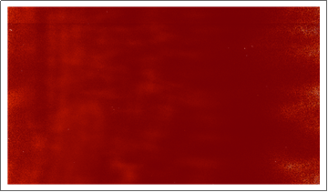
A recent DESY experiment reported
~60 ns plasma recovery time (lower limit)
D’Arcy et al. “Recovery time of a plasma-wakefield accelerator.” Nature 603, 58 (2022).
FlashForward parameters:
• drive bunch: 1 GeV, 0.5 nC
FACET-II parameters:
• plasma: 1.75 x 10¹⁶ cm⁻³ Ar
• drive bunch: 10 GeV, 2 nC
• plasma: 5 x 10¹⁶ cm⁻³ Li
• probe: secondary PWFA driver
at 1 ns < ∆t ≤ 150 ns + trailing
witness bunch
• optical probe at
1 ns < ∆t < ms
• Previous experiment observations:
• “recovery” measured after
single shots only. No account
of cumulative plasma heating.
10 Hz heated Li oven tens ˚C within minutes
“Hail Mary” E-224 result (Zgadaj, 2020):
0.3 ns
10 µs
FACET-II is uniquely positioned to resolve current
orders-of-magnitude uncertainty in plasma recovery time
Notes:
Plasma based accelerators and light sources - need to know rep rate for operation comparable to match conventional equivalents (luminosity and brilliance)
Meter scale beam driven plasma targets are more sensitive than e.g. gas jets because there’s no rapid laminar flow
Gas jets also carry complications/limitations at high rep rate
How rapidly does a stationary, meter scale plasma recover, and is recovery time dependent on rep rate, beam energy and/or charge?
J/m heating; developing probes to measure [R. Zgadzaj et al., Nat Commun 11, 4753 (2020)]
Similar study in H2 performed in R.Pompili et al., Commun Phys 7, 241(2024).

Slide 4
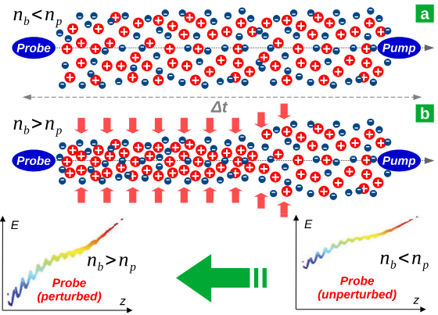
Another recent experiment reported ~0.7 ns plasma recovery time in H₂
R.Pompili et al., “Recovery of hydrogen plasma at the sub-nanosecond timescale in a plasma-wakefield accelerator” Commun Phys 7, 241(2024).
SPARC_LAB parameters:
• Drive bunch: 0.084 GeV, 0.5 nC, 167 fs duration
• Gas species: H₂ in 3 cm capillary
• Probe: trailing 0.084 GeV bunch
• Stated findings: Pump probe recovery at <0.7ns
Notes:
Plasma based accelerators and light sources - need to know rep rate for operation comparable to match conventional equivalents (luminosity and brilliance)
Meter scale beam driven plasma targets are more sensitive than e.g. gas jets because there’s no rapid laminar flow
Gas jets also carry complications/limitations at high rep rate
How rapidly does a stationary, meter scale plasma recover, and is recovery time dependent on rep rate, beam energy and/or charge?
J/m heating; developing probes to measure [R. Zgadzaj et al., Nat Commun 11, 4753 (2020)]
Similar study in H2 performed in R.Pompili et al., Commun Phys 7, 241(2024).

Slide 5
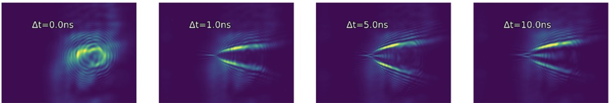
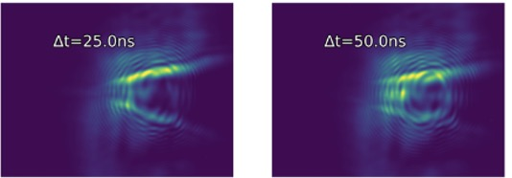
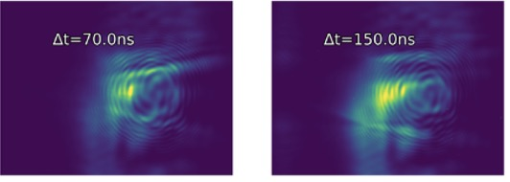
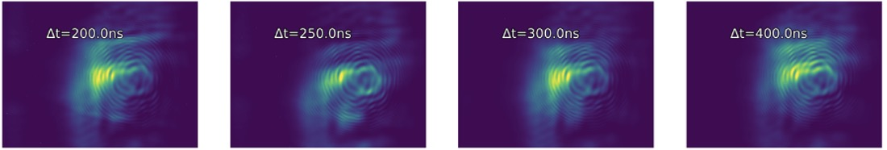
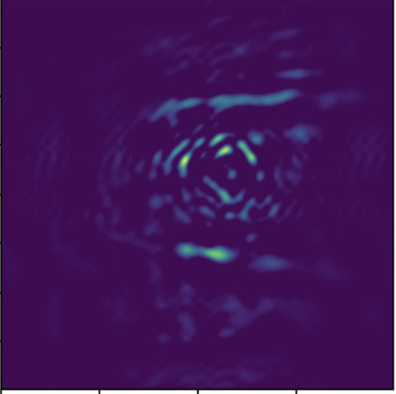
Shallow angle shadowgraph results in 1 Torr Ar plasma
DESY accelerator parameters:
• drive bunch: 1 GeV, 0.5 nC
+Z
f=750 mm
1:1 imaging
• plasma: 1.75 x 10¹⁶ cm⁻³ Ar
Θ=17 mrad
P1
CCD
FACET accelerator parameters:
Ar plasma
• drive bunch: 10 GeV, ~1.5 nC
Obj plane
• plasma: 3x10¹⁶ cm⁻³ Ar
~1m
2
∆t < 0
1 ns
5 ns
10 ns
25 ns
50 ns
+Z
y [mm]
-Z
0
P1
In-focus slice
-2
Out-of focus plasma
2
70 ns
150 ns
200 ns
250 ns
300 ns
400 ns
250 ns
0
y [mm]
-2
• expanding plasma observed out to ∆t ~ 300 ns (~4x longer than DESY results)
background-subtracted,
spatially-filtered
-- similar results obtained in 3 Torr Ar
Notes:
Repeating every 60 ns can lead to cumulative heating

Slide 6
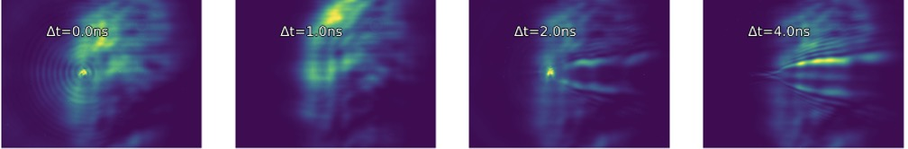
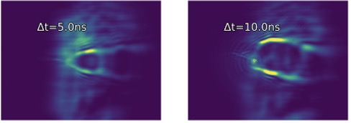
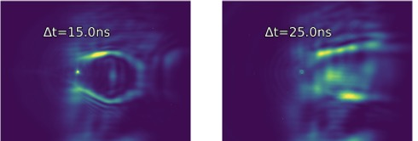
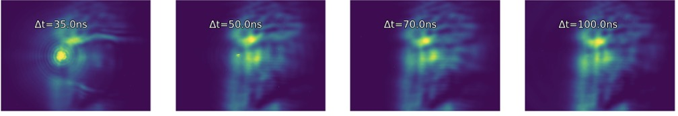
We observed 5-6x faster ion wake evolution in H₂ plasma
3 Torr H₂ plasma, e-beam-ionized
2
∆t < 0
1 ns
2 ns
4 ns
5 ns
10 ns
r [mm]
0
-2
2
15 ns
25 ns
35 ns
50 ns
70 ns
100 ns
0
r [mm]
-2
• Plasma structures no longer discernible for ∆t ≥ 70 ns
original probe profile
• Faster evolution consistent with ion motion governing plasma dynamics for ∆t ≳ 0.3 ns *
* Zgadzaj et al., Nature Commun. 11, 4753 (2020).
Notes:
Inverse dependence on ion mass/density with wake recovery time

Slide 7
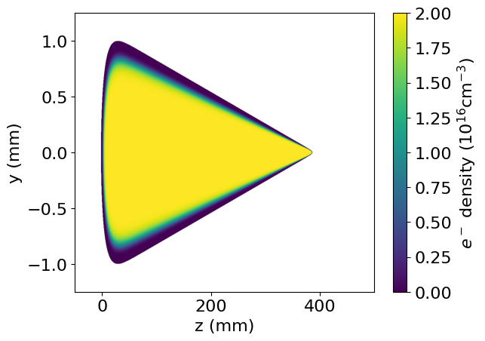
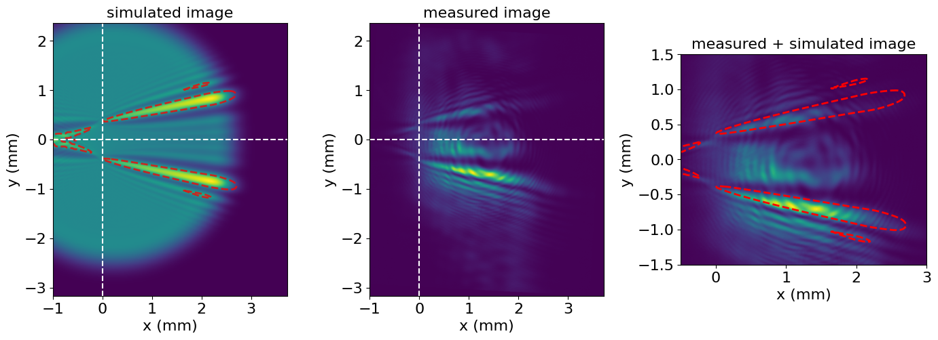
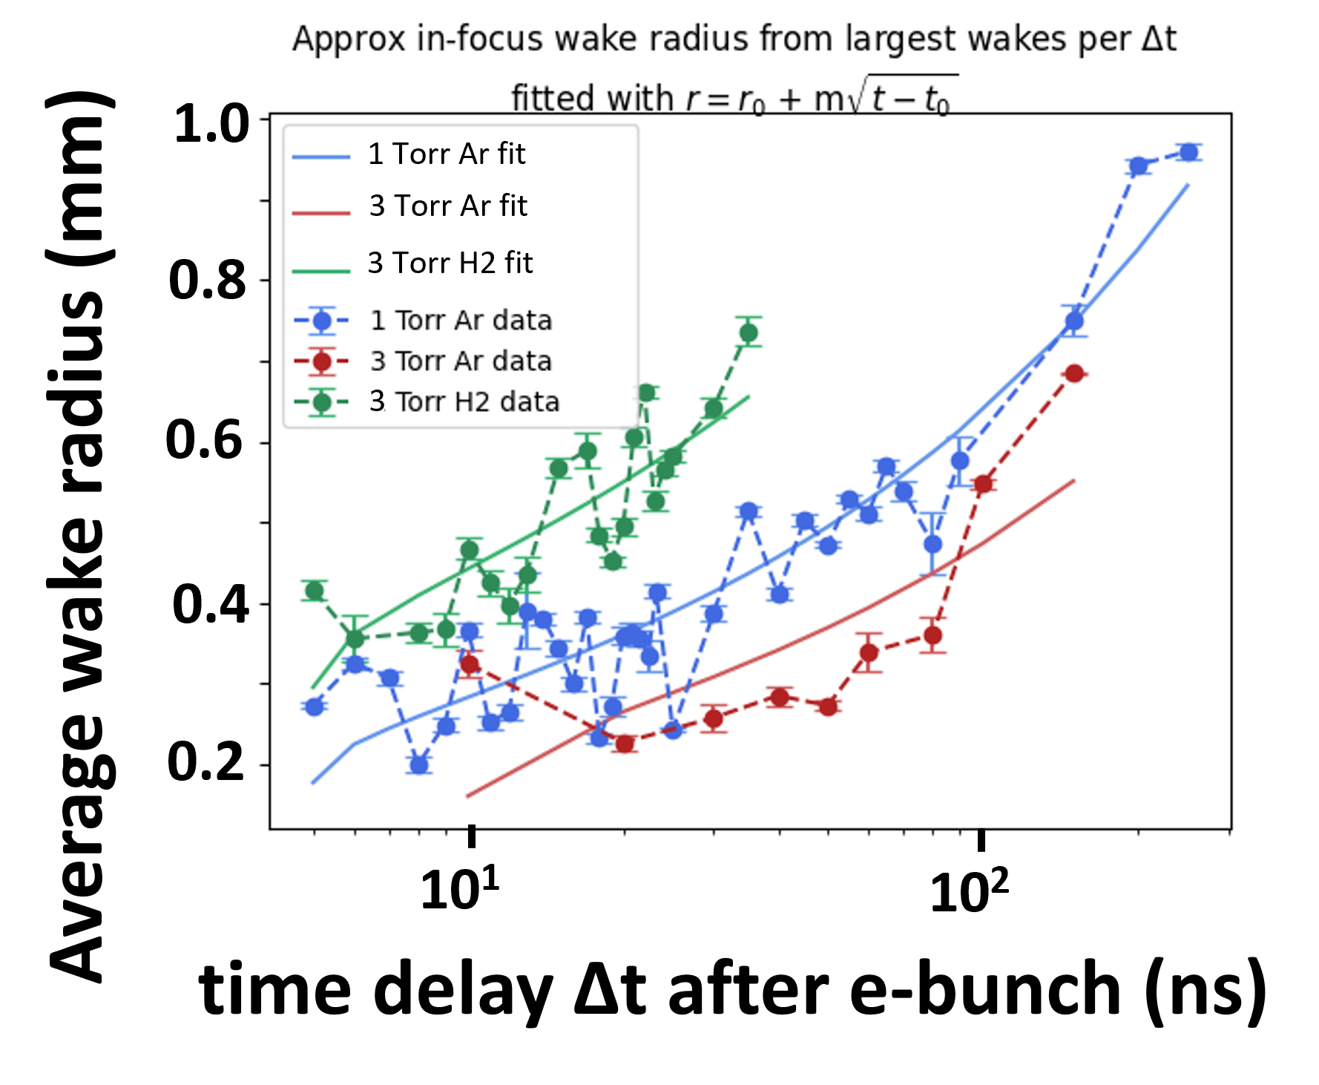

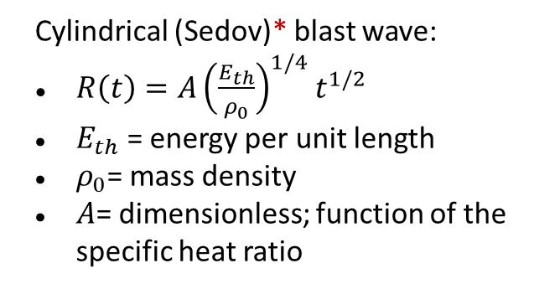
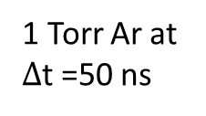
Wake evolution depends on ion mass and density; plasma profile tapers in z
Θ=17 mrad
1 Torr Ar at $Δ$t =50 ns
Θ$∼$1 mrad
Cylindrical (Sedov)* blast wave:
$R\left(t\right)=A{\left(\frac{E_{th}}{ρ_{0}}\right)}^{1/4}t^{1/2}$
$E_{th}$= energy per unit length
$ρ_{0}$= mass density
$A$= dimensionless; function of the specific heat ratio
*Sedov, L. I. “Propagation of strong shock waves,” Journal of Applied Mathematics and Mechanics, 10, 241-250. (1946).
Notes:
.

Slide 8
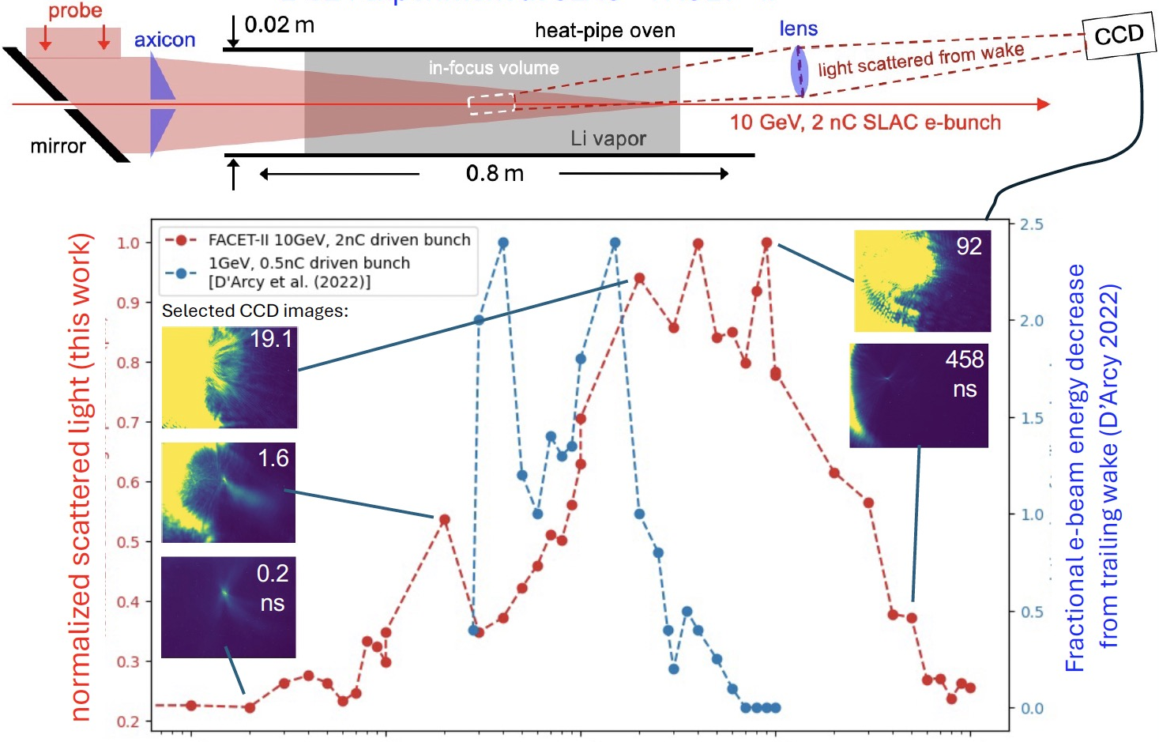

Scattered light from probe persists up to ~1us in Li oven
Θ$\sim$5 mrad
CCD
Obj plane
f=750 mm
1:1 imaging
10⁻¹
10⁰
10¹
10²
10³
time delay ∆t after e-bunch (ns)
Notes:
Plot in red shows sum of all pixels measured by scattered light from 6 mrad probe in Li with blue showing relative size of trailing e bunch measured in [D’Arcy et al. 2022]
Different beam energies, charge, gas species ( blue line Ar plasma with e density ~10¹⁷ cm⁻³; red line Li density ~5 x 10¹⁶ cm⁻³)

Slide 9


Bessel interferometry
Plasma
Vacuum
Interferometry used to improve sensitivity to us+ effects
New approach: repurpose Bessel beam as an interferometer
  Longitudinal variations -> shift in Bessel rings
CCD
plane
$$J_{0}{\left(kθr\right)}^{2}\sim cos(k(2θ)r−\frac{π}{2})$$
Head erosion
Ar plasma
angle
Transverse Bessel probe intensity asymptotic form
Obj plane
Thin lens
$$J_{0}{\left(kθr+b\right)}^{2}\sim cos(k(2θ)r+2b−\frac{π}{2})$$
angle
ΔOPD

Slide 10
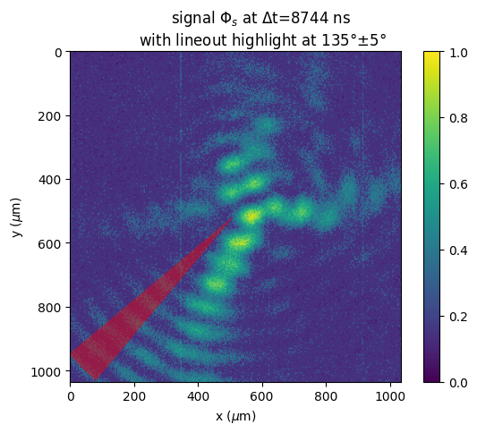
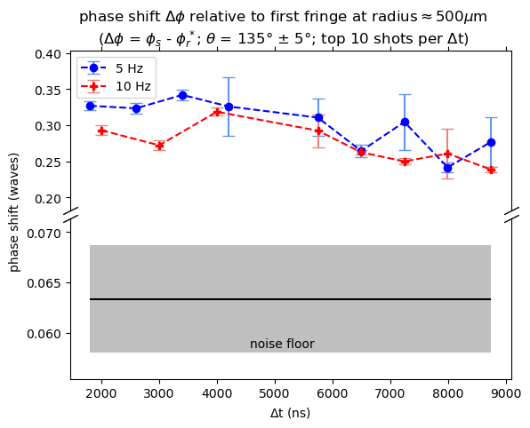
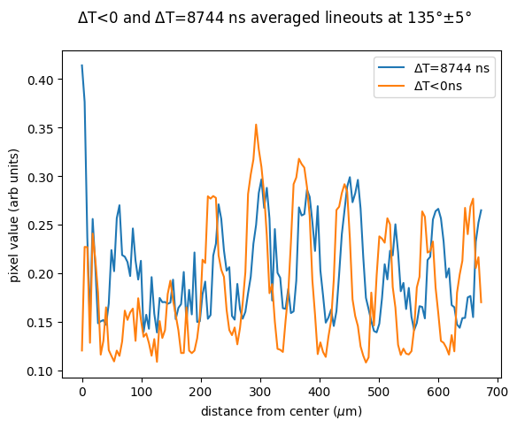

Bessel Interferometry reveals slow signal decay out to ∆t > 10 µs in 1 Torr Ar
1 Torr Ar, ~10 us time delay
Δt<0ns
Δt$\sim$10μs
Slow decay out to 10’s of us
10 deg averaging cone
averaging
cone
Noise floor

Slide 11
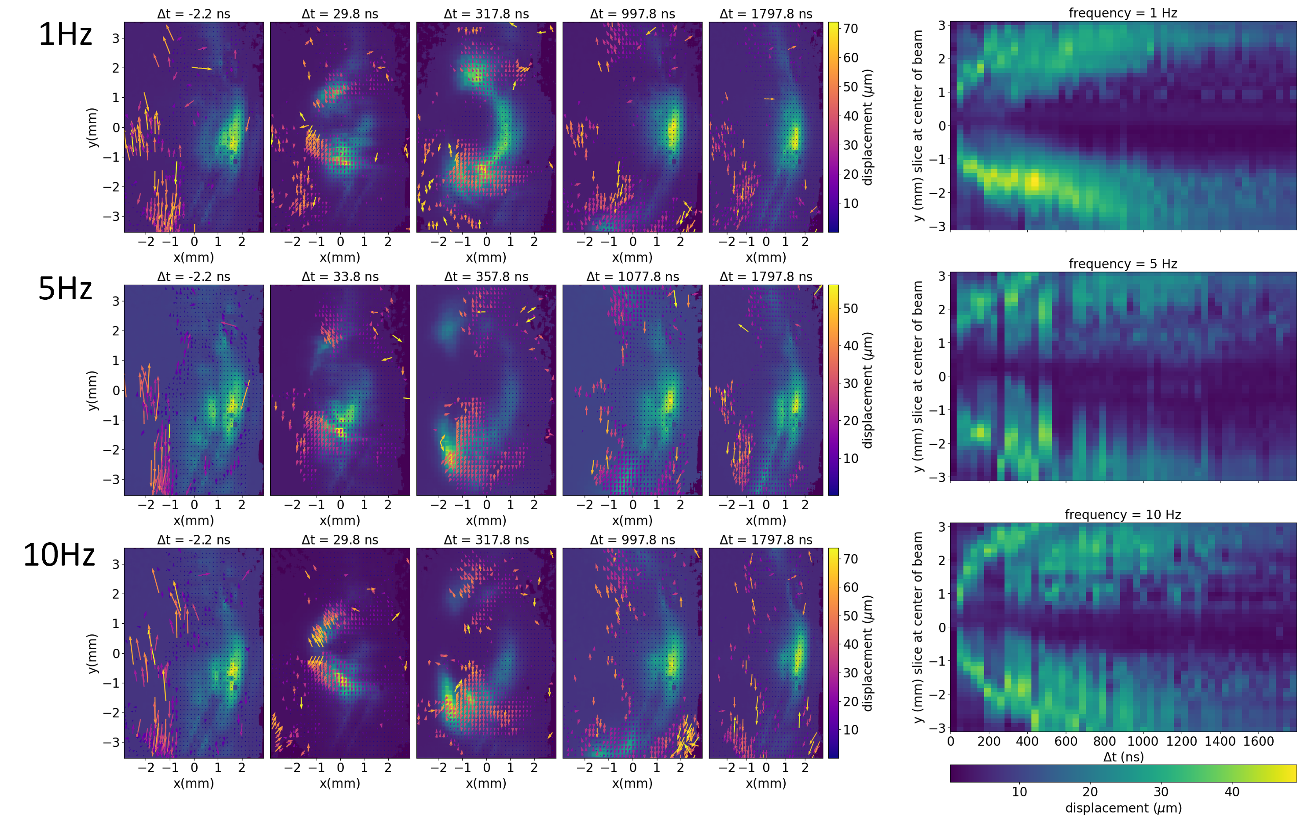
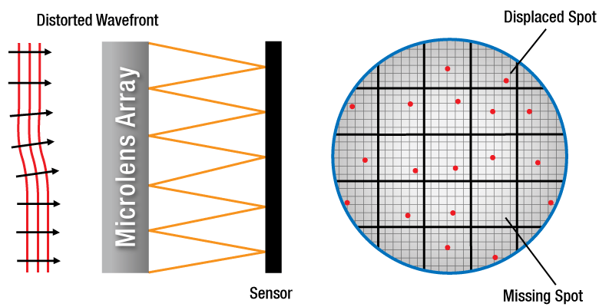
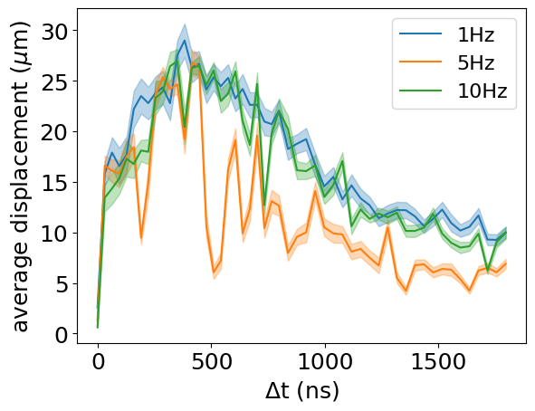
Li oven micro-lens measurements last out to >1us
e beam rep rate:
https://www.thorlabs.com/shack-hartmann-wavefront-sensors?tabName=SH%20Tutorial
Lingering displacement out to >few us

Slide 12
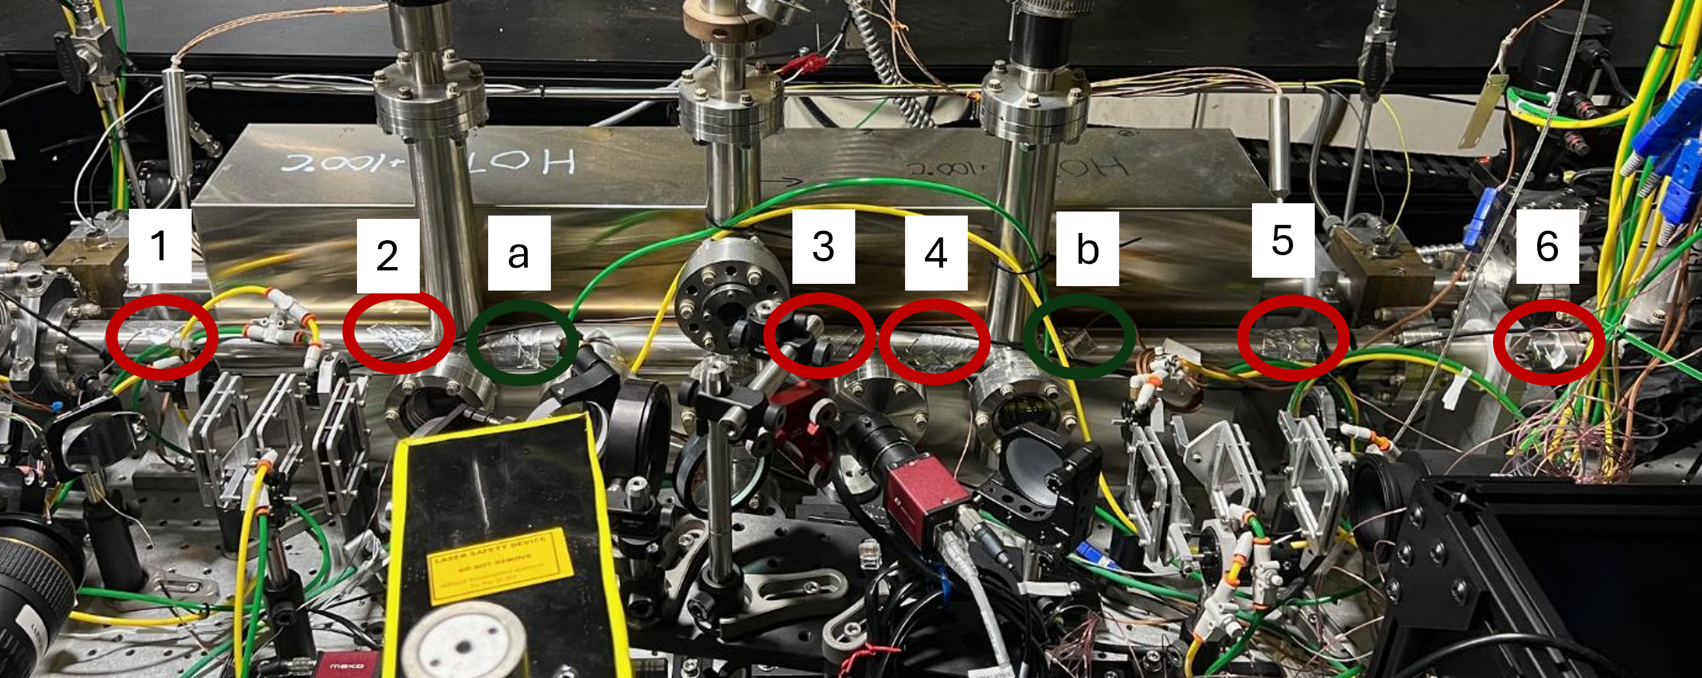
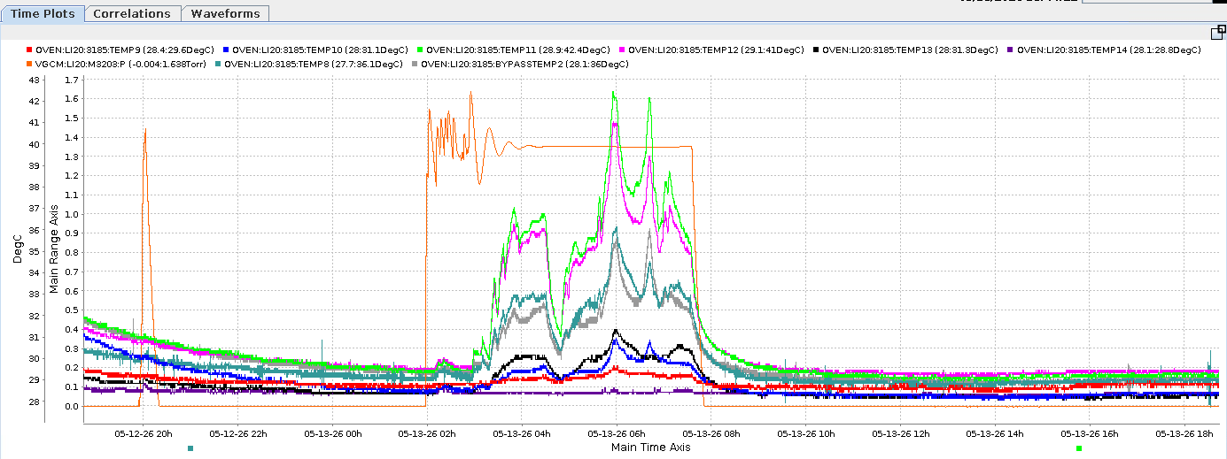
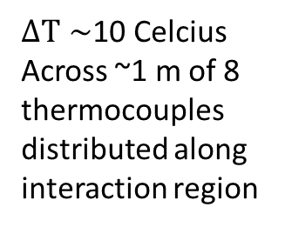
~10C heating observed via thermocouples
40
H2 static backfill
pressure
~1.35Torr
$ΔT∼$10 Celcius
Across ~1 m of 8 thermocouples distributed along interaction region
35
Deg C
30

Slide 13

Summary of main results
plasma
species
$$τ_{recovery}$$
Probe method
Wake excitation conditions
...0.0007 µs
H₂
recovery of e- probe properties
0.084 GeV, 0.5 nC¹
...0.06 µs
Ar
recovery of wake-accelerated e- properties
1 GeV, 0.5 nC drive bunch²
...0.3 µs
Ar
grazing-incidence shadowgraphy
10 GeV, 2 nC drive bunch³
...0.07 µs
H₂
“
“
...1 µs
Li
near-forward light scatter
“
...>1 µs
Li
Shack-Hartmann Wavefront sensor
“
...>10 µs
Ar
Bessel-beam interferometry
“
¹R.Pompili et al., “Recovery of hydrogen plasma at the sub-nanosecond timescale in a plasma-wakefield accelerator” Commun Phys 7, 241(2024).
²D’Arcy et al. “Recovery time of a plasma-wakefield accelerator.” Nature 603, 58 (2022).
³This work

Slide 14
Thank you!
Thanks to Brendan O’Shea, Robert Ariniello, Alex Knetsch, Mark Hogan, and all of the FACET-II staff for their help with this experiment
Thanks to NSF for supporting this project (award number 2308921)

Slide 15
Backups

Slide 16
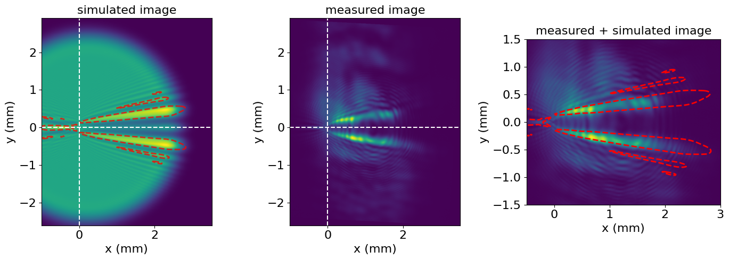
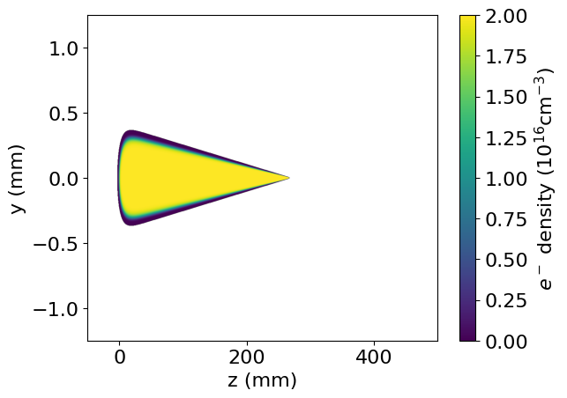



Simple plasma structure estimates
1 Torr Ar at $Δ$t = 1 ns
Θ=17 mrad
Θ$∼$1 mrad
1 Torr Ar at $Δ$t =50 ns
Θ=17 mrad
Θ$∼$1 mrad

Slide 17
We documented first 1.5 ns
of wake → plasma energy-transfer physics
using a grazing incidence optical probe
Zgadzaj et al., “Dissipation of e-beam-driven plasma wakes,” Nat. Commun. 11, 4753 (2020)
Low density plasma very transparent
  Very tenuous
  <1 degree grazing incidence
Special techniques needed to observe long timescale behavior
No optical scatter/background from drive beam at FACET
Notes:
1e16 cm^-3: equivalent to being 50,000m above sea level or 160000 feet (~5x typical airplane altitude)
Simulation 1: expansion of plasma generated by e beam from wake (no secondary e) (expansion of beam field ionized plasma
Simulation 2: secondary ionization and initial e, excitation of Li
No radiation physics
Simulation 2: 3 months of simulation time for ~1.5 ns of simulation

Slide 18
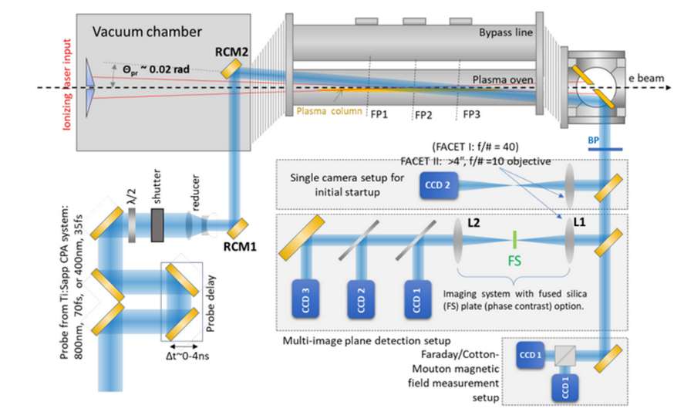
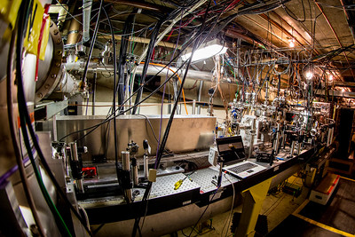
Optical measurement of the plasma wakefield evolution at the FACET-II facility
10GeV, 2 nC
e beam @ 10 Hz
Interchangeable lines
Three gases: Lithium (heat pipe oven) Argon and H2
Ar, H2 gas
Li oven
CCD1 obj plane
CCD2 obj plane
Bessel beam Interferometry
Shallow angle
Bessel scatter
Notes:
Few grains of salt:
Only imaged with one camera, with “bonus” improvised Bessel beam measurements that wasn’t fully optimized for our task.
One camera isn’t enough to fully determine probe phase or ion density. Bessel helps, but it has its own complications being worked out (see later slides). Therefore, “Lifetime” definition of plasmas will be very situational at the moment. Working on improving (future work boxes).
Beam ionized Ar and H2 are relatively unstable and can vary a lot shot-to-shot. 100 shots per time step is enough to get a little bit of statistics, but DAQ-to-DAQ results can swing as e beam parameters shift.
Shallow angle (17 mrad) probe profile imperfect and shifted a little throughout data collection, dulling background subtraction

Slide 19
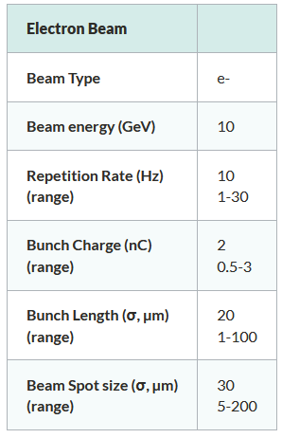
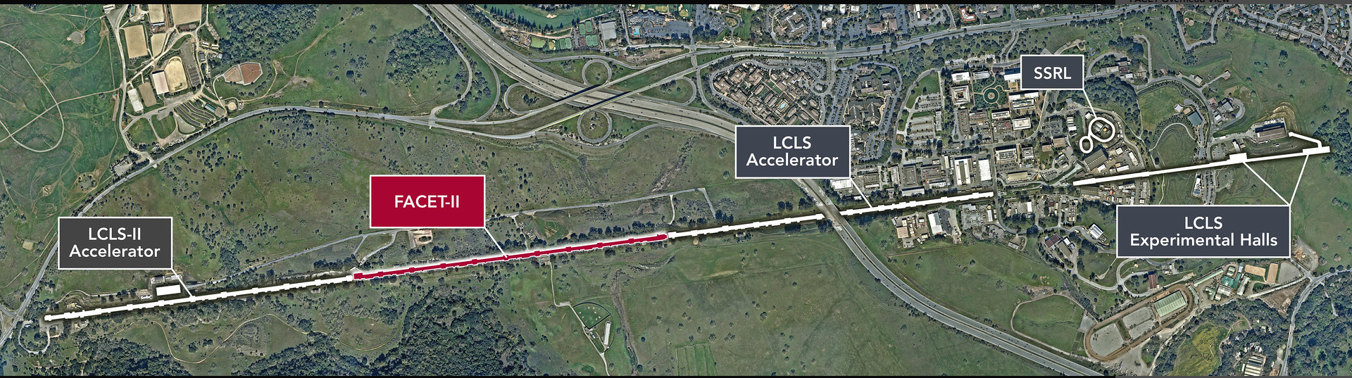
FACET facility
https://facet-ii.slac.stanford.edu/facility/beam-parameters
Experimental area
(3 floors underground)
1 Km
Notes:
User facility on a limited basis; apply for time

Slide 20
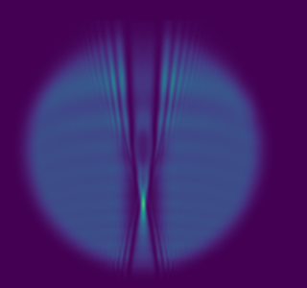
probe
P3
out of focus “bowtie”
θ
in focus element
plasma
P1
P2
+z
imaging lens
C3
Simulated plasma probe re-imaged on a camera using Code V
C2
C1
plasma
Reconstructed
P1
P2
P3
C1 image
C2 image
C3 image
In-focus phase and intensity at all z (derived via GS)

Slide 21


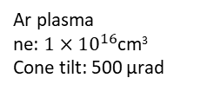
Vacuum ray trajectory
Object plane
Thin ideal lens
f=750 mm
Plasma ray
trajectory
$$θ_{vac}=θ_{plasma}\sim 5mrad$$
$$θ_{vac} !=θ_{plasma}$$
Ar plasma
ne: $1×{10}^{16}$cm³
Cone tilt: 500 μrad
image plane

Slide 22
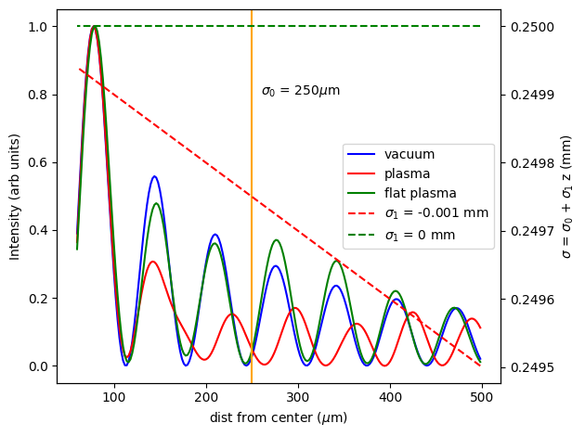
(right) Comparison with flat plasma, plasma with 1mrad tilt and no plasma (Code V simulation)
(below) FACET-II Bessel data

Slide 23
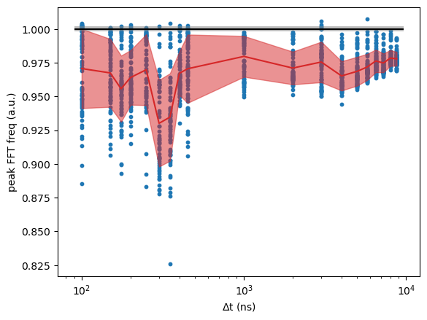
peak frequency vs Δt

Slide 24
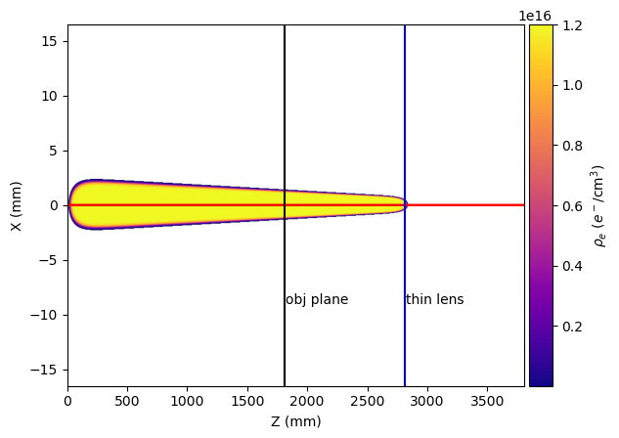
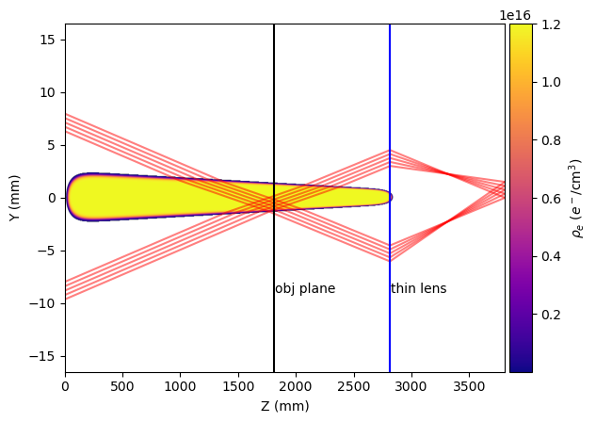
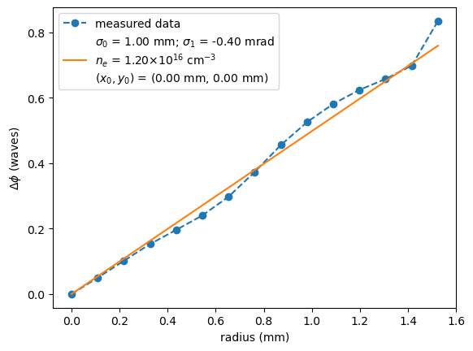
Comparison with data – on axis
Axicon ray trajectories
Δ t = 100 ns

Slide 25
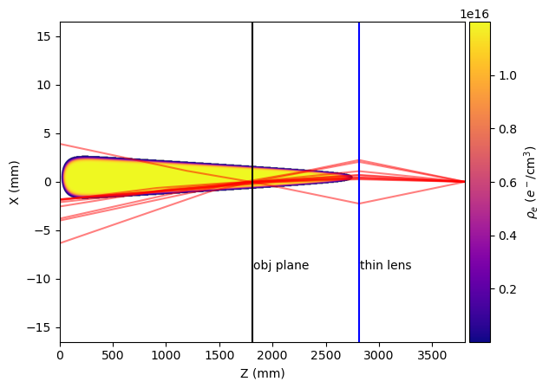
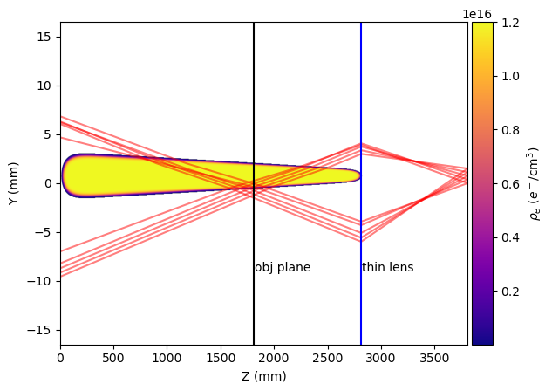
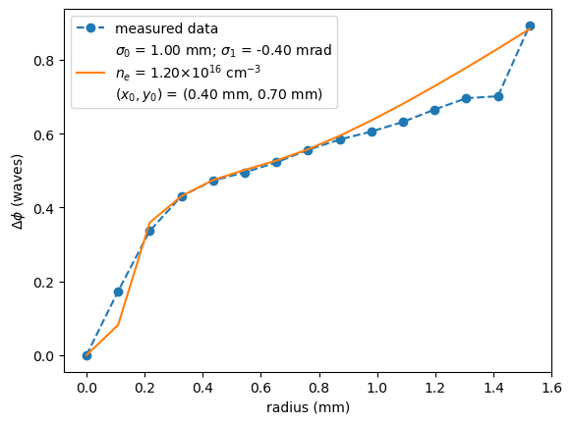
Comparison with data – off axis
Δ t = 8744 ns

Slide 26
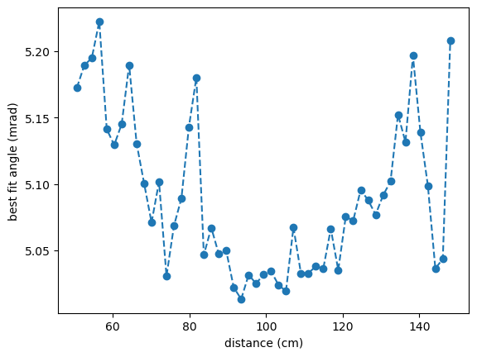
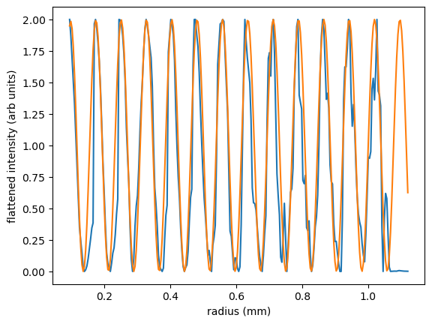
Alternative method for characterization
Discussion + equation of asymptotic of Bessel fit
average axicon half angle: 0.292 deg (5.091 mrad +/- 0.059 mrad)

Slide 27
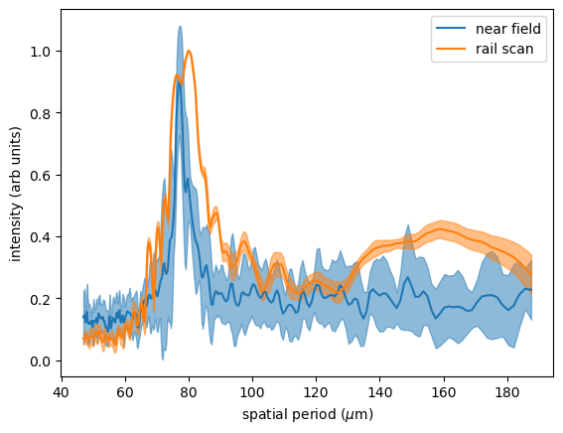

Image plane spatial calibration
New spatial calibration found by fitting peak in near field with rail scan peak

Slide 28

Probing Ar wakes at 3 Torr with 17 mrad probe
Probe from 0 ns to 400 ns
Probe fully recovered at ~T0 + 200 ns

