Slide 1
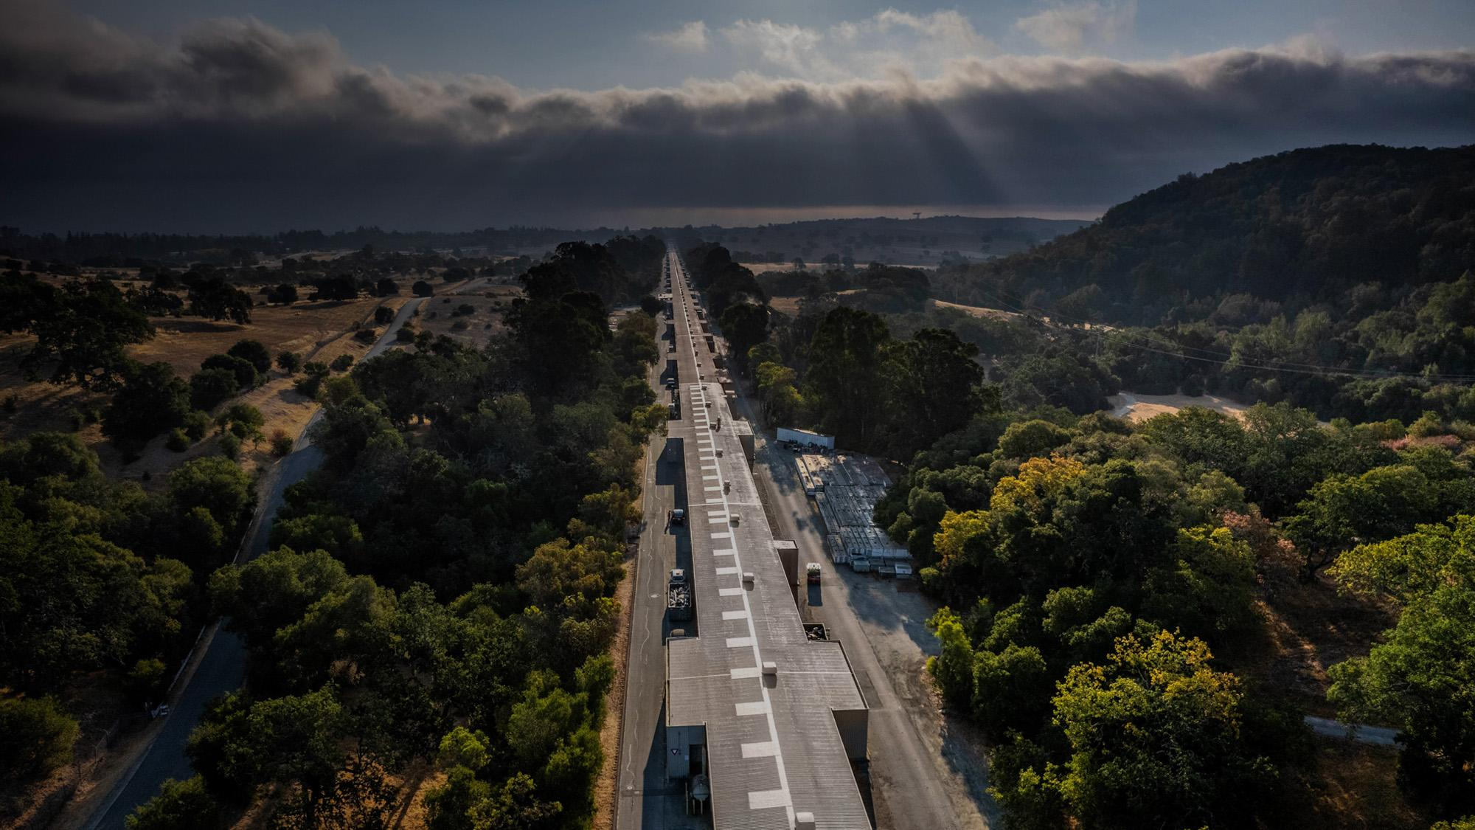


Virtual Diagnostic For Longitudinal Phase Space Prediction at FACET-II
SLAC National Accelerator Laboratory
AAC 2026, UCLA
Presenter: Jinseo Park, PI: Claudio Emma
Notes:
I’ll now start my presentation on recent progress of longitudinal phase space prediction, a k a virtual TCAV.

Slide 2
Motivation
Principle of Operation
Results / Application
Current Research Direction

Slide 3
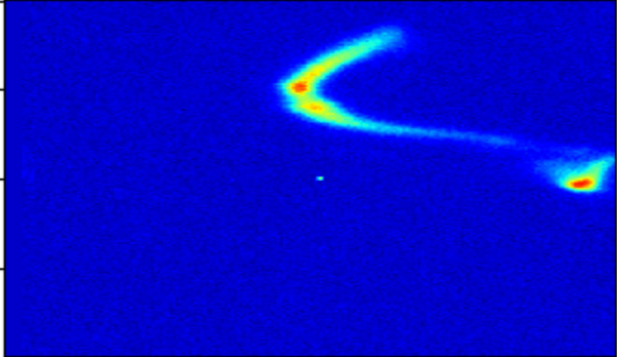
Longitudinal Phase Space
Driver Length
E
Bunch Separation
E Spread
Head → ζ → Tail

Slide 4
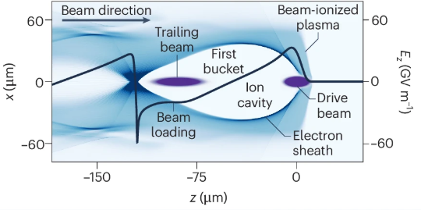
FACET-II S20 XTCAV Overview
SYAG
bunch
TCAV
(Horizontal Kick∝ζ)
bunch
IP
Dipole
(Vertical Kick ∝ 1/p)
DTOTR2
bunch
ζ
TCAV On(φ=90°)
E
ζs
Notes:
So, how do we measure longitudinal phase space at facet-two? We use XTCAV! I’m sure quite a few people in this room knows how to use it, but I’ll quickly revisit the basics.
After some betatron phase advance, ideally 90 degrees, the electrons arrive at DTOTR2, one of the OTR screens in front of the dump.
There are similar schemes at BC11 and at BC14, although not as widely used by the users.

Slide 5
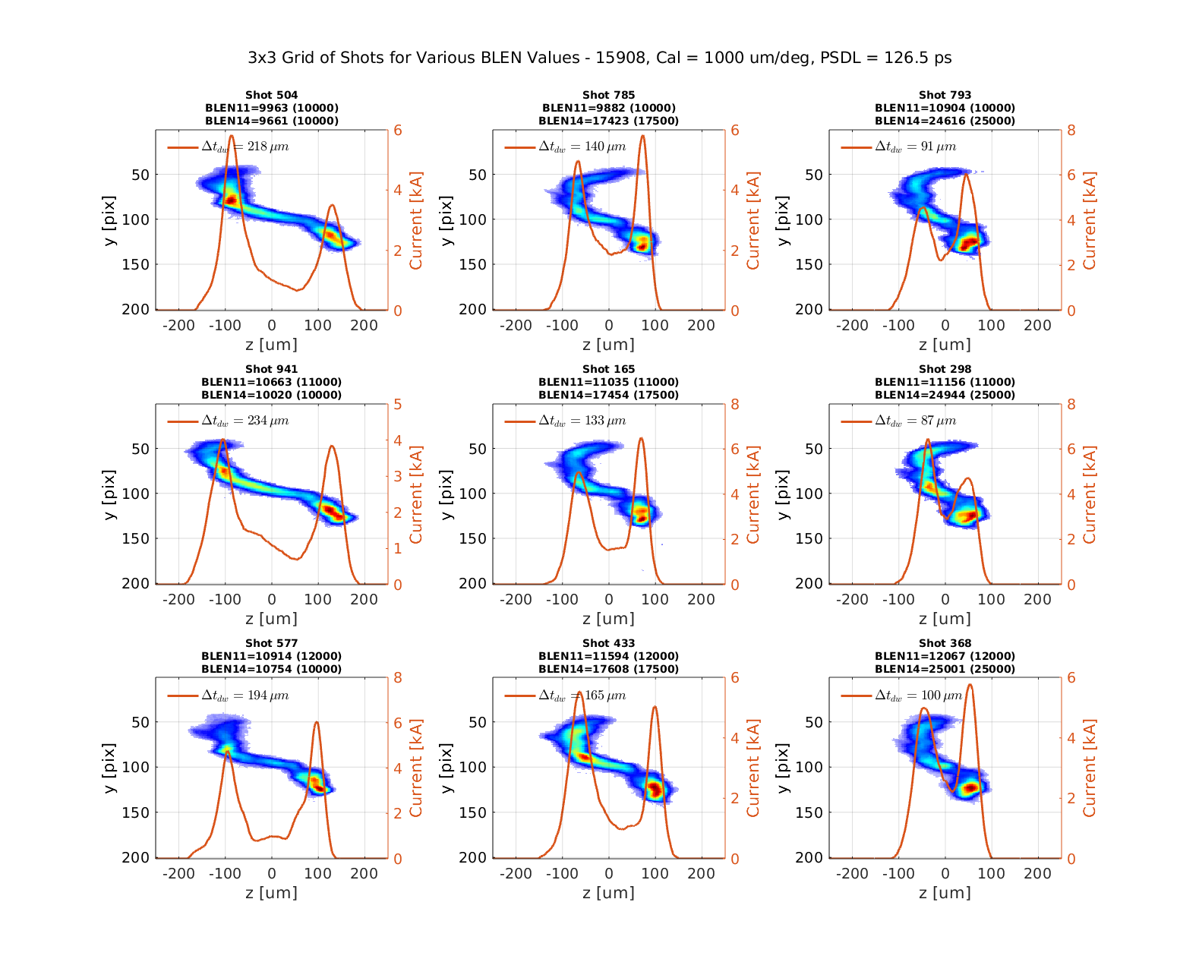
Shot-to-Shot
LPS
Variation
Figure provided by C. Emma

Slide 6
Motivation
Principle of Operation
Results / Application
Current Research Direction

Slide 7
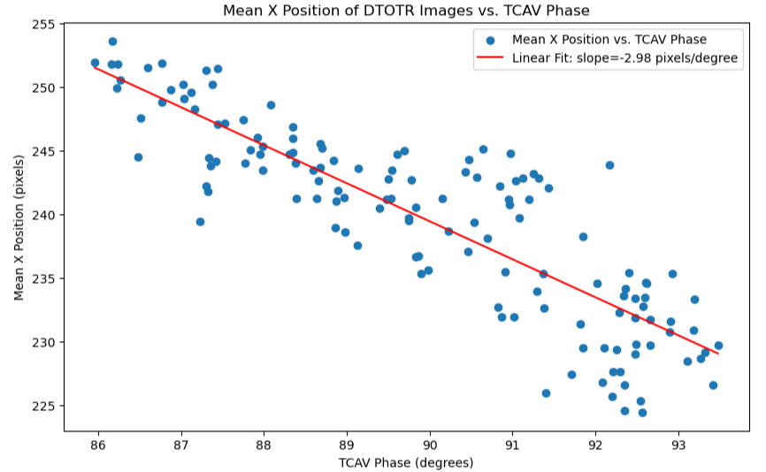
Training Set Preparation
TCAV Cal.
(um / deg)
TCAV DAQ w/
Toggler
Preprocessed LPS Data
Model Data
n x 250 x 850
(~n/3) x 100 x 150
Multiset Training
Toggler: Removes x-y Correlation, first order effect of orbit, etc.

Slide 8
Inference Model
Image Model
Normalized PVs → Image Encoding
[0, 1]^{#PV} → [0,1]^{EncodingDimension}
Example:
Random Forest (RF) Regressor
Image Encoding → Image
[0,1]^{EncodingDimension} → Image
^{EncodingDimension = 12-20}
Example:
Convolutional Variational Autoencoder (CVAE)
EPICs PV Acquisition
Filter PVs
(Before IP Only)
Bypass PVs
(Disconnected, …)
Normalization
Inference Model
Image Model
440x1
220x1
220x1
16x1
200x200
Postprocessing

Slide 9
Benefits of 2-Lv. Modularization
Backward Compatibility
PV Regularization
DTOTR2 Correction only applies to Image Model
PV Correction only applies to Inference Model
Notes:
There are some easily recognizable benefits of having this kind of two level modularization.

Slide 10
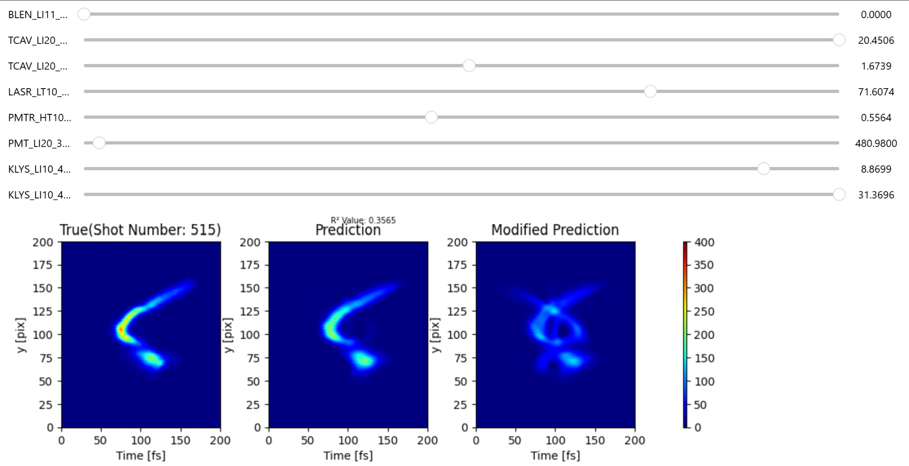

Perceptron VS CVAE
Notes:
Here, I’ll briefly explain the reason I picked cvae instead of the better known perceptron.

Slide 11
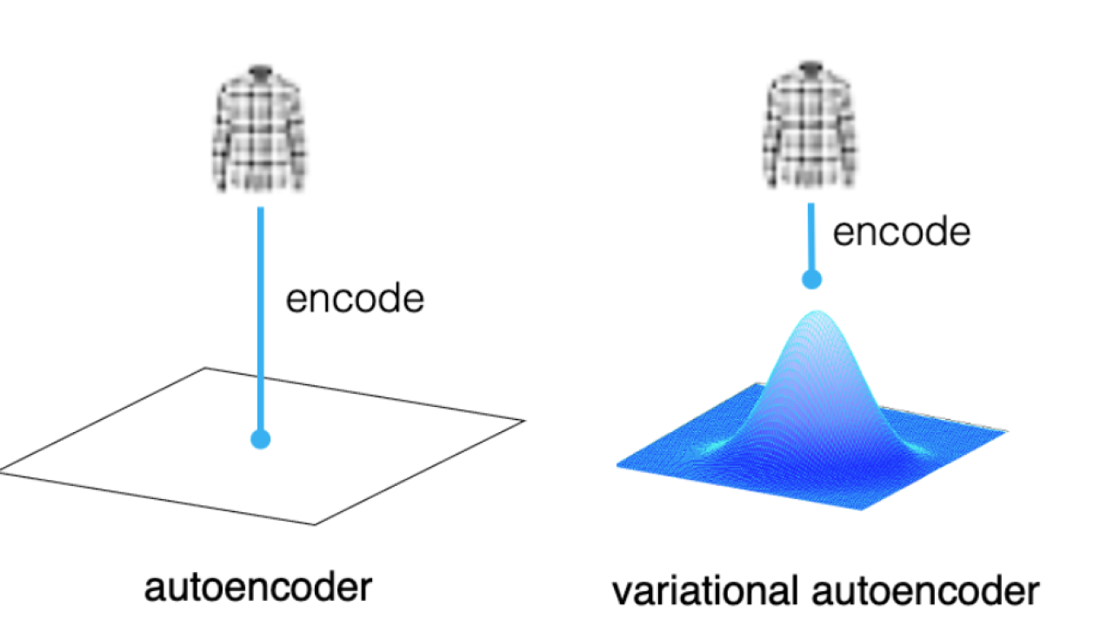
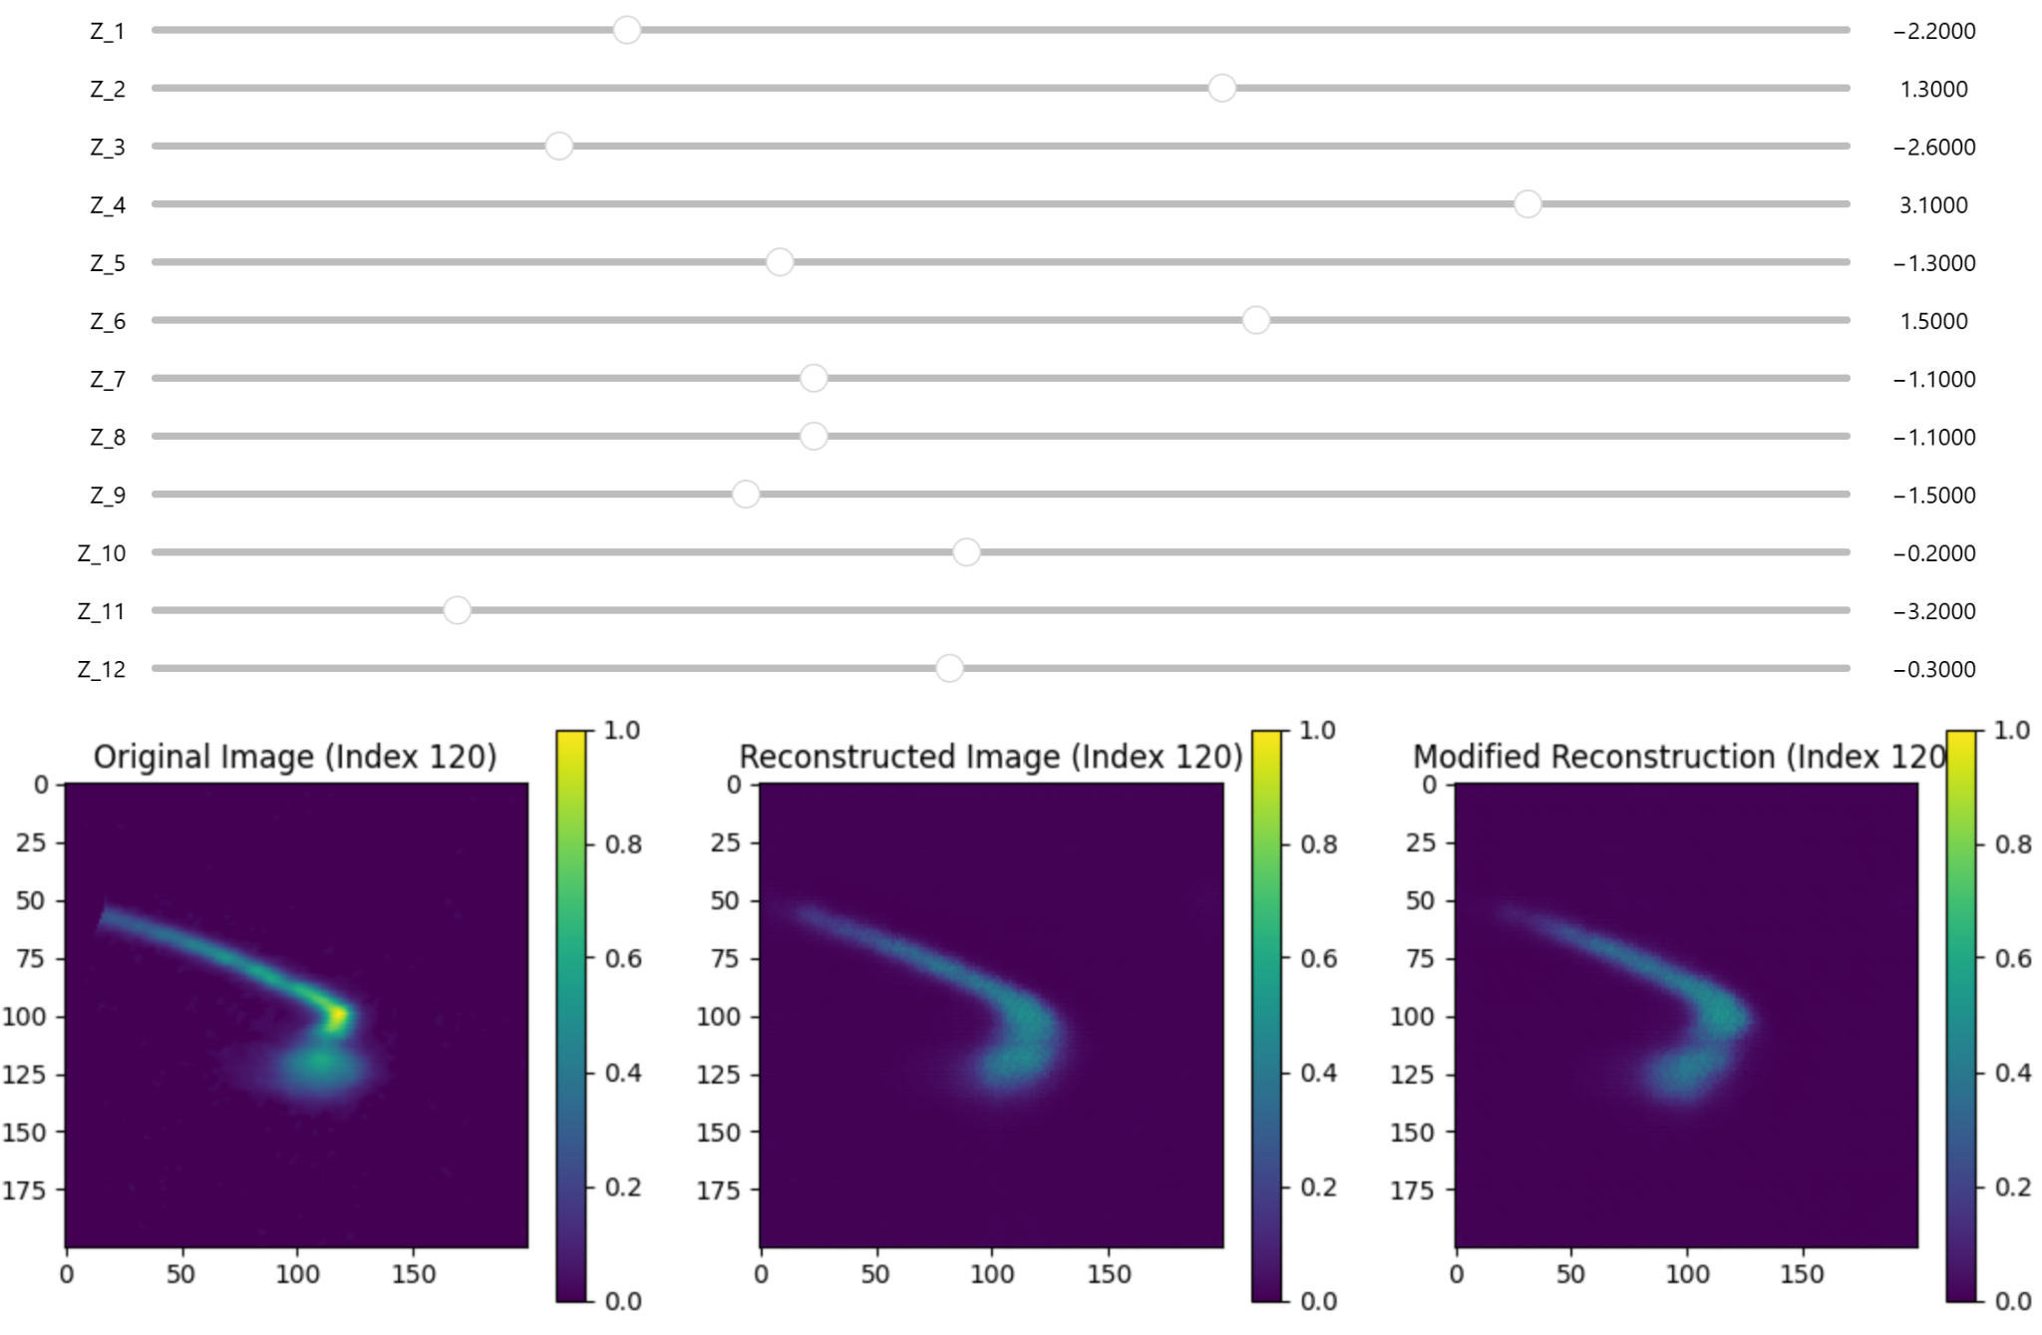
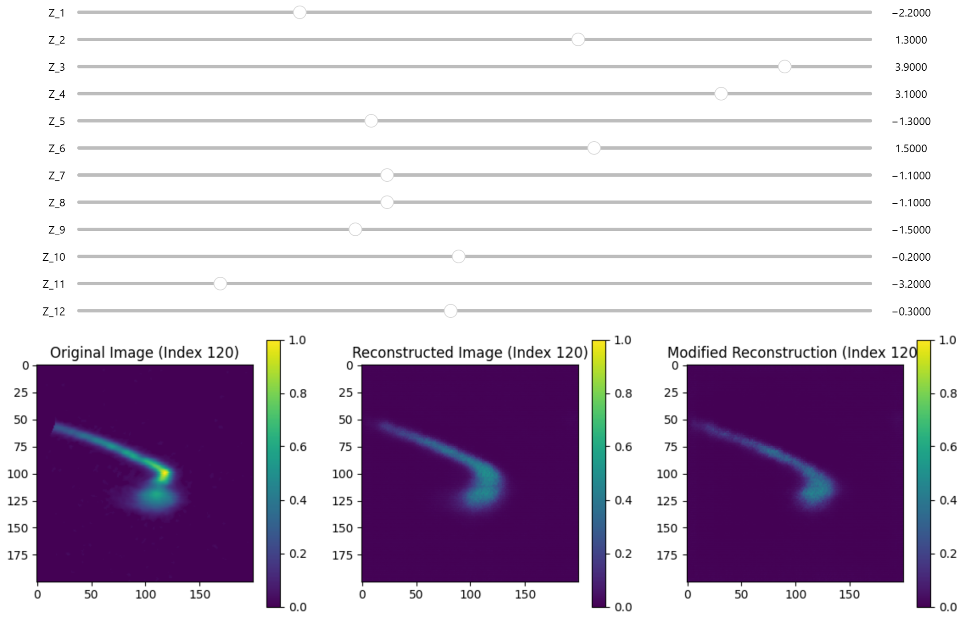
PCA vs CVAE
Dimension Reduction
Interpolatability
Notes:
Unlike perceptron,
A standard autoencoder is deterministic (Input A always equals Latent Point B). A Variational Autoencoder (VAE) is probabilistic. Instead of mapping an input to a single point in the latent space, it maps it to a distribution (a mean and a variance).
While Principal Component Analysis (PCA) only looks for linear relationships, an autoencoder uses non-linear activation functions (like ReLU or Sigmoid). This allows it to learn incredibly complex, curved relationships in your data—which is why it can "package" 200 features into 16 dimensions so much more effectively than simple math could.

Slide 12
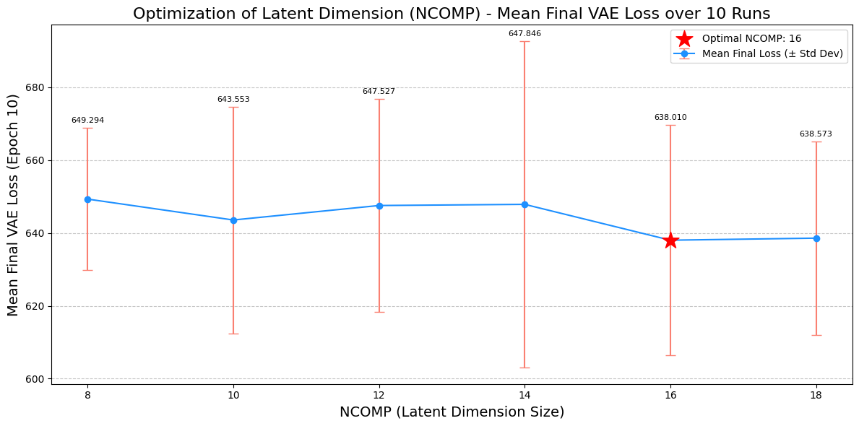
Hyperparameter Optimization: Image
Notes:
The latent dimension, or the number of components used for encoding, does have an optimum, which varies slightly depending on the dataset.

Slide 13
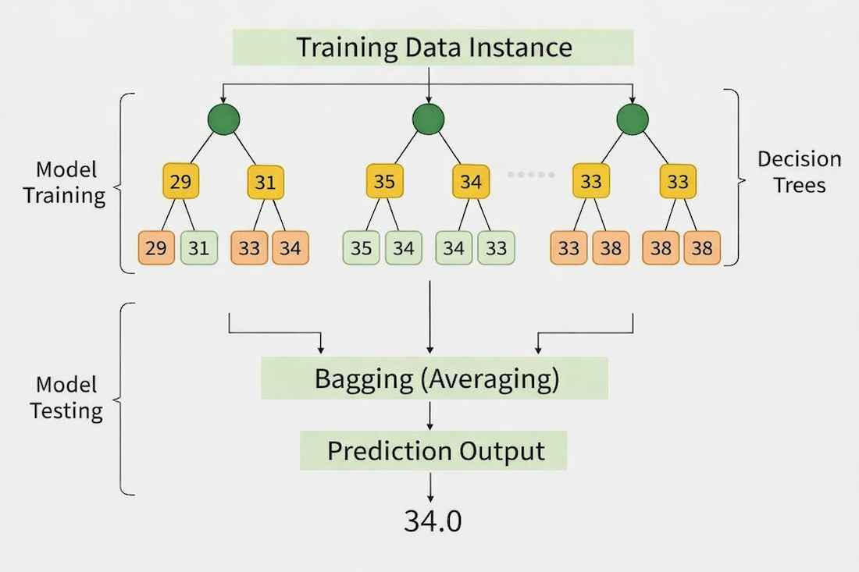
Inference: Random Forest
Single feature(PV) is compared each branch
Outputs latent encoding for the image model
https://www.geeksforgeeks.org/machine-learning/random-forest-regression-in-python/

Slide 14
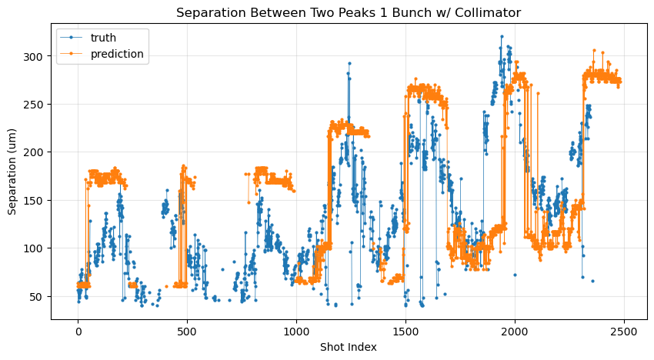
Sample Density Weighting
Ex: Sinusodialer Data E338_15552 → E338_15507 (8 Hrs Apart)
Without Density Weighting:
Notes:
It should be noted that the model used here is trained on a training set which is taken 8 hours after taking the data.

Slide 15
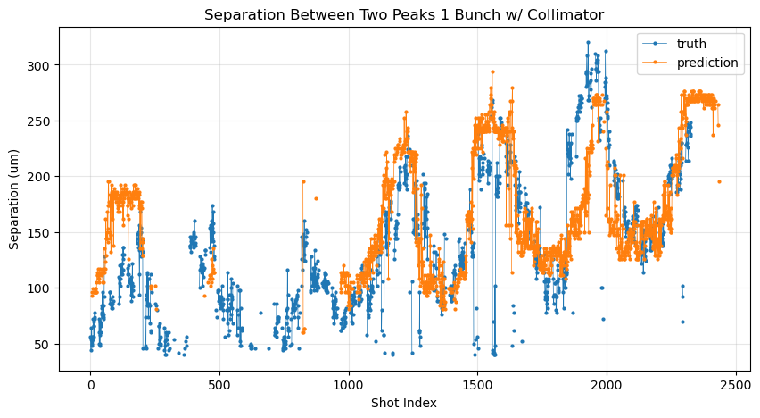
Sample Density Weighting
Ex: Sinusodialer Data E338_15552 → E338_15507 (8 Hrs Apart)
With Density Weighting:

Slide 16
Hyperparameter Optimization: Inference
model = RandomForestRegressor(
n_estimators=500,
max_depth=15,
min_samples_leaf=2,
random_state=42,
n_jobs=-1
)

Slide 17
Image: CVAE
Dimension Reduction
Interpolatability
Notes:
Unlike perceptron,
A standard autoencoder is deterministic (Input A always equals Latent Point B). A Variational Autoencoder (VAE) is probabilistic. Instead of mapping an input to a single point in the latent space, it maps it to a distribution (a mean and a variance).
While Principal Component Analysis (PCA) only looks for linear relationships, an autoencoder uses non-linear activation functions (like ReLU or Sigmoid). This allows it to learn incredibly complex, curved relationships in your data—which is why it can "package" 200 features into 16 dimensions so much more effectively than simple math could.

Slide 18
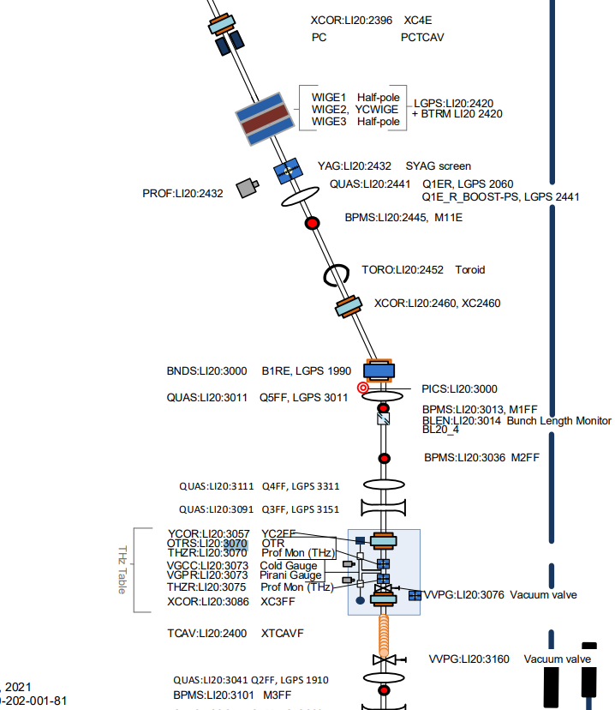
Filtering/Bypassing PVs
Downstream PV
Reconfigured PV
Disconnected PV
Rank | Feature Name | Importance Score | Sector / Component
1 | BLEN_LI20_3014_BRAW | 0.2989 | LI20 Bunch Length
2 | BLEN_LI14_888_BRAW | 0.128 | LI14 Bunch Length
3 | BPMS_LI14_801_X | 0.1278 | LI14 Beam Position (X)
4 | PMT_LI20_3070_QDCRAW | 0.0957 | LI20 Photomultiplier
5 | BPMS_LI20_2445_X | 0.0607 | LI20 Beam Position (X)
6 | BPMS_LI20_2445_Y | 0.0223 | LI20 Beam Position (Y)
7 | BLEN_LI11_359_BRAW | 0.0159 | LI11 Bunch Length

Slide 19
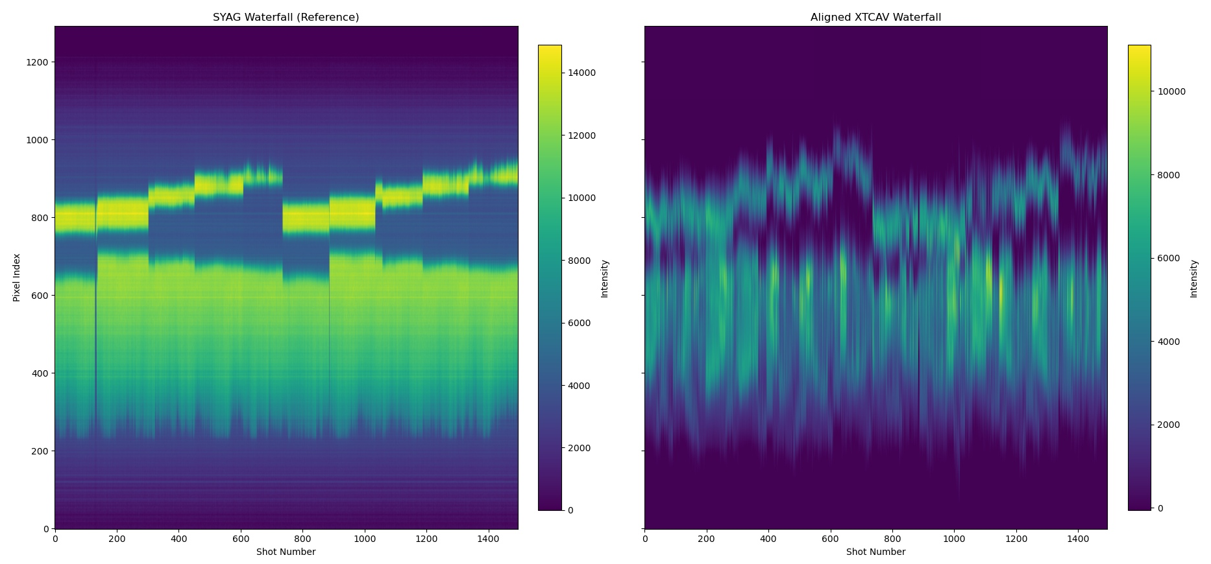
Real Time SYAG Integration
Train Without Collimator
Insert Collimator
Read SYAG Shadow
Apply LPS Shadow

Slide 20
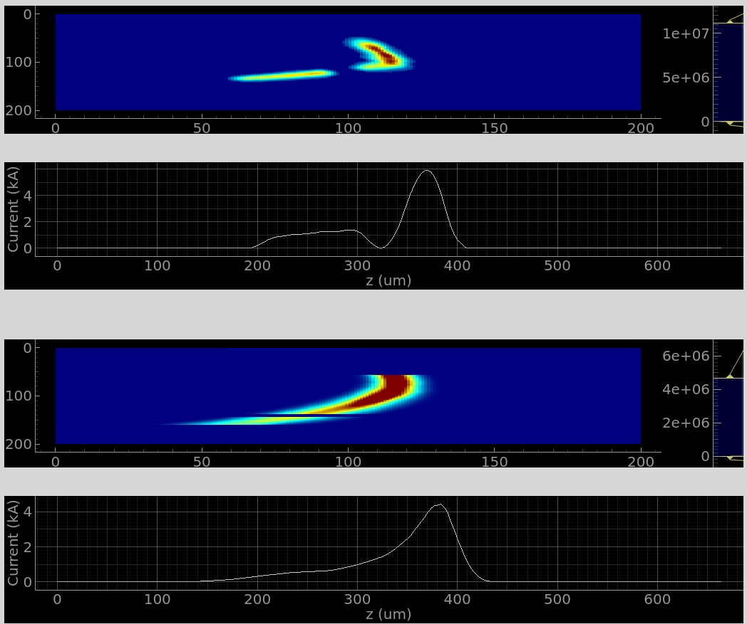
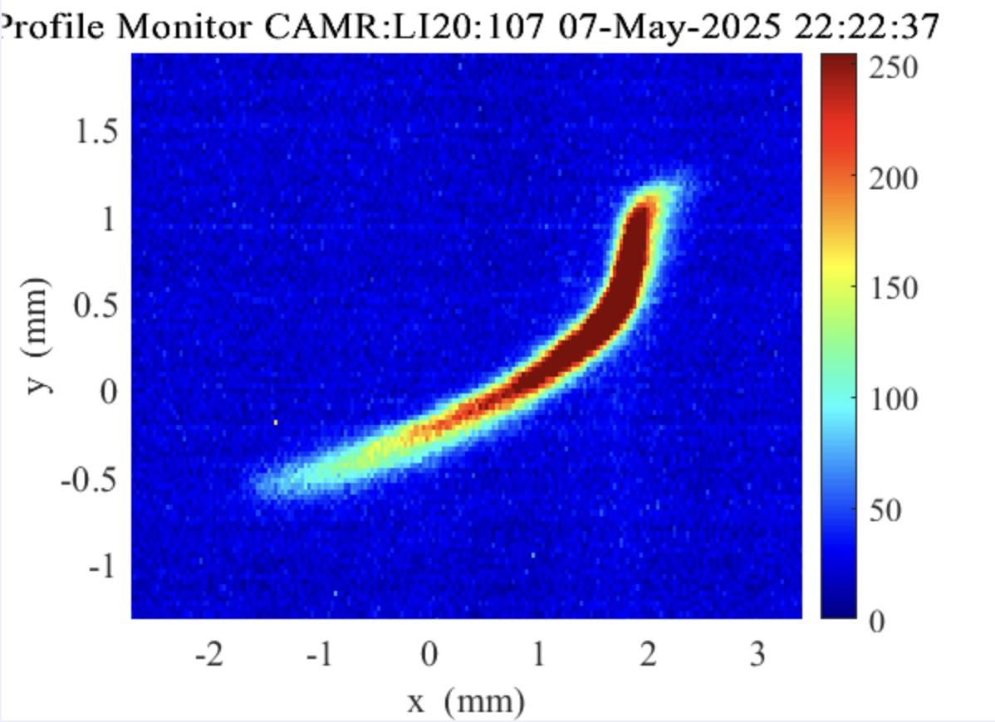
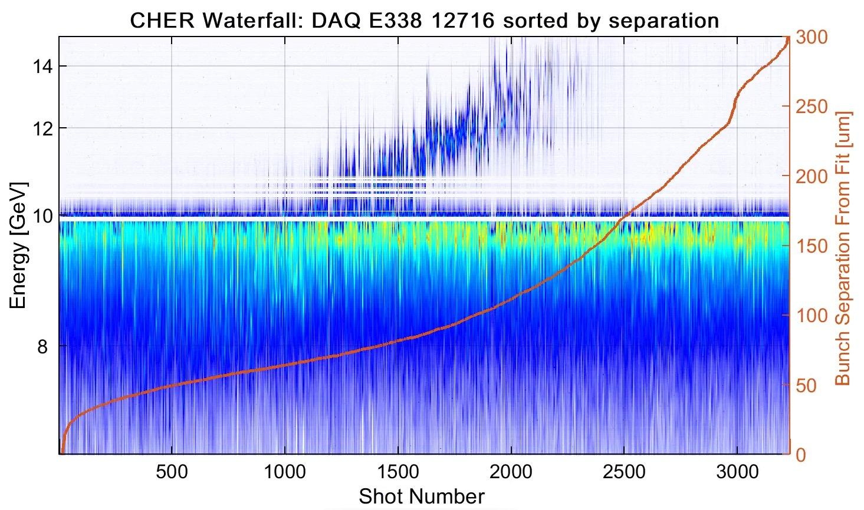
Under-compressed
BC14 BLEN = 9000
Notch
Jaw
tail
head
Notes:
I can arbitrarily increase the shadow cast by collimators, but that does not have much physical basis to reason upon.

Slide 21
Motivation
Principle of Operation
Results / Application
Current Research Direction

Slide 22
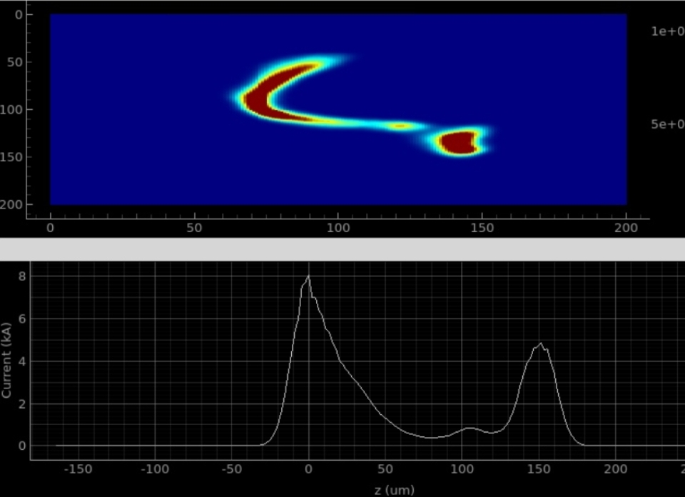
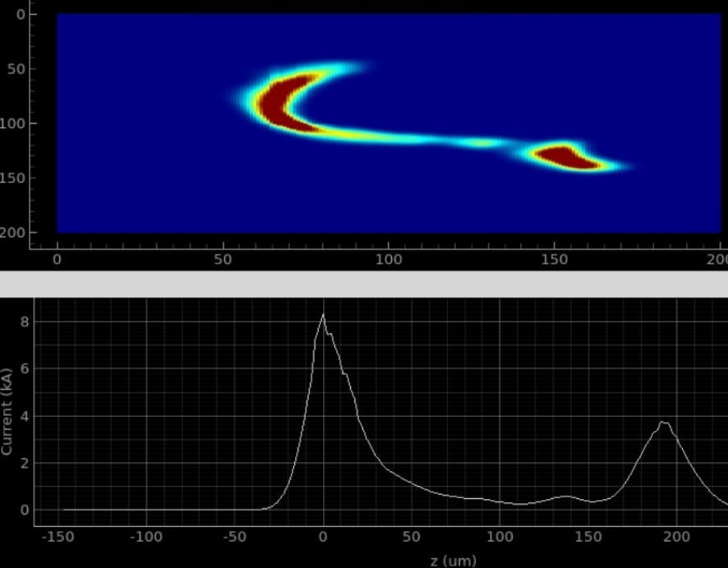
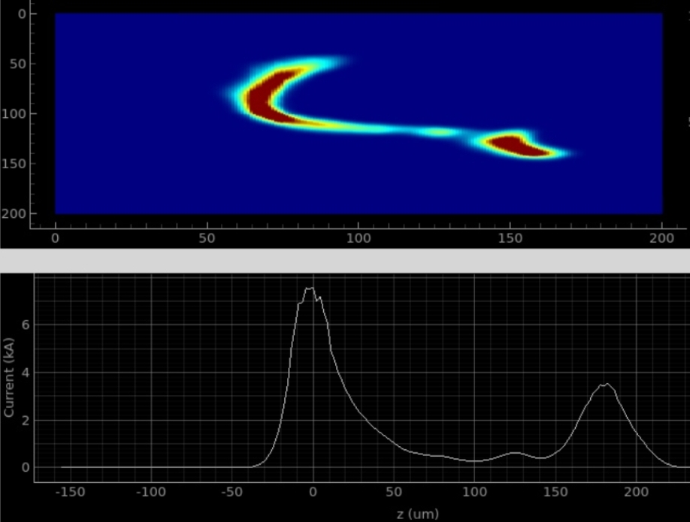
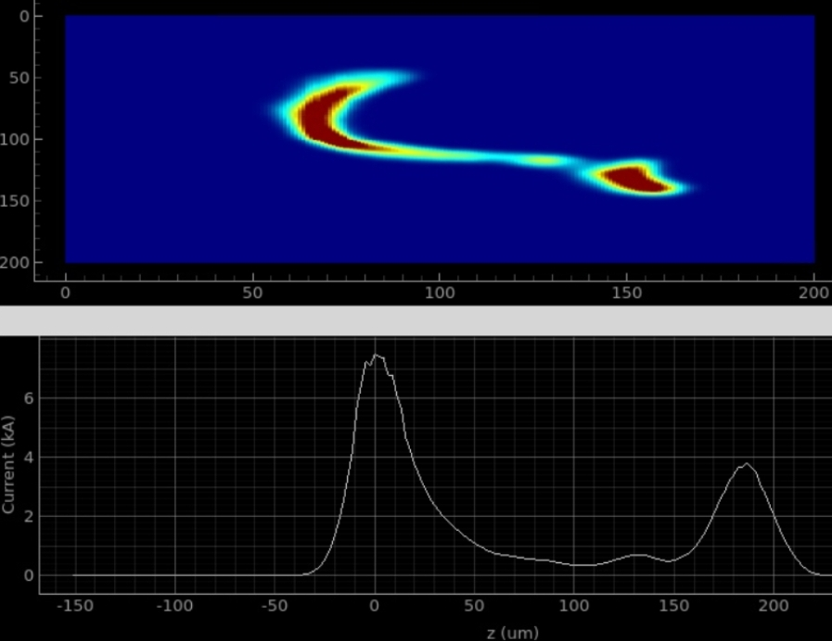
Model Output

Slide 23
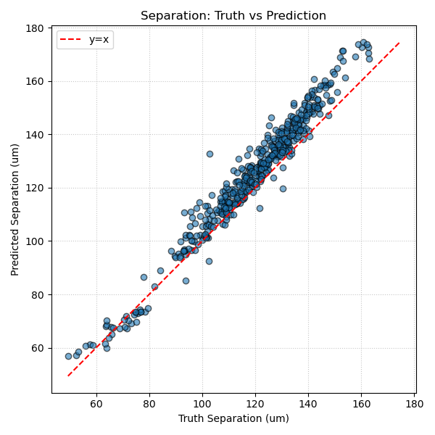
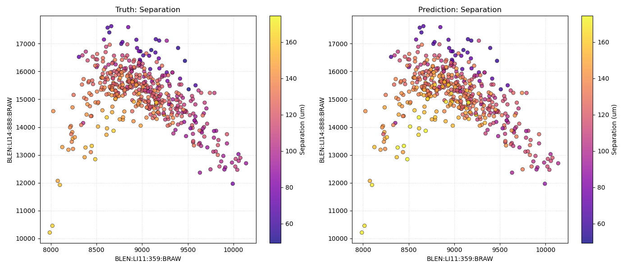
Current Profile Prediction

Slide 24
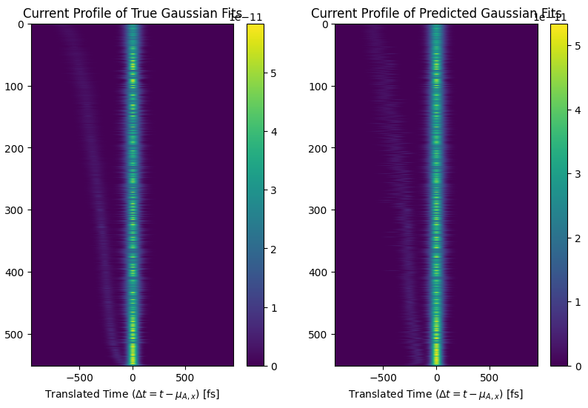
Current Profile Prediction
Current profile in Python, Matlab formats

Slide 25
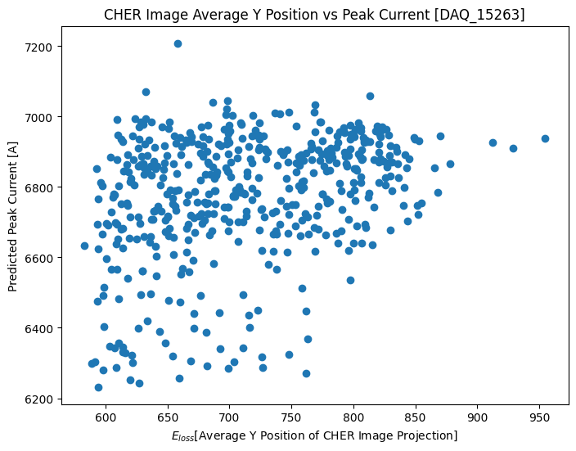
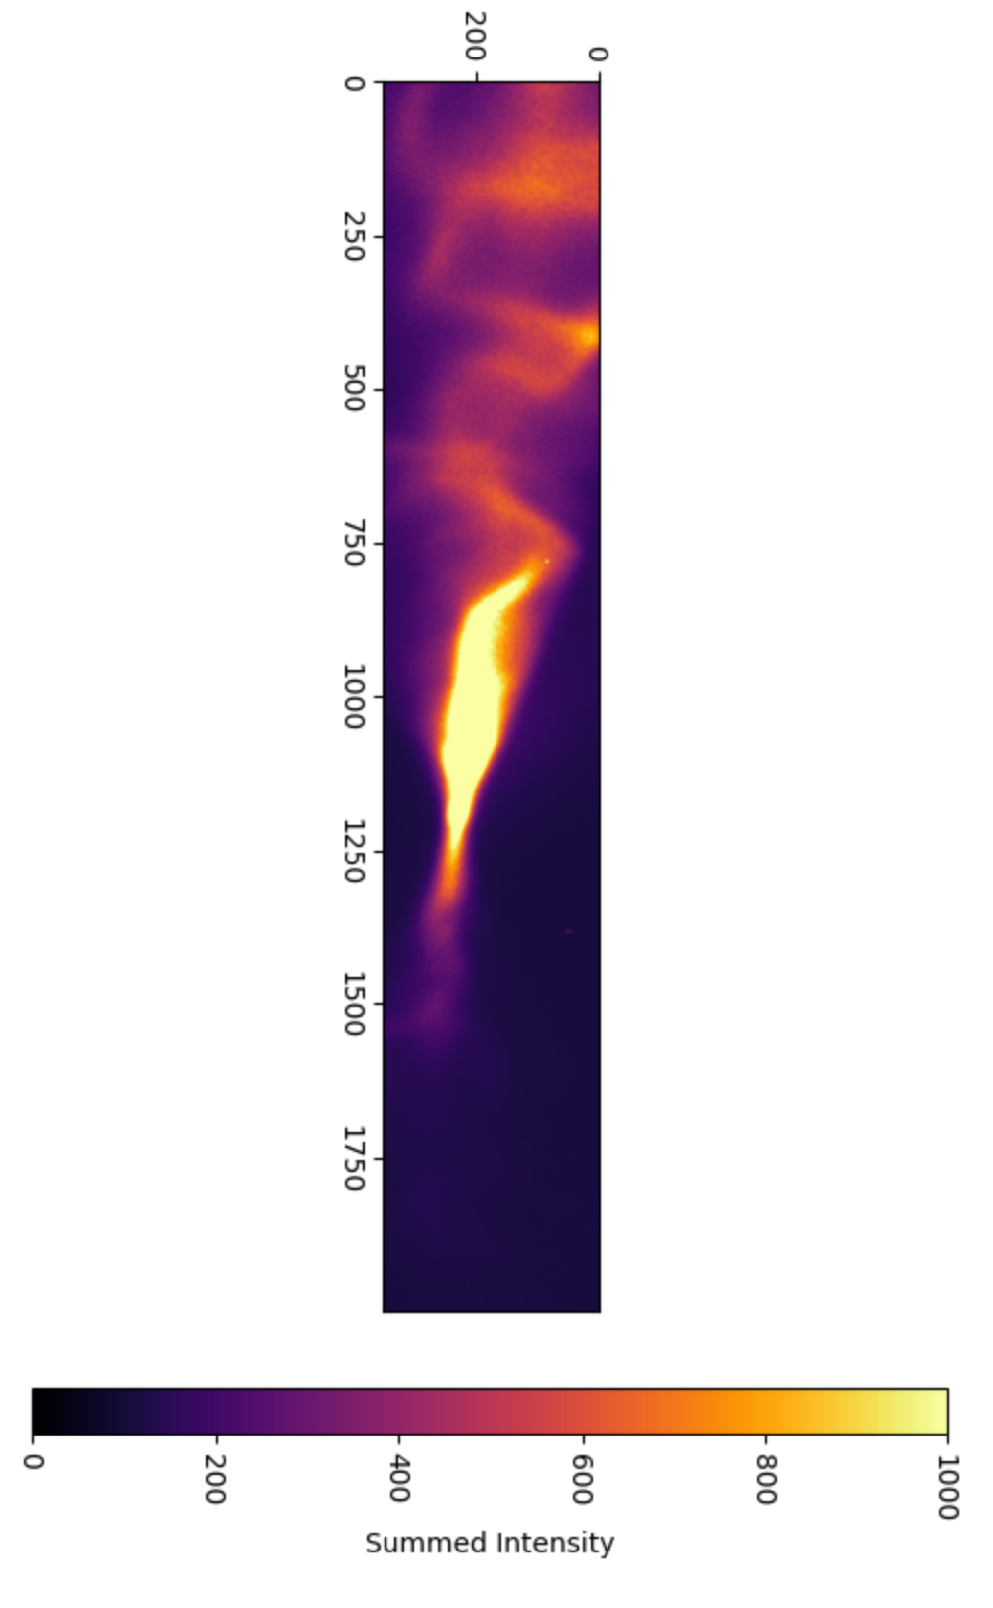
Offline Analysis: Plasma Interaction
Drive to Wake Energy Transfer
Notes:
Another analysis I worked on is to correlate Energy Transfer into Plasma, also known as ELOSS, using virtual TCAV. As you can see from the scatter plot, this is a much tougher job because while it is expected for ELOSS to correlate positively with longitudinal peak current, the horizontal distribution of the beam may still jitter shot to shot.

Slide 26
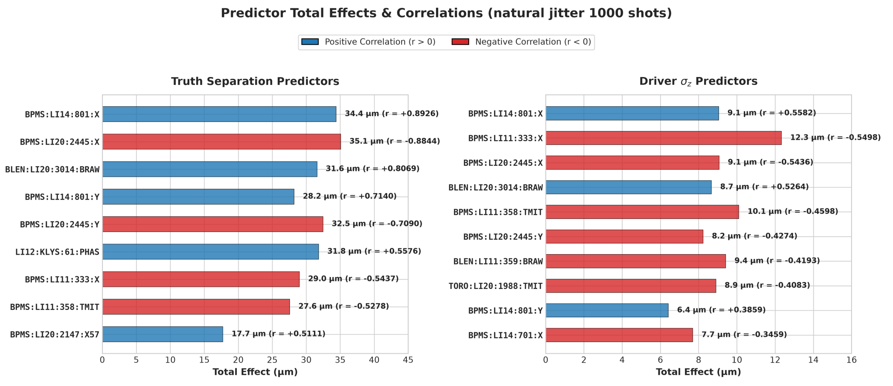
Correlation Studies
Bunch Compressor Orbit
L1
LI11
L2
LI14
L3
LI20

Slide 27
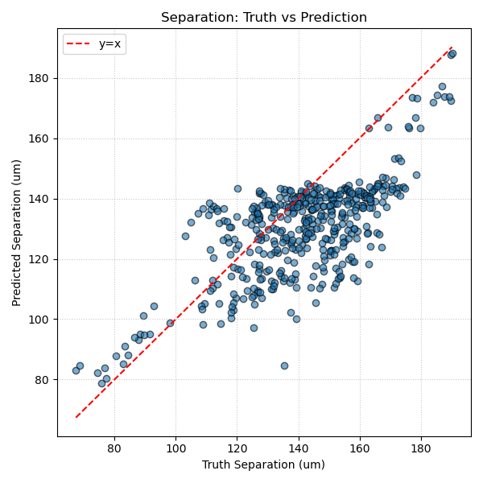
Anomaly Detection
Persistent problem across the entire ML world:
Building Trust!
When models give us bad predictions….. Why?
AAC 2026 E327: Virtual Diagnostic For Phase Space Prediction And Customization at FACET-II

Slide 28
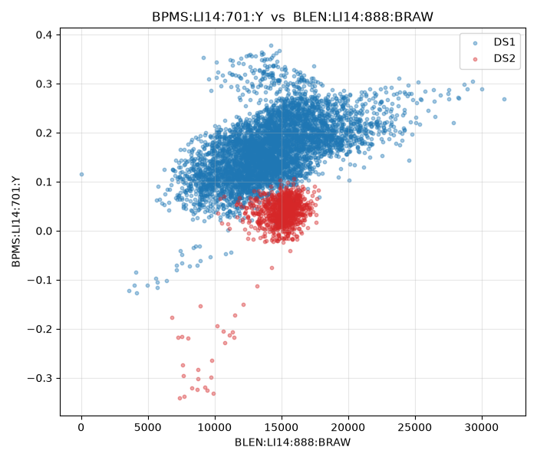
Anomaly Detection
Anomalies not immediately visible by checking any individual readout…
The inference model catches it in real time!
AAC 2026 E327: Virtual Diagnostic For Phase Space Prediction And Customization at FACET-II

Slide 29
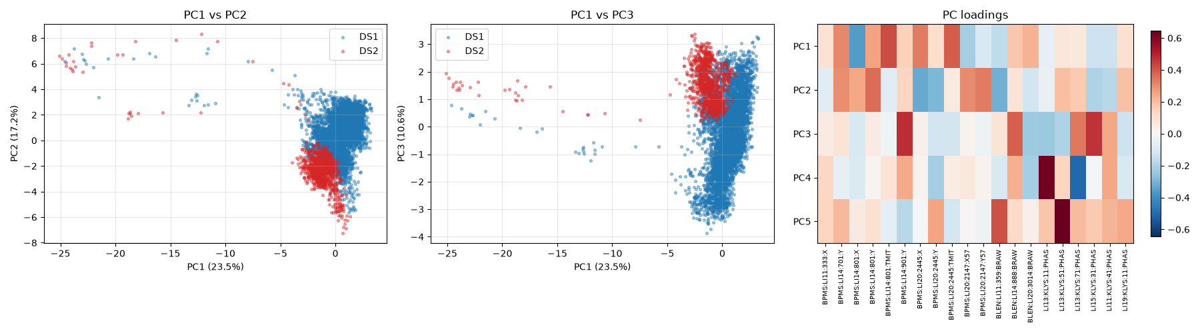
Real Time Confidence
Topological distance between training set and the current state, measured in real time
AAC 2026 E327: Virtual Diagnostic For Phase Space Prediction And Customization at FACET-II

Slide 30
Motivation
Principle of Operation
Results / Application
Current Research Direction

Slide 31
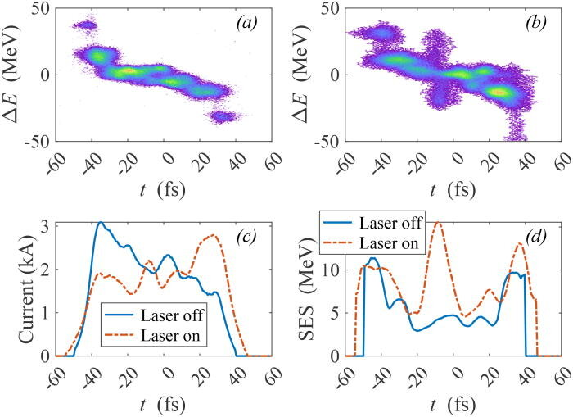
LCLS XLEAP application
Li, Siqi & Zhang, Zhen & Alverson, Shawn & Cesar, David & Driver, Taran & Franz, Paris & Isele, Erik & Duris, Joseph & Larsen, Kirk & Lin, Ming-Fu & Obaid, Razib & O'Neal, Jordan & Robles, River & Sudar, Nick & Guo, Zhaoheng & Vetter, Sharon & Walter, Peter & Wang, Anna & Xu, Joseph & Marinelli, Agostino. (2024). “Beam à la carte”: Laser heater shaping for attosecond pulses in a multiplexed x-ray free-electron laser. Applied Physics Letters. 125. 10.1063/5.0233468.

Slide 32

Also Check Out…

Slide 33
Summary
Virtual Diagnostics accurately predicts LPS from nondestructive diagnostics.
Prediction Confidence can be used for Real Time Anomaly Detection.
Acknowledgments
SLAC: D. Storey, R. Hessami, K. Larsen, R. Robles, K. Swanson,
C. Emma, A. Marinelli, Y. Ye, A. Kinderman, C.-E. Lin, T. Dalichaouch, D. Kalvik, A. Knetsch, S. Gessner, S. Corde, S. Rego, Z. Buschmann, R. Loney, J. Yocky,
A. Edelen, D. Cesar, A. Reed
Experimental Collaborations with: E-300, E-338
Special Thanks to: S. Amberkar, N. Majernik
Thank you for your attention

Slide 34
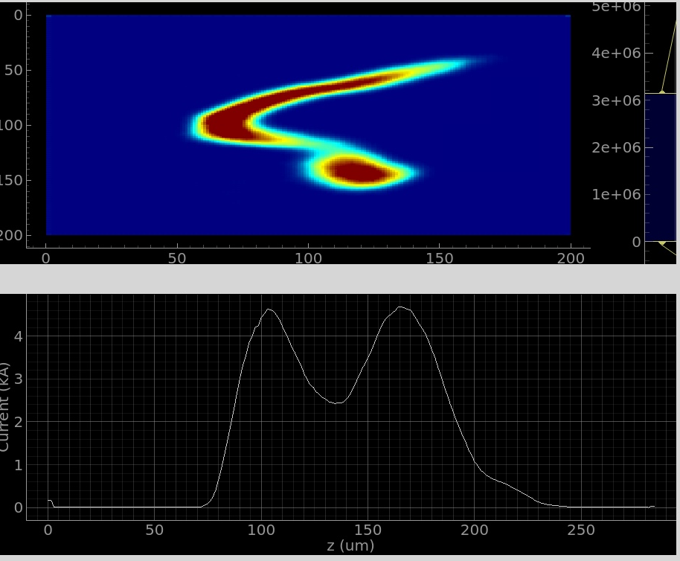
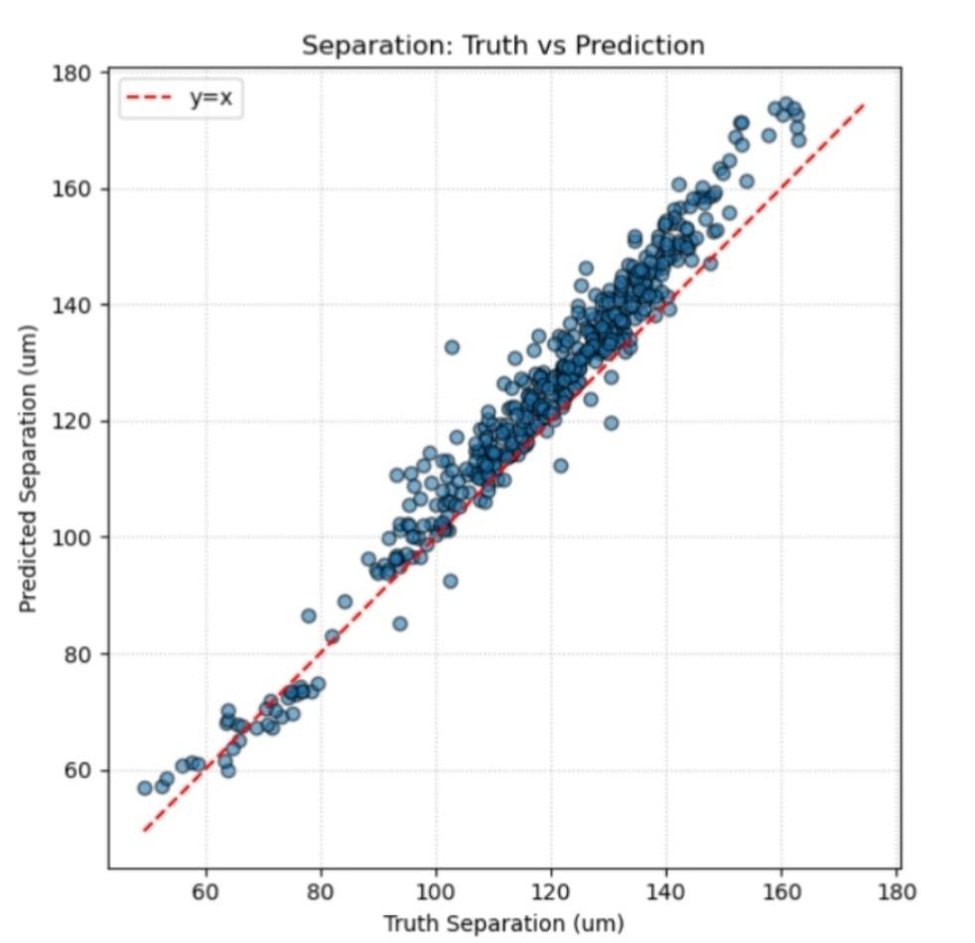
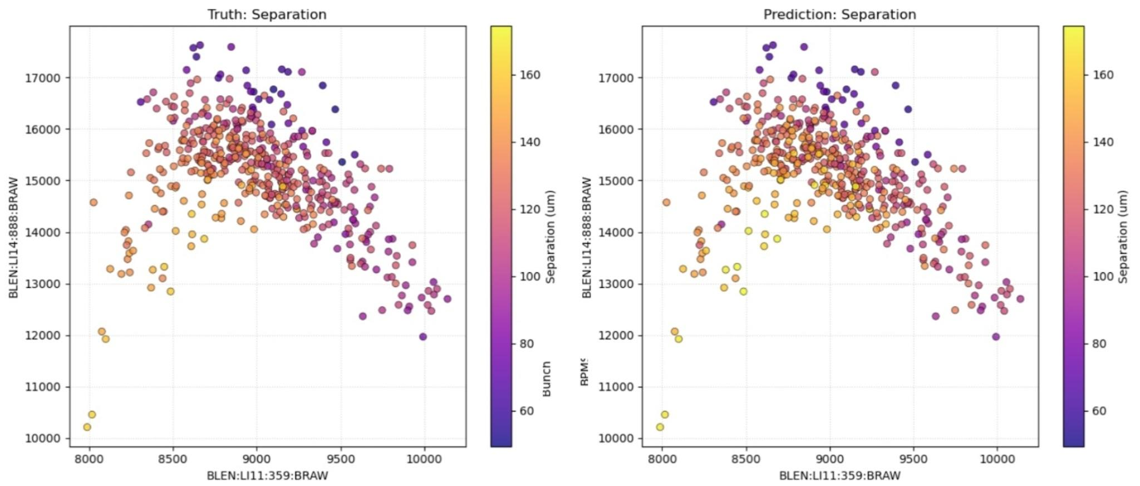
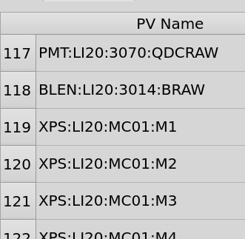
VTCAV: Virtual Diagnostic For Longitudinal Phase Space Prediction
EPICs PV Acquisition
Filter PVs
(Before IP Only)
Bypass PVs
(Disconnected, …)
Normalization
Inference Model
Image Model
200x200
440x1
220x1
220x1
16x1

Slide 35
Bunch Length Feedback System
L1 BLEN Count
L1 Energy BPM
L2 BLEN Count
L2 Energy BPM

