Slide 1


Interactive Simulated Beam Loss Diagnostics Enabled by a Location-of-Loss Surrogate Model
  Christopher M. Pierce

Slide 2
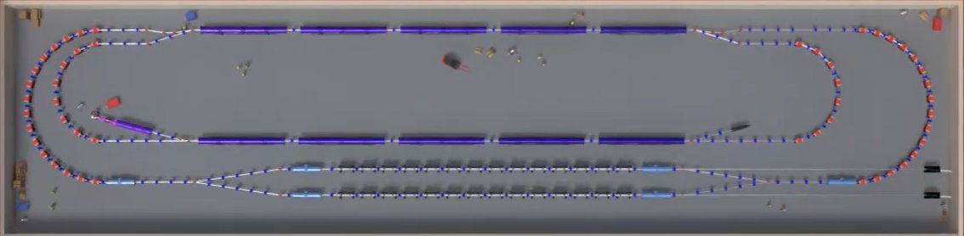
What is xLight?
Particle loss imposes operational limit at high avg. power
EUV Free Electron Laser Light Source for Semiconductor Manufacturing
Not enough time in this talk to discuss more. Come chat with me at banquet to hear more about application!

Slide 3
Scattering Calculations
How to estimate losses from RGS and Touschek

Slide 4
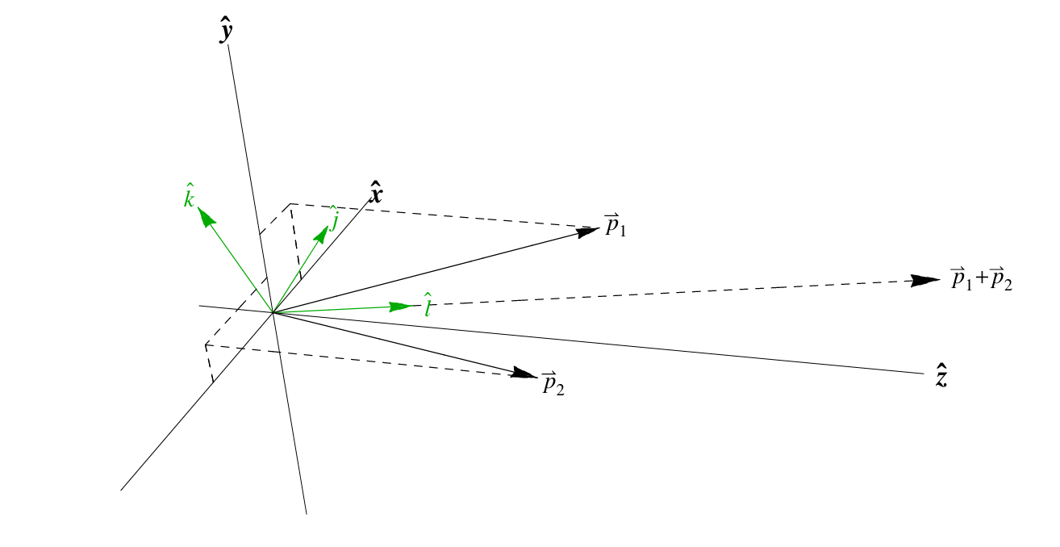
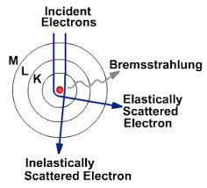

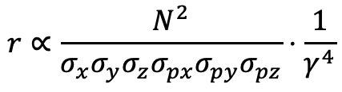
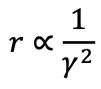
We Study Three Scattering Processes
Touschek
Bremsstrahlung
Coulomb
Single particle scattering process
Electrons fly past nuclei of residual gas and are slowed without much deflection
EM radiation is given off with the energy coming from the scattered electron
Single particle scattering process
As the electron flies past a residual gas nucleus, it is bent without changing the energy much.
The particle receives a kick in the transverse plane
Two electrons scatter in the beam’s rest frame
Transverse momentum is converted into longitudinal momentum which can be large when boosted into lab frame.
$$r∝\frac{N^{2}}{σ_{x}σ_{y}σ_{z}σ_{px}σ_{py}σ_{pz}}⋅\frac{1}{γ^{4}}$$
$$r∝\frac{1}{γ^{2}}$$
$$n∝−log⁡(δ)$$

Slide 5
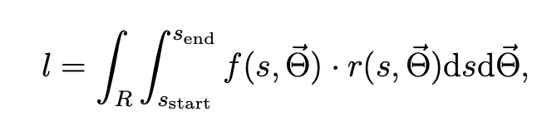
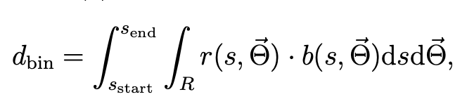
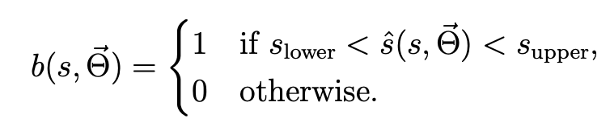
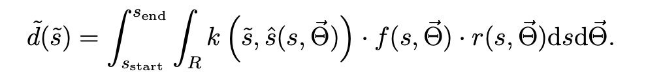
Loss Calc. Comes Down to Monte-Carlo Integral
Total Particle Loss Along Lattice
To find total particle loss, integrate the differential scatter rate against an “aperture function” and along the lattice
Also interested in the amount of particle deposition at different points along the lattice
  Histogram: integrate the number of particles where the location of loss (s hat) falls inside the bin
  Kernel estimate: integrate the density against a kernel which lets us cast result in terms of integral WRT lattice coordinate
Bottom Line: numerically calculate an integral of the scattering rate against a function of the lattice
Number of Particles Scattered into ”bin”
Kernel Density Estimator Version of Deposition Calculation

Slide 6



Tracking Particles to “Location of Loss” is Slow Part
Kernel Density Estimator Version of Deposition Calculation
SLOW!
”Location of Loss”
Aperture
Scattering Rate
At which s-position does a particle at some s, scattered to coordinate $Θ$ (ie $δ$ for longitudinal, $p_{x}/p_{y}$ for transverse) eventually land if lost. End of machine if it survives.
1 or 0, does the particles scattered here get lost eventually. Note: this is equal to following.
Calculated from beam properties and pressures. Assumed calculated from particle tracking already. Analytical scattering rates calculated efficiently.
$$f\left(s,\vec{Θ}\right)=\hat{s}\left(s,\vec{Θ}\right)==s_{end}$$

Slide 7
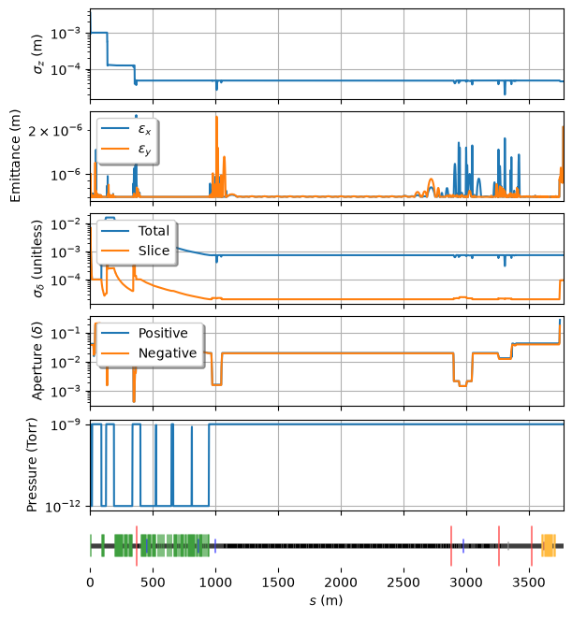
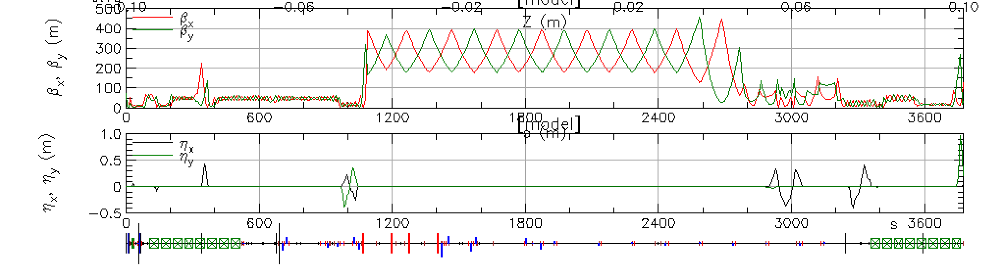
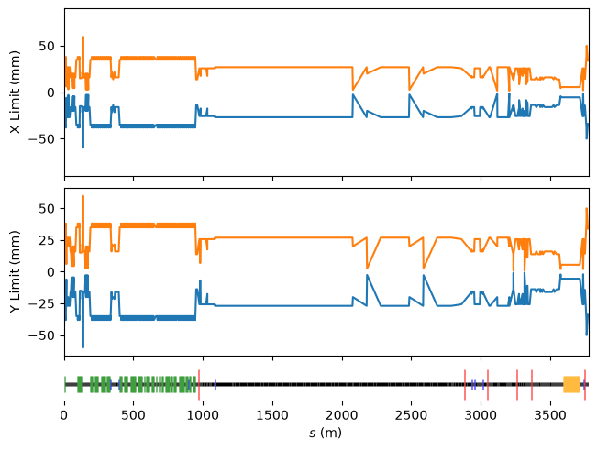
LCLS-II SC SXR as a Study Lattice
https://github.com/slaclab/lcls-lattice/
NOTE: Beam is from linear model for purposes of surrogate model studies. Not representative of actual scattering estimates for LCLS-II!

Slide 8
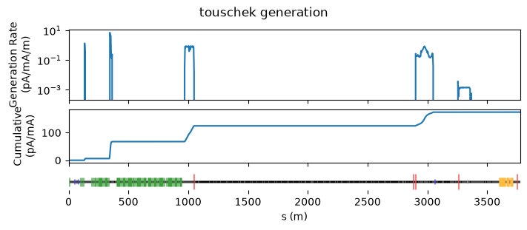
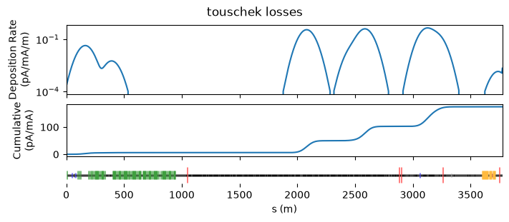
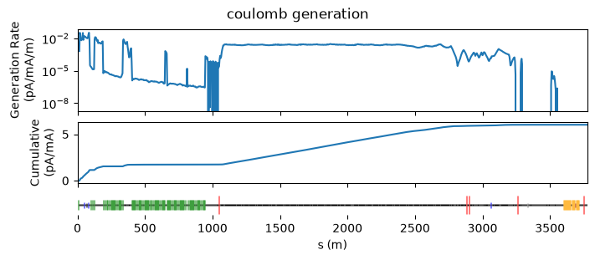
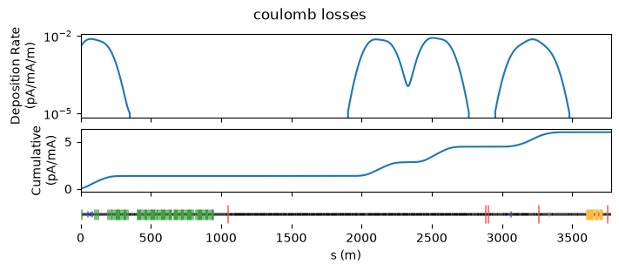
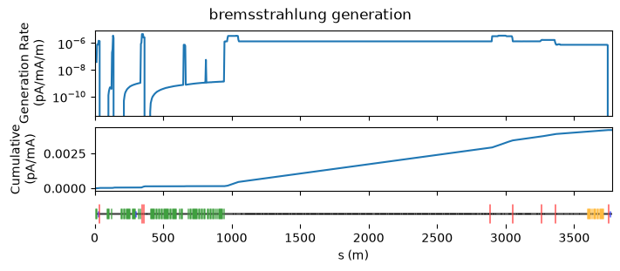
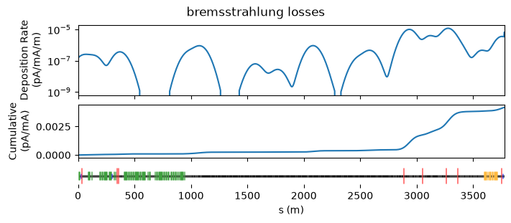
All Conventional Calcs: 60 CPU-Hours on HPC
How to speed up the “location of loss” calculation?
1k s positions, 16k scatter samples per position

Slide 9
Surrogate Modeling for “Location of Loss”
Turning Particle Tracking into a Data-Driven Model

Slide 10
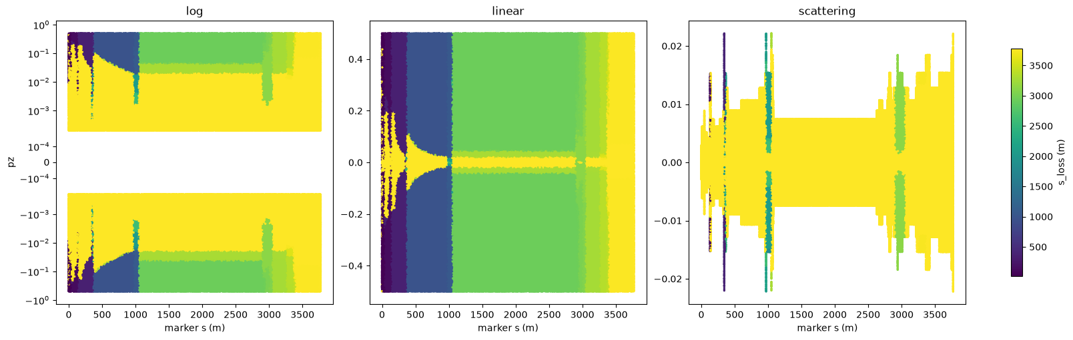
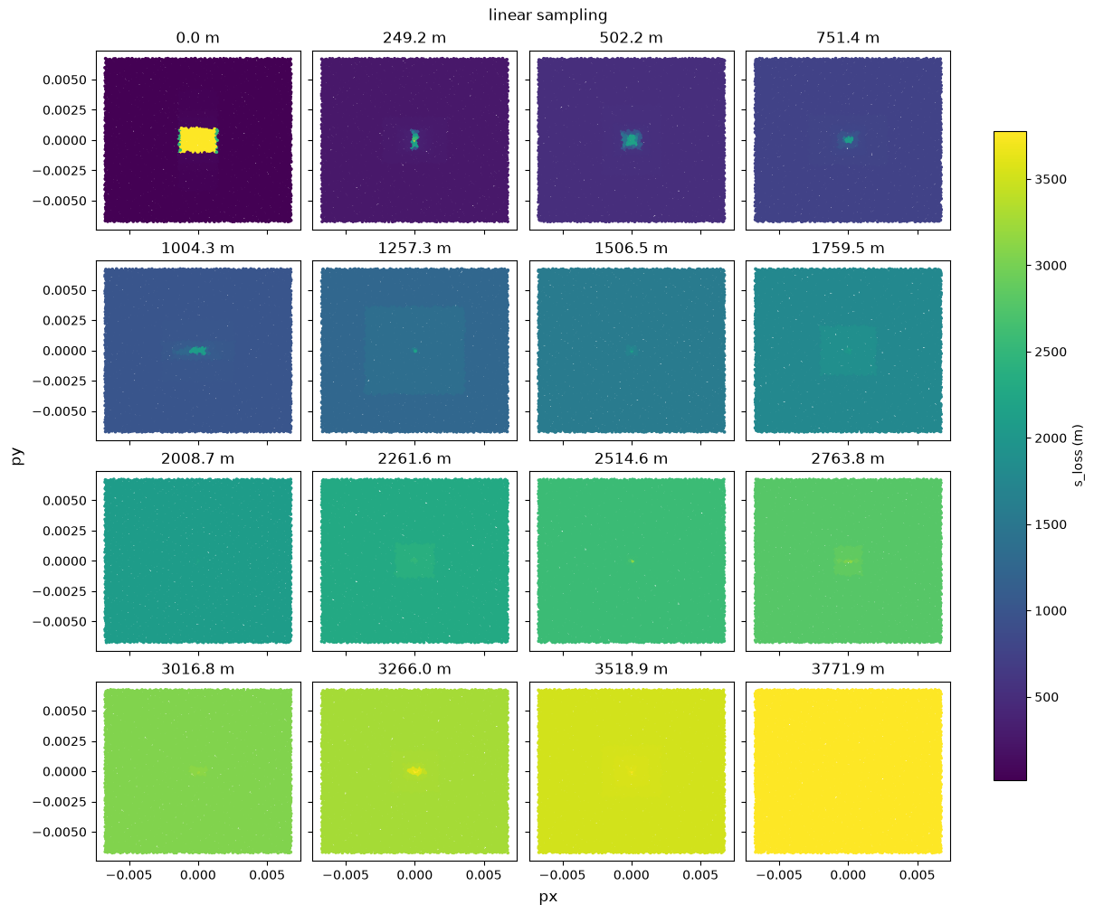
“Location of Loss” as a Data-Driven Problem
Transverse Location of Loss
Longitudinal Location of Loss
Train MLP on datasets and use in place of particle tracking

Slide 11
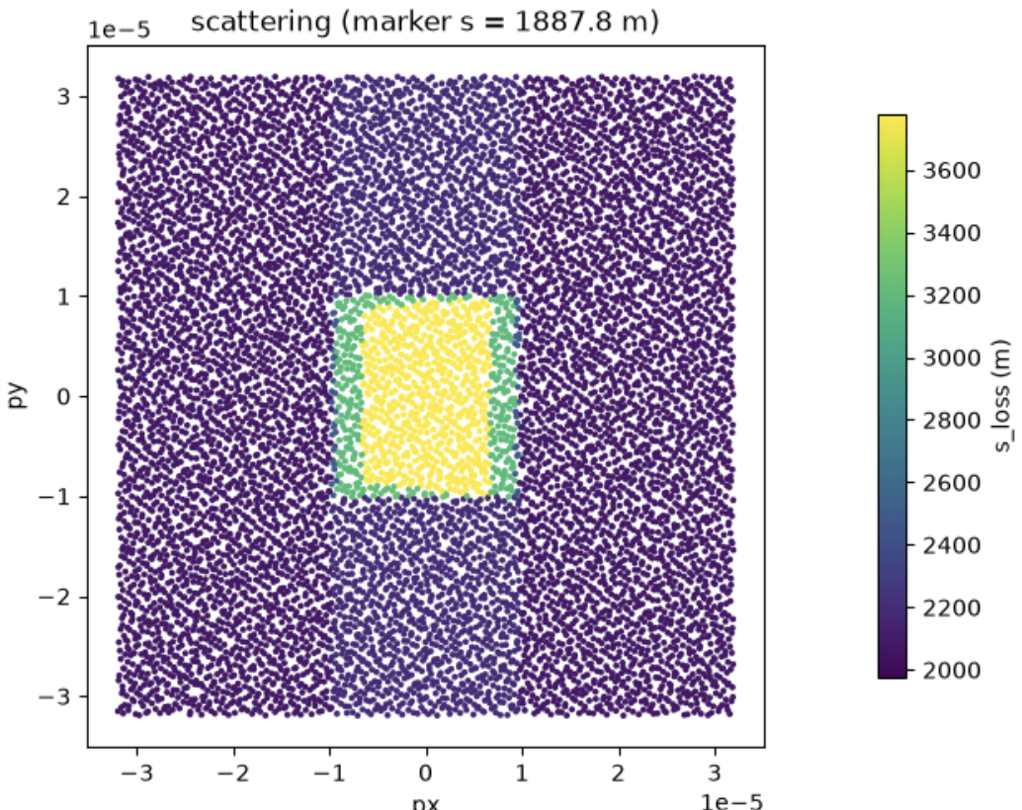
Problem 1: Scales Change by Orders of Magnitude

Slide 12
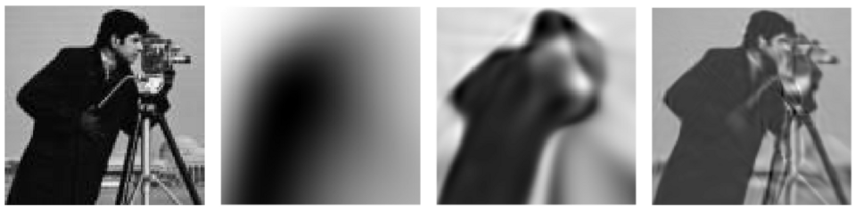
Problem 2: Spectral Bias
Zhi-Qin John Xu, Wikimedia Commons
Outputs of DNNs at step 80, 2000, 58000.
Neural networks tend to learn low frequency features first and may struggle to learn high frequency features.
Rahaman, Nasim, et al. "On the spectral bias of neural networks." International conference on machine learning. PMLR, 2019.

Slide 13
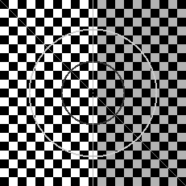
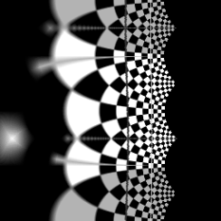
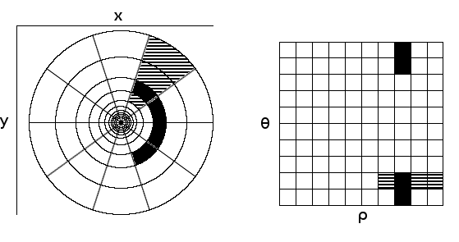


Solution 1: Log-Polar Transformation
Log-Polar Coordinates
Cartesian
Log-Polar
$$ρ=ln⁡(\sqrt{x^{2}+y^{2}})$$
$$θ=atan2(y, x)$$
https://andershast.com/2018/10/04/rotation-invariant-feature-matching-based-on-gaussian-filtered-log-polar-transform-and-phase-correlation/
https://sthoduka.github.io/imreg_fmt/docs/log-polar-transform/

Slide 14
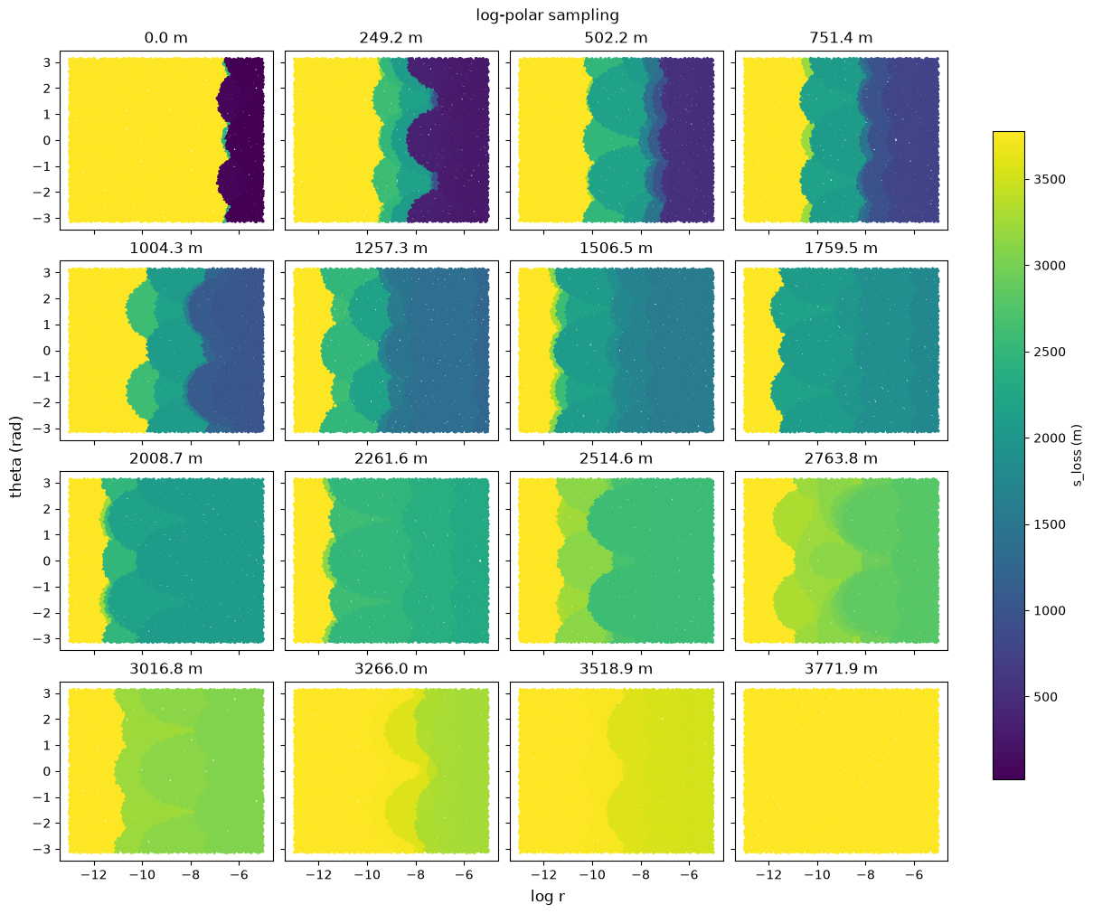
Aperture Becomes Visible in Log-Polar Coordinates

Slide 15
Aperture Becomes Visible in Log-Polar Coordinates
For longitudinal: take signed log-transform (ie sign(pz)*ln(|pz|-min(|pz|)).

Slide 16
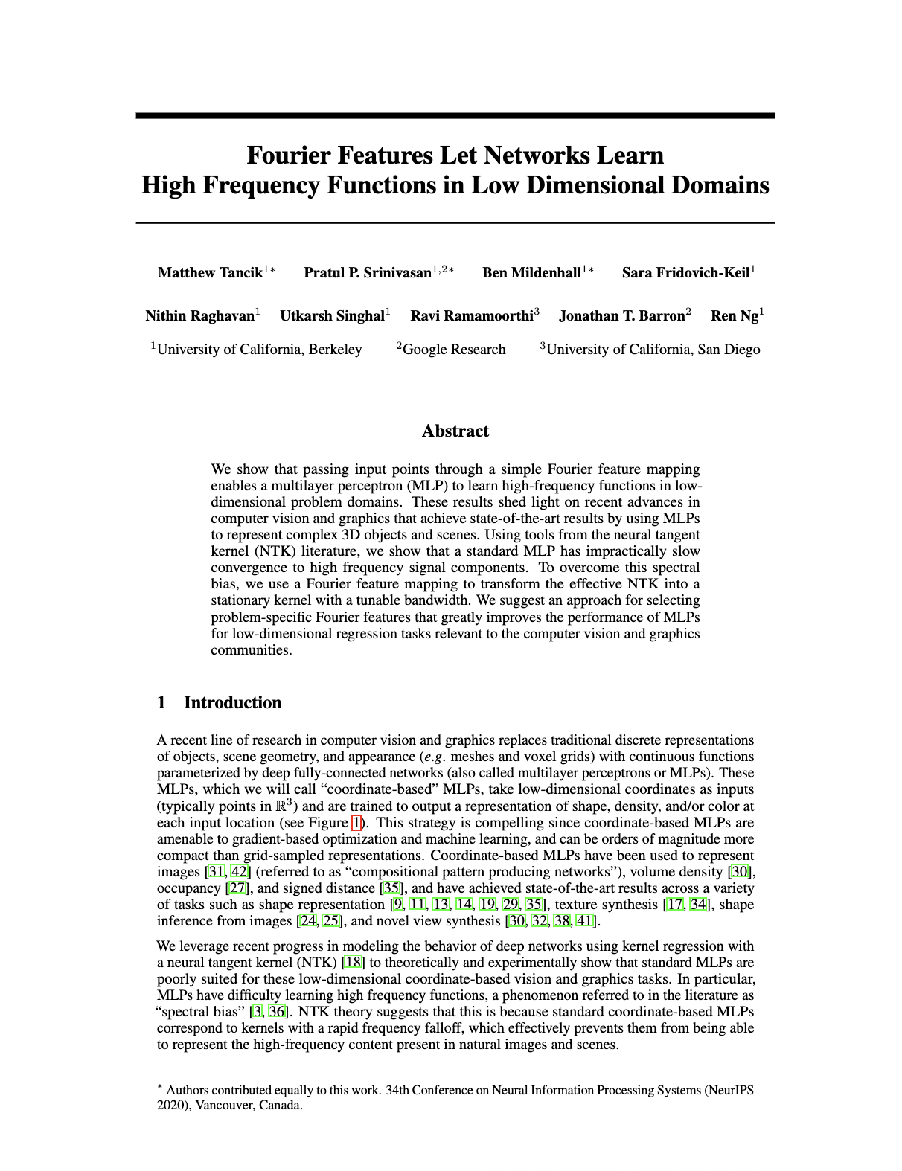
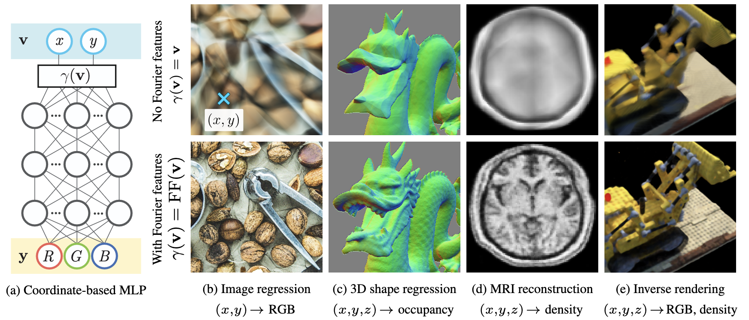
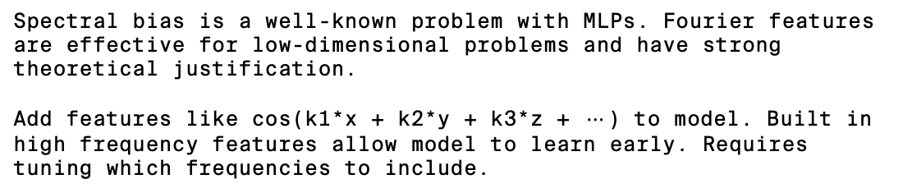
Solution 2: Fourier Features
Tancik, Matthew, et al. "Fourier features let networks learn high frequency functions in low dimensional domains." Advances in neural information processing systems 33 (2020): 7537-7547.
Spectral bias is a well-known problem with MLPs. Fourier features are effective for low-dimensional problems and have strong theoretical justification.
Add features like $\text{cos(}\text{k1}\text{∗x + k2∗y + k3∗z + }⋯\text{)}$ to model. Built in high frequency features allow model to learn early. Requires tuning which frequencies to include.

Slide 17
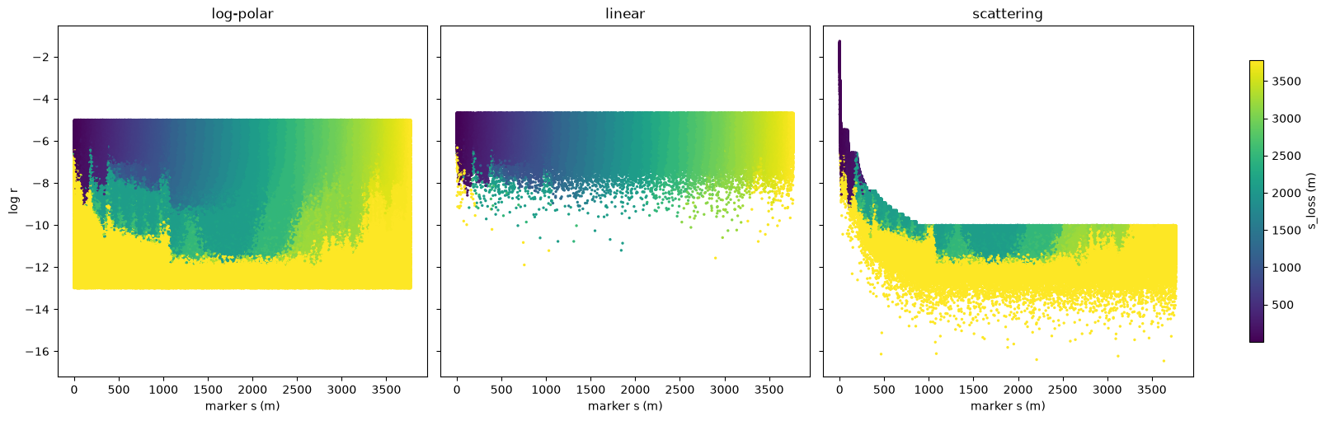
Use Samples from Scattering Calc for Validation in Tuning Experiments
Longitudinal
Transverse

Slide 18
Log-Scaled, Fourier Models Perform Best for Location-of-Loss
Transverse
Longitudinal
Model | Scatter Validation MAE (m)
Log-Polar, Fourier | 6.6 ± 0.3
Log-Polar, Standard | 17.9 ± 0.6
Linear, Fourier | 143 ± 8.5
Linear, Standard | 162 ± 6.9
Model | Scatter Validation MAE (m)
Log, Fourier | 0.6 ± 0.02
Linear, Fourier | 1.3 ± 0.07
Log, Standard | 1.9 ± 0.2
Linear, Standard | 5.4 ± 0.5
MAE = Mean Absolute Error of Predicted Location of Loss in Scattering Test Set
Results of hyperparameter tuning with equal resources per experiment, statistics collected with eight runs of best performing hyperparameters.

Slide 19
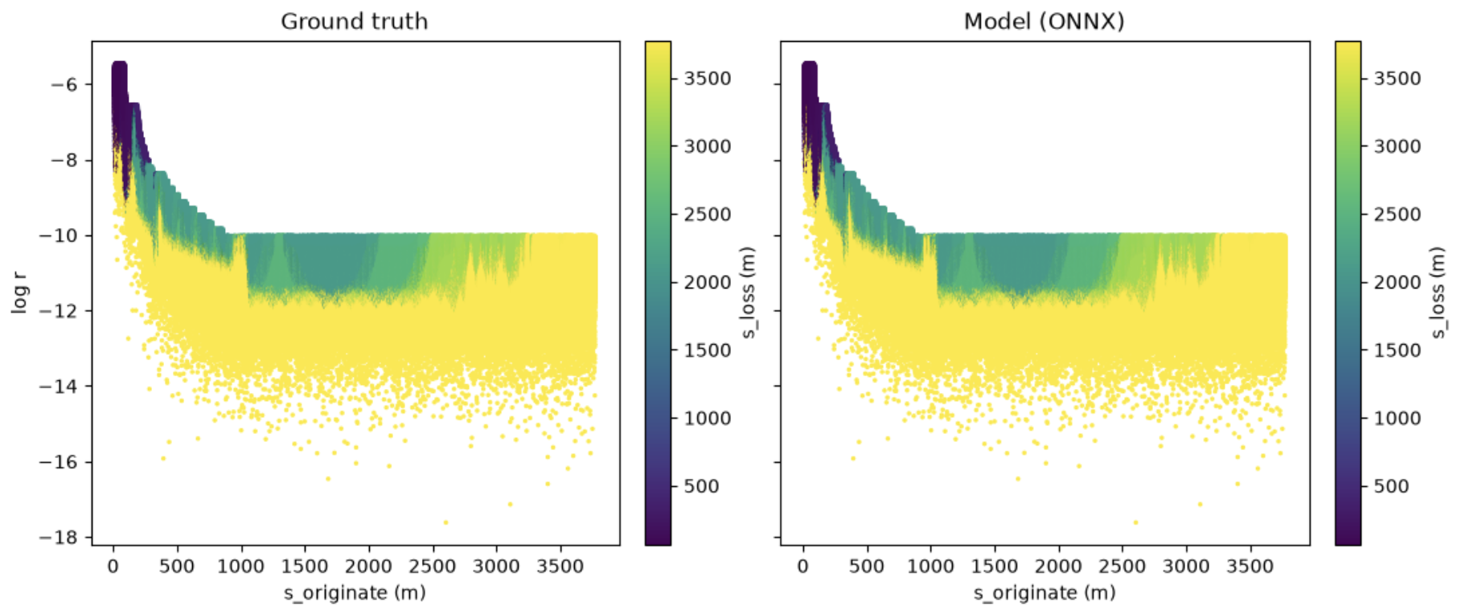
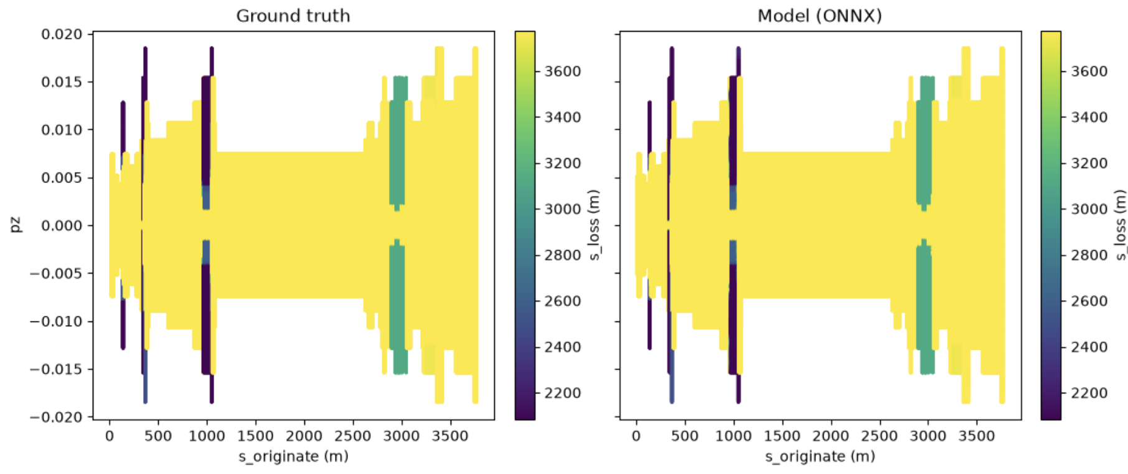
Trained Models Visually Match Ground Truth
Transverse
Longitudinal

Slide 20
Scattering Calculations Using Surrogates
Integrating the Surrogate Models Into Scattering Code

Slide 21
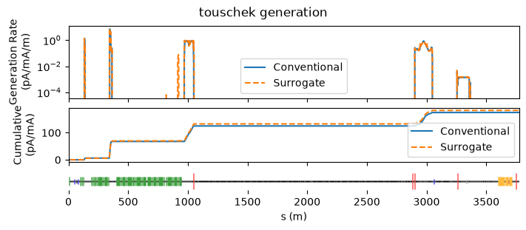
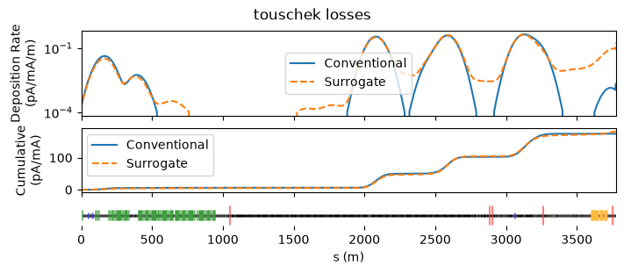
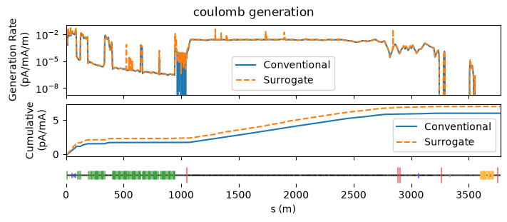
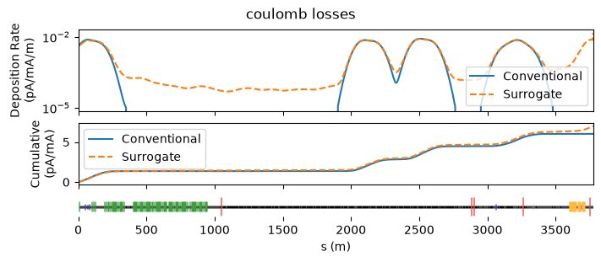
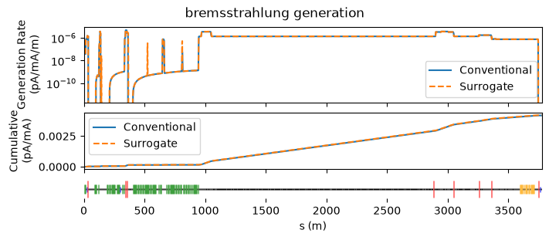
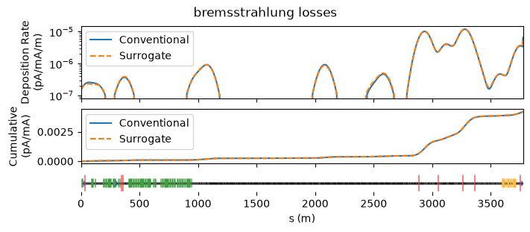
Conventional and Surrogate Scattering Match

Slide 22
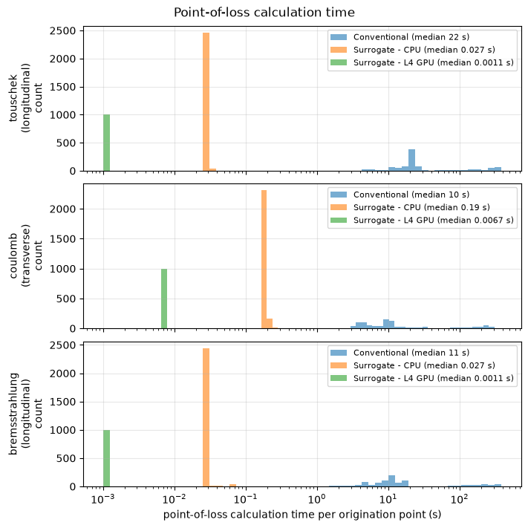
Performance Enables Interactive Use
Model | Speedup, Transverse | Speedup, Longitudinal
Conventional | 1 | 1
Surrogate, CPU | 53 | 800
Surrogate, GPU | 1,500 | 20,000
Models significantly outperform single-core tracking performance. Compare with single-thread ONNX CPU runtime, and with L4 GPU. Achieve 15 MP/s and 2.5 MP/s (million particles per second) inference for longitudinal and transverse model on GPU. With GPU scattering rates, full scattering calc of 20M samps would take 1s per long. scattering code and 7s transverse.
On GPU, 60 CPU-Hr calculation is reduced to 10s!
*faster GPUs than L4 exist and may get even better

Slide 23
Some Thoughts on Applications and Future Work
Orders of magnitude change in performance doesn’t just give a faster code – unlocks new ways of using tools.
  Models already allow live updating as beam settings and pressures in system vary.
  Monte Carlo calculation can continuously generate samples as fast as GPU will allow and update loss estimates in rolling manner.
  Fast surrogate allows solving inverse problem, identifying the sources of scattered particles which may hit sensitive components enabling protection studies.
Condition the model on machine parameters allowing live updating as machine state changes.
Integrated model of location-of-loss that includes both transverse and longitudinal scattering with log-spherical coordinates.

Slide 24

NOT FOR DISTRIBUTION
JANUARY 2026

