Slide 1
A Multi-Mode RFQ for Dual-Species and Short-Pulse Beam Production
Haoran Xu, Salvador Sosa Guitron, Kip Bishofberger (Chief Scientist), Dmitry Gorelov, Petr M. Anisimov, Gregory E. Dale (Project Director), Dimitre Dimitrov, Sergey Kurennoy, John W. Lewellen (Technical Director), Lawrence Rybarcyk, Tyler Thornton
July 30th, 2026
LA-UR-26-26393
Advanced Accelerator Concepts 2026
Jul 26 – 31, UCLA

Slide 2





Acknowledgment
This work was performed under the auspices of the US Department of Energy by Triad National Security under contract 89233218CNA000001.
This work benefitted from the use of the LANSCE accelerator facility.
The project team would like to very much thank Spallation Neutron Source at Oak Ridge National Laboratory for direct contributions to LAMP ion source technology.

Slide 3
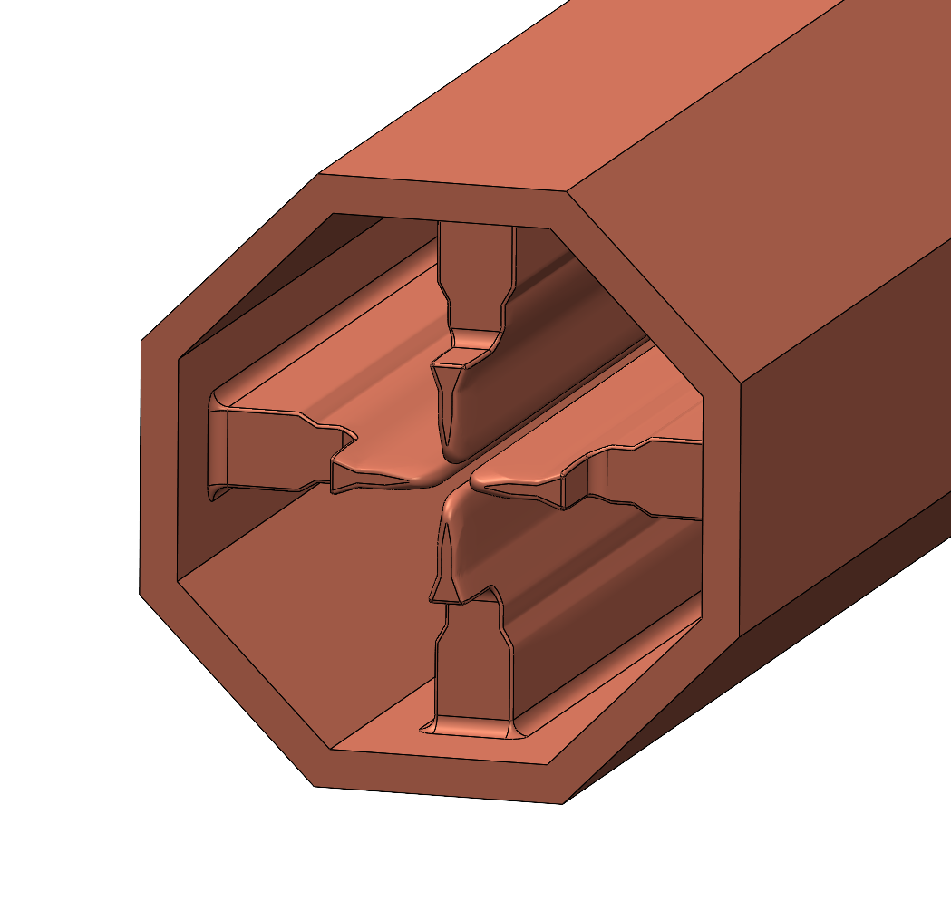
Outline
LAMP: LANSCE Accelerator Modernization Project
LAMP LEBT-RFQ Design Basis 1
LAMP LEBT-RFQ Design Basis 2
Short-pulse beam performance comparison
Conclusions
Beam-entrance end of the LAMP Conceptual Design RFQ model for RF validation, built in SolidWorks.

Slide 4
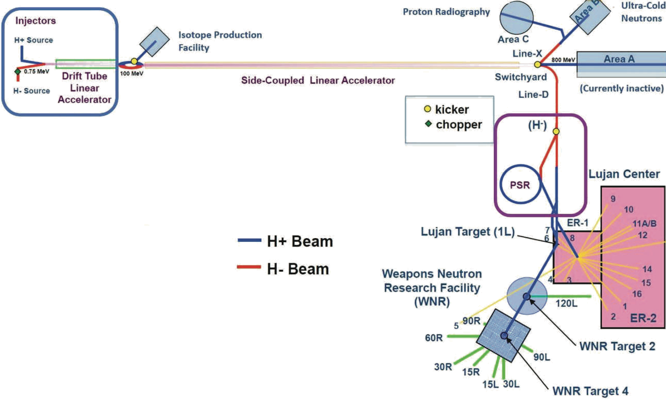
LANSCE: Los Alamos Neutron Science Center
LANSCE front end
LANSCE front end:
Cockcroft–Walton (CW, 0.75 MeV)
Drift-Tube Linac (DTL, 0.75–100 MeV)
LANSCE experimental areas:
Lujan Center​
Weapons Neutron Research Facility​
Proton Radiography​
Ultra-Cold Neutrons​
Isotope Production Facility
​LAMP scope ends at end of DTL (100 MeV).

Slide 5
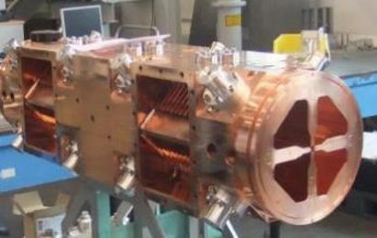
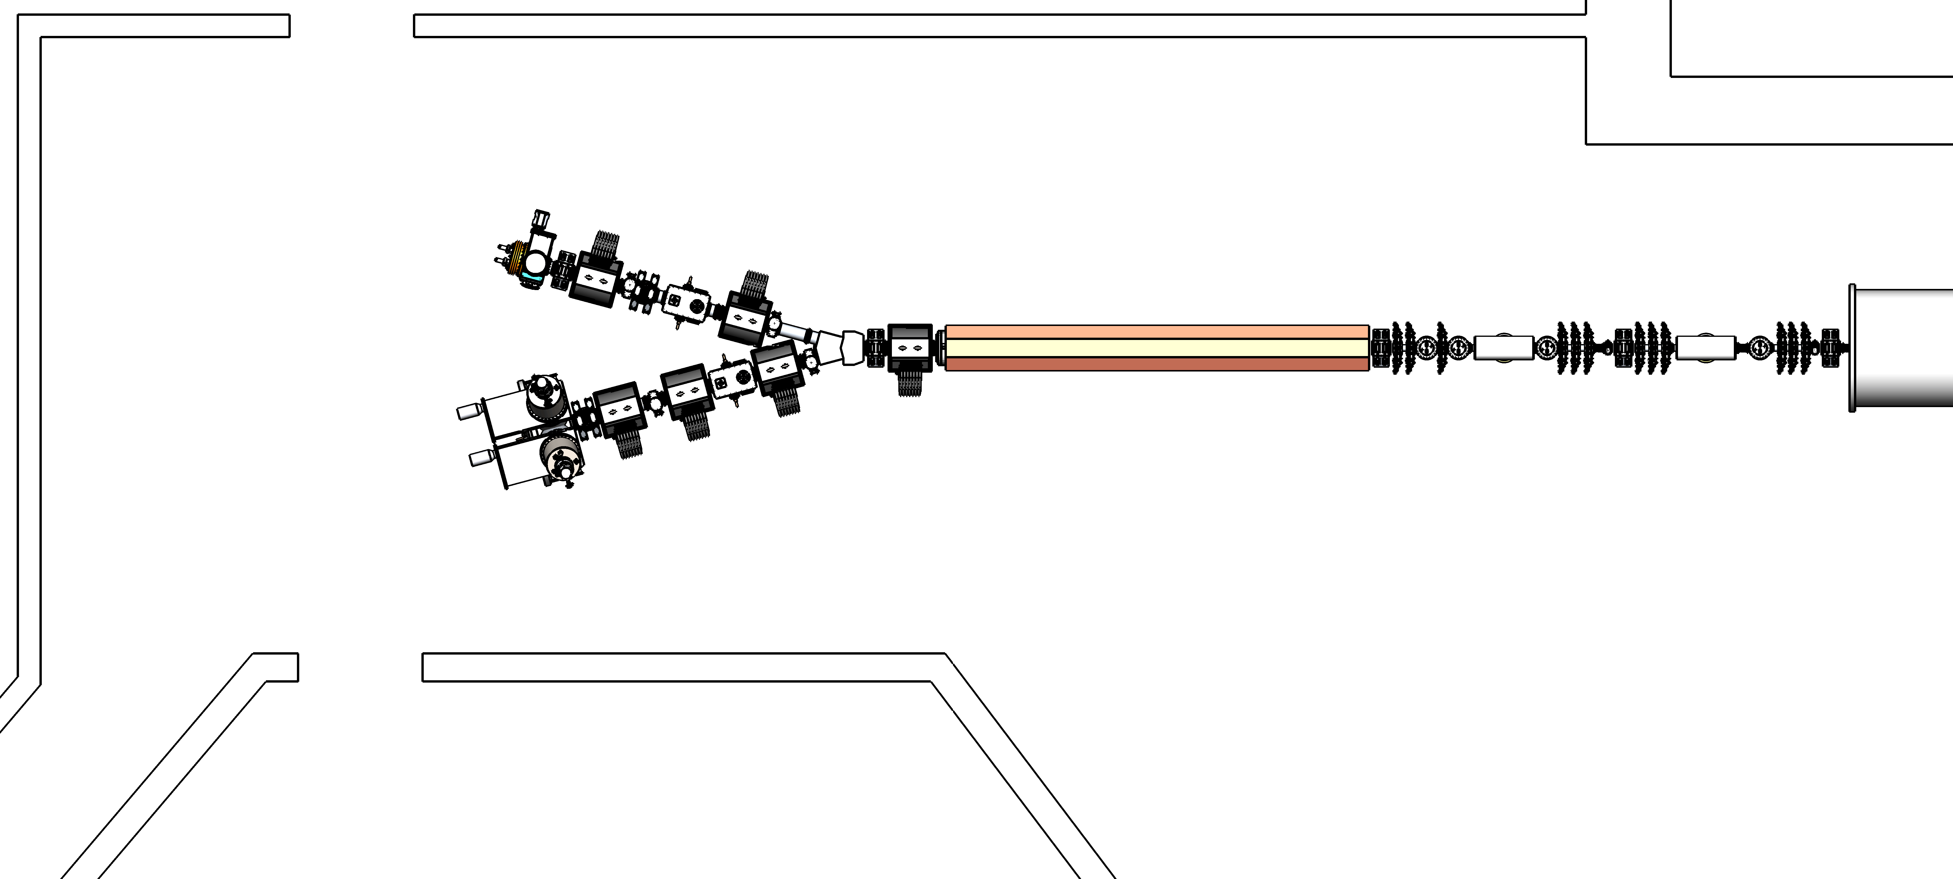
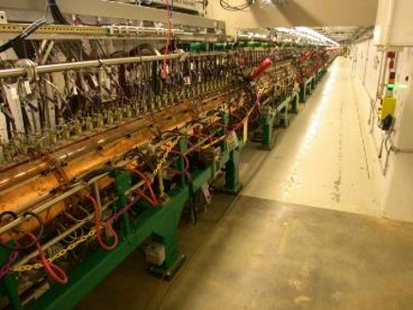
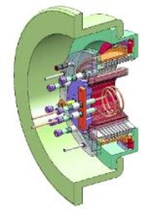
LAMP: LANSCE Accelerator Modernization Project
LANSCE Sector J layout: Design Basis 2
Radio-Frequency Quadrupole
DTL: 2.1 MeV – 100 MeV
H⁺/H– ion sources: 65 keV
RFQ: 65 keV – 2.1 MeV
MEBT: 2.1 MeV
Dual-species beamline
LAMP upgrades LANSCE’s CW-DTL layout to LEBT-RFQ-MEBT-DTL.
SNS-style H– ion source
Drift-Tube Linac

Slide 6
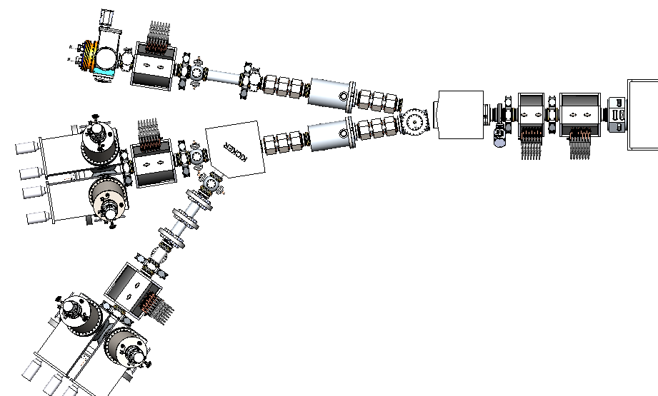
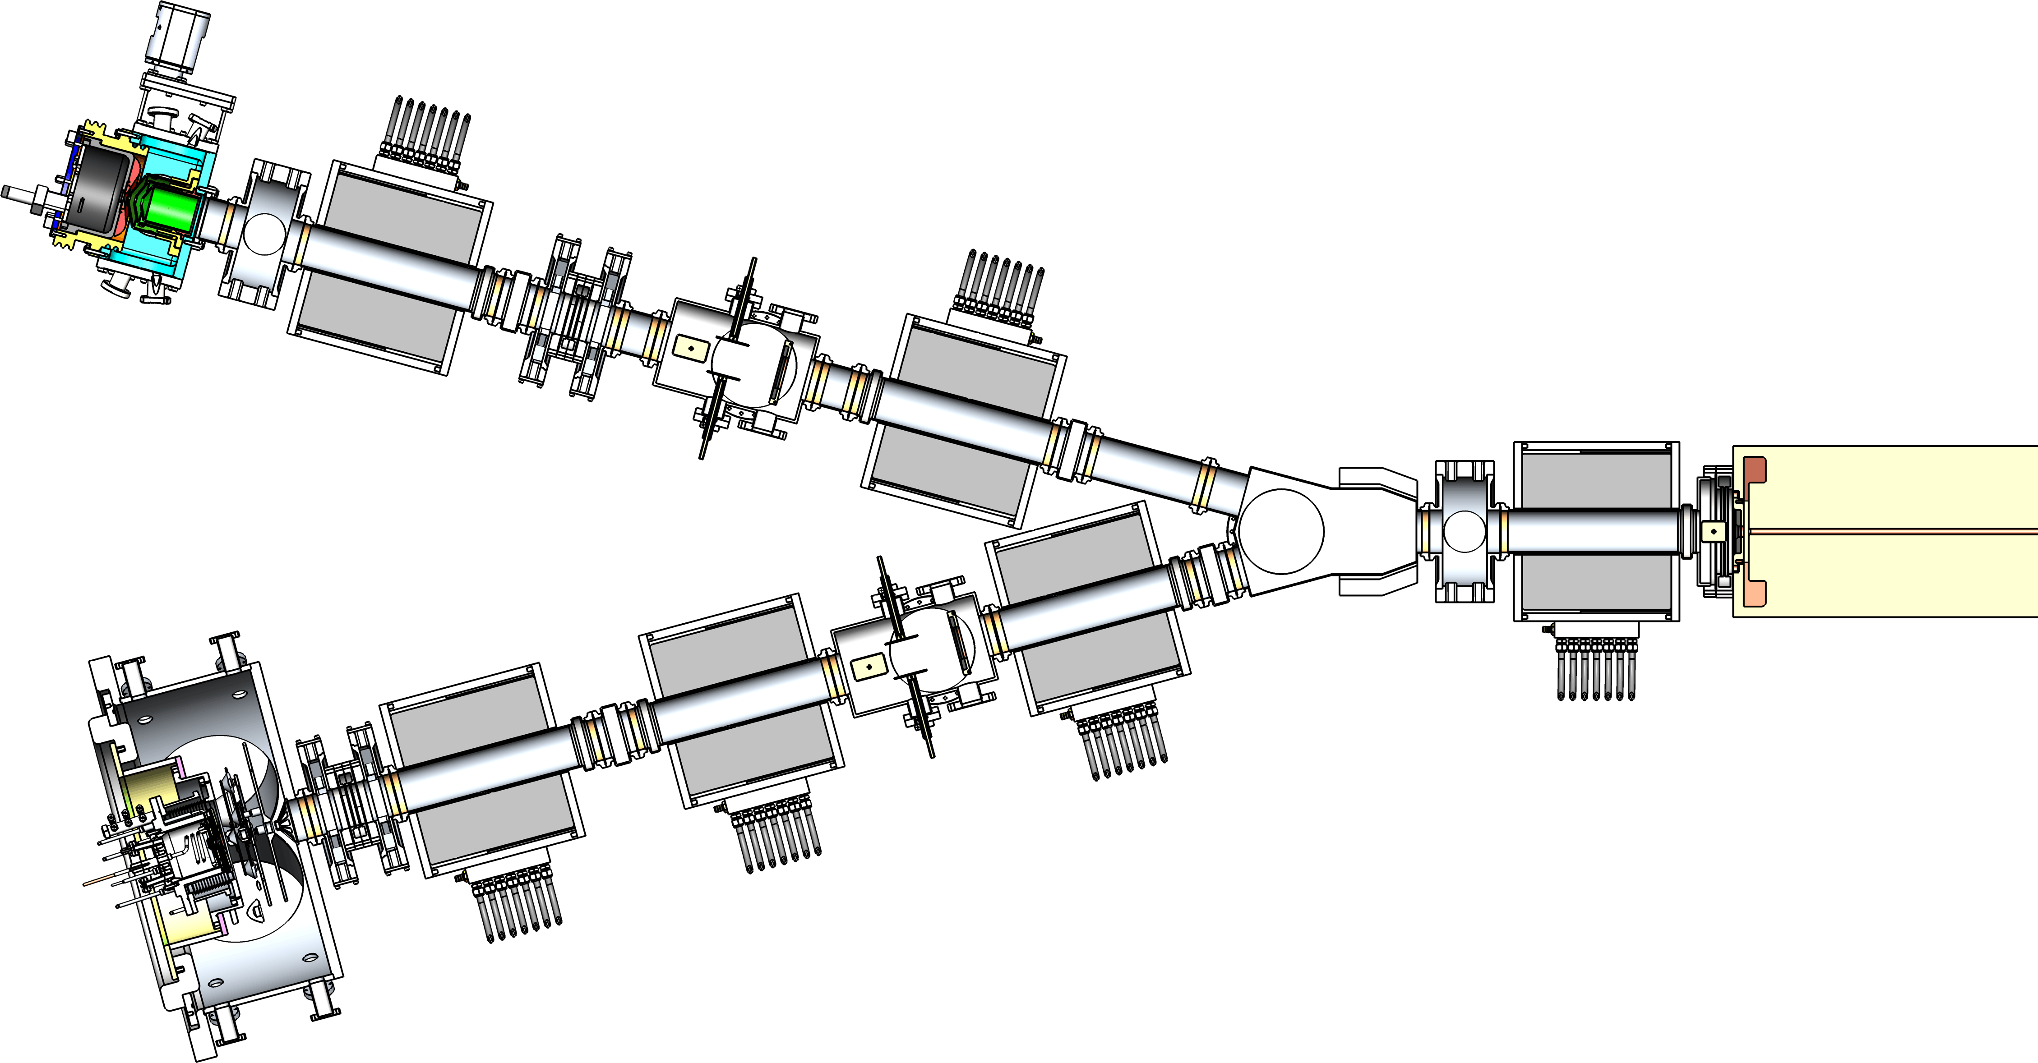
LAMP LEBT: DB1 vs. DB2
Design Basis 1 (DB1)
Design Basis 2 (DB2)
H⁺ ion source:
12 mA
H⁺ ion source:
12 mA
H– ion source:
55 / 16 mA
Equations: RFQ-entrance matching conditions.
DB1 variables: quads in branched beamlines;
DB2 variables: pulsed LEBT electrodes.
H– ion source:
35 mA
 | DB1 | DB2
Ion source (LEBT) energy | 100 keV | 65 keV
MEBT (RFQ exit / DTL entrance) energy | 3.0 MeV | 2.1 MeV
Number of H– ion sources | 2 | 1 (dual-mode)
Transverse beam focusing | solenoids & quad triplets | solenoids only
High-charge H– bunch formation | chopper & low-frequency buncher | two choppers
H– ion source:
16 mA
DB1 to DB2: risk mitigation and cost reduction

Slide 7
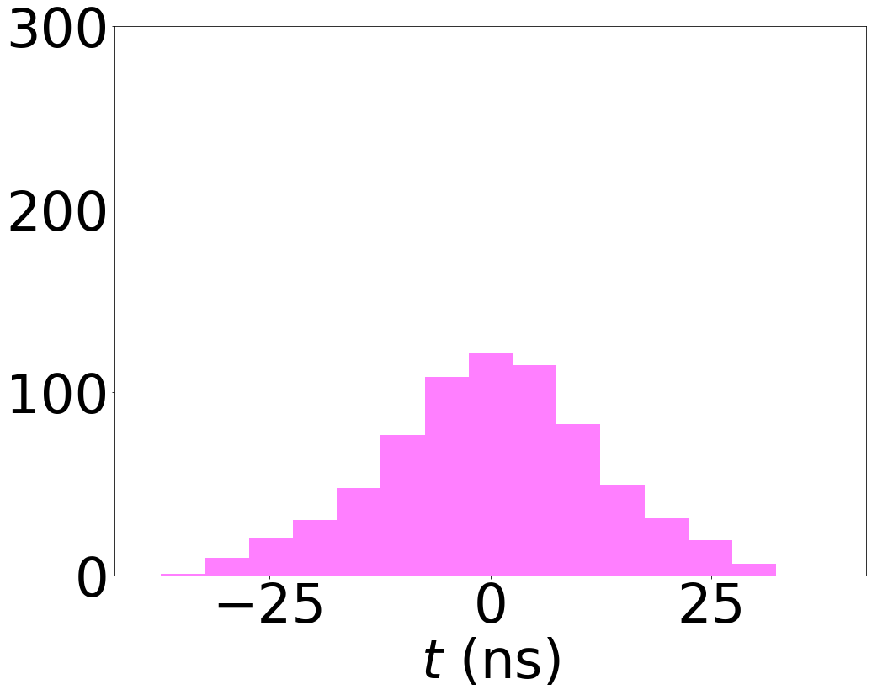
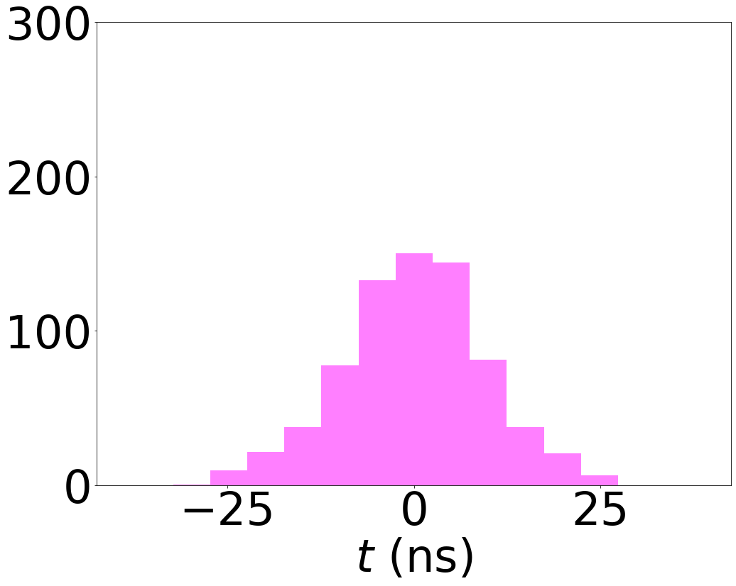
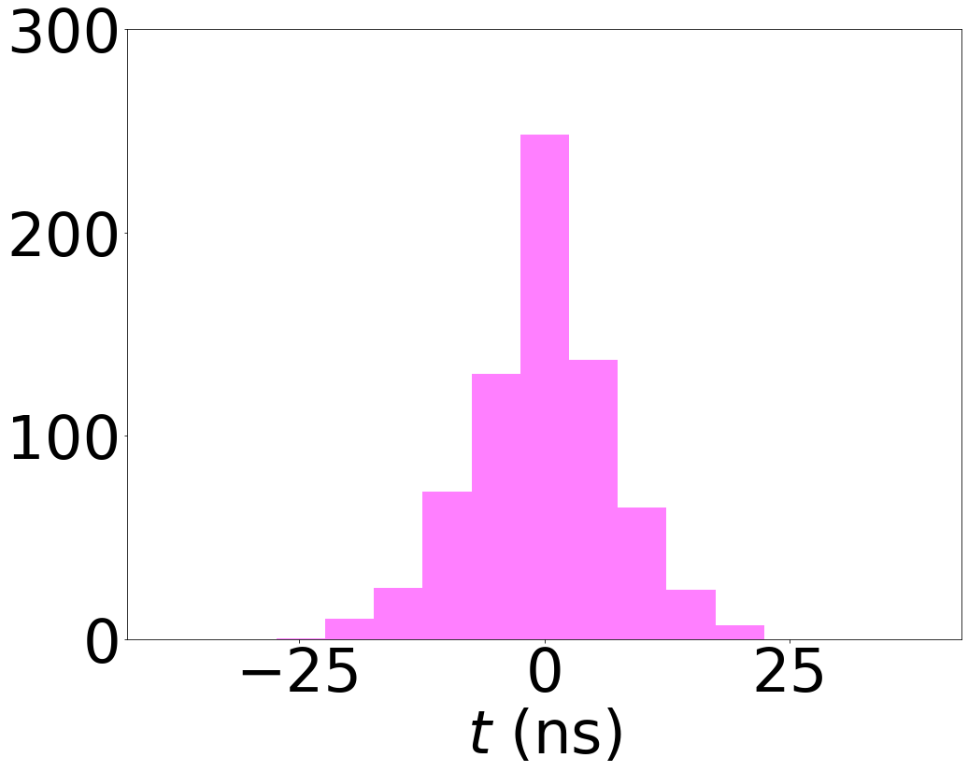
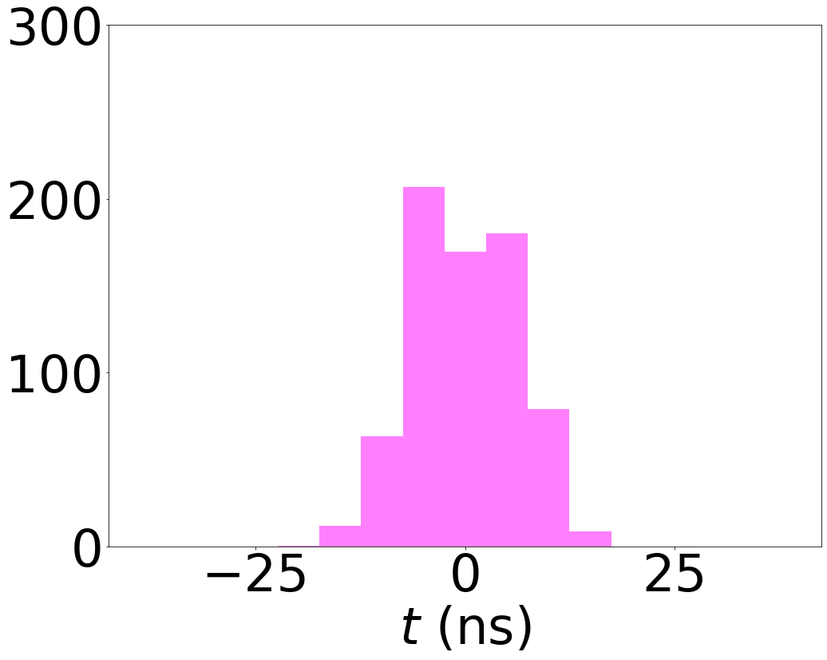
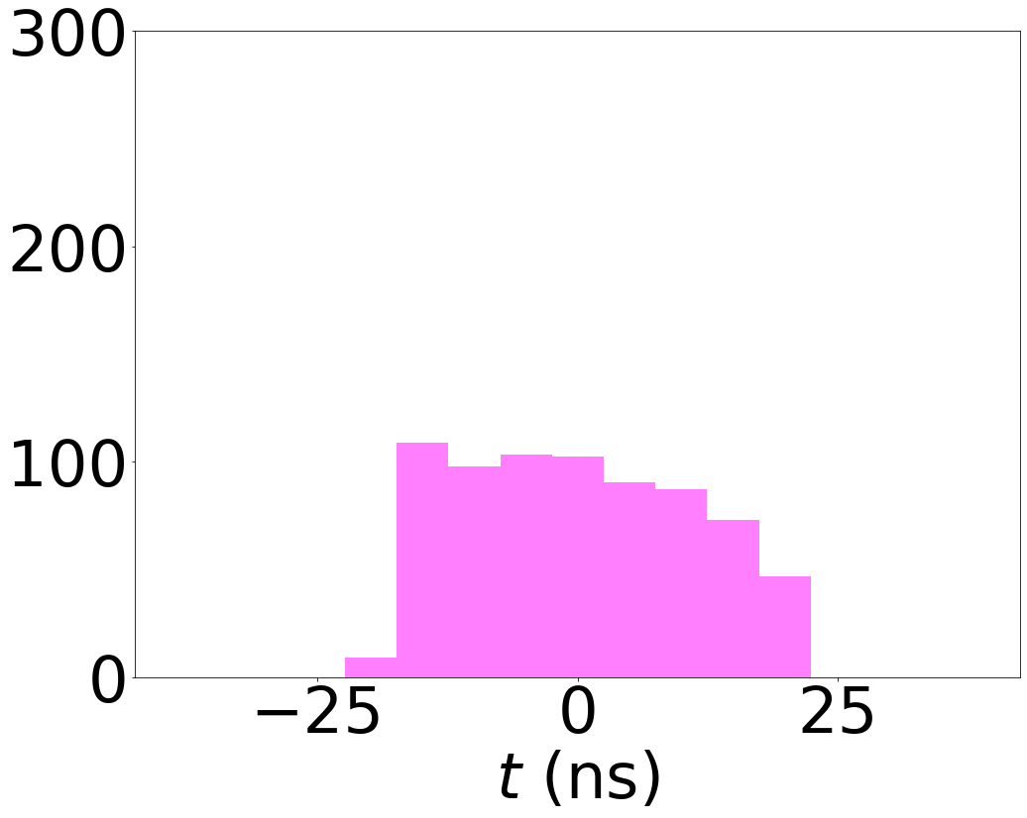
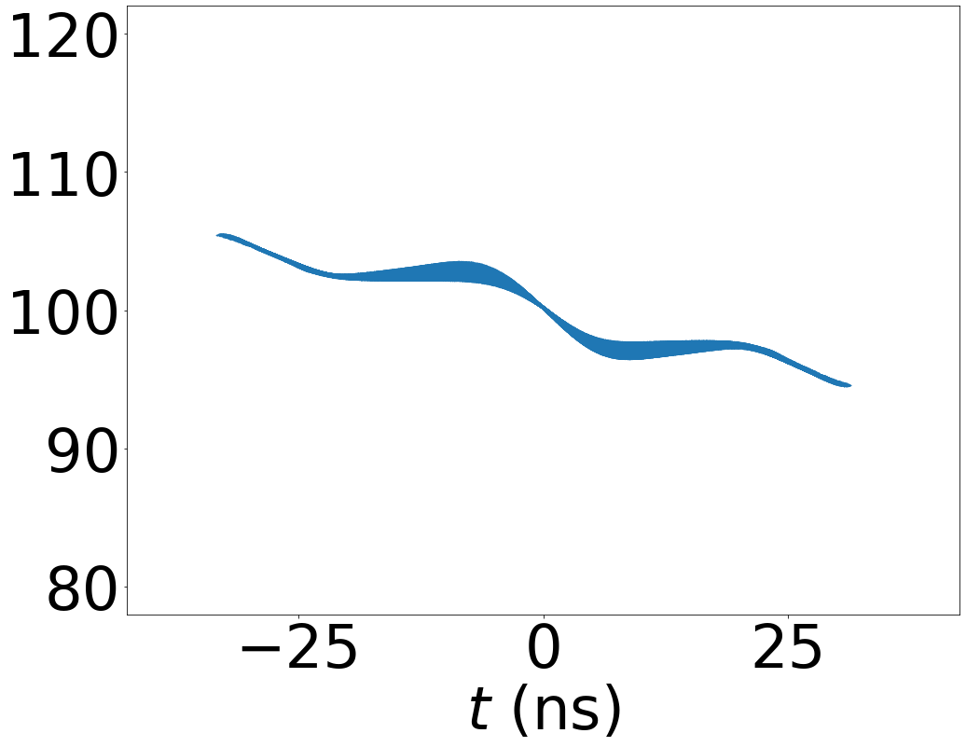
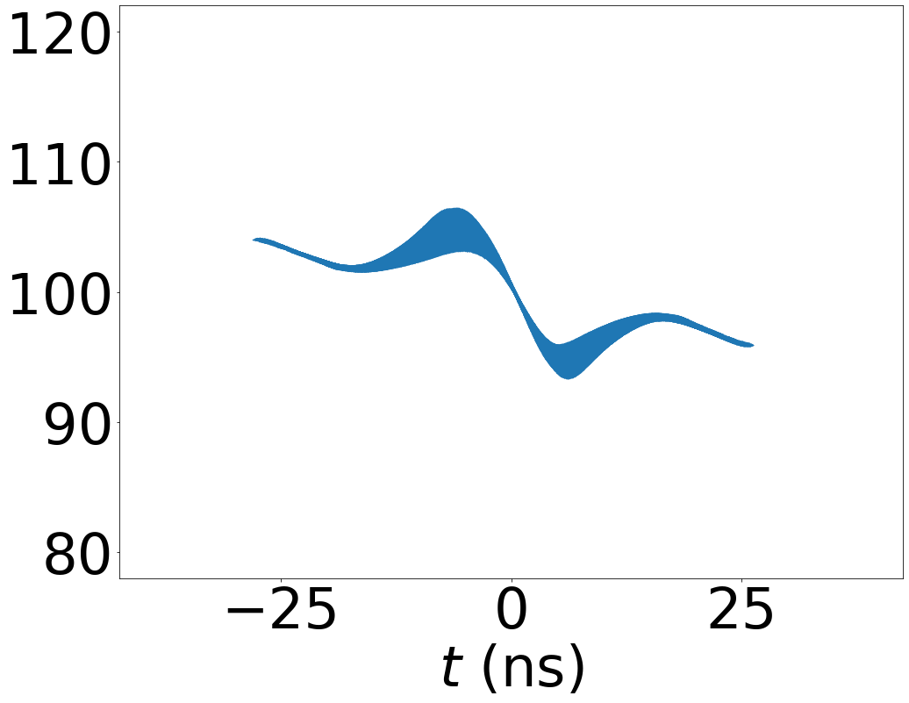
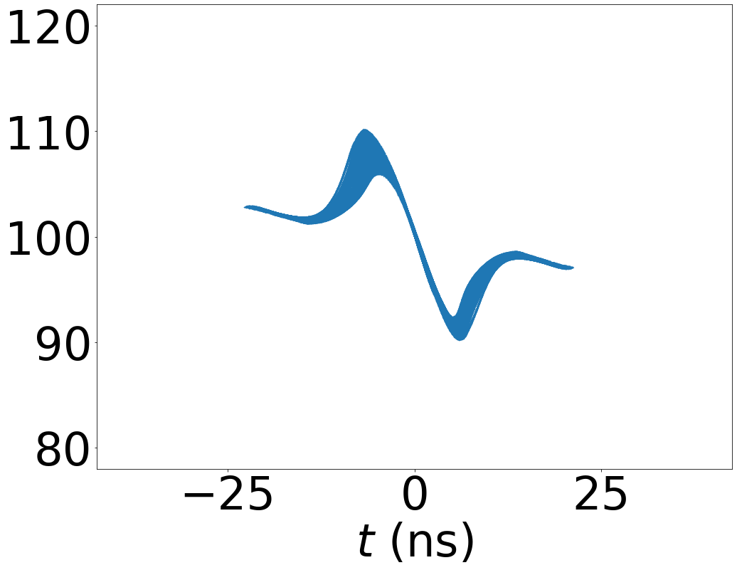
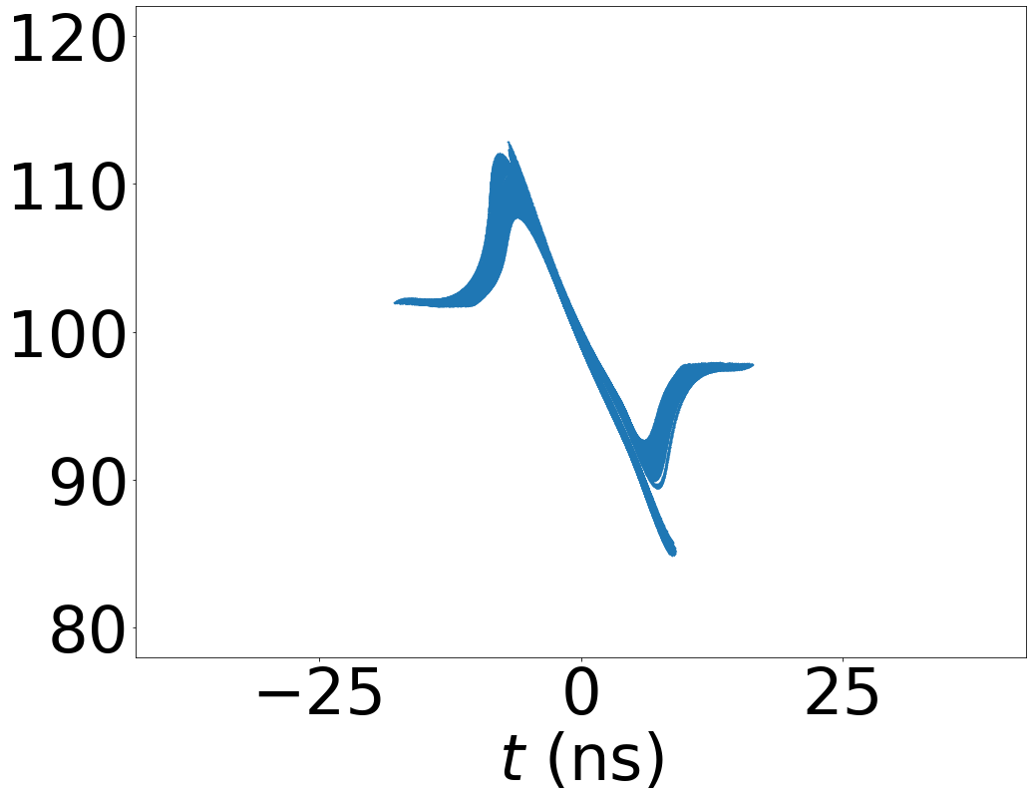
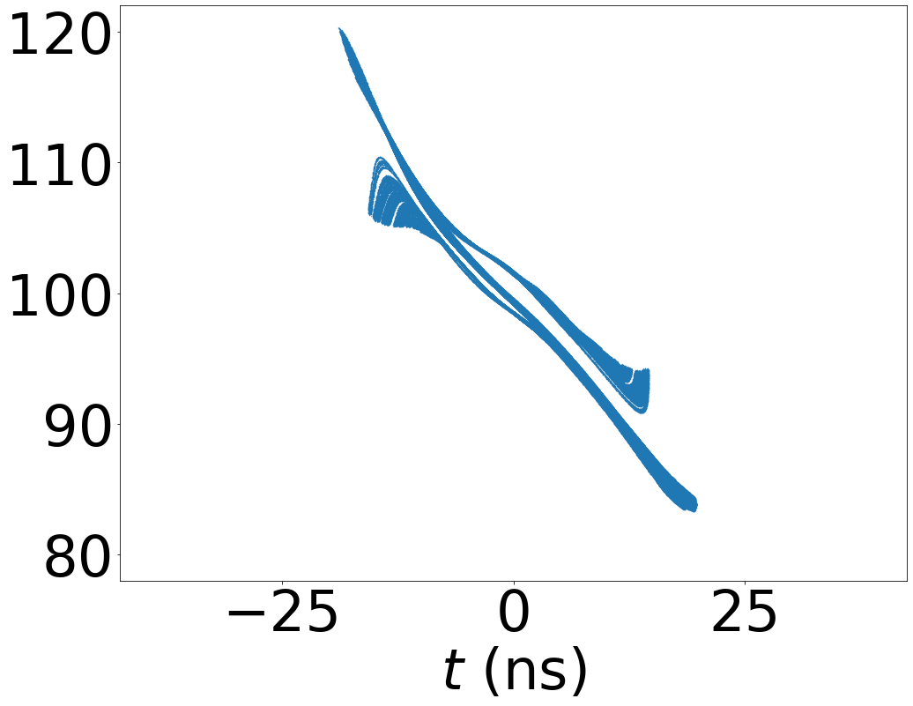




Short-Pulse Beam Production: LAMP DB1
16.77-MHz LFB:
V_{LFB}
LEBT chopper and low-frequency buncher (LFB).
Maximize RFQ-exit bunch charge by varying D₂ and V_{LFB}.
H+ Source (12 mA)
Merging magnet
RFQ
($τ$)
Chopper
LEBT kicker
$$D_{2}$$
$$D_{1}$$
LFB
H- Source (35 mA)
($V_{LFB}$)
V_{LFB} = 3 kV
V_{LFB} = 4 kV
V_{LFB} = 5 kV
V_{LFB} = 6 kV
V_{LFB} = 7 kV
charge per 201.25-MHz
period (pC)
H- Source (16 mA)
Solenoids.
Bend / merger.
Buncher.
Quadrupoles.
Chopper.
beam energy (keV)
Deflectors.
Sources.
RFQ.

Slide 8
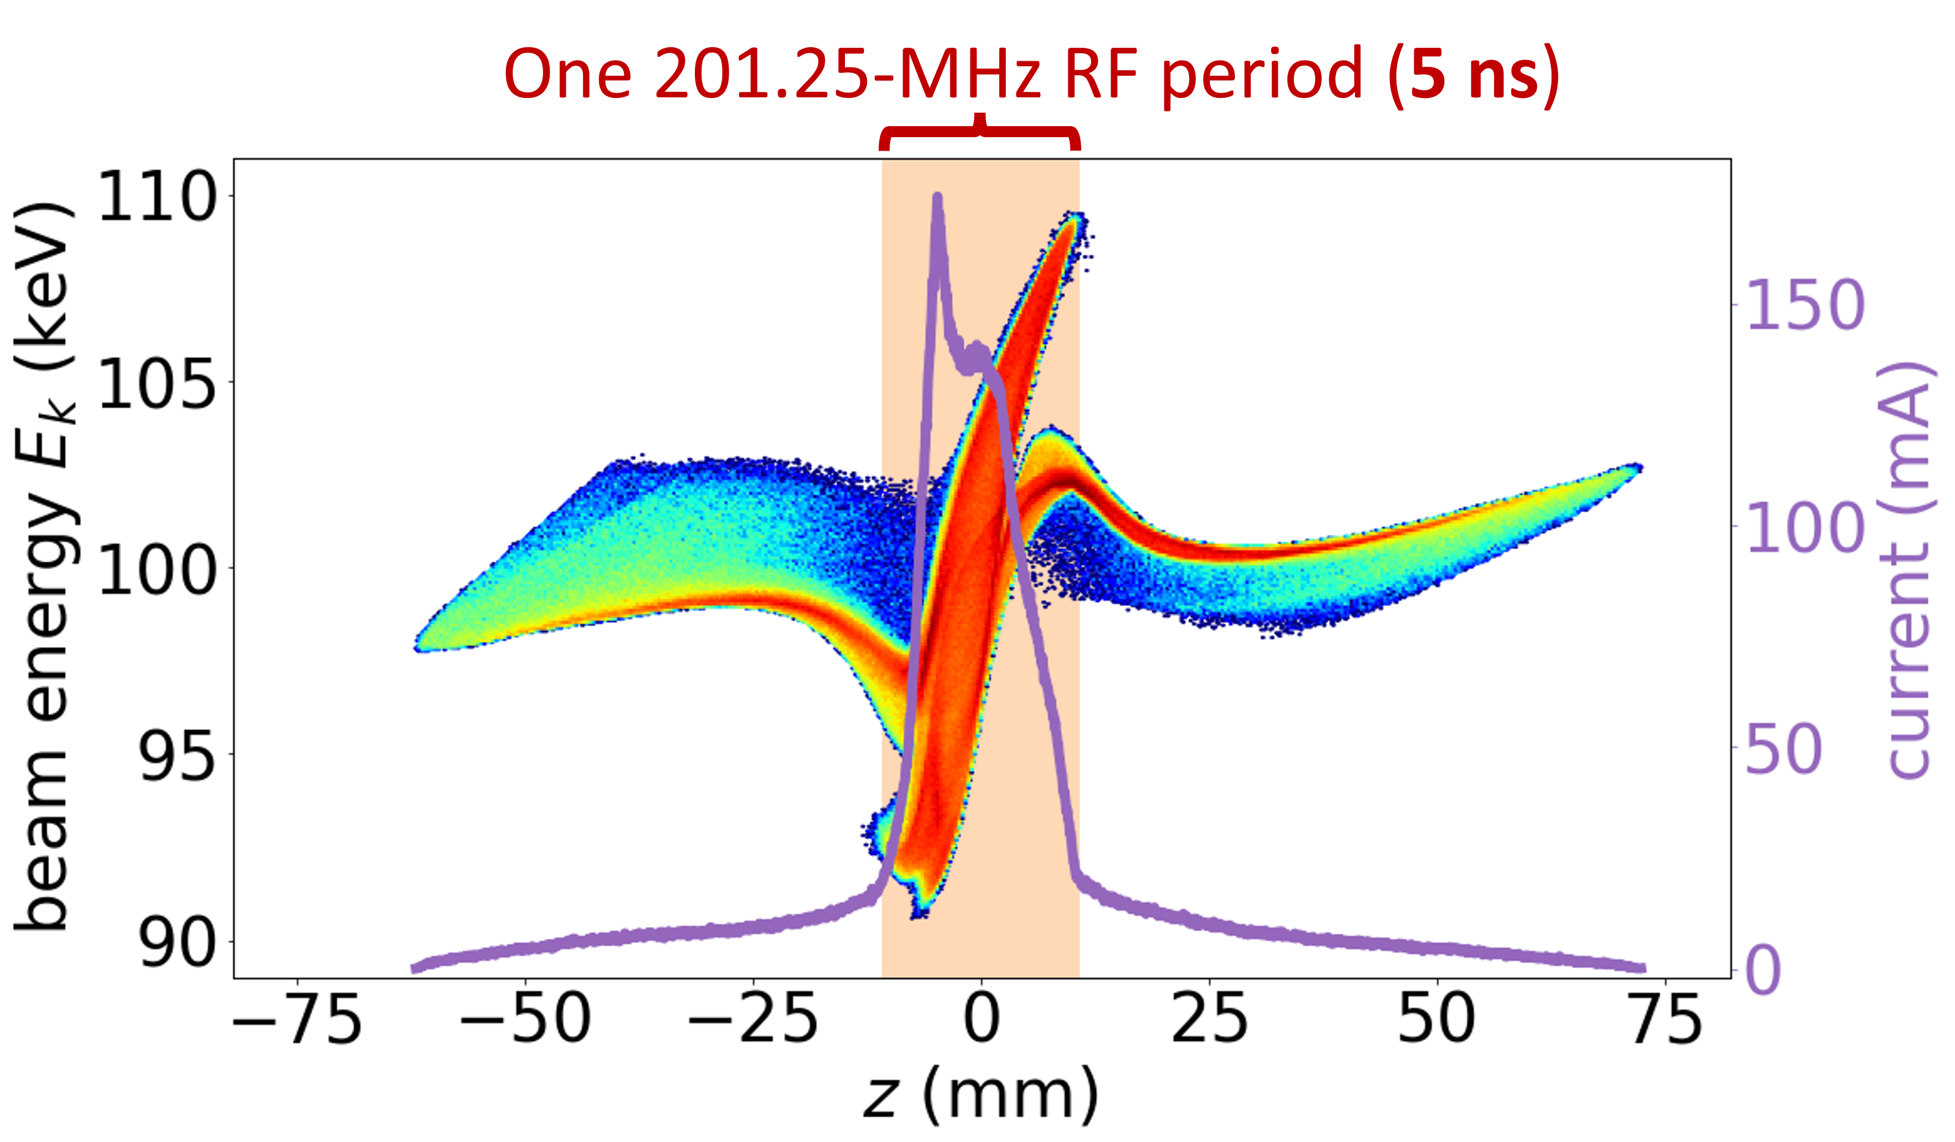
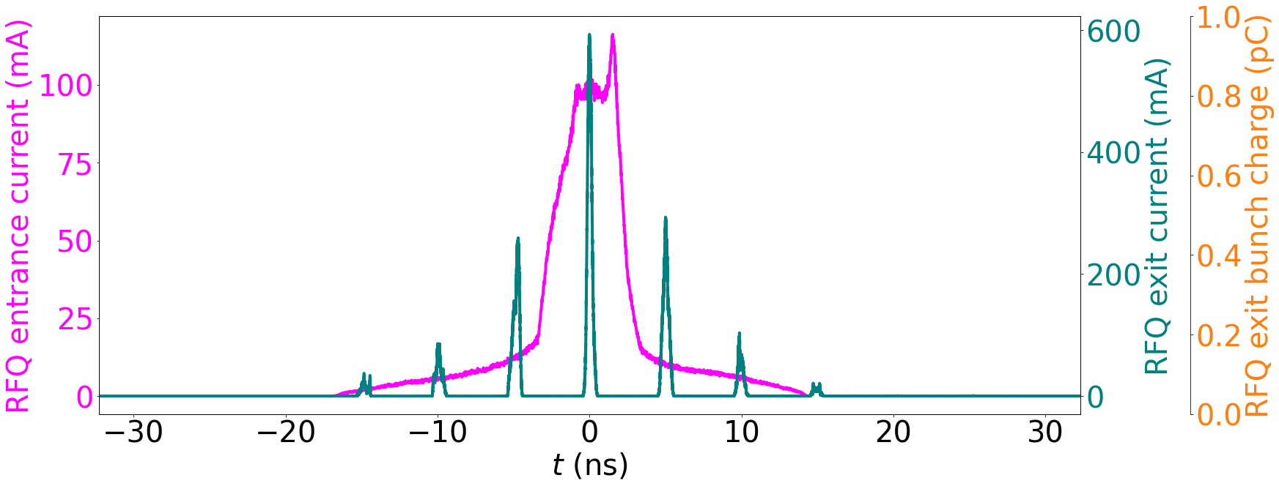
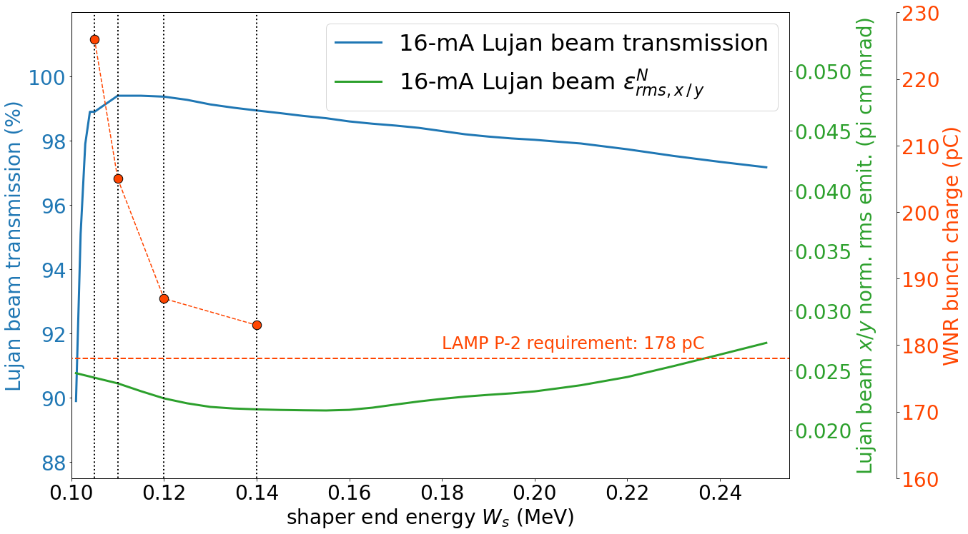
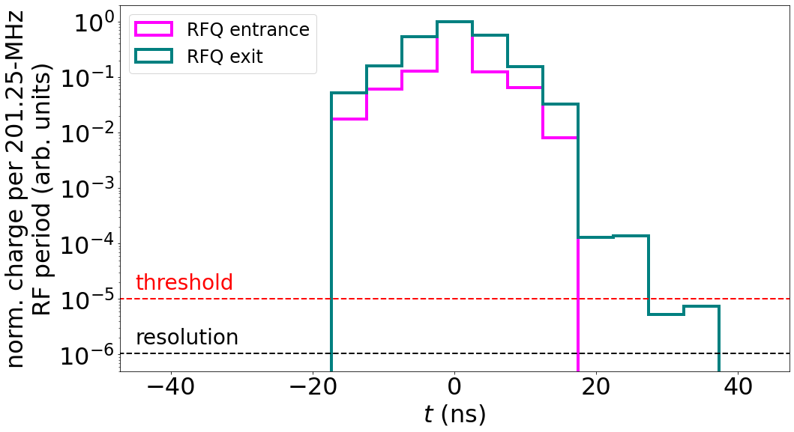
Short-Pulse Beam Production: LAMP DB1
Challenge: High energy spread at RFQ entrance.
Solution: Shortened shaper section of RFQ.
At RFQ entr. and exit
(CST PIC result)
207 pC
LAMP RFQ DB1 design point
DB1: LEBT ballistic bunching, shortened RFQ shaper section, chopping satellites in MEBT.

Slide 9
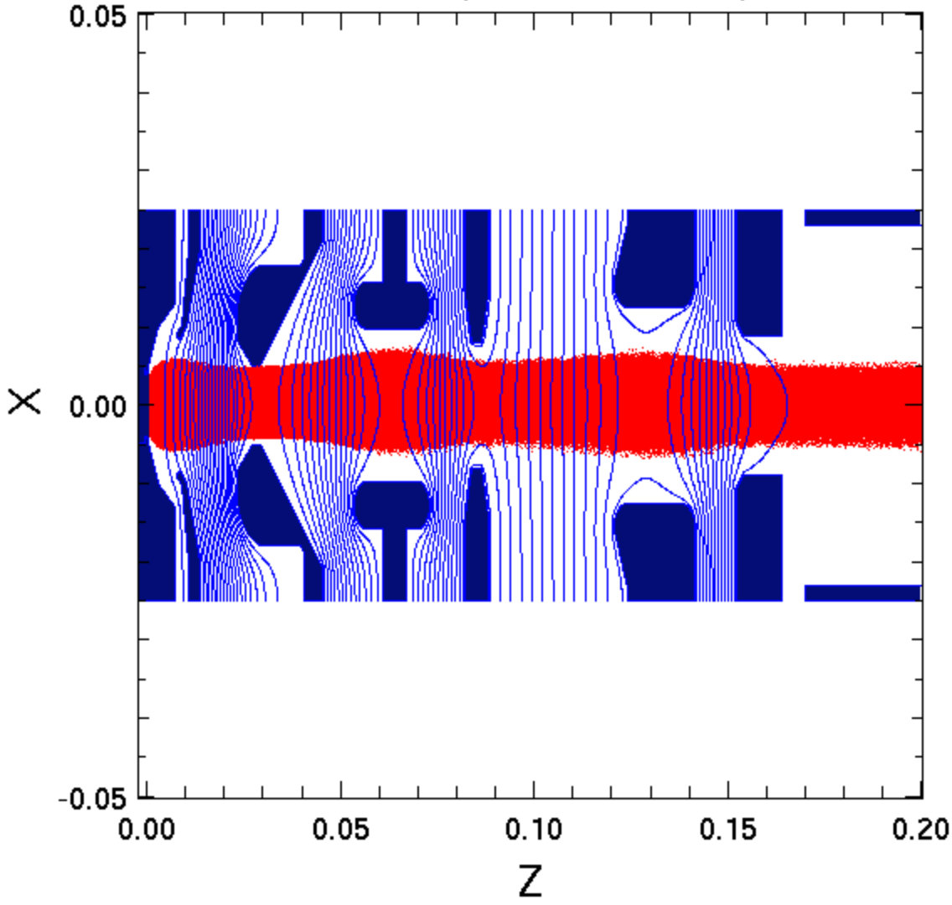
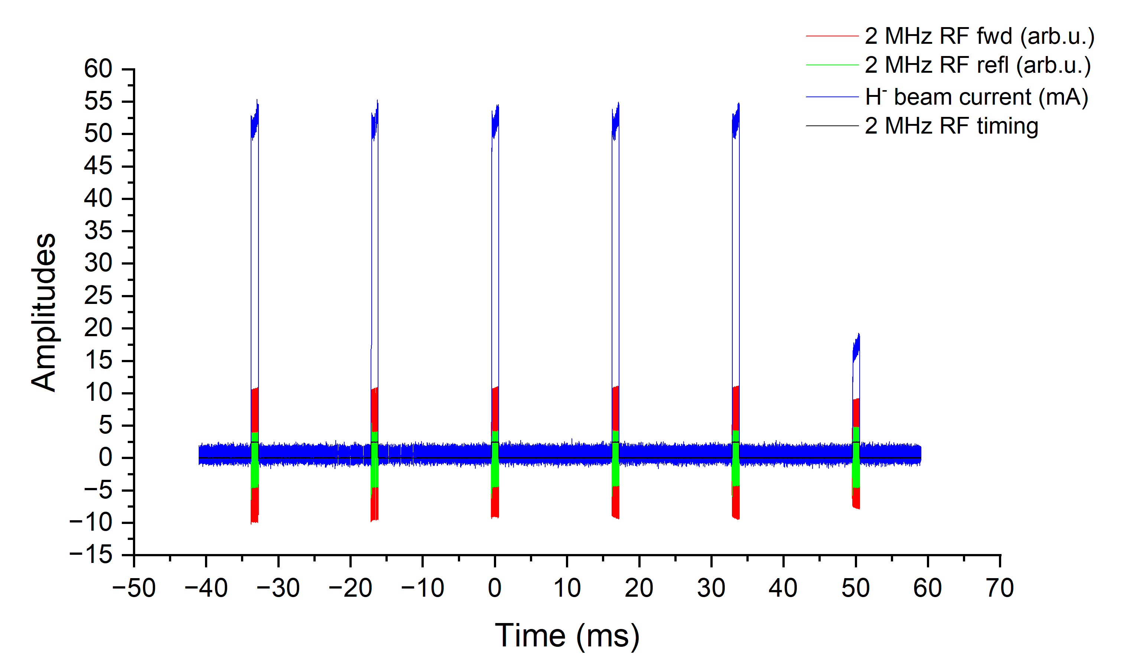
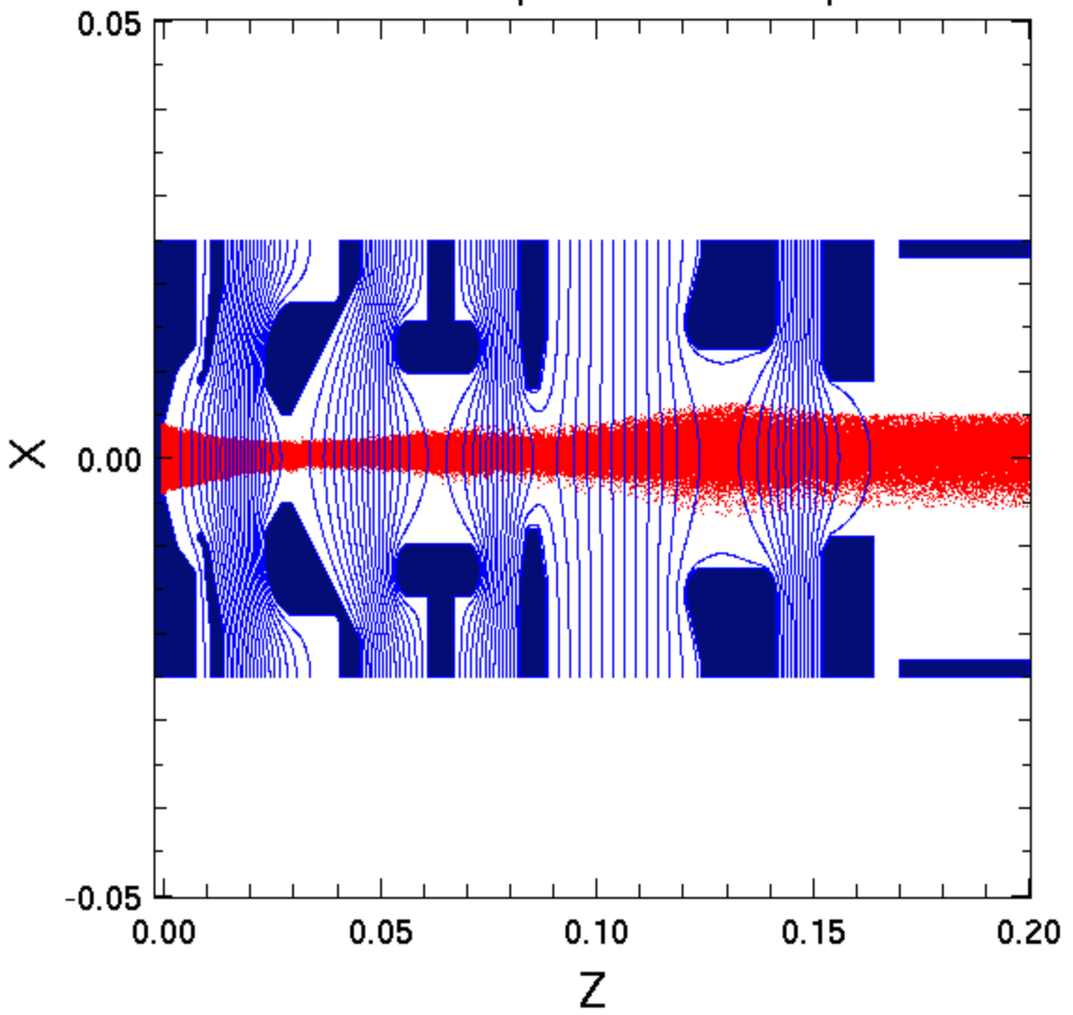
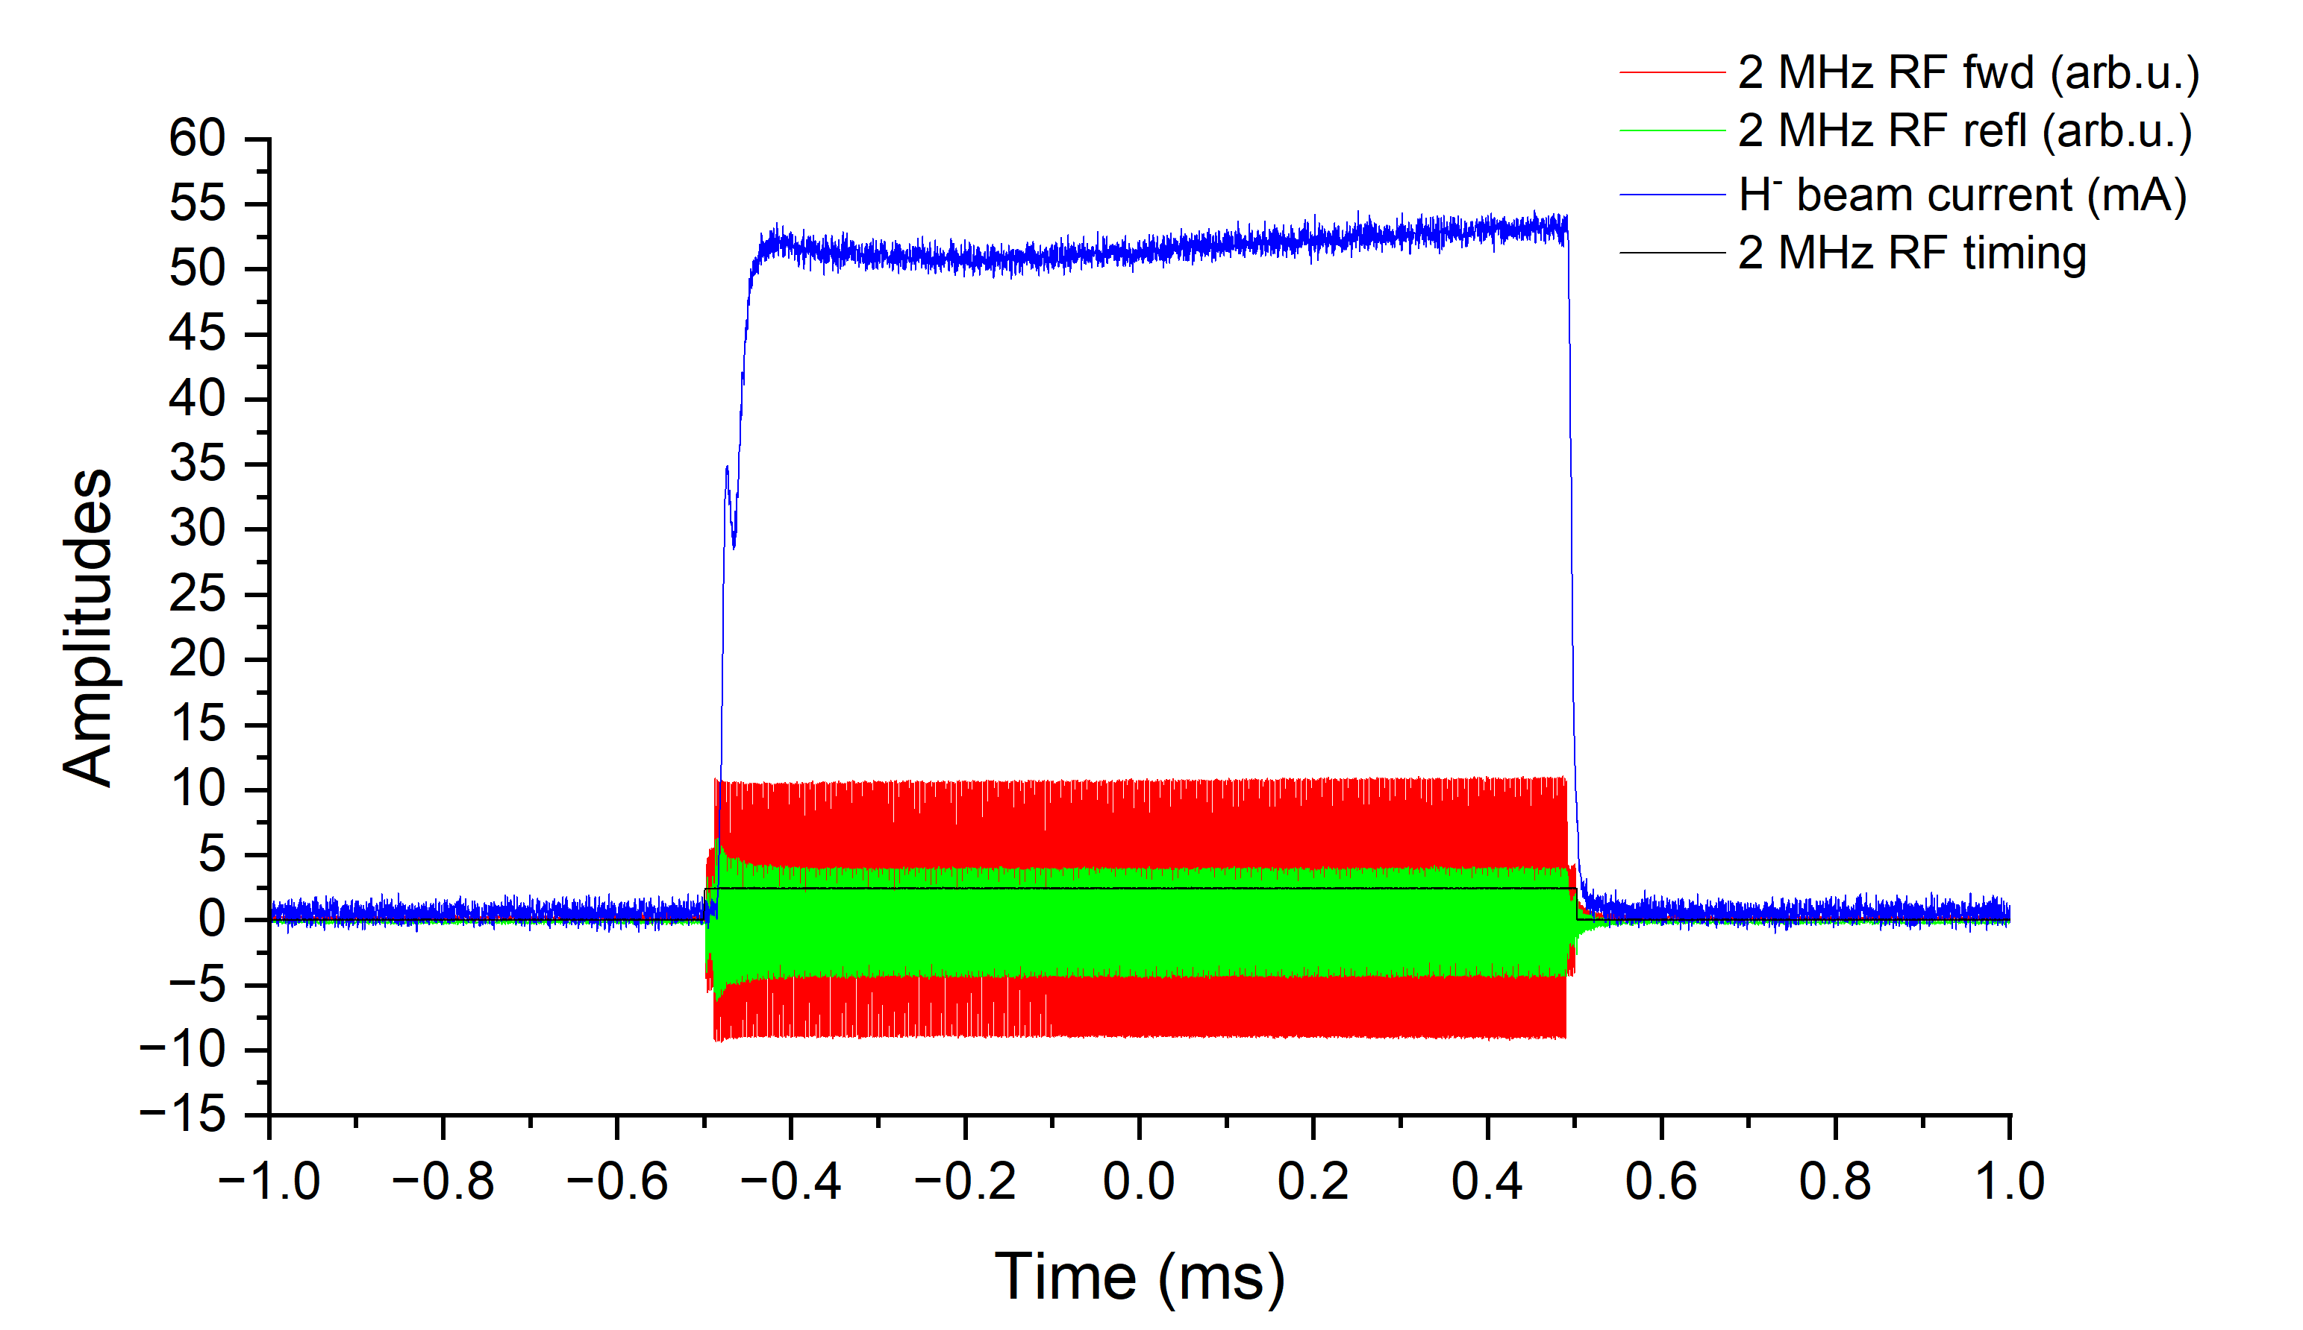
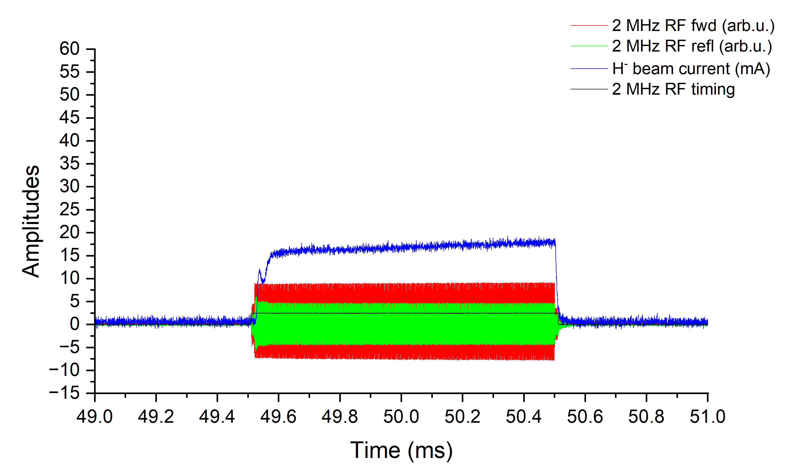
Short-Pulse Beam Production: LAMP DB2
Dual-mode H– ion source and two choppers.
SNS test data for LAMP: dual-mode H– ion source (60 Hz).
1
2
3
4
5
6
7
# | WNR [kV] | Lujan [kV]
1 | -65.0 | -65.0
2 | -58.8 | -58.8
3 | +6.0 | +6.0
4 | -41.0 | -48.0
5 | 0.0 | 0.0
6 | -42.3 | -45.3
7 | 0.0 | 0.0
WNR, 55 mA
1
2
3
4
5
6
7
Lujan, 16 mA
Challenge: Matching different beam currents in one beamline (different space charge conditions).
Solution: Pulsing einzel lens at different voltages.
Ion beam current adjusted by RF antenna power.

Slide 10
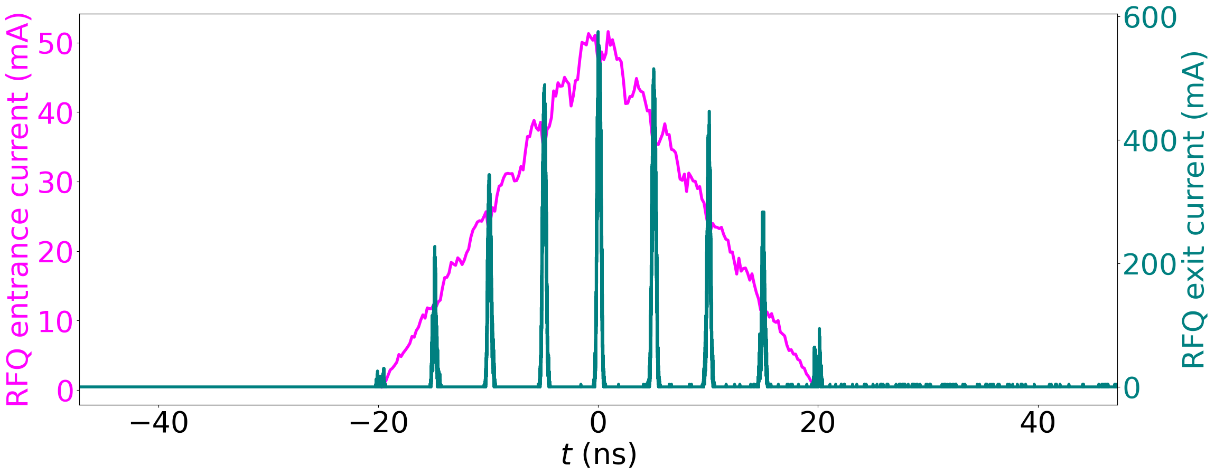
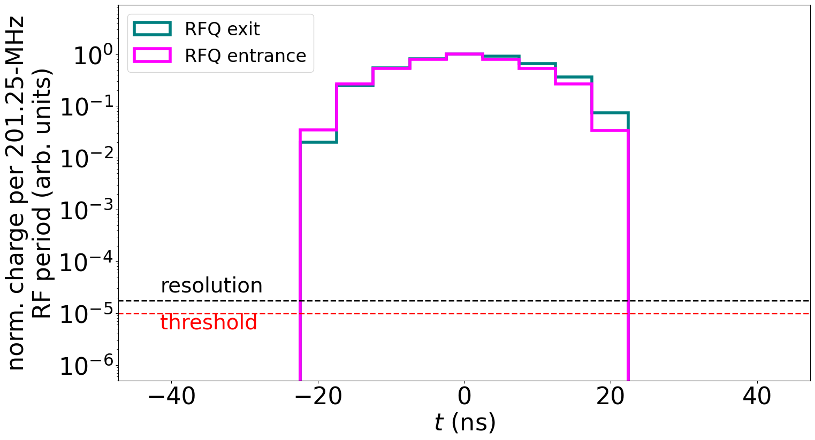
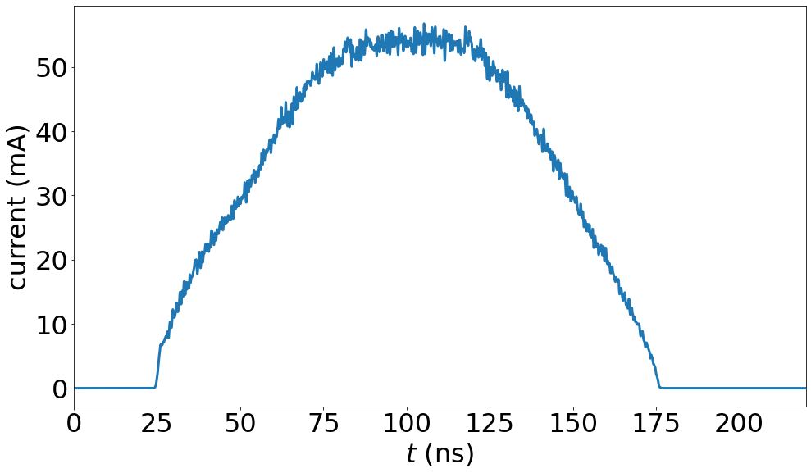
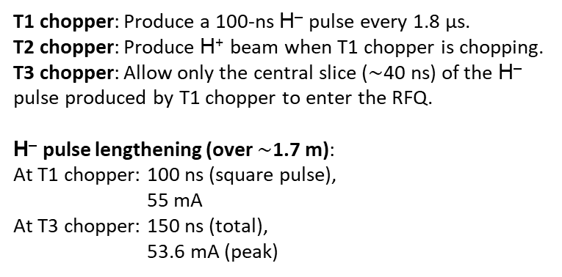
Short-Pulse Beam Production: LAMP DB2
H⁺ ion source:
12 mA
At RFQ entr. and exit
(CST PIC result)
T2 chopper
T3 chopper
H– ion source:
55 / 16 mA
T1 chopper
T1 chopper: Produce a 100-ns H– pulse every 1.8 μs.
T2 chopper: Produce H⁺ beam when T1 chopper is chopping.
T3 chopper: Allow only the central slice ($∼$40 ns) of the H– pulse produced by T1 chopper to enter the RFQ.
H– pulse lengthening (over $∼$1.7 m):
At T1 chopper: 100 ns (square pulse),
55 mA
At T3 chopper: 150 ns (total),
53.6 mA (peak)
199 pC
DB2: Dual-mode H– ion source, two-chopper pulse formation, chopping satellites in MEBT.
H– pulse current at T3 chopper

Slide 11
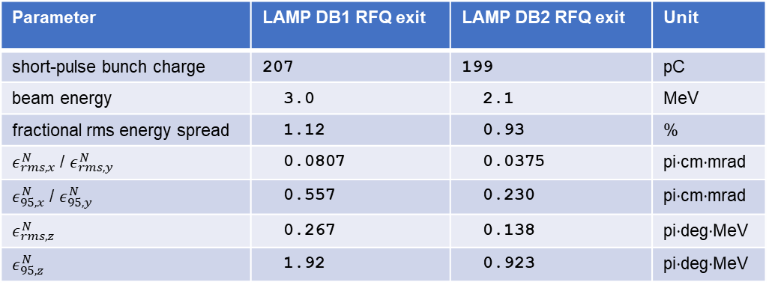
Short-Pulse Beam Performance
At RFQ exit:
Parameter | LAMP DB1 RFQ exit | LAMP DB2 RFQ exit | Unit
short-pulse bunch charge | 207 | 199 | pC
beam energy | 3.0 | 2.1 | MeV
fractional rms energy spread | 1.12 | 0.93 | %
$ε_{rms, x}^{N}$ / $ε_{rms,y}^{N}$ | 0.0807 | 0.0375 | pi⋅cm⋅mrad
$ε_{95,x}^{N}$ / $ε_{95,y}^{N}$ | 0.557 | 0.230 | pi⋅cm⋅mrad
$ε_{rms,z}^{N}$ | 0.267 | 0.138 | pi⋅deg⋅MeV
$ε_{95,z}^{N}$ | 1.92 | 0.923 | pi⋅deg⋅MeV
At DTL exit (TR entrance):
LAMP requirement (P-2): 128 pC
LAMP DB1: 170 pC
LAMP DB2: 192 pC*
Short-pulse beam quality of DB2 is significantly improved.

Slide 12
Summary
LANSCE Accelerator Modernization Project (LAMP) will upgrade the LANSCE front end, extending from the ion sources through the drift-tube linac.
LAMP must support distinct beam-current requirements and pulse-timing structures across the LANSCE experimental areas.
The most demanding requirement is producing a high-charge, single-bunch H⁻ beam.
LAMP designs of high-current, short-pulse H– beam production
LAMP Design Basis 1 used RF bunching: a low-frequency buncher with a drift space.
LAMP Design Basis 2 used a dual-mode H– ion source and a two-chopper scheme.
LAMP MEBT chopper removes satellite bunches.
LAMP low-energy beam transport design evolution from Design Basis 1 to 2 significantly improved the short-pulse H⁻ beam quality.

