Slide 1
Emittance Growth and Sensitivity Analysis of a Transverse Deflecting Cavity-Based Dechirper
Alex DeSimone
7/30/2026

Slide 2
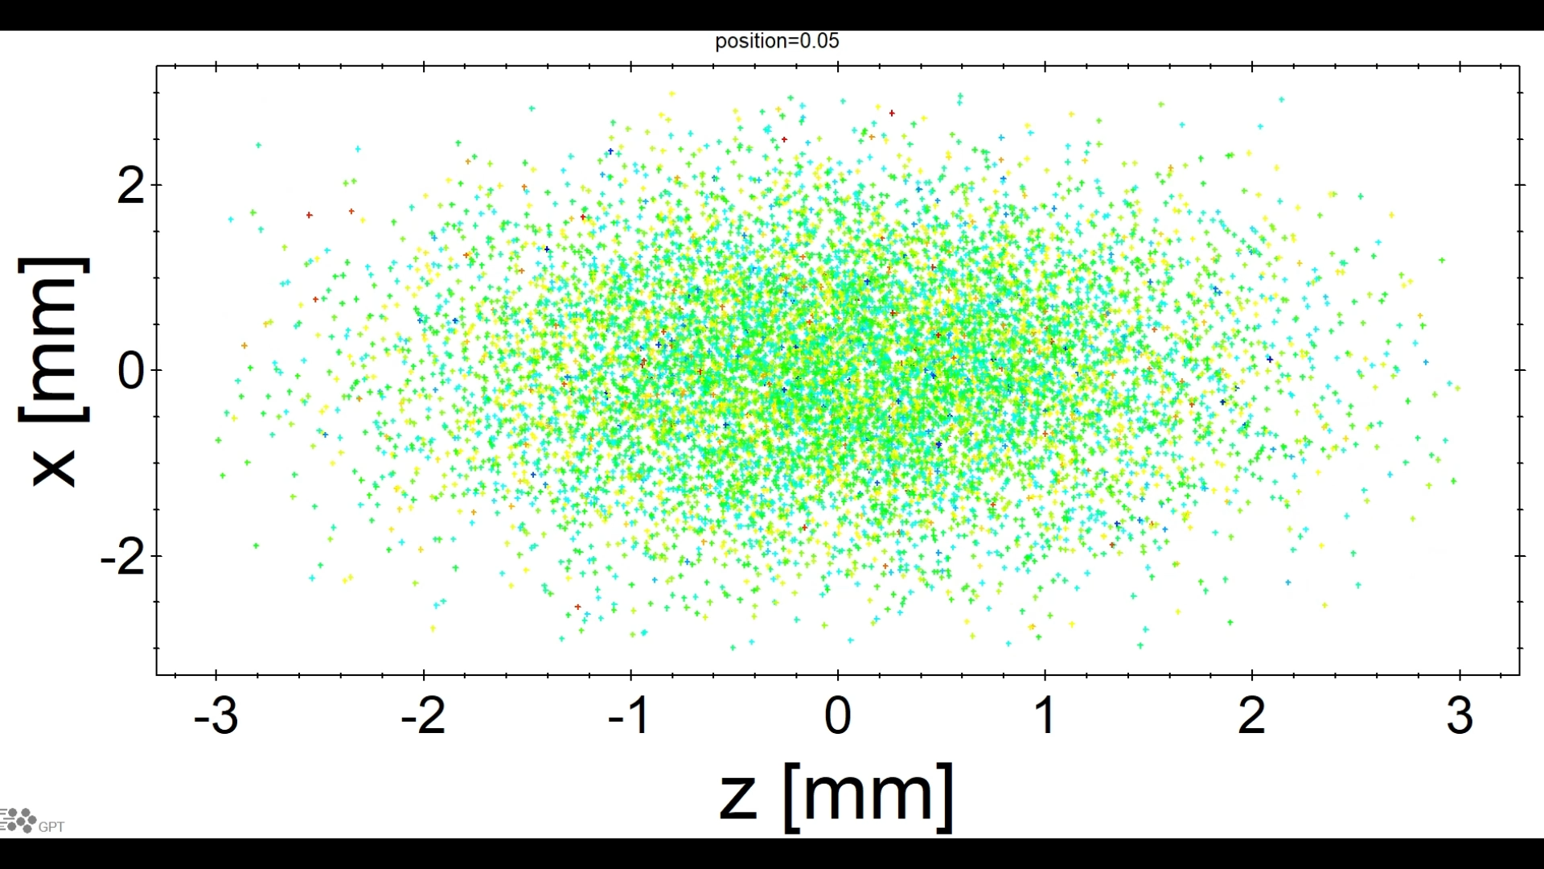
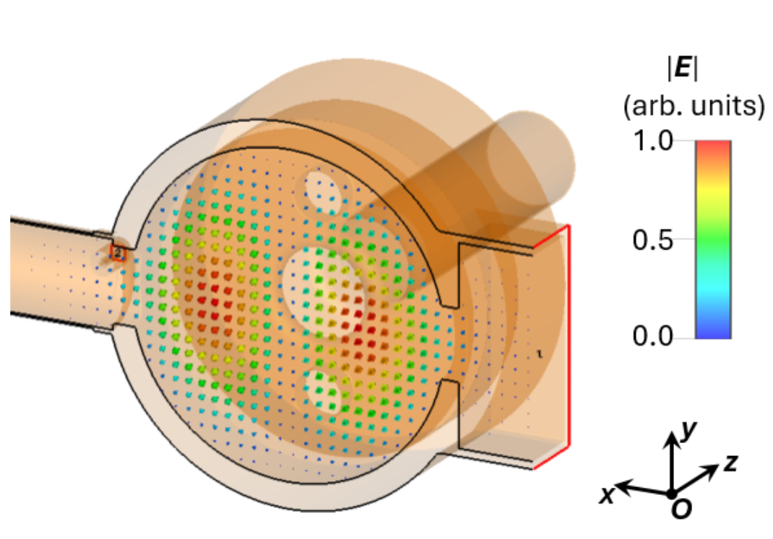

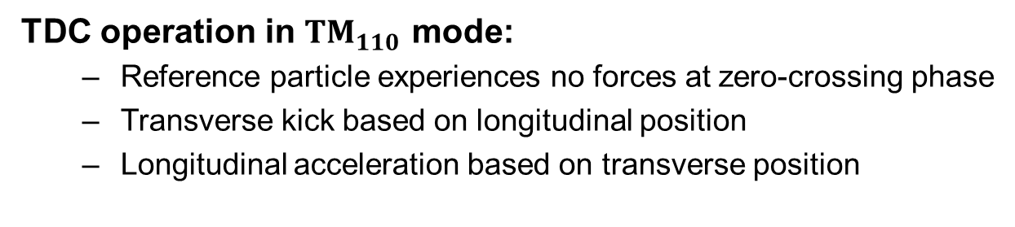
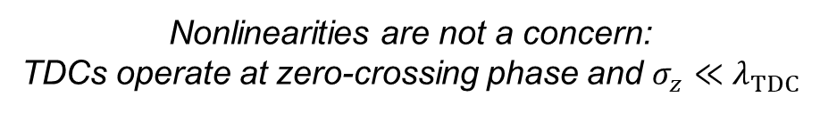



Transverse deflecting cavities (TDCs)
TDC operation in $TM_{110}$ mode:
  Reference particle experiences no forces at zero-crossing phase
  Transverse kick based on longitudinal position
  Longitudinal acceleration based on transverse position
$$B_{y}$$
$$E_{z}$$
$$z$$
Transverse kick, longitudinal acceleration
Nonlinearities are not a concern:
TDCs operate at zero-crossing phase and $σ_{z}≪λ_{TDC}$
$$x$$
TM₁₁₀
Color-coded for energy
Courtesy of H. Xu
Notes:
TDC figure ref.: WEP091 Haoran Xu

Slide 3
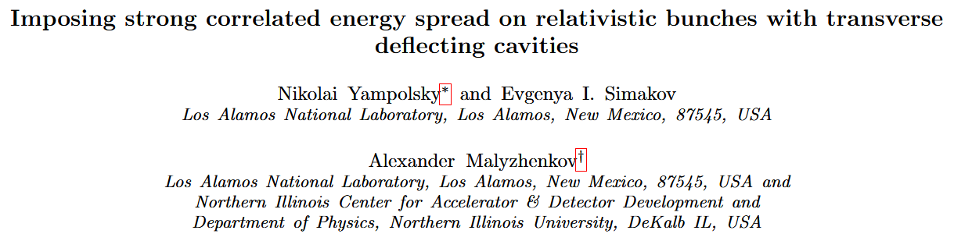


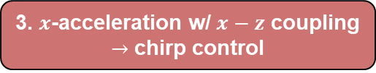
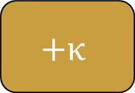



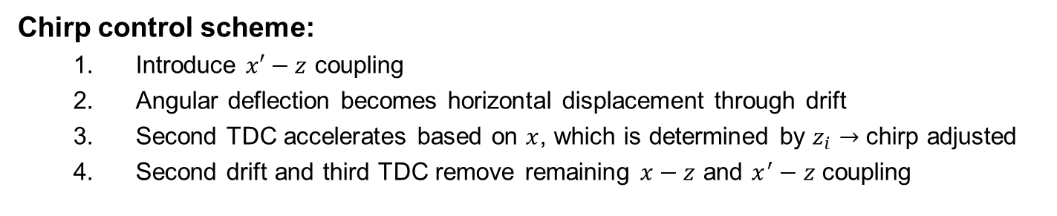


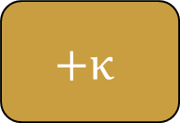

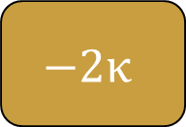




Principle of TDC-based chirping
Chirp control scheme:
  Introduce $x′−z$ coupling
  Angular deflection becomes horizontal displacement through drift
  Second TDC accelerates based on $x$, which is determined by $z_{i}→$ chirp adjusted
  Second drift and third TDC remove remaining $x−z$ and $x^{′}−z$ coupling
Accelerating cavities can operate on-crest
3. $x$-acceleration w/ $x−z$ coupling
$→$ chirp control
1. $x′−z$ coupling
4. Remove couplings
2. $x^{′}−z→x−z$
$κ∝V_{⊥}$
$$+κ$$
$$−2κ$$
$$+κ$$
Beam
$$x$$
$$x$$
$$x$$
$$x$$
$$x$$
$$x$$
z
z
z
z
z
z
$$x′$$
$$x′$$
$$x′$$
$$x′$$
$$x′$$
$$x′$$
z
z
z
z
z
z

Slide 4

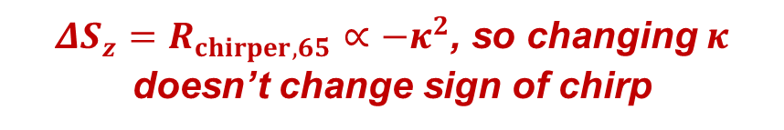


Principle of TDC-based chirping
Chirp control scheme:
  Introduce $x′−z$ coupling
  Angular deflection becomes horizontal displacement through drift
  Second TDC accelerates based on $x$, which is determined by $z_{i}→$ chirp adjusted
  Second drift and third TDC remove remaining $x−z$ and $x^{′}−z$ coupling
Accelerating cavities can operate on-crest
3. $x$-acceleration w/ $x−z$ coupling
$→$ chirp control
1. $x′−z$ coupling
4. Remove couplings
2. $x^{′}−z→x−z$
$κ∝V_{⊥}$
$$+κ$$
$$−2κ$$
$$+κ$$
Beam
$$x$$
$$x$$
$$x$$
$$x$$
$$x$$
$$x$$
$$R_{chirper}=\left(\begin{matrix}1 & L & 0 & 0 & 0 & 0 \\ 0 & 1 & 0 & 0 & 0 & 0 \\ 0 & 0 & 1 & L & 0 & 0 \\ 0 & 0 & 0 & 1 & 0 & 0 \\ 0 & 0 & 0 & 0 & 1 & 0 \\ 0 & 0 & 0 & 0 & −κ^{2}L′ & 1\end{matrix}\right)$$
$$L=2D+3L_{\text{TDC}}$$
z
z
z
z
z
z
$$L^{′}=2D+\frac{L_{\text{TDC}}}{2}$$
$ΔS_{z}=R_{chirper,65}∝−κ^{2}$, so changing $κ$ doesn’t change sign of chirp
$$x′$$
$$x′$$
$$x′$$
$$x′$$
$$x′$$
$$x′$$
z
z
z
z
z
z

Slide 5






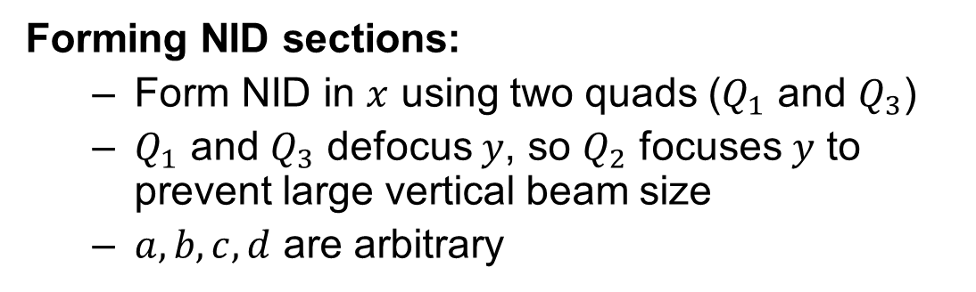







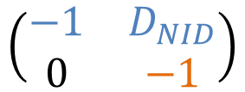





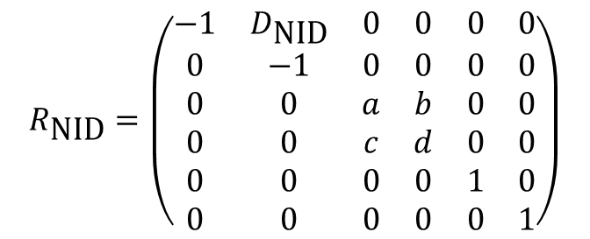
Negative identity drift (NID) transport
Transport between TDCs must be modified for $ΔS_{z}>0$:
$$Q_{1}$$
$$Q_{2}$$
$$Q_{3}$$
$$D_{1}$$
$$D_{2}$$
Beam
$$x′$$
$$x′$$
$$x′$$
$$x′$$
$$x′$$
Beam head has $x>0$
$$\left(\begin{matrix}−1 & D_{NID} \\ 0 & −1\end{matrix}\right)$$
$$x$$
$$x$$
$$x$$
$$x$$
$$x$$
Color-coded for initial $x$
$x_{f}^{′}=−x_{i}^{′}$
Forming NID sections:
  Form NID in $x$ using two quads ($Q_{1}$ and $Q_{3}$)
  $Q_{1}$ and $Q_{3}$ defocus $y$, so $Q_{2}$ focuses $y$ to prevent large vertical beam size
  $a,b,c,d$ are arbitrary
$$R_{\text{NID}}=\left(\begin{matrix}−1 & D_{\text{NID}} & 0 & 0 & 0 & 0 \\ 0 & −1 & 0 & 0 & 0 & 0 \\ 0 & 0 & a & b & 0 & 0 \\ 0 & 0 & c & d & 0 & 0 \\ 0 & 0 & 0 & 0 & 1 & 0 \\ 0 & 0 & 0 & 0 & 0 & 1\end{matrix}\right)$$
Transport produces correct $x−z$ and $x^{′}−z$ correlations for dechirping

Slide 6
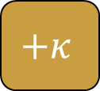




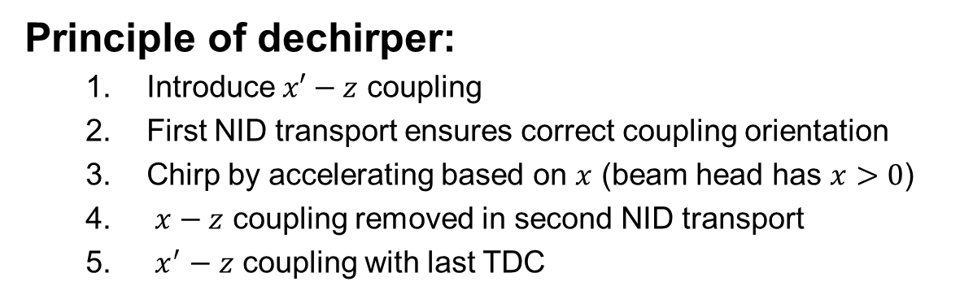
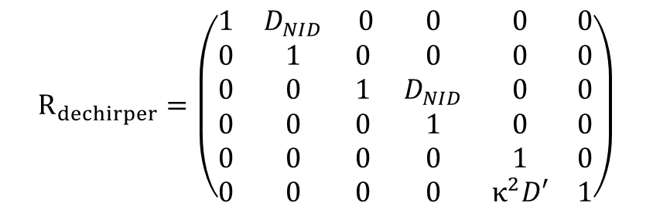

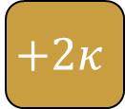


TDC-based dechirping using NIDs
Principle of dechirper:
  Introduce $x′−z$ coupling
  First NID transport ensures correct coupling orientation
  Chirp by accelerating based on $x$ (beam head has $x>0$)
  $x−z$ coupling removed in second NID transport
  $x^{′}−z$ coupling with last TDC
$$R_{dechirper}=\left(\begin{matrix}1 & D_{NID} & 0 & 0 & 0 & 0 \\ 0 & 1 & 0 & 0 & 0 & 0 \\ 0 & 0 & 1 & D_{NID} & 0 & 0 \\ 0 & 0 & 0 & 1 & 0 & 0 \\ 0 & 0 & 0 & 0 & 1 & 0 \\ 0 & 0 & 0 & 0 & κ^{2}D′ & 1\end{matrix}\right)$$
$$D^{′}=2D_{NID}−\frac{L_{TDC}}{2}$$
NID
NID
Beam
$$+κ$$
$$+2κ$$
$$+κ$$
$$x$$
$$x$$
$$x$$
$$x$$
$$x$$
$$x$$
z
z
z
z
z
z
Color-coded for energy
$$x′$$
$$x′$$
$$x′$$
$$x′$$
$$x′$$
$$x′$$
z
z
z
z
z
z

Slide 7
Simulation study of dechirper in preparation for experimental demonstration

Slide 8
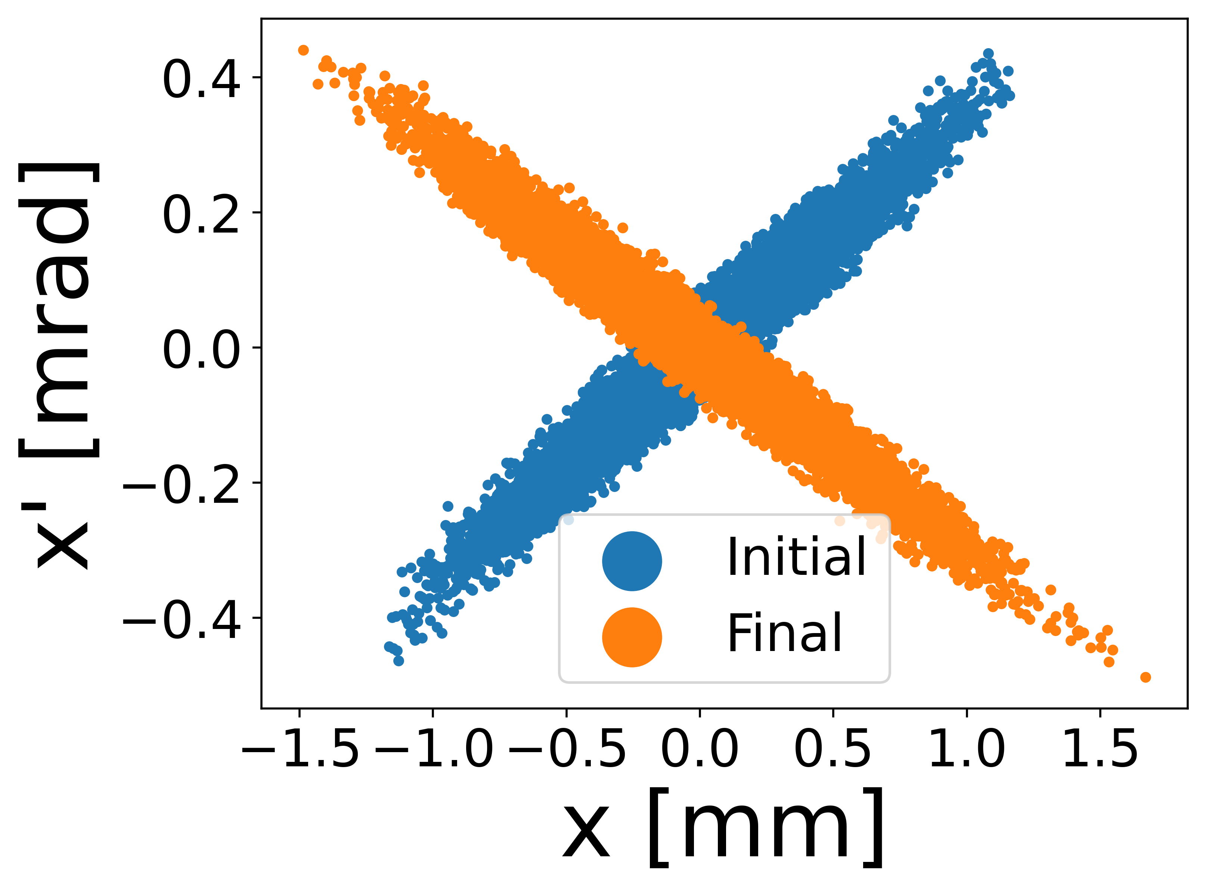
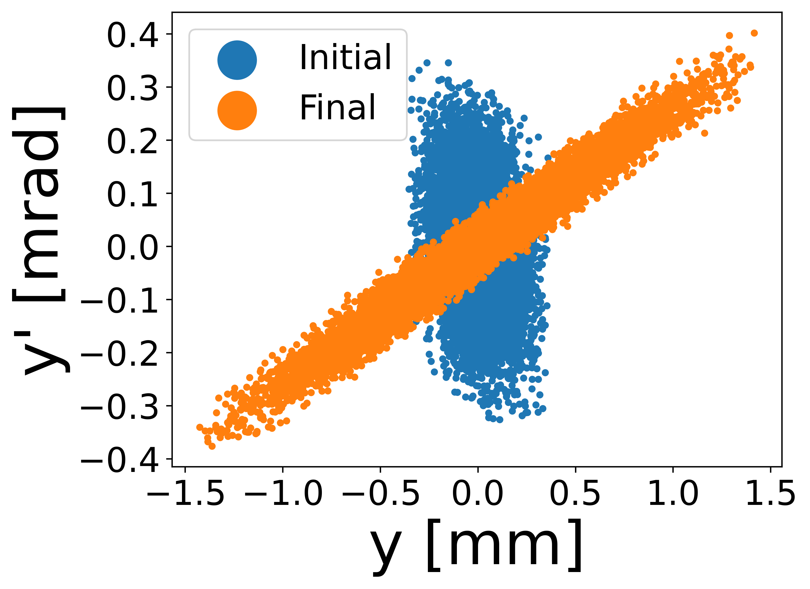
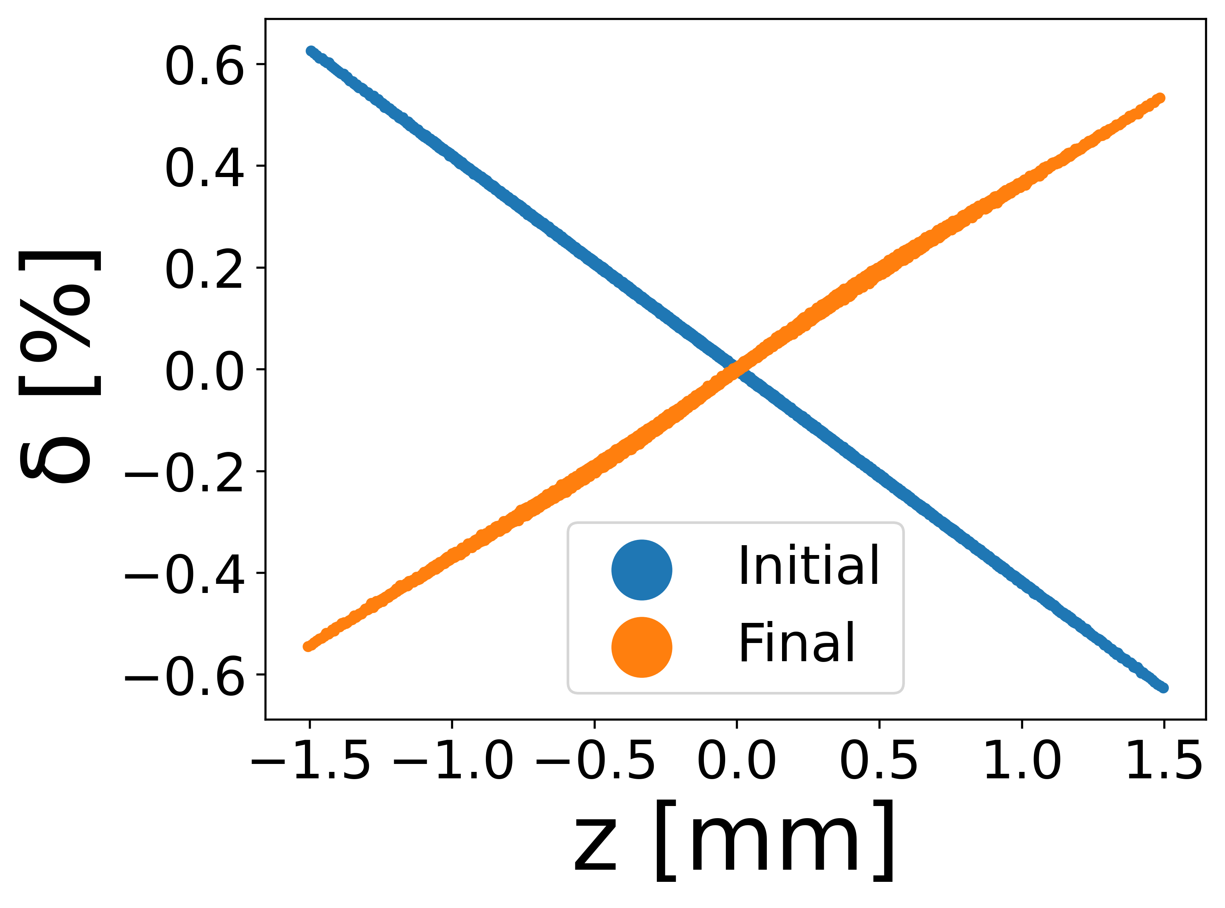






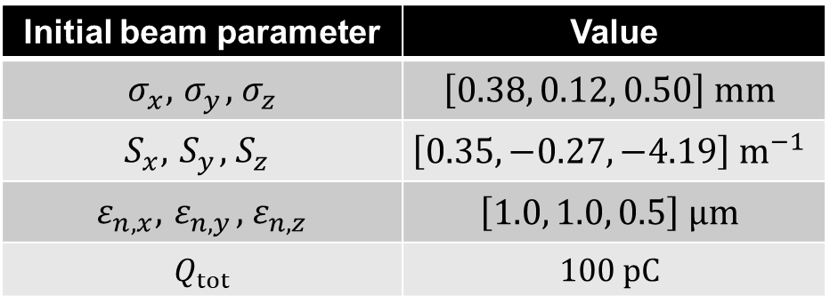
Simulation of optimal Gaussian beam
Initial beam parameter | Value
$$σ_{x},{ σ}_{y},{ σ}_{z}$$ | $$\left[0.38, 0.12, 0.50\right] mm$$
$$S_{x},{ S}_{y},{ S}_{z}$$ | $$\left[0.35, −0.27,−4.19\right] m^{−1}$$
$$ε_{n,x},{ ε}_{n,y},{ ε}_{n,z}$$ | $$\left[1.0, 1.0, 0.5\right] μm$$
$$Q_{tot}$$ | $$100 pC$$
Simulations were done in General Particle Tracer (GPT)
Chirp $=S_{z}=−\frac{α_{z}}{β_{z}}=\frac{\left\langle zδ\right\rangle }{\left\langle z^{2}\right\rangle }$
$P_{tot}=15 MW$
$$ΔS_{z}=+8 m^{−1}$$
$$Δε_{n,x}=0.02 μm$$
$$Δε_{n,y}=0.02 μm$$
$$Δε_{n,z}=2.34 μm$$
The dechirper can adjust chirp positively, but introduces emittance growth

Slide 9
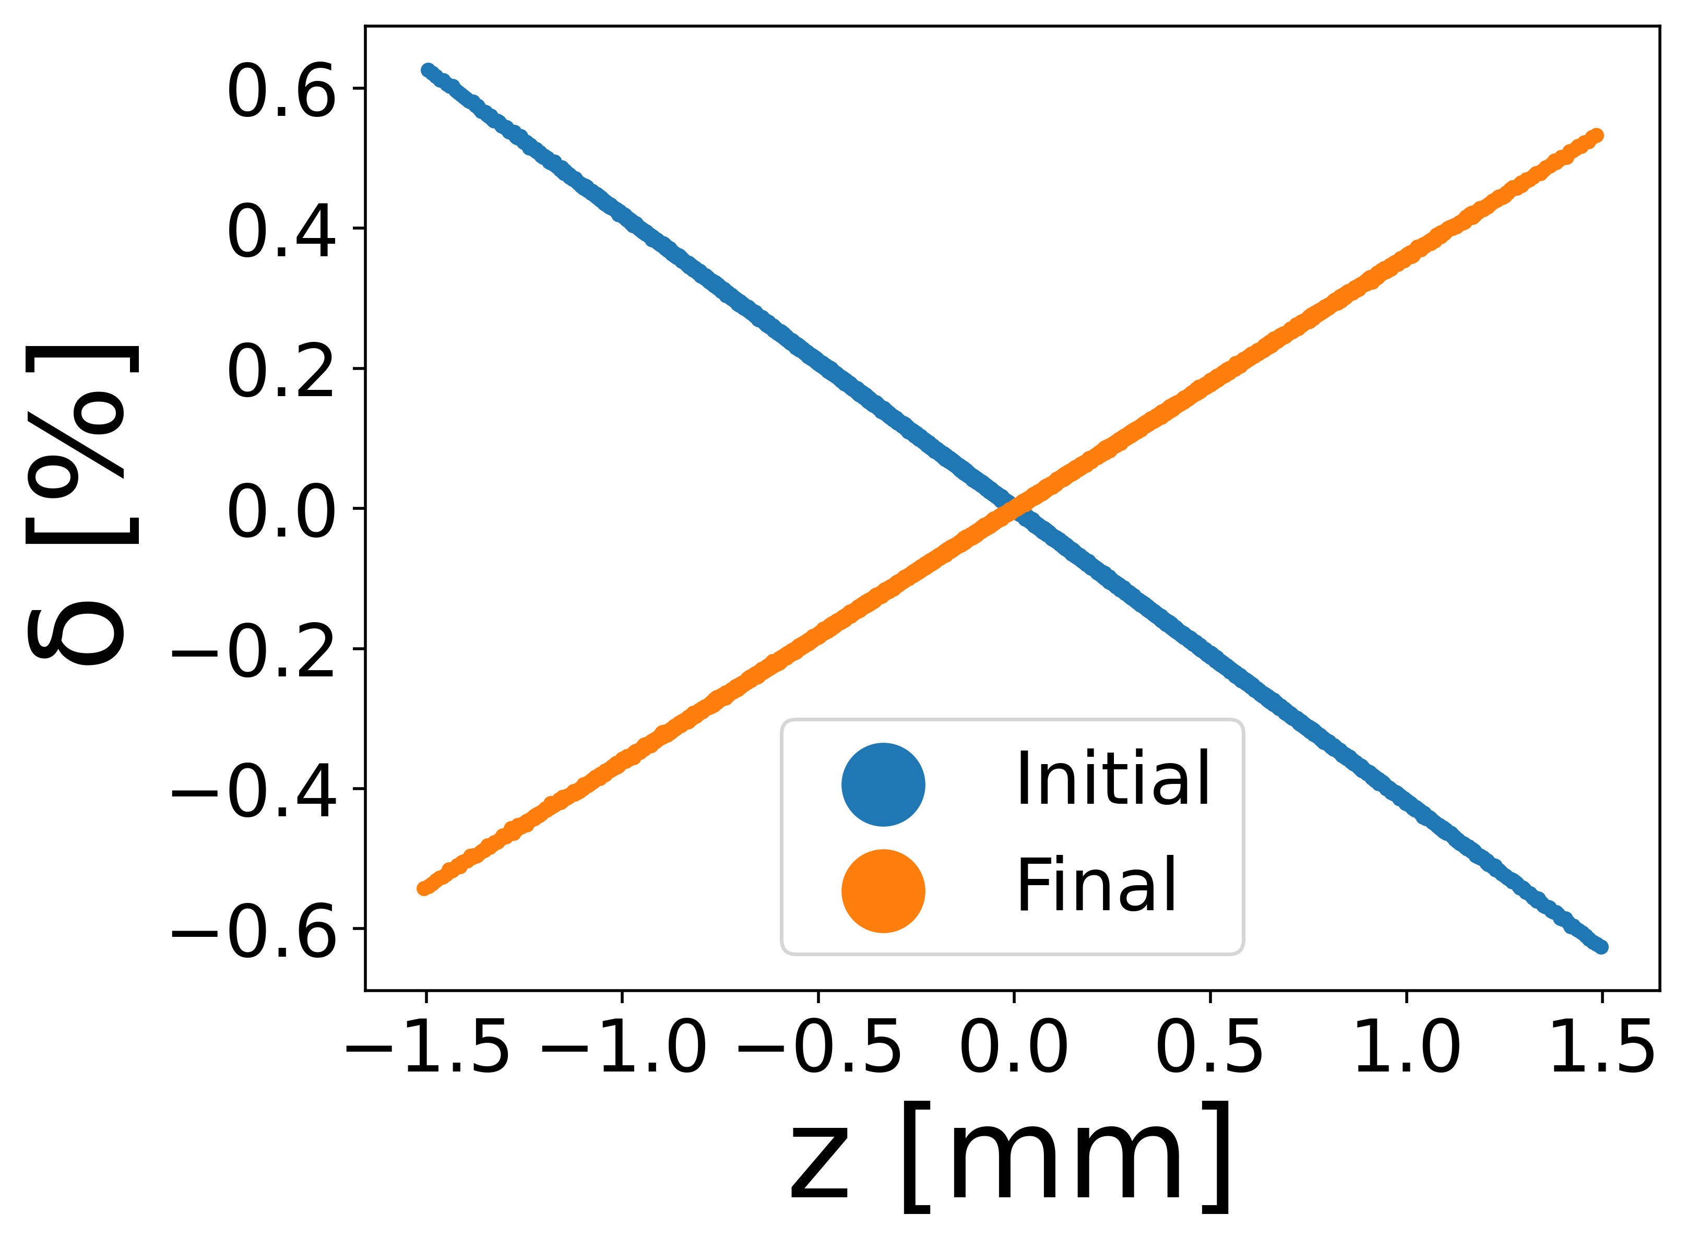
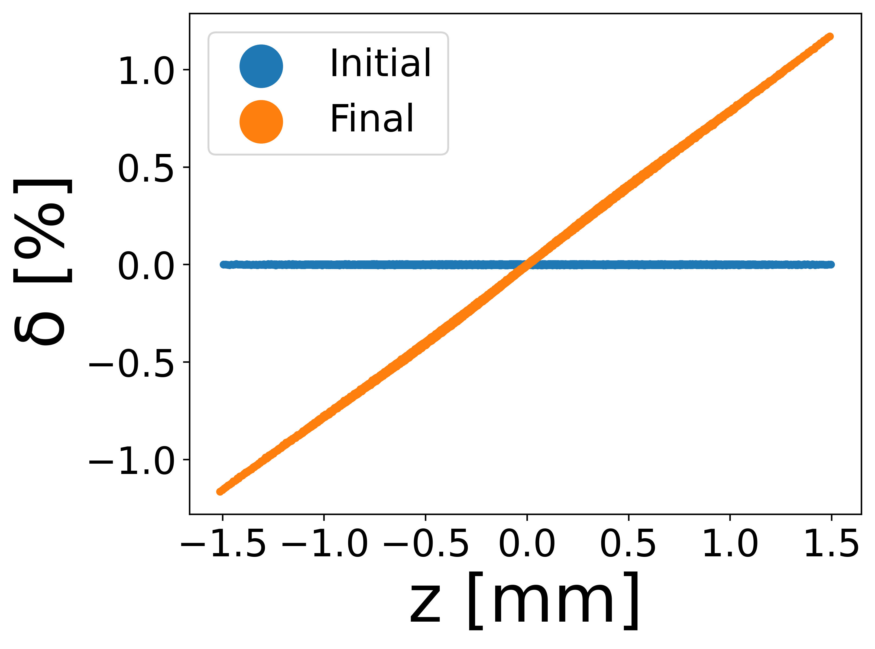
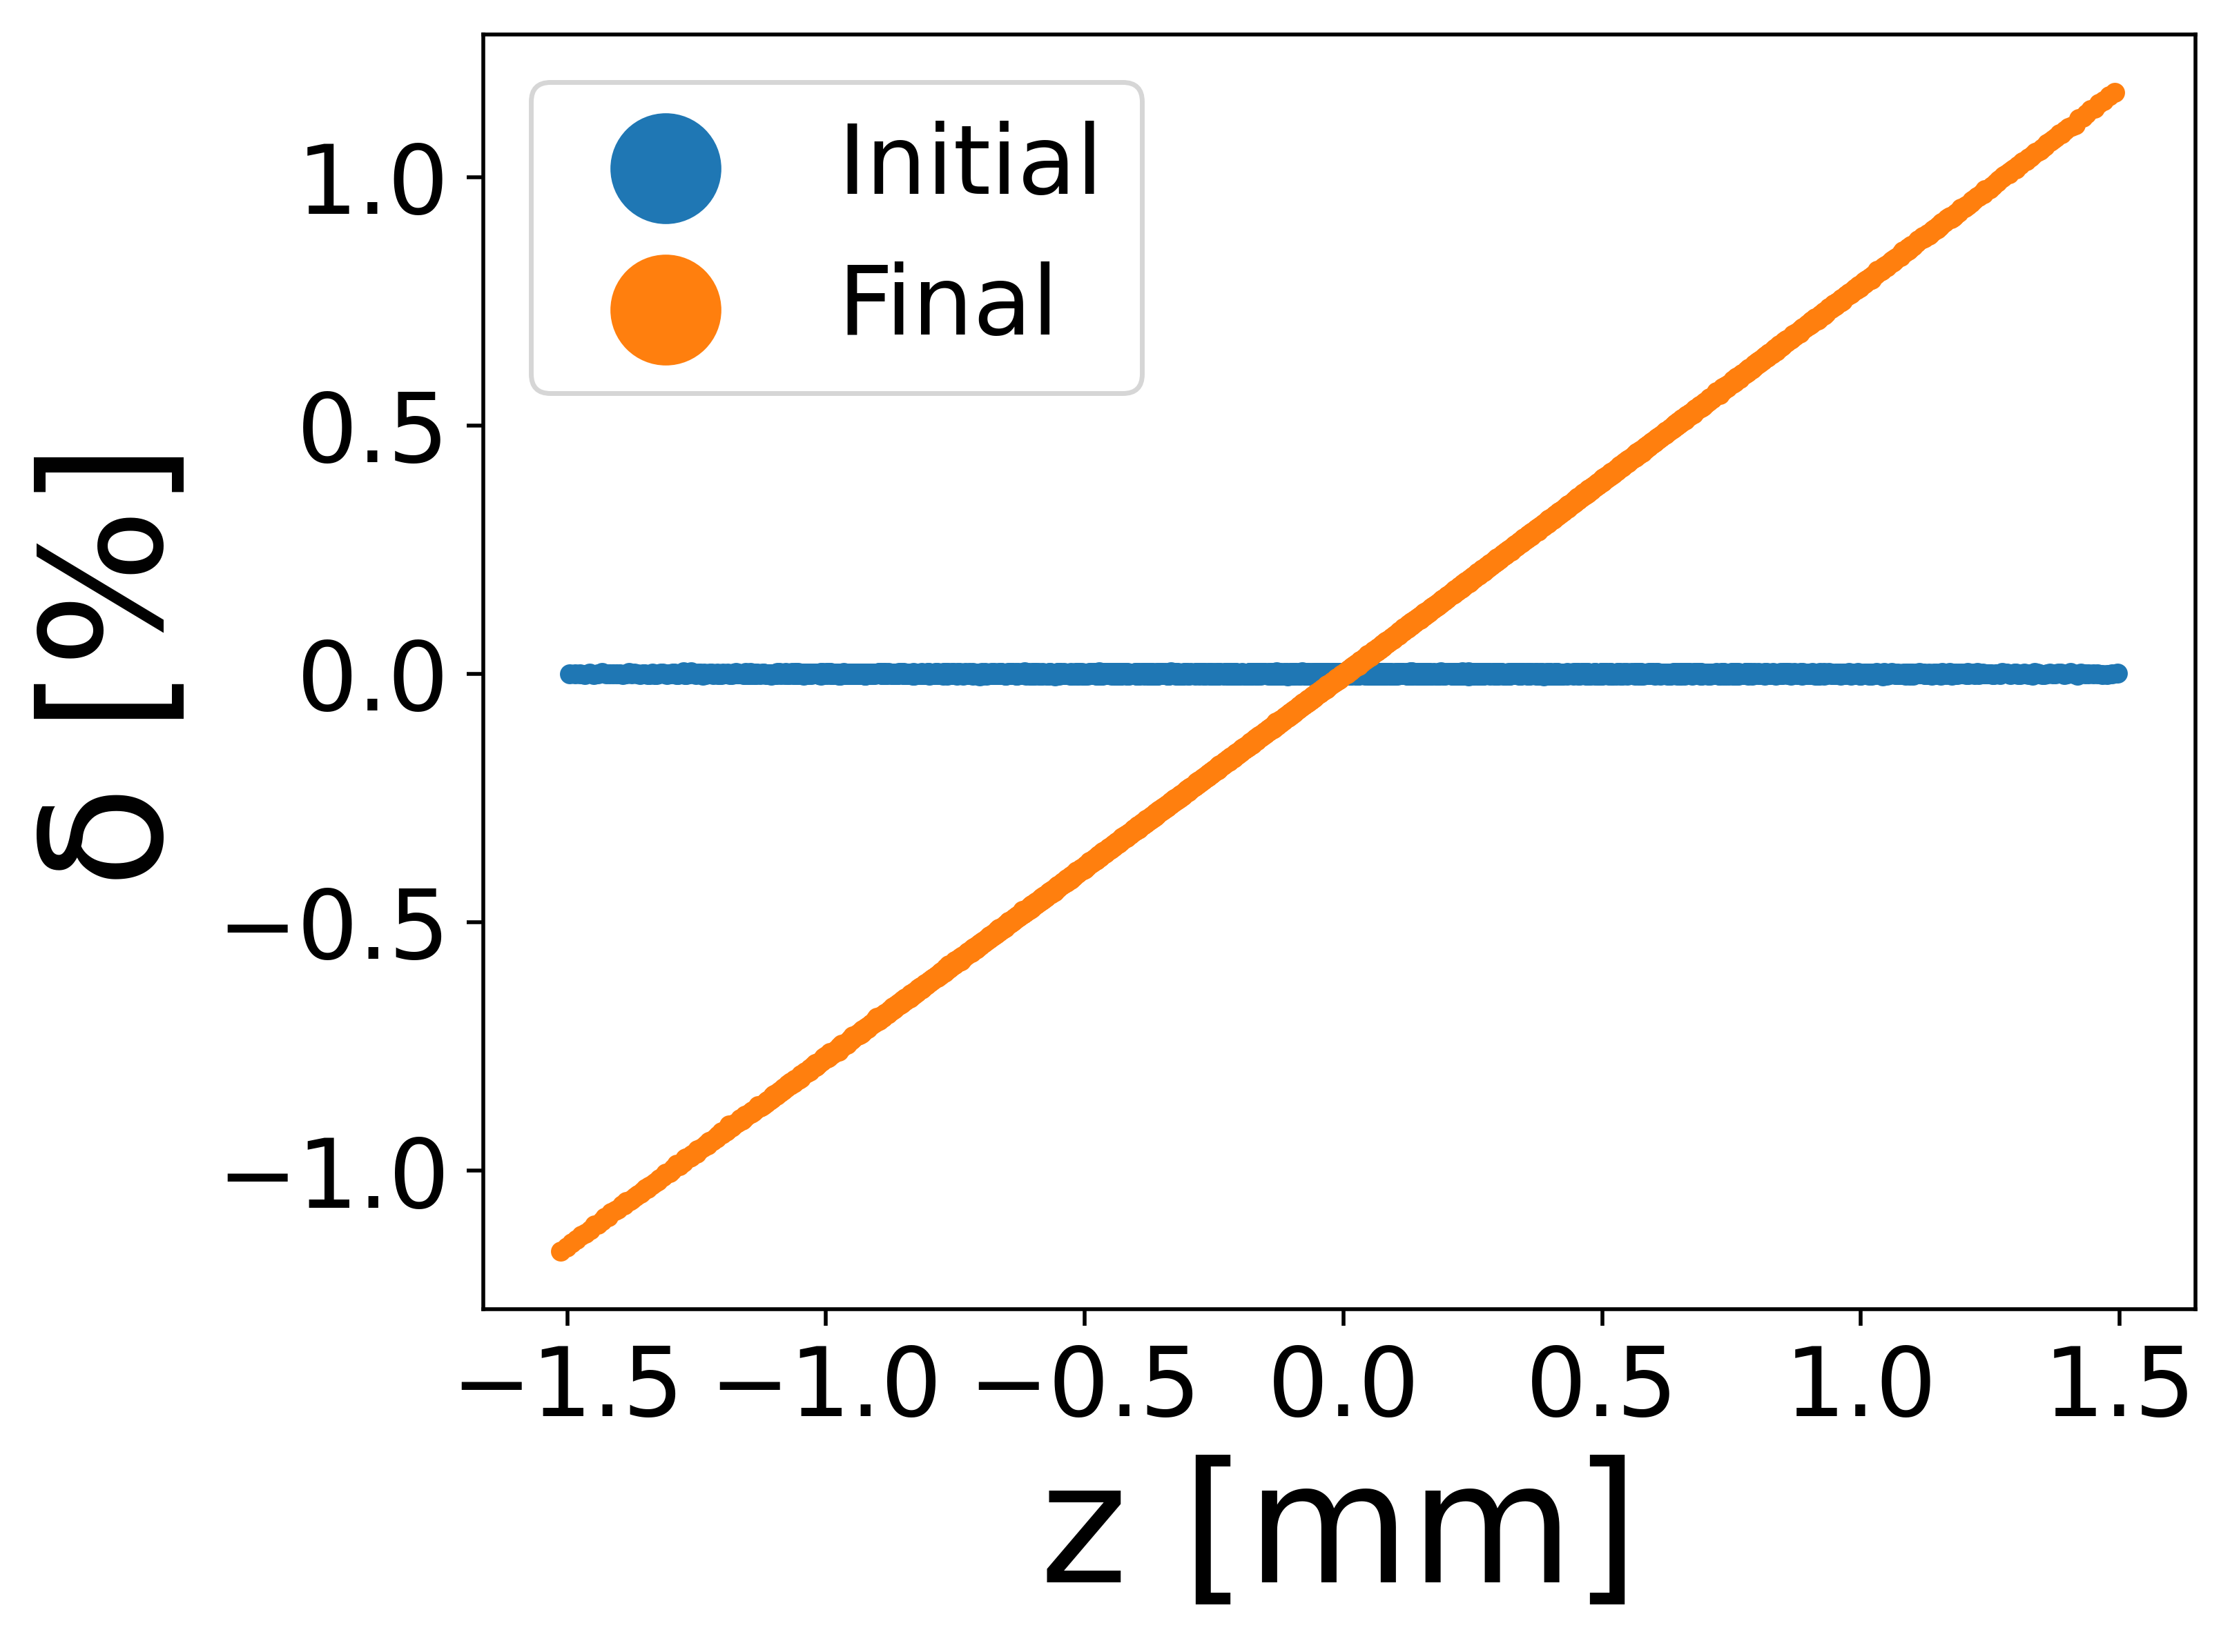

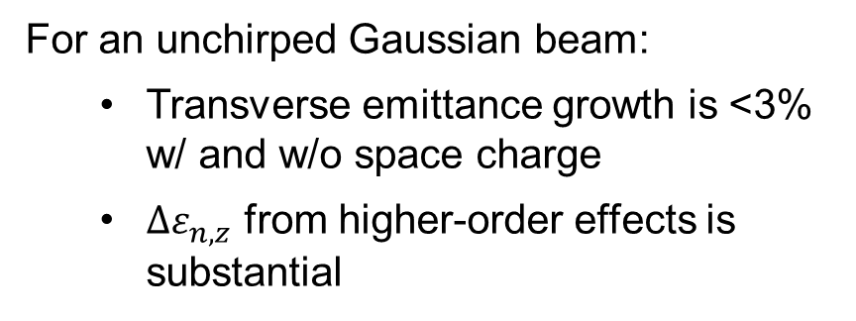




Identifying dominant emittance growth mechanism
LPS w/ space charge
LPS w/o space charge
$$Δε_{n,z}=2.34 μm$$
$Δε_{n,z}=0. 06 μm$
For an optimal Gaussian beam:
  Transverse emittance growth is <3% w/ and w/o space charge
  Space charge is dominant source of longitudinal emittance growth
In experimental plan, $S_{z,i}≈0 m^{−1}$
LPS w/ space charge
LPS w/o space charge
For an unchirped Gaussian beam:
  Transverse emittance growth is <3% w/ and w/o space charge
  $Δε_{n,z}$ from higher-order effects is substantial
$$Δε_{n,z}=2.47 μm$$
$Δε_{n,z}=0.56 μm$

Slide 10
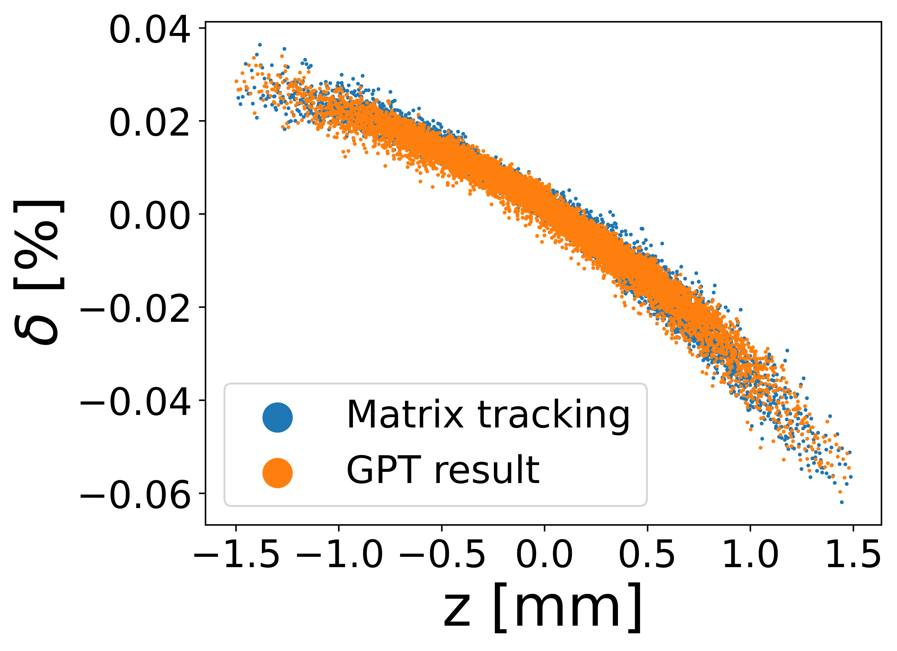
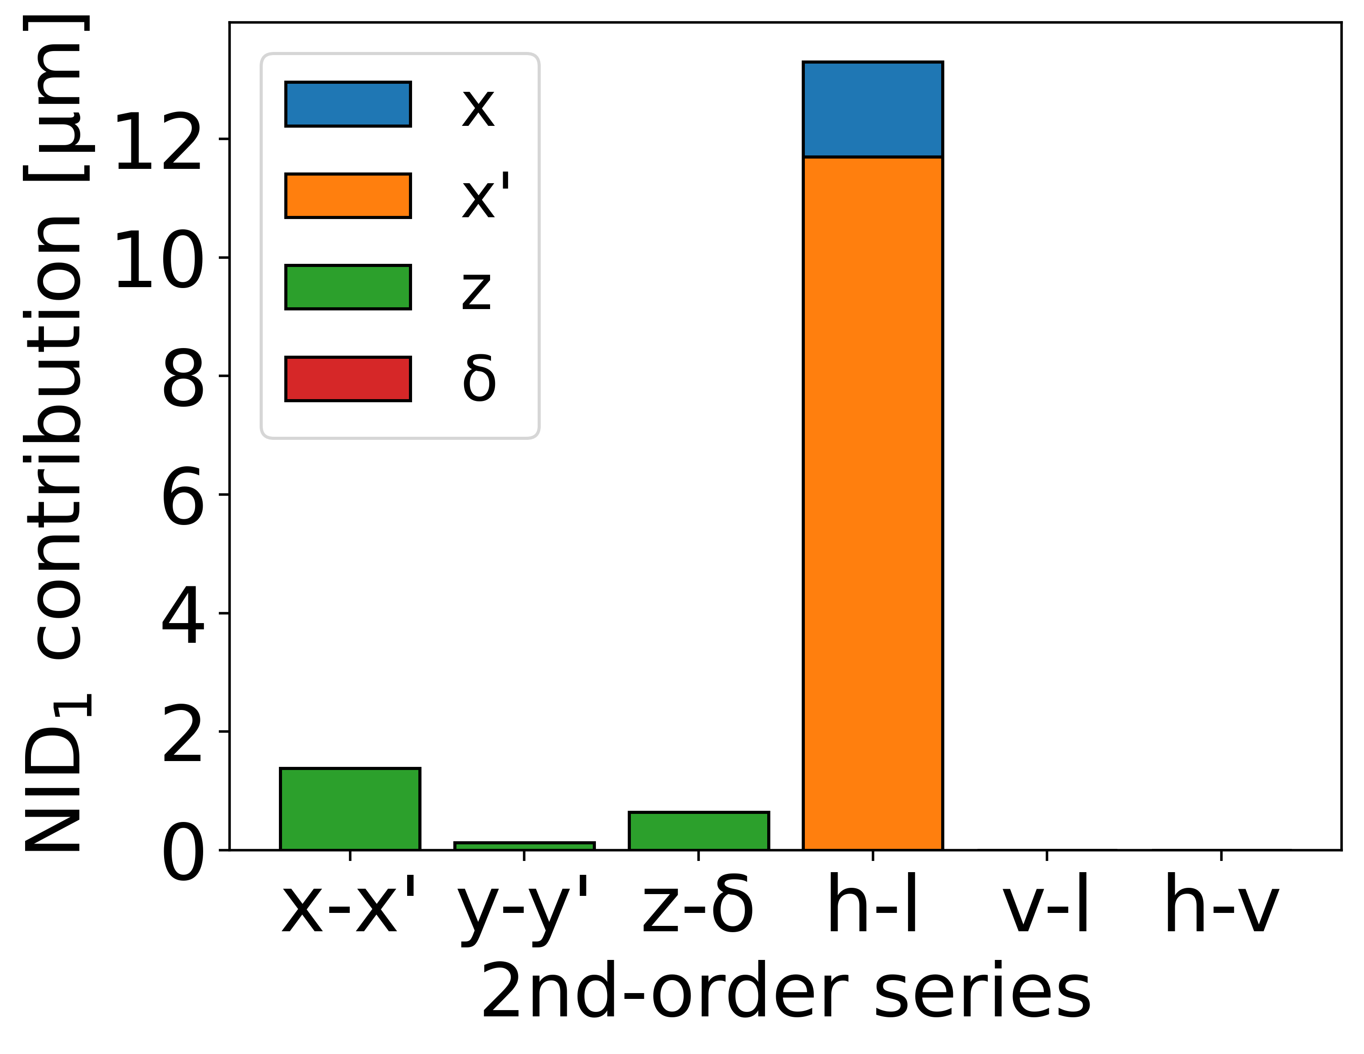
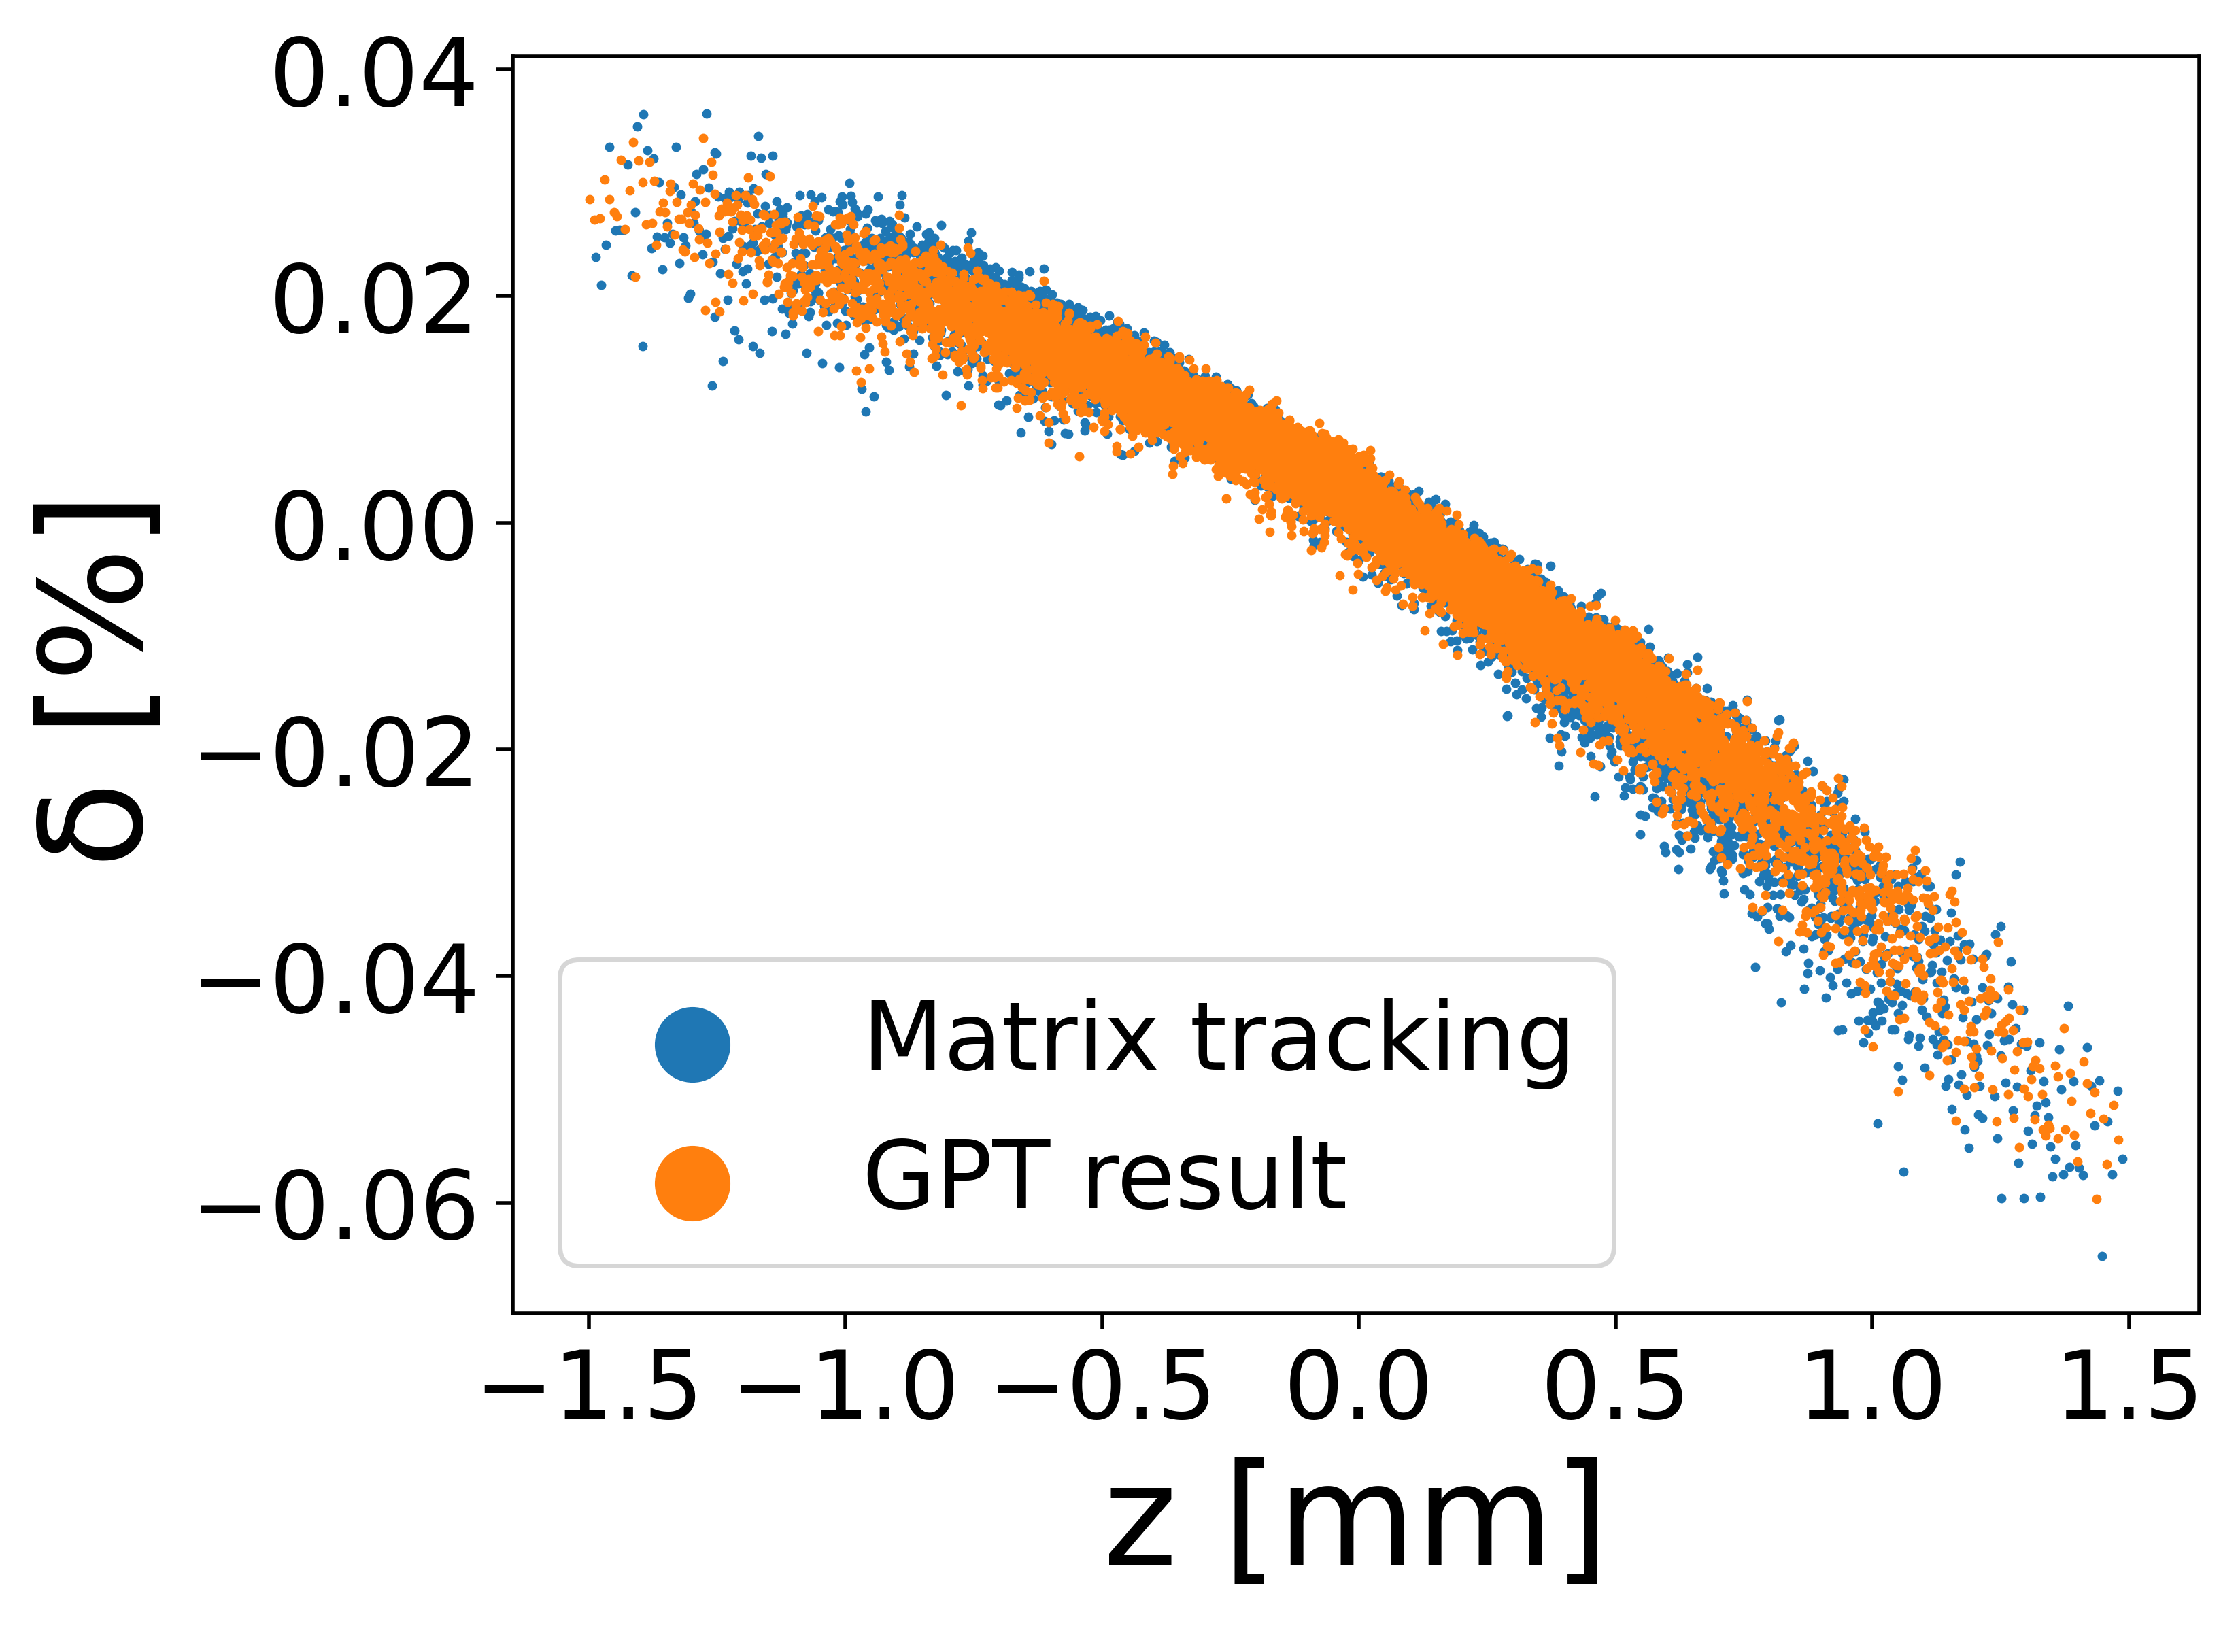
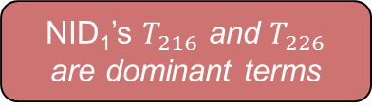

Identifying dominant emittance growth source
Combination linear and 2nd-order matrix tracking:
NID₂
Matrix-based tracking was done in Python
NID₁
Beam
TDC₁
TDC₂
TDC₃
One 2nd-order element at a time reveals source of $Δε_{n}$
Linear transport
Second-order transport
Output
Identification of dominant 2nd-order terms in dechirper:
NID₁ is dominant source of emittance growth
Contributions at end of NID₁
NID₁’s $T_{216}$ and $T_{226}$ are dominant terms
NID₁’s horizontal-longitudinal series contributions

Slide 11

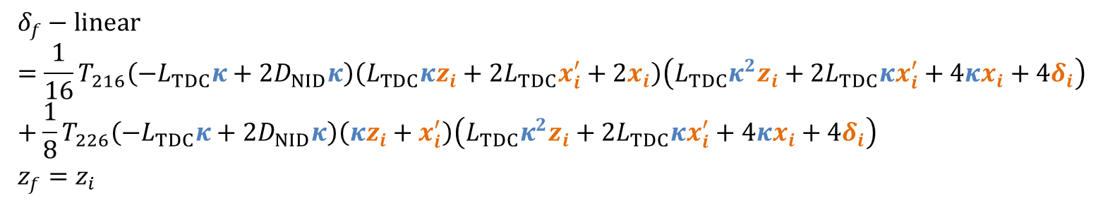
Analytical emittance growth results and mitigation options
Longitudinal transport equations counting only dominant terms:
$$δ_{f}−linear=\frac{1}{16}T_{216}\left(−L_{TDC}κ+2D_{NID}κ\right)\left(L_{TDC}κz_{i}+2L_{TDC}x_{i}^{′}+2x_{i}\right)\left(L_{TDC}κ^{2}z_{i}+2L_{TDC}κx_{i}^{′}+4κx_{i}+4δ_{i}\right)+\frac{1}{8}T_{226}\left(−L_{TDC}κ+2D_{NID}κ\right)\left(κz_{i}+x_{i}^{′}\right)\left(L_{TDC}κ^{2}z_{i}+2L_{TDC}κx_{i}^{′}+4κx_{i}+4δ_{i}\right) \\ z_{f}=z_{i}$$
Emittance growth mitigation strategies:
Add sextupoles to compensate nonlinearities in transport
Compensates longitudinal terms by using horizontal-longitudinal coupling
Reduce TDC strength (reducing chirp control range)
$$ΔS_{z}=R_{dechirper,65}∝κ^{2}$$

Slide 12
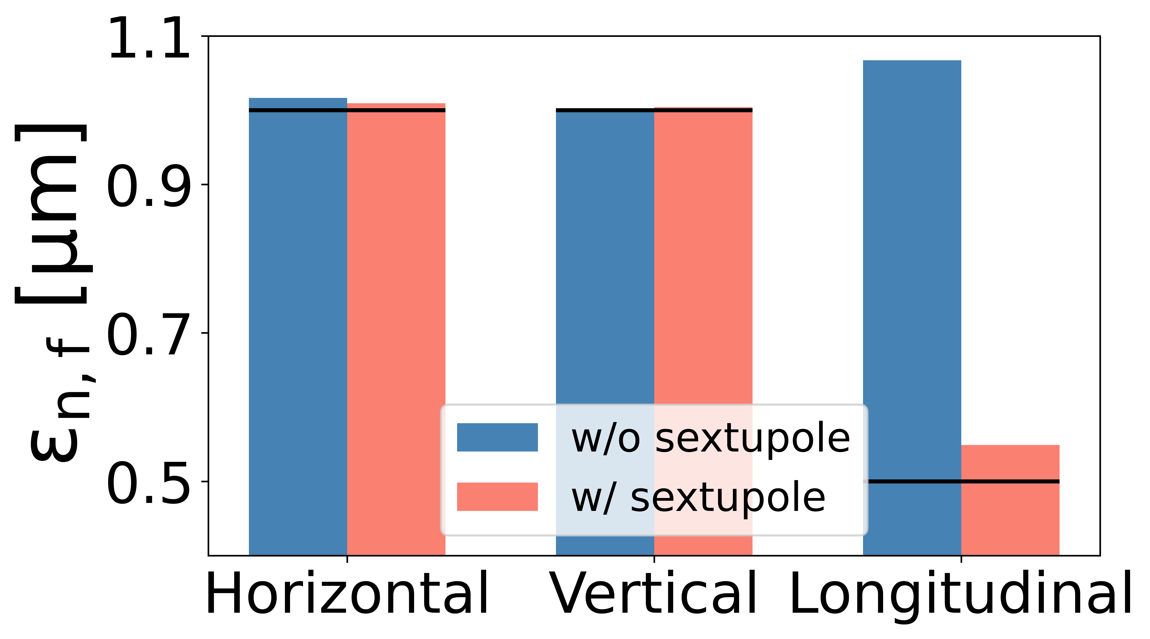
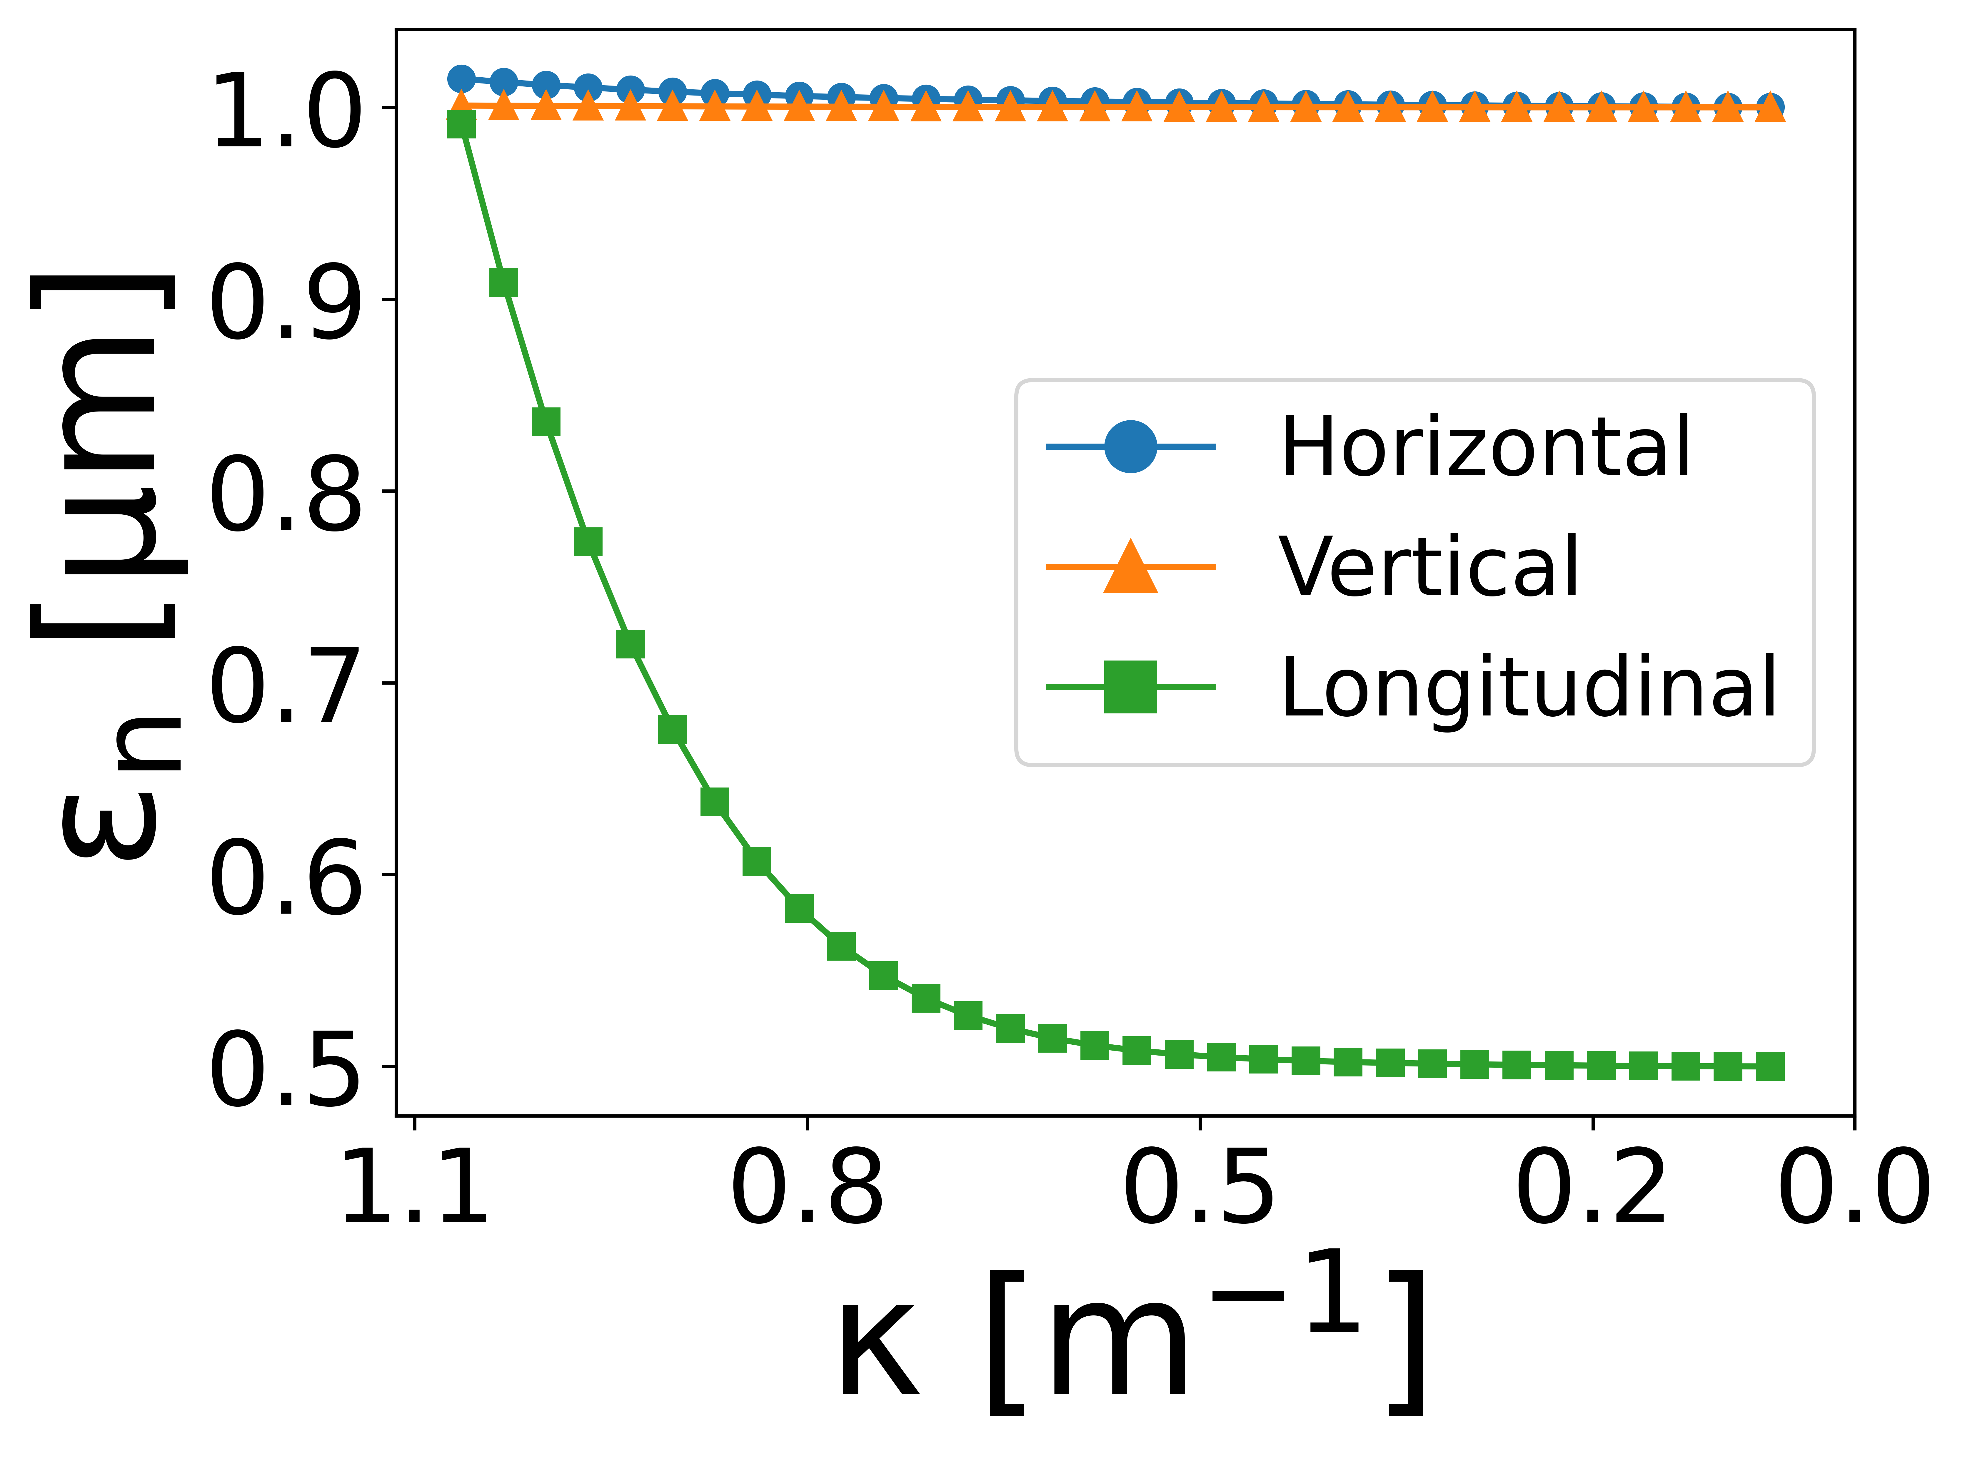
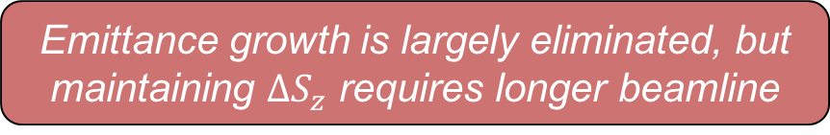
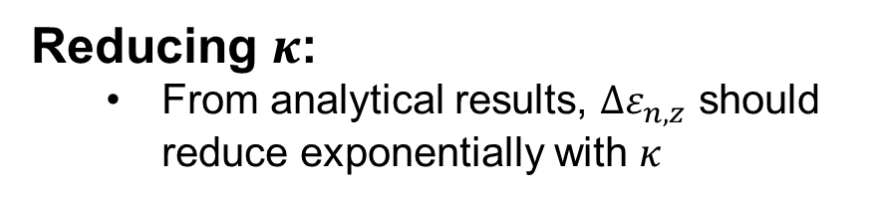



Emittance growth mitigation results
Adding sextupole to dechirper:
  One sextupole in NID can compensate nonlinear effects in $x$ and $z$
Reducing $κ$:
  From analytical results, $Δε_{n,z}$ should reduce exponentially with $κ$
$$Δε_{n,x},Δε_{n,y}: <2\%$$
$$Δε_{n,z}: 100\%→10\%$$
Emittance growth is reduced, but not eliminated
Emittance growth is largely eliminated, but maintaining $ΔS_{z}$ requires longer beamline

Slide 13
Emittance growth mitigation results
Adding sextupole to dechirper:
  One sextupole in NID can compensate nonlinear effects in $x$ and $z$
Reducing $κ$:
  From analytical results, $Δε_{n,z}$ should reduce exponentially with $κ$
$$Δε_{n,x},Δε_{n,y}: <2\%$$
$$Δε_{n,z}: 100\%→10\%$$
Emittance growth is expected in the dechirper’s experimental demonstration, but its sources and mitigation strategies have been identified
Emittance growth is reduced, but not eliminated
Emittance growth is largely eliminated, but maintaining $ΔS_{z}$ requires longer beamline

Slide 14
Sensitivity Study of Dechirper

Slide 15
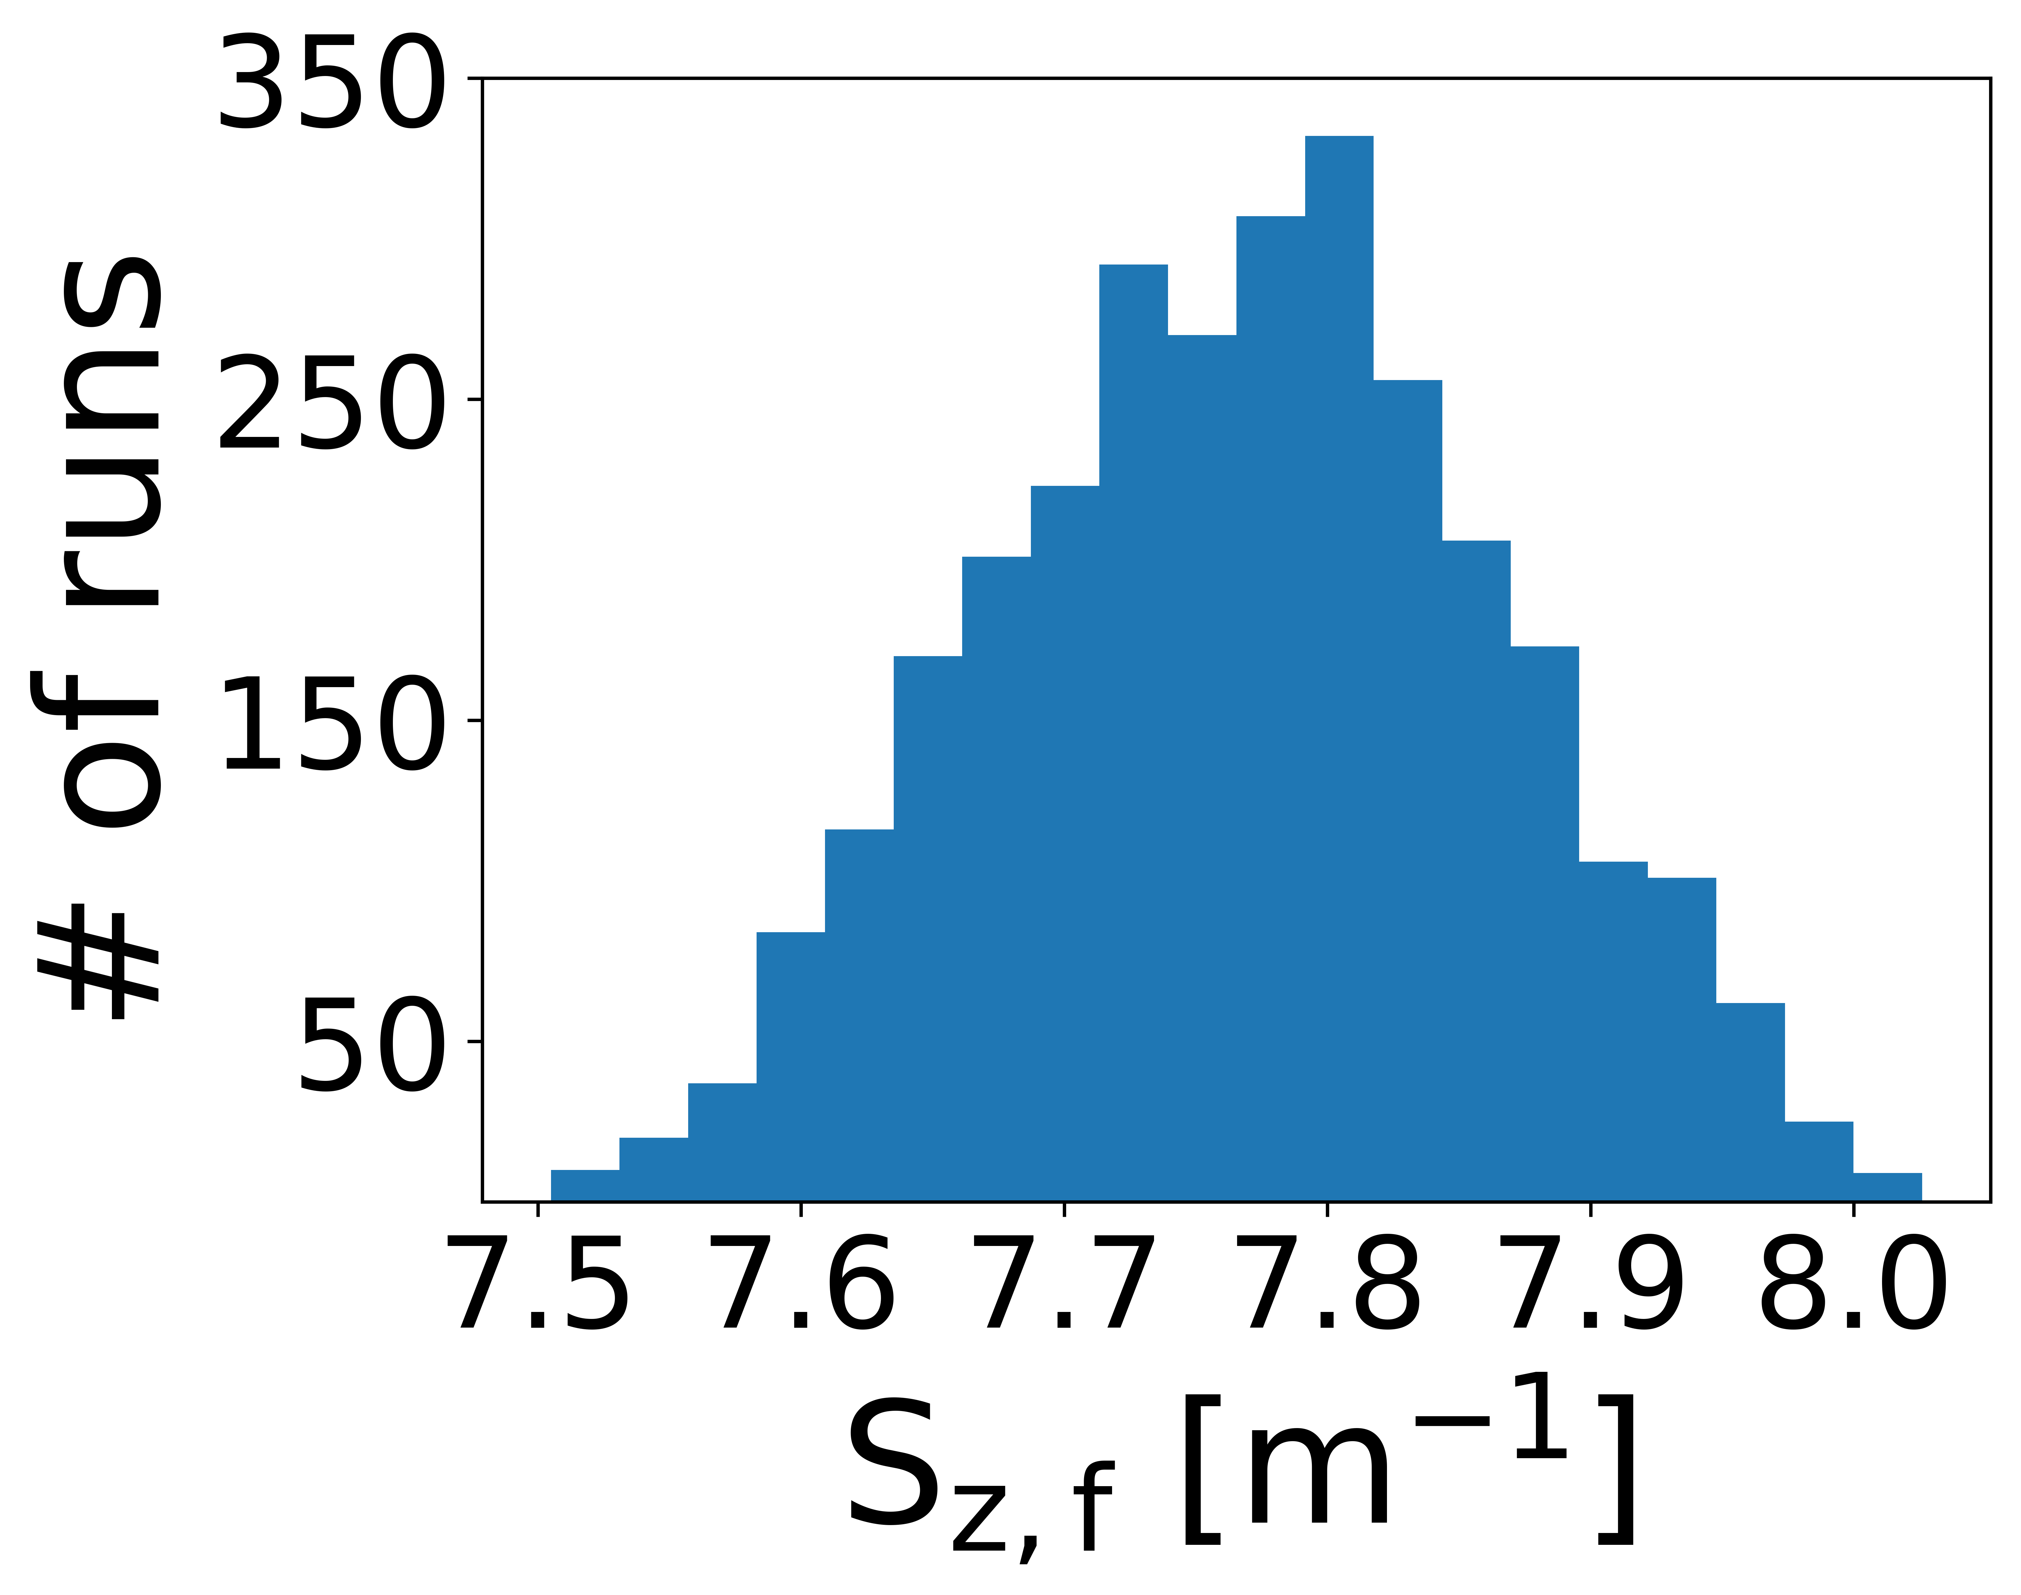

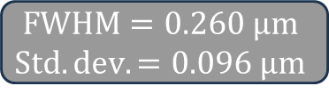
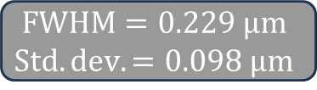
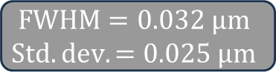
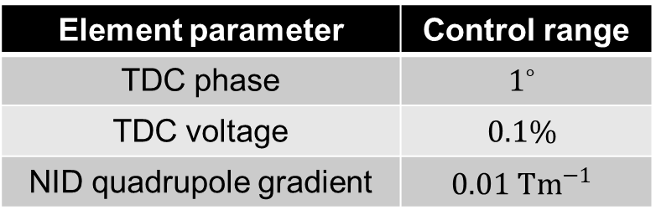
Engineering-informed sensitivity study
AWA engineering considerations:
All TDCs will have same phase and voltage variations
No feedback control
NID quadrupole gradients will vary independently
Element parameter | Control range
TDC phase | $$1^{∘}$$
TDC voltage | $$0.1\%$$
NID quadrupole gradient | $$0.01 Tm^{−1}$$
No particle losses seen
$$FWHM=0.032 μm$$
$$Std. dev.=0.025 μm$$
$$FWHM=0.229 μm$$
$$Std. dev.=0.098 μm$$
$$FWHM=0.260 μm$$
$$Std. dev.=0.096 μm$$
Ideal transport case
~4% max. variation in $ΔS_{z}$
Variations of <10% in beam parameters can be expected in experiment due to engineering constraints

Slide 16
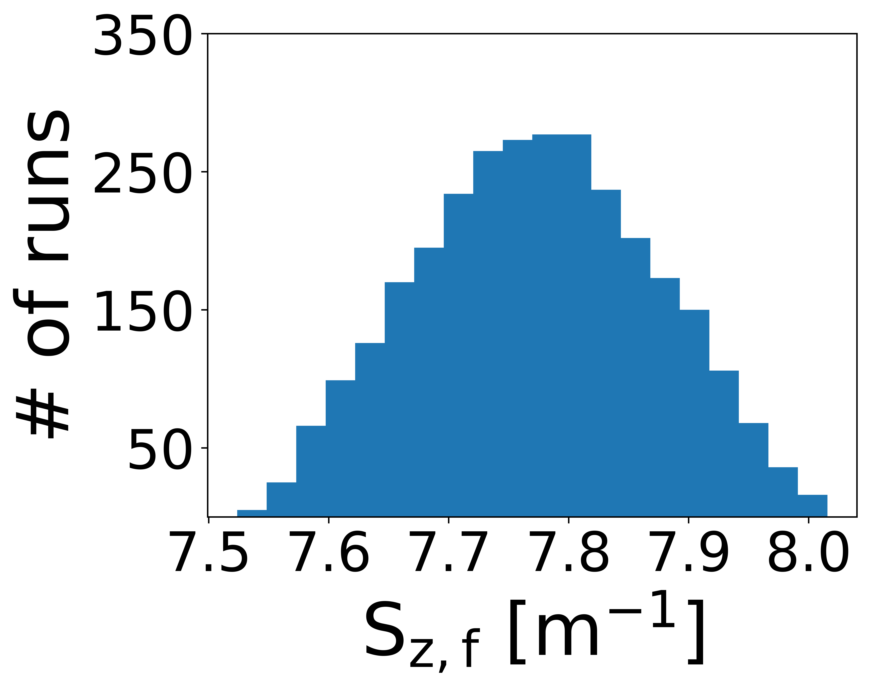
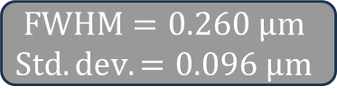
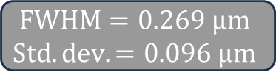
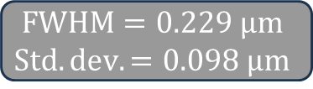
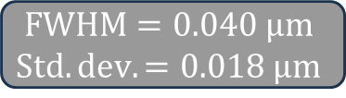
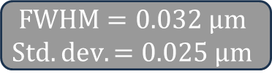
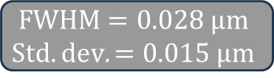


Comparison of $1^{∘}$ and $0.1^{∘}$ TDC phase control
AWA has $1^{∘}$ phase control, but a narrower control range is possible:
$$FWHM=0.229 μm$$
$$Std. dev.=0.098 μm$$
$$FWHM=0.032 μm$$
$$Std. dev.=0.025 μm$$
$1^{∘}$
$$FWHM=0.260 μm$$
$$Std. dev.=0.096 μm$$
$$FWHM=0.028 μm$$
$$Std. dev.=0.015 μm$$
$$FWHM=0.040 μm$$
$$Std. dev.=0.018 μm$$
$0.1^{∘}$
$$FWHM=0.269 μm$$
$$Std. dev.=0.096 μm$$
Tighter phase control drastically improves emittance growth, but not chirp control

Slide 17
Start-to-End Simulation of Dechirper

Slide 18
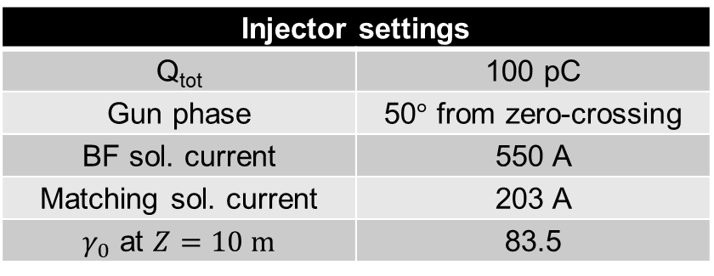
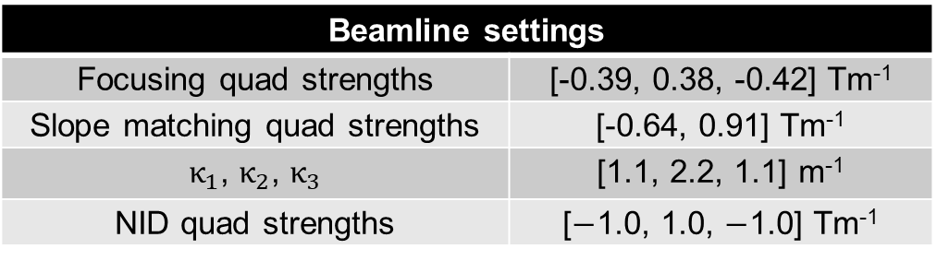
Start-to-end simulation of dechirper
Realistic beam was simulated with injector and transverse matching quadrupoles
Diagnostic section and upgraded injector will be simulated before experimental run
Focusing quads
Cathode at Z = 0.0 m
Accelerating section
10.0 m
13.6 m
14.1 m
13.9 m
L₁
L₂
L₃
L₅
Slope matching quads
NID quads
Chirping TDC
Matching solenoid
BF solenoid
23.0 m
22.8 m
23.8 m
26.9 m
30.0 m
Injector settings
Q_{tot} | 100 pC
Gun phase | 50$°$ from zero-crossing
BF sol. current | 550 A
Matching sol. current | 203 A
$γ_{0}$ at $Z=10 m$ | 83.5
Beamline settings
Focusing quad strengths | [-0.39, 0.38, -0.42] Tm⁻¹
Slope matching quad strengths | [-0.64, 0.91] Tm⁻¹
$κ_{1}$, $κ_{2}$, $κ_{3}$ | [1.1, 2.2, 1.1] m⁻¹
NID quad strengths | [$−$1.0, 1.0, $−$1.0] Tm⁻¹

Slide 19









Emittance and beam envelope up to dechirper entrance
Envelope evolution and matched phase spaces:
Transverse emittance evolution:
Five matching quads
Max. $ε_{n}$ not pictured
$$ε_{n,x}≈ε_{n,y}≈0.8 μm$$
  Matching solenoid set to minimize $ε_{n}$ at injector exit
  $ε_{n,z}$ not pictured due to scale difference ($≈20 μm$)
$$σ_{x}=1.0 mm$$
$$S_{x}=0.3 m^{−1}$$
$$σ_{y}=1.4 mm$$
$S_{y}=−0.2 m^{−1}$

Slide 20







Start-to-end dechirper simulation results
$Δε_{n,x}=9\%$
$Δε_{n,y}=12\%$
$Δε_{n,z}=10\%$
Dechirper performance:
  Emittance growth of realistic beam approximately agrees with results for Gaussian beam
  In experiment, emittance growth of ~10% can be expected in all directions
  Linearity of longitudinal phase space unchanged ($λ_{TDC}≫σ_{z}$)
The dechirper is expected to effectively control chirp without severe emittance growth

Slide 21
Summary
TDC-based chirper/dechirper experimental preparation is underway (run in September)
Dominant emittance growth sources and related mitigation strategies were identified
A sensitivity study was done to quantify expected beam parameter variations due to engineering constraints
A start-to-end simulation indicated effective chirp control with 10%-level emittance growth in all directions

Slide 22
Acknowledgements
Northern Illinois University
Gongxiaohui Chen
Scott Doran
Gwanghui Ha
Wanming Liu
Rachel Margraf-O’Neal
John Power
Eric Wisniewski
Los Alamos National Laboratory
Thomas Kim
Quinn Marksteiner
Haoran Xu
Nikolai Yampolsky

Slide 23

Mitigating emittance growth with a sextupole
Space charge off
Space charge on
#sextupole("wcs","z", 2.495, .1, 5.82856); #6.67313

Slide 24


Emittance growth by reducing $κ$

