Slide 1




Calorimetry of Multi-gev wakefield accelerators
Jul 28, 2026
José Franco Altamirano¹, C. Hojbota¹, P. Franke⁴, E. McCary⁴, R. Zgadzaj¹ , B. Diaconescu² , L. Tudor² , B. Hiddings³ , C. Aniculaesei^{3,} M. Osenberg³ M. Hegelich¹ Michael Downer¹ et. al.
¹Department of Physics, The University of Texas at Austin, US,
²Extreme Light Infrastructure – Nuclear Physics, Romania,
³Department of Physics, Heinrich Heine University Dusseldorf, Germany
⁴Tau Systems Inc., Austin, US
Gas cell
28cm
HPLS:
E=275J
τ=30fs
Calorimeter
10 cm
-e beam
Magnet
80cm
Pointing screen or any other
Component in the beam

Slide 2
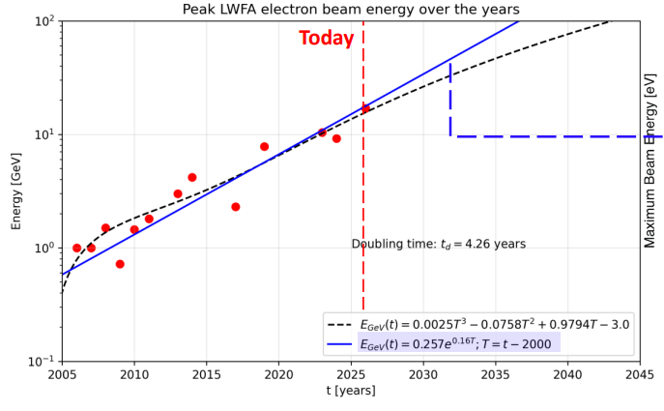
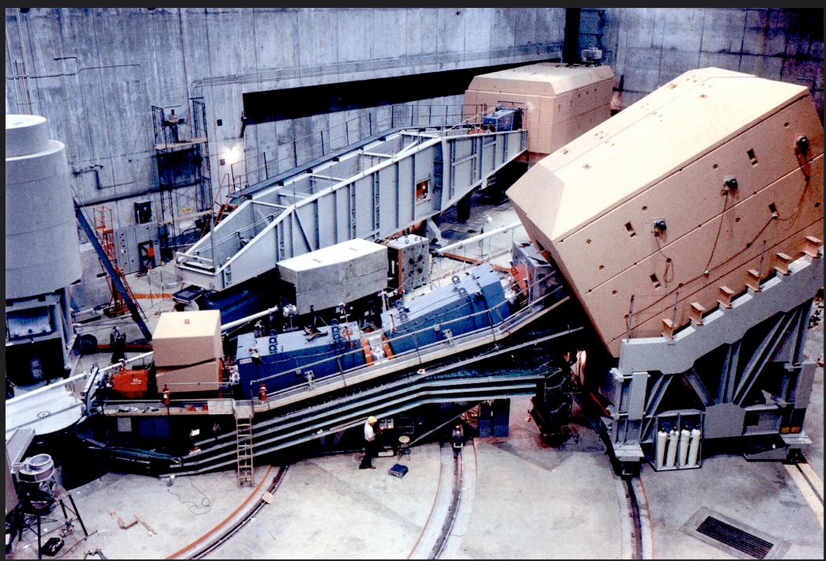
Need of new diagnostics for MPW facilities
SLAC End Station A
“Diagnostics should be compact, affordable and in one shot”
M. C. Downer.
As showed by C. Hojbota on yesterday’s plenary,
100GeV could be achieved in the next decade.

Slide 3


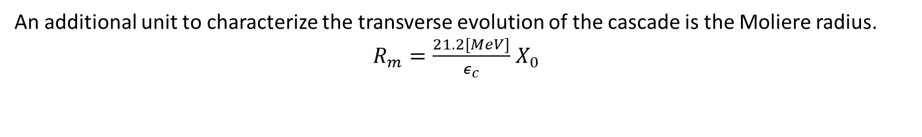
EM Calorimetry Basics: radiation-matter interaction
When electrons go through a material, they lose energy due Bremsstrahlung, producing photons, and ionization. The subsequent photons interact the material as well via Photoelectric effect, Compton Scattering and Pair production. These photon process also generate electrons that are able to interact with the material. The result of an electron or a photon traveling in a material ends up in a particle cascade. This type of cascade is called Electromagnetic (EM) cascade.
When talking about EM calorimetry, there are two important concepts [1],[2].
Radiation length:
Characteristic length at which an electron
going through a material loses all but 1/e of its
Energy.
Critical energy:
Critical energy is the energy at which an electron loses as much energy in collisions as in radiation. This is the energy at which the multiplication process is almost stopped (pair production), and Compton scattering and photoelectric effect are the main mechanisms.
$X_{0}\sim 180\frac{A}{Z^{2}}$ [g/cm2] for $Z≥13$.
$ε_{c}\sim \frac{550}{Z}$ [MeV]
An additional unit to characterize the transverse evolution of the cascade is the Moliere radius.
$R_{m}=\frac{21.2[MeV]}{ε_{c}}$ $X_{0}$
[1] C. Leroy and P.G. Rancoita, Rep. Prog. Phys. 63 (2000) 505–606
[2] R. Wigmans, Calorimetry – energy measurement in particle physics, 2nd edition, Oxford University Press (2017 )

Slide 4
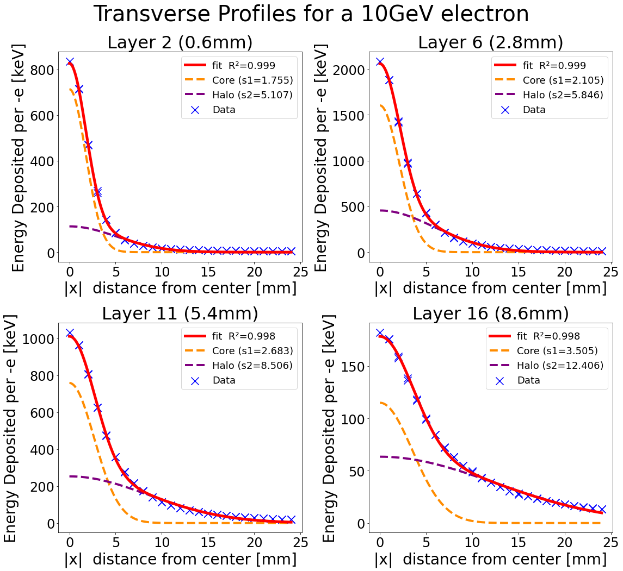
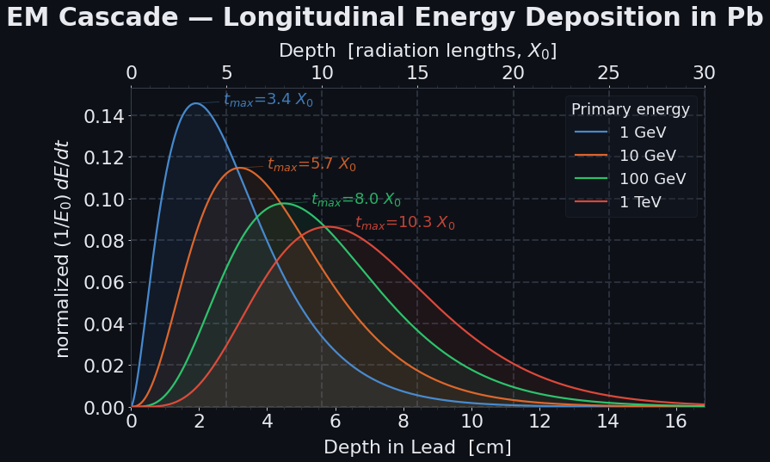

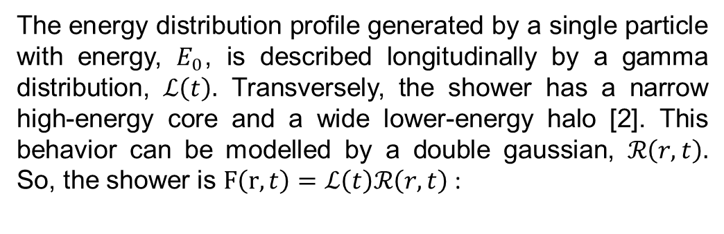


EM Calorimetry Basics: Shower development
The energy distribution profile generated by a single particle with energy, $E_{0}$, is described longitudinally by a gamma distribution, $ℒ\left(t\right).$ Transversely, the shower has a narrow high-energy core and a wide lower-energy halo [2]. This behavior can be modelled by a double gaussian, $ℛ\left(r,t\right).$ So, the shower is $F\left(r,t\right)=ℒ\left(t\right)ℛ\left(r,t\right)$ :
$$ℛ\left(r,t\right)= A_{c}e^{{−r^{2}}/{{2σ}_{c}^{2}}}+A_{h}e^{{−r^{2}}/{{2σ}_{h}^{2}}}$$
$${ℒ\left(t\right)= E}_{0}\frac{b{\left(bt\right)}^{α−1}e^{−bt}}{Γ(α)}$$
$$t_{max}= ln\frac{E}{ε_{c}}+c$$
*Radial evolution is commonly modelled by a double exponential decay. In this
case, Gaussians work since electrons got scattered by a beam block and multi-
ple Lanex screens along the beam path

Slide 5
EM Calorimetry Basics: Lateral Shower Containment
$R_{m}=\frac{21.2[MeV]}{ε_{c}}$ $X_{0}$

Slide 6
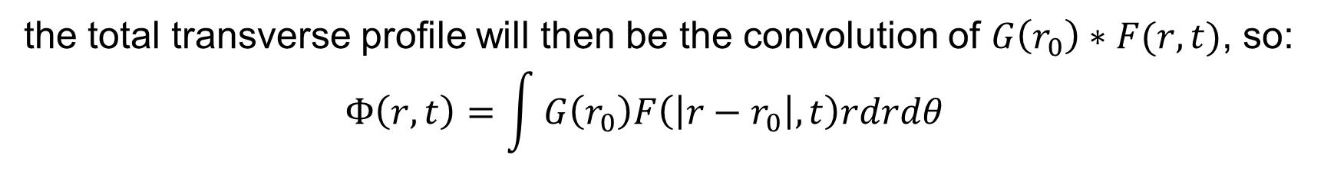
Dealing with bunches
Gas cell
28cm
HPLS:
E=275J
τ=30fs
Calorimeter
10 cm
-e beam
Magnet
80cm
Pointing screen or any other
Component in the beam
the total transverse profile will then be the convolution of $G\left(r_{0}\right)∗F(r, t)$, so:
  $$Φ\left(r,t\right)=\int{G\left(r_{0}\right)F\left(\left|r−r_{0}\right|,t\right)rdrdθ}$$
Will depend on elements in the beam path from experiment to experiment.
Go back to figure from 1st slide. Explain the need to treat the shower as a convolution of it’s original divergence,
Scattering and transport along the B.

Slide 7
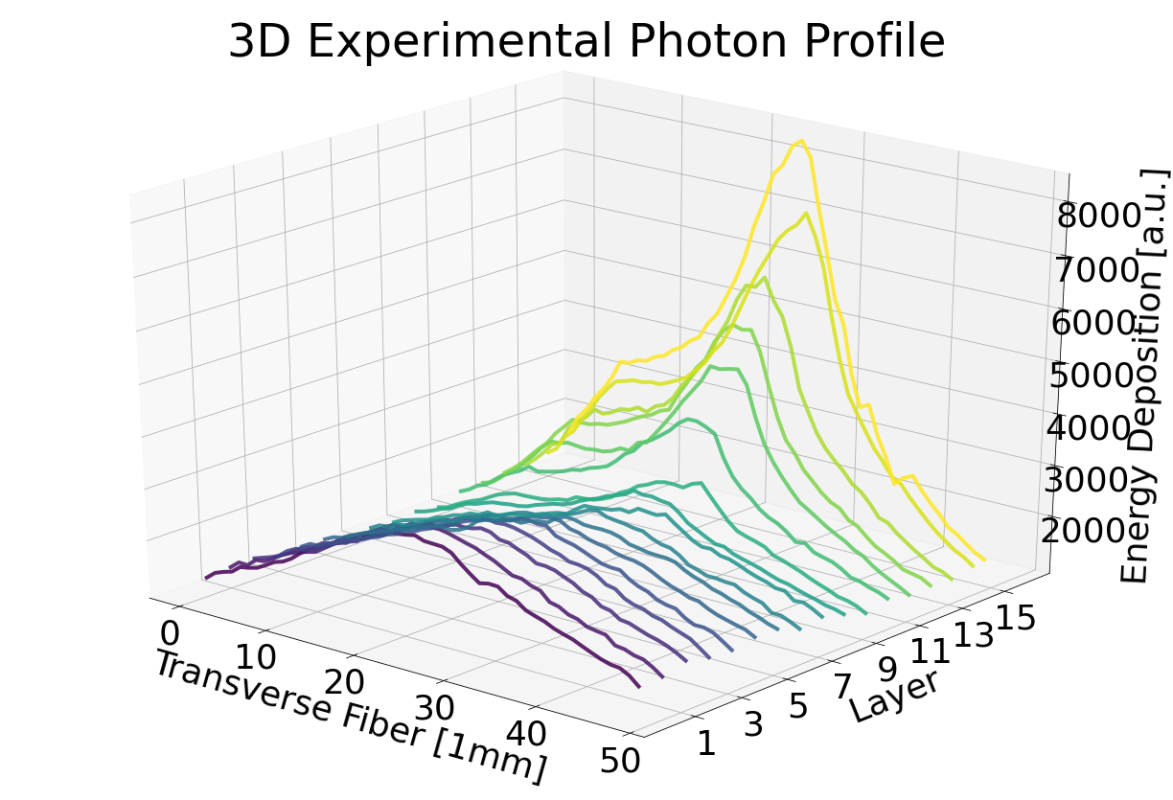
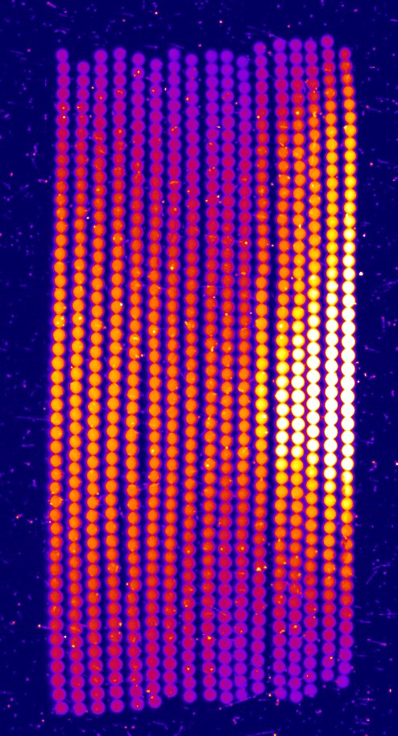
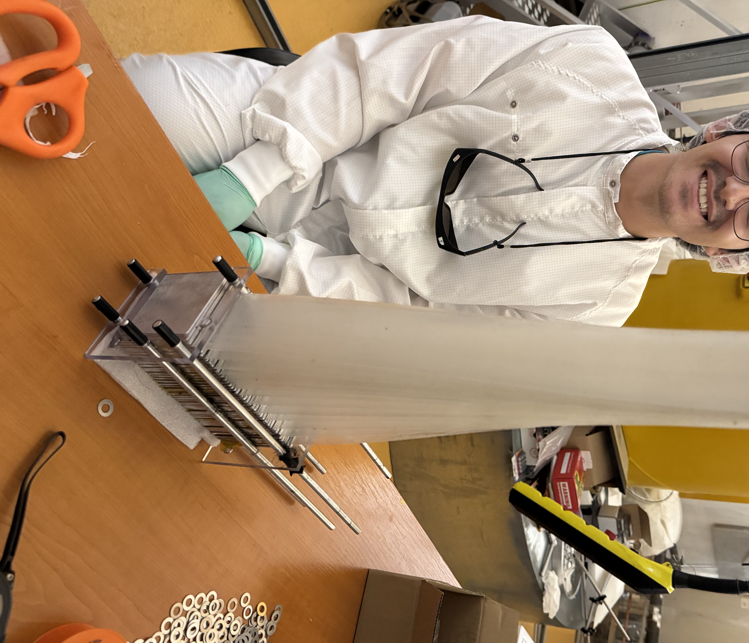
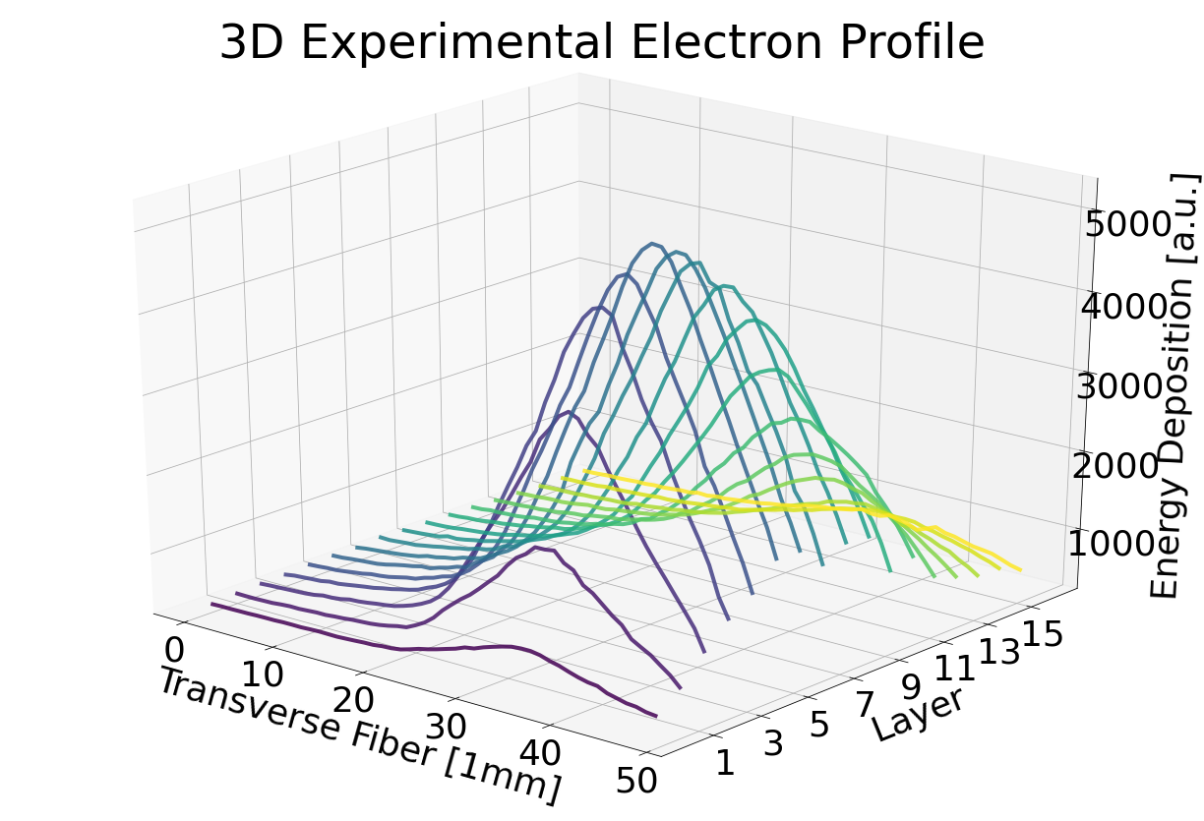
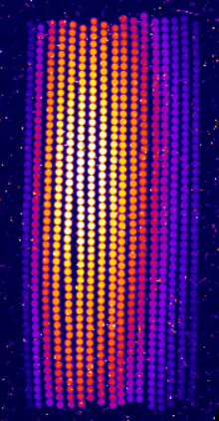
Scintillator-based calorimeters
Bremsstrahlung
Betatron
Electrons

Slide 8
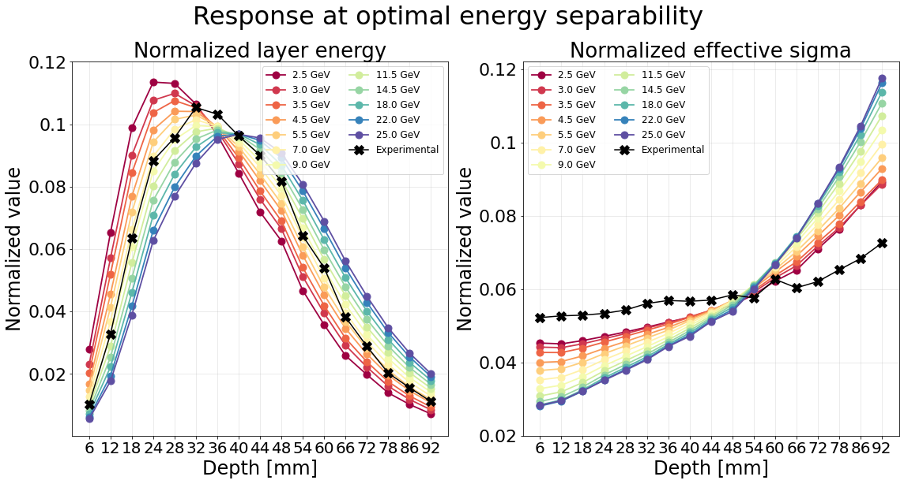

$$t_{max}= ln\frac{E}{ε_{c}}+c$$
Initial spread due transport
Separation made with cosine
distance between neighboring
energy bins.

Slide 9
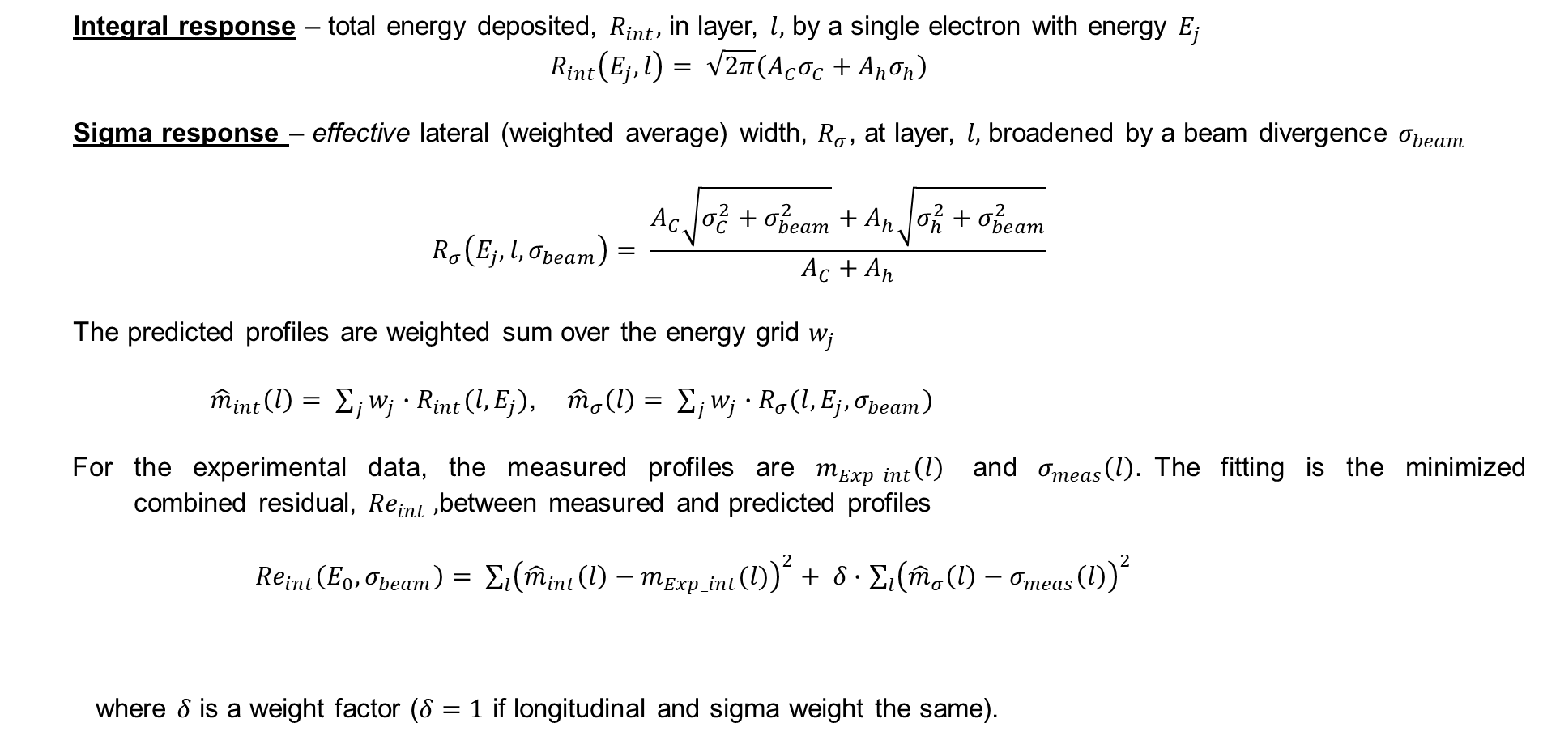
Fitting Strategy
  Integral response – total energy deposited, $R_{int},$ in layer, $l,$ by a single electron with energy $E_{j}$
  $$R_{int}\left(E_{j},l\right)= \sqrt{2π}\left(A_{C}σ_{C}+A_{h}σ_{h}\right)$$
  Sigma response – effective lateral (weighted average) width, $R_{σ}$, at layer, $l,$ broadened by a beam divergence $σ_{beam}$
  $$R_{σ}\left(E_{j},l,σ_{beam}\right)= \frac{A_{C}\sqrt{σ_{C}^{2}+σ_{beam}^{2}}+A_{h}\sqrt{σ_{h}^{2}+σ_{beam}^{2}}}{A_{C}+A_{h}}$$
  The predicted profiles are weighted sum over the energy grid $w_{j}$
${\hat{m}}_{int}\left(l\right)= \sum_{j}{w_{j}∙R_{int}(l,E_{j})}$, ${\hat{m}}_{σ}\left(l\right)= \sum_{j}{w_{j}∙R_{σ}(l,E_{j},σ_{beam})}$
For the experimental data, the measured profiles are $m_{Exp_int}\left(l\right)$ and$σ_{meas}\left(l\right).$The fitting is the minimized combined residual, ${Re}_{int} ,$between measured and predicted profiles
${Re}_{int}\left(E_{0}, σ_{beam}\right)= \sum_{l}{{\left({\hat{m}}_{int}\left(l\right)−m_{Exp_int}(l)\right)}^{2}}+ δ∙$ $\sum_{l}{{\left({\hat{m}}_{σ}\left(l\right)−σ_{meas}\left(l\right)\right)}^{2}}$
where $δ$ is a weight factor ($δ=1$ if longitudinal and sigma weight the same).
Integral (longitudinal)
Transverse evolution

Slide 10
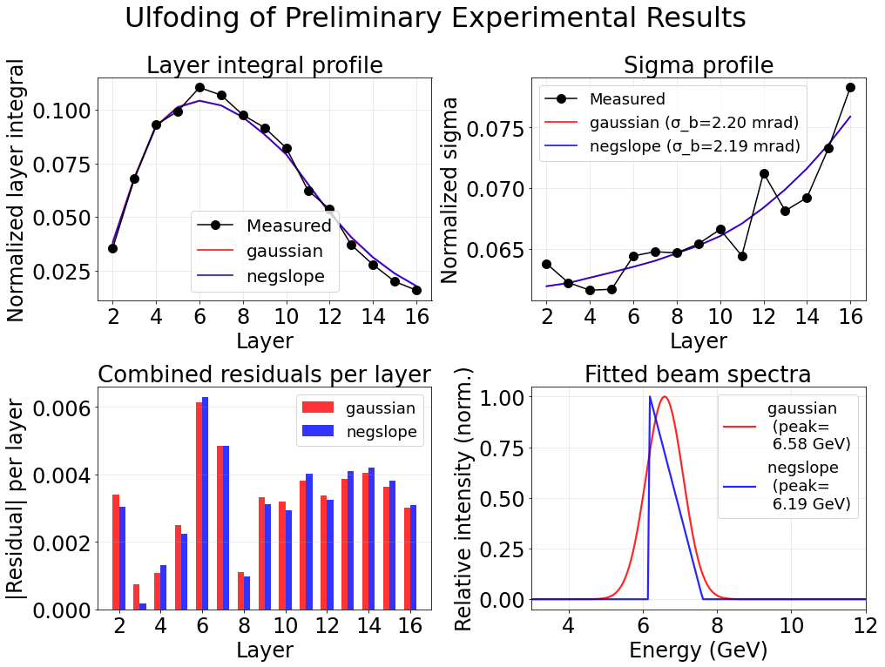
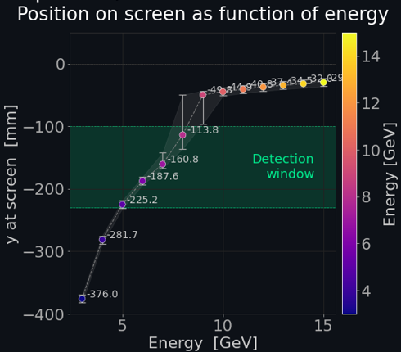
Preliminary Results

Slide 11
Conclusions & Outlook
Sampling calorimeters are well-suited for the detection of Multi-GeV beams from next-generation laser-plasma wakefield accelerators, offering a compact alternative where conventional magnetic spectrometers become impractical.
Preliminary unfolded results from ELI-NP indicate electron energies between 5 GeV and 8 GeV, consistent with the calorimeter's physical detection window. These results used a parametric model to guide the unfolding. A model-free approach is being considered (Covariant Matrix optimization or Bayes-based for example).
Calorimeters also act like beam dumps or muon converters, and provide secondary measurements of the beams, so why not use them?
Acknowledgments
This material is based upon work supported by the National Science Foundation under Grant No. PHY-23008921, by the Department of Energy under Grant No. DE-SC0011617 and by the Extreme Light Infrastructure for Nuclear Physics in project ELI50122.

