Slide 1

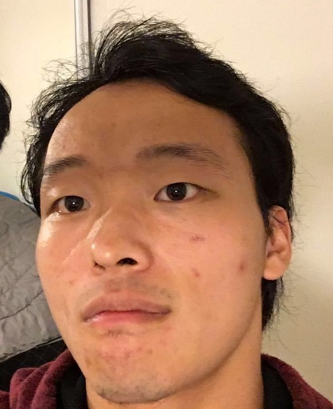
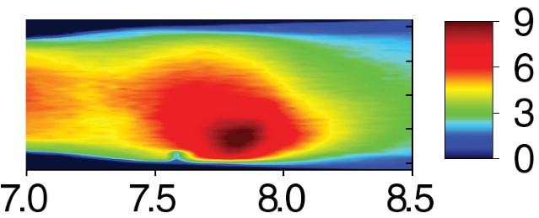
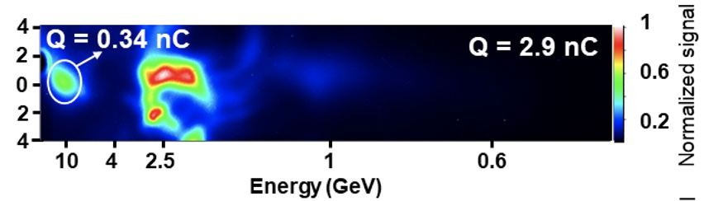
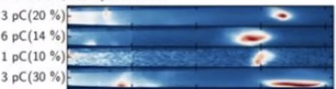

Compact electron spectrometry for tens-of-GeV laser-plasma accelerators
Advanced Accelerator Concepts Workshop – UCLA - July 26-31, 2026
Xiantao Cheng, Jose Franco Altamirano, Aaron Bernstein,
Rafal Zgadzaj, Michael Downer
Xiantao Cheng
PhD 2024
~ 10 GeV LPA electron results
Calin Hojbota
This Workshop
Plenary WG1 Mon 8:45am
LBNL
Gonsalves,
pC mrad⁻¹
GeV⁻¹
U. Md.
LBNL
PRL 122, 084801 (2019)
Texas
Anaculaesei, Matt. Rad.
Extremes 9, 014001 (2024)
Picksley, PRL 133, 255001 (2024)
Shrock, PRL 133, 045002 (2024)
1
angle
(mrad)
0
6 pC
ELI-NP
~17GeV
-1
E_{e} (GeV)
Pathways to 20-30 GeV (SLAC-like) LPA electron bunches:
• hybrid LWFA/PWFA
• multi-staging

Slide 2
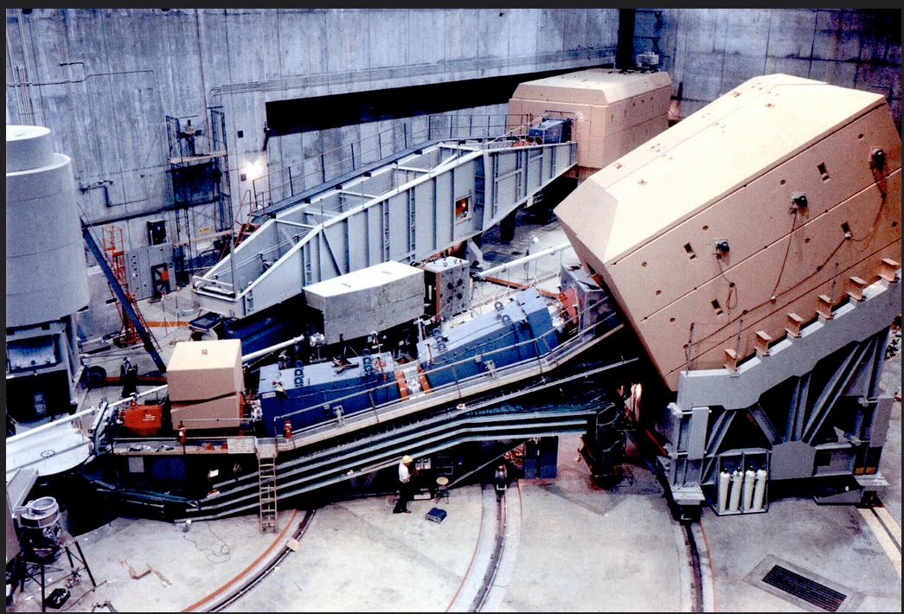
SLAC 30 GeV e-spectrometer
Multi-meter, multi-ton magnetic e-spectrometers
compromise the unique virtues of LPAs:
• compactness
• low expense

Slide 3
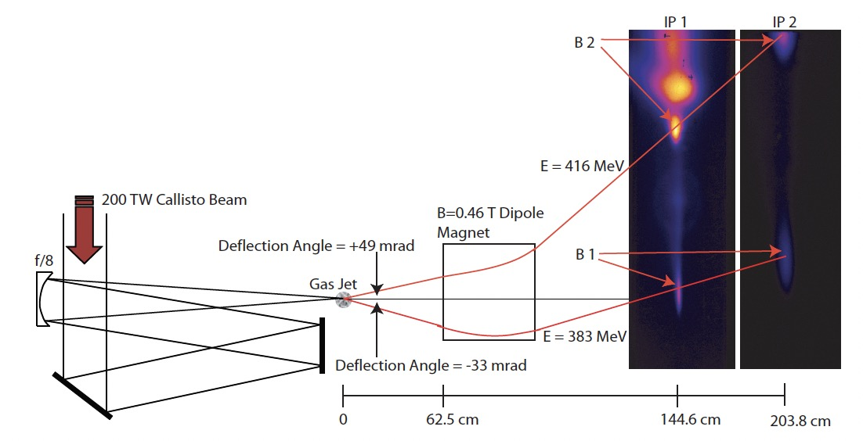
Dual-screen magnetic spectrometers help to deconvolve
electron launch angle variations from energy variations...
B. Pollock et al., “Two-screen method for determining electron beam energy and deflection from laser wakefield acceleration,”
Particle Accelerator Conference (2009)
Shape of peaks
changes between
screens.
Resulting errors
in electron energy
determination
increase rapidly
for E_{e} ≳ 3 GeV.
...but are limited in accuracy because they rely on
diffuse spectral features of the e-beam.

Slide 4
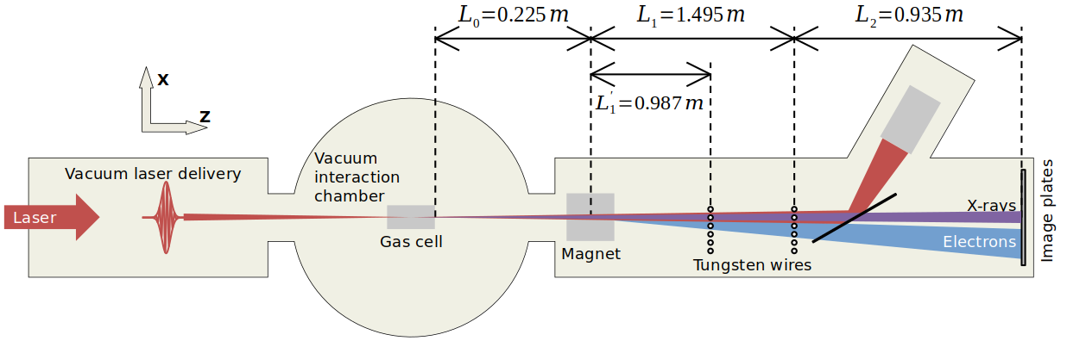
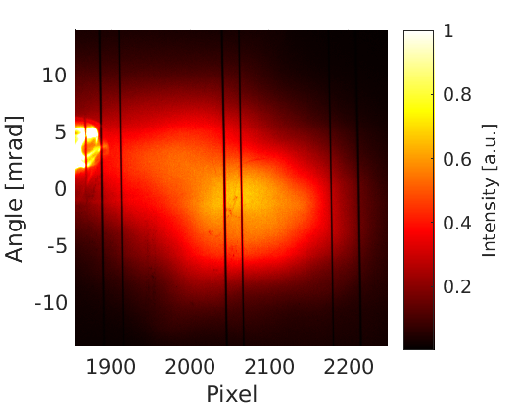
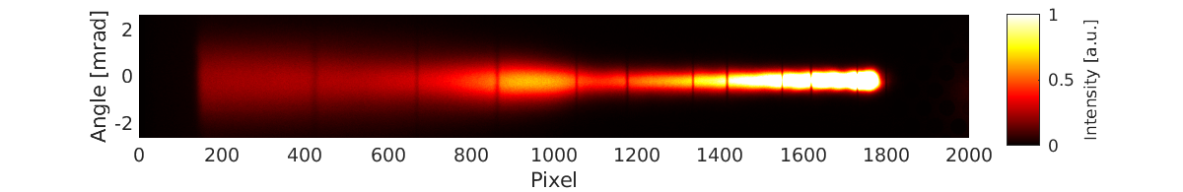




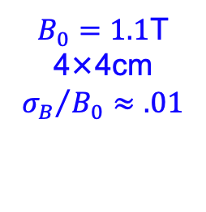

Fiducial wire e-spectrometer at Texas PW Laser
1st prototype deployed:
Wang et al., Nat. Commun. 4, 1988 (2013)
“compact”
$$L=L_{0}+L_{1}+L_{2}≲3m$$
e⁻/X-ray
source
location:
$$σ_{0}^{(⊥)}≈75µm$$
2 wire
arrays
150 J,
150 fs
f/45
Fujifilm
BAS—IP
50 or 100µm
pixels
7 cm
$B_{0}=1.1$T
4×4cm
$${σ_{B}}/{B_{0}≈.01}$$
diameter: 127 µm
$$σ_{s}≈20µm$$
$σ_{f}^{(⊥)}≈25µm$ (ISO 2768 CNC machining precision)
× 0.1
$β$-tron X-rays
electron signal
1

Slide 5
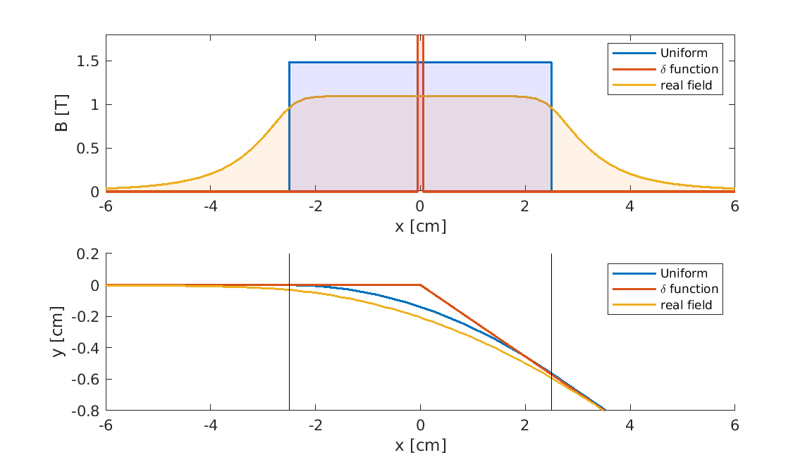
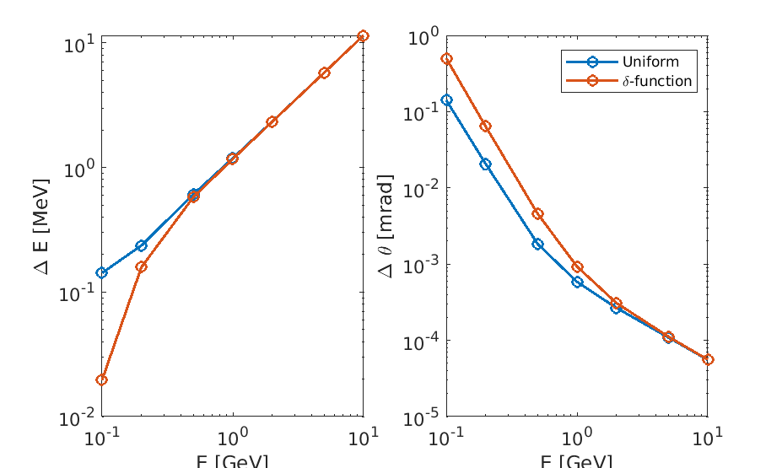
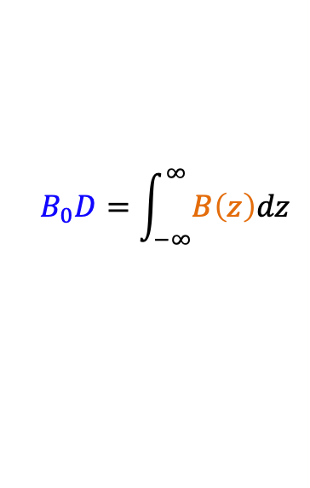
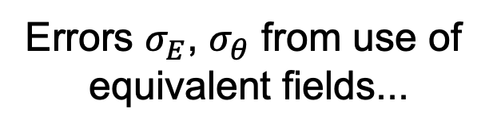

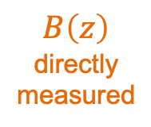


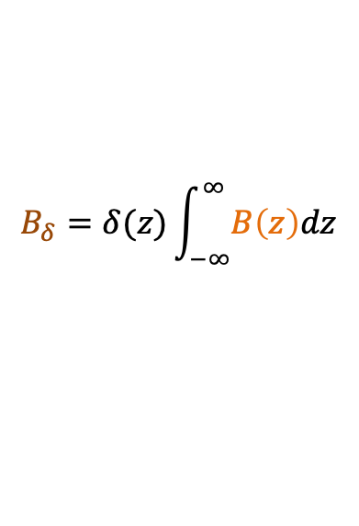





Magnetic field structure can be simplified at high e-energy
$$B_{0}D=\int_{−∞}^{∞}{B\left(z\right)dz}$$
$$B_{δ}=δ(z)\int_{−∞}^{∞}{B\left(z\right)dz}$$
Errors $σ_{E}$, $σ_{θ}$ from use of
equivalent fields...
$$B_{0}$$
$$D$$
$$B\left(z\right)$$
directly
measured
$z$ [cm]
*
$(z_{m}$,$x_{m})$
intra-magnet
e⁻ trajectories
$E$ [GeV]
$E$ [GeV]
...are negligible
$z$ [cm]
compared to contributions to $σ_{E}$, $σ_{θ}$ from variances in:
${• σ}_{0}^{(⊥)}≈75µm$ (source location)
• ${σ_{B}}/{B_{0}≈.01}$ (magnetic field)
• $σ_{f}^{(⊥)}≈25µm$ (fiducial wire positions)
• $σ_{s}≈20µm$ (shadow positions)
* pivot point

Slide 6
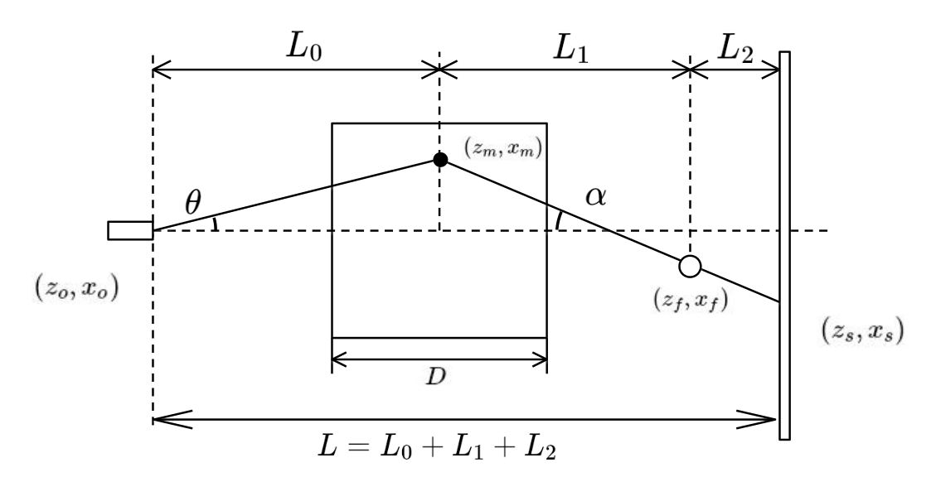
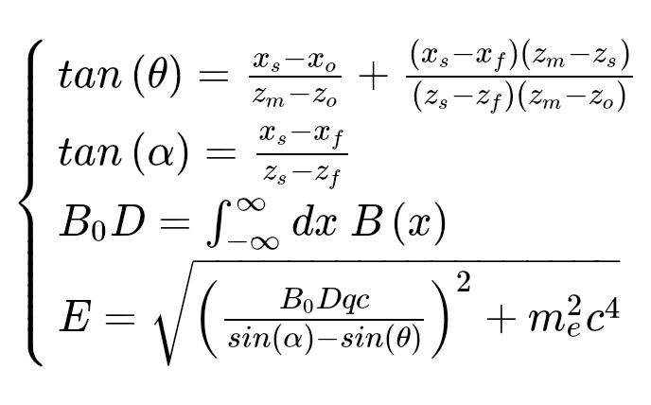
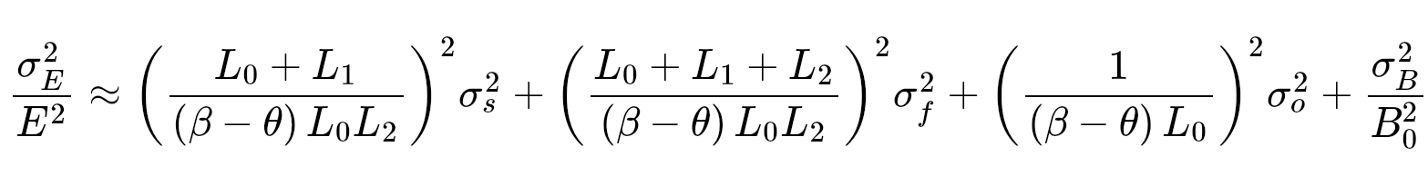

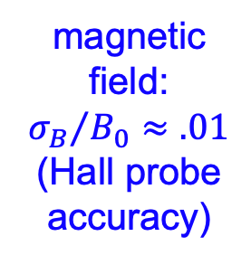

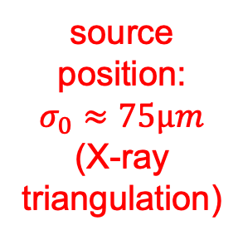


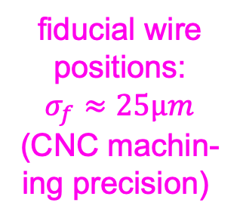

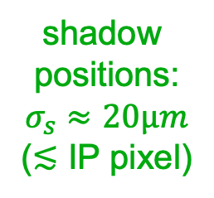


Estimation of measurement error
Electron trajectory formulas:
Error ($σ_{E})$ in electron energy propagates from errors in 4 independent variables:
$$σ_{B}^{2}$$
$$σ_{s}^{2}$$
$$σ_{f}^{2}$$
$$σ_{0}^{2}$$
$$α$$
$$α$$
$$α$$
shadow
positions:
$$σ_{s}≈20µm$$
(≲ IP pixel)
fiducial wire
positions:
$$σ_{f}≈25µm$$
(CNC machin-
ing precision)
source
position:
$$σ_{0}≈75µm$$
(X-ray
triangulation)
magnetic
field:
$${σ_{B}}/{B_{0}≈.01}$$
(Hall probe
accuracy)
3

Slide 7
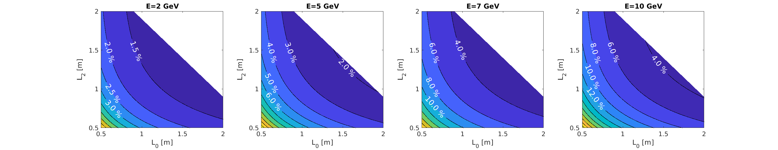
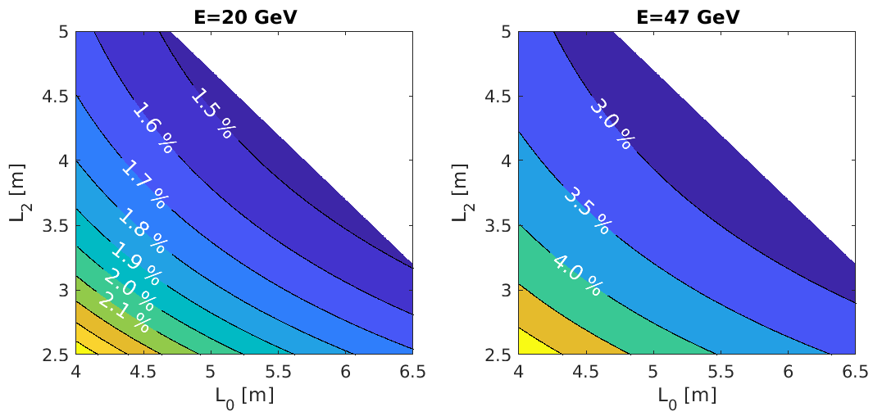
Measurement error contours ${(B}_{0}=1.5 T$)
D=5 cm
L=3 m
D=5 cm
L=3 m
Such contours are
essential for evaluating
spectrometer designs
for a specified energy
range (E), space (L),
and accuracy (∆E/E).
D=10 cm
L=10 m
D=10 cm
L=10 m
4

Slide 8
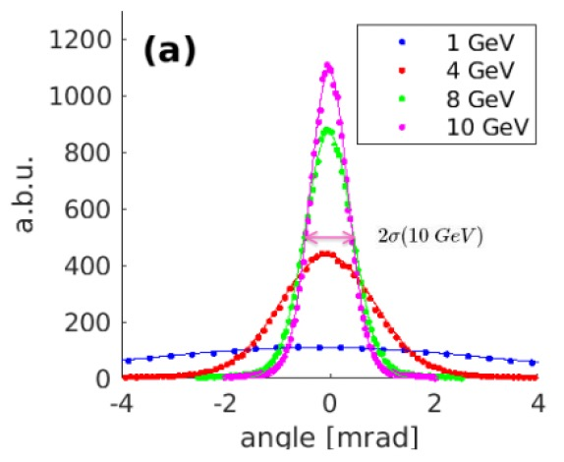
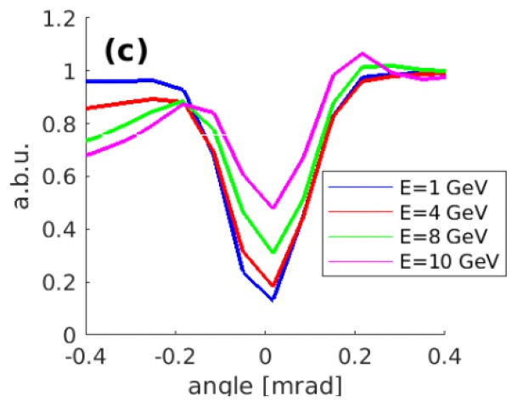
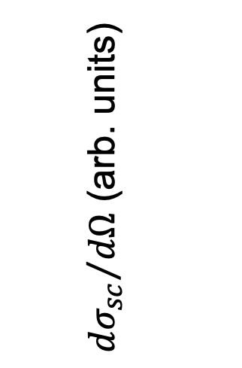
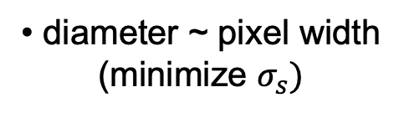
Design of fiducial wires
• cylindrical
(𝜃-independent)
• diameter ~ pixel width
(minimize $σ_{s})$
• high Z
(high-contrast shadow)
GEANT4 simulations reveal energy-dependent shadow shapes:
Relative recorded
brightness at detector
${dσ_{sc}}/{dΩ}$ (arb. units)
Energy-dependent shape & contrast of wire shadows provide
an independent (albeit coarse) e-spectrometer.

Slide 9
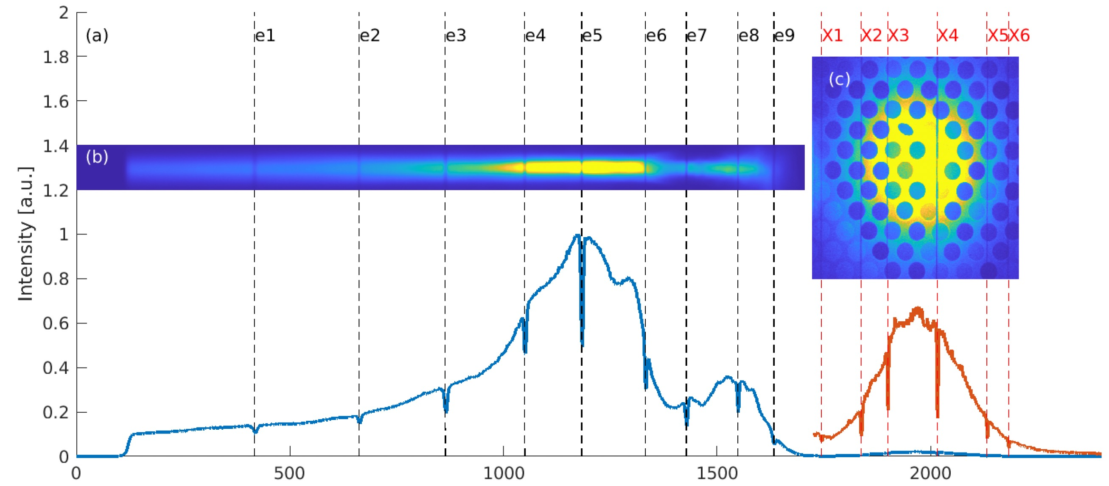
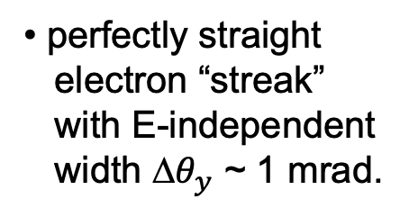
Everyday analysis of real data (Ex. 1)
Step 1) examine raw data
Ross filters for 𝛽-tron
X-ray spectrum analysis
• perfectly straight
electron “streak”
with E-independent
width ∆$θ_{y}$ ~ 1 mrad.
• Shadows e1-e9 on
e-streak; X1 – X6
on 𝛽-tron X-rays.
x [pixel no.]
~ 2 GeV

Slide 10
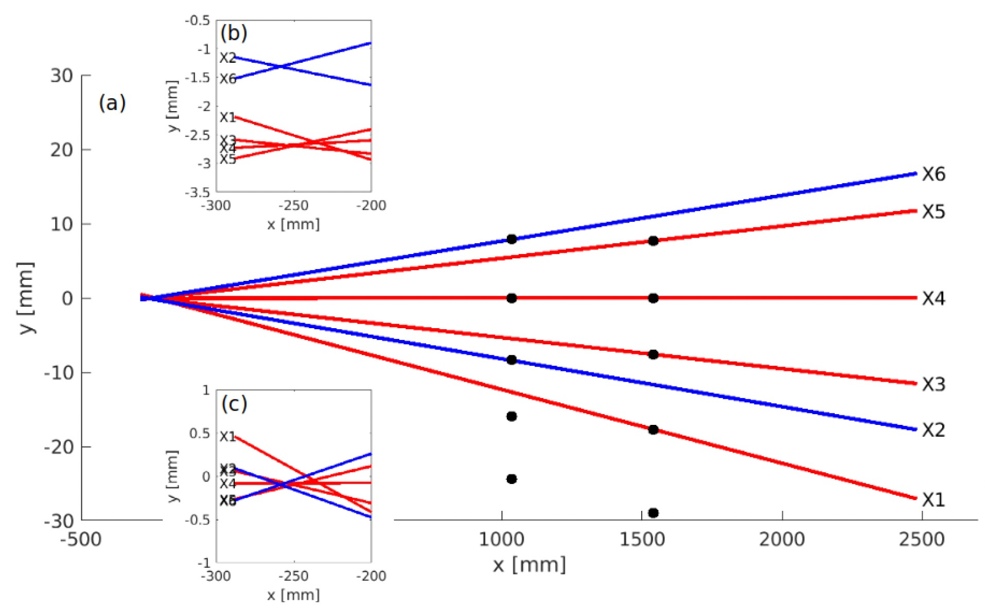
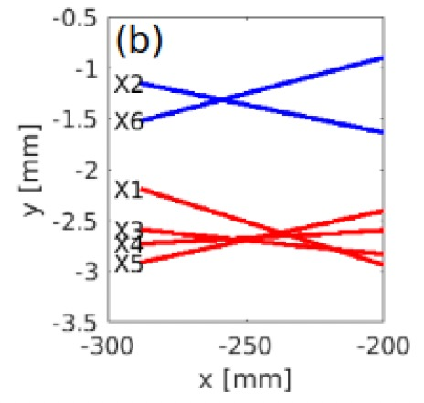
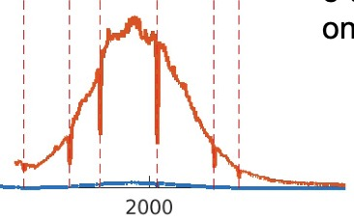
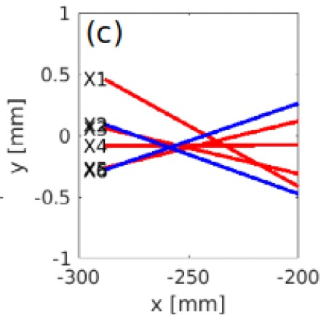
Everyday analysis of real data (Ex. 1)
Step 2) X-ray triangulation of source location
row 1
shadows
IP shifted ~1mm
due to loose fit in
holder.
1 mm IP shift
row 2
shadows
row 2
row 1
𝛽-tron X-ray data from IP
corrected for
IP shift
0
500
z [mm]

Slide 11
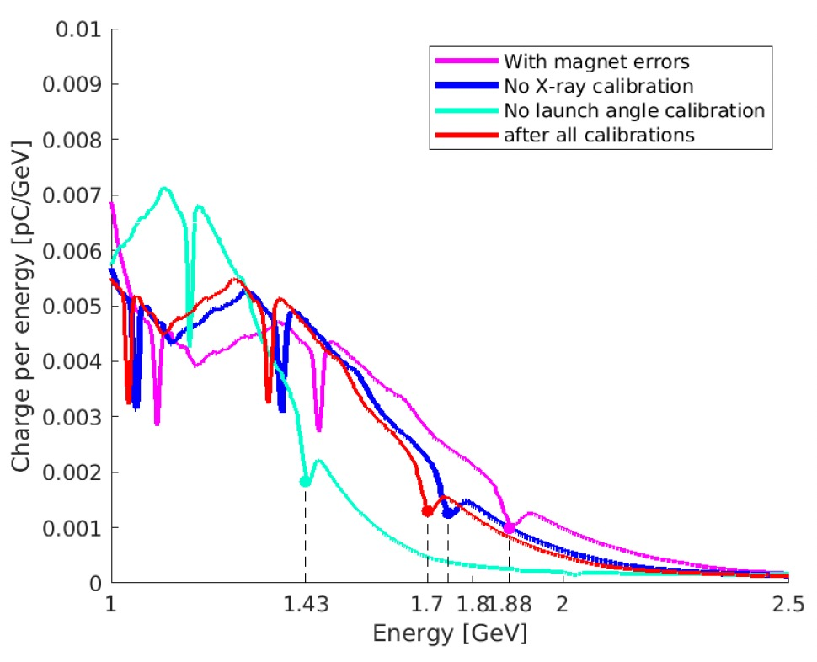
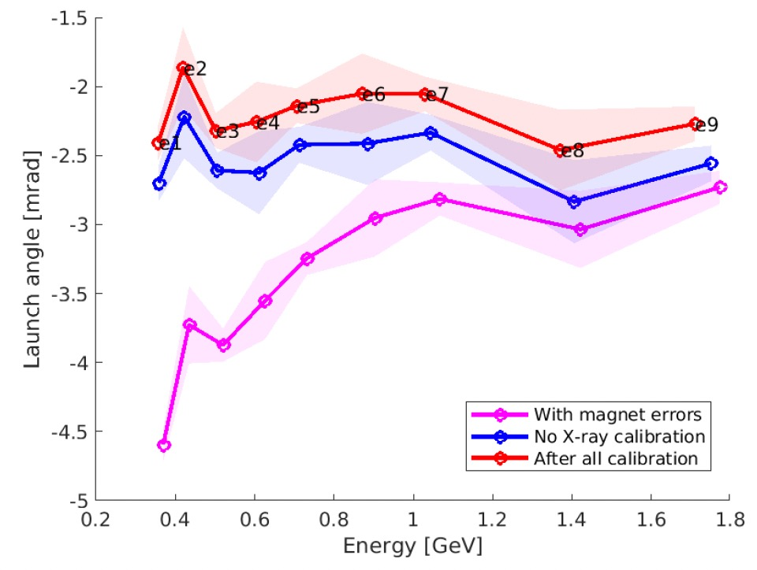
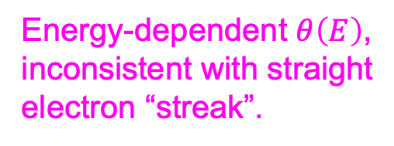
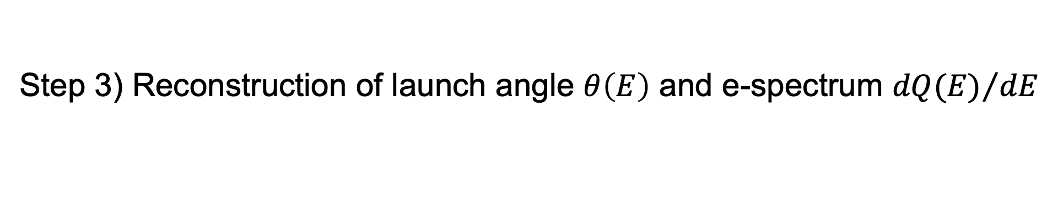
Everyday analysis of real data (Ex. 1)
Step 3) Reconstruction of launch angle $θ\left(E\right)$ and e-spectrum ${dQ(E)}/{dE}$
after correcting magnet
position error.
Energy-dependent $θ\left(E\right)$,
inconsistent with straight
electron “streak”.

Slide 12
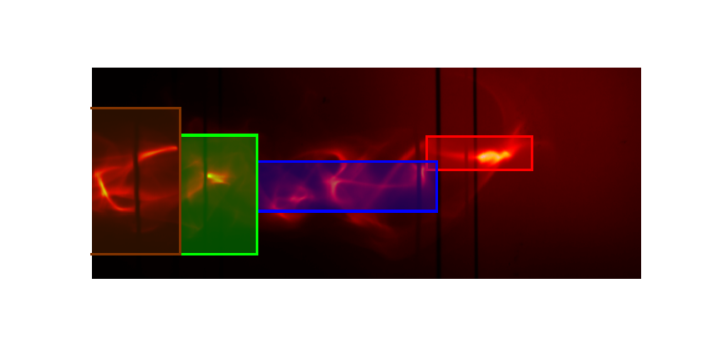
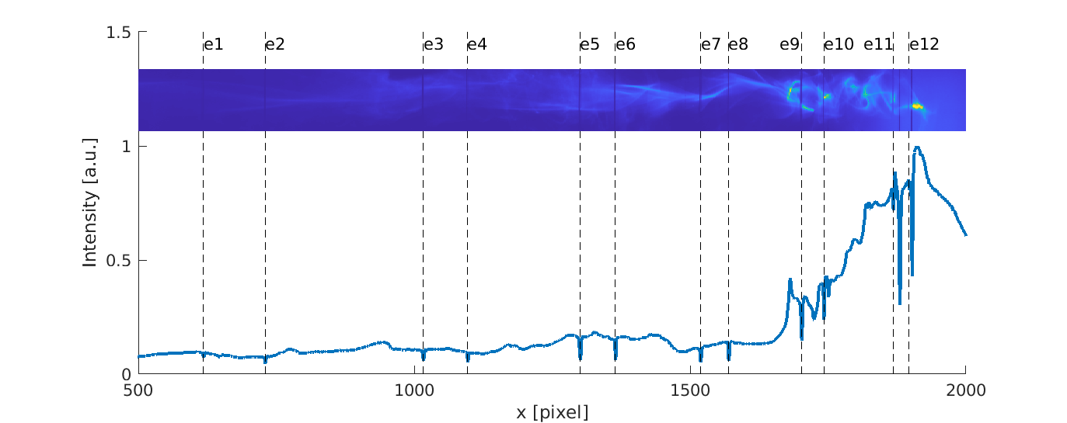
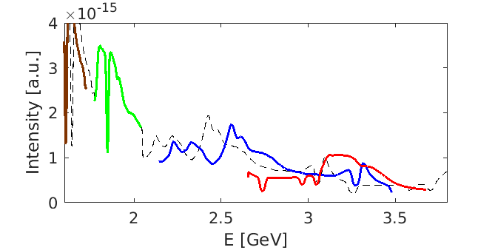
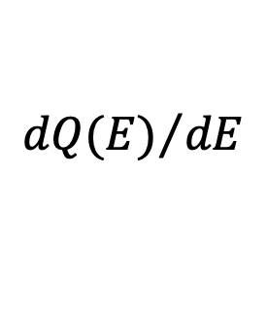
Ex. 2a: E > 3 GeV features + energy-dependent $θ\left(E\right)$
Anaculaesei et al. “Acceleration of high-charge electron bunch to10 GeV ni a 10cm nanoparticle-assisted wakefield accelerator,”
Matt. Rad. Extremes 9, 014001 (2024)
preliminary piece-wise
analysis of features with
different ∆y deflections.
$${dQ(E)}/{dE}$$
comprehensive
reconstruction
> 3 GeV
8

Slide 13
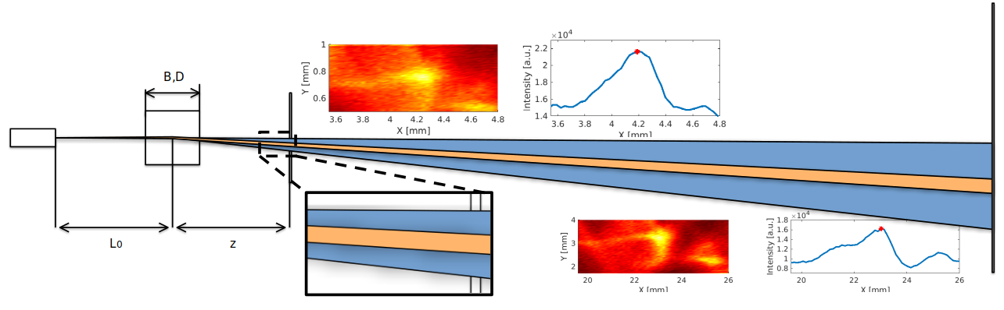
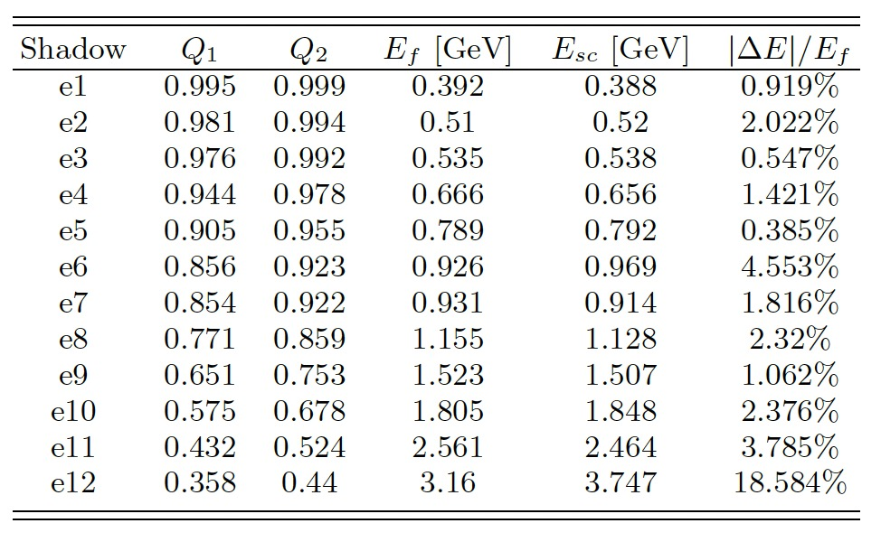
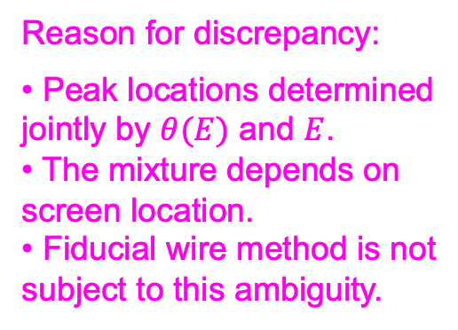
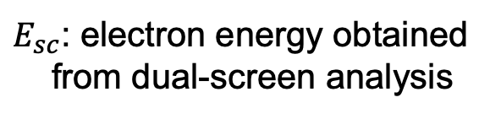
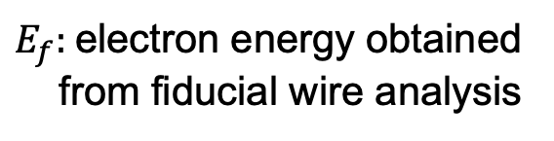
Ex. 2b: Comparison with simulated dual-screen measurement
E-beam from Ex. 2a, replicated in GEANT4, exposes 2 virtual screens.
screen 1
screen 2
Reason for discrepancy:
• Peak locations determined
jointly by $θ(E)$ and $E$.
• The mixture depends on
screen location.
• Fiducial wire method is not
subject to this ambiguity.
$E_{f}:$electron energy obtained
from fiducial wire analysis
$E_{sc}$: electron energy obtained
from dual-screen analysis
≤ 5%
discrepancy
large discrepancies for E ≳ 3 GeV
9

Slide 14


Ex. 3: “Zeeman” splitting of fiducial wire shadows
Studies of inverse Compton-scattered X-rays:
Hannasch et al., Sci. Rpts.11, 14368 (2021)
plasma
retro-
reflector
4 split shadows
close-up of split e6 shadow

Slide 15









“Zeeman” splitting analysis
Schumaker et al., “Ultrafast electron radiography of magnetic fields in high-intensity laser-solid interactions,” PRL 110, 015003 (2013)
Raj et al., “Probing ultrafast magnetic-field generation by current filamentation instability in fs relativistic laser-matter interactions,” PR Res 2, 023123 (2020)
⊗
$$B_{surf} \sim 7kT$$
depth ~ 10 µm
total angle $θ\left(E\right)$entering magnet
(launch + PM deflection)
Separated spectra ${dQ(E)}/{dE}$ of HE and LE electron bunches
Total angle [mrad]
7

Slide 16






Fiducial wire spectrometer at ELI-NP
C. I. Hojbota (PI), O. Z. Labun, D. D. Phan, R. Sain, D. Stec, B.M. Hegelich
A. J. Franco-Altamirano, T. Araujo, Ross Rudzynsky, Afsana Mimi Raka, Erick Martinez, Bryan Dinh, R. Zgadzaj, M. C. Downer
B.Hidding, C. Aniculaesei, M. Cerchez, M. Osenberg, O. Bilen, T. Heinemann, E. Hartmann, N. Thomas, T. Wilson, A. Pukhov
P. Franke, T. Ha, E. McCary, S. Milton, L. Labun, J. Paye, C. Neacsu, G. Tiwari, G. Plateau, H. Smith
V. Winter
B. Diaconescu (Co-PI/LER), L. Tudor, V. Nastasa, L. Neagu, S. Balascuta, K. Sphor, P.G. Bleotu, V. Phung Ling Jen, C. Ticos, S. Ter-Avetisyan, M. Patrascoiu, M. Gugiu, S. Popa, V. Popescu, D. Ursescu, A. Dumitru, L. Vasescu, A. Nazaru, D. Nistor, S. Rusnac, A. Lazar, R. Schmelz, I. Dancus, P. Ghenuche (Co-PI), V. Malka, C.A. Ur, et al.

Slide 17


Double dipole configurations
Two dipoles - enhanced dispersion
B
B
Fiducial wire array
Half chicane – lower dispersion
B
B
Fiducial wire array

Slide 18





Fiducial wire shadow visability
Monoenergetic e-bunches, 1mrad beam divergence, 100 μm spatial resolution of detctor, for 250 μm W wires
125 μm diam. W wire
10GeV
15GeV
25GeV
250 μm diam. W wire

Slide 19

Fiducial wire shadow with finite bandwidth and divergence are shallower but still detectable
Uniform spectral density 10GeV – 14GeV
125 μm diam. W wire
250 μm diam. W wire
Fiducial wire shadow projection

Slide 20

SUMMARY
• The fiducial wire spectrometer provides a low-cost, versatile, small-laboratory method for
determining energy and launch angle of electrons from pointing-unstable LPAs with few-%
accuracy up to tens of GeV.
• Avoids reference to diffuse spectral features of the beam itself.
• We have developed principles for...
...designing fiducial wires
...optimizing accuracy
...analyzing spectral errors
• We have shown that individual fiducial wire shadows independently measure...
...electron energy
...angular divergence
...magnetic fields from intense
laser-matter interactions
...pointing angle
...electron density
X. Cheng et al., “Compact high-resolution multi-GeV electron spectrometer for PW-laser-driven plasma accelerators,” - forthcoming.
X. Cheng,”Advanced diagnostics of laser-driven plasma accelerators,” PhD Thesis, U. Texas at Austin.
Financial support: US Dept. of Energy grant DE-SC0011617.

Slide 21

Shadow visibility vs. E and L₂ (GEANT4 simulations)
d = 0.127 mm, tungsten (W)
5

