Slide 1



Characterizing a Gas-Ionization Platform for Single-Shot Beam Diagnostics
T. Nichols*¹, P. Denham¹, P. Musumeci¹, G. Andonian^{1,2}
1 University of California Los Angeles, Los Angeles, CA, USA
2 RadiaBeam Technologies, Santa Monica, CA, USA
*Contact: travisnichols@ucla.edu

Slide 2
Talk Outline
Motivation for ionization-based beam diagnostics
Design of the gas sheet monitor
Preliminary experimental results
Redesign goals and improvements
Live work

Slide 3
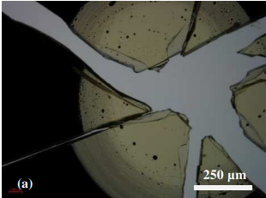
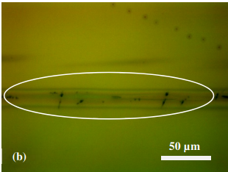
Motivation for minimally invasive single-shot diagnostics
High intensity beams cause damage to conventional diagnostics
Koch & Grünert (2023)
Desired Diagnosable Quantities:
Charge — 0th moment (∫ρ dx)
Position — 1st moment (⟨x⟩, beam centroid)
Spot size — 2nd moment (⟨x²⟩ − ⟨x⟩², rms width)
Injector
Single-Shot Diagnostic
Application
(FEL, Wakefield, ect)
e-
e-
e-
e-
useful for fast corrections to injector line
useful information for shot to shot fluctuation

Slide 4
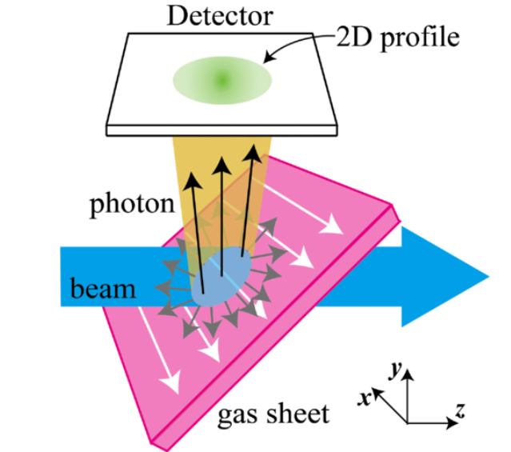
Ionization-Based Monitors (Decades of use in rings & high-intensity accelerators)
Prior Approaches (detect fluorescence)
Ionization of trace amounts of residual gas in the vacuum provides information about beam.^{1,2,3,4,5}
In some cases, gas is injected into chamber to boost signal⁶
Photons emitted in all directions → poor collection efficiency^{7,8}
Low signal: needs long integration over many shots → not truly single-shot^{7,8}
Light cannot respond to EM fields and thus there are no options for velocity mapping
Our Approach (Detect ions & e⁻ )
Redirected by bias voltage, focused by an electrostatic lens column → much higher collection efficiency
Detect on a micro-channel plate → boost signal
Single-shot recovery of charge, position & spot size
Enables modular magnification and velocity mapping modalities
Interchangeable gas nozzle allows for custom interaction geometries
[1] F. Hornstra & W. H. DeLuca, Proc. VI HEACC (1967). [2] B. Hochadel et al., Nucl. Instrum. Methods A 343, 401 (1994). [3] I. Yamada et al., Phys. Rev. Accel. Beams 24, 042801 (2021). [4] V. Shiltsev, Nucl. Instrum. Methods A 986, 164744 (2021). [5] P. Scherkl et al., Phys. Rev. Accel. Beams 25, 052803 (2022). [6] V. Tzoganis & C. P. Welsch, Appl. Phys. Lett. 104 (2014). [7] A. Variola, R. Jung & G. Ferioli, Phys. Rev. ST Accel. Beams 10, 122801 (2007). [8] A. Salehilashkajani et al., Appl. Phys. Lett. 120 (2022). [9] P. Denham et al., Phys. Rev. Accel. Beams (2024).
Image Source [3]

Slide 5
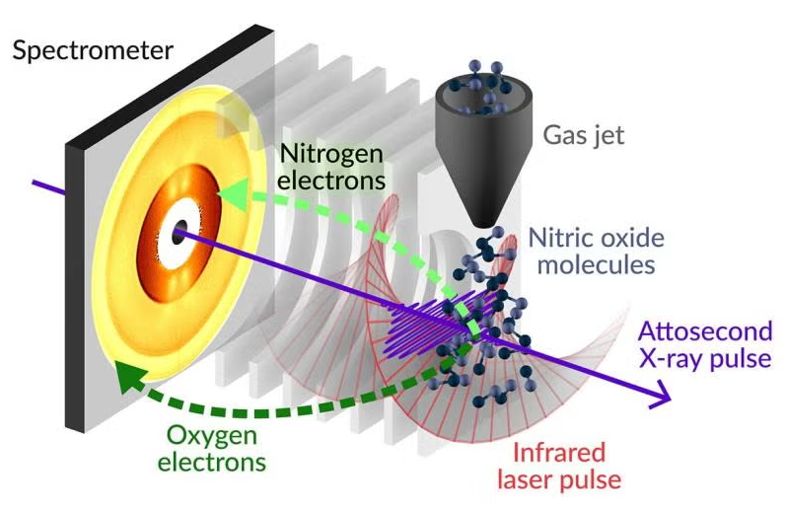
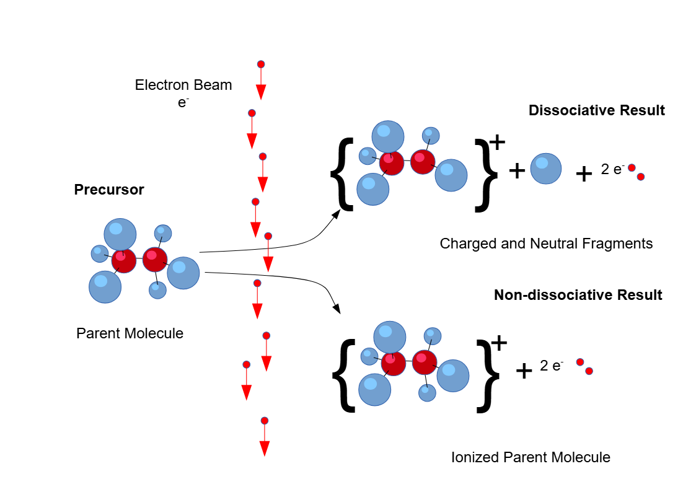
Beyond transverse diagnostics: a versatile platform
The ionization mechanism (field vs. impact-ionization) balance is set by the bunch's peak space-charge field, making the ionization signature a sensitive probe of peak current and longitudinal compression
Streaking the ionization products maps arrival time → transverse position, recovering the single-shot temporal current profile and bunch length
Resolution of multiple ionization products via different ionization mechanisms. This device also acts as a platform to investigate the physics of different ionization pathway
S. Li (2022)

Slide 6
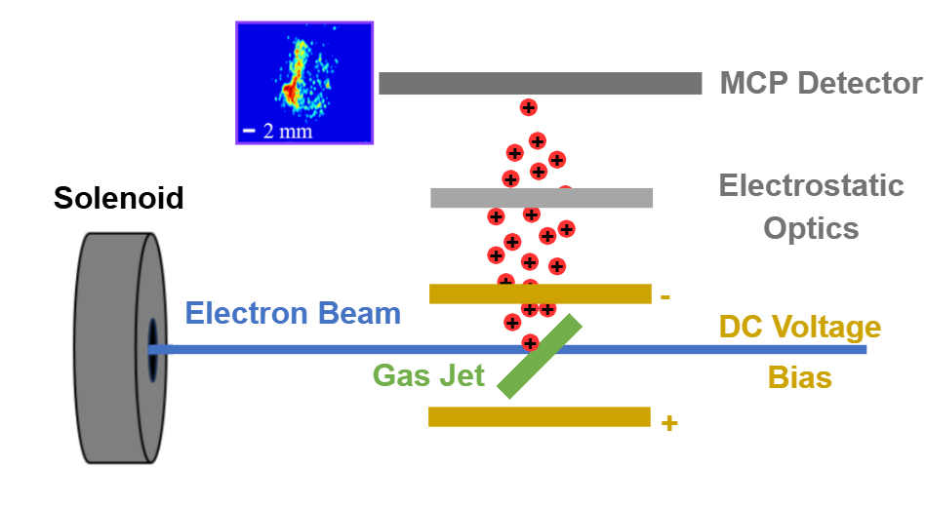
Gas Sheet Monitor (GSM)
Electrostatic optics tunable for imaging and velocity mapping
Imaging ions or electrons possible by inverting polarity of voltage bias

Slide 7
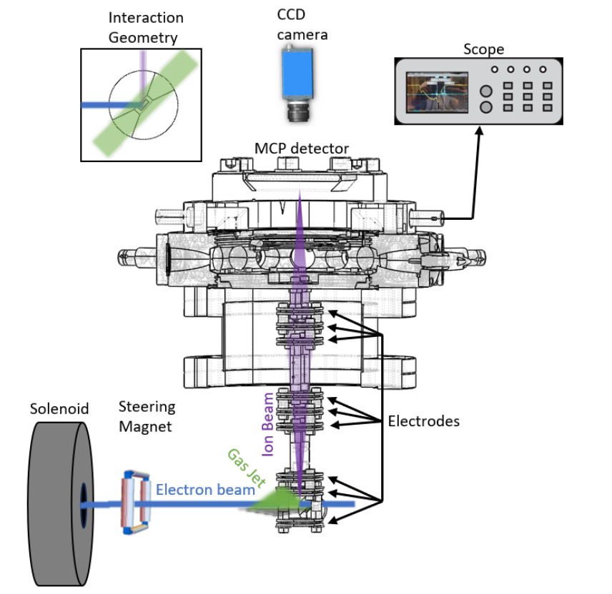
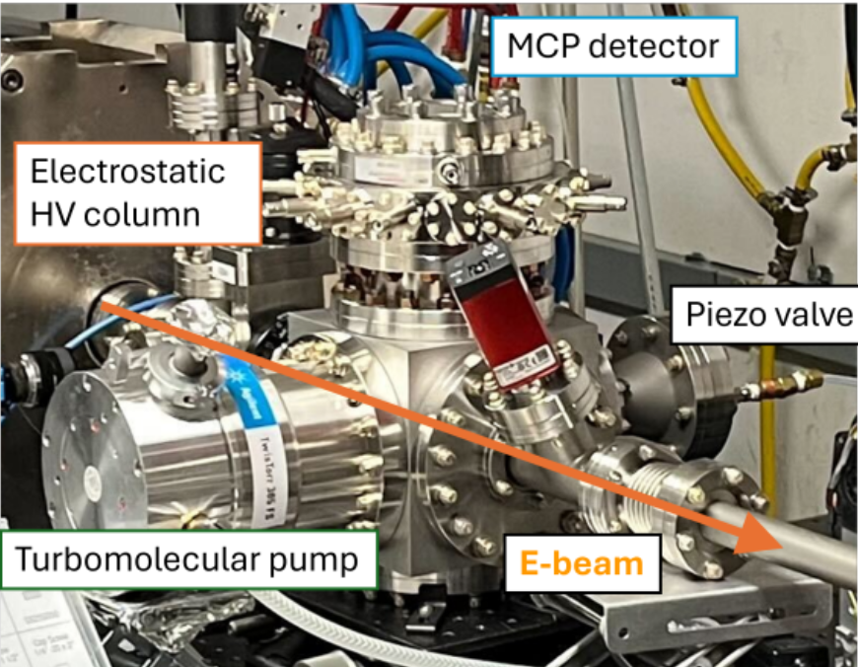
Gas Sheet Monitor (GSM) schematic

Slide 8
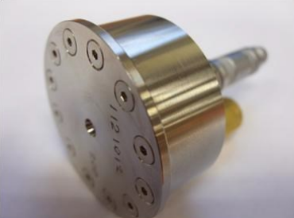
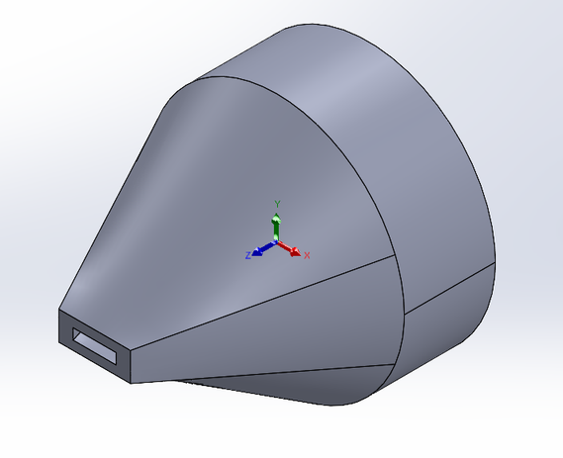
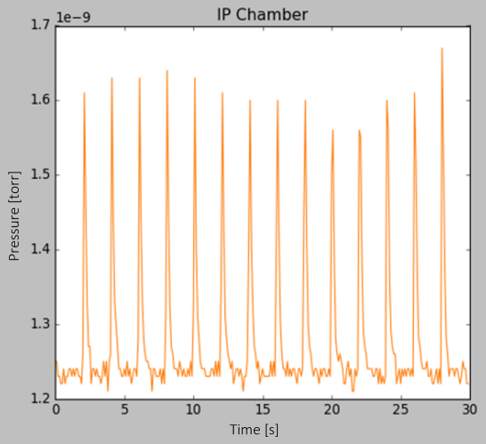
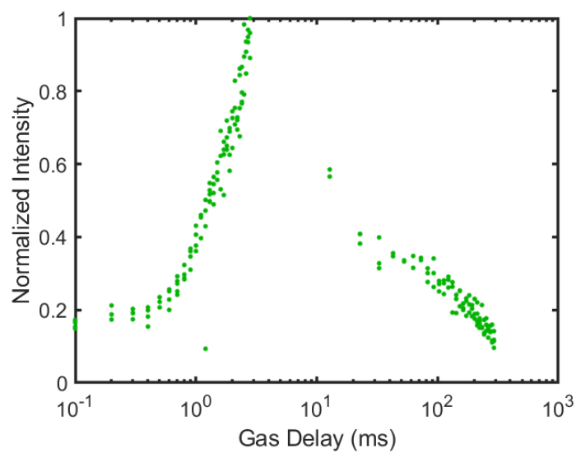
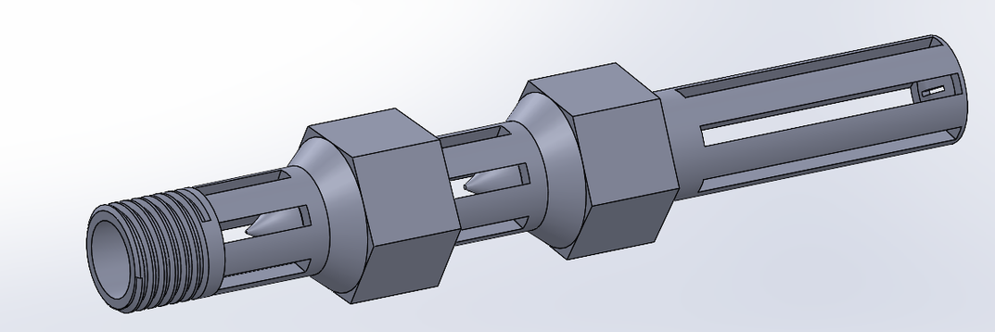
Gas: shape, timing, and vacuum considerations.
Piezo valve produces 40-400μs pulses nitrogen gas
Nozzles shape gas into a sheet ~500μm with density ~ 10¹⁵cm⁻³
Short pulses decrease load on turbomolecular pumps to maintain vacuum
Gas trigger is tunable to ensure highest gas density at the beams time of arrival
P. Denham (2024)
N. Burger (2022)

Slide 9
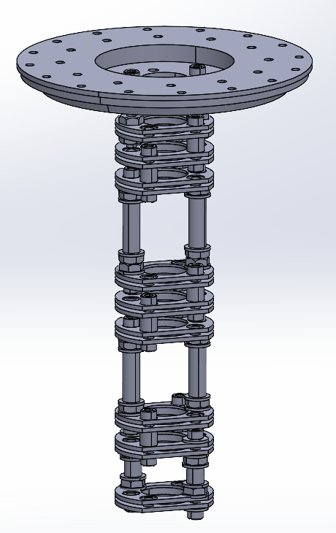
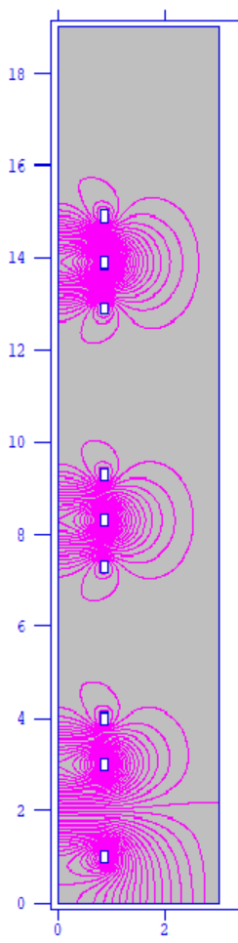
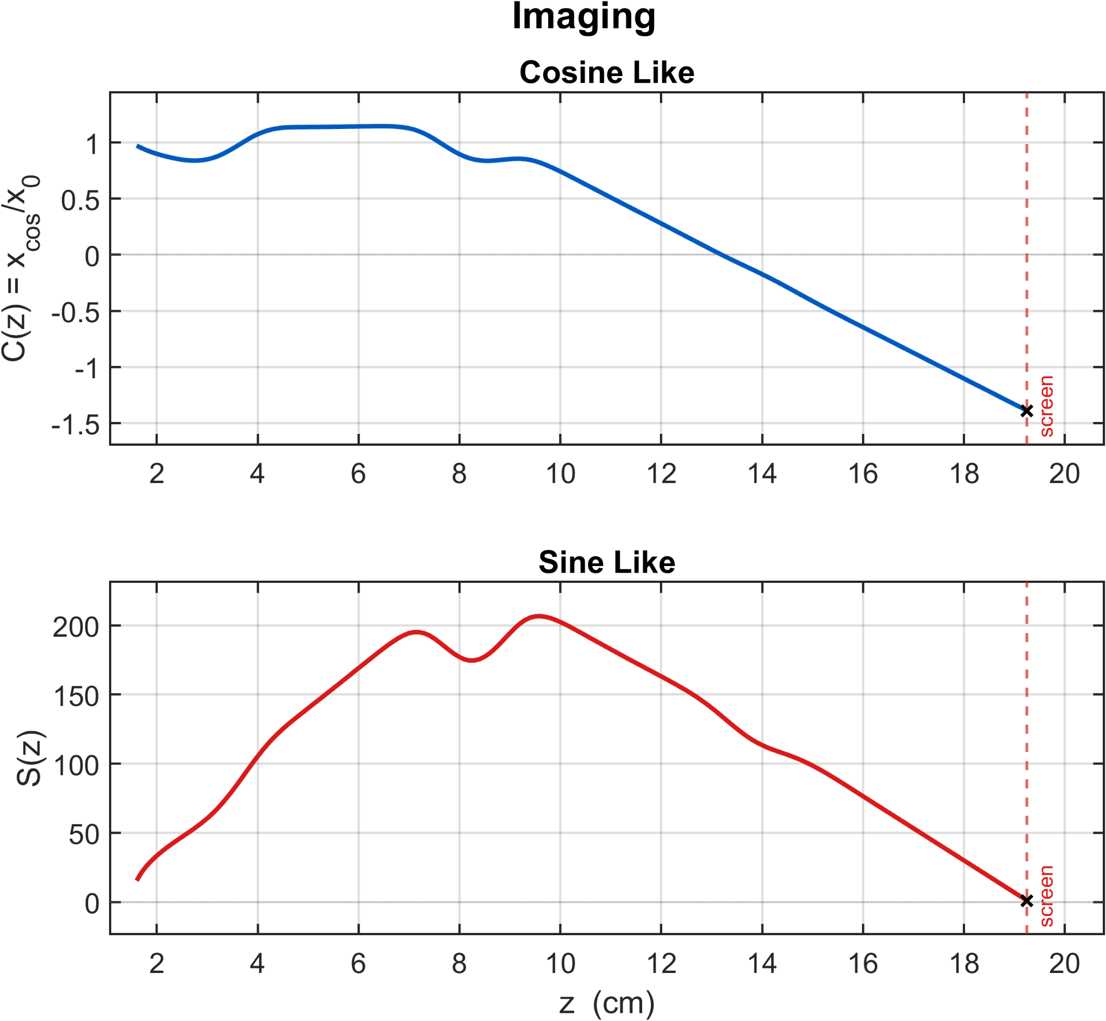
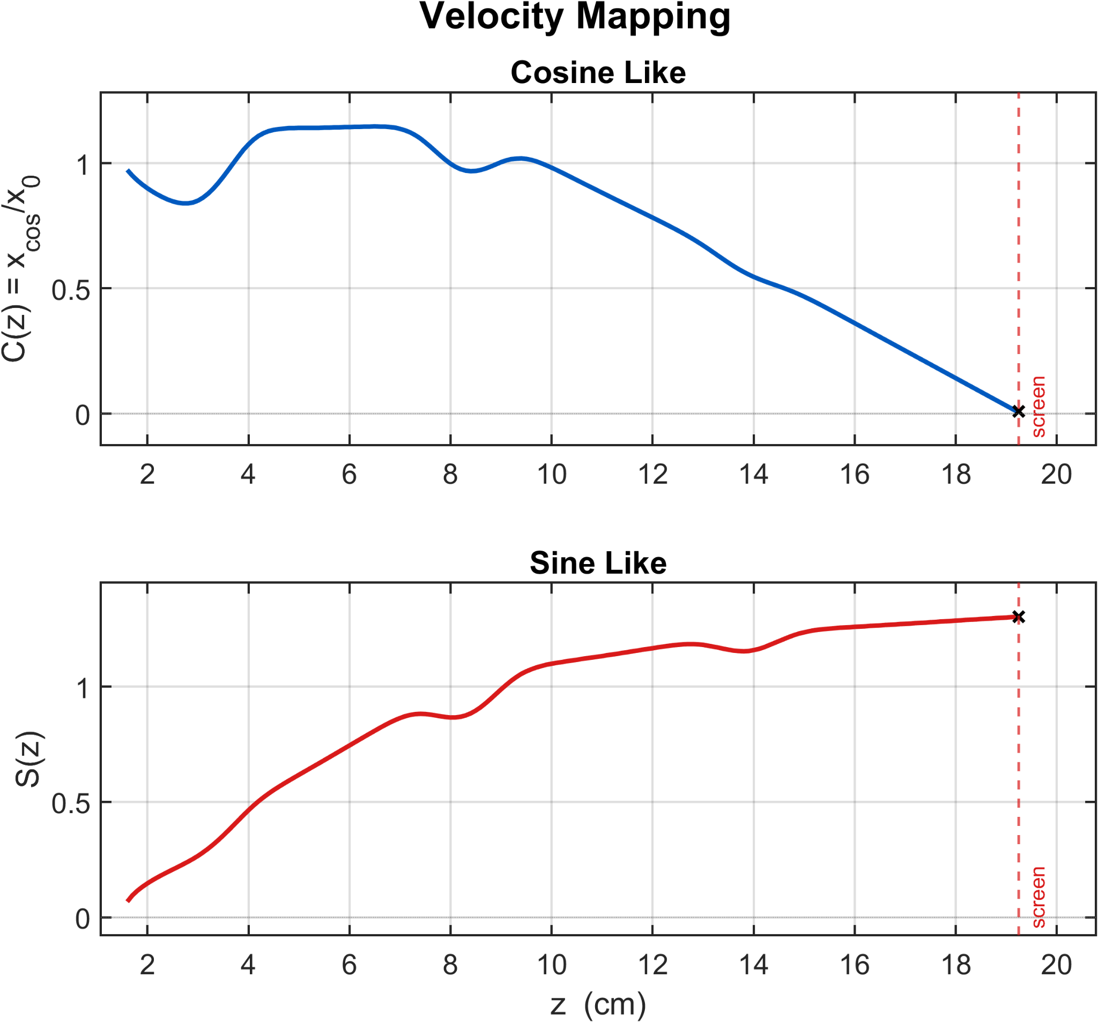
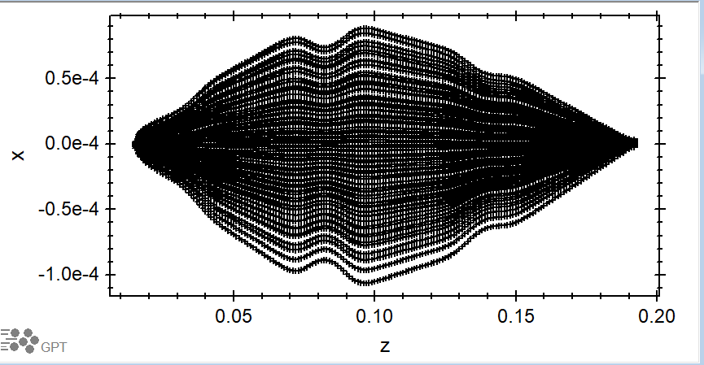
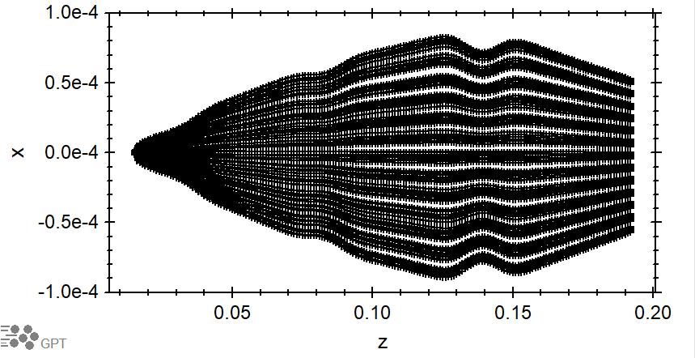
Electrostatic Lens Column
Create fieldmaps in Poisson Superfish then model transport in GPT
Confirm imaging and velocity mapping with cosine-like and sine-like ray tracing
{
Einzel Triplet 2
{
Einzel Triplet 1
{
Repeller, Extractor, and Collimator

Slide 10
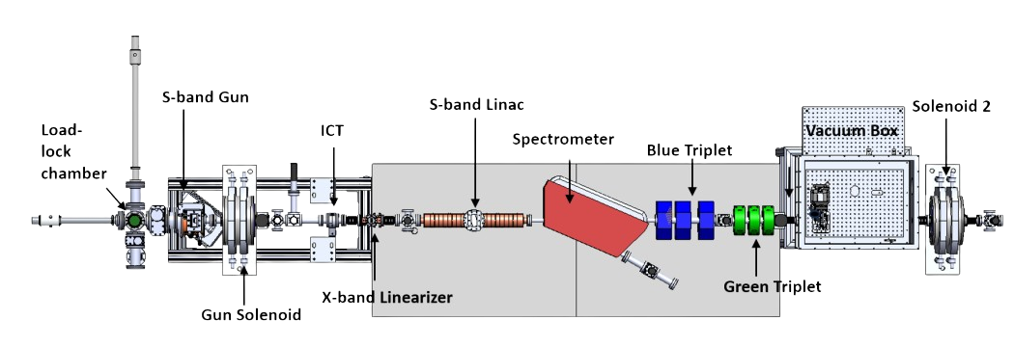
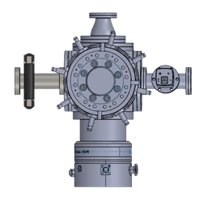
PEGASUS Beamline (8 MeV · 1 fC–500 pC · tunable transverse and temporal size)
Ti:sapphire drive laser — 780 nm, 40 fs; frequency-converted to UV onto a high QE photocathode
S-band RF photogun — 75 MV/m gradient → 3.2 MeV, up to 500 pC/bunch; differential pumping keeps gun at ≤10⁻⁹ Torr for cathode
Solenoid 1 + booster linac — focus and accelerate beam to 7 MeV
Solenoid 2 + steering magnet — transverse focus into the interaction chamber; steering sets the e-beam / gas-jet interaction point
Gas Sheet Monitor — diagnosis of beam charge, position and spot size
Gas Sheet Monitor
Steering Magnet

Slide 11
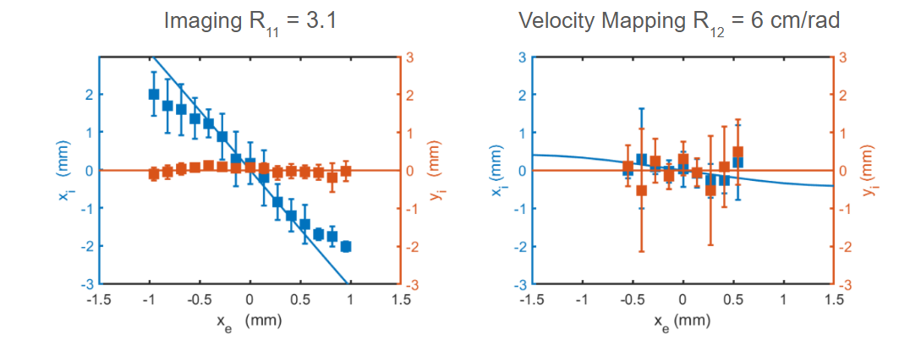
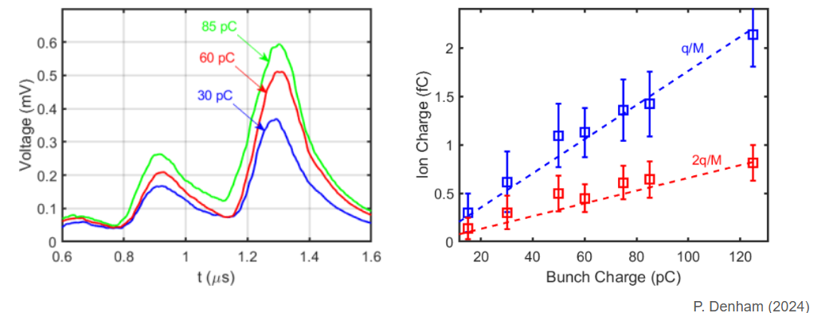
Preliminary experimental results
▪ Sweeping the beam through the jet confirmed imaging (R₁₁ = 3.1) and velocity-mapping (R₁₂ = 6 cm/rad) modes.
▪ Ion charge scales linearly with bunch charge; two scope peaks → singly and doubly ionized nitrogen.
Promising results, with areas for improvement.
▪ The gas-jet shape is largely unknown. Thus measurements can be clouded by the change in gas density rather than a change in beam dynamics
▪ Magnification and R12 for velocity mapping are both too low for desired applications

Slide 12
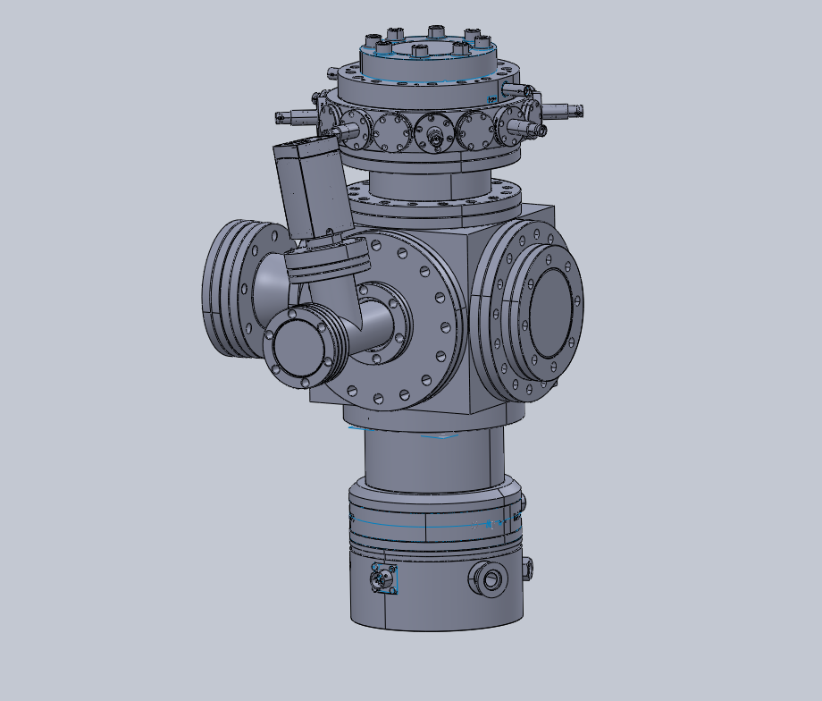
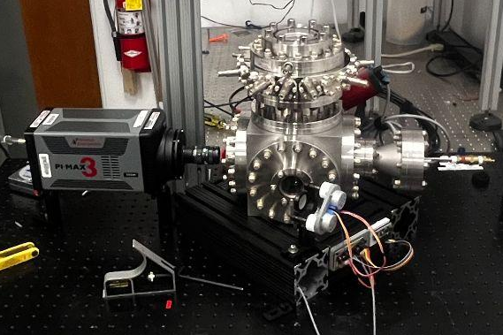
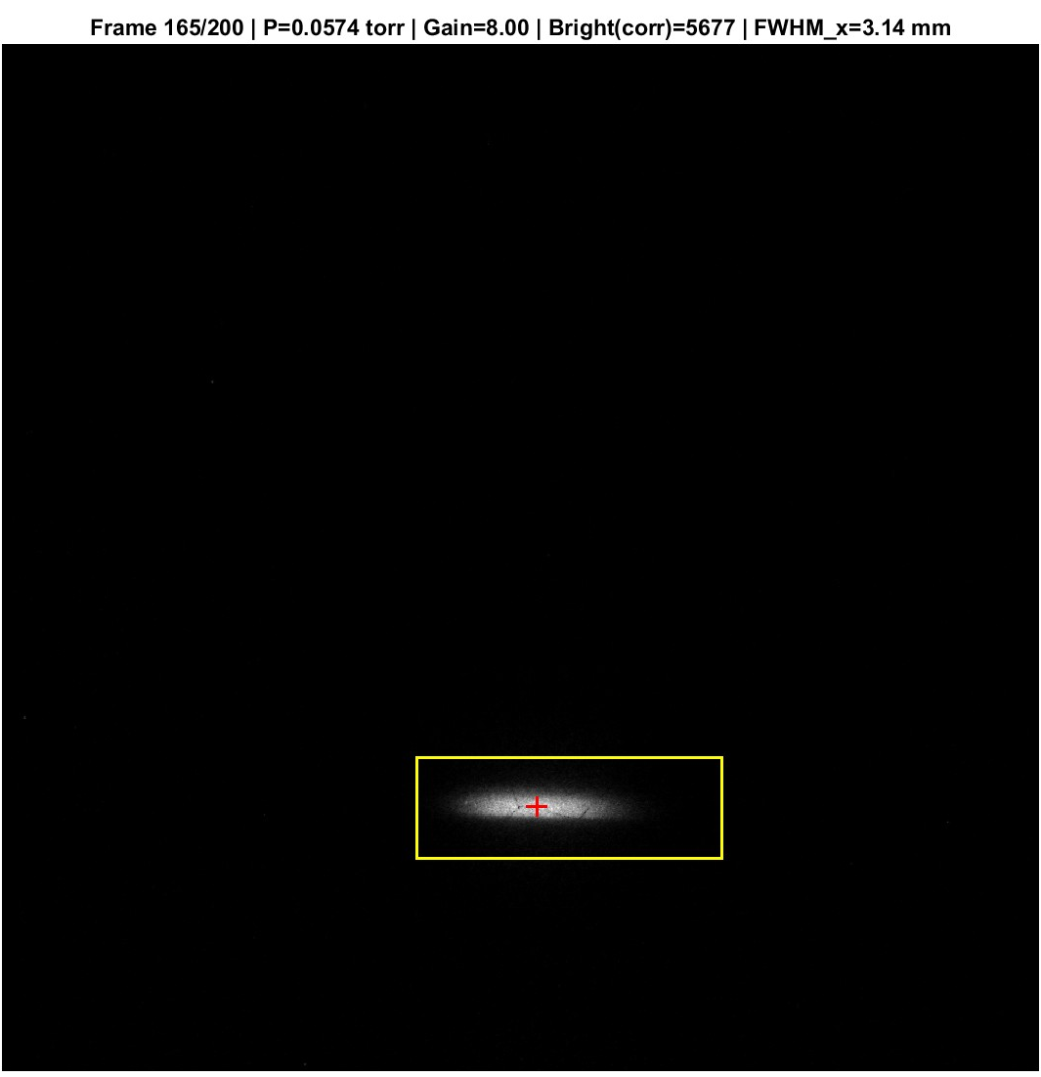
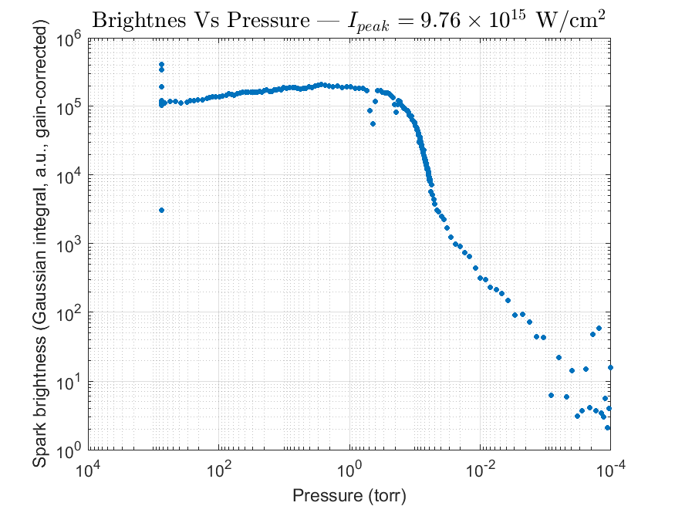
Diagnostic for mapping the gas density profile
25cm focusing optic is used to focus 800nm, 0.5mJ, 40fs, laser pulse to 14μm. Intensity above multiphoton ionization threshold
Plasma Ions and electrons recombine, emitting light
PIMAX 3 intensified camera images the recombination spark
Piezo mirror sweeps the laser focus in two directions combined with a translation stage for a 3D scan
Plasma Brightness to Pressure Calibration:
Decrease background pressure in chamber and image plasma
Ideal gas law gives us a calibration from integrated brightness to local particle density
MCP detector
Electrostatic column
Piezo Valve
PIMAX 3
widow
Laser
Turbomolecular Pump
Focusing lens
on translation stage
Piezo mirror
PIMAX 3
Gas Nozzle

Slide 13
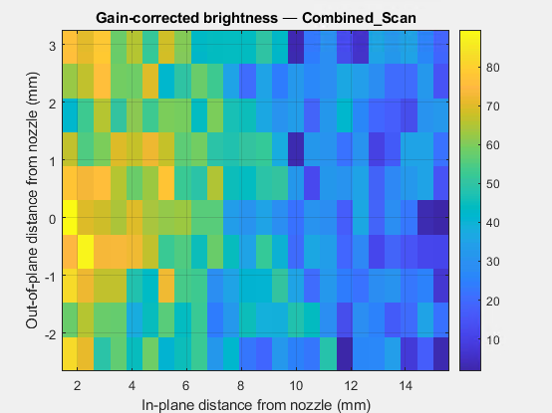
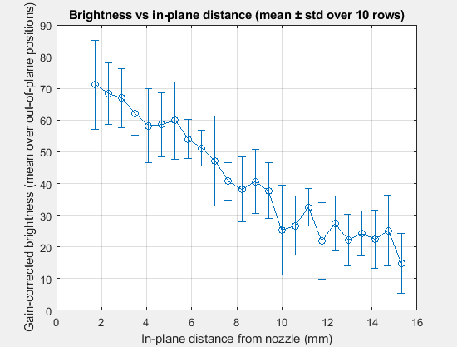
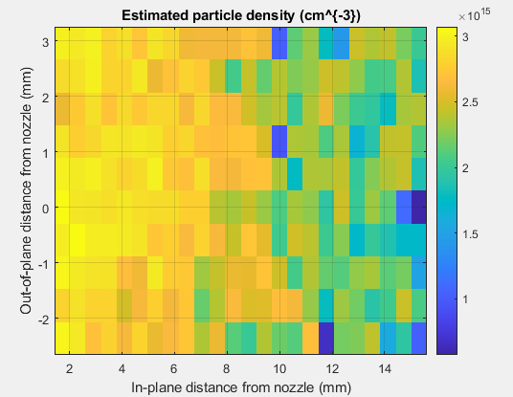
2D Laser spot scan for density mapping
Verified density of gas jet to be ~ 10¹⁵cm⁻³
Demonstrated a change in particle density as a function of distance from the nozzle (to be verified with flow simulations)
Provides a platform to test nozzle design for optimizing gas shape
Gas Nozzle

Slide 14
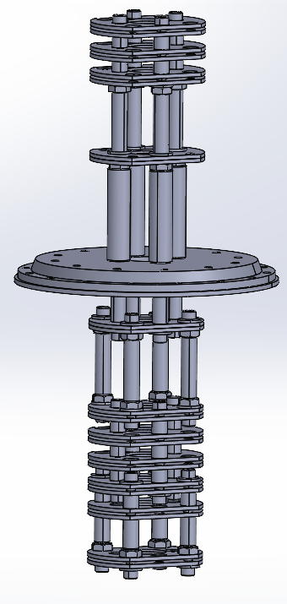
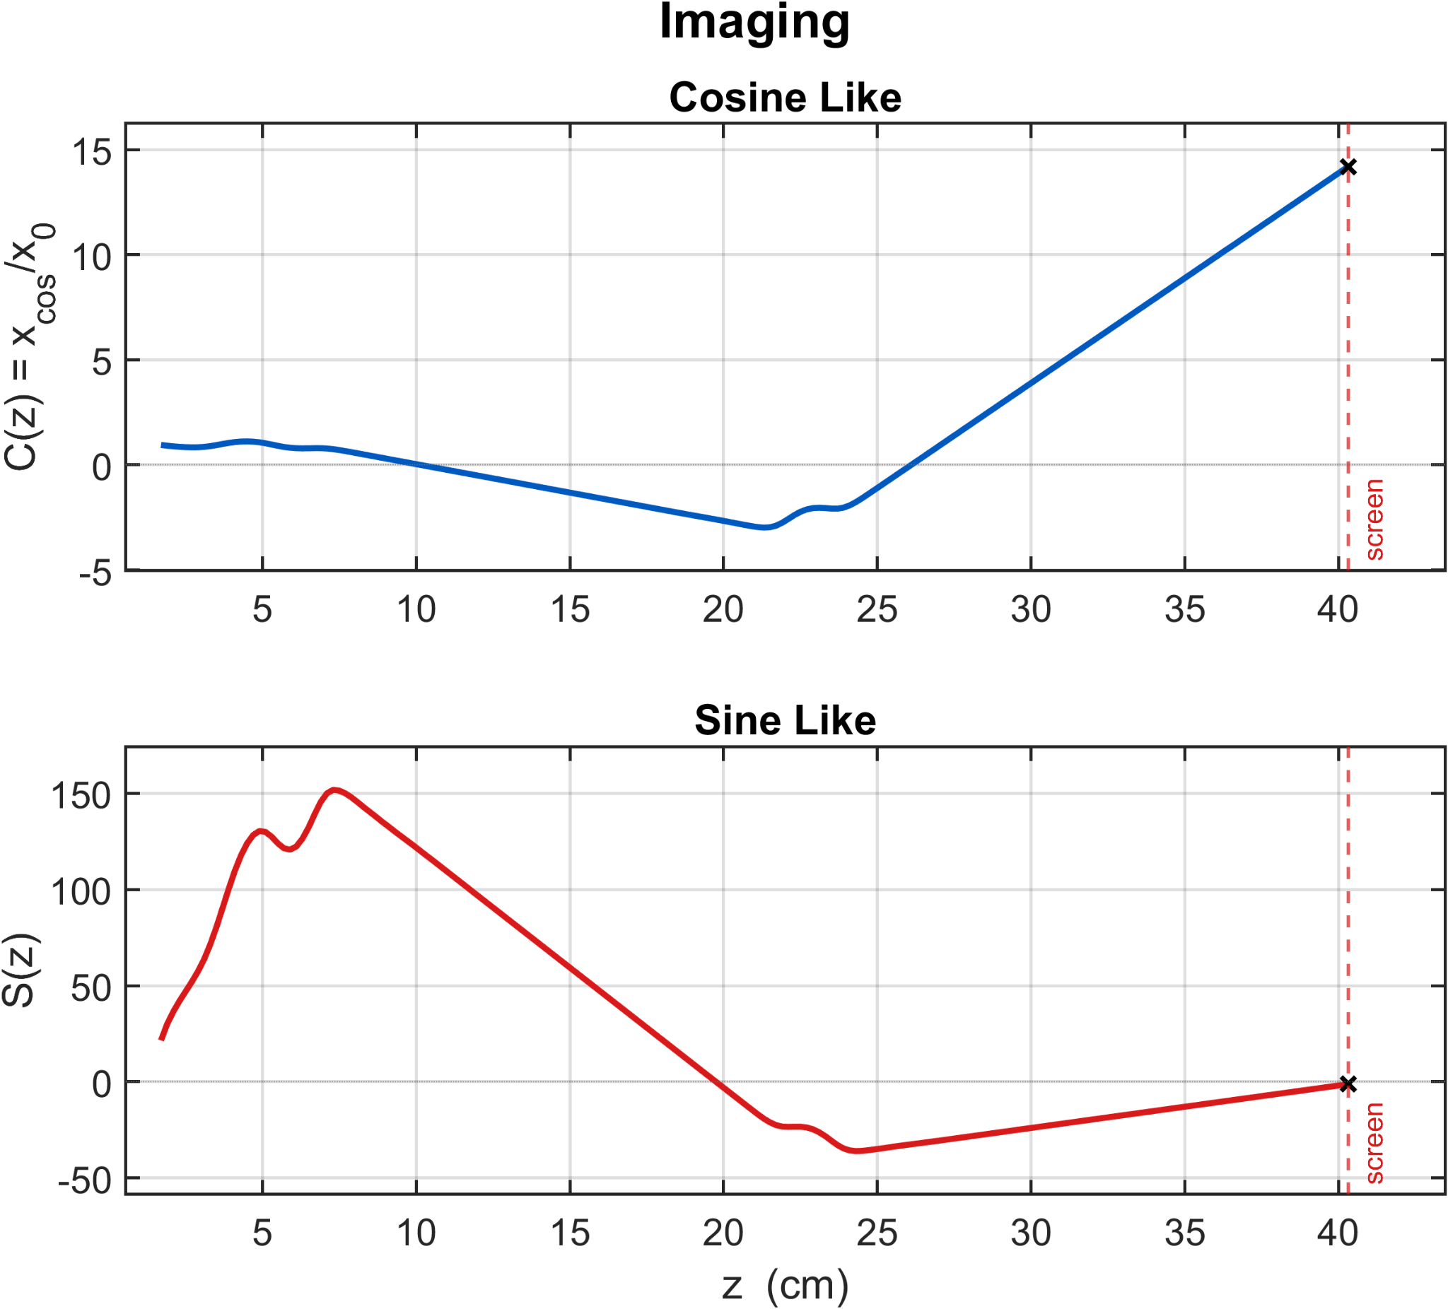
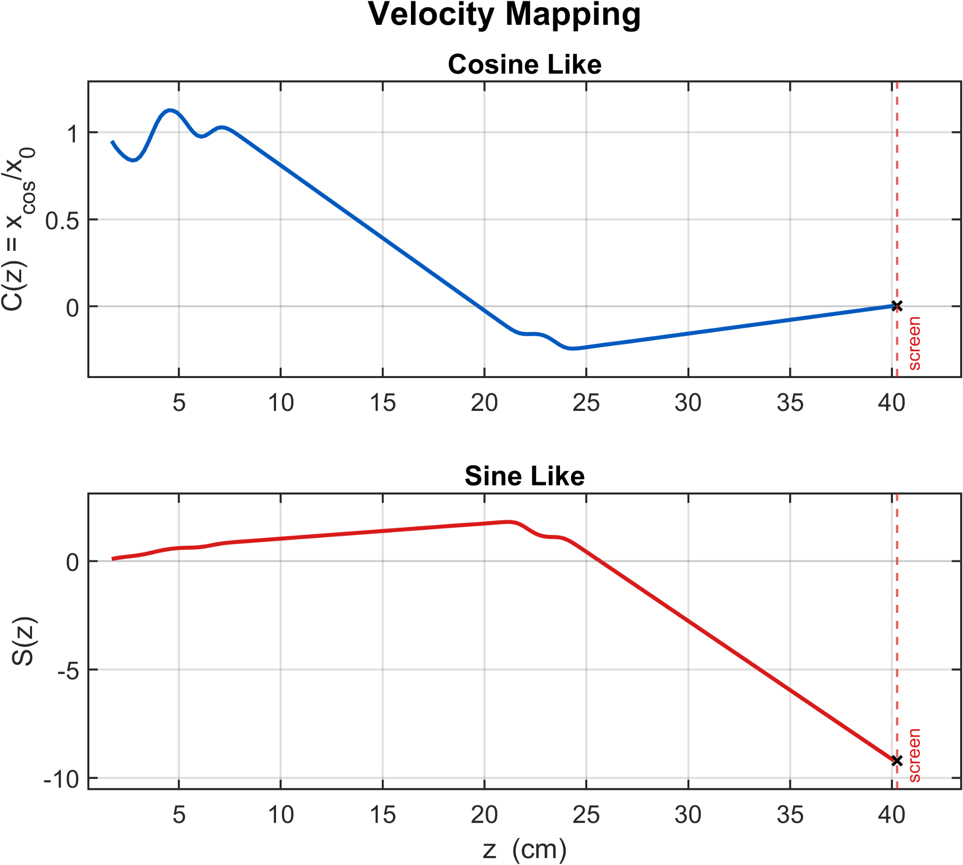
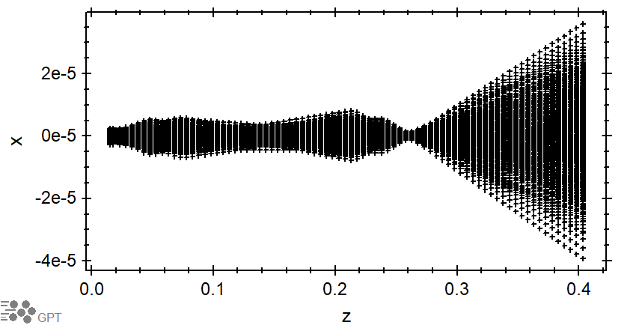
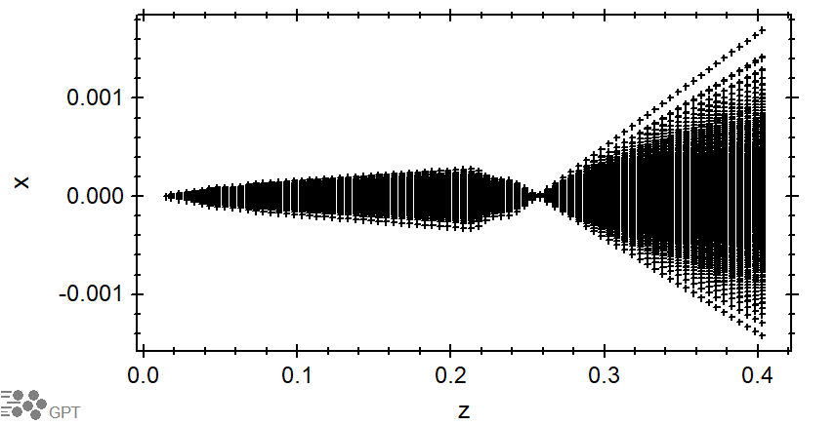
Redesigning Lens Column
Lens distances extended and optimized for R₁₁ ~ 14 and R₁₂ ~ -64.5cm/rad
Transverse spacing between supports widend to prevent dielectric polarization of ceramic skeleton and additional supports added for alignment
Imaging and Velocity mapping are verified by tracking Sine-Like and Cosine-Like rays
Transport of a 1μm rms 100 mrad beam in an imaging configuration or Velocity mapping configuration

Slide 15
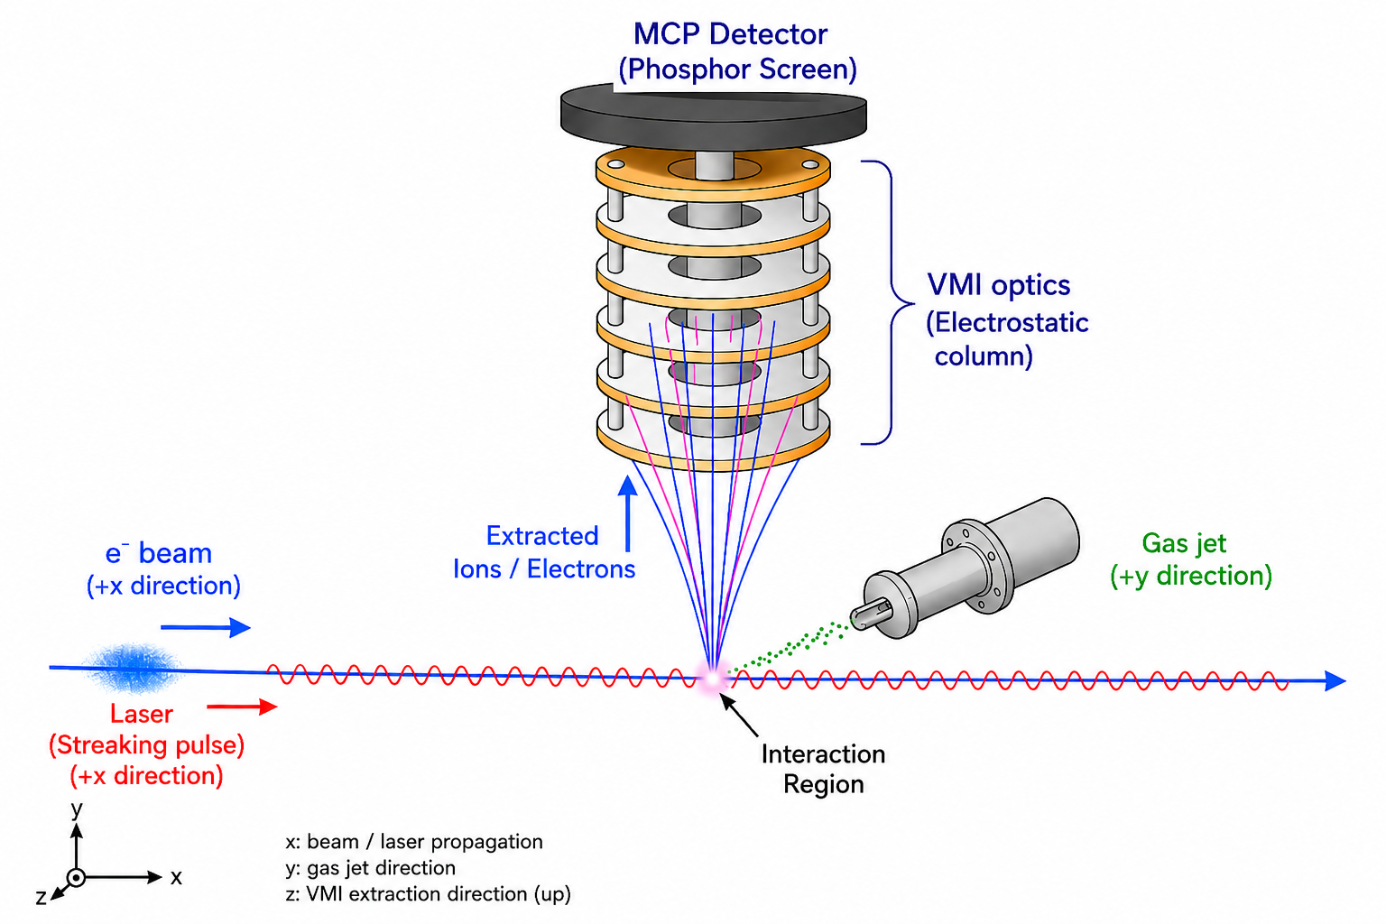
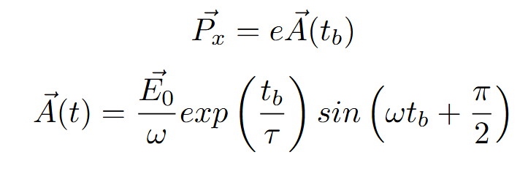
Plans for streaking experiments
Plasma electrons are born at different times as the electron beam passes through the gas.
A co-propagated laser gives electrons transverse momentum corresponding to the vector potential

Slide 16
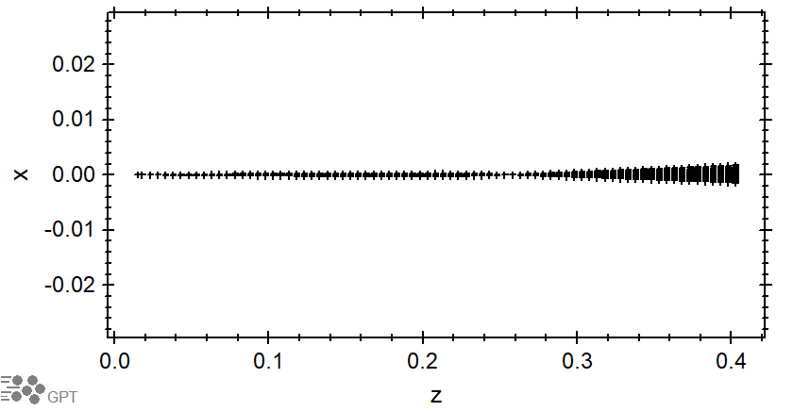
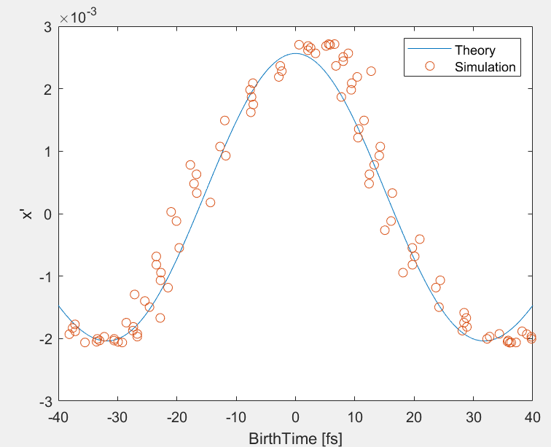
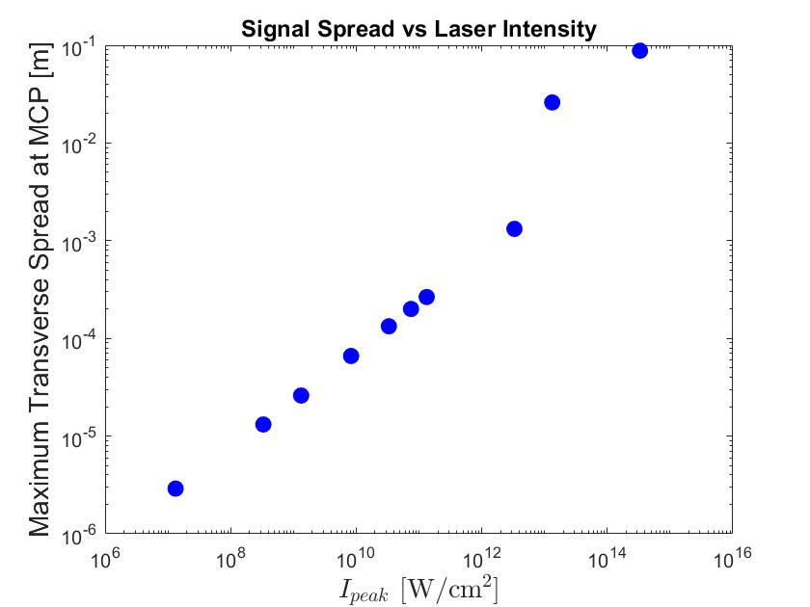
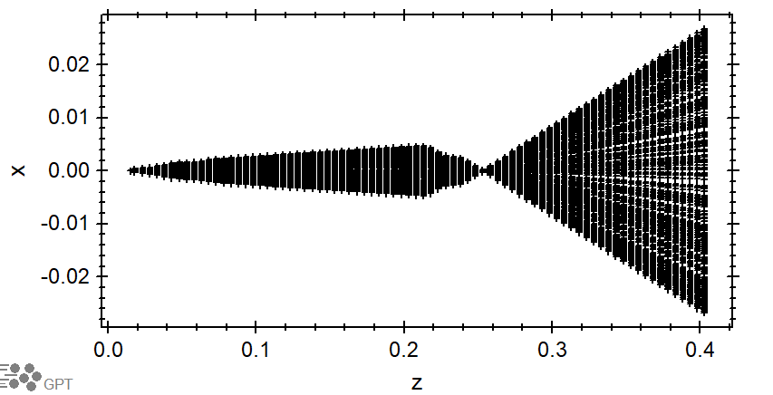
Streaking with laser: GPT simulations
GPT laser-streaking: kick ∝ vector potential and spread ∝ √intensity, matching the analytic model.
Laser off
Laser on

Slide 17
Conclusions
Live work
Hardware and preliminary experiments completed before my time at UCLA
Uncertainty in gas shape made diagnostics unreliable and we desire to use the GSM as a platform for many experiments
Preliminary Streaking experiment via ionization with a UV laser and streaking with an IR laser. Proof of concept for laser streaking experiment planned for fall/winter at PEGASUS
Build new column for higher resolution
Long plasma channels via laser filamentation

Slide 18
Thank you
Image References:
Burger, N., et al. "Experimental Characterization of Gas Sheet Transverse Profile Diagnostic." Proceedings of the 5th North American Particle Accelerator Conference (NAPAC2022), JACoW Publishing, 2022
Denham, P., et al. "Single-Shot Ionization-Based Monitor for Pulsed Electron Beams." arXiv, 2024, arxiv.org/abs/2411.15460.
Koch, Andreas, and Jan Grünert. "Radiation Hardness of Luminescent Screens under FEL Radiation." Optics Damage and Materials Processing by EUV/X-ray Radiation (XDam8), edited by Libor Juha et al., vol. 12578, SPIE, 2023, p. 1257803, https://doi.org/10.1117/12.2665629.
Stewart, Greg. Illustration of the attosecond electron-motion experimental setup. SLAC National Accelerator Laboratory, 27 Jan. 2022, www6.slac.stanford.edu/news/2022-01-27-researchers-use-attosecond-x-ray-pulses-track-electron-motion-highly-excited.
Yamada, Ippei, et al. “High-Intensity Beam Profile Measurement Using a Gas Sheet Monitor by Beam Induced Fluorescence Detection.” Physical Review Accelerators and Beams,vol. 24, no. 4, 2021, p. 042801, https://doi.org/10.1103/PhysRevAccelBeams.24.042801.
This work supported by DOE grant No. DE-SC0009914 and SBIR contracts No. DE-SC0019717 and DE-SC0017691. Travis Nichols is supported by the U.S. Department of Energy, Office of Science, High Energy Physics, under Award Number DE-SC0024907, the Tigner Traineeships in Accelerator Science program.

