Slide 1


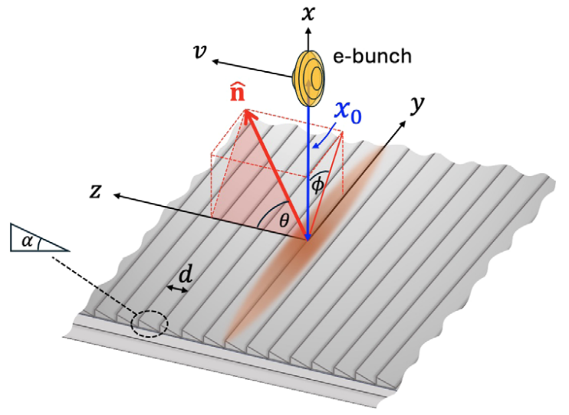
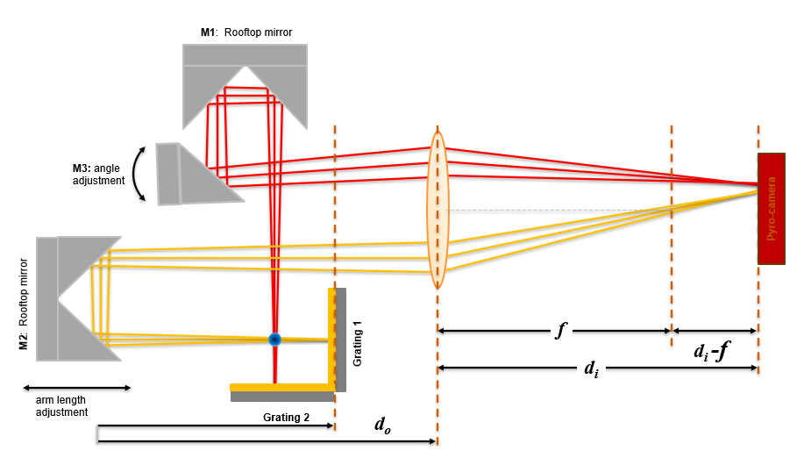
The role of coherent Smith-Purcell radiation for LWFA e-beam diagnosis
𝜆
CSPR intensity
CCD
267 nm
N
S
N
S
N
S
N
S
N
S
N
S
µ-bunched FEL beam
S
N
S
N
S
N
S
N
S
N
S
N
Author: Ross Rudzinsky
Co-authors: Z. Ouyang, B. Dinh, J. Brooks, L. Zhang, R. Zgadzaj, M. Downer¹, A. Irman, Y.-Y. Chang, J. M. Klopf, M. LaBerge, P. Üfer, S. Schöbel, F. Herrmann, J. C. Deinert, S. Kovalev, U. Schramm, T. Cowan²
¹The University of Texas at Austin, Department of Physics, 2515 Speedway, Austin, Texas ²Helmholtz-Zentrum Dresden-Rossendorf, Institute of Radiation Physics, Bautzner Landstr. 400, 01328, Dresden, Germany

Slide 2
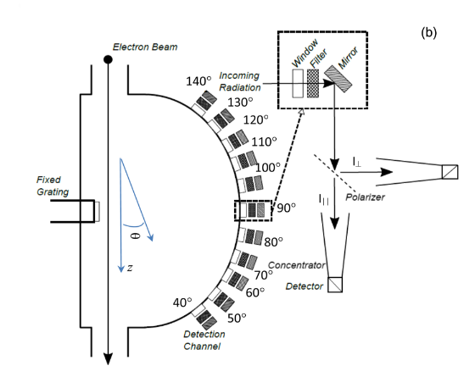
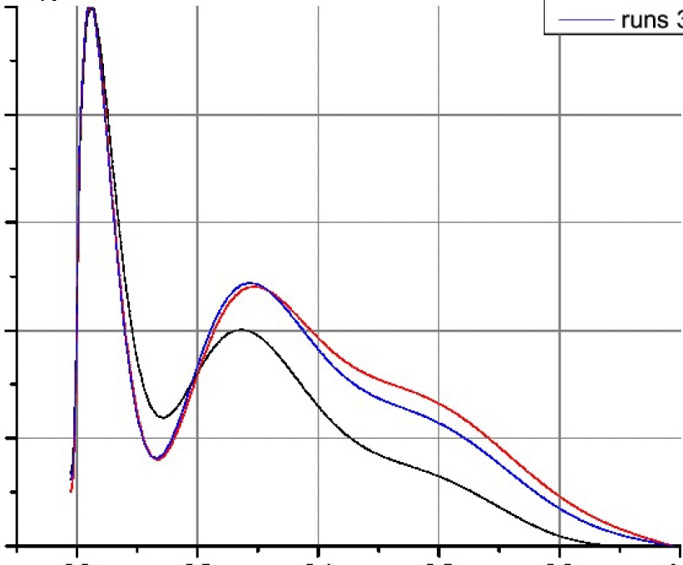
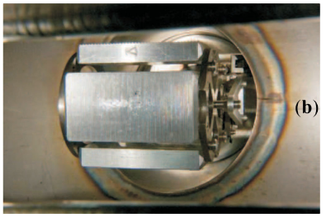
Previous work on bunch reconstruction
Reconstructed longi-
tudinal bunch profile
Used conventional RF linacs, with bunch durations ~2.5 ps
Electron bunches in MeV to GeV range
mm-wave regime
1
⇒
current (normalized)
0
0
1
time [ps]
1.) Blackmore V., et. al., “First measurements of the longitudinal bunch profile of a 28.5 GeV beam using coherent Smith-Purcell radiation”, Phys. Rev. Spec. Topics – Acc. And Beams, 12, 032803, (2009)
2.) Andrews H. L., et. al., “Reconstruction of the time profile of 20.35 GeV, subpicosecond long electron bunches by means of coherent Smith-Purcell radiation”, Phys. Rev. Spec. Topics – Acc. And Beams, 17, 052802, (2014)
3.) Konoplev I. V., et. al., “Single shot, nondestructive monitor for longitudinal subpicosecond bunch profile measurements with femtosecond resolution”, Phys. Rev. Acc. And Beams, 24, 022801, (2021)

Slide 3
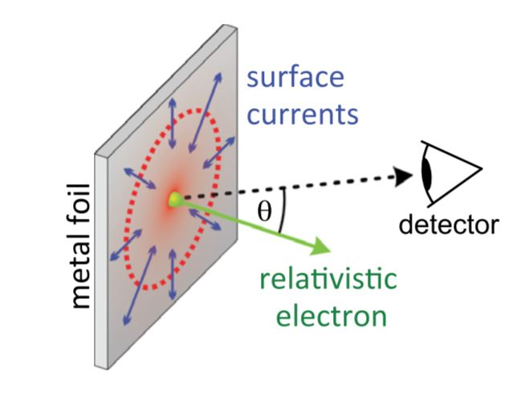
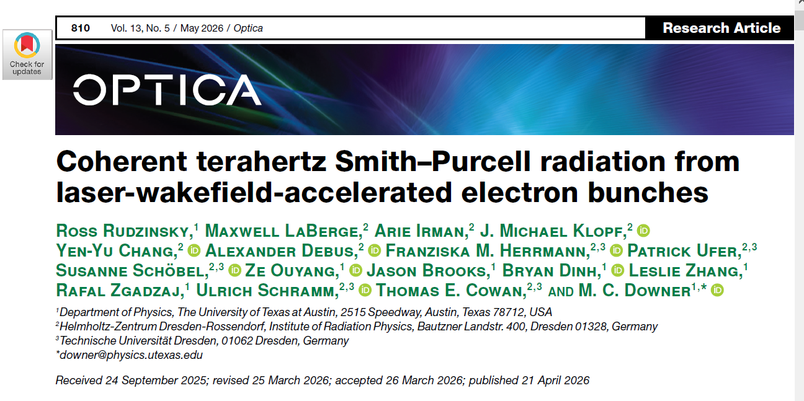
State of the art LWFA e-beam diagnostics
Electron bunches from LWFA: fs-level bunch duration
  Requires diagnostics that are sensitive to this ultrashort structure
And/or talk on Thursday:
Mike Downer, 5:20 PM, Legacy A (Luskin)
Coherent Transition Radiation (CTR)
Coherent Smith-Purcell Radiation (CSPR)
Non-invasive
Tunability
Acts like its own spectrometer
See Poster Session later today!! #42

Slide 4
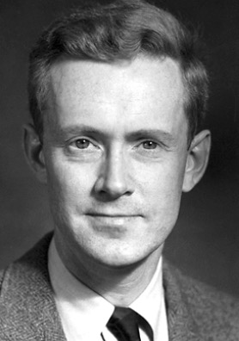
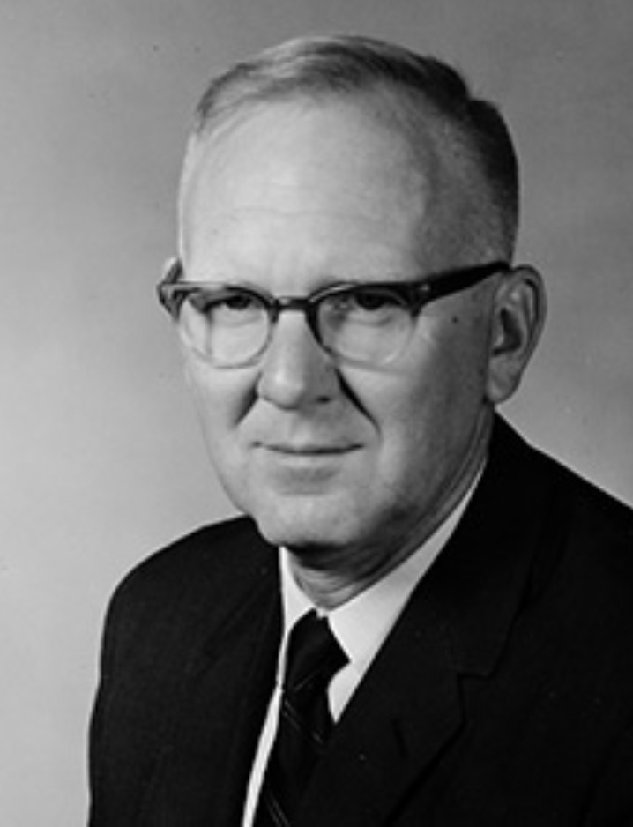
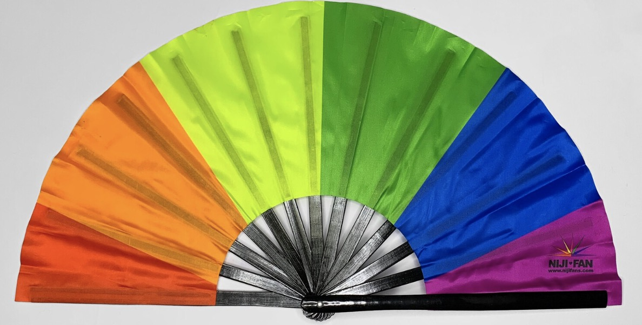
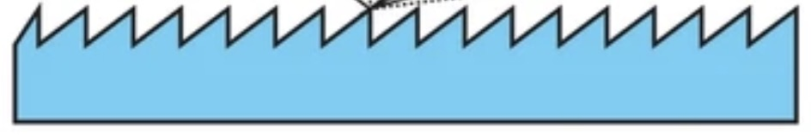
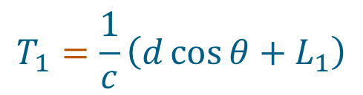
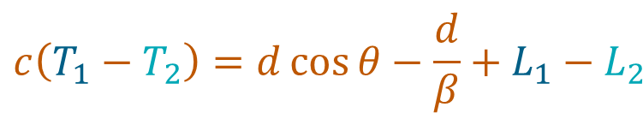











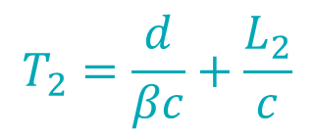

Smith-Purcell Radiation (SPR) – Tunability
$$L_{1}$$
$$nλ$$
$$T_{1}=\frac{1}{c}\left(d\cos{θ+L_{1}}\right)$$
$$d\cos{θ}$$
electron
$$L_{2}$$
$$T_{2}=\frac{d}{βc}+\frac{L_{2}}{c}$$
$$=T_{1}$$
$$θ$$
Edward M. Purcell
1912-1997
(Nobel Prize 1952)
grating
surface
$$d$$
$$λ_{SPR}= d$$
For constructive interference:
$$λ_{SPR}<d$$
$$λ_{SPR}>d$$
$$L_{1}−L_{2}=nλ$$
$$c\left(T_{1}−T_{2}\right)=d\cos{θ−\frac{d}{β}+L_{1}−L_{2}}$$
$$λ=\frac{d}{n}\left(\frac{1}{β}−\cos{θ}\right)$$
e⁻
Wavelength tunability
Stephen J. Smith
1925-2017
(EMP PhD student)

Slide 5


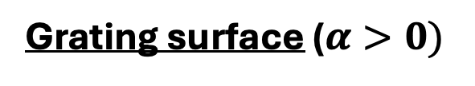
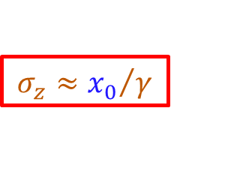



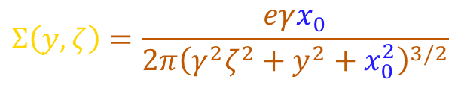
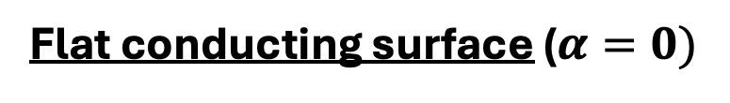


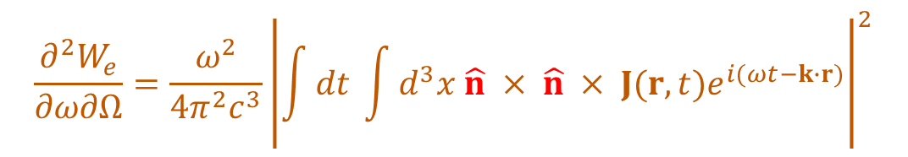

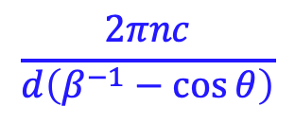
J. H. Brownell, J. Walsh, & G. Doucas, “Spontaneous Smith-Purcell radiation described through induced surface currents,” Phys. Rev. E 57, 1975 (1998)
Flat conducting surface ($α=0)$
Induced charge:
$$Σ\left(y,ζ\right)=\frac{eγx_{0}}{2π{\left(γ^{2}ζ^{2}+y^{2}+x_{0}^{2}\right)}^{3/2}}$$
electron
$$ζ≡z−vt$$
“Footprint”:
$$σ_{y}≈x_{0} ,$$
$$σ_{z}≈{x_{0}}/γ$$
Induced current:
$K\left(y,ζ\right)=Σ\left(y,ζ\right) v(y,$ $ζ)$
(non-radiating)
$$v_{y} \hat{y}+v \hat{z}$$
$$σ_{y}≈x_{0}$$
Grating surface ($α>0)$
Induced current:
$$J\left(r,t\right)=Σ\left(r,t\right) v(r,t)$$
Energy radiated into far field per unit $ω$ per unit $Ω$:
$$\frac{∂^{2}W_{e}}{∂ω∂Ω}=\frac{ω^{2}}{4π^{2}c^{3}}{\left|\int{dt \int{d^{3}x \hat{n} × \hat{n} × J(r,t)e^{i(ωt−k∙r)}}}\right|}^{2}$$
Jackson, 3rd ed., Eq. 14.67
$$\frac{2πnc}{d\left(β^{−1}−\cos{θ}\right)}$$
$${=\left(\frac{dW_{e}}{dΩ}\right)}_{1}$$
$$δ(ω−ω_{n})$$
SP condition

Slide 6



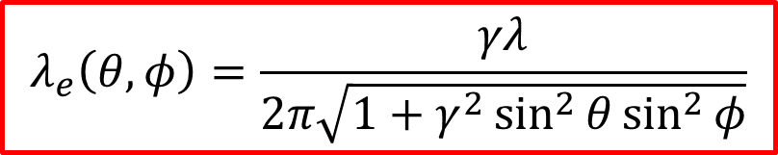
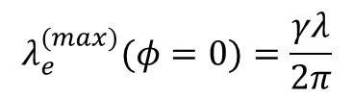


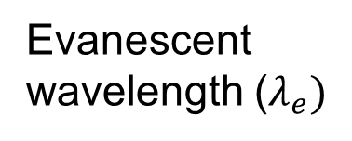
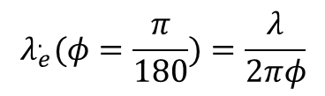


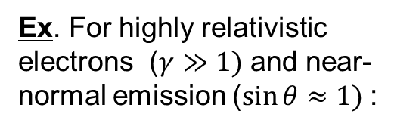



J. H. Brownell, J. Walsh, & G. Doucas, “Spontaneous Smith-Purcell radiation described through induced surface currents,” Phys. Rev. E 57, 1975 (1998)
$${\left(\frac{dW_{e}}{dΩ}\right)}_{1}∝exp\left[\frac{−2x_{o}}{λ_{e}}\right]R^{2}$$
electron
Evanescent wavelength ($λ_{e})$
Decaying exponential
Grating efficiency (R²)
$$λ_{e}\left(θ,φ\right)=\frac{γλ}{2π\sqrt{1+γ^{2}\sin^{2}{θ\sin^{2}{φ}}}}$$
$$σ_{y}≈x_{0}$$
$$x_{0}≲λ_{e}$$
⇒
strong SPR
Decaying exponential =1/e → $x_{o}=λ_{e}/2$
460 MeV
$$λ_{e}^{(max)}(φ=0)=\frac{γλ}{2π}$$
$1.4 mm$ ($λ=10 µm$, $γ=900$)
$$=$$
$3.1 cm$ ($λ=10 µm$, $γ=2000$)
Ex. For highly relativistic electrons ($γ≫1)$ and near-normal emission ($\sin{θ}≈1)$:
1 GeV
$$λ_{e}^{.}(φ=\frac{π}{180})=\frac{λ}{2πφ}$$
$0.09 mm$ ($λ=10 µm$, $γ=900$)
$$=$$
$0.09 mm$ ($λ=10 µm$, $γ=2000$)

Slide 7
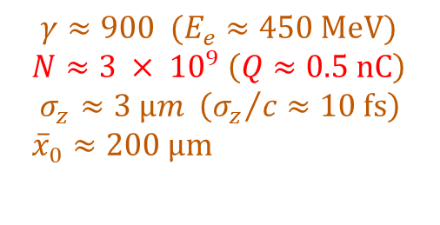




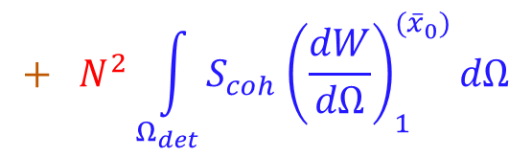



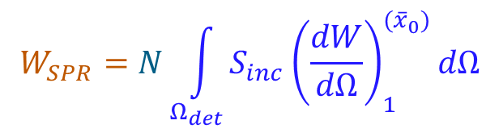







Incoherent vs. Coherent SPR
$$\sim {10}^{−24} J$$
(1 electron)
$$\sim {10}^{−24} J$$
Example:
detected wavelength:
$$W_{SPR}=N\int_{Ω_{det}}^{.}{S_{inc}{\left(\frac{dW}{dΩ}\right)}_{1}^{({\overline{x}}_{0})}dΩ}$$
$$+ N^{2}\int_{Ω_{det}}^{.}{S_{coh}{\left(\frac{dW}{dΩ}\right)}_{1}^{({\overline{x}}_{0})}dΩ}$$
$$λ_{SPR}≈10 µm$$
electron bunch:
$γ≈900 (E_{e}≈450 MeV)$
$N≈3 × {10}^{9} \left(Q≈0.5 nC\right)$
$$σ_{z}≈3 µm \left({σ_{z}}/c≈10 fs\right)$$
${\overline{x}}_{0}≈200 µm$
$$\sim 3 × {10}^{−15} J$$
(N electrons)
$$\sim {10}^{−5} J$$
Lens
grating:
Detection geometry:
$$d=10 µm$$
$$R^{2}=0.42$$
$$α=27˚$$
$$L=2.5 cm$$
$$θ≈90˚$$
$$λ_{SPR} \sim σ_{z}$$
$$φ≈0$$
$$λ_{SPR}> σ_{z}$$
$$Ω_{det}=0.7×{10}^{−4} sr$$
derived quantities:
$$λ_{e}=1.4 mm$$
$$λ_{SPR}< σ_{z}$$
$$S_{inc}≈S_{coh}≈0.6$$
e⁻
bunch
“Cutoff” in SPR spectrum:

Slide 8
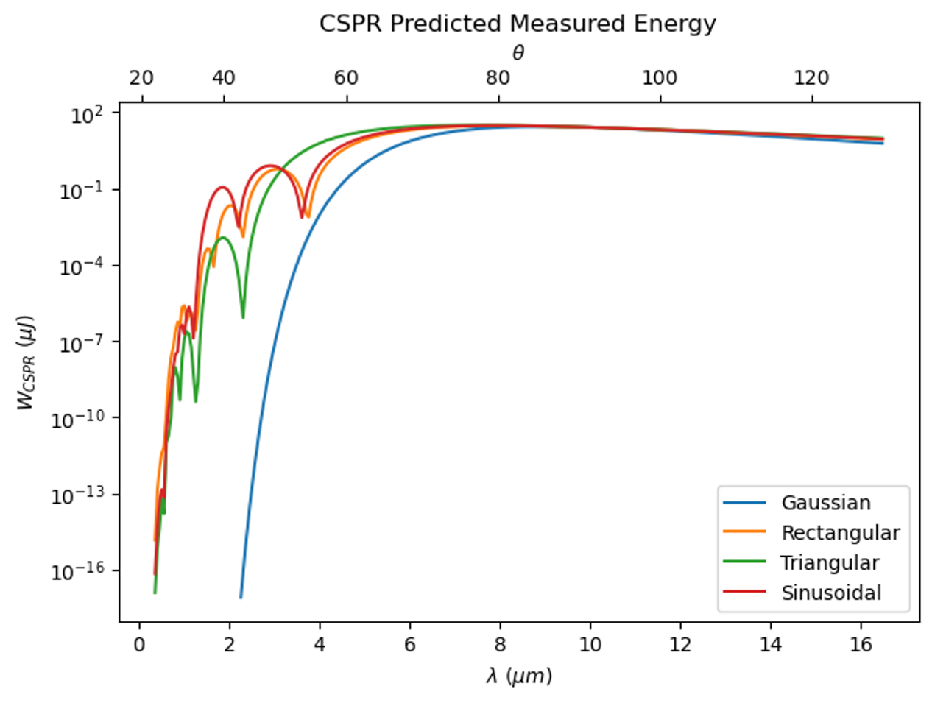









Simulation Results for various simple bunch shapes
Variations due to bunch shape
Example:
detected wavelength:
$$λ_{SPR}≈10 µm$$
electron bunch:
$γ≈900 (E_{e}≈450 MeV)$
$N≈3 × {10}^{9} \left(Q≈0.5 nC\right)$
$$σ_{z}≈3 µm \left({σ_{z}}/c≈10 fs\right)$$
${\overline{x}}_{0}≈200 µm$
Incoherent
Coherent
grating:
Detection geometry:
$$d=10 µm$$
$$R^{2}=0.42$$
$$α=27˚$$
$$L=2.5 cm$$
See Erick Martinez’ poster for more details!
$$θ≈varied$$
$$φ≈0$$
$$Ω_{det}=0.7×{10}^{−4} sr$$
Transition Region
derived quantities:
$$λ_{e}=1.4 mm$$
$$S_{inc}≈S_{coh}≈0.6$$

Slide 9
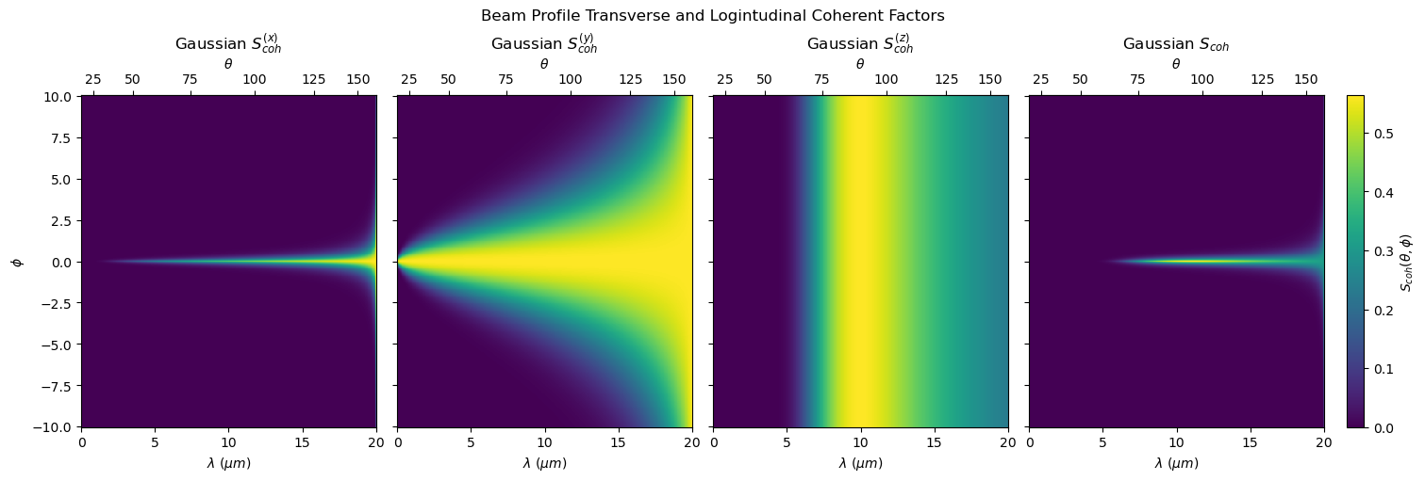
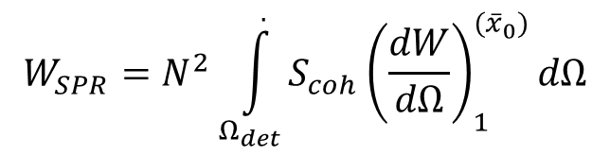
How would one extract bunch information from this curve?
$${W_{SPR}=N}^{2}\int_{Ω_{det}}^{.}{S_{coh}{\left(\frac{dW}{dΩ}\right)}_{1}^{({\overline{x}}_{0})}dΩ}$$
For the Gaussian e-bunch case:

Slide 10
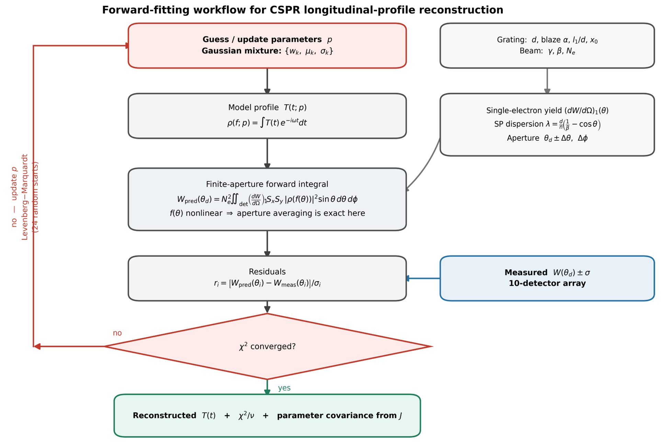

Slide 11
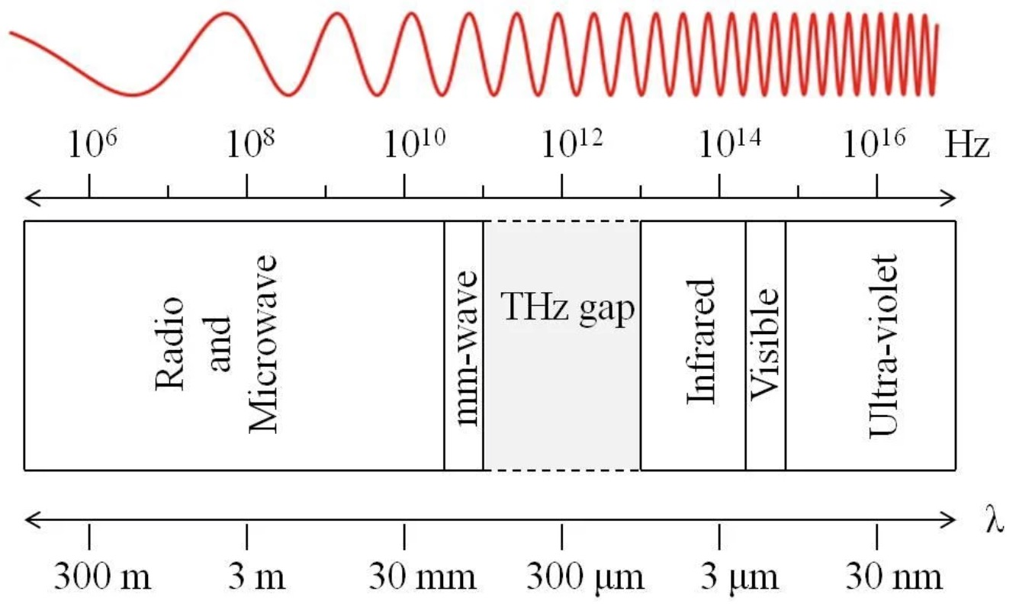




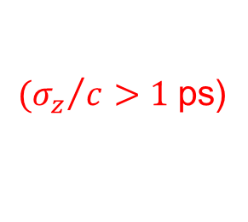





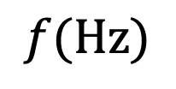
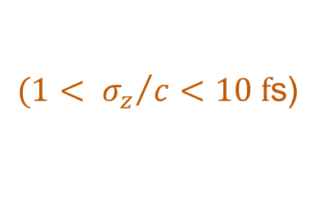
Coherent SPR (CSPR) sources & applications
$${10}^{10}$$
$${10}^{11}$$
$${10}^{12}$$
$${10}^{13}$$
Ross’
experiment
$${10}^{14}$$
$${10}^{15}$$
$$f(Hz)$$
RF accelerators:
THz band
• $σ_{z}>300 µm$
mm-wave
Infrared
Visible
${{(σ}_{z}}/c>1$ps)
30,000
3,000
300
30
10
3
0.3
$$λ(µm)$$
𝜆
Laser-driven wakefield accelerators
• ${0.3< σ}_{z}<3 µm$
${{(1< σ}_{z}}/c<10 f$s)
CSPR intensity
CCD
267 nm
• noninvasive diagnostic of fs e-bunches
N
S
N
S
N
S
N
S
N
S
N
S
- intra-FEL operation in real time
- observe UV signatures of microbunching
µ-bunched
FEL beam
- incorporate into COTR-based diagnostic suite
- distribute SPR gratings along e-beam path
S
N
S
N
S
N
S
N
S
N
S
N

Slide 12
Using cSPR as a beam position monitor
Side View
y
x
z
Pyro-camera
M1: Rooftop mirror
d_{i} -f
f
Grating 1
d_{i}
arm length
adjustment
d_{o}

Slide 13
Using cSPR as a beam position monitor
Side View
y
M1: Rooftop mirror
x
z
M3: angle
adjustment
Pyro-camera
M2: Rooftop mirror
f
Grating 1
d_{i} -f
d_{i}
arm length
adjustment
Grating 2
d_{o}

Slide 14
Using cSPR as a beam position monitor
This is the same configuration as in the previous slide, but with the bunch having moved relative to grating 1
Side View
y
M1: Rooftop mirror
x
z
M3: angle
adjustment
Pyro-camera
M2: Rooftop mirror
f
Grating 1
d_{i} -f
d_{i}
arm length
adjustment
Grating 2
d_{o}

Slide 15
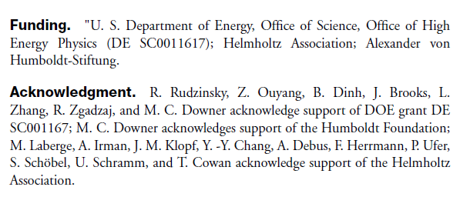
Summary – Thank you!
cSPR is a promising mechanism for which a LWFA electron bunch can be probed non-invasively

Slide 16
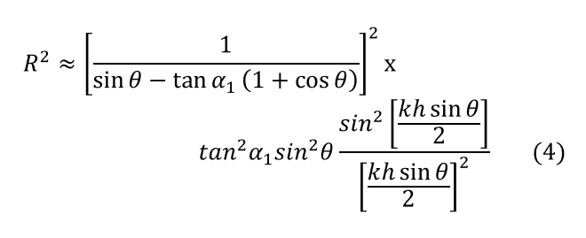
Appendix Slide – R^2 + S_coh

