Slide 1
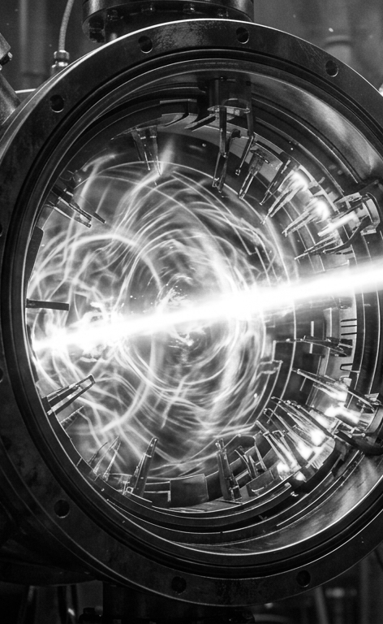

Cavity-Based Beam Charge and Arrival Time Monitor
A. Kulkarni, B. Schaap, D. Garcia, M. Lenz, Z. Liu, P. Musumeci, UCLA
D. Wang, G. Huang, T. Luo, W. Liu, Q. Ji, LBNL
Notes:
c

Slide 2
Outline
Motivation
The Beam Arrival Monitor (BAM)
Charge resolution
Arrival-time resolution
What’s next

Slide 3
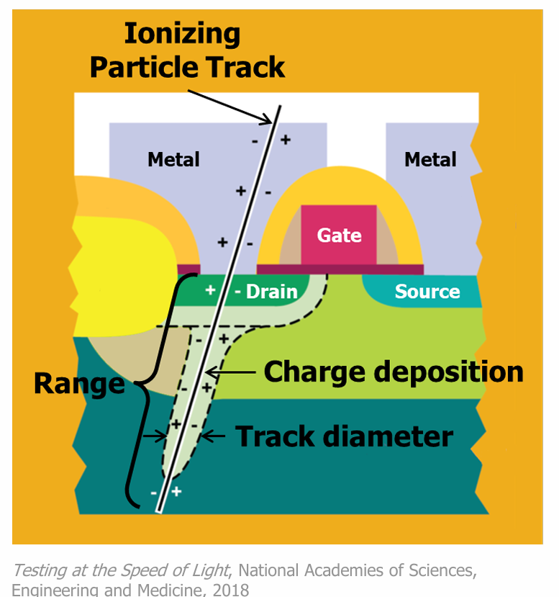
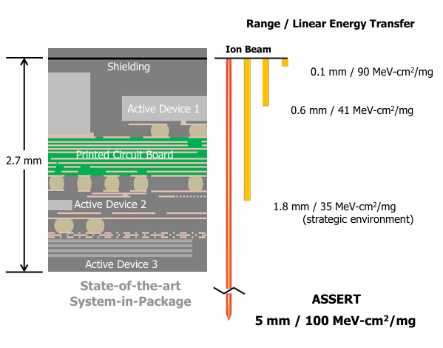
Single-Event Effects Testing
High-energy particle dumps energy through direct ionization
Carrier generation in the device can cause shorts, bit flips, or full destruction
Usually tested using heavy-ions at cyclotrons
Current research investigates using pulsed electrons to achieve the same device response
DARPA ASSERT BAA

Slide 4
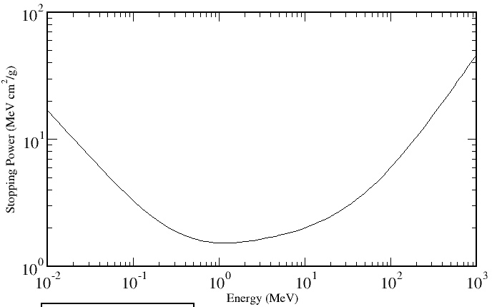
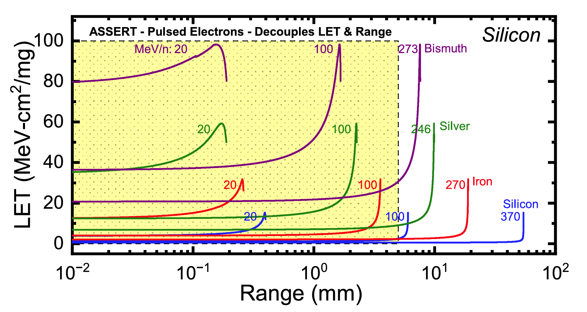
Single-Events Testing with Electrons
NIST Electron Stopping Power Tables
0.001531
MeV cm² mg⁻¹
0.002013
MeV cm² mg⁻¹
Key Metric: Linear Energy Transfer (LET) -> energy deposited into the sample
Single electron stopping power is very small -> need multiple electrons to achieve required LETs
LET range of interest requires ~1-10 fC of bunch charge
Tzintzarov et al., TNS (2025)
Single-shot, non-destructive charge measurements are vital to SEE testing with electrons

Slide 5
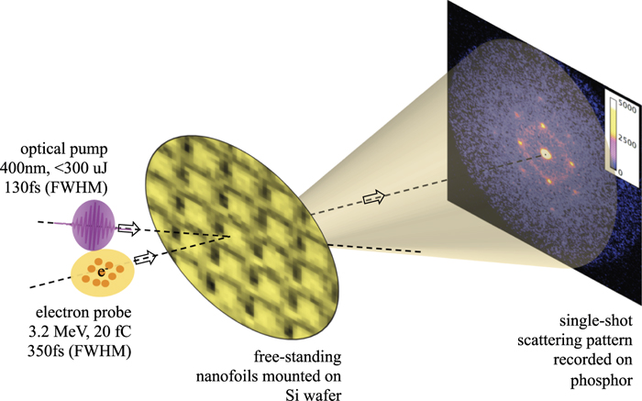
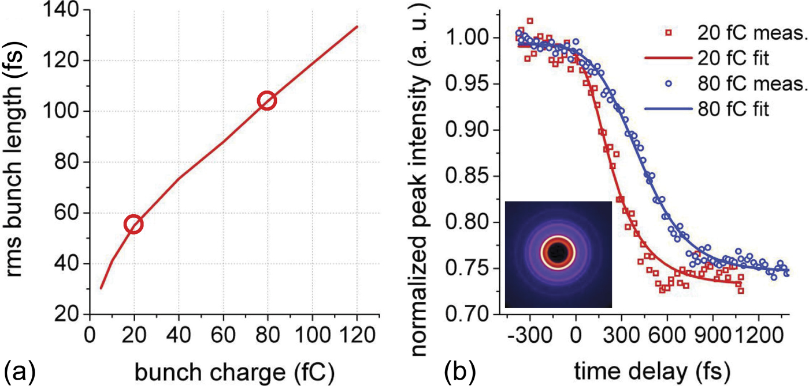
MeV-Ultrafast Electron Diffraction (MeV-UED)
Mo et al. Rev. Sci. Instrum. (2016)
Ultrafast Electron Diffraction pump-probe experiments rely on:
~fC bunch charge
consistent timing between the beam (probe) and the pump
Weathersby et al. Rev. Sci. Instrum. (2015)
A single-shot, non-destructive charge and arrival time monitor would be exceptionally useful for UED

Slide 6
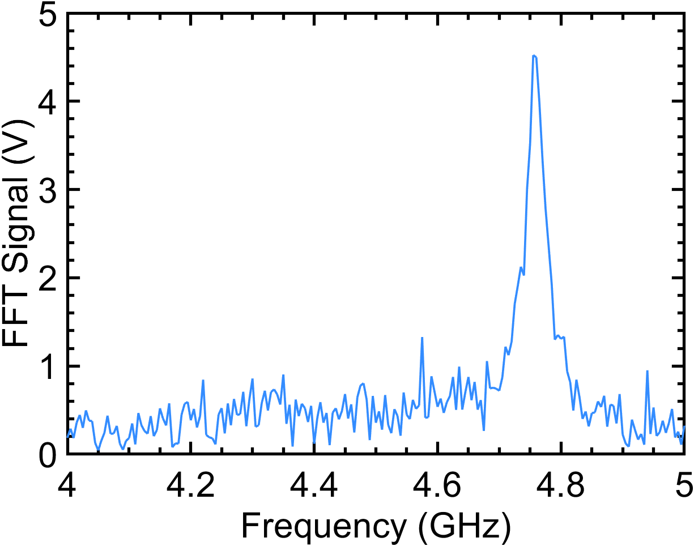
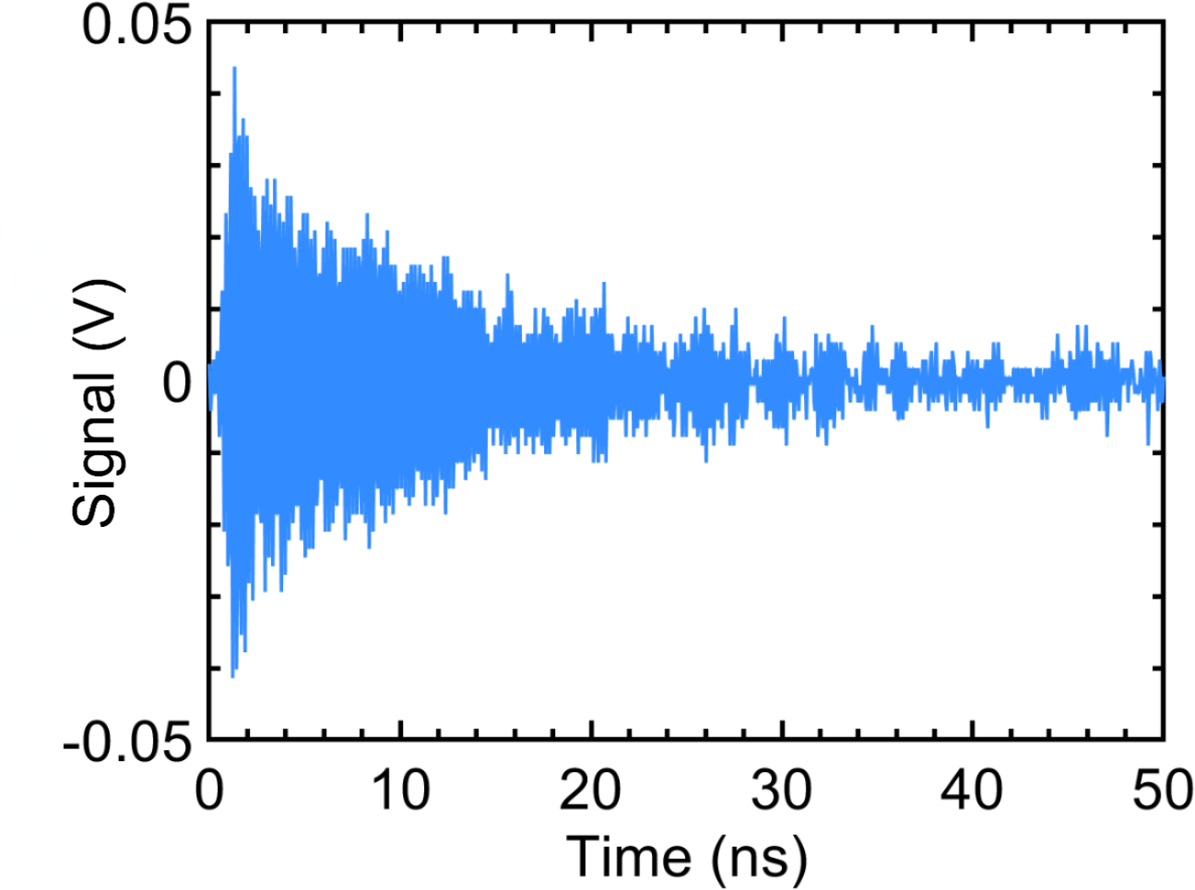
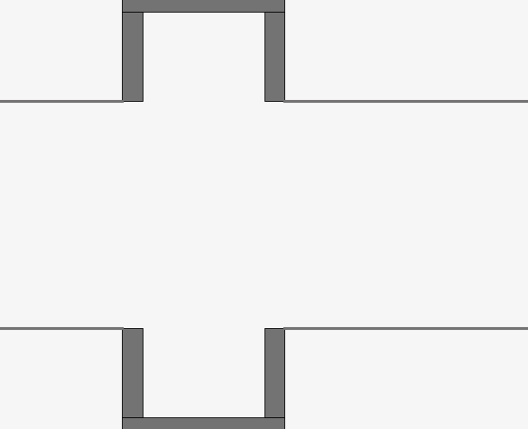
Cavity-Based Beam Diagnostic
Beam will excite a small cavity wake-field (TM010 mode) which encodes:
  Charge -> proportional to the energy in the wake
  Time-of-Arrival (TOA) -> related to the phase of the wake by causality
RF-based measurements have been used before:
  Czwalinna, et. al, IBIC (2019) showed 3 fs timing resolution at 250 pC with an RF pickup
  Song, et. al, PRAB 26, 012803 (2023) showed 33 fs timing resolution at 0.7 pC with a cavity diagnostic

Slide 7
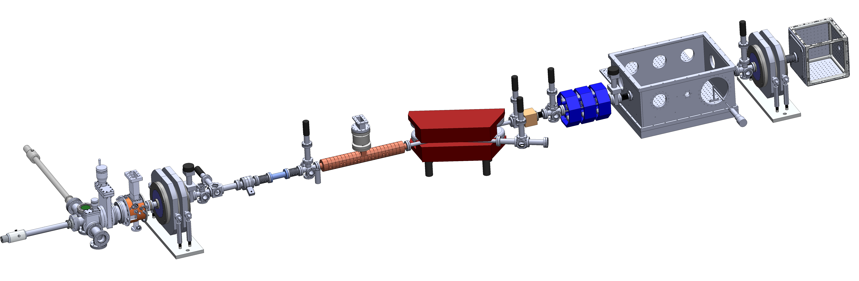
UCLA PEGASUS Facility
3-8 MeV electron test accelerator
1.6 cell S-band photo-gun + 11 cell S-band linac
Research on high-brightness beams, dynamics, and applications
Versatile capabilities (ultrashort pulse widths, FELs, Compton scattering, ultrasmall spot sizes)
Beam Arrival Monitor (BAM)
~6 m

Slide 8
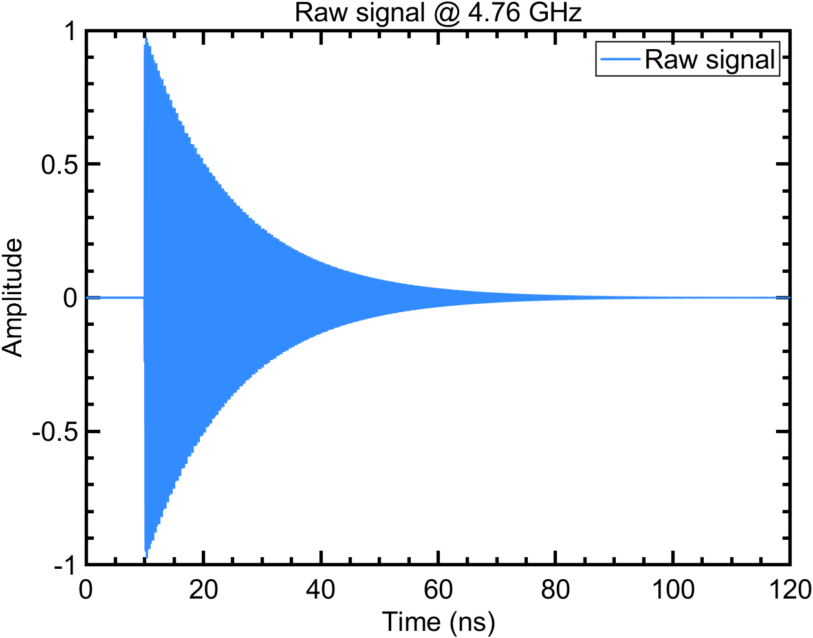
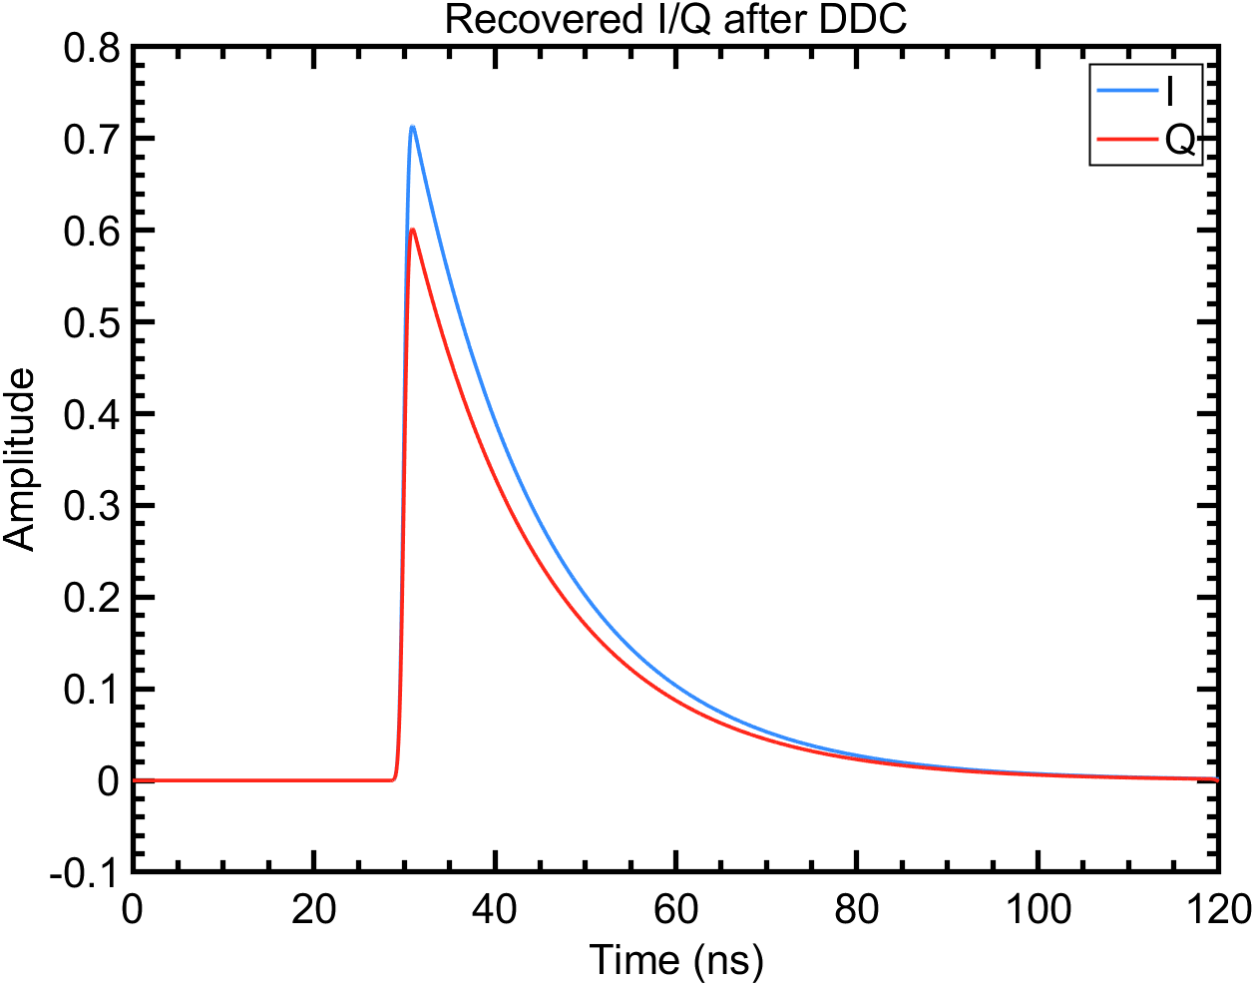
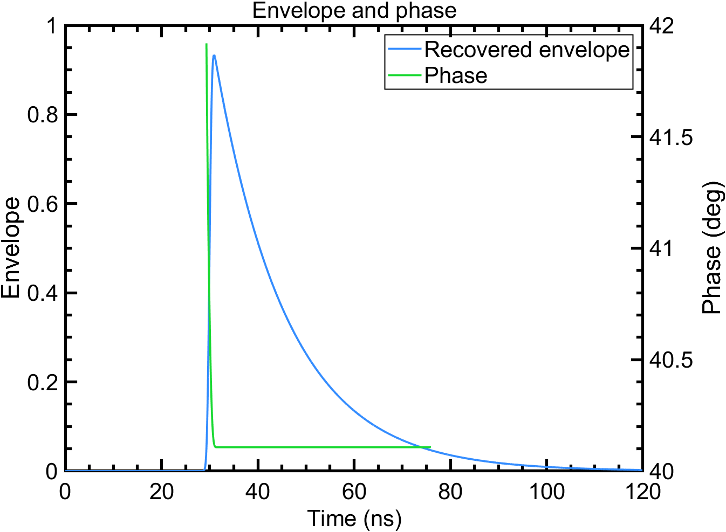
Signal Processing
Mix at signal frequency
Raw signal is acquired on an 8 GHz (20 GSPS) oscilloscope
Amplifiers help improve SNR and analog filters help eliminate S-band noise
Down-conversion converts the signal to complex phasors where signal energy and phase can be recovered
Can use all the points in the signal captured to recover the parameters of interest
Recover phase and amplitude

Slide 9
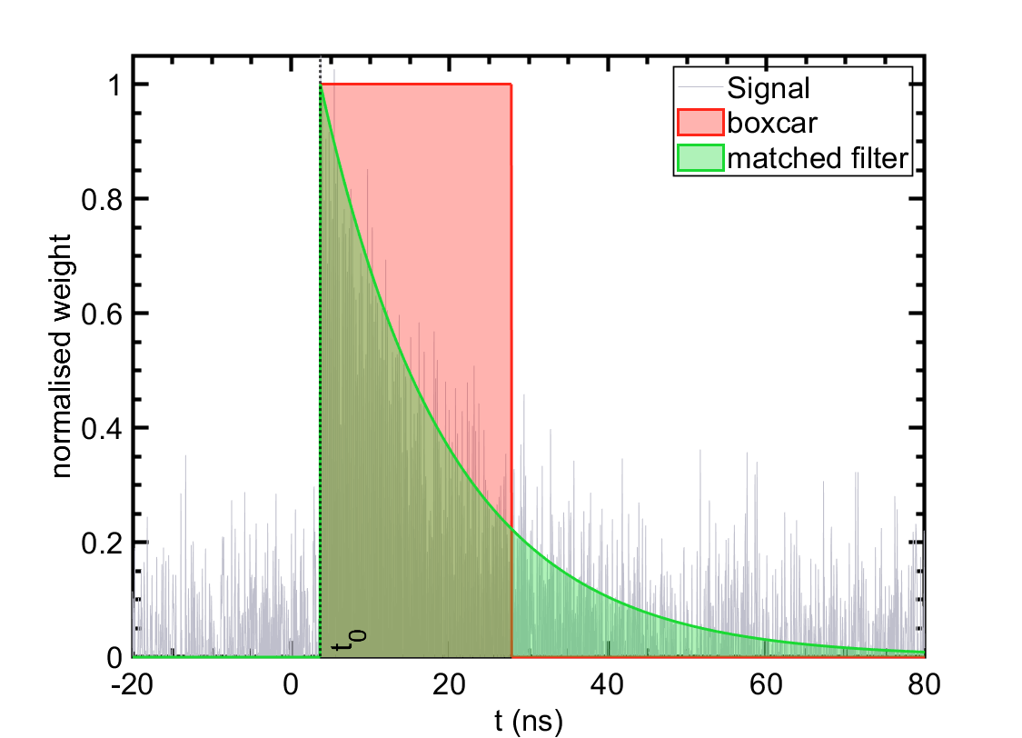
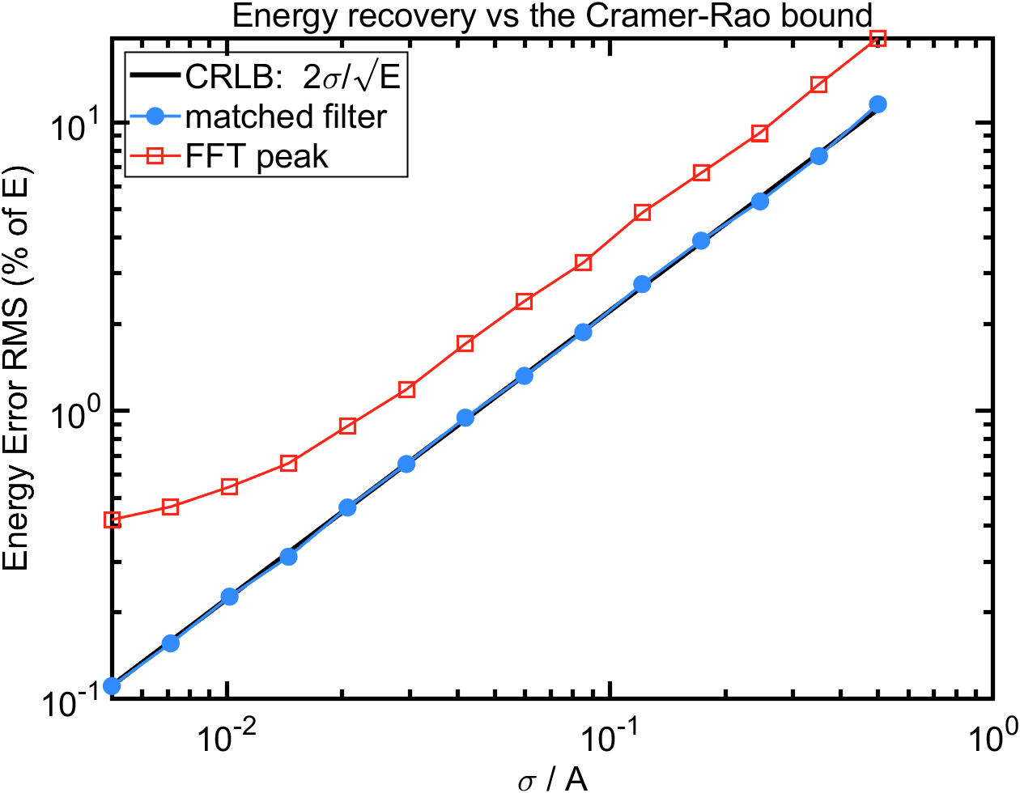
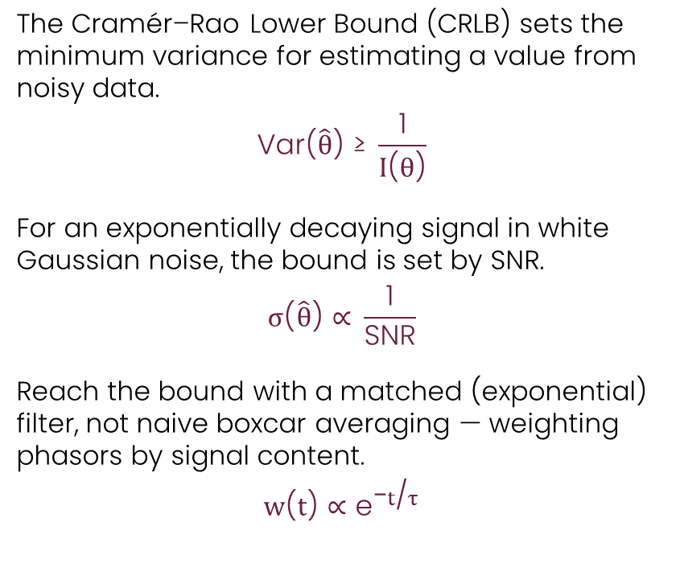
Reaching the Cramér–Rao Bound
The Cramér–Rao Lower Bound (CRLB) sets the minimum variance for estimating a value from noisy data.
$$\text{Var}\text{(}\hat{θ}\text{) ≥ }\frac{\text{1}}{I\text{(}θ\text{)}}$$
For an exponentially decaying signal in white Gaussian noise, the bound is set by SNR.
$$σ\text{(}\hat{θ}\text{) ∝ }\frac{\text{1}}{\text{SNR}}$$
Reach the bound with a matched (exponential) filter, not naive boxcar averaging — weighting phasors by signal content.
$$w\text{(}t\text{) ∝ }{\text{e}}^{\text{−}t\text{/}τ}$$

Slide 10
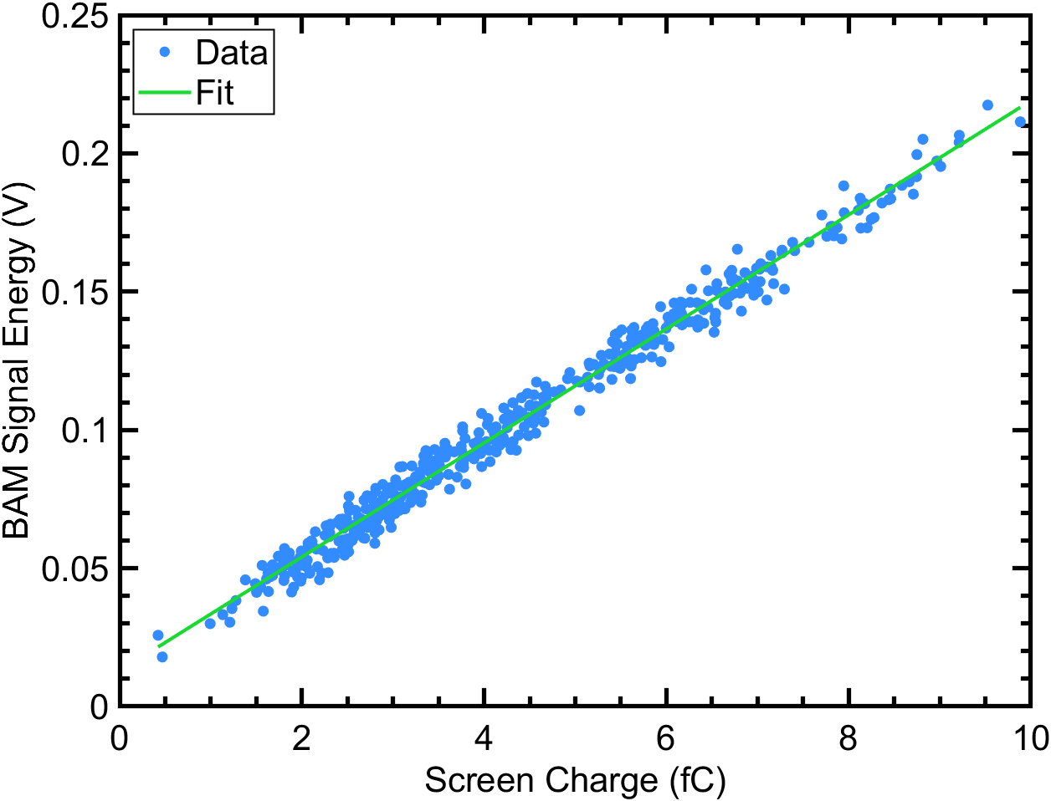
Measuring Charge
Measuring charge requires determining the energy in the signal -> sum across the decaying exponential signal
Use screen intensity to measure charge destructively
Linear fit residuals: 260 aC RMS
Existing SOTA: Turbo-ICT (~ 30 fC uncertainty)

Slide 11
Measuring Time of Arrival
The beam time of arrival is encoded in the phase of the wake excited
Direct acquisition on an 8 GHz (20 GSPS) scope
Any kind of triggered acquisition will suffer from jitter in the trigger
Solution: We acquire our master clock (2.856 GHz) at the same time on a second channel

Slide 12
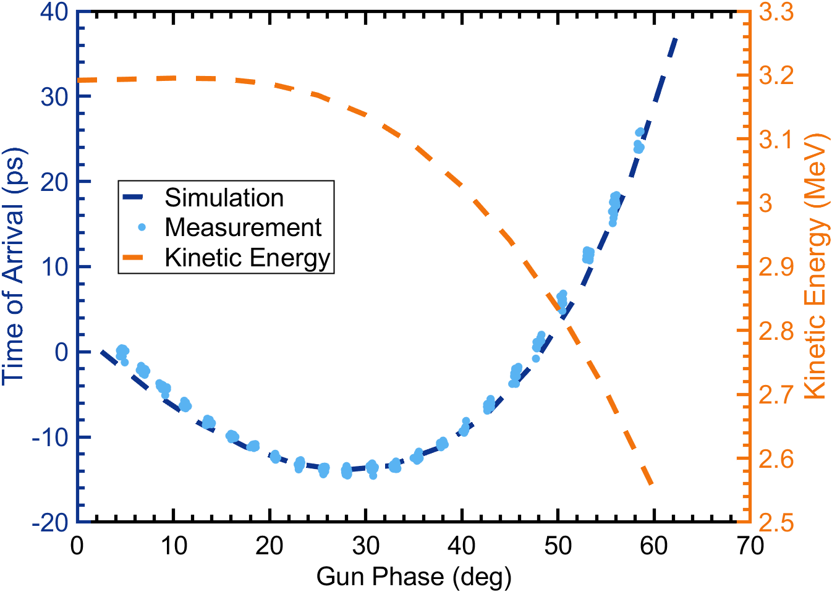
Time of Arrival Dynamics
Gun phase scan yields per-shot time of arrival
Good simulation-data agreement
1.6 cell S-band gun dynamics minimize energy jitter and arrival time jitter at different phases
How can we assess phase recovery resolution?

Slide 13
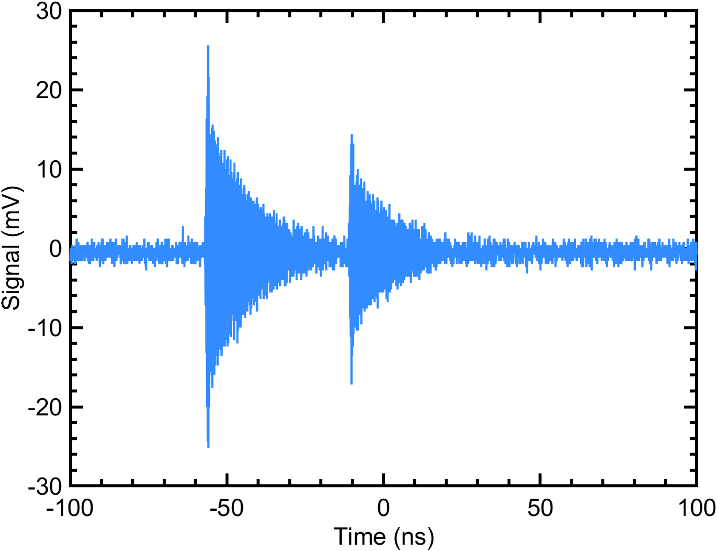
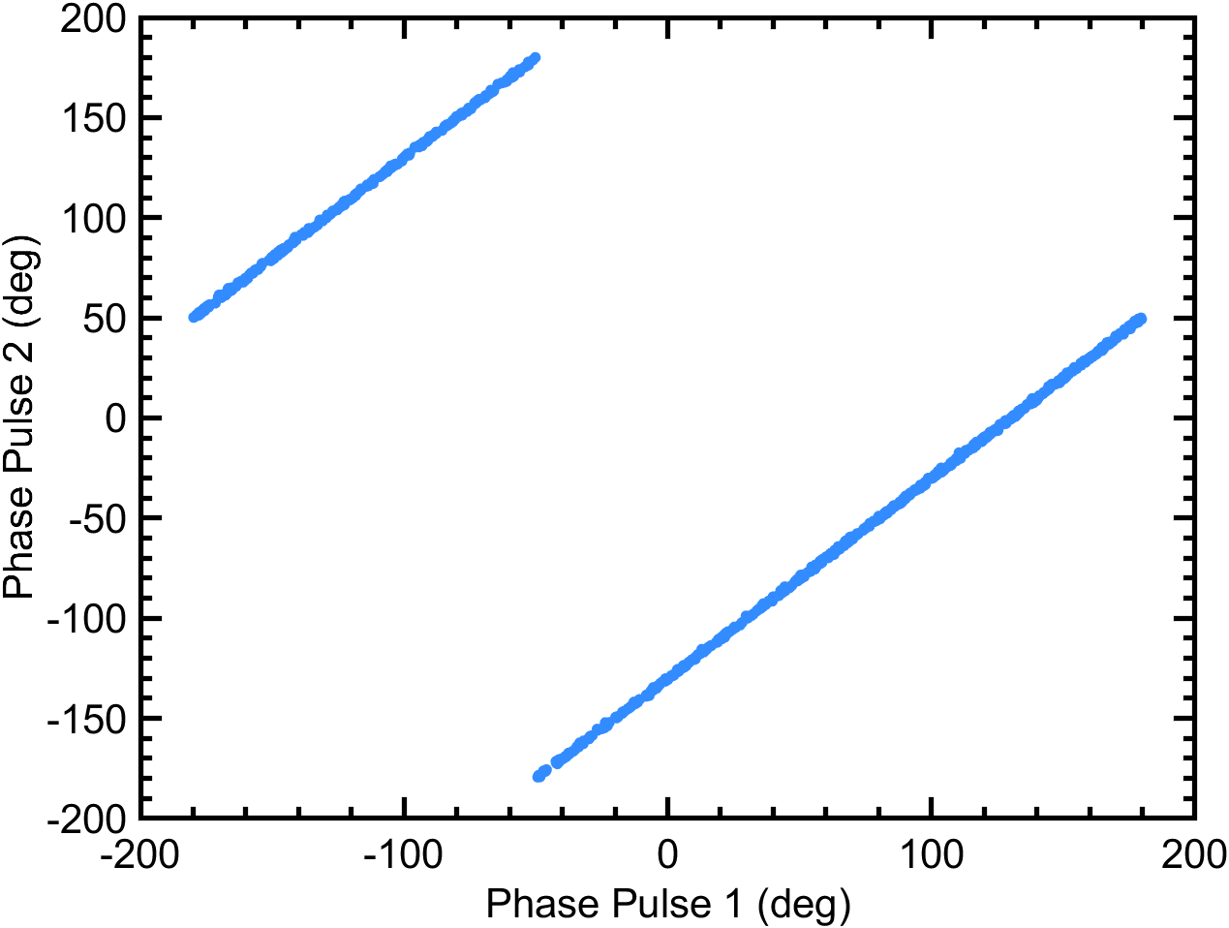
Two-Pulse Scheme
Fixed delay (~40-50 ns) between two beam pulses fixes phase delay
Error in simultaneous phase between pulses yields resolution of the system
Linear fit residuals yield ~100 fs single pulse resolution
Etalon
Delay Stage
HWP
PBS
UV 260 nm
Polarizer

Slide 14
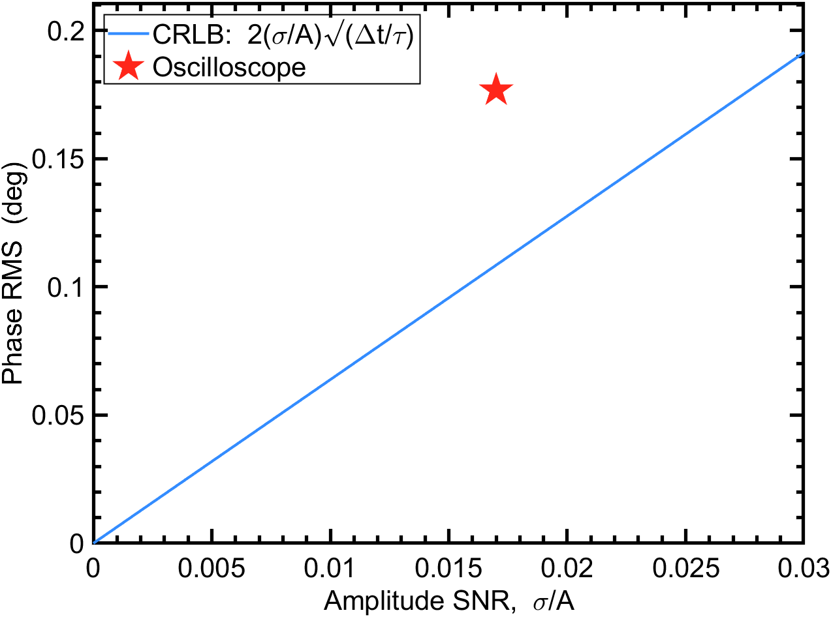
Limits to Performance
Performance is limited by SNR according to Cramér-Rao Lower Bound
Oscilloscope data sits above the bound likely due to:
ADC aperture jitter
effective number of bits (ENOB)
Improvements to the system will require:
Improved acquisition to reduce noise
Redesign of the cavity to outcouple more energy

Slide 15
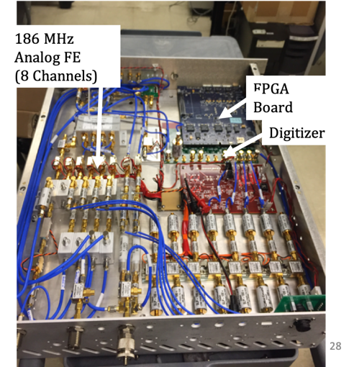
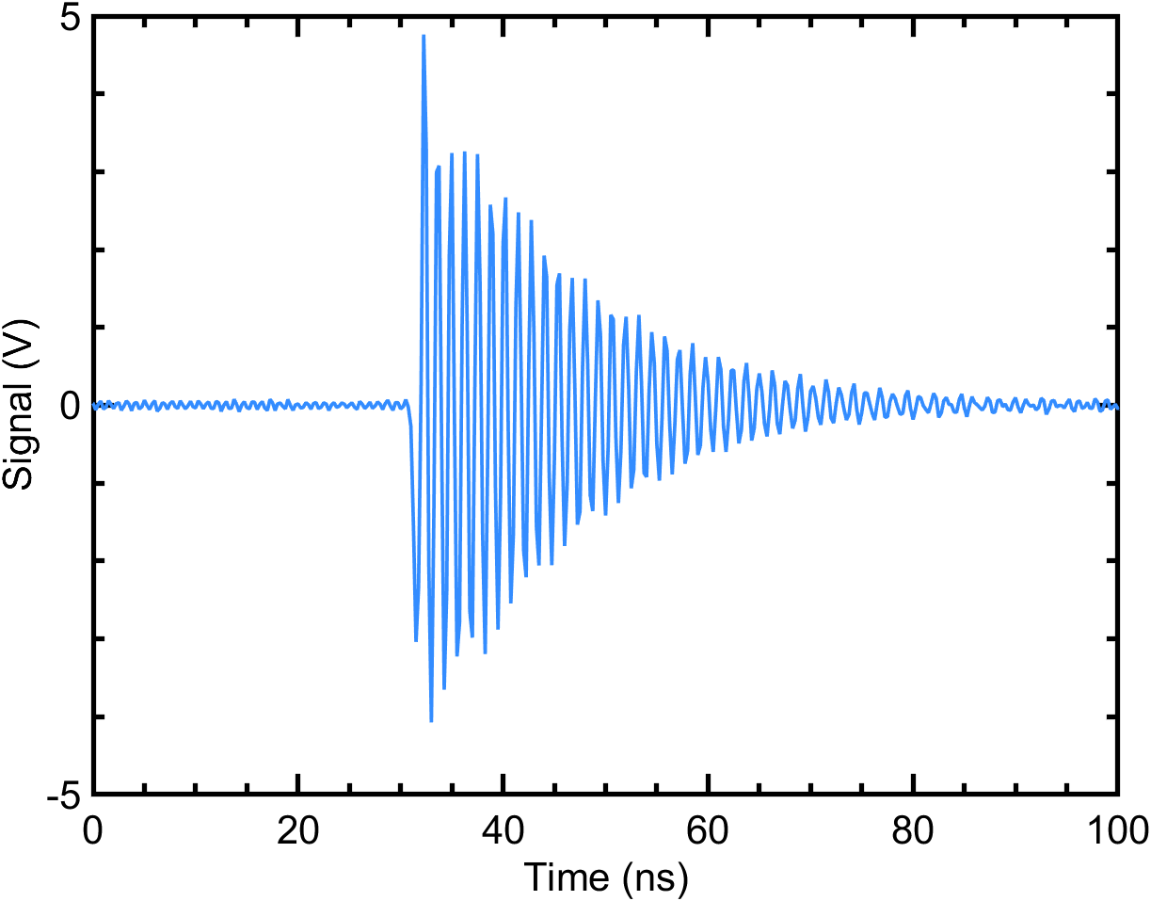
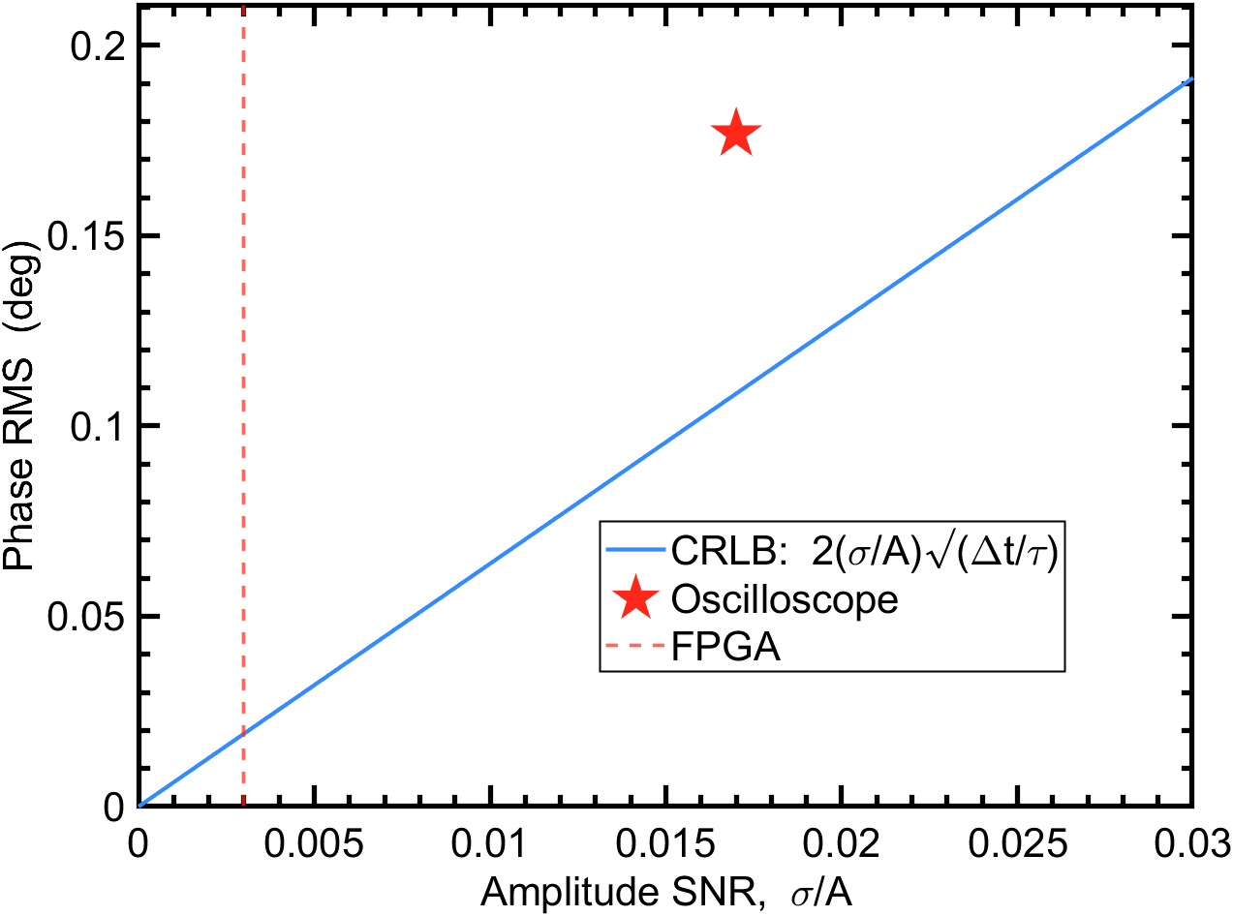
Towards Better Acquisition
Collaboration with LBNL for FPGA-based (Xilinx ZCU208) solution to improve acquisition (digital down conversion)
FPGA helps improve signal-to-noise considerably -> CRLB expects 0.02 deg RMS error ~ 12 fs
High-speed acquisition will allow for real-time processing and feedback

Slide 16
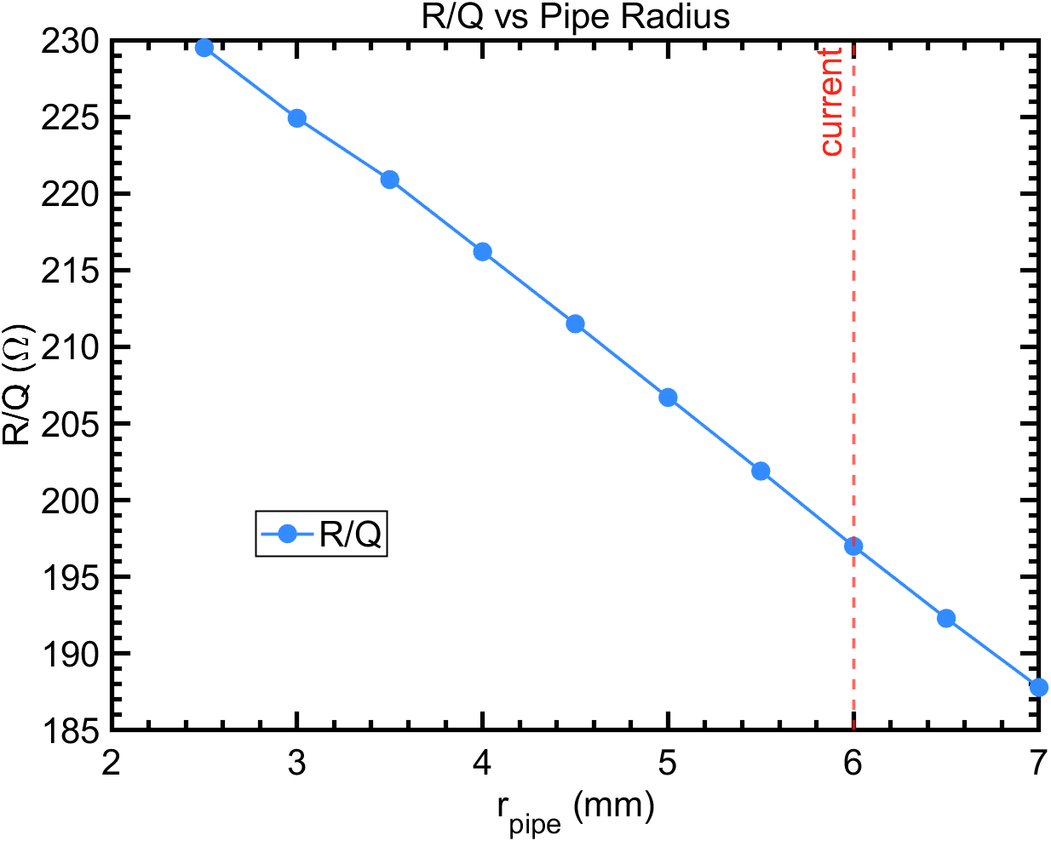
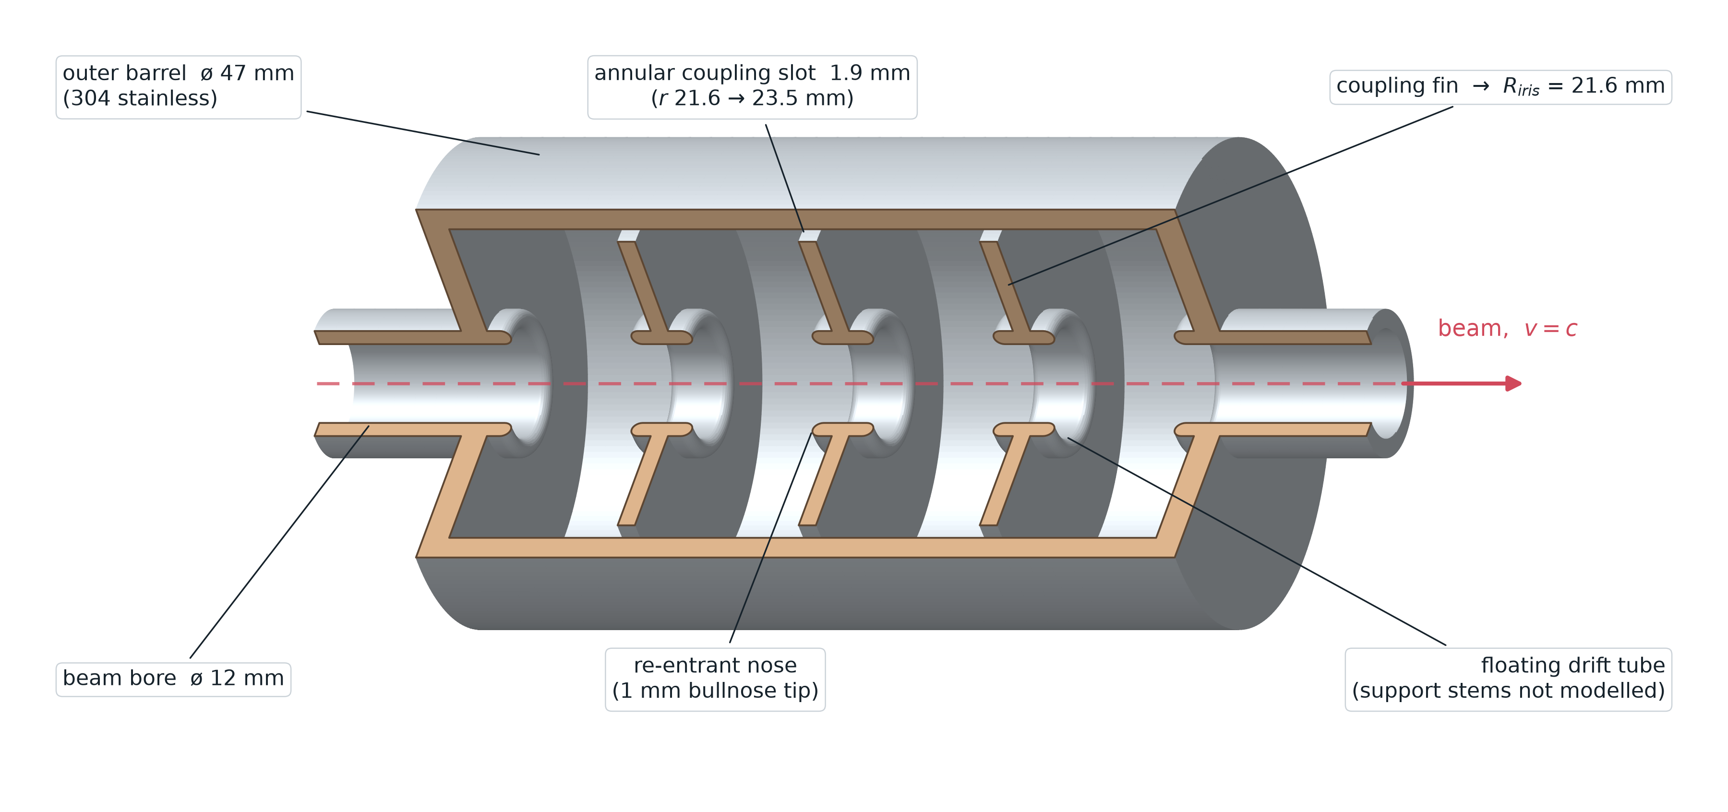

A New Cavity
Increasing energy extracted requires increase R/Q -> smaller apertures
  Small gains in R/Q
  More practical challenges
Outcouple energy from multiple cells
  Individual signals can be averaged
  Optimized coupler to extract all the energy together
$$V_{b0}=qω_{c}\frac{R}{Q}$$

Slide 17
Summary
A cavity-based (TM010 wakefield) monitor measures both bunch charge and time-of-arrival single-shot and non-destructively, demonstrated at UCLA PEGASUS.
Enables fC-level diagnostics for electron single-event-effects testing and MeV-UED pump-probe experiments.
Charge resolution of 260 aC RMS — over 100× better than the Turbo-ICT state of the art (~30 fC).
~100 fs single-pulse timing resolution via a two-pulse scheme; a co-acquired master clock removes trigger jitter, and a matched exponential filter reaches the Cramér–Rao bound.
Next steps: LBNL FPGA acquisition (ZCU208) targeting ~12 fs, and a higher-R/Q / multi-cell cavity to outcouple more energy.

Slide 18
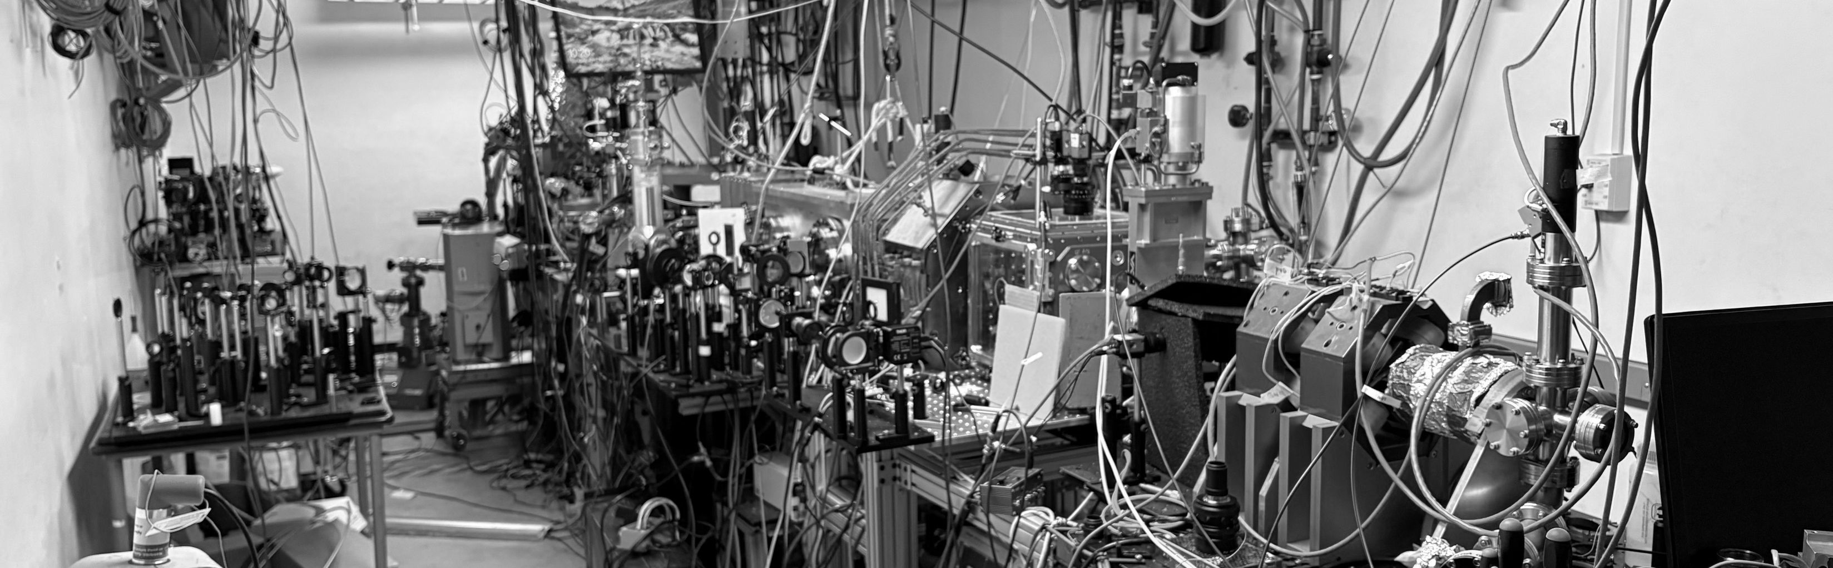




Acknowledgements
Authored by UCLA
G. Tzintzarov, J. Teng, A. Bushmaker (The Aerospace Corporation)
G. Allen (The Jet Propulsion Lab)
A. Murokh, G. Andonian (RadiaBeam Technologies)
Atharva is supported by the U.S. Department of Energy, Office of Science, High Energy Physics, under Award Number DE-SC0024907, the Tigner Traineeships in Accelerator Science program.

