Slide 1
Phase-Diversity Electro-Optic Sampling for Shaped Electron Beam Profile Monitoring
Spencer Kelham
AAC’2026, Working Group #5

Slide 2
Contents
Introduction
ML assisted reconstruction
Planned DEOS experiment
Future work

Slide 3
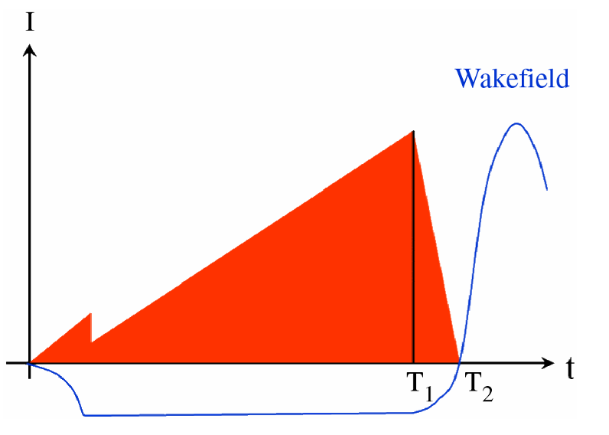
Motivation
Shaped drive bunches can increase the transformer ratio in beam-driven wakefield accelerators.
These shaped beams contain sharp temporal features that demand high-resolution longitudinal diagnostics.
Future high-energy, high-current facilities will require non-invasive diagnostics, with single shot measurement capabilities.
This work investigates Phase-Diversity Electro-Optic Sampling (DEOS) for measuring shaped electron bunches and explores methods to improve the reconstruction accuracy.
Fig: Shaped beam distribution and wakefield, Courtesy of B. Jiang, C. Jing, P. Schoessow, J. Power, and W. Gai.

Slide 4
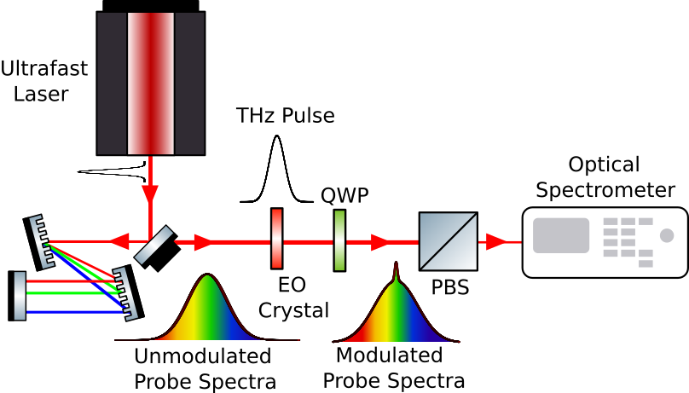
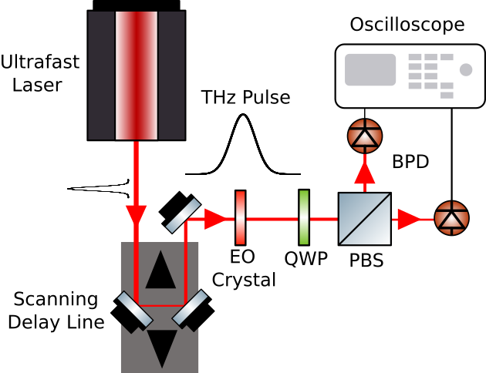
Electro-Optic Sampling
Electro-Optic Sampling (EOS) technique where a THz field is imprinted onto a probe laser via the Pockel’s Effect.
As a diagnostic tool for accelerators, the THz field under interest can be near-field or far-field sources.
For a highly relativistic particle bunch, the measured transverse field maps to its longitudinal current profile.
EOS is a non-destructive and non-invasive measurement.
Various EOS techniques exist:
  Scanning EOS
  Spectral Encoding
Fig: Simplified Scanning EOS experiment.
Fig: Simplified Spectral Encoding EOS experiment.

Slide 5
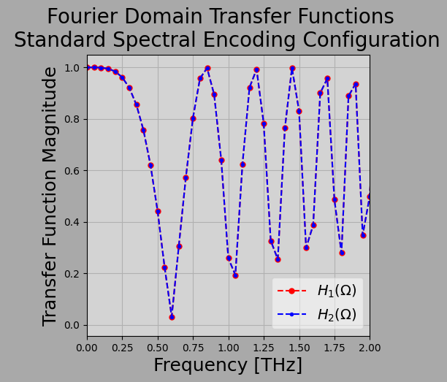
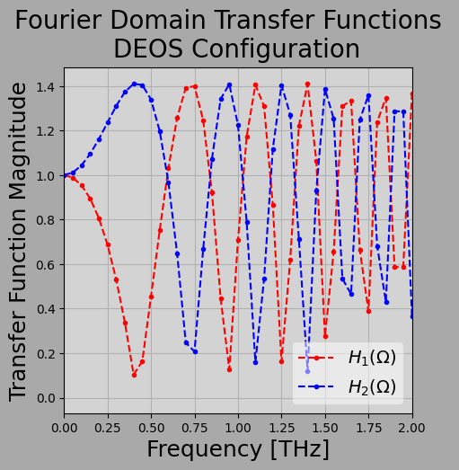
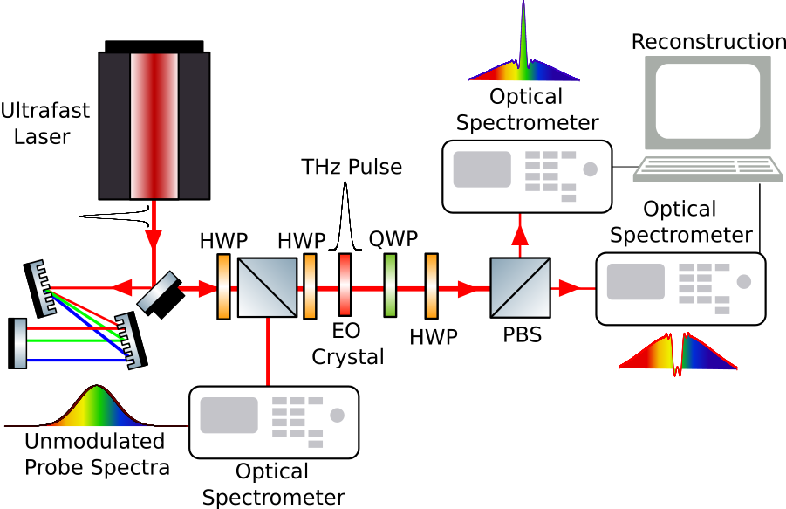
Phase Diversity Electro-Optic Sampling
Spectral encoding with optics oriented for maximum sensitivity, loses information at transfer-function nulls, limiting temporal resolution.
Phase Diversity Electro-Optic Sampling (DEOS) is a technique that aims to resolve the spectral information loss.
Optics are intentionally oriented to create different modulation responses on orthogonal polarizations.
DEOS measures and combines two complementary polarization responses.
Combined information is well-posed.
Fig. : Transfer functions for electro-optic signals in conventional spectral encoding configuration.
Fig: Transfer functions for electro-optic signals in DEOS configuration.
Fig: Simplified DEOS experimental setup.

Slide 6
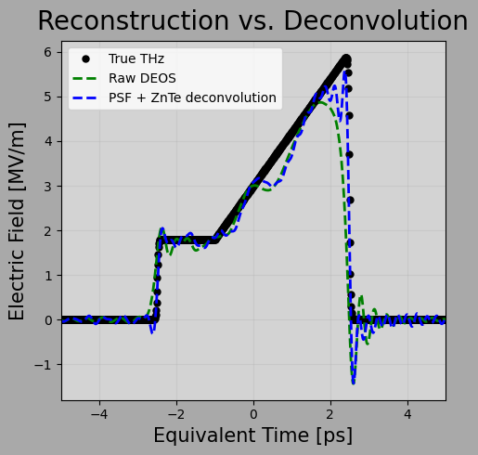
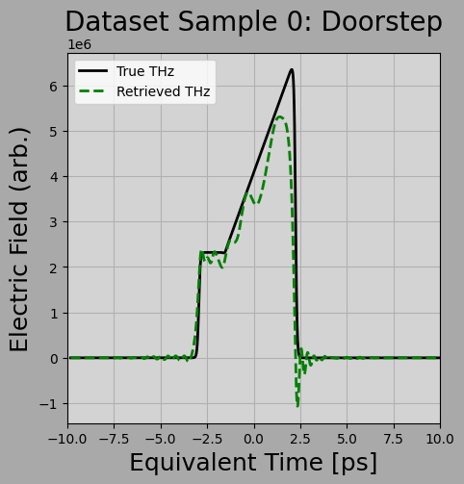
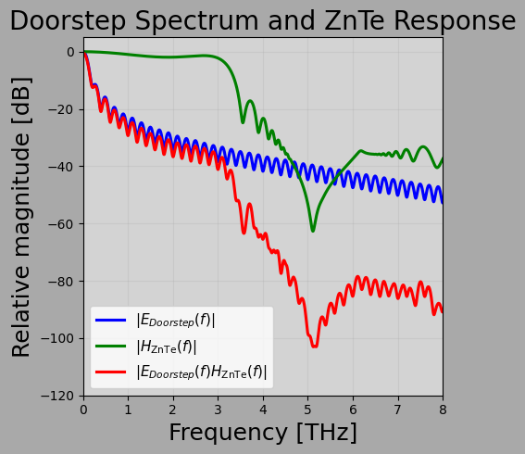
Reconstruction Techniques Beyond DEOS
EOS measures phase retardance, which typically treated as Γ(t) ∝ E_{THz}(t) (Pockels Effect).
Due to real crystal parameters, crystal response function H(f,d) ≠ 1.
Spectrometer (Detector) resolution is modeled by Gaussian Point-spread function (PSF) convoluted with measured intensity spectra.
Probe laser bandwidth also effects temporal resolution.
Because these effects act like filters, deconvolution can partially recover the bunch shape.
Fig. : Relative magnitude of doorstep pulse spectrum, ZnTe response function G(f,d), and phase-retardance FFT.
Fig: Raw DEOS reconstruction (green) vs. deconvolution using ZnTe response function and camera PSF.
Fig. : Sample doorstep pulse reconstruction, including ZnTe response function and spectrometer resolution.

Slide 7
DEOS + ML: Concept
Train a machine learning network to map a the DEOS reconstruction with real world resolution limits to underlying bunch profile.
Idea is similar to image de-blurring with ML.
Simulation provides paired reconstruction and ideal profiles for training.
Experimental training and validation will pair DEOS measurements with TDC benchmarks.
Fig: Idealized Doorstep and Reconstruction to serve as input and output.

Slide 8
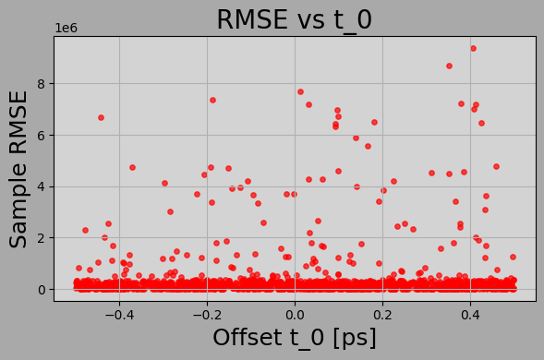
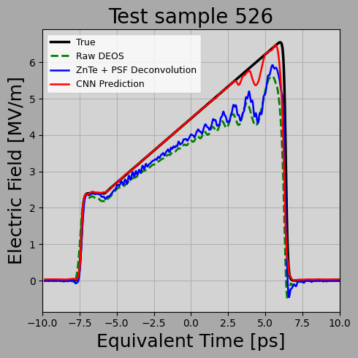
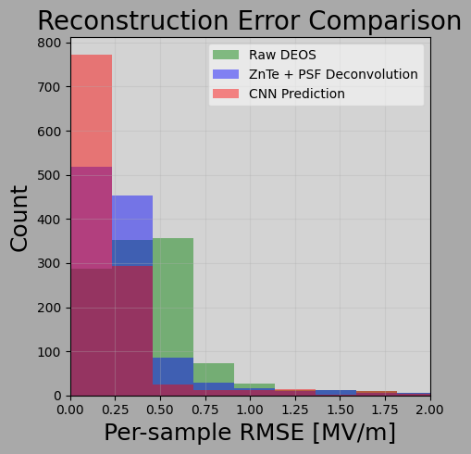
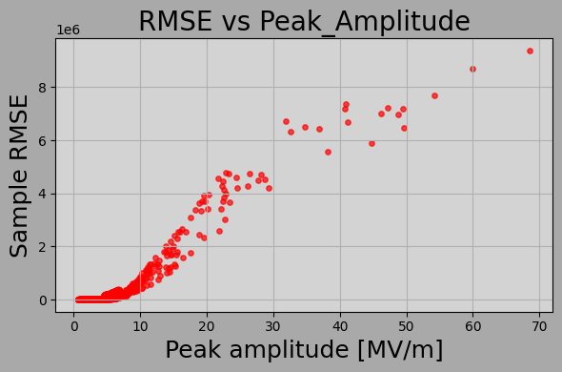
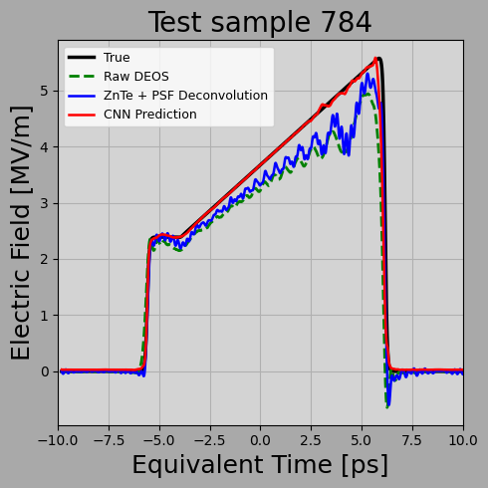
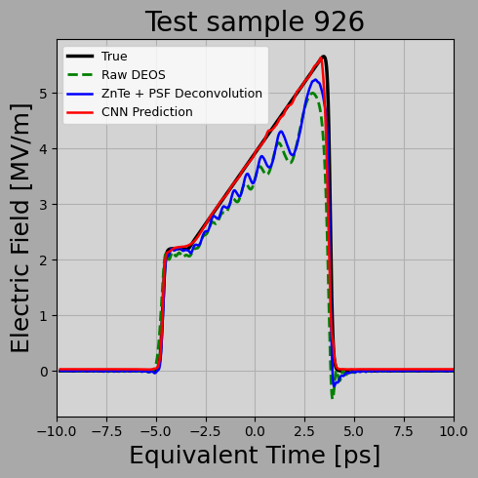
DEOS + ML: Current Results and Status
Model takes in 3 parameters.
  DEOS reconstruction
  Bunch charge
  Bunch profile family (Gaussian or Doorstep)
Trained on dataset of ~10k generated and simulated reconstructed pulses.
Custom loss function designed to discourage discontinuities and ringing.
Simulated results outperform conventional deconvolution; experimental validation remains.
Fig. Overall model comparison.
Fig: Error vs parameter testing.
Fig: Sample reconstruction comparisons.

Slide 9
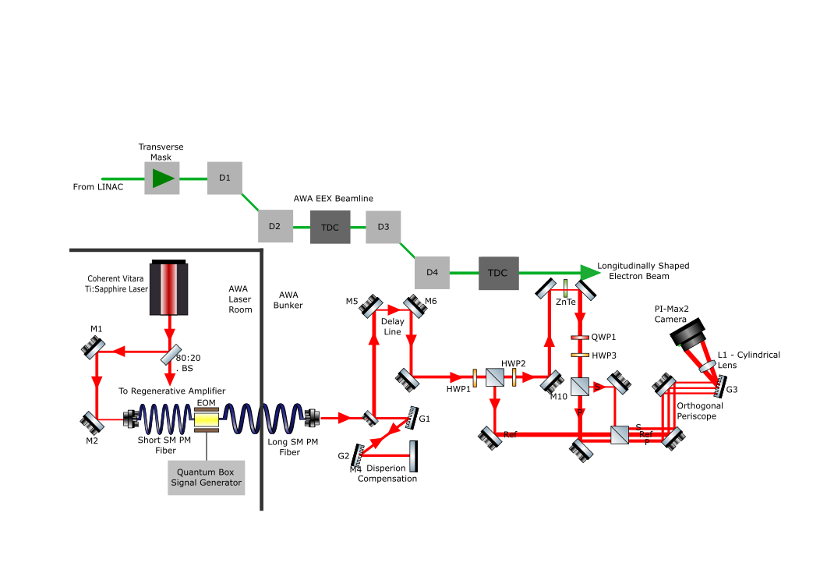
Planned DEOS Experiment Design
Fig: Experimental layout of planned DEOS experiment on the EEX beamline at AWA.

Slide 10
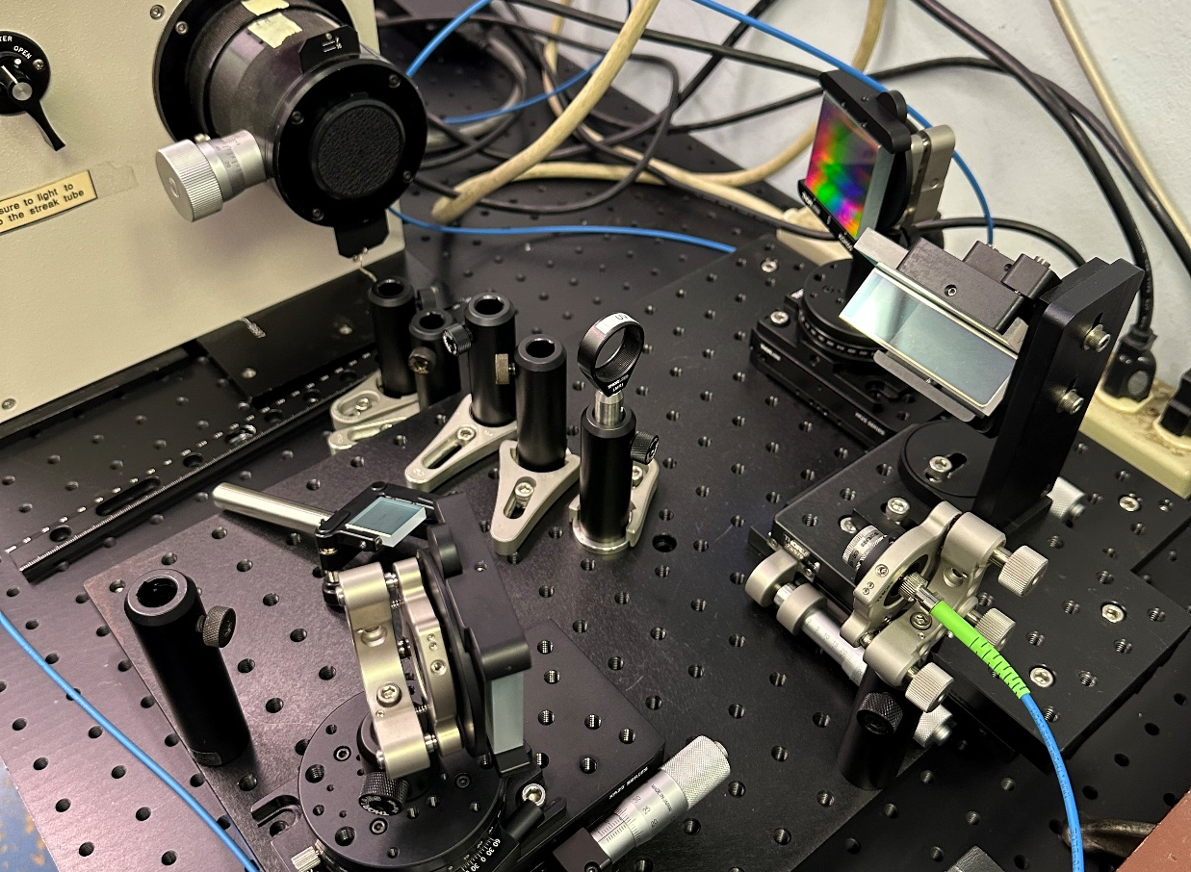
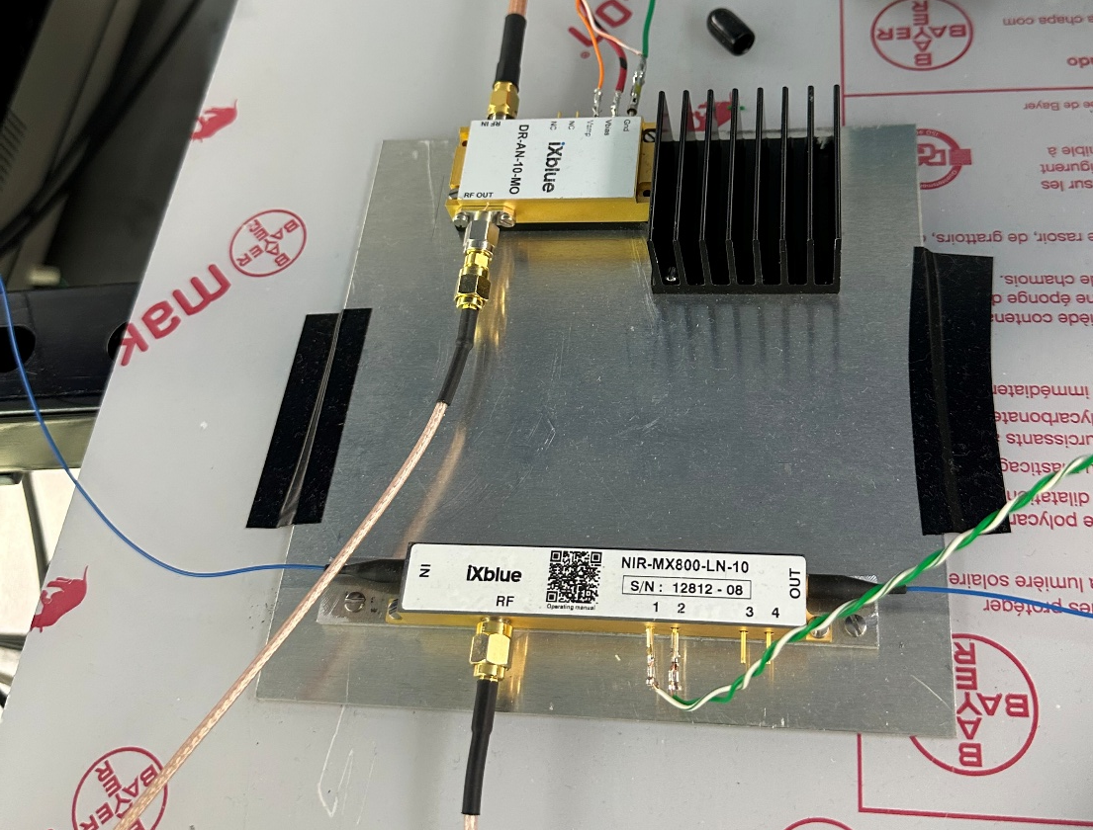
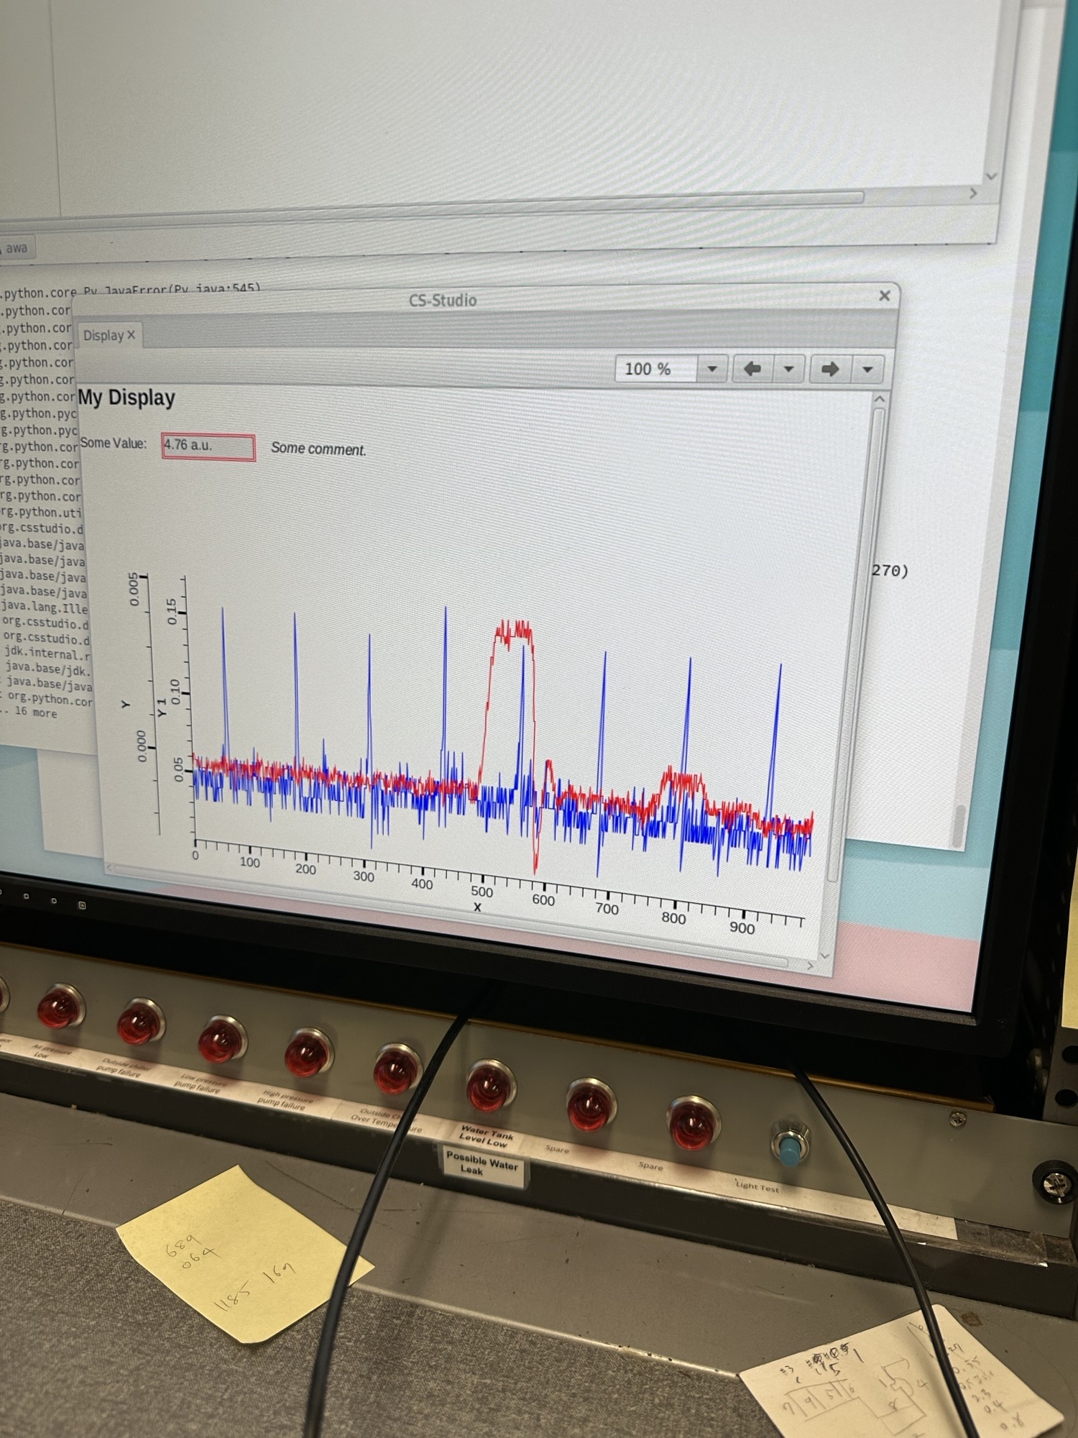
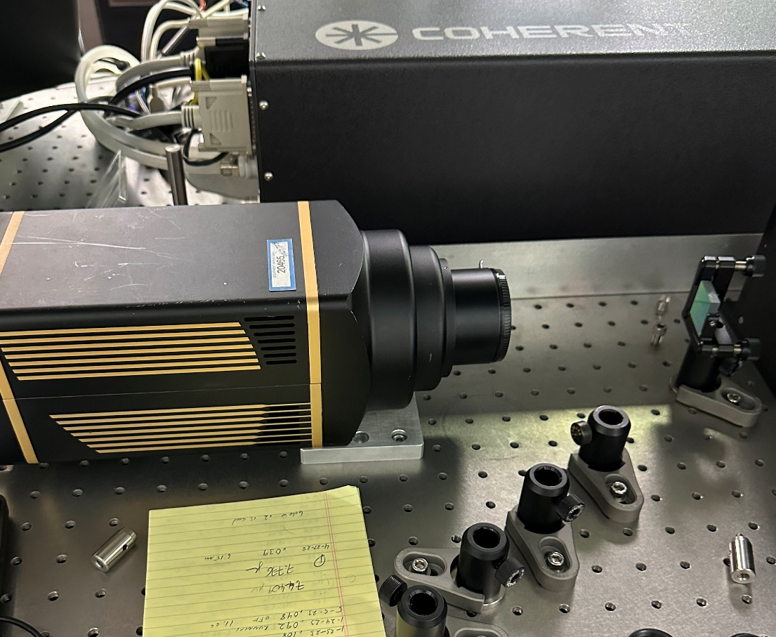
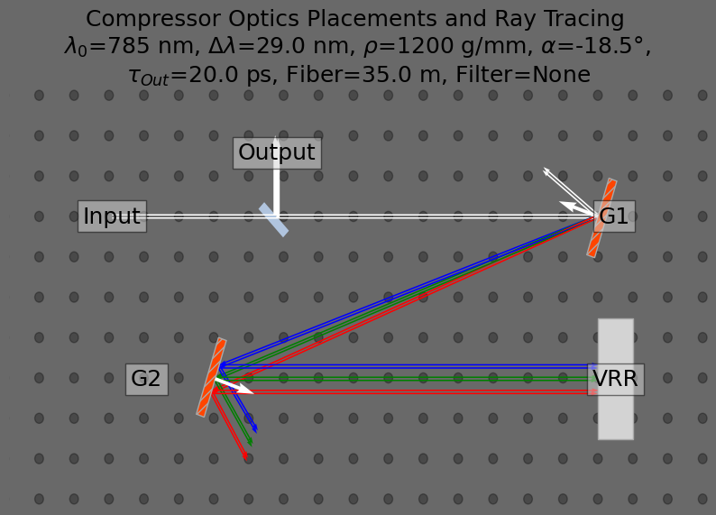
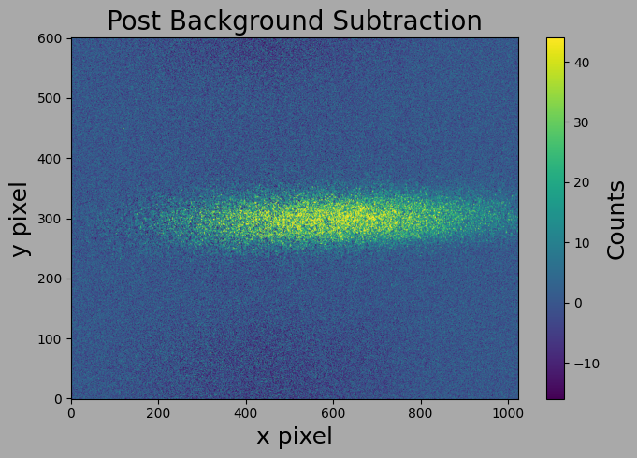
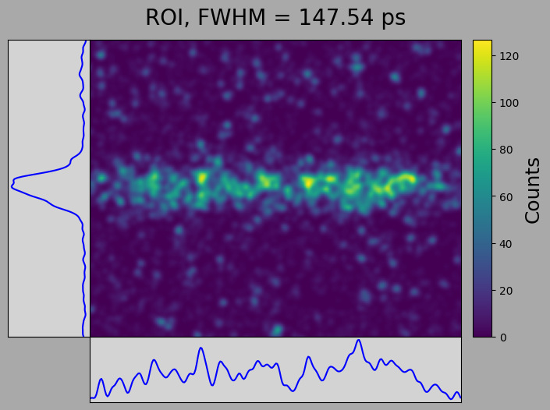
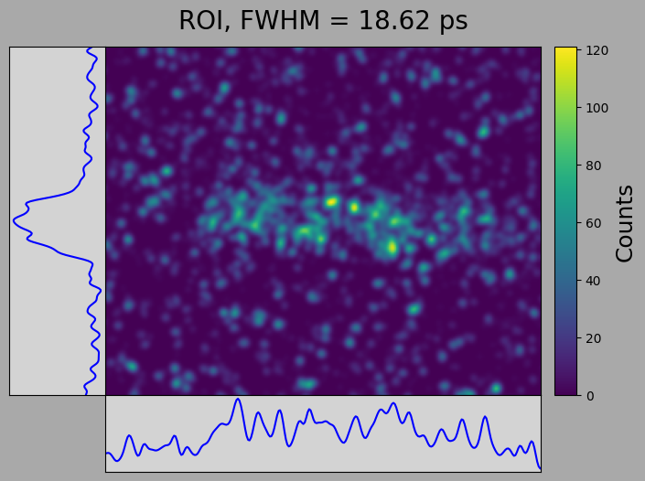
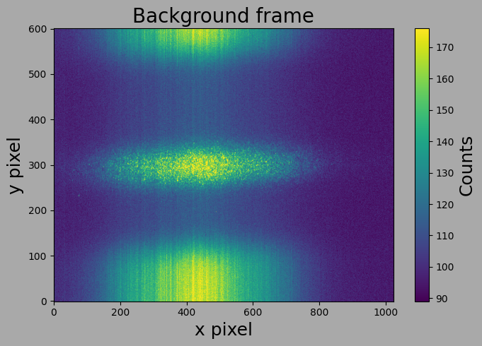
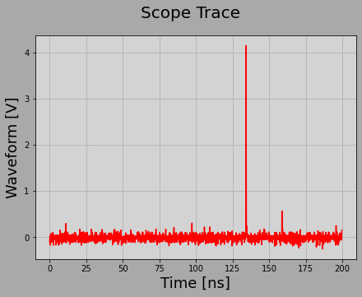
DEOS Experiment Preparation
Probe laser considerations:
  Coherent Vitara
    λ₀ = 785 nm
    Δλ = 29 nm FWHM
    Pulse Rep. Frequency = 81.25 MHz
  Pulser picker required.
    iXblue NIR-MX-Ln-10 Mach-Zehnder Electro-Optic Modulator used to suppress unwanted pulses. RF pulse used to gate single pulse for use in experiment.
  PI-Max camera to detect picked pulse.
    Gate time 50 ns.
  Chirp imparted on laser via fiber transport + two-grating compressor.
    Chirped pulse duration measured using streak camera.
Fig. : Vitara pulse train measured with fast IR photodiode and oscilloscope. Blue trace is photo-diode signal. Red trace is RF gate signal.
Fig. : Mach-Zehnder EOM as pulse picker. DC bias set to cause destructive interference of probe laser. RF gating signal passes single pulse.
Fig. : Compressor design to compensate for 35 m PM-780HP fiber optic cable. Outgoing pulse length ~20 ps.
Fig. : Picked pulse post-background subtraction on PI-Max2 camera.
Fig. : Compressor pulse length measurement with streak camera.
Fig. : Scope trace after pulse picking. One pulse passed, all others suppressed.
Fig. : PI-Max2 camera and diffraction grating testing in AWA laser room.
Fig. : Raw diffracted beam image on PI-Max2 camera.
Fig. : Streak camera image pre-compressor (long pulse).
Fig. : Streak camera image post-compressor (chirped pulse).

Slide 11
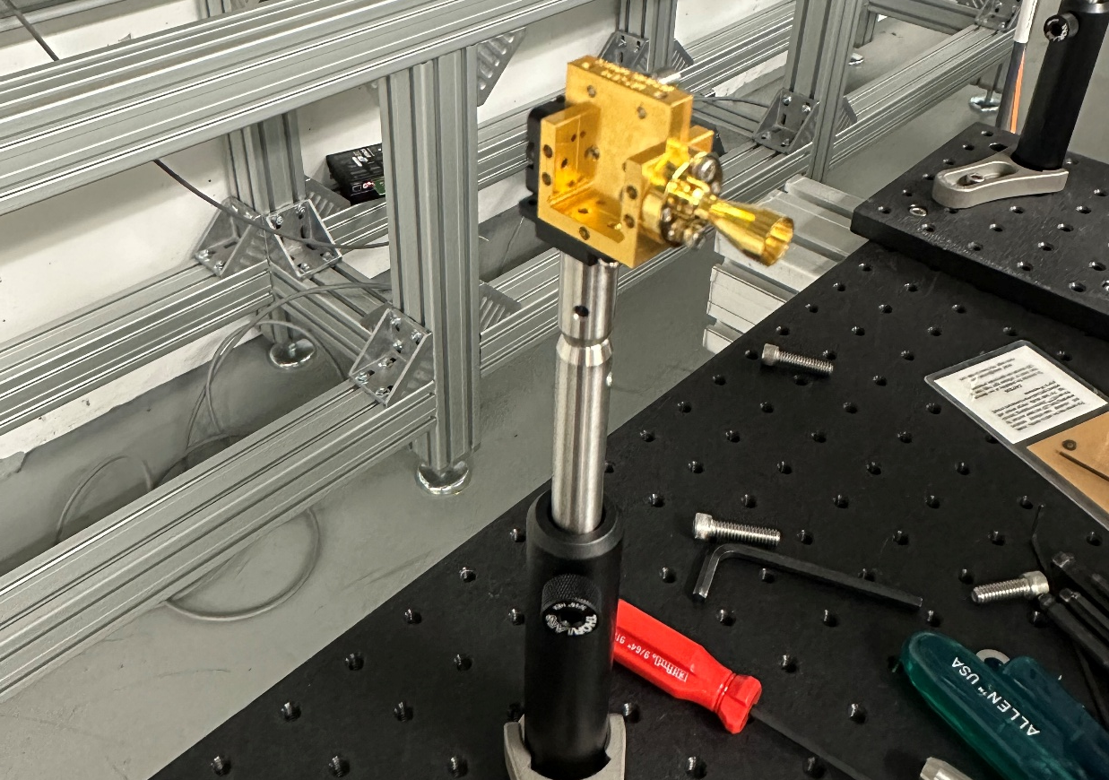
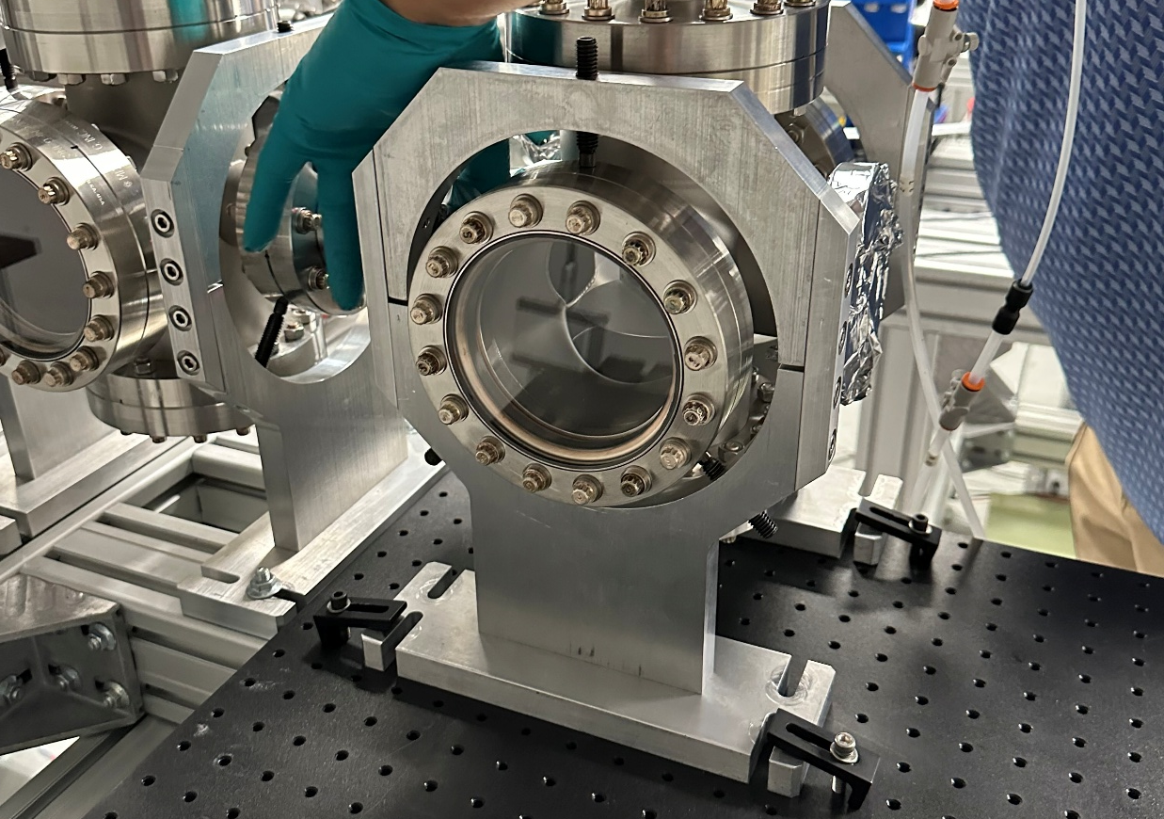
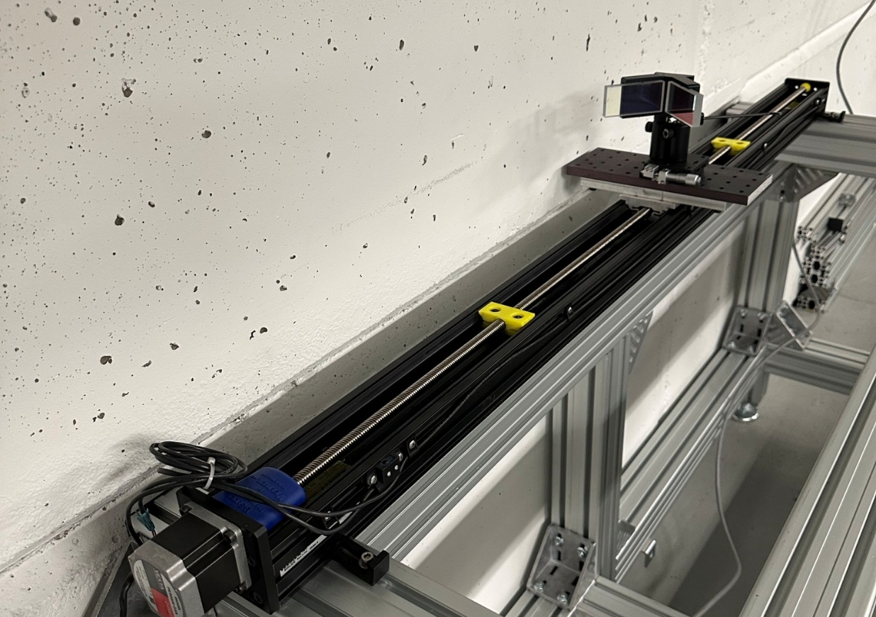
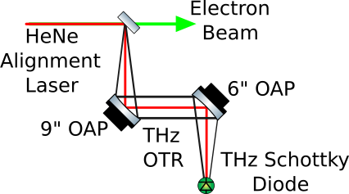
DEOS Experiment Preparation
Synchronization strategy for electron beam and probe laser
  Course timing set using pulse-picker.
  Fine timing set using delay line.
  Arrival-time monitored using fast THz Schottky diode and fast IR photodiode.
Synchronization strategy for PI-Max camera trigger and probe laser
  Increase RF gate signal width, allows for 4-5 pulses in a short packet to be gated in (50-60 ns).
  Set PI-Max camera trigger to same delay as course timing.
  Scan around course timing to identify in 1 ns steps to identify beginning and end of short pulse train.
  Reduce RF gate signal width and camera delay until single pulse captured on PI-Max.
Fig. : Bunch Arrival-time measurement.
Fig. : Fast THz Schottky Diode Borrowed from APS.
Fig. : OTR mirror within cross during setup. Cross is not under vacuum.
Fig. :Delay Line and Horizontal Retro-Reflector.
Fig. : Vitara pulse train. Blue trace: photodiode signal. Red trace: RF gate.

Slide 12
Next Steps
Quality of life improvements
  Cleaner data collection system.
  Automated synchronization script.
  EOM DC bias control with feedback.
Run experiment
  Scheduled for this summer; delayed due to machine troubles.
  Opportunity in late September.
  Revisiting crystal in vacuum design for possible experiment next year.
Test and fine tune ML DEOS network on electro-optic sampled data and TDC data.
Systematic study for entire DEOS experiment.
Special Thanks
Academic Advisor: Gwanghui Ha
AWA Staff: John Power, Alex Ody, Wanming Liu, Josh Hlavenka, & Scott Dorian, Charles Whiteford

