Slide 1
Compact THz Streaking Framework for Robust Longitudinal Diagnostics in Advanced Accelerators
Gerard Lawler¹, Banan Yamani², Matthias Nabinger³, Micha Dehler¹, Evan Ericson¹, Nicole Hiller¹, Michael Nasse³, Alexander Molodozhentsev², Rasmus Ischebeck¹
¹ Paul Scherrer Institute ² Extreme Light Infrastructure ³ Karlsruhe Institute of Technology
Notes:
Leverage PSI expertise in longitudinal diagnostics and to develop and improve THz diagnostics for scalable beamline implementations

Slide 2
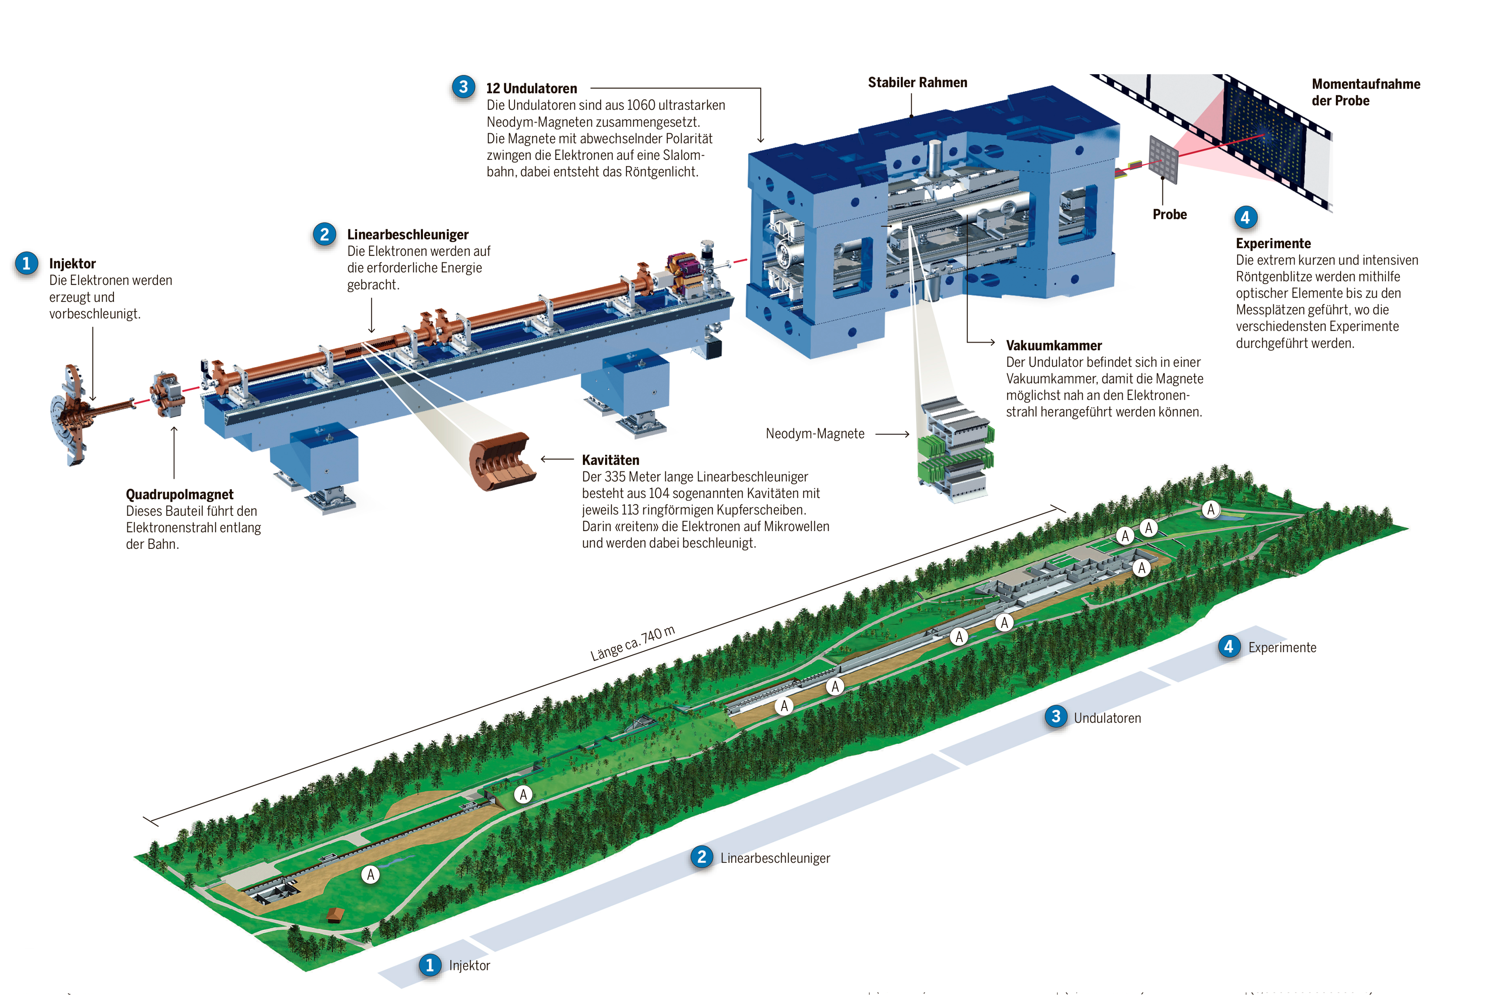
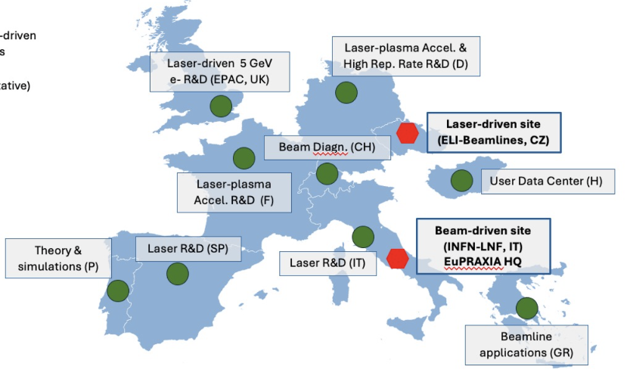
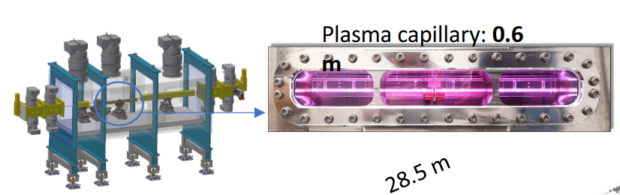
Motivation
PACRI European funded project to develop key plasma accelerator technologies for Europe’s future research infrastructures, such as EuPRAXIA and Extreme Light Infrastructure (ELI)
SWISSELITE: Swiss Contributions to Technological Advancements at ELI Beamlines
https://agenda.infn.it/event/50880/contributions/288551/attachments/146220/222591/EuPO_Marinelli.pdf

Slide 3
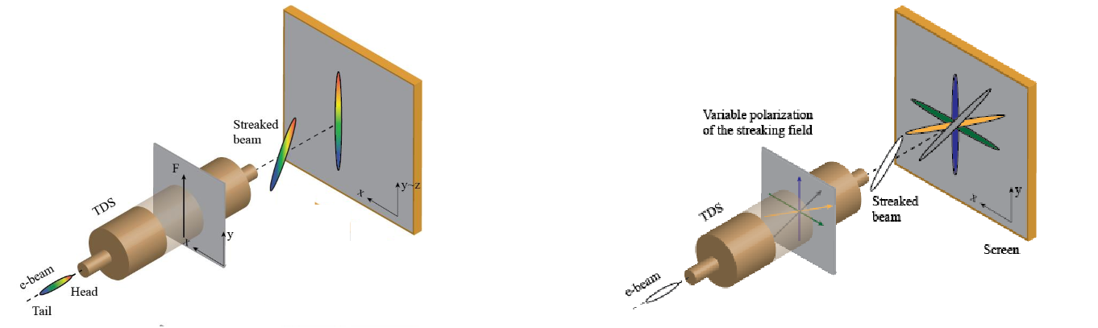
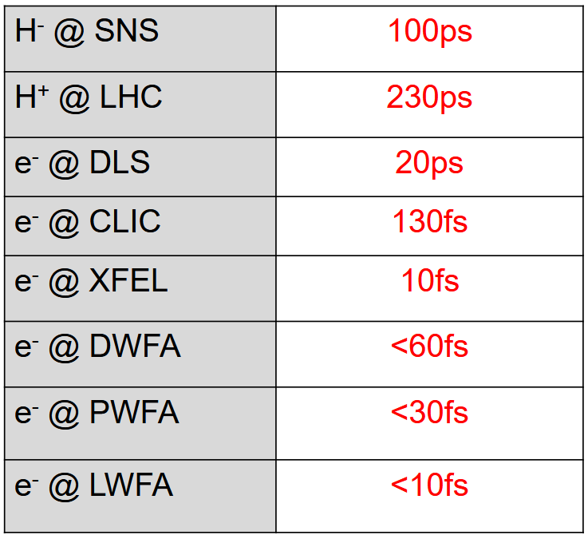
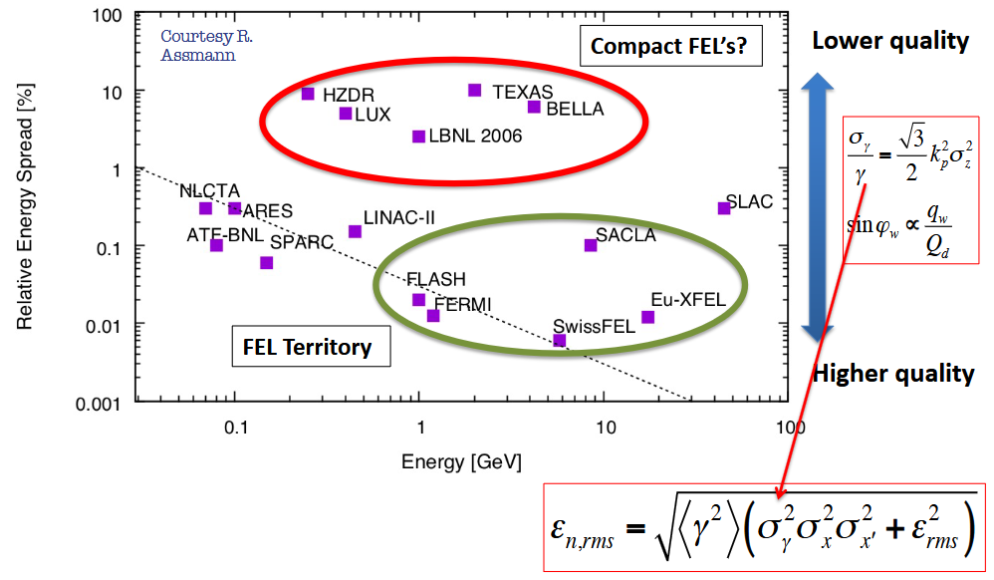
RF Deflecting cavity
State of the art PSI PolariX TDS
Meters on beamline
https://indico.cern.ch/event/1335148/contributions/5663218/attachments/2769854/4825803/PolariX_CLIC_Mini_Week.pdf
https://indico.cern.ch/event/1380440/contributions/6176576/attachments/2969104/5224846/CAS24_longitudinal_BI.pdf
Marchetti, B., Grudiev, A., Craievich, P. et al. Experimental demonstration of novel beam characterization using a polarizable X-band transverse deflection structure. Sci Rep 11, 3560 (2021).

Slide 4
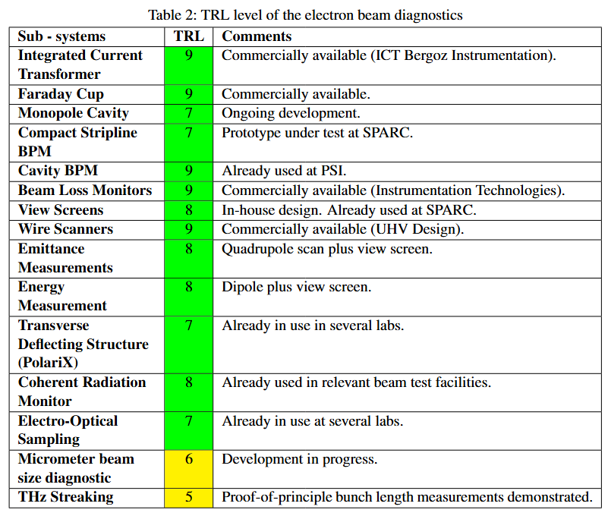
RF Deflecting cavity
State of the art PSI PolariX TDS
Meters on beamline
https://indico.cern.ch/event/1335148/contributions/5663218/attachments/2769854/4825803/PolariX_CLIC_Mini_Week.pdf
https://indico.cern.ch/event/1380440/contributions/6176576/attachments/2969104/5224846/CAS24_longitudinal_BI.pdf
Marchetti, B., Grudiev, A., Craievich, P. et al. Experimental demonstration of novel beam characterization using a polarizable X-band transverse deflection structure. Sci Rep 11, 3560 (2021).

Slide 5
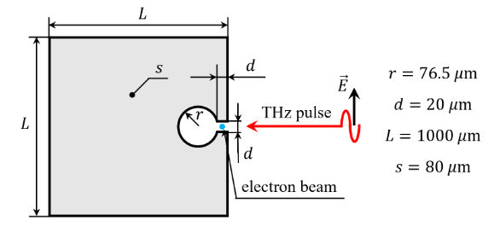
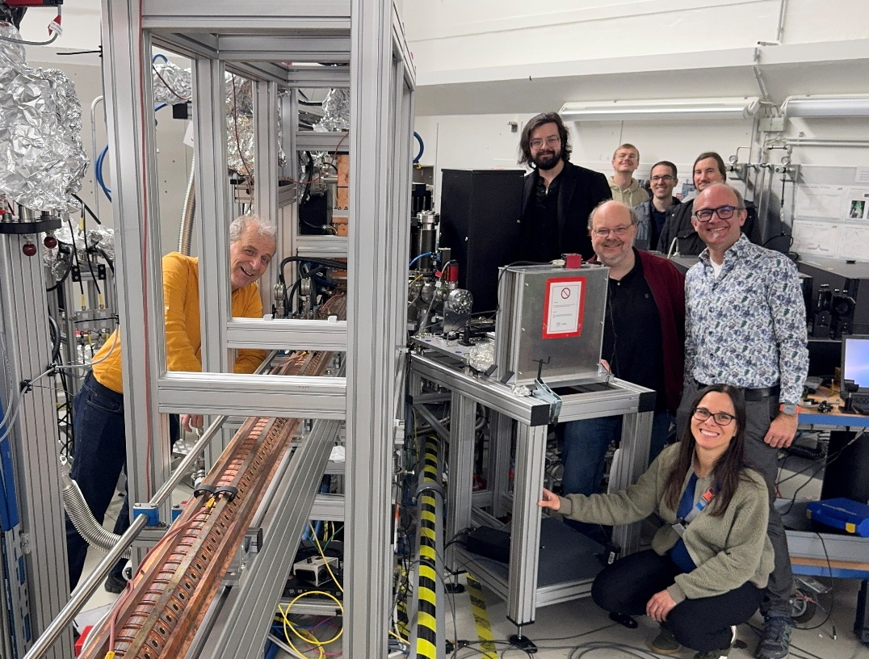
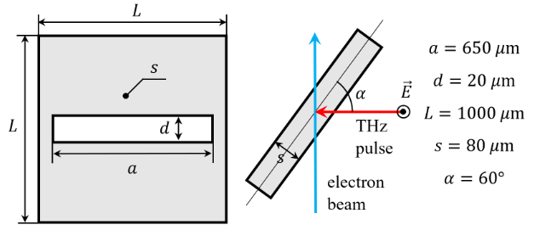
Proof of concept geometries
Resonant structures manufactured and tested in collaboration with Karlsruhe Institute of Technology (KIT) @ FLUTE (Ferninfrarot Linac- und Test-Experiment)
Inverse Split Ring Resonator (ISRR)
Tilted-slit Resonator (TSR)
Glukhov, Sergei, et al. "Simulations of the compact transverse deflecting system for ultra-short electron bunch diagnostic." Proc. IPAC’23 (2023): 4887-4890.

Slide 6
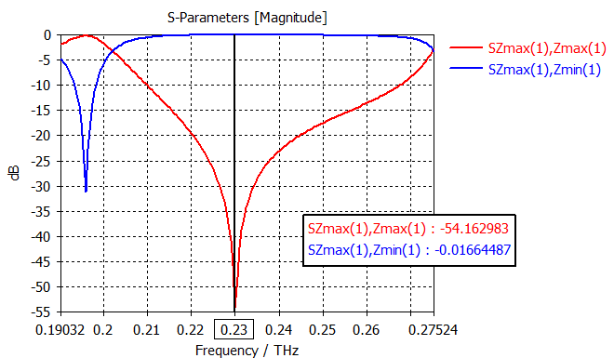
What changed?
Not necessarily max Q
Focus on want stronger streaking field for the same incident THz energy, shunt impedance, and longer interaction length
RF TDS | THz Resonator
Higher Q beneficial | Higher Q increases field enhancement
Narrowband | THz pulse may be broadband
Filling time not critical | Filling time may exceed pulse duration
Goal to maximize voltage | Goal to maximize kick per available THz energy

Slide 7
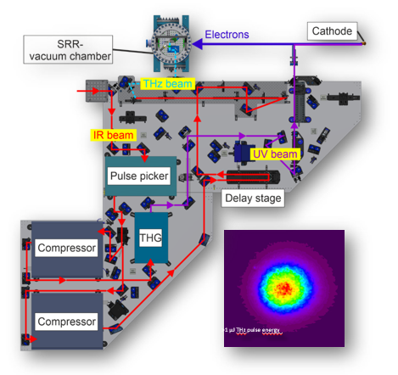
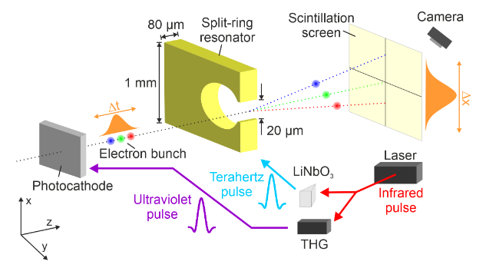
Why THz?
RF systems challenging in certain situations
Existing laser systems when RF difficult (e.g. KIT right)
Short pulse synchronization
Treat THz less like optical diagnostic and more like mini-RF systems
MeV energy electrons
Schaefer, Jens, et al. "Split-ring resonator experiments and data analysis at FLUTE." Proc. 14th International Particle Accelerator Conf.(IPAC’23). 2023.

Slide 8
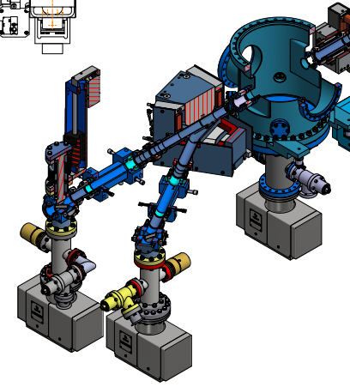
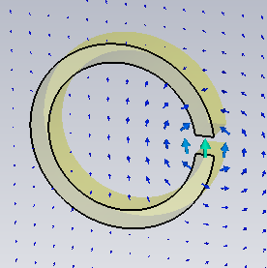
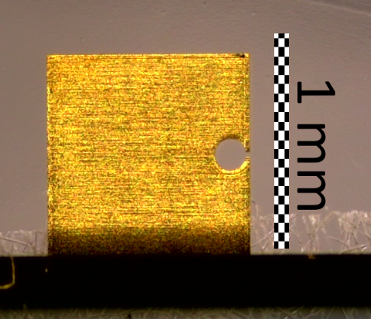
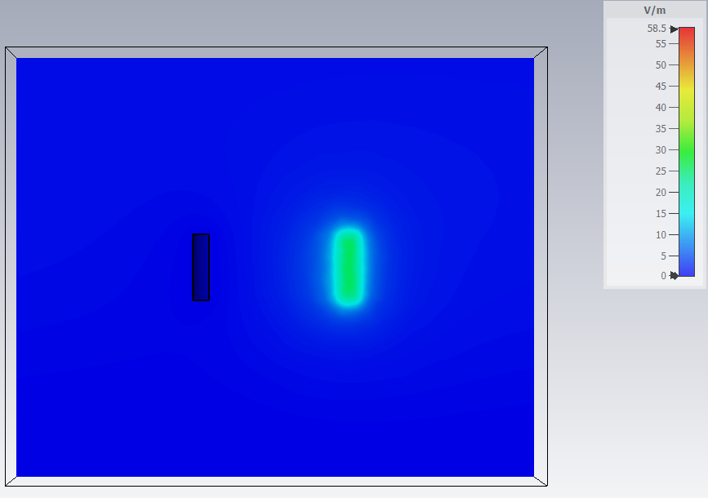
THz Generation
Experimental chamber proceeded by photogun, magnetic optics, and collimator followed by dipole + screens
High Q resonator -> RF like behavior with field enhancement >50 in gap
Approx 10 urad/fs streaking strength
Experimental chamber
Dipole magnet
Schäfer, Jens, et al. "Split Ring Resonator Experiment-Simulation Results." Proc. IPAC’21 (2021): 888-891.

Slide 9
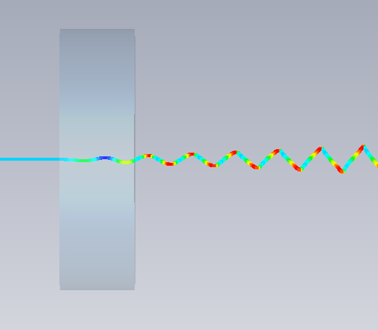
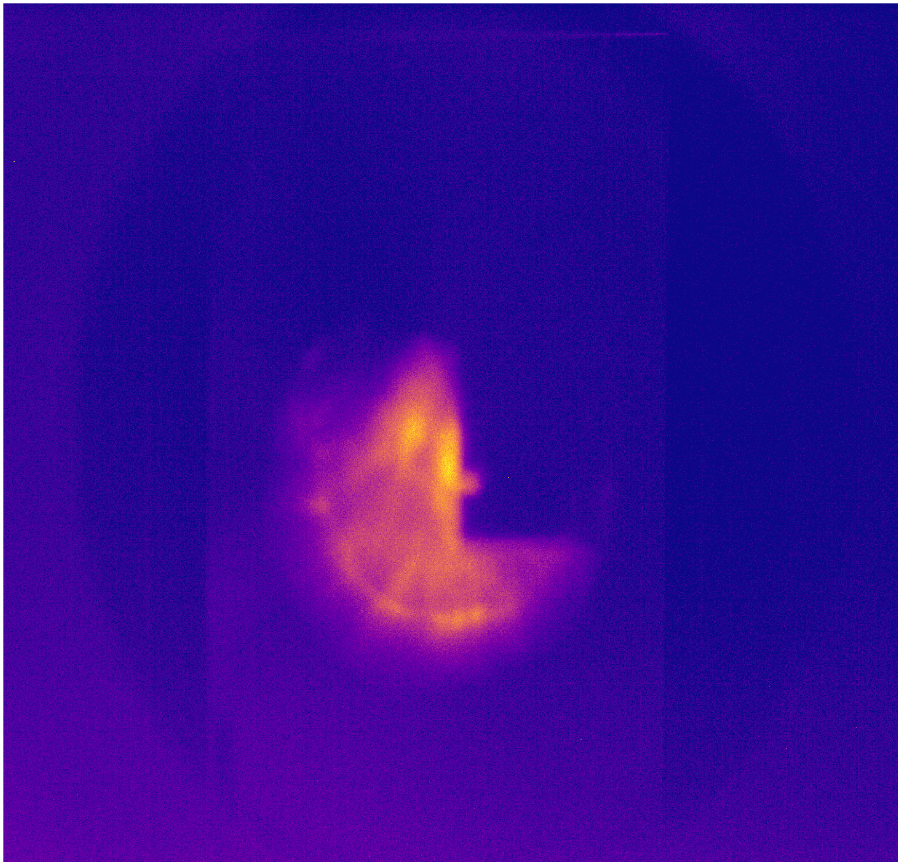
Entering New Regime
Underlying diagnostic logic still recognizable as RF streaking
Micron gap aperture
THz higher in frequency so imprint more on beam of same length
RF TDS | THz Resonator
Linearized streak | Highly nonlinear
Single 0 crossing | Multiple visible cycles
Simple observable | Complex image morphology
RF infrastructure | Laser systems
cm gap | micron gap

Slide 10
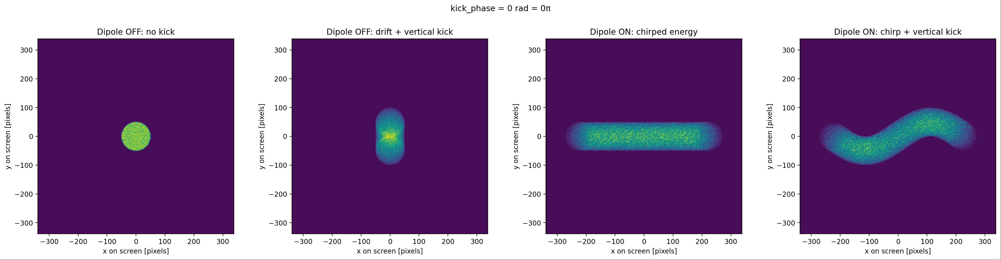
Visualization
Linear energy chirp allows dispersive section to see multiple cycles

Slide 11
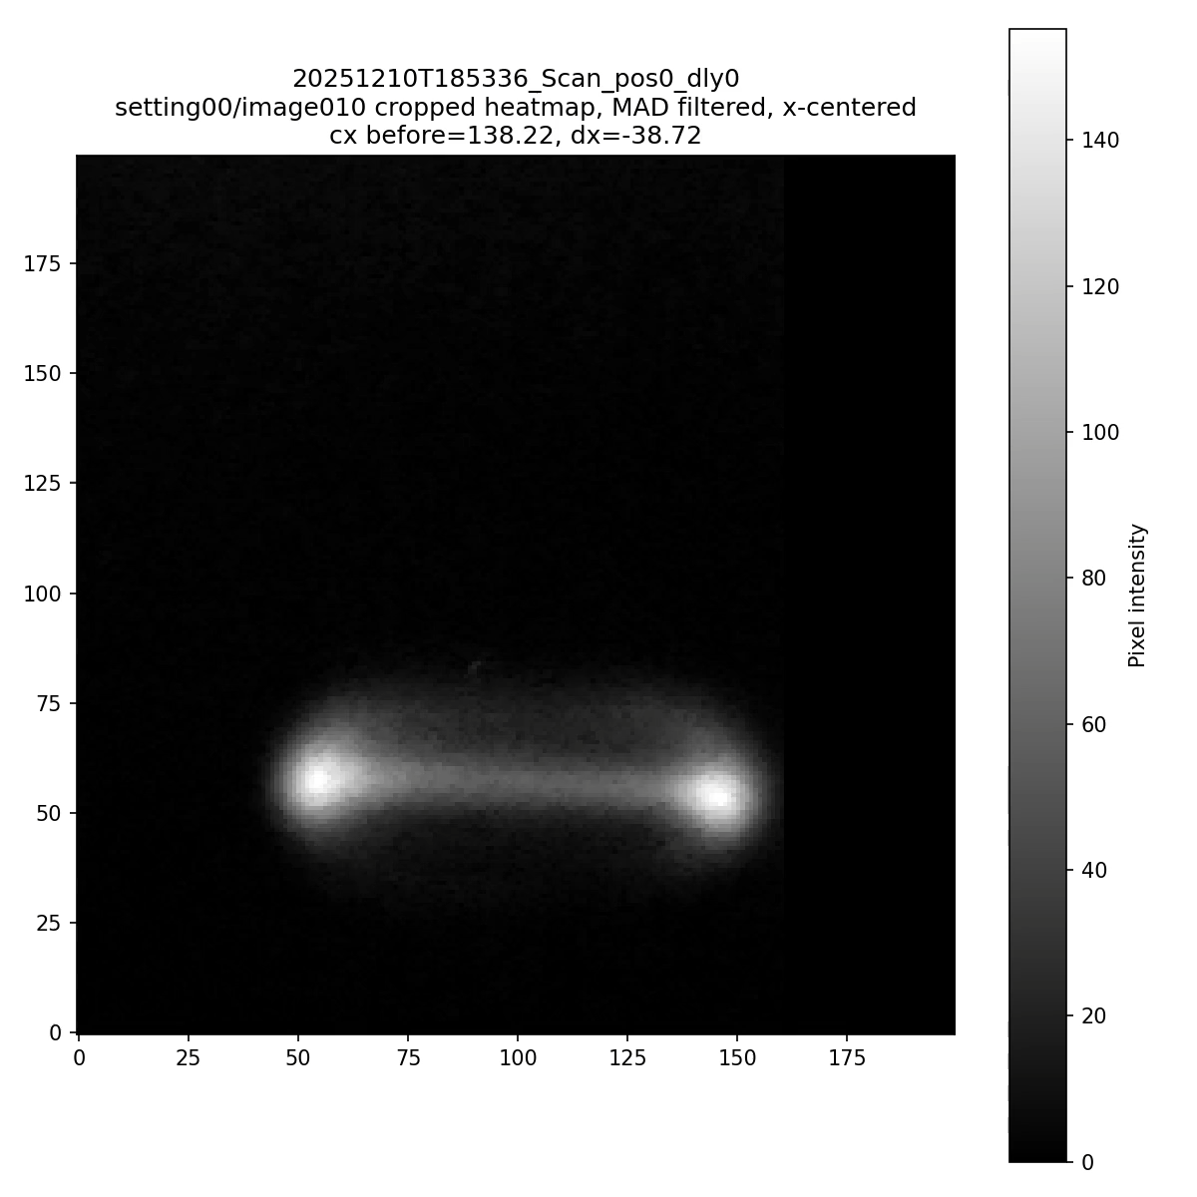
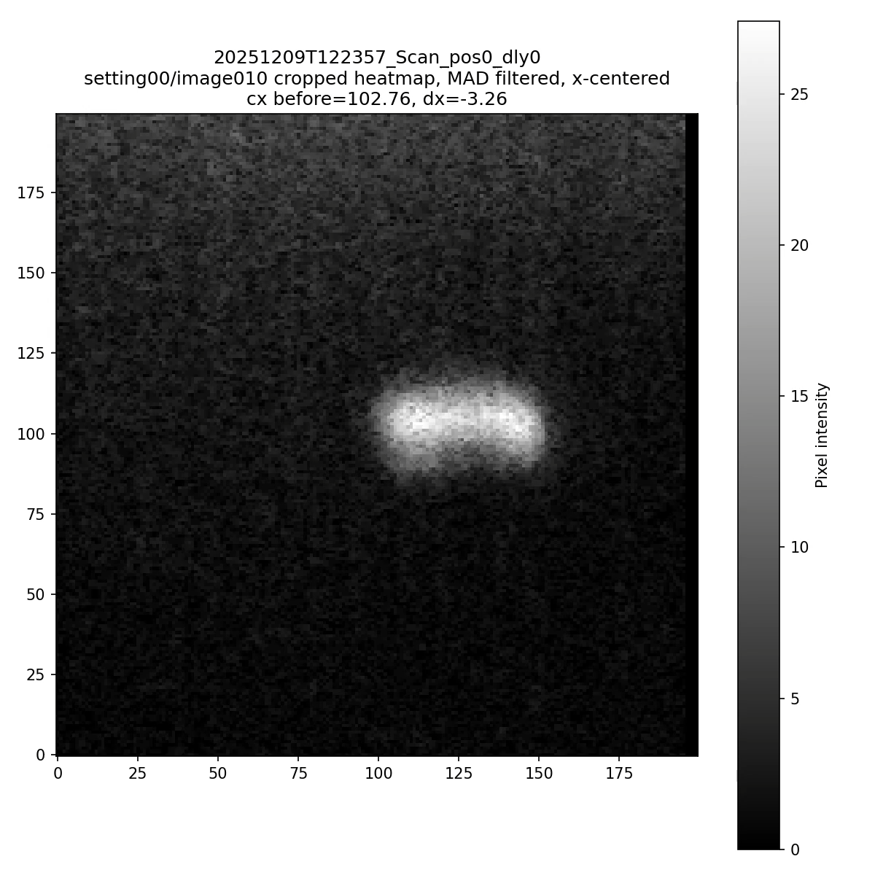
FLUTE data
In FLUTE data we get linear energy chirp from S-band photogun
THz phase delay dependent morphology
ISRR
TSR

Slide 12
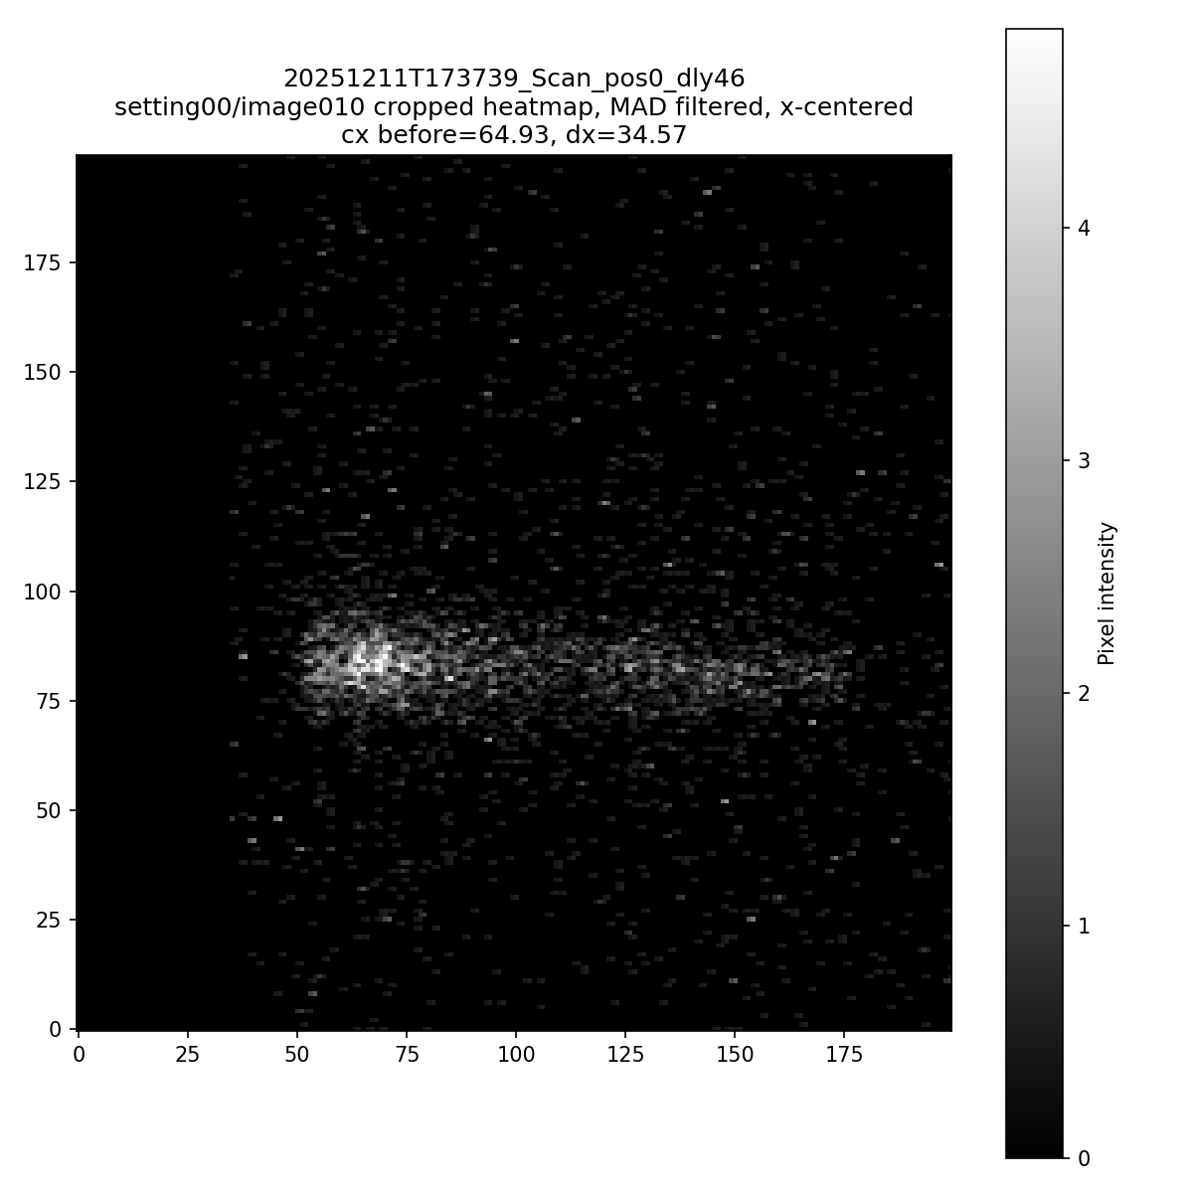
FLUTE data
In FLUTE data we get linear energy chirp from S-band photogun
THz phase delay dependent morphology
ISRR
TSR

Slide 13
FLUTE data
In FLUTE data we get linear energy chirp from S-band photogun
THz phase delay dependent morphology
ISRR
TSR

Slide 14
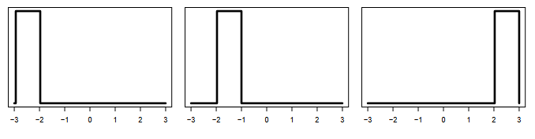


Failure of existing observables
Complex shapes lead to difficult comparison
For three example densities p1, p2, p3
Each pair has the same distance in L1, L2
L1
https://www.stat.cmu.edu/~larry/=sml/Opt.pdf

Slide 15
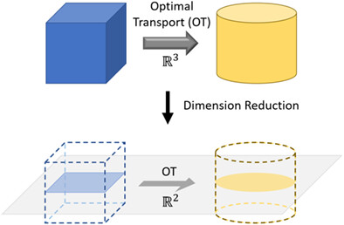
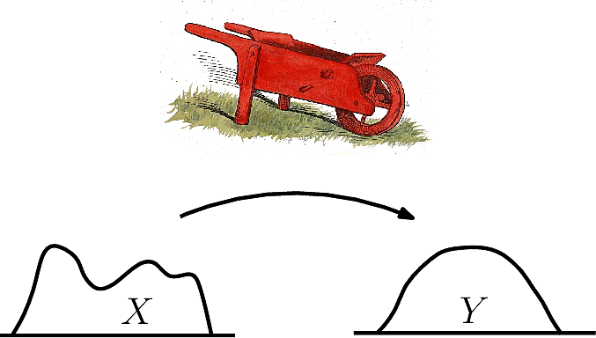
Morphology based image comparison
Earth Mover’s Distance (EMD) calculate minimum “work” used to transform distributions optimally
Common in machine learning
Projections into lower dimensions can be used
Zhang, J., Ma, P., Zhong, W., & Meng, C. (2023). Projection-based techniques for high-dimensional optimal transport problems. WIREs Computational Statistics, 15(2), e1587. https://doi.org/10.1002/wics.1587
https://sbl.inria.fr/doc/Earth_mover_distance-user-manual.html

Slide 16
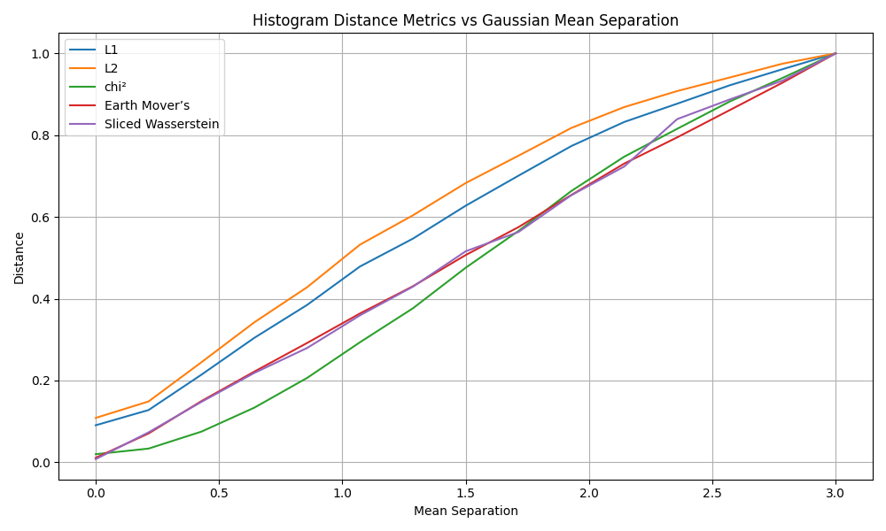
Intuition
EMD AKA Wasserstein metric linearity unlike L1, L2, or chi^2
Gives more reliable positioning jitter reduction
Faster algorithms for EMD noisier but on average still effective

Slide 17
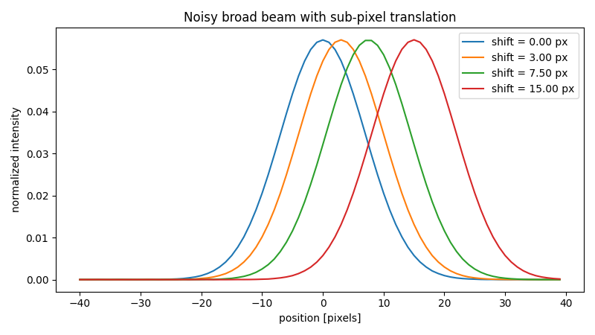
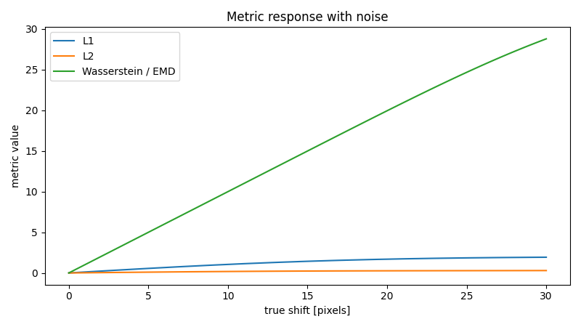
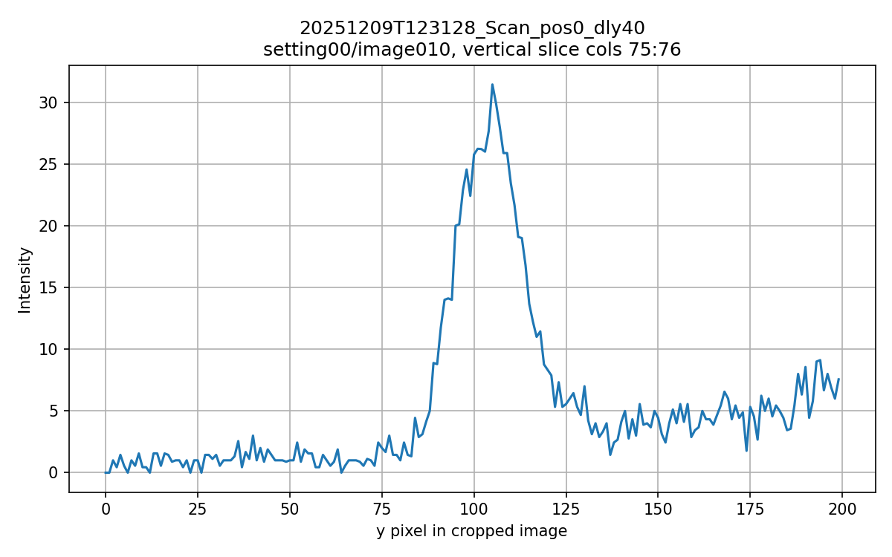
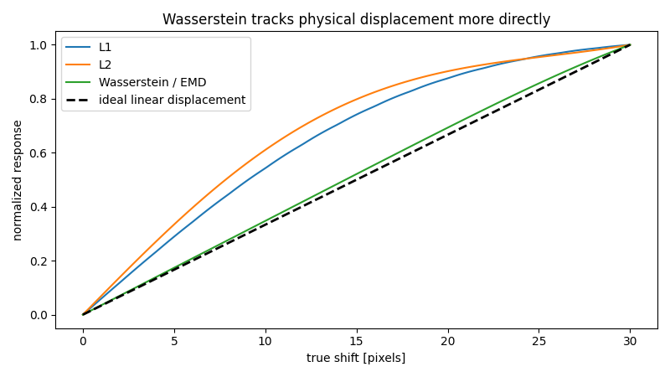
Applications for THz streak
Low noise

Slide 18
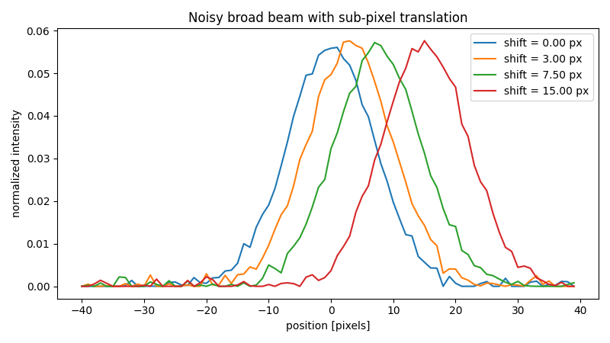
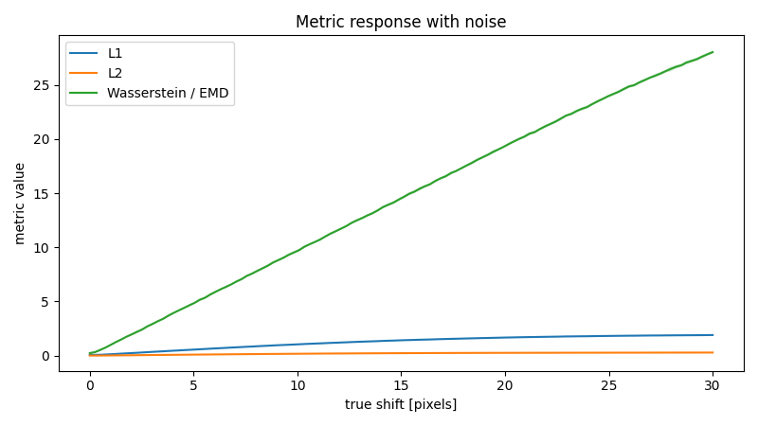
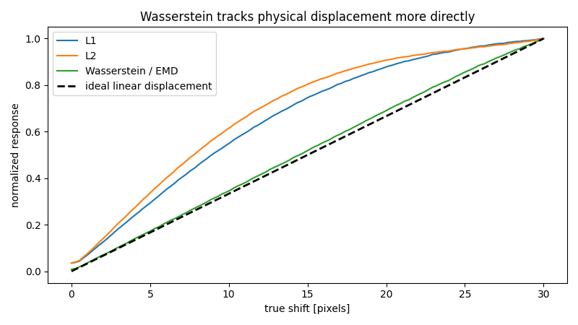
Applications for THz streak
Moderate noise

Slide 19
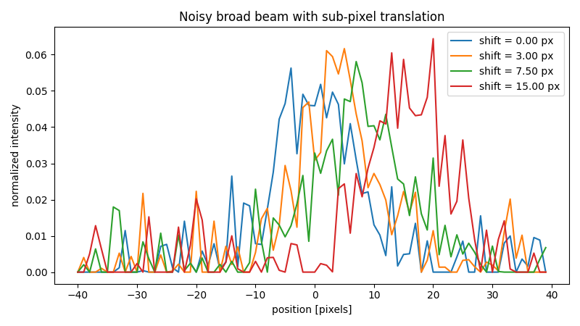
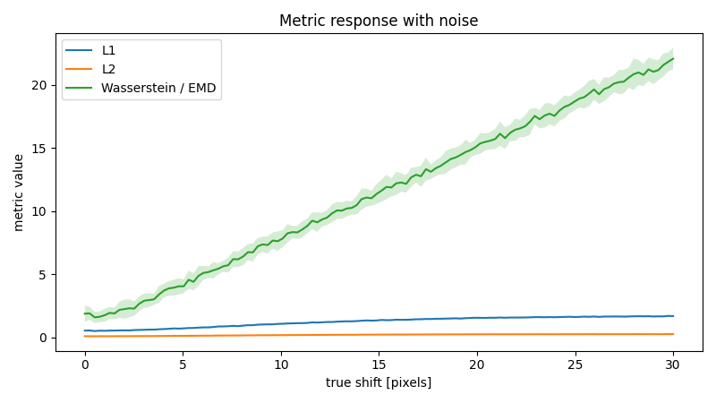

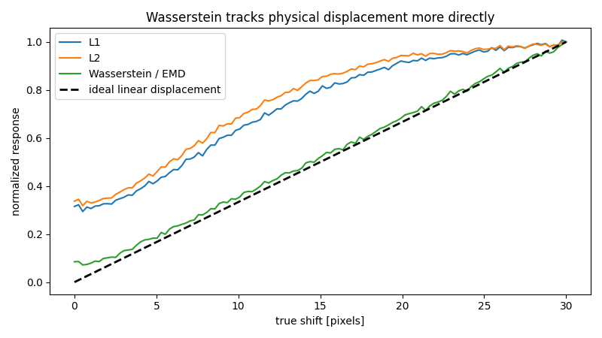
Applications for THz streak
High noise

Slide 20
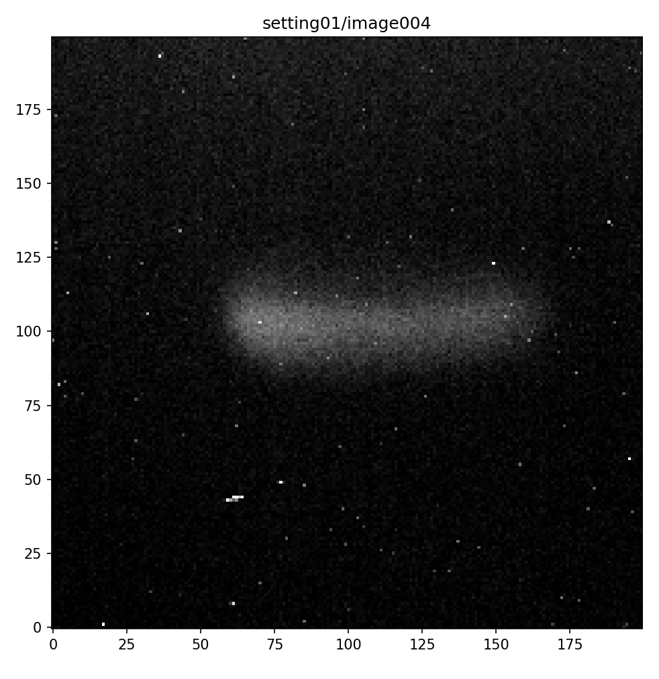
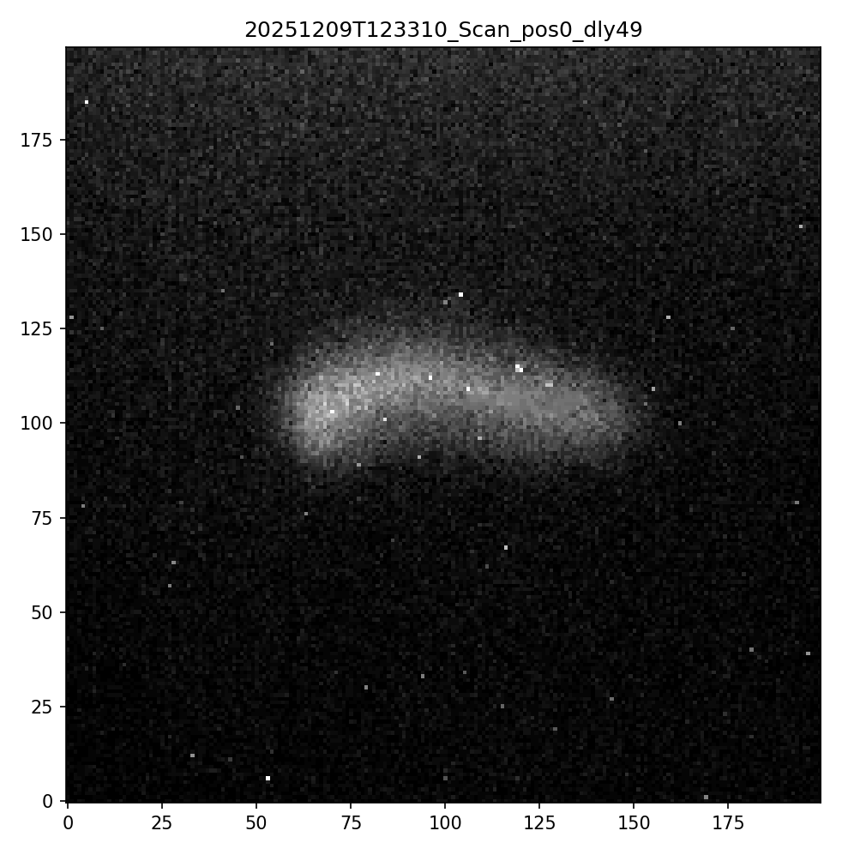
Experimental images
Example longitudinal data for TSR
2.87 ps

Slide 21
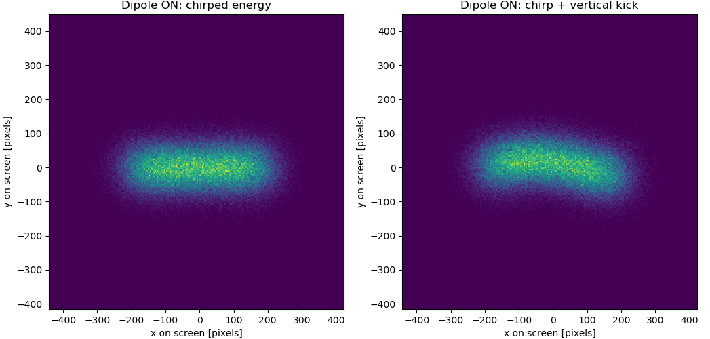
Theory + simulation
Experimental error limited to angular resolution in 10s of fs, improvements possible with EMD
2.87 ps

Slide 22
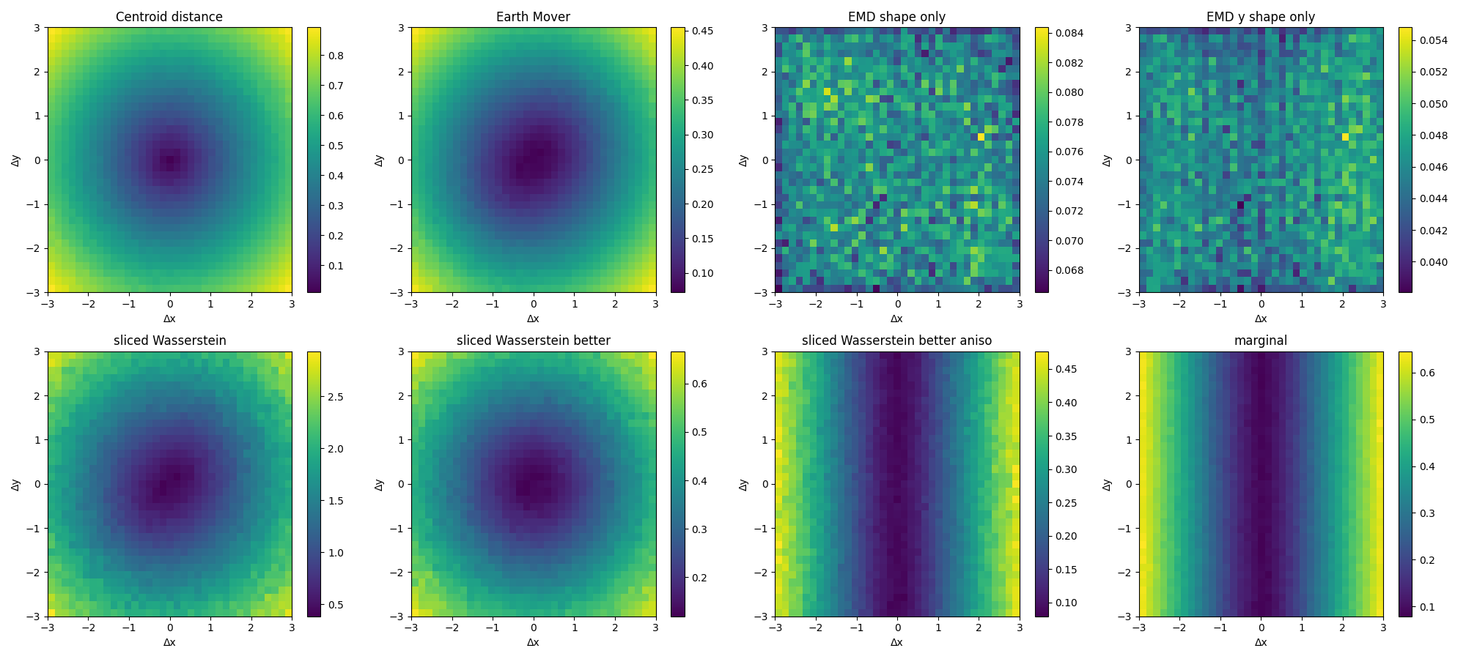
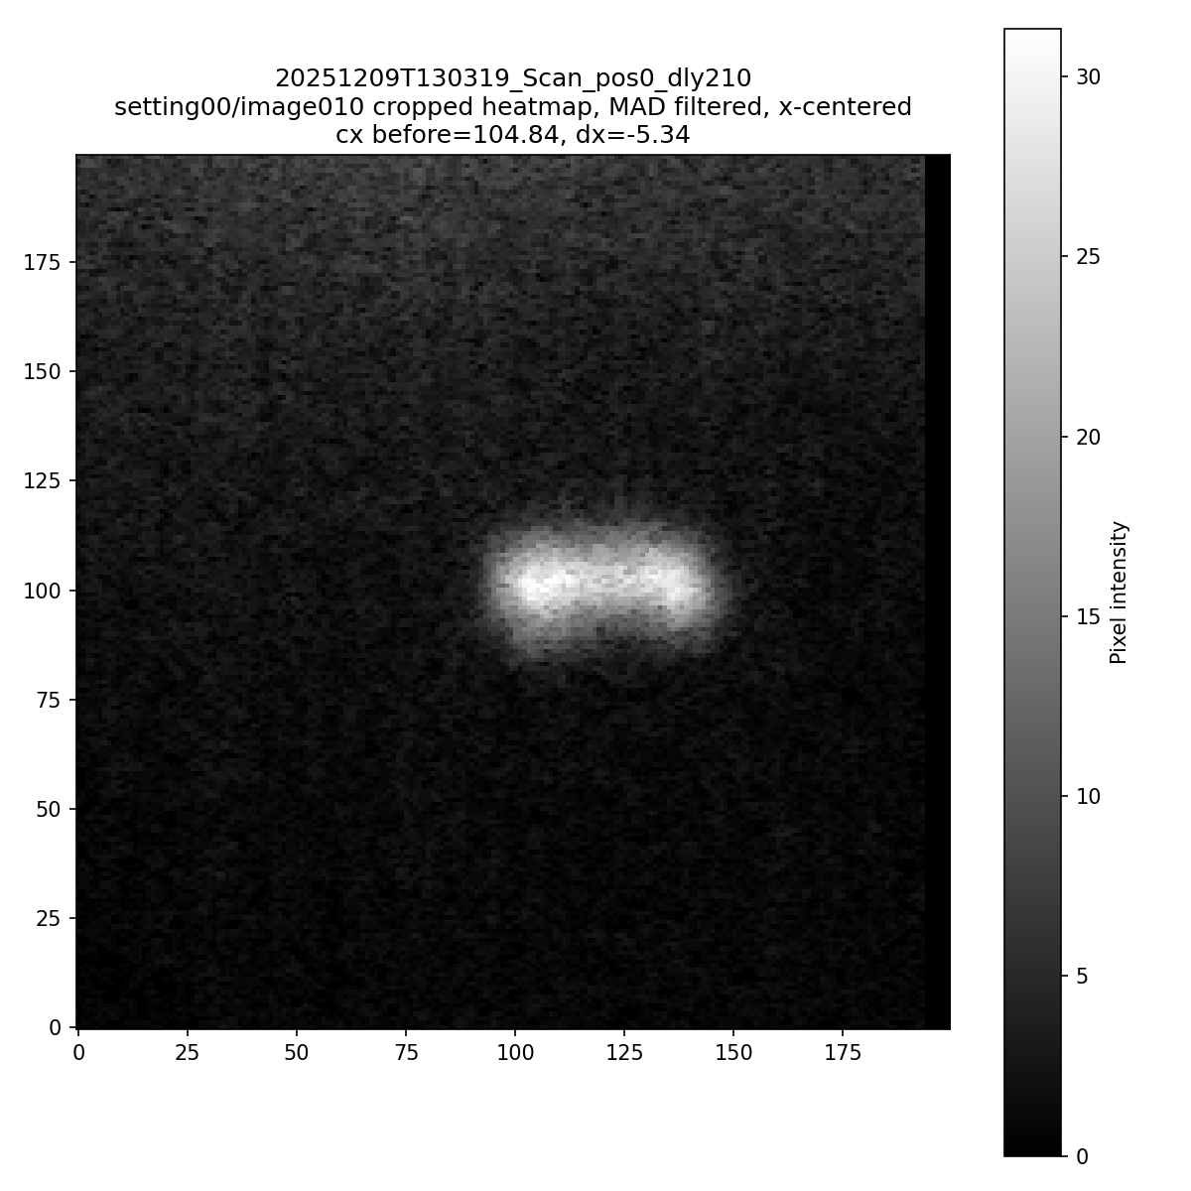
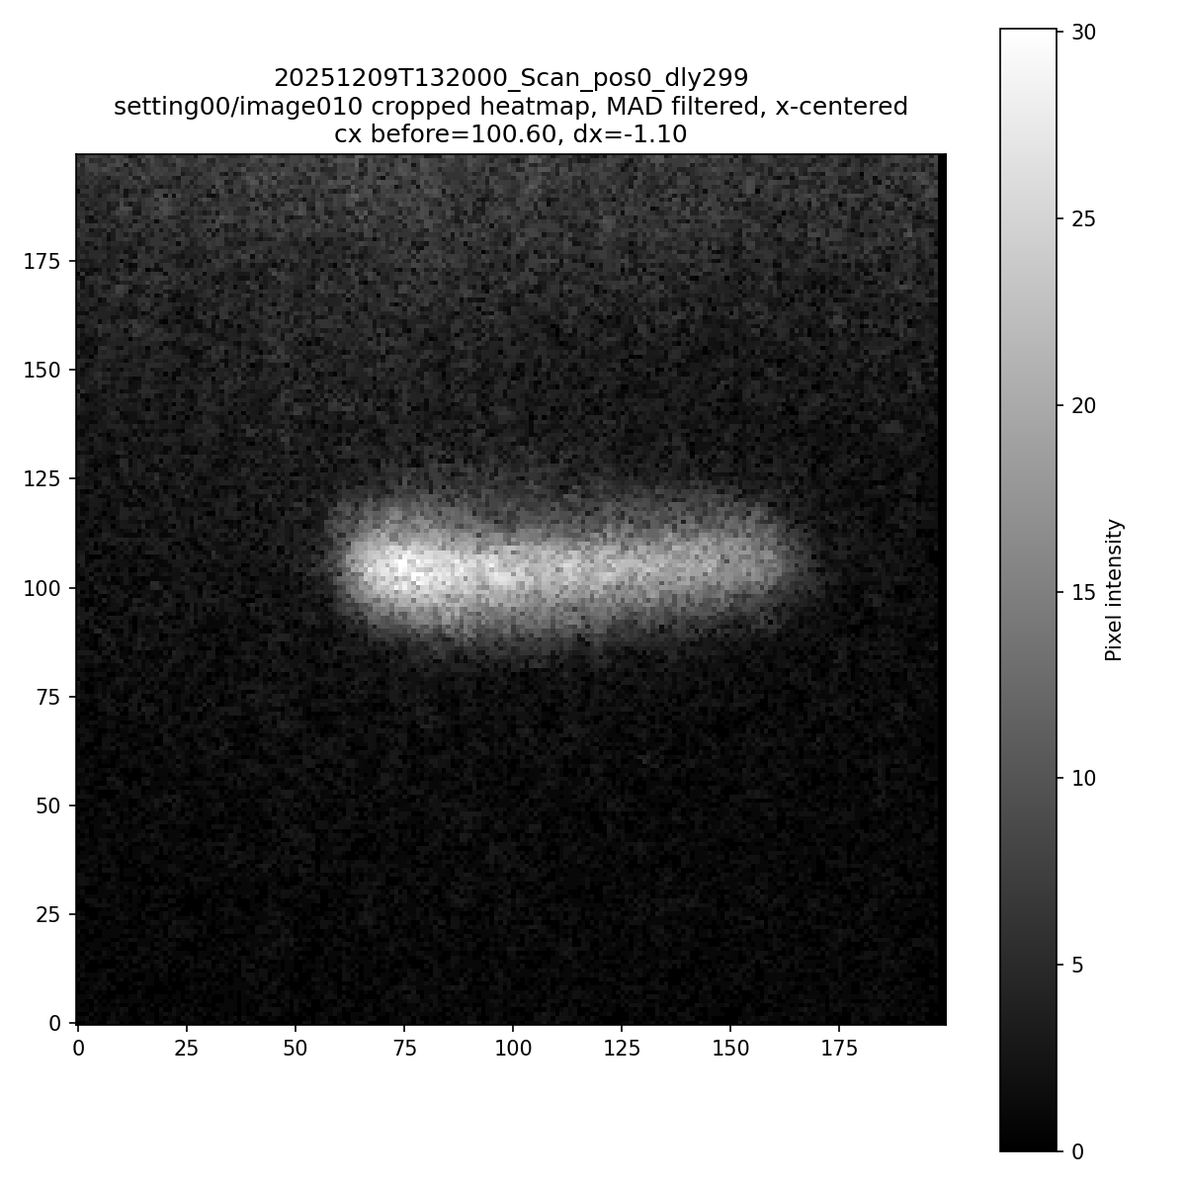
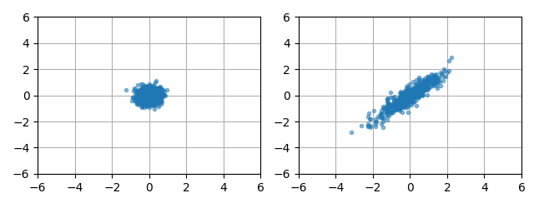
Modified EMD
1 dimension calculation for streak

Slide 23
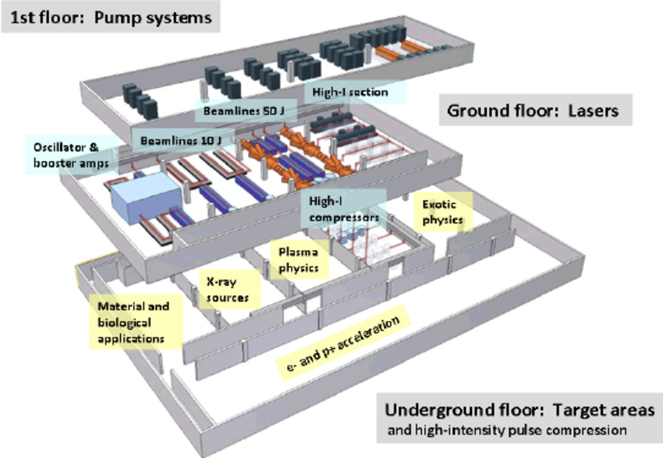
Scalability Needs
Laser Undulator-Illuminated Source (LUIS) in phase 0
Phase 1 10^5–10^7 incoherent soft X-ray photons per pulse
Phase 2 high-flux coherent XUV 10^9–10^11 photons per pulse

Slide 24
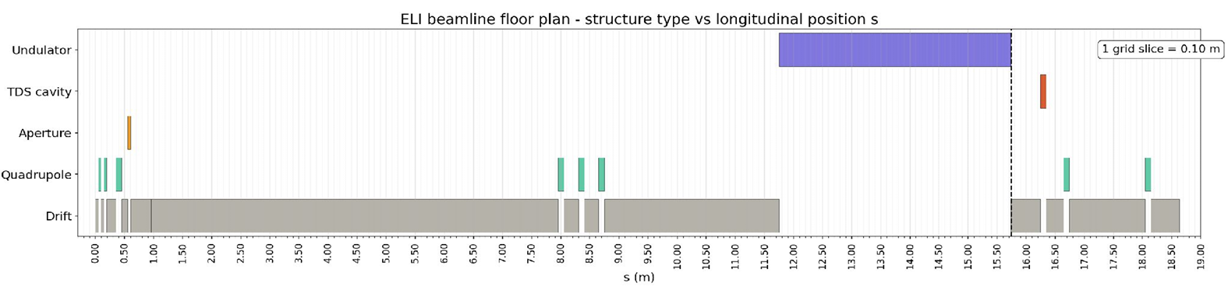
Higher energy beams
100 MeV case w/ RF TDS on way to 300 MeV ELI case
24.71 pC, 308.24 MeV, beam
THz TDS cavity 0.3 THz, 4.9 MV, 49 MV/m
Notes:
Activity 2.1.2. Feasibility study and Conceptual design of the laser-based THz TDS setup
Participants: ELI, PSI / Lead: PSI
Deliverable 2.1.2 (D2) Conceptual design of the integrated THz TDS setup
Milestone 2.1.2 (M2) Scope of work and list of components of the integrated THz DS setup, including laser, dielectric structure and relevant diagnostics.

Slide 25
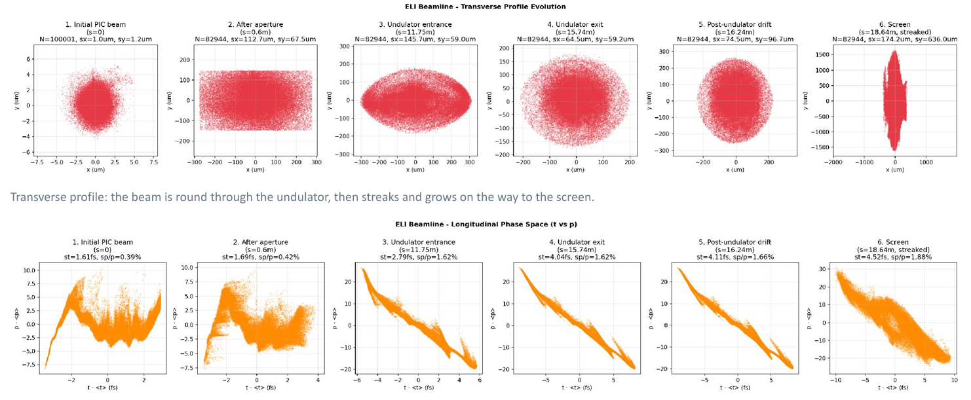
Higher energy beams
100 MeV case w/ RF TDS on way to 300 MeV ELI case

Slide 26
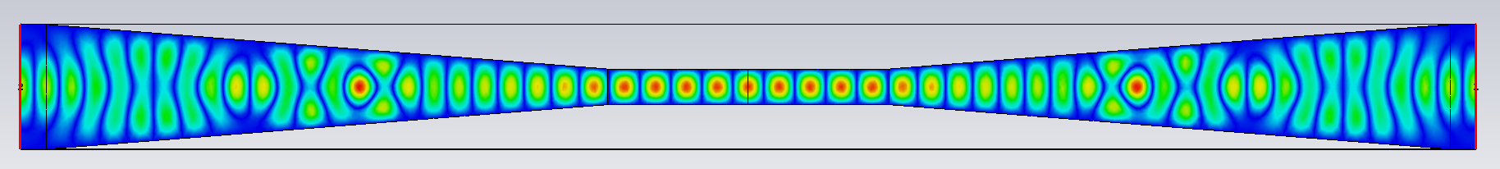
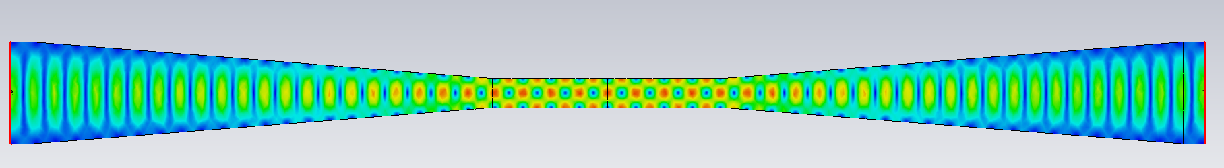
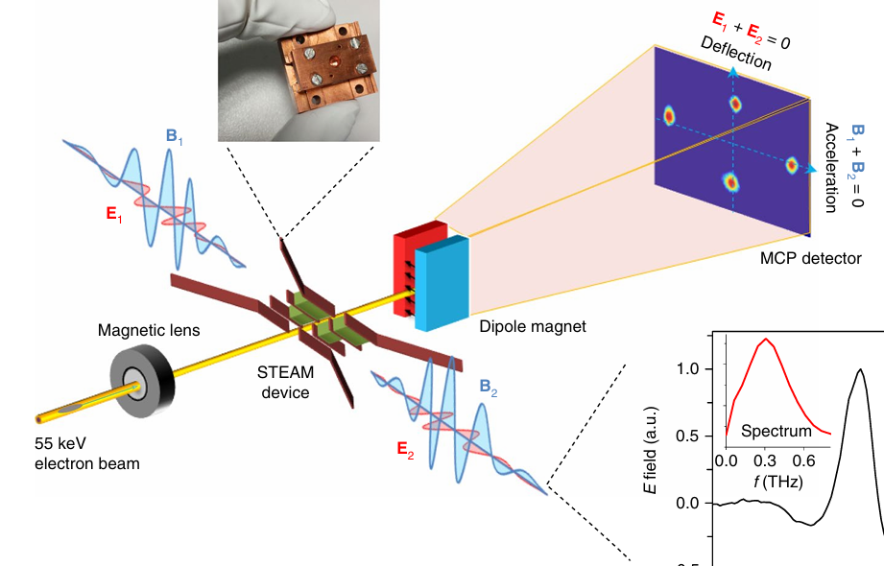

Segmented THz structures
Primarily to increase effective interaction length
With previous performance 1-2 cm needed
Zhang, Dongfang, et al. "Segmented terahertz electron accelerator and manipulator (STEAM)." Nature photonics 12.6 (2018): 336-342.
Notes:
Improve upon horn geometry and coupling with CST Microwave Studios optimization

Slide 27



Preliminary implementation
Conceptual design ongoing but clamped structure shows promise
10s mm linear dimensions

Slide 28
Conclusions
THz resonators can reproduce familiar RF streaking concepts in smaller package
Understanding which assumptions survive and which do not is an ongoing process and translating PolariX TDS performance remains goal
New regime benefits from advanced image-processing methods for interpreting more complicated morphology
Promising scalable solution for compact research infrastructure such as Eupraxia at ELI
Notes:
Leverage PSI expertise in longitudinal diagnostics and to develop and improve THz diagnostics for scalable beamline implementations

Slide 29
Conclusions
THz resonators can reproduce familiar RF streaking concepts in smaller package
Understanding which assumptions survive and which do not is an ongoing process and translating PolariX TDS performance remains goal
New regime benefits from advanced image-processing methods for interpreting more complicated morphology
Promising scalable solution for compact research infrastructure such as Eupraxia at ELI
Questions?

Slide 30
Further References
Floettmann K., PRSTAB,6, 034202 (2003)
Glukhov, Sergei, et al. "Simulations of the compact transverse deflecting system for ultra-short electron bunch diagnostic." Proc. IPAC’23 (2023): 4887-4890.
He, Xie, et al. "Terahertz-Driven Two-Dimensional Mapping for Electron Temporal Profile Measurement." Acs Photonics 12.6 (2025): 3064-3072.
Lenz, Maximilian, et al. "High temporal resolution THz streaking of high brightness relativistic electron beams." arXiv preprint arXiv:2605.00125 (2026).
Migliorati M. et al, Physical Review Special Topics, Accelerators and Beams 16, 011302 (2013)
Qi, Hong, et al. "Self-synchronized ultrafast electron beam diagnostics using a split-ring resonator driven by multicycle THz pulses." Nuclear Engineering and Technology 57.6 (2025): 103434.
Qi, Yingpeng, et al. "Theoretical studies of the THz compression of low-to-medium energy electron pulses and the single-shot stamping of electron–THz timing jitter." New Journal of Physics 23.6 (2021): 063052.
Schaefer, Jens, et al. "Split-ring resonator experiments and data analysis at FLUTE." Proc. 14th International Particle Accelerator Conf.(IPAC’23). 2023.
Schäfer, Jens, et al. "Split Ring Resonator Experiment-Simulation Results." Proc. IPAC’21 (2021): 888-891.

Slide 31




Bonus: Wasserstein metric Properties
n_pixels = 80
pixel_pitch = 1.0
sigma_beam = 7.0 # broad beam
noise_level = 0.01 # moderate noise
max_shift = 1.0 # maximum sub-pixel shift

Slide 32




Bonus: Wasserstein metric Properties
n_pixels = 80
pixel_pitch = 1.0
sigma_beam = 7.0 # broad beam
noise_level = 0.002 # moderate noise
max_shift = 1.0 # maximum sub-pixel shift

Slide 33




Bonus: Wasserstein metric Properties
n_pixels = 80
pixel_pitch = 1.0
sigma_beam = 7.0 # broad beam
noise_level = 0.001 # moderate noise
max_shift = 1.0 # maximum sub-pixel shift

Slide 34




Bonus: Wasserstein metric Properties
n_pixels = 80
pixel_pitch = 1.0
sigma_beam = 7.0 # broad beam
noise_level = 0.00001 # moderate noise
max_shift = 1.0 # maximum sub-pixel shift

