Slide 1

High temporal resolution THz streaking of high brightness relativistic electron beams
By Maximilian Lenz
Advanced Accelerator Concepts
July 27 2026
Notes:
The main topic I would like to talk about is THz streaking as a longitudinal bunch length diagnostics
but also another laser based beam diagnostic we performed at UCLA

Slide 2

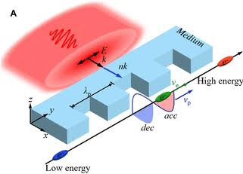
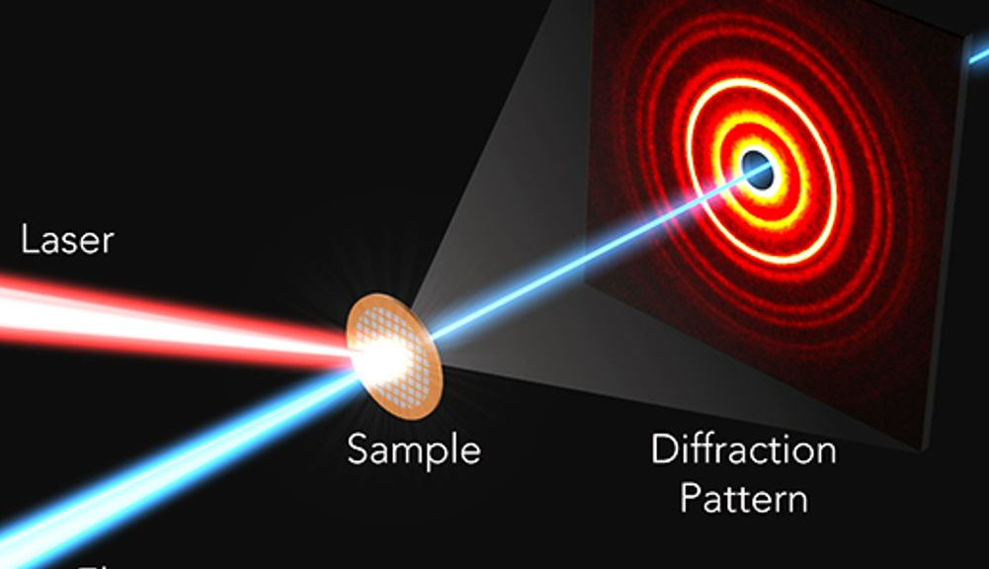
Motivation
Inverse Compton Scattering
Laser electron beam synchronization
Longitudinal bunch length diagnostics
Animation by Brian Schaap
Dielectric Laser Accelerator
Ultrafast Electron Diffraction Dexter Johnson (2017)
Mei et al. Ultrafast Science 2023
Notes:
Let me motivate this:
Lasers are finding more and more applications in accelerators and beam interactions
We need reliable tools to measure out the timing between laser and electron beam

Slide 3
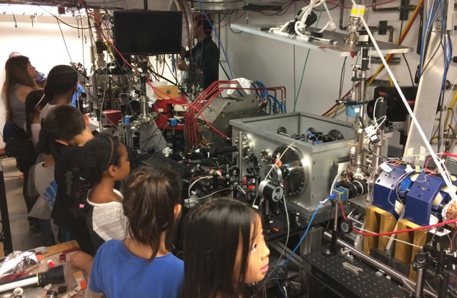
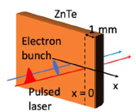
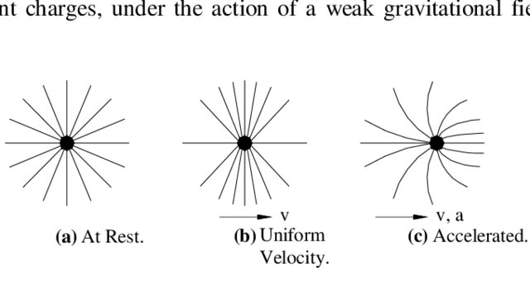
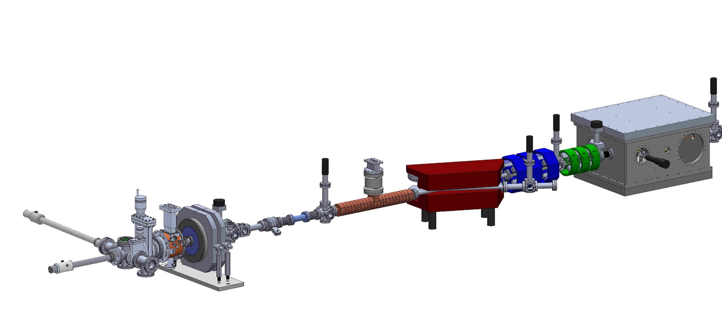
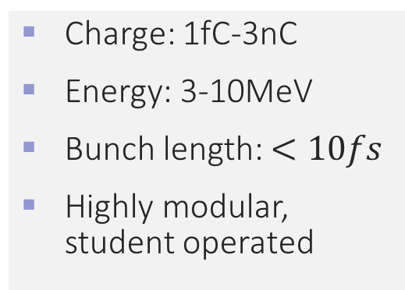
PEGASUS beamline
Electro – Optic Sampling
THz streaking
THz
Rest frame
Lab frame
Charge: 1fC-3nC
Energy: 3-10MeV
Bunch length: $<10fs$
Highly modular, student operated
Ota, M., et al. IRMMW-THz 2022
Quadrupoles
Photogun
1.6 cell S-band
ICT
Vacuum chamber
Linac 11 cell S-band
Dipole spectrometer
Solenoid
Notes:
Before I introduce the two THz experiments we did at Pegasus let me first show you Pegasus
Here is a schematic of Pegasus
It’s a highly modular beamline and parts are changing all the time
Even this figure from three years ago is outdated
Fully student run. Pietro always shows this picture when he talks about his students. Shows how he truly sees us…
Photo gun produces a few MeV electron beams
Linac then allows us to further accelerate, compress or deaccelerate the beam

Slide 4
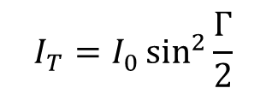
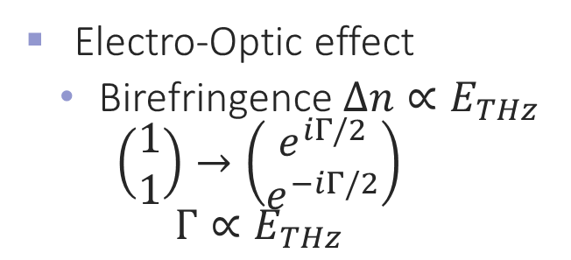


Electro-Optic Sampling (EOS)
Electro-Optic effect
  Birefringence $Δn∝E_{THz}$
  $$\left(\begin{matrix}1 \\ 1\end{matrix}\right)→\left(\begin{matrix}e^{iΓ/2} \\ e^{−iΓ/2}\end{matrix}\right)$$
  $$Γ∝E_{THz}$$
$$I_{T}$$
$$I_{0}$$
vacuum
chamber
$$I_{T}=I_{0}\sin^{2}{\frac{Γ}{2}}$$
ZnTe
e-beam
polarizer
polarizer
CMOS camera
Notes:
This has been performed many times but what’s unique is that we directly hit the crystal

Slide 5
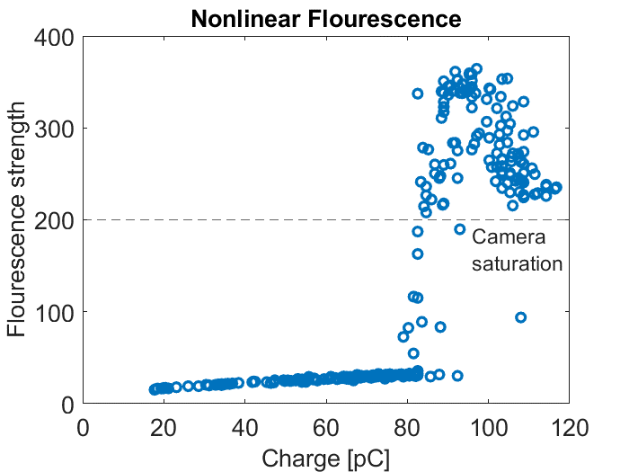
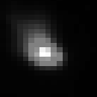
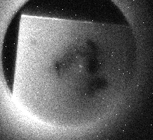
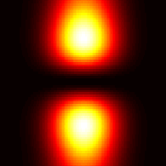
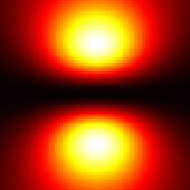
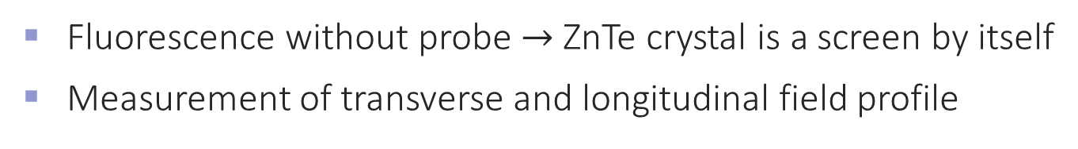

Transverse and longitudinal information
Fluorescence without probe $→$ ZnTe crystal is a screen by itself
Measurement of transverse and longitudinal field profile
Longitudinal slice
Transverse slice
E-beam fluorescence
Measured
ZnTe damage
Analytic

Slide 6
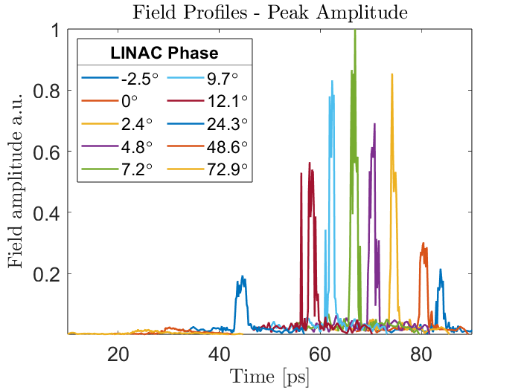
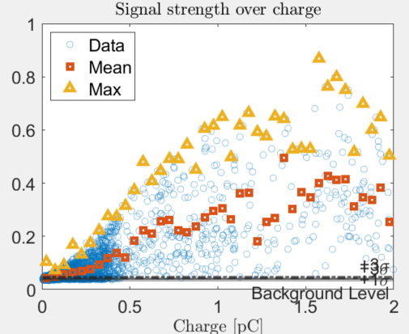
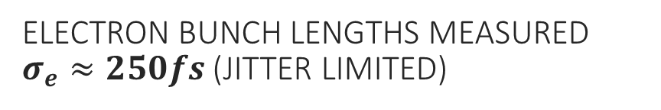

EOS on e-beam fields
Electron bunch lengths measured $σ_{e}≈250fs$ (Jitter Limited)
Signal observable at $<50fC$

Slide 7
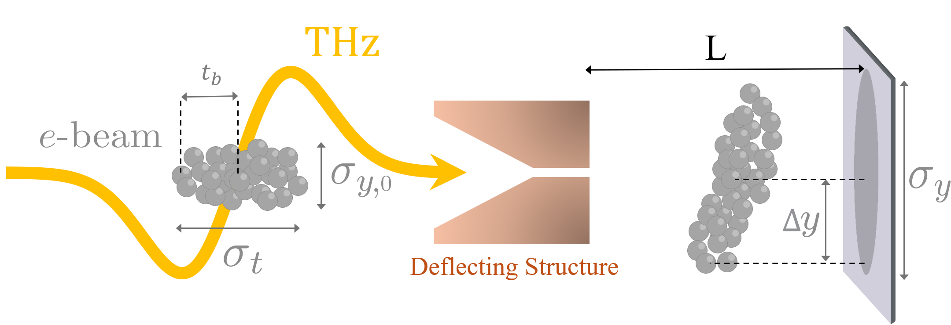
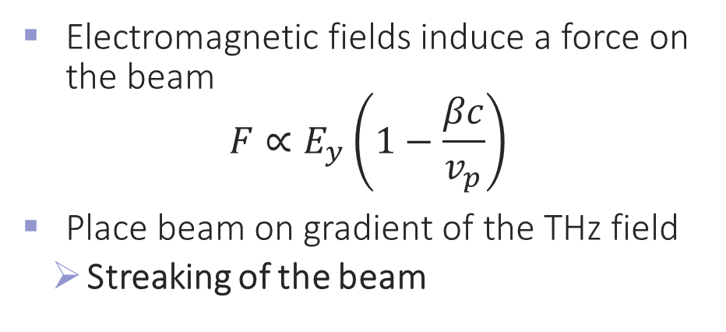
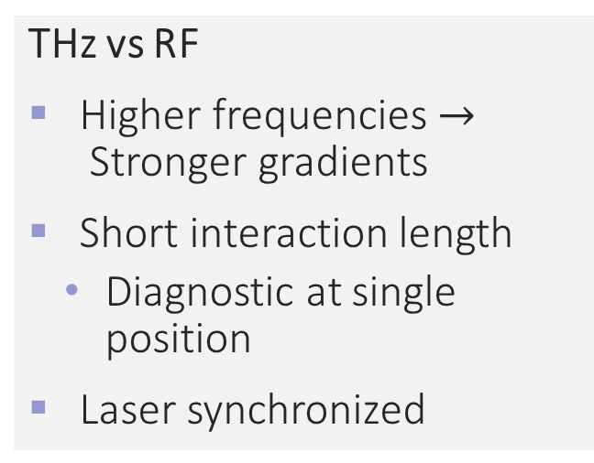
THz streaking
THz vs RF
Higher frequencies $→$Stronger gradients
Short interaction length
  Diagnostic at single position
Laser synchronized
Electromagnetic fields induce a force on the beam
$$F∝E_{y}\left(1−\frac{βc}{v_{p}}\right)$$
Place beam on gradient of the THz field
        Streaking of the beam
Notes:
Overlap a THz wave with an electron beam
Propagate through a field enhancing structure
Wave induces a Lorentz force on the particles that deflects them
If we place the beam on the zero crossing of the wave it gets streaked
Allows us to map out this longitudinal profile transversely on a screen

Slide 8
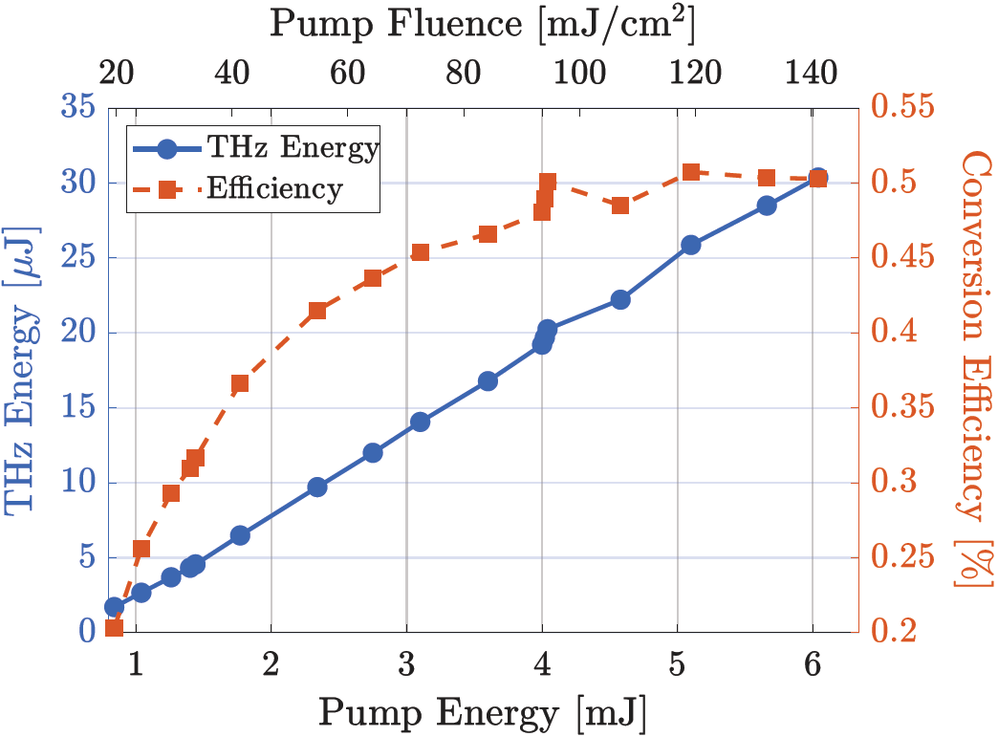
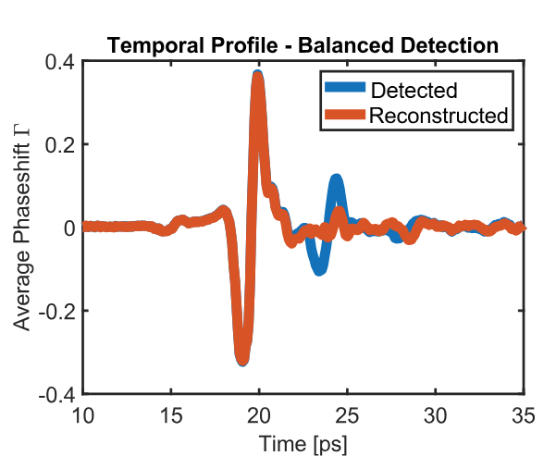
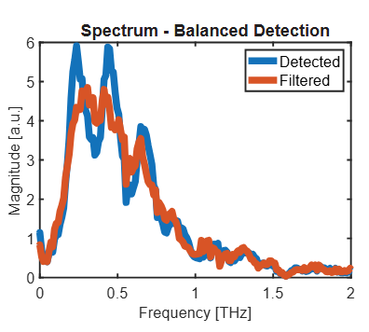
THz source setup
Mg:LiNbO3 crystal
Grating – imaging configuration for phase matching
CCD
Wollaston
OAP f=2”
OAP f=4”
QWP
THz
EOS line
Amplifier
Compressor
Pellicle
780 nm,
100 fs, 10 mJ
Ti:Sapph laser system
Notes:
Many iterations of this setup

Slide 9
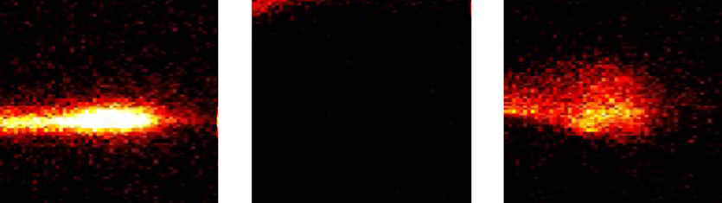
THz streaking – Experimental Setup
THz signal on ZnTe
Different streaking structures
        Adjustable position in x, y, z and tilt around x-axis
OAP with 3mm hole: Overlap of beam and THz
THz off
Solenoid
Quads
RF
Photogun
Vacuum Box
THz on
Pinhole

Slide 10
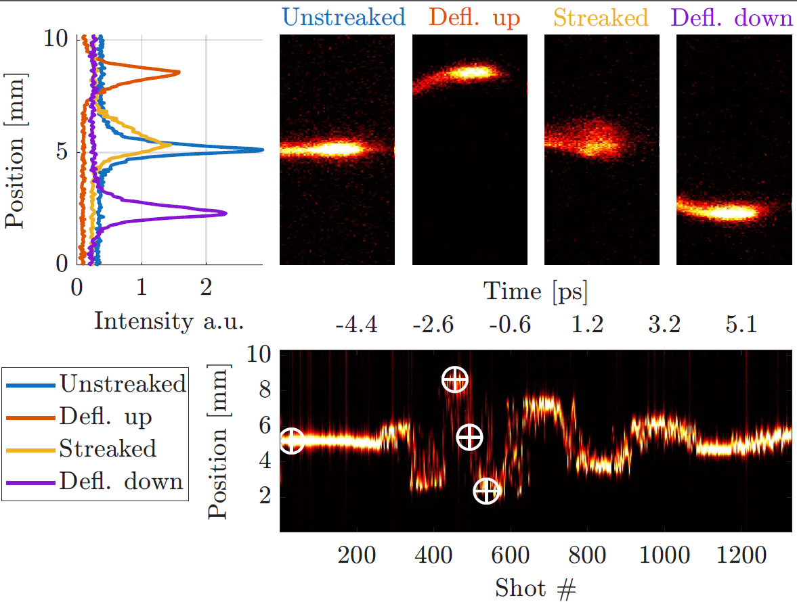
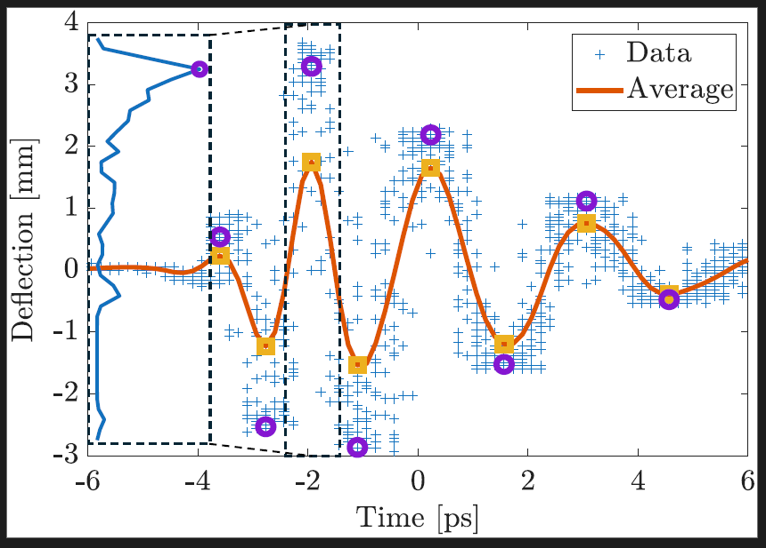
THz streaking – Calibration
Notes:
What we now need is to understand this longitudinal to transverse mapping

Slide 11
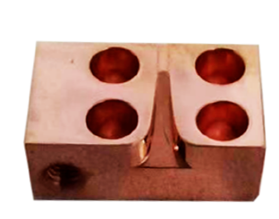
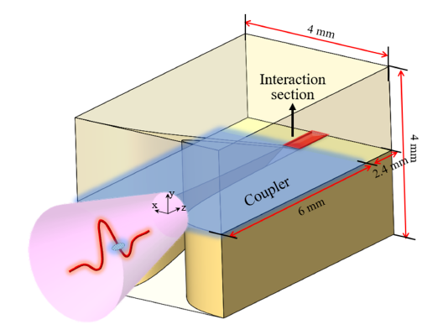
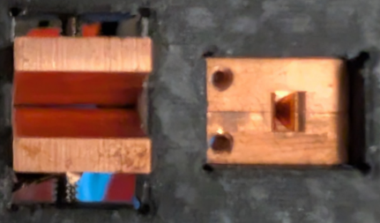
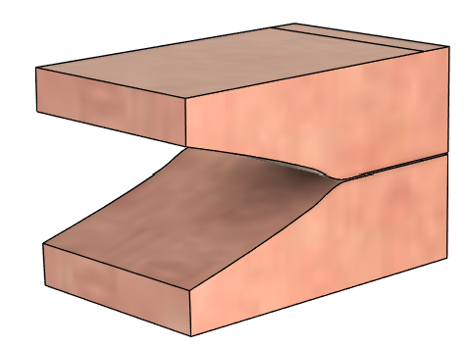



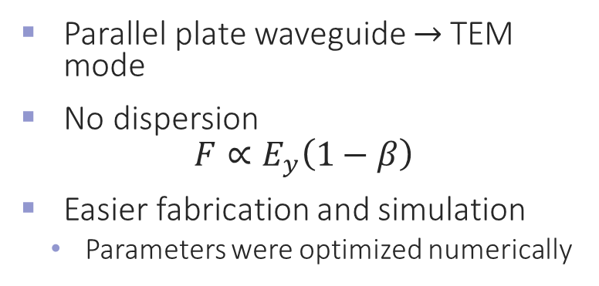


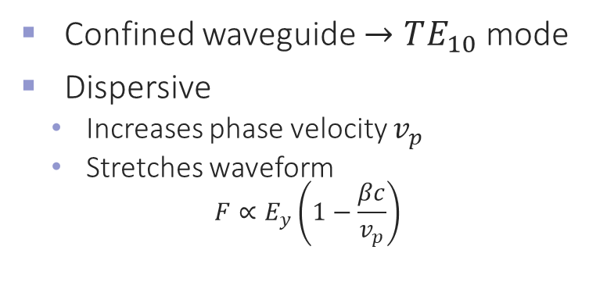

THz Streaking Structures
Tsinghua Structure
Ucla structure
Confined waveguide $→TE_{10}$ mode
Dispersive
  Increases phase velocity $v_{p}$
  Stretches waveform
$$F∝E_{y}\left(1−\frac{βc}{v_{p}}\right)$$
Parallel plate waveguide $→$TEM mode
No dispersion
$$F∝E_{y}\left(1−β\right)$$
Easier fabrication and simulation
  Parameters were optimized numerically
One half
Front view
Model
Front view
Waveguide section
100 $μm$
Waveguide section
$w_{x}=400$ $μm$
50 $μm$
750 $μm$
Yuemei Tan (Tsinghua university)

Slide 12
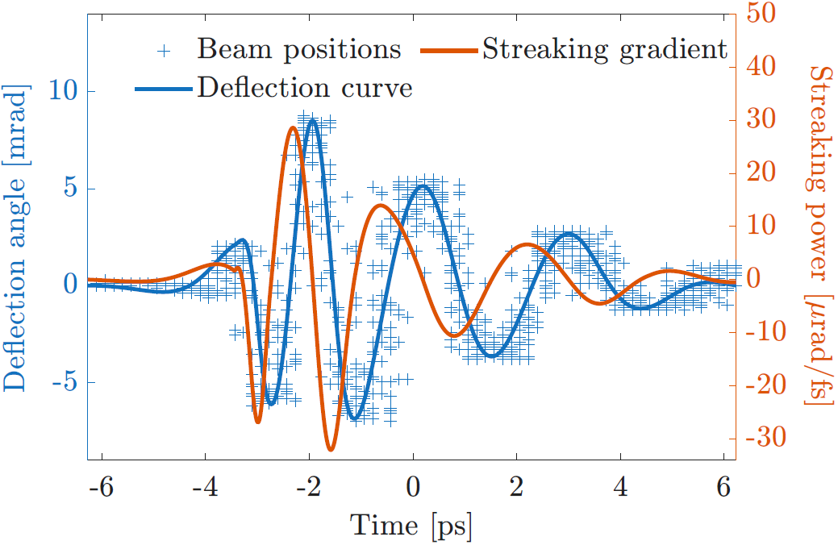
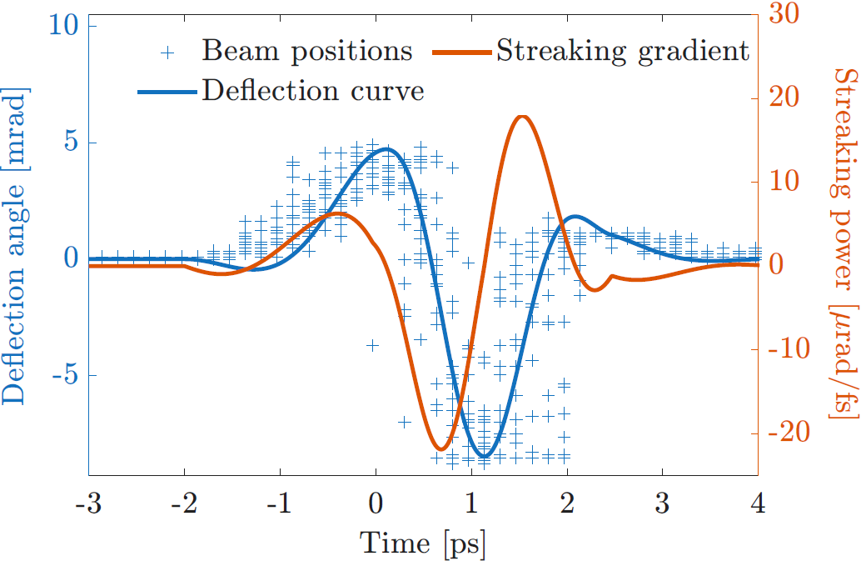


Streaking gradients
$$32μrad/fs$$
$$22μrad/fs$$

Slide 13
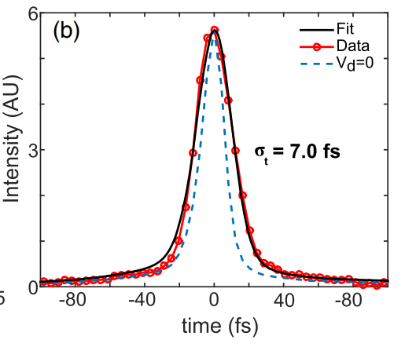
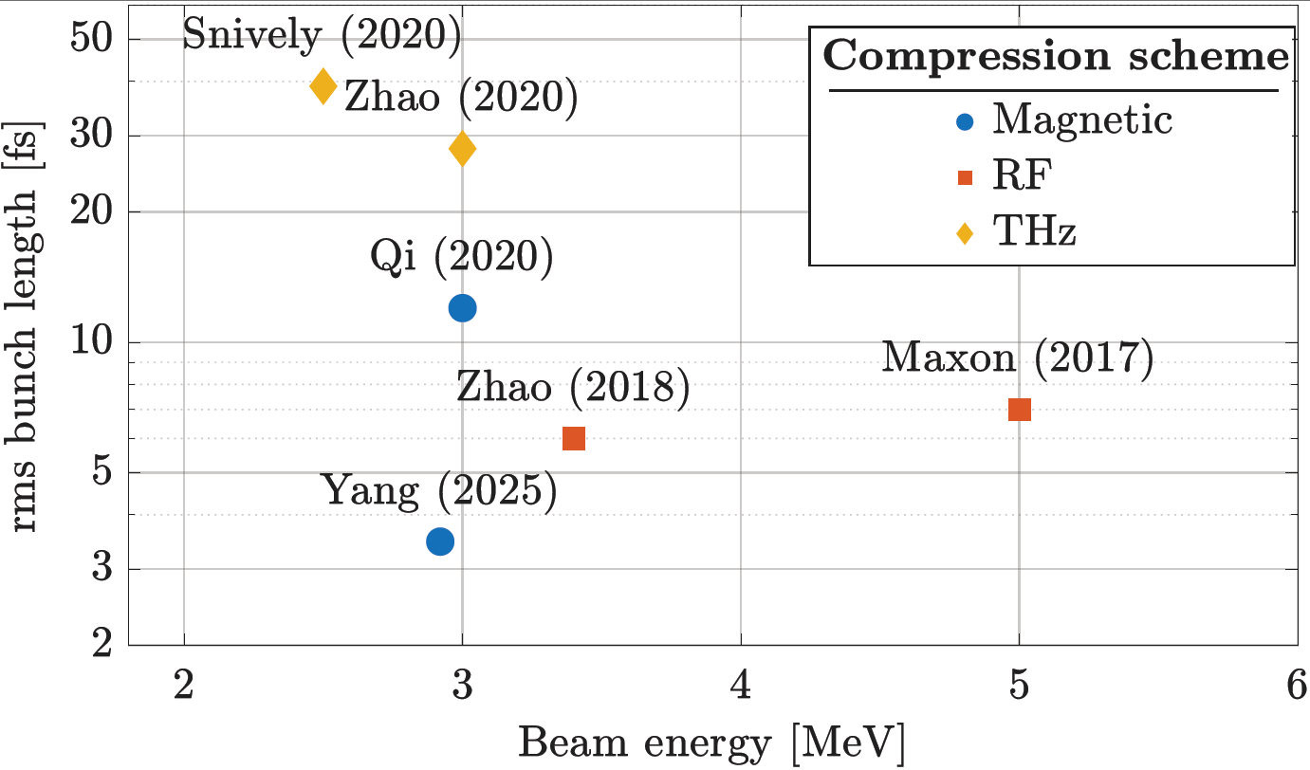
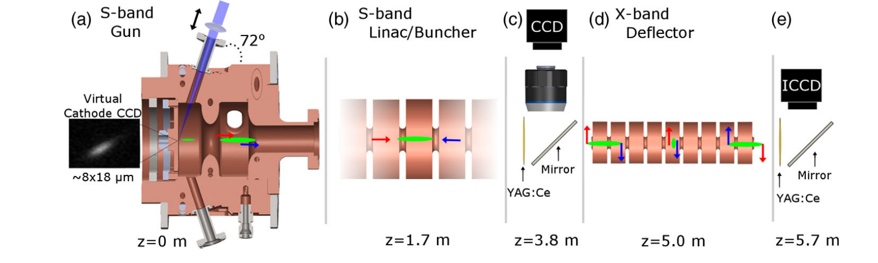
Road to 1fs electron beams
Attosecond bunchlengths would be a major milestone!
  UED, FELs, Compton sources
THz streaking
Maxson et al., PRL 118, 154802 (2017)
L. Zhao. Phys. Rev. X 8, 021061 (2018)
F. Qi et al., Phys. Rev. Lett. 124, 134803 (2020)
Snively, E. C., et al. Phys. Rev. Lett. (2020)
Yang, Yining, et al. arXiv:2508.03946 (2025).
H. W. Kim et al., Nat. Phot., 14, 245 (2020)

Slide 14
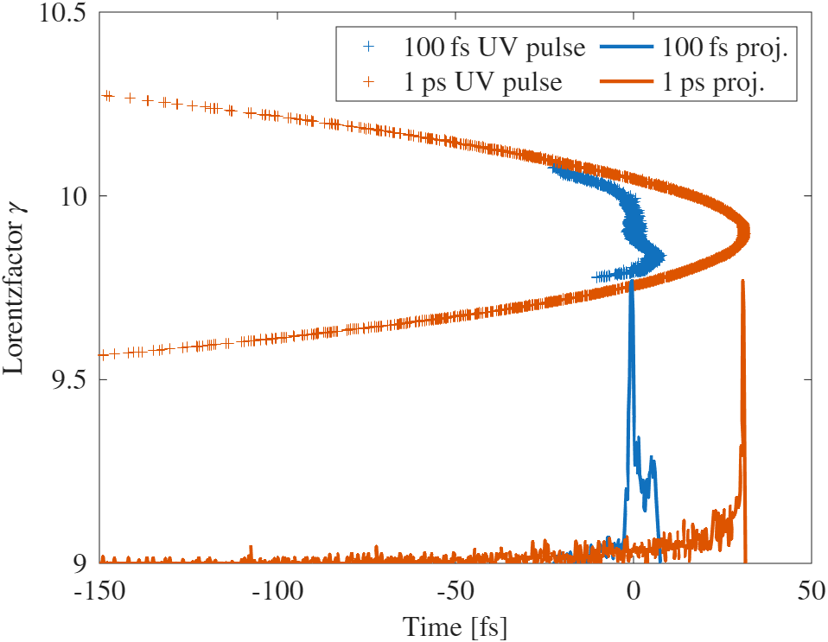


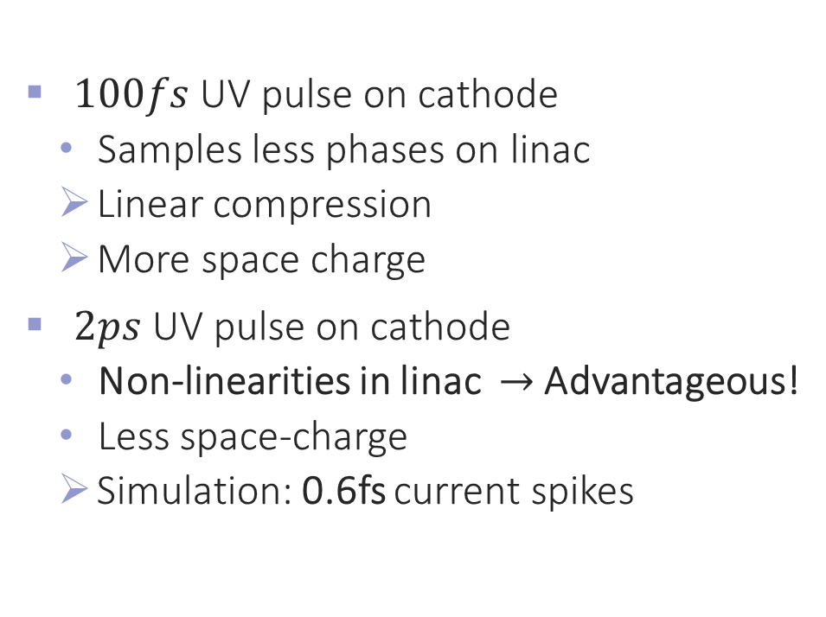
Road to 1fs electron beams
$$f_{1000}$$
$100fs$ UV pulse on cathode
  Samples less phases on linac
        Linear compression
        More space charge
$2ps$ UV pulse on cathode
  Non-linearities in linac $→$ Advantageous!
  Less space-charge
        Simulation: 0.6fs current spikes
Virtual cathode
camera
100$μ$m Pinhole
Notes:
Keep short if we’re short on time!

Slide 15
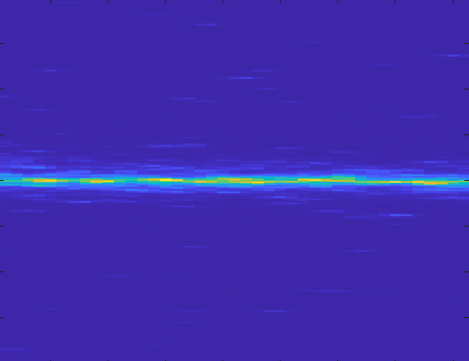
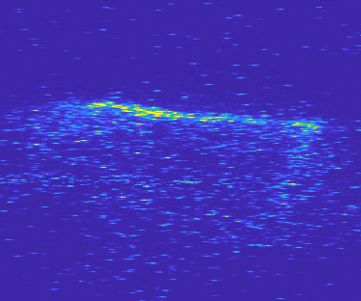
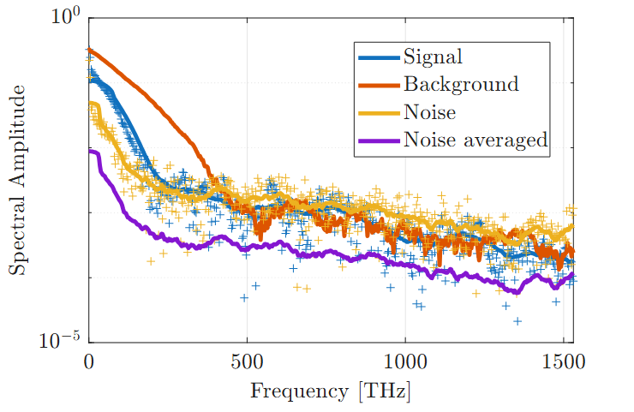
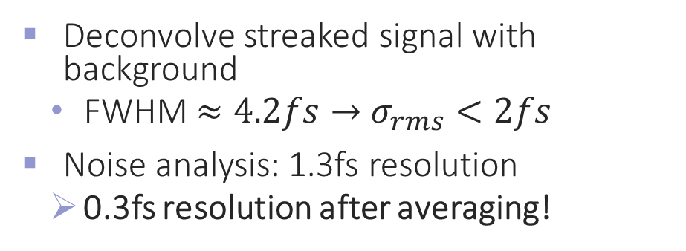
Temporal Resolution
THz off
THz on
Deconvolve streaked signal with background
  FWHM $≈4.2fs→$ $σ_{rms}<2fs$
Noise analysis: 1.3fs resolution
        0.3fs resolution after averaging!
4.2 fs

Slide 16
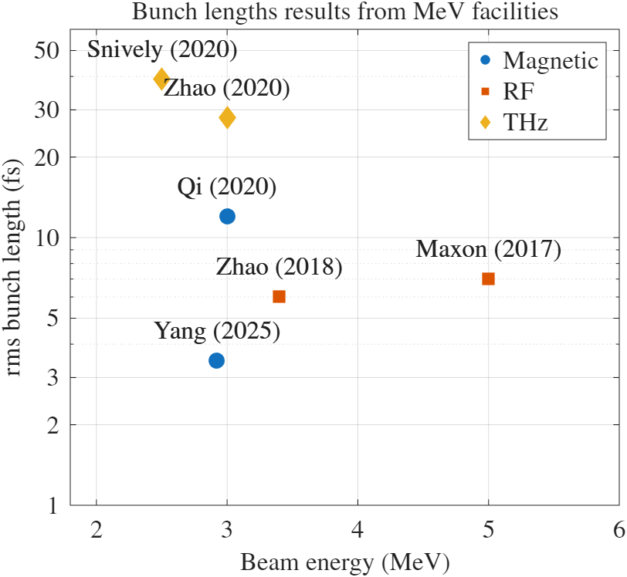
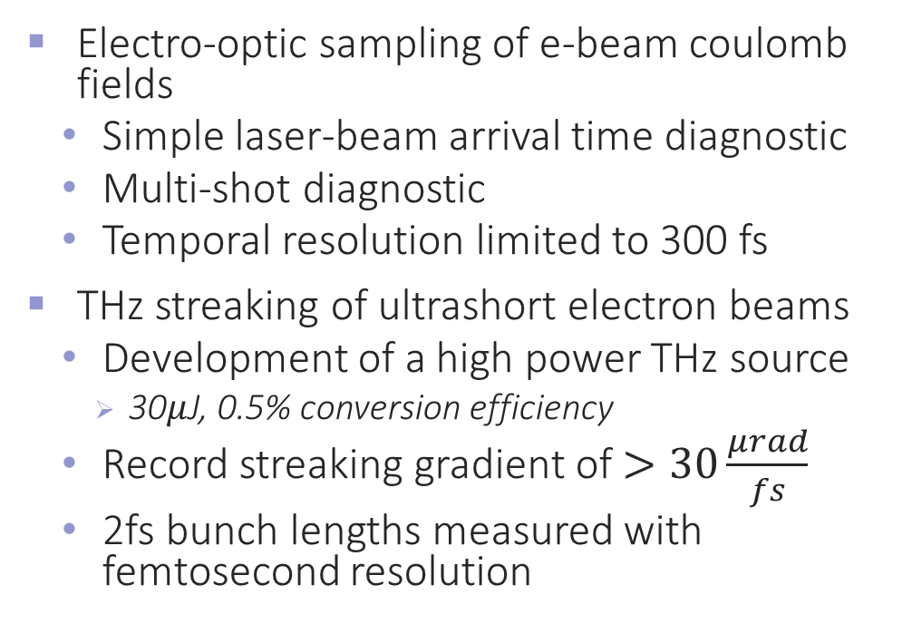
Summary
Electro-optic sampling of e-beam coulomb fields
  Simple laser-beam arrival time diagnostic
  Multi-shot diagnostic
  Temporal resolution limited to 300 fs
THz streaking of ultrashort electron beams
  Development of a high power THz source
    30$μ$J, 0.5% conversion efficiency
  Record streaking gradient of $>30\frac{μrad}{fs}$
  2fs bunch lengths measured with femtosecond resolution
Pegasus 2026?

Slide 17




Acknowledgements
Collaborators Tsinghua University
  Renkai Li, Yining Yang, Yuemei Tan
Work supported by NSF grant PHY-1734215 and DOE grants DE-SC0009914 and DE-SC0021190
Pietro Musumeci
Brian Schaap
Renkai Li

Slide 18
Thank you!
Questions?

Slide 19
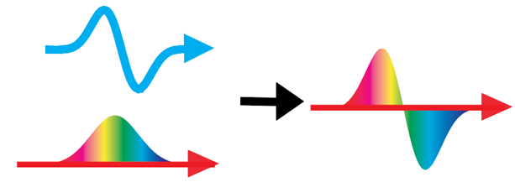
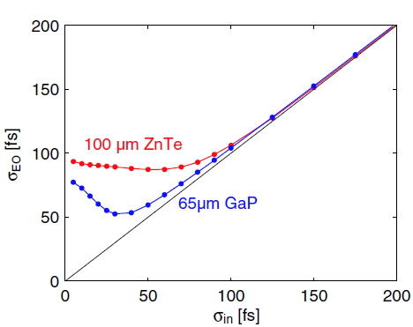
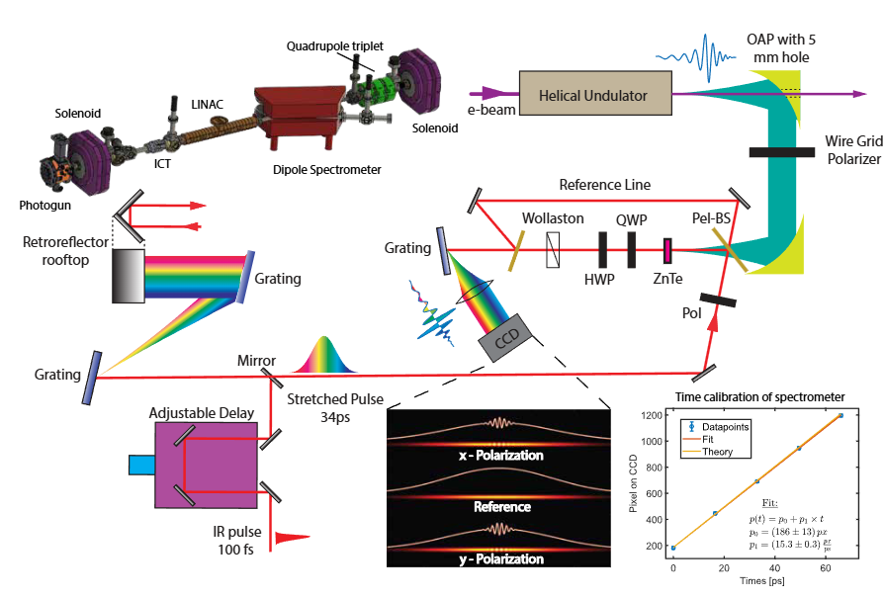
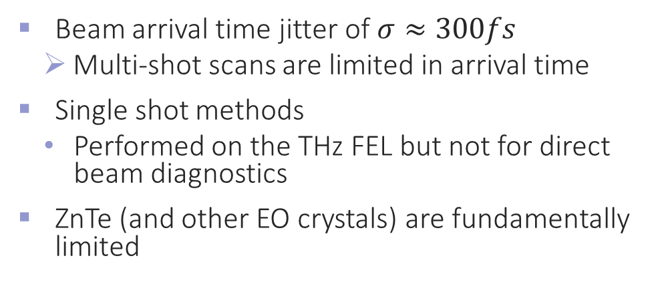
Temporal Resolution Limit
Beam arrival time jitter of $σ≈300fs$
        Multi-shot scans are limited in arrival time
Single shot methods
  Performed on the THz FEL but not for direct beam diagnostics
ZnTe (and other EO crystals) are fundamentally limited
THz FEL diagnostics
Casalbuoni, S., et al. – PRAB 2008

Slide 20





Mg:LiNbO3 THz source
In LiNbO3 :
$$n_{THz}≈5, n_{IR}^{gr}≈2$$
$→$ Vastly different velocities
Tilted pulse fronts
  Image grating into crystal
Notes:
Been demonstrated to have the best balance between conversion efficiency and damage threshold

Slide 21

Calibration
Find extrema positions
Take projections
Find peak of projections
Reconstruct waveform from extrema
$$Δy\left(t\right)=A\left(t\right) cos⁡(φ\left(t\right))$$

Slide 22




Streaking Power at different beam energies
Streaking power $S∝\frac{1}{γ}$
  Mismatch between theory and experiment $→$ Clipping within structure
Reached structural limitations
2.4mm
$$10mrad$$
$$50μm$$
Notes:
Go over quickly

Slide 23

THz Streaking - Conclusion and outlook
Developed THz source for THz streaking
  $30μJ$ of pulse energy at 0.5% generation efficiencies
Record streaking gradient of $>40\frac{μrad}{fs}$
  Limited by the structure itself
Non-linear ballistic compression $\sim$2fs beam structures measured
Different Streaking geometries
Pegasus 2026?

Slide 24




Outlook – Double tapered PPWG
Increase horizontal focusing?
  PPWG has no horizontal focusing element
  Enclosed waveguide will increase dispersion
    Pulse stretching
    Change in phase velocity $→$ Shorter interaction length
Possible solution: Double tapered parallel plate waveguide

Slide 25



Outlook – Breaking the streaking power limits
Very low dispersion!
  $v_{ph}\left(0.5THz\right)≈1.005c$
  For refrerence:
    Tsinghua structure: $v_{ph}(0.5THz)=1.08c$
$20×$ field enhancement
  Tsinghua structure: $4×$
$140\frac{MV}{m}$ measured at $0.5μJ$
$→\frac{GV}{m}$ gradients possible
Rohrbach, David, et al. "Wideband dispersion-free THz waveguide platform." Scientific Reports 13.1 (2023): 15228.
Iwaszczuk, Krzysztof, et al. "Terahertz field enhancement to the MV/cm regime in a tapered parallel plate waveguide." Optics express 20.8 (2012): 8344-8355.

Slide 26




DT-PPWG test at UCLA
UCLA designed structure
  Slit width: $s=400μm$
  Gap size: $g=100μm$
  $→$ Far away from optimal
  $$s=100μm, g=20μm$$
Resin printed and coated with copper tape
Better fabrication capabilities at SLAC than UCLA

Slide 27


Outlook – Perpendicular Streaking geometry
Increase vertical focusing?
  Clipping of beam
Possible solution: perpendicular geometry
  Stronger force
  Shorter interaction length
Copropagating case: Magnetic fields counter electric fields
$$F_{y}=E_{y}+βc B_{x}=E_{y}\left(1−\frac{βc}{v_{p}}\right)$$
Perpendicular geometry: B is along $z$ $→$ No magnetic field effect
Baek, In Hyung, et al. "Real-time ultrafast oscilloscope with a relativistic electron bunch train." Nature communications 12.1 (2021): 6851.

Slide 28



Outlook – Perpendicular streaking
Longer bunches can be captured
$→$ Better single shot capabilities
No spectrometer required
Baek, In Hyung, et al. "Real-time ultrafast oscilloscope with a relativistic electron bunch train." Nature communications 12.1 (2021): 6851.

Slide 29




Outlook – Perpendicular streaking
Tilted Pulse Front THz source
Dephasing effects $→$ Beam should sample less than half a cycle
$$f=0.5THz→s<300μm$$
  Fabrication challenge
With significant field enhancement
$→$ THz source can be simplified
  Simple ZnTe/GaP crystal for THz generation
$$f=75mm$$
$$f=500mm$$
Mg:LiNbO3

