Slide 1
Towards Low-MTE Photocathodes in Accelerators
Oksana Chubenko
Department of Physics, Northern Illinois University

Slide 2
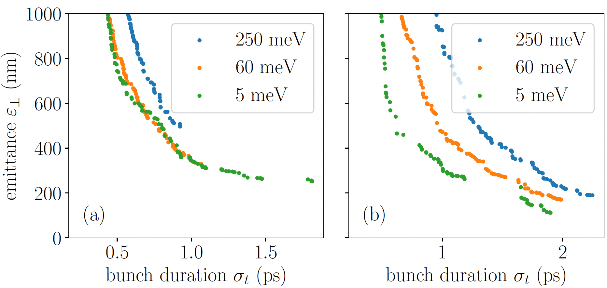
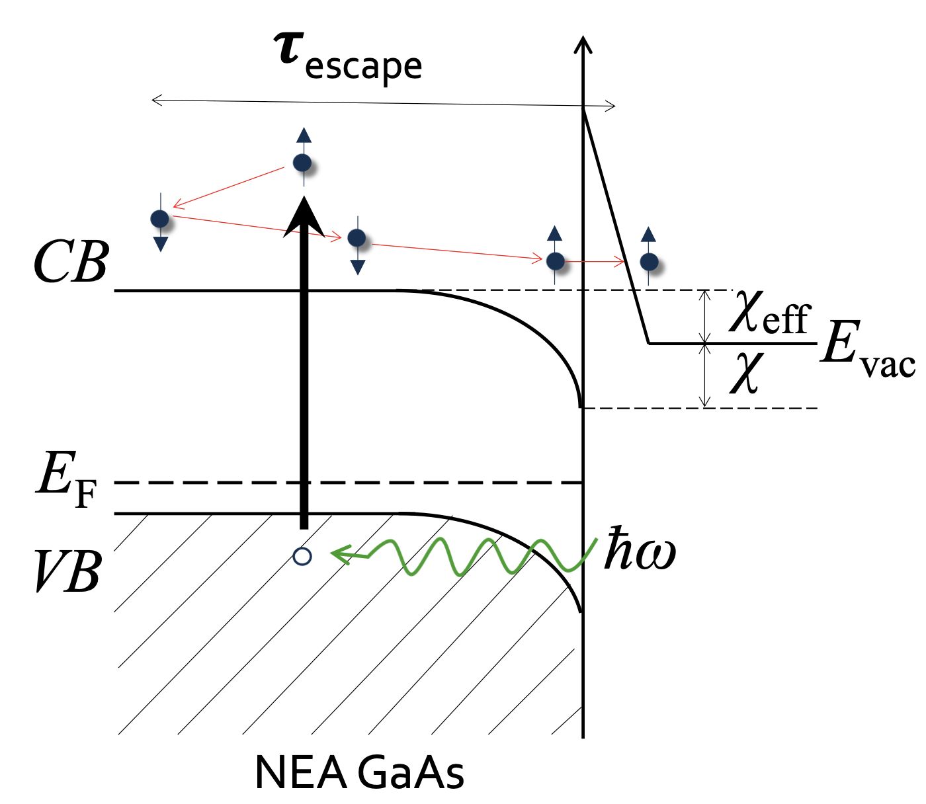

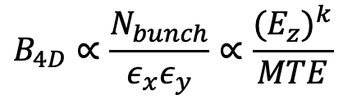
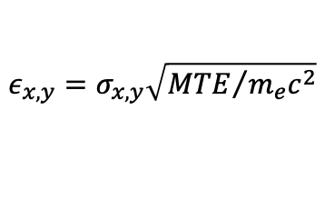
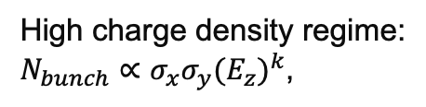
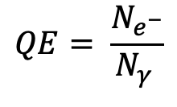
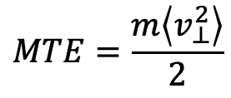
Introduction
High-quality electron beams =
bright beams
High charge density regime:
$N_{bunch}∝σ_{x}σ_{y}{(E_{z})}^{k}$,
$$B_{4D}∝\frac{N_{bunch}}{ε_{x}ε_{y}}∝\frac{{{(E}_{z})}^{k}}{MTE}$$
$$1≤k≤2$$
$$ε_{x,y}=σ_{x,y}\sqrt{{MTE}/{m_{e}c^{2}}}$$
Bazarov et al., Phys. Rev. Lett. 102, 104801 (2009).
High-quality photocathodes =
low mean transverse energy,
$$MTE=\frac{m\left\langle v_{⊥}^{2}\right\rangle }{2}$$
MTE ~ k_{B}T ~ 25 meV at room temperature
Factors, limiting MTE:
requirements of the high charge density
disordered nature of photocathode materials
surface roughness and work function variations
→ MTE ~ few 100s meV
$$QE= \frac{N_{e^{−}}}{N_{γ }}$$
Frame, Marzouk, Chubenko et al, Instruments 7, 48 (2023).
high quantum efficiency,
prompt response time
robustness + long operational lifetime under realistic photoinjector conditions (5-100 MV/m to extract ~ 50-1000 pC/mm² of charge densities/bunch)

Slide 3
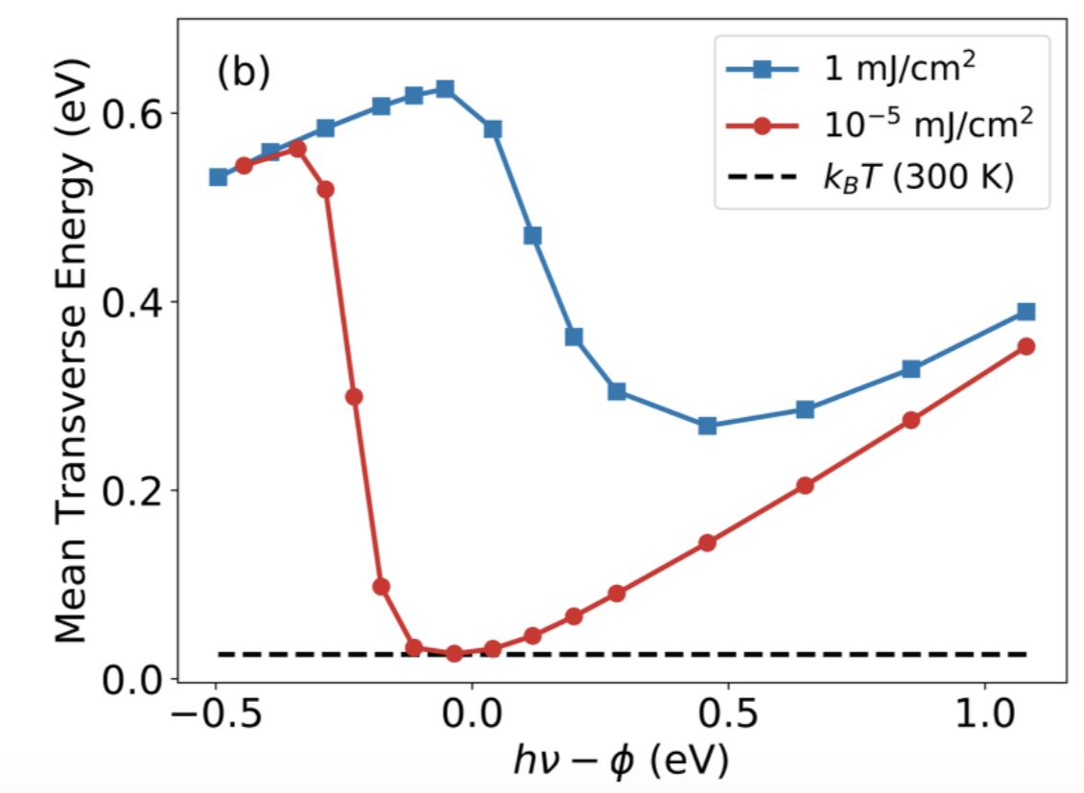
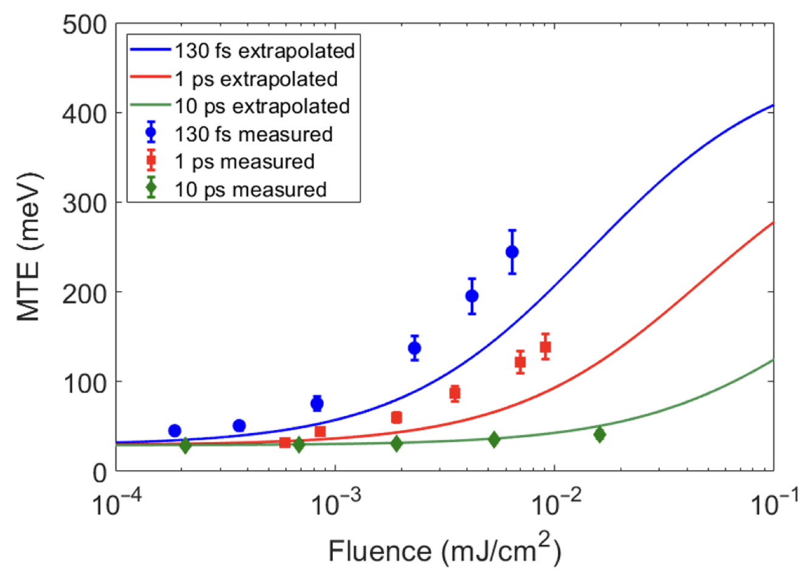
Low-electron-affinity semiconductor photocathodes
Multi-photon absorption limits MTE!
Bae et al. J. App. Phys. 124, 244903 (2018)
Knill et al., Phys. Rev. Accel. Beams 26, 093401 (2023)
Low-electron-affinity semiconducting photocathodes are better candidates to operate under high laser fluences.

Slide 4
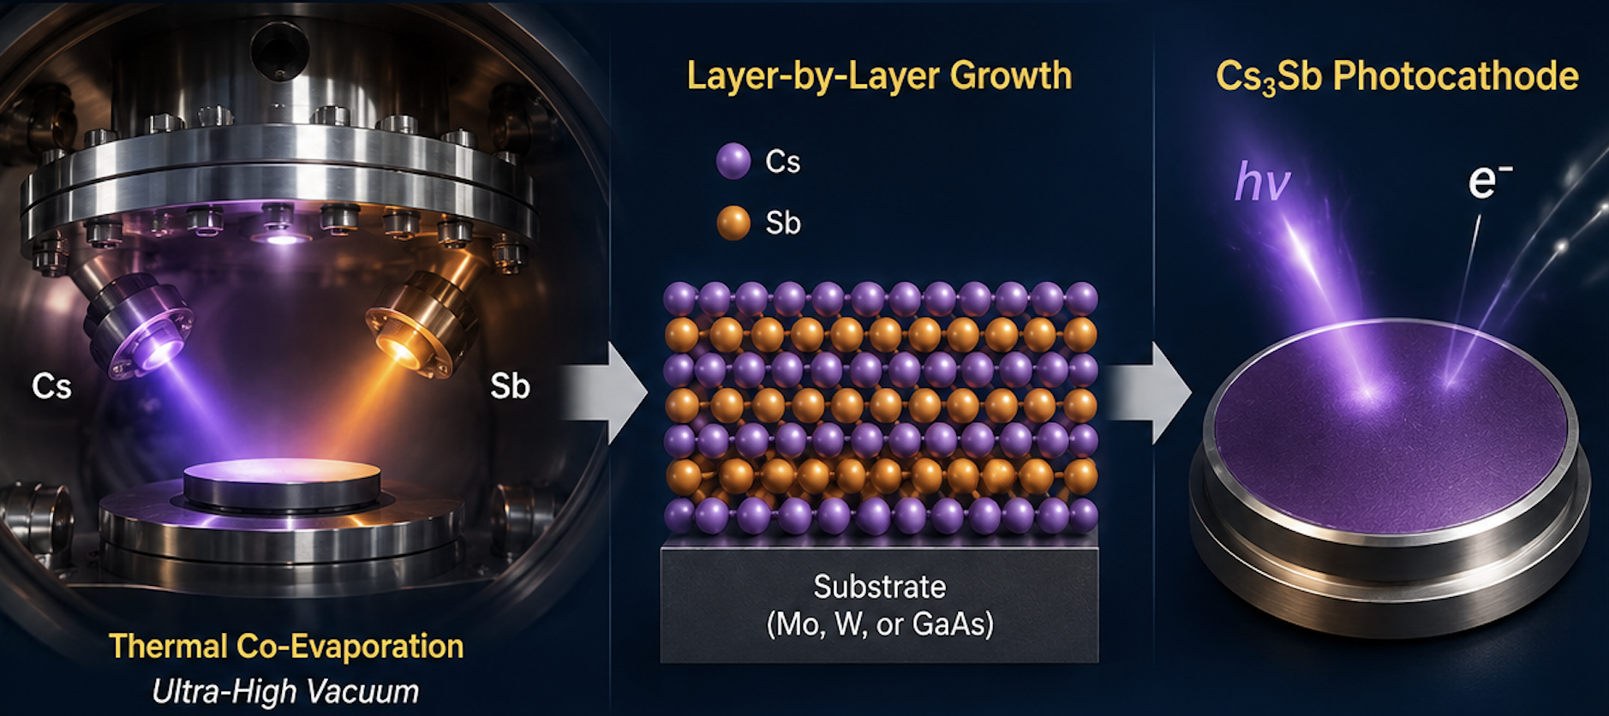
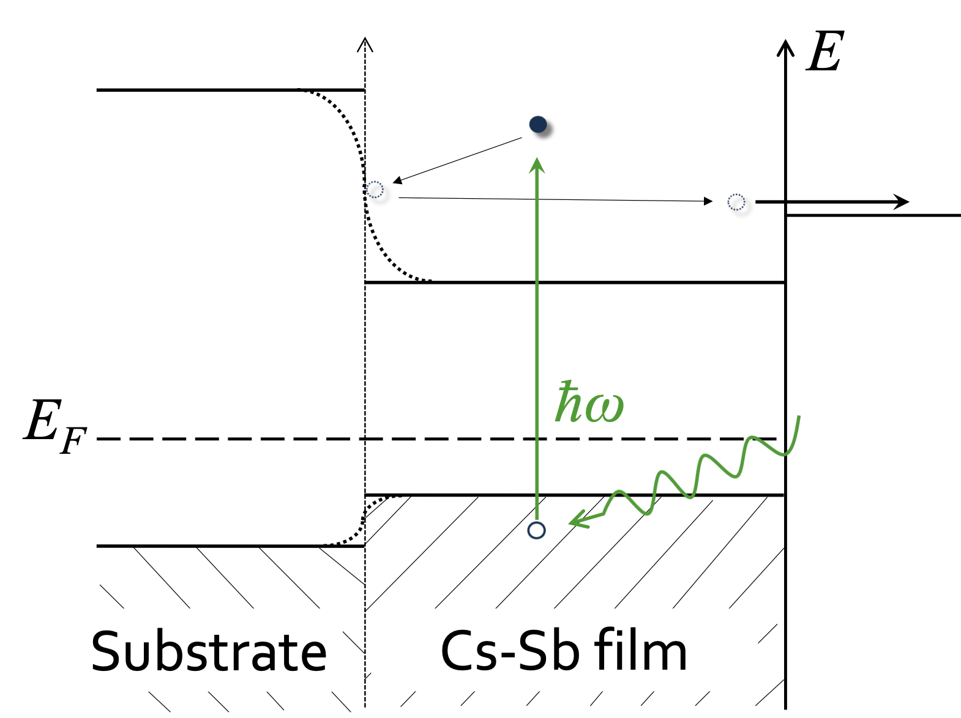
Cesium-antimonide photocathodes
Cesium-antimonide photocathodes (Cs-Sb):
promising candidates for generating extremely bright electron beams for XFELs, UED, and UEM.
can be easily deposited through thermal evaporation at moderate temperatures.
thin films (several 10s of nm).
Substrate

Slide 5
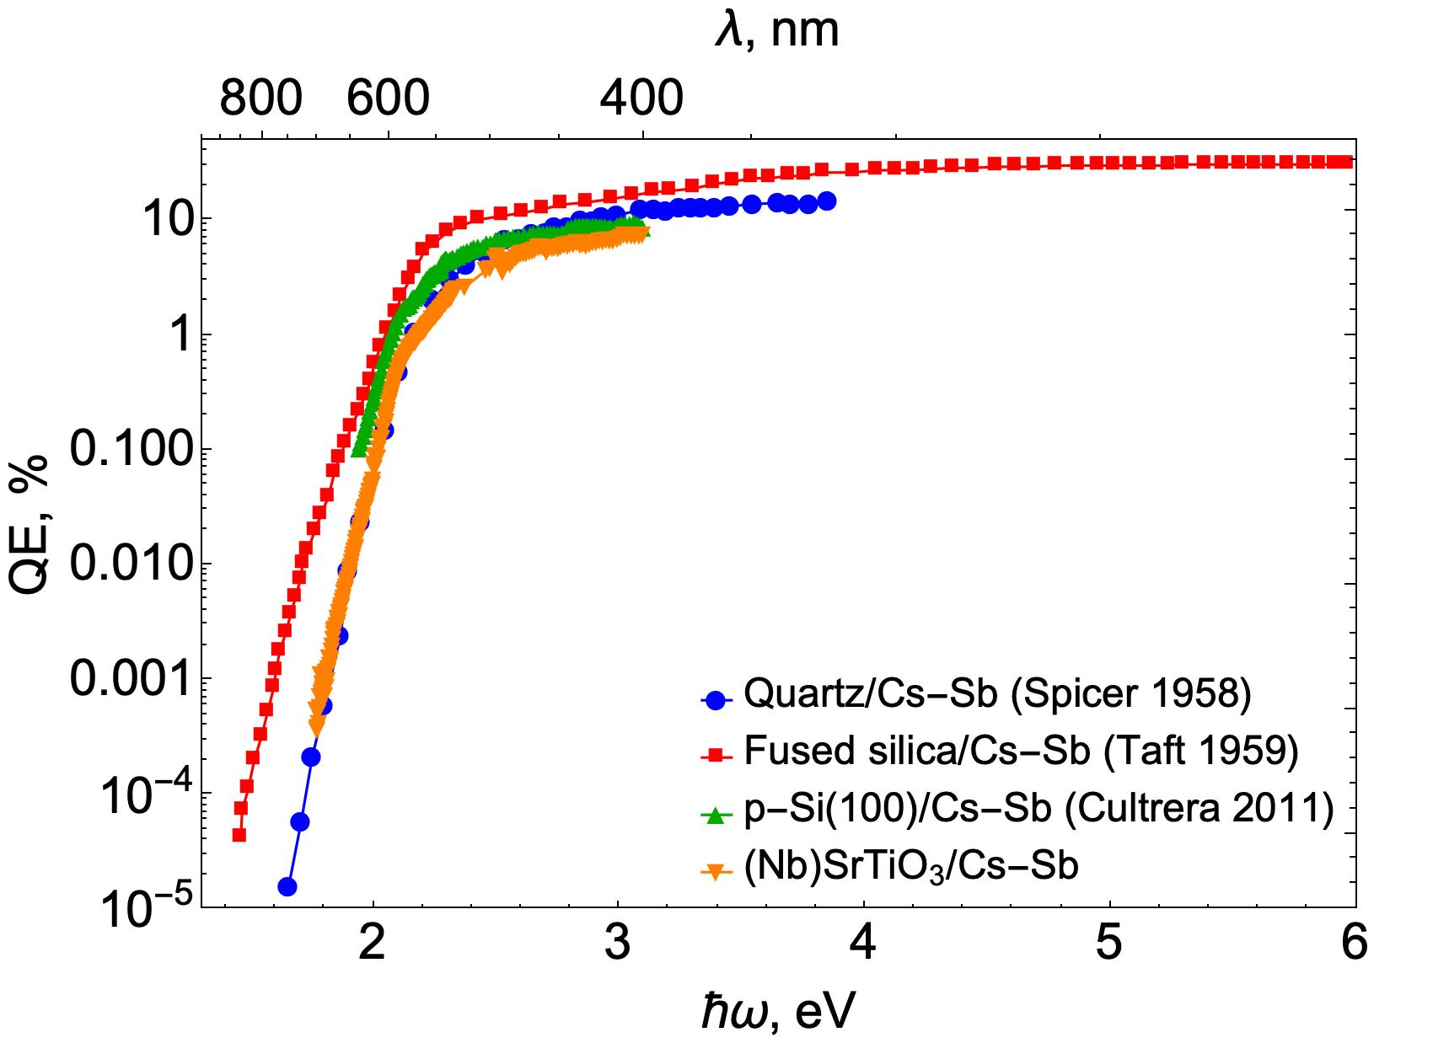
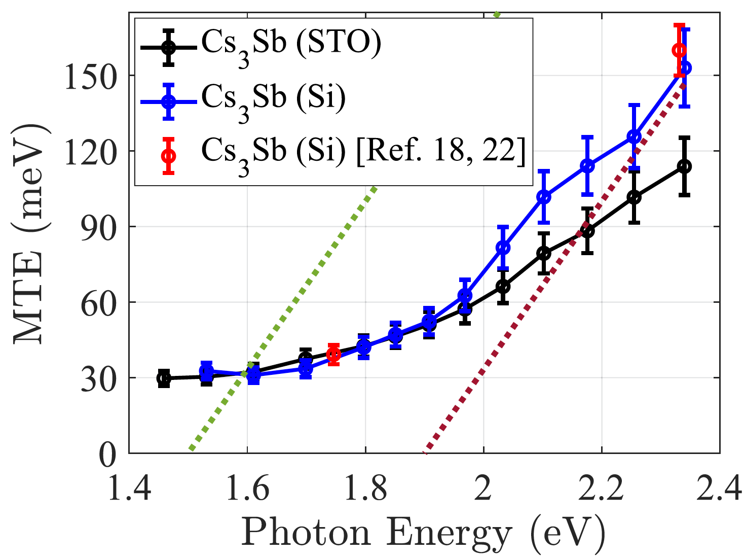
Cesium-antimonide photocathodes
Operational photon energy affects MTE!
Photon Energy, eV
A. Kachwala, P. Saha, P. Bhattacharyya, E. Montgomery, O. Chubenko, and S, Karkare, Appl. Phys. Lett. 123, 044106 (2023)
Cesium-antimonide photocathodes demonstrate thermal-limit MTE and relatively high QE at photoemission threshold.

Slide 6
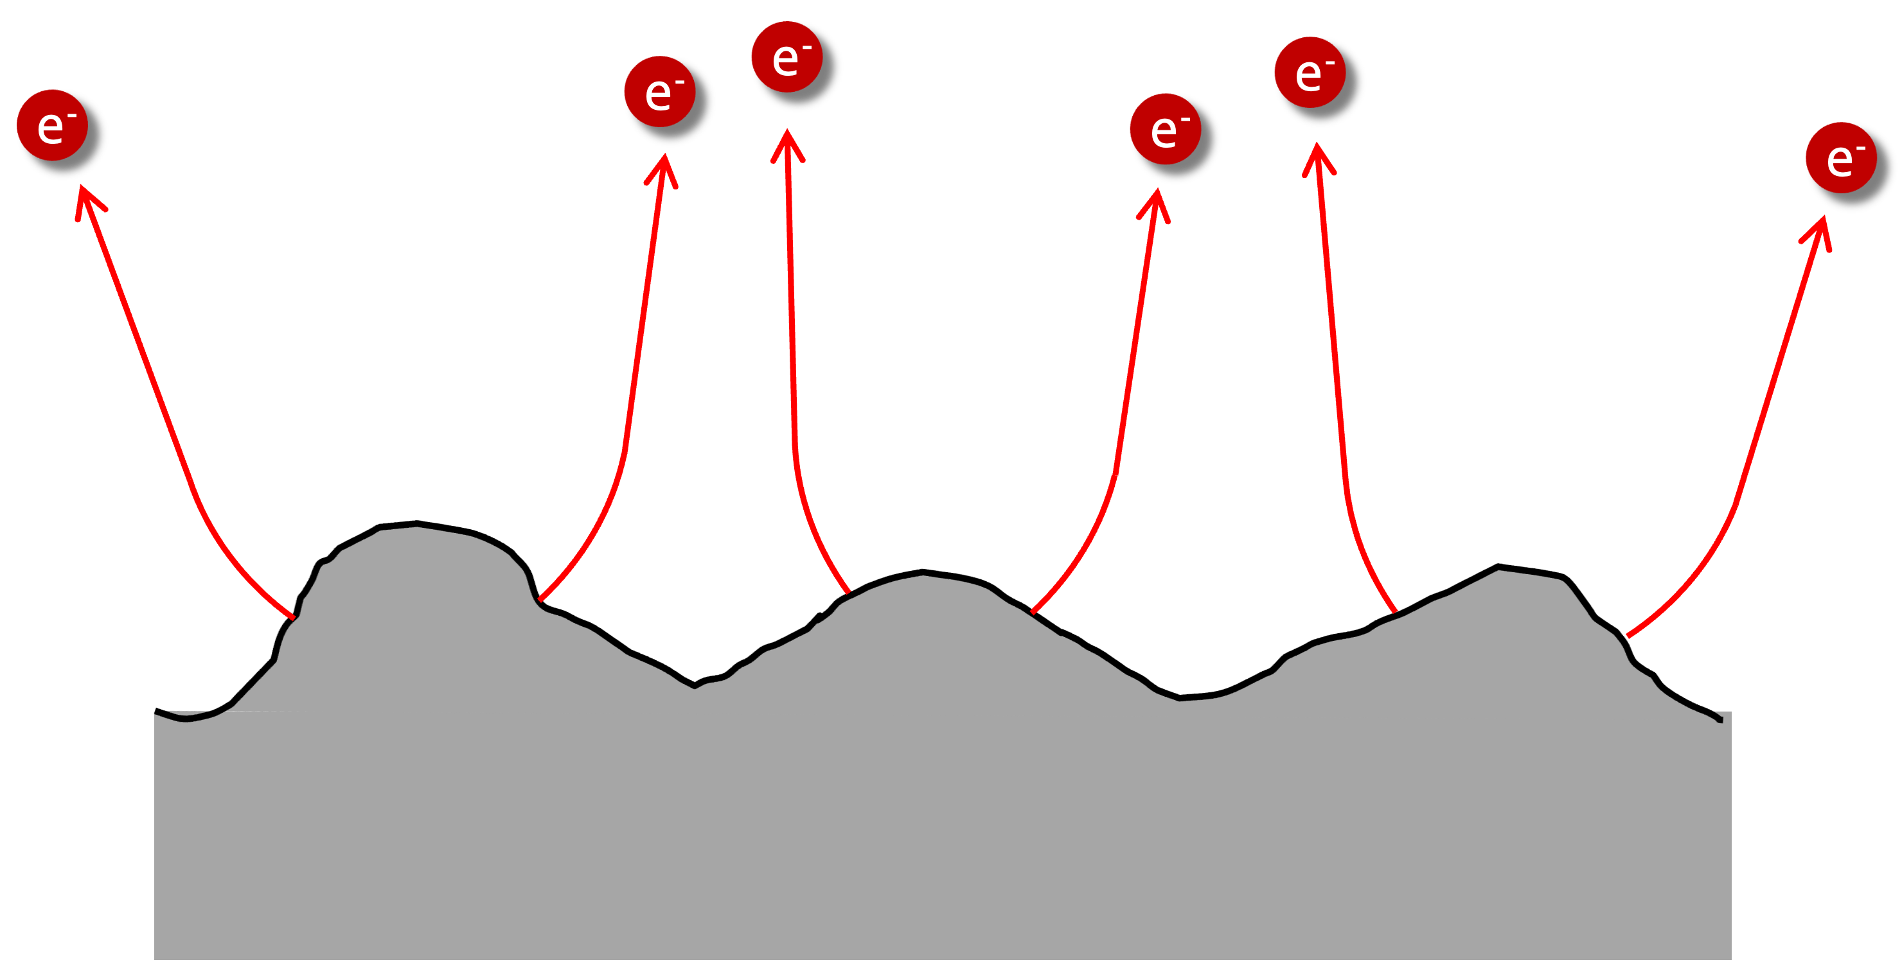
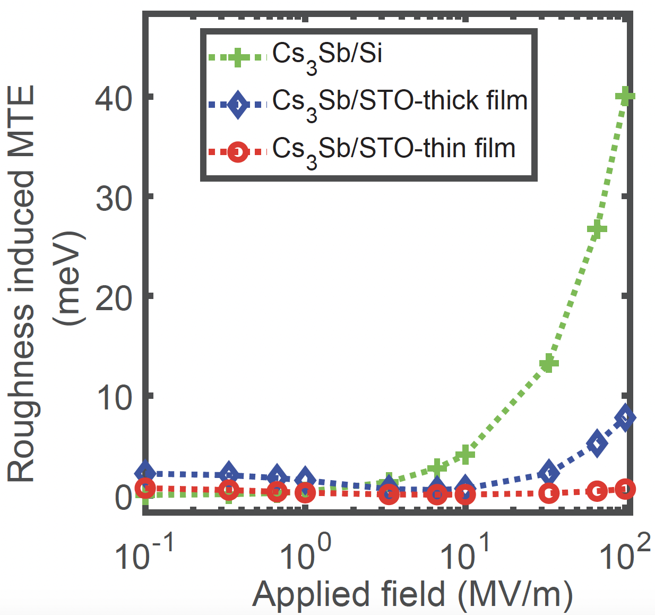
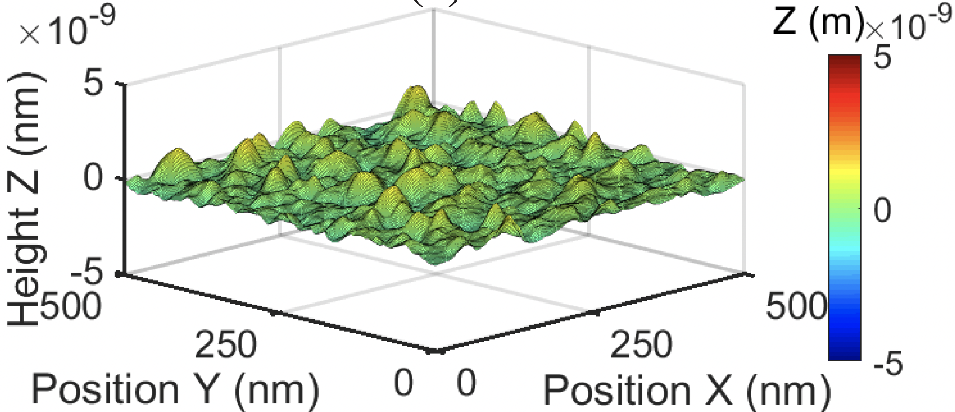
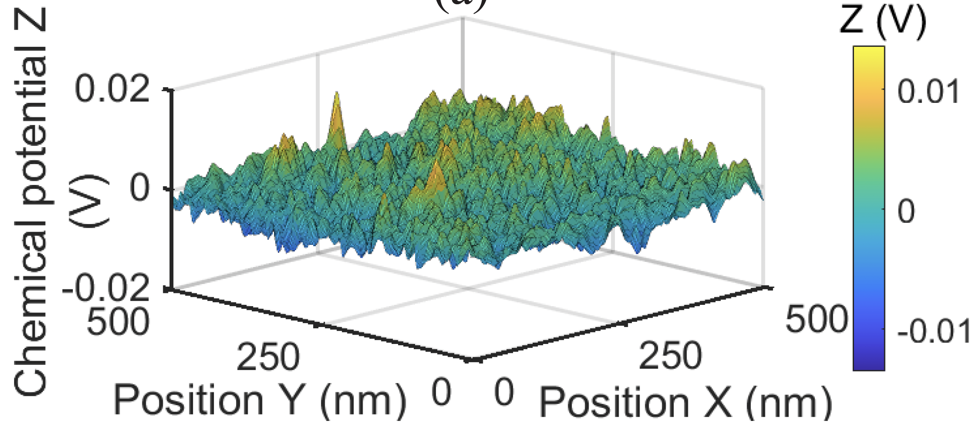
Cesium-antimonide photocathodes
Surface roughness and work function variation limit MTE!
Saha, Chubenko et al, Appl. Phys. Lett. 120, 194102 (2022).
Cesium-antimonide films grown on lattice-matched single crystal strontium titanate (STO) substrates demonstrate roughness-induced MTE < 10 meV even at large applied fields.

Slide 7
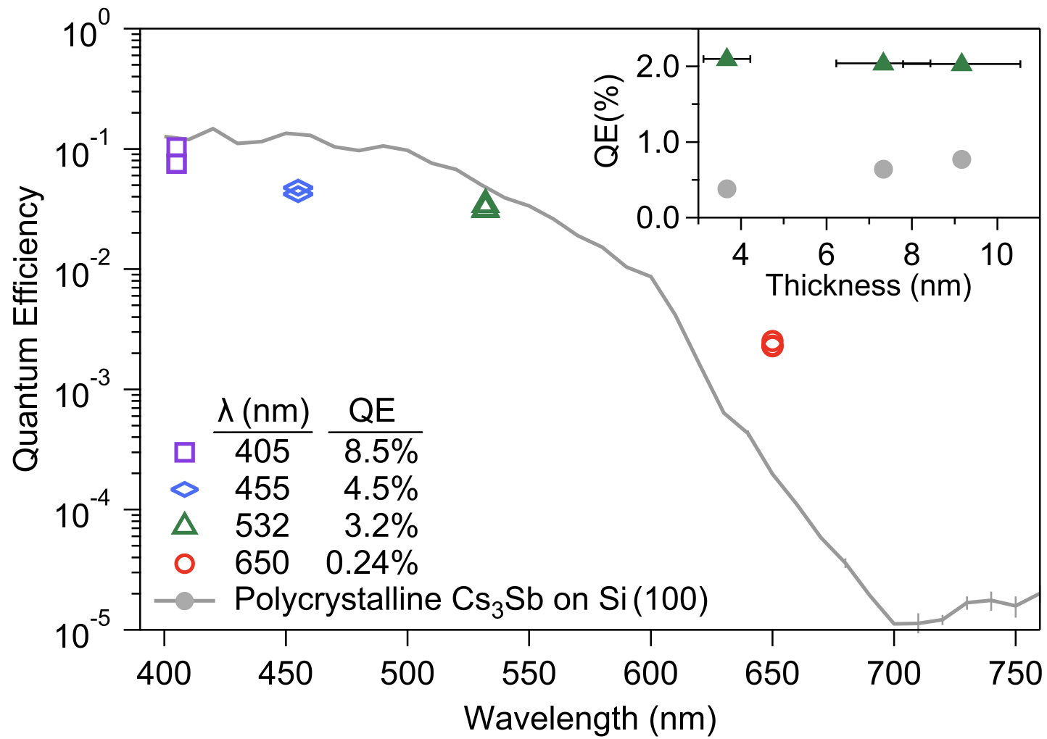
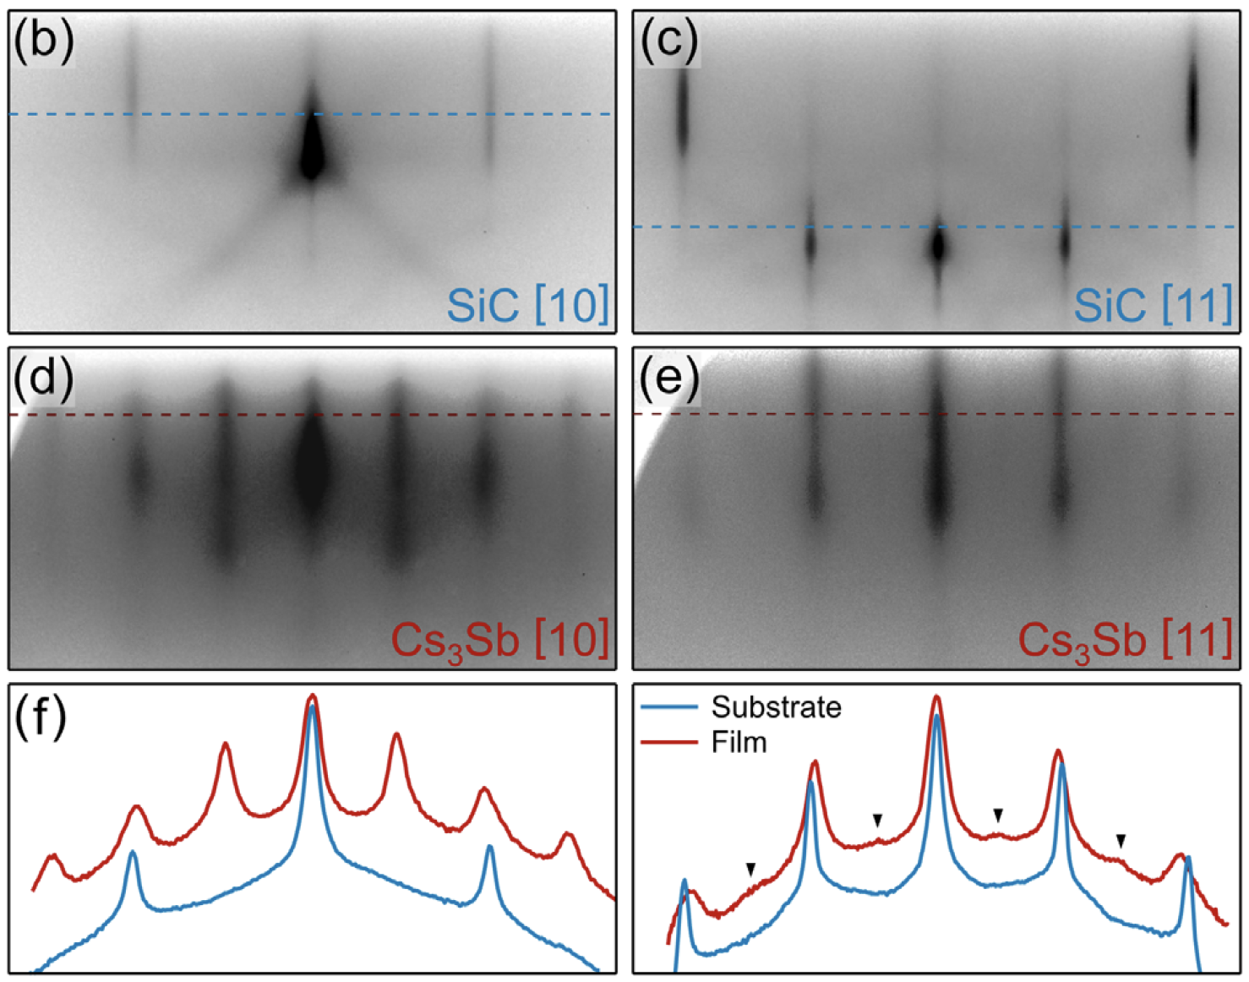
Cesium-antimonide photocathodes
Disordered crystal structure limits MTE!
RHEED images of an annealed SiC substrate and a 10 u.c. Cs₃Sb film.
High red QE from single crystal Cs₃Sb
Parzyck et al, Phys. Rev. Lett. 128, 114801 (2022).
Epitaxial growth of cesium-antimonide films on lattice-matched single crystal SiC substrates.

Slide 8
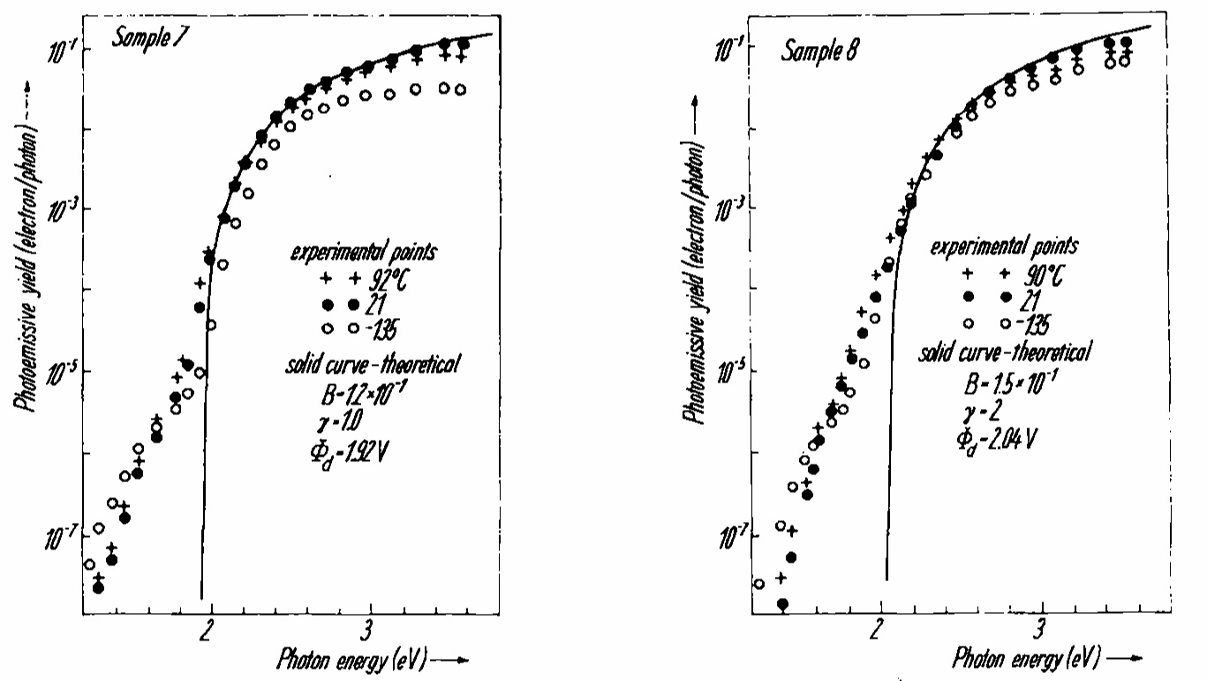
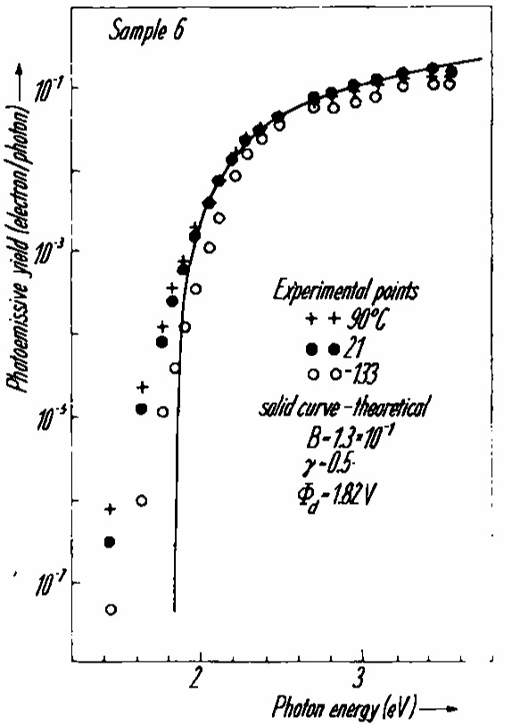
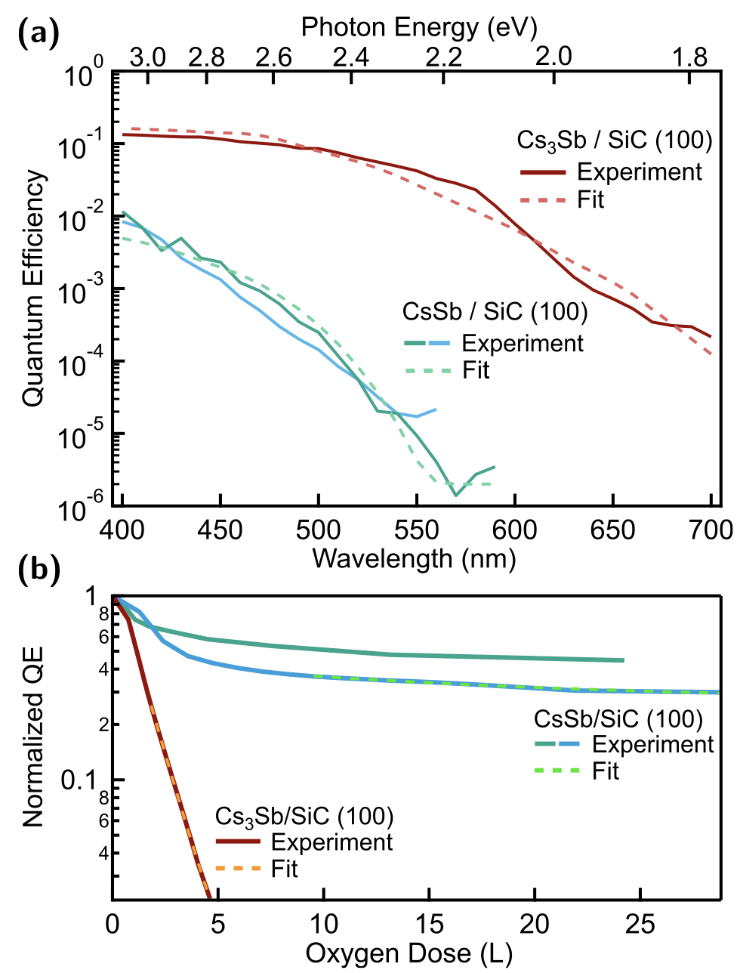
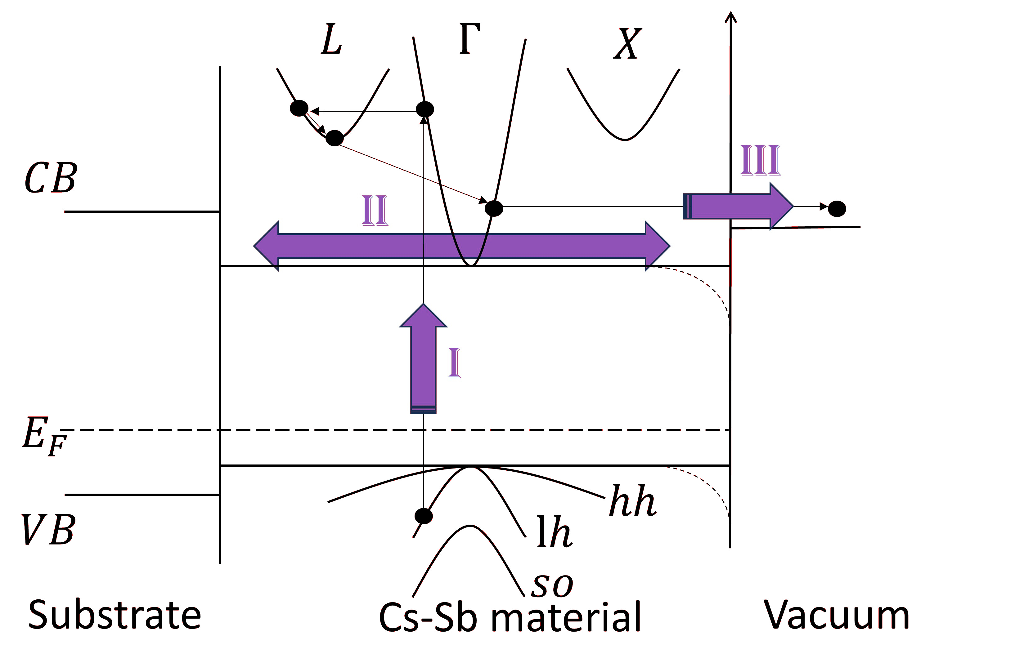
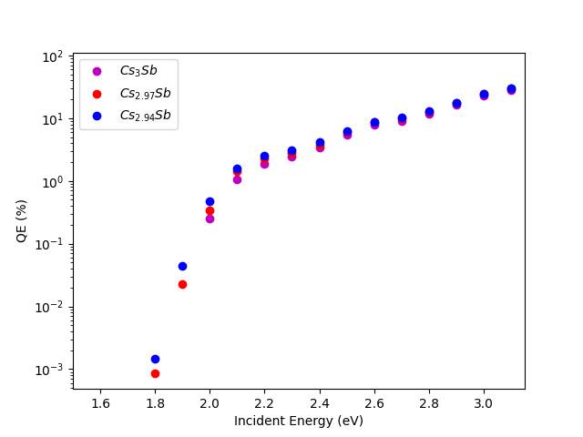

Cesium-antimonide photocathodes
Stoichiometry influences photoemission!
Stoichiometric variation
Cs₃Sb vs CsSb
robustness against oxidation is up to 15 times greater
Near Cs₃Sb
Cs-rich
High yield
Parzyck et al., APL Mater. 11, 101125 (2023)
Hagino et al, Phys. Stat. Sol. 17, 609 (1966).
DFT + Monte Carlo investigation of stoichiometry influence on photoemission
Daniel Franklin,
T21 (Tuesday)
Detailed modeling and advanced growth and characterization are required to achieve desired stoichiometry.

Slide 9
Testing alkali-antimonide photocathodes in accelerators
Alkali-antimonide photocathodes (Cs-Sb, Na-K-Sb):
Low MTE
High QE
Thin films → prompt response time
Robustness + long operational lifetime under realistic photoinjector conditions ?
✅
✅
✅

Slide 10
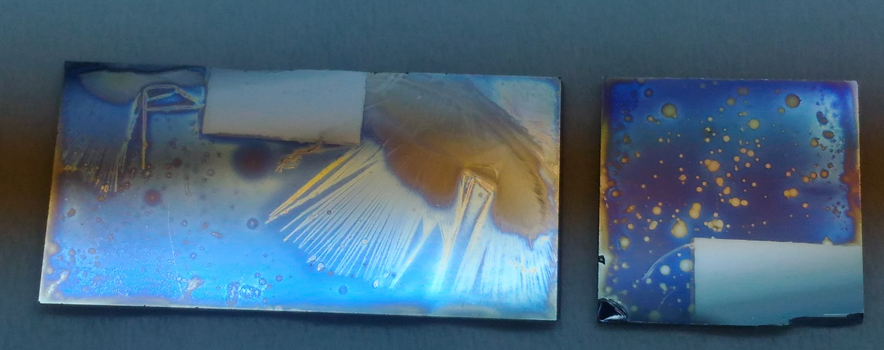
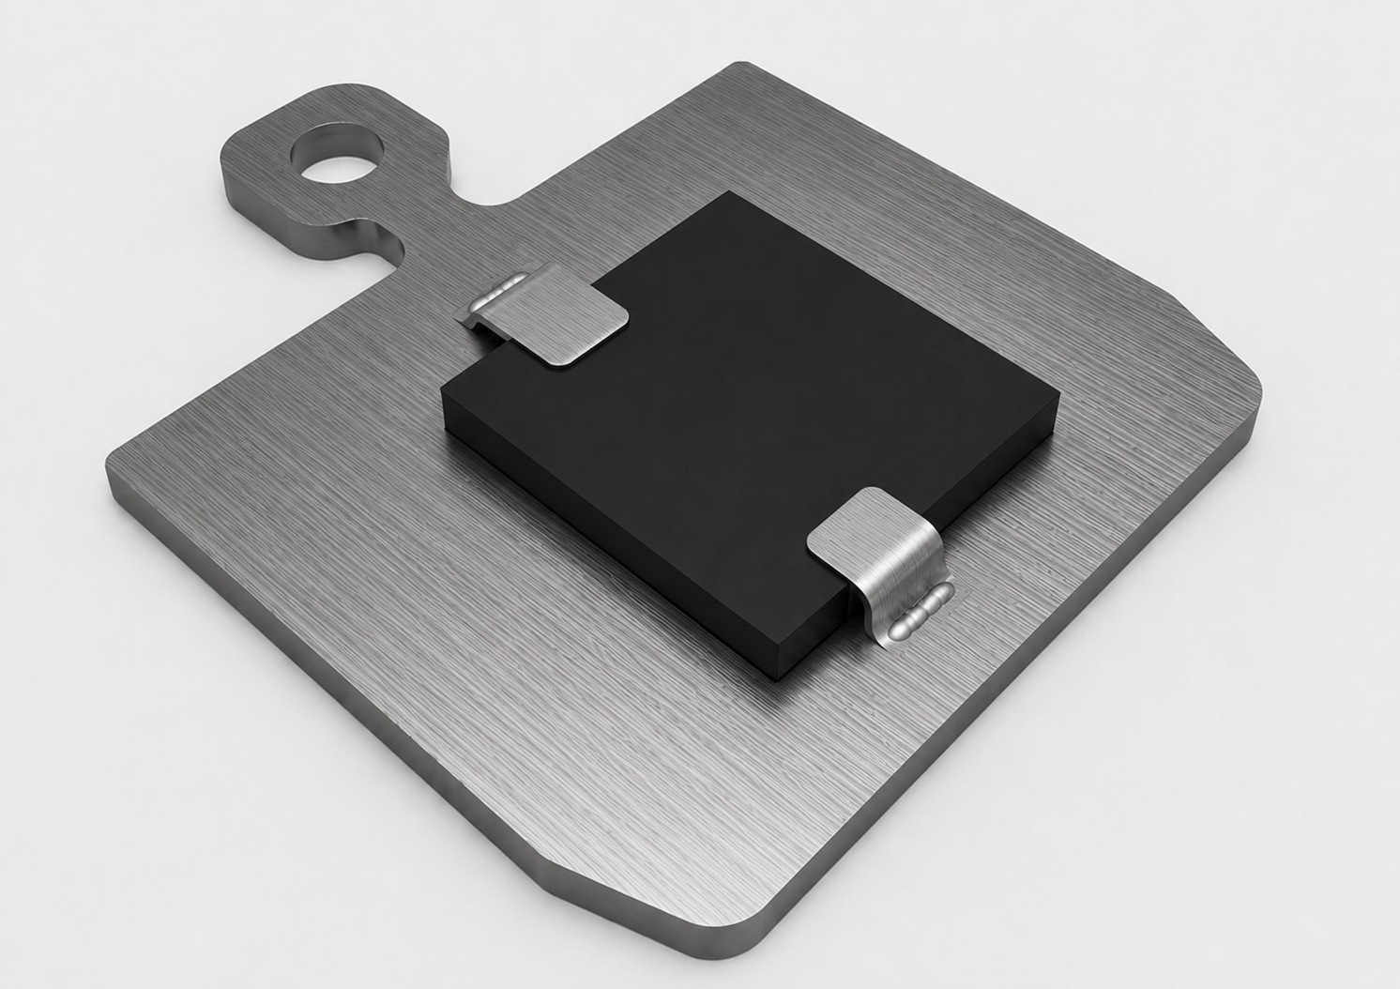
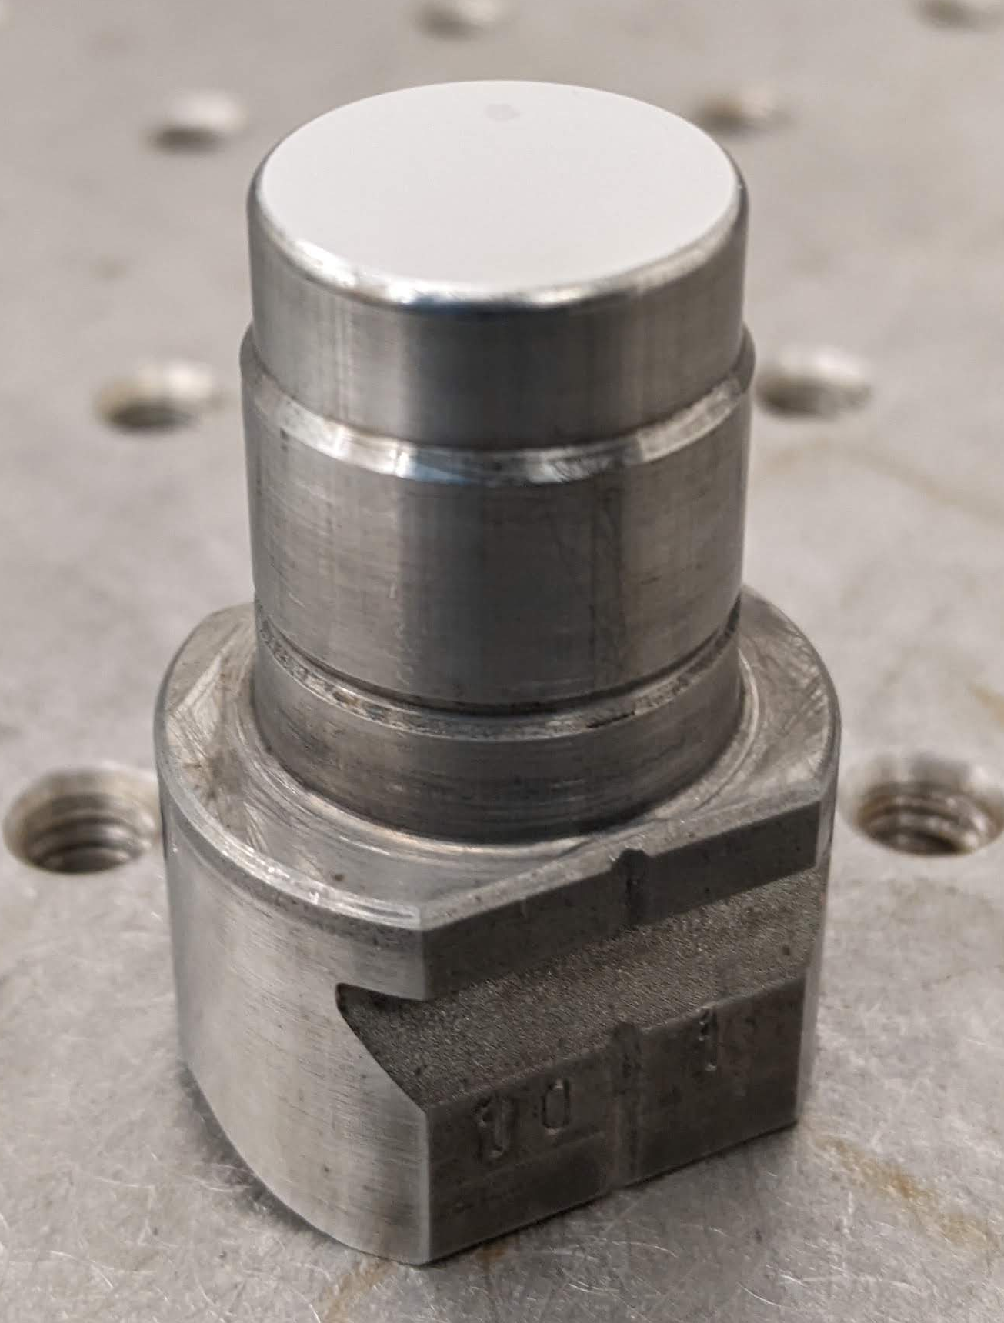
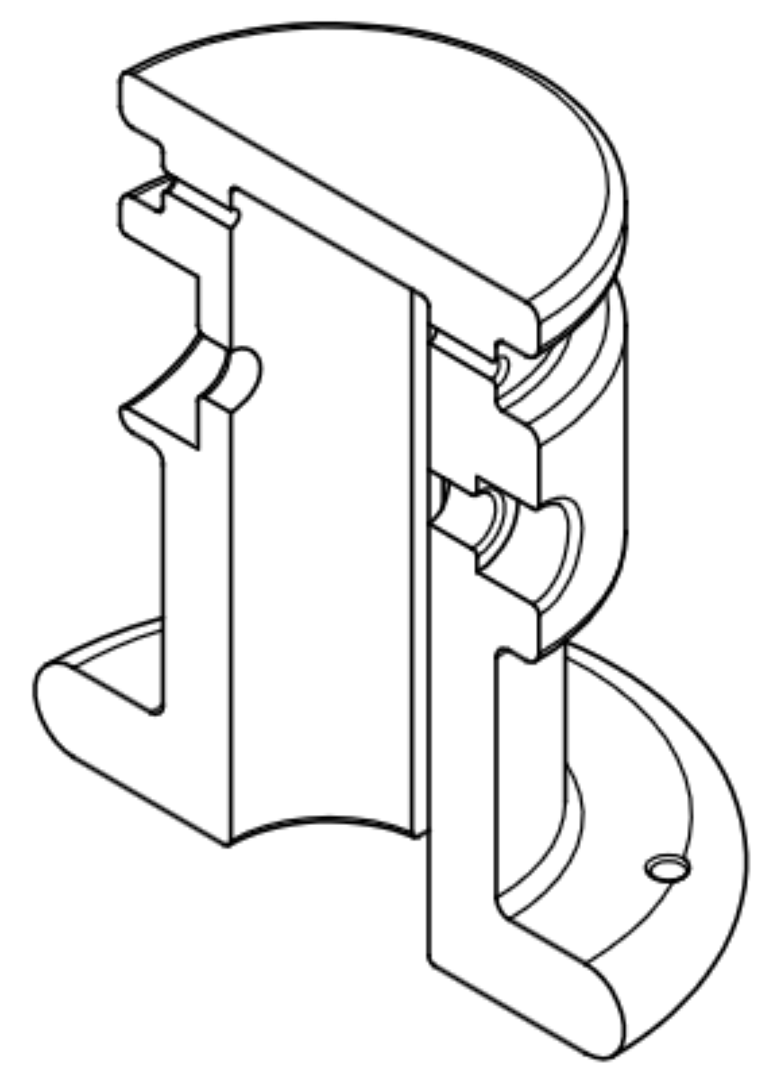
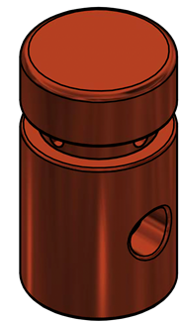
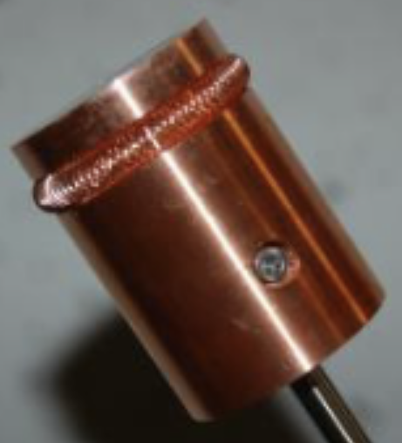
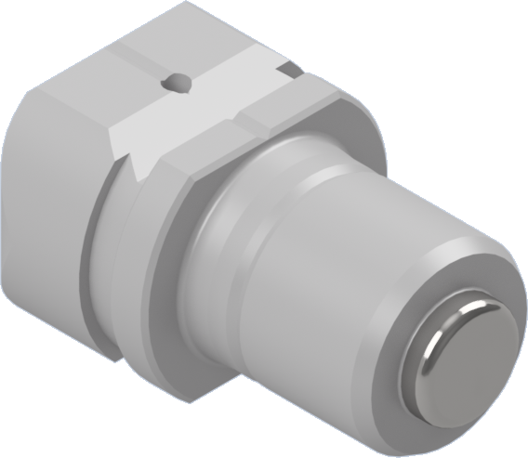
Testing alkali-antimonide photocathodes in accelerators
Previous experience:
many tests in DC guns
very few tests of bialkali-antimonides in high field RF/SRF guns
no RF tests of Cs-Sb films grown on SC substrates.
Oxidation of Cs-Sb films after ~ 5 min in air
Complications:
photocathode sensitivity to vacuum conditions
incompatibility between photocathode growth systems and photoinjectors
Flag-style sample holder
Old INFN-style
New INFN-style
AWA drive gun
ACT gun
Witness gun
University labs
FermiLab, SLAC, UCLA, Cornell
Argonne

Slide 11
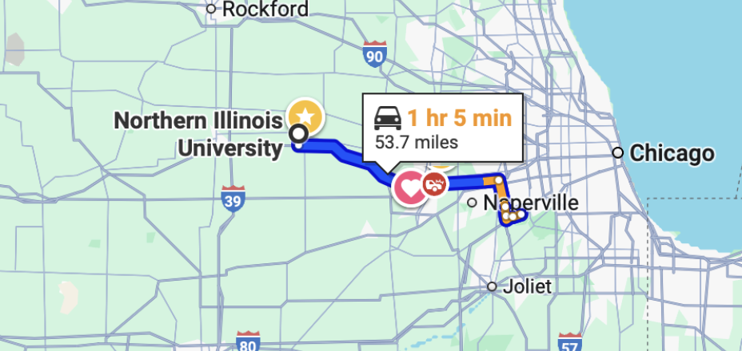
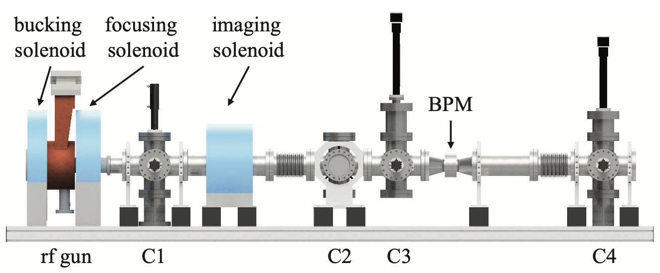
Testing alkali antimonide photocathodes at AWA Facility
Argonne Cathode Teststand (ACT):
L-band 1.3 GHz single-cell photocathode RF gun.
Emittance measurement capability.
Close proximity to NIU.
Currently suitable for testing air-stable materials only.
Unique plug design.
Shao et al, IPAC 2018
Planned ACT updates:
Update the pump system to achieve ~10⁻¹⁰ Torr.
Integrate NIU-compatible photocathode plug suitable for testing different photocathode substrates.
Possibility of adding the deflecting cavity for photocathode response time measurements.

Slide 12
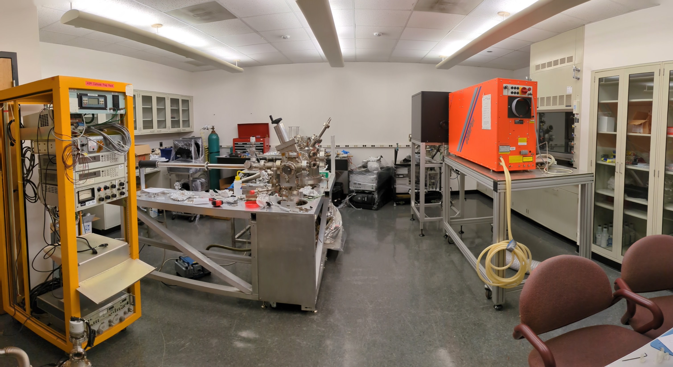
NIU Photoemission Research Lab
Pulsed Laser Deposition system
Thermal Evaporation system
Oksana Chubenko,
T35 (Tuesday)
This Talk

Slide 13

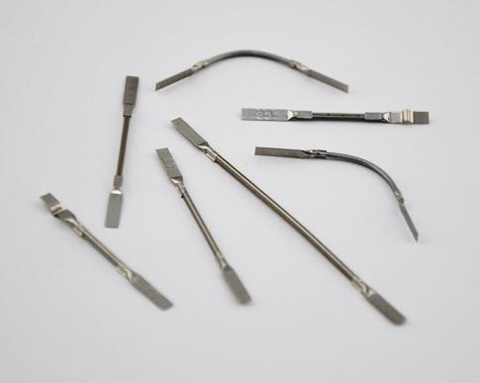
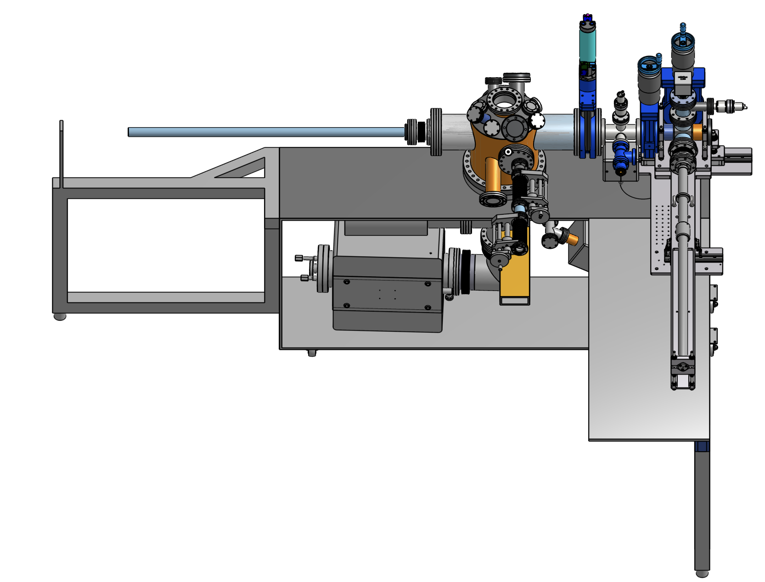
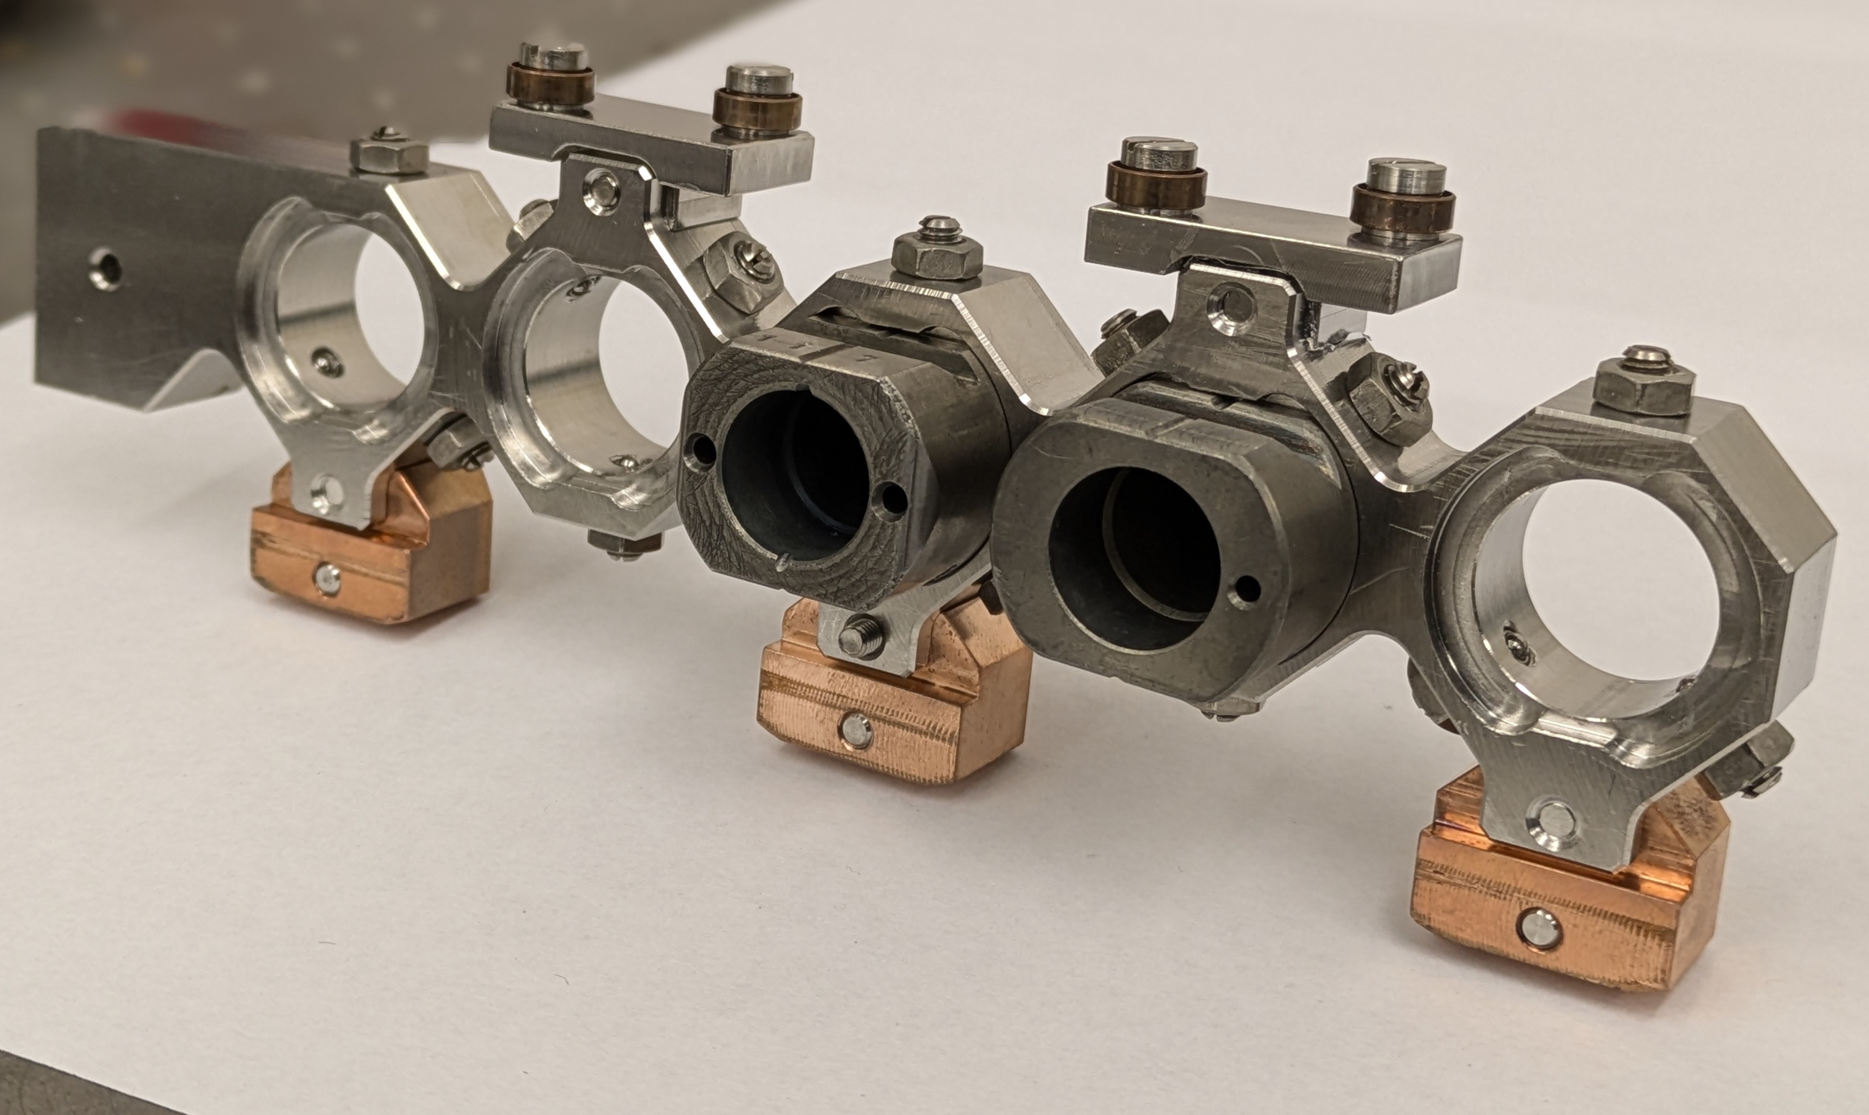
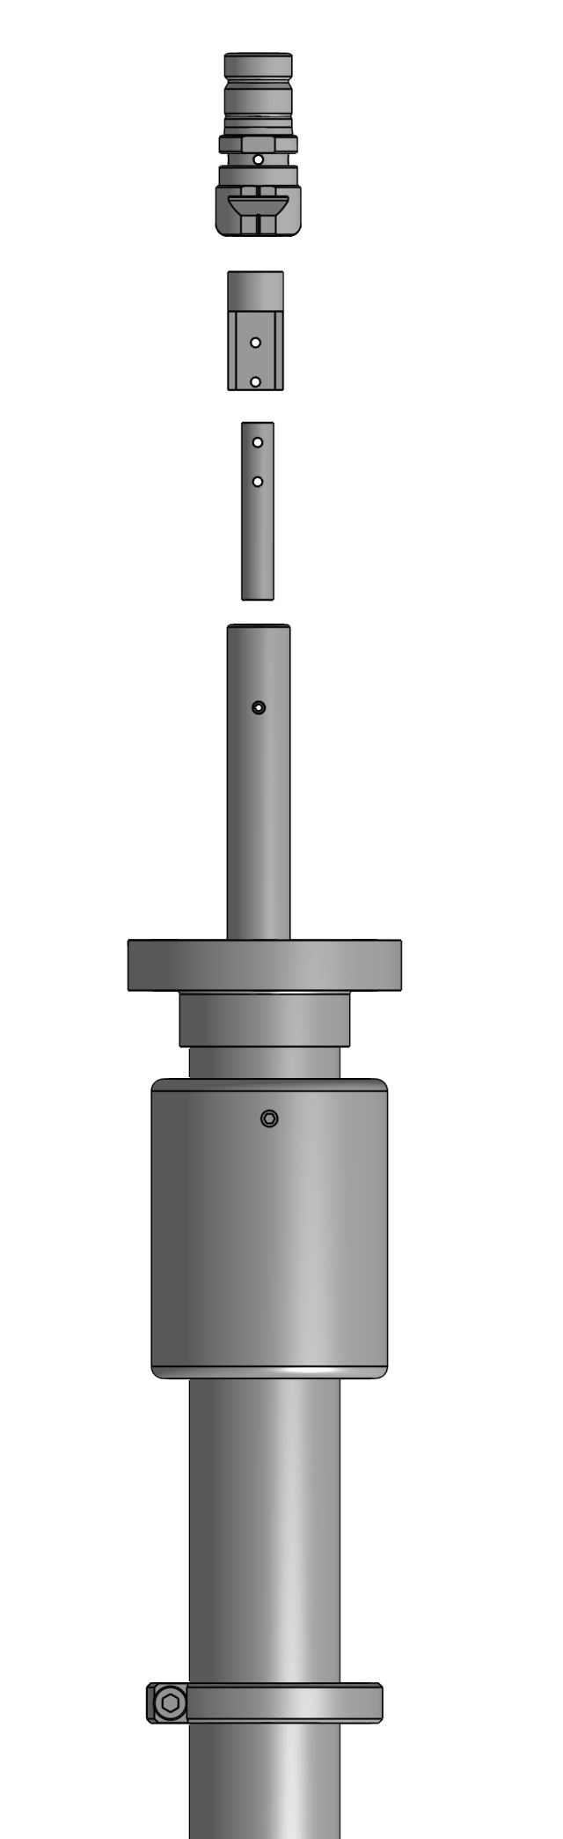
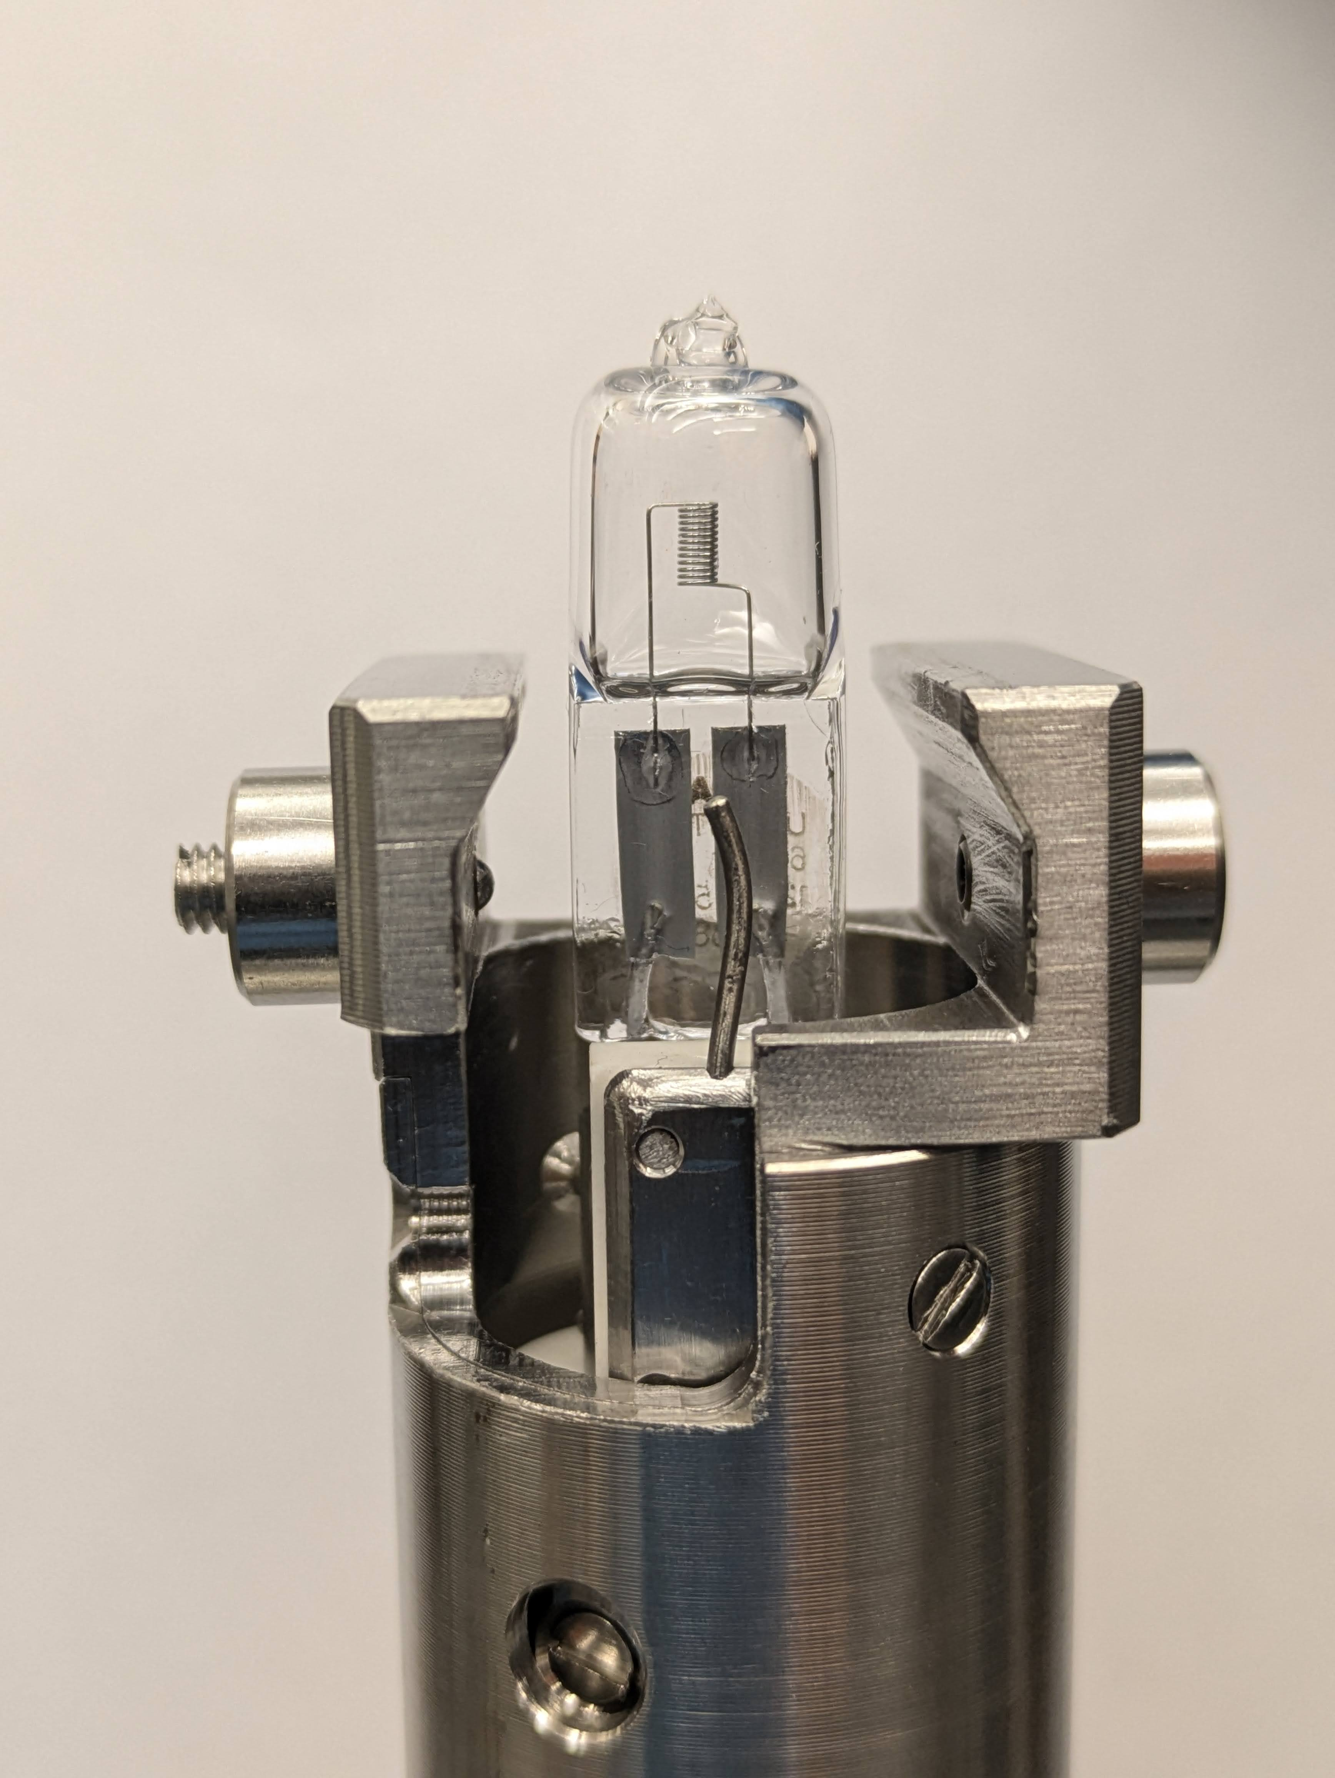
Growth of alkali-antimonide films at NIU
Thermal evaporation system previously used to grow Cs-Te films on old INFN-type photocathode plug at Fermilab.
SAES dispensers
Carriage for 5 INFN-style plugs
Pincer with
built-in heater
Vacuum Suitcase

Slide 14
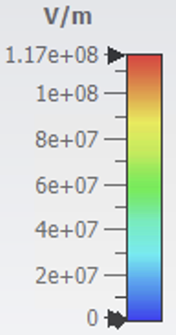
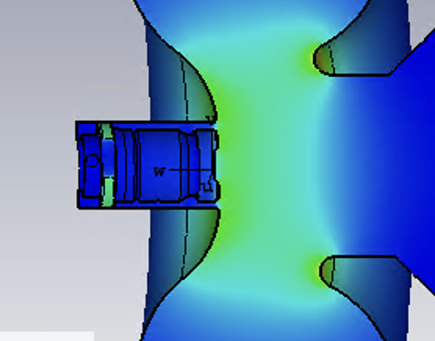
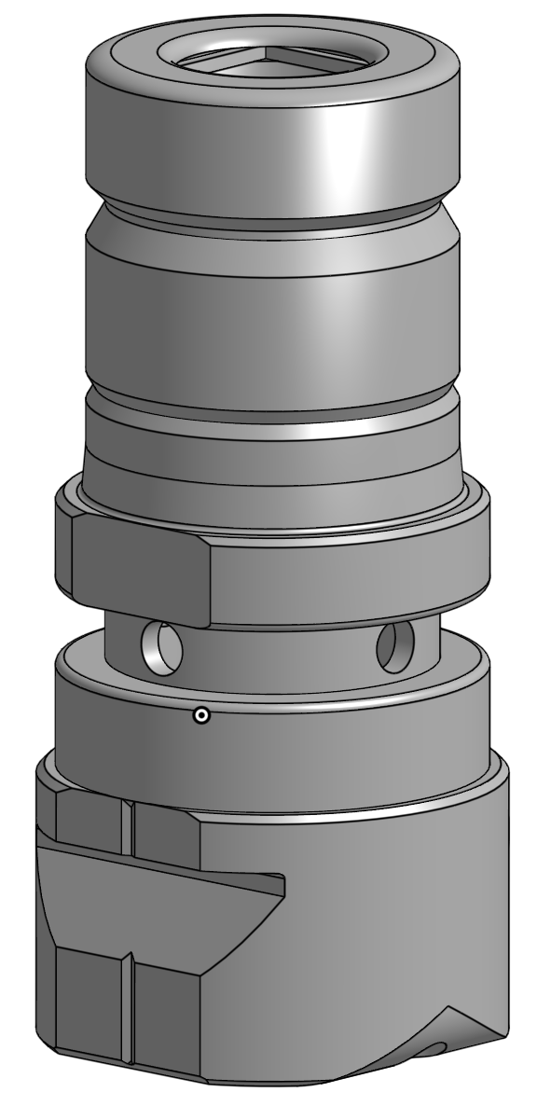
Growth of alkali-antimonide films at NIU
New plug enables growth of low-MTE Cs₃Sb films on semiconductor substrates.
Compatible with ACT
Old INFN-style plug
New NIU plug
ACT plug
NIU plug in ACT

Slide 15
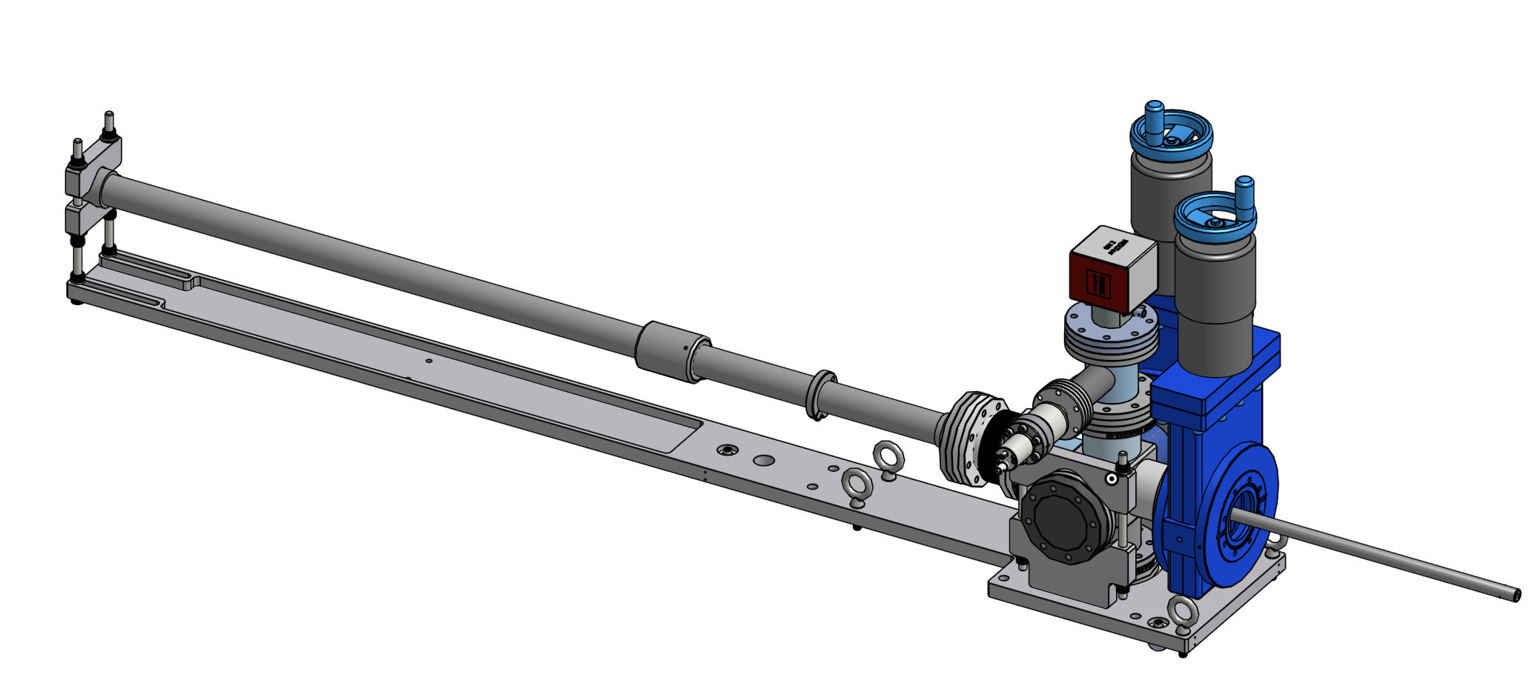
Growth of alkali-antimonide films at NIU
Developed vacuum suitcase compatible with ACT.
K. J. Lesker sample transfer device with rolling metal & ceramic bearings for smooth, low friction actuation, with minimal outgassing.
NEXTorr® UHV pump.
Two VAT GVs.

Slide 16
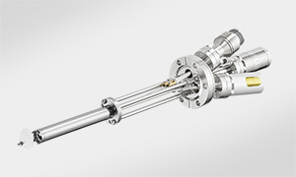
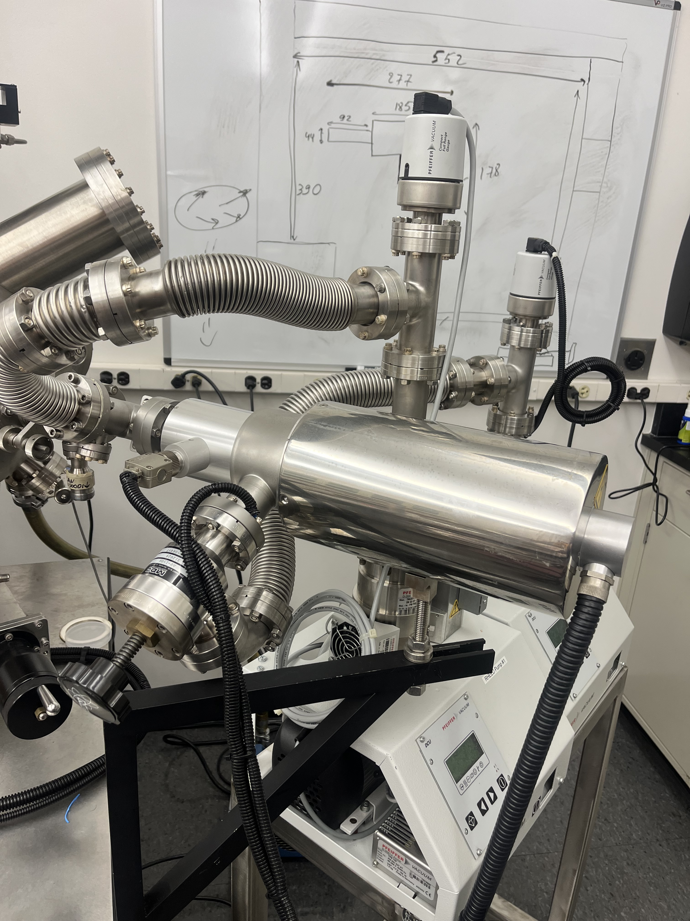
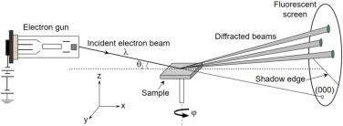
Growth of alkali-antimonide films at NIU
Further system upgrades:
More efficient particle sources
SAES dispensers
Effusion cell
Implement RHEED system or other mechanism for controlled epitaxial growth of alkali antimonide photocathodes with desired stoichiometry.

Slide 17
Summary
High-quality photocathode development through epitaxial growth of atomically smooth crystalline materials.
Developed experimental setup for the epitaxial growth of alkali antimonide photocathodes on lattice-matched substrates.
Extensive testing and characterization of photocathodes will be carried out in the L-band RF gun of ACT.
This project aims to bridge the gap between university-based photocathode R&D and the reliable deployment of high-quality photocathodes in accelerator facilities.

Slide 18
Acknowledgements
Undergrad students:
Collaborators:
Grace Straub (NIU)
John Power (ANL)
Scott Doran (ANL)
Eric Wisniewski (ANL)
Gongxiaohui Chen (ANL)
Philippe Piot (ANL)
Grad students:
Tariqul Hasan (NIU)
Funding agencies:
The Center for Bright Beams (CBB), NSF award PHY-1549132.
Launching of Early-Career Academic Pathways in the Mathematical and Physical Sciences (LEAPS-MPS), NSF Award Number 2532996.
Thank you!

