Slide 1
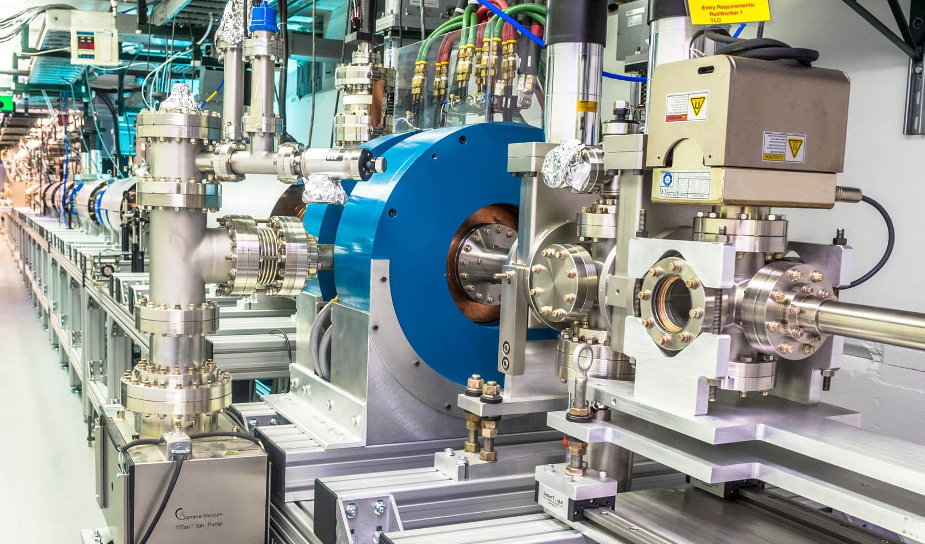
Modeling and Experimental Characterization of a High-Field, High-Charge L-Band Photoinjector
Chengkun Huang¹, Xueying Lu^{2,3}, Omkar Ramachandran², Gaurab Rijal²
1. Los Alamos National Laboratory (LANL)
2. Northern Illinois University (NIU)
3. Argonne National Laboratory (ANL)
AAC 26

Slide 2
Acknowledgments
A. Alexander (LANL)
Gongxiaohui Chen (ANL)
D. A. Dimitrov (LANL)
Alex Ody (ANL)
John Power (ANL)
Omkar Ramachandran (NIU)
Gaurab Rijal (NIU)
E. I. Simakov (LANL)
Gaoxue Wang (LANL)
Eric Wisniewski (ANL)
This research was supported by:
Los Alamos National Laboratory (LANL): LDRD 20230011DR
Northern Illinois University (NIU): DE-SC0021928,DE-SC0024445.
Argonne National Laboratory (ANL): DE-AC02-06CH11357

Slide 3
Outline
Goal:
  Understanding of Cs₂Te photocathode operation in a high-field photocathode gun
Approach:
  Modeling: DFT + Monte-Carlo + thin-film optical interference
  Experimental benchmarking at the Argonne Wakefield Accelerator, using an L-band (1.3 GHz) high-field Cs₂Te photogun
Application:
  High-brightness beam generation
  High-gradient photoguns (e.g., normal-conducting photoguns at other frequencies, such as C- or X-band, water-cooled or cryogenic; SRF guns)
3

Slide 4
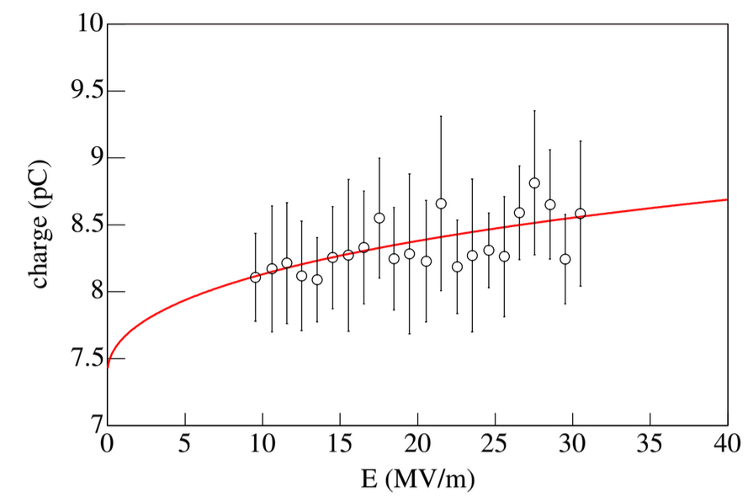
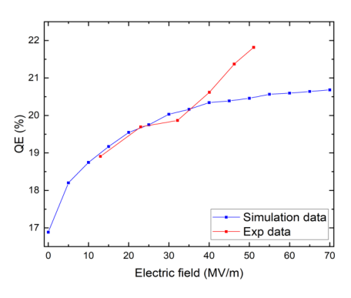
Understanding semiconductor photocathode in gun operating conditions
High-field operation is of advantage for increasing beam brightness but also has inherent complexity
  Suitable photocathode materials (e.g., Cs₂Te)
  Mitigation design and optimization
Adequate models and knowledge of material properties to help guide the photocathode and gun design
  No suitable existing models for high-field photoemission, some include Schottky and space-charge effects in emission
  Unknown or uncertain material properties (e.g., optical constants for Cs₂Te)
PITZ Cs₂Te gun
J. H. Han, PAC 2005
G. Adhikari, EWPAA 2022

Slide 5
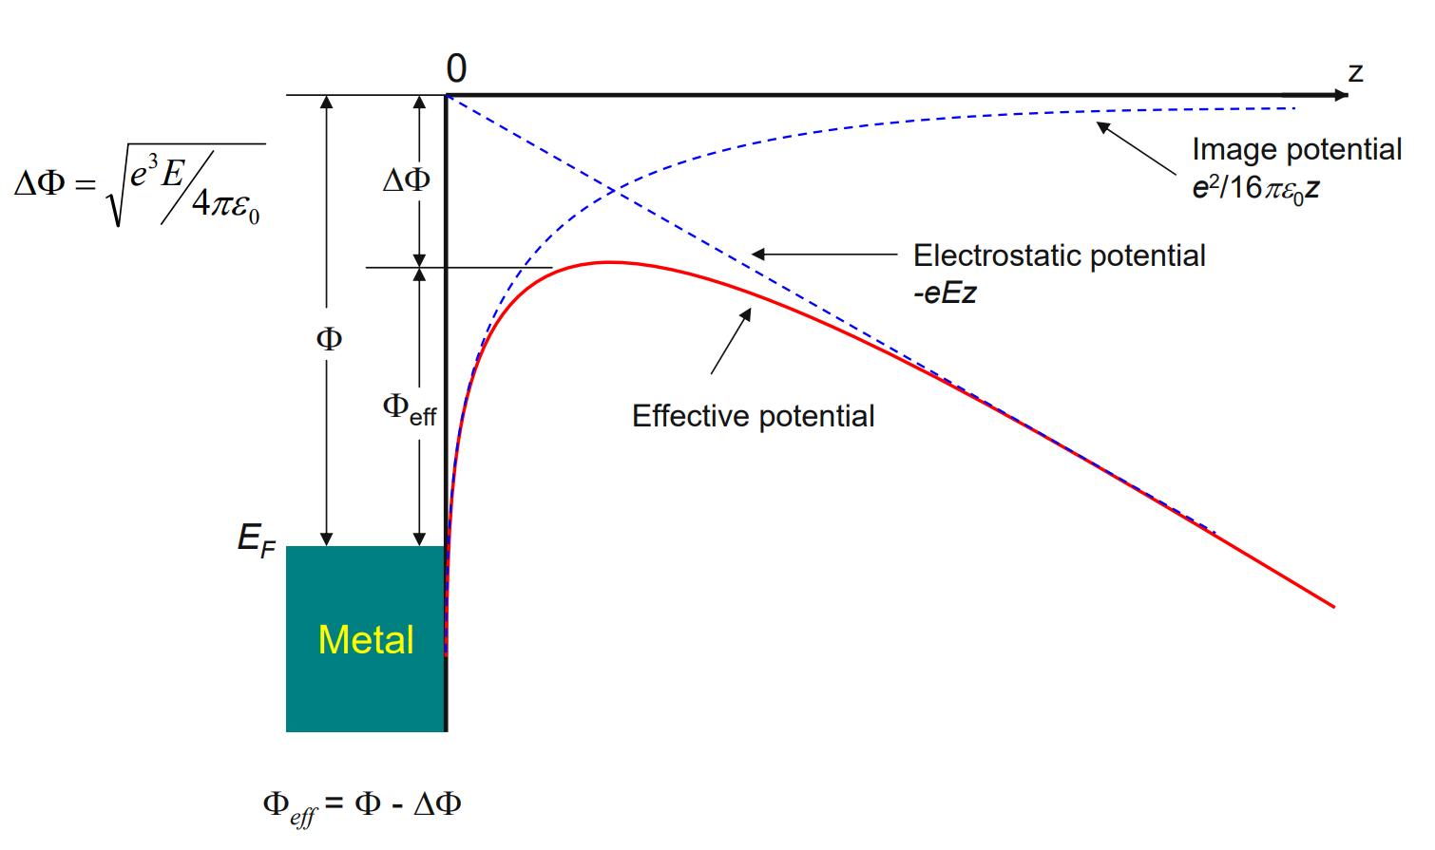


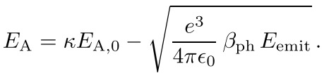
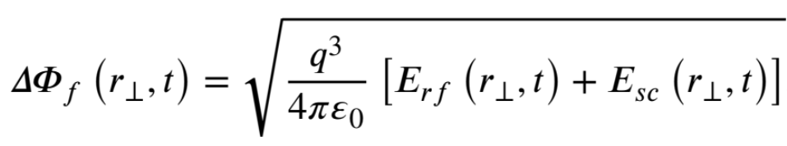
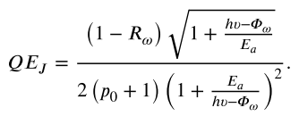
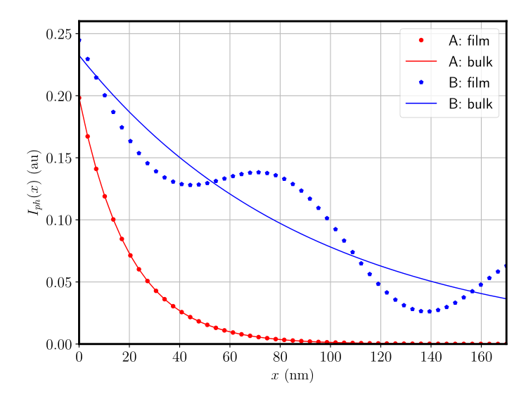
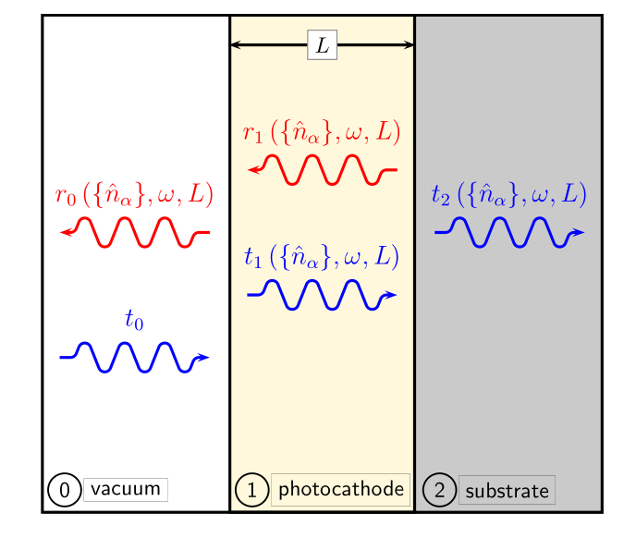
Schottky effect
Emission models
Fowler–Dubridge
Additional field effects: Field enhancement;
Space charge; Band bending
Spicer
Optical interference effect
Jensen
Cs₃Sb on Cu,
λ = 532 nm
(B) CsK₂Sb on Ag,
λ = 650 nm

Slide 6
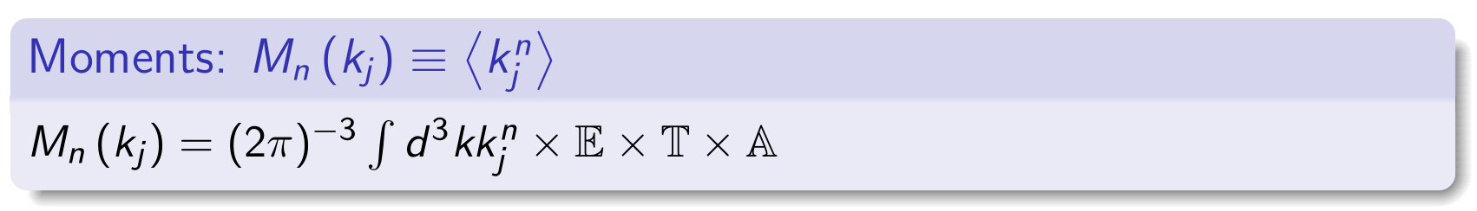
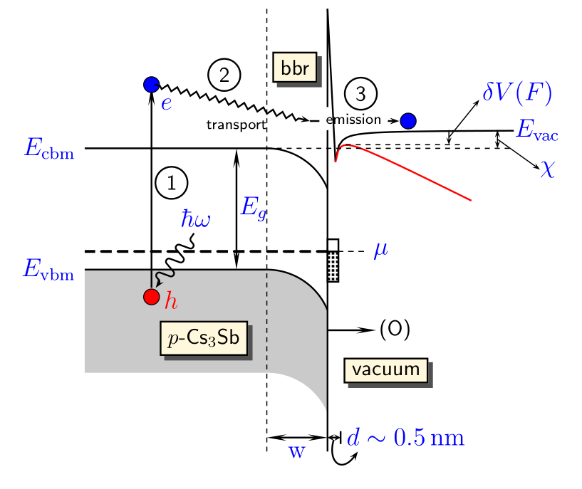
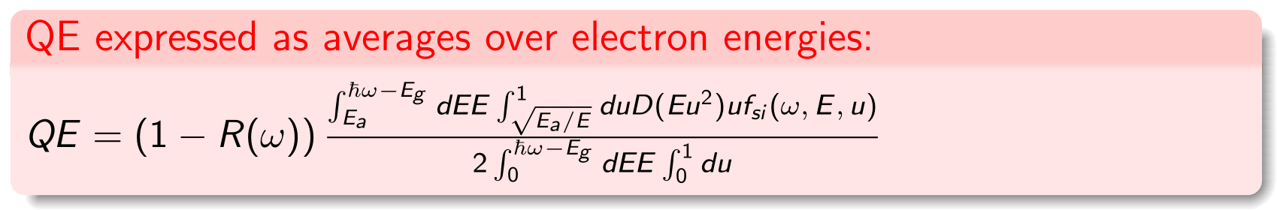
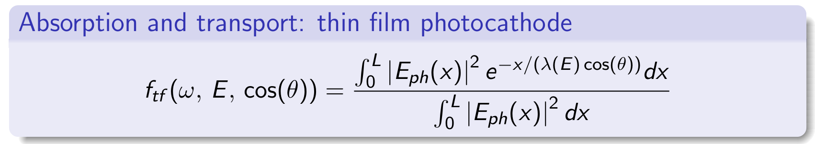
Moment model and Monte-Carlo modeling
Moment model for photoemission
Monte-Carlo approach is suitable for detailed transport process modeling
absorption (A), transport (T), emission (E)
for a semi-infinite photocathode
Photo excitation
Charge transport
Surface emission

Slide 7
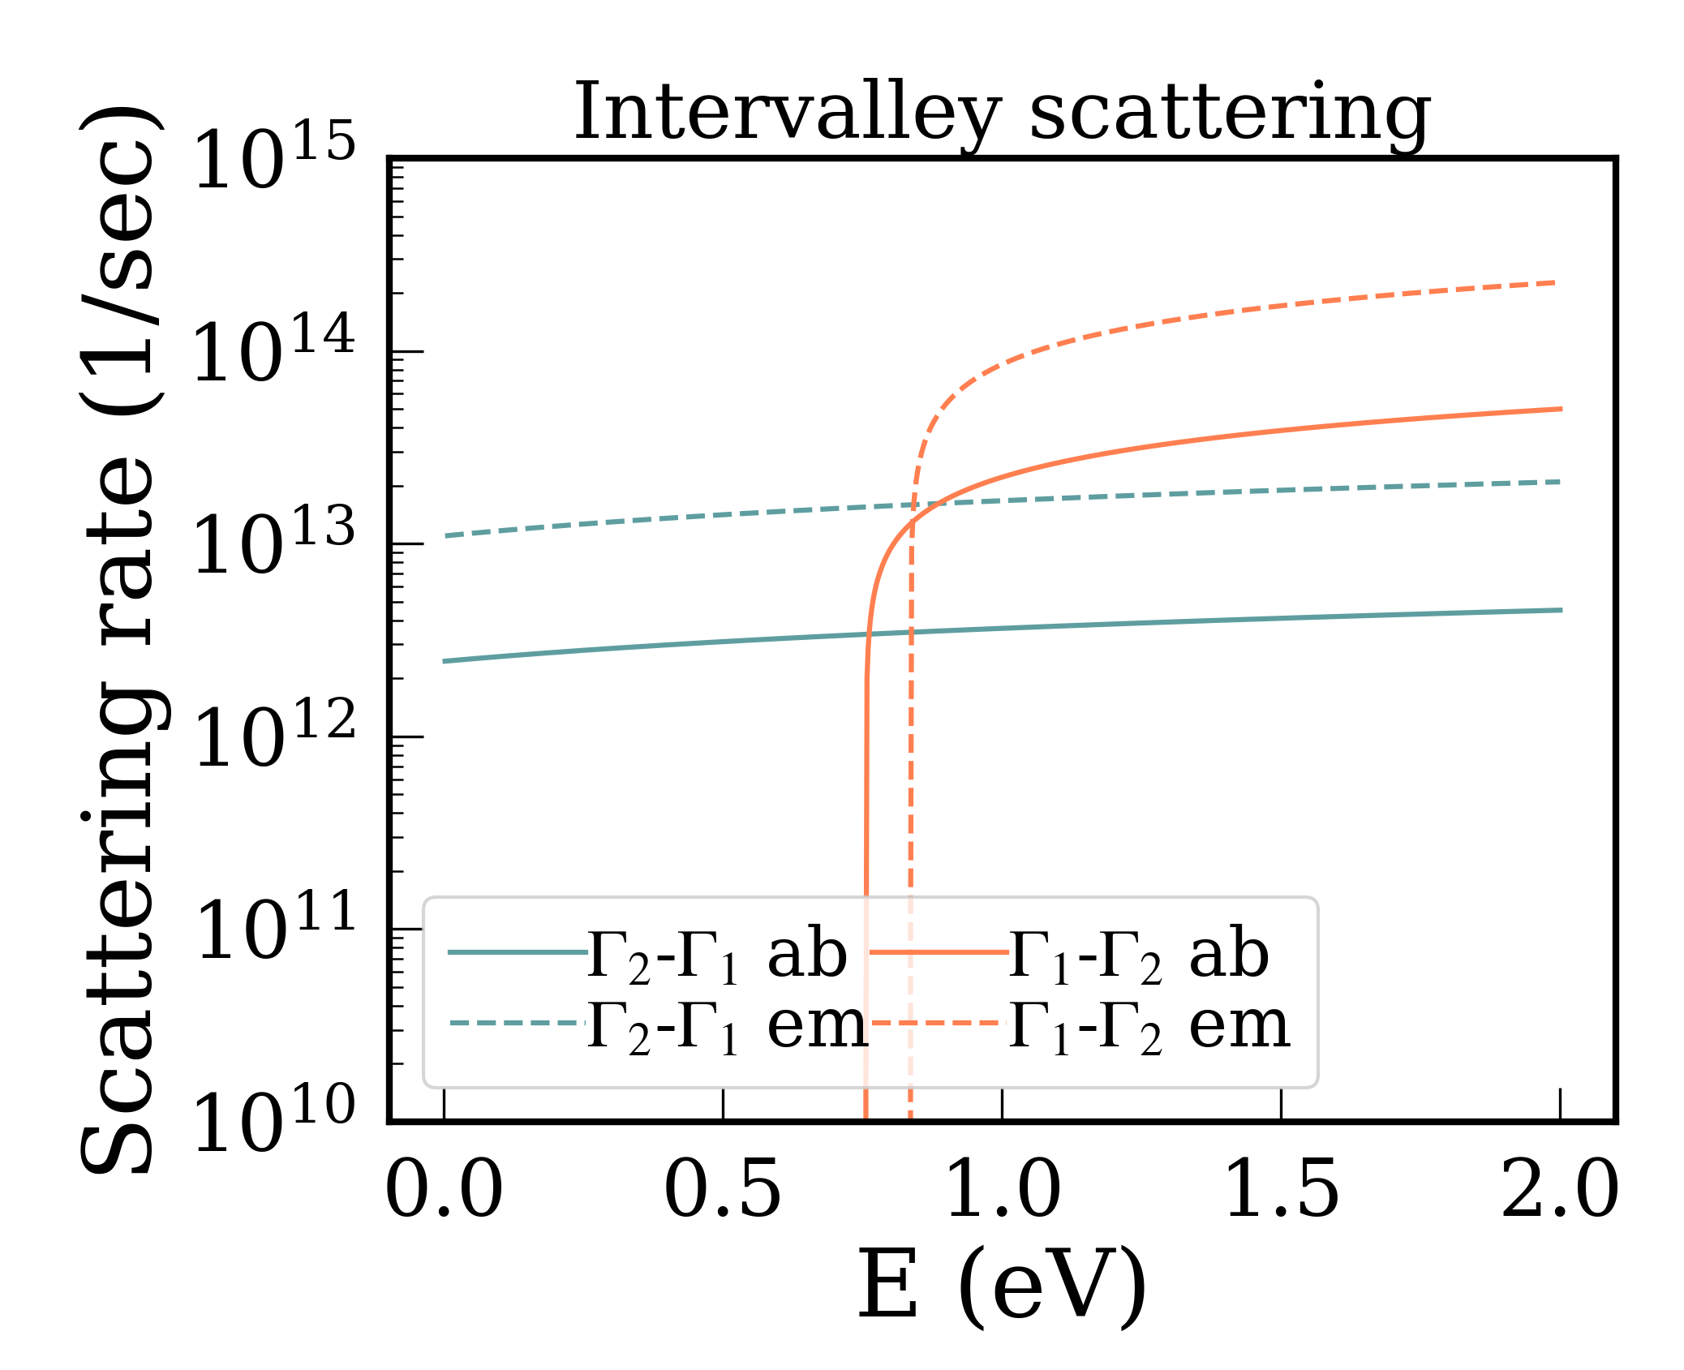
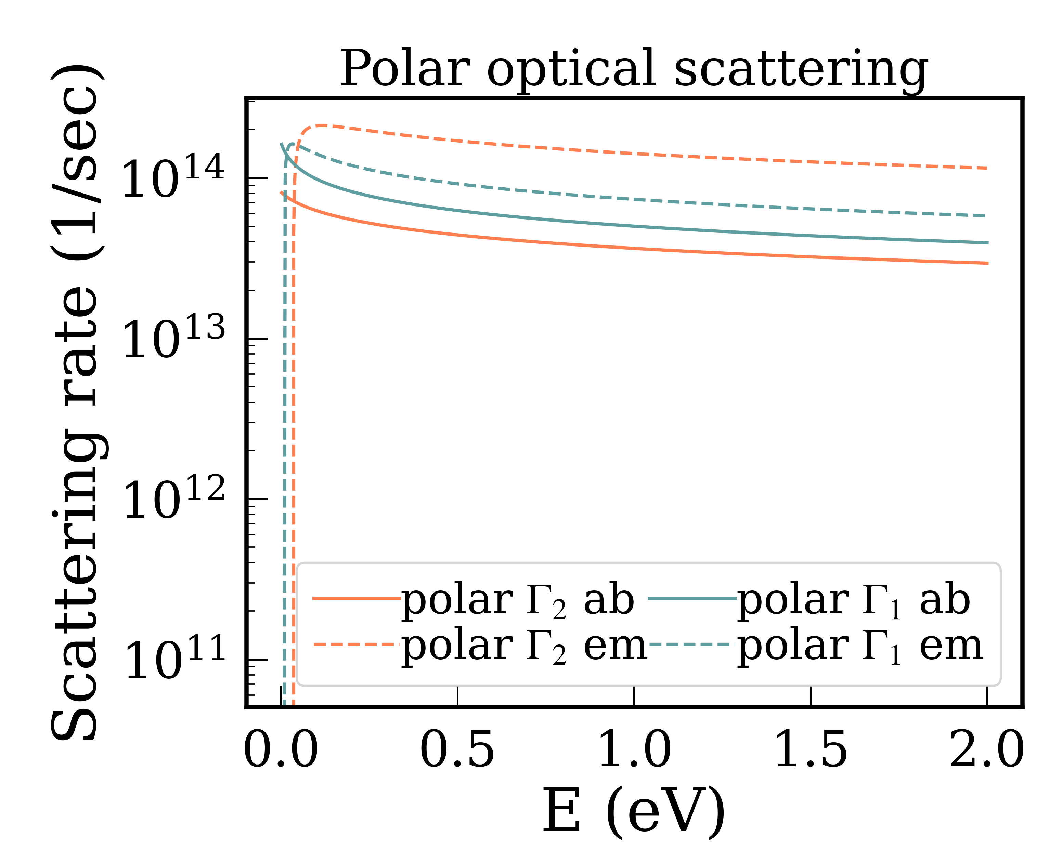
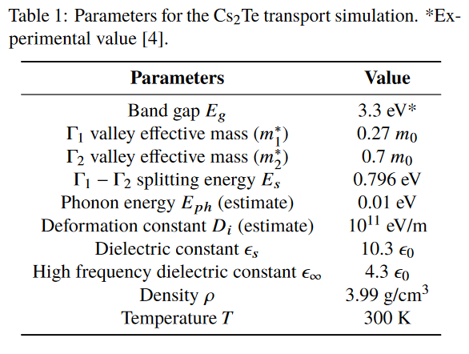
Informing emission model with parametrized MC transport
We utilize a Monte Carlo simulation model and adapt the simulations for Cs₂Te semiconductor cathodes.
Electronic properties from DFT calculation (as well as from literature/experiment)
We will use these MC simulation results to inform the thin-film photoemission model at high field

Slide 8
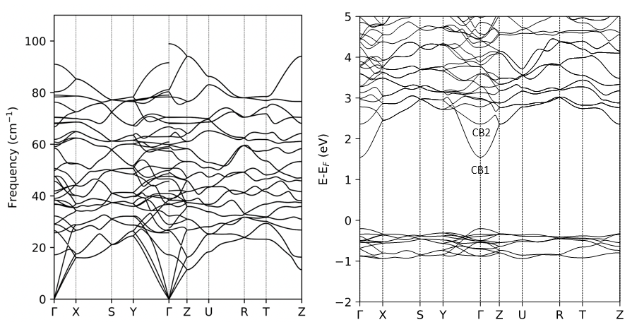
DFT modeling of Cs₂Te
We conducted computation study of the material properties of Cs₂Te needed for high field applications: structure, optical, electronic and phonons
G. Wang et al., “First-principles study of structural, elastic, electronic, transport properties, and dielectric breakdown of Cs2Te photocathode,” Sci. Rep., vol. 15, p. 2780, 2025
Optical properties used in the optical interference model
Phonon dispersion
Band structure

Slide 9
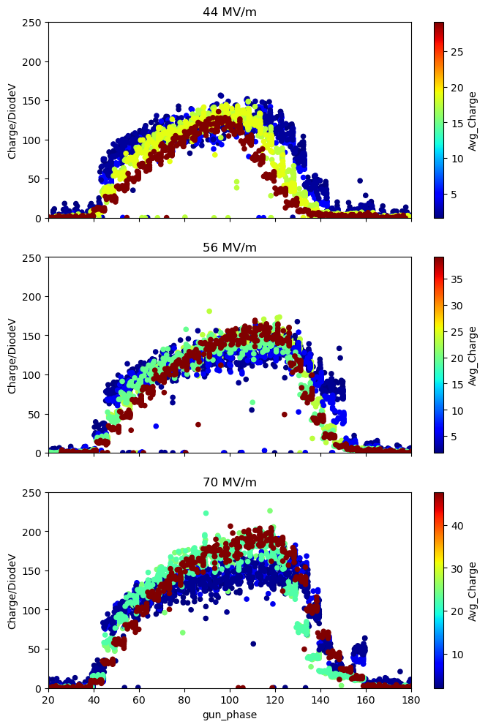
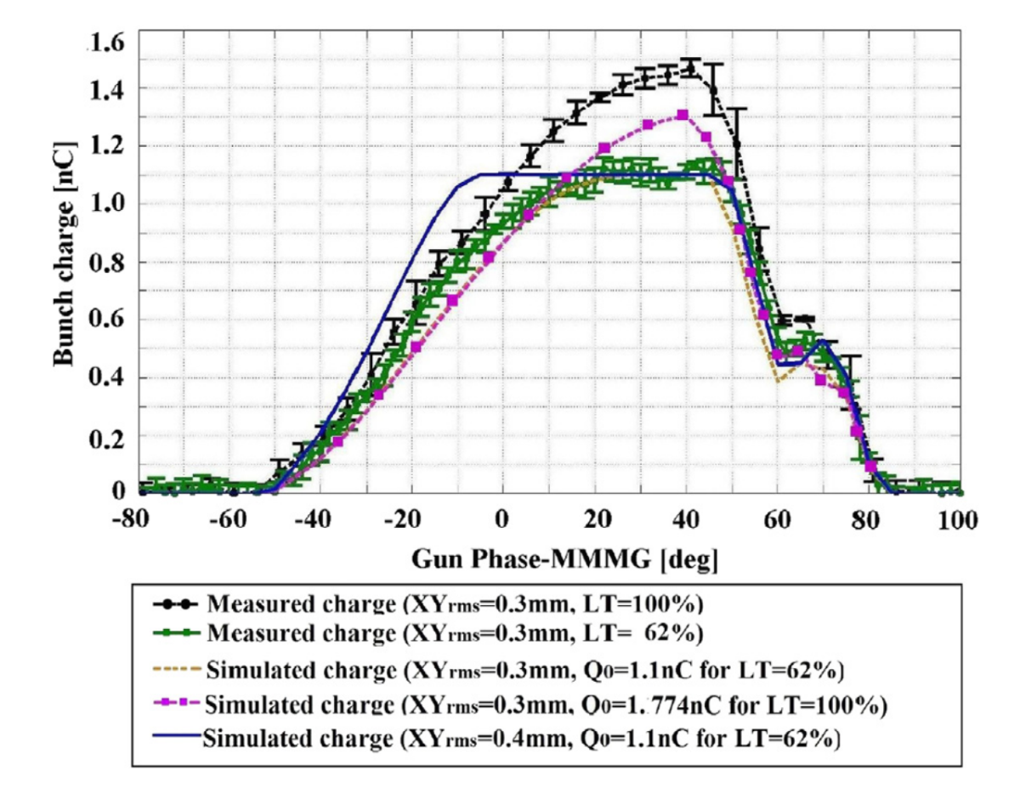
Gun phase scan with semiconductor photocathodes
Space charge limited regime
Space charge during emission
source limited regime
Secondary emission
PITZ gun phase scan
AWA gun phase scan

Slide 10
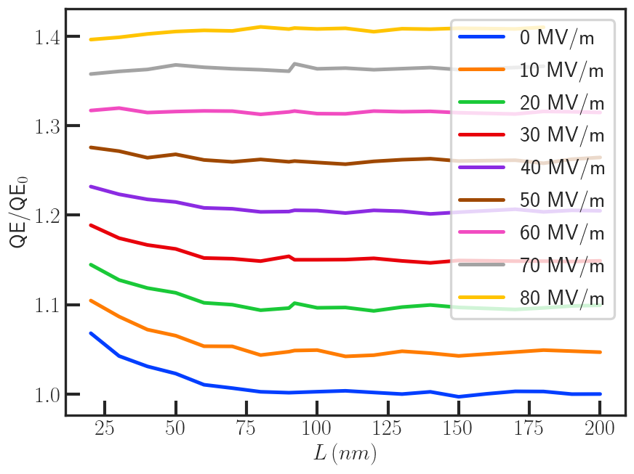
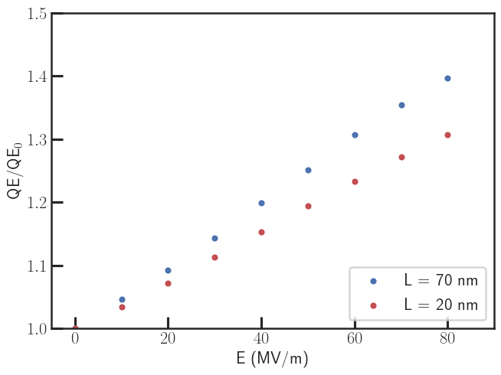
Monte-Carlo calculation at high fields : enhancement from electron transport in Cs2Te*
Preliminary Results : Effects from film thickness and gradients
* tunneling is included in the gun simulation

Slide 11
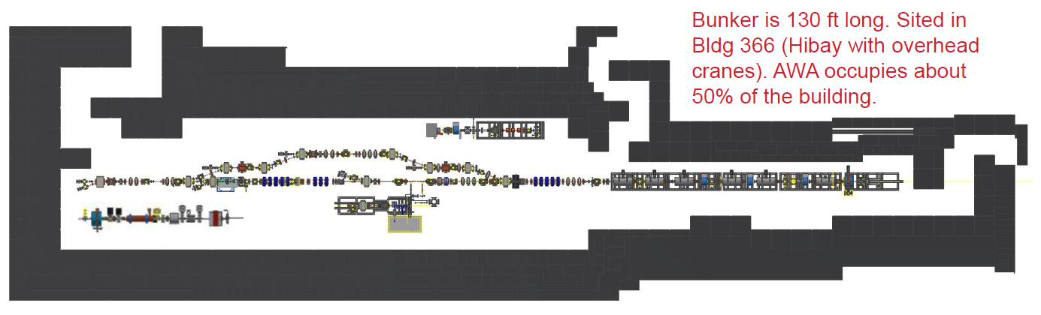
Argonne Wakefield Accelerator (AWA) Facility Overview
3 L-band photoinjector beamlines
  Drive beamline (this work)
  Witness beamline
  Argonne Cathode Test-stand (ACT)
1 X-band short-pulse photoinjector powered by structure wakefield acceleration

Slide 12

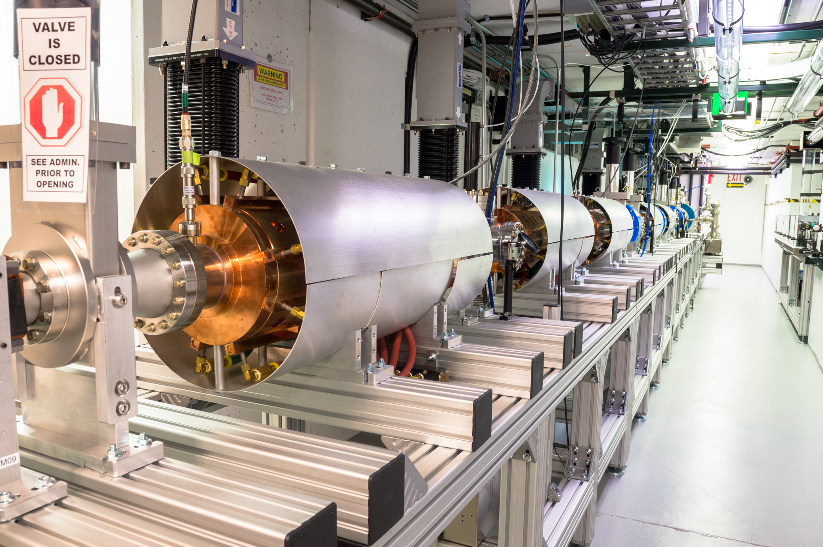

L-band drive photoinjector
1.5-cell, 1.3 GHz photogun with a 31 mm (diameter) Cs₂Te cathode
  Laser wavelength 262 nm, laser pulse duration 1 to 8 ps
  UHV load-lock chamber with a base pressure of 1.5E-10 Torr
High-field operation
  Cathode surface peak field over 80 MV/m, RF pulse length 7.6 $μ$s
Wide charge range
  Single-bunch operation: 100 pC to 100 nC
  Bunch-train operation: up to 32 bunches in a train, up to 600 nC total charge
  High-charge capability is the key driver behind recent breakthroughs in high-gradient, short-pulse acceleration using (beam-driven) structure wakefield acceleration

Slide 13
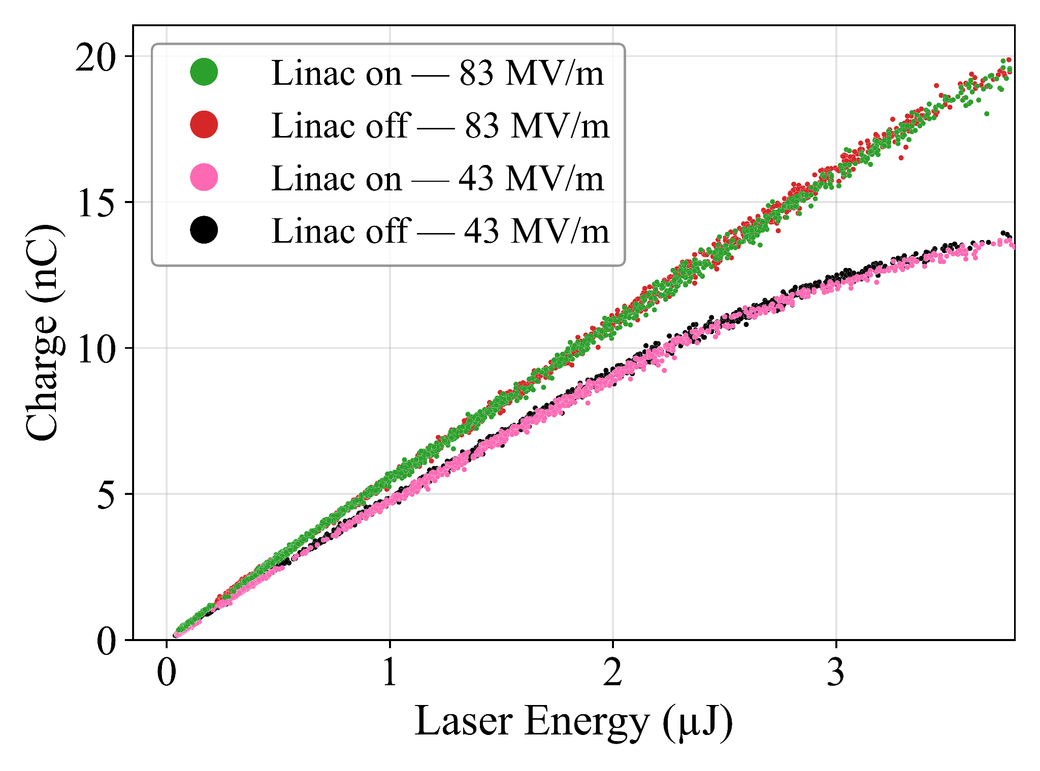
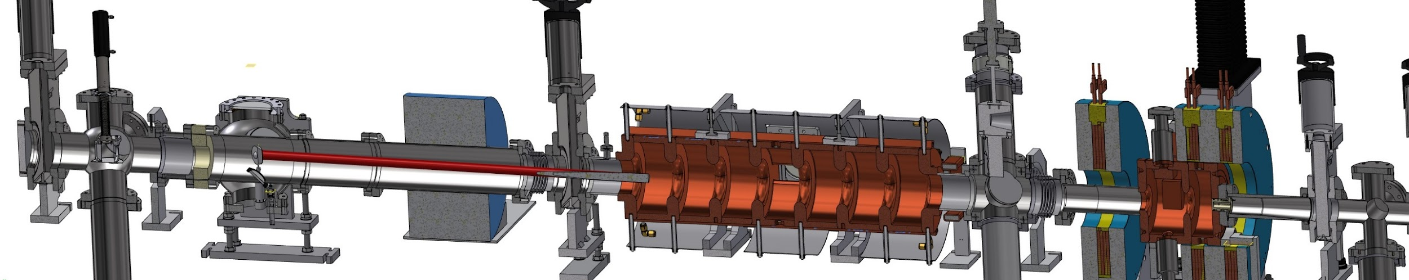
QE measurement setup
Challenge #1: closest charge monitor is not immediate after the photogun exit
  Conducted two sets of meas. w/ linac on and off
  Same charge measured with the linac on and off at all the gradients studied
    Complemented with beam dynamics sims
Challenge #2: large laser energy jitter
  Photodiode measurement using leakage light
Charge monitor
Photogun
Linac

Slide 14
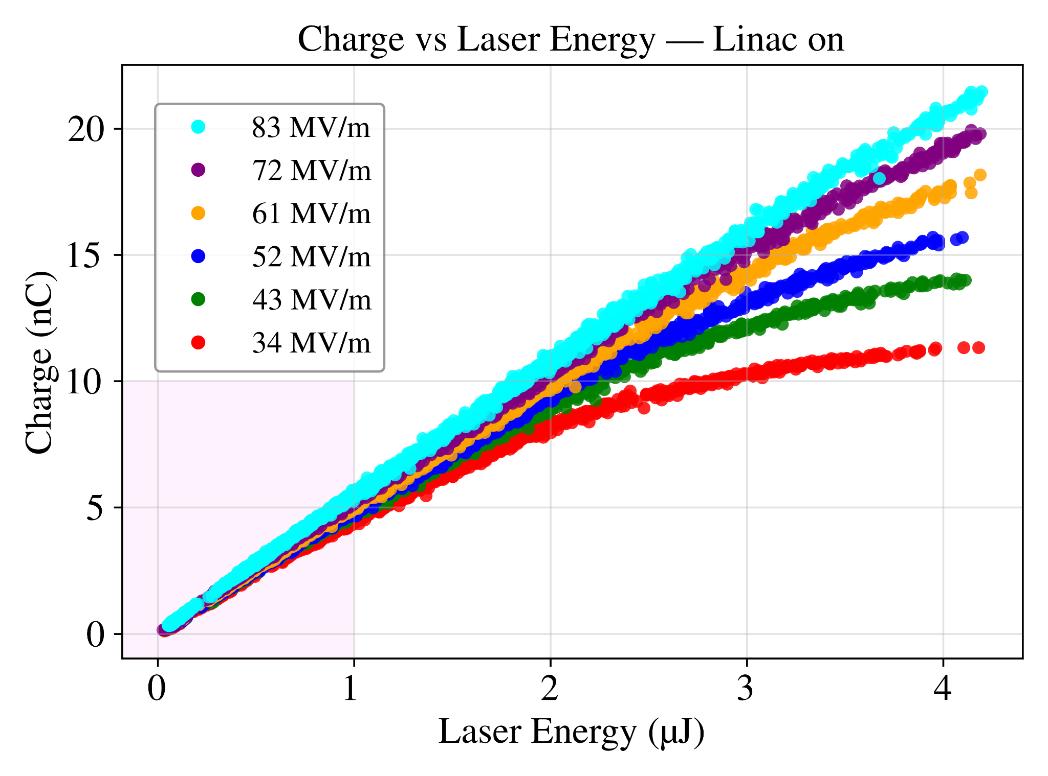
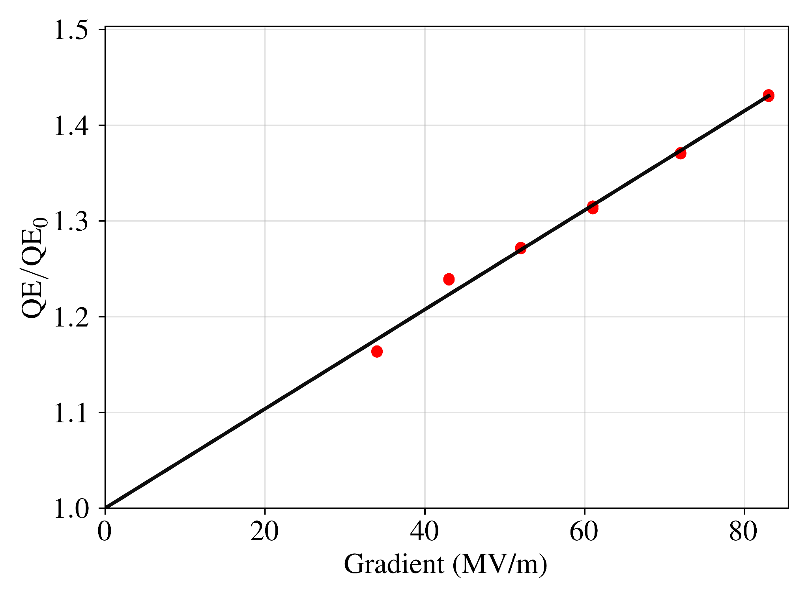
Exp. results: QE vs. gradient
By Gaurab Rijal and AWA
Gradient and charge scan at the nominal injector operating condition
  RF gun = 50 deg, linac = 90 deg, laser spot size 5 mm (radius)
Charge vs. laser energy nonlinearity at low gradient & high energy due to space charge effects
QE increases with gradient (calculated using data in the low-charge shaded region)

Slide 15
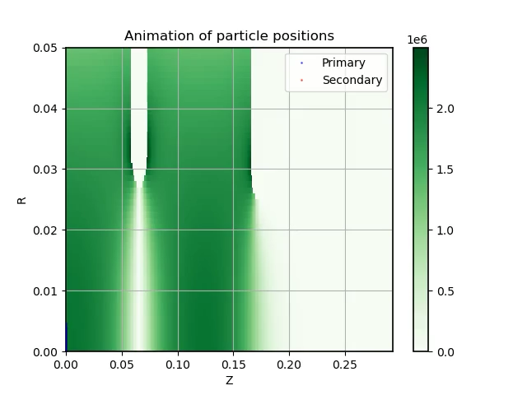
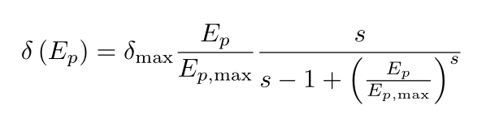
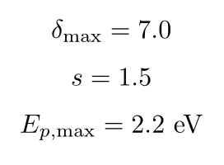
By Omkar Ramachandran
Beam-dynamics simulations w/ MC emission model
Code development
To simulate transport through the gun and linac, we developed a tracking code with the following features:
Initializes distributions using the Monte-Carlo photoemission model (incl. Schottky effect).
Beamline elements are modeled with 3D field-maps.
3D space charge is modeled using with a rest-frame Poisson solve at each timestep.
Secondary electron emissions are modeled on the photocathode surface.

Slide 16
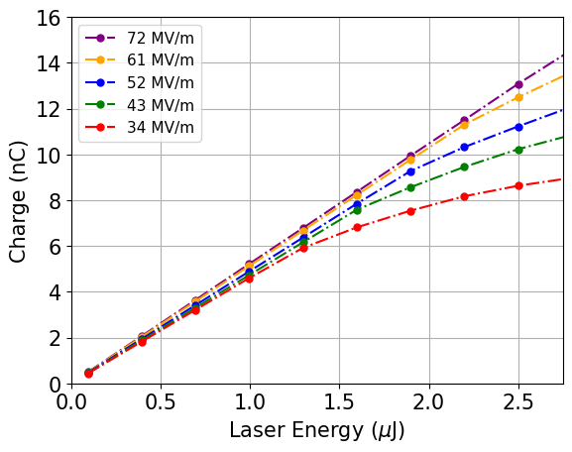
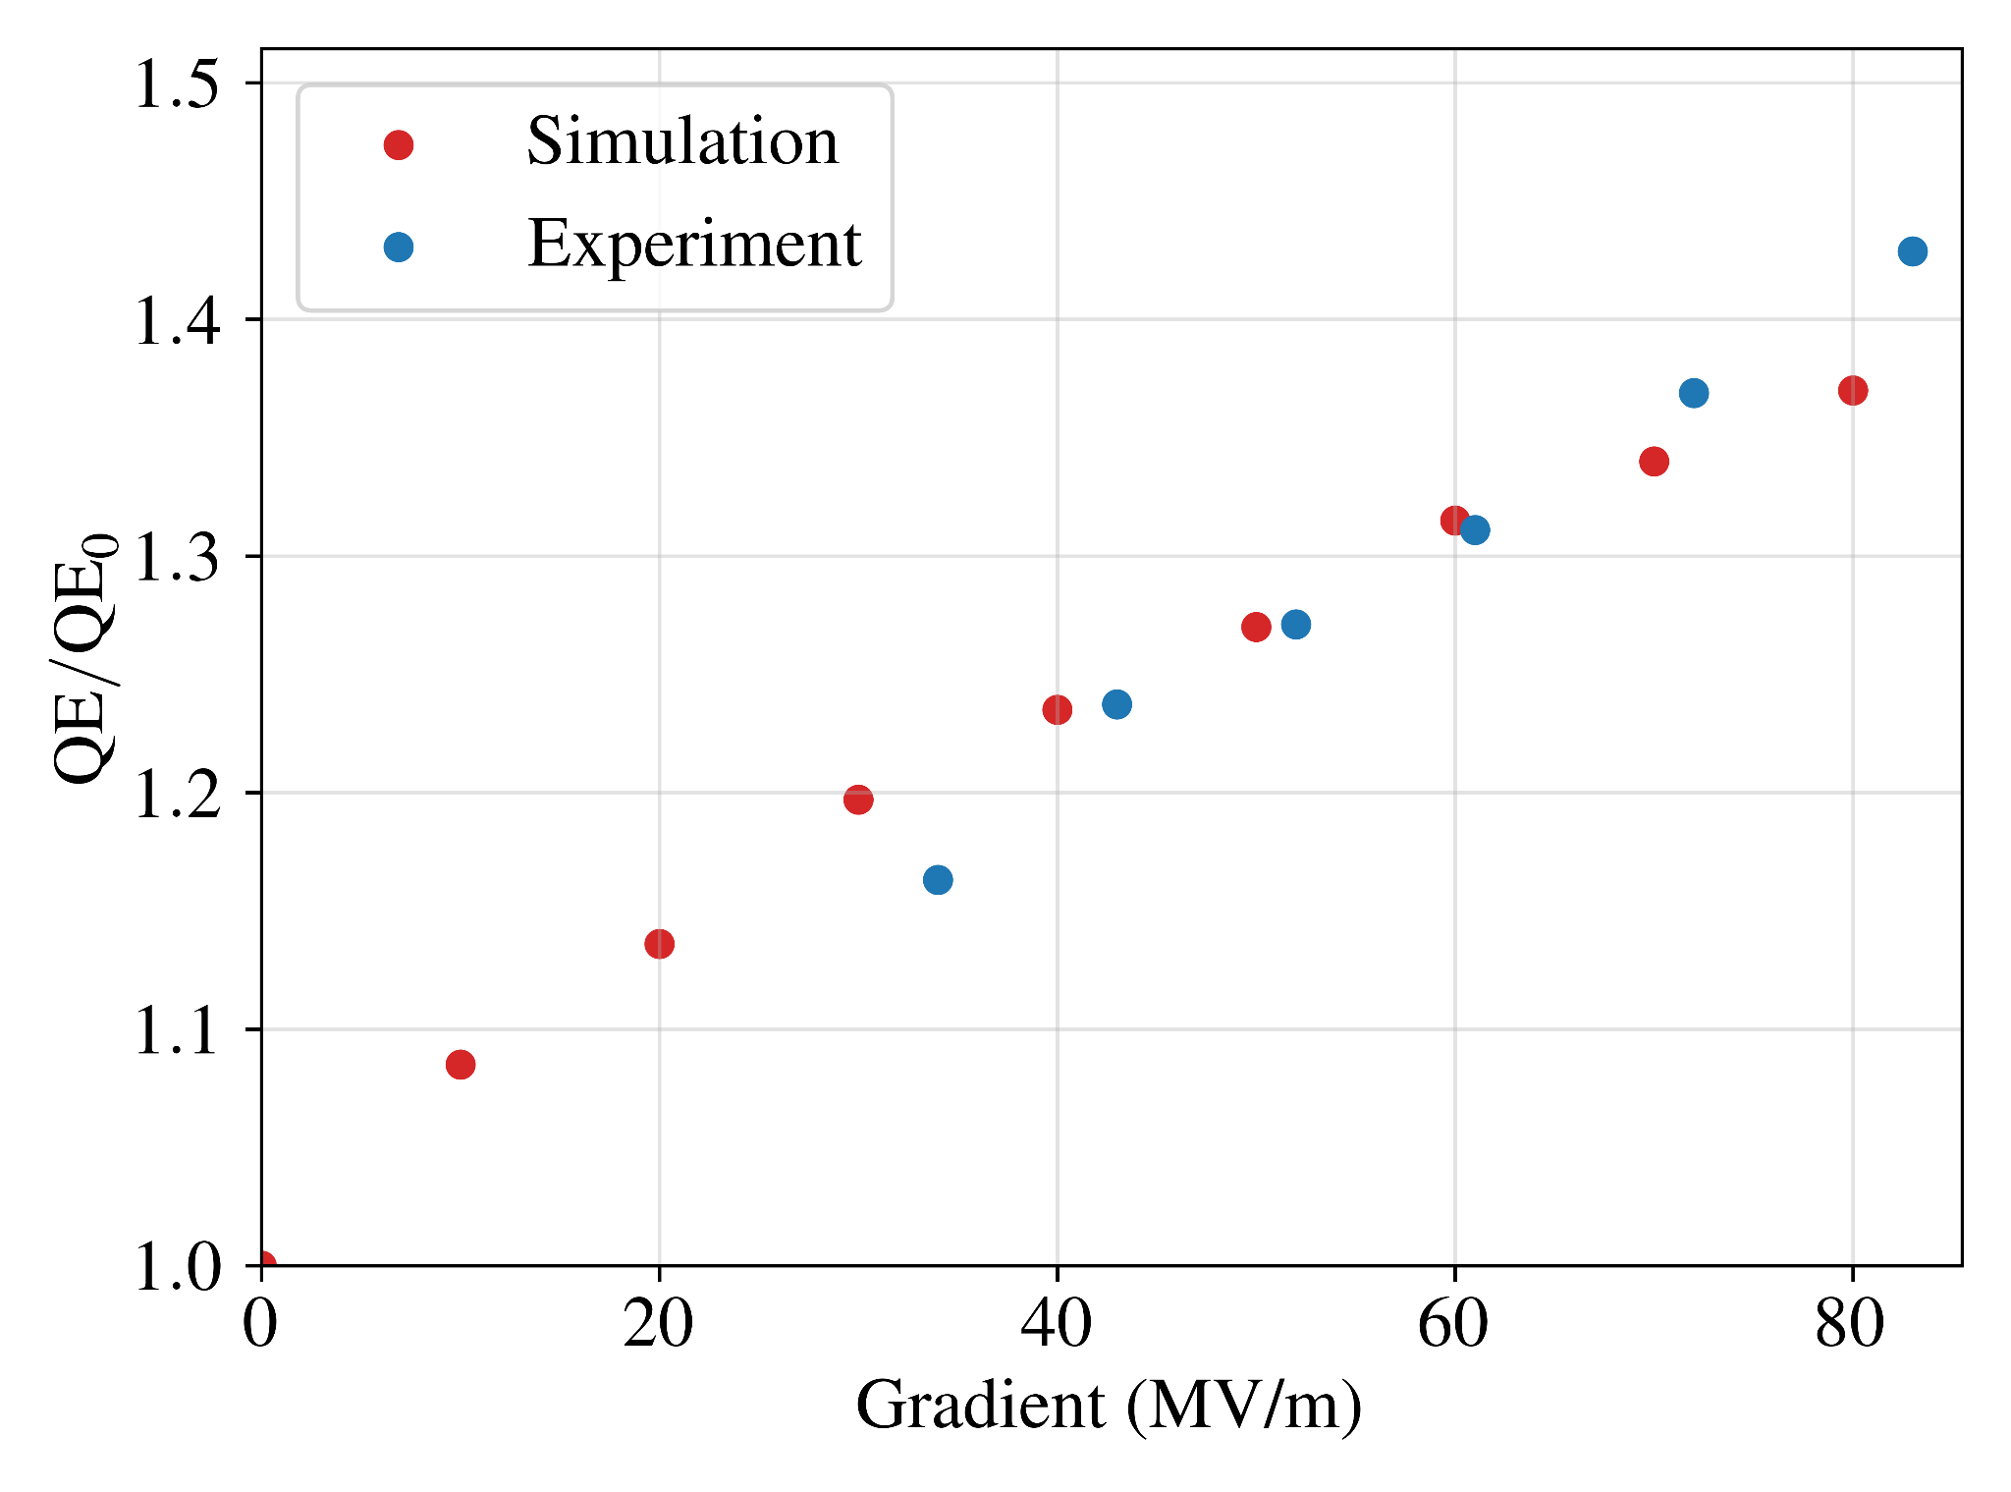
Beam-dynamics simulations w/ MC emission model
Preliminary Results
Measurement from previous slide
Simulations
At low gradient & high charge, space charge effect leads to beam loss at the charge monitor location.
Beam dynamics simulations performed with distributions obtained from the MC Model predict ~40% increase from 0 to 80 MV/m.
These results are largely in line with experimental data.

Slide 17
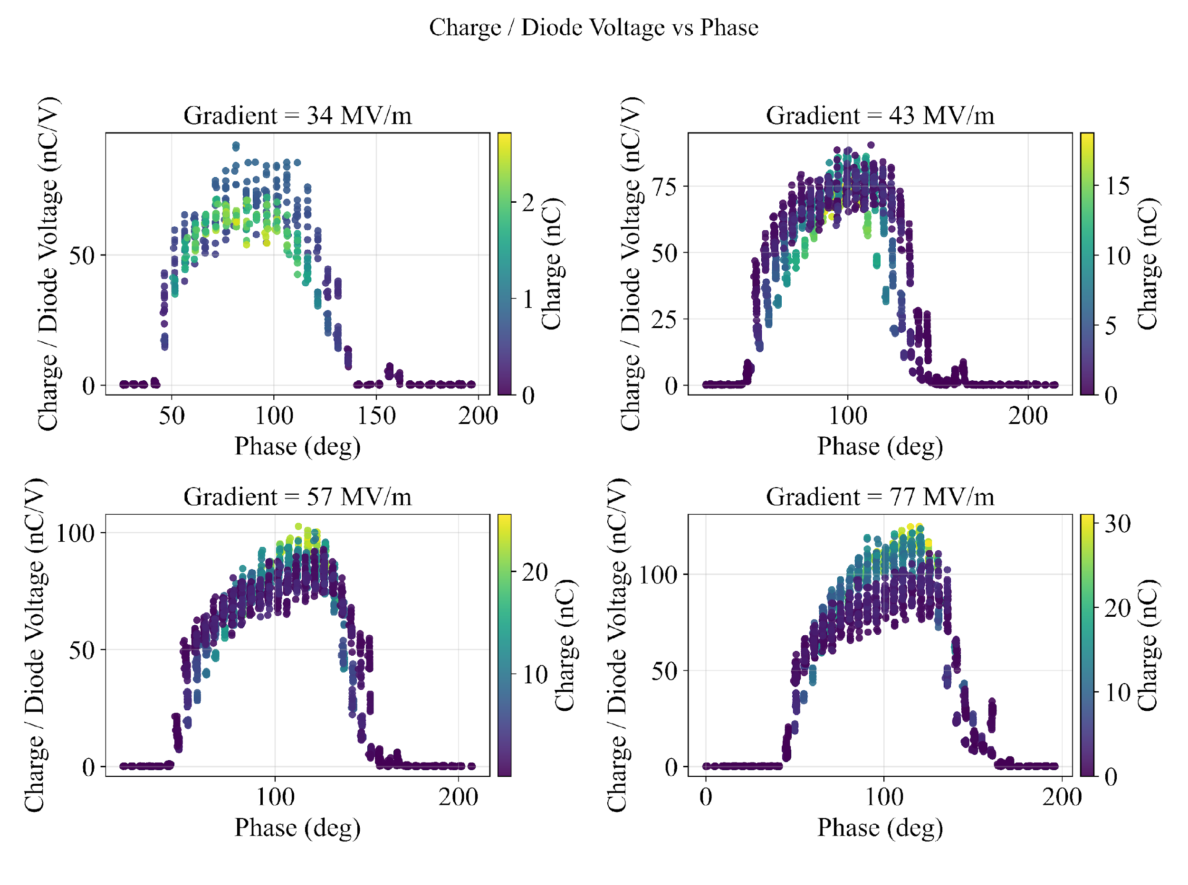
RF phase scan at various gradient & charge
The phase scans from experiment all demonstrate the increase in charge due to QE from 0-100 deg.
All 4 gradients have secondary bumps after around 120 degrees.

Slide 18
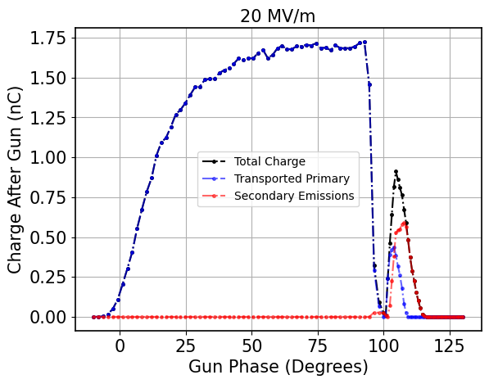
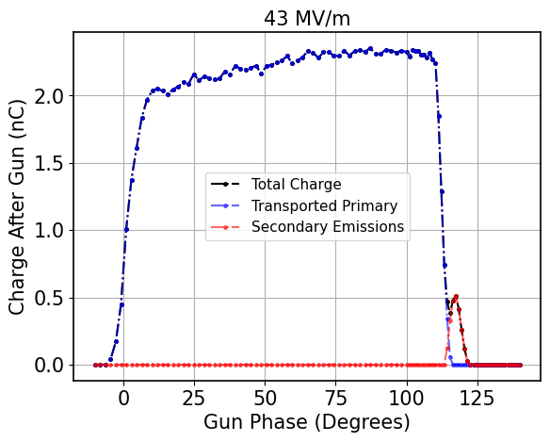
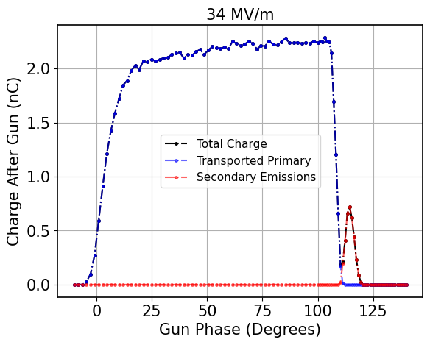
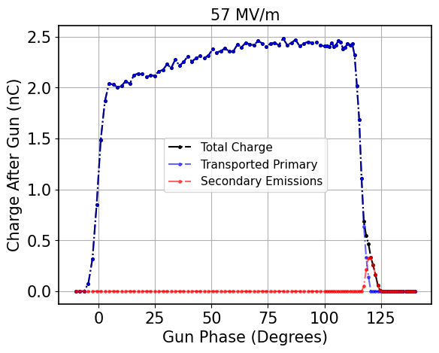
RF phase scan at various gradient & charge
Preliminary Results
At the exit of the gun,
The gradual increase in charge from 0-100 degrees is explained by increases in QE due to gradient.
The bump at ~120 deg can be explained by a combination of transport and secondary emission at low gradients, and pure secondary emission at high gradients.
Notes:
OHR: These simulation results are all immediately after the gun with no solenoids. This slide is mainly to show of the secondary emission contribution.

Slide 19

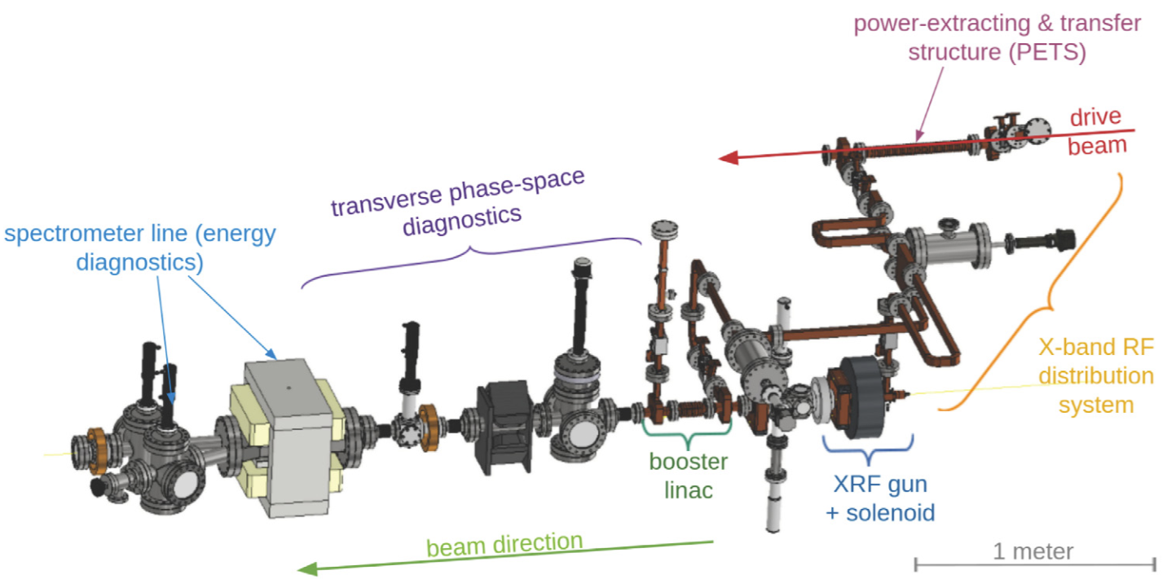
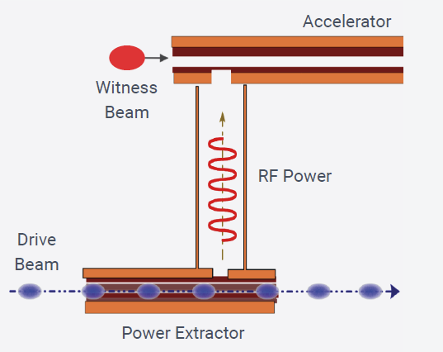
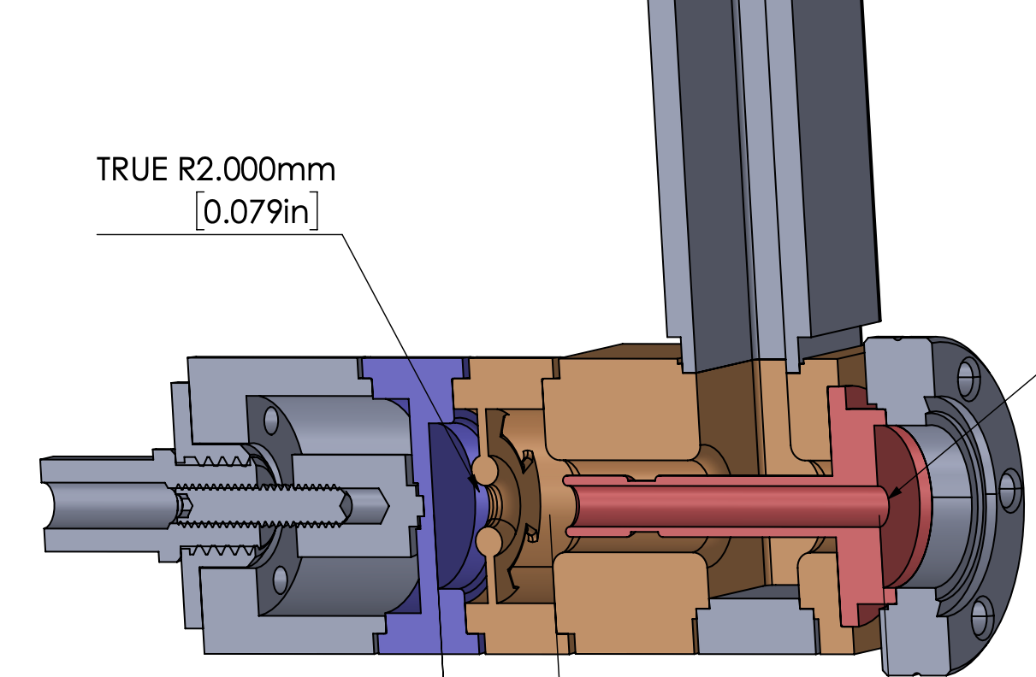
X-band short-pulse photogun
Close to 400 MV/m measured on an X-band photocathode surface in a photogun driven by 6 ns RF pulses, two-beam acceleration
  Rapid RF conditioning, low dark current, reliable operation
  A reduction of emittance expected; detailed beam characterization in progress
A new photogun with removable cathode plug expected in the near future
  High-gradient cathode testing could inform other gun designs
power extractor
RF
(6 ns)
beam

Slide 20
Conclusion
Phase-scan and Cs₂Te cathode QE measurements of the AWA L-band high-field photogun are performed to characterize semiconductor-cathode behavior under various operating conditions.
Monte Carlo and beam-dynamics simulations are compared with experimental measurements and show reasonable agreement.
The Monte Carlo emission model can be used to study intrinsic emittance and beam brightness.
As future high-brightness photoguns move toward even higher gradients, this approach can support their design and optimization.

