Slide 1
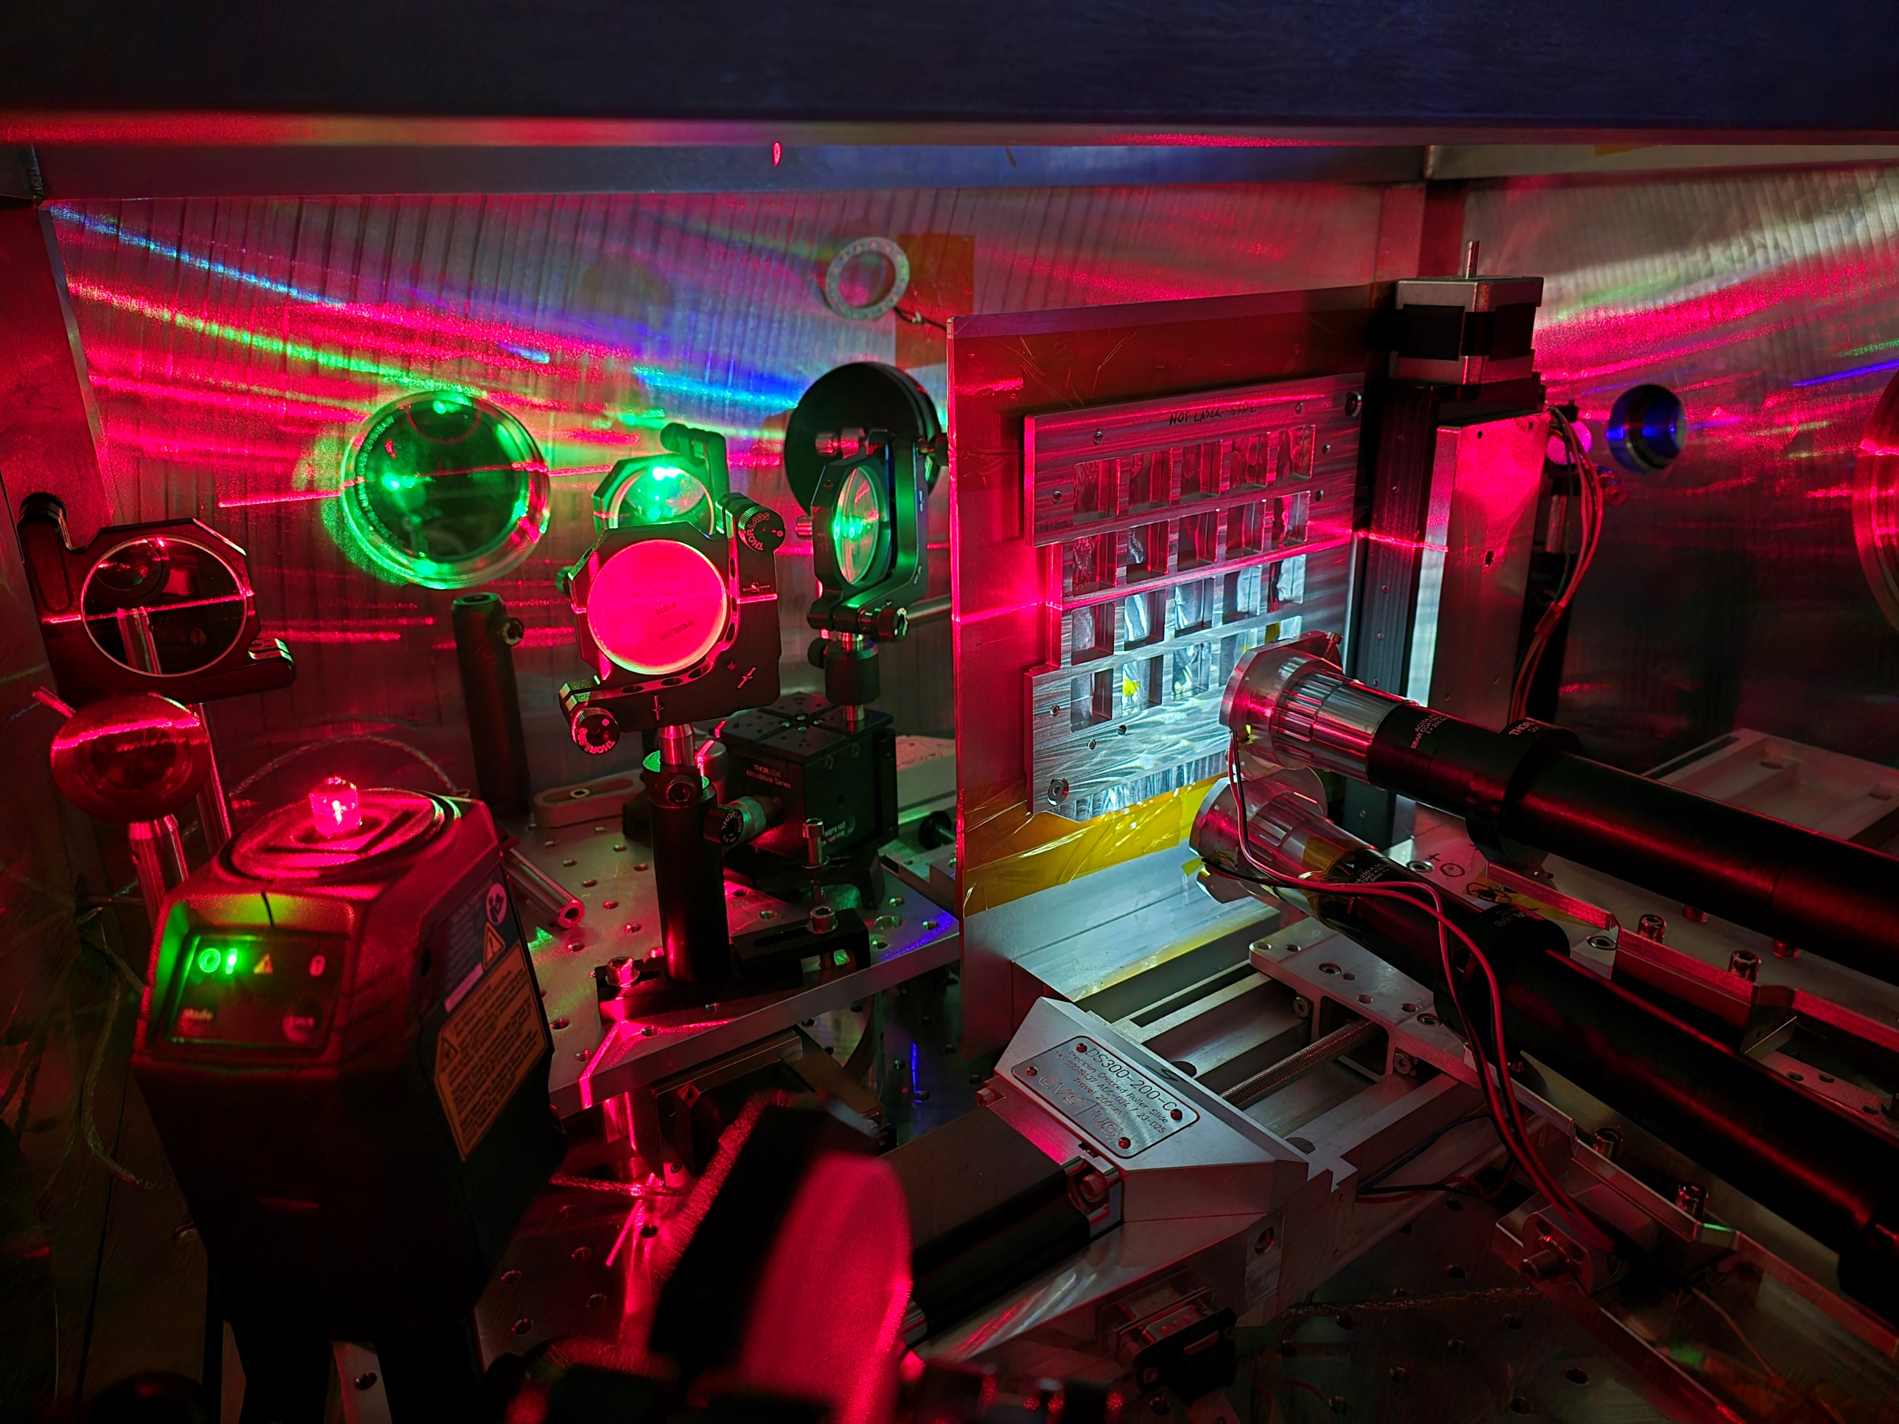

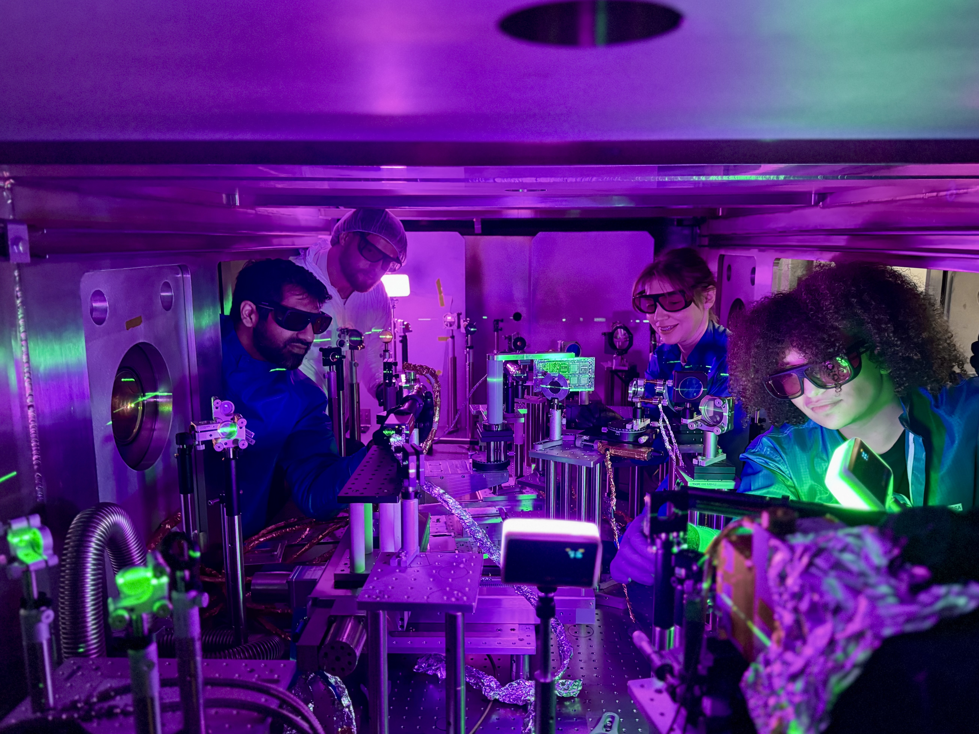
Advanced Accelerator Workshop 2026
July 31 - August 1 , 2026 | Los Angeles, USA
Recent progress on proton focusing using hemi-spherical targets at high repetition rate for proton fast ignition
Sophia Malko | Princeton Plasma Physics Laboratory

Slide 2
Advanced IFE concepts are being explored: Fast Ignition
Central hot spot ignition
Fast ignition
Dense fuel
Dense fuel
Hot
spot
Hot
spot
External heating source
M. Tabak et al., Phys. Plasmas 1, 1626 (1994)

Slide 3
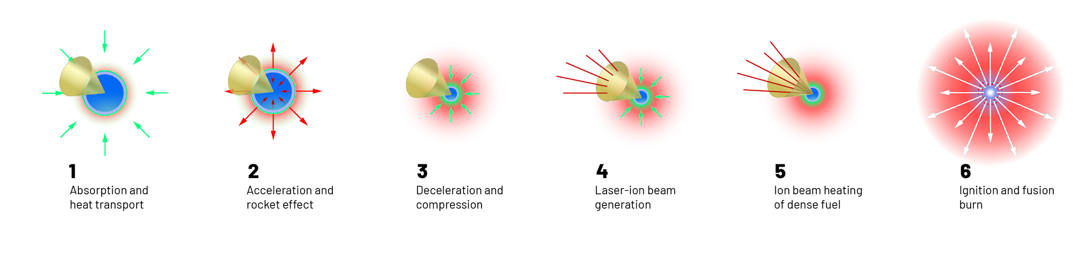
Proton fast ignition uses a short pulse laser generated proton beam to heat a hotspot to ignition temperatures
Compression
Heating
Ignition
Cone provides access to the dense core
No longer need high fuel velocity to heat hotspot – heating is done by a separate laser source
Challenge is to produce, focus, deposit enough protons to create hotspot

Slide 4
Proton fast ignition approach to inertial confinement fusion
M. Roth, T. E. Cowan, M. H. Key, et al. , Phys. Rev. Lett. 86, 436 (2001).
Notes:
Another scheme is proton fast ignition. Here the DT fuel is compressed to a cold, dense state. And an intense laser-generated proton beam is focused into the fuel in order to heat it to ignition temperatures. This mechanism depends critically on the stopping power of the protons
in the dense fuel, which is passing through a wide range of plasma conditions as it is heated from 100’s of eV to multi-keV temperatures.

Slide 5
Proton fast ignition approach to inertial confinement fusion
Proton beam with ∼20 kJ of total energy and a mean particle energy of 4-8 MeV, focused to a radius of 15-20 μm and generated no more than 1 mm from the assembled fuel
M. Roth, T. E. Cowan, M. H. Key, et al. , Phys. Rev. Lett. 86, 436 (2001).
Notes:
Another scheme is proton fast ignition. Here the DT fuel is compressed to a cold, dense state. And an intense laser-generated proton beam is focused into the fuel in order to heat it to ignition temperatures. This mechanism depends critically on the stopping power of the protons
in the dense fuel, which is passing through a wide range of plasma conditions as it is heated from 100’s of eV to multi-keV temperatures.

Slide 6
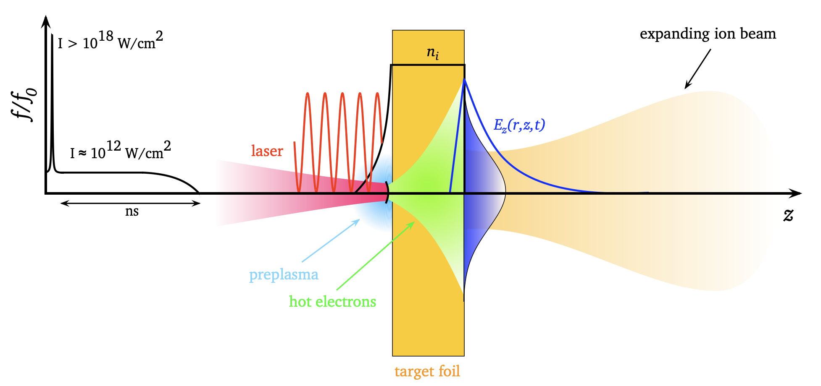
Protons are accelerated via TNSA mechanism
Target normal sheath acceleration (TNSA) is a well-established mechanism for accelerating protons to MeV energies with low beam emittance and relatively high conversion efficiency.
Source: M. Schollmeier Thesis

Slide 7
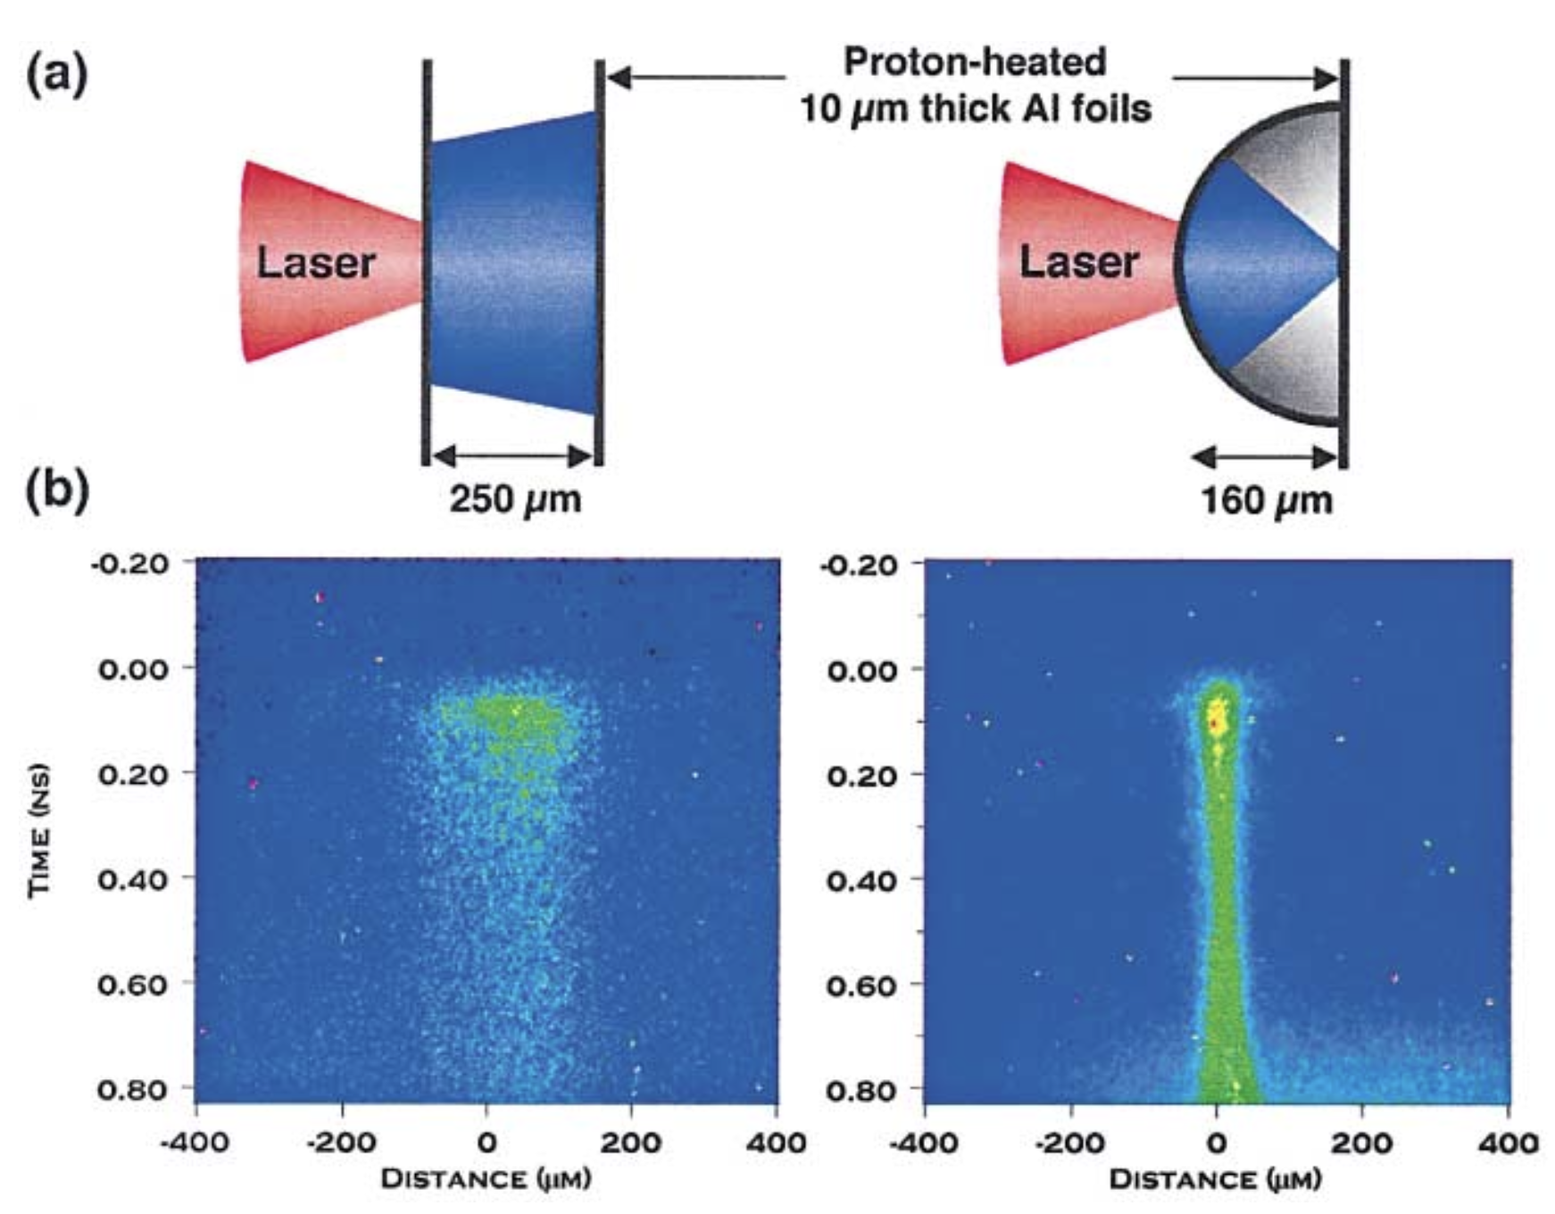
Accelerated Protons can be focused via hemispherical targets
P.K. Patel et al., Phys. Rev. Lett. 91, 125004 (2003)
P. K. Patel, Phys. Rev. Lett. 91, 125004 (2003).

Slide 8
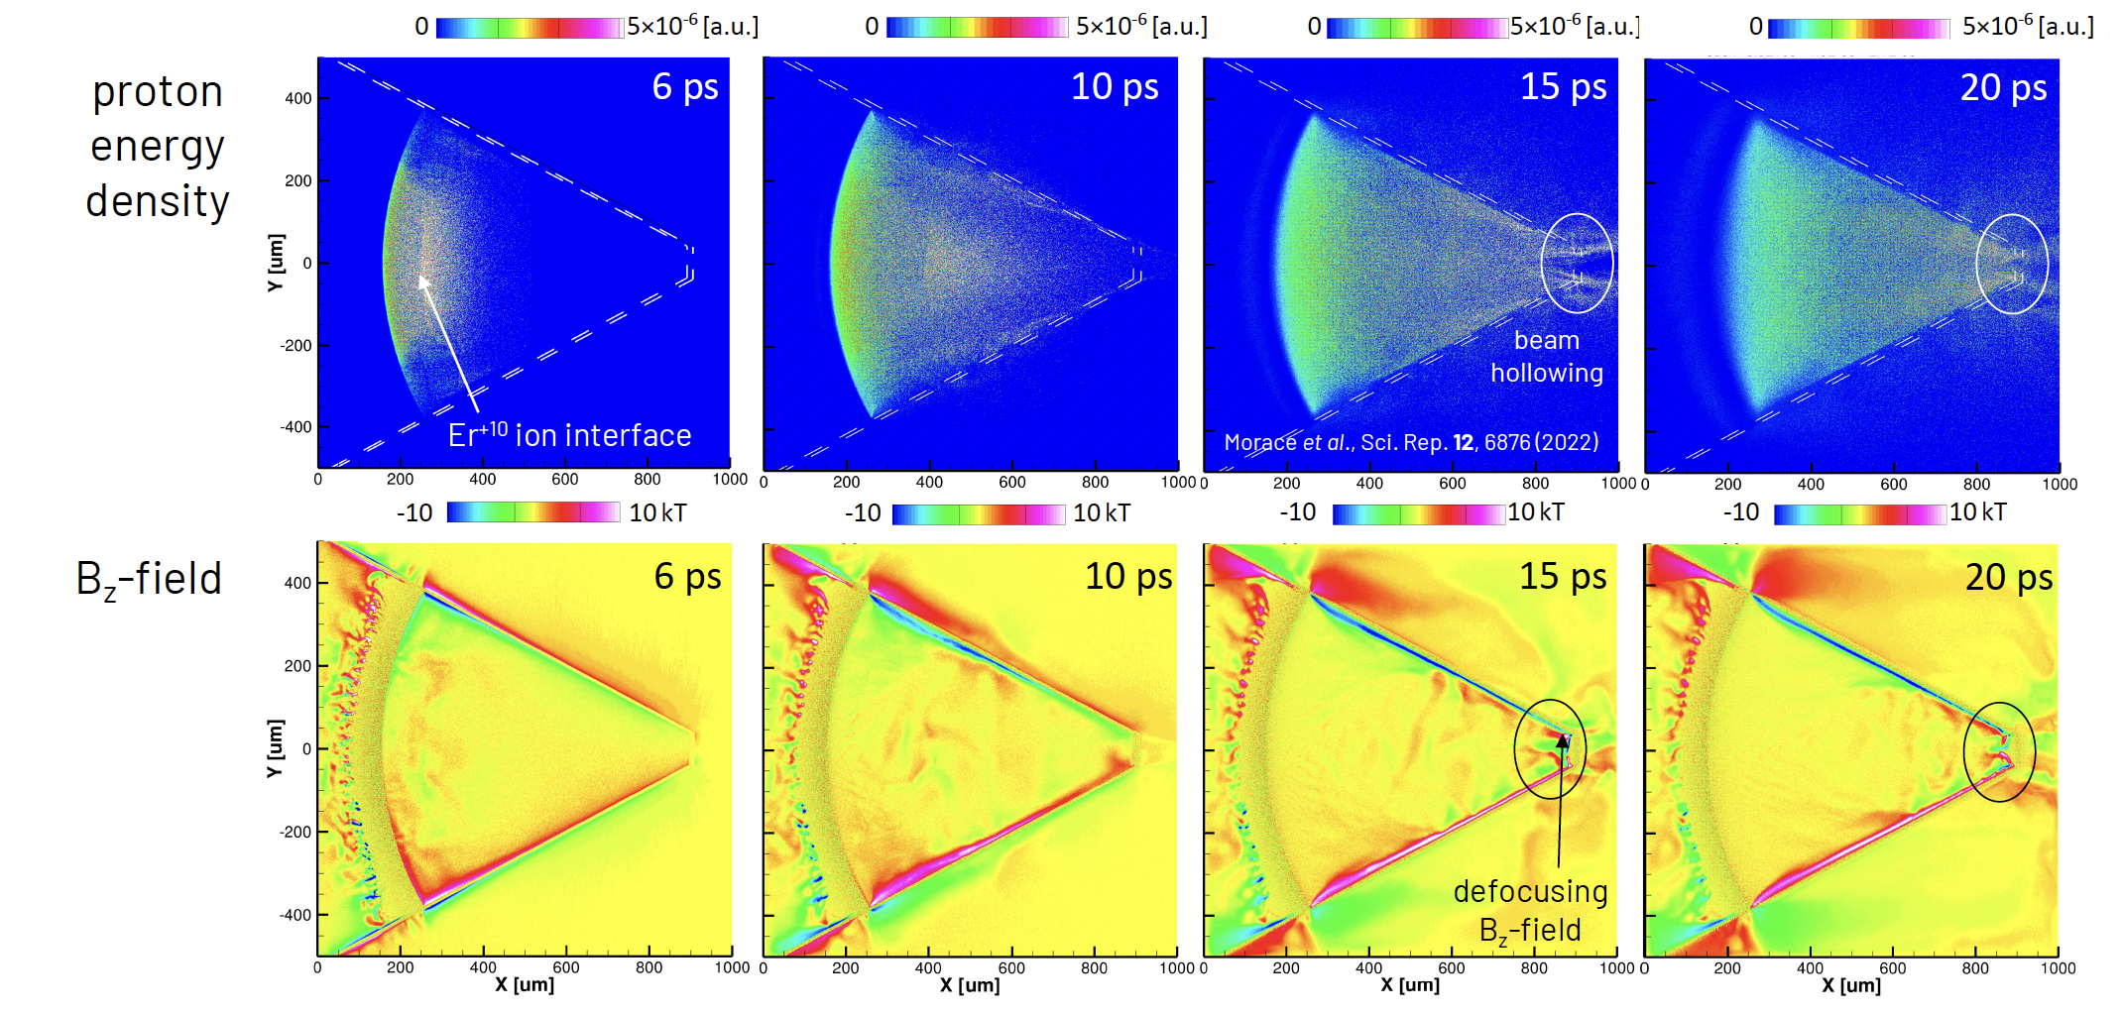
“Hemi” must be protected by the cone
The cone changes the beam focusing dynamics:
Magnetic field compressed at the cone tip defocuses the proton beam
2D Particle in Cell (PIC)¹ simulation of proton acceleration in cones
¹Arber et al., PPCF 57, 113001 (2015)

Slide 9
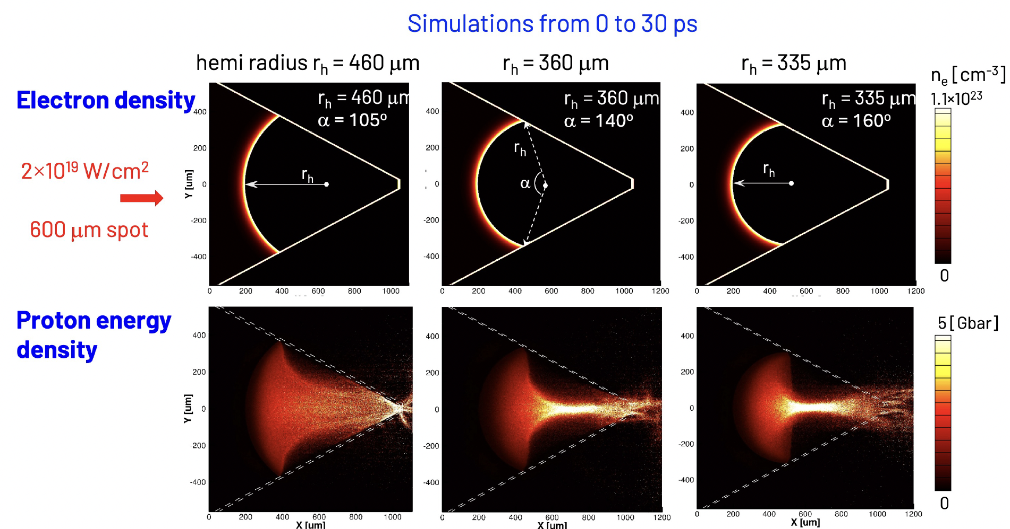
“Hemi” must be protected by the cone
The cone changes the beam focusing dynamics:
“Hemi” curvature can be changed to control beam divergence to find optimum focusing through the cone tip
J. Honrubia, Morace and Murakami, MRE 2, 28 (2017)

Slide 10
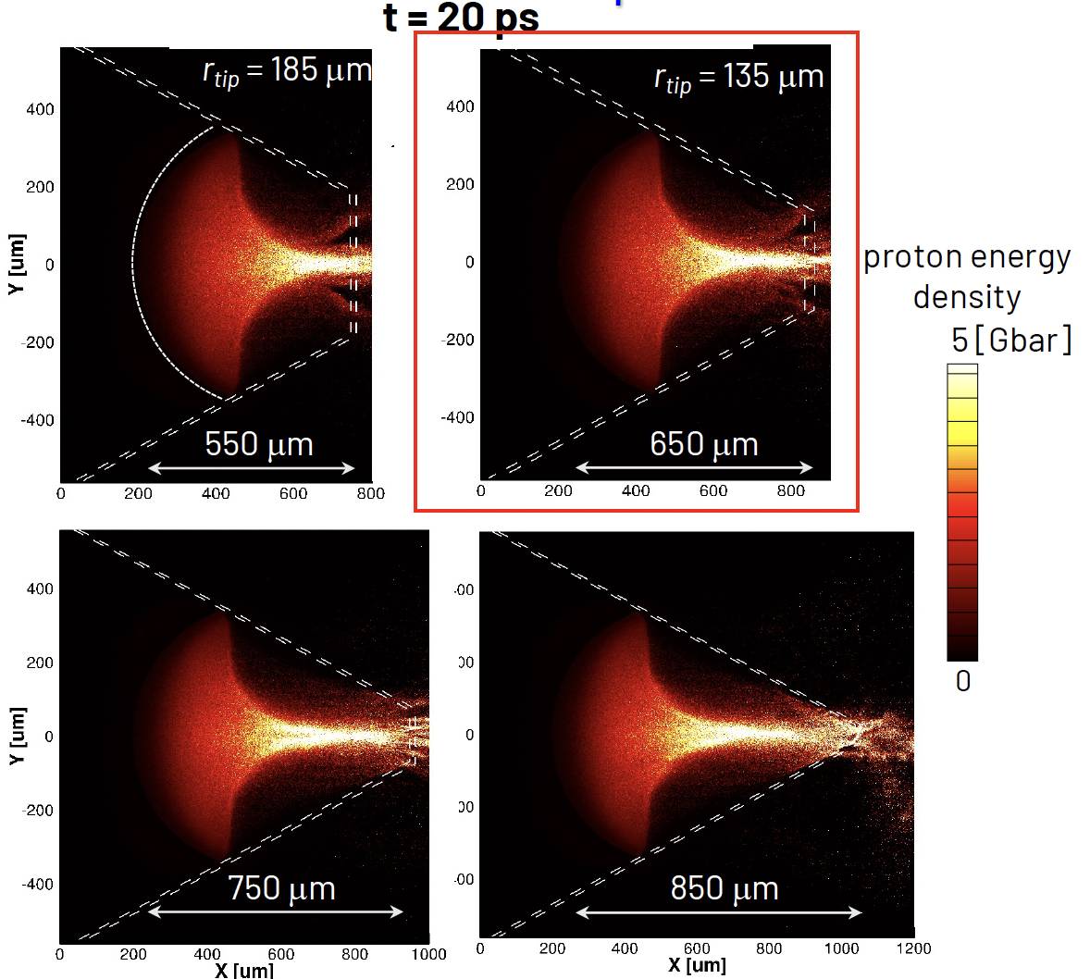
“Hemi” must be protected by the cone
The cone changes the beam focusing dynamics:
Cone opening angle can also be changed to control beam divergence to find optimum focusing through the cone tip

Slide 11
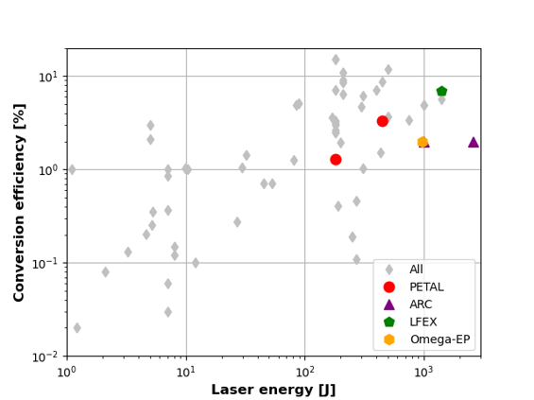
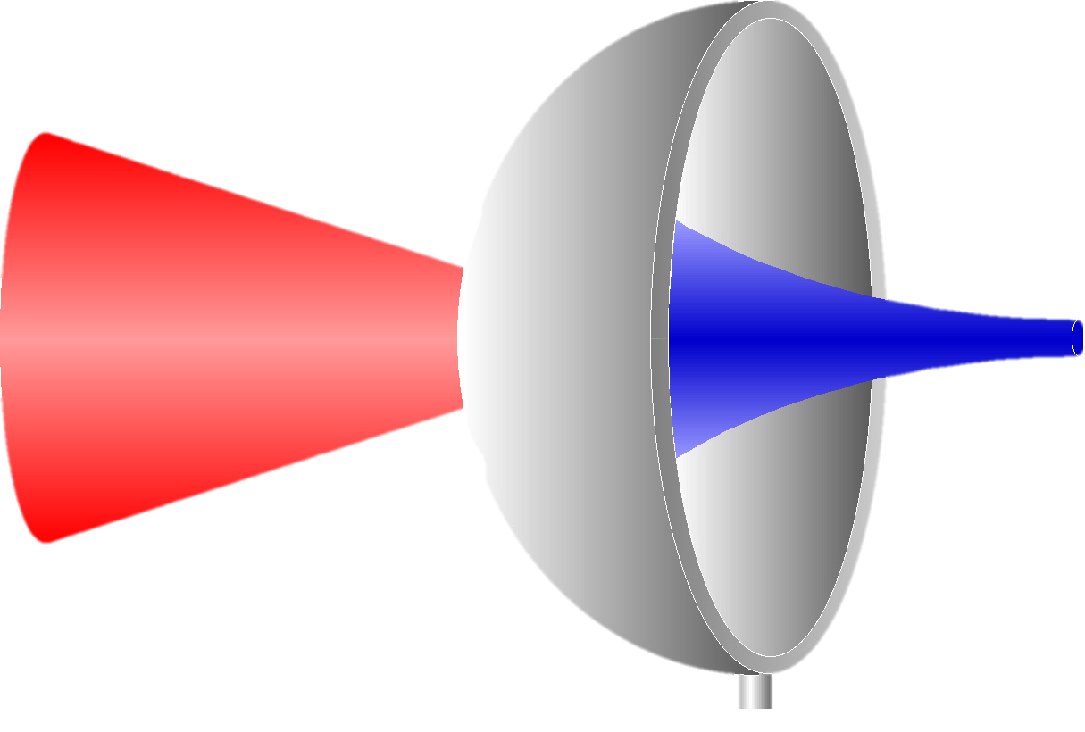


Main challenges to be addressed
Laser to proton conversion efficiency
Laser
$$E_{p}?$$
$$E_{L},τ_{L}$$
A. Kemp et al., Phys. Plasmas 32, 093102 (2025)

Slide 12

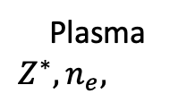



Main challenges to be addressed
Proton stopping power
Laser
$E_{0}$, $v_{p}$
Plasma
$$Z^{∗},n_{e},v_{th,e}$$
$$E_{1}<E_{0}$$
$E_{L}$
$$\frac{∂E}{∂x}$$
?
S. Malko et al., submitted PPCF (2026)
S. Malko et al. , Nature Communications 13 (2022)

Slide 13



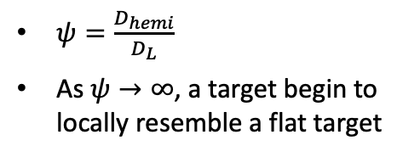


Main challenges to be addressed
Proton focusing
Laser
$E_{L}$
$$D_{L}$$
$φ_{p}$?
$$D_{Hemi}$$
$ψ=\frac{D_{hemi}}{D_{L}}$
As $ψ→∞$, a target begin to locally resemble a flat target
$L$?
[1] P. K. Patel et al., Phys. Rev. Lett. 91, 12 (2003)
[2] P. K. Patel et al., Plasma Phys. Control. Fusion 47 B833 (2005)
[3] R. A. Snavely et al., Phys. Plasmas 14, 092703 (2007)
[4] S. Kar et al., Phys. Rev. Lett. 106, 225003 (2011)
[5] D. T. Offerman et al., Phys. Plasmas 18, 056713 (2011)
[6] T. Bartal et al., Nature Physics 8, 139 (2012)
[7] S. N. Chen et al., Phys. Rev. Lett. 108, 055001 (2012)
[8] J. Griff-McMahon et al., Phys. Rev. Research 8, 013182 (2026)
[9] R. Nedbailo et al. , in prep + (2026)

Slide 14
High repetition rate facilities enable parameter scans and statistics to understand better and optimize proton focusing
Chen [7]
Offerman [5]
Patel [2]
Chen [7]
Offerman [5]
Patel [2]
Bailly-Grandvaux [4]
Kar [4]
Kar [4]
Patel [2]
Snavely [3]
McGuffey [5]
Griff-McMahon[8]
Griff-McMahon[8]
Bartal [6]
Bartal [6]
Snavely [3]
Patel [1]
Snavely [3]
Patel [1]
Patel [1]
Nedbailo [9]
Nedbailo [9]
Vaisseau [6]
Notes:
Though promising there remain some key open questions which limit the application of focused proton beams.
We hope to address some of them during this campaign

Slide 15
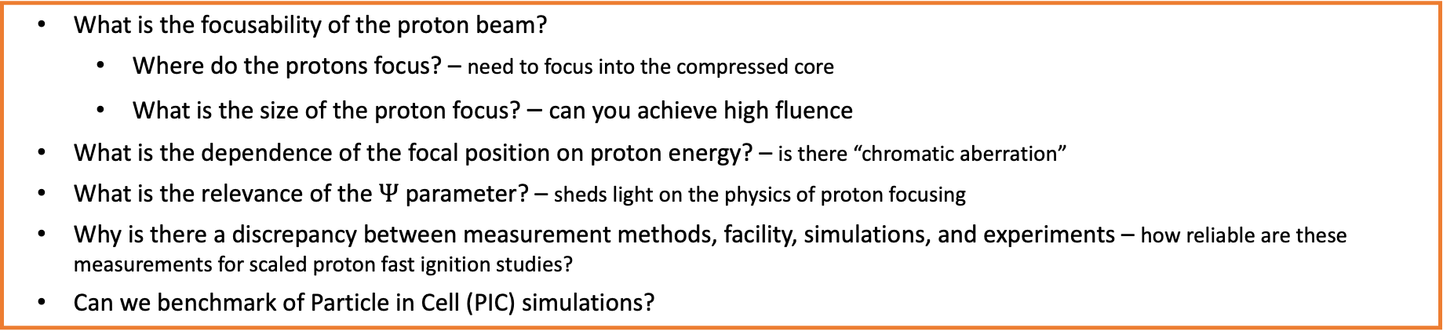
High repetition rate facilities enable parameter scans and statistics to understand better and optimize proton focusing
Chen [7]
Offerman [5]
Patel [2]
Chen [7]
Offerman [5]
Patel [2]
Bailly-Grandvaux [4]
Kar [4]
Kar [4]
Patel [2]
Snavely [3]
McGuffey [5]
Griff-McMahon[8]
Griff-McMahon[8]
Bartal [6]
Bartal [6]
Snavely [3]
Patel [1]
Snavely [3]
Patel [1]
Patel [1]
Nedbailo [9]
Nedbailo [9]
Vaisseau [6]
What is the focusability of the proton beam?
  Where do the protons focus? – need to focus into the compressed core
  What is the size of the proton focus? – can you achieve high fluence
What is the dependence of the focal position on proton energy? – is there “chromatic aberration”
What is the relevance of the $Ψ$ parameter? – sheds light on the physics of proton focusing
Why is there a discrepancy between measurement methods, facility, simulations, and experiments – how reliable are these measurements for scaled proton fast ignition studies?
Can we benchmark of Particle in Cell (PIC) simulations?
Notes:
Though promising there remain some key open questions which limit the application of focused proton beams.
We hope to address some of them during this campaign

Slide 16


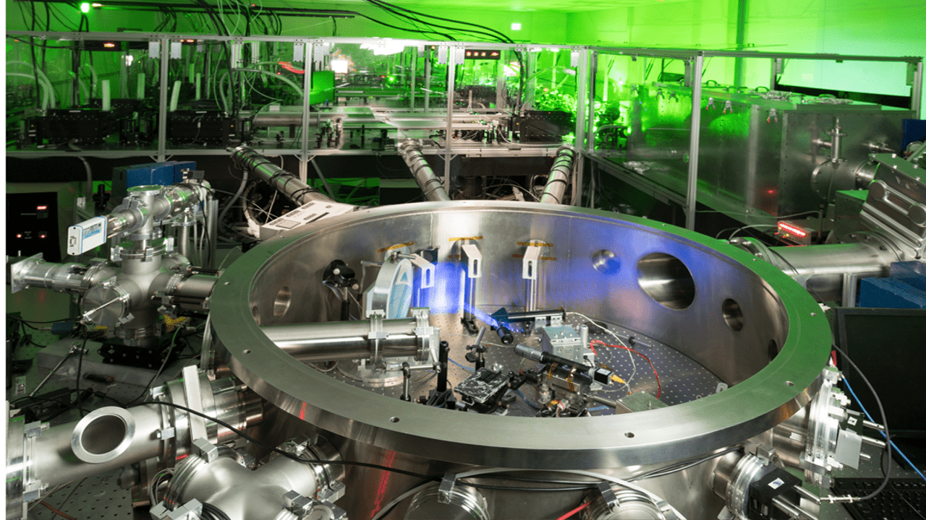
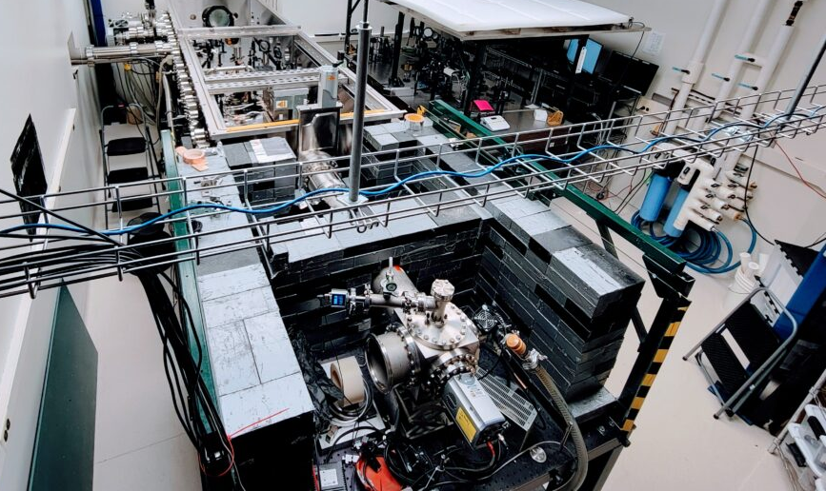

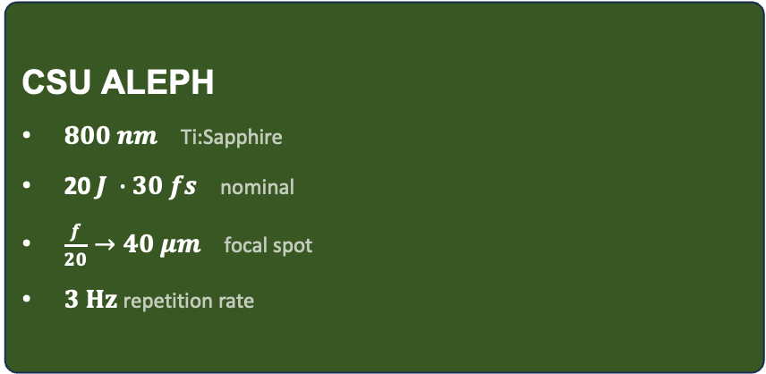

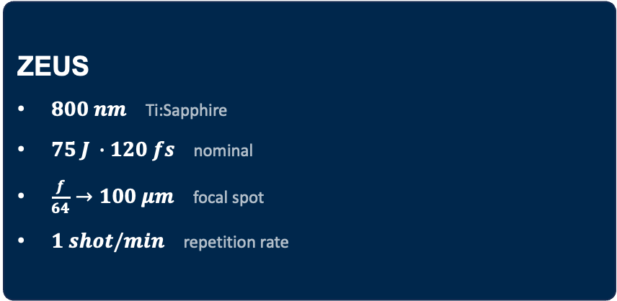
These high repetition rate facilities are offering unique capabilities
Highest power laser in USA
CSU ALEPH
$800 nm$ Ti:Sapphire
20$J ∙30 fs$ nominal
$\frac{f}{20}→40 μm$ focal spot
$3 Hz$repetition rate
ZEUS
$800 nm$ Ti:Sapphire
$75 J ∙120 fs$ nominal
$\frac{f}{64}→100 μm$ focal spot
$1 shot/min$ repetition rate
Achieved during our run
$$\text{>}\text{3}\text{00} \text{shots} \text{recorded}$$
Achieved during our run
$$\text{>400 }\text{shots} \text{recorded}$$

Slide 17
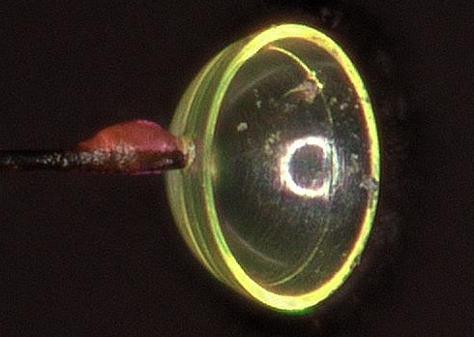
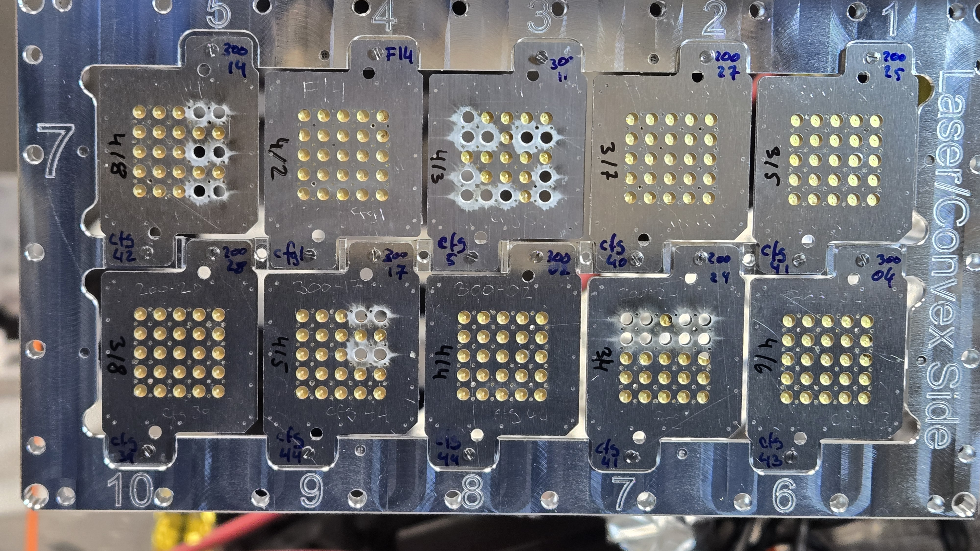
Historically targets have been limited to a low repetition rate configuration
Single shot
Phase 1
Drive
Laser
High Rep-Rate
Notes:
Historically these campaign have relied on low rep rate, single shot targets like the ones you see ehre from OMEGA EP
Experiementally we wanted to take advantage of the rep rate offered by the zeus laser facility

Slide 18
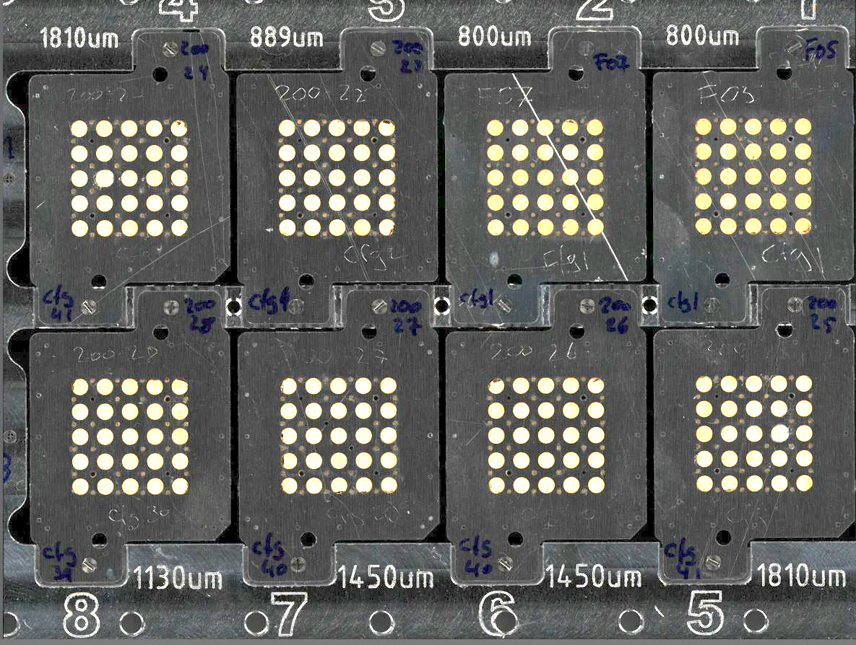
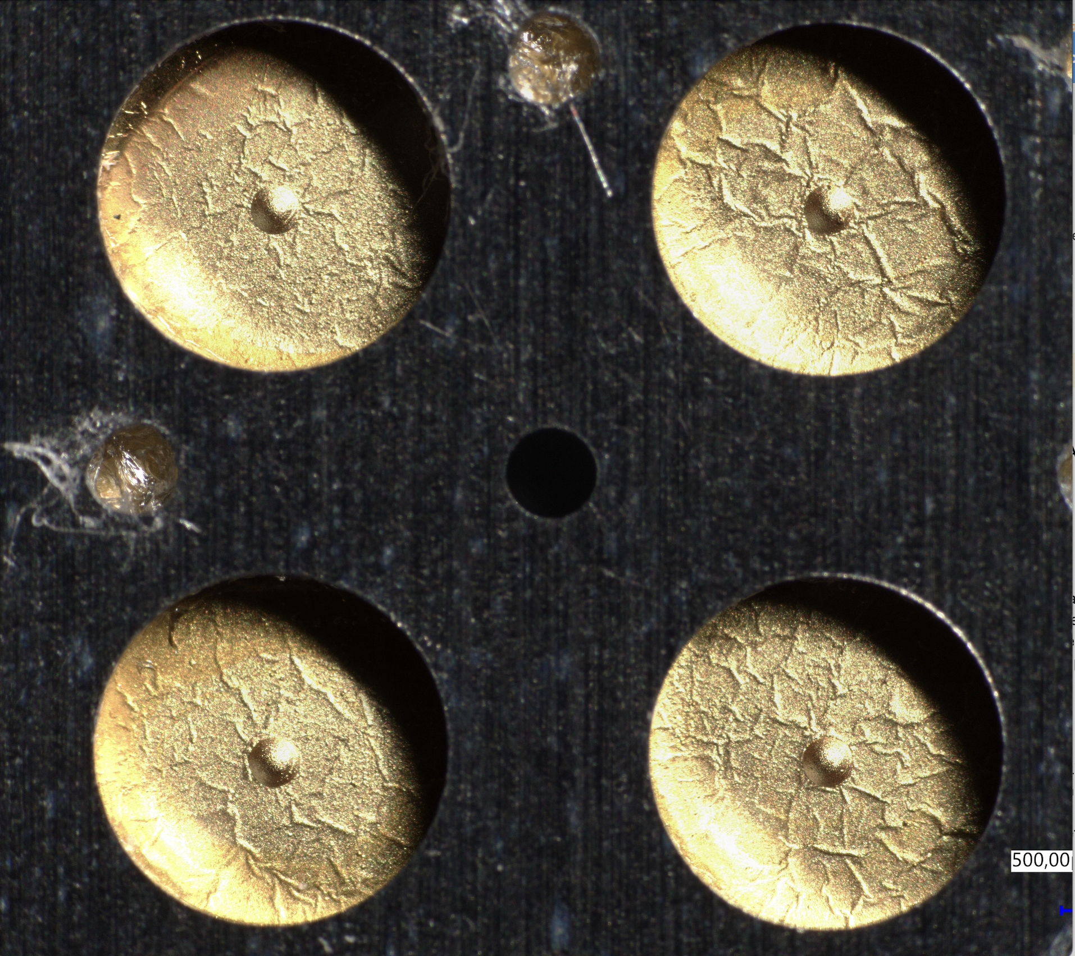
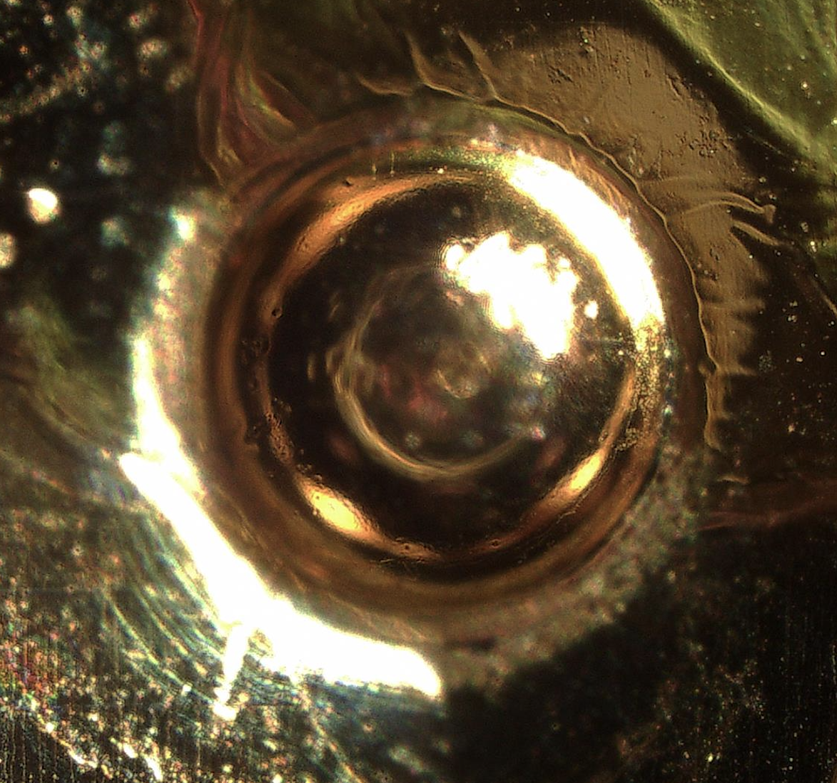
Mass manufactured hemispherical targets
12 cm
HRR operation was enabled by “mass manufactured” hemispherical targets + mesh/secondary in a raster like target.
2 mm
Hemispherical foil
450 μm
450 μm
Frame contained a varied sample of secondary samples and meshes depending on the desired configuration
Developed and manufactured by Focused Energy
Notes:
HRRvtargets

Slide 19
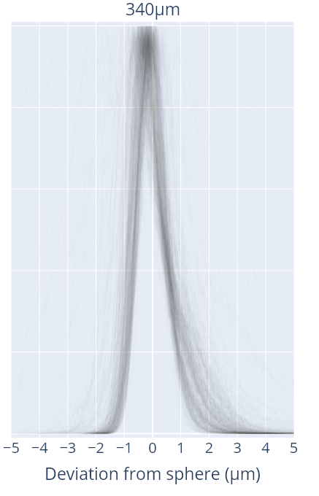
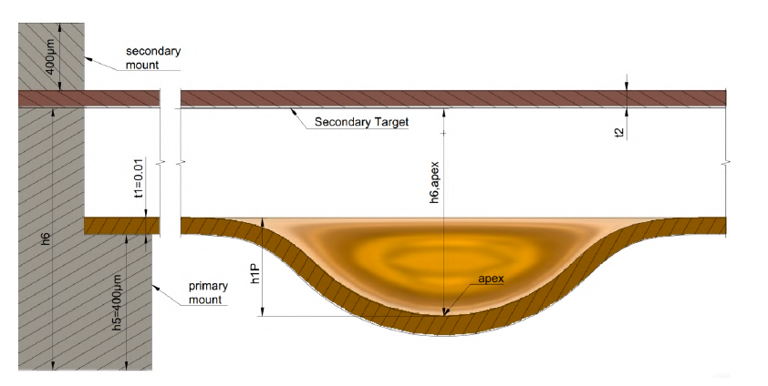
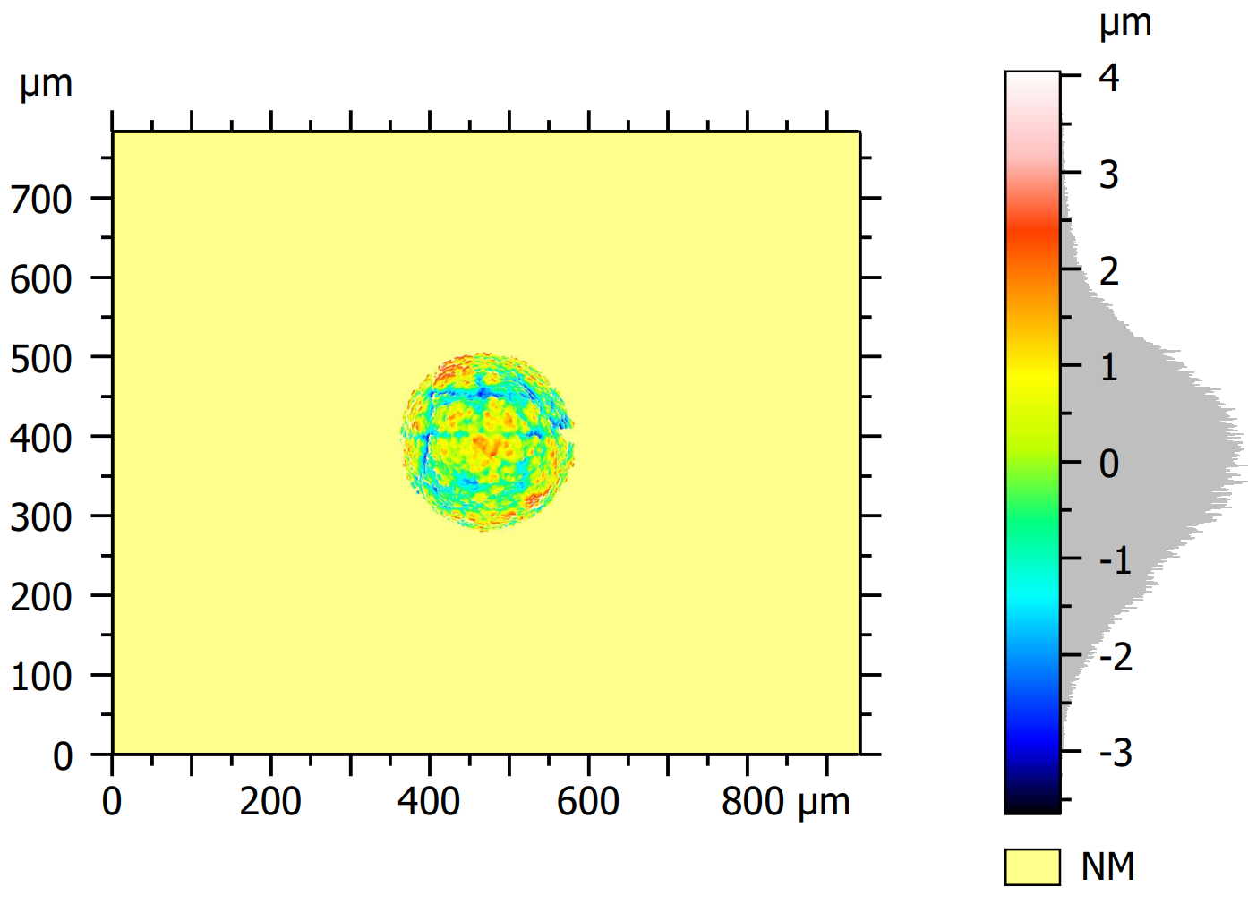
Extensive metrology was performed of targets to ensure quality and reproducibility
Surface deviation from an ideal sphere
Surface deviation over an extended region (⌀220 μm)
Subtraction of a Ø340um sphere from a 3D scan of the surface
T. Karpowski, PhD Thesis , University of Darmstadt, Germany (2025)

Slide 20
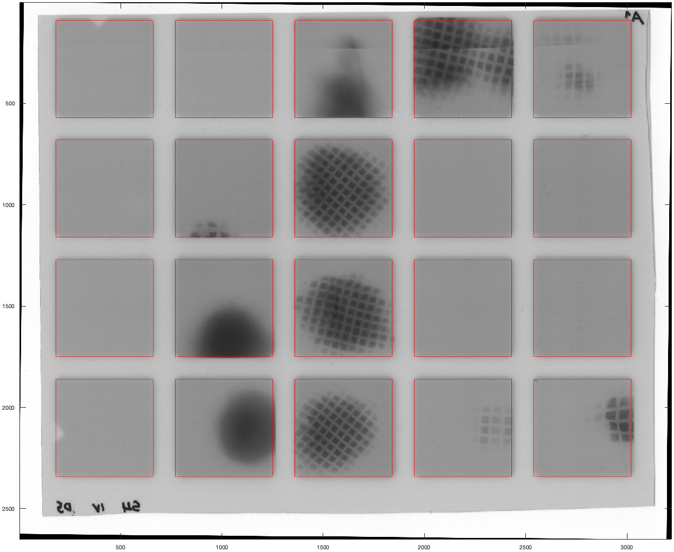
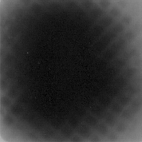
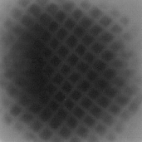
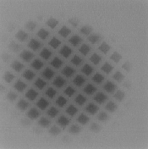
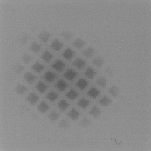
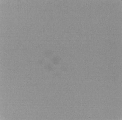

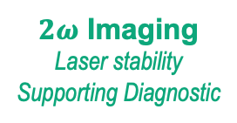

High repetition rate experimental platform studying Proton Focusing
Proton Focusing – Used mesh radiography to determine proton focal location
$$2ω$$
Layer 1
$2ω$ Imaging
Laser stability
Supporting Diagnostic
Layer 2
Example RCF data
Layer 3
Hemi
Protons
Thomson Parabola
Proton Spectra
Supporting Diagnostic
Drive Laser
Layer 4
Layer | Avg E [MeV]
1 | 1.13
2 | 3.20
3 | 4.54
4 | 5.61
5 | 6.54
6 | 7.38
$$Δz$$
Cu Mesh
Radiochromic film Stack
Proton Trajectories
Layer 5
Hemi Diameter [µm] | Mesh LPI | Mesh Distances [µm]
240 340 540 | 400 600 | 350 690 750 1000
Layer 6

Slide 21
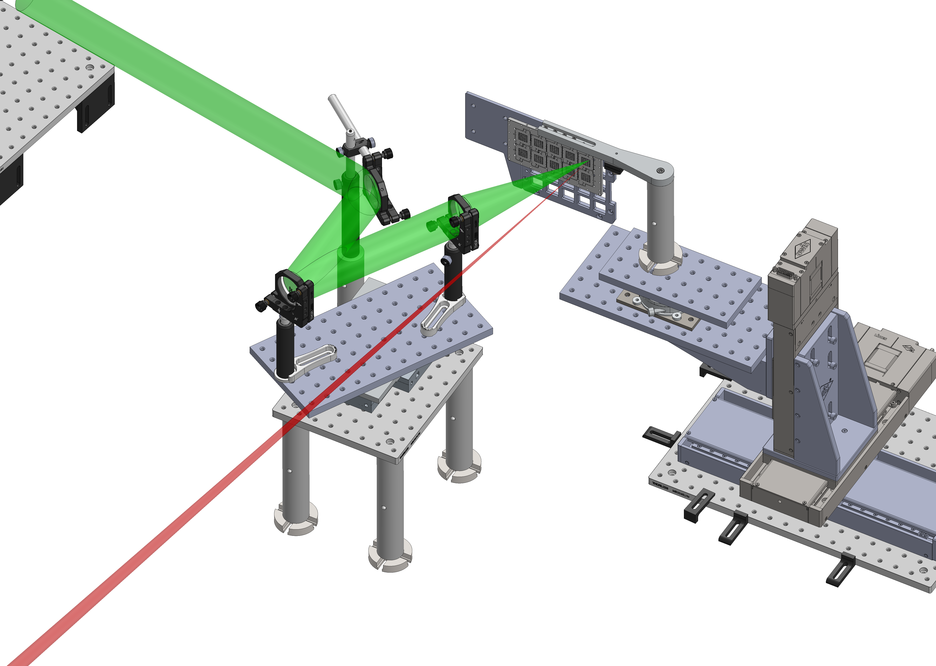

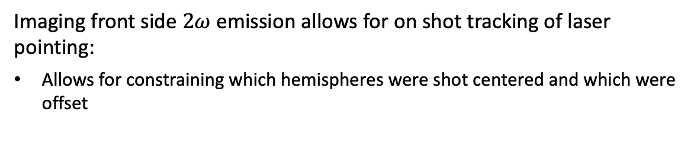


Laser pointing is critical for these experiments
Imaging front side $2ω$ emission allows for on shot tracking of laser pointing:
Allows for constraining which hemispheres were shot centered and which were offset
$∅$540 µm
$∅3$40 µm
$∅2$40 µm

Slide 22
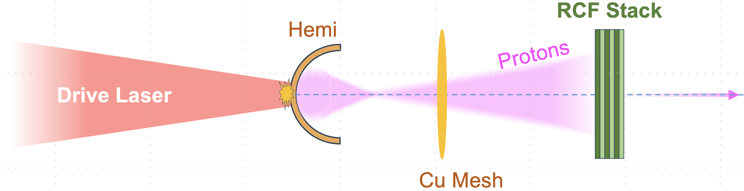
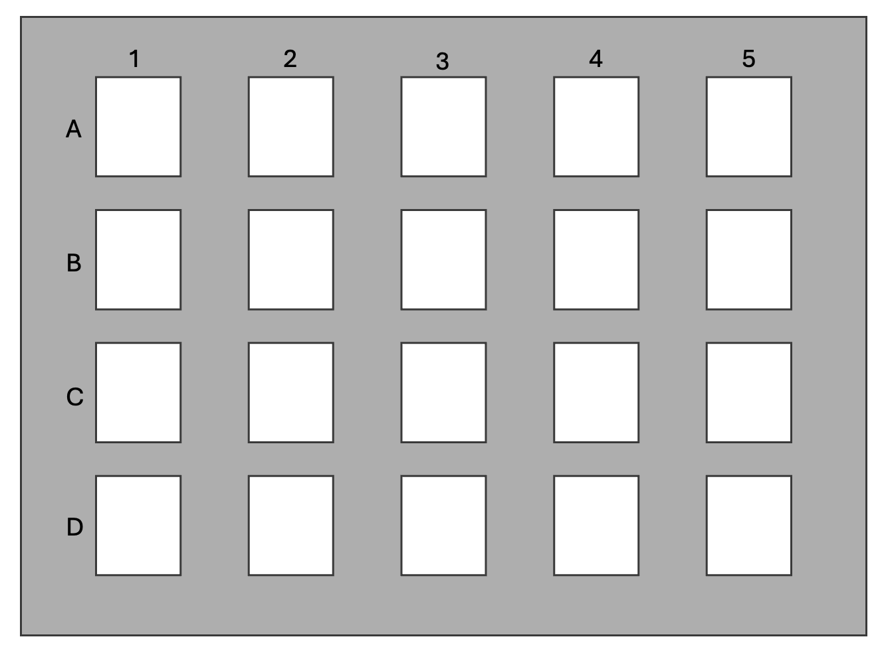
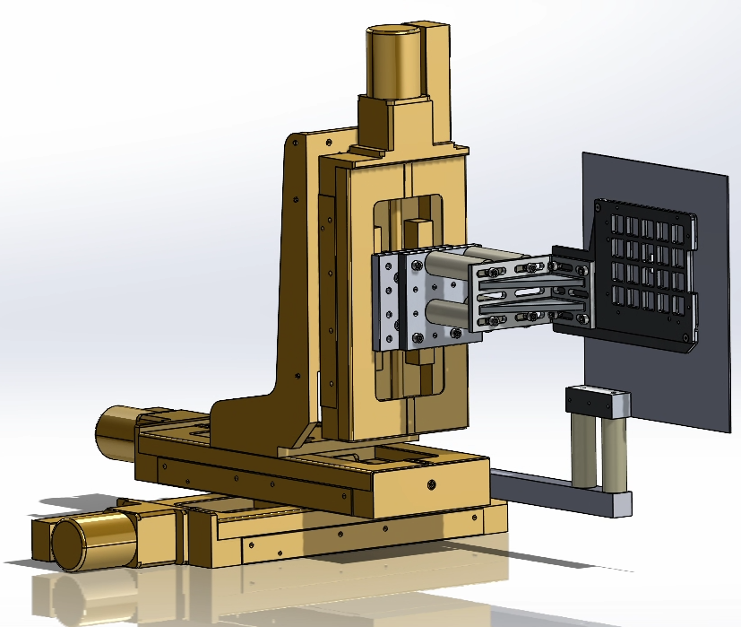
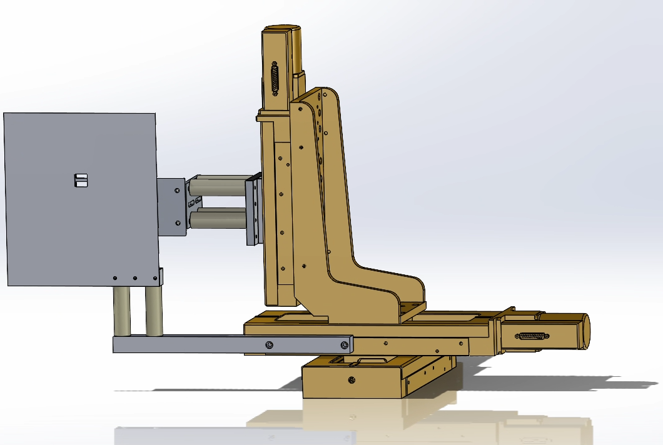
Detector for mesh radiography
RCF loaded into HRR raster stage for large dataset collection ~ 25 shots per vacuum cycle
(4-6 Layers)
2 mm Al
12.5 µm Al
HD-V2
HD-V2
HD-V2
HD-V2
1.1 MeV
3.2 MeV
4.5 MeV
5.6 MeV
6.5 MeV
7.4 MeV
There are more HHR suitable detectors!
Thursday, July 30
A2-Working group # 2, Veronica Conteras:
“Scintillator-Based High Repetition Rate Diagnostic for Multi-Energy Proton Beam Imaging & Probing”

Slide 23
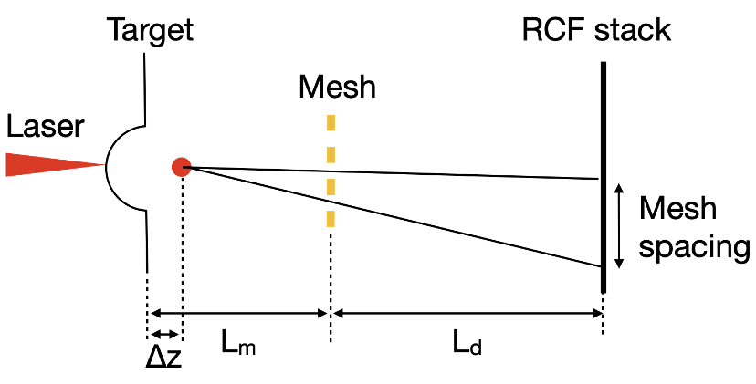
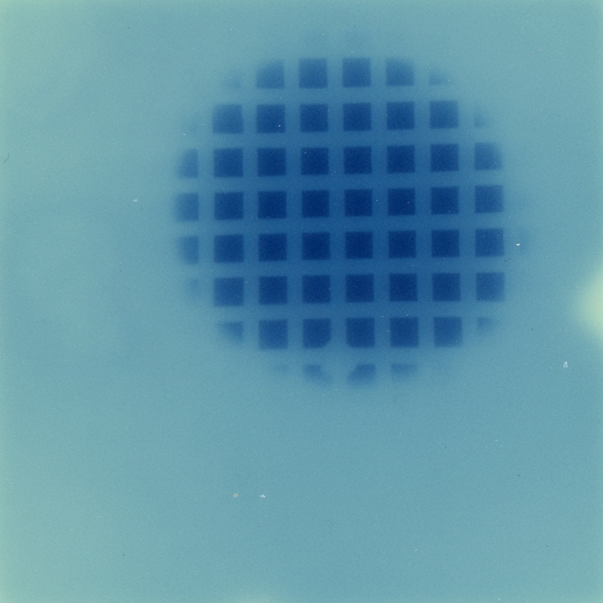

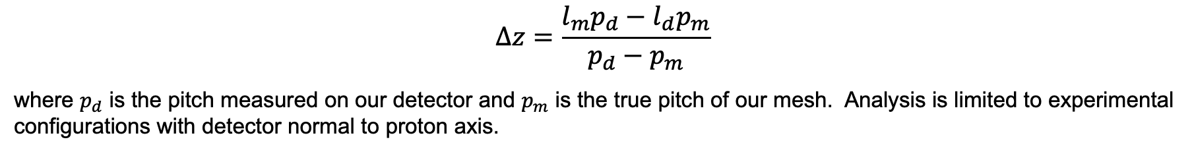



Mesh Radiography data can be analyzed using a Magnification Analysis
The focal position can be determined via geometric magnification
$$p_{d}$$
$$l_{m}$$
$$l_{d}$$
$$Δz$$
2 cm
$$Δz=\frac{l_{m}p_{d}−l_{d}p_{m}}{p_{d}−p_{m}}$$
where $p_{d}$ is the pitch measured on our detector and $p_{m}$ is the true pitch of our mesh. Analysis is limited to experimental configurations with detector normal to proton axis.

Slide 24
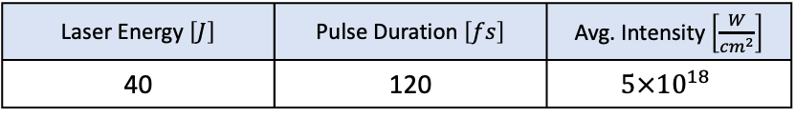
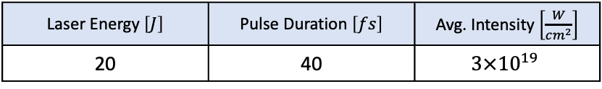
What we learned: Proton energy dependence
J. Griff-McMahon et al., Phys. Rev. Research 8, 013182 (2026)
R. Nedbailo et al., in prep + (2026)
Laser Energy $\left[J\right]$ | Pulse Duration $\left[fs\right]$ | Avg. Intensity $\left[\frac{W}{cm^{2}}\right]$
20 | 40 | $$3×{10}^{19}$$
Laser Energy $\left[J\right]$ | Pulse Duration $\left[fs\right]$ | Avg. Intensity $\left[\frac{W}{cm^{2}}\right]$
40 | 120 | $$5×{10}^{18}$$
CSU
ZEUS
Proton Focal positions at higher laser energy conditions may exhibit stronger dependence on proton energies

Slide 25
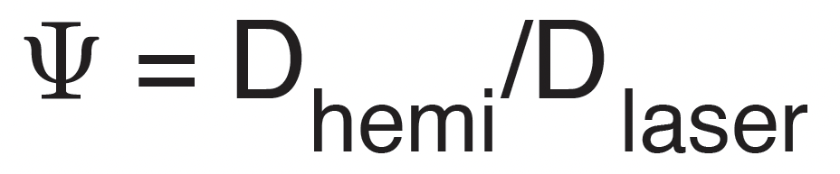
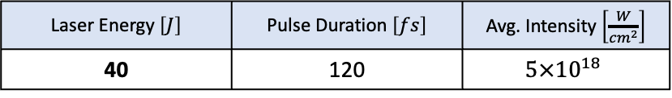
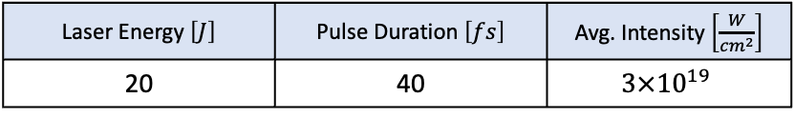
What we learned: Geometric scaling of proton focusing
J. Griff-McMahon et al., Phys. Rev. Research 8, 013182 (2026)
R. Nedbailo et al., in prep + (2026)
Laser Energy $\left[J\right]$ | Pulse Duration $\left[fs\right]$ | Avg. Intensity $\left[\frac{W}{cm^{2}}\right]$
20 | 40 | $$3×{10}^{19}$$
Laser Energy $\left[J\right]$ | Pulse Duration $\left[fs\right]$ | Avg. Intensity $\left[\frac{W}{cm^{2}}\right]$
40 | 120 | $$5×{10}^{18}$$
CSU
ZEUS
6.1
9.1
14.6
2.4
3.4
5.4

Slide 26
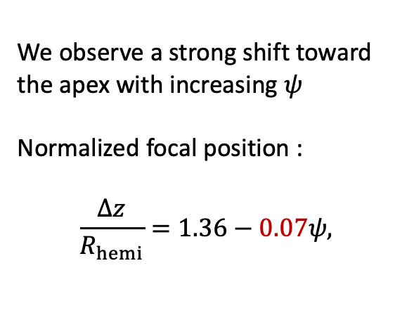
What we learned: Geometric scaling of proton focusing
J. Griff-McMahon et al., Phys. Rev. Research 8, 013182 (2026)
Laser Energy $\left[J\right]$ | Pulse Duration $\left[fs\right]$ | Avg. Intensity $\left[\frac{W}{cm^{2}}\right]$
20 | 40 | $$3×{10}^{19}$$
We observe a strong shift toward the apex with increasing $ψ$
Normalized focal position :
$$\frac{Δz}{R_{hemi}}=1.36−0.07ψ,$$
CSU
6.1
9.1
14.6

Slide 27
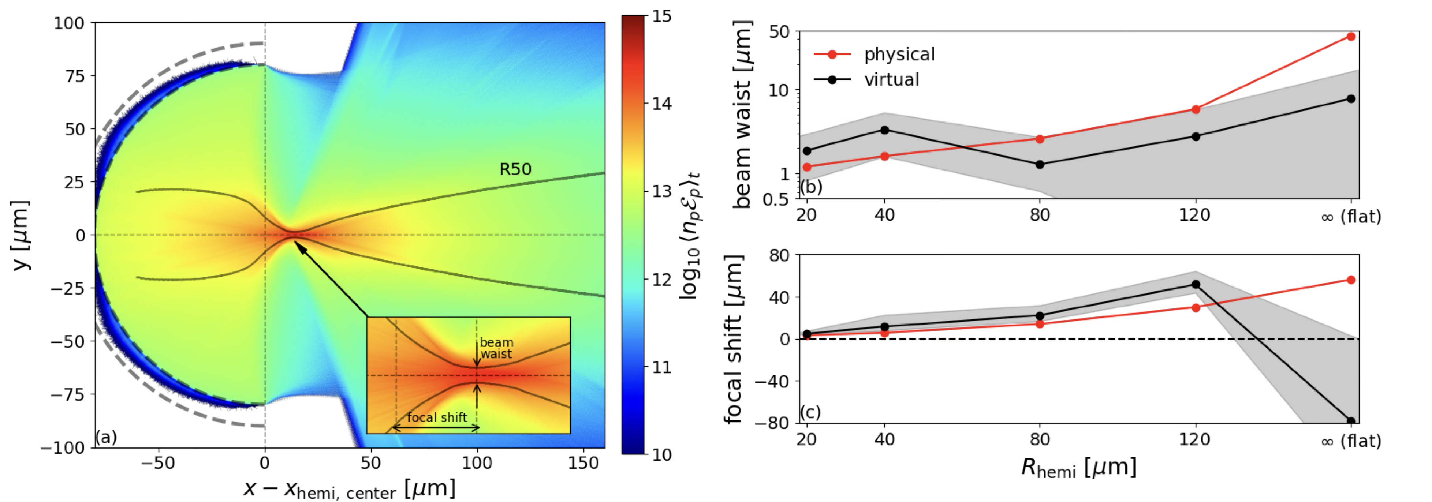
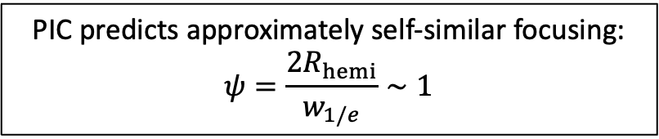
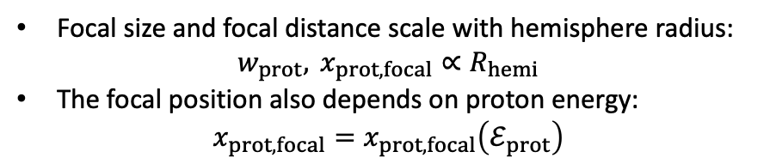
2D PIC simulations reveal that proton beam spot size and focal plane scale linearly with hemi radius
K. Lezhnin et al., accepted Phys. Rev. Research (2026)
PIC predicts approximately self-similar focusing:
$$ψ=\frac{2R_{hemi}}{w_{1/e}}∼1$$
Focal size and focal distance scale with hemisphere radius:
$$w_{prot}, x_{prot,focal}∝R_{hemi}$$
The focal position also depends on proton energy:
$$x_{prot,focal}=x_{prot,focal}\left(ℰ_{prot}\right)$$

Slide 28

What we learned: Geometric scaling of proton focusing (Experiment vs Simulation)
J. Griff-McMahon et al., Phys. Rev. Research 8, 013182 (2026)
We observe a strong shift toward the apex with increasing $ψ$
Normalized proton focal position
Experiment :
$$\frac{Δz}{R_{hemi}}=1.36−0.07ψ,$$
Simulations:
$$\frac{Δz}{R_{hemi}}≈0.066+0.03ψ$$
Laser Energy $\left[J\right]$ | Pulse Duration $\left[fs\right]$ | Avg. Intensity $\left[\frac{W}{cm^{2}}\right]$
20 | 40 | $$3×{10}^{19}$$
6.1
9.1
14.6
Opposite trend!

Slide 29


We can also measure proton focusing by quantifying proton heating of secondary foil
Proton Heating – Measured thermal temperature of proton heated plasma
$$2ω$$
XUV
$2ω$ Imaging
Laser stability
Supporting Diagnostic
XUV Imaging
Plasma Temperature
Hemi
TP
Protons
Thomson Parabola
Proton Spectra
Supporting Diagnostic
Drive Laser
Witness Foil
Hemi Diameter [µm] | Secondary Sample | Sample Distances [µm]
240 340 540 | Cu – 2 µm Al – 5 µm | 160 230 320 460 640

Slide 30

What we learned: Proton heating of warm dense matter to 10 eV
Witness Foil
Drive Laser
160 µm
230 µm
320 µm
$$Δz$$
  Minimal temperature difference between different hemi diameters.
  Modest focal spot size difference between different hemi diameters.
  But from mesh radiography we saw focusing inside the larger hemispheres?

Slide 31

What we learned: Proton heating decreases as a function of distance
$[μ$m]
Witness Foil
Drive Laser
160 µm
320 µm
$$Δz$$
  Reduced temperature at longer distance
    There is an increased spot size for different sample distances - proton beam slowly defocuses
    “Rayleigh length” - extended focusing effect

Slide 32
Summary
Mesh radiography is a well-established diagnostic, but it primarily identifies a virtual source position—the location corresponding to the smallest apparent proton spot.
Proton-heating measurements: significant heating is still observed when the sample is moved away from the nominal focus.
Multiple diagnostics are needed to to understand what’s going on
Direct comparison between PIC simulations and experiment remains challenging because of:
  experimental and numerical uncertainties;
  limitations of 2D simulations and differences between 1D, 2D, and fully 3D behavior;
  uncertainty in whether the model captures the relevant physics;
  sensitivity to exact experimental parameters, including laser spot size, preplasma, target geometry, and proton-energy selection.
High-repetition-rate experiments provide the statistical leverage needed to reduce uncertainty, perform systematic parameter scans, and discriminate between competing numerical models.

Slide 33

How does this study connect to ignition scale?
Benchmarking of simulations is the main goal.
Experimental results across broad energy range indicate extended focus for higher energy systems beyond the hemi geometric center
Extrapolating from the trend here would indicate a very long focal distance for a kJ scale facility needed for PFI.
Understanding and establishing a robust scaling relationship will require comprehensive simulation and experimental studies
Hemi geometric center
Hemi apex
Hemi Apex

Slide 34
Our experimental plan based on using current laser facilities to advance understanding of proton focusing and heating
Robust target design
Modular target approach study
Study the role of the cone
High Repetition Rate operation
Target and diagnostics development
Optimized target design
Large parametric study
250 kJ, 10ps
CSU ALEPH
ZEUS
OMEGA-EP
FI Ignitor beam
2 kJ, 10 ps
75 J, 100 fs
30 J, 30 fs

Slide 35





Collaborators
PPPL
Krish Bhutwala
Jesse Griff-McMahon
Kirill Lezhnin
Ashraf Essa
Kyle Kemmerer
UT Austin
Ryan Nedbailo
Focused Energy
Xavier Vaisseau
Franziska Treffert
Pravesh Patel
Valeria Ospina-Bohórquez
Prof. Javier Honrubia
University of Michigan
Paul Campbell
Yong Ma
Veronica Contreras
Anatoly Maksimchuk
John Nees
University of Alberta
John Matthew Gjevre
Prof. Robert Fedosejevs
Colorado State University
Ghassan Zeraouli
Prof. Reed Hollinger
UC San Diego
Alex Pietrow
Prof. Farhat Beg

Slide 36




Acknowledgements
This work is based upon research conducted at the ZEUS facility which is supported by the National Science Foundation under award 2126181
The research was conducted under the Laboratory Directed Research and Development (LDRD) Program at Princeton Plasma Physics Laboratory under Prime Contract No. DE-AC02-09CH11466.
Supported by INFUSE program under CRADA No. 2725 between Princeton Plasma Physics Laboratory and Focused Energy Inc. company under its U.S. Department of Energy Contract No. DE-AC02-09CH11466.
The experimental work was supported by the U.S. Department of Energy’s (DOE) Office of Science (SC) Fusion Energy Sciences (FES) program under DE-SC0021246: the Laser-NetUS initiative at the Advanced Beam Laboratory

