Slide 1
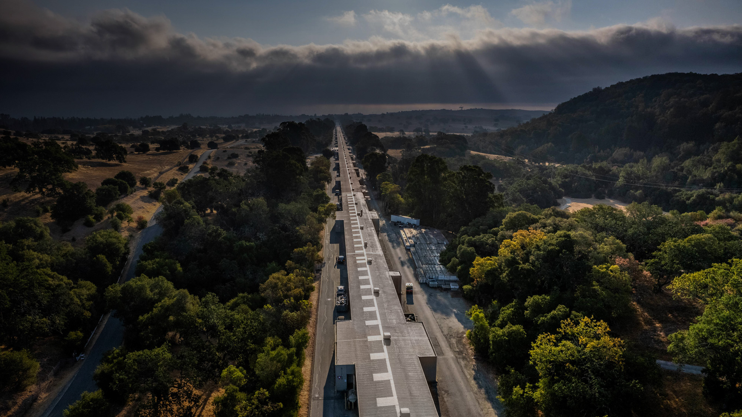
Facility for Advanced
Accelerator Experimental Tests
Recent Advances in Plasma Wakefield Acceleration at FACET-II
Advanced Accelerator Concepts 2026
Doug Storey | FACET-II | SLAC National Accelerator Laboratory
July 27, 2025

Slide 2
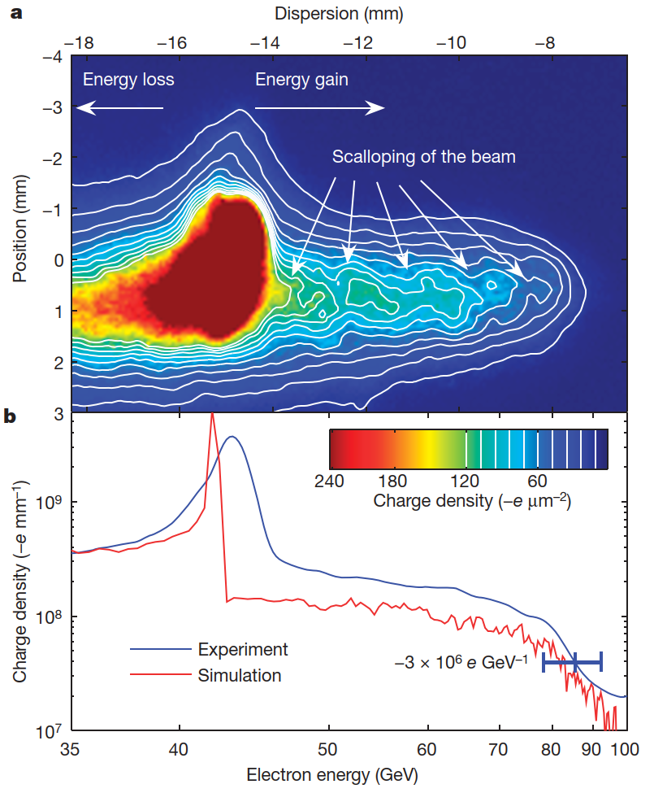
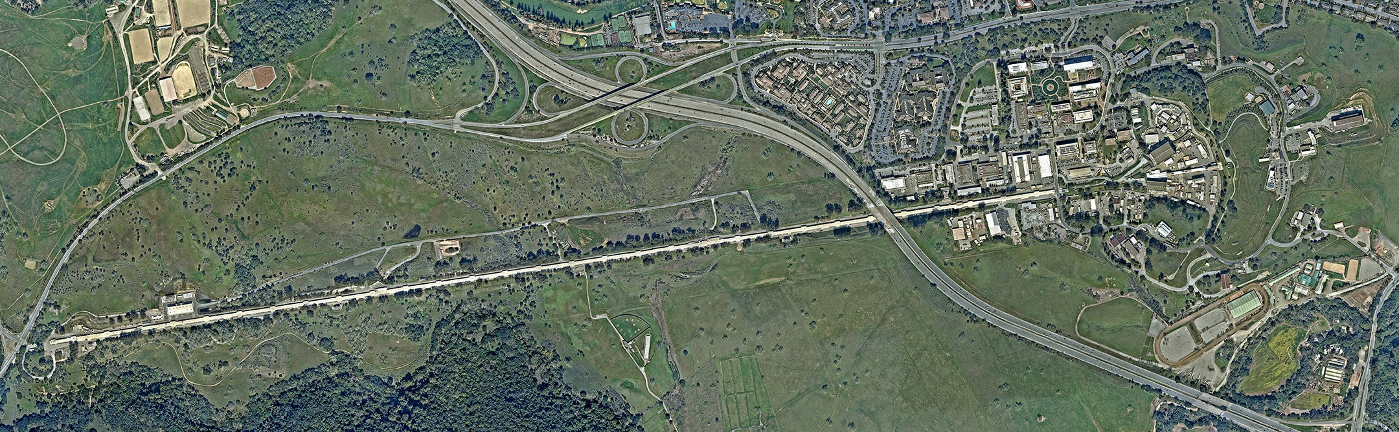
Beam driven PWFA at SLAC - FFTB
Blumenfeld et al., Nature 445, 741 (2007)
Energy doubling of 42 GeV electrons in the SLAC linear accelerator
High energy gain - but not a discrete bunch
FFTB: 1999-2006

Slide 3
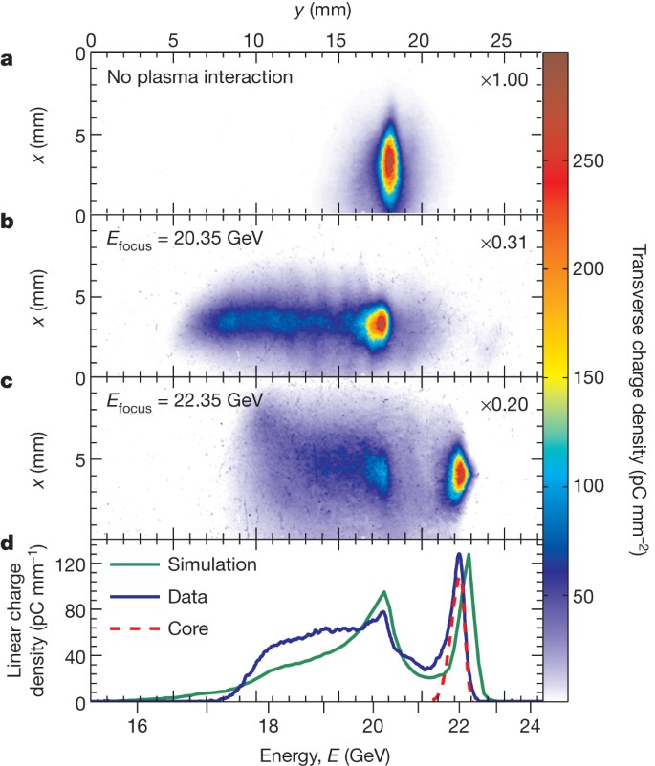
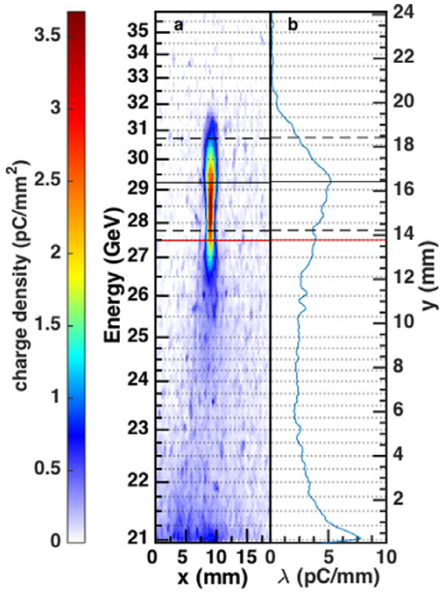
Beam driven PWFA at SLAC - FACET
Two bunch PWFA
Multi-GeV energy gain, few-% transfer eff.
Litos, et al., Nature 515, 92 (2014)
Litos, et al., PPCF 58, (2016)
FFTB: 1999-2006
FACET: 2010-2016

Slide 4
FACET-II – A facility for precision PWFA studies
SLAC linac further divided
FACET-II: Demonstrate single stage plasma wakefield acceleration at collider-relevant energy scale
  Single or double bunches from a new RF photo-injector
  RF linac and bunch compressors for precise control of longitudinal phase space
LCLS Accelerator
FACET-II
LCLS-II Accelerator

Slide 5
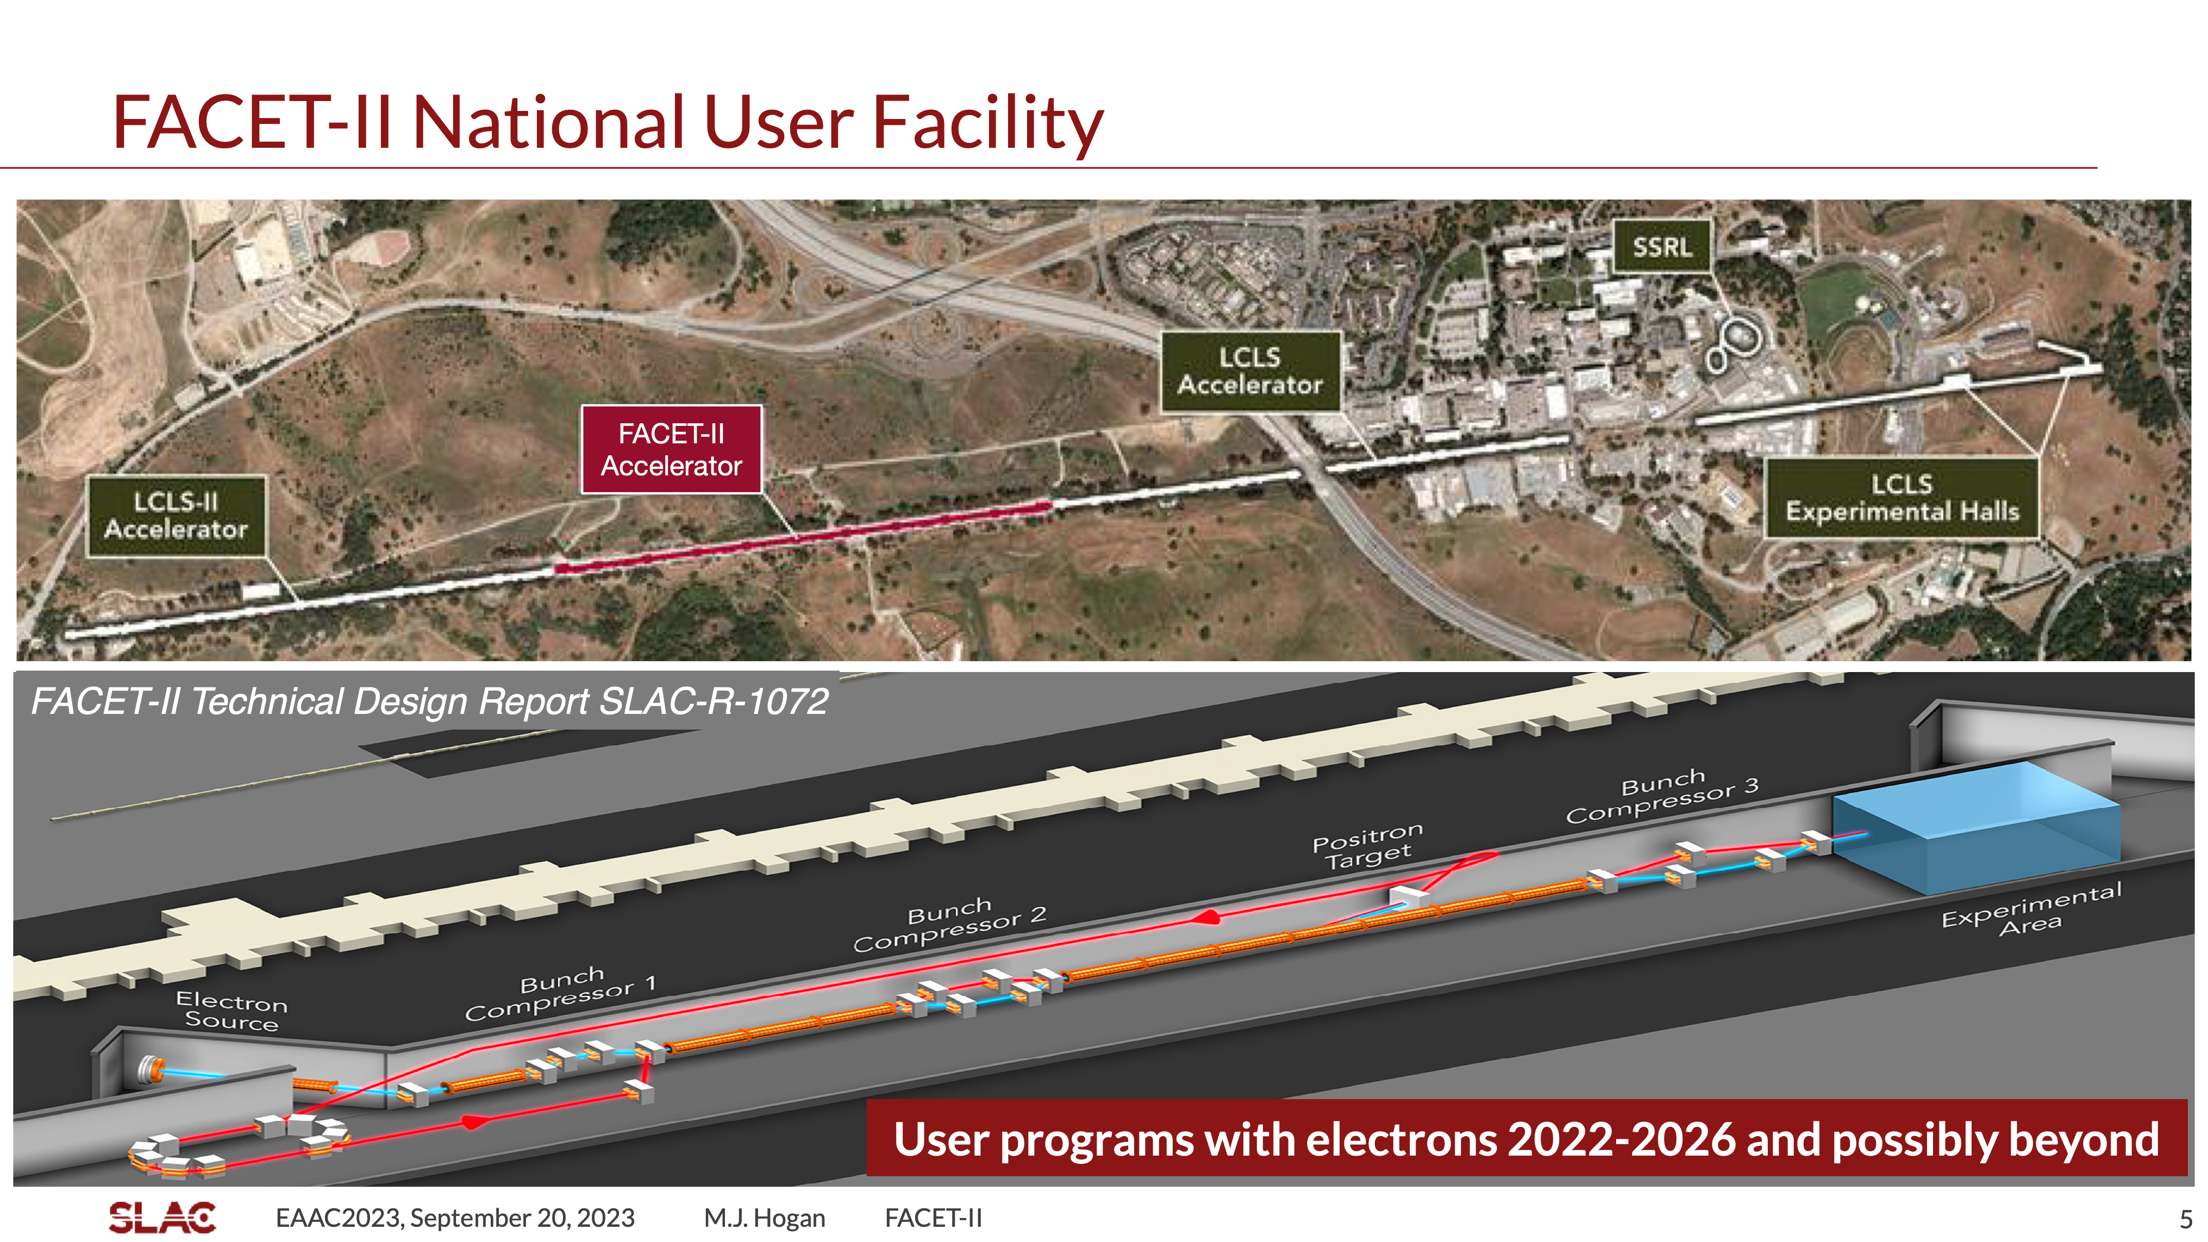
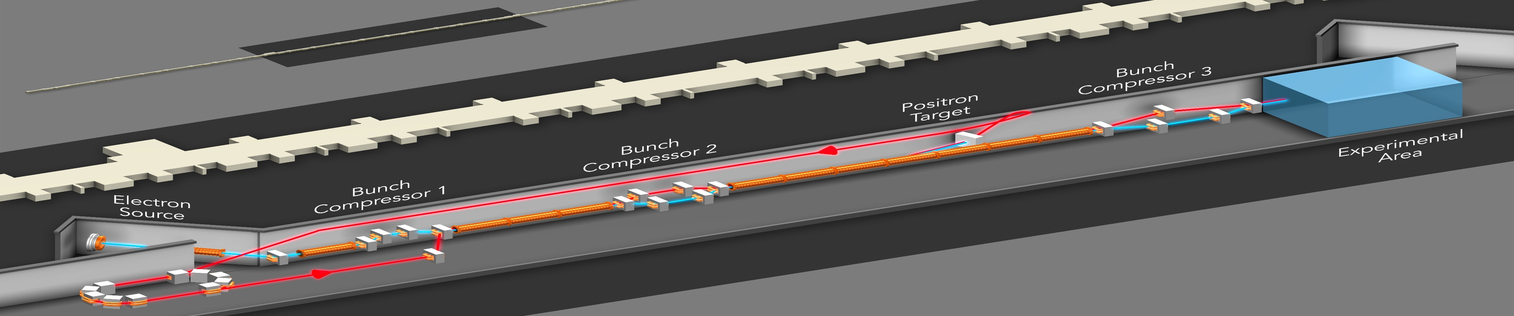
FACET-II provides 10 GeV beams for PWFA studies
SLAC National Accelerator Laboratory
FACET-II Technical Design Report SLAC-R-1072
Single or double bunches at 10 GeV
𝒪(10𝜇m) emittance, 𝒪(100kA) peak currents

Slide 6
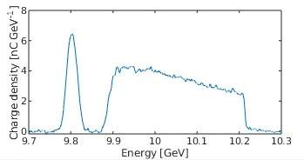
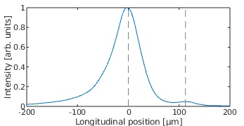
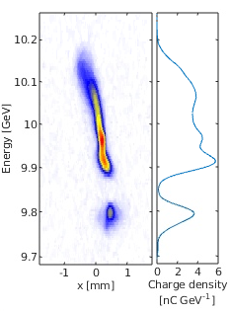
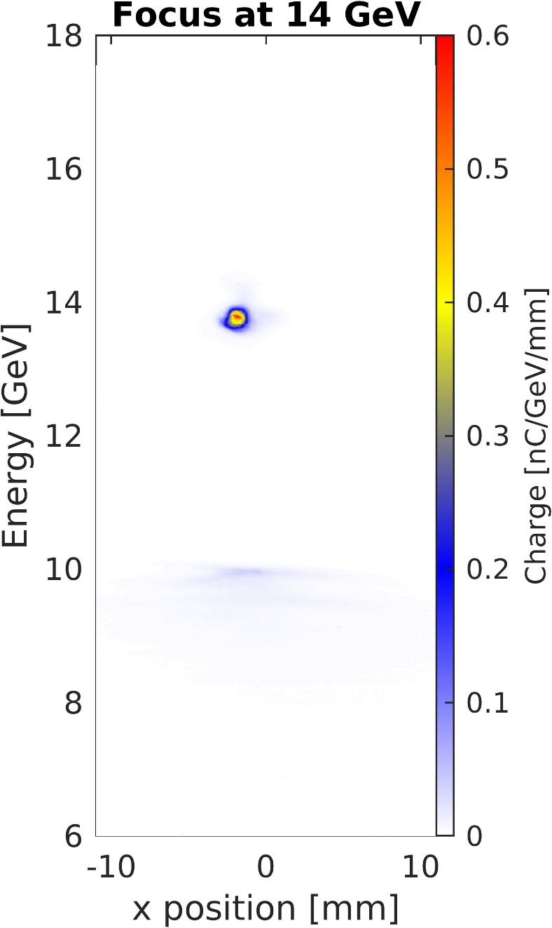
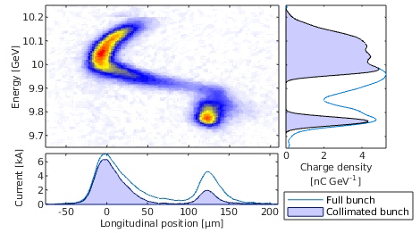
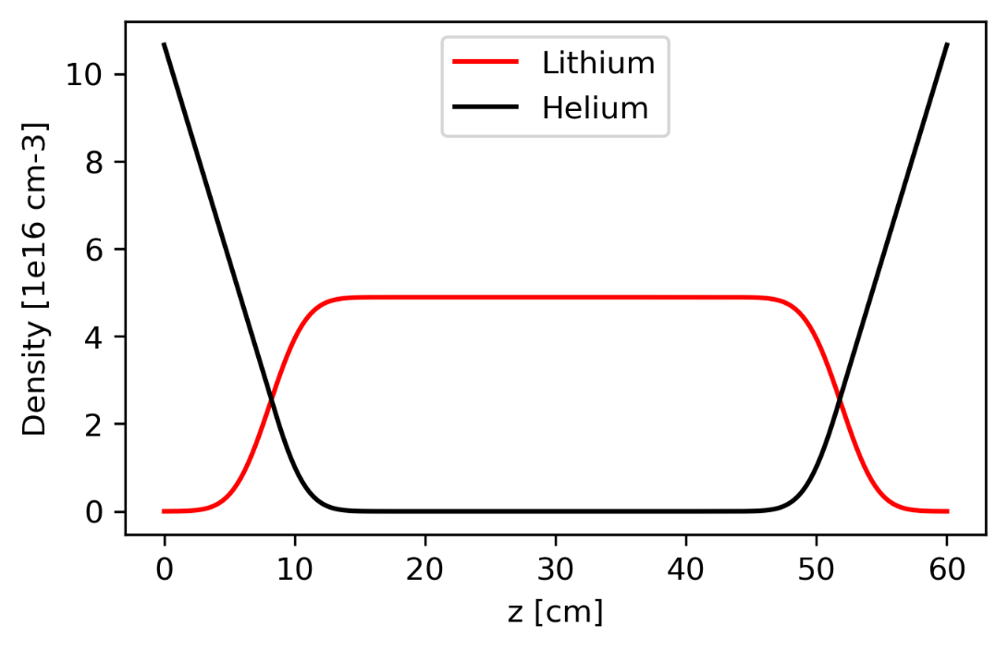
FACET-II experimental area
E. Ros, WG5 M 17:20
Two-bunch energy profile
Longitudinal profile
No plasma
Witness
Drive
Drive
Drive
PWFA beams
Witness
Collimators
YAG
screen
Final focus quadrupoles
Witness
Witness
Spectrometer quadrupoles
Magnetic chicane
Spectrometer dipole
Transverse deflecting cavity
YAG
screen
EOS
Gas jet
Long plasma sources
2D longitudinal phase space
Li plasma profile
Drive
Drive
Cherenkov spectrometer
Witness
J. Park, WG5 Th 15:20
Notes:
Jinseo – Virtual TCAV

Slide 7
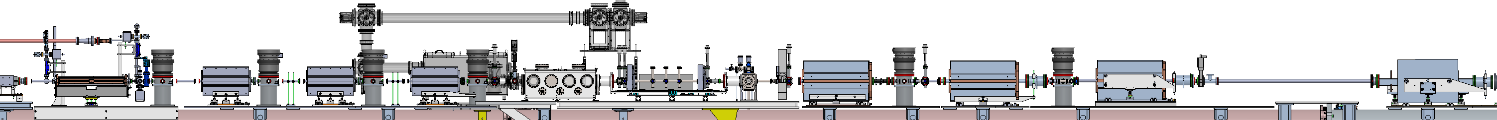
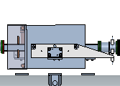
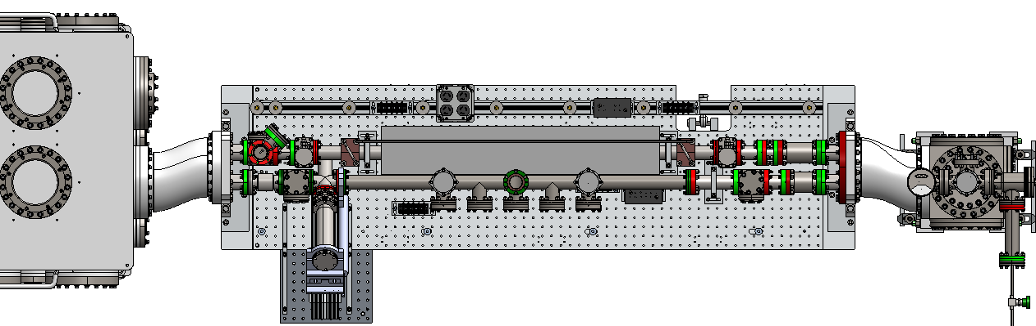
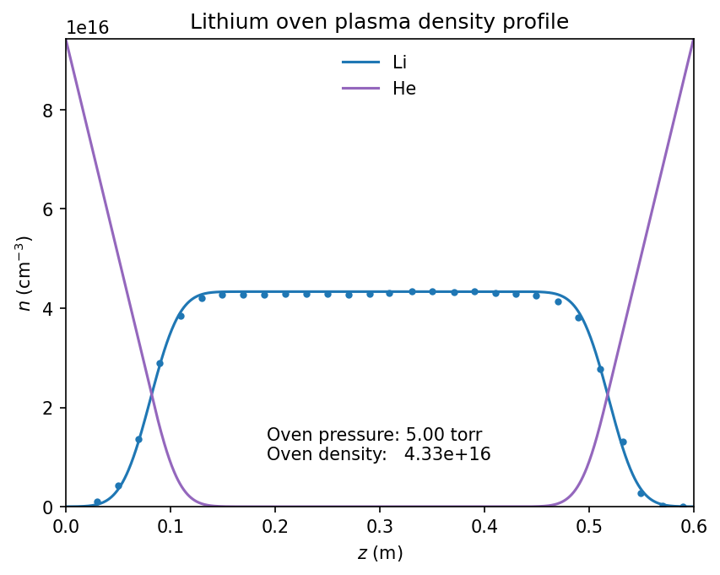
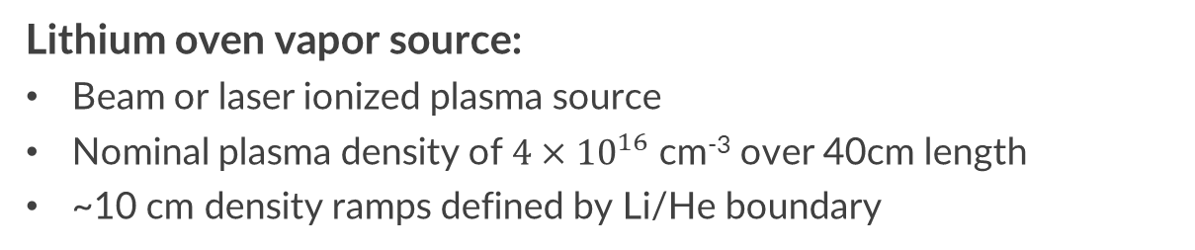
Plasma sources at FACET-II: Li oven plasma source
DS Be
window
Upstream DPS and final focus quads
US Be
window
Li Oven /
Bypass line
Downstream DPS and reimaging quads
XTCAV
Spectrometer Bend
Picnic Basket
Li Oven
Laser Extraction
Bypass line
Lithium oven vapor source:
Beam or laser ionized plasma source
Nominal plasma density of $4×{10}^{16}$ cm⁻³ over 40cm length
~10 cm density ramps defined by Li/He boundary

Slide 8
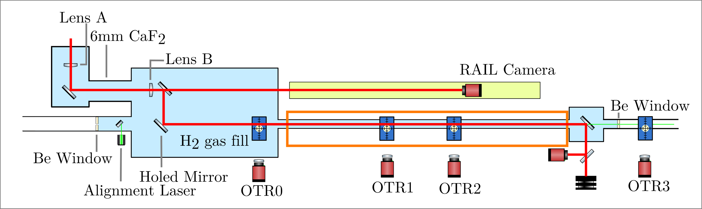
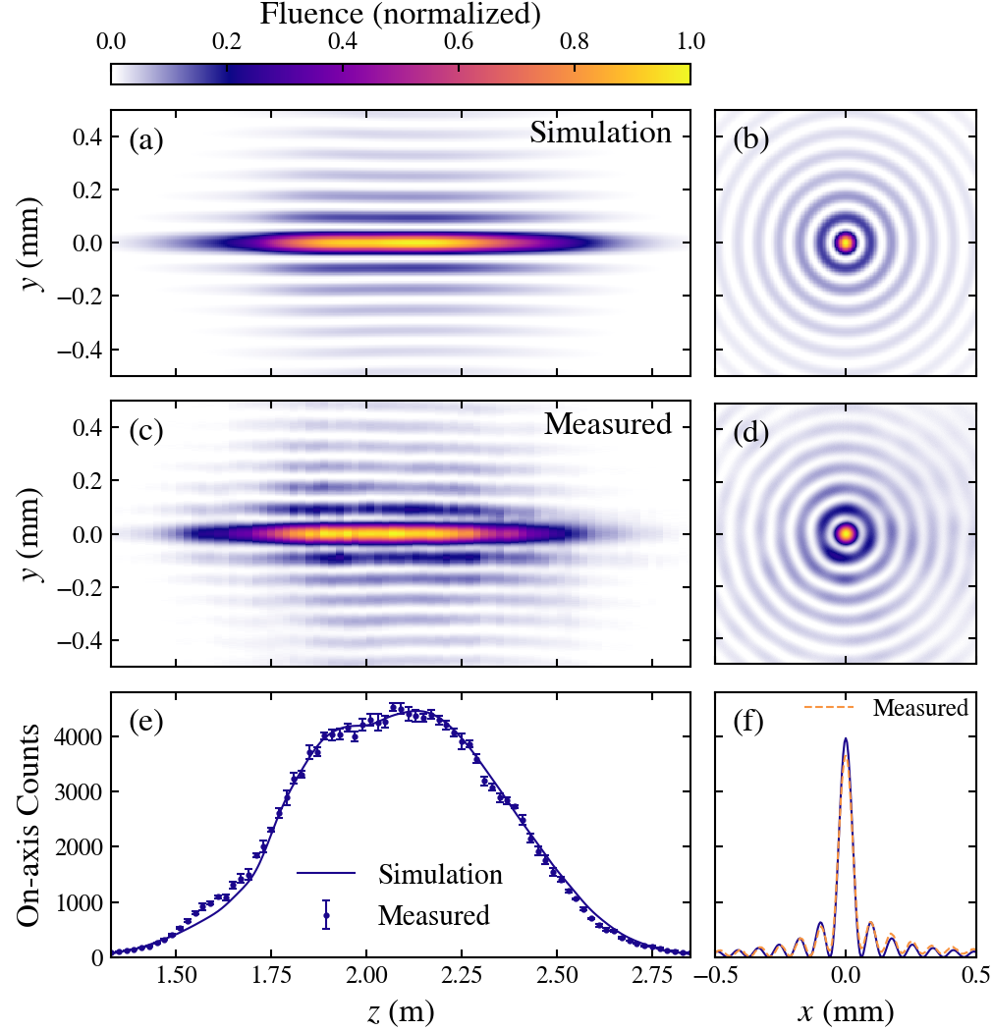
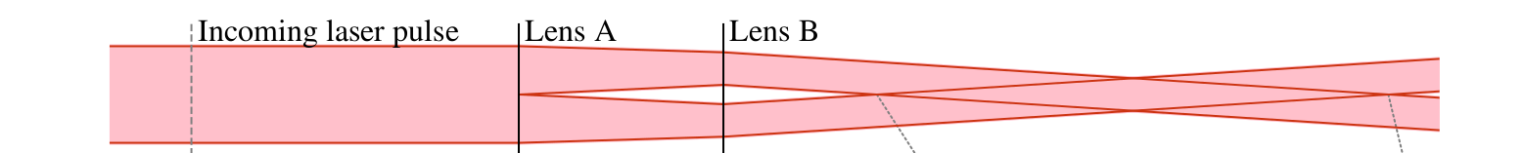
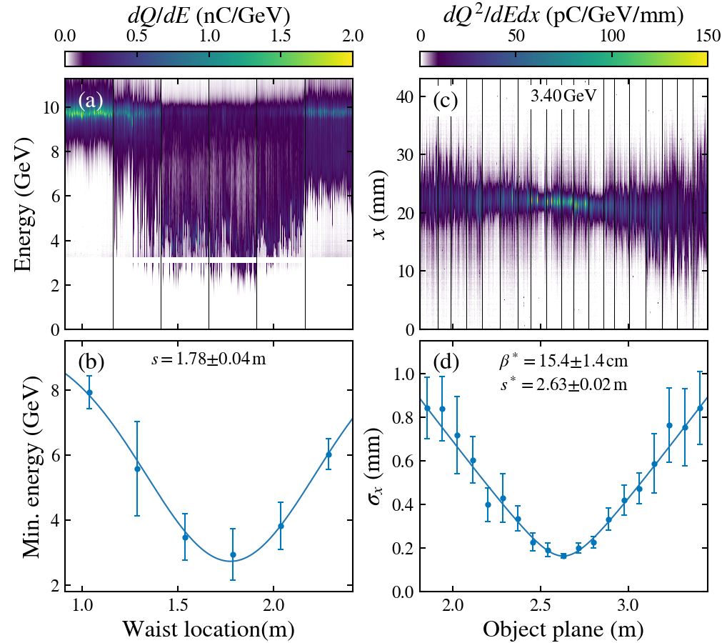
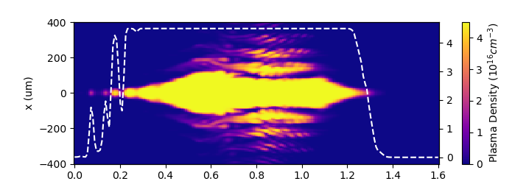
Plasma sources at FACET-II: Laser ionized hydrogen plasma
Laser-ionized unconfined H2 gas
Tandem lens shapes intensity and phase
On-axis density at 5x10¹⁶ cm⁻³ over 80 cm
Longitudinal laser intensity measurement confirms lens design and beam-based measurement confirms plasma length
Ariniello, R., V. Lee, and M. D. Litos, Optics Express 33.25 (2025): 52019-52034.

Slide 9
Topic #1
Multi-GeV PWFA with high beam quality and efficiency

Slide 10
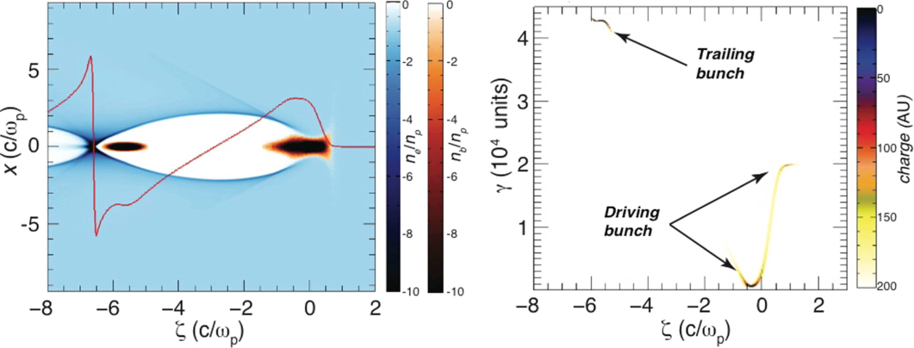
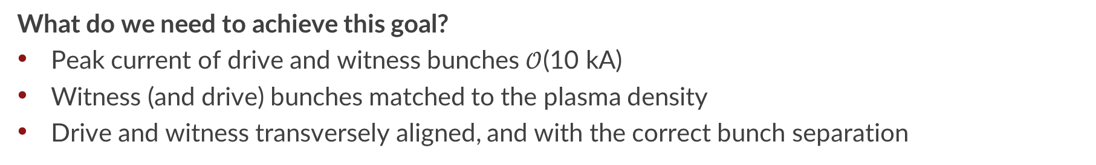
FACET-II Goal: PWFA with high efficiency and high beam quality
  Multi-GeV energy gain, with 10’s-% energy transfer efficiency, and beam quality preservation
Joshi et al., PPCF 60, 034001 (2018)
  What do we need to achieve this goal?
  Peak current of drive and witness bunches $𝒪$(10 kA)
  Witness (and drive) bunches matched to the plasma density
  Drive and witness transversely aligned, and with the correct bunch separation

Slide 11
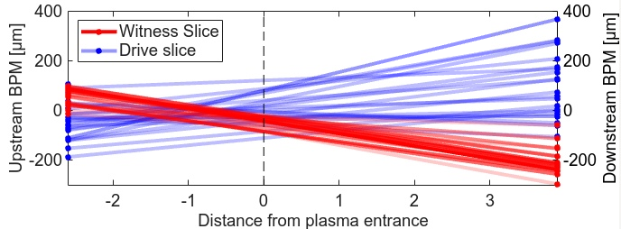
The beam alignment problem – How do you measure it?
Upstream BPM
Collimators
Downstream BPM
YAG
screen
Final focus quadrupoles
Plasma source
Spectrometer quadrupoles
Magnetic chicane
Spectrometer dipole
Transverse deflecting cavity
EOS
YAG
screen
Cherenkov spectrometer
Energy-slice IP trajectories
Plasma entrance
  Energy slice-BPM measurements
  Collimators select energy slice
  BPMs measure IP trajectory of that slice
Y. Ye, WG3 M 14:50
Novel slice BPM dispersion measurement allows for measurement and optimization of critical beam properties

Slide 12

The beam alignment problem – How do you fix it!
Upstream BPM
Collimators
Downstream BPM
YAG
screen
Final focus quadrupoles
Plasma source
Spectrometer quadrupoles
Transverse deflecting cavity
Spectrometer dipole
Sextupole Magnets
EOS
YAG
screen
  Sexutpole magnets in dispersive region of chicane
  Adjust sextupole strength and position to align energy slices
  12 degrees of freedom to tune!
Cherenkov spectrometer
Drive
Plasma
ML
Drive
Plasma
Witness
Witness
Machine learning enables more efficient bunch alignment in this high-dimensional search space

Slide 13
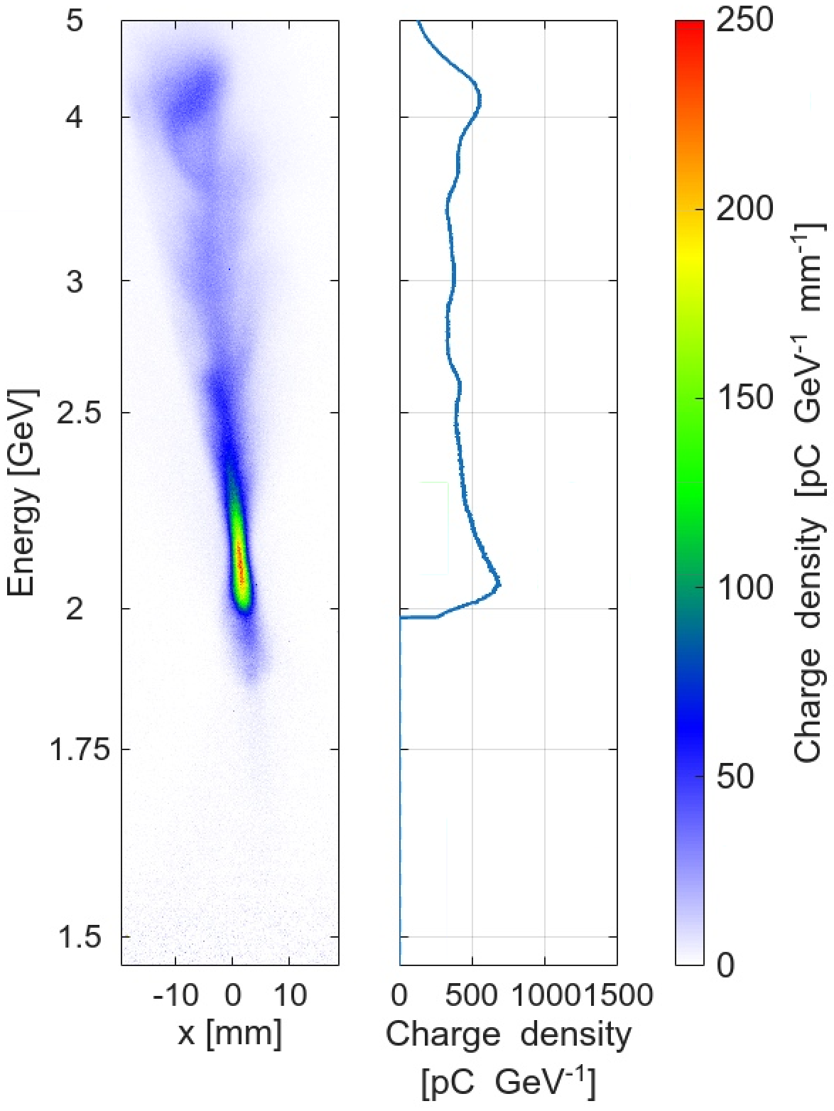
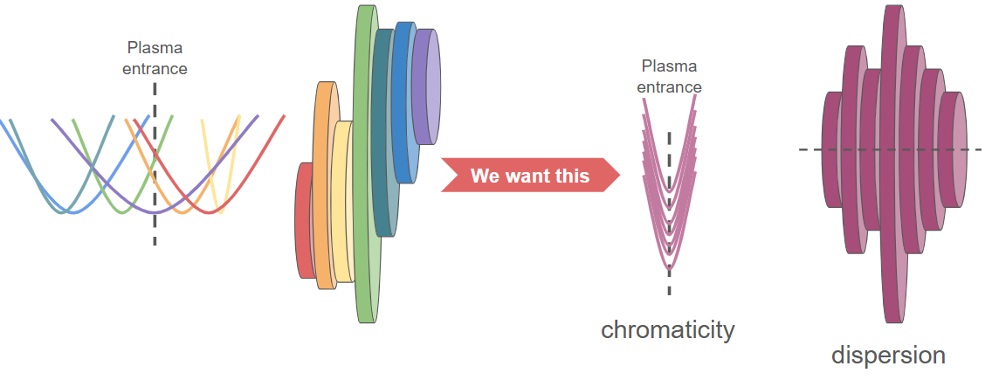

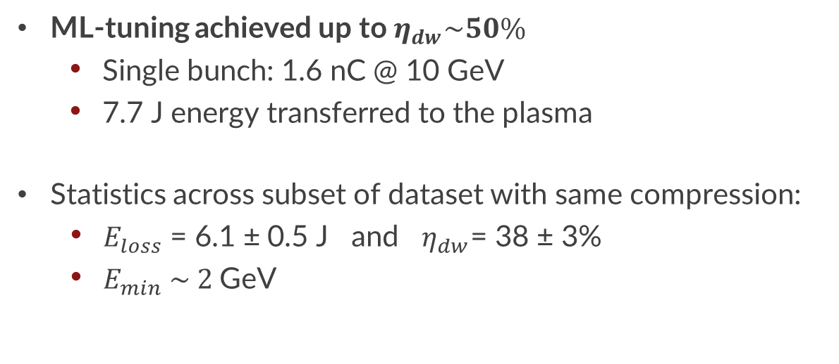
Maximizing drive‑to‑wake energy transfer with ML beam tuning
ML-tuning achieved up to $η_{dw}\sim 50\%$
    Single bunch: 1.6 nC @ 10 GeV
    7.7 J energy transferred to the plasma
Statistics across subset of dataset with same compression:
  $E_{loss}$ = 6.1 ± 0.5 J and $η_{dw}$= 38 ± 3%
  $E_{min} \sim 2$GeV
Depleted energy spectrum
Credit: S. Rego,
Ecole Polytechnique
$E_{loss}$ = 7.7 J
$η_{dw}$= 48%
Image credit: Y. Ye, SLAC
Approaching the energy-transfer scale required for efficient staging applications
Notes:
Note – HALHF - 80% efficiency, 4 GeV drive, 8 nc → 25J transferred to the wake. Factor of 3 higher than achieved here.

Slide 14
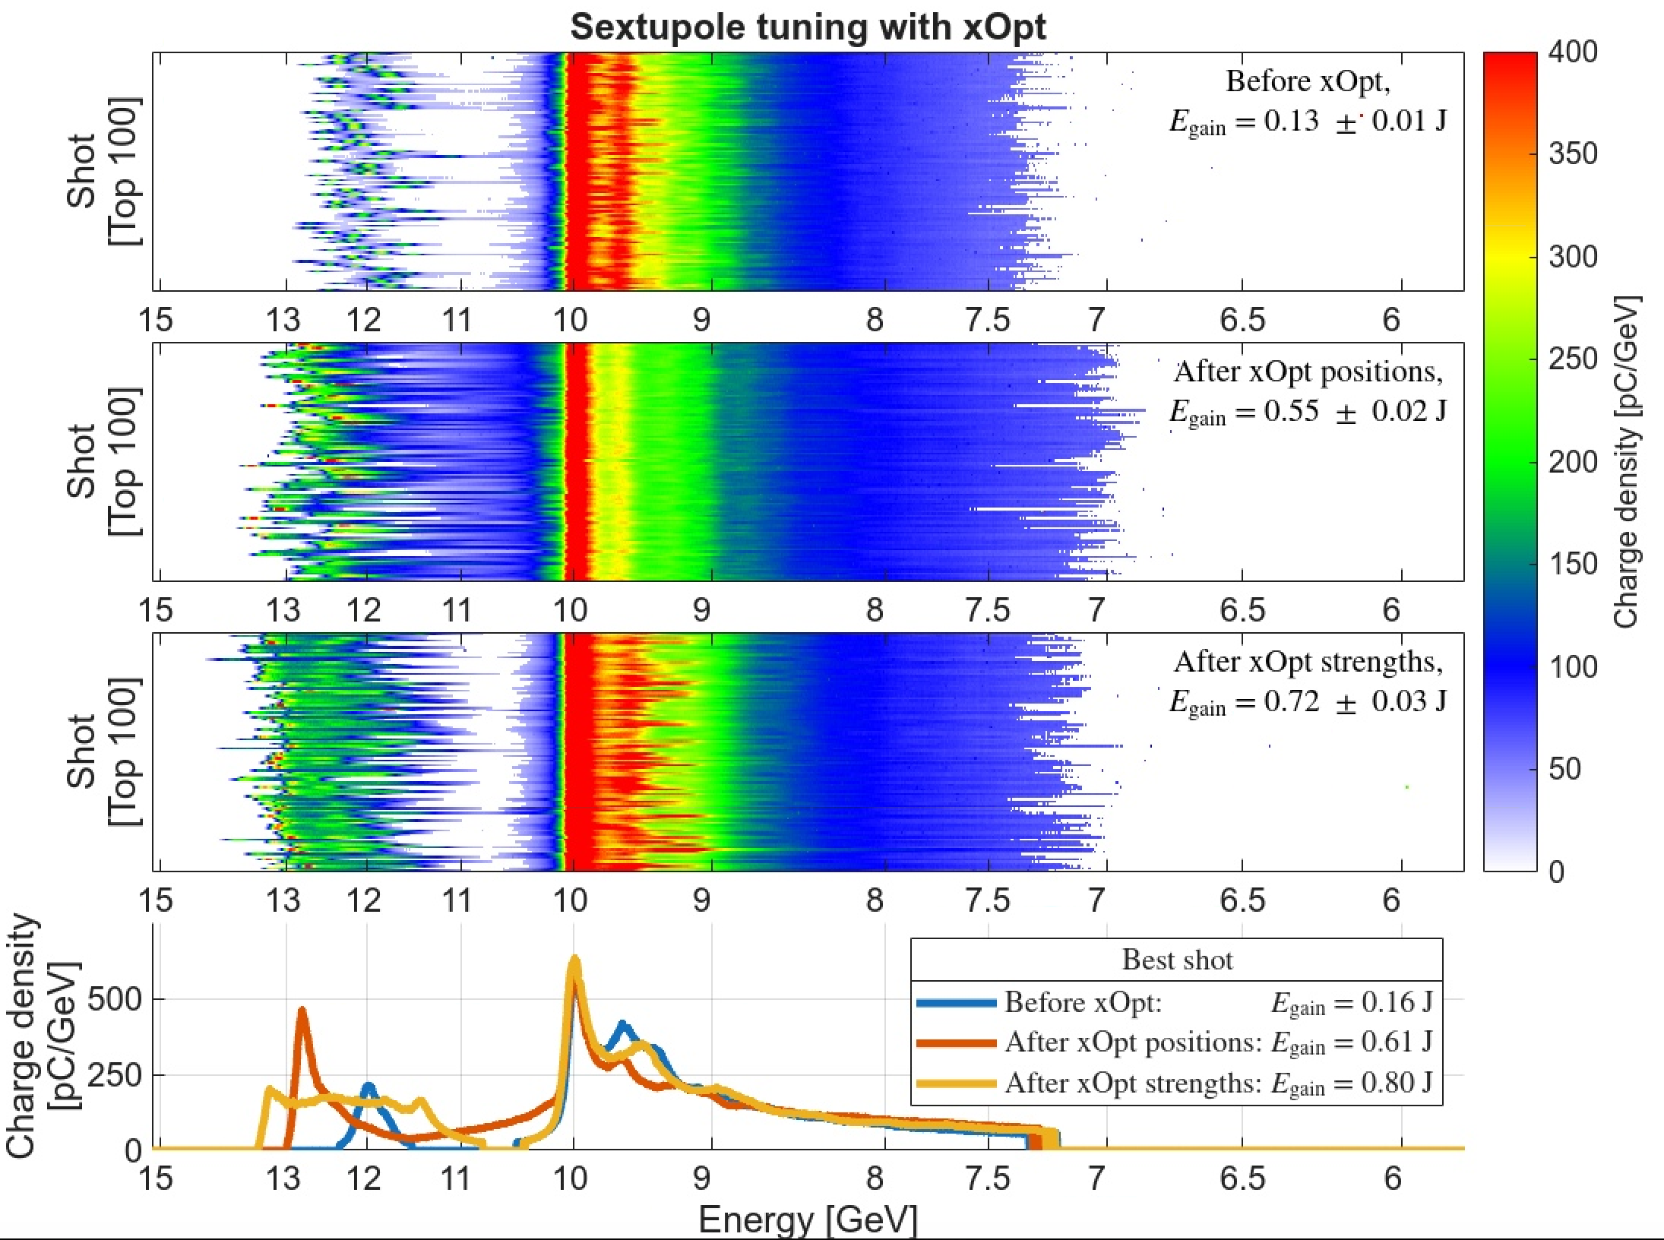
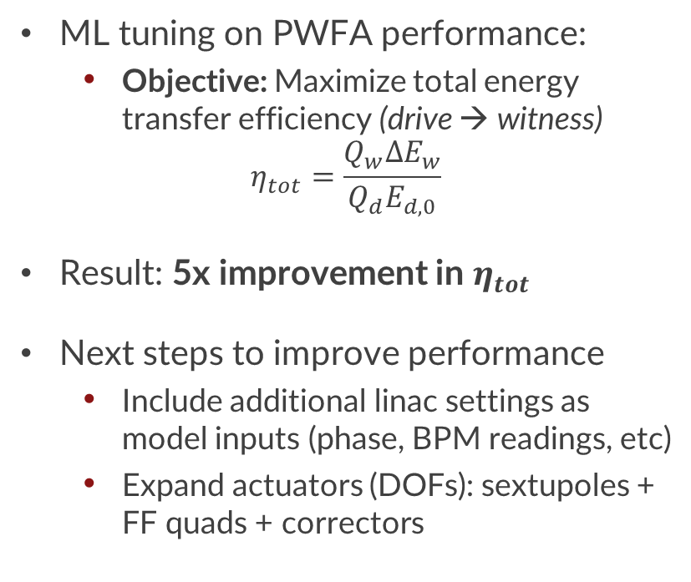
Plasma-based ML optimization of two bunch PWFA
ML tuning on PWFA performance:
  Objective: Maximize total energy transfer efficiency (drive → witness)
$$η_{tot}=\frac{Q_{w}ΔE_{w}}{Q_{d}E_{d,0}}$$
Result: 5x improvement in $η_{tot}$
Next steps to improve performance
  Include additional linac settings as model inputs (phase, BPM readings, etc)
  Expand actuators (DOFs): sextupoles + FF quads + correctors
Credit: S. Rego, Ecole Polytechnique
ML optimization is now part of routine PWFA tuning, enabling faster, repeatable operation

Slide 15
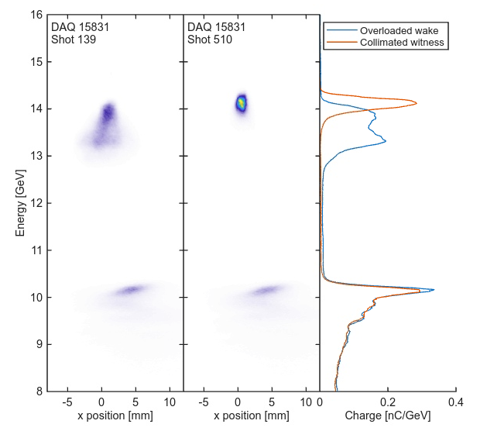
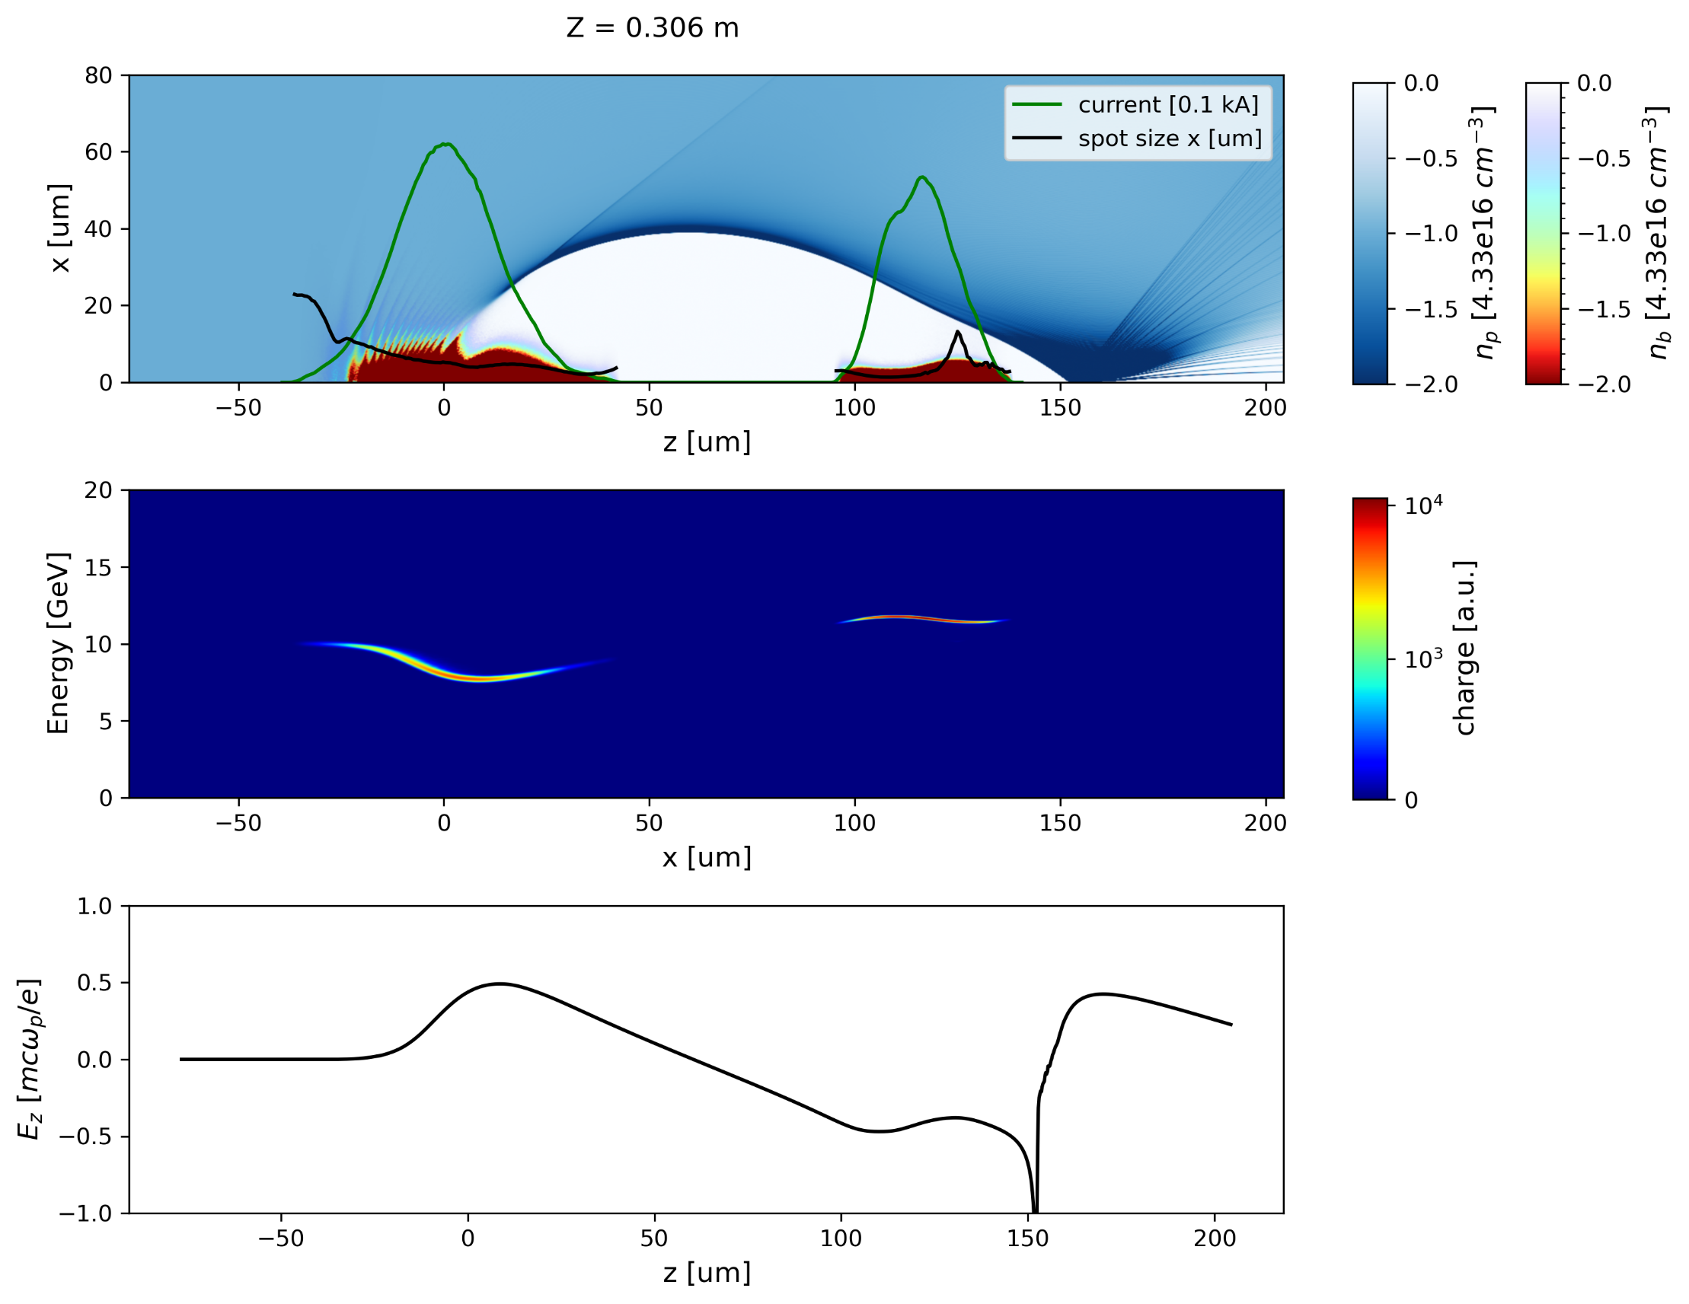

Optimizing beam loading to reduce energy spread
Overloaded
Collimated
Next step – use collimators to shape the witness profile to optimize beam loading
  By flattening the wake: $σ_{E} \sim 5\% → <1\%$
Overloading in QPAD simulation
Credit: T. Dalichaouch, UCLA/SLAC
Can achieve <1% energy spread on witness after proper bunch shaping

Slide 16
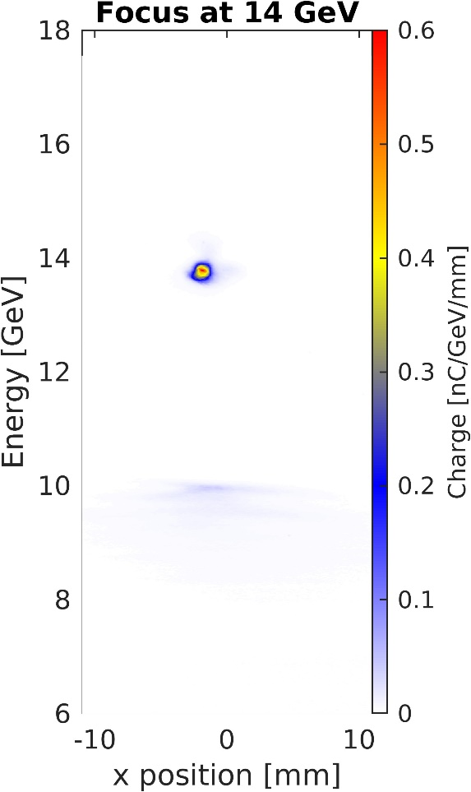
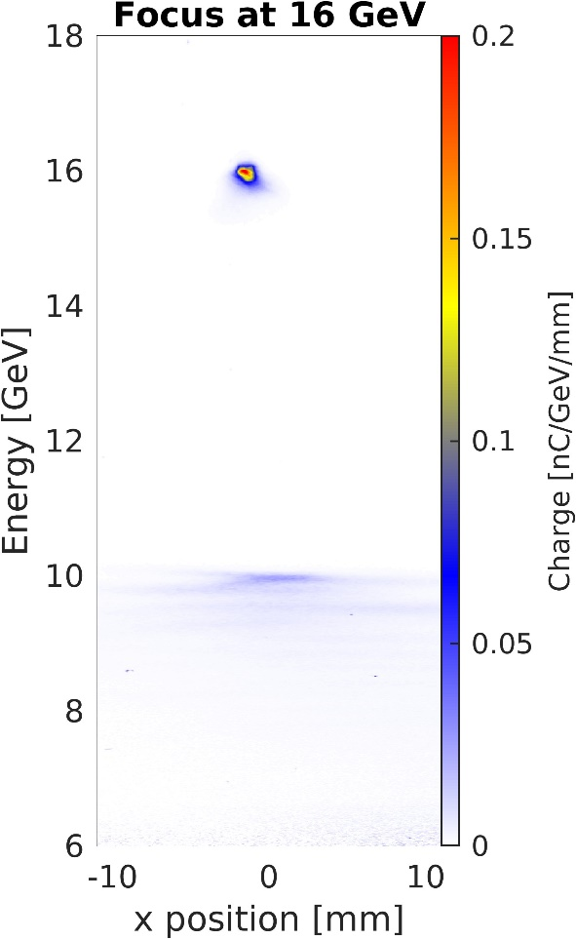
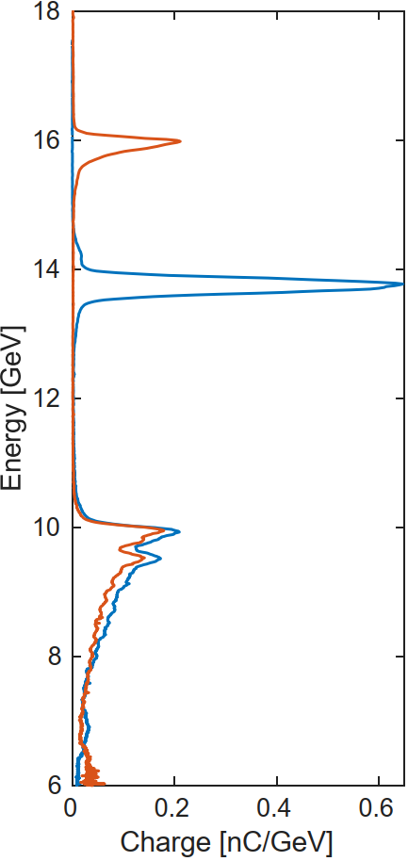
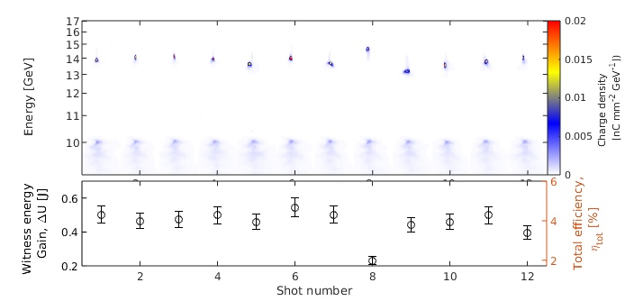
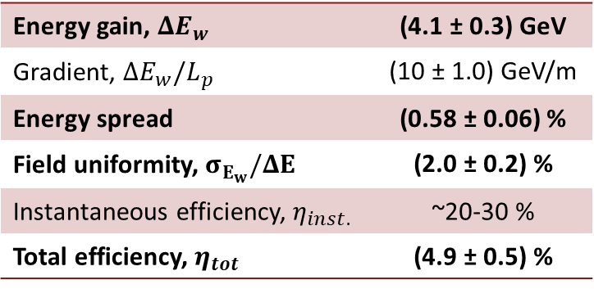
Multi-GeV acceleration with high field-uniformity and efficiency
Stable witness acceleration across shots with comparable incoming beam parameters
  Driver: 1.2 nC, 6-8 kA, Witness: ~250 pC
  Plasma: 40cm long lithium plasma, 4e16 cm⁻³
Energy gain, $ΔE_{w}$ | (4.1 ± 0.3) GeV
Gradient, $ΔE_{w}/L_{p}$ | (10 ± 1.0) GeV/m
Energy spread | (0.58 ± 0.06) %
Field uniformity, $σ_{E_{w}}/ΔE$ | (2.0 ± 0.2) %
Instantaneous efficiency, $η_{inst.}$ | ~20-30 %
Total efficiency, $η_{tot}$ | (4.9 ± 0.5) %
Precision PWFA studies at collider-relevant energy scale

Slide 17
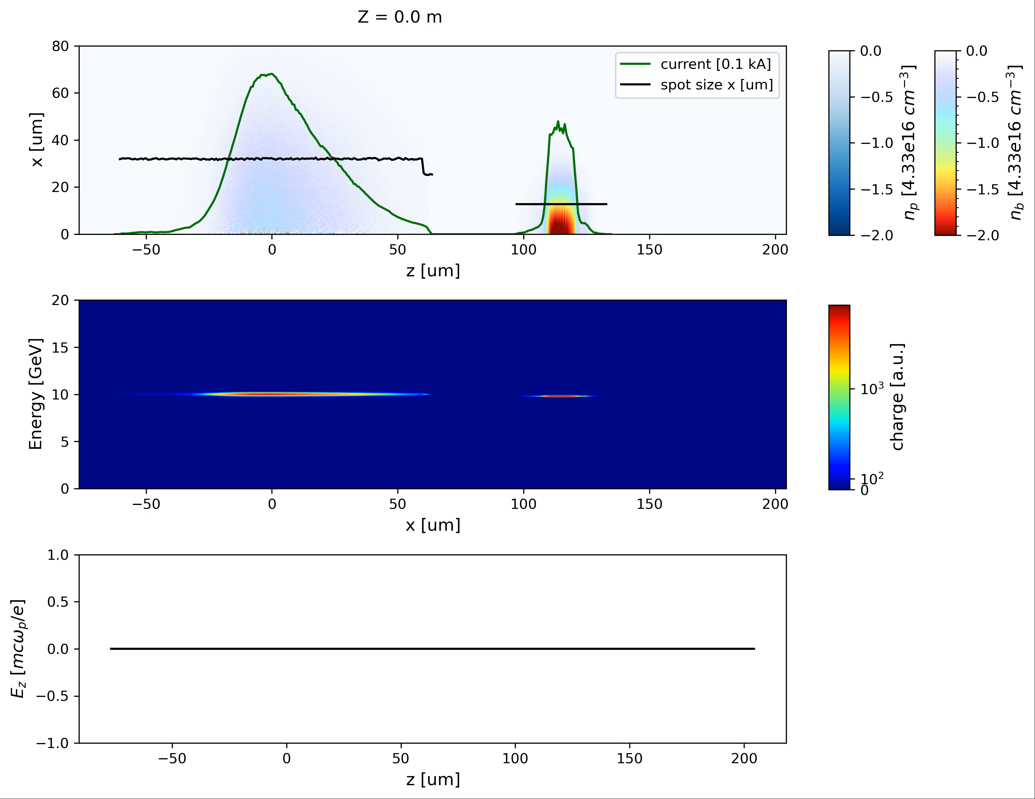
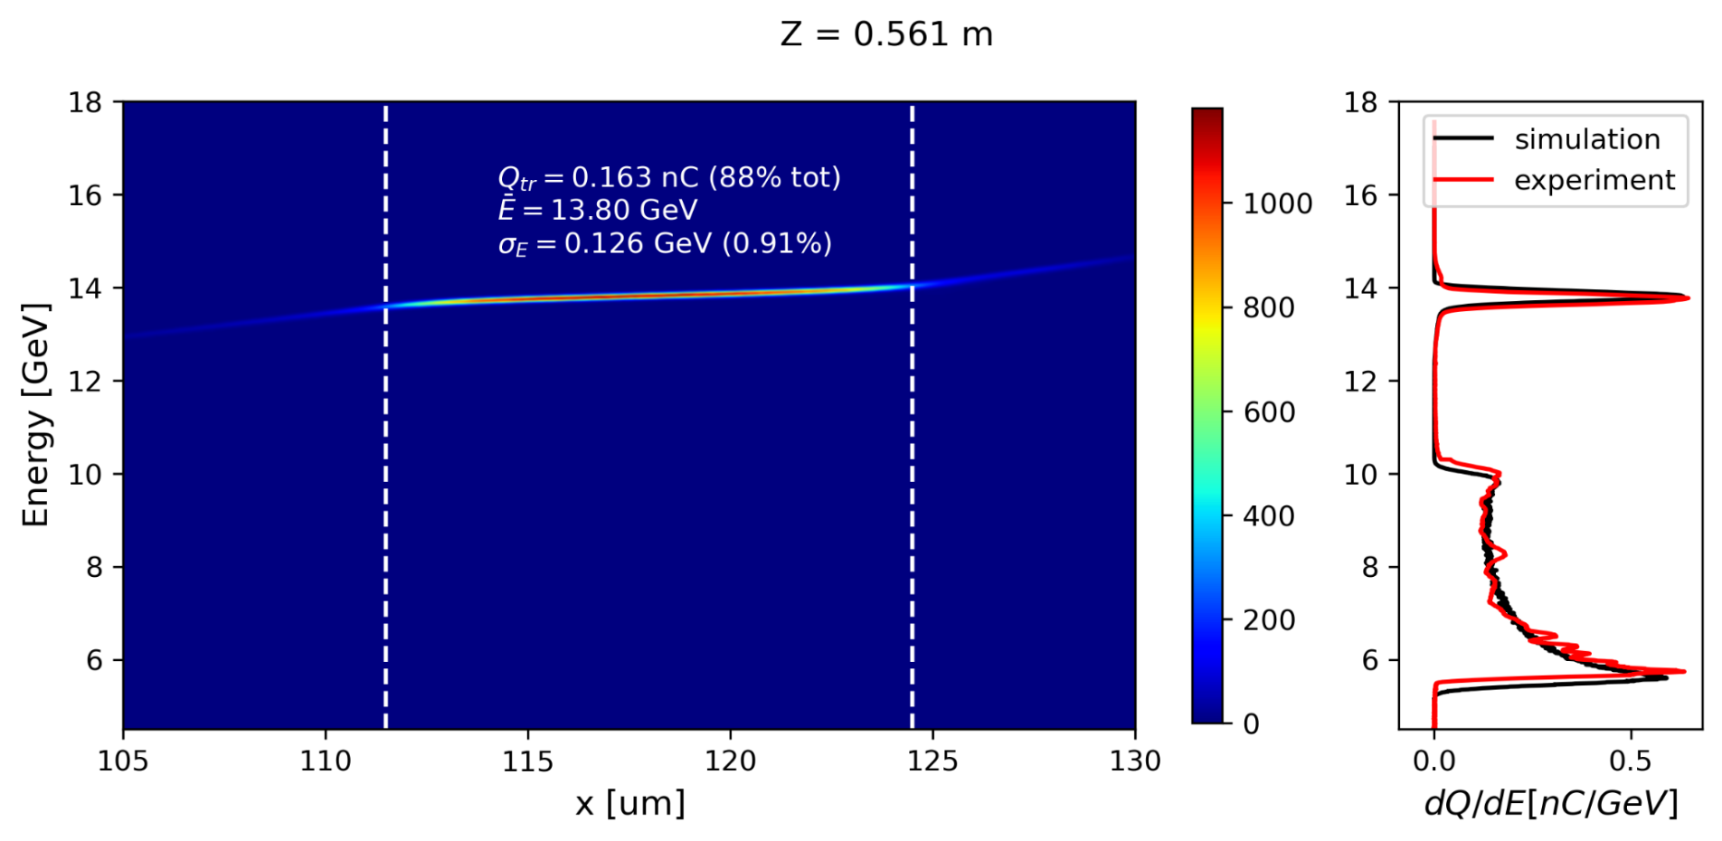
PIC simulations are guiding future progress
  QPAD simulations used to better understand loading, matching, etc
  Performed by T. Dalichaouch (UCLA/SLAC)
  Simulation matches experimental setup
  With plasma density ramps
  Similar LPS and emittances, but with azimuthal symmetry
Credit: T. Dalichaouch, UCLA/SLAC
Excellent agreement between PIC sims and experimental results

Slide 18
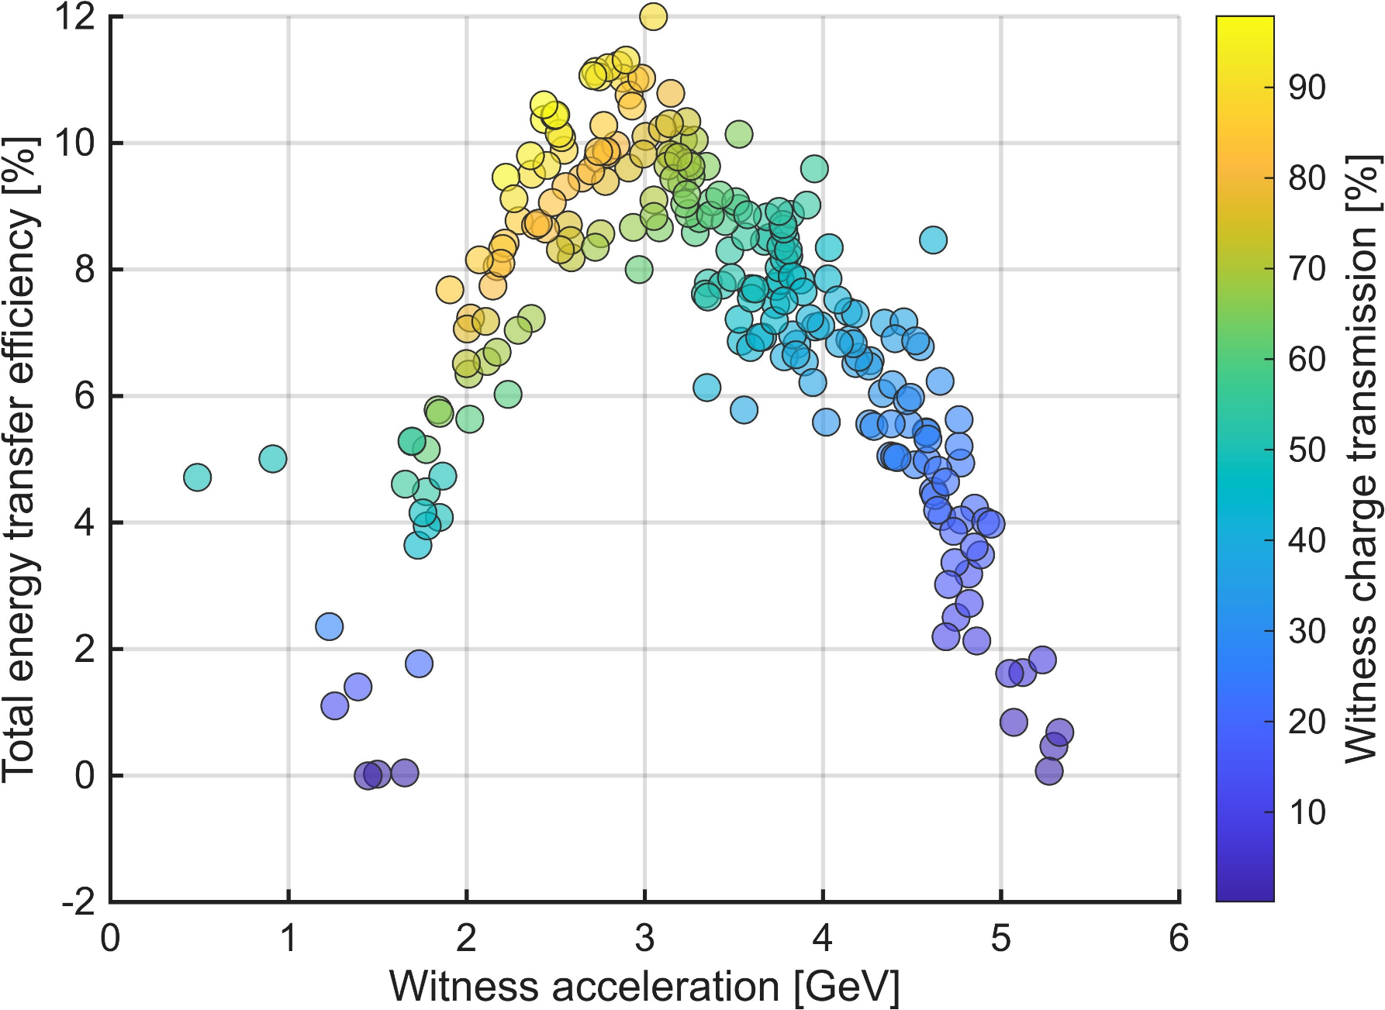
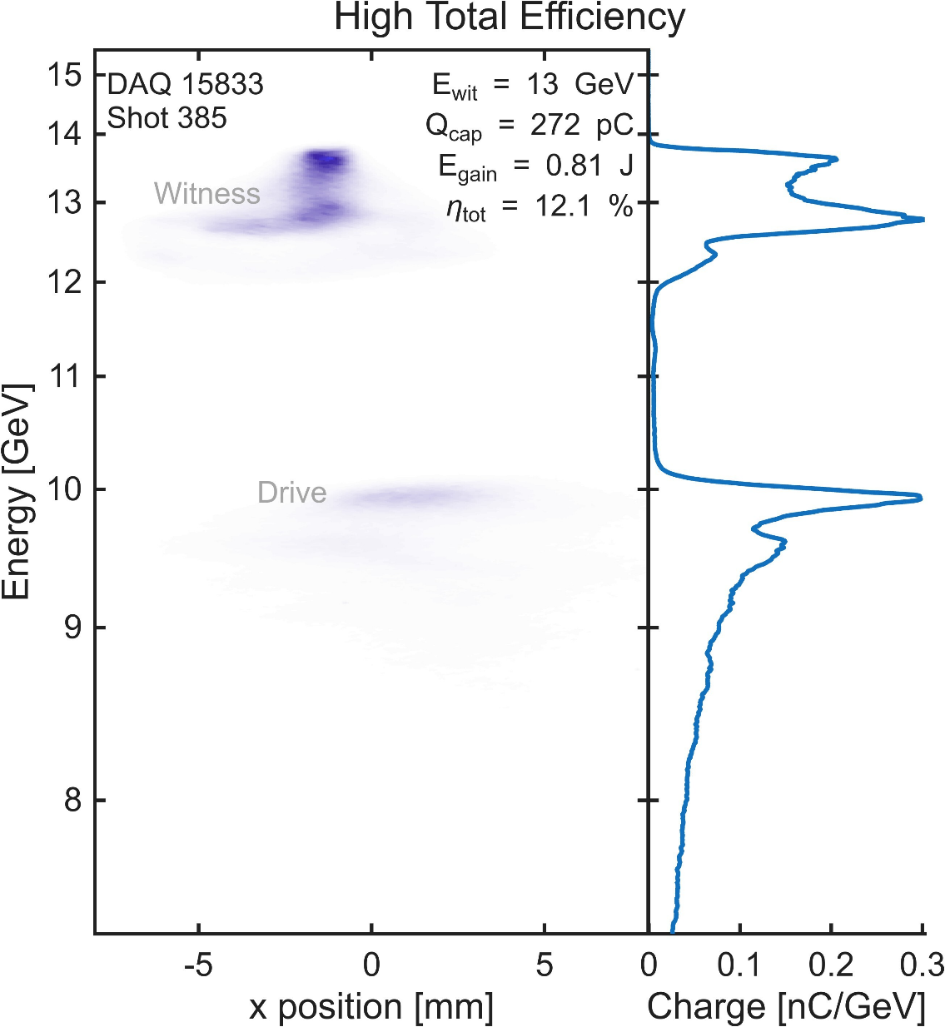
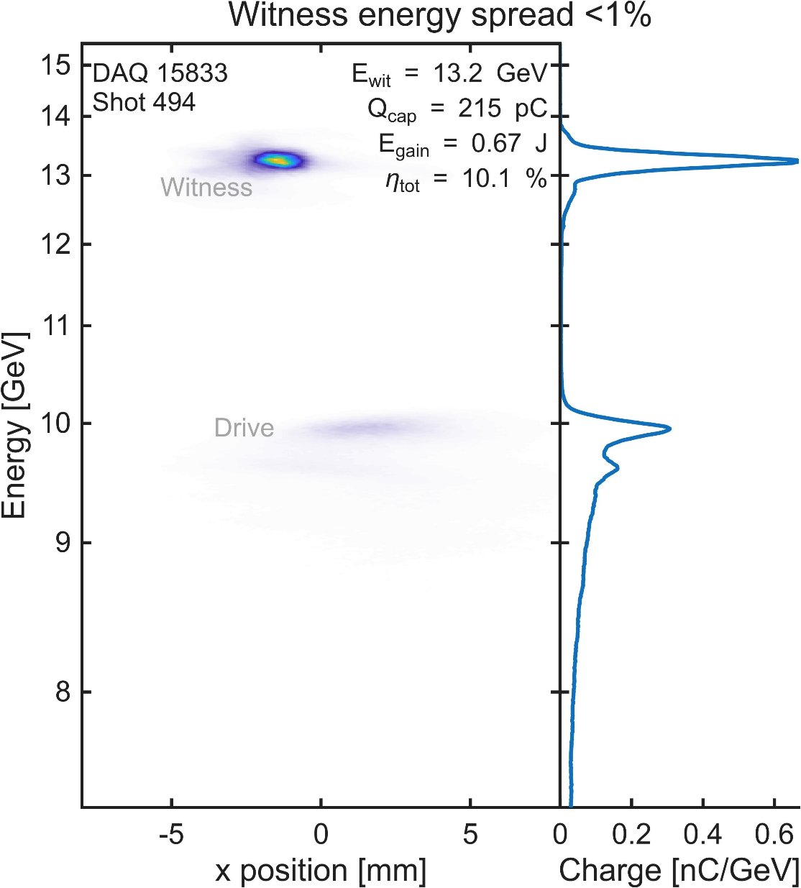
Pushing the energy-transfer efficiency beyond $η_{tot}=10\%$
New tools have pushed our total efficiency to ~10% while maintaing sub percent energy spread
(a)
(b)
Preliminary
(a)
(b)
Pushing the bounds of energy transfer efficiency, while maintaining high quality acceleration

Slide 19
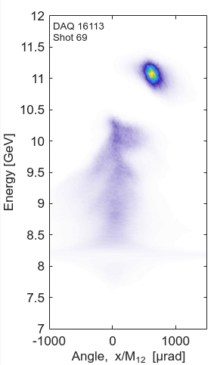
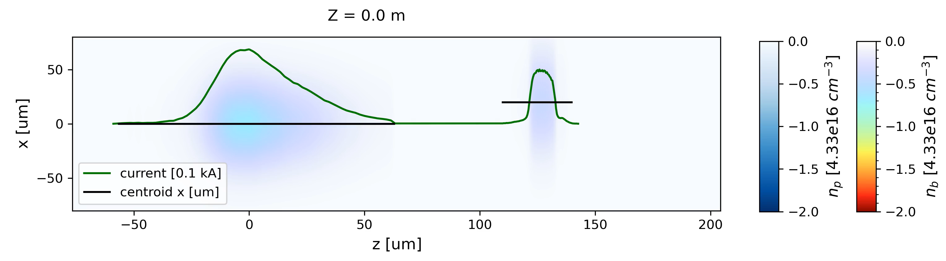


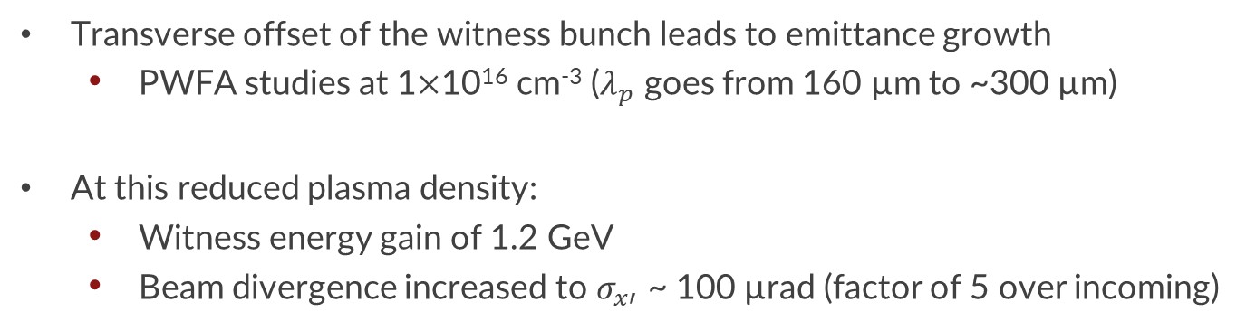
Work towards matching and emittance preservation
Y. Ye, WG3 M 14:50
20 µm transverse offset of the witness
4.4$×$10¹⁶ cm⁻³
Witness
Drive
Credit: T. Dalichaouch, UCLA/SLAC
Transverse offset of the witness bunch leads to emittance growth
  PWFA studies at 1$×$10¹⁶ cm⁻³ ($λ_{p}$ goes from 160 µm to ~300 µm)
At this reduced plasma density:
  Witness energy gain of 1.2 GeV
  Beam divergence increased to $σ_{x′}$ ~ 100 µrad (factor of 5 over incoming)
1$×$10¹⁶ cm⁻³

Slide 20

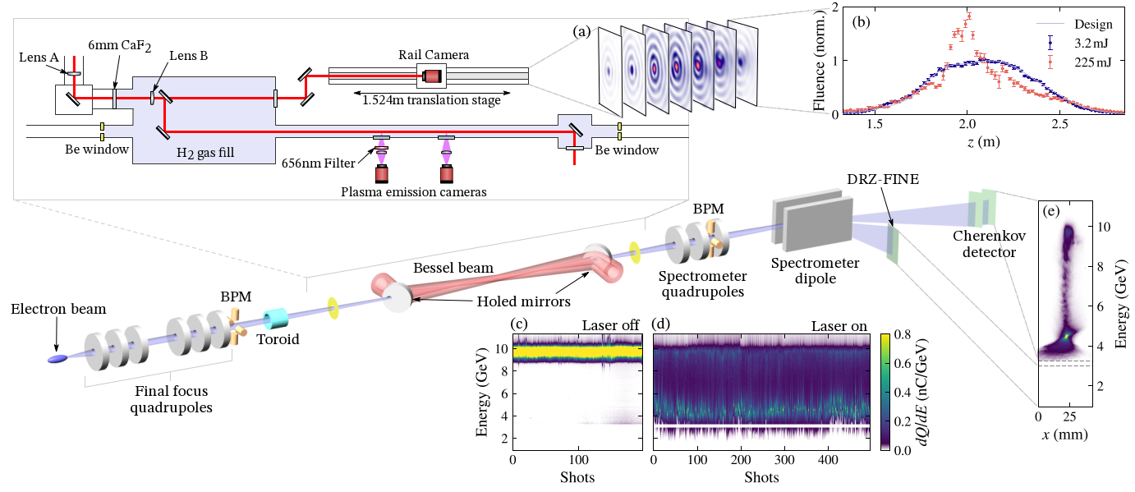
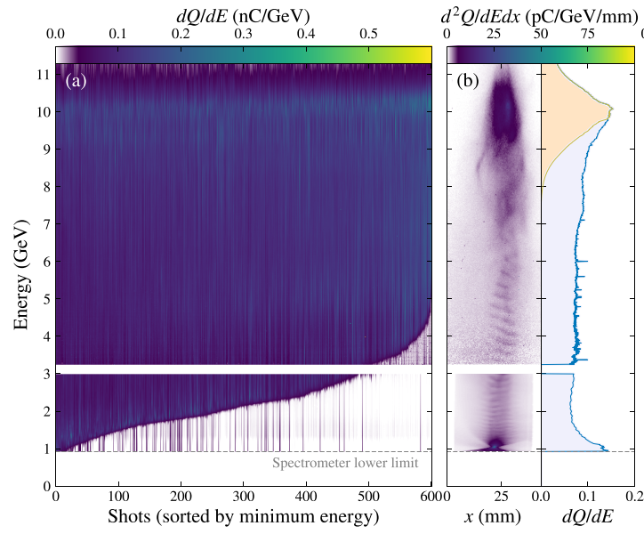
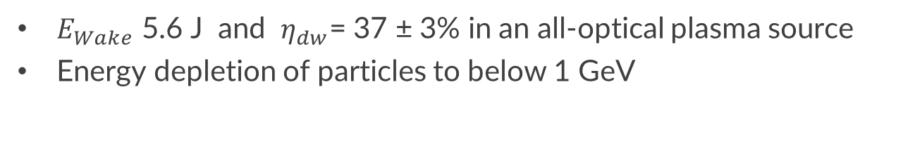
Drive beam depletion in laser-ionized hydrogen plasma source
Ariniello et al., arXiv:2511.15143 (2025)
$E_{Wake}$ 5.6 J and $η_{dw}$= 37 ± 3% in an all-optical plasma source
Energy depletion of particles to below 1 GeV
Lee et al., PRAB 29, 041001 (2026)
Multi-joule energy transfer demonstrated in the laser ionized plasma source

Slide 21







High-performance PWFA in laser-ionized hydrogen plasma
V. Lee, WG3 Tu 14:10
Large energy gain
Large total efficiency
High overall quality
Large energy Gain
Large total efficiency
High overall quality
High quality and high efficiency witness acceleration in an application-relevant plasma source

Slide 22





Optical probing of plasma wakes via dark field shadowgraphy
Observation of plasma wakes to diagnose wake structures in PWFA and exotic regimes
PWFA regime
Beam direction
PWFA regime
Credit: S. Rego, Ecole Polytechnique
H. Zhang, WG3 Th 14:50

Slide 23


Optical probing of plasma wakes via dark field shadowgraphy
Observation of plasma wakes to diagnose wake structures in PWFA and exotic regimes
Wakeless regime
Beam direction
Minimal wake structure behind the beam
Wakeless regime
Credit: S. Rego, Ecole Polytechnique
H. Zhang, WG3 Th 14:50
Notes:
Applications to ion channel laser, e+ acceleration

Slide 24
Topic #2
Ultra-high brightness plasma injectors and brightness transformers

Slide 25



Plasma-wakefield injector boosts energy and brightness
Gas-jet in static fill
Meter-scale static fill H2 gas, with H2 gas jet
Three stage brightness booster:
  Stage 1: Plasma lens
  Stage 2: Density downramp injection
  Stage 3: Plasma Accelerator
Density
downramp
10 GeV Driver
~2.8m
Gas jet
Zhang et al., Nat. Comms. 16, 10719 (2025)

Slide 26

Plasma-wakefield energy and brightness booster
Meter-scale static fill H2 gas, with H2 gas jet
Three stage brightness booster:
  Stage 1: Plasma lens
  Stage 2: Density downramp injection
  Stage 3: Plasma Accelerator
Zhang et al., Nat. Comms. 16, 10719 (2025)

Slide 27



High transformer ratio acceleration of the injected bunch
10 GeV incoming electron bunch
  Charge: $Q_{D}=1.6$nC
  Emittance: $ε_{n,x}=23$mm mrad
  Energy spread: $σ_{E}=0.5\%$
  Current: $I_{peak} \sim 8$kA
Outgoing beams:
  Injected charge: $Q_{W}$ up to ~40 pC
  Emittance: $ε_{n,x}<\sim 2$mm mrad
  Energy spread: $σ_{E,W} \sim 1\%$
  Current: ??
Extension of this idea:
  TeV electron beams from Plasma Acceleration via Regenerative Cascading
Zhang and Joshi , arXiv:2607.07979 (2026)
C. Zhang, WG3 Tu 13:30
Plasma injected bunches accelerated up to 30 GeV with transformer ratio greater than 2

Slide 28



Brightness transformer with high conversion efficiency
Use the measured energy spectrum to infer the current profile from a physics informed model of the plasma acceleration process
Zhang et al., Nat. Comms. 16, 10719 (2025)
Brightness of injected beams up to 38x brighter than incoming bunch

Slide 29





Stable density downramp injection – next steps
New fixed length plasma source tested
Modulated downramp injection
Xu et al., Nat. Comms. 13, 3364 (2022)
Credit: C. Zhang, UCLA
Generating stable, low-emittance, pre-bunched beams in a plasma wakefield accelerator

Slide 30



Trojan Horse injection for ultra-bright electron beams
New FACET IP layout
Habib and Heinemann, et al., Ann. Phys. 2023, 353, 2200655
Collinear Trojan Horse injection
  nm rad-scale emittance
  Application towards future light sources
Reconfiguration of the FACET-II experimental area underway!
Habib et al., Nat. Comms. 14, 1054 (2023)
B. Hidding, WG6 M 16:40, WG3 Th 14:30, …
N. Thomas, WG3 M 13:50
E. Hartmann, WG5 M 14:50
First collinear Trojan Horse injection experiments will take place this fall

Slide 31


Energy chirp in PWFA beams enable compression to <100 nm duration
Chicane
E_{b}
E_{b}
z
z
E_{b}
z
Plasma chirper
89 MeV/um
R. Hessami, WG6 M 16:00
Compression of plasma-chirped witness beams → increased CSR emission as compression is increased
Plenary: K. Swanson, Th 10:45

Slide 32

PWFA studies at FACET-II
Multi-GeV acceleration with high beam quality and efficiency at collider-relevant energy scales
  ~10% energy efficiency with sub percent energy spread
  Next step – emittance preservation!
Ultra-high brightness plasma injectors and brightness transformers
  Transformer ratios >2
  >38x brightness boost

Slide 33










Many thanks to all my collaborators
SLAC Advanced Acceleration Research Department team:
  S. Crisp, T. Dalichaouch, K. Downham, A. Edelen, C. Emma,
  S. Gessner, C. Hast, J.P. Gonzalez Aguilera, M. Hogan, P. Kicsiny, A. Kinderman, A. Knetsch, C. Lin, J. Park, S. Perez, I. Rajkovic,
  D. Storey, K. Swanson, Y. Ye, J. Wang, B. O’Shea
  Z. Buschmann, R. Loney, M. Parker, G. Yocky
Plus many more contributions:
    FACET-II is supported in part by the U.S. Department of Energy under contract number DE-AC02-76SF00515

Slide 34

Thank you!
Questions?

Slide 35
Extra materials

Slide 36

TeV electron beams from Plasma Acceleration via Regenerative Cascading
TeV beams from a two-stage sub-kilometer plasma accelerator

Slide 37



FACET-II provides 10 GeV beams for PWFA studies
FACET-II Technical Design Report SLAC-R-1072
Positron Damping Ring (not installed)
Two ways to produce 2 bunches at the experimental area for PWFA studies:
Single chirped long bunch, collimated to produce lower current drive and witness
Notch Collimator
SYAG
Witness
Drive
To PWFA
FINAL FOCUS
Jaw Collimators

Slide 38



FACET-II provides 10 GeV beams for PWFA studies
FACET-II Technical Design Report SLAC-R-1072
Positron Damping Ring (not installed)
Two ways to produce 2 bunches at the experimental area for PWFA studies:
TCAV Long. Phase Space
EOS Temporal Profile
Two bunches off the photo cathode, co-accelerated through the linac
Witness
Drive
Time
Drive
Energy [GeV]
Witness
Drive
Witness
Energy

Slide 39

PWFA in the laser-ionized hydrogen plasma source
Credit: V. Lee, CU Boulder
5$×$10¹⁶ cm⁻³ laser ionized plasma, 80 cm length

Slide 40






Post plasma diagnostics
Plasma
sources
Spectrometer
Dipole
Electron and Gamma Screens
Spectrometer Quadrupoles
UV Spectrometers
gammas
e-
Imaging electron spectrometer
Betatron radiation diagnostics
UV and XUV spectrometers
P. San Miguel Claveria et al., AAC (2022)
  Compton Spectrometer upcoming, covering a range of 180 keV-28 MeV
C. Emma et al., PRL 134, 085001 (2025)
D. Storey et al., PRAB 27 051302 (2024)

Slide 41





Laser pre-ionization of Lithium plasma
Pre-ionization increases PWFA performance over relying on beam ionization
  ~1 mm wide plasma channel
  Increased participating drive charge
  Increased witness acceleration and total efficiency
 | Laser Ionized | Beam Ionized
Energy gain, $ΔE_{w}$ | (4.0 ± 0.2) GeV | (3.7 ± 0.2) GeV
Field uniformity, $σ_{E_{w}}/ΔE$ | (2.3 ± 0.2) % | (3.4 ± 0.6) %
Total efficiency, $η_{tot}$ | (5.5 ± 0.5) % | (4.6 ± 0.3) %
Witness charge capture, $Q_{w}$ | (68 ± 6) % | (64 ± 4) %

Slide 42
Longitudinal Phase Space delivered to the plasma
Range of Longitudinal Phase Space Profiles
Control of the LPS is critical for:
  Ensuring proper bunch spacing
  Optimizing driver intensity for efficient energy transfer
  Beam loading of the wake for minimizing witness energy spread
Achieved through combination of RF phases, collimators, cathode laser pulse separation
LPS measured via transverse deflecting cavity before the plasma
Drive
Witness
Collimation
Drive
Witness

